Slide 1
Studying the Unitary Fermi Gas using Discretized Pion-less EFT on the Lattice.
6/10/2026
Hunter Duggin (UNC), Charles Kacir (UNC), Amy Nicholson (UNC, LBNL), Dmitra Pefkou (LBNL, UC Berkeley)

Slide 2
Outline
Unitary Fermi
Gas
CNUGS 2026

Slide 3
Outline
Unitary Fermi
Gas
Theoretical
Methods
CNUGS 2026

Slide 4
Outline
Unitary Fermi
Gas
Theoretical
Methods
Effective Mass
& Current Matrix
Elements
CNUGS 2026

Slide 5
Outline
Unitary Fermi
Gas
Theoretical
Methods
Effective Mass
& Current Matrix
Elements
Conclusion &
Future Work
CNUGS 2026

Slide 6
The Unitary Fermi Gas

Slide 7
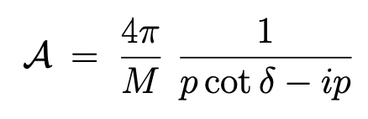
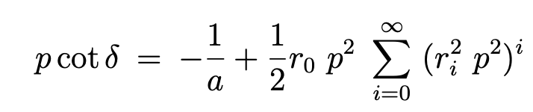
Optical Theorem
We know from constraints given by the unitarity of the S-matrix, the S-wave scattering amplitude is given by
At low energies it makes sense to use the Effective range expansion
Where a is the scattering length, r₀ is known as the effective range and r_{i} are the shape parameters
0
0
CNUGS 2026
Notes:
Regimes of a Fermi gas as function of inverse interaction strength: the weakly interacting BCS limit (weakly bound Cooper pairs), the BEC limit of strongly bound (bosonic) molecules, and the unitary Fermi gas that exhibits maximally strong interactions between fermionic particles. The critical temperature is exponentially small in the BCS limit, while at unitarity it is remarkably high for a fermionic system (value shown is our numerical prediction)

Slide 8
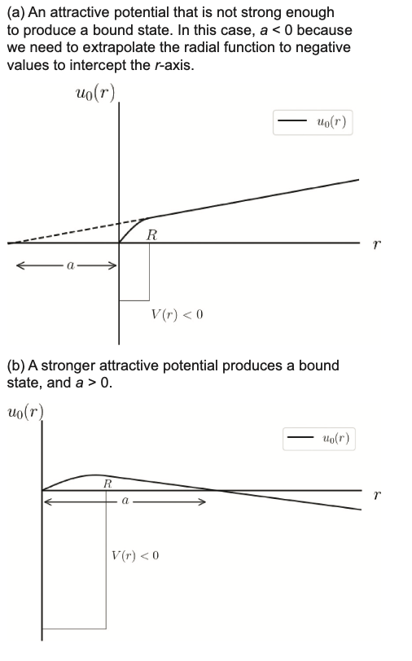
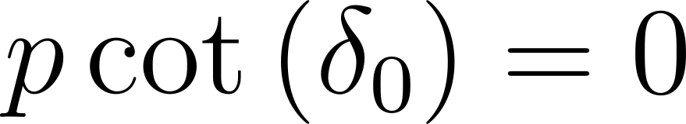
Unitarity
Unitarity is the special limit where the scattering length goes to infinity, and the effective range goes to zero.
Unitarity is important to study because it removes all scales out of the problem, leads to conformal physics
Revista Brasileira de Ensino de Física, vol. 45, e20230079 (2023)
CNUGS 2026
Notes:
I tried to generate this plot in mathematica at unitarity but it wouldn’t work.

Slide 9
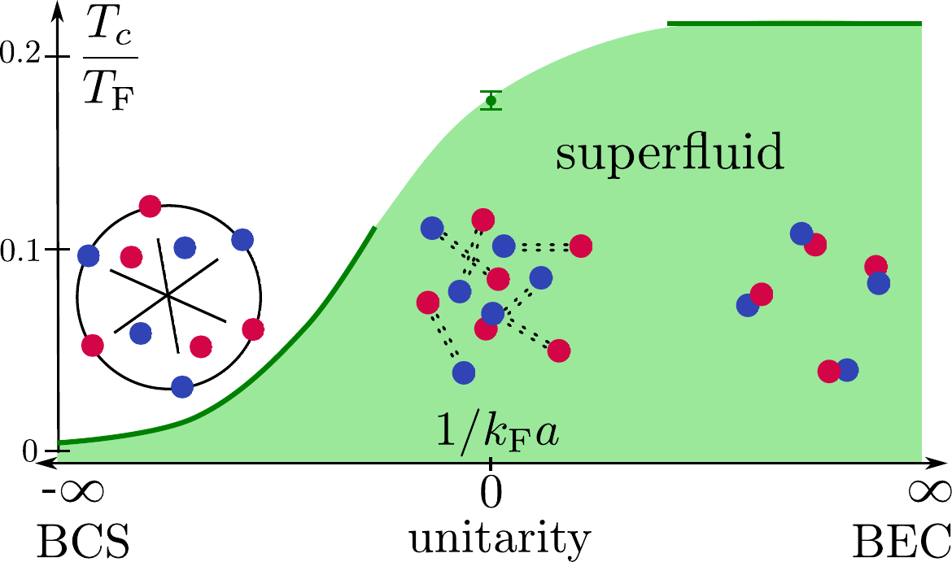
The Unitary Fermi Gas
The UFG is a gas of Fermions tuned to the unitary limit
Applicable to systems with large numbers of fermions (like neutrons!)
Olga Goulko
CNUGS 2026
Notes:
Regimes of a Fermi gas as function of inverse interaction strength: the weakly interacting BCS limit (weakly bound Cooper pairs), the BEC limit of strongly bound (bosonic) molecules, and the unitary Fermi gas that exhibits maximally strong interactions between fermionic particles. The critical temperature is exponentially small in the BCS limit, while at unitarity it is remarkably high for a fermionic system (value shown is our numerical prediction)

Slide 10
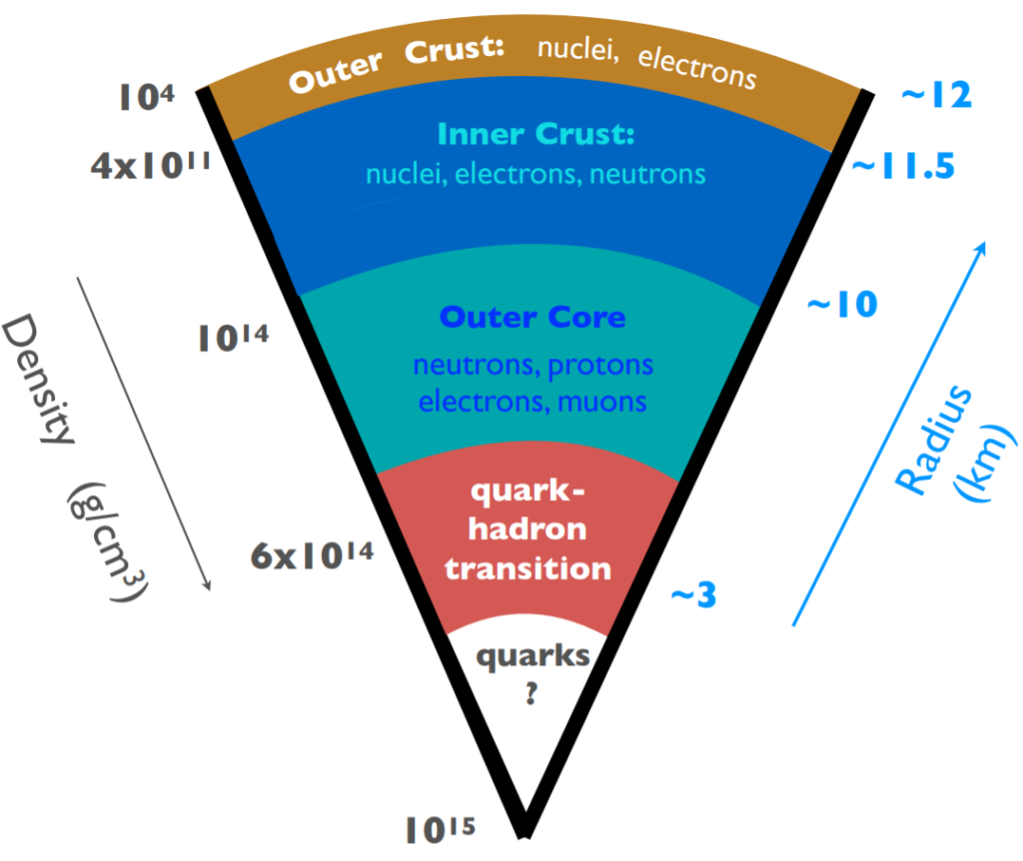
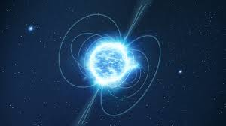
Neutron Stars
The Outer Core region of a neutron star
ESA
3G Science White
CNUGS 2026

Slide 11
Theoretical Methods:
Lattice EFT

Slide 12
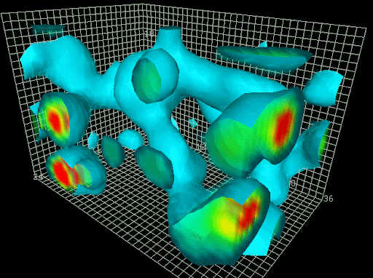
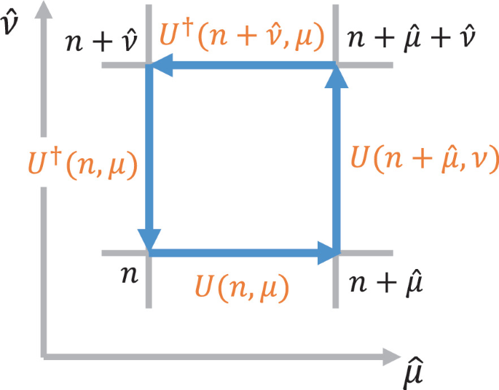
Lattice Field Theory
Lattice field theory is a non-perturbative tool used to study properties of strongly interacting field theories.
Allows for direct evaluation of the path integral using numerical techniques.
Has well documented systematic errors.
Naturally regulates the theory.
Leinweber – QCD Vacuum
Yanagihara, 2021
CNUGS 2026
Notes:
Regimes of a Fermi gas as function of inverse interaction strength: the weakly interacting BCS limit (weakly bound Cooper pairs), the BEC limit of strongly bound (bosonic) molecules, and the unitary Fermi gas that exhibits maximally strong interactions between fermionic particles. The critical temperature is exponentially small in the BCS limit, while at unitarity it is remarkably high for a fermionic system (value shown is our numerical prediction)

Slide 13
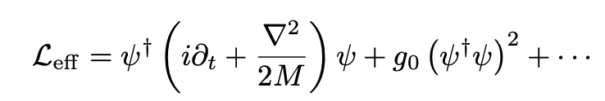
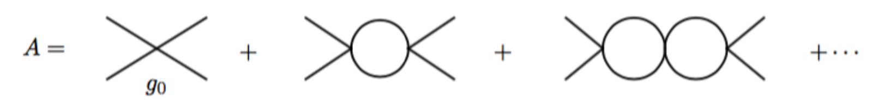
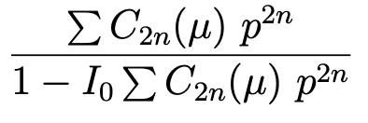
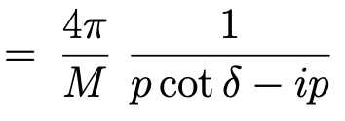
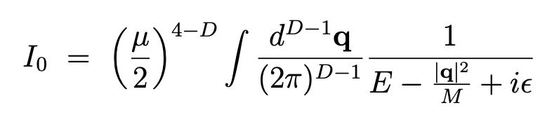
Pion-less EFT
Effective field theory involving two point-like nucleons interacting via contact interactions.
The scattering amplitude is a geometric sum of bubble diagrams
Geometric Series
Optical Theorem
CNUGS 2026
Notes:
I will explain the amplitude part in words

Slide 14
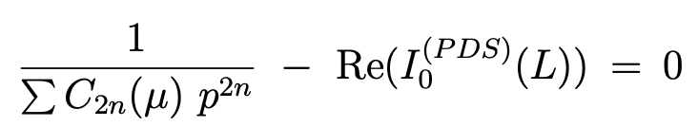
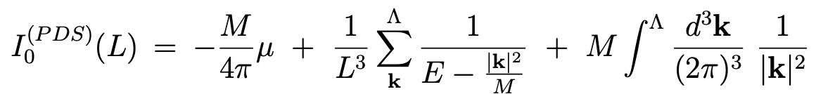
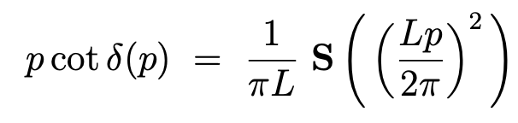
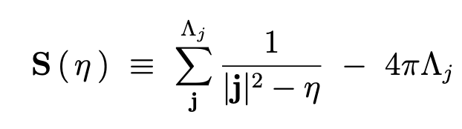
Pion-less EFT: Finite to Infinite Volume
Looking for poles in the amplitude, we see
This relates the discrete energy spectrum to the infinite volume scattering amplitude
Analogous to the Lüscher quantization condition
We can solve this for the states to see the following eigenvalue problem
where
CNUGS 2026
Notes:
Regimes of a Fermi gas as function of inverse interaction strength: the weakly interacting BCS limit (weakly bound Cooper pairs), the BEC limit of strongly bound (bosonic) molecules, and the unitary Fermi gas that exhibits maximally strong interactions between fermionic particles. The critical temperature is exponentially small in the BCS limit, while at unitarity it is remarkably high for a fermionic system (value shown is our numerical prediction)

Slide 15
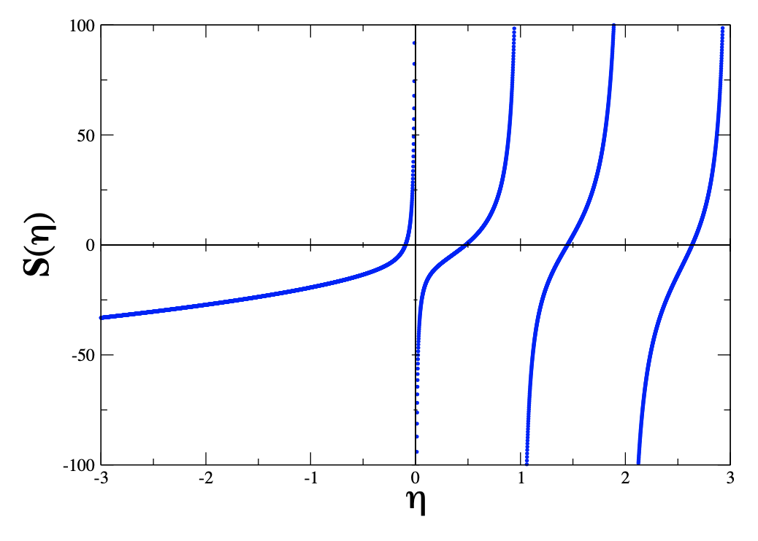
Pion-less EFT: States
S.R. Beane, P.F.Bedaque, A. Parreno, M.J. Savage,
Two Nucleons on the Lattice

Slide 16
Pion-less EFT: States
Unitarity
S.R. Beane, P.F.Bedaque, A. Parreno, M.J. Savage,
Two Nucleons on the Lattice

Slide 17
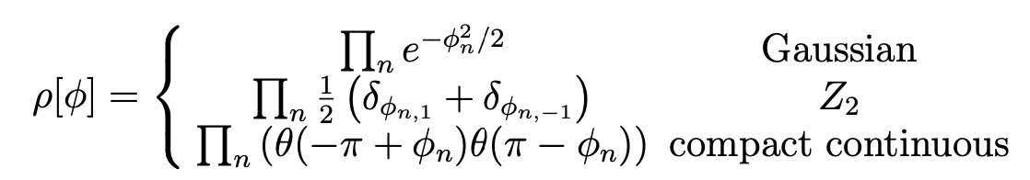
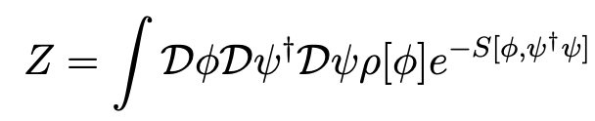
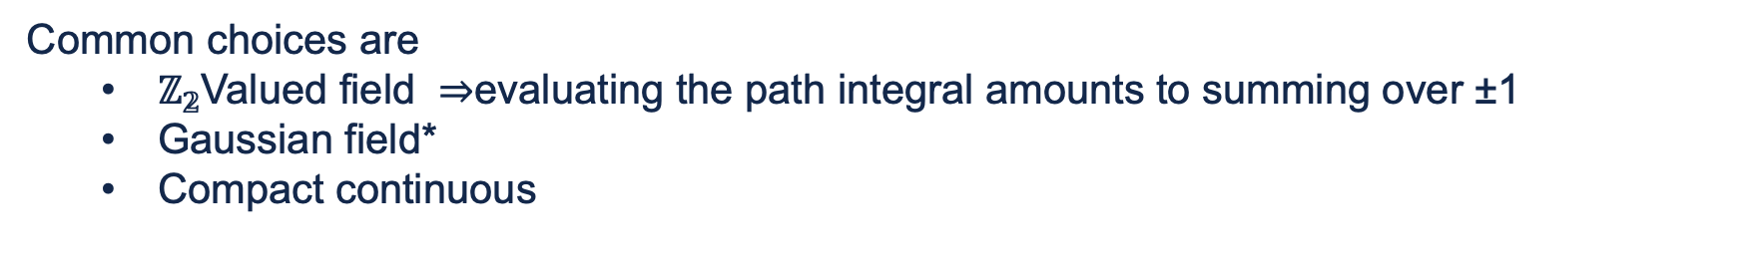
But Wait! There are Fermions!
As seen in Kostas Originos’s lectures, Fermions have issues on the lattice
We introduce a bosonic auxiliary field that mediates the interaction
We also have the freedom to pick the auxiliary field provided it is compact and has mean zero
Common choices are
  $ℤ_{𝟚}$Valued field $⇒$evaluating the path integral amounts to summing over ±1
  Gaussian field*
  Compact continuous
CNUGS 2026
Notes:
Regimes of a Fermi gas as function of inverse interaction strength: the weakly interacting BCS limit (weakly bound Cooper pairs), the BEC limit of strongly bound (bosonic) molecules, and the unitary Fermi gas that exhibits maximally strong interactions between fermionic particles. The critical temperature is exponentially small in the BCS limit, while at unitarity it is remarkably high for a fermionic system (value shown is our numerical prediction)

Slide 18
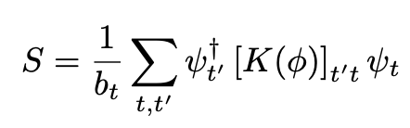
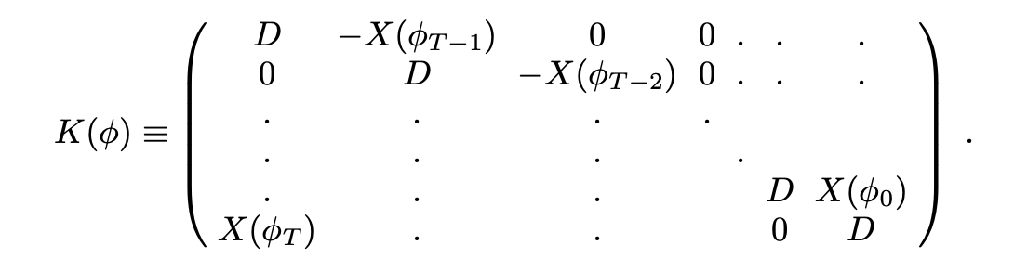
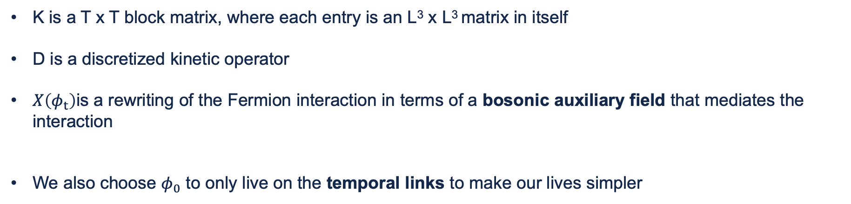
Discretizing Pion-less EFT
We start by discretizing the pion-less EFT action in the following way
M. G. Endres, D. B. Kaplan, J.-W. Lee, and A. N. Nicholson, Phys. Rev. A 84, 043644 (2011).
K is a T x T block matrix, where each entry is an L³ x L³ matrix in itself
D is a discretized kinetic operator
$X\left(φ_{t}\right)$is a rewriting of the Fermion interaction in terms of a bosonic auxiliary field that mediates the interaction
We also choose $φ_{0}$ to only live on the temporal links to make our lives simpler
CNUGS 2026
Notes:
Regimes of a Fermi gas as function of inverse interaction strength: the weakly interacting BCS limit (weakly bound Cooper pairs), the BEC limit of strongly bound (bosonic) molecules, and the unitary Fermi gas that exhibits maximally strong interactions between fermionic particles. The critical temperature is exponentially small in the BCS limit, while at unitarity it is remarkably high for a fermionic system (value shown is our numerical prediction)

Slide 19
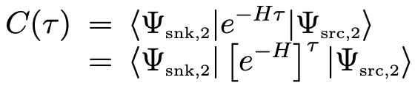

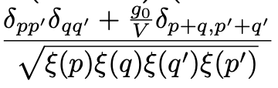

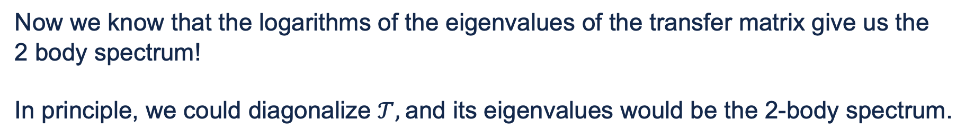
Tuning g₀ : Connecting to the Spectral Decomposition
From statistical mechanics:
Now we know that the logarithms of the eigenvalues of the transfer matrix give us the
2 body spectrum!
In principle, we could diagonalize $𝒯,$and its eigenvalues would be the 2-body spectrum.
Where
We can compare this result to the one discussed earlier using Lüscher methods to tune the coupling, g₀
CNUGS 2026
Notes:
Explain here why we use

Slide 20
Effective Mass & Current Insertion Matrix
Elements

Slide 21
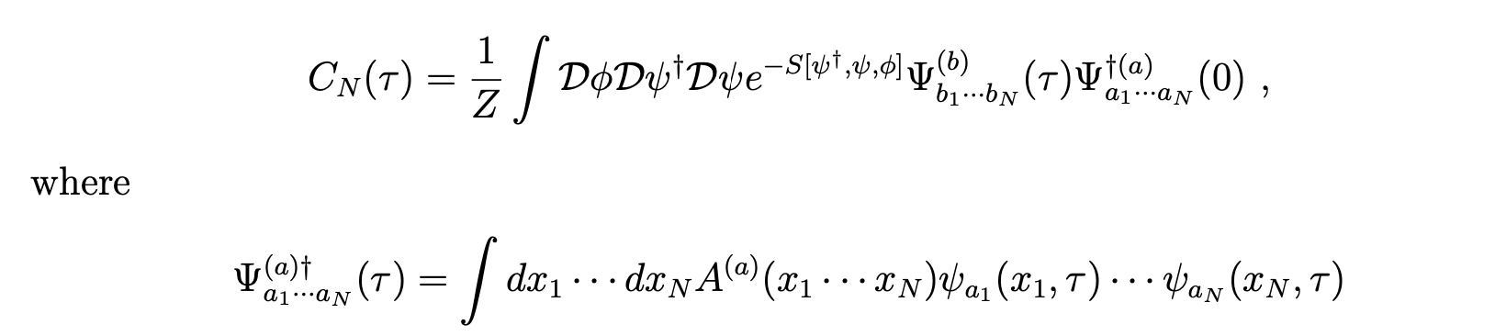
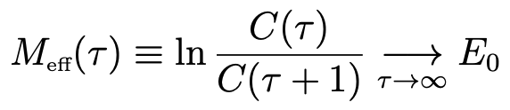
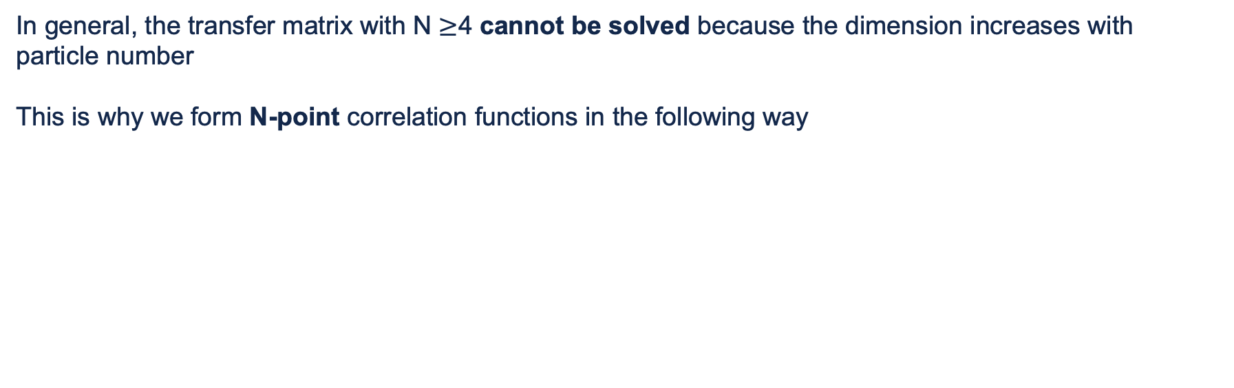
Effective Mass
In general, the transfer matrix with N $≥$4 cannot be solved because the dimension increases with particle number
This is why we form N-point correlation functions in the following way
Using this correlation function, we can calculate the system’s Effective Mass
CNUGS 2026

Slide 22
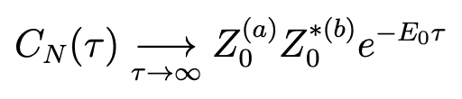
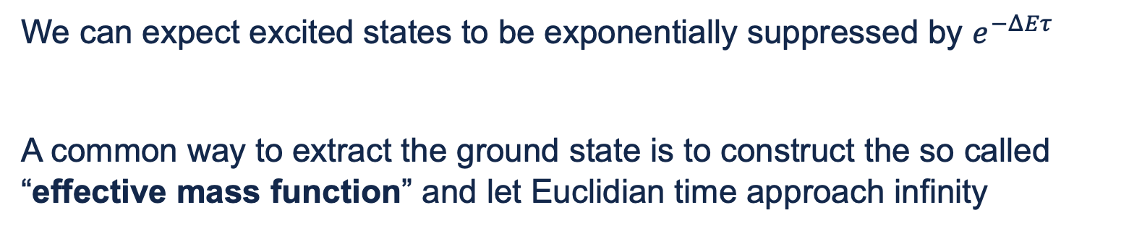
Effective Mass
We can expect excited states to be exponentially suppressed by $e^{−ΔEτ}$
A common way to extract the ground state is to construct the so called “effective mass function” and let Euclidian time approach infinity
CNUGS 2026
Notes:
Regimes of a Fermi gas as function of inverse interaction strength: the weakly interacting BCS limit (weakly bound Cooper pairs), the BEC limit of strongly bound (bosonic) molecules, and the unitary Fermi gas that exhibits maximally strong interactions between fermionic particles. The critical temperature is exponentially small in the BCS limit, while at unitarity it is remarkably high for a fermionic system (value shown is our numerical prediction)

Slide 23
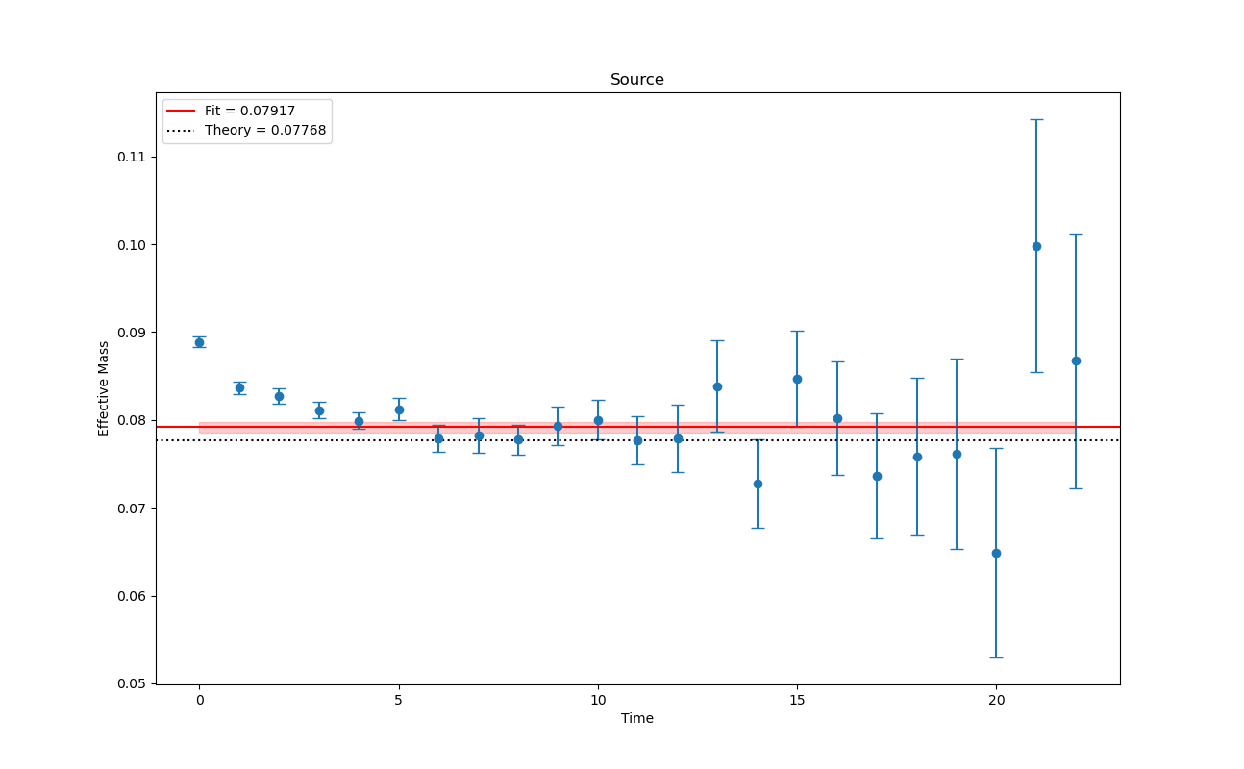
PRELIMINARY

Slide 24
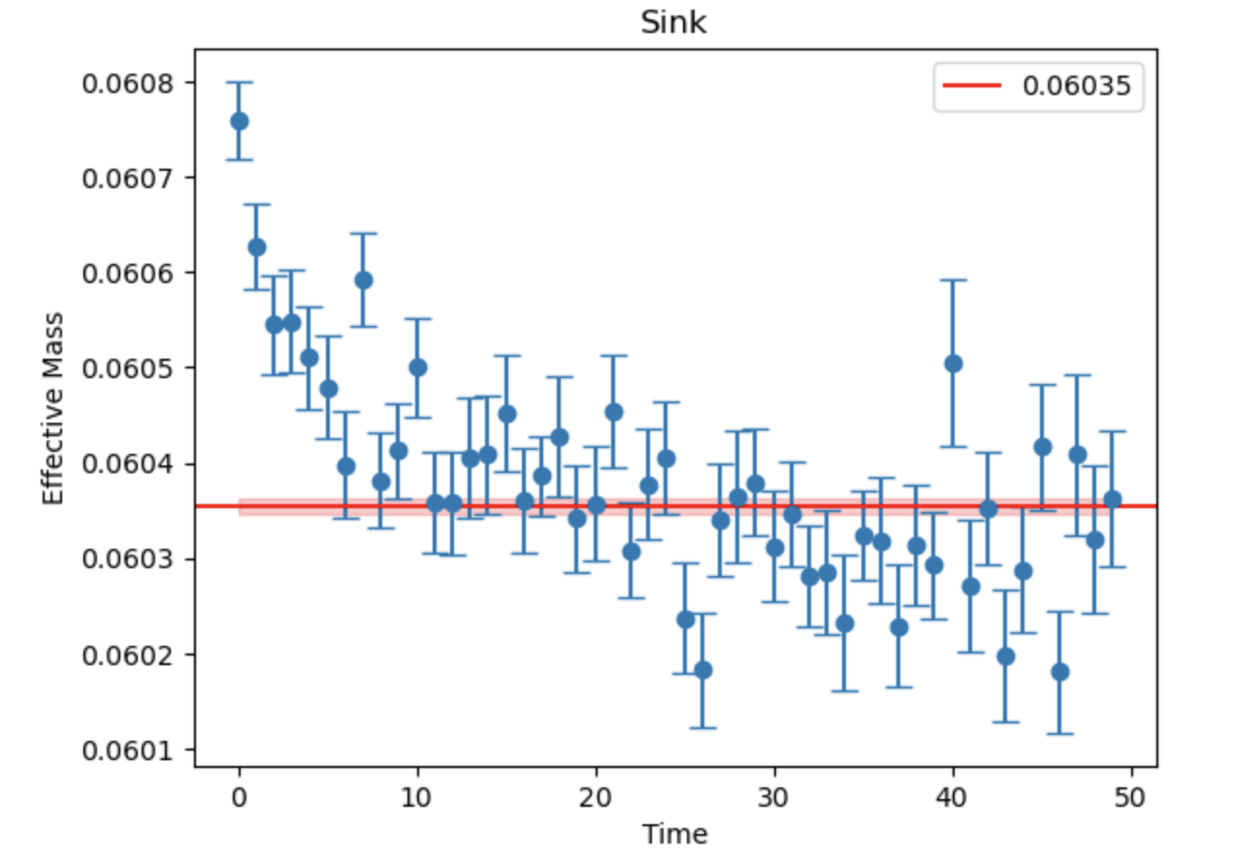

Slide 25
Gravitational (Mechanical) Form Factors
Related to the Lorentz decomposition of EMT current matrix elements
GFFs can be related to GPD physics (through computing GPD moments)
e.g. Proton form factors related to GPD moments
(Girod, 2018)
Following the methods discussed in Kostas Originos’s lectures, we can extract matrix elements relevant to GFFs for the unitary fermi gas by taking constrained ratios of 3-pt and 2-pt functions!
CNUGS 2026
Notes:
Here I have written “mechanical” because

Slide 26
Future Work

Slide 27
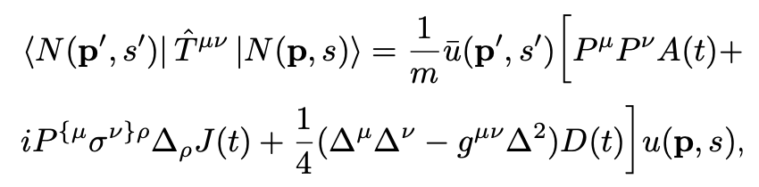
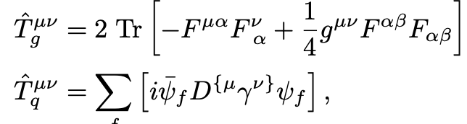
Gravitational (Mechanical) Form Factors
Proton GFF matrix element Lorentz decomposition
Hackett, Pefkou, Shanahan 2024
Following the methods discussed in this paper, we can extract GFFs for the unitary fermi gas by taking constrained ratios of 3-pt and 2-pt functions!
CNUGS 2026
Notes:
Regimes of a Fermi gas as function of inverse interaction strength: the weakly interacting BCS limit (weakly bound Cooper pairs), the BEC limit of strongly bound (bosonic) molecules, and the unitary Fermi gas that exhibits maximally strong interactions between fermionic particles. The critical temperature is exponentially small in the BCS limit, while at unitarity it is remarkably high for a fermionic system (value shown is our numerical prediction)

Slide 28
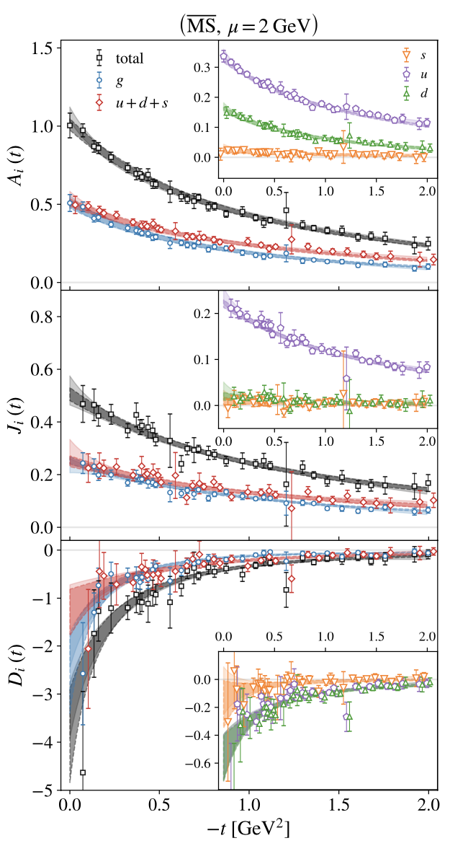
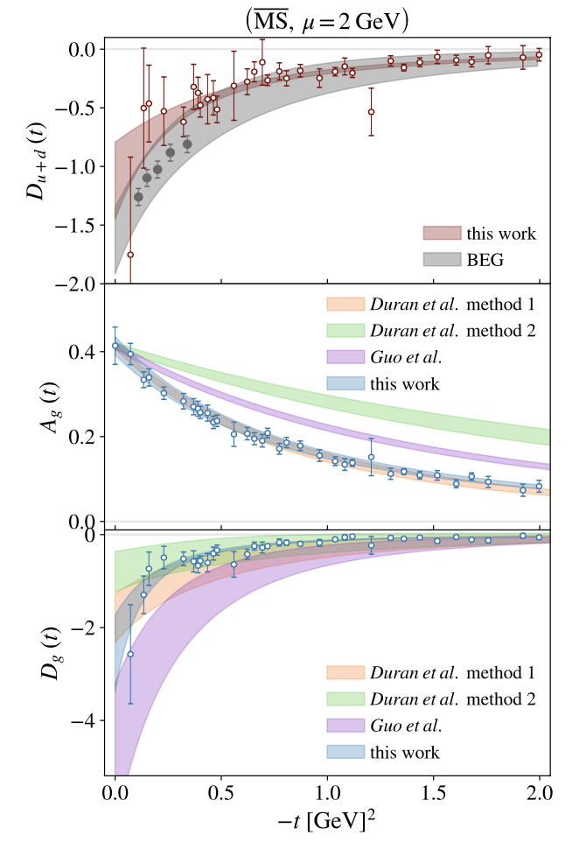
Hackett, Pefkou, Shanahan 2024
Notes:
Three GFFs of the proton computed on the lattice QCD ensemble of this work, and their decomposition into gluon and total quark contributions, are shown as func- tions of t. Inset figures show the isosinglet quark GFFs fur- ther decomposed into up-, down-, and strange-quark contri- butions. The total GFFs are renormalization scheme- and scale-independent, while all other GFFs are shown in the MS scheme at μ = 2 GeV. The dark bands represent dipole fits to the data in the case of g and q = u+d+s, and linear com- binations of the dipole fits to q, v1, and v2 in all other cases. The lighter bands show analogous fits using the z-expansion.
The proton GFFs Ag(t), Dg(t), and Du+d(t) and cor- responding dipole fits, computed on the lattice QCD ensem- ble of this work, are compared with the experimentally con- strained multipole parametrizations of Refs. [24] (BEG), [42] (Duran et al.), and [46] (Guo et al.). For this comparison, the results for Ag(t) are re-scaled such that the gluon momentum fraction is Ag(0) = 0.414(8) [69], which is the value used as an input in the extraction of Refs. [42] and [46]. This does not a↵ect the t-dependence of the GFF.
28

Slide 29
Future Work
Change wavefunction parameters to make the effective mass plateau
Lorentz decompose the EMT and interpret the meaning of the GFFs
Extract GFFs using the ratio of 3pt and 2pt functions
CNUGS 2026
Notes:
Regimes of a Fermi gas as function of inverse interaction strength: the weakly interacting BCS limit (weakly bound Cooper pairs), the BEC limit of strongly bound (bosonic) molecules, and the unitary Fermi gas that exhibits maximally strong interactions between fermionic particles. The critical temperature is exponentially small in the BCS limit, while at unitarity it is remarkably high for a fermionic system (value shown is our numerical prediction)

Slide 30
Where are we at now?
Run Code &
Generate Data
Fit the data
Find Physics
Notes:
How I thought it worked

Slide 31
Where we are actually at
Run Code &
Generate Data
Fit the data
Find New Physics
Modify Parameters
Interpret data
Notes:
How I thought it worked

Slide 32
Thank You! Questions? hpduggin@unc.edu

Slide 33
BONUS SLIDES

Slide 34
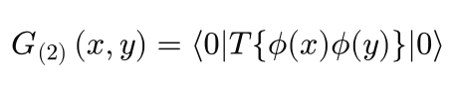
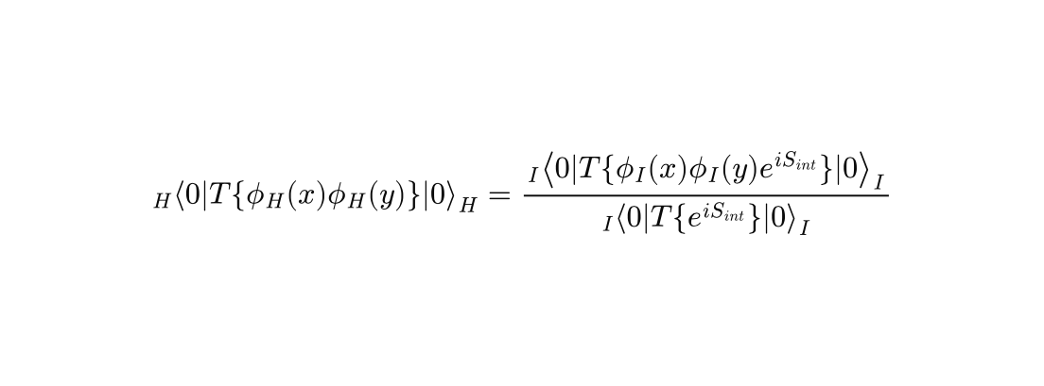
Review: Field Theory
Field theory concerns itself with calculating probability amplitudes for relativistic quantum systems
The probability amplitude for a particle to propagate from one point (x) to another point (y) is called the 2-point function.
In a free theory, the 2-point function is known as a propagator
You can find propagators by direct integration, or by finding the Green function for the equations of motion.
If we have an Interacting theory the calculation of 2-point functions becomes more complicated
Typically, we expand the exponential in the above expression and apply Wick’s Theorem to relate the time ordered vacuum expectation values (later time to the left) to normal ordered expectation values (all creation operators are to the left of annihilation operators).
This process gives us a diagrammatic expansion of the amplitude we are interested in
This can be generalized for n-point functions as well
Notes:
Propagator in position space and momentum space, Heisenberg picture to interaction picture

Slide 35
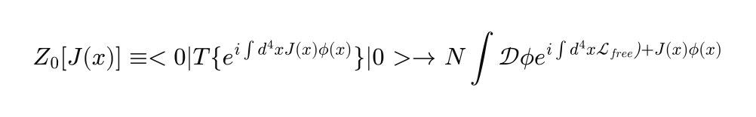
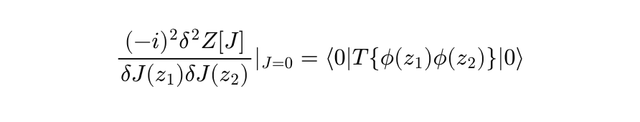
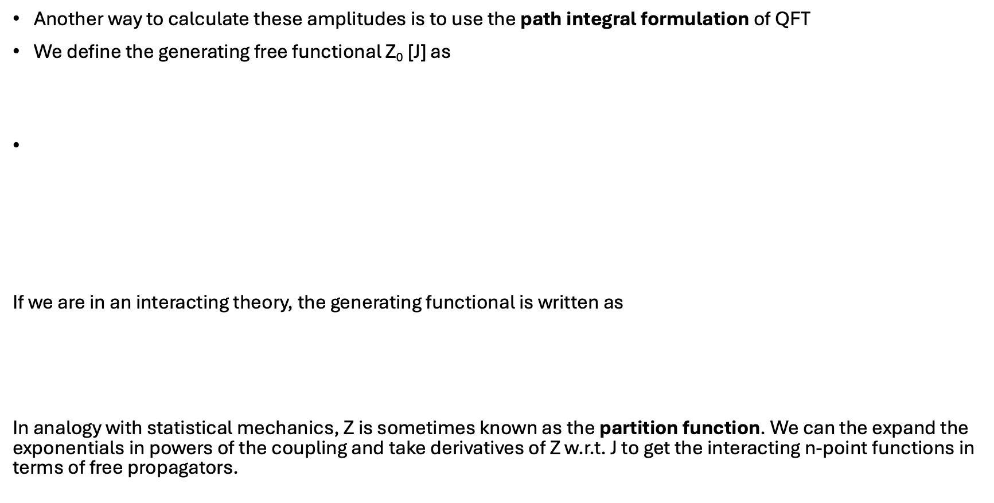
Review: Path integrals
Another way to calculate these amplitudes is to use the path integral formulation of QFT
We define the generating free functional Z₀ [J] as
If we are in an interacting theory, the generating functional is written as
In analogy with statistical mechanics, Z is sometimes known as the partition function. We can the expand the exponentials in powers of the coupling and take derivatives of Z w.r.t. J to get the interacting n-point functions in terms of free propagators.
Such that
Notes:
Add in picture of generating functional in both Wick’s theorem representation and path integral representation
\frac{(-i)^2\delta^2 Z[J]}{\delta J(z_1)\delta J(z_2)}\vert_{J=0}=\left<0|T\{\phi(z_1)\phi(z_2)\}|0 \right>
Z_0[J(x)] \equiv <0|T\{e^{i \int d^4 xJ(x)\phi(x)}\}|0> \to N\int \mathcal{D}\phi e^{i\int d^4x \mathcal{L_{free})}+J(x)\phi(x)}
Z[J] = N'∫\mathcal{D} ϕ e^{i\int d^4 x \mathcal{L}_{int}(\frac{(-i)\delta}{δJ})} Z_0[J]

Slide 36

Review: Divergences
When performing such calculations, either using Wick’s theorem or path integrals, divergences arise in the calculation.
We can regulate these divergences however we like to make the integrals finite.
e.g. $φ^{4}$ scalar theory
Momentum (UV) cutoff regulator
*Dimensional Regularization ($d=4−ϵ$)
Notes:
Add in picture of generating functional in both Wick’s theorem representation and path integral representation
\frac{(-i)^2\delta^2 Z[J]}{\delta J(z_1)\delta J(z_2)}\vert_{J=0}=\left<0|T\{\phi(z_1)\phi(z_2)\}|0 \right>
Z_0[J(x)] \equiv <0|T\{e^{i \int d^4 xJ(x)\phi(x)}\}|0> \to N\int \mathcal{D}\phi e^{i\int d^4x \mathcal{L_{free})}+J(x)\phi(x)}
Z[J] = N'∫\mathcal{D} ϕ e^{i\int d^4 x \mathcal{L}_{int}(\frac{(-i)\delta}{δJ})} Z_0[J]

Slide 37
When does perturbation theory fail?
PT fails when the coupling is > 1.
Terms higher order in the coupling become more important.
e.g. Low energy QCD, high energy QED, various many body systems
What non-perturbative techniques can we use?
Functional RG
Instantons
Large N expansions
Lattice field theory

Slide 38
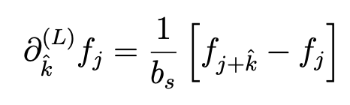
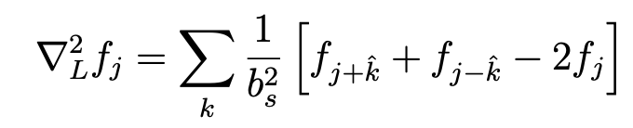
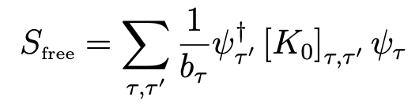
The Lattice
The lattice turns derivatives into differences and integrals into sums.
Finite Euclidian volume (L).
  Quantizes the momentum
Lattice simulations give the n-point functions by directly evaluating the path integral using monte-carlo sampling.
Nicholson 2016
Notes:
Don’t focus on the action too much, this is just to show that an integral becomes a sum

Slide 39
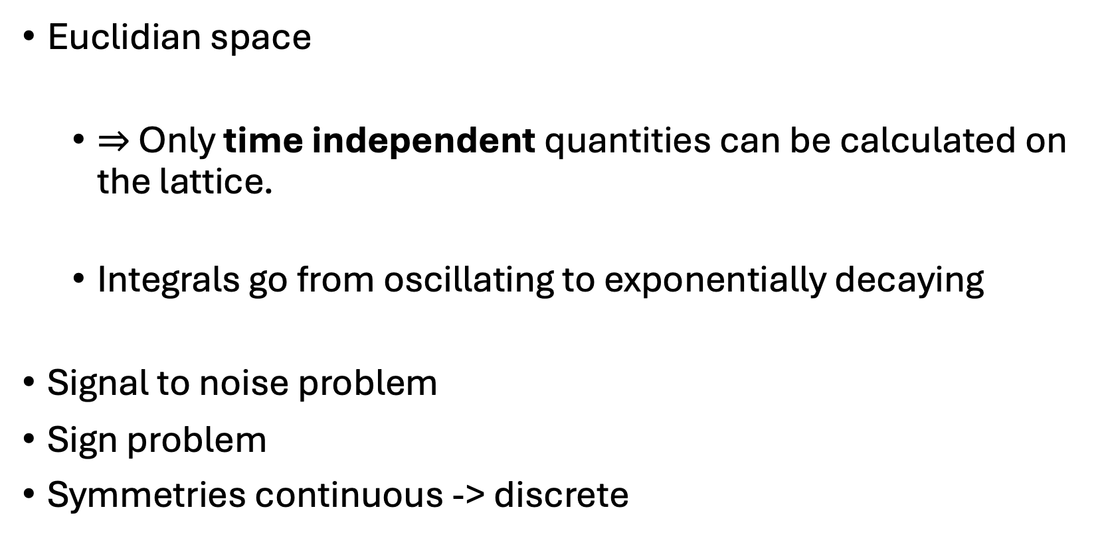
Problems on the Lattice
Euclidian space
  $⇒$ Only time independent quantities can be calculated on the lattice.
  Integrals go from oscillating to exponentially decaying
Signal to noise problem
Sign problem
Symmetries continuous -> discrete

Slide 40
The Unitary Fermi Gas
The system of interest is a gas of Fermions tuned to the unitary limit
Applicable to systems with large numbers of fermions
3G Science White
ESA

Slide 41
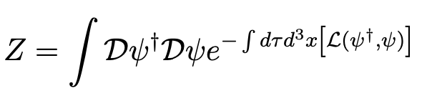
Pion-less EFT
Effective field theory involving two point-like nucleons interacting via contact interactions.
Higher order terms add derivatives of fields, and therefore, different couplings to different spin states. Thus, we ignore the spin of the nucleons.
Z is the Euclidian path integral for this theory.

Slide 42
Pion-less EFT: 2 body amplitude calculation (small g₀)
Scattering amplitude is a sum of bubble diagrams
But, we know from the optical theorem that
Therefore, we know that if the coupling is small
Notes:
C_2n(mu) are the scale dependent contact operator coefficients
2n space derivatives acting on nucleon fields (or n t derivatives)
Only works if these are less than normal sized
M is nucleon mass
E is NR energy

Slide 43
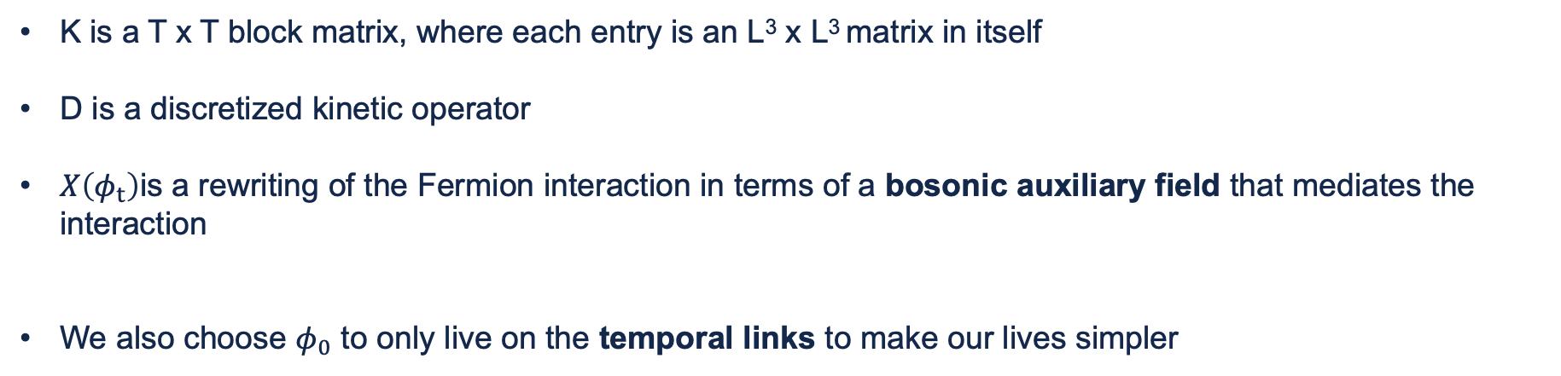
Discretizing Pion-less EFT
We start by discretizing the pion-less EFT action in the following way
K is a T x T block matrix, where each entry is an L³ x L³ matrix in itself
D is a discretized kinetic operator
$X\left(φ_{t}\right)$is a rewriting of the Fermion interaction in terms of a bosonic auxiliary field that mediates the interaction
We also choose $φ_{0}$ to only live on the temporal links to make our lives simpler

Slide 44





Calculating the spectrum of the 2 body system
The two body correlation function becomes
We can integrate out the fermion fields to see
After a bunch of simplification
Transfer Matrix
Notes:
where Ψsrc,2(snk,2) is a source (sink) wavefunction involving one spin up and one spin down particle
Eft lecture notes 16-18

Slide 45

Calculating the spectrum of the 2 body system
From statistical mechanics:
Now we know that the logarithms of the eigenvalues of the transfer matrix give us the
2 body spectrum!
In principle, we could diagonalize $𝒯$and its eigenvalues would be the 2-body spectrum.
Where
We can compare this result to the one discussed earlier using Lüscher methods to tune the coupling
Notes:
Eft lecture notes 16-18

Slide 46

Effective Mass
In general, the transfer matrix with N $≥$4 cannot be solved because the dimension increases with particle number
This is why we form N-point correlation functions
Notes:
Psi is a source for N particles with spin / flavor indices a1…an and spatial wave function A
Only requirement on A is that there is non-zero overlap with the ground state (correct quantum numbers for the state of interest)

Slide 47


Effective Mass
We can expand $C_{N}\left(τ\right)$
$Z_{m}^{\left(a\right)}$is the overlap of the wavefunction a with the eigenstate m
In the zero-temperature limit (large Euclidian time) we expect
Notes:
If the correlation function is tau insertions of the transfer matrix between the source and sink, we can expand C_N(t)

Slide 48

Effective Mass
We can expect excited states to be exponentially suppressed by $e^{−ΔEτ}$
A common way to extract the ground state is to construct the so called “effective mass function” and let Euclidian time approach infinity
Notes:
Delta E is the energy splitting between E_n and E_0

Slide 49
Approach to calculating GFF’s on the lattice

Slide 50
Gravitational Form Factors (GFFs)
A form factors are functions that describe the shape, size, and distributions of various different types of charges
They can be calculated from scattering cross sections (observed experimentally)
Related to the decomposition of current matrix elements
GFFs can be related to GPD physics (through GPD moments)
The gravitational form factors (GFFs) describe the angular momentum, mass, and force distributions in your system
e.g. Proton form factors related to GPD moments
(Girod, 2018)
Notes:
J^q(t)=\frac{1}{2}\int_{-1}^1 dx x[H^q(x,\xi,t)+E^q(x,\xi,t)] \\
M_2(t) +\frac{4}{5}d_1(t)\xi^2 = \frac{1}{2}\int_{-1}^1dx x H^q(x,\xi,t)

Slide 51
Current Insertion
Proton GFF matrix element decomposition
Hackett, Pefkou, Shanahan 2024
Following the methods discussed in this paper, we can extract GFFs for the unitary fermi gas by taking constrained ratios of 3-pt and 2-pt functions!
Notes:
N is proton state
U is dirac spinor

Slide 52
Hackett, Pefkou, Shanahan 2024
Notes:
Three GFFs of the proton computed on the lattice QCD ensemble of this work, and their decomposition into gluon and total quark contributions, are shown as func- tions of t. Inset figures show the isosinglet quark GFFs fur- ther decomposed into up-, down-, and strange-quark contri- butions. The total GFFs are renormalization scheme- and scale-independent, while all other GFFs are shown in the MS scheme at μ = 2 GeV. The dark bands represent dipole fits to the data in the case of g and q = u+d+s, and linear com- binations of the dipole fits to q, v1, and v2 in all other cases. The lighter bands show analogous fits using the z-expansion.
The proton GFFs Ag(t), Dg(t), and Du+d(t) and cor- responding dipole fits, computed on the lattice QCD ensem- ble of this work, are compared with the experimentally con- strained multipole parametrizations of Refs. [24] (BEG), [42] (Duran et al.), and [46] (Guo et al.). For this comparison, the results for Ag(t) are re-scaled such that the gluon momentum fraction is Ag(0) = 0.414(8) [69], which is the value used as an input in the extraction of Refs. [42] and [46]. This does not a↵ect the t-dependence of the GFF.
52

Slide 53


How is this done for the proton?
We define the momentum projected proton 2-pt correlation function
Where
Is fit to the usual
Notes:
The momentum-projected two-point correlaXtion function of the proton for spin channel s s’ is defined as
Gamma are usual spin projector operators
Chi is the interpolating operator
C is charge conjugation

Slide 54

How is this done for the proton?
Next, we write the Euclidian EMT contributions as
The elements of which transform like two different irreps of the hypercubic group that can be mapped back to Minkowski space
We can then write the 3-pt function used to extract the matrix elements as
Notes:
I index tells us which T we are working with (quark, gluon, etc)
R is the irrep index
L is the index that denotes the vector in the basis of said irreps

Slide 55

How is this done for the proton?
In the long time limit
To cancel out the overlap factors, we form the ratio
Which is a linear combination of the form factors with kinematically known coefficients. (don’t ask me how, this feels like magic to me).
Notes:
I index tells us which T we are working with (quark, gluon, etc)
R is the irrep index
L is the index that denotes the vector in the basis of said irreps

Slide 56
End Slide 2 – White

