Slide 1
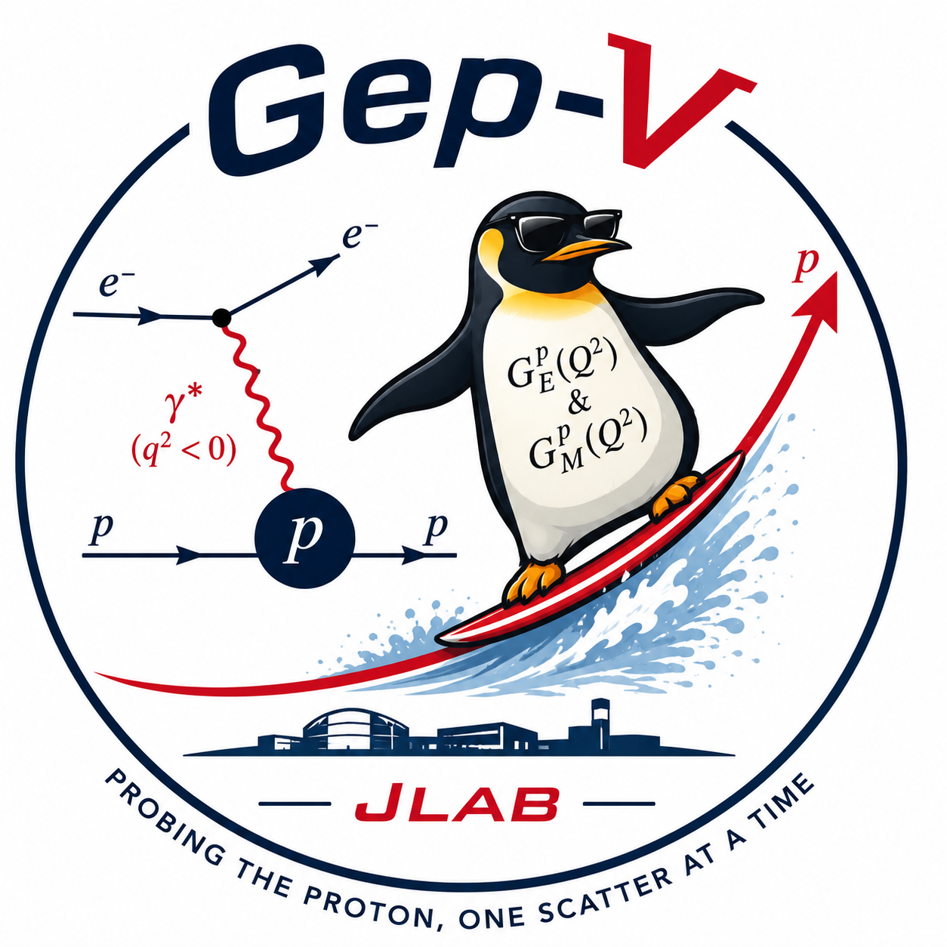
Measuring the Electromagnetic Form Factor Ratio of the Proton
Benjamin Spaude • CNUGS 2026
William & Mary

Slide 2
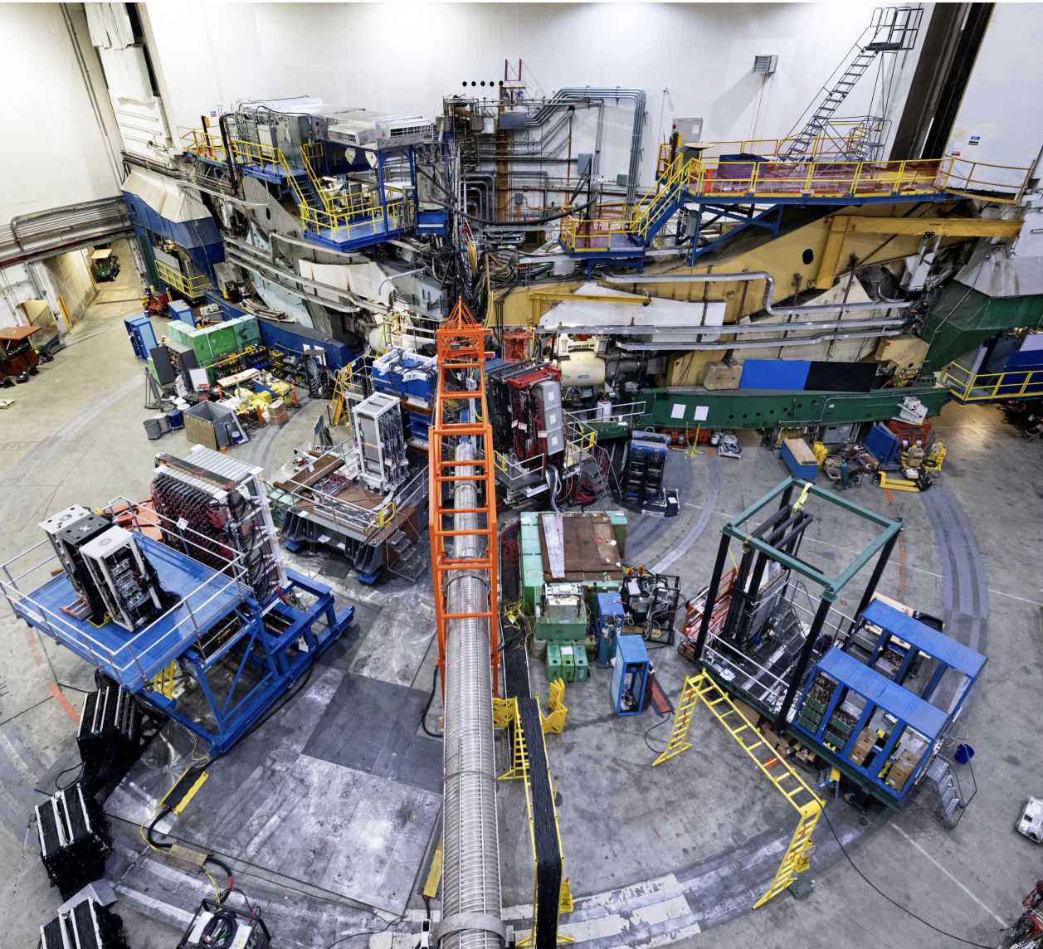
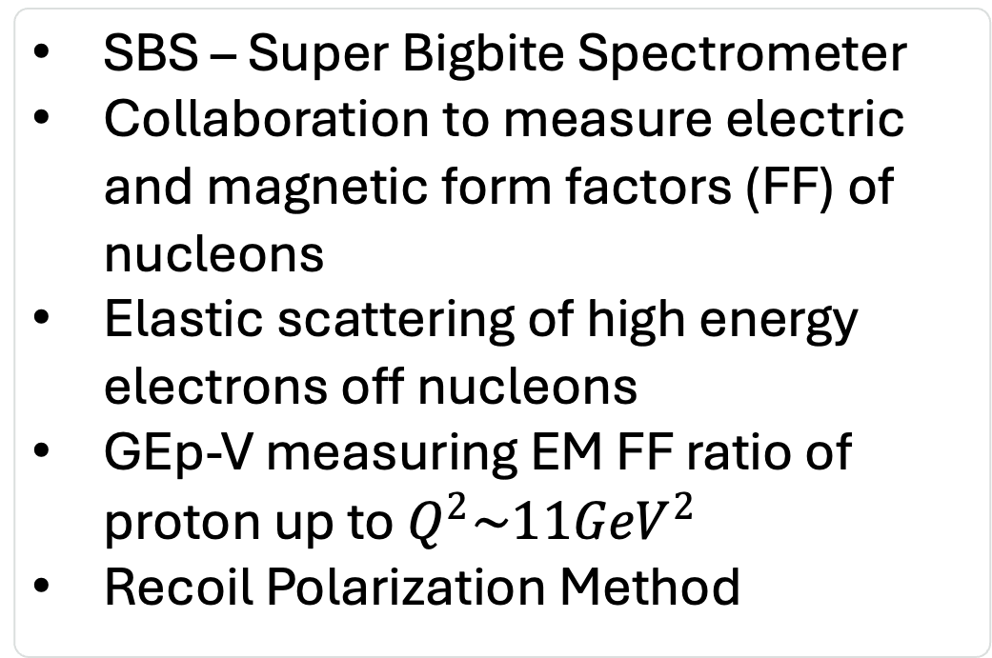

SBS Collaboration
SBS – Super Bigbite Spectrometer
Collaboration to measure electric and magnetic form factors (FF) of nucleons
Elastic scattering of high energy electrons off nucleons
GEp-V measuring EM FF ratio of proton up to${ Q^{2}\sim 11GeV}^{2}$
Recoil Polarization Method
Pion consisting of $q\overline{q}$pair, spin-0
W&M

Slide 3
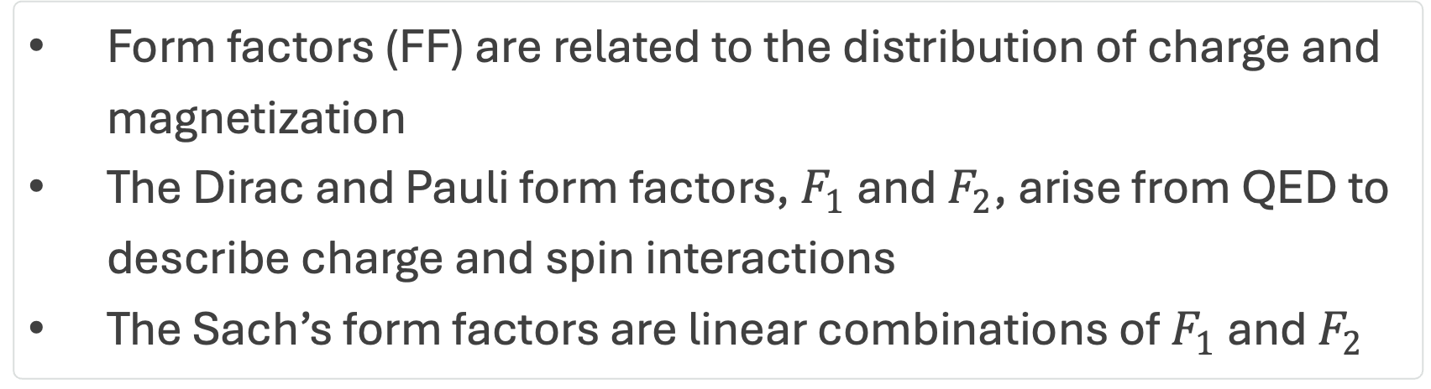

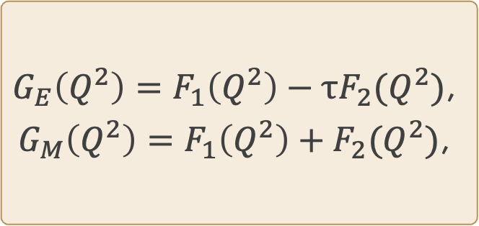
Form Factors
Form factors (FF) are related to the distribution of charge and magnetization
The Dirac and Pauli form factors, $F_{1}$ and $F_{2}$, arise from QED to describe charge and spin interactions
The Sach’s form factors are linear combinations of $F_{1}$ and $F_{2}$
$$G_{E}\left(Q^{2}\right)=F_{1}\left(Q^{2}\right)−τF_{2}(Q^{2})\text{,}$$
$$G_{M}\left(Q^{2}\right)=F_{1}\left(Q^{2}\right)+F_{2}(Q^{2})\text{,}$$
$$τ=\frac{Q^{2}}{4M^{2}}$$
W&M

Slide 4
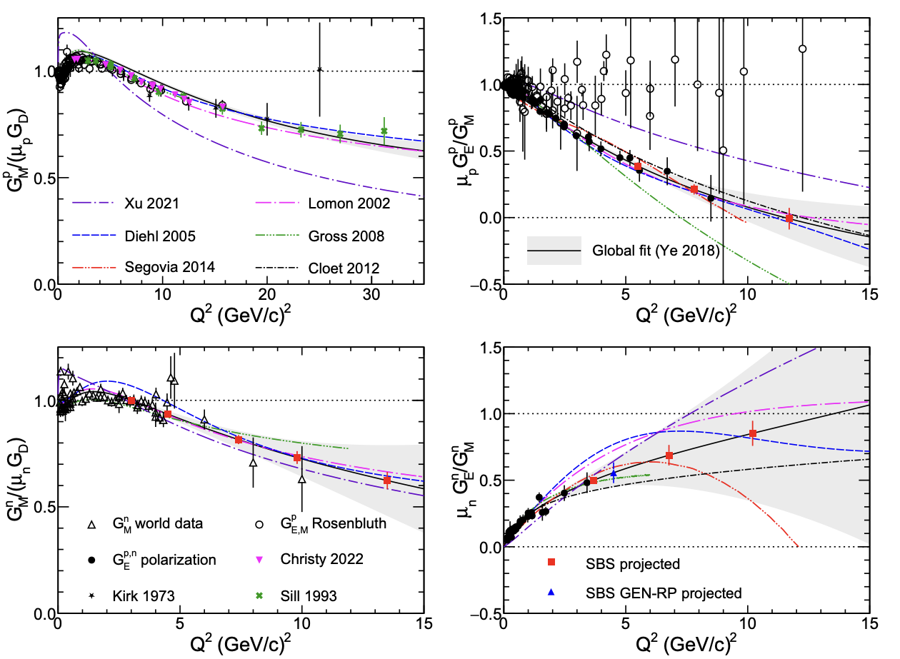
Proton FF
Neutron FF
W&M

Slide 5
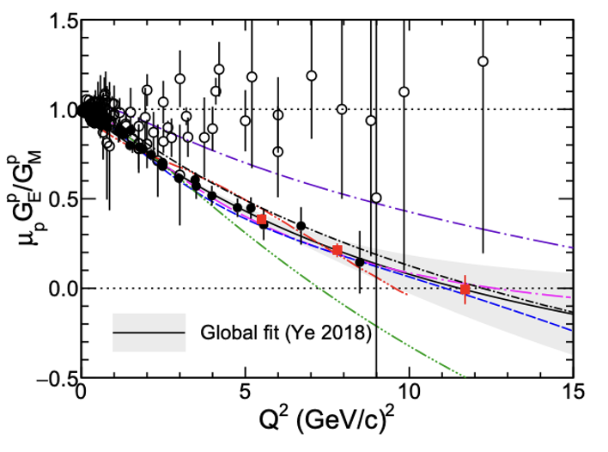
Rosenbluth Technique vs Recoil Polarization
Linear fall off
Cannot decrease forever
W&M

Slide 6
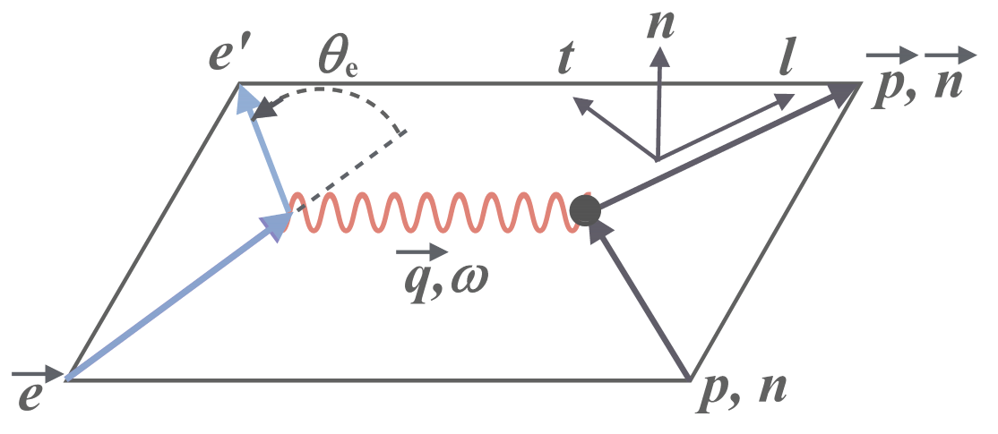
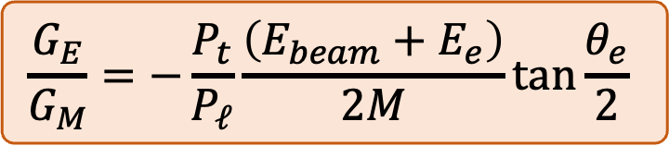
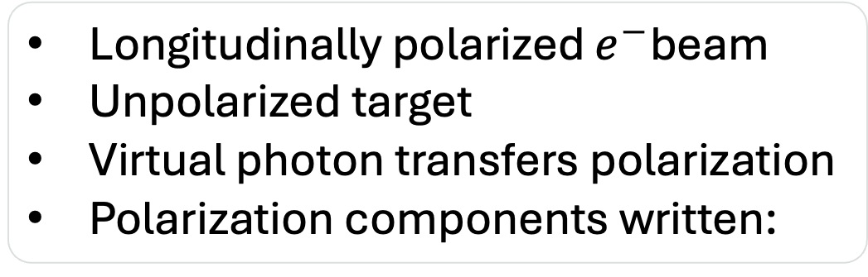
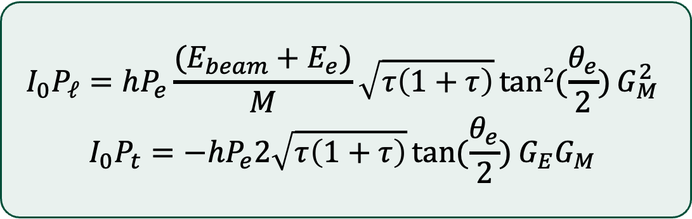
Recoil Polarization
Longitudinally polarized $e^{−}$beam
Unpolarized target
Virtual photon transfers polarization
Polarization components written:
$$I_{0}P_{ℓ}=hP_{e}\frac{(E_{beam}+E_{e})}{M}\sqrt{τ\left(1+τ\right)}tan2{(\frac{θ_{e}}{2})}G_{M}^{2}$$
$$I_{0}P_{t}=−hP_{e}2\sqrt{τ\left(1+τ\right)}\tan{(\frac{θ_{e}}{2})}G_{E}G_{M}$$
$$\frac{G_{E}}{G_{M}}=−\frac{P_{t}}{P_{ℓ}}\frac{\left(E_{beam}+E_{e}\right)}{2M}\tan{\frac{θ_{e}}{2}}$$
Take ratio:
W&M

Slide 7

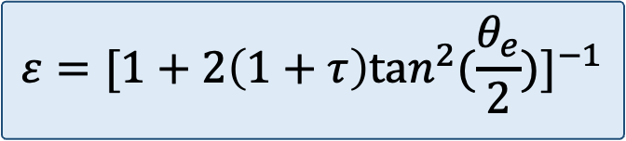
Rosenbluth vs Recoil Polarization
Rosenbluth Technique
Rosenbluth requires absolute cross-section
$$σ_{R}\left(ε\right)= εG_{E}^{2}\left(Q^{2}\right)+ τG_{M}^{2}(Q^{2})$$
At high $Q^{2}$, $G_{M}$ dominates
  $G_{E}$ extracted from small slope
Highly sensitive to higher order effects
Recoil Polarization
FF come out neatly via polarization ratio
Can measure with just polarization components
Less sensitive to higher order effects
$$ε=[1+2\left(1+τ\right)tan^{2}(\frac{θ_{e}}{2})]^{−1}$$
W&M

Slide 8
Experimental Setup
Electron Calorimeter
Absorber
Electron Arm
Coordinate Detector
e⁻
LH2
Beam
CH2 Analyzer
p
Magnet
Hadron Arm
Hadron Calorimeter
GEMs Front/Back Tracker
W&M

Slide 9
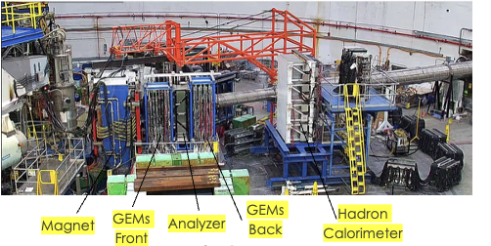
Hadron Arm
Magnet
  Momentum Measurement
GEMS
  Tracking Detector
Analyzer
  Polarization Measurement
HCal
  Proton Energy
W&M

Slide 10
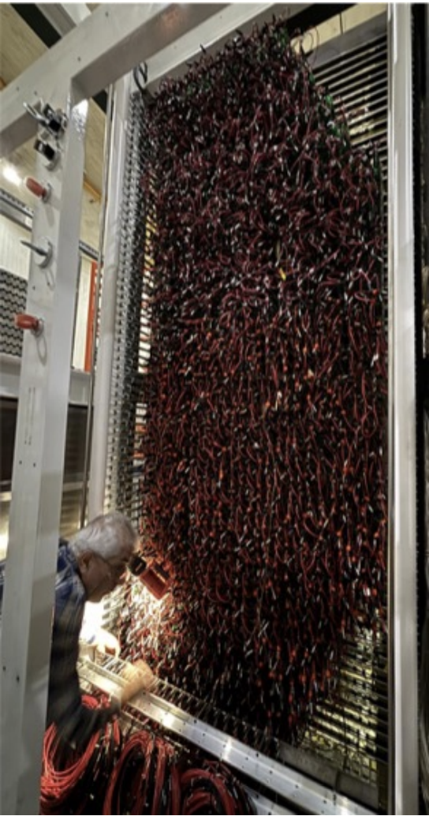
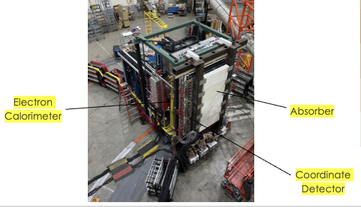
Electron Arm
Electron energy
Reduce low energy junk
Vertical position tracking
W&M

Slide 11
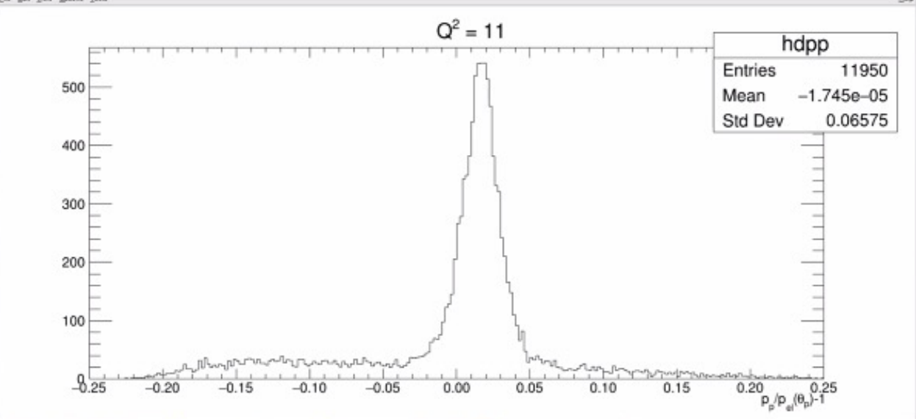
Experiment Status
Place final plot here
(Fπ vs Q²)
Main takeaway
Peak showing elastic e-p identification
Calorimeter calibrations need improvement
Tracking calibrations need improvement
W&M

Slide 12
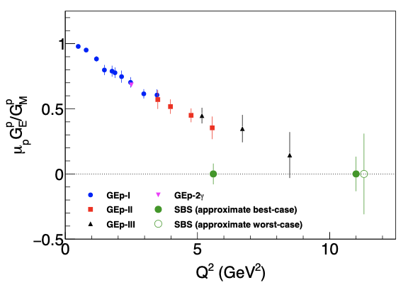
Experiment Projections
Place final plot here
(Fπ vs Q²)
W&M

