Slide 1



Extraction of the Charged Pion Form Factor
from Electroproduction up to Q² ≈ 8.5 GeV²
Sameer Jain
Supervisor: Dr. Tanja Horn
CNUGS · June 2026
Sameer Jain (CUA)
PionLT Collaboration

Slide 2
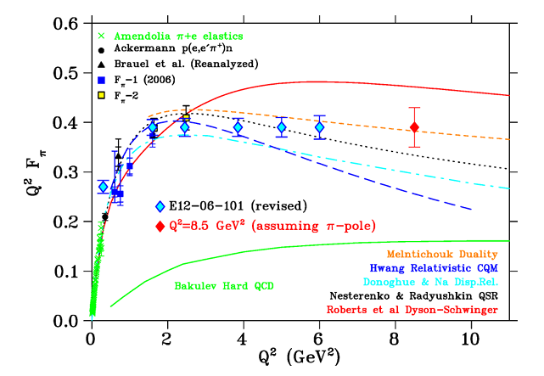
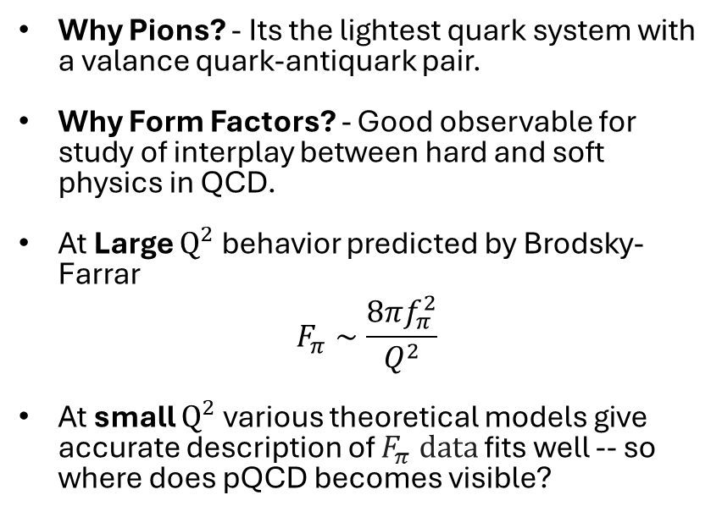
Motivation
Overview of pion form-factor measurements
Why Pions? - Its the lightest quark system with a valance quark-antiquark pair.
Why Form Factors? - Good observable for study of interplay between hard and soft physics in QCD.
At Large $Q^{2}$ behavior predicted by Brodsky-Farrar
$$F_{π}∼\frac{8πf_{π}^{2}}{Q^{2}}$$
At small $Q^{2}$ various theoretical models give accurate description of $F_{π} data$ fits well -- so where does pQCD becomes visible?
Sameer Jain (CUA)
PionLT Collaboration
1

Slide 3
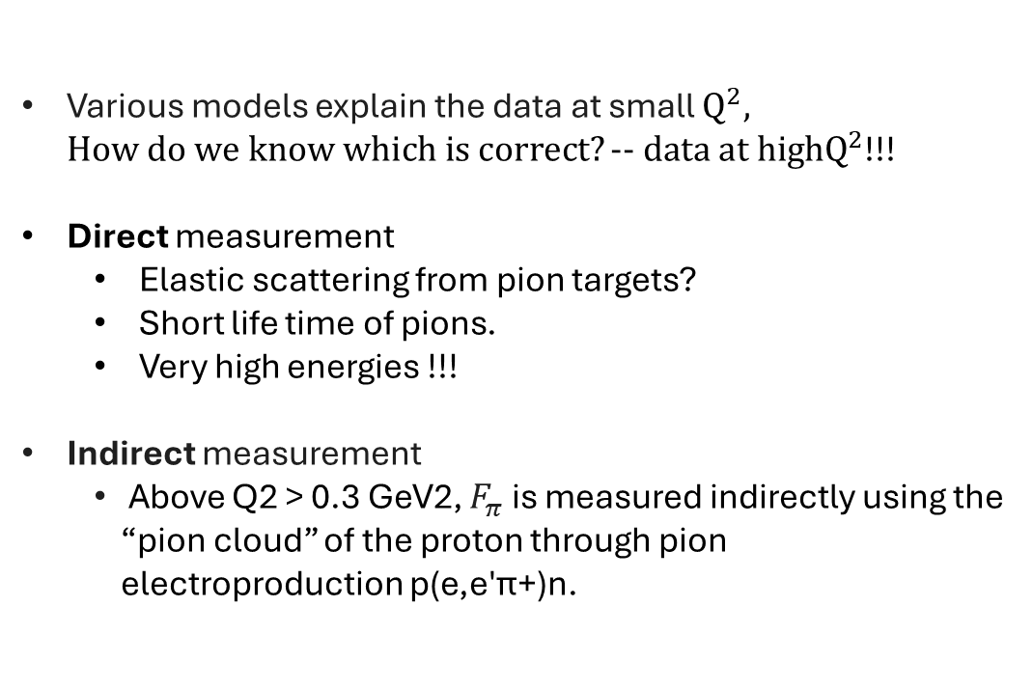
Motivation
Overview of pion form-factor measurements
Various models explain the data at small $Q^{2}, How do we know which is correct?−− data at highQ^{2}$!!!
Direct measurement
  Elastic scattering from pion targets?
  Short life time of pions.
  Very high energies !!!
Indirect measurement
  Above Q2 > 0.3 GeV2, $F_{π}$ is measured indirectly using the “pion cloud” of the proton through pion electroproduction p(e,e′π+)n.
Sameer Jain (CUA)
PionLT Collaboration
2

Slide 4
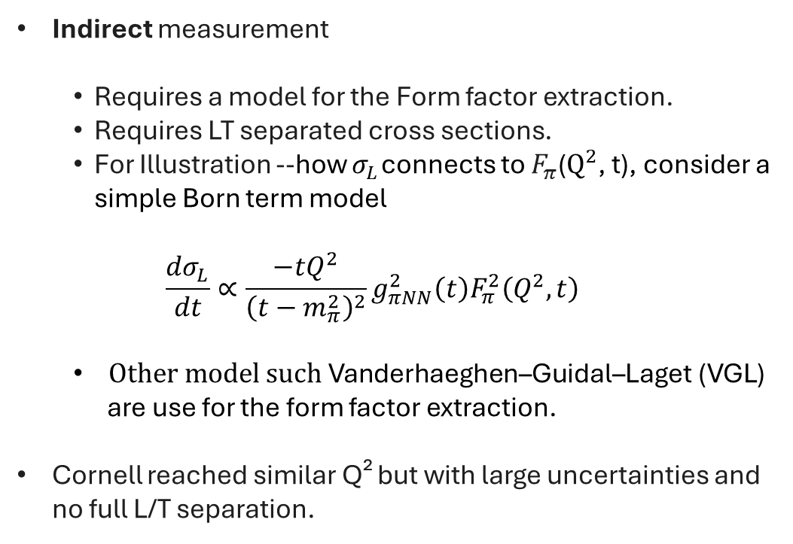
Motivation
Overview of pion form-factor measurements
Indirect measurement
  Requires a model for the Form factor extraction.
  Requires LT separated cross sections.
  For Illustration --how $σ_{L}$ connects to $F_{π}$($Q^{2}$, t), consider a simple Born term model
  $$\frac{dσ_{L}}{dt}∝\frac{−tQ^{2}}{{\left(t−m_{π}^{2}\right)}^{2}}g_{πNN}^{2}\left(t\right)F_{π}^{2}\left(Q^{2},t\right)$$
  $Other model such \text{Vanderhaeghen}\text{–}\text{Guidal}\text{–}\text{Laget}\text{ (}\text{VGL}\text{)}$
  are use for the form factor extraction.
Cornell reached similar Q² but with large uncertainties and no full L/T separation.
Sameer Jain (CUA)
PionLT Collaboration
3

Slide 5
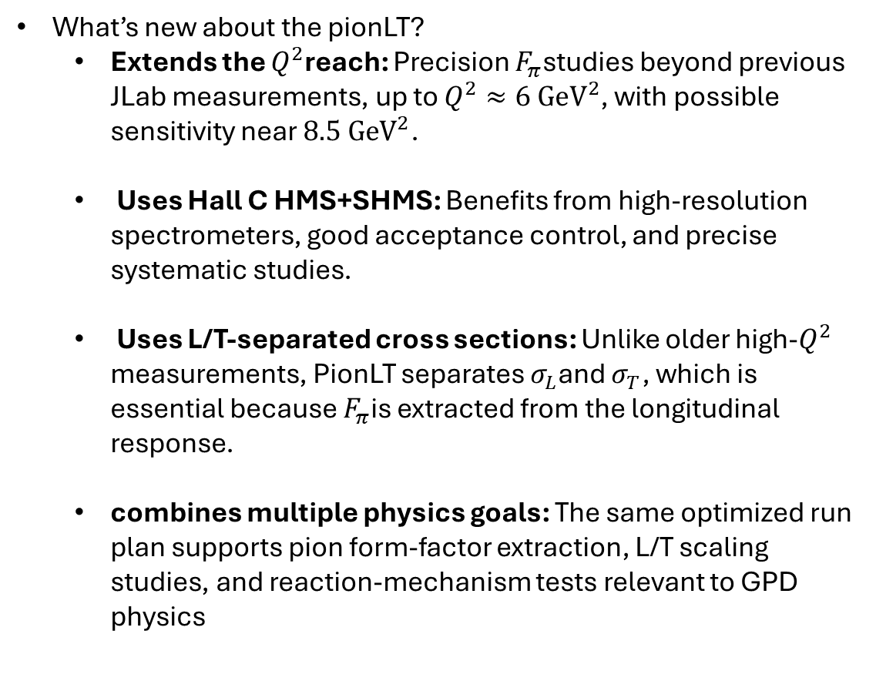
Motivation
PionLT Experiment
What’s new about the pionLT?
  Extends the $Q^{2}$reach: Precision $F_{π}$studies beyond previous JLab measurements, up to $Q^{2}≈6 {GeV}^{2}$, with possible sensitivity near $8.5 {GeV}^{2}$.
  Uses Hall C HMS+SHMS: Benefits from high-resolution spectrometers, good acceptance control, and precise systematic studies.
  Uses L/T-separated cross sections: Unlike older high-$Q^{2}$ measurements, PionLT separates $σ_{L}$and $σ_{T}$, which is essential because $F_{π}$is extracted from the longitudinal response.
  combines multiple physics goals: The same optimized run plan supports pion form-factor extraction, L/T scaling studies, and reaction-mechanism tests relevant to GPD physics
Sameer Jain (CUA)
PionLT Collaboration
4

Slide 6
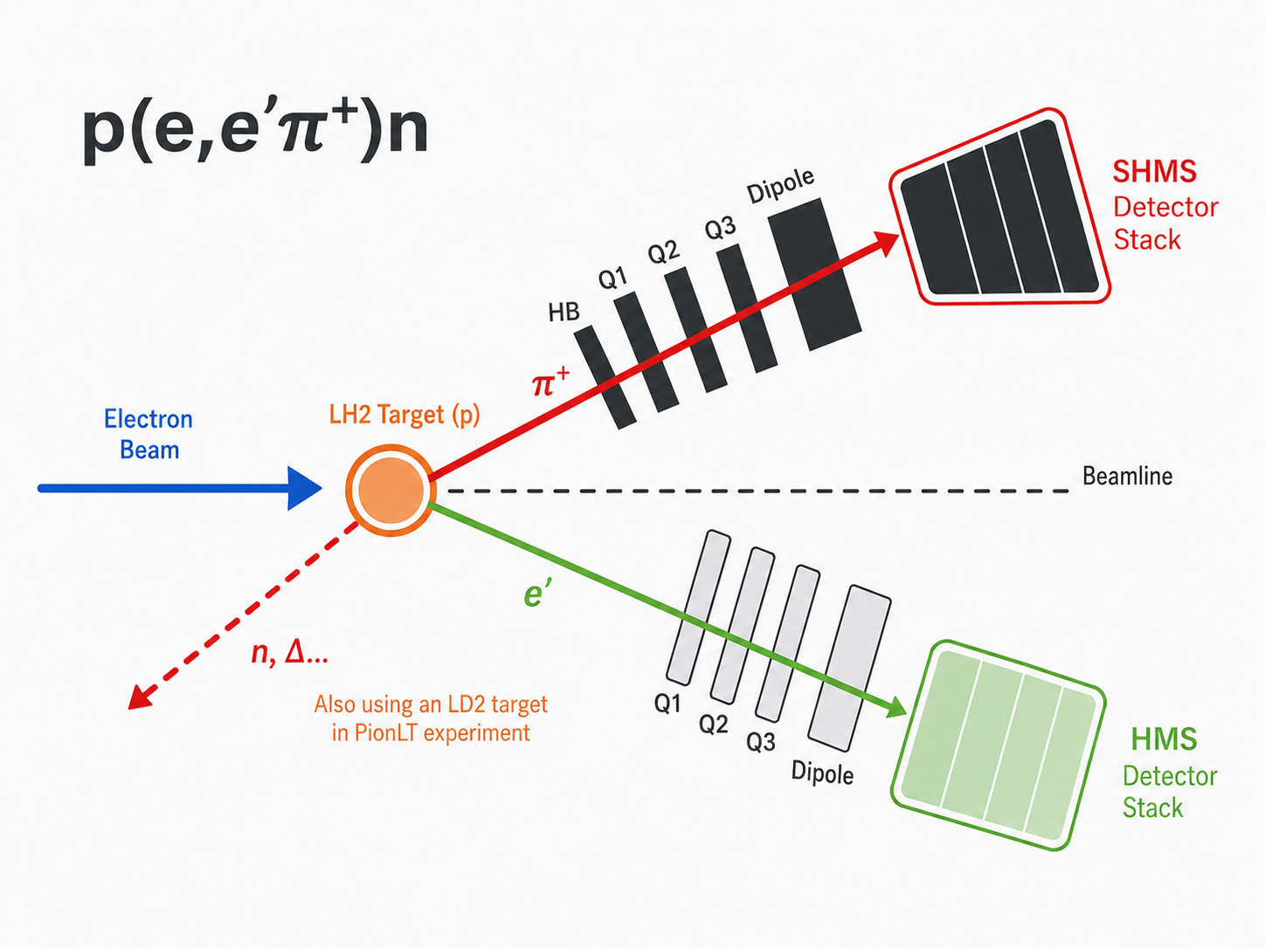
Experiment
PionLT at Hall C
HMS
SHMS
Beam Dump
Target Chamber
Sameer Jain (CUA)
PionLT Collaboration
5

Slide 7
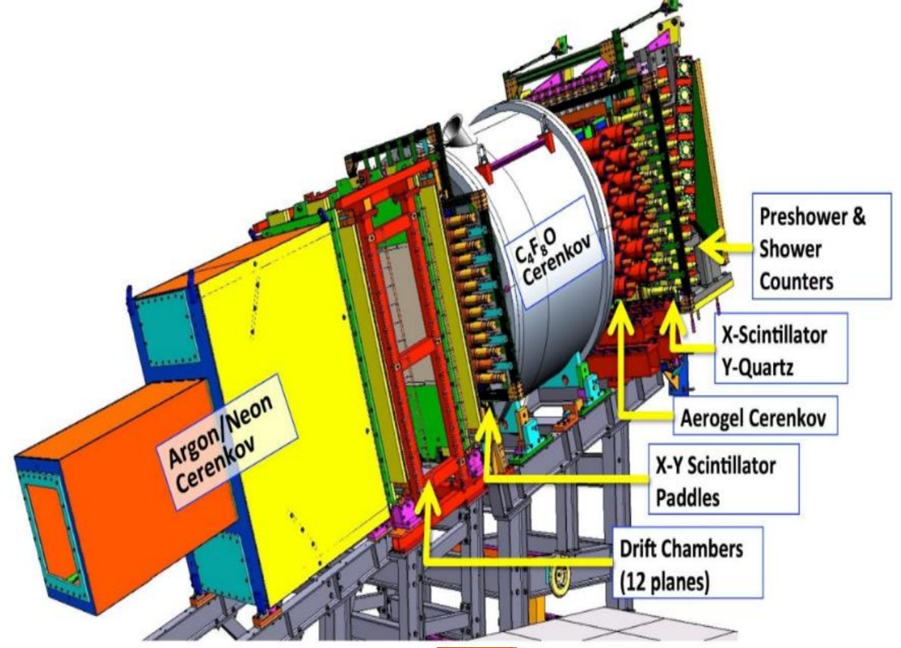
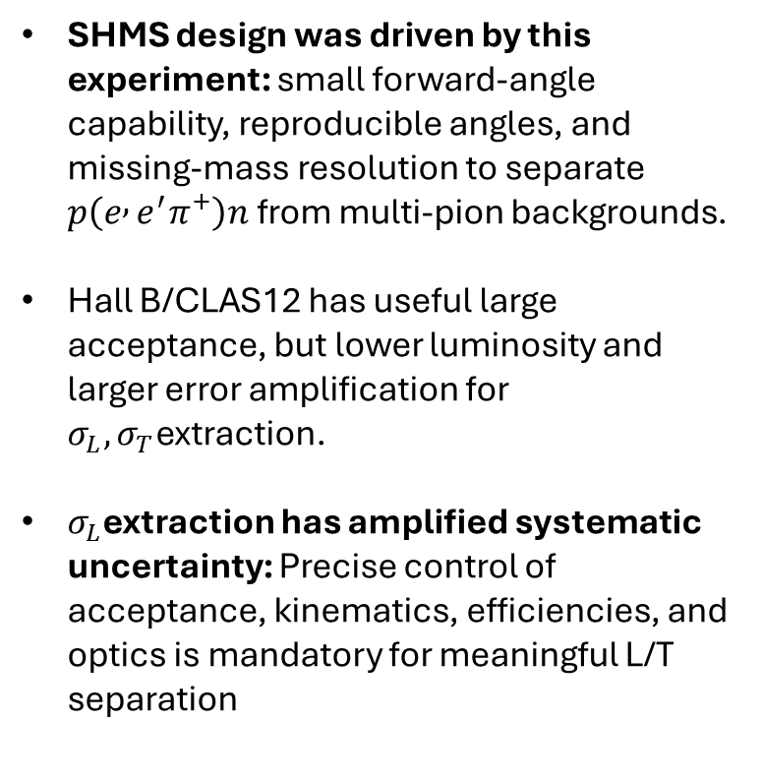
Experiment
Spectrometers
SHMS design was driven by this experiment: small forward-angle capability, reproducible angles, and missing-mass resolution to separate $p\left(e , e^{′}π^{+}\right)n$ from multi-pion backgrounds.
Hall B/CLAS12 has useful large acceptance, but lower luminosity and larger error amplification for $σ_{L},σ_{T}$extraction.
$σ_{L}$extraction has amplified systematic uncertainty: Precise control of acceptance, kinematics, efficiencies, and optics is mandatory for meaningful L/T separation
SHMS Detector Stack
Sameer Jain (CUA)
PionLT Collaboration
6

Slide 8
Analysis
Pion LT Kinematic Settings and Assignments
Q²
W
−tmin
Assigned to
Status
LH2
Target
1.45
2.02
0.11
--
--
LH2
1.60
3.08
0.03
Sameer Jain
Ongoing
LD2
1 .60
1.60
3.08
0.03
Kathleen Ramage & Nermin Sadoun
Ongoing
LH2
2.12
2.05
0.19
Nathan Heinrich
Preliminary cross section
LH2
2.45
3.20
0.05
Sameer Jain
Ongoing
LH2
2.73
2.63
0.12
--
--
LH2
3.85
2.02
0.49
Muhammad Junaid
Preliminary cross section
LH2
3.85
2.62
0.21
Muhammad Junaid & Nathan Heinrich
Preliminary cross section
LD2
3.85
2.62
0.21
Nermin Sadoun
Ongoing
LH2
3.85
3.07
0.12
Muhammad Junaid
Preliminary cross section
LD2
3.85
3.07
0.12
Kathleen Ramage
Ongoing
LH2
5.00
2.95
0.20
Nathan Heinrich
Preliminary cross section
LH2
6.00
2.40
0.53
Sameer Jain
Ongoing
LD2
6.00
2.40
0.53
Nermin Sadoun & Kathleen Ramage
Ongoing
LH2
6.00
3.19
0.21
Nathan Heinrich & Sameer Jain
Preliminary cross section
LH2
8.50
2.79
0.55
--
--
Sameer Jain (CUA)
PionLT Collaboration
7

Slide 9
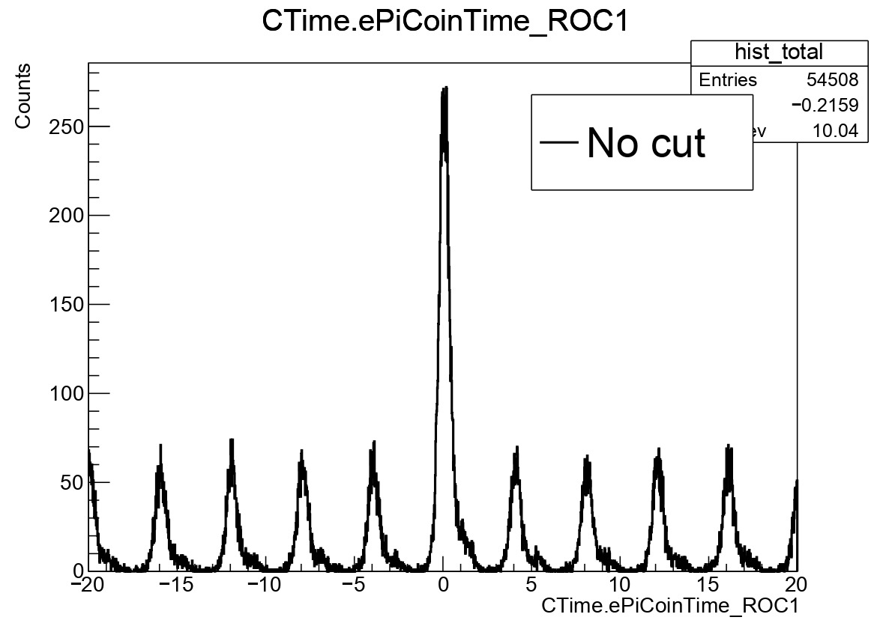
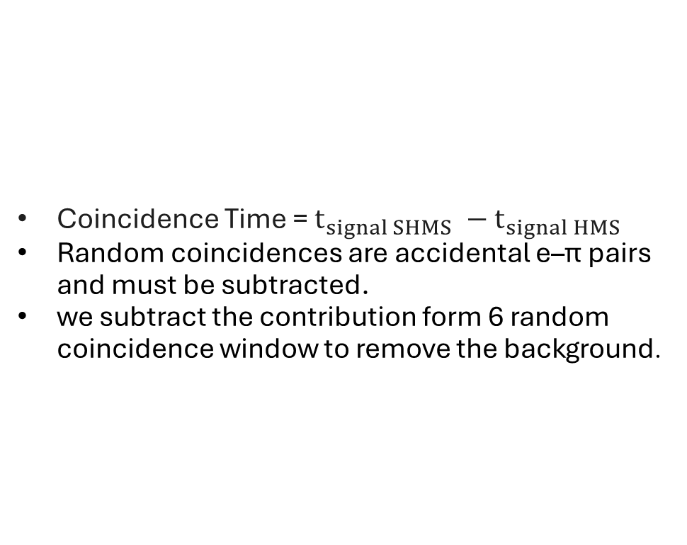
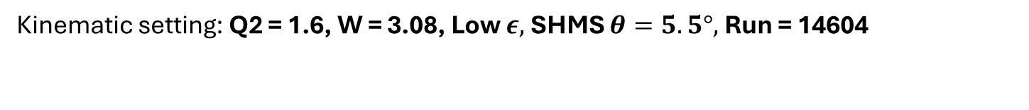

Analysis
Good Event Selection
Kinematic setting: Q2 = 1.6, W = 3.08, Low $ε,$SHMS $θ=5.5°\text{, }\text{Run}\text{ = 14604}$
Coincidence Time = $t_{signal SHMS} −{ t}_{signal HMS}$
Random coincidences are accidental e–π pairs and must be subtracted.
we subtract the contribution form 6 random coincidence window to remove the background.
Good Events
Coincidence time (ns)
Random coincidences
Sameer Jain (CUA)
PionLT Collaboration
8

Slide 10
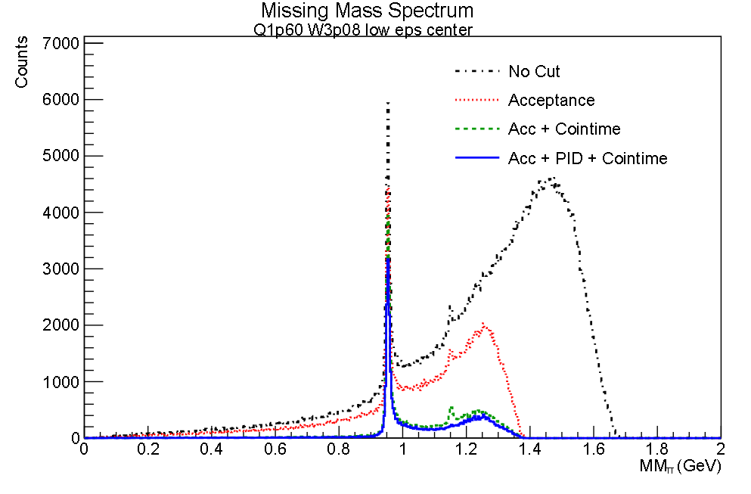
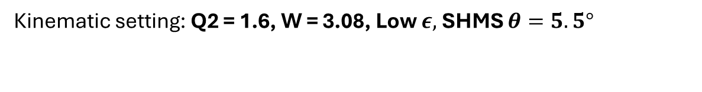
Analysis
Good Event Selection
Kinematic setting: Q2 = 1.6, W = 3.08, Low $ε,$SHMS $θ=5.5°$
Similar to coincidence time we apply following simple cuts for each event :
Electrons selection in HMS
  # of Photoelectron produced in HMS Heavy Gas Cerenekov >1.5
  Energy deposited in HMS calorimeter/particles momentum >0.7
Pion selection in SHMS
  # of Photoelectron produced in SHMS Aerogel Cerenekov >0.1
  # of Photoelectron produced in SHMS Heavy Gas Cerenekov>0.1
No Cut: 543357.0 entries
Acceptance: 177973.0 entries
Acc + Cointime: 47005.0 entries
Acc + PID + Cointime: 35766.0 entries
Sameer Jain (CUA)
PionLT Collaboration
9

Slide 11
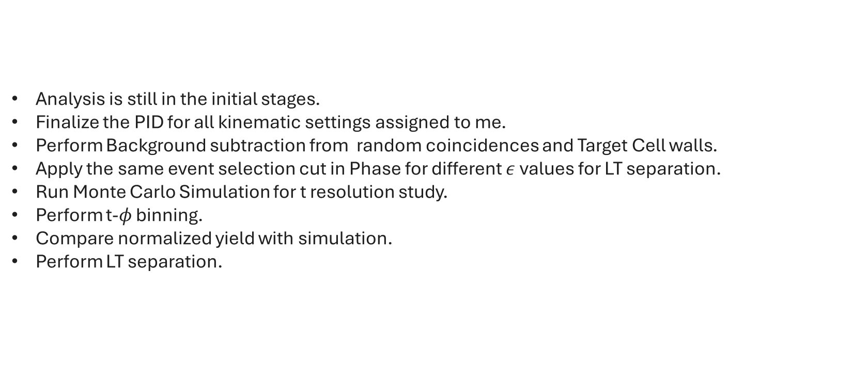
Outlook
Next steps
Analysis is still in the initial stages.
Finalize the PID for all kinematic settings assigned to me.
Perform Background subtraction from random coincidences and Target Cell walls.
Apply the same event selection cut in Phase for different $ε$ values for LT separation.
Run Monte Carlo Simulation for t resolution study.
Perform t-$φ$ binning.
Compare normalized yield with simulation.
Perform LT separation.
Sameer Jain (CUA)
PionLT Collaboration
10

Slide 12
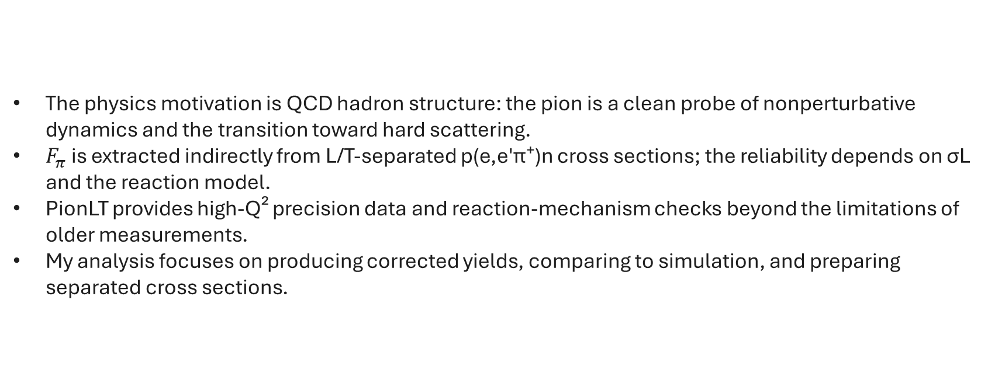
Summary
Summary
The physics motivation is QCD hadron structure: the pion is a clean probe of nonperturbative dynamics and the transition toward hard scattering.
$F_{π}$ is extracted indirectly from L/T-separated p(e,e′π⁺)n cross sections; the reliability depends on σL and the reaction model.
PionLT provides high-Q² precision data and reaction-mechanism checks beyond the limitations of older measurements.
My analysis focuses on producing corrected yields, comparing to simulation, and preparing separated cross sections.
Thank you for your attention!!
Questions?
Sameer Jain (CUA)
PionLT Collaboration
11

Slide 13
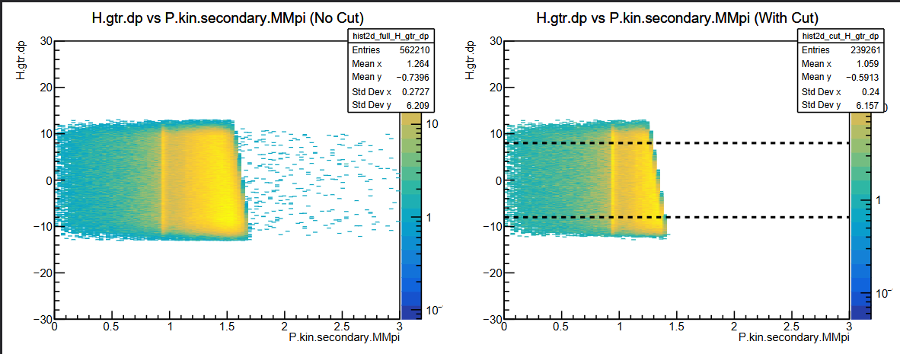
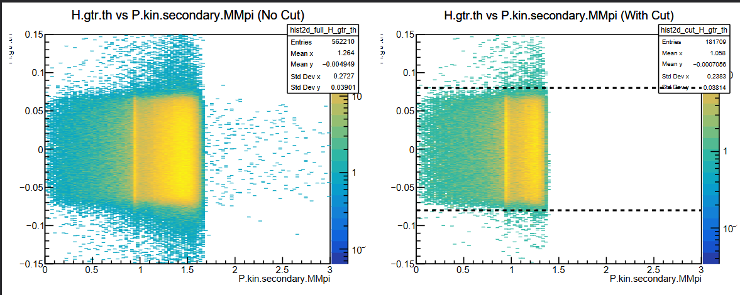
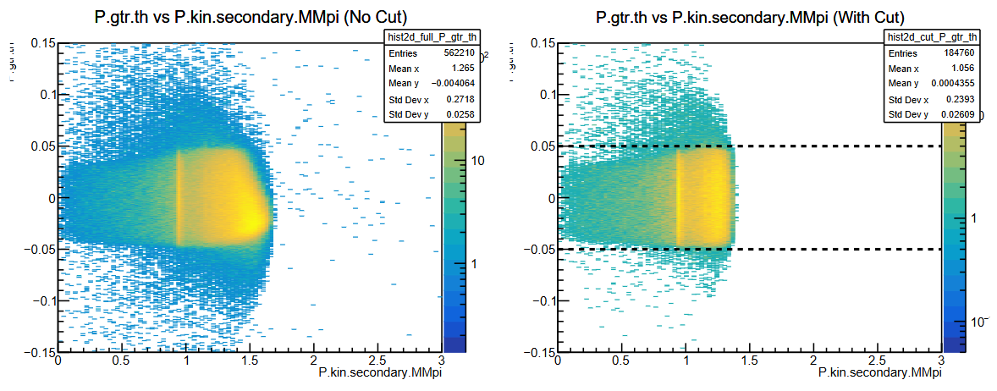
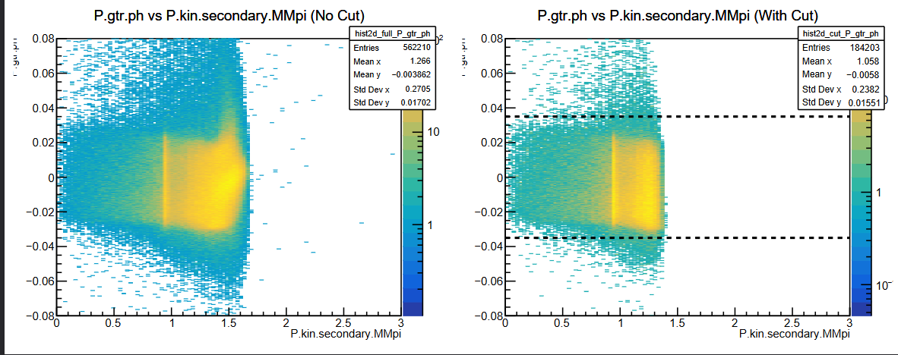
Summary
Backup slide
Acceptance cuts
All acceptance cuts - except the cut on the explicit variable
H.hod.goodstarttime == 1
H.gtr.dp > -8 && H.gtr.dp < 8
H.gtr.th > -0.08 && H.gtr.th < 0.08
H.gtr.ph > -0.04 && H.gtr.ph < 0.04
P.hod.goodstarttime == 1
P.gtr.dp > -10 && P.gtr.dp < 20
P.gtr.th > -0.05 && P.gtr.th < 0.05
P.gtr.ph > -0.035 && P.gtr.ph < 0.035
Sameer Jain (CUA)
PionLT Collaboration

Slide 14
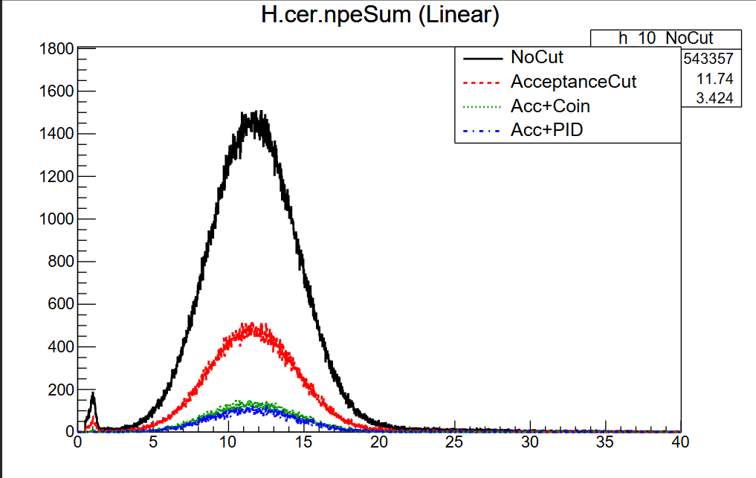
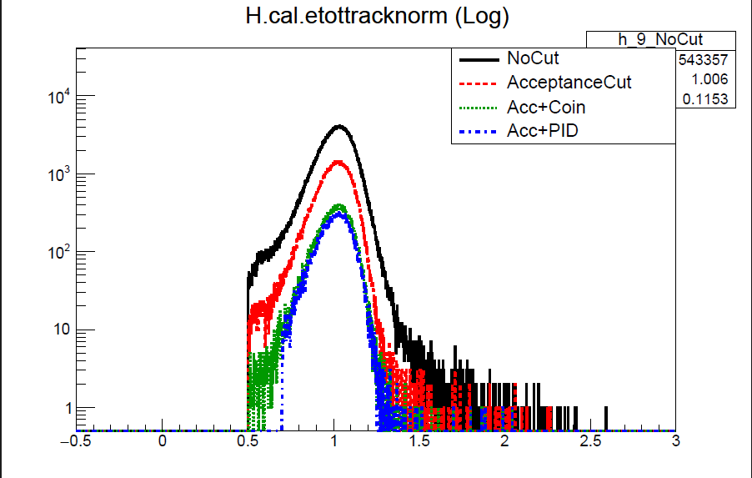
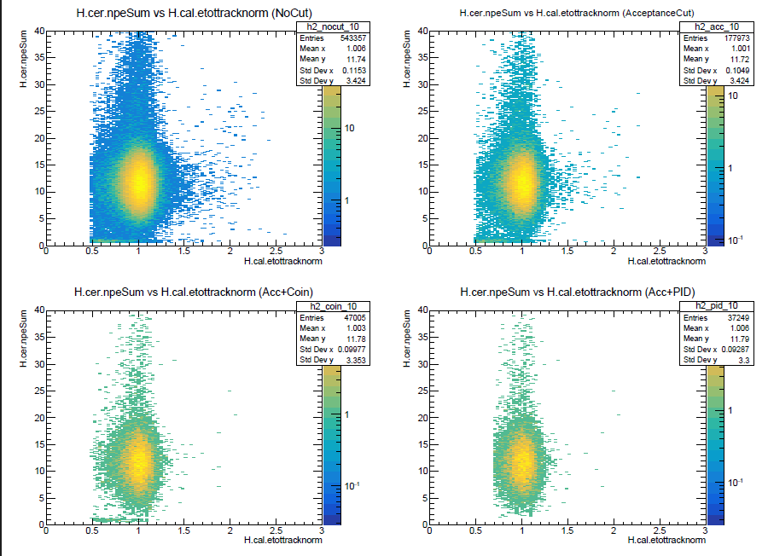
Summary
Backup slide
Paticle Identification cuts
All cuts - except the cut on the explicit variable
H.cer.npeSum > 1.5
H.cal.etottracknorm > 0.7
P.aero.npeSum >0.1
P.hgcer.npeSum > 0.1
Sameer Jain (CUA)
PionLT Collaboration
12 / 12

Slide 15
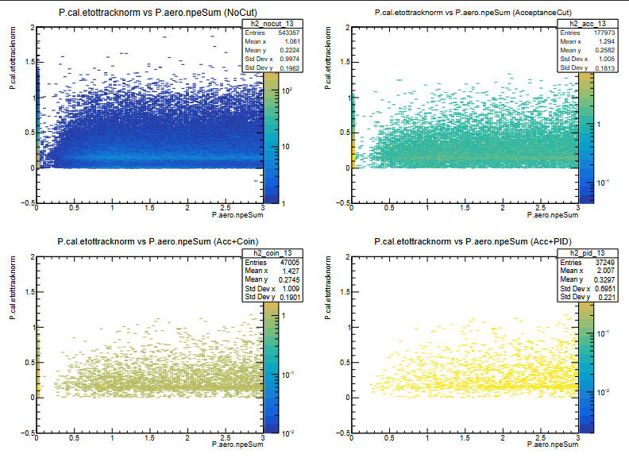
Summary
Backup slide
Paticle Identification cuts
All cuts - except the cut on the explicit variable
H.cer.npeSum > 1.5
H.cal.etottracknorm > 0.7
P.aero.npeSum >0.1
P.hgcer.npeSum > 0.1
Sameer Jain (CUA)
PionLT Collaboration

