Slide 1
η → 3π as a Precision Probe of Isospin Breaking and the Light-Quark Mass Ratio
Payton Arber
Department of Physics

Slide 2
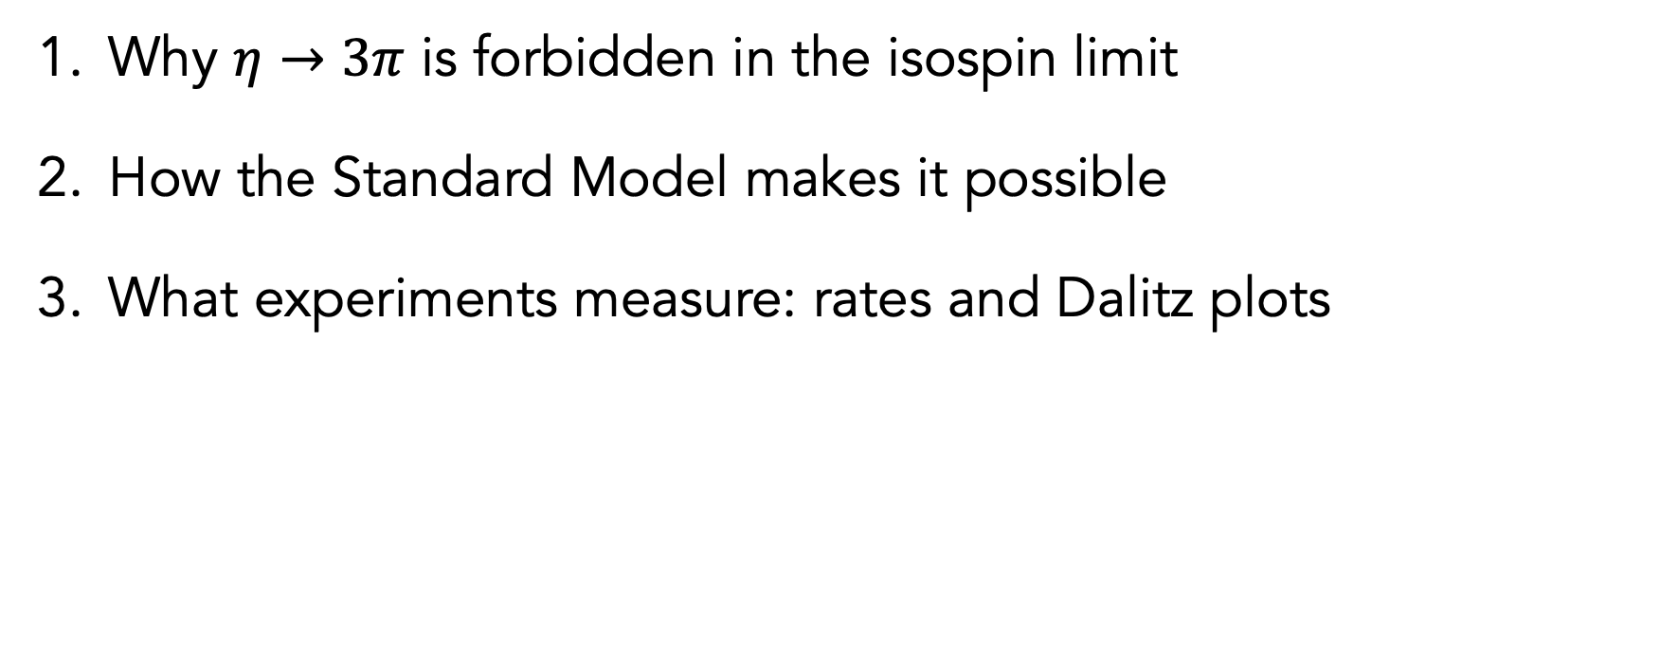
Outline
η → 3π as a Precision Probe of Isospin Breaking and the Light Quark Mass Ratio
Department of Physics
Why $η→3π$ is forbidden in the isospin limit
How the Standard Model makes it possible
What experiments measure: rates and Dalitz plots

Slide 3
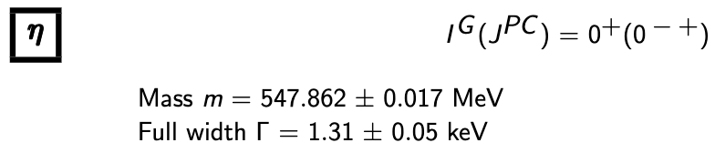

The $η$ meson is a particularly clean probe of fundamental symmetries
η → 3π as a Precision Probe of Isospin Breaking and the Light Quark Mass Ratio
Department of Physics
It’s a flavor conserving neutral pseudoscalar meson
Long-lived compared to many hadrons
Strong and electromagnetic decays are often symmetry suppressed
Sensitive to low-energy QCD and possible rare effects – which makes it accessible to precisions studies and BSM searches

Slide 4

The Decay Channels
η → 3π as a Precision Probe of Isospin Breaking and the Light Quark Mass Ratio
Department of Physics
$$η→π^{0}π^{+}π^{−} and η→{3π}^{0}$$
Branching Fractions:
Where does the rest of the decay go?

Slide 5
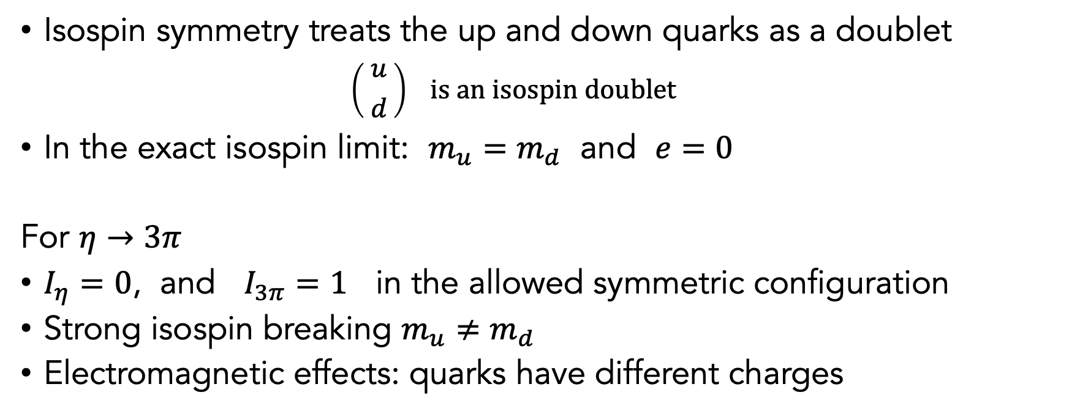
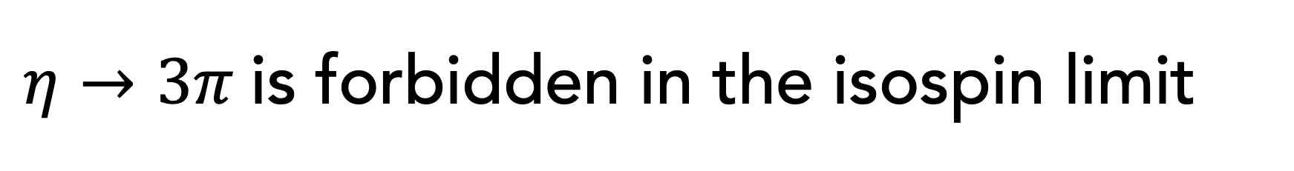
$η→3π$is forbidden in the isospin limit
η → 3π as a Precision Probe of Isospin Breaking and the Light Quark Mass Ratio
Department of Physics
Isospin symmetry treats the up and down quarks as a doublet
  $$\left({{ u}^{ } \atop { d}_{ }}\right) is an isospin doublet$$
In the exact isospin limit: $m_{u}=m_{d}$ and $e=0$
For $η→3π$
$I_{η}=0$, and $I_{3π}=1$ in the allowed symmetric configuration
Strong isospin breaking $m_{u}≠m_{d}$
Electromagnetic effects: quarks have different charges

Slide 6

What part of the Standard Model makes this decay possible?
η → 3π as a Precision Probe of Isospin Breaking and the Light Quark Mass Ratio
Department of Physics
$$ℒ_{mass}=−m_{u}\overline{u}u−m_{d}\overline{d}d−m_{s}\overline{s}s$$
$$\hat{m}=\frac{m_{u}+m_{d}}{2}, δ=\frac{m_{u}−m_{d}}{2}$$
$$∴ \hat{m}+δ=m_{u} , \hat{m}−δ=m_{d}$$
$$−m_{u}\overline{u}u−m_{d}\overline{d}d=−\left(\hat{m}+δ\right)\overline{u}u−\left(\hat{m}−δ\right)\overline{d}d=−\hat{m}\left(\overline{u}u+\overline{d}d\right)−δ\left(\overline{u}u−\overline{d}d\right)$$
$$ℒ_{mass}=−\hat{m}\left(\overline{u}u+\overline{d}d\right)−m_{s}\overline{s}s−\frac{m_{u}−m_{d}}{2}\left(\overline{u}u−\overline{d}d\right)$$
$$ℒ_{IB}=−\frac{m_{u}−m_{d}}{2}\left(\overline{u}u−\overline{d}d\right)$$

Slide 7
What part of the Standard Model makes this decay possible?
η → 3π as a Precision Probe of Isospin Breaking and the Light Quark Mass Ratio
Department of Physics
$$ℒ_{mass}=−m_{u}\overline{u}u−m_{d}\overline{d}d−m_{s}\overline{s}s$$
$$\hat{m}=\frac{m_{u}+m_{d}}{2}, δ=\frac{m_{u}−m_{d}}{2}$$
$$∴ \hat{m}+δ=m_{u} , \hat{m}−δ=m_{d}$$
$$−m_{u}\overline{u}u−m_{d}\overline{d}d=−\left(\hat{m}+δ\right)\overline{u}u−\left(\hat{m}−δ\right)\overline{d}d=−\hat{m}\left(\overline{u}u+\overline{d}d\right)−δ\left(\overline{u}u−\overline{d}d\right)$$
$$ℒ_{mass}=−\hat{m}\left(\overline{u}u+\overline{d}d\right)−m_{s}\overline{s}s−\frac{m_{u}−m_{d}}{2}\left(\overline{u}u−\overline{d}d\right)$$
$$ℒ_{IB}=−\frac{m_{u}−m_{d}}{2}\left(\overline{u}u−\overline{d}d\right)$$

Slide 8
What part of the Standard Model makes this decay possible?
η → 3π as a Precision Probe of Isospin Breaking and the Light Quark Mass Ratio
Department of Physics
$$ℒ_{mass}=−m_{u}\overline{u}u−m_{d}\overline{d}d−m_{s}\overline{s}s$$
$$\hat{m}=\frac{m_{u}+m_{d}}{2}, δ=\frac{m_{u}−m_{d}}{2}$$
$$∴ \hat{m}+δ=m_{u} , \hat{m}−δ=m_{d}$$
$$−m_{u}\overline{u}u−m_{d}\overline{d}d=−\left(\hat{m}+δ\right)\overline{u}u−\left(\hat{m}−δ\right)\overline{d}d=−\hat{m}\left(\overline{u}u+\overline{d}d\right)−δ\left(\overline{u}u−\overline{d}d\right)$$
$$ℒ_{mass}=−\hat{m}\left(\overline{u}u+\overline{d}d\right)−m_{s}\overline{s}s−\frac{m_{u}−m_{d}}{2}\left(\overline{u}u−\overline{d}d\right)$$
$$ℒ_{IB}=−\frac{m_{u}−m_{d}}{2}\left(\overline{u}u−\overline{d}d\right)$$

Slide 9
What part of the Standard Model makes this decay possible?
η → 3π as a Precision Probe of Isospin Breaking and the Light Quark Mass Ratio
Department of Physics
$$ℒ_{mass}=−m_{u}\overline{u}u−m_{d}\overline{d}d−m_{s}\overline{s}s$$
$$\hat{m}=\frac{m_{u}+m_{d}}{2}, δ=\frac{m_{u}−m_{d}}{2}$$
$$∴ \hat{m}+δ=m_{u} , \hat{m}−δ=m_{d}$$
$$−m_{u}\overline{u}u−m_{d}\overline{d}d=−\left(\hat{m}+δ\right)\overline{u}u−\left(\hat{m}−δ\right)\overline{d}d=−\hat{m}\left(\overline{u}u+\overline{d}d\right)−δ\left(\overline{u}u−\overline{d}d\right)$$
$$ℒ_{mass}=−\hat{m}\left(\overline{u}u+\overline{d}d\right)−m_{s}\overline{s}s−\frac{m_{u}−m_{d}}{2}\left(\overline{u}u−\overline{d}d\right)$$
$$ℒ_{IB}=−\frac{m_{u}−m_{d}}{2}\left(\overline{u}u−\overline{d}d\right)$$

Slide 10
What part of the Standard Model makes this decay possible?
η → 3π as a Precision Probe of Isospin Breaking and the Light Quark Mass Ratio
Department of Physics
$$ℒ_{mass}=−m_{u}\overline{u}u−m_{d}\overline{d}d−m_{s}\overline{s}s$$
$$\hat{m}=\frac{m_{u}+m_{d}}{2}, δ=\frac{m_{u}−m_{d}}{2}$$
$$∴ \hat{m}+δ=m_{u} , \hat{m}−δ=m_{d}$$
$$−m_{u}\overline{u}u−m_{d}\overline{d}d=−\left(\hat{m}+δ\right)\overline{u}u−\left(\hat{m}−δ\right)\overline{d}d=−\hat{m}\left(\overline{u}u+\overline{d}d\right)−δ\left(\overline{u}u−\overline{d}d\right)$$
$$ℒ_{mass}=−\hat{m}\left(\overline{u}u+\overline{d}d\right)−m_{s}\overline{s}s−\frac{m_{u}−m_{d}}{2}\left(\overline{u}u−\overline{d}d\right)$$
$$ℒ_{IB}=−\frac{m_{u}−m_{d}}{2}\left(\overline{u}u−\overline{d}d\right)$$

Slide 11
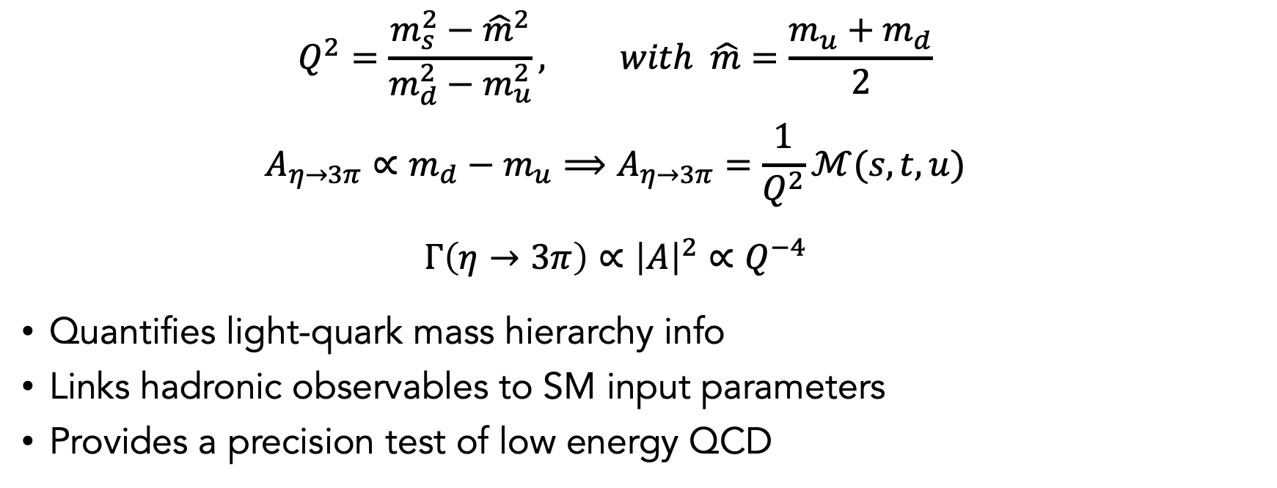

Importance of quark mass ratio $Q$
η → 3π as a Precision Probe of Isospin Breaking and the Light Quark Mass Ratio
Department of Physics
  $$Q^{2}=\frac{m_{s}^{2}−{\hat{m}}^{2}}{m_{d}^{2}−m_{u}^{2}}, with \hat{m}=\frac{m_{u}+m_{d}}{2}$$
  $$A_{η→3π}∝m_{d}−m_{u}⟹A_{η→3π}=\frac{1}{Q^{2}}ℳ(s,t,u)$$
  $$Γ\left(η→3π\right)∝{\left|A\right|}^{2}∝Q^{−4}$$
Quantifies light-quark mass hierarchy info
Links hadronic observables to SM input parameters
Provides a precision test of low energy QCD

Slide 12
Observables
η → 3π as a Precision Probe of Isospin Breaking and the Light Quark Mass Ratio
Department of Physics
Branching fractions & Partial widths
Event distributions over phase space
Dalitz plot parameters
Comparisons between charged and neutral channels

Slide 13
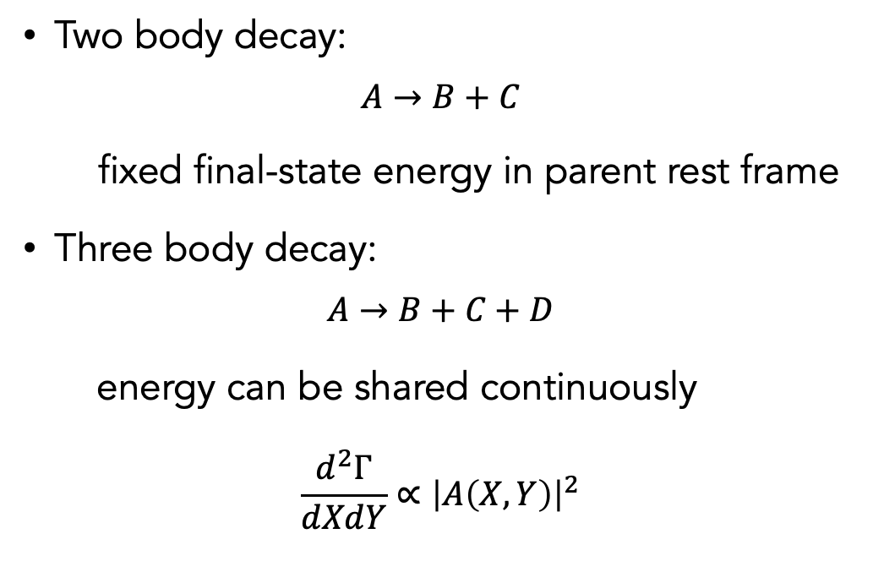
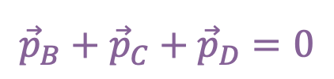


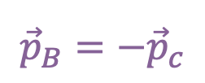
Why Dalitz plots help describe three-body decays
η → 3π as a Precision Probe of Isospin Breaking and the Light Quark Mass Ratio
Department of Physics
B
energy
Two body decay:
$$A→B+C$$
fixed final-state energy in parent rest frame
Three body decay:
$$A→B+C+D$$
energy can be shared continuously
$$\frac{d^{2}Γ}{dXdY}∝{\left|A\left(X,Y\right)\right|}^{2}$$
$$E_{B}+E_{C}=m_{A}$$
A
momenta
$${\vec{p}}_{B}=−{\vec{p}}_{c}$$
C
B
C
A
$$E_{B}+E_{C}+E_{D}=m_{A}$$
$${\vec{p}}_{B}+{\vec{p}}_{C}+{\vec{p}}_{D}=0$$
D

Slide 14




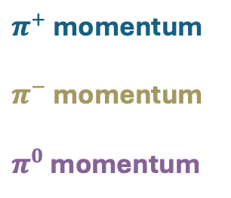
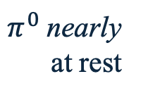

Charged $π$ kinetic energy in the $η$ rest frame
η → 3π as a Precision Probe of Isospin Breaking and the Light Quark Mass Ratio
Department of Physics
$$T_{−}$$
$π^{0}$nearly
at rest
$π^{+}$at rest
$π^{+}$ momentum
$π^{−}$ momentum
$π^{0}$ momentum
$π^{−}$at rest
$$T_{+}$$

Slide 15
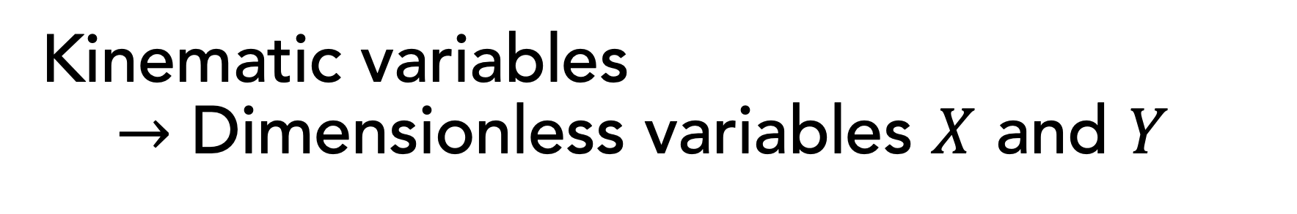
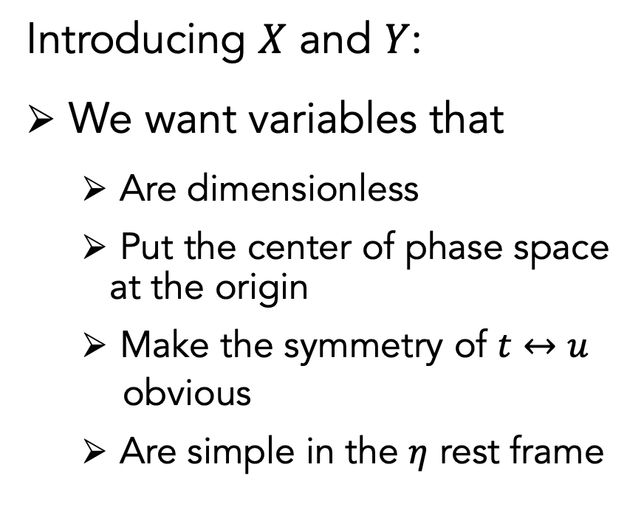
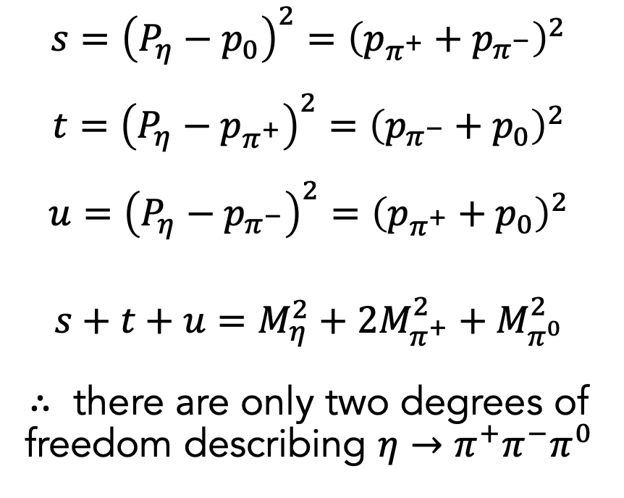
Kinematic variables
$→$ Dimensionless variables $X$ and $Y$
η → 3π as a Precision Probe of Isospin Breaking and the Light Quark Mass Ratio
Department of Physics
$$s={\left(P_{η}−p_{0}\right)}^{2}={\left(p_{π^{+}}+p_{π^{−}}\right)}^{2}$$
$$t={\left(P_{η}−p_{π^{+}}\right)}^{2}={\left(p_{π^{−}}+p_{0}\right)}^{2}$$
$$u={\left(P_{η}−p_{π^{−}}\right)}^{2}={\left(p_{π^{+}}+p_{0}\right)}^{2}$$
$$s+t+u=M_{η}^{2}+{2M}_{π^{+}}^{2}+M_{π^{0}}^{2}$$
$∴$ there are only two degrees of freedom describing $η→π^{+}π^{−}π^{0}$
Introducing $X$ and $Y$:
We want variables that
  Are dimensionless
  Put the center of phase space at the origin
  Make the symmetry of $t↔u$
  obvious
  Are simple in the $η$ rest frame

Slide 16
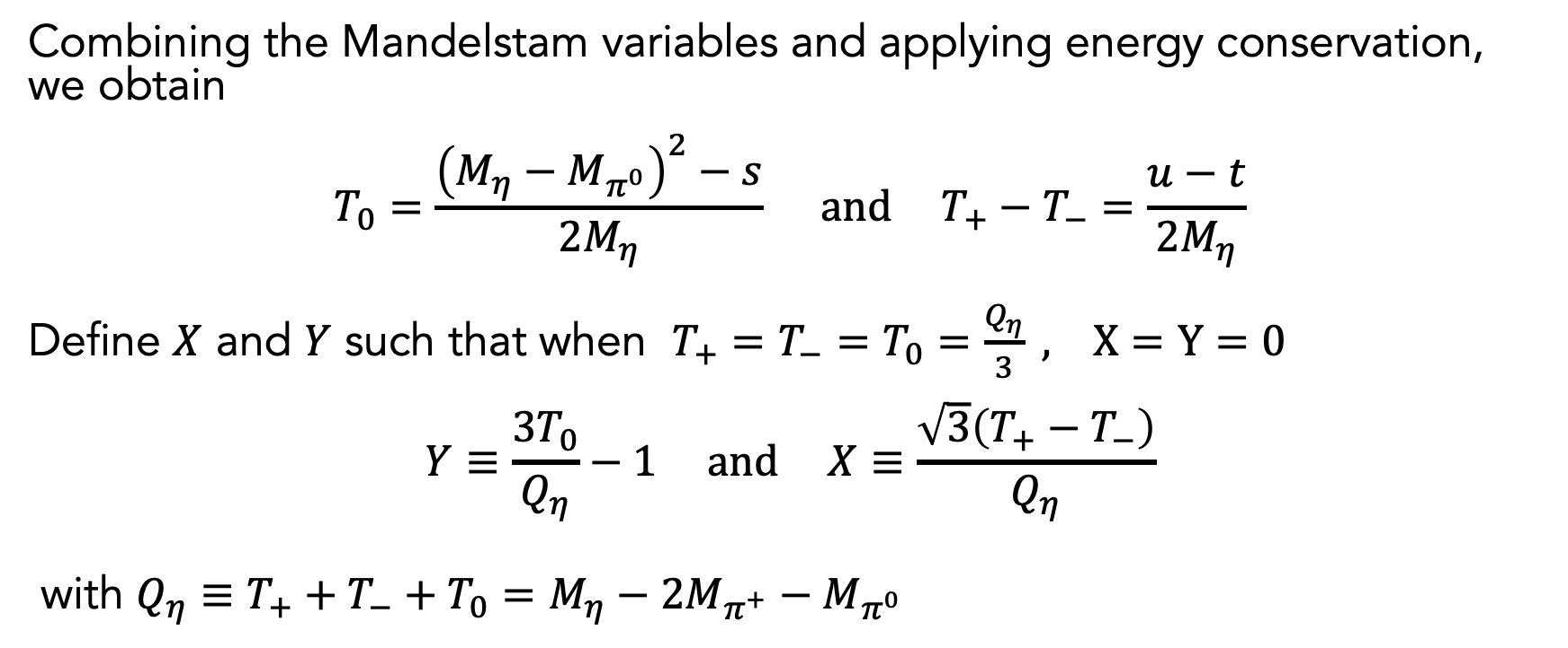
Constructing the Dalitz variables
η → 3π as a Precision Probe of Isospin Breaking and the Light Quark Mass Ratio
Department of Physics
Combining the Mandelstam variables and applying energy conservation, we obtain
$$T_{0}=\frac{{\left(M_{η}−M_{π^{0}}\right)}^{2}−s}{2M_{η}} and T_{+}−T_{−}=\frac{u−t}{2M_{η}}$$
Define $X$ and $Y$ such that when $T_{+}=T_{−}=T_{0}=\frac{Q_{η}}{3} , X=Y=0$
$$Y≡\frac{3T_{0}}{Q_{η}}−1 and X≡\frac{\sqrt{3}\left(T_{+}−T_{−}\right)}{Q_{η}}$$
with $Q_{η}≡T_{+}+T_{−}+T_{0}=M_{η}−2M_{π^{+}}−M_{π^{0}}$

Slide 17
Constructing the Dalitz variables
η → 3π as a Precision Probe of Isospin Breaking and the Light Quark Mass Ratio
Department of Physics
Combining the Mandelstam variables and applying energy conservation, we obtain
$$T_{0}=\frac{{\left(M_{η}−M_{π^{0}}\right)}^{2}−s}{2M_{η}} and T_{+}−T_{−}=\frac{u−t}{2M_{η}}$$
Define $X$ and $Y$ such that when $T_{+}=T_{−}=T_{0}=\frac{Q_{η}}{3} , X=Y=0$
$$Y≡\frac{3T_{0}}{Q_{η}}−1 and X≡\frac{\sqrt{3}\left(T_{+}−T_{−}\right)}{Q_{η}}$$
with $Q_{η}≡T_{+}+T_{−}+T_{0}=M_{η}−2M_{π^{+}}−M_{π^{0}}$

Slide 18


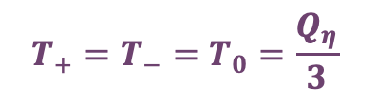



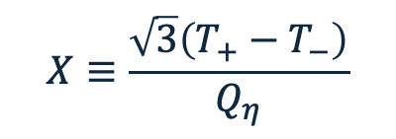

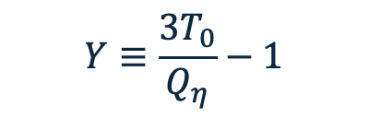
Constructing a Dalitz Plot
η → 3π as a Precision Probe of Isospin Breaking and the Light Quark Mass Ratio
Department of Physics
$$Y$$
$π^{−}$at rest
$$Y≡\frac{3T_{0}}{Q_{η}}−1$$
$π^{+}$at rest
0.5
0
-0.5
$$T_{+}=T_{−}=T_{0}=\frac{Q_{η}}{3}$$
$$=2−\frac{3(T_{+}+T_{−})}{Q_{η}}$$
$$X≡\frac{\sqrt{3}\left(T_{+}−T_{−}\right)}{Q_{η}}$$
$π^{0}$at rest
-0.5 0 0.5
$$X$$

Slide 19


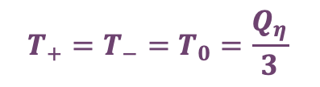








Comparing Dalitz Plots
η → 3π as a Precision Probe of Isospin Breaking and the Light Quark Mass Ratio
Department of Physics
$$T_{−}$$
$$Y$$
$π^{0}$at rest
$π^{+}$at rest
$π^{+}$at rest
$π^{−}$at rest
0.5
0
-0.5
$$T_{+}=T_{−}=T_{0}=\frac{Q_{η}}{3}$$
$π^{−}$at rest
$π^{0}$at rest
$$T_{+}$$
-0.5 0 0.5
$$X$$

Slide 20
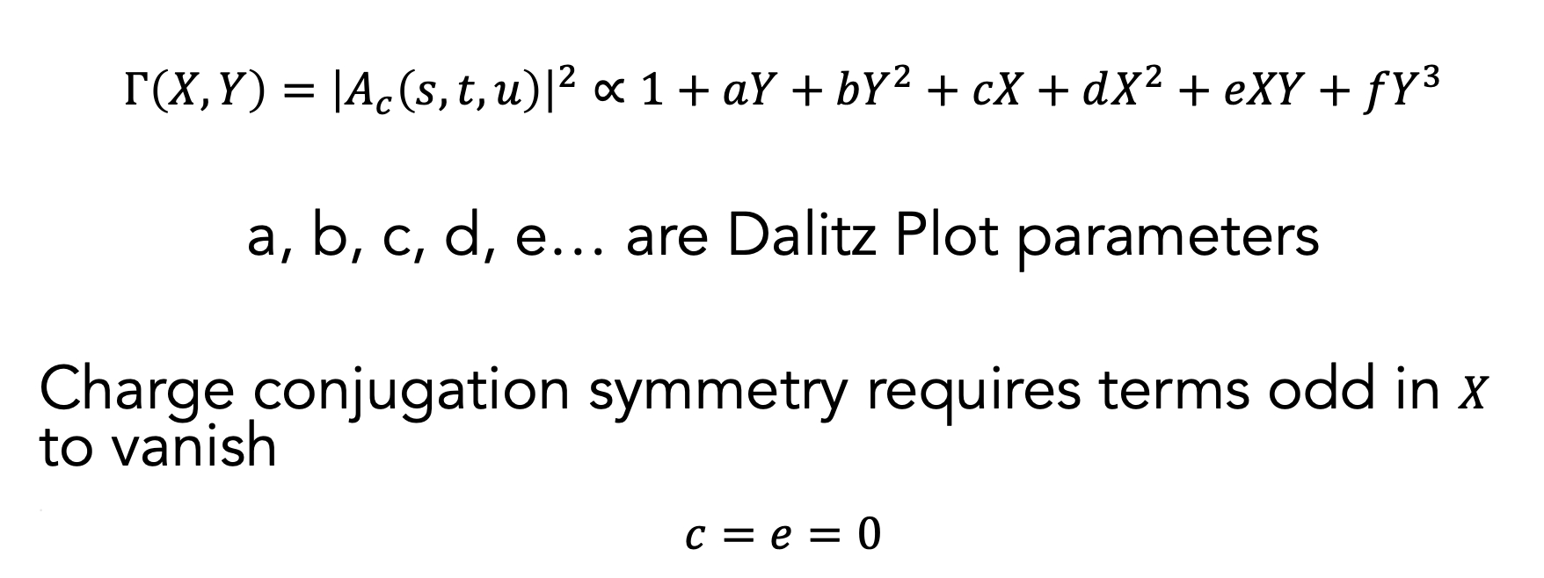
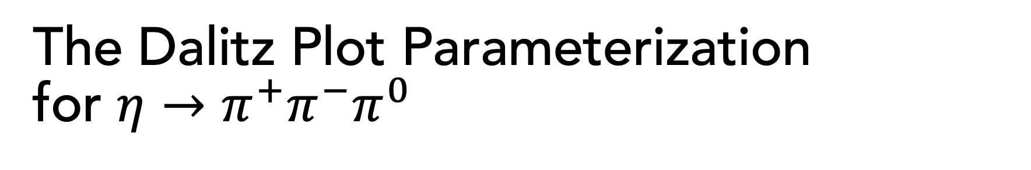
The Dalitz Plot Parameterization for $η→π^{+}π^{−}π^{0}$
η → 3π as a Precision Probe of Isospin Breaking and the Light Quark Mass Ratio
Department of Physics
$$Γ\left(X,Y\right)={\left|A_{c}\left(s,t,u\right)\right|}^{2}∝1+aY+bY^{2}+cX+dX^{2}+eXY+fY^{3}$$
a, b, c, d, e… are Dalitz Plot parameters
Charge conjugation symmetry requires terms odd in $X$ to vanish
.
$$c=e=0$$

Slide 21
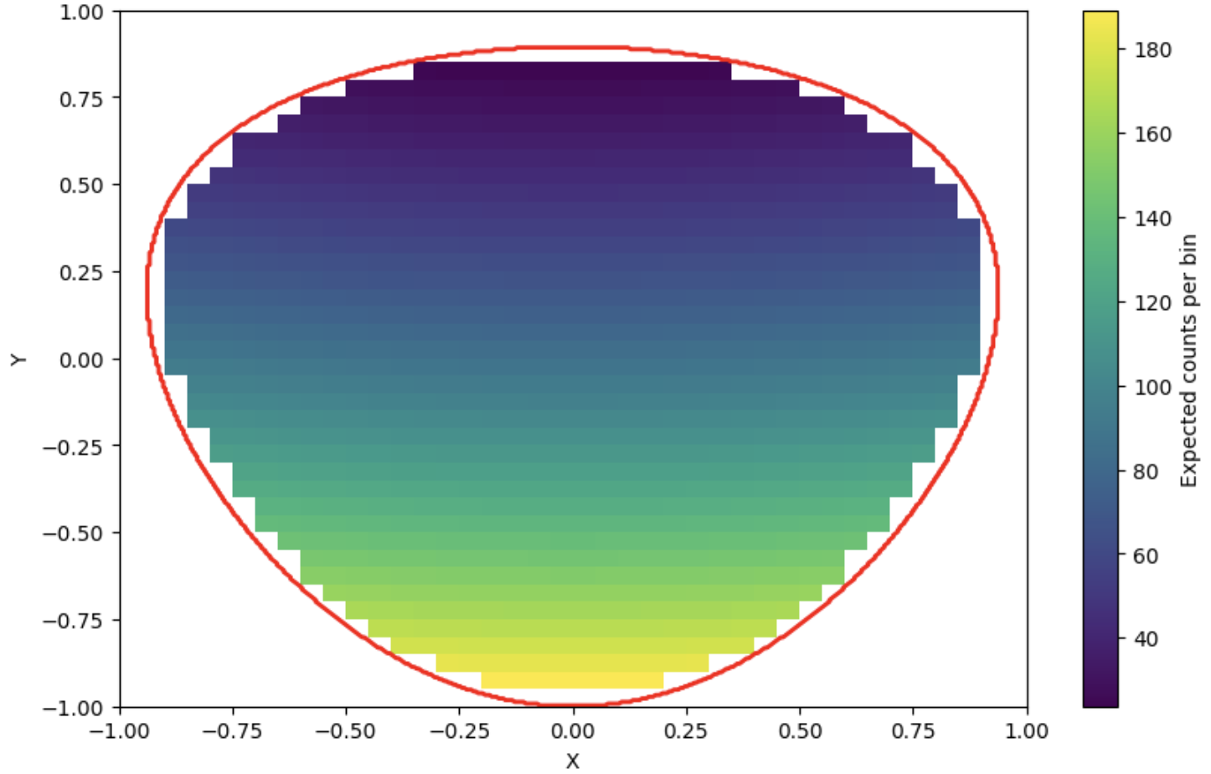
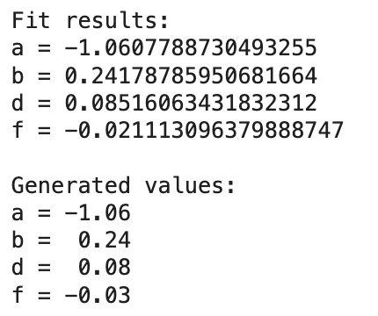

Dalitz Plot for $η→π^{+}π^{−}π^{0}$
η → 3π as a Precision Probe of Isospin Breaking and the Light Quark Mass Ratio
Department of Physics

Slide 22
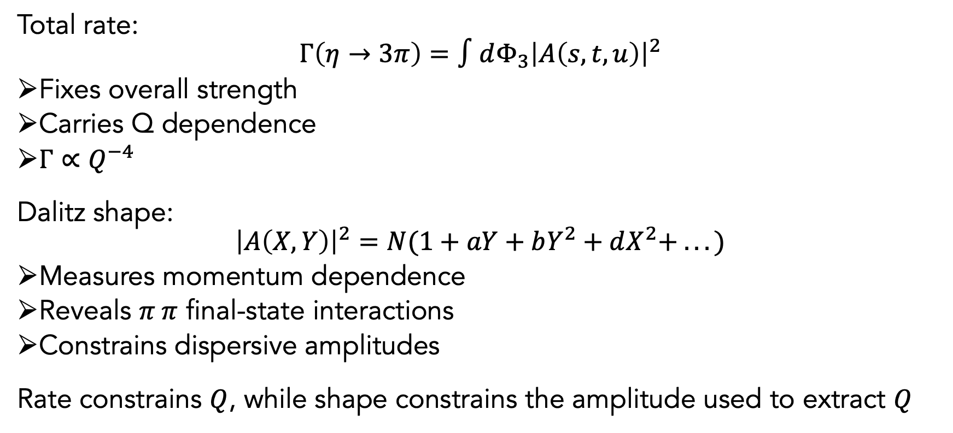
Why the Dalitz Plots are Essential
η → 3π as a Precision Probe of Isospin Breaking and the Light Quark Mass Ratio
Department of Physics
Total rate:
$$Γ\left(η→3π\right)=∫dΦ_{3}{\left|A\left(s,t,u\right)\right|}^{2}$$
Fixes overall strength
Carries Q dependence
$Γ∝Q^{−4}$
Dalitz shape:
$${\left|A\left(X,Y\right)\right|}^{2}=N(1+aY+bY^{2}+dX^{2}+ . . .)$$
Measures momentum dependence
Reveals $π π$ final-state interactions
Constrains dispersive amplitudes
Rate constrains $Q$, while shape constrains the amplitude used to extract $Q$

Slide 23
Why the Dalitz Plots are Essential
η → 3π as a Precision Probe of Isospin Breaking and the Light Quark Mass Ratio
Department of Physics
Total rate:
$$Γ\left(η→3π\right)=∫dΦ_{3}{\left|A\left(s,t,u\right)\right|}^{2}$$
Fixes overall strength
Carries Q dependence
$Γ∝Q^{−4}$
Dalitz shape:
$${\left|A\left(X,Y\right)\right|}^{2}=N(1+aY+bY^{2}+dX^{2}+ . . .)$$
Measures momentum dependence
Reveals $π π$ final-state interactions
Constrains dispersive amplitudes
Rate constrains $Q$, while shape constrains the amplitude used to extract $Q$

Slide 24
Why the Dalitz Plots are Essential
η → 3π as a Precision Probe of Isospin Breaking and the Light Quark Mass Ratio
Department of Physics
Total rate:
$$Γ\left(η→3π\right)=∫dΦ_{3}{\left|A\left(s,t,u\right)\right|}^{2}$$
Fixes overall strength
Carries Q dependence
$Γ∝Q^{−4}$
Dalitz shape:
$${\left|A\left(X,Y\right)\right|}^{2}=N(1+aY+bY^{2}+dX^{2}+ . . .)$$
Measures momentum dependence
Reveals $π π$ final-state interactions
Constrains dispersive amplitudes
Rate constrains $Q$, while shape constrains the amplitude used to extract $Q$

Slide 25
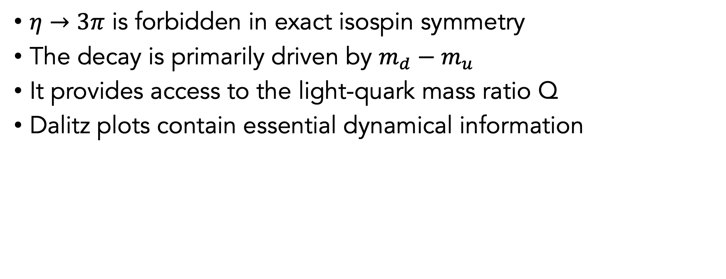
Summary
η → 3π as a Precision Probe of Isospin Breaking and the Light Quark Mass Ratio
Department of Physics
$η→3π$ is forbidden in exact isospin symmetry
The decay is primarily driven by $m_{d}−m_{u}$
It provides access to the light-quark mass ratio Q
Dalitz plots contain essential dynamical information

Slide 26
Thank You ☺

Slide 27
Backup Slides

Slide 28

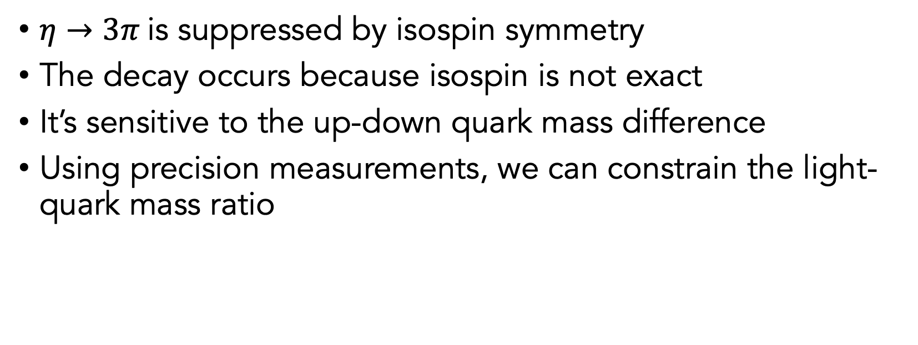
Motivation
What the $η→3π$decay can teach us about QCD
η → 3π as a Precision Probe of Isospin Breaking and the Light Quark Mass Ratio
Department of Physics
$η→3π$is suppressed by isospin symmetry
The decay occurs because isospin is not exact
It’s sensitive to the up-down quark mass difference
Using precision measurements, we can constrain the light-quark mass ratio

Slide 29
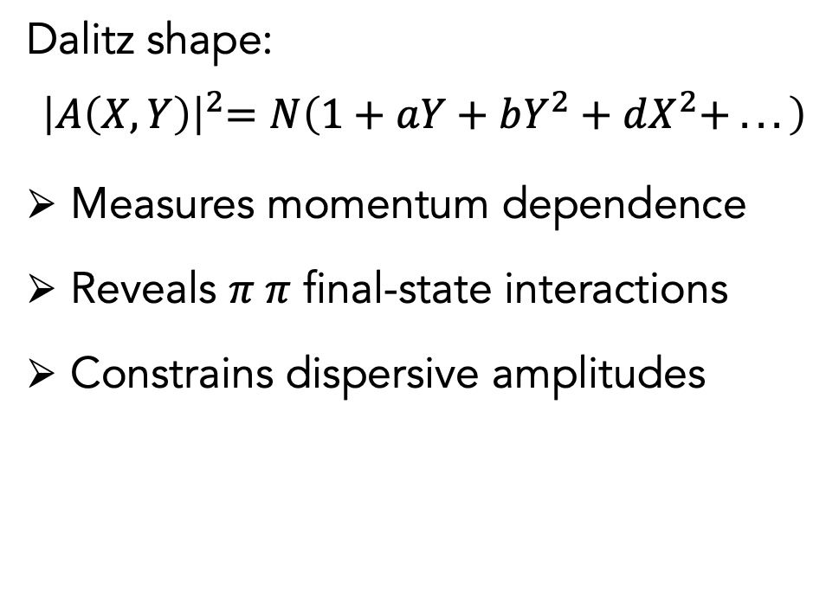
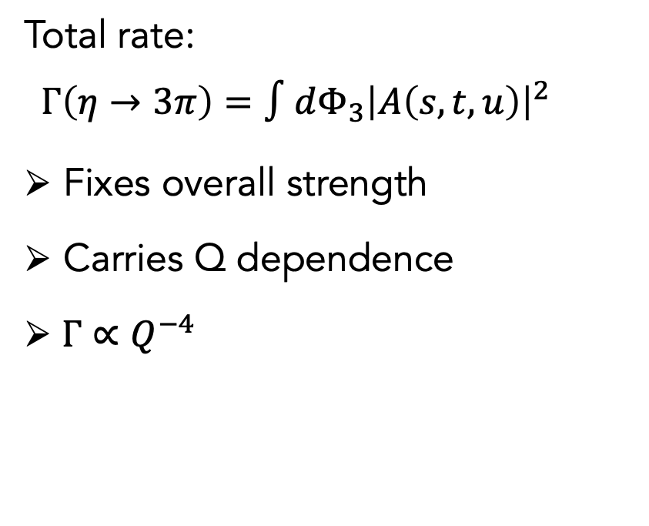
Why the Dalitz Plots are Essential
η → 3π as a Precision Probe of Isospin Breaking and the Light Quark Mass Ratio
Department of Physics
Total rate:
$$Γ\left(η→3π\right)=∫dΦ_{3}{\left|A\left(s,t,u\right)\right|}^{2}$$
Fixes overall strength
Carries Q dependence
$Γ∝Q^{−4}$
Dalitz shape:
$${ \left|A\left(X,Y\right)\right|}^{2}=N\left(1+aY+bY^{2}+dX^{2}+ . . .\right)$$
Measures momentum dependence
Reveals $π π$ final-state interactions
Constrains dispersive amplitudes
Rate constrains $Q$, while shape constrains the amplitude used to extract $Q$

Slide 30
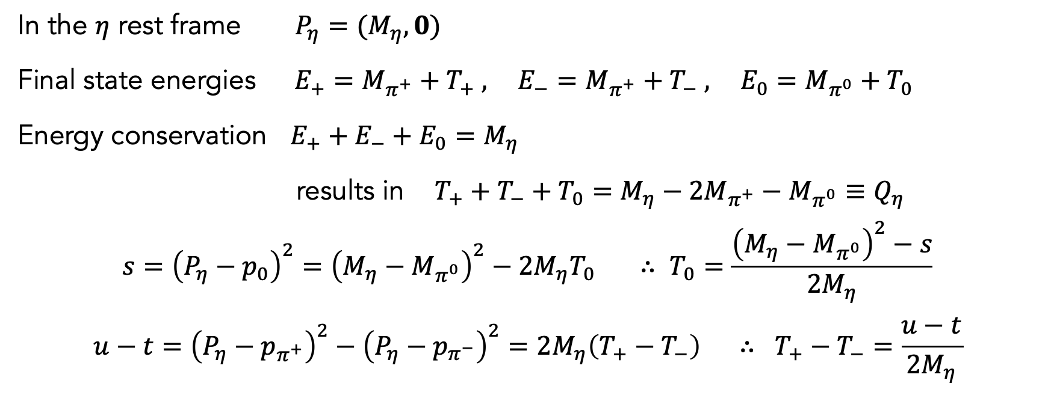
Constructing the Dalitz variables
η → 3π as a Precision Probe of Isospin Breaking and the Light Quark Mass Ratio
Department of Physics
In the $η$ rest frame $P_{η}=(M_{η},0)$
Final state energies $E_{+}=M_{π^{+}}+T_{+} ,$ $E_{−}=M_{π^{+}}+T_{−} ,$ $E_{0}=M_{π^{0}}+T_{0}$
Energy conservation $E_{+}+E_{−}+E_{0}=M_{η}$
results in $T_{+}+T_{−}+T_{0}=M_{η}−2M_{π^{+}}−M_{π^{0}}≡Q_{η}$
$$s={\left(P_{η}−p_{0}\right)}^{2}={\left(M_{η}−M_{π^{0}}\right)}^{2}−2M_{η}T_{0} ∴ T_{0}=\frac{{\left(M_{η}−M_{π^{0}}\right)}^{2}−s}{2M_{η}}$$
$$u−t={\left(P_{η}−p_{π^{+}}\right)}^{2}−{\left(P_{η}−p_{π^{−}}\right)}^{2}=2M_{η}\left(T_{+}−T_{−}\right) ∴ T_{+}−T_{−}=\frac{u−t}{2M_{η}}$$

Slide 31
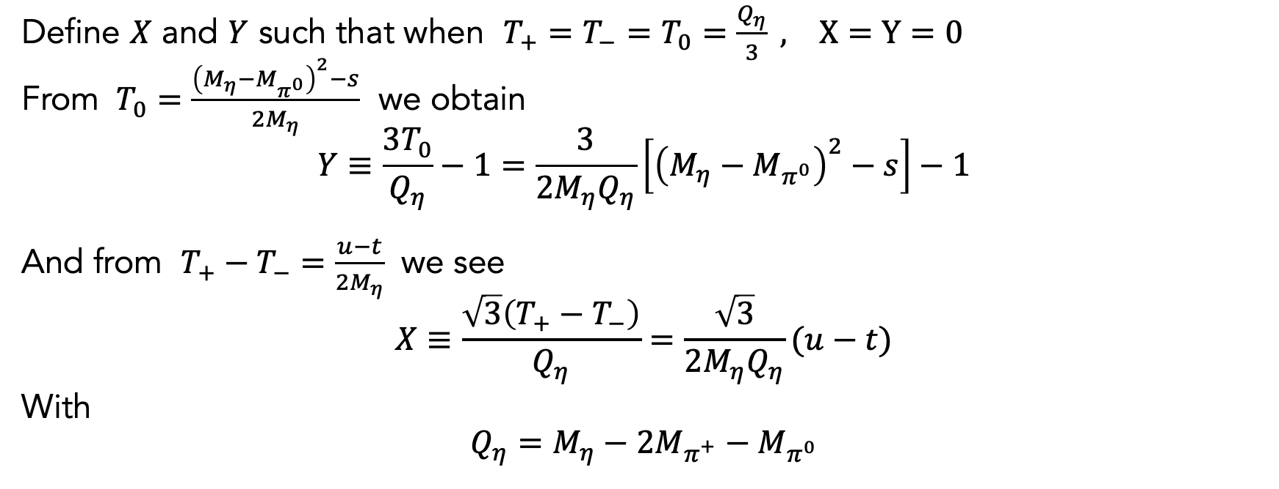
Constructing the Dalitz variables
η → 3π as a Precision Probe of Isospin Breaking and the Light Quark Mass Ratio
Department of Physics
Define $X$ and $Y$ such that when $T_{+}=T_{−}=T_{0}=\frac{Q_{η}}{3} , X=Y=0$
From $T_{0}=\frac{{\left(M_{η}−M_{π^{0}}\right)}^{2}−s}{2M_{η}}$ we obtain
$$Y≡\frac{3T_{0}}{Q_{η}}−1=\frac{3}{2M_{η}Q_{η}}\left[{\left(M_{η}−M_{π^{0}}\right)}^{2}−s\right]−1$$
And from $T_{+}−T_{−}=\frac{u−t}{2M_{η}}$ we see
$$X≡\frac{\sqrt{3}\left(T_{+}−T_{−}\right)}{Q_{η}}=\frac{\sqrt{3}}{2M_{η}Q_{η}}(u−t)$$
With
$$Q_{η}=M_{η}−2M_{π^{+}}−M_{π^{0}}$$

