Slide 1




Transverse Momentum Broadening in Nuclear Media at JLAB’s CLAS
Esteban Molina C.

Slide 2
Is confinement understood?

Slide 3
NO :)

Slide 4
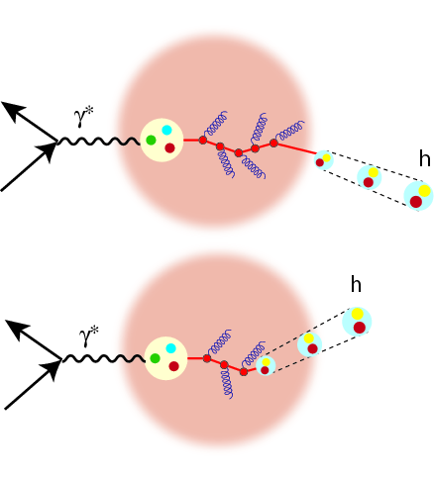
Transverse Momentum Broadening
Nucleus can be used in the purpose of understanding the process of hadronization [2].
Diagram of hadronization in nuclear medium [1].
[1] Guiot, B.; Kopeliovich, B. (2020). Spacetime Development of in-medium hadronization : Scenario for Leading Hadrons.
[2] Accardi, A.; Muccifora, V.; Pirner, H.J. (2003). Hadron production in deep inelastic lepton-nucleus scattering.

Slide 5


Transverse Momentum Broadening
[3]
Broadening shows how much/long the energetic quark traveled!
Diagram of hadronization in nuclear medium [1].
[1] Guiot, B.; Kopeliovich, B. (2020). Spacetime Development of in-medium hadronization : Scenario for Leading Hadrons.
[3] Baier, B.; Dokshitzer, Y.; Mueller, A.; Peigné, S.; Schiff, D. (1997). Radiative energy loss and pt-broadening of high energy partons in nuclei.

Slide 6
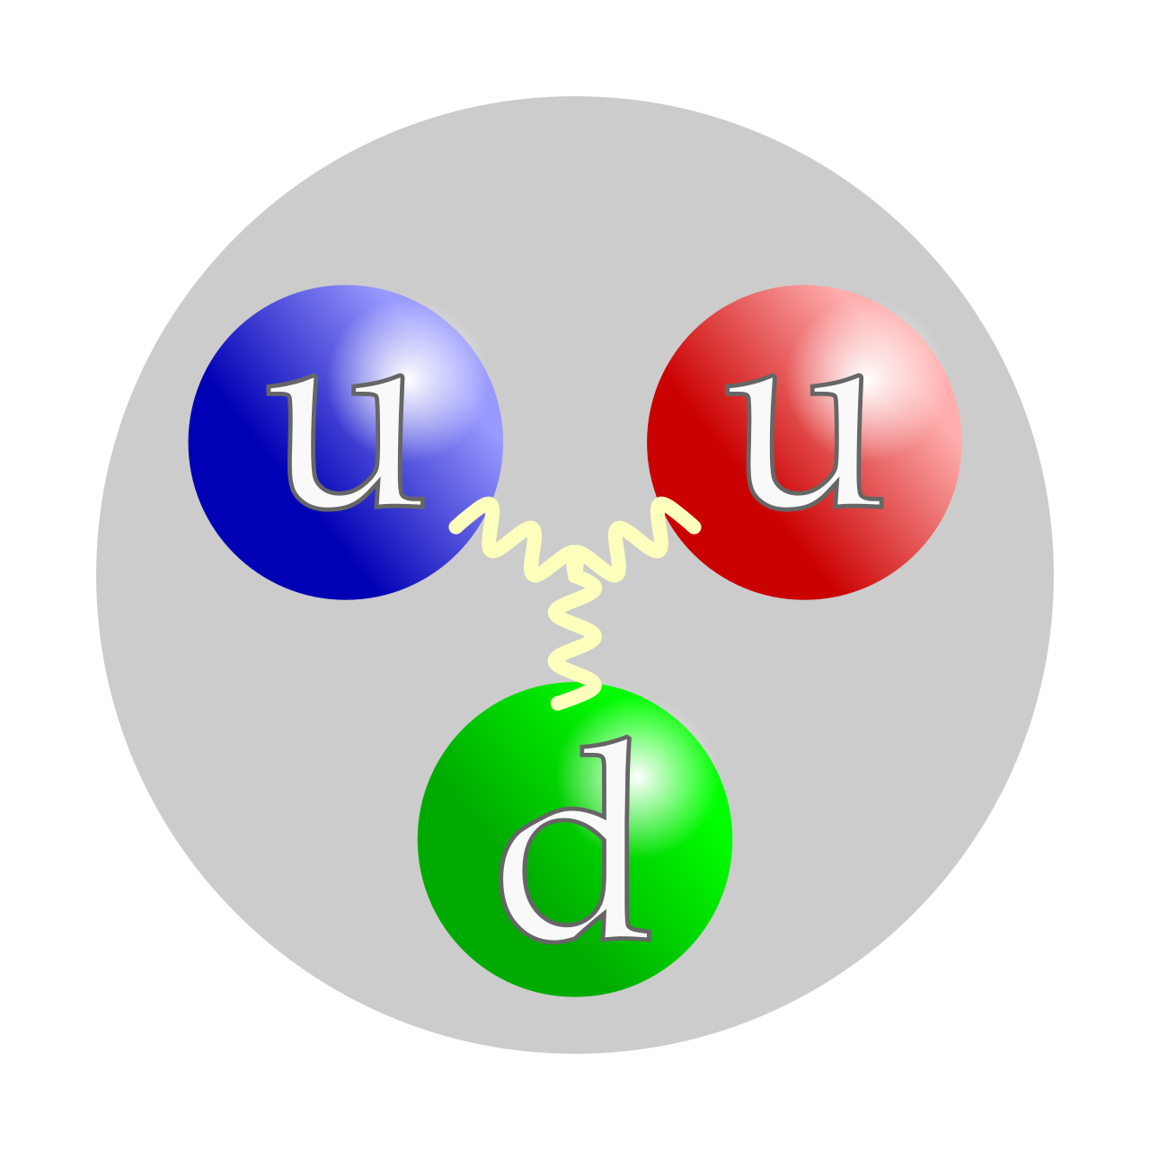
Transverse Momentum Broadening
Broadening can indicate where the energetic quark transitioned into a forming hadron!
Nucleus A

Slide 7
Transverse Momentum Broadening
A deep inelastic scattering occurs!
Nucleus A

Slide 8
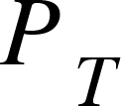

Transverse Momentum Broadening
Pretend the struck quark did not appeared from the left of the screen :)
The struck quark travels a certain distance until color neutralization happens.
While traversing the nucleus it loses energy.
Nucleus A

Slide 9
Transverse Momentum Broadening
Color neutralized object travels another distance before hadronising.
Nucleus A

Slide 10
Transverse Momentum Broadening
Broadening shows how much/long the energetic quark traveled!
Nucleus A

Slide 11
Transverse Momentum Broadening
Different nuclei can be used as confinement landmarks of the hadronizing energetic quarks.
Nucleus A

Slide 12
HOW?

Slide 13
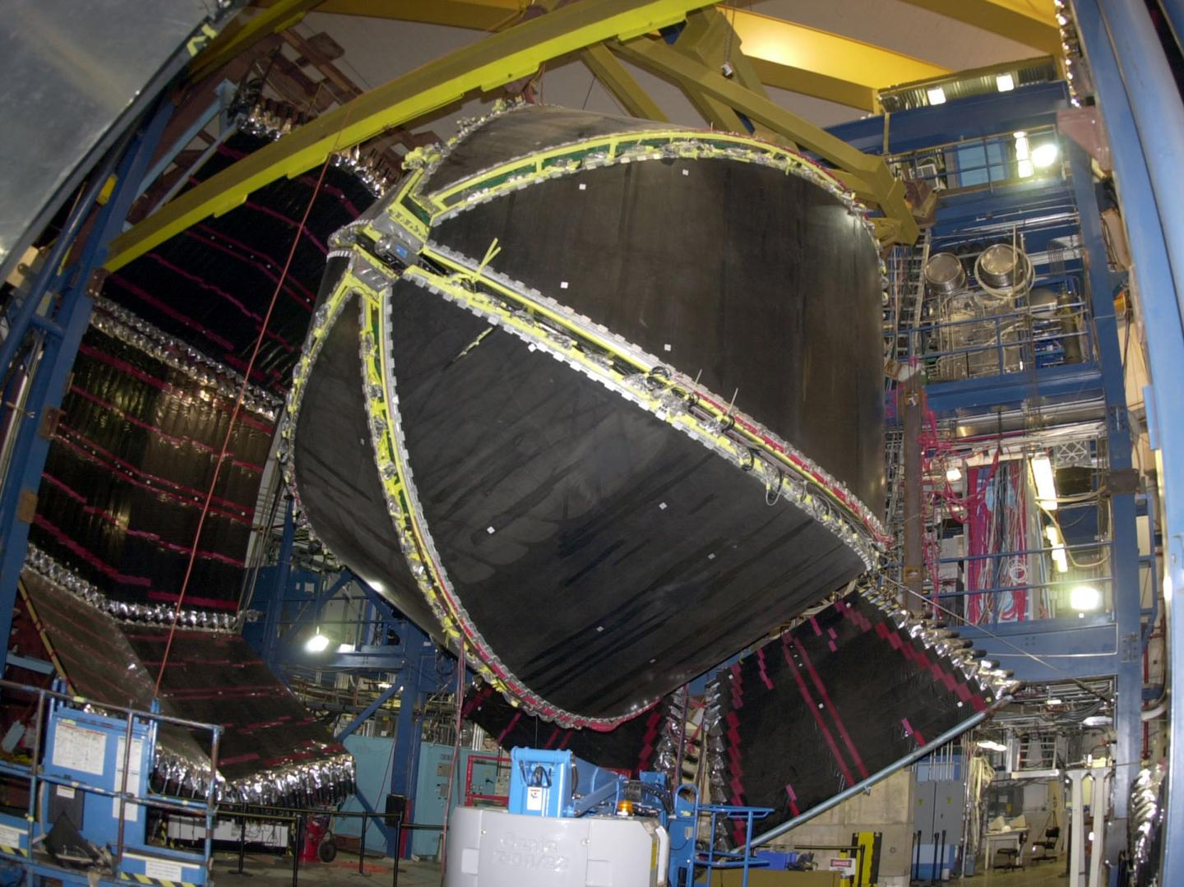
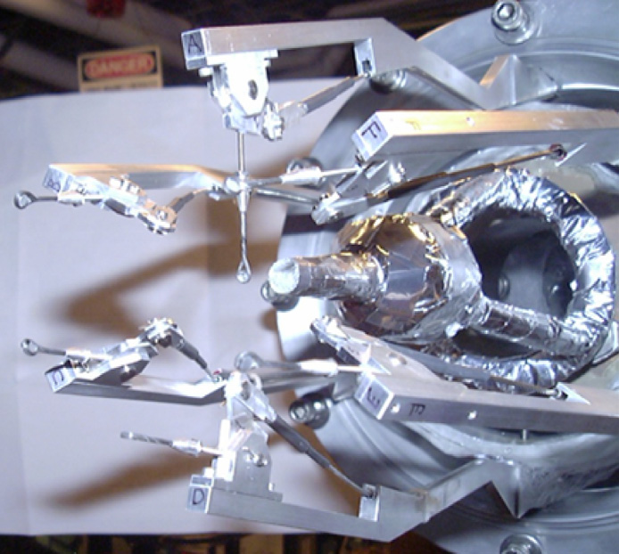
CLAS and The EG2 Run Period (2004)
CLAS detector.
Double-target system [3].
[3] Hakobyan, H.; Brooks, W.; et al. (2008). A double-target system for precision measurements of nuclear medium effects.

Slide 14


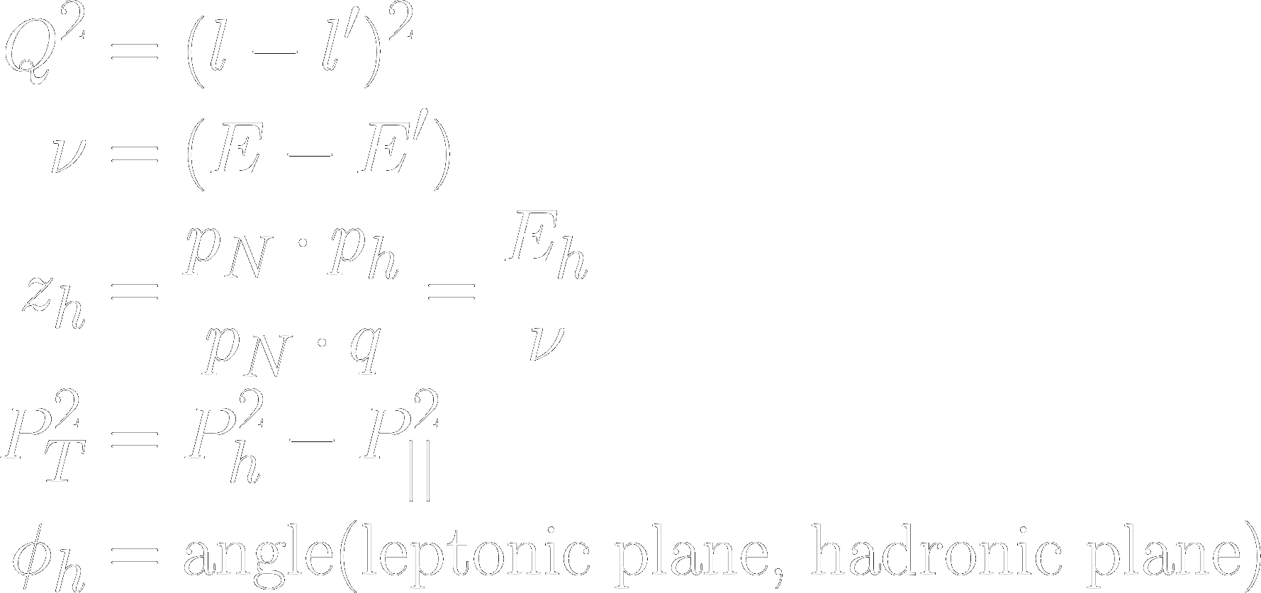

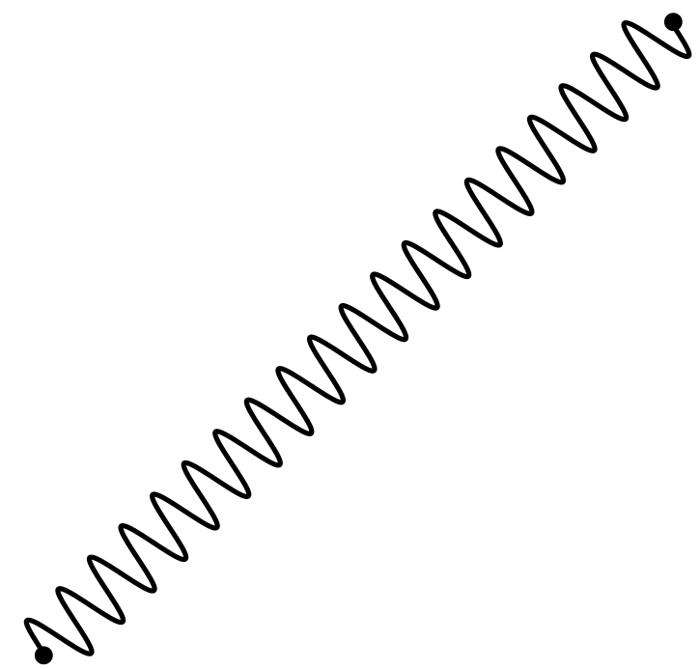


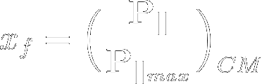
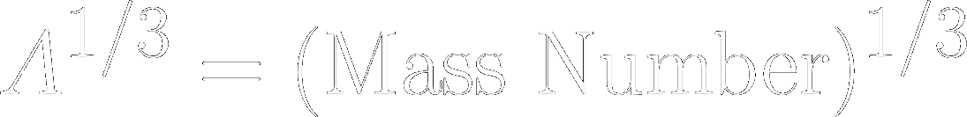
Semi-Inclusive Deep Inelastic Scattering
Kinematical variables:
Additionally, we used:

Slide 15
Semi-Inclusive Deep Inelastic Scattering
Kinematical variables:
Additionally, we used:
Positive values to select current fragmentation region events.
Not enough time :(

Slide 16
Now, the full measurements!

Slide 17
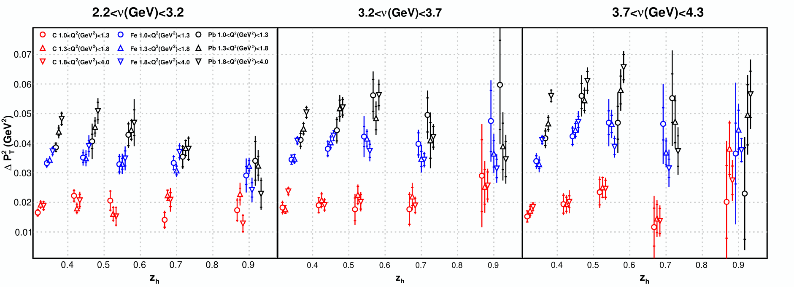
Broadening of Pi+ (all fragmentation regions)
CLAS PRELIMINARY
Strong correlation of the observable with respect to the target size.
Noticeable correlation of the observable with respect to zh.

Slide 18
Broadening of Pi+ (all fragmentation regions)
CLAS PRELIMINARY
Strong correlation of the observable with respect to the target size.
Noticeable correlation of the observable with respect to zh.
At zh->1, the broadening does not go to zero! Intrinsic quark momentum ?

Slide 19
Broadening of Pi+ (all fragmentation regions)
CLAS PRELIMINARY
Notice that the bigger the nucleus, a plateau starts to appear.

Slide 20
Broadening of Pi+ (all fragmentation regions)
CLAS PRELIMINARY
Notice that the bigger the nucleus, a plateau starts to appear.
According to theoretical models, this is an indication that the quark starts its hadronization in a distance smaller than the size of Pb!

Slide 21
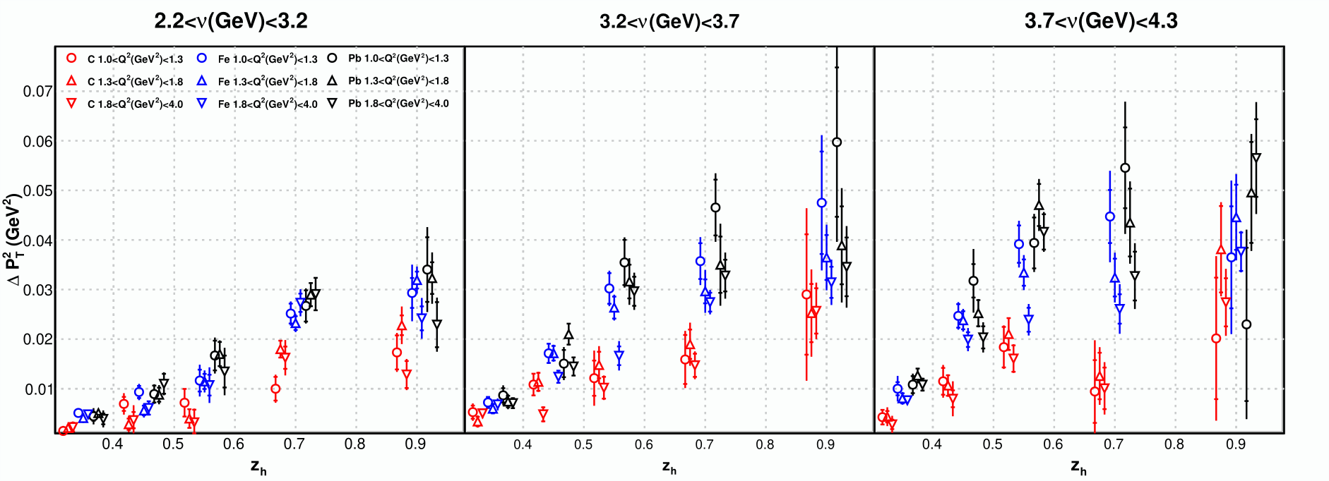
Transverse Momentum Broadening of Pi+
CLAS PRELIMINARY
By isolating the current fragmentation region similar conclusions can be extracted!
  With the exception of the emerging strong correlation w.r.t. zh.

Slide 22
Conclusions
Confinement distance is suggested to be smaller than the size of Pb.
At zh->1 the broadening does not vanish. This suggests a contribution coming from other process!
  HERMES does not show such behavior.
A strong correlation of the broadening with zh and the sizes of nuclei is observed in our results.
A weak correlation of the broadening with Q2 and Nu is observed. However; it seems the latter has a stronger correlation.
The target fragmentation region events have a noticeable impact on the shape of the observable.

Slide 23
Conclusions
Confinement distance is suggested to be smaller than the size of Pb.
At zh->1 the broadening does not vanish. This suggests a contribution coming from other process!
  HERMES does not show such behavior.
A strong correlation of the broadening with zh and the sizes of nuclei is observed in our results.
A weak correlation of the broadening with Q2 and Nu is observed. However; it seems the latter has a stronger correlation.
The target fragmentation region events have a noticeable impact on the shape of the observable.
Stay tuned for the paper during the next months!
  Also, stay tuned for the Energy-energy correlators paper at LHCb in the next months :)

Slide 24
Backup Slides

Slide 25
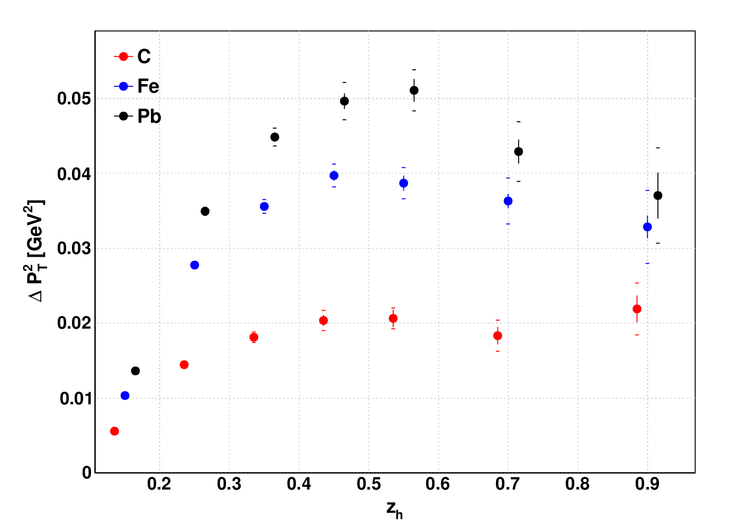
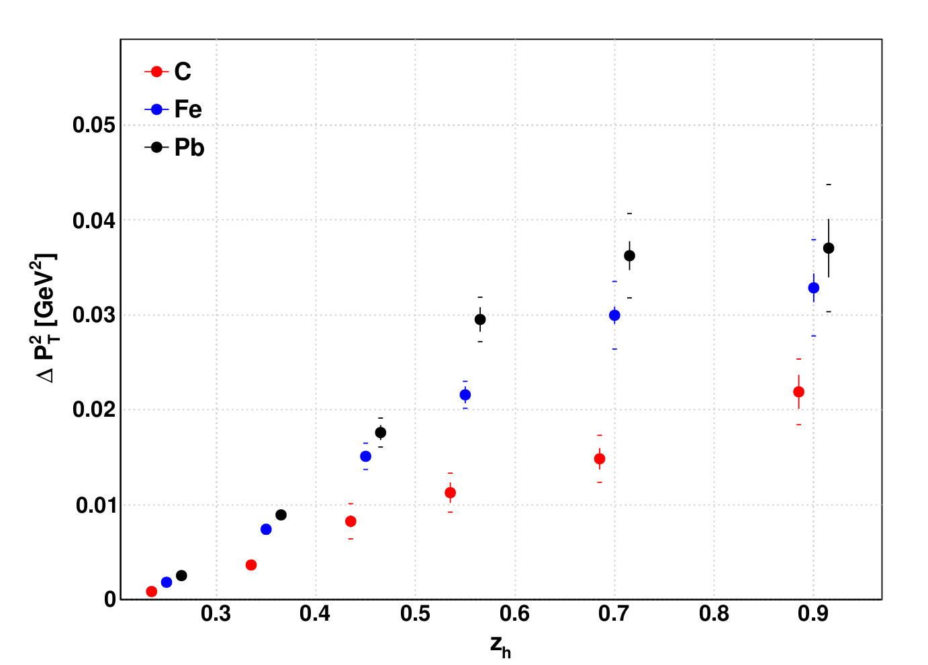
Transverse Momentum Broadening of Pi+
CLAS PRELIMINARY
CLAS PRELIMINARY
xf>0 cut applied.

Slide 26
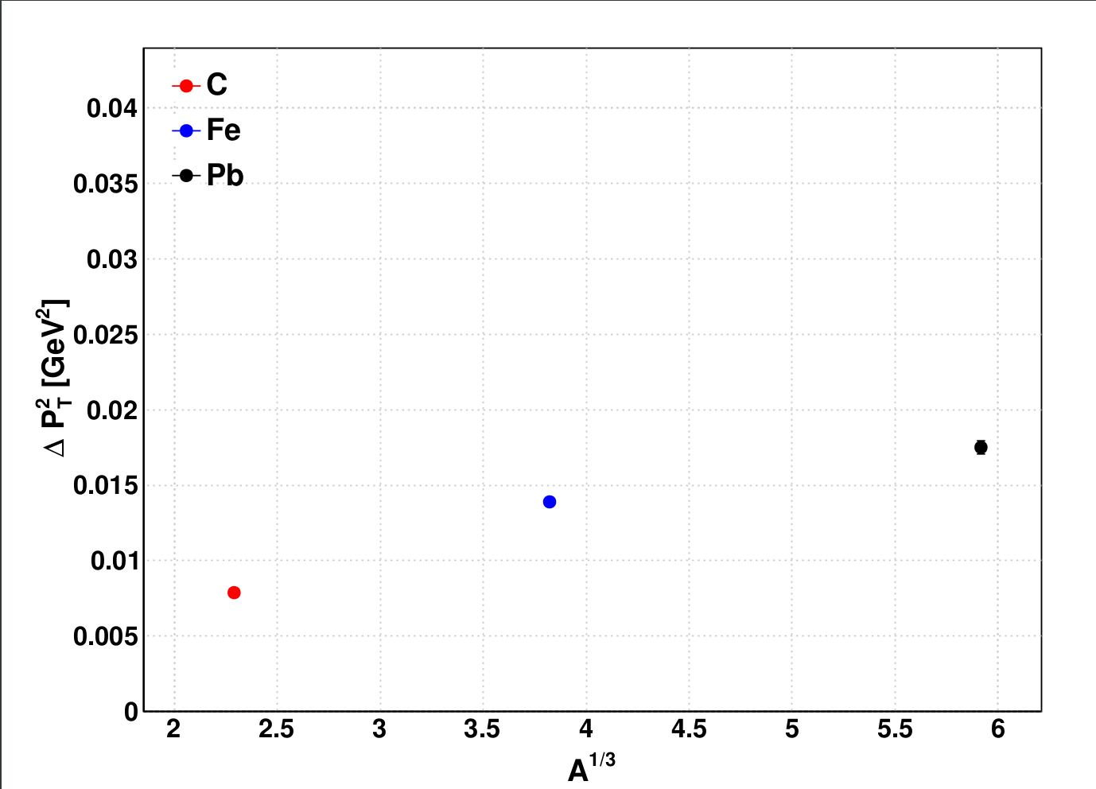
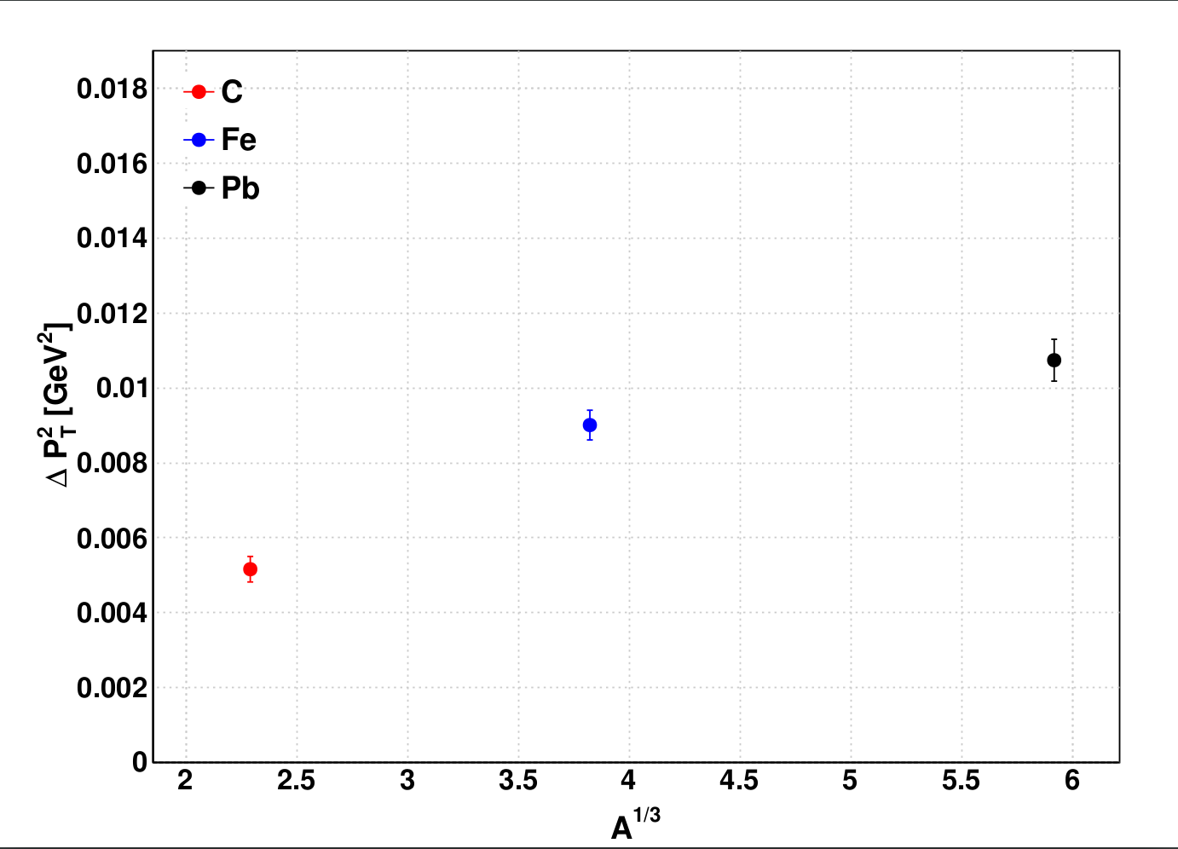
Transverse Momentum Broadening of Pi+
Error bars are very small!
CLAS PRELIMINARY
CLAS PRELIMINARY
xf>0 cut applied.

Slide 27
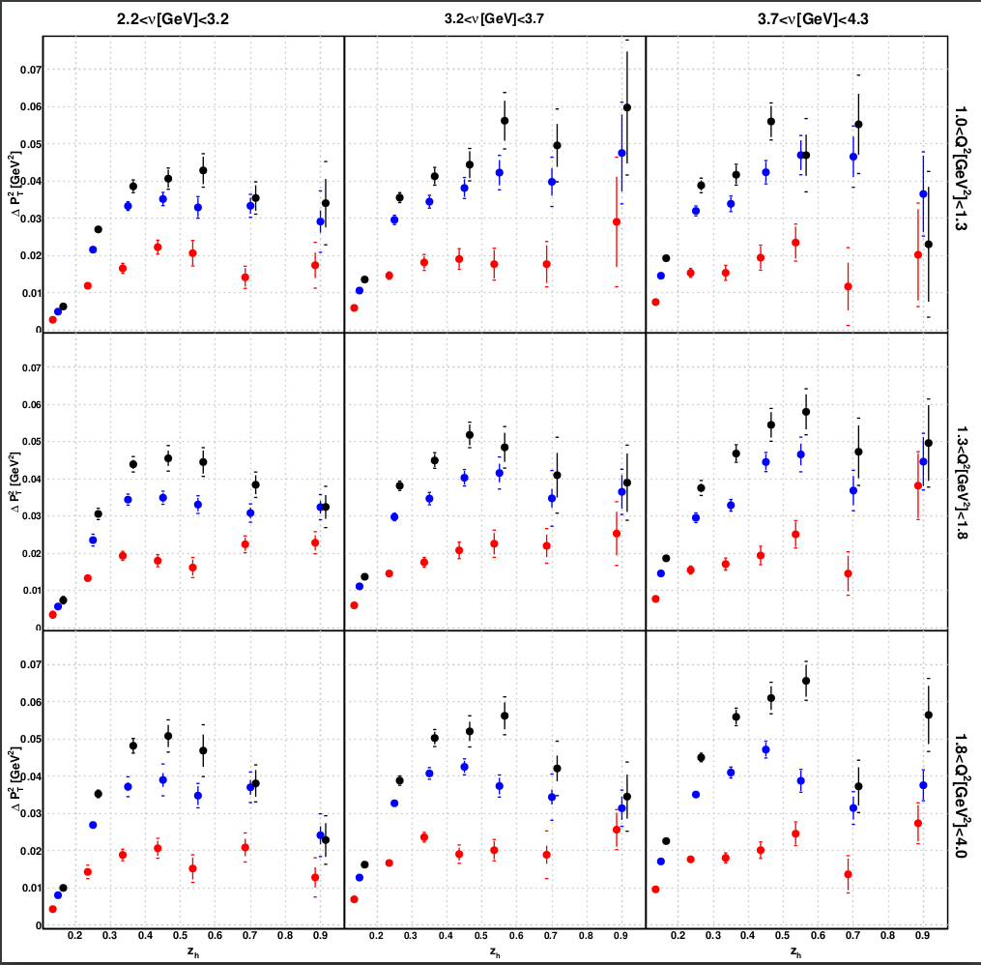
Three-dimensional Results
Legend:
Carbon
Iron
Lead
Observations:
Strong correlation with zh.
Weak correlation with nu and Q².
CLAS PRELIMINARY

Slide 28
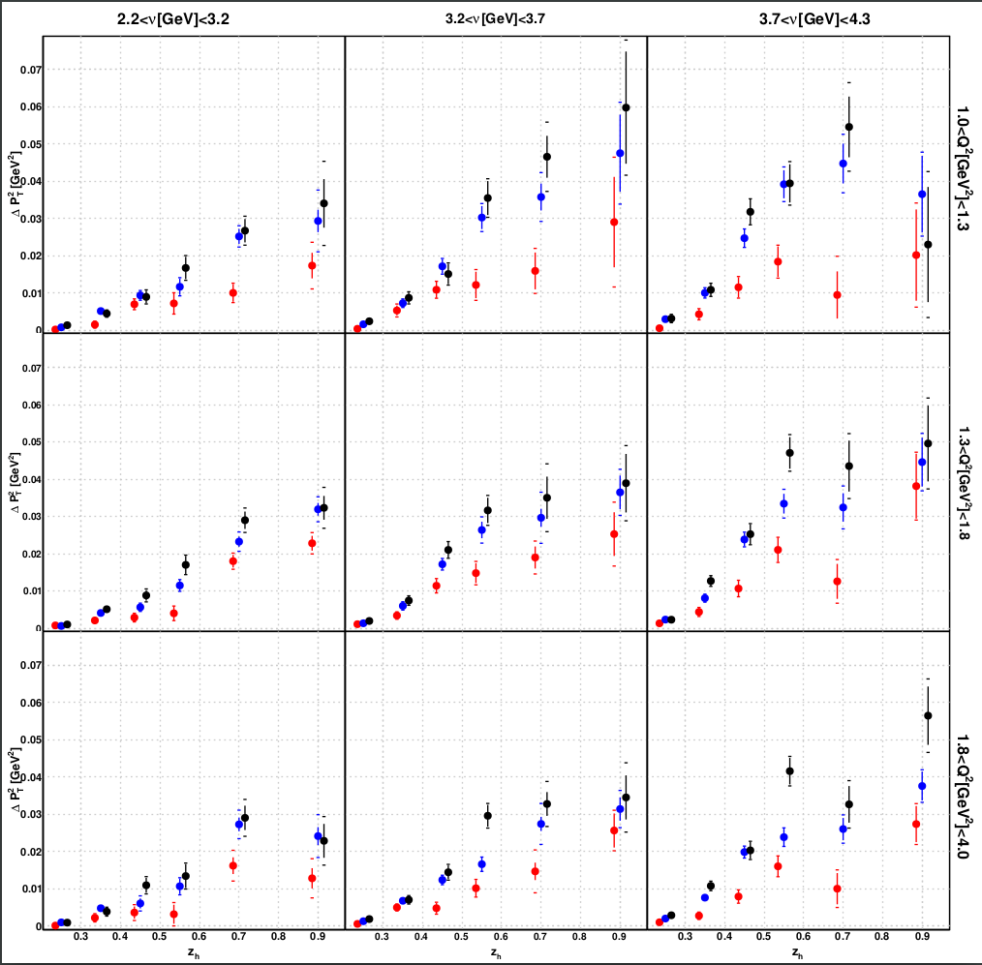
Three-dimensional Results
Legend:
Carbon
Iron
Lead
Observations:
Strong correlation with zh.
Weak correlation with nu and Q².
CLAS PRELIMINARY
CLAS PRELIMINARY

Slide 29
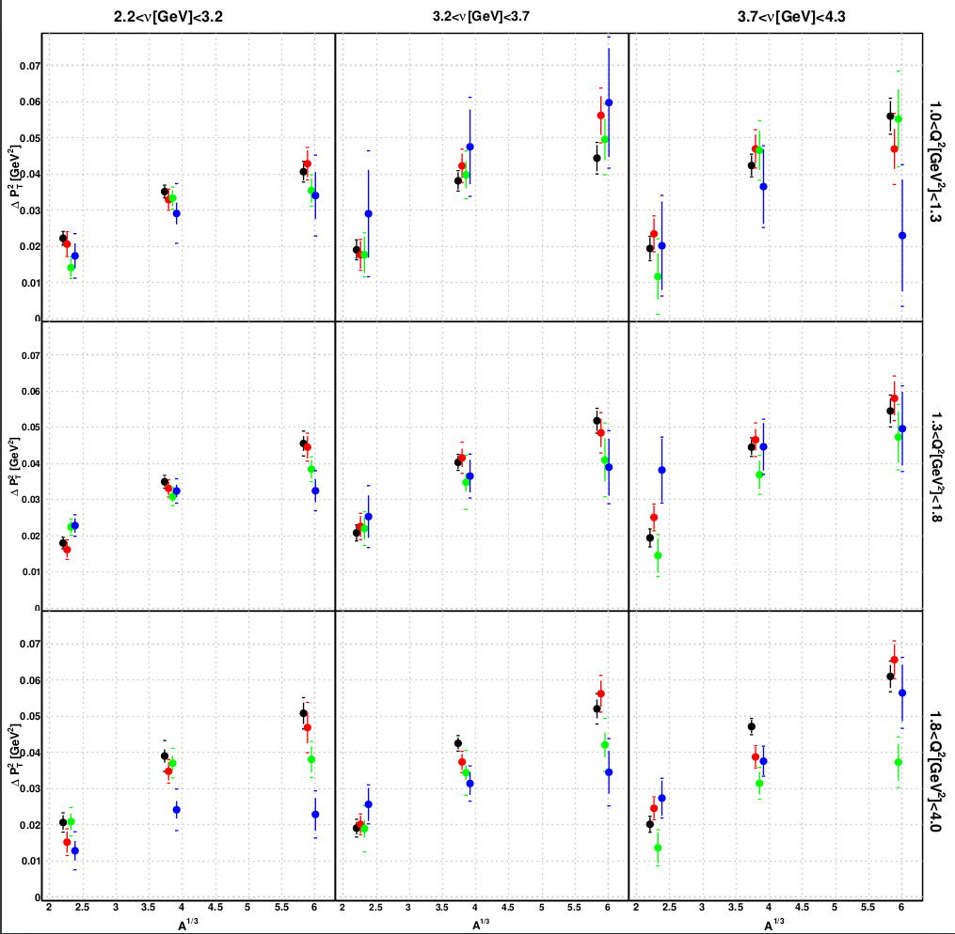




Three-dimensional Results
Legend:
Observations:
Strong correlation with zh.
Weak correlation with nu and Q².
Linear or curve behavior w.r.t. A¹/³.
CLAS PRELIMINARY

Slide 30
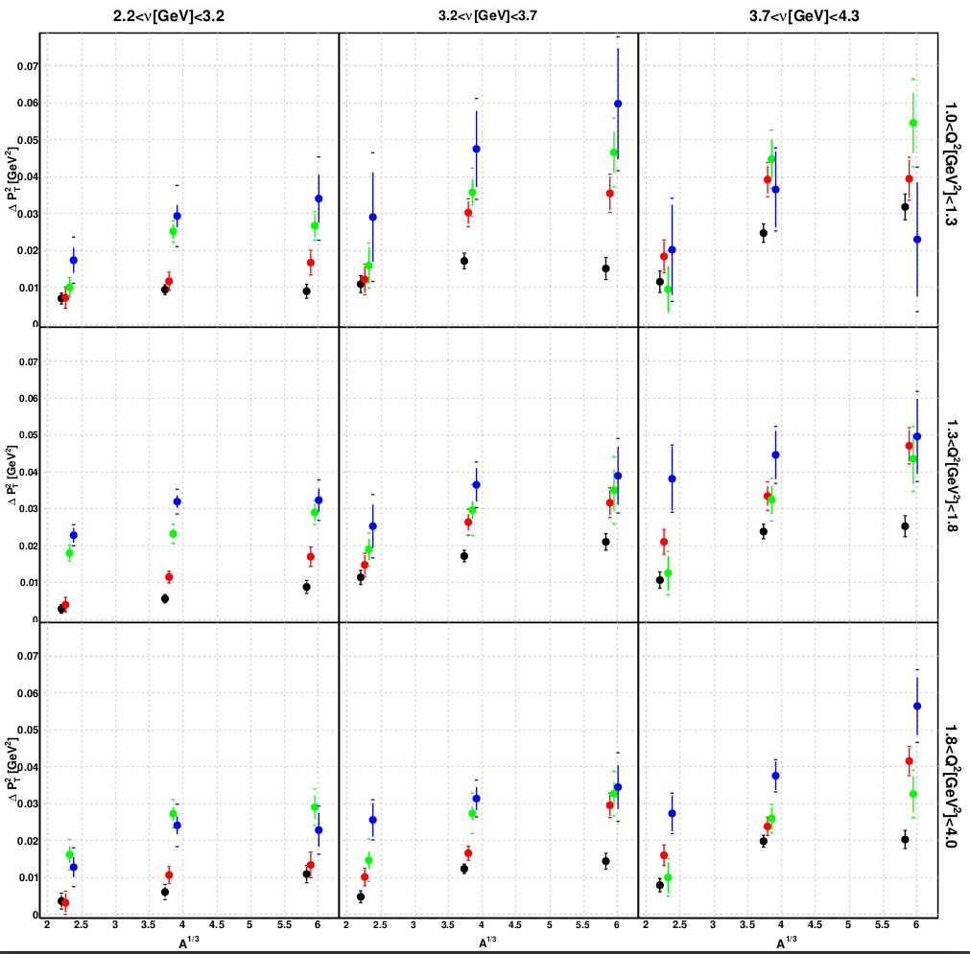
Three-dimensional Results
Legend:
Observations:
Strong correlation with zh.
Weak correlation with nu and Q².
Mostly linear behavior w.r.t. A¹/³.
CLAS PRELIMINARY

Slide 31
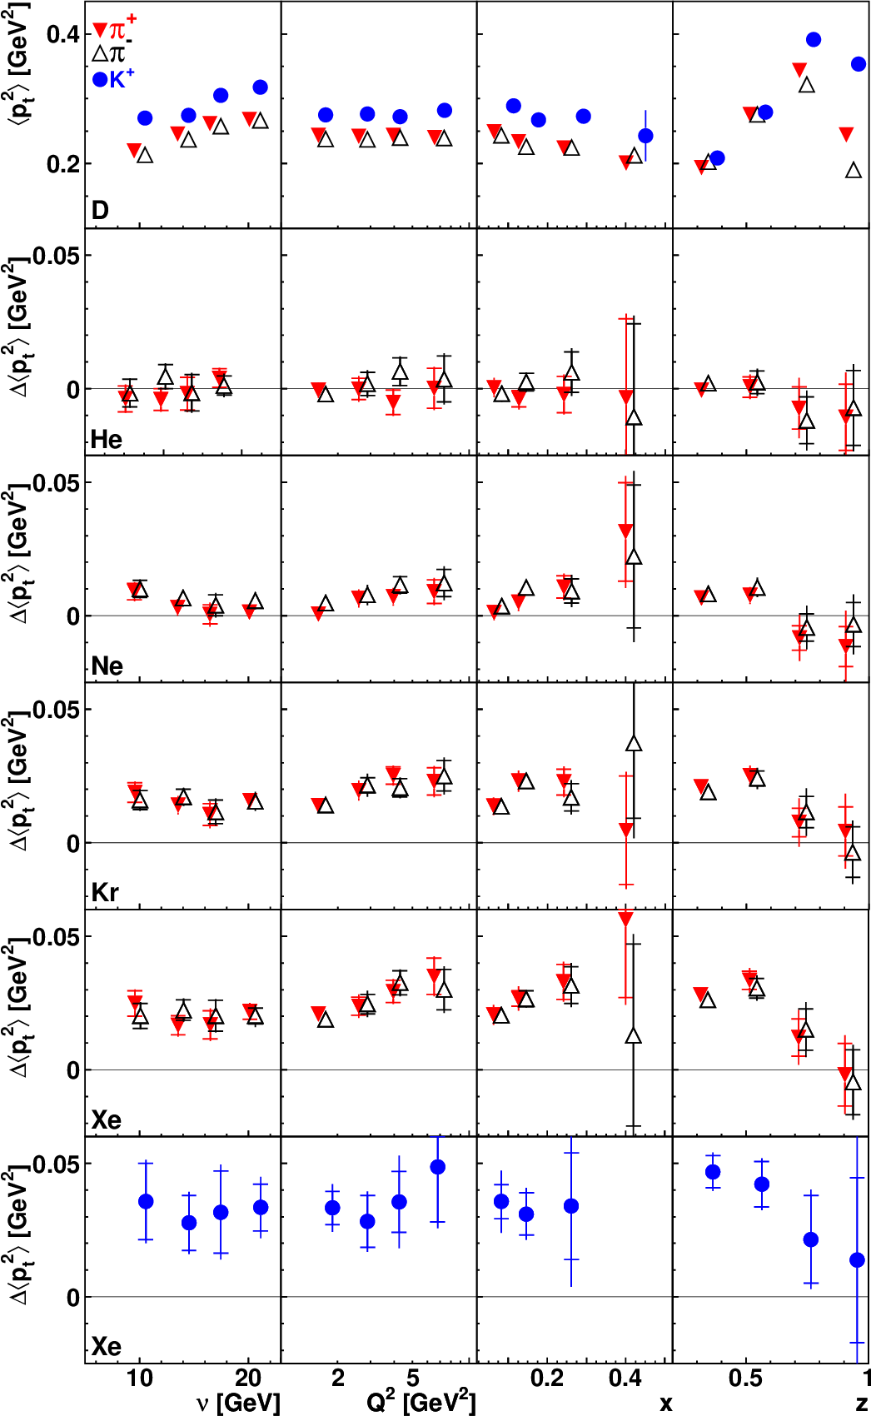
HERMES Broadening

Slide 32
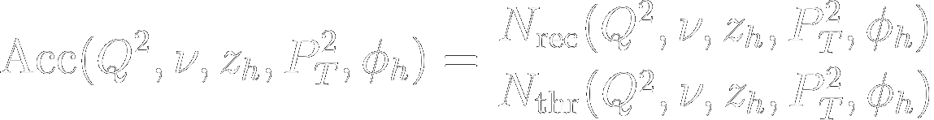
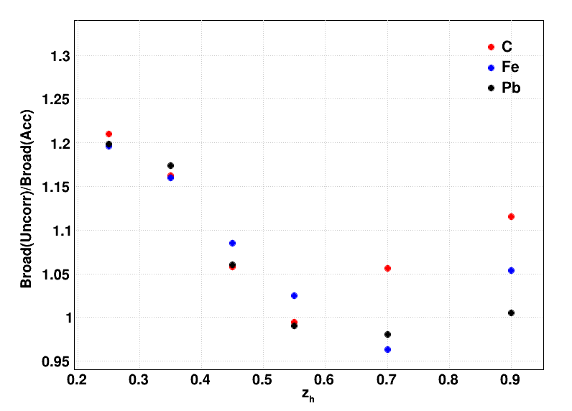
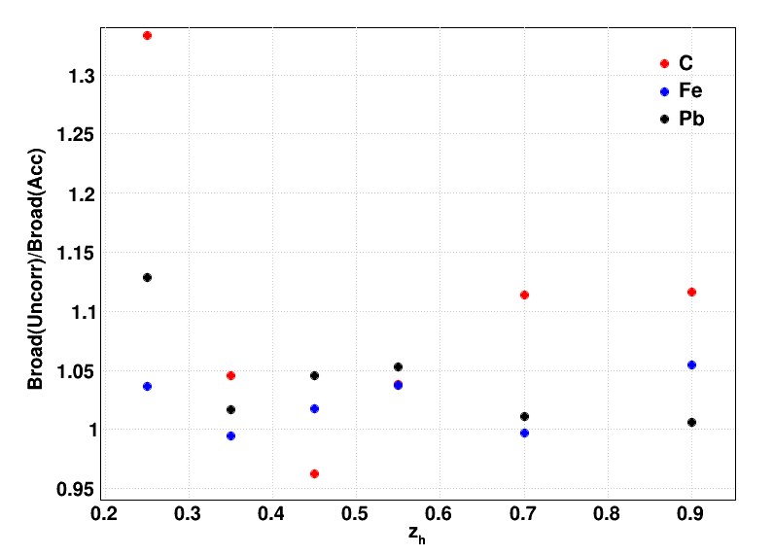
Corrections to Data: Acceptance Correction
Acceptance correction is used to account for detector inefficiencies. Is defined as:
Geant3
Pythia6
CLAS PRELIMINARY
CLAS PRELIMINARY
No xf cut applied.
xf>0 cut applied.

Slide 33
Corrections to Data: Acceptance Correction
Acceptance correction is used to account for detector inefficiencies. Is defined as:
CLAS PRELIMINARY
CLAS PRELIMINARY
No xf cut applied.
xf>0 cut applied.

Slide 34



Correction to Data: Radiative Corrections
Radiative correction accounts for events with real photon emission, among others:
Non-radiative SIDIS event
Radiative SIDIS events

Slide 35
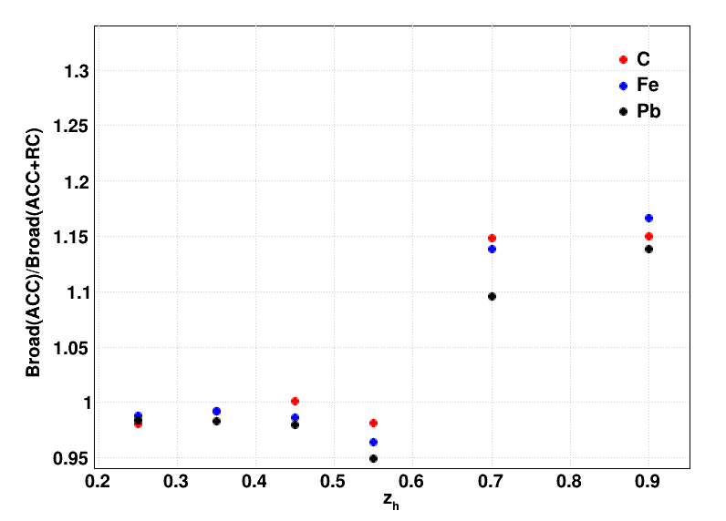
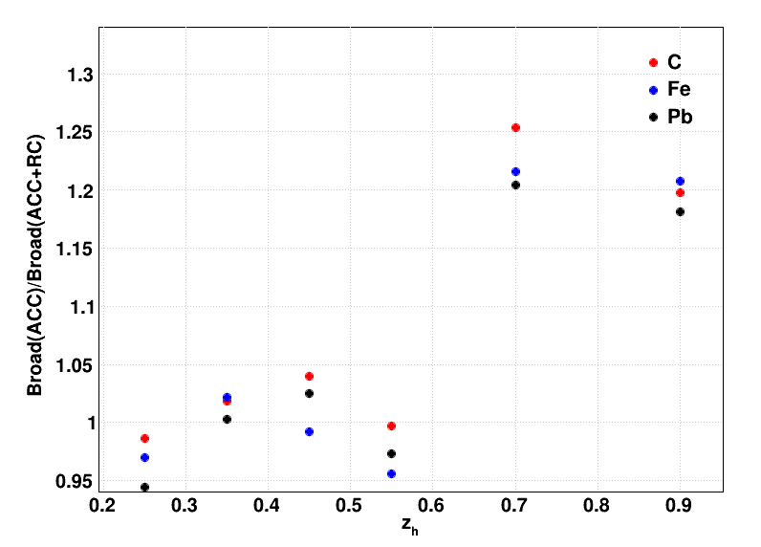
Correction to Data: Radiative Corrections
Radiative correction accounts for events with real photon emission:
CLAS PRELIMINARY
CLAS PRELIMINARY
No xf cut applied.
xf>0 cut applied.

Slide 36
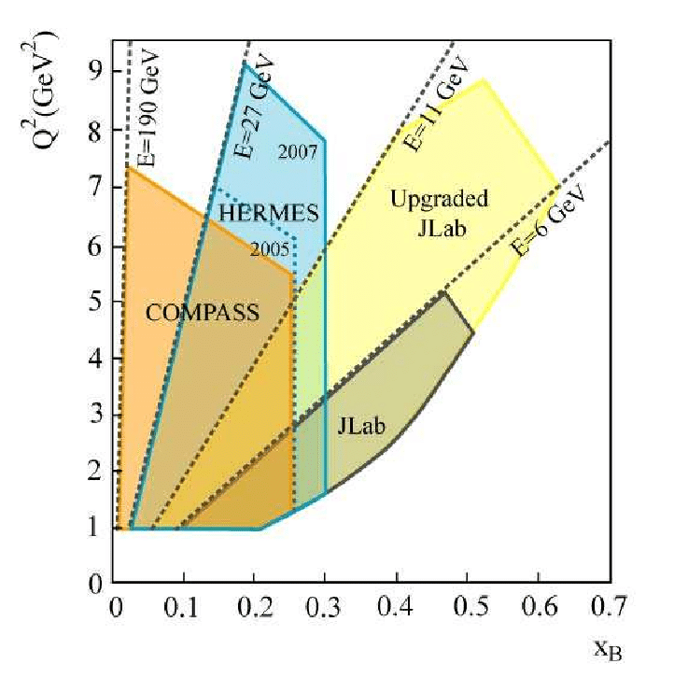
Kinematic Coverage

Slide 37
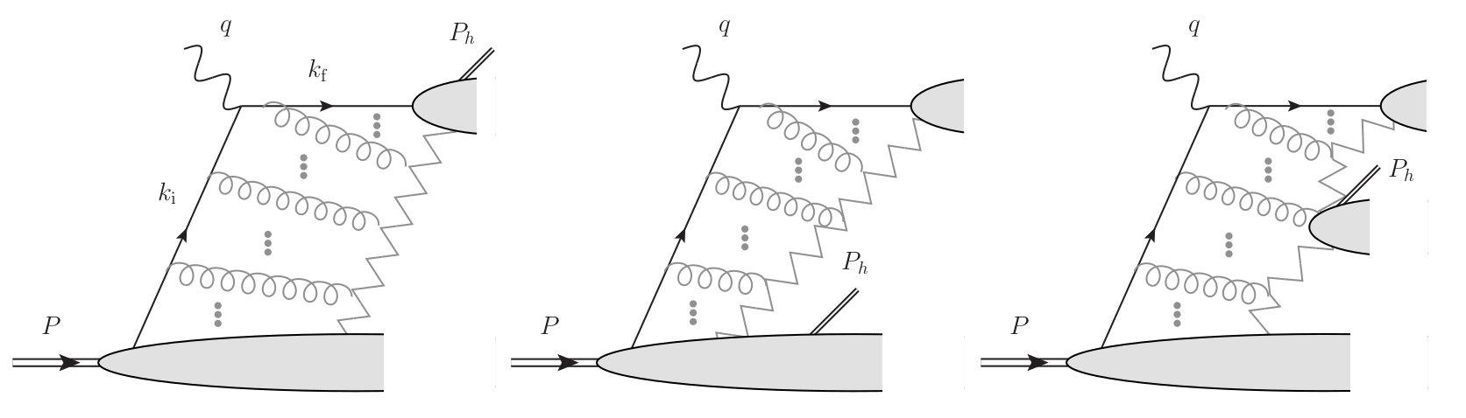
Fragmentation Regions
Current Target Mixed
[-] Boglione, M.; et al. (2017). Kinematics of current region fragmentation in semi-inclusive deep inelastic scattering.

Slide 38
Systematic Errors
We studied nine sources of systematic errors:
Pion Identification
Vertex Selection
  Vertex Cut
  |ΔZ| cut variation
Acceptance
  Naccept
  Acc
  Different Pt2 binning
  Closure Test
Background Subtraction
Radiative Corrections

