Slide 1


FOSTERING A POSITIVE & RESPECTFUL WORKPLACE
Awareness & Resources To Prevent Bullying, Harassment & Discrimination in the Workplace
Human Resources & STEM Workforce Development
May 21, 2026

Slide 2
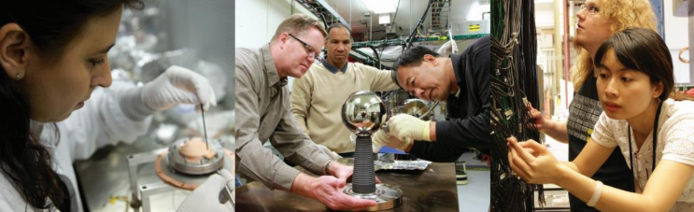
Community STandards
  Everyone at Jefferson Lab has a responsibly to foster an environment where all employees, users, students, guests, visitors, and subcontractors feel welcome and supported in advancing the lab’s mission.
  Jefferson Lab actively promotes a harassment-free experience for all. While it is not possible to provide a complete list of the types of improper behavior below, prohibited conduct includes, but is not limited to:
  Obscene or abusive language
  Bullying or deliberate intimidation
  Inappropriate physical contact
  Stalking/following
  Unwelcome sexual attention or advances
  Disrespectful or offensive comments/gestures
  Displaying or circulating sexually suggestive materials
  Violating security or environment, safety, and health issues
  Everyone is expected to model professionalism and respectful behavior at all times.
Notes:
HR

Slide 3
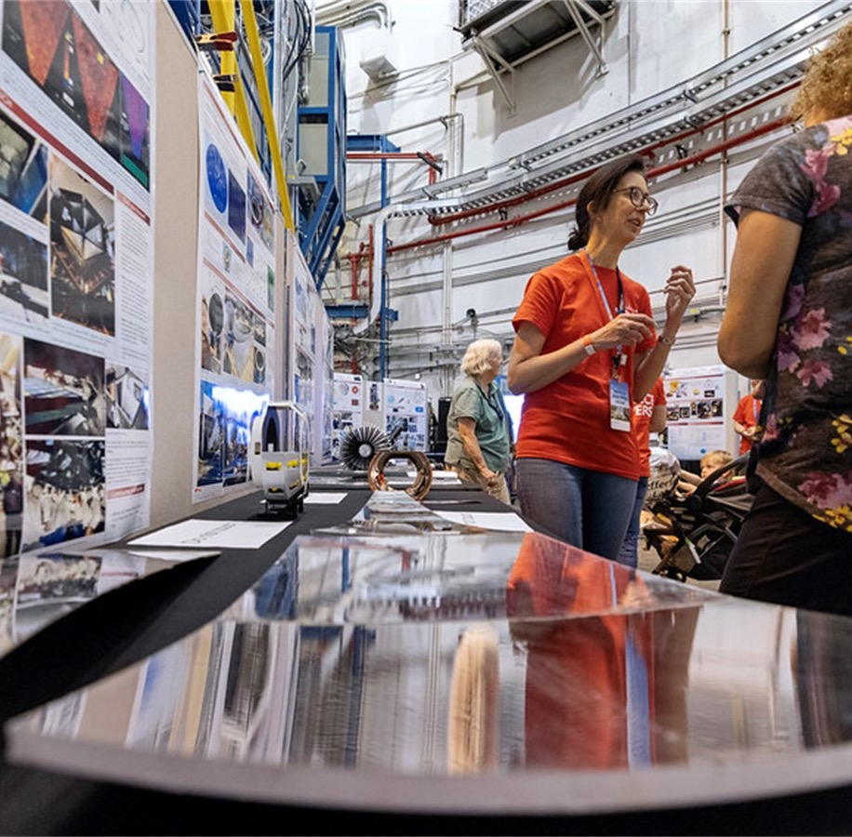
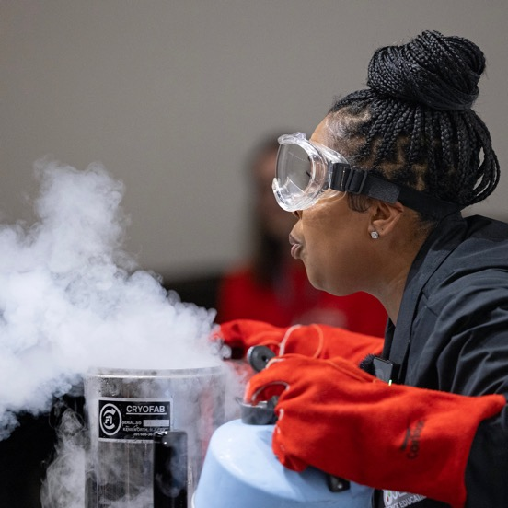
OUR CULTURE
What Are We Passionate About?
Safety
Learning & Innovation
Philosophy of Human Performance
Just Culture
Our Values
  Accountability
  Communication
  Service Focus/Teamwork
  Safety
Notes:
HR

Slide 4


You Matter to Us: Respect at the Lab
RESPECT
A feeling of deep admiration for someone or something elicited by their abilities, qualities, or achievements
Due regard for the feelings, wishes, or rights of others
Oxford Dictionary
RESPECT fosters a positive culture and environment where open communication and collaboration thrive:
Speak up without fear/offer different viewpoints
Take measured risks, admit mistakes
Ask questions without being judged
Trust between colleagues
Notes:
HR

Slide 5
OBJECTIVES
By the end of the session, you will be able to:
Recognize the value Jefferson Lab places on a respectful work environment
Understand and follow JSA/Jefferson Lab’s policies regarding harassment and bullying
Recognize workplace harassment & bullying and differentiate between them
Know who and how to report an incident and cooperate with any investigative process
Help promote and maintain a comfortable, productive work environment
Notes:
HR

Slide 6


AT Jefferson LAB
The Lab promotes an environment that values:
Respect and Professionalism
Differing opinions
Being free from harassment and discrimination of ANY kind
We do not tolerate:
  Verbal or physical harassing conduct
  Creating an intimidating, offensive, or hostile environment
Notes:
SciEd

Slide 7

Bullying & Harassment: What’s the Difference
Bullying is unwanted behavior from a co-worker or supervisor that involves a real or perceived power imbalance. The behavior is:
  Targeted, repeated, or has the potential to be repeated over time
  Impacts group/individual morale
  Socially excludes someone or negatively affects someone’s work tasks
Harassment is a form of discrimination based on the victim's race, religion, sex, national origin, age, disability, or other protected characteristic. The behavior may:
  Include any unwanted, unwelcome, physical or verbal behavior that offends or humiliates
  Become a condition of continued employment (ex: victim must go on a date/accept sexual advances or miss out on work opportunities)
  Not directly result in lost opportunities, but does make it difficult for the victim to work because of constant ridicule, belittling comments, teasing, etc.
  Persist over time
Both can create a hostile work environment that “a reasonable person” would consider intimidating or abusive
Notes:
SciEd

Slide 8
HARASSMENT & BULLYING BEHAVIORS
Include:
Abusive, threatening, offensive, degrading, inappropriate, belittling, or intimidating comments, jokes, phone calls, emails, notes, text, or posts on social media
Inappropriate physical contact or coercive behavior which is intended to be derogatory or intimidating
Insulting or threatening gestures
Unwelcome touching or continued invitations for dates
Suggestion that sexual engagement is a condition of continued work/employment
Notes:
SciEd

Slide 9
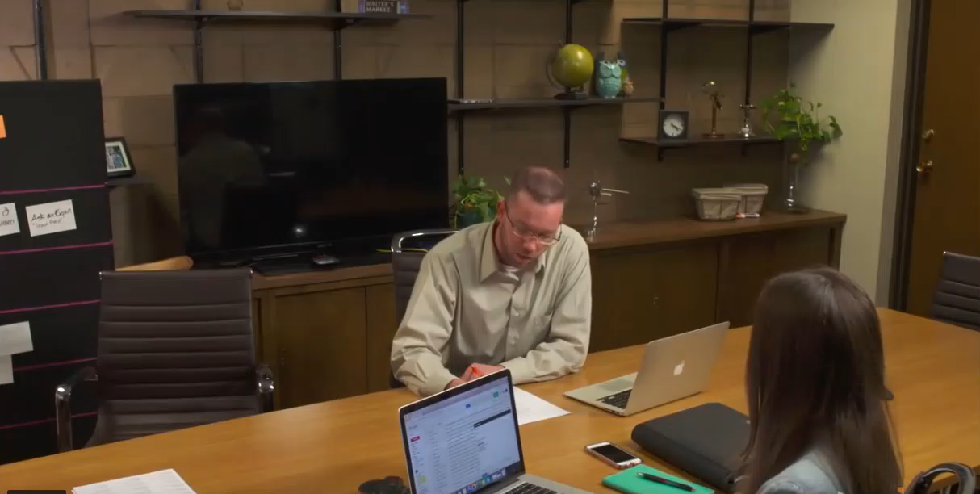
A HOSTILE ENVIRONMENT?
Notes:
SciEd

Slide 10

HARASSMENT: HOSTILE ENVIRONMENT
Key characteristics:
  Frequency and severity of behavior
  Anyone can commit this type of harassment – supervisors/sponsors, co-workers, students, and non-employees who are at the Lab
  Behavior is unwelcome
  Conduct is pervasive and long-lasting
  Atmosphere perceived to be intimidating or offensive
Notes:
SciEd

Slide 11

EVERYONE KNOWS THERE’s A PROBLEM…
Reasons why people do not come forward:
Fear of retaliation
Fear of getting a bad reputation
Feel nothing will be done
Fear of getting the perpetrator in trouble
Fear they or the complaint will not be taken seriously
Feel it is not any of their business
Do not know what to do
Bystander effect (less likely to help someone when others are around)
Notes:
SciEd

Slide 12

WE All have the power to Prevent Harassment with the 4ds
Delegate: Get Help!
Sponsor, Program Manager, Human Resources, Ethics Officer, or Employee Concerns Program (ECP)
Distract: Do something to break the moment! Cough loudly, drop something, be a pest!
Direct: Tell the perpetrator to stop in a way that you feel comfortable doing.
Delay: Check in with the victim to make sure they are ok and to offer any help or resources that you can.
But at all times, before you act, assess your safety!
Notes:
SciEd

Slide 13

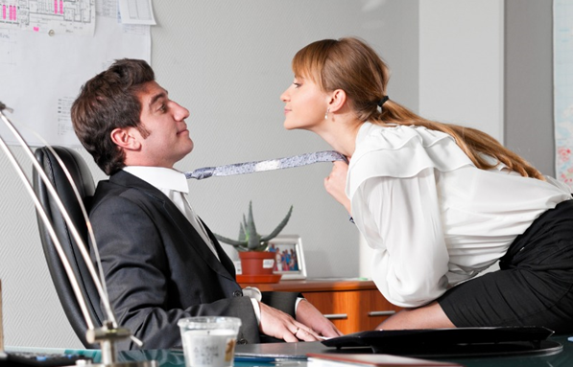


BALANCE
Would a “reasonable person” feel the behavior is offensive, intimidating, or humiliating the person involved?
Does the person feel offended, intimidated, or humiliated?
INTENT IS IRRELEVANT!!
Notes:
SciEd

Slide 14

Bullying & Harassment are NOT:
Accurate, constructive, and courteous remarks
Reasonable management decisions, discussions, or actions (including performance management)
Differences of opinion
  Conflicts and disagreements with co-workers generally do not constitute harassment/bullying
Notes:
SciEd

Slide 15

PREVENTION GUIDELINES
Avoid behavior that may be questionable in the workplace: Do NOT assume familiarity with co-workers
Do NOT invade another individual’s personal space
No touching
Inform those engaging in inappropriate behavior you find it objectionable
If you believe you are a victim of unwelcome bullying/harassment, you have a responsibility to notify others: speak with the offender, report, or file a complaint about the situation as soon as possible!
Notes:
SciEd

Slide 16

Employee Concerns Program
Have issues or concerns that are work-related:
Seek resolution from your sponsor or program manager
Seek assistance from Human Resources:
  Ryan Wood x7020
  Rhonda Barbosa x5991
If the issue is not resolved internally, then concerns may be filed to our third-party ECP – Ethics Hotline 24 hours a day
  Employee Concerns Hotline: 1-888-296-8301
  Employee Concerns Website: http://www.jsaecp.ethicspoint.com
The Department of Energy Employee Concerns Program
  Employees of contractors who believe they have been retaliated against for engaging in protected activity have the right to file a complaint under the DOE Contractor Whistleblower Protection Program
Notes:
HR

Slide 17
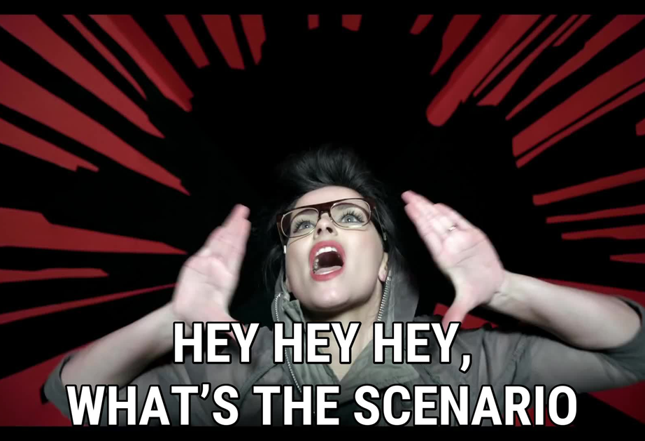
SO WHAT’s THE Scenario!
Checking your Understanding
Notes:
HR

Slide 18

Scenario 1: All in fun
Participants: Sarah and John, both students, are working on a project. They overhear/see Brian, another student, making sexual overtures toward Jessica. Jessica turns red but Brian keeps taunting her and smiles.
What would YOU do if you were Sarah or John?
Action to take:
  Action 1: Report this immediately to your mentor
  Action 2: Walk over to Brian and explain that this behavior is not tolerated at the Lab
  Action 3: Report this incident to either your sponsor, mentor, program manager, Human Resources, or the Employee Concerns Program
  Action 4: Ignore the situation, it is not your problem
  Action 5: Make sure Jessica knows her options and who to go to for help
Notes:
HR

Slide 19

Scenario 2: Singled out
Participants: Peter shows up for work everyday on time. However, he is falling behind and not completing his assignments on time, which is impacting others on the team. His mentor, Jenna, has been critical of his work and advised him that he needs to improve, or he risks being removed from the program.
What would YOU do if you were Peter?
Action to take:
  Action 1: Set up a meeting with the mentor and explain that the comments are making you uncomfortable
  Action 2: Accept the feedback; ask for additional help if needed and make an effort to complete your part of the project on time
  Action 3: Ignore Jenna; she comes on strong but doesn’t follow through with consequences
Notes:
HR

Slide 20

Scenario 3: DISCRIMINATION in the workplace
Participants: A senior scientist mentoring a dynamic and gifted student, commented that they needed to remove their braids, as this hair style was not appropriate and appeared ‘unkempt’ for a professional work environment if they wanted to advance their research studies.
What would YOU do if you were this student?
Action to take:
  Action 1: Keep quiet, you have worked too hard to get to this point
  Action 2: Immediately get a new hair style
  Action 3: Report this incident to either your sponsor, mentor, program manager, Human Resources, or the Employee Concerns Program
  Action 4: Discuss the situation with your mentor to understand why this was said about your appearance
Notes:
HR

Slide 21

Scenario 4: CHAT COMMENTS
Participants: A group of students are presenting project ideas to their mentor via a virtual meeting. After Adam presents, he notices two students making disrespectful comments about his presentation in the chat box.
What would YOU do if you were Adam?
Action to take:
  Action 1: Respond in the chat box that the comments are unprofessional and inappropriate
  Action 2: Speak directly to the two students if you are comfortable
  Action 3: Report this incident to either your sponsor, mentor, program manager, Human Resources, or the Employee Concerns Program
  Action 4: Ignore them
Notes:
HR

Slide 22
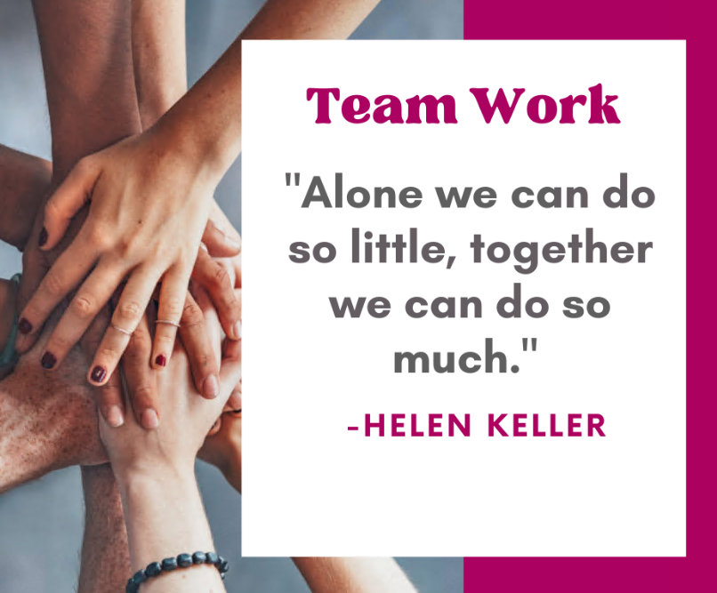
FINAL THOUGHTS
Everyone at Jefferson Lab, from employees to users, visitors to contractors, help shape and advance our culture through daily interactions with each other. To have the professional, respectful, and harassment free environment we all expect, each of us must be committed to this common objective and act accordingly.
Ultimately, we rely on you to be informed and appreciate our united responsibility in fostering an environment where all feel welcome, safe, and supported.
Thank you for your effort in this very important endeavor!
Contact Information
  Ryan Wood X7020
  Rhonda Barbosa x5991
  Employee Concerns
    Hotline 1-888-296-8301
    Website: http://www.jsaecp.ethicspoint.com
Notes:
HR

