Slide 1
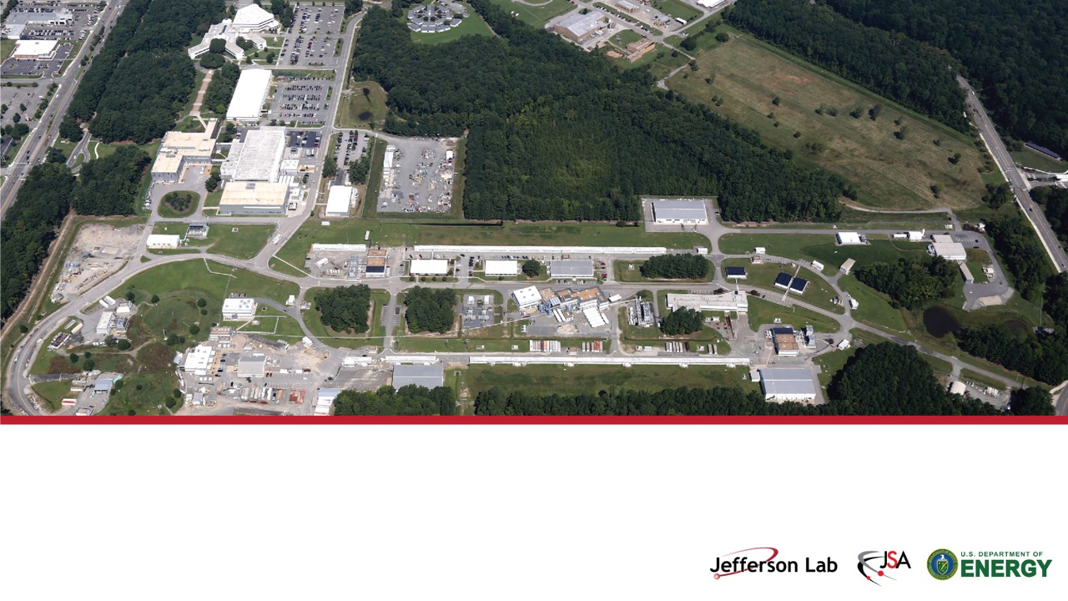
Continuous Electron Beam Accelerator Facility: Past, Present, & Future
Douglas W. Higinbotham, Ph.D.
Acting Associate Director of Experimental Nuclear Physics

Slide 2
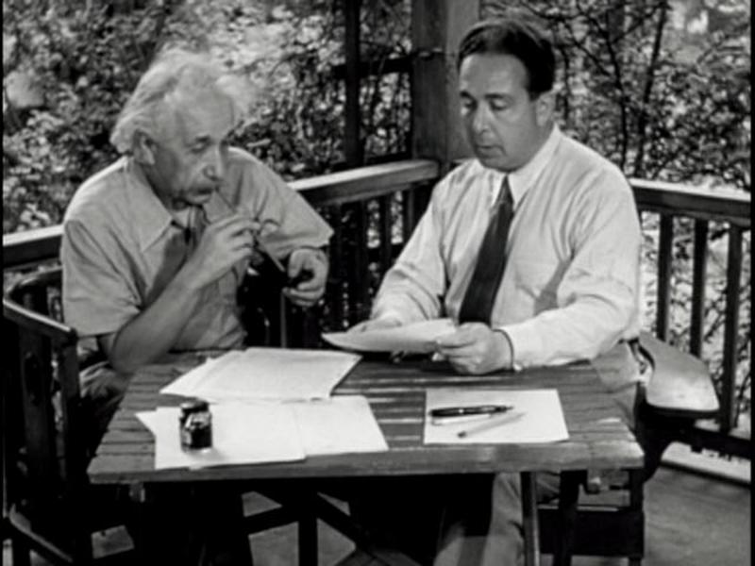
DOE’s Programmatic Heritage
In August 1939, Albert Einstein wrote to President Franklin D. Roosevelt, informing him that a nuclear chain reaction might make possible the construction of “extremely powerful bombs” (Einstein Szilard letter)
In 1942, the Army Corps of Engineers established the Manhattan Engineer District to design and produce the first atomic bomb.
Los Alamos, Oak Ridge and Hanford were subsequently created.
https://ahf.nuclearmuseum.org/ahf/key-documents/einstein-szilard-letter/

Slide 3


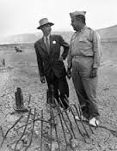
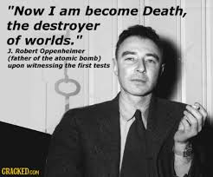
J. Robert Oppenheimer
1904 - 1967
Professor - theoretical physics at Berkeley
Wartime head of the Los Alamos Laboratory, scientific Director of the Manhattan Project and "father of the atomic bomb“
  July 16, 1945 – after Trinity test in New Mexico – quoted Bhagavad Gita: "Now I am become Death, the destroyer of worlds."
Chairman of the influential General Advisory Committee of the newly created United States Atomic Energy Commission.
With sparse evidence at best - security clearance revoked in a much-publicized hearing in 1954
Winner of the Enrico Fermi Award
Director of the Institute for Advanced Study at Princeton
Major Motion Picture in 2023
And in many ways the father of the National Lab system.
Oppenheimer with General Groves.
Groves Oversaw Both the Pentagon Construction and the Manhattan Project

Slide 4
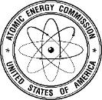
The Cold War
Following the war, Congress passed the Atomic Energy Act of 1946 and created the Atomic Energy Commission (AEC), which took over the Manhattan Project’s sprawling scientific and industrial complex.
  Initially, the AEC focused on designing and producing nuclear weapons and developing nuclear reactors for naval propulsion
  The Atomic Energy Act of 1954 ended exclusive government use of the atom and began the growth of the commercial nuclear power industry, giving the AEC authority to regulate the new industry.

Slide 5
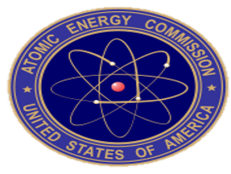
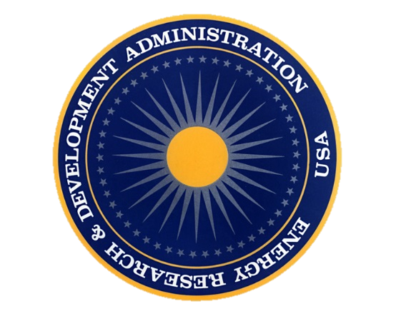

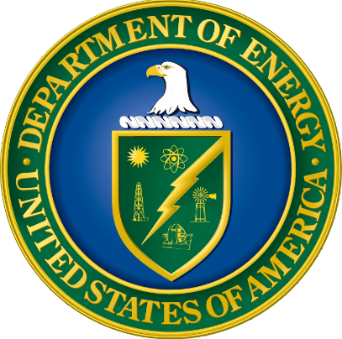
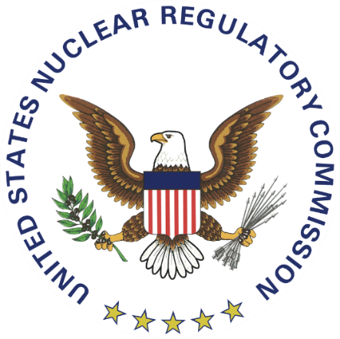
From the Manhattan Project to the Department of Energy
Manhattan Engineering District (1942)
Atomic Energy Commission (1946)
Energy Research & Development Administration (1974)
Department of Energy (1977)
Nuclear Regulatory Commission (1974)

Slide 6
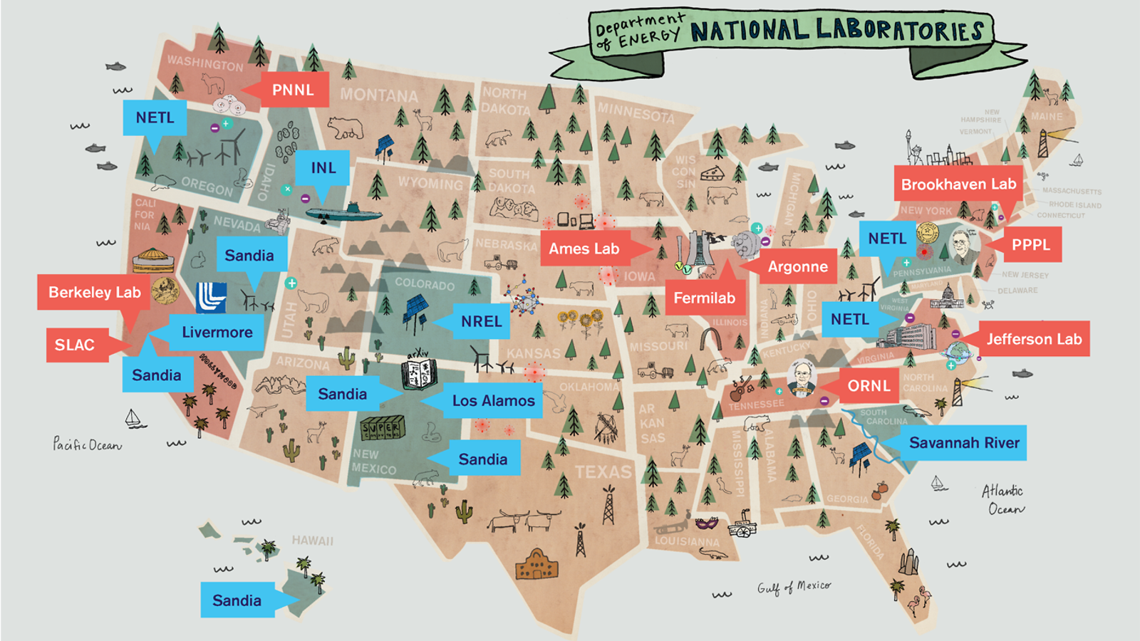
6

Slide 7
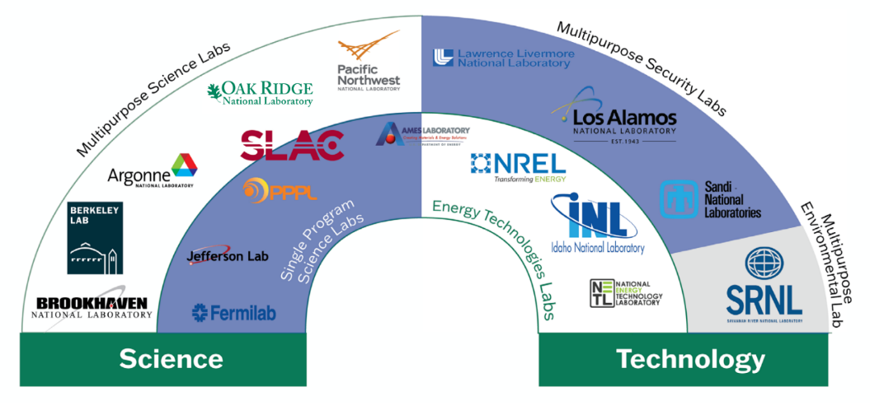
https://www.tiki-toki.com/timeline/entry/2083284/The-DOE-National-Laboratory-System/

Slide 8
FFRDCs
16 of the 17 DOE National Labs are Federally Funded Research and Development Centers (FFRDC):
  Meet special long-term national research and development needs of considerable complexity that cannot be met as effectively by in-house government or contractor resources;
  Have access to information beyond what is common to the normal contractual relationship;
  Cannot use special access to compete with the private sector;
  Are required to operate in the public interest, free from organizational conflict of interest;
  Anticipate a long-term relationships with the government;
  Provide the continuity that will attract high-quality personnel;
  Maintain currency in field(s) of expertise;
  Maintain objectivity and independence;
  Preserve familiarity with the needs of its sponsor(s);
  Provide a quick response capability.
The National Science Foundation keeps a list of FFRDCs by name, sponsoring agency, administrator type, location, and activity type.
Notes:
There are 43 FFRDCs as of February 2023. Doe has 16 FFRDCs, NETL is not an FFRDC.
Federally Funded Research and Development Centers (FFRDCs) trace their origins to World War II, when new institutions were needed to address new challenges. The extraordinary science and engineering problems posed by the war called for a sustained R&D effort that combined independent and highly technical capabilities with the kind of long-term funding commitment that only the government could make.
Early precursors to today’s FFRDCs included the Applied Physics Laboratory at Johns Hopkins University, the Jet Propulsion Laboratory at the California Institute of Technology, and the Radiation Lab at MIT. These facilities offered first-rate R&D capabilities from the private sector underpinned by federal funding, the very essence of the FFRDCs.
As Sandia President and Labs Director Paul Hommert notes, the iconic predecessor and model for FFRDCs was Los Alamos Scientific Laboratory, where the nation invested substantial resources to develop the atomic weapons that ended World War II.
Paul recounts that Gen. Leslie Groves, who headed the Manhattan Project, initially envisioned Los Alamos as a pure government operation. Robert Oppenheimer, tapped by Groves to lead the Los Alamos lab for the project, convinced Groves that a more effective approach — and one more likely to succeed in drawing the top scientists and engineers that project demanded — would be to have an outside entity manage the lab, backed by government investment. Groves agreed and the results validated the approach.
The successes of Los Alamos and the other wartime labs offered a compelling model for FFRDCs, a structure that was formalized in the post-war era with the establishment of the RAND Corporation and several Atomic Energy Commission laboratories, including Sandia. Today there are 41 FFRDCs sponsored by agencies from across the government.

Slide 9
GOGOs and GOCOs
GOCO (Government Owned/Contractor Operated) operated laboratories are owned by the Federal Government but managed by contractors.
Contractors may be individual universities, university consortia, private companies, or nonprofits. GOCO dates back to the original laboratories of the Manhattan Project.
While the DOE national labs are GOCOs, most Federal laboratories are GOGOs(GovernmentOwned/Government Operated); NETL is the only GOGO DOE national lab.
GOCO researchers are not Federal employees and have more freedom than GOGO scientists. GOCO employees can assert copyrights, consult with industry, and participate in start-ups based on technology developed at the laboratory.
Even at the GOGO lab, ~2/3 of the people who work there are contractors forming what is almost a GOCO within the GOGO lab.
Notes:
Slide from Dimitri Kusnezov presentation to CRENEL on July 18, 2014 “The DOE’s National Lab Complex)

Slide 10
DOE’s M&O Contracts
DOE’s FFRDCs operate under M&O contracts – a special Federal Acquisition Regulation (FAR) designation for GOCO facilities
Origin is in character of work done through the Manhattan Project, but designation dates back to a Secretary of Energy Memo in 1983
M&O contracts are “an agreement under which the Government contracts for the operation, maintenance, or support, on its behalf, of a Government-owned or –controlled research, development, special production, or testing establishment wholly or principally devoted to one or more major programs of the contracting federal agency.” (FAR 17.601)
Notes:
Slide from Dimitri Kusnezov presentation to CRENEL on July 18, 2014 “The DOE’s National Lab Complex)

Slide 11
DOE Laboratory | M&O Administrator | M&O Members
Ames Laboratory | Iowa State University | Iowa State
Argonne National Laboratory (ANL) | UChicago Argonne, LLC | University of Chicago, Universities Research Association (URA)
Brookhaven National Laboratory (BNL) | Brookhaven Science Associates, LLC | Stony Brook University, Battelle, 6 core universities
Fermi National Accelerator Laboratory (FNAL) | Fermi Research Alliance, LLC transitioning to Fermi Forward Discovery Group, LLC | University of Chicago, Universities Research Association (URA)
Idaho National Laboratory (INL) | Battelle Energy Alliance, LLC | Battelle
Lawrence Berkeley National Laboratory (LBNL) | University of California | University of California
Lawrence Livermore National Laboratory (LLNL) | Lawrence Livermore National Security, LLC | Bechtel, University of California, BWXT, Battelle
Los Alamos National Laboratory (LANL) | Triad National Security, LLC | Battelle, Univ of California, Texas A&M University
National Energy Technology Laboratory (NETL) | N/A (DOE GOGO)
National Renewable Energy Lab (NREL) | Alliance for Sustainable Energy, LLC | Battelle, MRI Global
Oak Ridge National Laboratory (ORNL) | UT-Battelle, LLC | Battelle, University of Tennessee
Pacific Northwest National Laboratory (PNNL) | Battelle Memorial Institute | Battelle
Princeton Plasma Physics Laboratory (PPPL) | Princeton University | Princeton University
Sandia National Laboratories (SNL) | National Technology and Engineering Solutions of Sandia, LLC | Honeywell, URA
Savannah River National Laboratory (SRNL) | Battelle Savannah River Alliance, LLC | Battelle
SLAC National Accelerator Laboratory | Stanford University | Stanford
Thomas Jefferson National Accelerator Laboratory (TJNAF) | Jefferson Science Associates, LLC until May 31st | Southeastern Universities Research Association
Notes:
Talk about what happens when contracts come up for bids

Slide 12
Recent M&O Bid Processes
SNL (Sandia)
  On 1 May 2017, Sandia National Laboratories acquired a new administrator (National Technology and Engineering Solutions of Sandia, LLC, a subsidiary of Honeywell International, Inc.). The previous administrator was Sandia Corporation, a subsidiary of Lockheed Martin Corp.
LANL (Los Alamos)
  On 9 June 2018, Los Alamos National Laboratory acquired a new industrial firm administration (Triad National Security, LLC). Between June 2006 and June 2018, Los Alamos National Laboratory was administered by Los Alamos National Security, LLC. Prior to June 2006, the administrator was the University of California.
SRNL (Savanna River)
  On 22 December 2020, Savannah River National Laboratory acquired a new nonprofit administrator, Battelle Savannah River Alliance, LLC. The previous administrator, Savannah River Nuclear Solutions, continues to administer the Savannah River Site.
FNAL (Fermi)
  Just completed the process and on 1 January 2025 the new contractor: Fermi Forward Discovery Group, LLC will be running the lab.
  New LCC led by the University of Chicago and Universities Research Association (URA) and two industrial partners, Longenecker & Associates and Amentum
TJNAF (Jefferson Lab)
  Successful bid was announced March 31st and SURATech to assume full responsibility for the laboratory’s operation on June 1, 2026.
  SURA -> JSA LLC -> SURATech LLC
Reference: https://science.osti.gov/Acquisition-Management/M-and-O-Competitions
12
Notes:
Talking points
How bid teams organize are wildly different (SNL took off top layer of execs, LANL was a mix)
DOE went through a period of recompeting, seems to be backing off now
Every M&O contract is different (an often creates challenges in working or moving between labs)

Slide 13
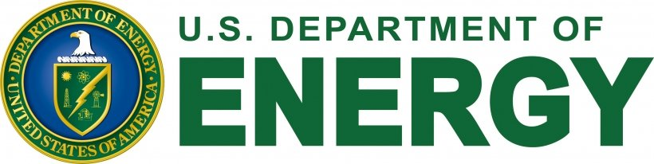
How would you explain what the U.S. Department of Energy does?!

Slide 14
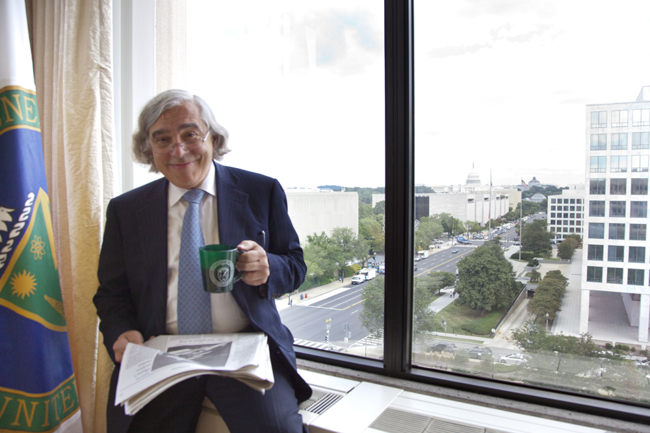
Ernest Moniz’s Answer To The Question Is Amazing
NOTE: Moniz was secretary of energy for the Obama administration, professor at MIT and a Nuclear Physicist with many excellent papers.
14

Slide 15
Quarks
Quagmires
Weapons
Windmills
Credit to former DOE Secretary of Energy Ernest Moniz for coming up with this very concise explanation of what DOE does.
15

Slide 16
Quarks
Quagmires
17.69%
19.21%
Weapons
Windmills
14.63%
48.47%

Slide 17
Continuous Electron Beam Accelerator Facility
(CEBAF) a Department of Energy user facility
Newport News, VA

Slide 18
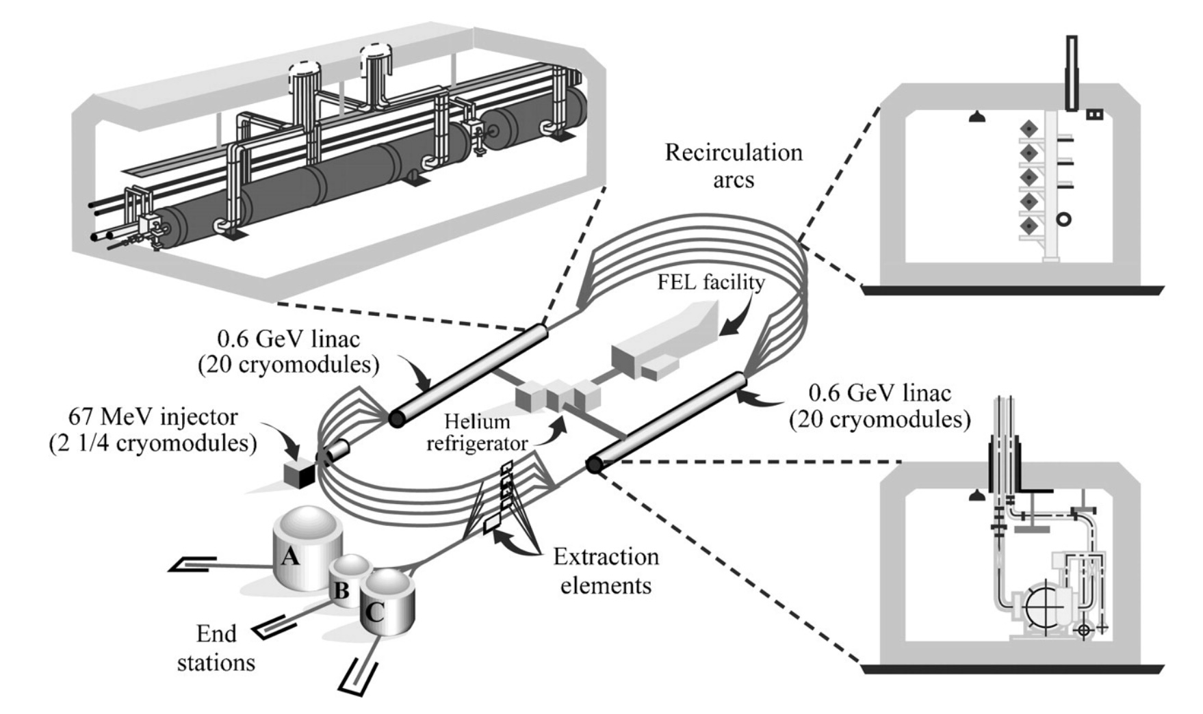

Slide 19
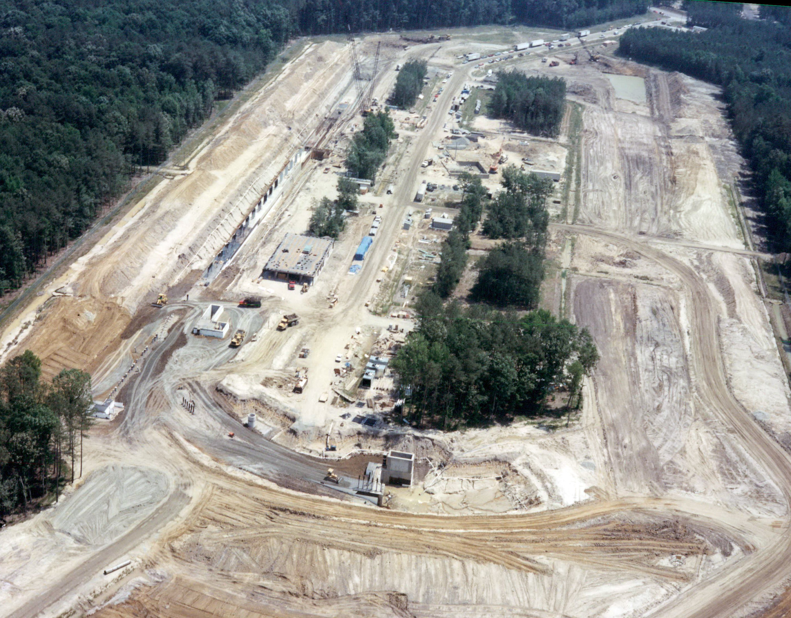

Slide 20
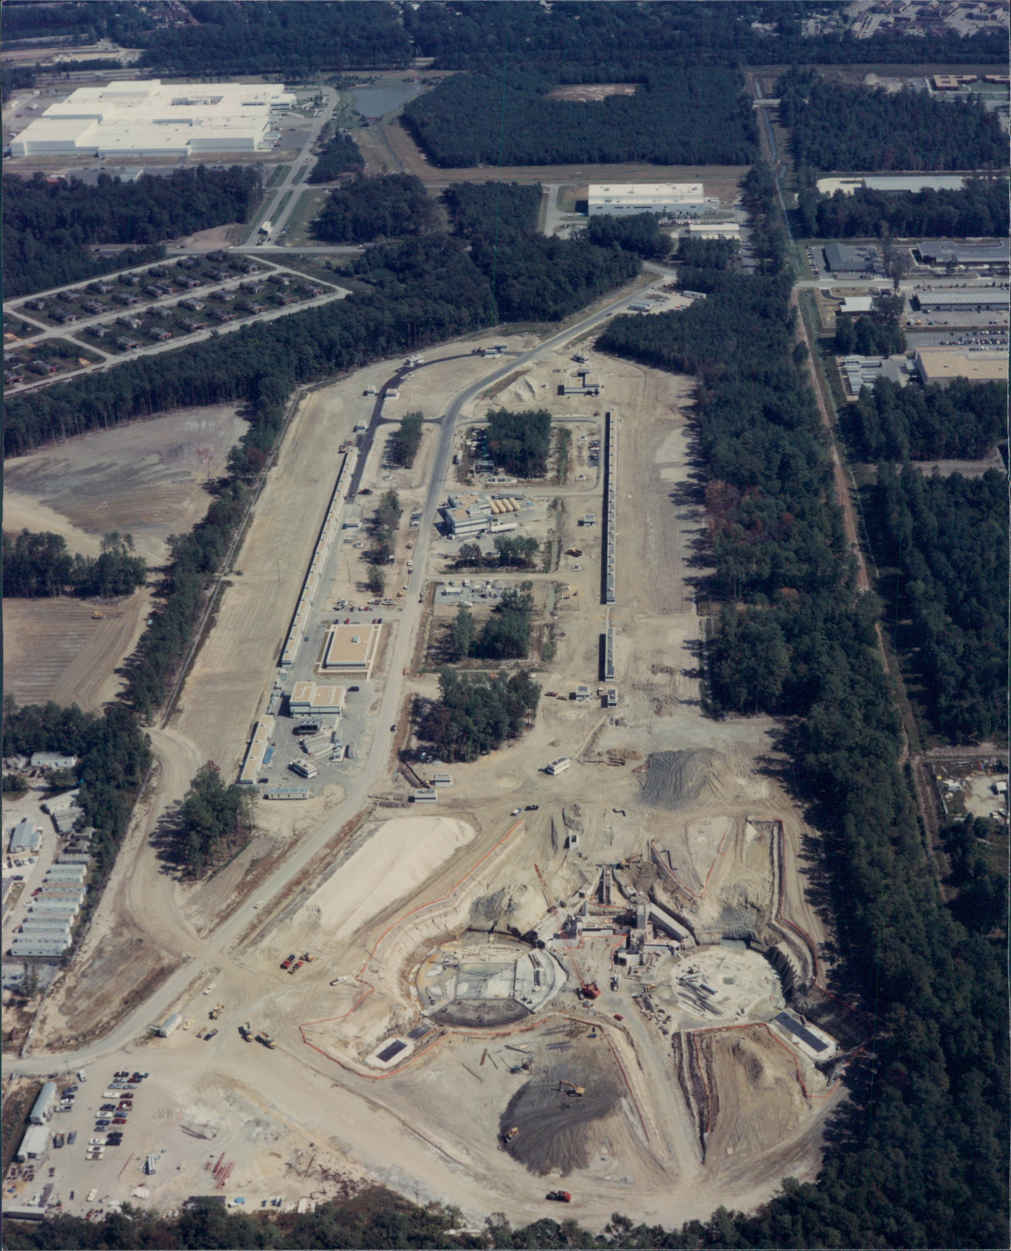
20

Slide 21
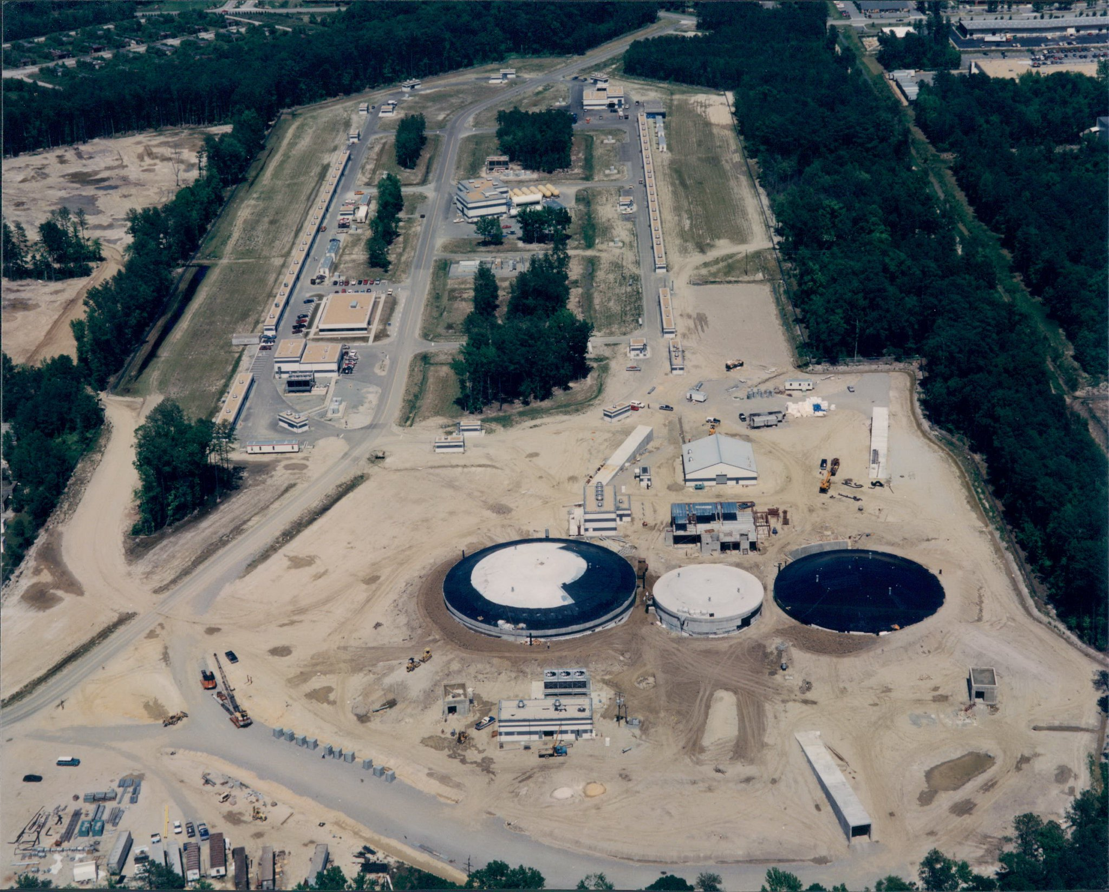

Slide 22
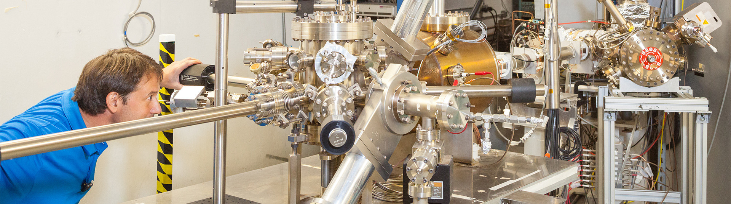
22

Slide 23
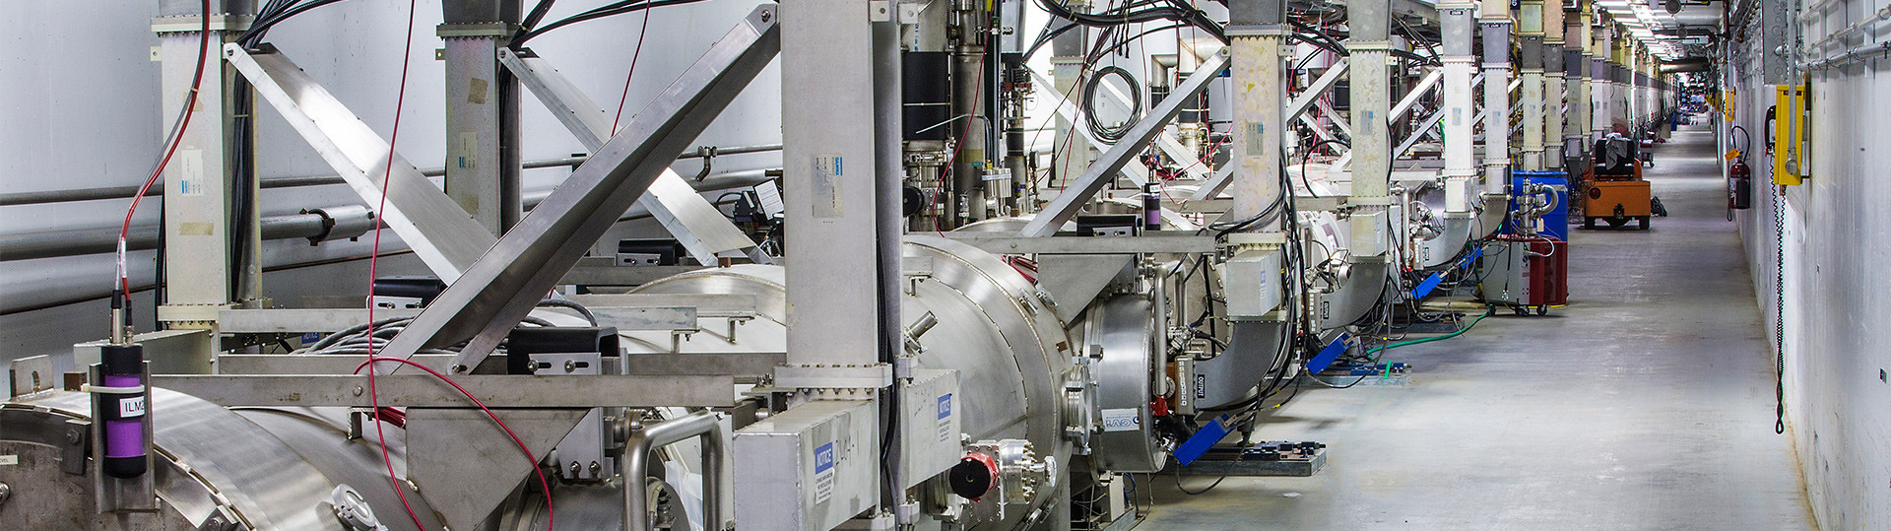

Slide 24
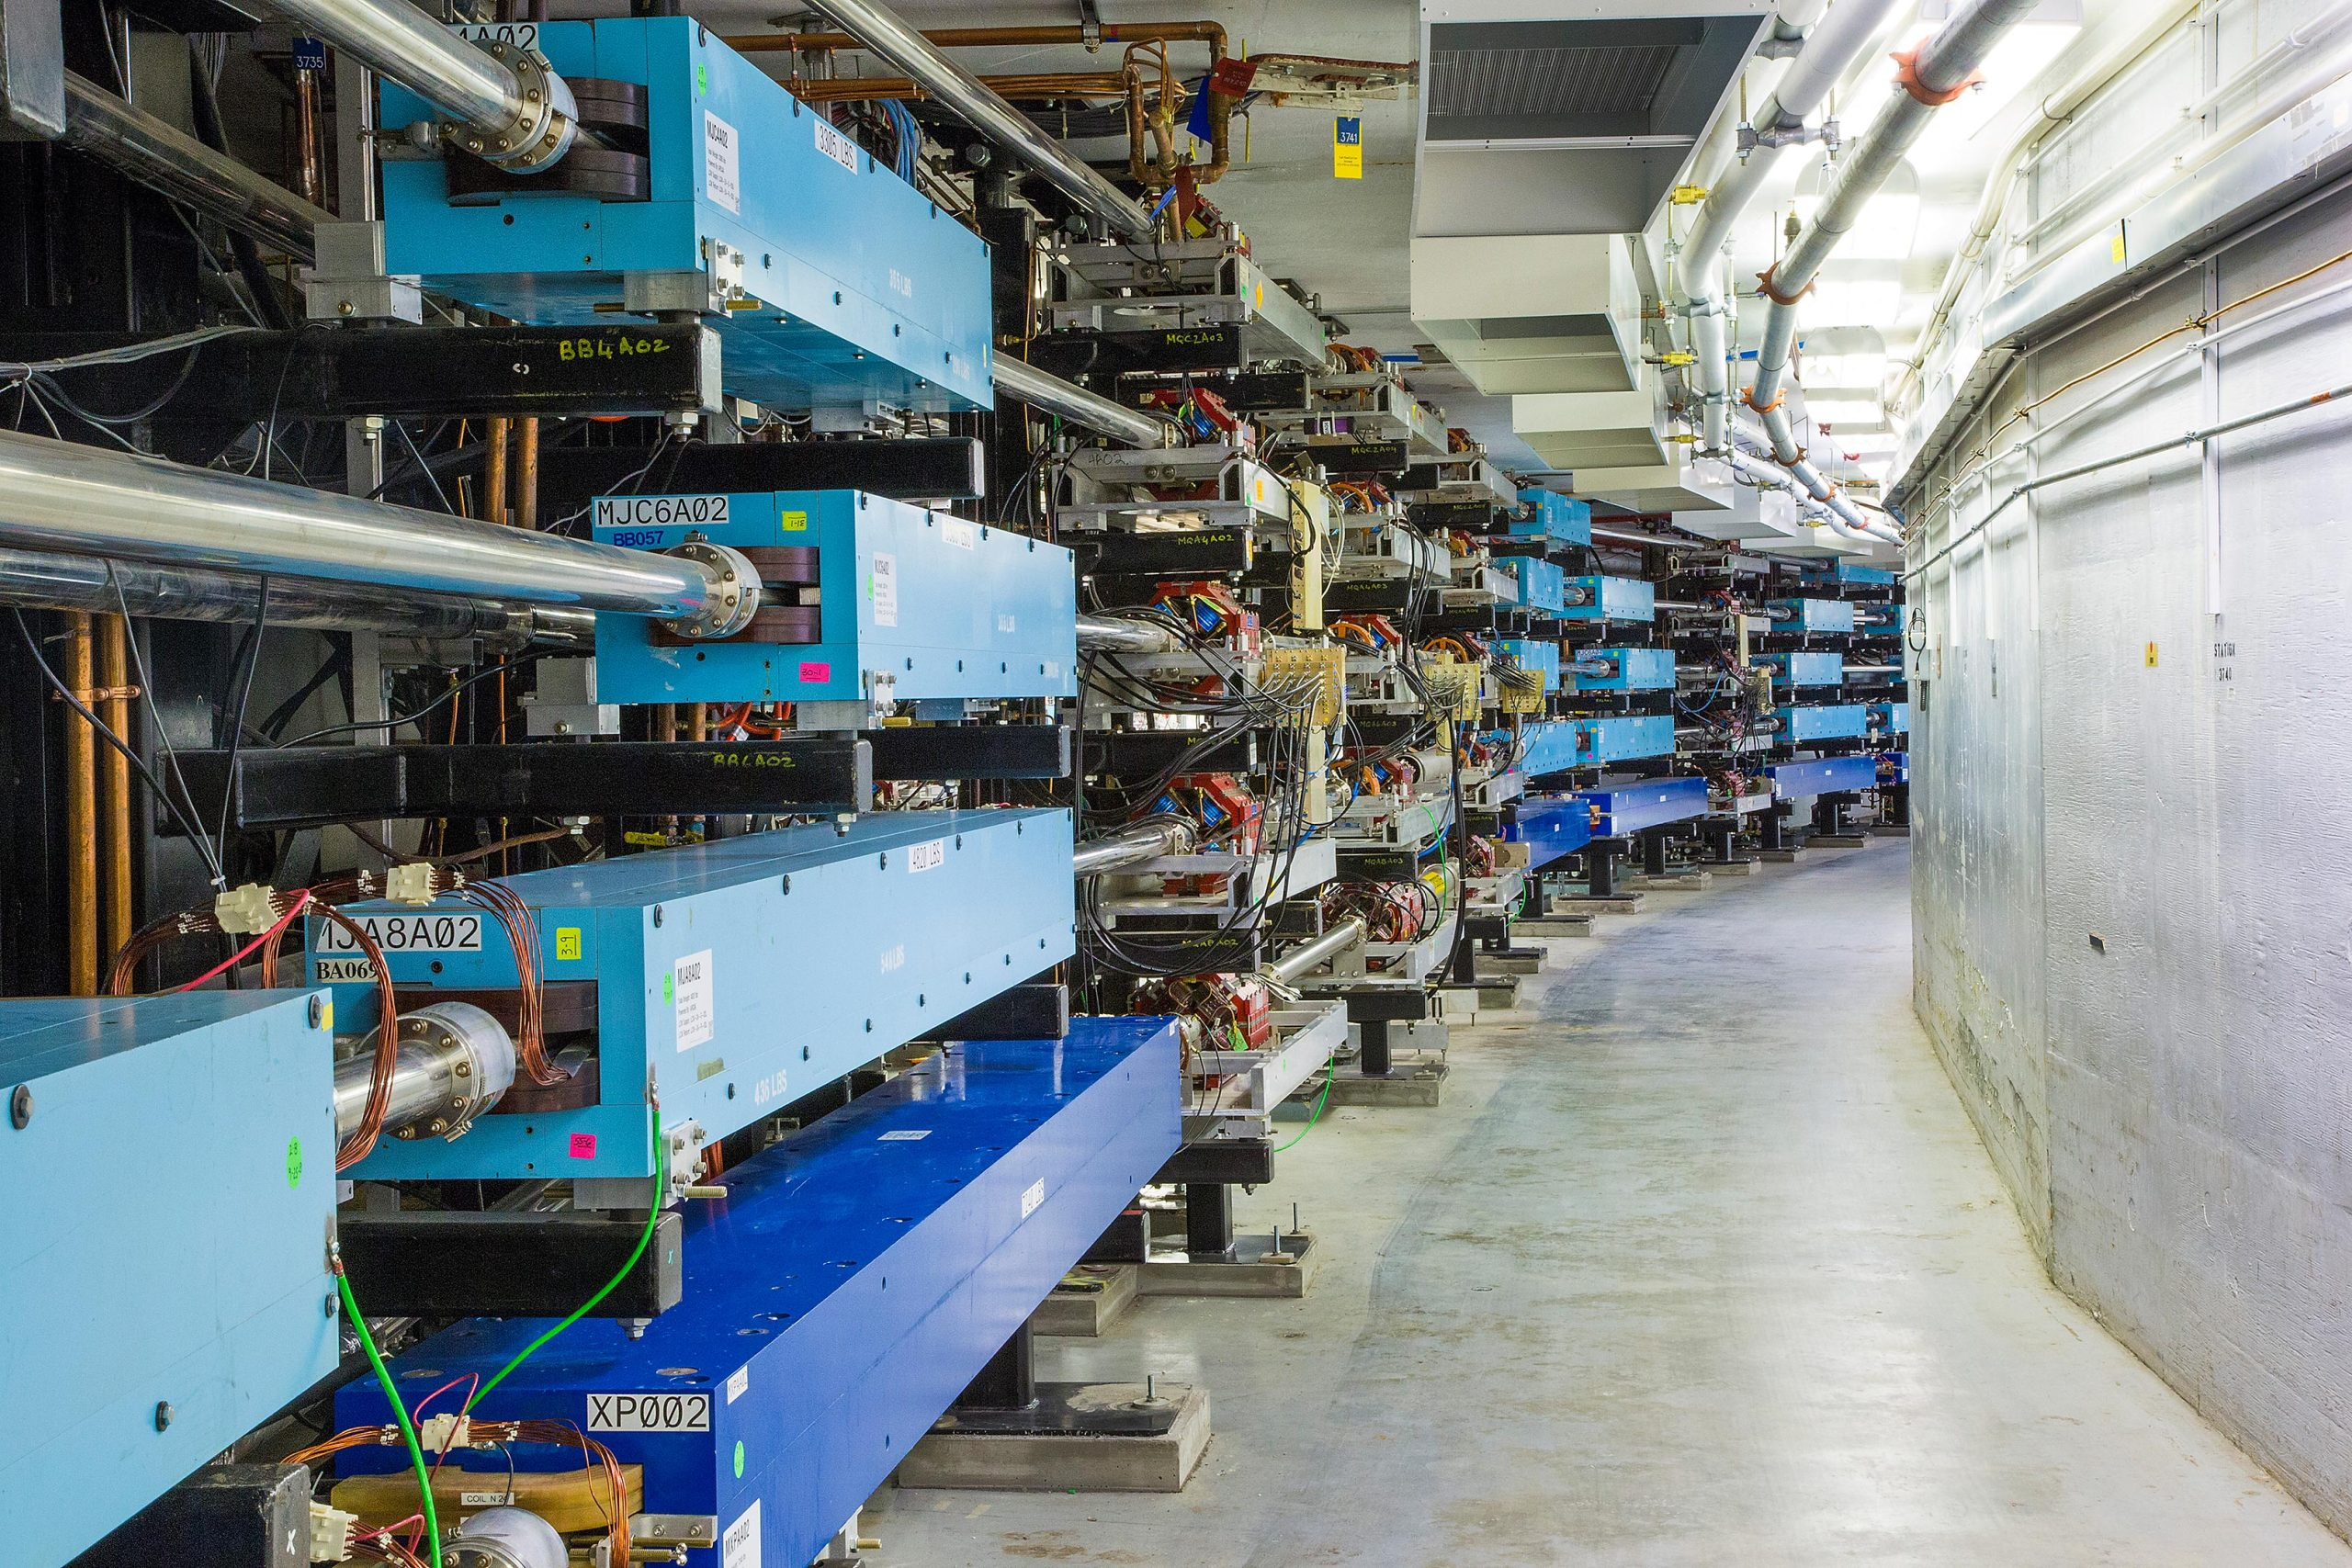
24

Slide 26
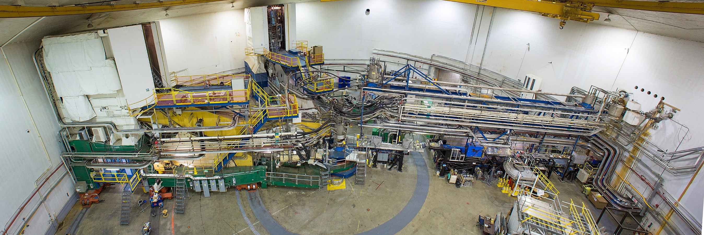
Jefferson Lab’s Experimental Hall A (classic picture)
High luminosity hall, >1E10³⁸ cm⁻² s⁻¹ with a high-power dump (1MW)

Slide 27
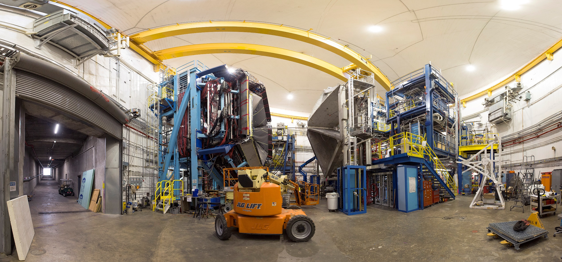
Jefferson Lab’s Experimental Hall B
Lower luminosity, ~1E10³⁵ with a low power dump, but many areas can used for testing.
https://www.eiccenter.org/content/detector-testing-capabilities-hall-b

Slide 28
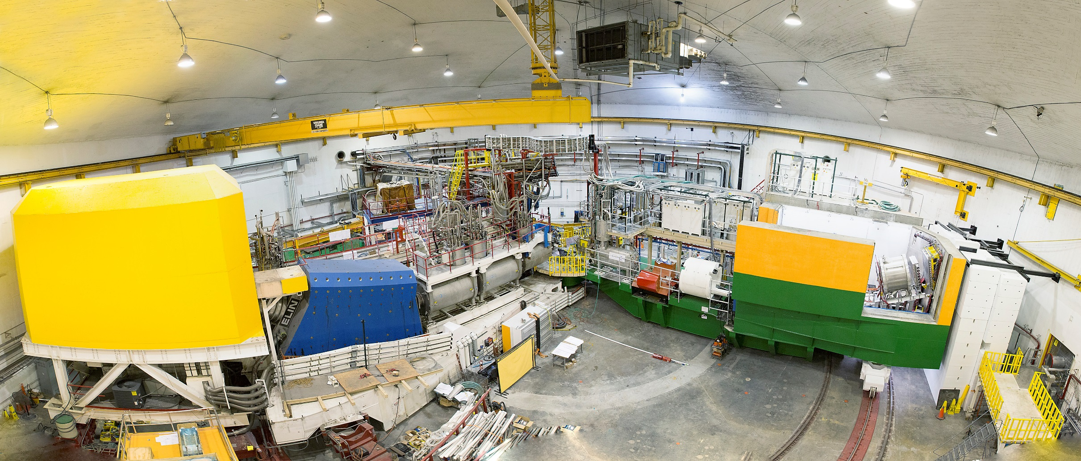
Jefferson Lab’s Experimental Hall C
High luminosity, ~1E10³⁸ , with a high-power dump (1MW).

Slide 29
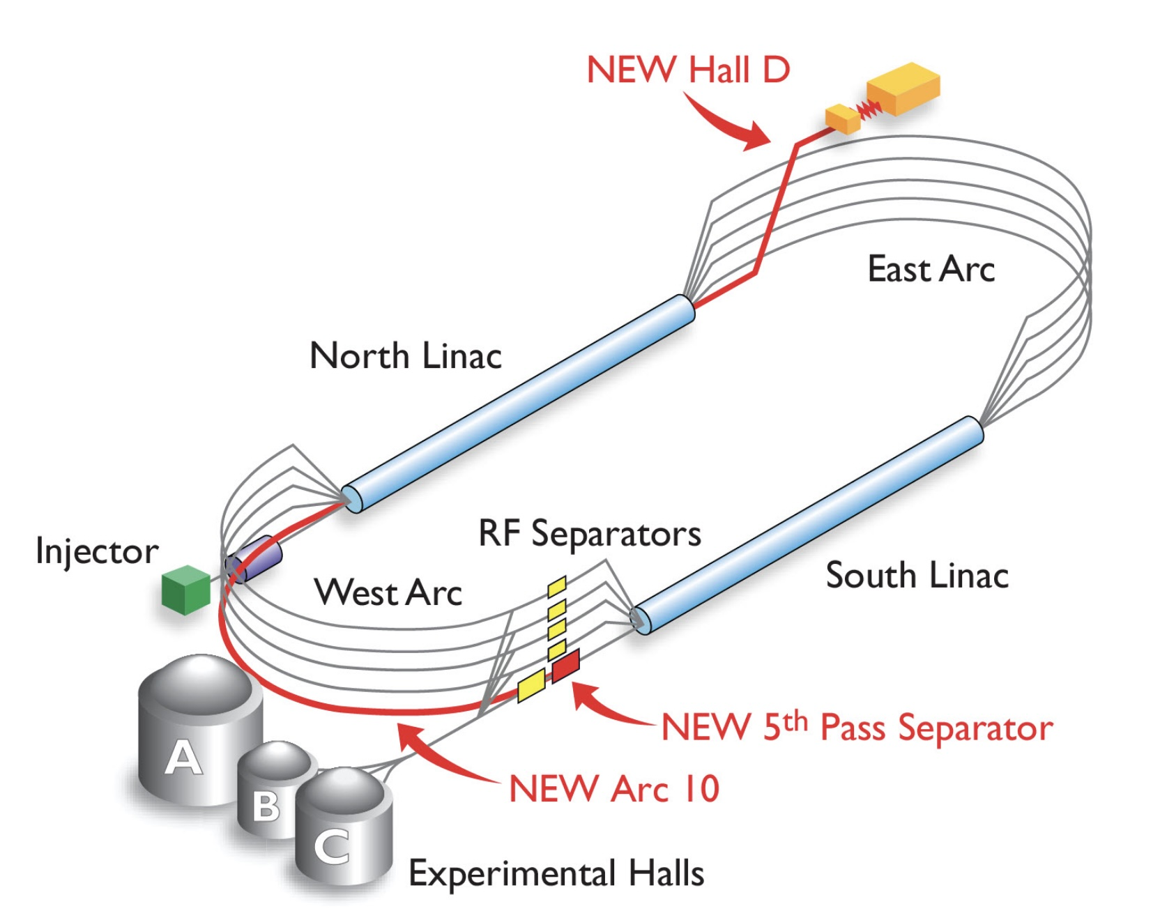

Slide 30
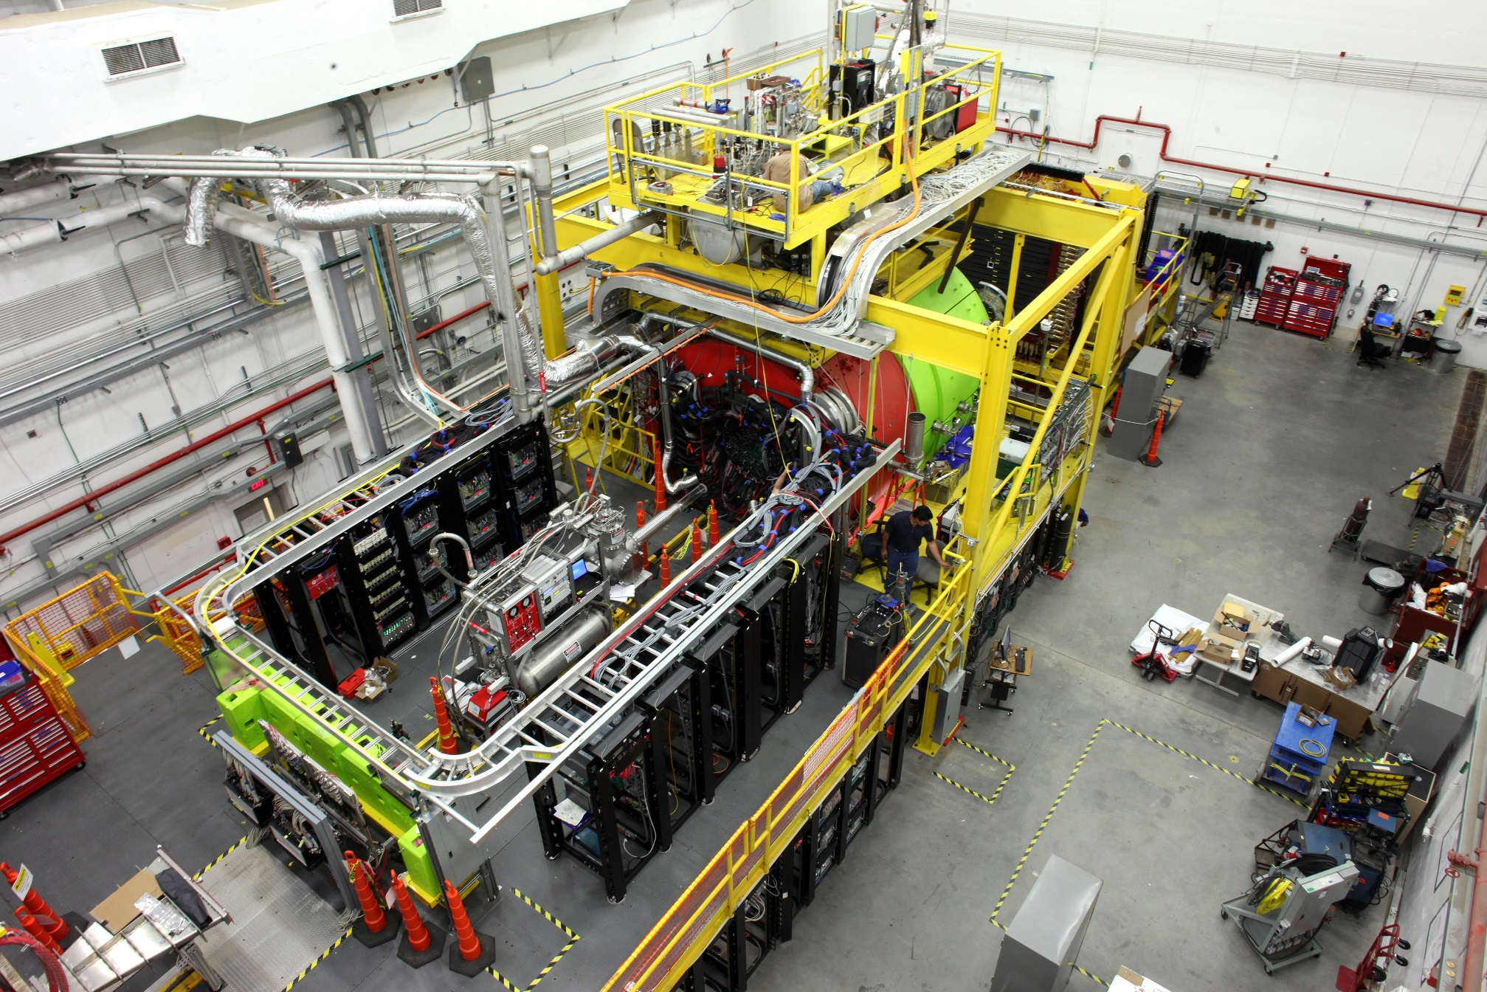
Jefferson Lab’s Experimental Hall D
Real photos into the hall, but also a tagger vault with 12 GeV electrons on a radiator.

Slide 31
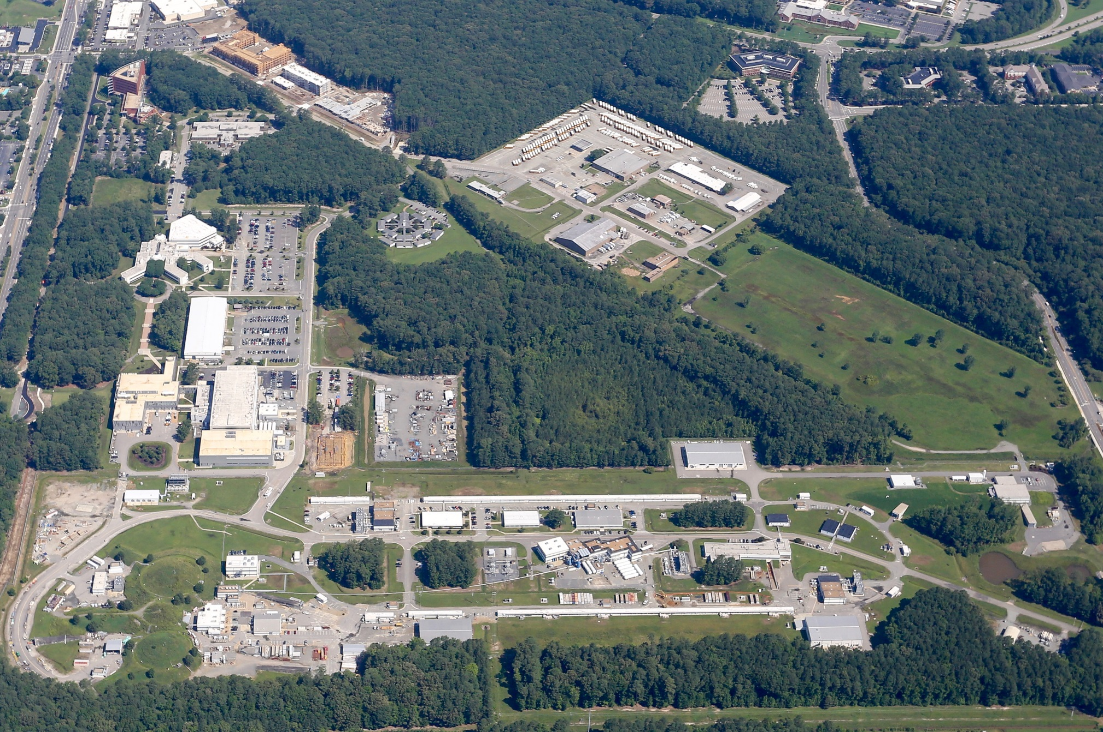
Thomas Jefferson National Accelerator Facility

Slide 32
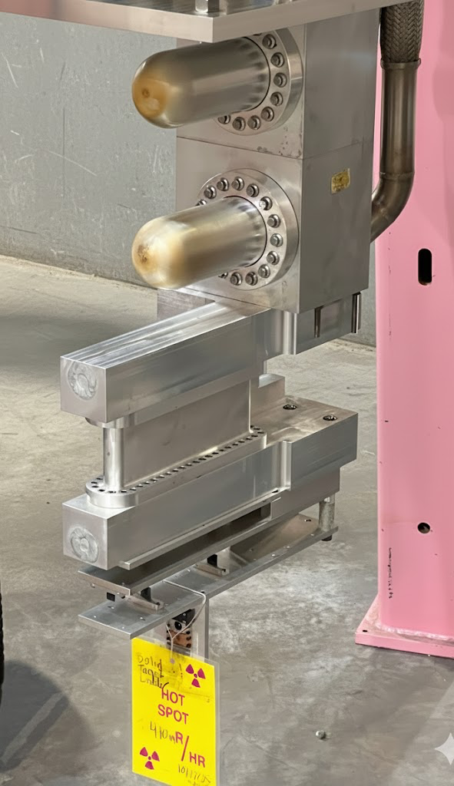
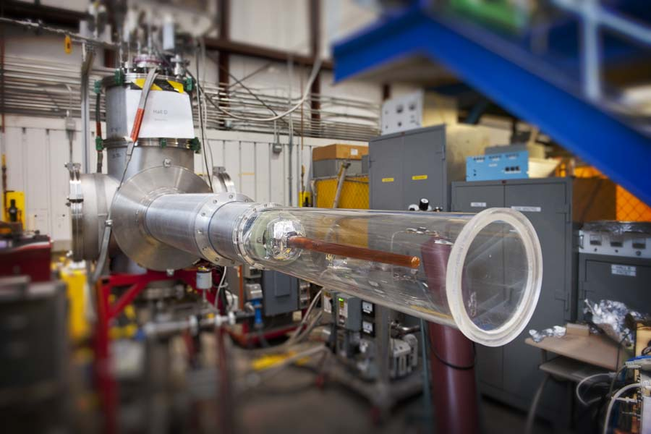
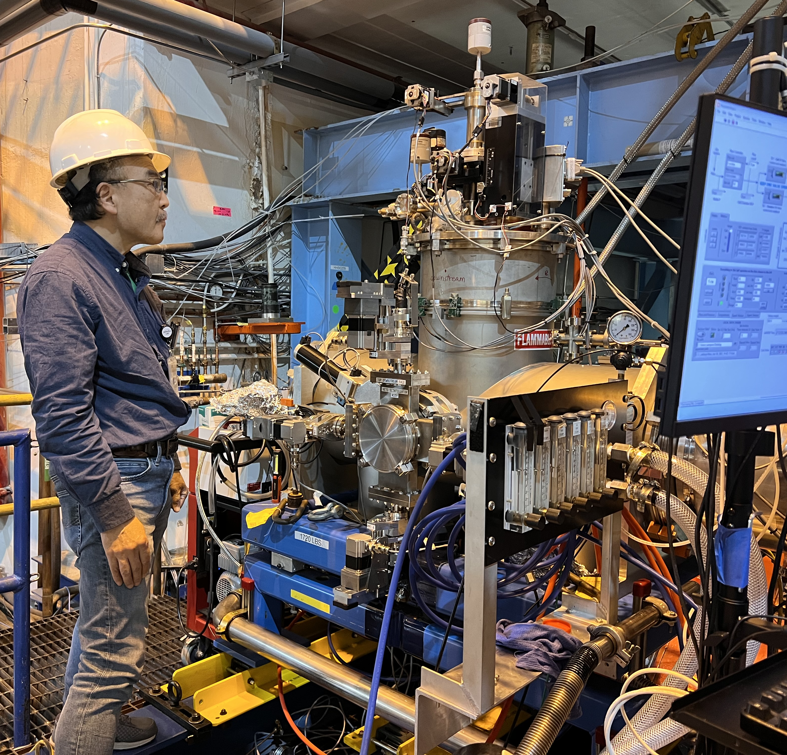
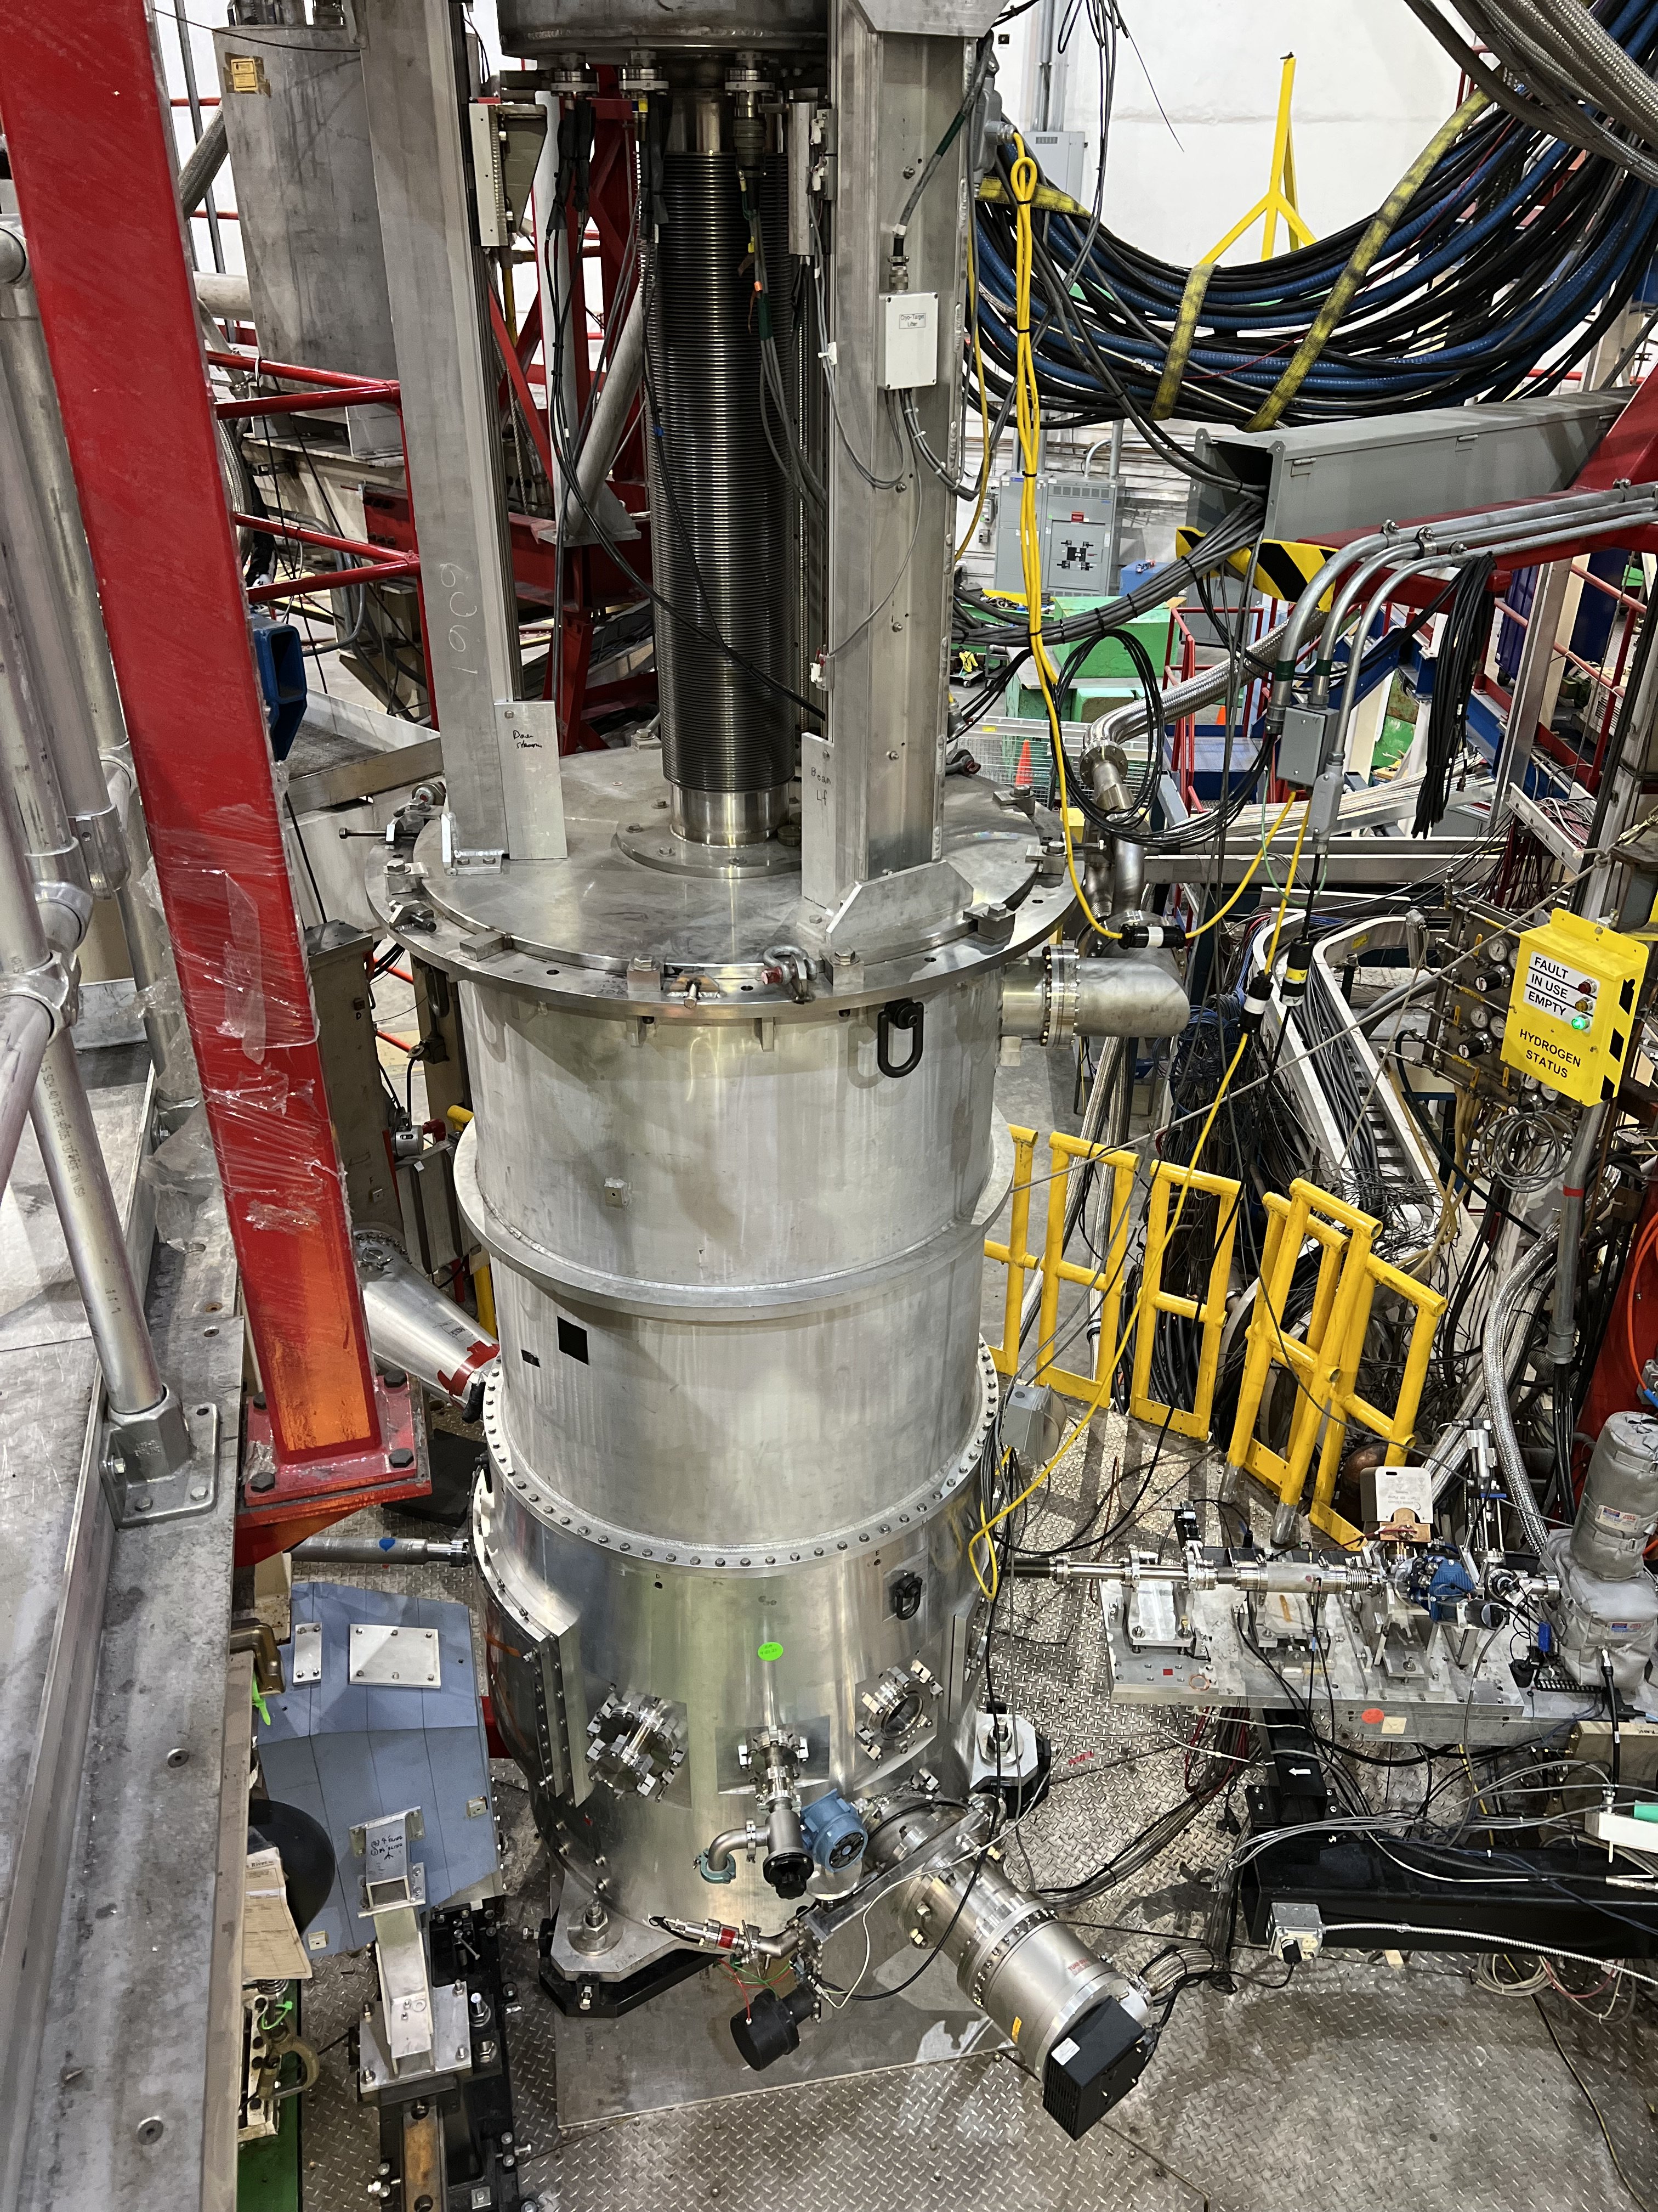
Our Support Groups Are Critical To The Success Of THE CEBAF NP Program
Highlighting here the fixed targets for the FY26 run.
Hall B: PRad-II H2 gas target
Hall C: LH2/LD2 cryotarget
Hall D: GlueX LH2/LD2 cryotarget

Slide 33
CEBAF physics focus: transition from hadronic to partonic degrees of freedom
  Nucleon structure: Precision measurements of form factors and parton distributions reveal how quarks and gluons are arranged and bound.
  Excited states & resonances: Mapping the baryon spectrum tests how QCD confinement generates mass and structure.
  3D imaging of quarks: Generalized Parton Distributions (GPDs) from Deeply Virtual Compton Scattering and meson production give a “tomographic” picture of the nucleon.
  Short-range nuclear forces: Studies of correlated nucleon pairs show how QCD at the quark level translates into the nuclear force.
  Exotic matter: Searches for hybrid mesons and gluonic excitations test predictions of QCD beyond the simple quark model.
  Tests of the Standard Model and Fundamental Symmetries: Precision measurement such as MOLLER making ultra-precise measurements of the electron's weak charge and the weak mixing angle to search for physics beyond the standard model.

Slide 34
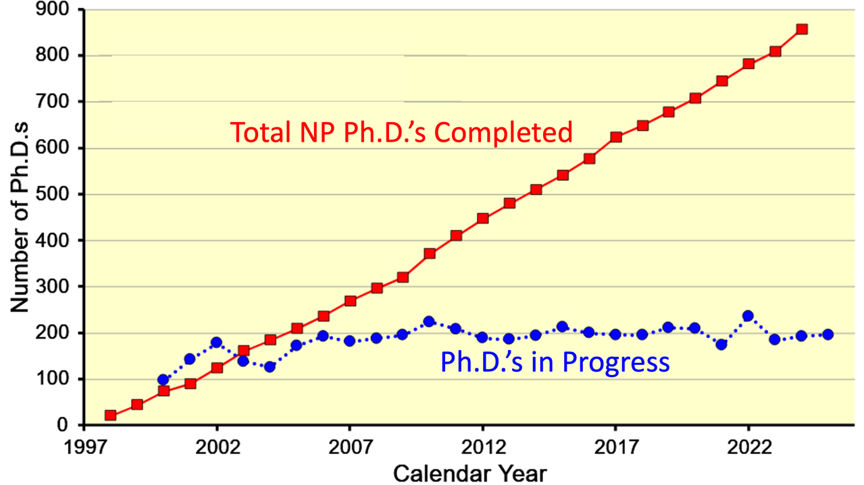
Jefferson Lab Research Used in 1/3 of all U.S. Nuclear Physics Ph.D.’s

Slide 35
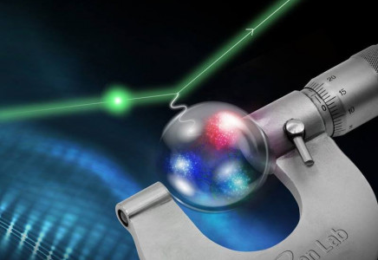
Elastic electron-proton scattering still produces exciting new insights.
PRAD Experiments
Proton Form Factor Experiments
Proton Radius Measurements: 0.831+/-0.014 fm, Xiong et al.,Nature 575, 147 (2019)
Second generation experiment being installed now.

Slide 36
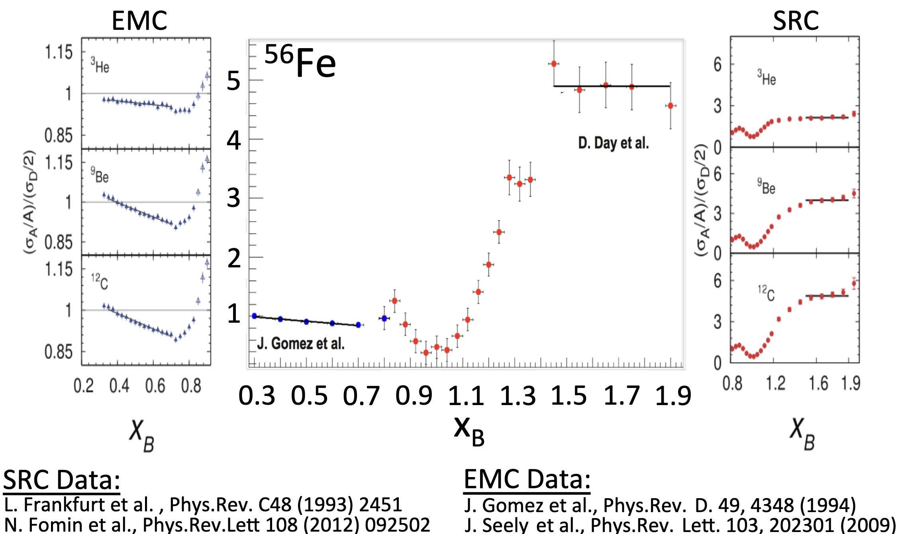

Slide 37
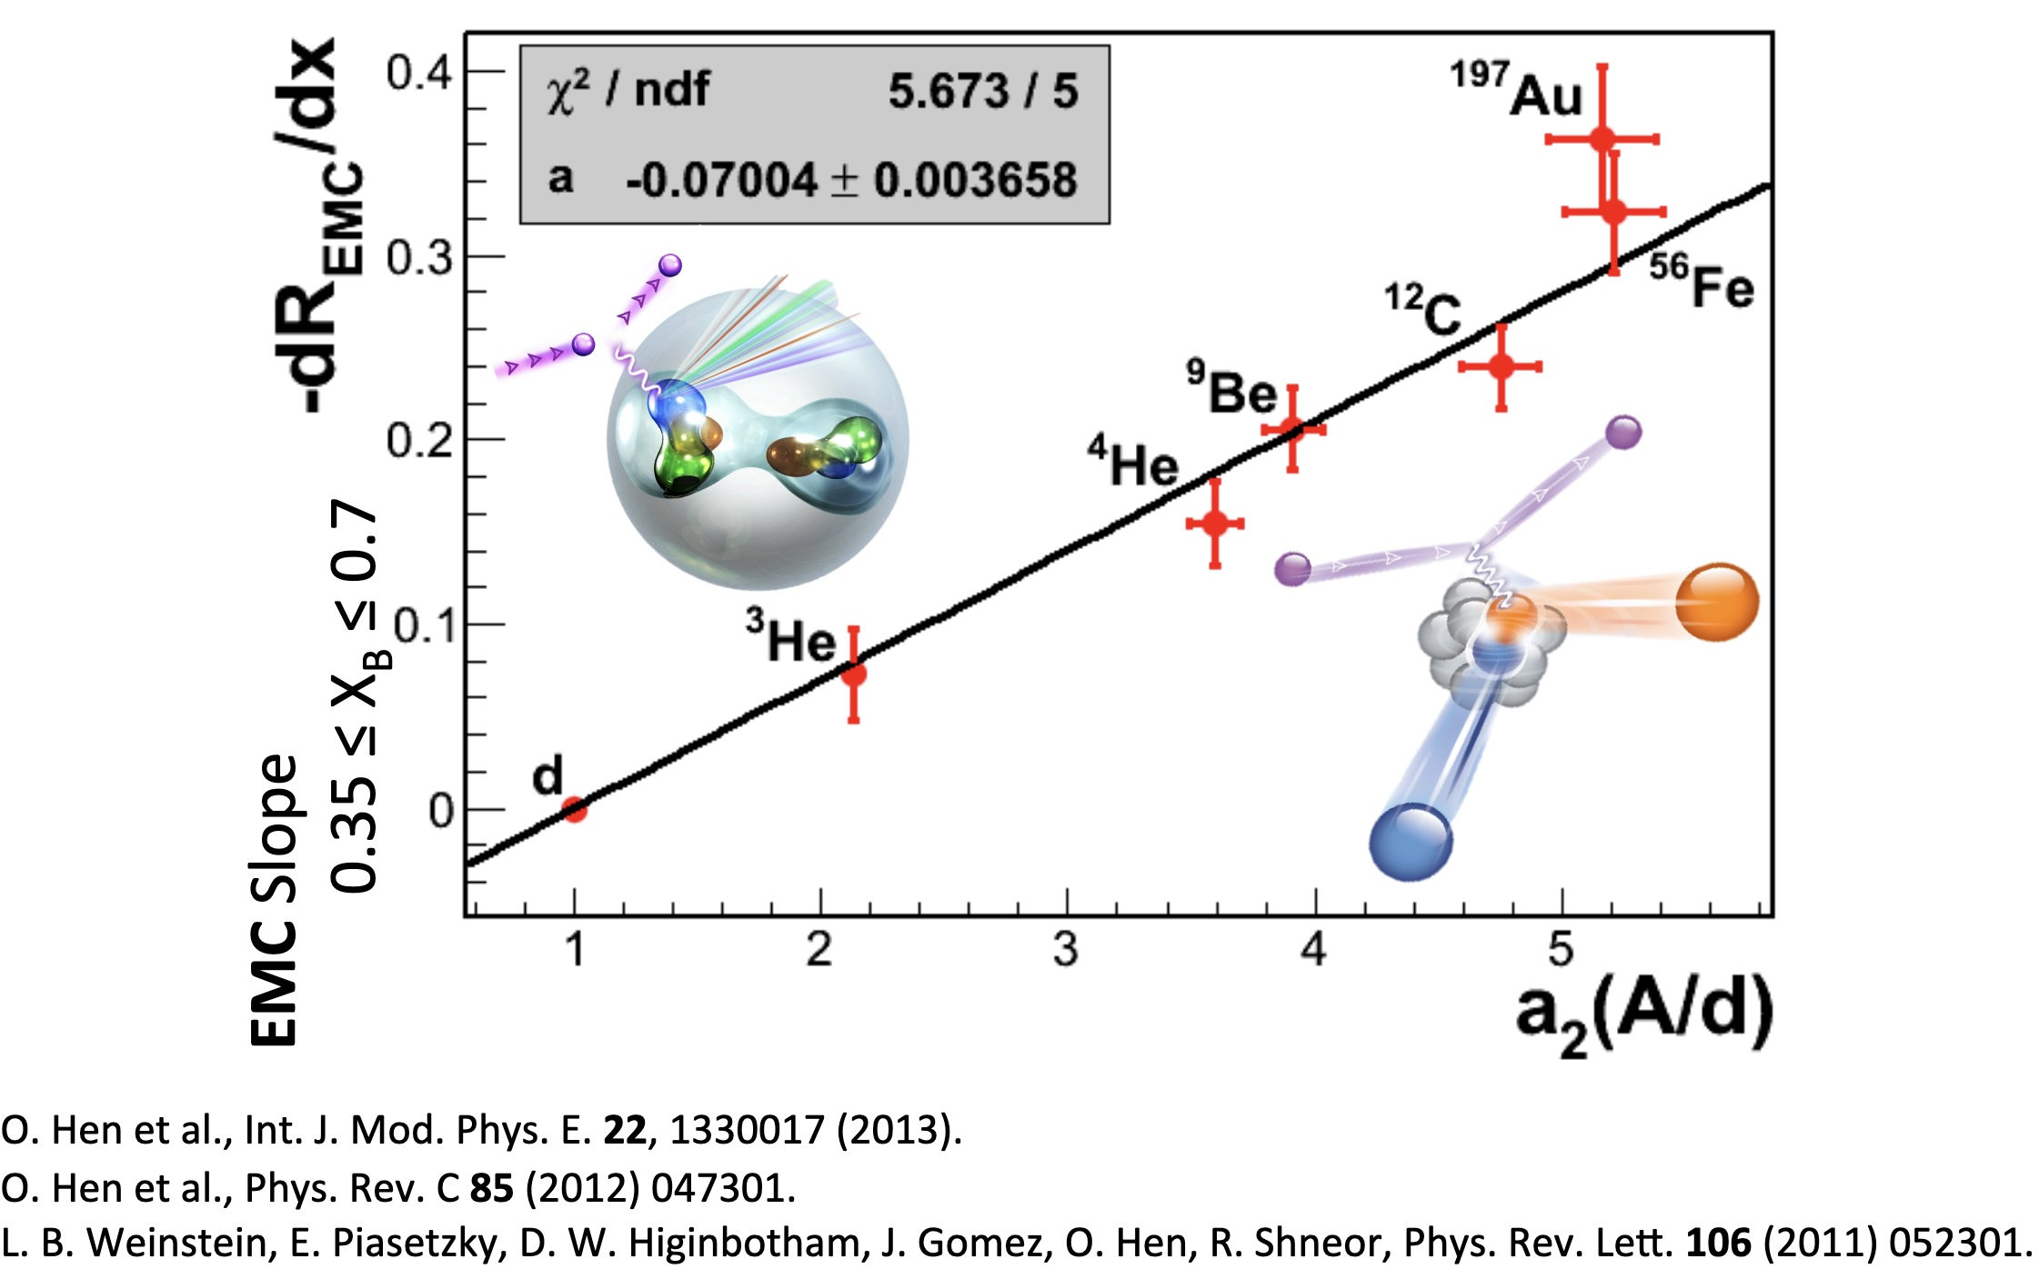

Slide 38
FY25 CEBAF showed outstanding performance with over 85% up time.
Energy of 1060 MeV/linac (up from 1047 MeV/linac in FY24 )
Beam Power > 800 kW
Low Number Beam Trips ( < 10 per hour )
This meant we were able to deliver on the experimental program as well as do the beam studies we need for the future program!
Notes:
Use for: Introducing new topics
To change the photo: Right-click on photo and select change photo

Slide 39
Dear Colleagues,
On behalf of the entire user community, the JLUO Board of Directors extends its gratitude to you, the staff of Jefferson Lab, for the successful CEBAF run completed on Sept. 3. This run significantly advanced the scientific program of the community, with highlights including:
Completion of the GEp run in Hall A, paving the way for the installation of MOLLER
Installation and operation of A Low Energy Recoil Tracker (ALERT) in Hall B and the completion of the four run group experiments
Completion of the Large Acceptance Detector (LAD) experiment in Hall C
Commissioning of a new calorimeter in Hall D and acquiring over 5 petabytes of raw data for the JLab Eta Factory (JEF) and GlueX experiments.
We deeply appreciate being able to call on you as engineers, technicians, machine operators, run coordinators and shift workers at any time, even in the middle of the night, and to have you answer that call with such support and enthusiasm for the scientific mission of the lab. You weren’t deterred by the challenges along the way, whether they were caused by the high-water table, the Virginia summertime heat or simply a curious snake!
Congratulations to you for setting a CEBAF reliability record in the 12 GeV era and doing so while operating at higher beam energy and current than in years past. We look forward to continuing to work together to pursue the ambitious future nuclear physics program that draws us to Jefferson Lab from institutions around the world.
With Sincere Thanks,
The Jefferson Lab Users Organization Board of Directors

Slide 40
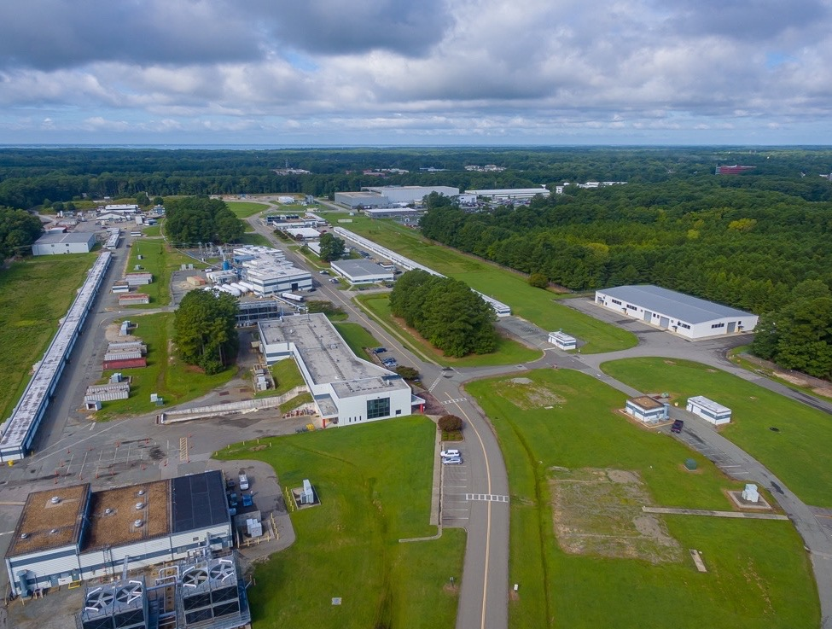
FY26 CEBAF Run Plan
Running Halls B, C and D
Part 1: Special 345 MeV/linac Run
  Hall B PRad-II ( large installation experiment )
  Hall C Low energy Cryo-target experiments
  Hall D special low energy GlueX experiment
Two Weeks To Re-scale the Machine
Part 2: Back to 1060MeV/linac
  Hall B High energy part of PRad-II then X17
  Hall C High energy cryo-target experiments
  Hall D Complete the GlueX-II / JEF experiment
Notes:
Guidelines: 6-8 bullets per slide; Use sentence fragments for bullets
To change the photo: Right-click on photo and select change photo

Slide 41
CEBAF Experimental Program For FY26
Hall B
E12-20-004: PRad-II (Contact: A. Gasparian (NCSU), D. Dutta (MS), H. Gao (Due), N. Liyanage (UVA), E. Pasyuk(JLab), C. Peng (ANL). W. Xiong (Shandong), and DWH (JLab))
E12-21-003: X17 Boson Search: (Contact: A. Gasparian (NCSU), D. Dutta (MS), H. Gao (Due), T. Hague (JLab), N. Liyanage (UVA), R. Paremuzyan(JLab), C. Peng (ANL). W. Xiong (Shandong))
Hall C
E12-22-001: N-> Delta (Contact: N. Sparveris (Temple), H. Atac (Temple), A. Camsonne(JLab), M. Jones(JLab), and M. Paolone (NMS)
E12-23-001: VCS (Contact: N. Sparveris (Temple), H. Atac (Temple), A. Camsonne(JLab), M. Jones(JLab) and M Paolone (NMS)
E12-24-001: Nuclear-R SIDIS (Contact: D. Gaskell (JLab), P. Bosted(W&M), W. Brooks (Fed. ST. Maria), R. Ent(JLab), E. Kinney(UC), and H. Mkrtchyan (Yerevan))
E12-06-104: Nucleon R SIDIS (Contact: R. Ent(JLab), P. Bosted(W&M), E.Kinny(UC) and H. Mkrtchyan(Yerevan))
E12-06-107: Color Transparency Search (Contact H. Vance(FIU/ODU/JLab), C. Gayoso(W&M), and D. Dutta(MS))
Hall D
E12-25-005: GlueX with a 1-4 GeV Photon Beam ( contact: M. Dalton(JLab) & F. Afzal (JLab), V. Crude (FSU), P. Hurck (UB), I. Jeagle (ODU), and A. Thiel (UG) )
E12-12-002: GlueX-II (Contact: C. Meyer (CMU) and M. Shepherd (IU))
E12-12-002A: Jefferson Lab Eta Factor (JEF) (Contact: L. Gan (UNCW) & Z. Papandreou, A. Somov(JLab), and S. Tayler(JLab))

Slide 42
Overview of the Science program of the next 5 years:
Hall A MOLLER Experiment will be completed, and Hall A will start the transition to the next large-scale experiment.
Hall B will complete a number of high impact run group experiments and start running the transversely polarized target SIDIS program.
Hall C will install and run the A-rated Hypernuclear experiments and once that is complete start the Tensor polarized deuteron experiments.
Hall D will run the A-rated GlueX-III & the 2nd generation real photon SRC experiments and then install & run the K-Long experiment.

Slide 43
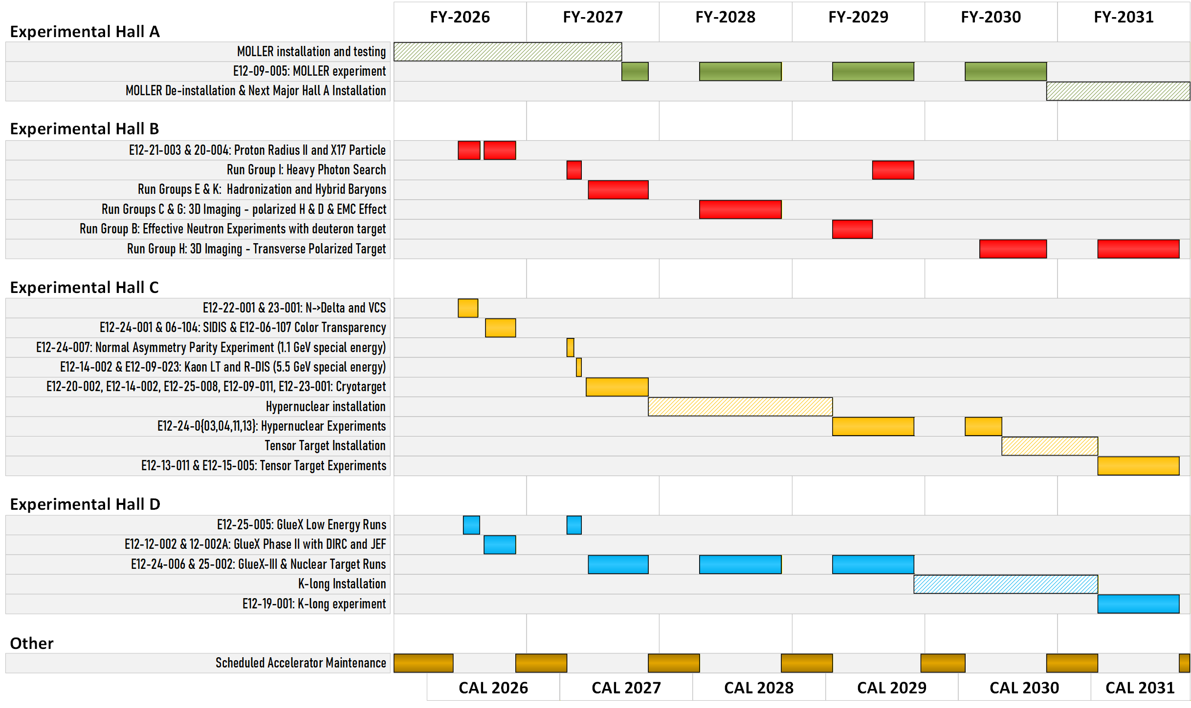
Five year look ahead

Slide 44
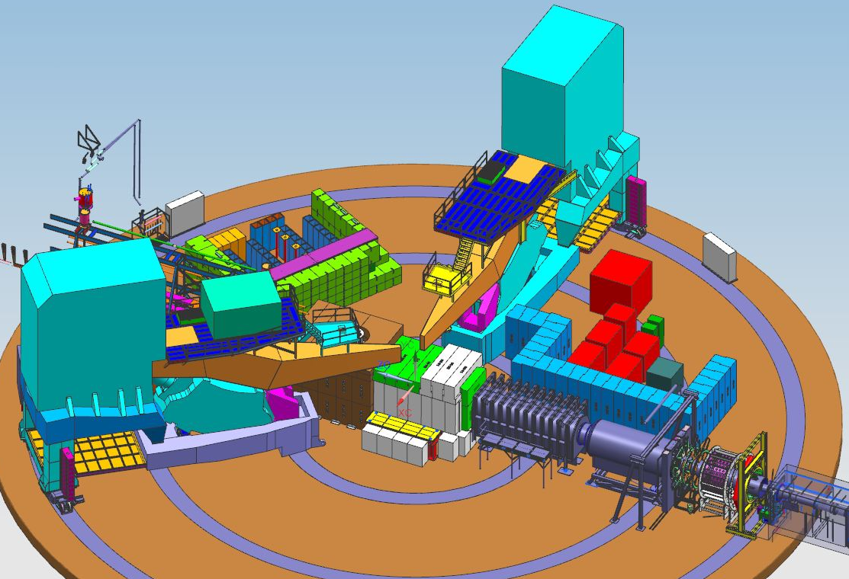
MOLLER experiment probes BSM in the multi-TeV range through Parity Violation
Installation of this experiment is going on in experimental hall A.

Slide 45
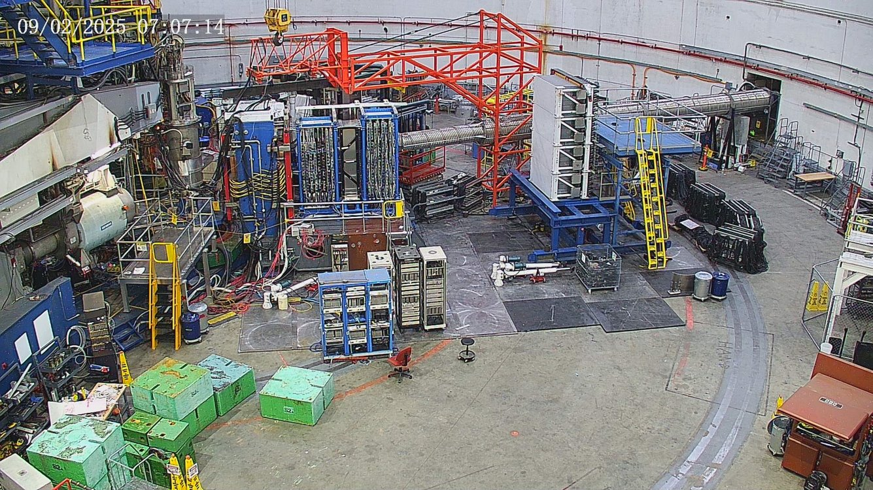
Experimental Hall A Setup for the SBS Experiment 2 Sept. 2025

Slide 46
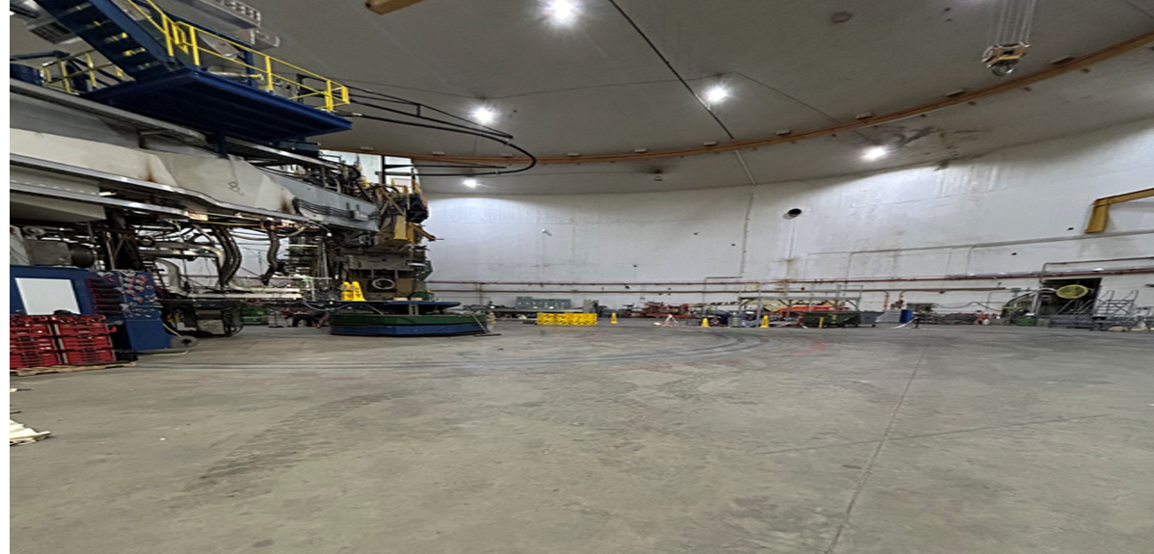
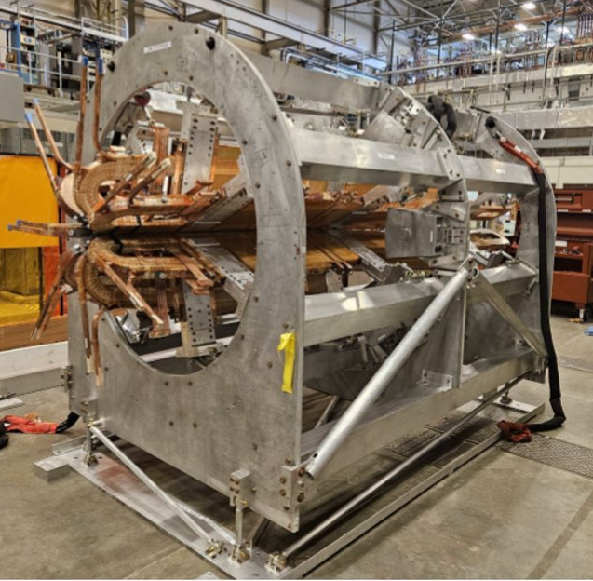
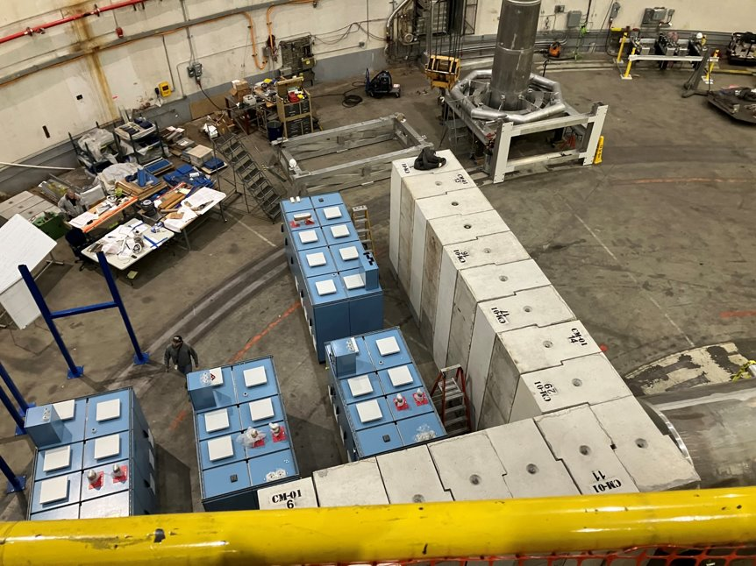
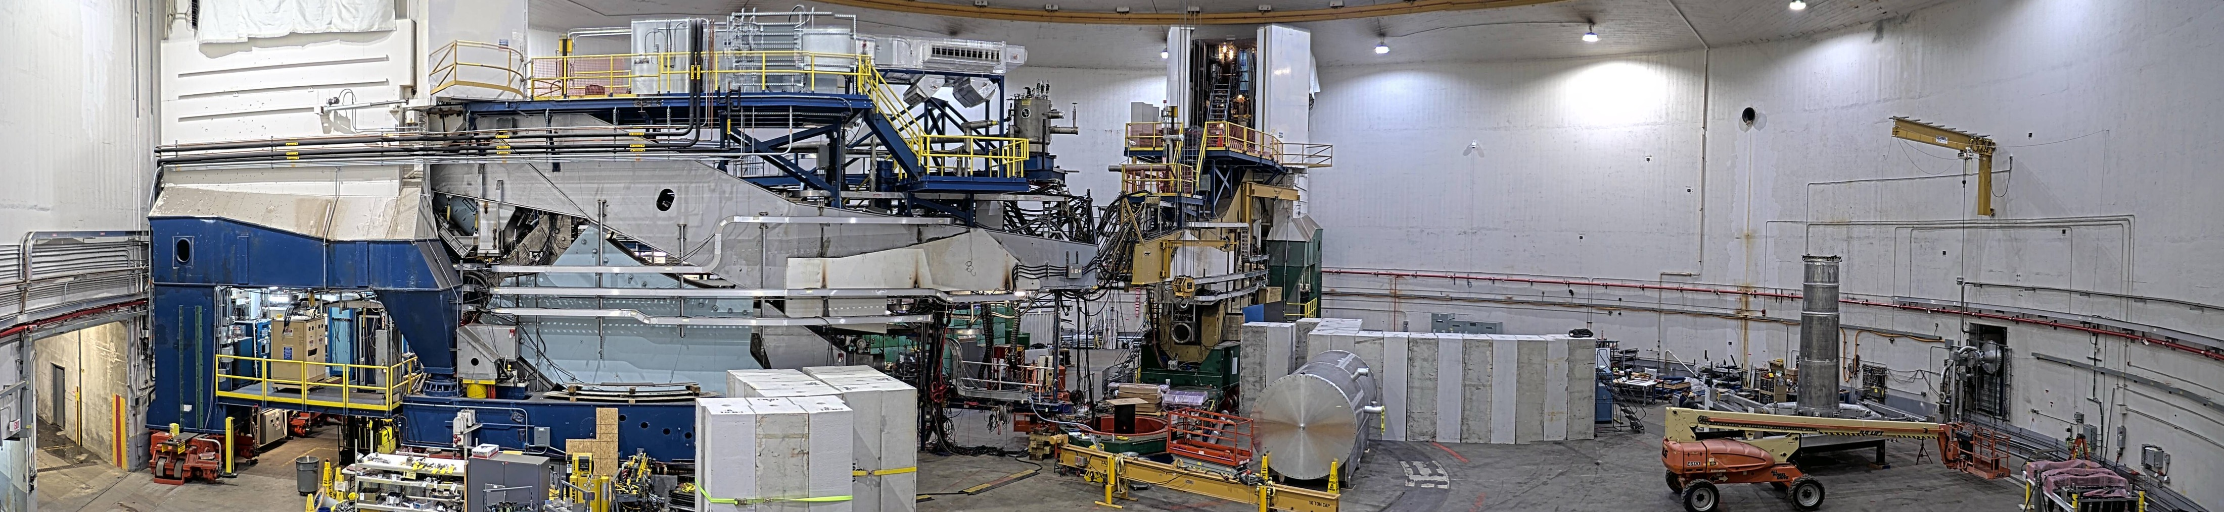
MOLLER Assembly in Hall A Now Well Underway
Hall A After SBS Removal
New Magnet (TM4) In Test Lab
New Power Supplies
Panoramic photo of the Hall A Moller installation take on 15 March 2026.

Slide 47
This has been a rough year at JLab with lots of uncertainty
  Government Shutdown with Possible Furloughs
  January 22nd the lab’s workforce was reduced
  March 31st the new M&O contractor was named with June 1st SURATech will start running the lab.
Genesis / American Science cloud are a new direction for DOE but one that is very like to be a big part of the department for the foreseeable future.
Top priority for physics division is to run the experimental program while also delivering on our DOE 413.3B project commitments to MOLLER and EIC.
But the goal going forward will be to grow Jefferson Lab into a multi-program and multi-mission lab.

Slide 48
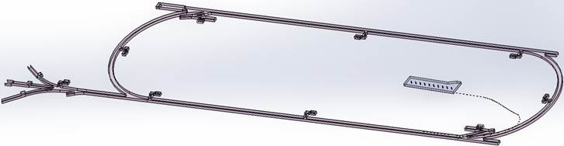
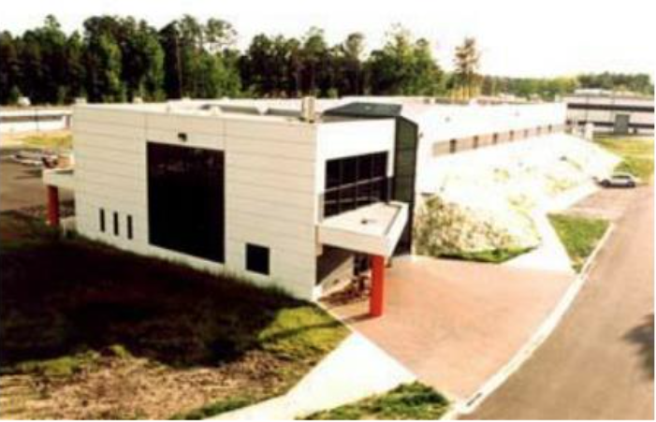
Low Energy Recirculator Facility (LEFRF) As The New Injector Facility for CEBAF
123 MeV e+
(650 MeV e-)
Inject e⁺ into North Linac to usual 12 GeV (w/ magnets reversed)
Build e⁺ injector at the LERF
Build new LERF to CEBAF tunnel
123 MeV e+
(650 MeV e-)
Build new transport line along South Linac and West Arc
48

Slide 49
Program Advisory Committee Positron Approved Experiments
NUMBER | TITLE | CONTACT PERSON | HALL | DAYS REQUESTED | DAYS AWARDED | SCIENTIFIC RATING | PAC DECISION
PR12+23-002 | Beam Charge Asymmetries for Deeply Virtual Compton Scattering on the Proton at CLAS12 | Eric Voutier | B | 100 | 100 | A- | C1
PR12+23-003 | Measurement of Deep Inelastic Scattering from Nuclei with Electron and Positron Beams to Constrain the Impact of Coulomb Corrections in DIS | Dave Gaskell | C | 9.3 | 9.3 | A- | C1
PR12+23-005 | A Dark Photon Search with a JLab positron beam | Bogdan Wojtsekhowski | B | 60 | 55 | A- | C1
PR12+23-006 | Deeply Virtual Compton Scattering using a positron beam in Hall C | Carlos Munoz Camacho | C | 137 | 137 | A- | C1
PR12+23-008 | A Direct Measurement of Hard Two-Photon Exchange with Electrons and Positrons at CLAS12 | Axel Schmidt | B | 55 | 55 | A | C1
PR12+23-012 | A measurement of two-photon exchange in unpolarized elastic positron–proton and electron–proton scattering | Michael Nycz | C | 56 | 56 | A- | C1
C1 = Conditionally Approved w/Technical Review by the Lab
49

Slide 50
Summary & Outlook
The Thomas Jefferson National Accelerator Facility ( Jefferson Lab ) is one of the Department of Energy’s seventeen national labs and hosts the CEBAF user facility.
Presently able to run up to four experimental halls simultaneously with highly polarized electron beams with energies up to 11 GeV to halls A, B, and C and 12 GeV to hall D.
March 31st the new M&O for Jefferson Lab was named and the transition to SURATech will be completed June 1st.
Presently running experiments in halls B, C and D while we complete the MOLLER installation experimental Hall A. You all will get to visit Hall A this Friday!
The laboratory is starting the transition from a single sponsor lab (DOE nuclear physics) to a multiple program lab with the addition of a HPDF (high performance data facility) with Advanced Scientific Computing Research (ASCR) funding.

