Slide 1
Hypernuclear Target System
David Meekins
Hall C Hypernuclear Experimental Readiness Review
June 4, 2026

Slide 2
Overview
Conceptual design
  Overall view
  Design concept
  Ladder design
  Thermal analysis of key targets
Target Project
  Costs
  Resources required

Slide 3

Major Design Elements
Vacuum System
  Chamber
  Load lock
  Stand
  Pumping systems
Cold Ladder
  Cryo interface
  Ladder
  Motion system
  Solid targets
Cryo system
  Transfer can
  Small flex T-lines
  Large supply and return T-lines with control valves
Instrumentation and controls
  Interlocks/FSD
  Software
  Instrumentation
  Breakout boxes etc.

Slide 4
Target Position in Hall C
Target is 6.57 m downstream from nominal pivot.
J. Shiflett
Units are (cm)

Slide 5
Hall C HKS Layout
Target

Slide 6

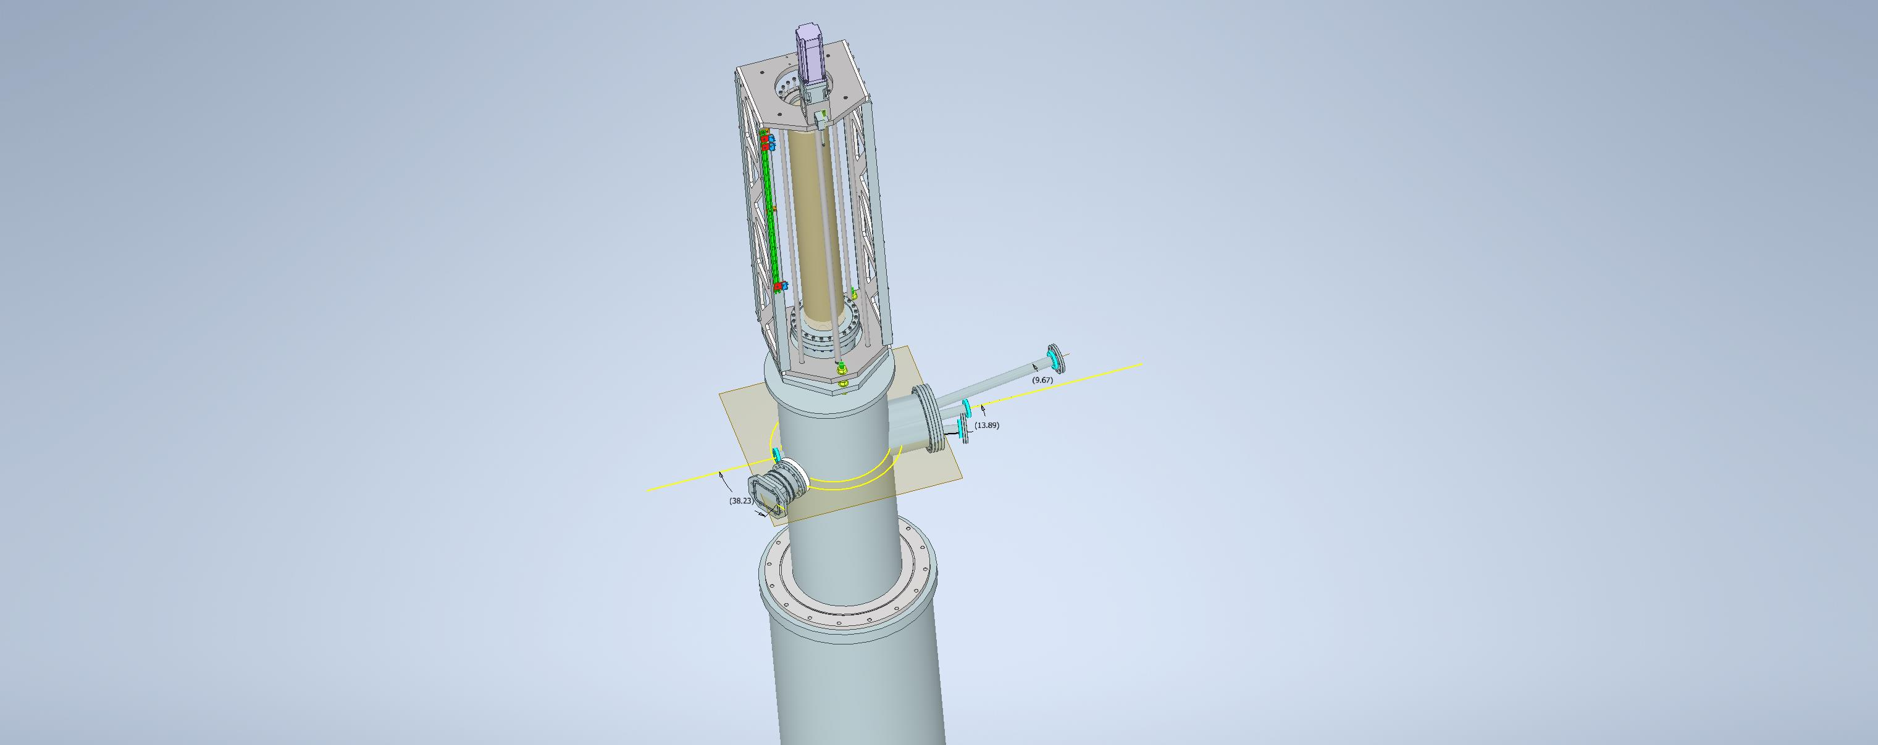
HKS Target Concept
Motion system
HES (10 deg)
Proposed load lock
Scattering Chamber
(norm beam height)
Beam
HKS 14 deg
Scattering Chamber support
Enge

Slide 7
Scattering Chamber Requirements
5 Connections to various vacuum spaces
  Up/Down stream beamline
  Each Spectrometer
  All but one of these must be flexible connections
    ENGE shall be fixed
Load lock feature is needed
  Allow full vacuum isolation from beamline and spectrometers
  Provide easy access to the chamber for loading sensitive targets - Ca,Li, and LiH
  Small volume for rapid pump down - Limit exposure time to sensitive targets
Additional alignment fixture will need to be included
  Chamber is fixed to ENGE.
  Target alignment requirements driving the need for this subsystem

Slide 8
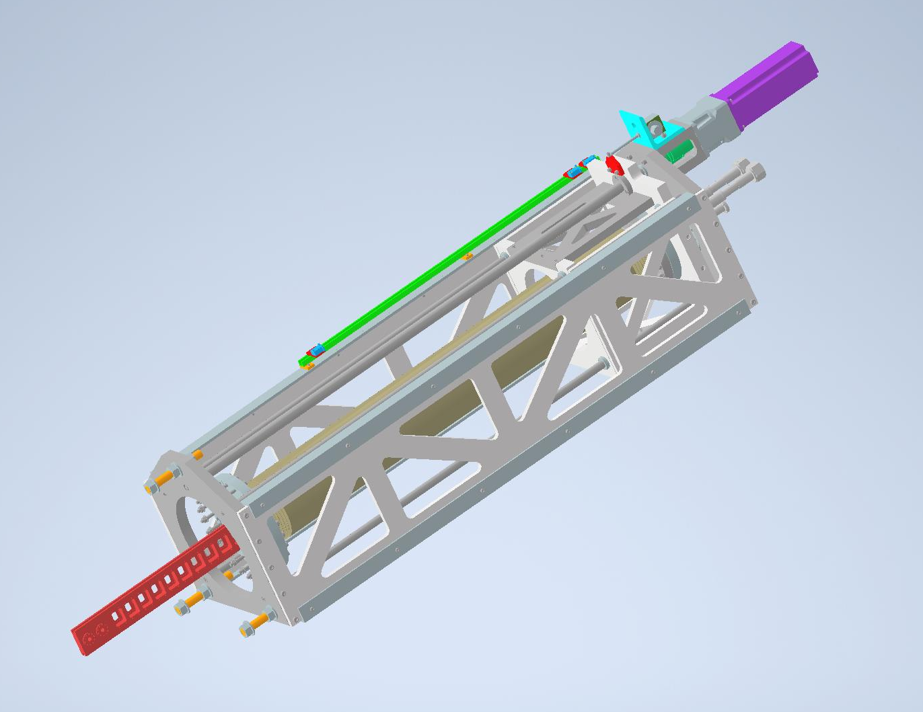
Motion System and Ladder
Develop new motion system with travel through load lock feature to handle O2 sensitive targets.
  Travel requirement is extended to more than 30 inches with load lock/alignment components
  This is additional expense and design/fab challenge
Simple linear motion design for moving the target along the beam-y axis only
Feedthru for cryogenic lines and thermometry
Base model will be developed from PREX system

Slide 9

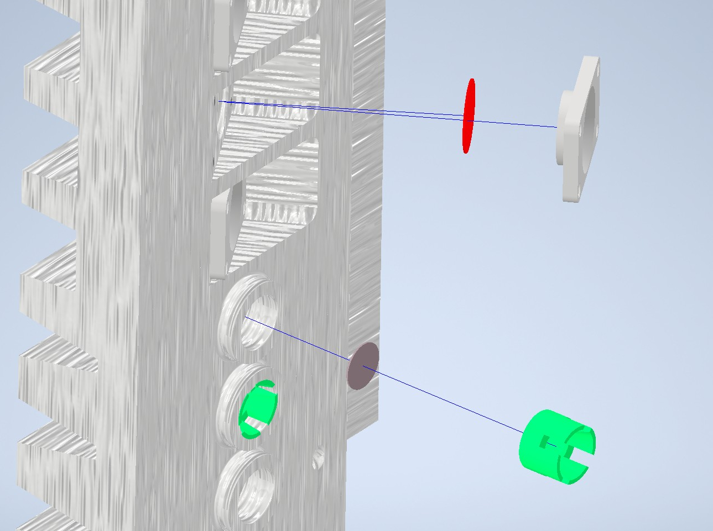
Cold Ladder Concept
Cryogenic ladder to carry full list of solid targets
Accommodates both 0 deg and 30 deg targets
Provides protection for sensitive/high value targets
Cartridge feature should allow for quick loading of oxygen sensitive targets
Fabricated from aluminum with copper cooling lines
Upstream face
Downstream face

Slide 10
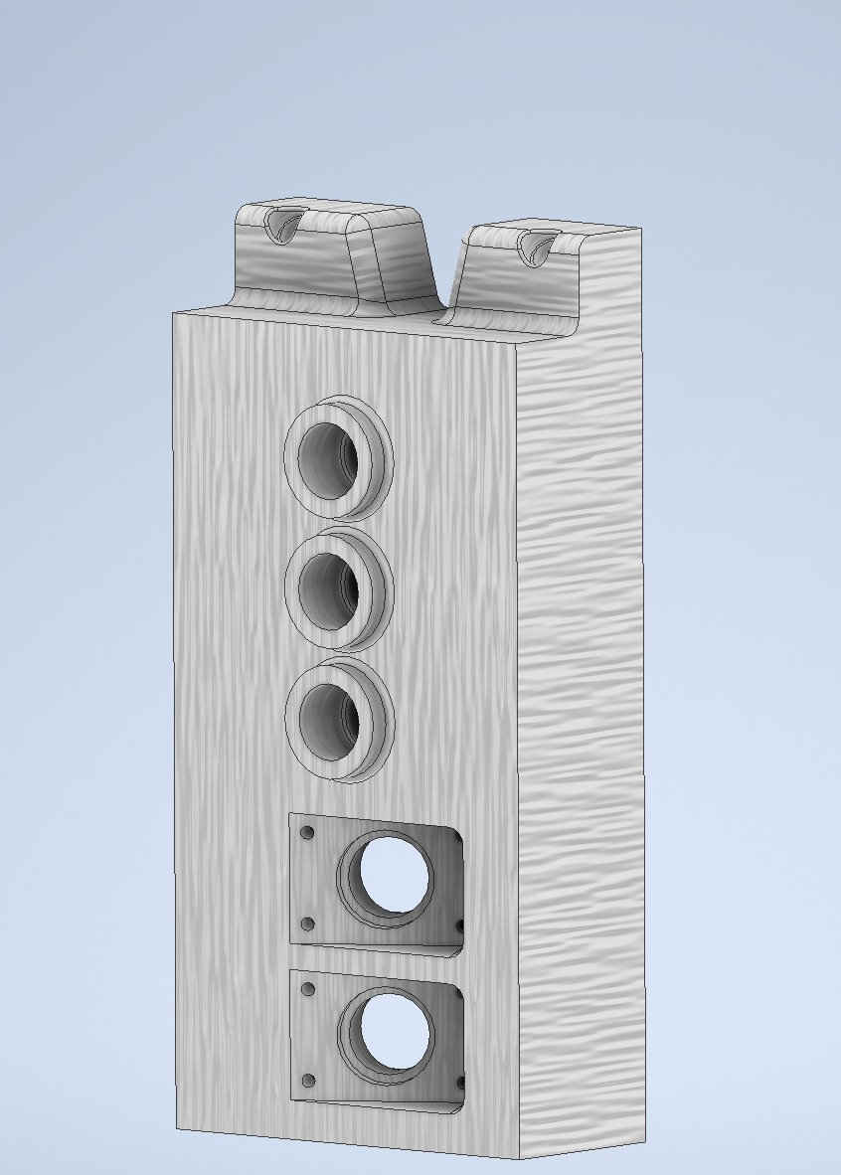
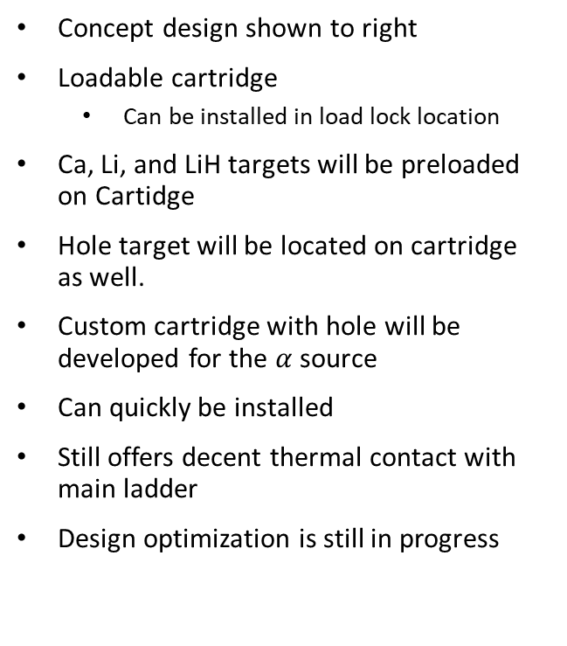
Loadable Cartridge
Concept design shown to right
Loadable cartridge
  Can be installed in load lock location
Ca, Li, and LiH targets will be preloaded on Cartidge
Hole target will be located on cartridge as well.
Custom cartridge with hole will be developed for the $α$source
Can quickly be installed
Still offers decent thermal contact with main ladder
Design optimization is still in progress
Locating Notch
High power target
Ca40 and Ca48
30 deg target
Downstream Face

Slide 11

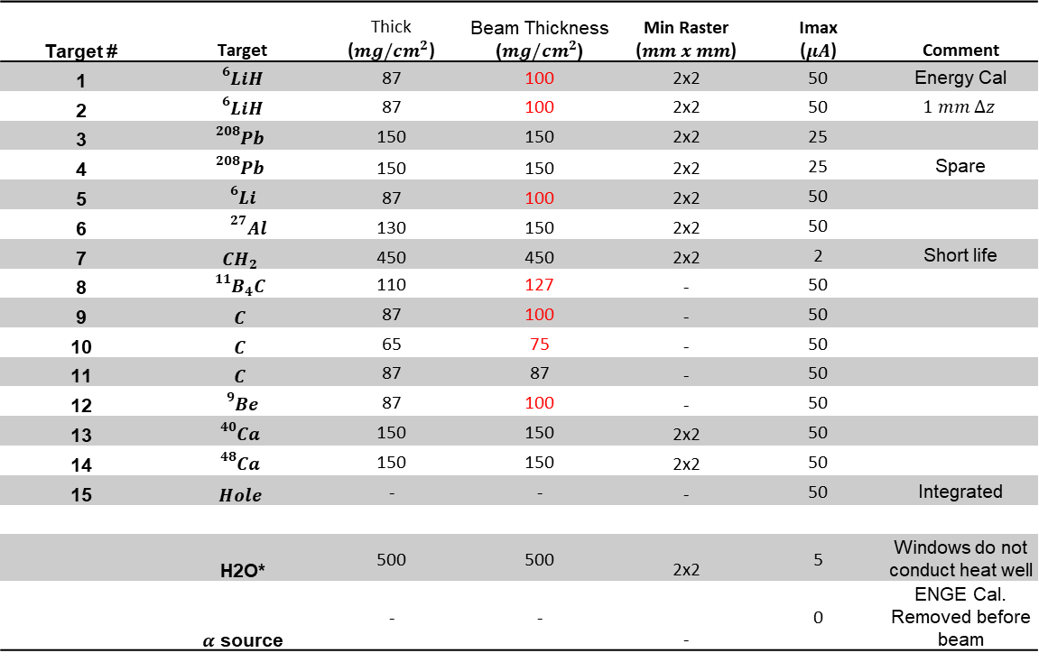
Solid Targets
Target # | Target | Thick ($mg/cm^{2}$) | Beam Thickness ($mg/cm^{2}$) | Min Raster ($mm x mm$) | Imax ($μA$) | Comment
1 | $${}_{}^{6}LiH$$ | 87 | 100 | 2x2 | 50 | Energy Cal
2 | $${}_{}^{6}LiH$$ | 87 | 100 | 2x2 | 50 | $$1 mm Δz$$
3 | $${}_{}^{208}{Pb}$$ | 150 | 150 | 2x2 | 25
4 | $${}_{}^{208}{Pb}$$ | 150 | 150 | 2x2 | 25 | Spare
5 | $${}_{}^{6}Li$$ | 87 | 100 | 2x2 | 50
6 | $${}^{27}Al$$ | 130 | 150 | 2x2 | 50
7 | $$CH_{2}$$ | 450 | 450 | 2x2 | 2 | Short life
8 | $${}_{}^{11}{B_{4}C}$$ | 110 | 127 | - | 50
9 | $$C$$ | 87 | 100 | - | 50
10 | $$C$$ | 65 | 75 | - | 50
11 | $$C$$ | 87 | 87 | - | 50
12 | $${}_{}^{9}{Be}$$ | 87 | 100 | - | 50
13 | $${}_{}^{40}{Ca}$$ | 150 | 150 | 2x2 | 50
14 | $${}_{}^{48}{Ca}$$ | 150 | 150 | 2x2 | 50
15 | $$Hole$$ | - | - | - | 50 | Integrated
 | H2O* | 500 | 500 | 2x2 | 5 | Windows do not conduct heat well
 | $α$ source | - | - | - | 0 | ENGE Cal. Removed before beam
* H2O cell backup for LiH
Rotated ${30}^{o}$

Slide 12
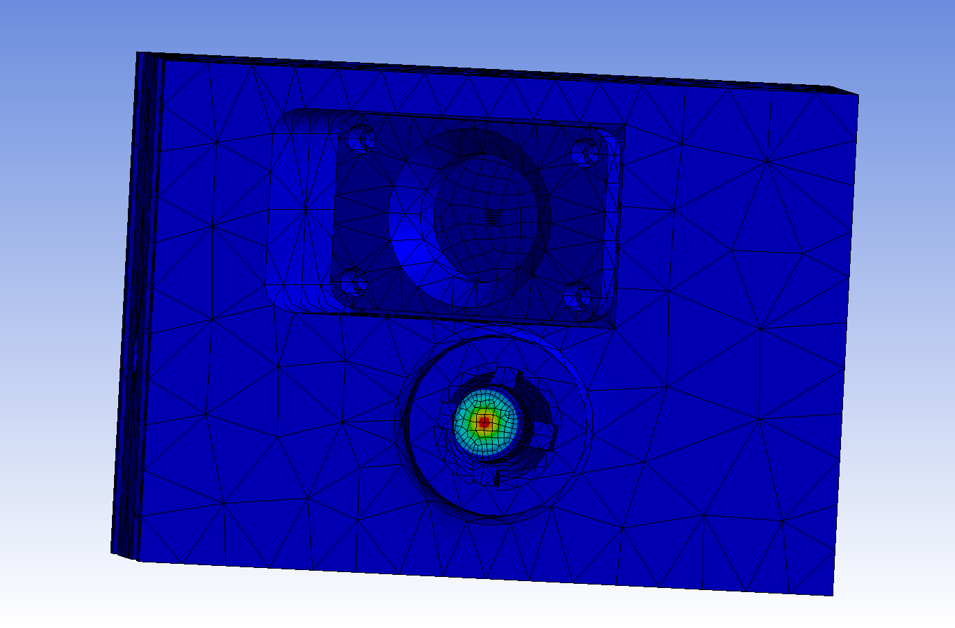
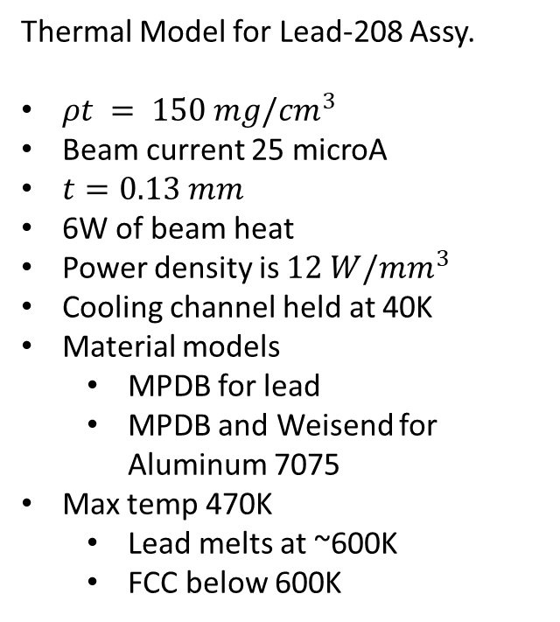
Thermal Model for Lead-208 Assy.
$ρt = 150 mg/{cm}^{3}$
Beam current 25 microA
$t=0.13 mm$
6W of beam heat
Power density is $12 W/mm^{3}$
Cooling channel held at 40K
Material models
  MPDB for lead
  MPDB and Weisend for Aluminum 7075
Max temp 470K
  Lead melts at ~600K
  FCC below 600K
Held at 40K in cooling channel

Slide 13
Labor Resources Required to Fabricate
Name | Remaining Work
DA | 507.81 hrs
ENG | 426 hrs
Designer | 376 hrs
Vacuum Tech | 475.33 hrs
Cryo Tech | 96 hrs
Pipe fitter | 139.33 hrs
Software | 504 hrs
Welder | 328 hrs
Aluminum welder | 8 hrs
Material Handler | 307.33 hrs
Assembly Tech | 189.33 hrs
Machinist tech | 356 hrs
Electronics Tech | 616.19 hrs
Electrician | 214.67 hrs
Tech Rep | 80 hrs
Labor breakdown

Slide 14
Cost Estimate
Cost Breakdown
Name | Remaining Cost | Cost2
HKS Target System | $866,266.13 | $523,500.00
Vacuum System | $152,440.00 | $109,500.00
Cold target ladder | $395,360.00 | $314,000.00
Transfer can and T-lines | $50,760.00 | $15,000.00
Instrumentation/Controls | $141,369.47 | $35,000.00
Assembly Installation | $126,336.67 | $50,000.00
H2O cell/ladder | ++ $106,000.00 | ++ $50,000.00
Solid target materials $250K

Slide 15
Target Group Skill Matrix
 | Group Member
Skill | D. Akers | J. Brock | C. Carlin | C. Flanagan | D. Griffith | M. Hoegerl | P. Hood | T. Kagawa | C. Keith | H. Lu | S. Madlock | J. Maxwell | D. Meekins | J. Thorton | D. Williams
Assembly Tech |  | √ |  | √ | √ | √ | √ |  | √ | √ | √ |  | √ | √ | √
Cryo Tech |  | √ |  |  |  |  | √ |  | √ |  | √ |  | √
DA | √ |  |  |  |  |  |  |  |  |  |  |  | √
Designer | √ | √ |  | √ |  |  |  |  |  | √ |  |  | √
Electrician |  |  |  |  | √
Electronics Tech |  | √ | √ |  | √ |  |  |  | √ |  |  |  | √ | √
ENG | √ | √ |  |  |  |  |  |  | √ |  |  |  | √
Machinist tech |  | √ |  |  |  | √ | √ |  |  |  | √ |  | √ |  | √
Material Handler |  | √ |  |  |  | √ | √ |  |  |  | √ |  | √ |  | √
Pipe fitter |  | √ |  |  |  | √ | √ |  | √ |  | √ |  | √
Tech Rep |  | √ |  |  |  |  |  | √ | √ | √ |  | √ | √
Vacuum Tech |  | √ |  |  |  |  | √ |  | √ |  | √ |  | √
Welder |  |  |  |  |  | √ |  |  |  |  | √
Software |  |  | √ |  |  |  |  |  | √ | √ |  | √ | √

Slide 16
Summary
HKS Target list has been finalized
Conceptual design has matured to meet requirements for 3 spectrometer operations
Total estimated cost $870K
  Non-labor $500K ($250K for solid targets)
  Roughly 4800 hours of labor to complete
Target group has resources to complete this work however, there is competition for these resources.

