Slide 1
Beamline for Hypernuclear Experiments in Hall C
Hypernuclear ERR
Dave Gaskell
Jefferson Lab
June 4-5, 2026

Slide 2
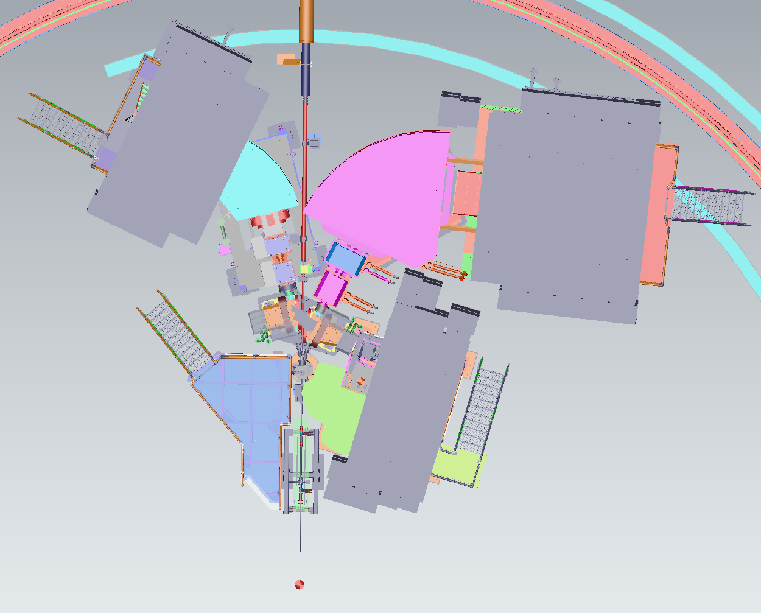
Hypernuclear Setup in Hall C and Beam Requirements
Hypernuclear target 6.6 meters downstream of nominal targets position
Key requirements:
  Successfully transport beam to dump, mitigating stray fields from magnets close to beamline
  Beam energy spread σ_{E}/E <= 3 x 10⁻⁵ (70 keV at 2.24 GeV)
  Beam position precision and stability at target: σ_{x} = 0.25 mm, σ_{y} = 2 mm
HES
HKS
Hypernuclear target
ENGE
Standard pivot

Slide 3
Beam Position Measurement Requirements
Required precision on beam position at target: σ_{x} = 0.25 mm, σ_{y} = 2 mm
Horizontal precision driven by Decay Pion Spectroscopy measurements
1 mm horizontal shift → momentum shift = 38 keV/c
DPS requires 10 keV accuracy → 0.25 mm
(e,e’K) experiments only require σ_{x} = 2 mm, σ_{y} = 2 mm
Summarized in a note by Shoe Nagao:
https://hallcweb.jlab.org/wiki/images/b/b1/BPM_Requirements_by_Simulation_202605.pdf

Slide 4
Beam Position Measurement
Existing BPMs (3H07A/B/C) are too far from hypernuclear target to provide required precision (0.25 mm) by themselves
  Δz_{BPM-target} = 9.8/8.8/7.9 meters for existing BPMs
  Assuming σ_{x/y}=0.1 mm for each BPM, σ_{target} = 0.65 mm
Additional position monitors will be added between pivot and hypernuclear target
  Will use existing polarized target girder
  Has 2 BPMs → 3.9 and 2.2 meters from target
  Using 3H07A/B/C + new BPMs, σ_{target} = 0.11 mm
In addition to girder installation work, BPM and harp readout will require support from I&C and Accelerator Software

Slide 5
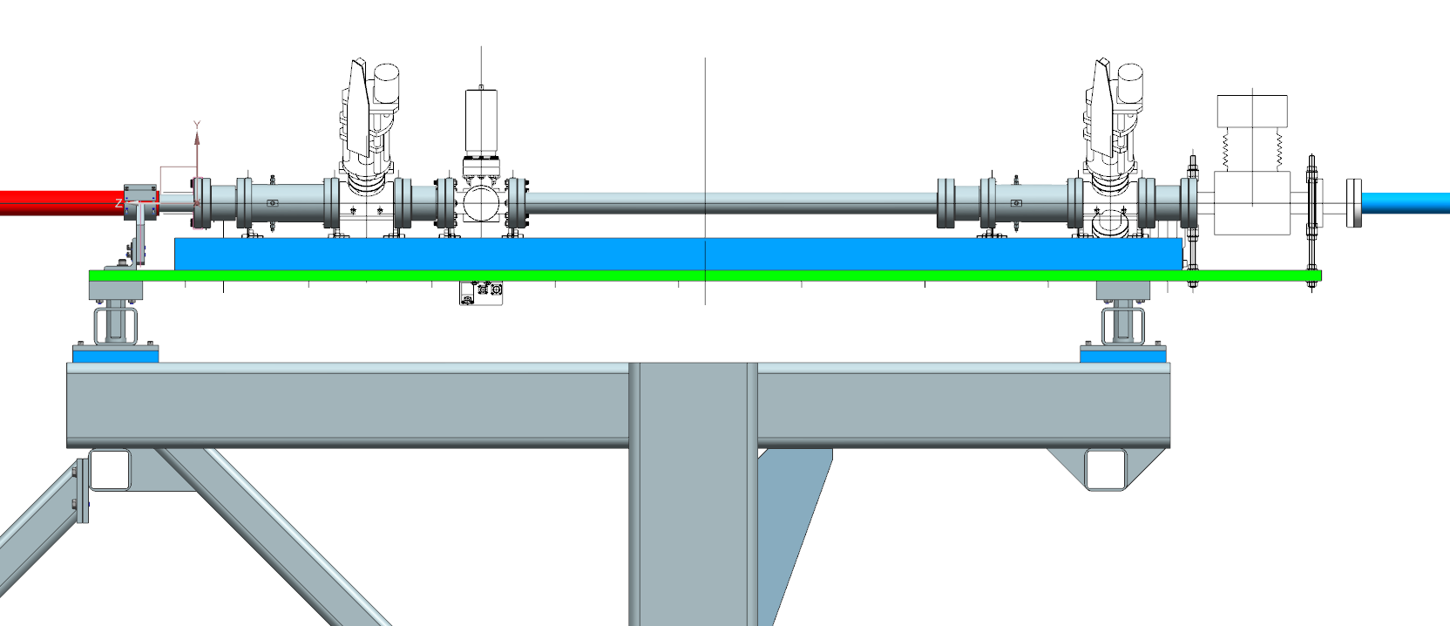
Polarized Target Girder
M20 (3 inch) BPMs
Superharps

Slide 6
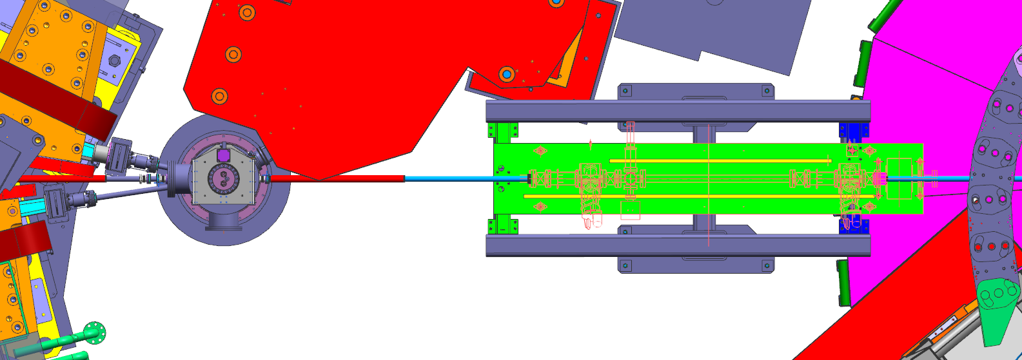
Downstream Diagnostic Girder

Slide 7
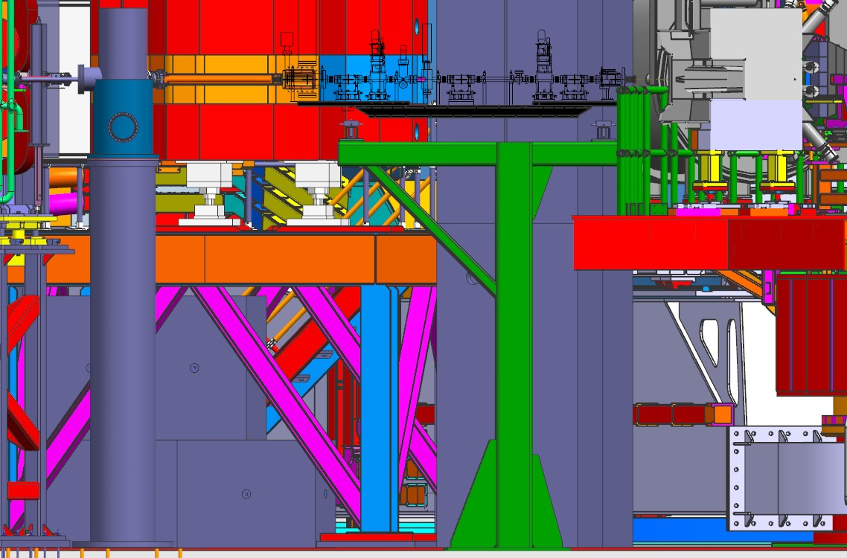
Downstream Diagnostic Girder

Slide 8
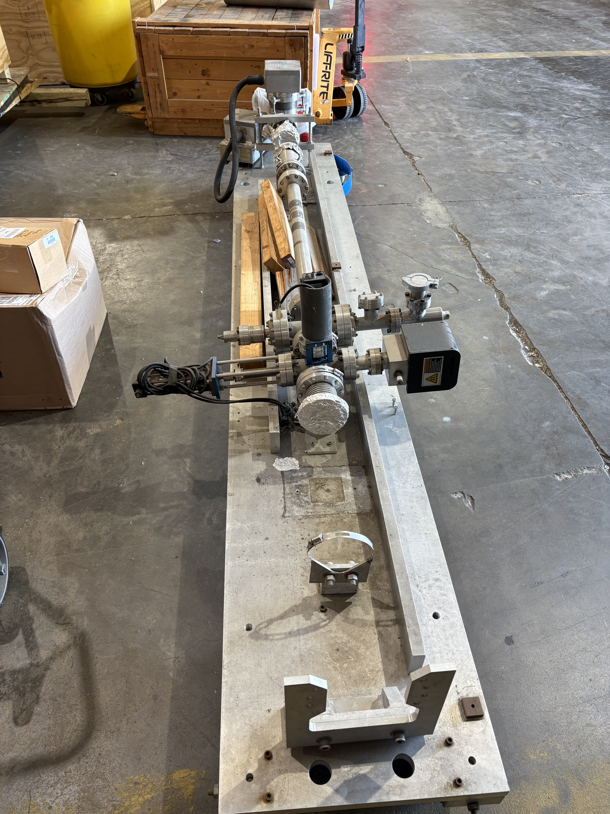
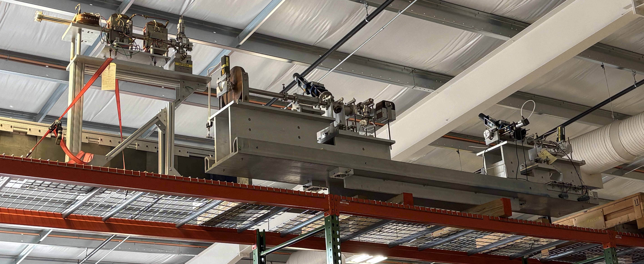
Polarized Target Girder
Polarized target girder has been removed from Physics Storage and staged in ESB
Significant refurbishment will be required
One BPM is missing – I&C has spare 3-inch BPM on hand
Spare harps can be taken from Q-Weak girder stored in ESB
New spool piece also needed
Work on girder can begin once MOLLER installation is mostly complete (early 2027)
→ Support from ACC software will also be needed to add controls, readout, update screens, etc.

Slide 9
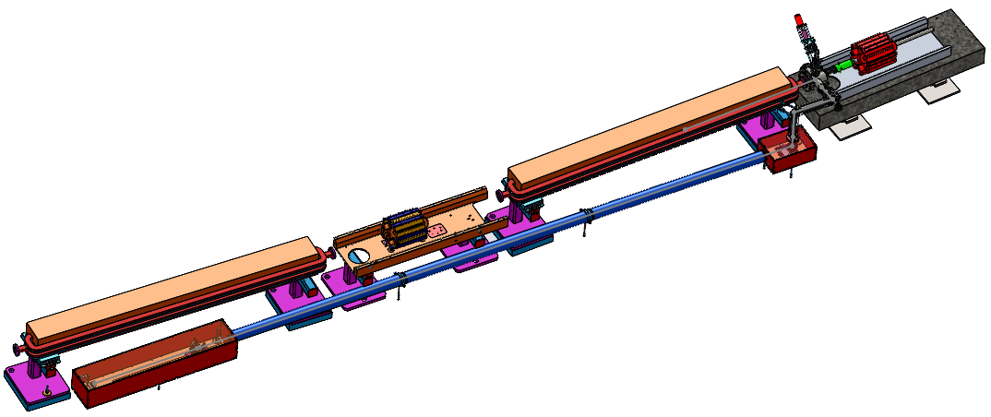
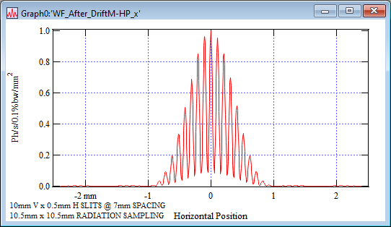
Beam Energy Spread
Beam energy spread will be continuously monitored using new Synchrotron Radiation Interferometer
SLI was installed before FY25 run period
→ Non-invasive and invasive tests with beam have beam carried out since then
Key issue: Capability of low-level RF used for new C100s and C75s to provide required energy spread
3C12 GIRDER
Joe Gubeli
TURNING MIRROR
(TW0 AXIS SERVO)
CAMERA, SLIT STAGE

Slide 10
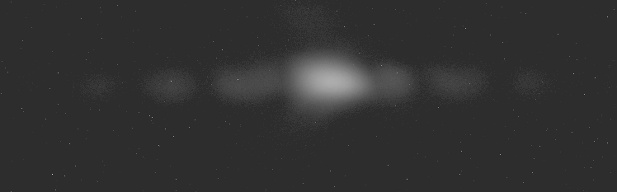
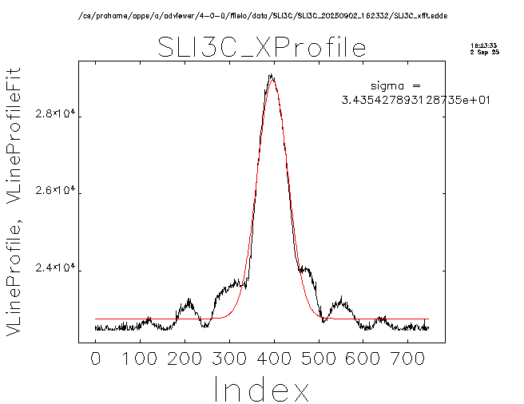
FY25 Beam Test
Dedicated beam test was performed at end of FY25 run to checkout SLI and extract beam energy width → 9/2/2025
Beam energy = 2.2 GeV, similar to hypernuclear
Interference fringes were visible on SLI, but central peak too bright for reliable fit
Beam energy width was extracted using beam size from harp scan and measured beam emittance: σ_{E}/E~3.2x10⁻⁵ → meets experiment requirement
Beam size from SLI used to monitor energy spread over several hours → 4.5x10⁻⁵
Work continuing during this run period to understand source of bright central peak
Presentation from Nick Sereno:
https://hallcweb.jlab.org/doc-private/ShowDocument?docid=1318

Slide 11
Beam Energy and Arc Dipole Monitoring: 9th Dipole
Additional information about relative beam energy can be provided using “9th dipole”
System used during previous hypernuclear experiment in Hall C
Not used for absolute beam energy measurement a la Hall A
BE magnet wired in series with Hall C arc magnets
NMR probe placed at fixed position in dipole
BE magnet still in place in BSY service building – needs modest amount of work to revive
Re-cable magnet leads
Locate and install NMR
Implement remote NMR readout

Slide 12
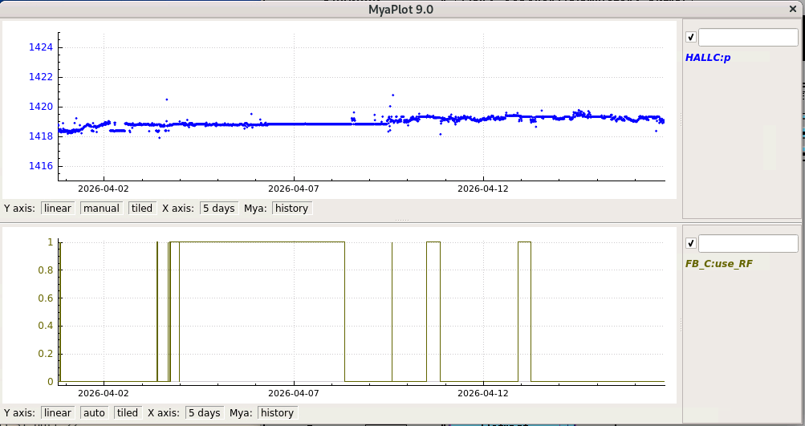
Beam Energy Stability: Fast Feedback
Energy fast feedback (@5 pass) in Hall A will be used during MOLLER running
When Hall A is off for extended periods (on the order of hours), Hall C will request FFB in Hall C be engaged
  FFB in Hall C recently recommissioned and used during FY26 run
Switching FFB from Hall A to C may result in small beam energy shift in Hall C
  This is ok → beam energy will be monitored (HALLC:p, 3C12 position)
  Energy shifts can be accounted for in data analysis

Slide 13
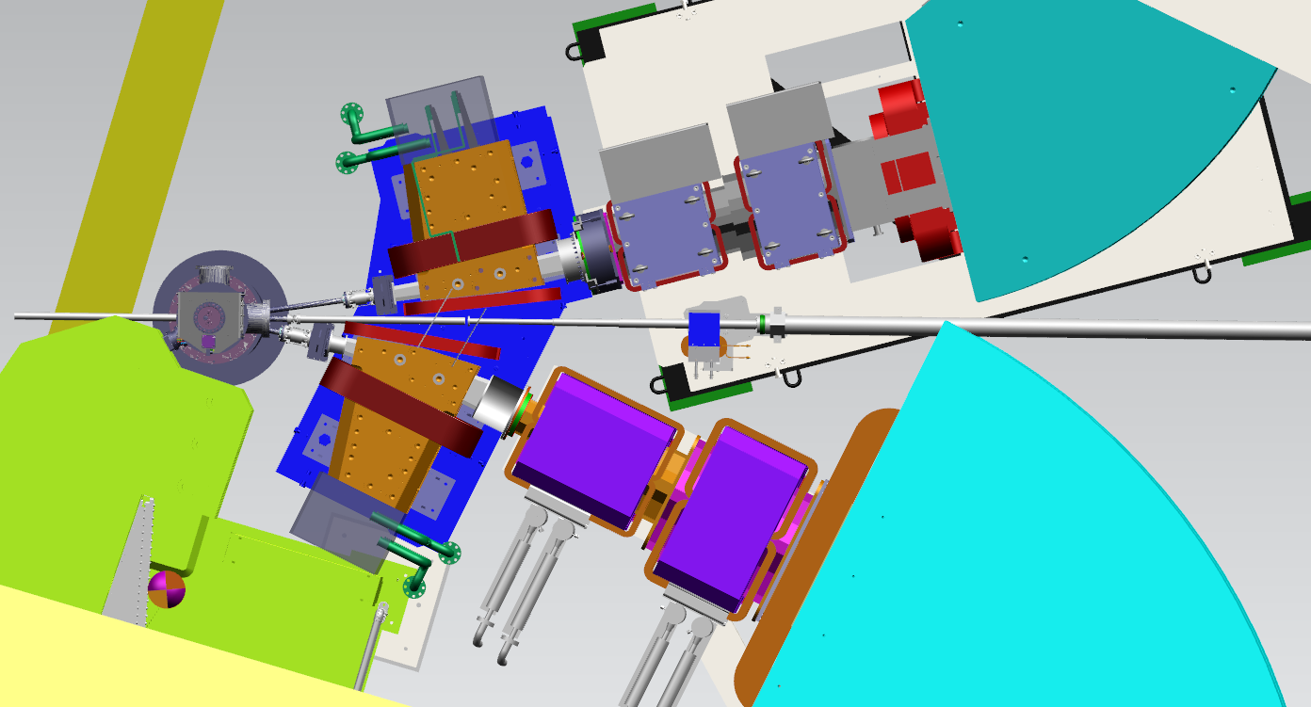
Stray Fields
If unmitigated – stray fields from the hypernuclear magnets will results in unacceptably large beam deflection at dump face
No stray fields from quads
Dominant effects from PCS magnets and dipoles
Stray fields can be partially compensated by using the NPS corrector magnet
Tosca model predicts integral field @ maximum current of 150 A = ʃ B.dL ~ 0.0424 T.m
Need additional mitigation – beamline magnetic shielding
Multiple locations for beamline shield and corrector location were investigated
NPS correction magnet
Fe shield pipe
Slides and calculations from Steven Lassiter

Slide 14
Sum of Stray Fields – No Field Corrections
Slides and calculations from Steven Lassiter

Slide 15
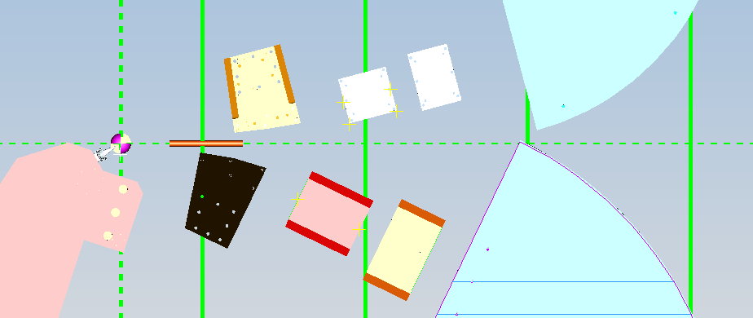
Sum of Stray Fields with Front Fe beam line shielding
HES
Fe Beam Pipe Shielding
NPS corrector Magnet
ENGE
HKS
Slides and calculations from Steven Lassiter

Slide 16
Stray Field Updates
Existing TOSCA model developed by Steve Lassiter before his retirement
Beamline design has been updated since then → existing TOSCA model not entirely compatible with new design
Jay Benesch has agreed to work with us to update the TOSCA model and provide field maps
These new field maps will be used in radiation simulations and beam tracking calculations
Timeline for TOSCA/field map updates not yet known – existing files under study
  Radiation and beam tracking simulations complete about a month after that field map updates available

Slide 17
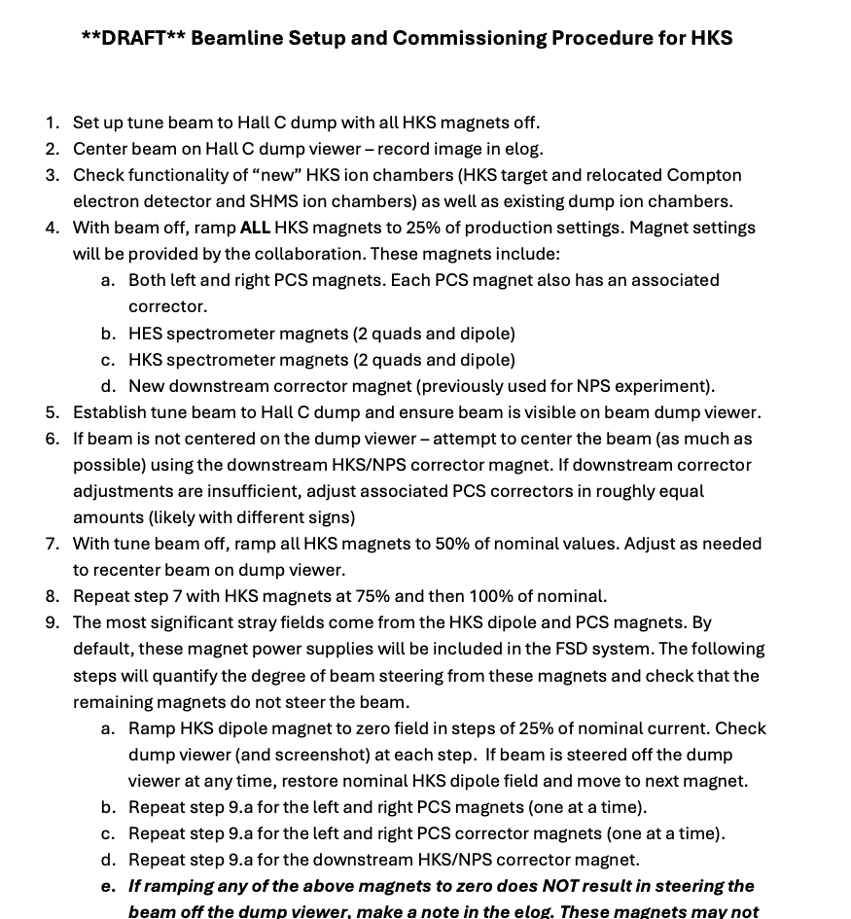
Beam Setup
Draft hypernuclear beamline setup plan has been developed with input from Hall C APELs and Ops Liaisons
Document link:
https://hallcweb.jlab.org/wiki/images/4/43/HKS_beamline_tuneup.pdf
Key steps
Check ion chamber functionality
Steer beam to dump with all hypernuclear magnets off
Ramp magnets in steps (25%, 50%, 75%,100%) to nominal currents, while checking beam position at dump
Check degree of beam steering from magnets with significant stray field
Check beam steering from magnets with small stray field

Slide 18
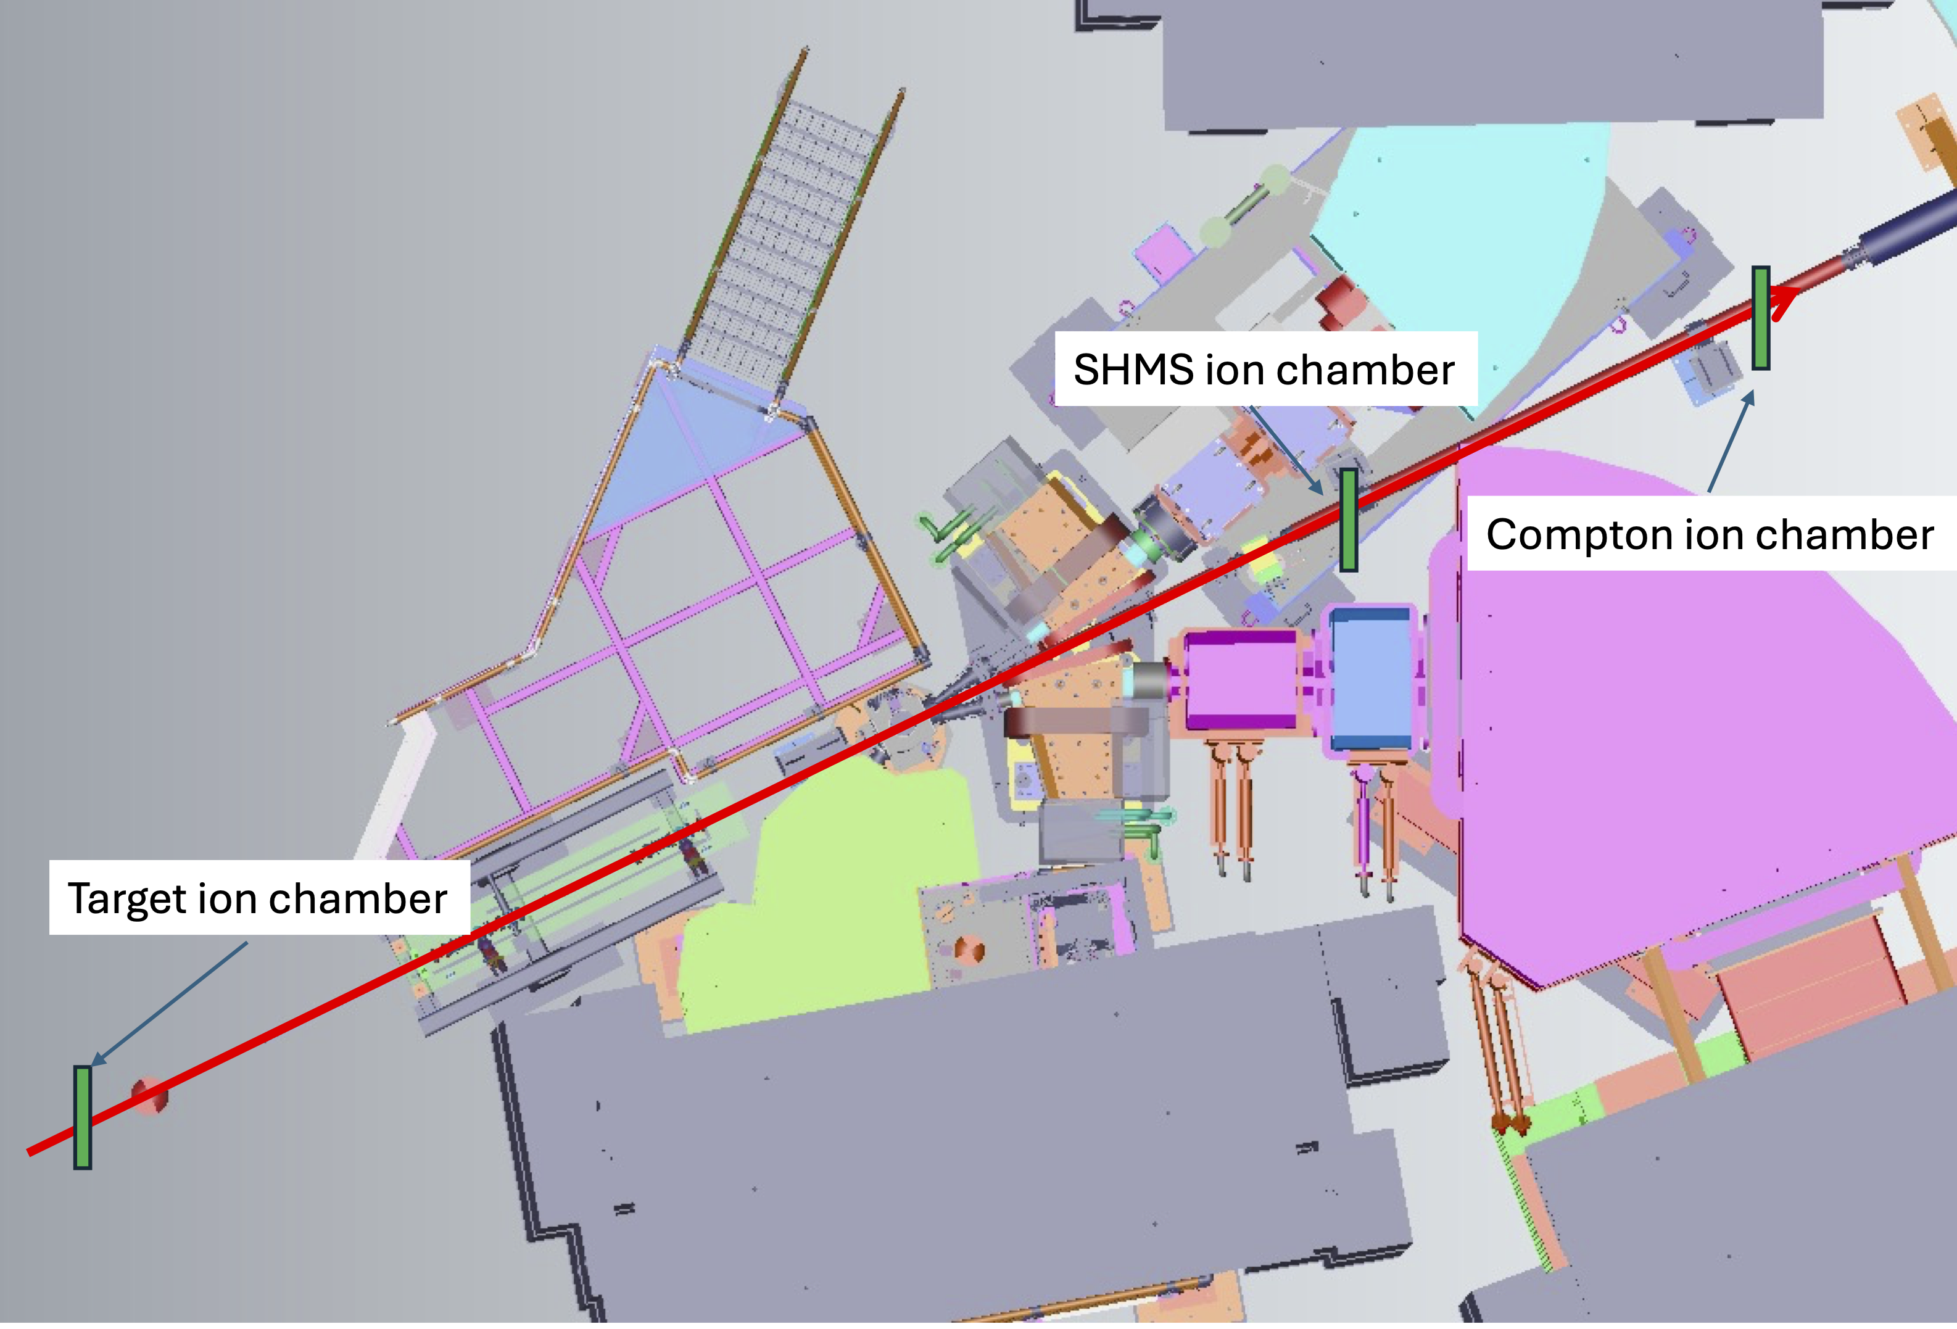
Machine Protection Configuration
https://hallcweb.jlab.org/wiki/images/a/af/HKS_MPS_plan.pdf
Existing ion chambers in Hall C will be relocated to provide protection for hypernuclear target and detectors
Power supply currents from magnets with large stray fields will be included in FSD system
PCS magnets and correctors
HKS and HES dipoles
NPS corrector
Window around nominal current will be used to determine FSD threshold
All magnets will be controlled by Ops

Slide 19
Other Issues
A few other small issues will need to be addressed before hypernuclear experiments
Hypernuclear experiments will require event-by-event readout of BPM information
  This has not been done in Hall C since Q-Weak experiment (2012)
  Hardware still in place → spares will become available after MOLLER installation in Hall A (switching to new technology)
  Have been testing a few BPMs with existing Hall C DAQ and spare FADC channels
Fast raster controls will need to be modified to account for longer drift to hypernuclear target
  Straightforward controls modification → done during Q-Weak

Slide 20
Beamline Support
Support will be required from several groups to ensure beamline readiness
  Accelerator Operations (Hall C Ops liaison and APEL)
  Instrumentation and Controls Group (I&C)
  Accelerator Controls Software Group
  Diagnostic Development Group
  Hall C Engineering and Design
Coordination has begun, and affected groups are aware of requested support for hypernuclear beamline

Slide 21
Summary
Hypernuclear experiments will require modifications to Hall C beamline
  All changes to beamline are downstream of standard Hall C pivot
Additional diagnostic girder will be added downstream of Hall C pivot to provide required precision on beam position measurement
New Synchrotron Radiation Interferometer (SRI) will be used to non-invasively monitor beam energy spread → currently be commissioned
  Beam test during FY25 run verified that required beam energy spread is achievable with 12 GeV configuration
  Tests with SRI still ongoing
Beam deflection due to stray fields has been investigated and will be mitigated by combination of passive shielding and corrector magnet
  Draft beam setup procedure has been developed with input from Ops and APEL
  MPS configuration has been discussed with SSG
No significant issues anticipated for hypernuclear beamline

Slide 22
Backup

Slide 23
Polarized Target Girder
M20 (3 inch) BPMs
Viewer
Superharps

Slide 24
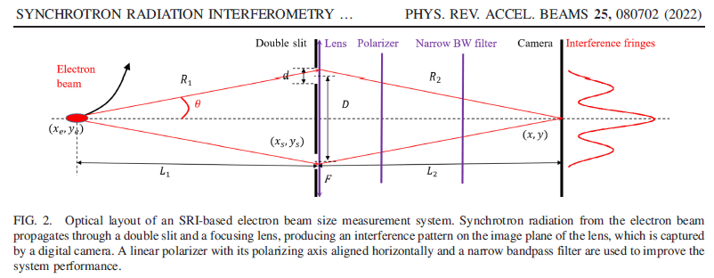
MEASURING THE BEAM SIZE [NON-INVASIVE]
SYNCHROTRON RADIATION INTERFEROMETER
Joe Gubeli

Slide 25
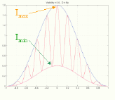
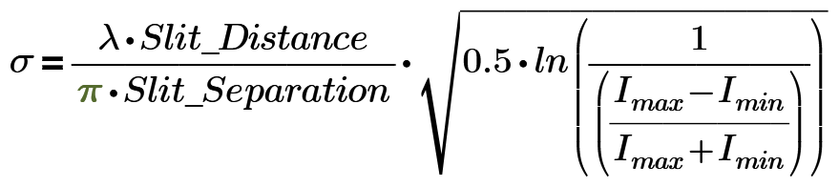
SYNCHROTRON RADIATION WORKSHOP (SRW) SIMULATIONS
TYPICAL FULL CAMERA FRAME
TYPICAL ZOOMED IN CAMERA IMAGE
HORIZONTAL SLICE THROUGH IMAGE CENTER
Joe Gubeli

Slide 26
Spectrometer Parameters with PCS Correction coils run at full current
Beam Energy e- @ 2.24 Gev
HKS Angle at -25.8° K+@1.200 Gev/c PCS(K+) angle is at -11.5°
PCS (K+):
Main coil J = -393.50 AT/cm^2, NI = -109,167.1 A.T, N = 96, I = -1,137.2 A
Trim coil J = 666.67 AT/cm^2, NI = 88,000.0 A.T, N = 88, I = 1,000.0 A
HES Angle at +14.9° e- @0.744 Gev/c PCS(e-) angle is at +8.5°
PCS (e-):
Main coil J = 50.50 AT/cm^2, NI = 14,010.7 A.T, N = 96 I = 145.9 A
Trim coil J = -666.67 AT/cm^2, NI = -88,000.0 A.T, N = 88, I = -1,000.0 A
Enge: Angle at 210° (-30°) 110Mev/c Pions

