Slide 1
Polarized Ion Beam at EIC
Vadim Ptitsyn
EIC Project
Brookhaven National Laboratory

Slide 2
Outline of This Lecture
Intro: EIC and its polarized beam requirements
Acceleration of polarized ion beams. Spin resonances
Siberian Snakes and their properties
HSR Snakes
HSR Spin Rotators
Acceleration of Polarized He-3 in EIC
Acceleration of Polarized Deuterons in EIC
Summary

Slide 3
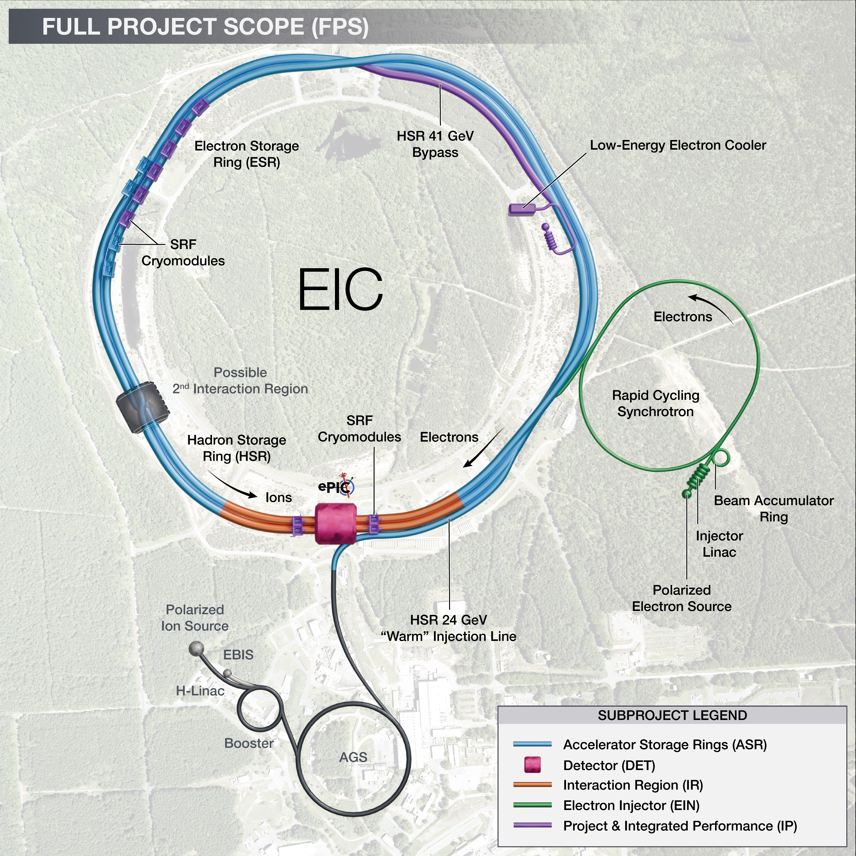
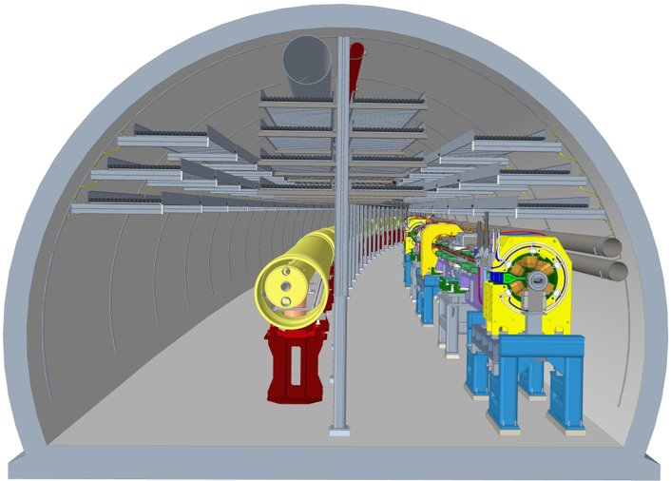
Electron-Ion Collider
Hadron Storage Ring (HSR) 40-275 GeV
Superconducting magnets (existing)
1160 bunches, 1A beam current (3x RHIC)
bright vertical beam emittance 1.5 nm
hadron cooling
Electron Storage Ring (ESR) 2.5–18 GeV
large beam current, 2.5 A ➔ 9 MW S.R. power
S.C. RF cavities
Need to inject polarized bunches
Electron Rapid Cycling Synchrotron (RCS) 0.4- 18GeV
1 Hz
Spin transparent due to high periodicity
EIC is a unique, high-energy, high-luminosity, polarized beam collider that will be one of the most challenging and exciting accelerator complexes ever built.
HSR
ESR

Slide 4
EIC Hadron Storage Ring
Hadron Storage Ring (HSR) 100-275 GeV, 41 GeV
Based on existing Yellow ring of RHIC
Superconducting magnets (existing)
1160 bunches, 1A beam current (3x RHIC)
Flat beams; bright vertical beam emittance 1.5 nm
Tripled beam current (as compared with RHIC) combined with increased bunch peak current call for significant upgrades of vacuum system and beam instrumentation
Increased top energy (250 GeV->275 GeV) leads to modifications of central part of the straight sections.
New transfer line bringing the beam to IR4 area where new injection system and septum magnets will be installed
Low Energy Cooler in IR2 area to form emittances for the Ultimate Performance EIC .

Slide 5
EIC Polarized Beam Requirements
Highly polarized beams of:
Electrons (polarization goal: 70% average)
Proton, ³He⁺² (polarization goal: 70%)
Note: Polarized deuterons under discussion.
Spin orientation at the collision point:
Electrons: longitudinal
Hadrons: longitudinal or vertical
Using bunches with opposite spin orientation on the same fill
protons
electrons

Slide 6
How to get polarized ion beams?
Only way to produce the ion polarized beams is to use a polarized ion source and then accelerate polarized ions to the high energy required for physics experiment.
The acceleration process can easily destroy beam polarization, since many spin resonance must crossed on the way to high energy.
Several special techniques and hardware are used to preserve polarization during the acceleration.

Slide 7
RHIC: polarized protons
RHIC: only polarized proton collider in the world. Up to 65% at 100 GeV, up to 60% at 255 GeV.
EIC will take favor of existing hardware in RHIC and in the injector chain to accelerate polarized protons (up to 275 GeV) and He-3 (up to 184 GeV/u) .
Absolute Polarimeter (H jet)
RHIC pC Polarimeters
Siberian Snakes
PHENIX (p)
Spin flipper
STAR (p)
Spin Rotators
(longitudinal polarization)
Solenoid Partial Siberian Snake
Spin Rotators
(longitudinal polarization)
LINAC
BOOSTER
Pol. H⁻ Source
Helical Partial
Siberian Snake
200 MeV Polarimeter
AGS
AGS Polarimeters
Strong AGS Snake

Slide 8
Polarized ions in EIC
Polarized protons and He-3 ions are in the EIC Physics program scope. EIC hadron accelerator should provisions to preserve polarization of these species and provide the polarization direction control at the detector
Present RHIC/eRHIC physics program does not include polarized deuterons.
However feasibility of polarized deuteron acceleration in the HSR has been studied by the accelerator physicist.
 | p | ³He⁺² | d
m, GeV | 0.938 | 2.808 | 1.876
G | 1.79 | -4.18 | -0.14
E/u, GeV | 24-275 | 16-183 | 12-138
|Gγ | | 46.5-525.5 | 72.6-819.4 | 1.9-20.9

Slide 9
Acceleration of Polarized Ion Beams

Slide 10
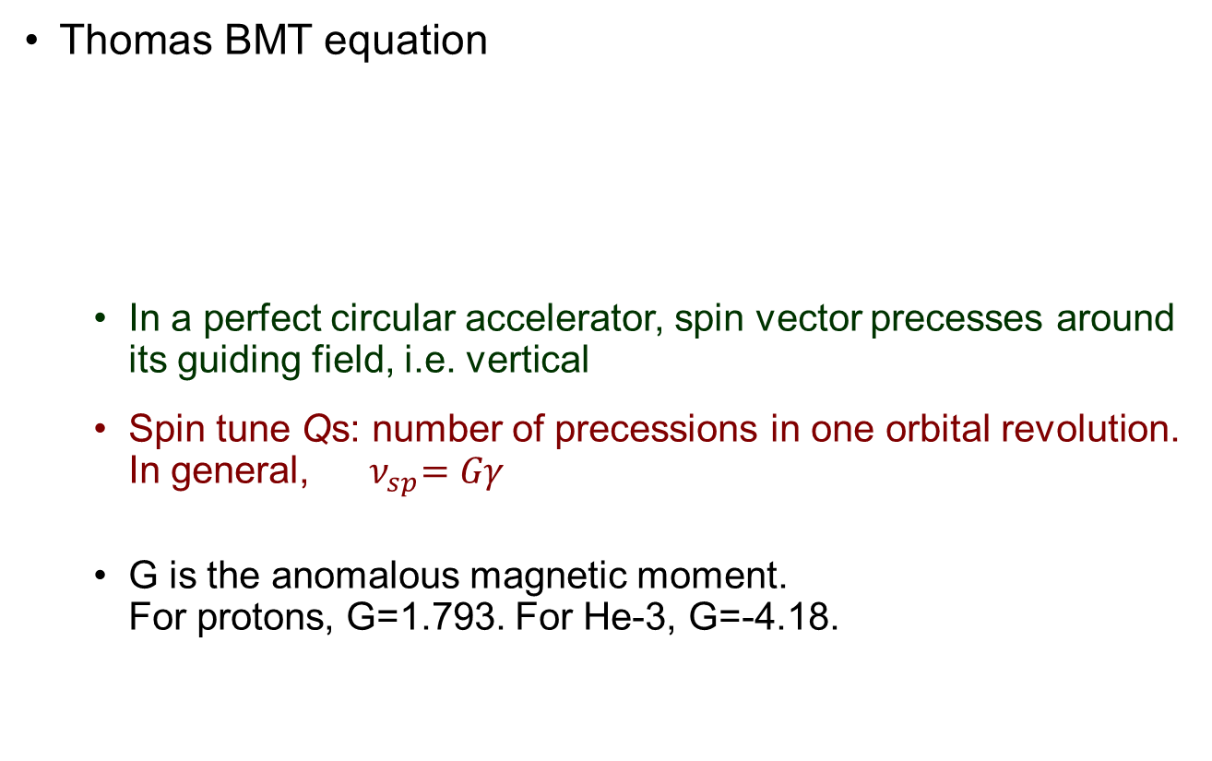
Spin motion in a circular accelerator
y
Thomas BMT equation
In a perfect circular accelerator, spin vector precesses around its guiding field, i.e. vertical
Spin tune Qs: number of precessions in one orbital revolution. In general,${ ν}_{sp}=Gγ$
G is the anomalous magnetic moment. For protons, G=1.793. For He-3, G=-4.18.
z
x
beam direction

Slide 11
Stable Spin in Ideal Circular Accelerator
Let’s consider circular accelerator with no spin rotators.
Ideal accelerator: no misalignment and magnet errors
Central beam orbit is formed by guiding vertical dipole field. It lies all in the horizontal plane.
n₀
B-field
In this case periodical spin solution n₀ is vertical at any ring azimuth.

Slide 12
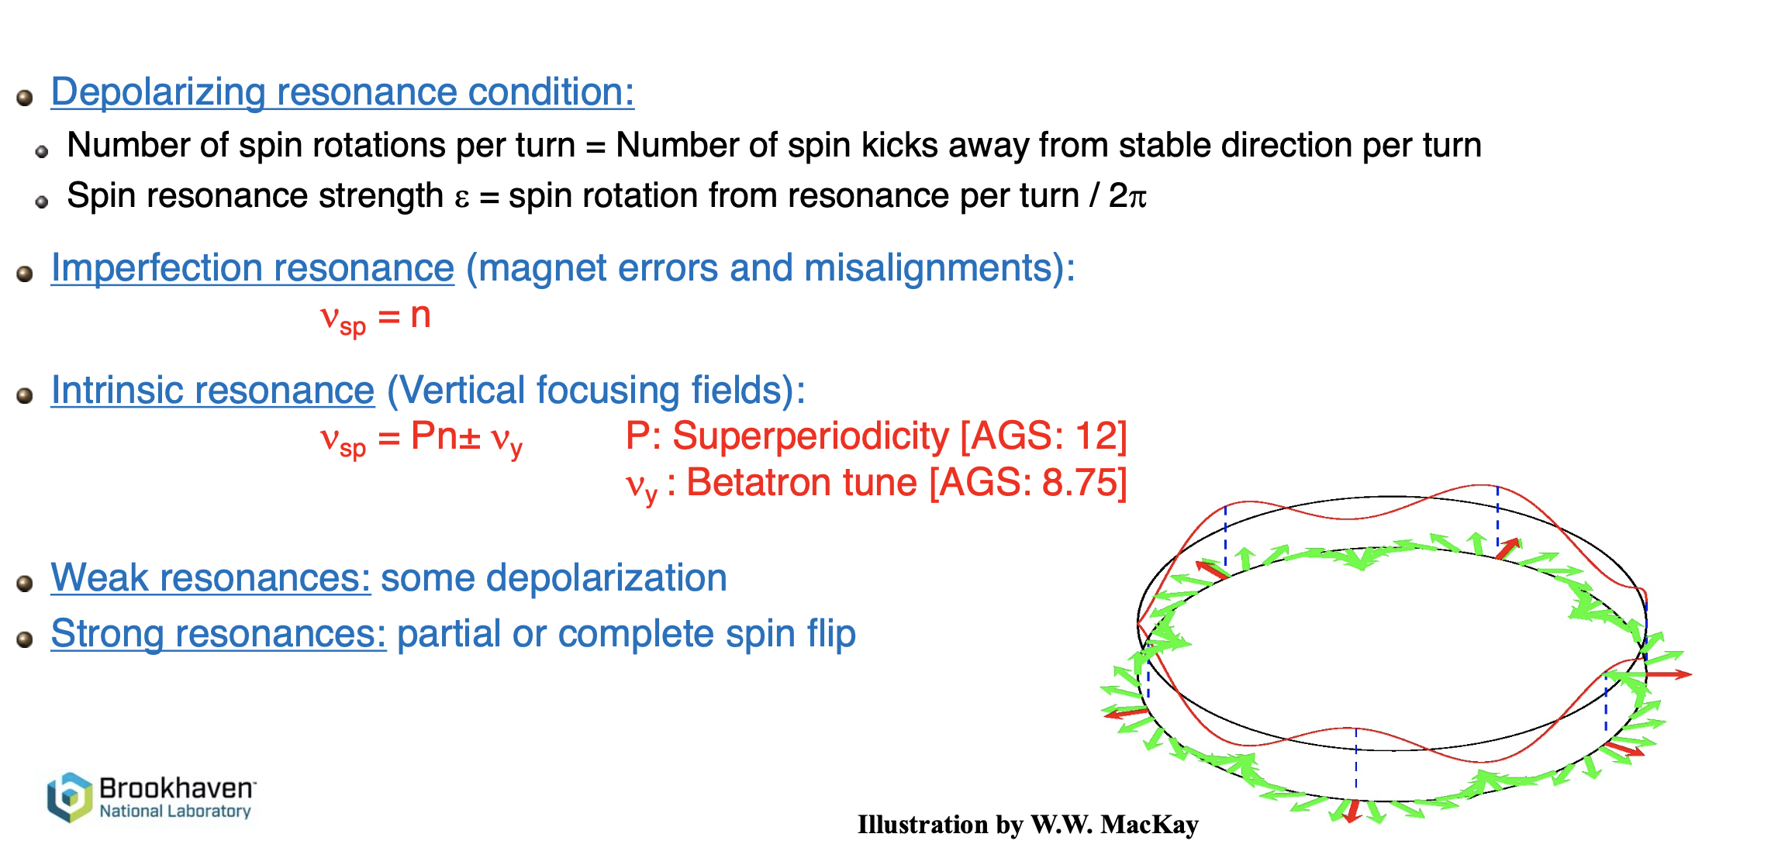
Spin tune and depolarizing resonances
Kicks on the spin vector from horizontal field leads the spin vector away from its stable direction, i.e. vertical.

Slide 13

Crossing an isolated resonance
Froissart-Stora formula: general form, directly applicable to the case of an imperfection resonance with strength |ε| .
where $θ=ω_{0}t$
Resonance crossing rate
Effective Froissart-Stora formula for a Gaussian distributed beam crossing an isolated intrinsic spin resonance
ε_{rms}: resonance strength of a partice
at rms emittance

Slide 14
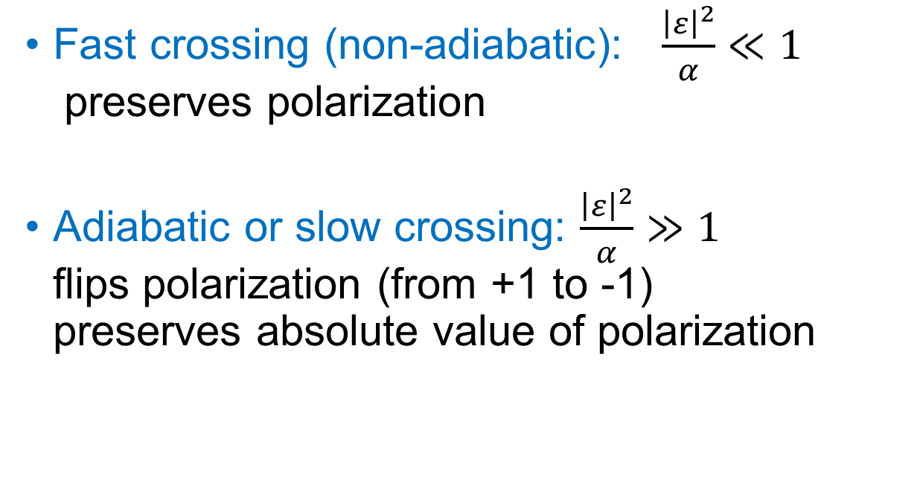
Two methods of resonance crossing
Fast crossing (non-adiabatic): $\frac{{\left|ε\right|}^{2}}{α}≪1$ preserves polarization
Adiabatic or slow crossing: $\frac{{\left|ε\right|}^{2}}{α}≫1$ flips polarization (from +1 to -1) preserves absolute value of polarization

Slide 15
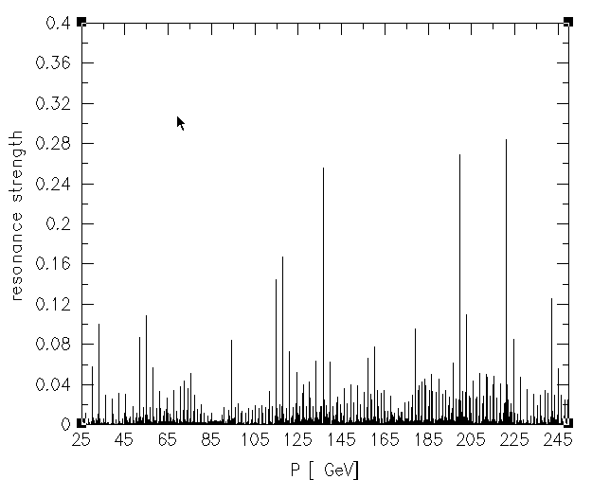
RHIC intrinsic spin resonance strength
Intrinsic spin resonance
Qx=28.73, Qy=29.72, emit= 10

Slide 16
Technologies for spin resonance crossing
Non-adiabatic (ε²/α << 1) ↔ Adiabatic (ε²/α >> 1)
P_{f} /P_{i} = 1 P_{f} /P_{i} = − 1
Imperfection Resonances:
Correction Dipoles (ε small) (RHIC Booster) Enhanced oribt excursion (ε large) (RHIC Booster)
Partial Snake (ε large) (AGS, IUCF)
Intrinsic Resonances:
Pulsed Quadrupoles (α large) (ZGS,AGS ) RF Dipole (ε large) (AGS past)
Lattice modifications (ε small) Strong Partial Snake (ε large) (AGS present)
Ultimate tool:
Full Siberian Snakes in RHIC (2 per ring) prevent first-order spin resonance conditions.
Weak depolarization still possible due to high-order spin resonances.

Slide 17
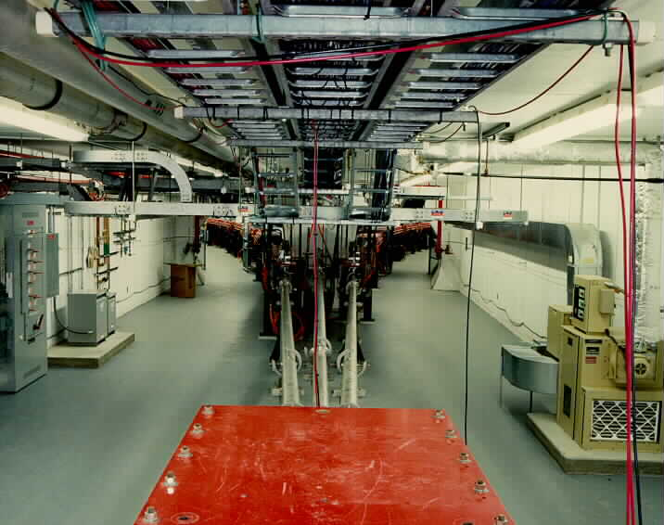
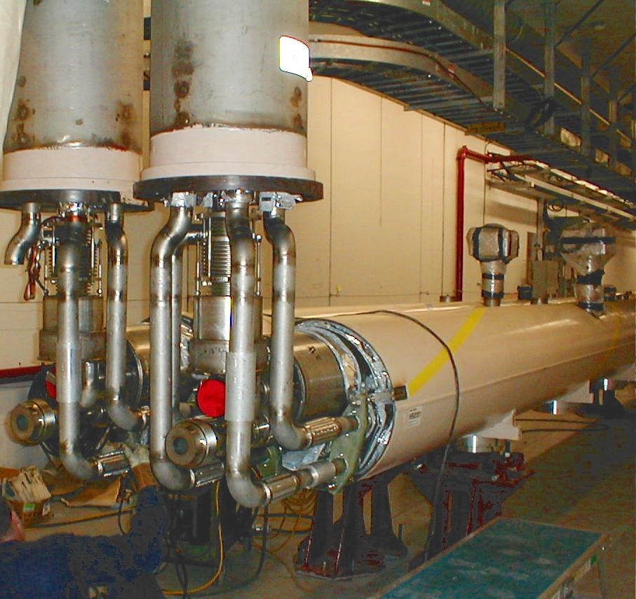
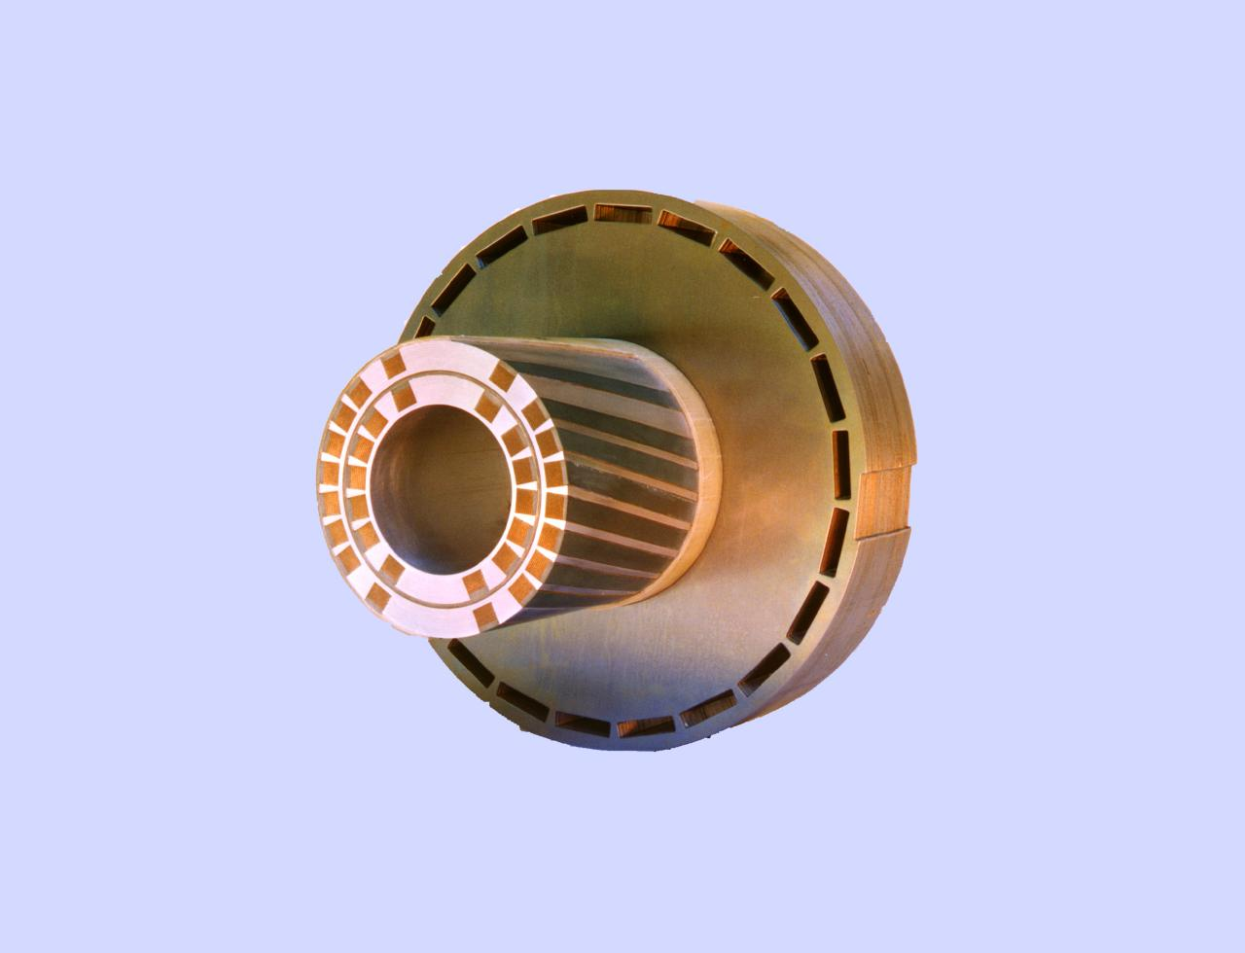
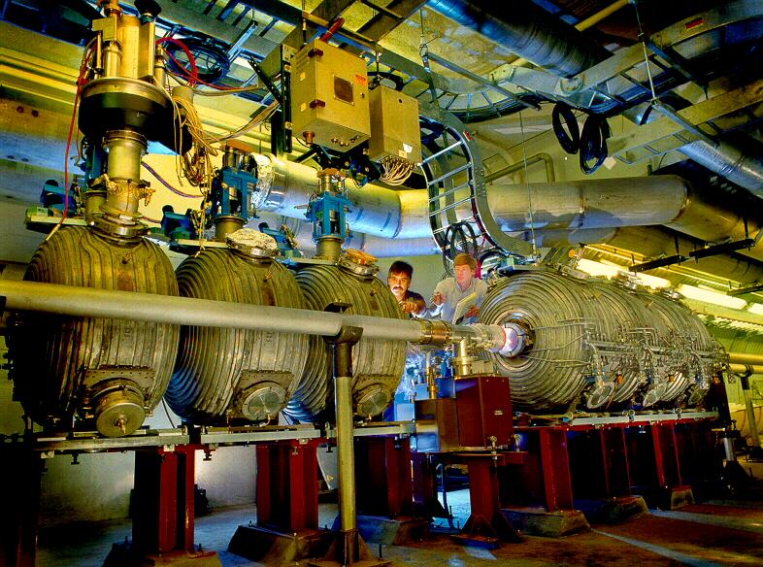
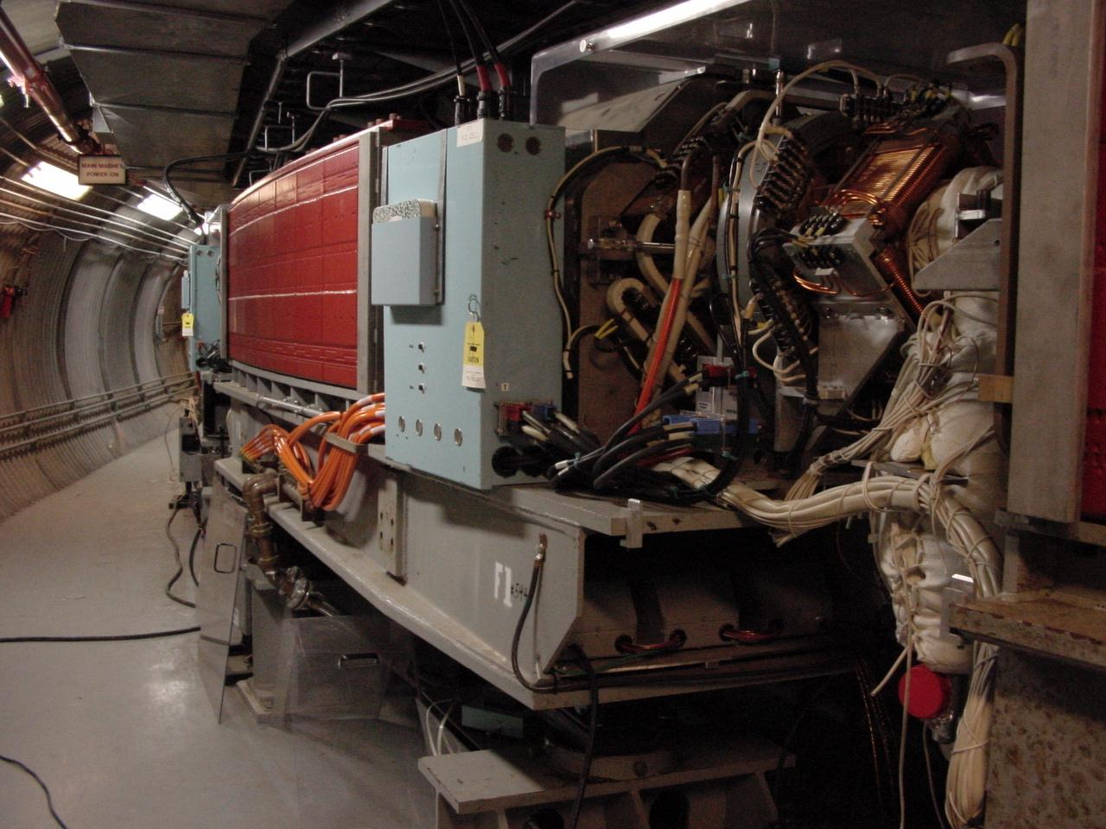
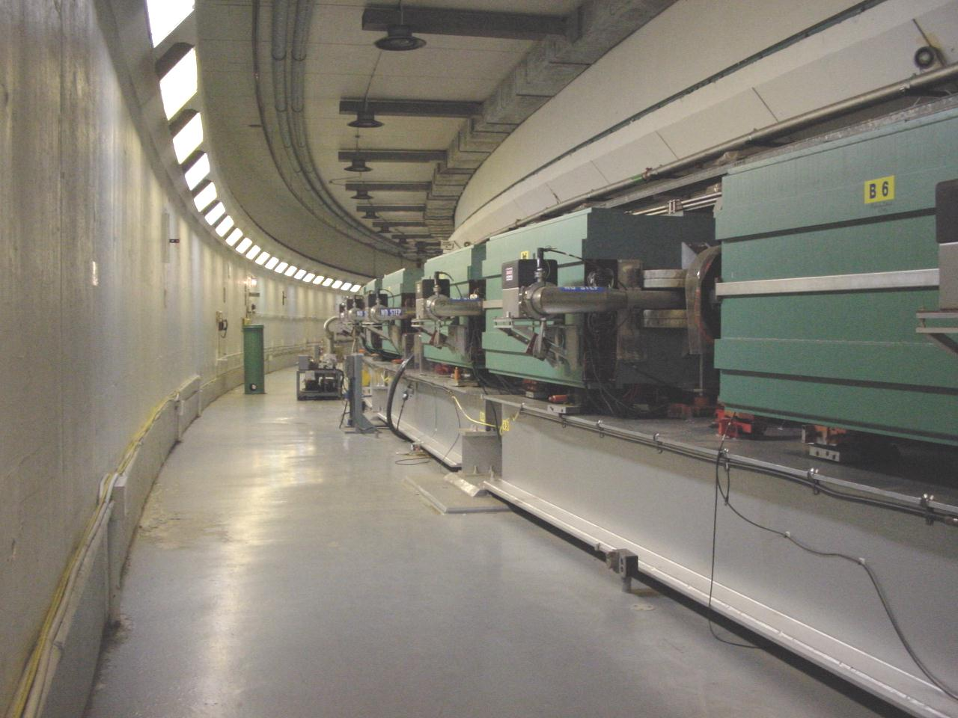
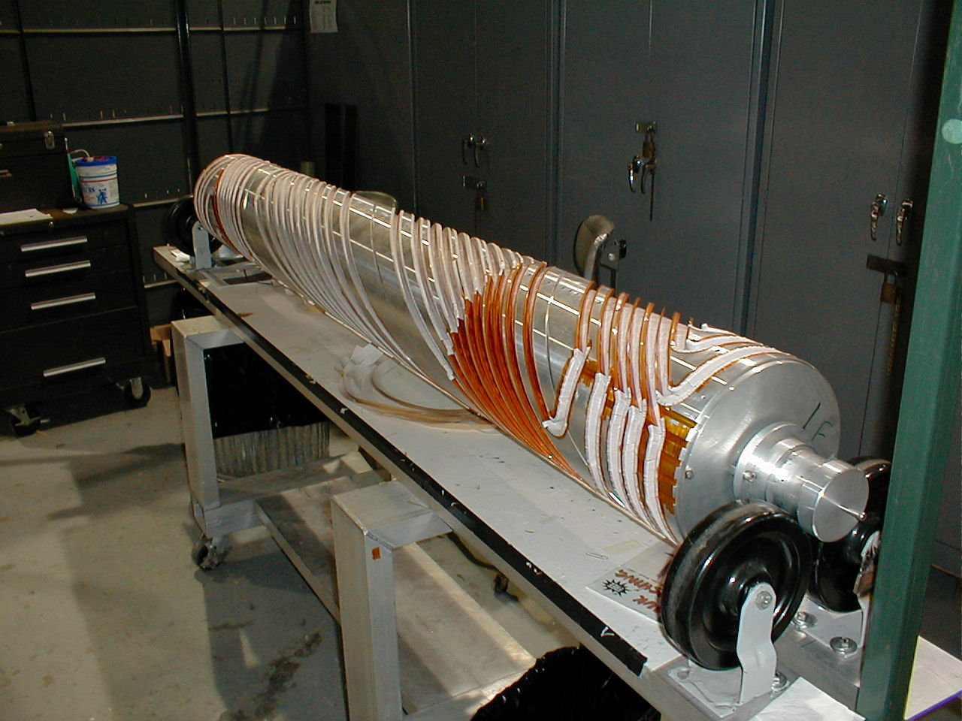
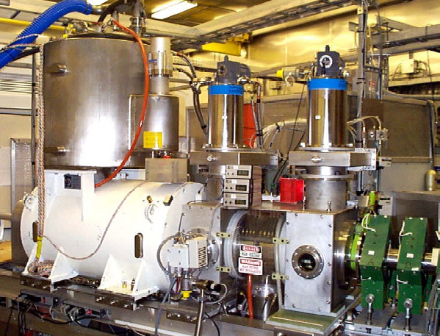
BRAHMS(p)
Absolute Polarimeter (H jet)
RHIC pC Polarimeters
Siberian Snakes
PHENIX (p)
Spin flipper
STAR (p)
Spin Rotators
(longitudinal polarization)
Spin Rotators
(longitudinal polarization)
Solenoid Partial Siberian Snake
LINAC
BOOSTER
Pol. H⁻ Source
Helical Partial
Siberian Snake
200 MeV Polarimeter
AGS
AGS Polarimeters
Strong AGS Snake

Slide 18
Siberian Snakes and their properties

Slide 19
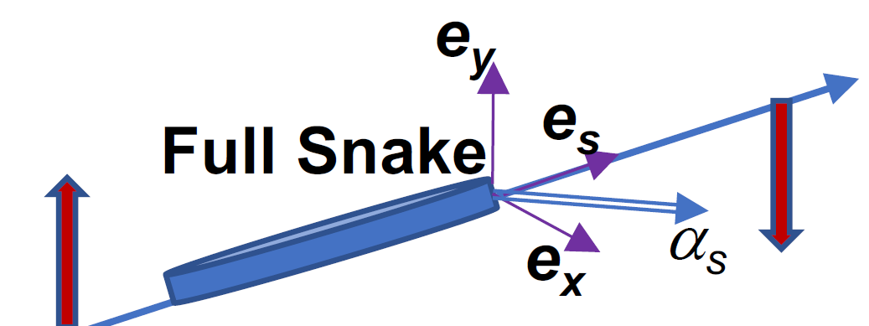
Siberian Snake (Full Snake)
Rotation axis
Siberian Snake (or Full Snake): spin rotating device which rotates particle spin by 180 degree around a rotation axis, called Snake axis (which is usually in horizontal plane).
Snake axis angle α_{s} characterizes the orientation of the Snake axis in the horizontal plane.

Slide 20
History of Snakes
Idea (Ya.S.Derbenev, A.M. Kondratenko): 1976
Electron Partial Snake experiment at VEPP-2M (1977)
Snakes studies for SSC (in 80s): 36000 resonances!
IUCF cooler: Siberian Snake proof of principle studies (from 1989)
Proton Partial Snake at AGS(1994)
Electron Siberian Snakes in AmPS (1995) and SHR (MIT-Bates)
Proton Siberian Snakes (and Spin Rotators) in RHIC 1999-now

Slide 21
Two Siberian Snakes Configuration Properties
Let’s consider two Snakes placed on the opposite azimuths of the ring and having Snake Axis
angles α_{s1 and} α_{s2}.
Stable spin direction n₀ is vertical in the ring arcs, pointing up in one half, and down on another.
Spin tune is independent on energy and defined by the Snake axis orientations:
Thus, for instance, to get the spin tune equal to 0.5, the Snake axes should be at 90 degree angle to each other.

Slide 22
Siberian Snakes in RHIC
RHIC employed the configuration with two
Siberian Snakes in each ring.
The Snake axes are at 45 and 135 degrees
(symmetrical around longitudinal direction), thus giving the spin tune 0.5
RHIC Snakes allowed for acceleration of polarized protons up to 255 GeV with minimal polarization loss. Up 60% polarization in the store.

Slide 23
Properties of Configuration with Even Number of Snakes
Spin tune then is:
Main rule: place the Snakes in such locations
that this term becomes 0.
The spin tune is independent on energy.
If spin tune is independent on energy the spin resonance conditions are avoided during the acceleration process.
By selecting proper orientations of Snake axes one can choose the value of the spin tune. Common approach to have it at 0.5.
Stable spin direction n₀ is vertical in arcs. Each Snake switches n₀ from up to down, and vice verse.

Slide 24
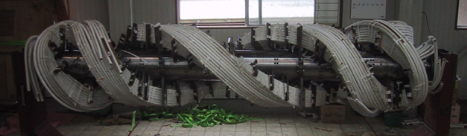
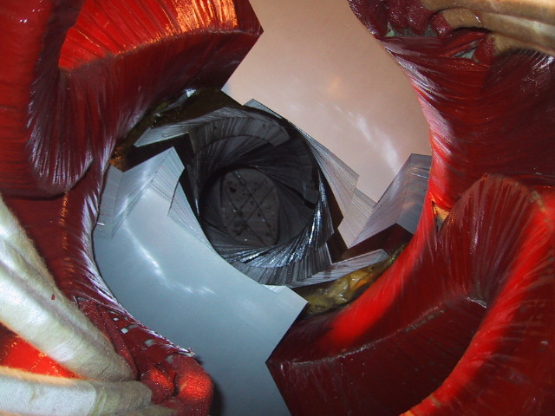
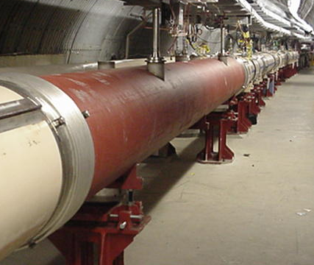
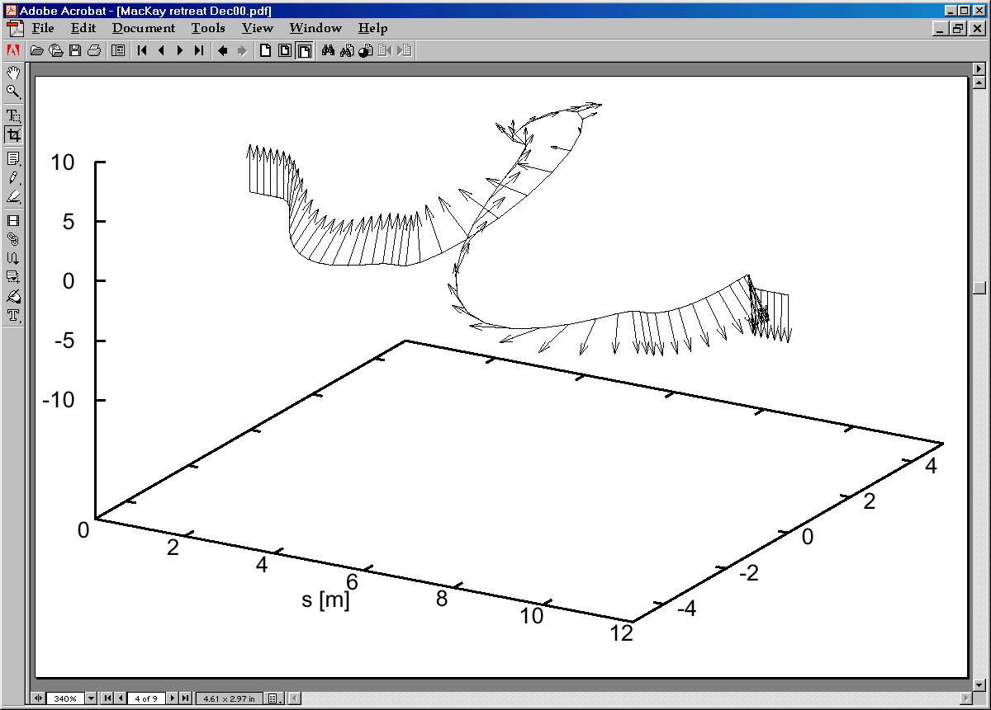
Partial and Full Snakes on Helical Dipoles
2.6 m
2.6 m
AGS Partial Snakes: variable twist helical dipoles, 1.5 T (RT) and 3 T (SC), 2.6 m long
RHIC Full Snakes: 4 SC helical dipoles, 4 T, each 2.4 m long and full 360° twist

Slide 25
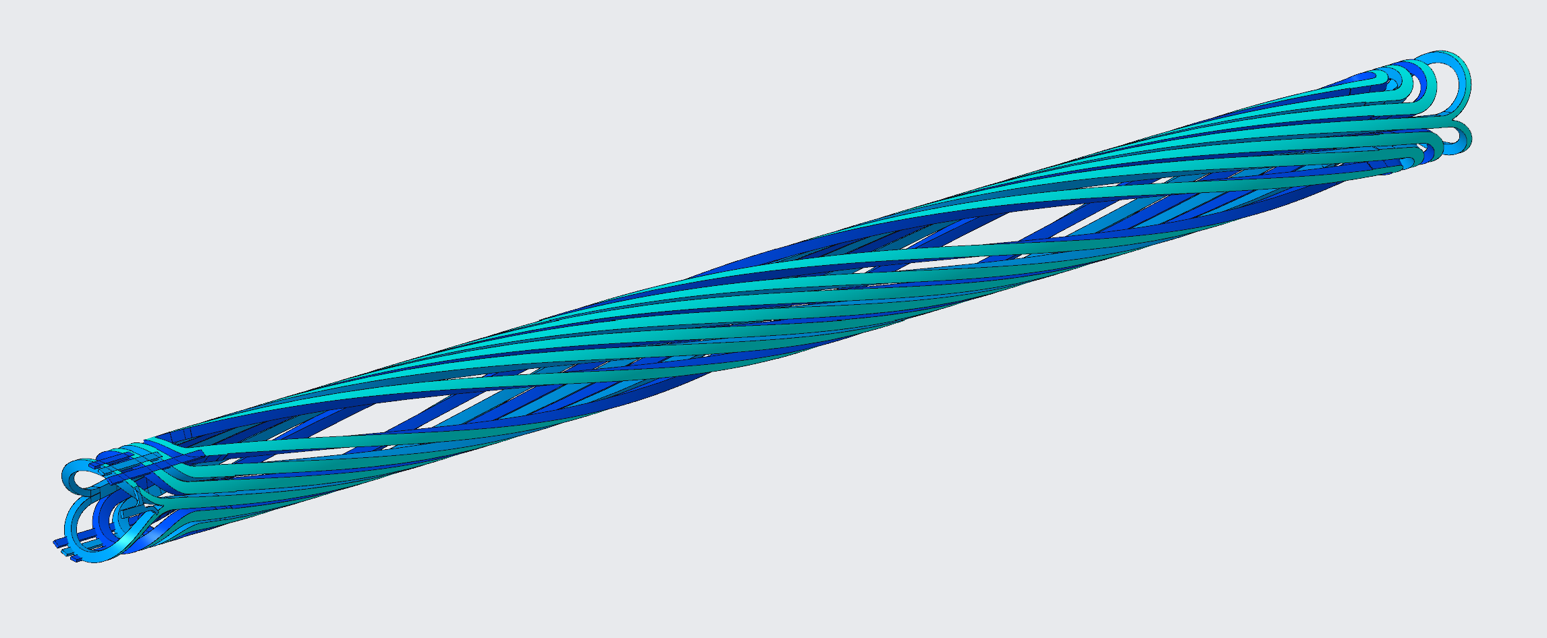
The Helical Magnets for Snakes and Rotators
These magnets are dipoles that have been twisted about the longitudinal axis into a helix.
RHIC and the future EIC will have two types of helical dipole assemblies which serve two different purposes:
Snakes: rotate the spin of polarized particles 180º to avoid depolarization from spin resonances.
Rotators: rotate the spin of polarized particles into the horizontal plane to satisfy longitudinal polarization at collisions.
Each helical magnet assembly consists of four 2.4 m full twist helical dipoles.

Slide 26
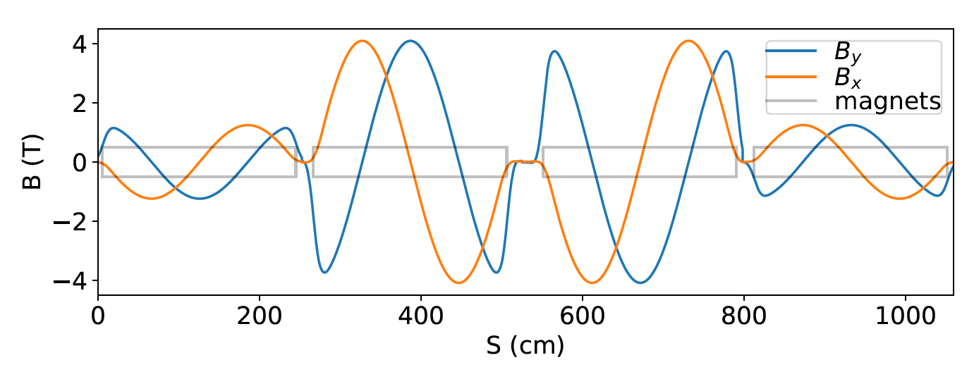
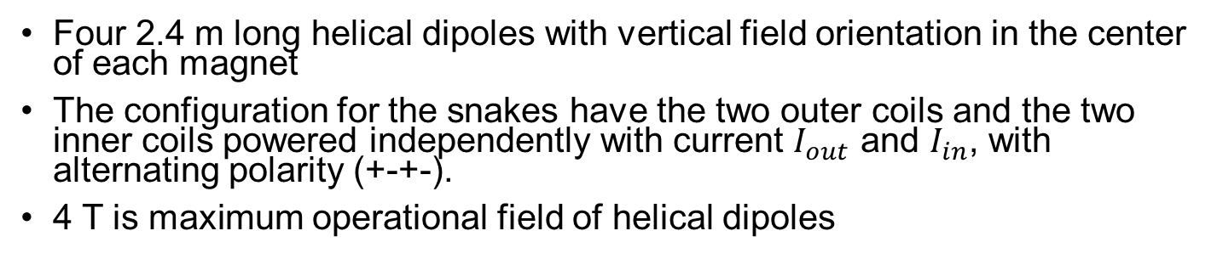
RHIC (and HSR) Helical Magnet Snake
Four 2.4 m long helical dipoles with vertical field orientation in the center of each magnet
The configuration for the snakes have the two outer coils and the two inner coils powered independently with current $I_{out}$ and $I_{in}$, with alternating polarity (+-+-).
4 T is maximum operational field of helical dipoles

Slide 27
RHIC (and HSR) Helical Snake: Spin and Orbit
Spin and orbit evolution
through RHIC helical Snake
Orbit deviation drops inversely proportionally
to beam energy.
Helical magnets have intrinsically non-linear fields,
thus the effect on particle dynamics should be carefully
evaluated. (Betatron tune shift, beta-function distortions)

Slide 28
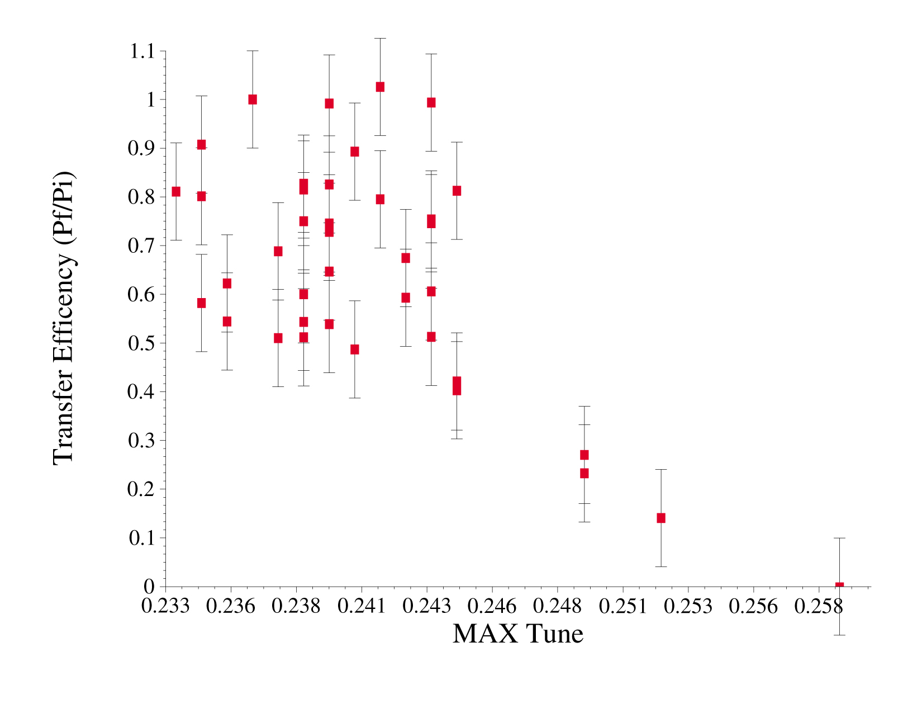
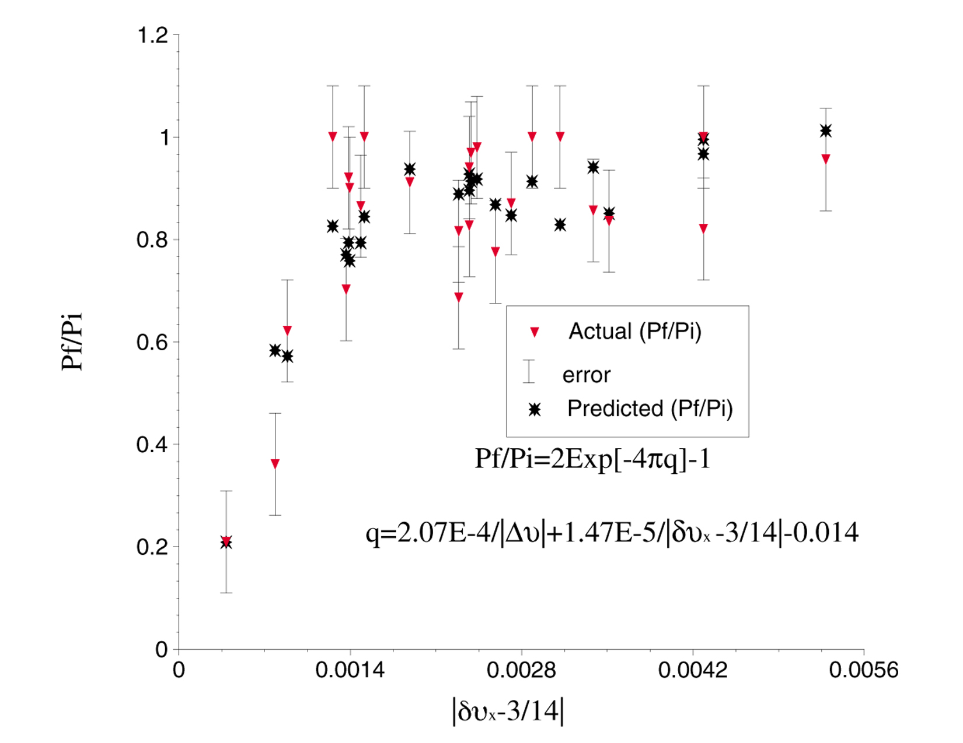
High-order Spin Resonances Observed in RHIC
¼ snake resonance
Coupled 3/14 snake resonance
While Snakes are suppressing first order resonances, the polarization still can be affected by high order spin resonances (Snake resonances) are
pronounced at higher energies and has to be avoided:

Slide 29
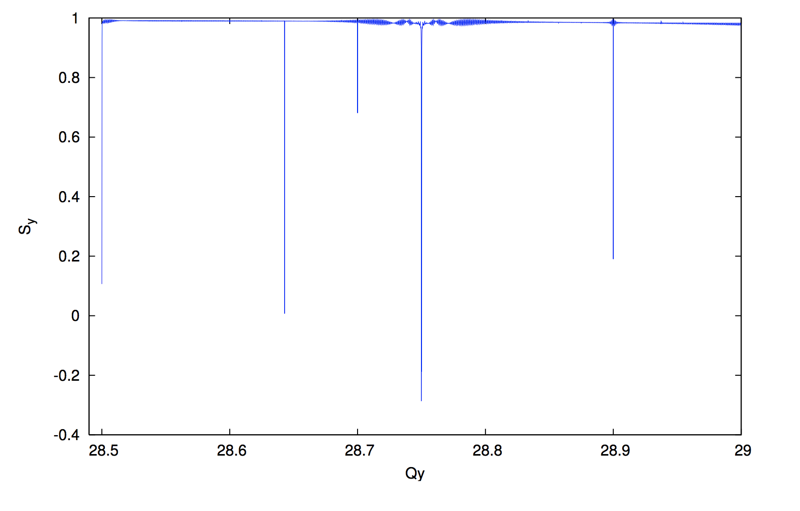
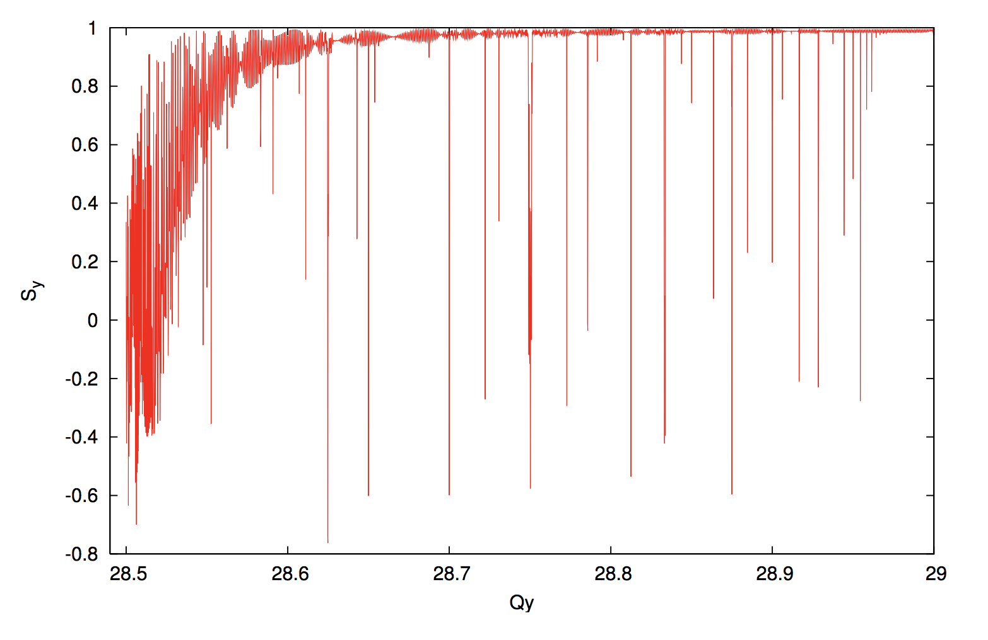
High-order spin resonance with different number of Snakes
RHIC with 2 Snakes
Snake resonance spectrum
EIC Hadron Ring with 6 Snakes
½ =m +/- nQ_{y}
S_{y}
S_{y}
RHIC tune space
6-snakes
2-snakes
Q_{y}
Increasing number of Snakes suppresses the strength of high-order spin resonances.
EIC HSR will use six Snakes

Slide 30
EIC Spin Rotators

Slide 31
Spin Rotators in Accelerators
Natural orientation of stable spin direction in accelerators is vertical. Particle physics experiments often require a specific polarization orientation (often, longitudinal) in experimental detectors.
In a circular accelerator usually a pair of spin rotators is installed around detector area, where the second rotator restored the polarization orientation to vertical.
Spin rotators also often used at low energies to convert the beam polarization produced by the particle source to a wanted orientation.

Slide 32
EIC Spin Rotators
EIC HSR will reuse the spin rotators from RHIC.
The rotators are based on the sequence of four helical dipole modules, similar to Siberian Snakes.
But, unlike the Snakes they use the helical magnets with with horizontal field orientation at the center of each helical module

Slide 33
EIC Spin Rotators
EIC HSR IR
RHIC IR6
The Hadron Storage Ring spin rotators:
The spin rotators used presently in RHIC will be re-used in the EIC HSR.
The locations of the spin rotators in the HSR differ considerably from their RHIC locations The net bending angle between HSR spin rotators is non-zero.
Snakes must be adjusted when the rotators are turned on at the store energy.
From RHIC experience:
In order to ensure correct operation of spin
rotators and longitudinal polarization at
the interaction point the polarization measurement between rotators and the IP is required.

Slide 34
Polarized He-3 in the EIC HSR

Slide 35
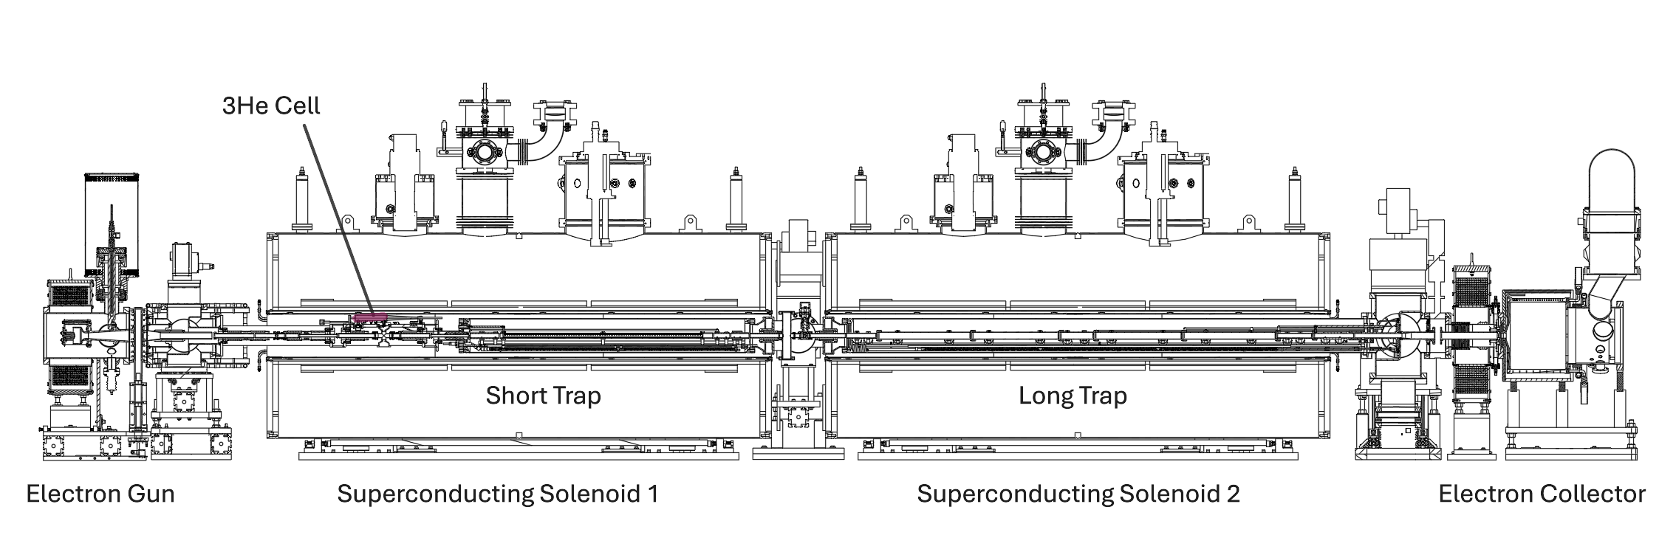
EBIS Polarized ³He⁺⁺
The polarized ³He ion source will be installed inside Solenoid 1.
The atoms of the ³He gas will be polarized by MEOP technique: Metastability Exchange Optical Pumping
The fast pulse valve will inject the polarized gas into the ion trap region of the EBIS.
Inside trap the³He ions will be stripped of electrons to the ³He⁺⁺ state.
The trap barrier is lowered and beam sent to Booster.
Intensity ~ 2.5∙10¹¹ ³He⁺⁺ ions in 20 us pulse ~4 mA-peak current
85% polarization at source to meet EIC 70% ring requirement

Slide 36
Polarized ³He⁺² in EIC
 | p | ³He⁺²
m, GeV | 0.938 | 2.808
G | 1.79 | -4.18
E/u, GeV | 24-275 | 16-183
|Gγ | | 46.5-525.5 | 72.6-819.4
RHIC Siberian snakes and spin rotators can be used for the spin control, with less orbit excursions than with protons.
More spin resonances. Larger resonance strength.
Proton spin resonances (10 mm*mrad)
He-3 spin resonances (10 mm*mrad)

Slide 37
Polarized ³He Acceleration in EIC HSR
Spin simulation studies showed that 6 Snakes are necessary to preserve ³He polarization at acceleration in HSR
Using Low Energy Cooling provides more margin against possible polarization loss by reducing the vertical beam emittance and, thus, intrinsic spin resonance strength
Crossing strongest spin resonance with 2 and 6 Snakes

Slide 38
He-3 Longitudinal Polarization
Rotator magnet power supply currents required to create longitudinal polarization at different energies
Using the same spin rotators as for protons
Summary table of currents show multiple configurations supported for each energy.
Energy | V2H outer | V2H inner | H2V outer | H2V inner
41 | 75 (-173) | 150 (-234) | 171 (-164) | 160 (-133)
100 | 174 (-94) | 221 (-138) | 47 (-157) | 181 (-255)
183 | 174 (-139) | 193 (-119) | 174 (-89) | 225 (-141)
K. Hock

Slide 39
Acceleration of polarized deuterons in EIC

Slide 40
Possibility for Polarized Deuterons in EIC
Unpolarized deuteron beam has been used in RHIC in the course of its ion physics program.
Presently, EIC physics program does not include polarized deuterons. Although there is a clear interest from n some part of nuclear physics community.
EIC accelerator scientists looked into possibility of getting highly polarized deuteron beam in EIC
 | p | ³He⁺² | d
m, GeV | 0.938 | 2.808 | 1.876
G | 1.79 | -4.18 | -0.14
E/u, GeV | 24-275 | 16-183 | 12-138
|Gγ | | 46.5-525.5 | 72.6-819.4 | 1.9-20.9
Small deuteron G:
Much higher magnetic field required for spin rotation
But:
Weaker resonances
Small number of resonances

Slide 41
Acceleration of Polarized Deuteron through the Injector Chain
Booster:
E: 0.95 GeV -> 1.3 GeV
Gγ : 0.14 -> 0.2
No imperfection resonances
With a proper choice of betatron tune: no intrinsic resonances
AGS:
E: 1.3 GeV -> 10 GeV
Gγ : 0.2 -> 1.5
Only one (very weak) imperfection resonance
Three weak intrinsic resonances
AGS acceleration rate is fast enough, and these resonances do not cause any polarization loss.

Slide 42
Polarized Deuteron Acceleration in EIC Hadron Ring
Energy: 10 GeV -> 137.5 GeV
Gγ : 1.5 – 20.9
Expected spin resonance strength:
Imperfection resonances: σ_{co} < 0.3 mm , ε_{imp} < 0.0015
Intrinsic resonances: ε_{int} ~0.0005-0.004
Polarization loss at imperfection resonances can be overcome by applying a periodic magnetic field (in the horizontal plane) to create an artificial strong resonance: Partial Snake ( technology used in AGS )
It produces adiabatic resonance crossing with spin-flip
For creating the partial snake detector solenoids, helical magnets, vertical orbit bumps, or combination of those can be used.

Slide 43
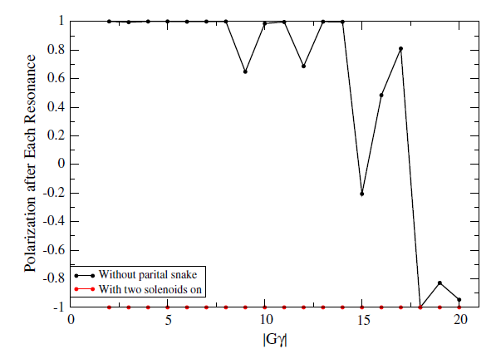
Overcoming Imperfection Resonance for Polarized Deuterons with Partial Snakes
Points on the plot demonstrate the efficiency of crossing imperfection resonances
Application of partial snakes based on solenoids (~20 Tm total field integral) prevents the polarization loss
H.Huang

Slide 44
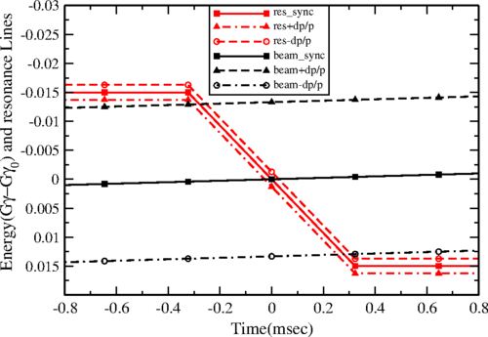
Overcoming Intrinsic Resonance for Polarized Deuterons with Tune Jump
Speed up crossing of intrinsic resonances using betatron tune jump ( technology used in AGS and IUCF )
Special quadrupoles are used capable of changing field on the scale of several hundred microseconds

Slide 45
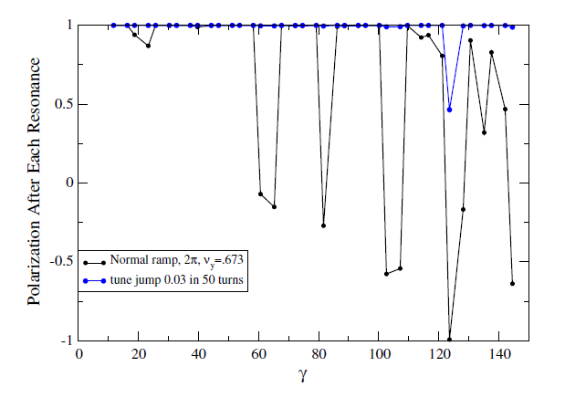
Overcoming Intrinsic Resonance for Polarized Deuterons with Tune Jump
Points on the plot demonstrate the efficiency of crossing intrinsic resonances
Application of betatron tune jumps prevents the polarization loss

Slide 46
Deuteron longitudinal polarization
Helical spin rotators require unreasonably large field (~300T*m)
Approach: use spin resonances Gγ =n to control spin direction At the resonance stable spin direction lies at the horizontal plane
Move the beam energy to an integer spin tune
Use combination of fields of detector solenoids, helical magnets and vertical orbit bumps (~3-4mm amplitude) to arrange the longitudinal polarization in one or two experimental detector locations
This way the longitudinal polarization is obtained at particular energies. For single detector operation these energies are separated by 6.58 GeV

Slide 47
Summary for Polarized Ions in EIC
Polarized He-3 will utilize devices and techniques presently used to accelerate polarized protons in the injector chain and in RHIC ring.
Number of Snakes in the hadron ring must be increased to 6 to guarantee the He-3 polarization preservation
Work on polarized He-3 source is underway in BNL. The source of the EBIS source.
Testing of polarized He-3 acceleration through the injector chain is expected in 2028-2030.
Acceleration of polarized deuteron looks feasible, involving a number of state-of-the-art technologies. Further polarized deuteron studies, including detailed simulations, can be arranged if a clear eRHIC physics program interest is declared in this topic.

Slide 48
Thank you for your attention!

