Slide 1
Beamline for Polarized Target Experiments in Hall C
b1/Azz Collaboration Meeting
Dave Gaskell
Jefferson Lab
June 3, 2026

Slide 2
Hall C Beamline – Layout for Unpolarized Targets
Compton Polarimeter
ARC and BSY
Møller Polarimeter
Møller Polarimeter
BCMs
Target
Fast raster
Diagnostic girder (harps, BPMs)

Slide 3
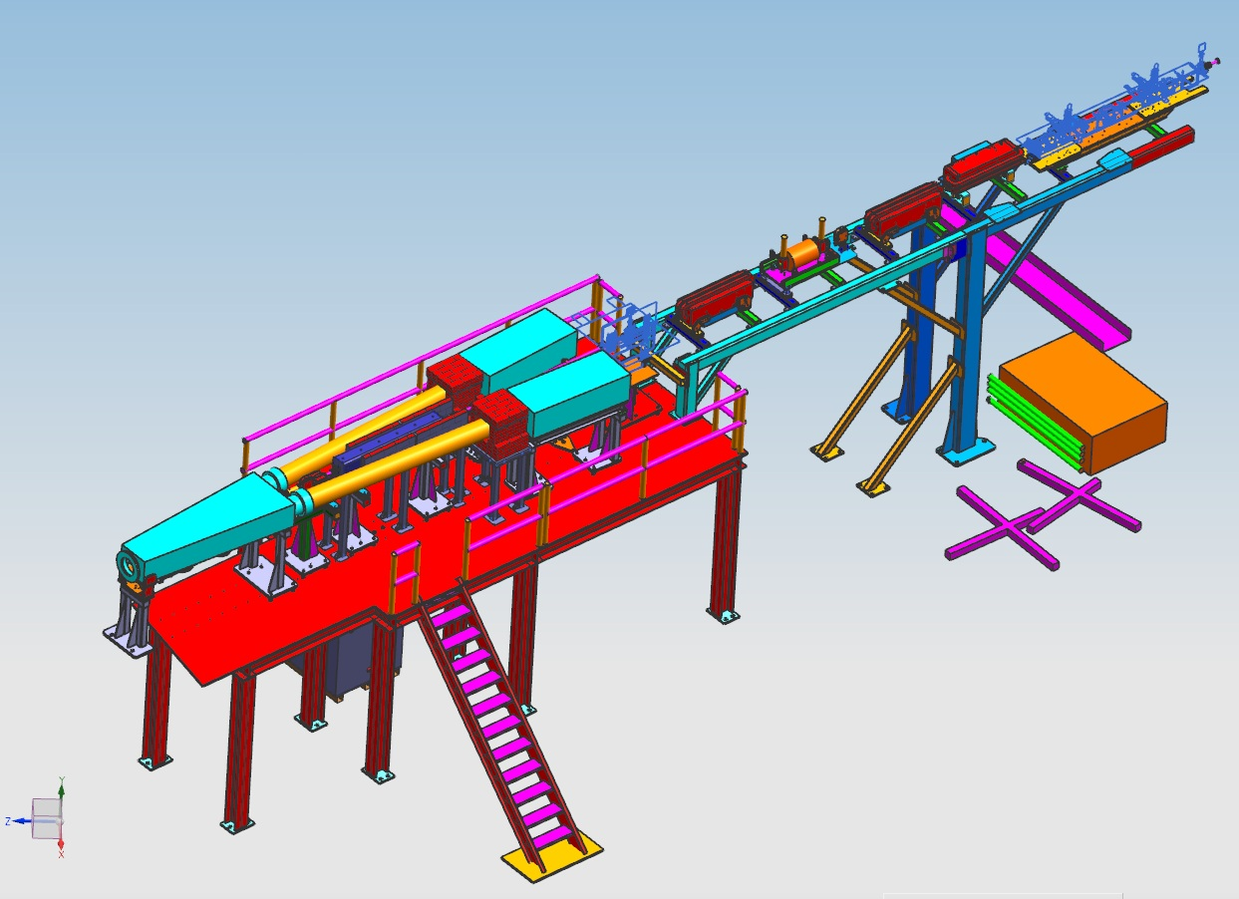
Nominal Hall C 12 GeV Beamline
BE magnets
BCM 4a/4b/4c
Diagnostic girder
Fast raster coils
BCM1/Unser/BCM2

Slide 4
Beamline for (not transversely) Polarized Targets
BE magnets
Slow raster coils
(2 x/y pairs)
Diagnostic girder
Polarized target girder
Fast raster coils (1 x/y pair)
Unused horizontal BE
(SHMS beam steering contingency)
BCM1/Unser/BCM2

Slide 5
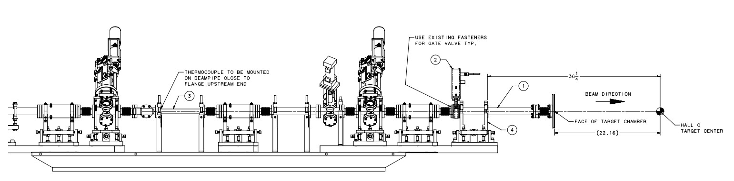
(Standard) Superharp Girder
1.5 inch beam pipe
2 inch BPMS

Slide 6
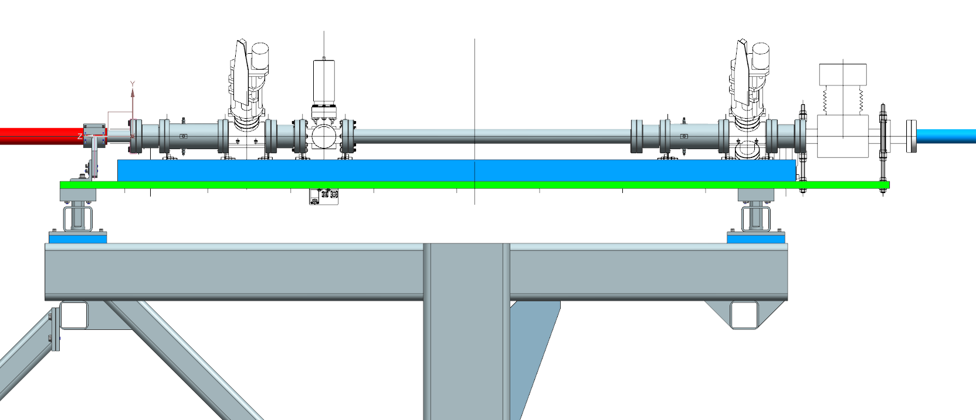
Polarized Target Girder
M20 (3 inch) BPMs
Larger aperture beam pipe and BPMs to accommodate slow raster
Superharps

Slide 7
Polarized Target Girder
Space for possible low current calibration device?

Slide 8
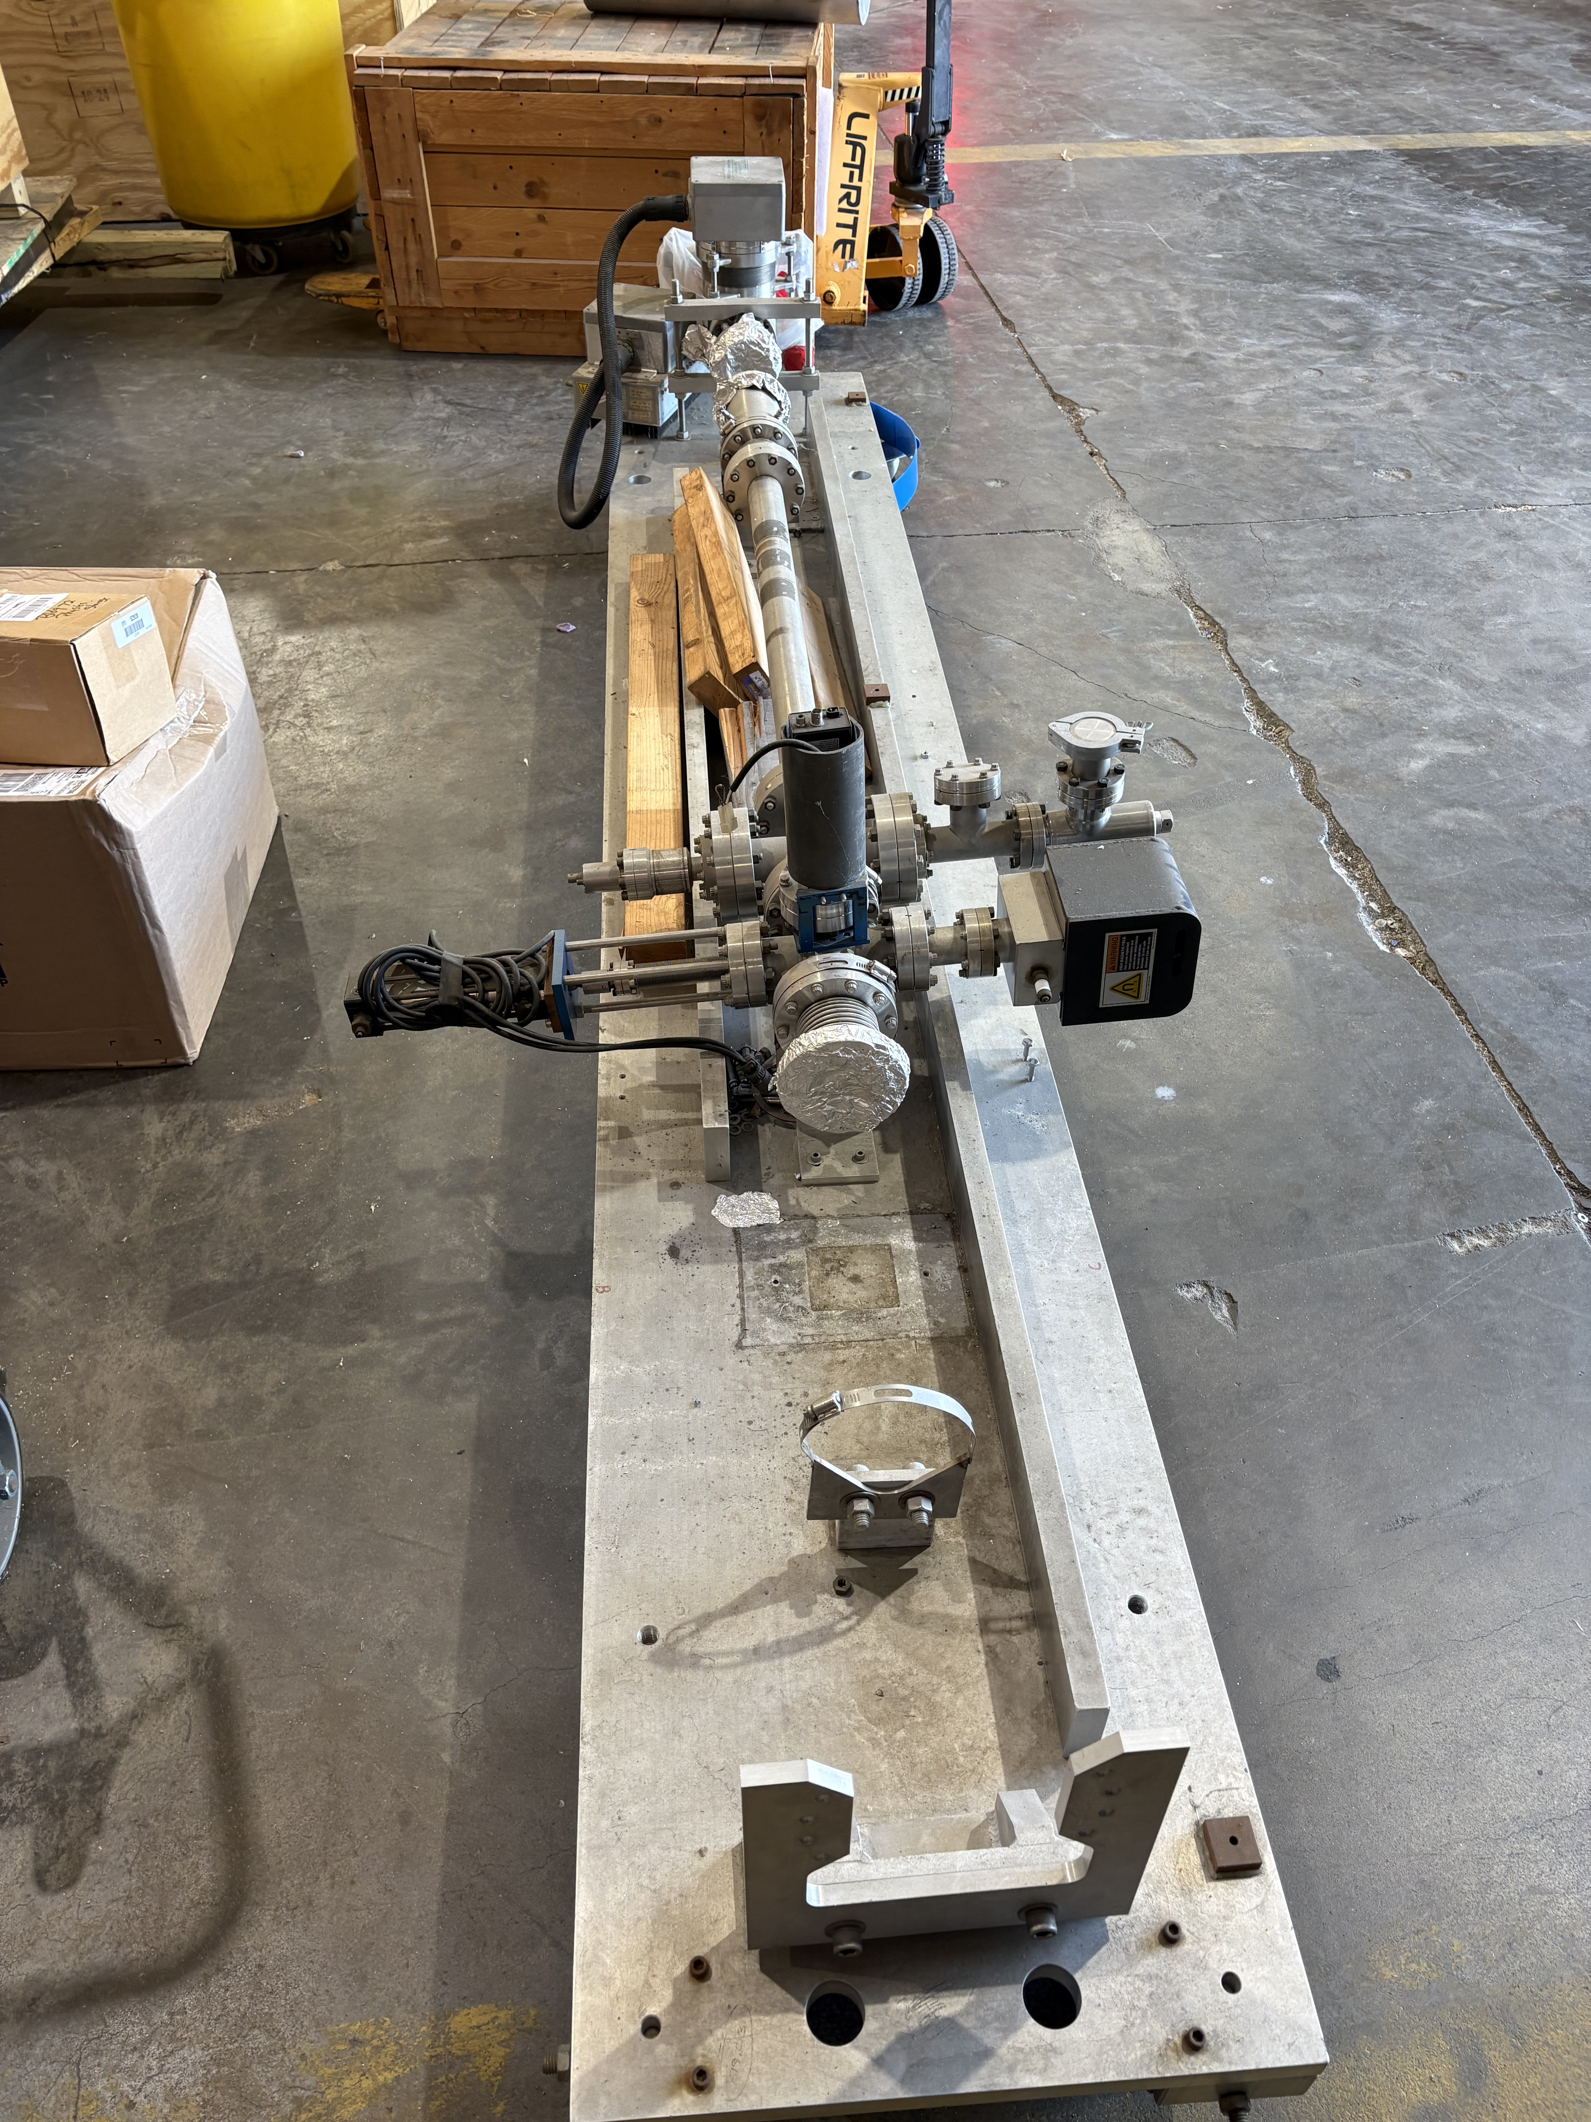
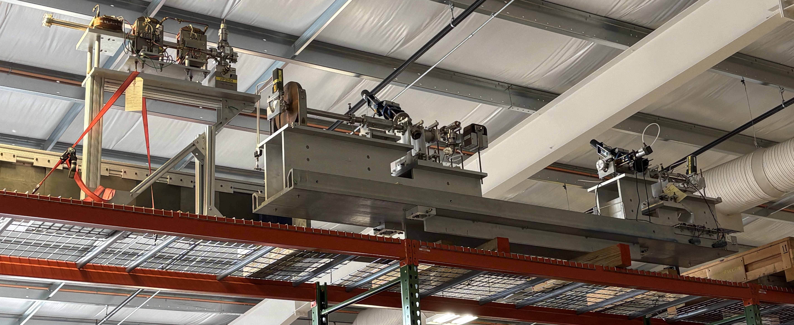
Polarized Target Girder
Polarized target girder will be used to provide additional diagnostics for Hypernuclear experiments
Polarized target girder has been removed from Physics Storage and staged in ESB
Significant refurbishment will be required
One BPM is missing – I&C has spare 3-inch BPM on hand
Spare harps can be taken from Q-Weak girder stored in ESB
New spool piece also needed
SEM has been removed

Slide 9
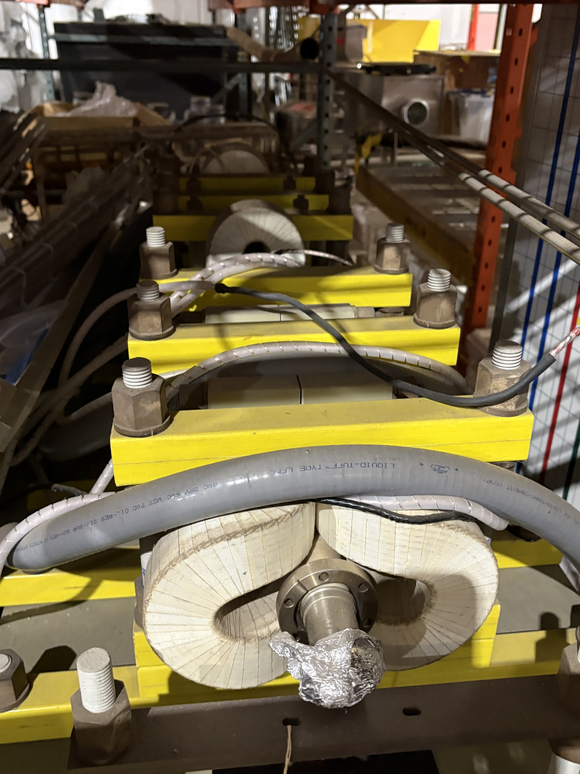
Slow Raster System
Before retirement, Chen Yan prepared all the raster coils that would be needed for 12 GeV era
2 sets of x/y fast raster coil pairs
2 sets of of x/y slow raster coil pairs
Found one set of slow raster coils on shelf in Physics Storage building
So far, unable to locate 2nd set of slow raster coils
One pair might have been lent to Hall B for HD-ICE target tests
→ Search ongoing

Slide 10
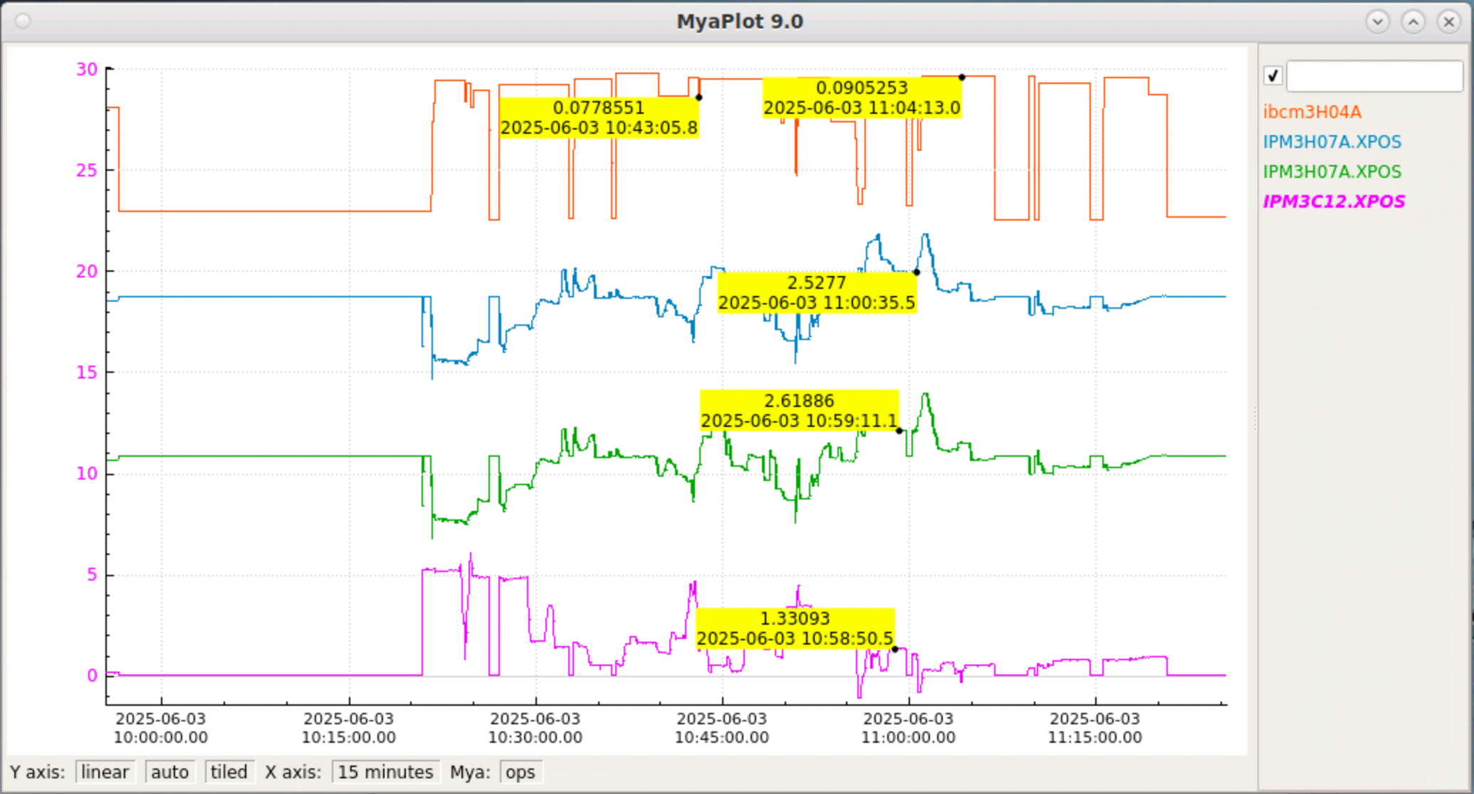
Beamline Performance at Low Currents
LAD experiment ran at lower currents during last run period
Typical production running was at 300 nA
Some tests were done at even lower currents (<100 nA)
Like 6 GeV era, beamline instrumentation (BPMs, BCMs) functioned ok
There was some issue getting the slow position locks working, but this could have been resolved if more time had been taken

Slide 11
Transverse Target Experiments
Ryan Bodenstein
JLab Tech note: 25-023
Target magnet
1m dipole
2m dipole
Transversely polarized target will require vertical chicane to successfully transport beam to dump
Central dipole will need to be at different elevation for each energy
Existing 1 m BE dipole and 2m FZ dipole not strong enough
In 6 GeV era, had telescoping stand for polarized target chicane
→ located in Physics Storage

Slide 12
Polarized Target Chicane Magnets
Polarized target chicane magnet requirements
  1 m dipole: 1.54 T
  2 m dipole capable of 1.45 T
Existing 1m BE dipole does not provide enough field → new dipole will be needed
Existing 2m FZ dipole can be used with modifications and new coils
Jay Benesch
JLab Tech note: 24-027
Jay Benesch has modelled and designed suitable dipole
Pole width reduced from 29.2 cm to 25 cm to make room for new coils
1000 A @ 75 V power supply needed

Slide 13
Scope of Work for Upstream Beamline
b1/Azz
  Detailed design for slow raster, polarized target girder placement
  Refurbish polarized target girder
  Installation (accelerator installation, vacuum groups, instrumentation, survey and alignment)
g2p
  Detailed design and fabrication of new and refurbished chicane magnets ($$)
  Detailed design of beamline → remove “bridge”, re-install telescoping stand + slow raster, target girder as noted above
  Installation – this will be significantly more complex and time consuming.

Slide 14
Beam and Beamline Personnel
Hall C APEL will be transitioning from Jay Benesch to Ryan Bodenstein → will play crucial role in beamline updates, especially for g2p
New Operations Liaison is Ashley Yoon (formerly Les Richardson) → provides important input on procedures, checks for beamline accuracy in CED and drawings, notes special requirements for experiments for Operations
Hall BCM Point of Contact is now Ciprian Gal
  We are fortunate that Dave Mack has returned to JLab as a User, but his focus will be on his research and developing Positron Program
Upstream beamline and polarimetry point of contact: Dave G.
  Bill Henry is also a Hall C Moller expert so can assist with questions, setup, running, etc.

Slide 15
EXTRA

Slide 16
Polarized Target Girder
M20 (3 inch) BPMs
Viewer
Superharps

