Slide 1


g2p2 Experiment Preparations
Tensor SIDIS Workshop
6/5/26
David Ruth

Slide 2
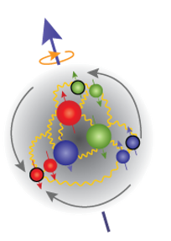
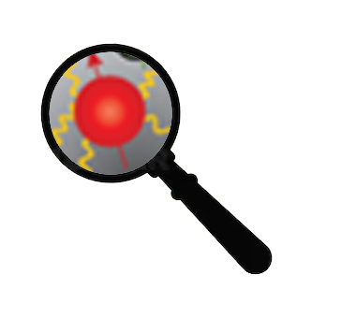
QCD
?
Low
Q²
High
Partons Combine to Form Nucleon
Confinement
Effective Theories: χPT
Can’t use Twist Approx.
Quark/Gluon Correlations
Lattice QCD
Higher Twists
Individual Partons
Asymptotic Freedom
Perturbative QCD
Leading Twist

Slide 3

How to study QCD and higher twist in the transition region?
In unpolarized systems, F₁ / F₂ structure functions describe quark-gluon distribution:
In a spin-½ polarized system, g₁/g₂ describe the spin distribution :
Nucleon Spin Structure
Quark-Gluon Correlations

Slide 4
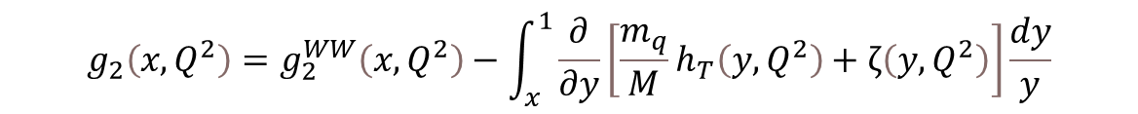

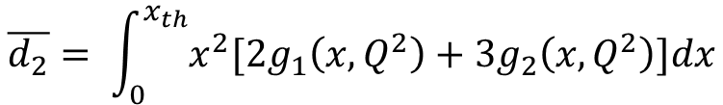
g₂ Structure Function enables direct tests of QCD and higher twist
Higher Twist:
Benchmarking (Lattice) QCD:
Small
$$g_{2}\left(x,Q^{2}\right)=g_{2}^{WW}\left(x,Q^{2}\right)−\int_{x}^{1}{\frac{∂}{∂y}\left[\frac{m_{q}}{M}h_{T}\left(y,Q^{2}\right)+ζ\left(y,Q^{2}\right)\right]\frac{dy}{y}}$$
$\overline{g_{2}}$ - Never measured for the proton!
Twist-3
Function of g₁
Weighted integrals (moments) of the spin structure functions can be directly calculated by effective theories:
Polarizabilities describe nucleon’s ensemble response to an external field
B-Field
$$\overline{d_{2}}= \int_{0}^{x_{th}}{x^{2}[{2g}_{1}\left(x,Q^{2}\right)+{3g}_{2}\left(x,Q^{2}\right)]dx}$$
Proton
Proton

Slide 5
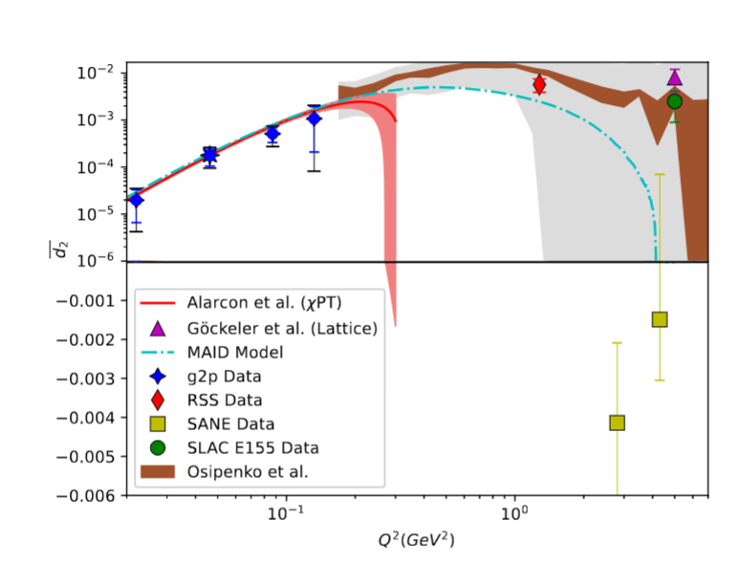
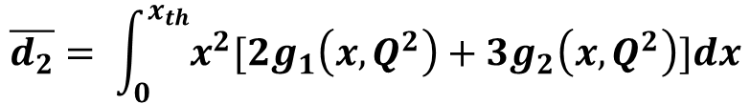
“Color Polarizability” d₂
$$\overline{d_{2}}= \int_{0}^{x_{th}}{x^{2}[{2g}_{1}\left(x,Q^{2}\right)+{3g}_{2}\left(x,Q^{2}\right)]dx}$$
At high Q²: color polarizability / “color Lorentz force”
Interesting differences in existing data motivate further study
Upcoming lattice predictions in this region need experimental benchmark!

Slide 6

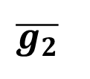
g₂ is the perfect quantity to study the transition regime…
$$g_{2}(x,Q^{2})$$
Examine quark-gluon correlations ✅
Study interaction dependent (twist-3) effects ✅
Benchmark Lattice QCD ✅
However…
$$\overline{g_{2}}$$
d₂

Slide 7
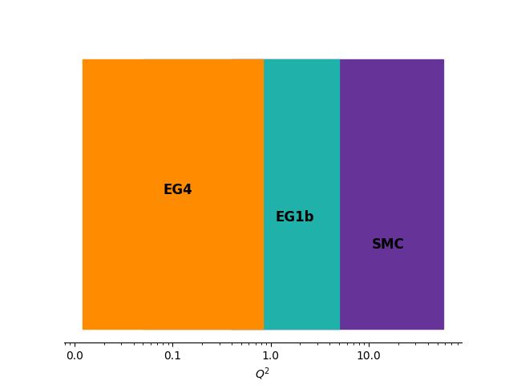
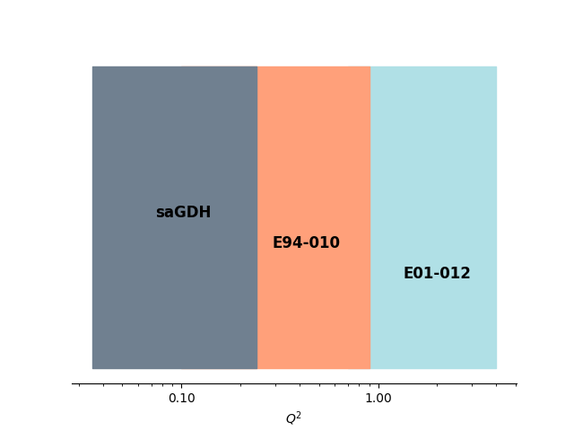
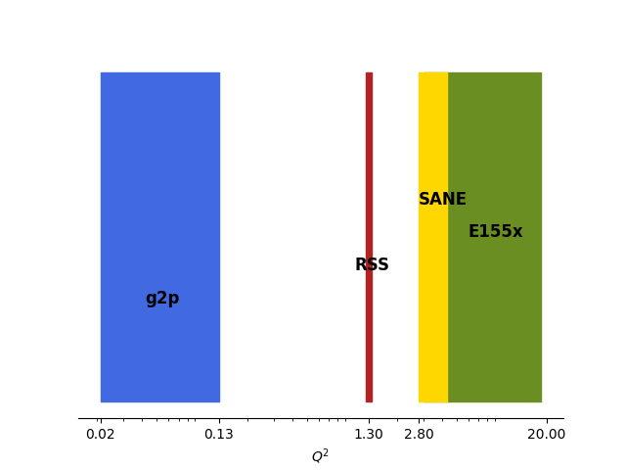
Proton
Neutron
g₁
g₂

Slide 8
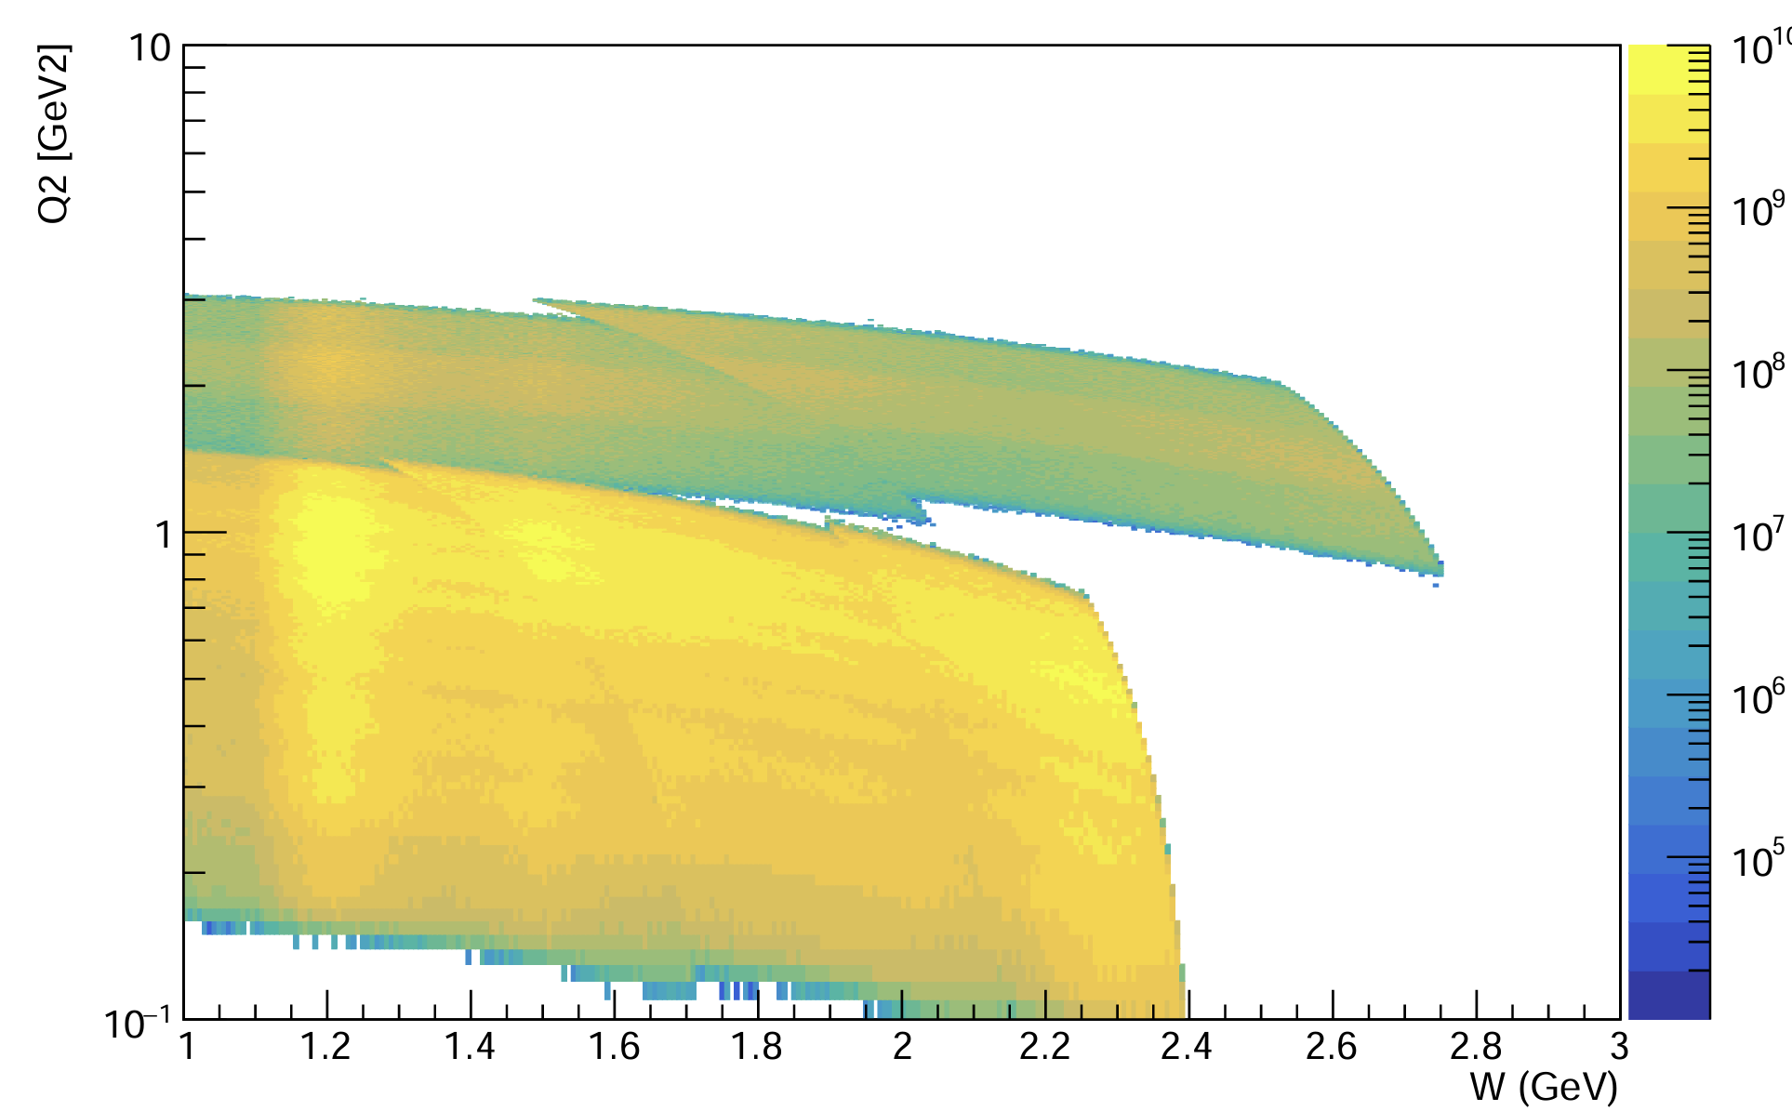
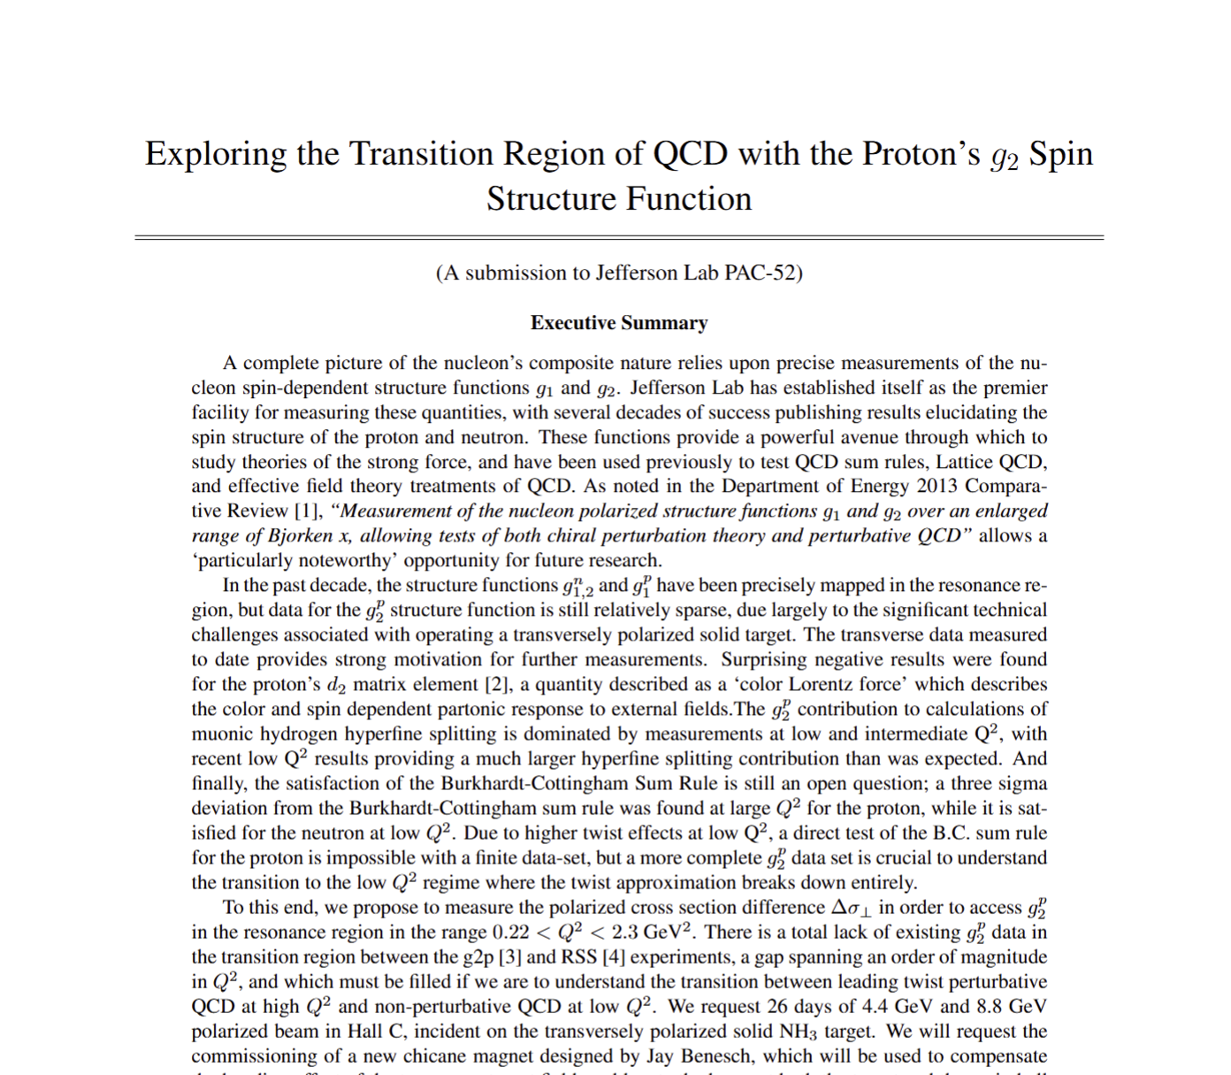
g2p2 Experiment (E12-24-002)
Measure proton g₂ in the resonance region for a full order of magnitude in Q² range from 0.2 GeV² - 2.2 GeV²
Use a transversely polarized NH₃ target and the SHMS spectrometer in Hall C
Collect the first transition region measurement of the proton’s g₂, and extract its moments and higher twist effects
8.8 GeV Beam
4.4 GeV Beam
Approved
A-
26 PAC Days

Slide 9
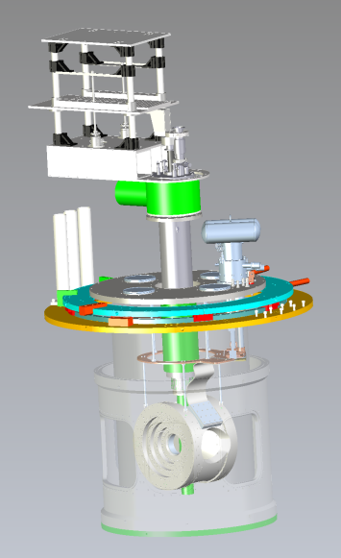
Synergy with Tensor Experiments
Hall C Experimental setup shares many equipment needs:
  Solid Polarized DNP Target
  Slow Raster
  Low Current Beamline Instrumentation
Differences:
  Tensor Enhancement Techniques
  Chicane Magnets
  Transverse Target Field
  Beamline revision to include pivot
Seems likely to be scheduled for run period after b₁/A_{zz}
Makes sense to collaborate on building the target, etc.
Potential for shared ERR

Slide 10
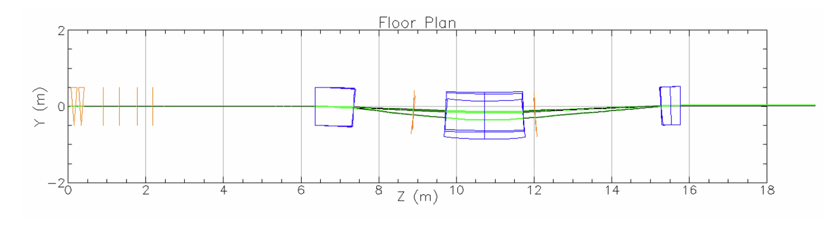
Chicane Magnet
See R. Bodenstein, JLAB-TN-25-023
The transverse target field needs pre-bending of the beam
Chicane design (J. Benesch) would replace two existing 1m dipoles
Further BMAD optimization performed by R. Bodenstein
High Priority: designs/drawings for the chicane and hoist-included beamline

Slide 11
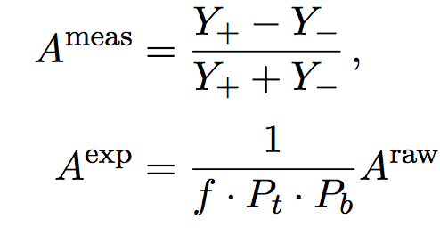
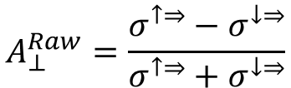
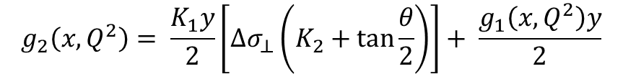


g₂ Extraction Method
Measure Asymmetry and Cross Section:
Form Polarized XS Difference:
Extract g₂
$$A_{⊥}^{Raw}=\frac{σ^{↑⇒}−σ^{↓⇒}}{σ^{↑⇒}+σ^{↓⇒}}$$
$$\frac{d2σ}{dΩdE′}=\frac{(ps)N}{N_{in}ρ(LT)ε_{det}}\frac{f}{ΔΩΔE′ΔZ}$$
Spin-Dependent Effects
Unpolarized
Scattering
$${∆σ}_{⊥} =2A_{⊥}^{exp}σ_{0}$$
Input from
Hall B Data
$$g_{2}\left(x,Q^{2}\right)= \frac{K_{1}y}{2}\left[Δσ_{⊥}\left(K_{2}+\tan{\frac{θ}{2}}\right)\right]+ \frac{g_{1}\left(x,Q^{2}\right)y}{2}$$

Slide 12
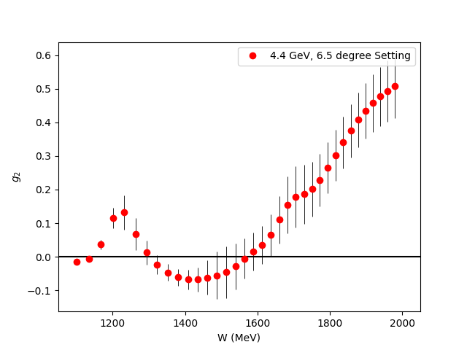
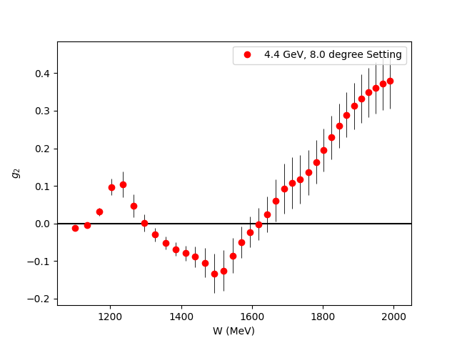
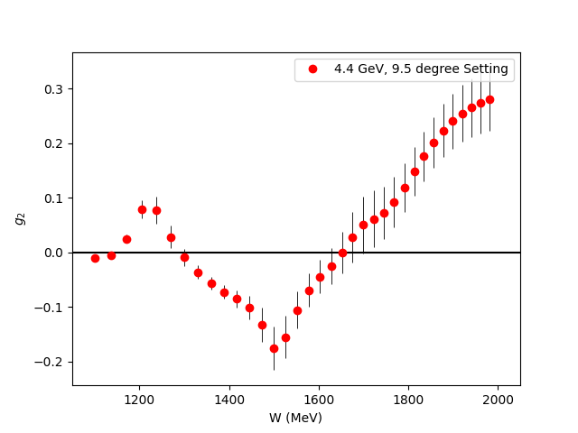
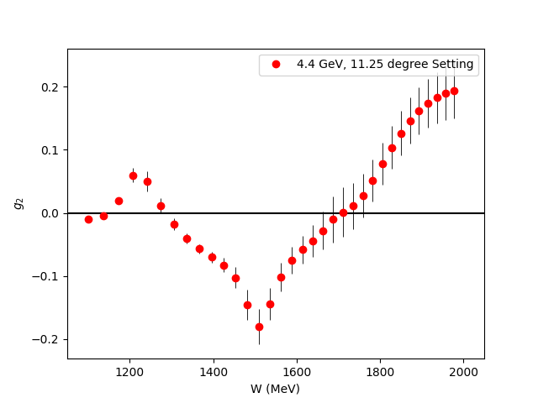
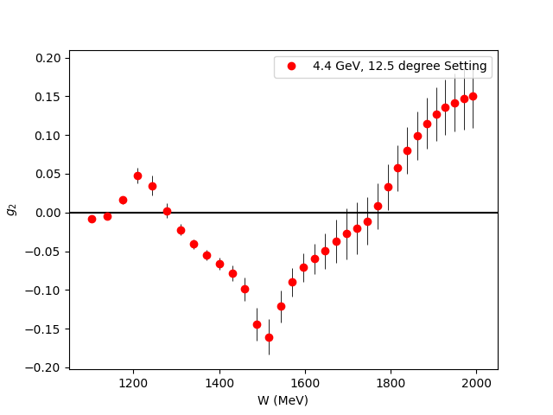
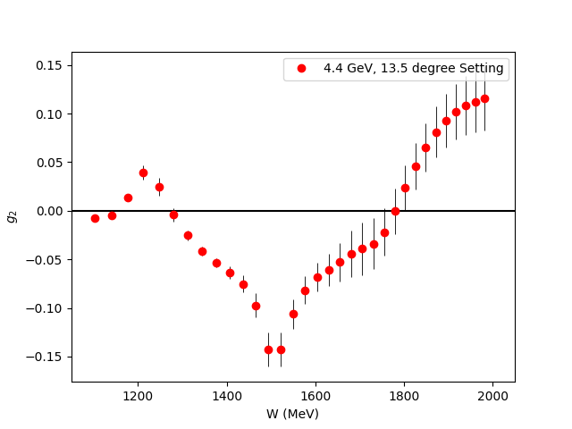
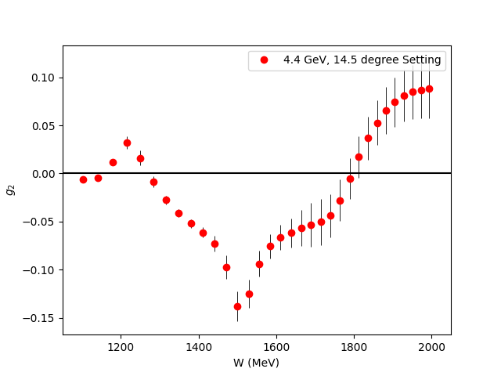
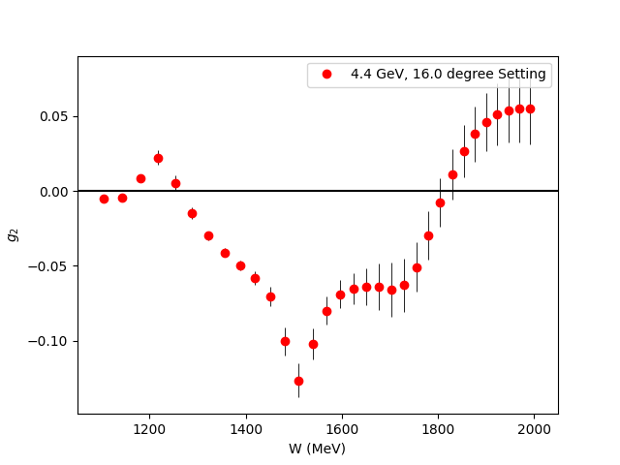
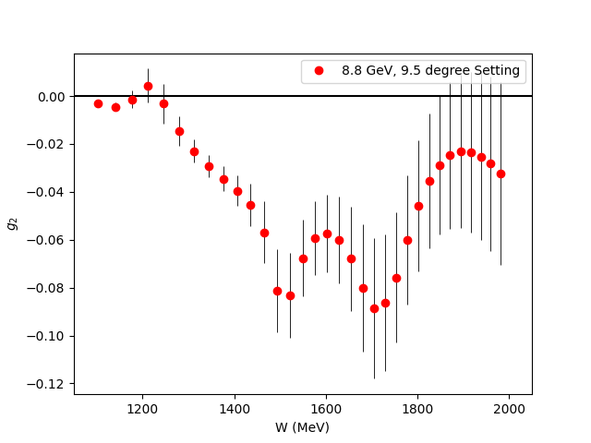
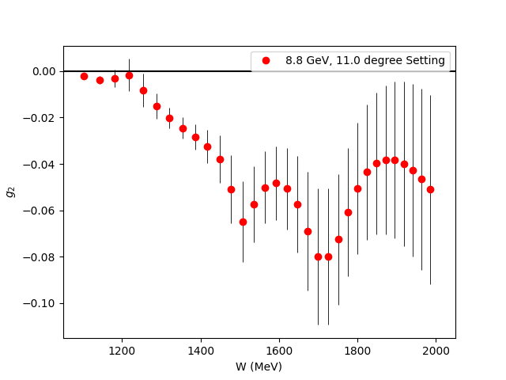
Projected g₂ Uncertainties
Fills the last major Q² spectrum gap for the nucleon spin structure functions
Covers almost the entire transition region

Slide 13
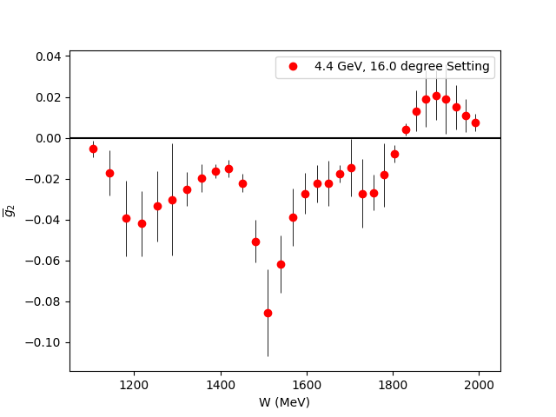


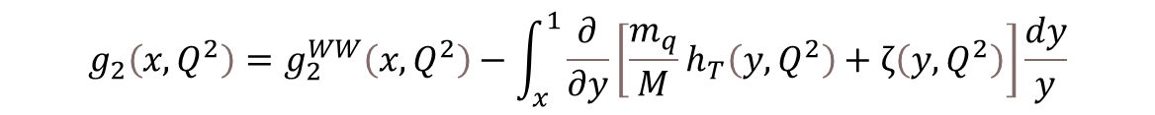
$\overline{g_{2}}$ (Twist 3 Extraction)
Small
$$g_{2}\left(x,Q^{2}\right)=g_{2}^{WW}\left(x,Q^{2}\right)−\int_{x}^{1}{\frac{∂}{∂y}\left[\frac{m_{q}}{M}h_{T}\left(y,Q^{2}\right)+ζ\left(y,Q^{2}\right)\right]\frac{dy}{y}}$$
$\overline{g_{2}}$ (Twist-3)
Utilize CLAS Hall B Results
for g₁ in same regime
Direct extraction of Twist 3 effects in the regime they contribute most significantly
Can also be used to study Dynamical Mass Generation
World First Extraction of this quantity

Slide 14
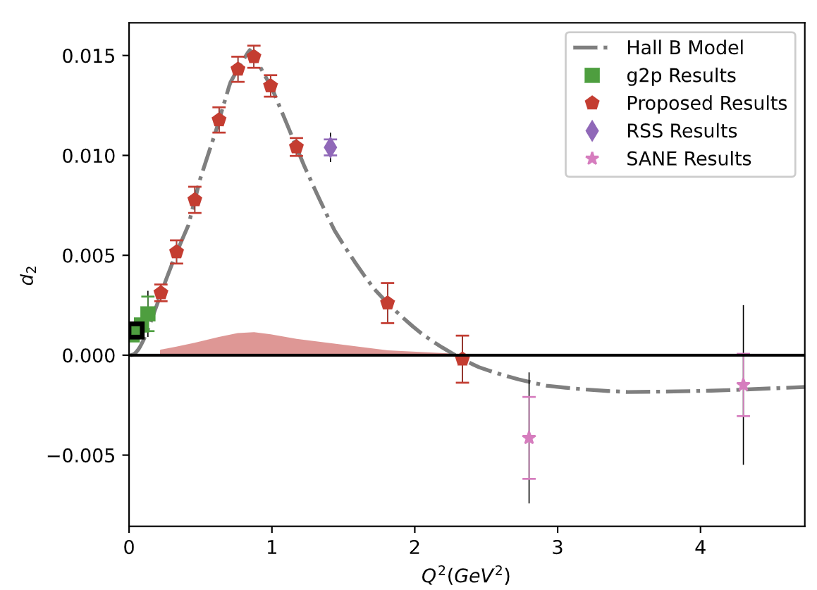

Projected $\overline{d_{2}}$ Uncertainties
Can benchmark Lattice QCD in the regime where Perturbative QCD starts failing
New Lattice calculations expected in next few years!

Slide 15
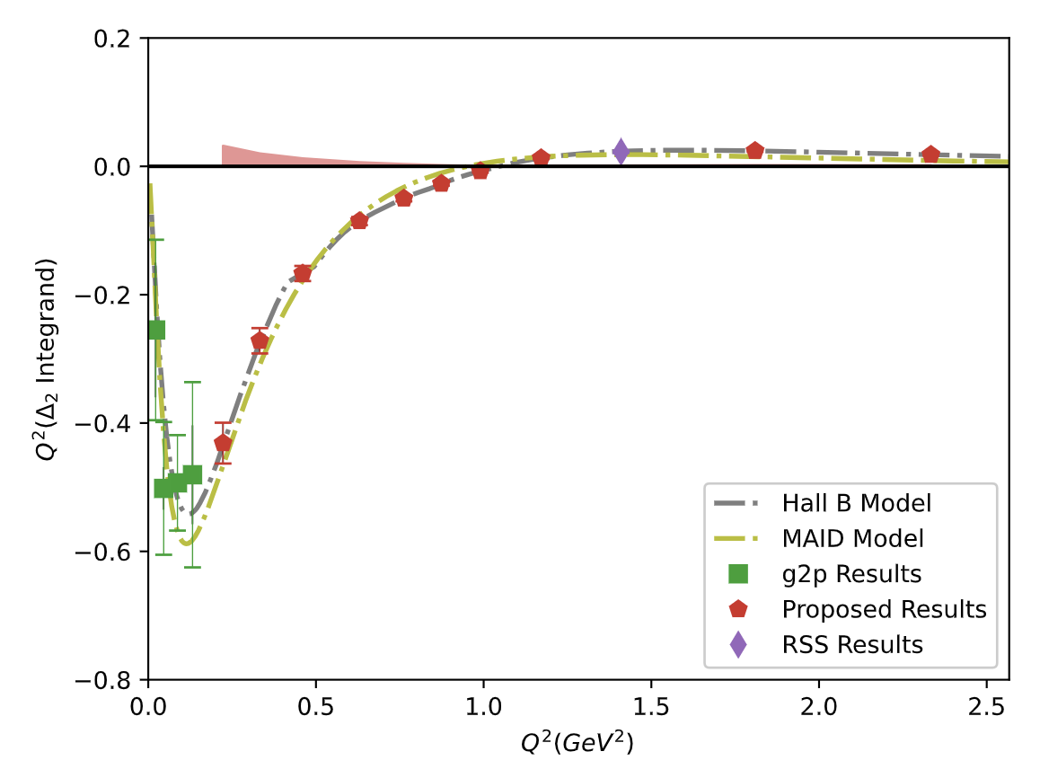
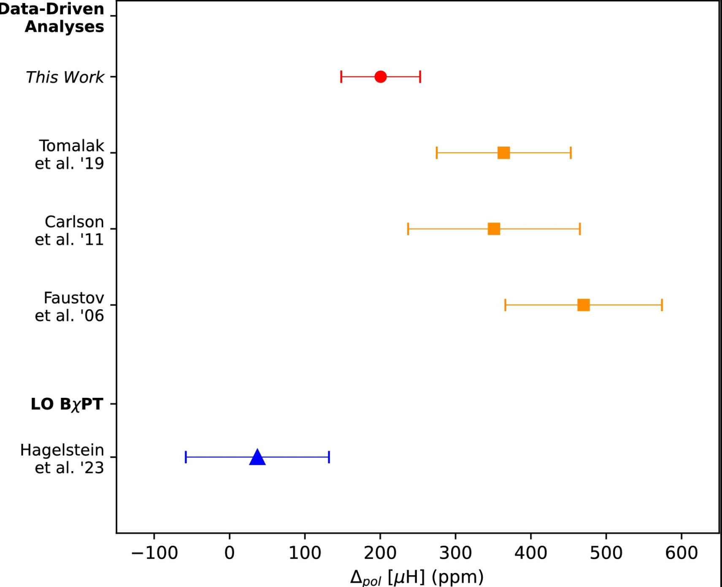
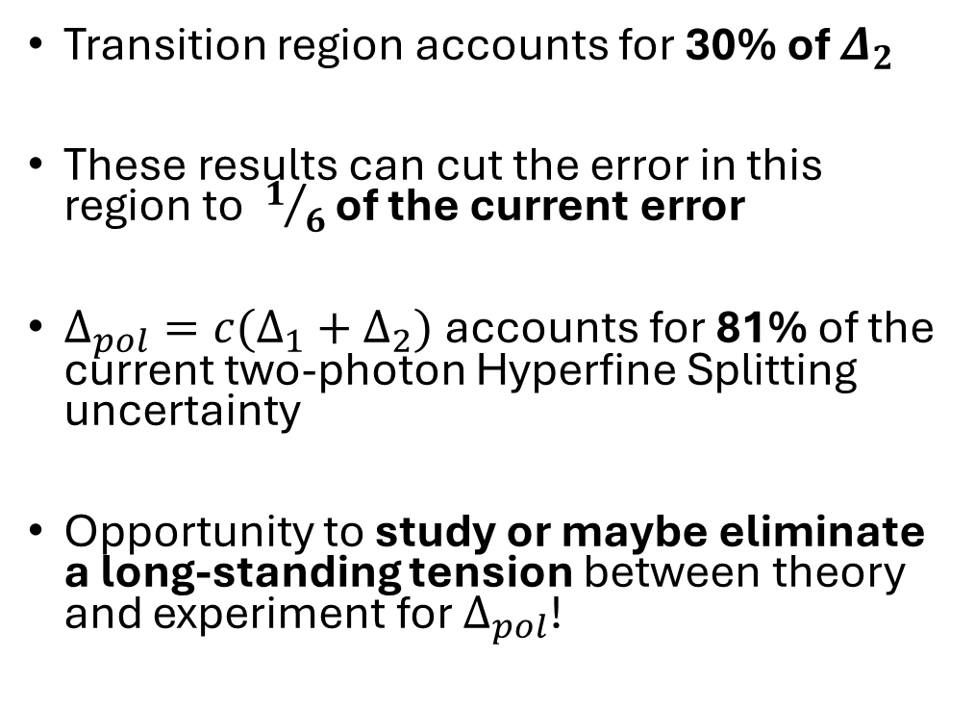


Hyperfine Splitting Impact
$$Δ_{2}=−24M_{p}^{2}\int_{0}^{∞}{\frac{dQ^{2}}{Q^{4}}}\int_{0}^{x_{th}}{\tilde{β_{2}}\left(x , Q^{2}\right)g_{2}\left(x , Q^{2}\right)dx}$$
Transition region accounts for 30% of $Δ_{2}$
These results can cut the error in this region to $1/6$ of the current error
$Δ_{pol}={c(Δ}_{1}+Δ_{2})$ accounts for 81% of the current two-photon Hyperfine Splitting uncertainty
Opportunity to study or maybe eliminate a long-standing tension between theory and experiment for $Δ_{pol}$!
Ruth
et al. ‘24
$$Δ_{pol}$$

Slide 16
Preparing for ERR
Major Requirements (guess):
  Proving the transverse target will be operational in time
  Designs and drawings for beamline revision outlined by D. Gaskell
  Proving the beamline instruments can run at 85 nA
Collaboration is ready to send students to help build the target
Need support from the lab to complete beamline design work + drawings
Hall C / Target Group Review Late 2027

Slide 17

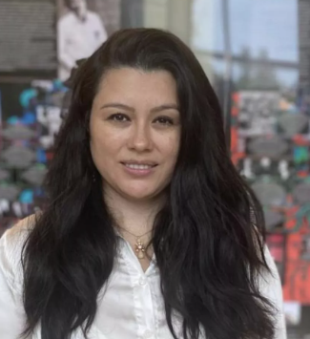
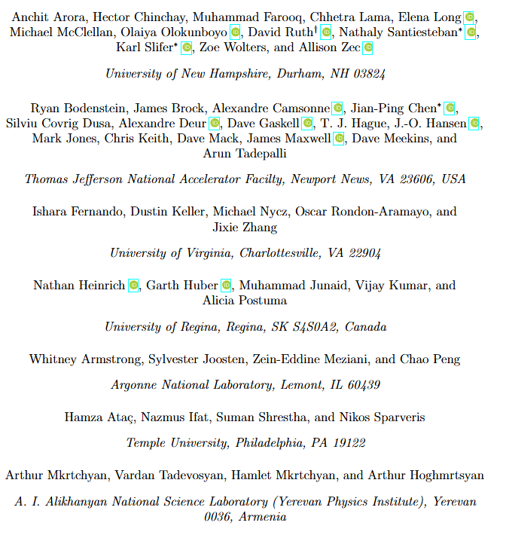
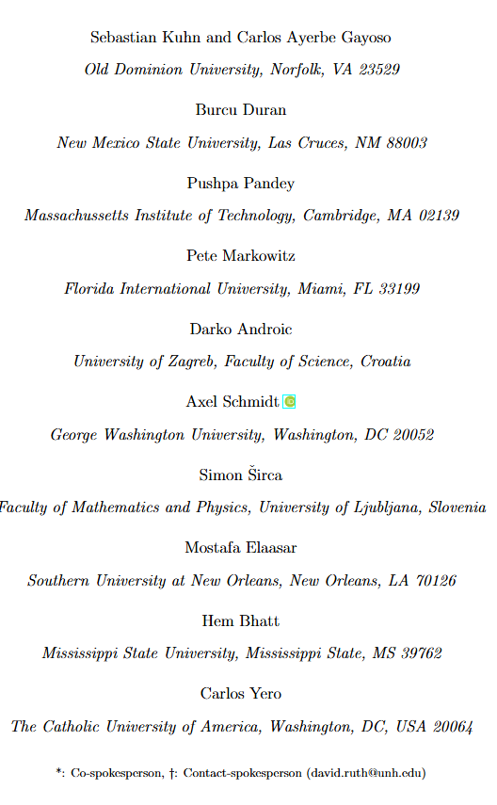
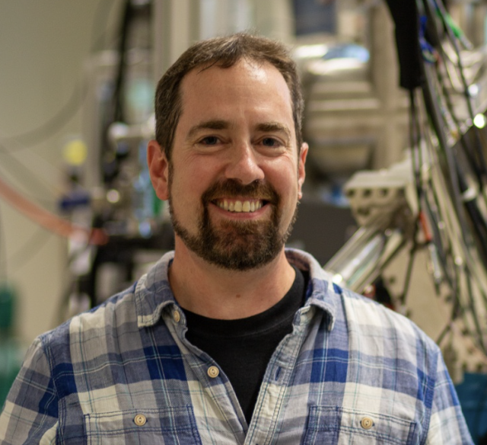
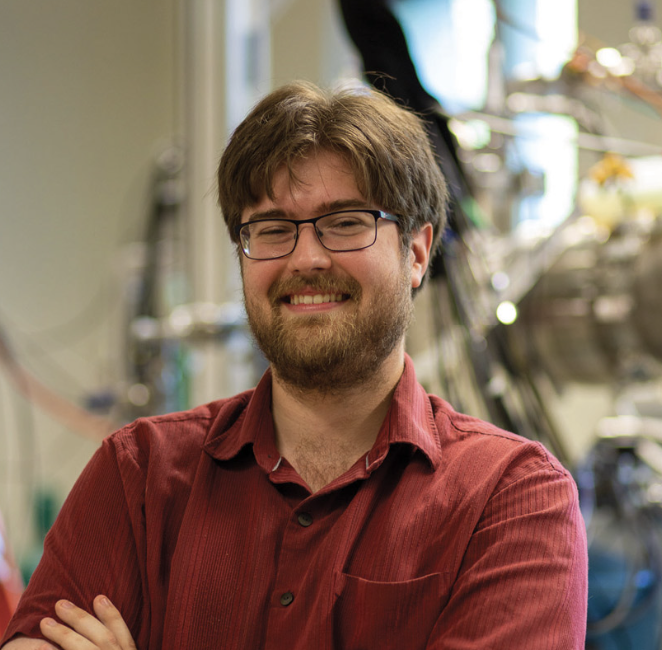
Thanks to the Collaboration!
Thanks especially to all the lab staff who helped us prepare the proposal:
Jian-Ping Chen
Nathaly Santiesteban
D. Gaskell
D. Mack
C. Keith
J. Benesch
R. Bodenstein
D. Higinbotham
M. Jones
S. Lassiter
And others…
Karl Slifer
David Ruth
Notes:
.

Slide 18
fin

Slide 19
Backup Slides

Slide 20
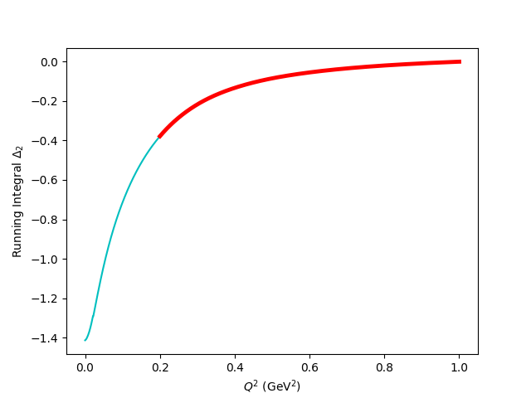

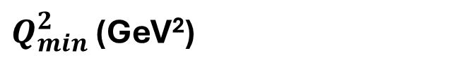
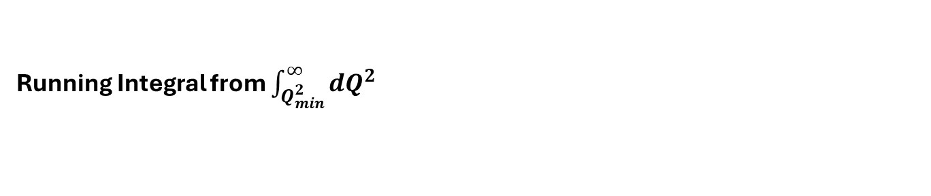
Hyperfine Contribution
Running Integral from $\int_{Q_{min}^{2}}^{∞}{dQ^{2}}$
$$Δ_{2}=−24M_{p}^{2}\int_{0}^{∞}{\frac{dQ^{2}}{Q^{4}}}\int_{0}^{x_{th}}{\tilde{β_{2}}\left(x , Q^{2}\right)g_{2}\left(x , Q^{2}\right)dx}$$
The leading error in theoretical calculations of the hydrogen HFS comes from these spin-structure function dependent integrals!
The subject of an ongoing tension between theory and experiment
The transition region accounts for ~30% of the integral!
Running Integral
$Q_{min}^{2}$ (GeV²)

Slide 21
Rates Table
E₀ (GeV) | Scattering Angle (deg) | P₀ (GeV) | Target Q² (GeV²) | Proton Rate (Hz) | Rate (kHz) | Time (h)
4.4 | 6.5 | 3.607 | 0.22 | 77 | 40.0 | 1
 |  | 2.661 |  | 65 | 25.1 | 1
 |  | 1.963 |  | 69 | 18.9 | 1
 | 8 | 3.607 | 0.33 | 41 | 21.4 | 1.3
 |  | 2.661 |  | 28 | 11.5 | 1.9
 |  | 1.963 |  | 30 | 8.3 | 1.8
 | 9.5 | 3.607 | 0.46 | 18 | 9.1 | 2.3
 |  | 2.661 |  | 14 | 5.9 | 3.0
 |  | 1.963 |  | 15 | 4.3 | 2.8
 | 11.2 | 3.607 | 0.62 | 7 | 3.7 | 6.0
 |  | 2.661 |  | 6 | 3.0 | 6.5
 |  | 1.963 |  | 7 | 2.2 | 5.9
 | 12.5 | 3.607 | 0.765 | 4 | 2.0 | 9.1
 |  | 2.661 |  | 4 | 1.9 | 8.5
 |  | 1.963 |  | 4 | 1.5 | 7.6
 | 13.5 | 3.607 | 0.892 | 2 | 1.3 | 16.5
 |  | 2.661 |  | 3 | 1.3 | 13.7
 |  | 1.963 |  | 3 | 1.1 | 12.1
 | 14.5 | 3.607 | 1.028 | 1 | 0.8 | 23.2
 |  | 2.661 |  | 2 | 1.0 | 17.4
 |  | 1.963 |  | 2 | 0.8 | 14.9
 | 16 | 3.607 | 1.250 | 0 | 0.4 | 50.8
 |  | 2.661 |  | 1 | 0.6 | 32.7
 |  | 1.963 |  | 1 | 0.5 | 26.6
8.8 | 11 | 7.213 | 2.3 | 0 | 0.5 | 33.3
 |  | 5.321 |  | 0 | 0.8 | 19.0
 | 14 | 7.213 | 3.44 | 0 | 0.1 | 101.8
 |  | 5.321 |  | 0 | 0.2 | 31.6
Total PAC Days:
13.0

Slide 22
Overhead
Overhead | Number | Time Per (hr) | (hr)
Target Anneal | 26 | 2.0 | 52.0
Beamline Survey | 10 | 8.0 | 80.0
Target Swap | 2 | 4.0 | 8.0
Target T.E. | 6 | 4 | 24.0
Target Field Ramp | 10 | 1.0 | 10.0
Carbon, Dummy, Empty runs | 28 | 0.5 | 14.0
Pass Change | 2 | 4.0 | 8.0
Momentum Change | 28 | 0.5 | 14.0
Moller Measurement | 10(+1 shift) | 4.0(+8.0) | 48.0
Pair-Symmetric Background | 2 | 4.0 | 8.0
Optics Calibration | 2 | 16.0 | 32.0
BCM Calibration | 2 | 4.0 | 8.0
Total: 12.7 Overhead Days (305.5)

Slide 23
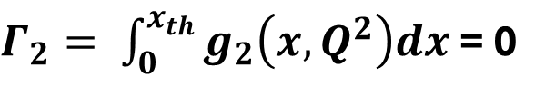
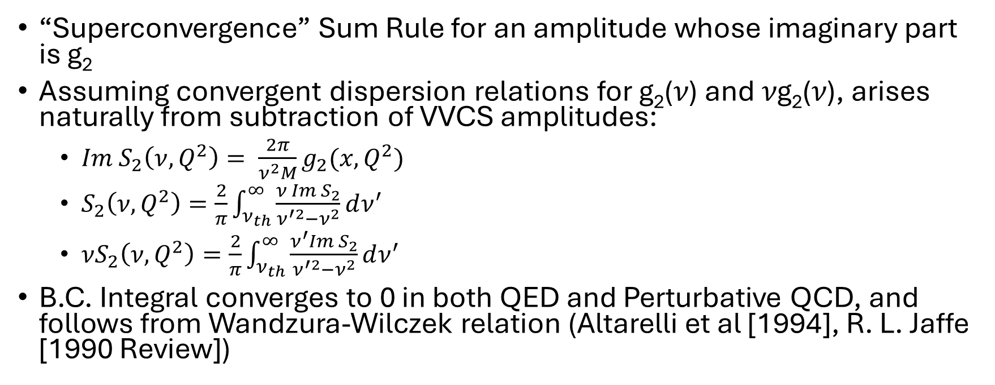
Burkhardt-Cottingham Sum Rule
$Γ_{2}= \int_{0}^{x_{th}}{g_{2}\left(x,Q^{2}\right)dx}$ = 0
“Superconvergence” Sum Rule for an amplitude whose imaginary part is g₂
Assuming convergent dispersion relations for g₂(𝜈) and 𝜈g₂(𝜈), arises naturally from subtraction of VVCS amplitudes:
  $Im S_{2}\left(ν,Q^{2}\right)= \frac{2π}{ν^{2}M}g_{2}(x,Q^{2})$
  $S_{2}\left(ν,Q^{2}\right)=\frac{2}{π}\int_{ν_{th}}^{∞}{\frac{ν Im S_{2}}{ν^{′2}−ν^{2}}dν^{′}}$
  $νS_{2}\left(ν,Q^{2}\right)=\frac{2}{π}\int_{ν_{th}}^{∞}{\frac{ν^{′}Im S_{2}}{ν^{′2}−ν^{2}}dν^{′}}$
B.C. Integral converges to 0 in both QED and Perturbative QCD, and follows from Wandzura-Wilczek relation (Altarelli et al [1994], R. L. Jaffe [1990 Review])

Slide 24
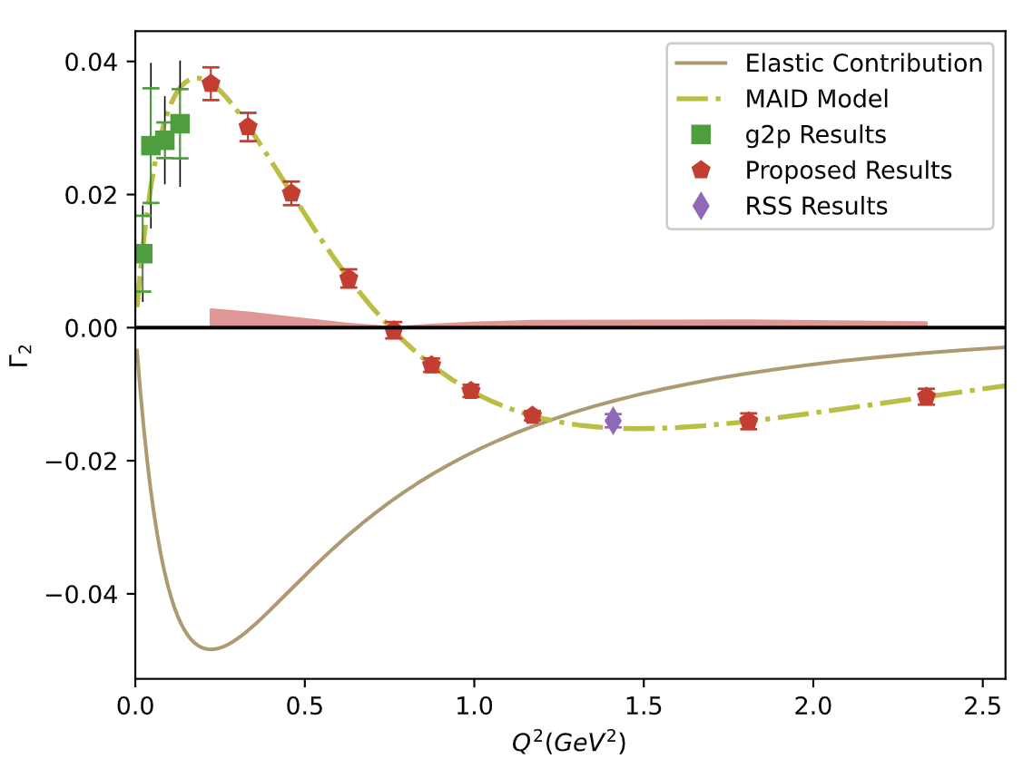
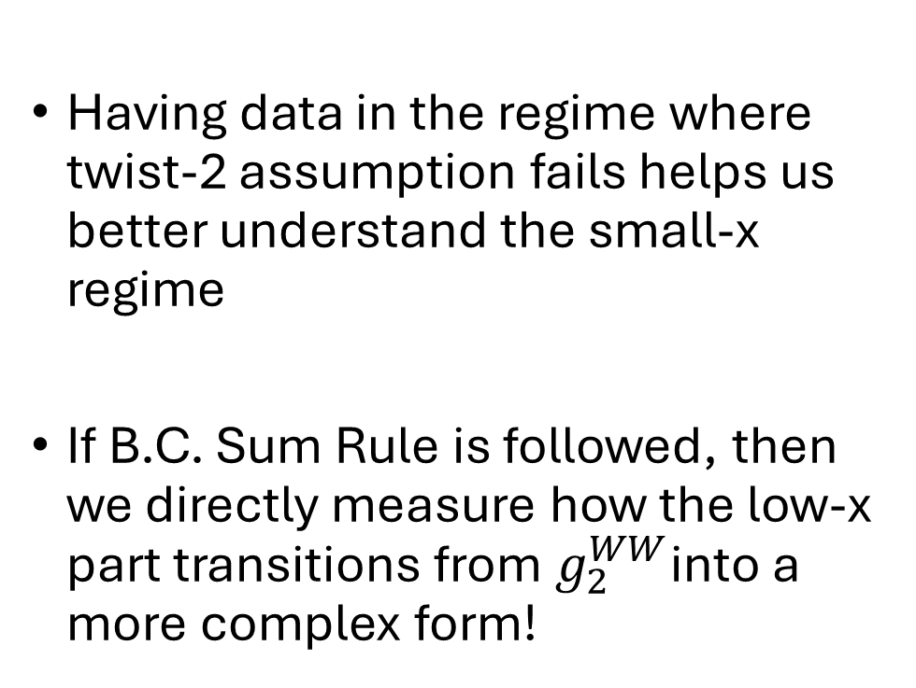

Projected $Γ_{2}$ Uncertainties
Having data in the regime where twist-2 assumption fails helps us better understand the small-x regime
If B.C. Sum Rule is followed, then we directly measure how the low-x part transitions from $g_{2}^{WW}$into a more complex form!

