Slide 1
Machine-Learning Enhanced Polarization Extraction and Manipulation
Devin Seay

Slide 2
Outline
Polarization Extraction Methods
Neural Networks
Results for Vector Polarization Extraction
ML-Powered Spin-1 Manipulation and Extraction

Slide 3
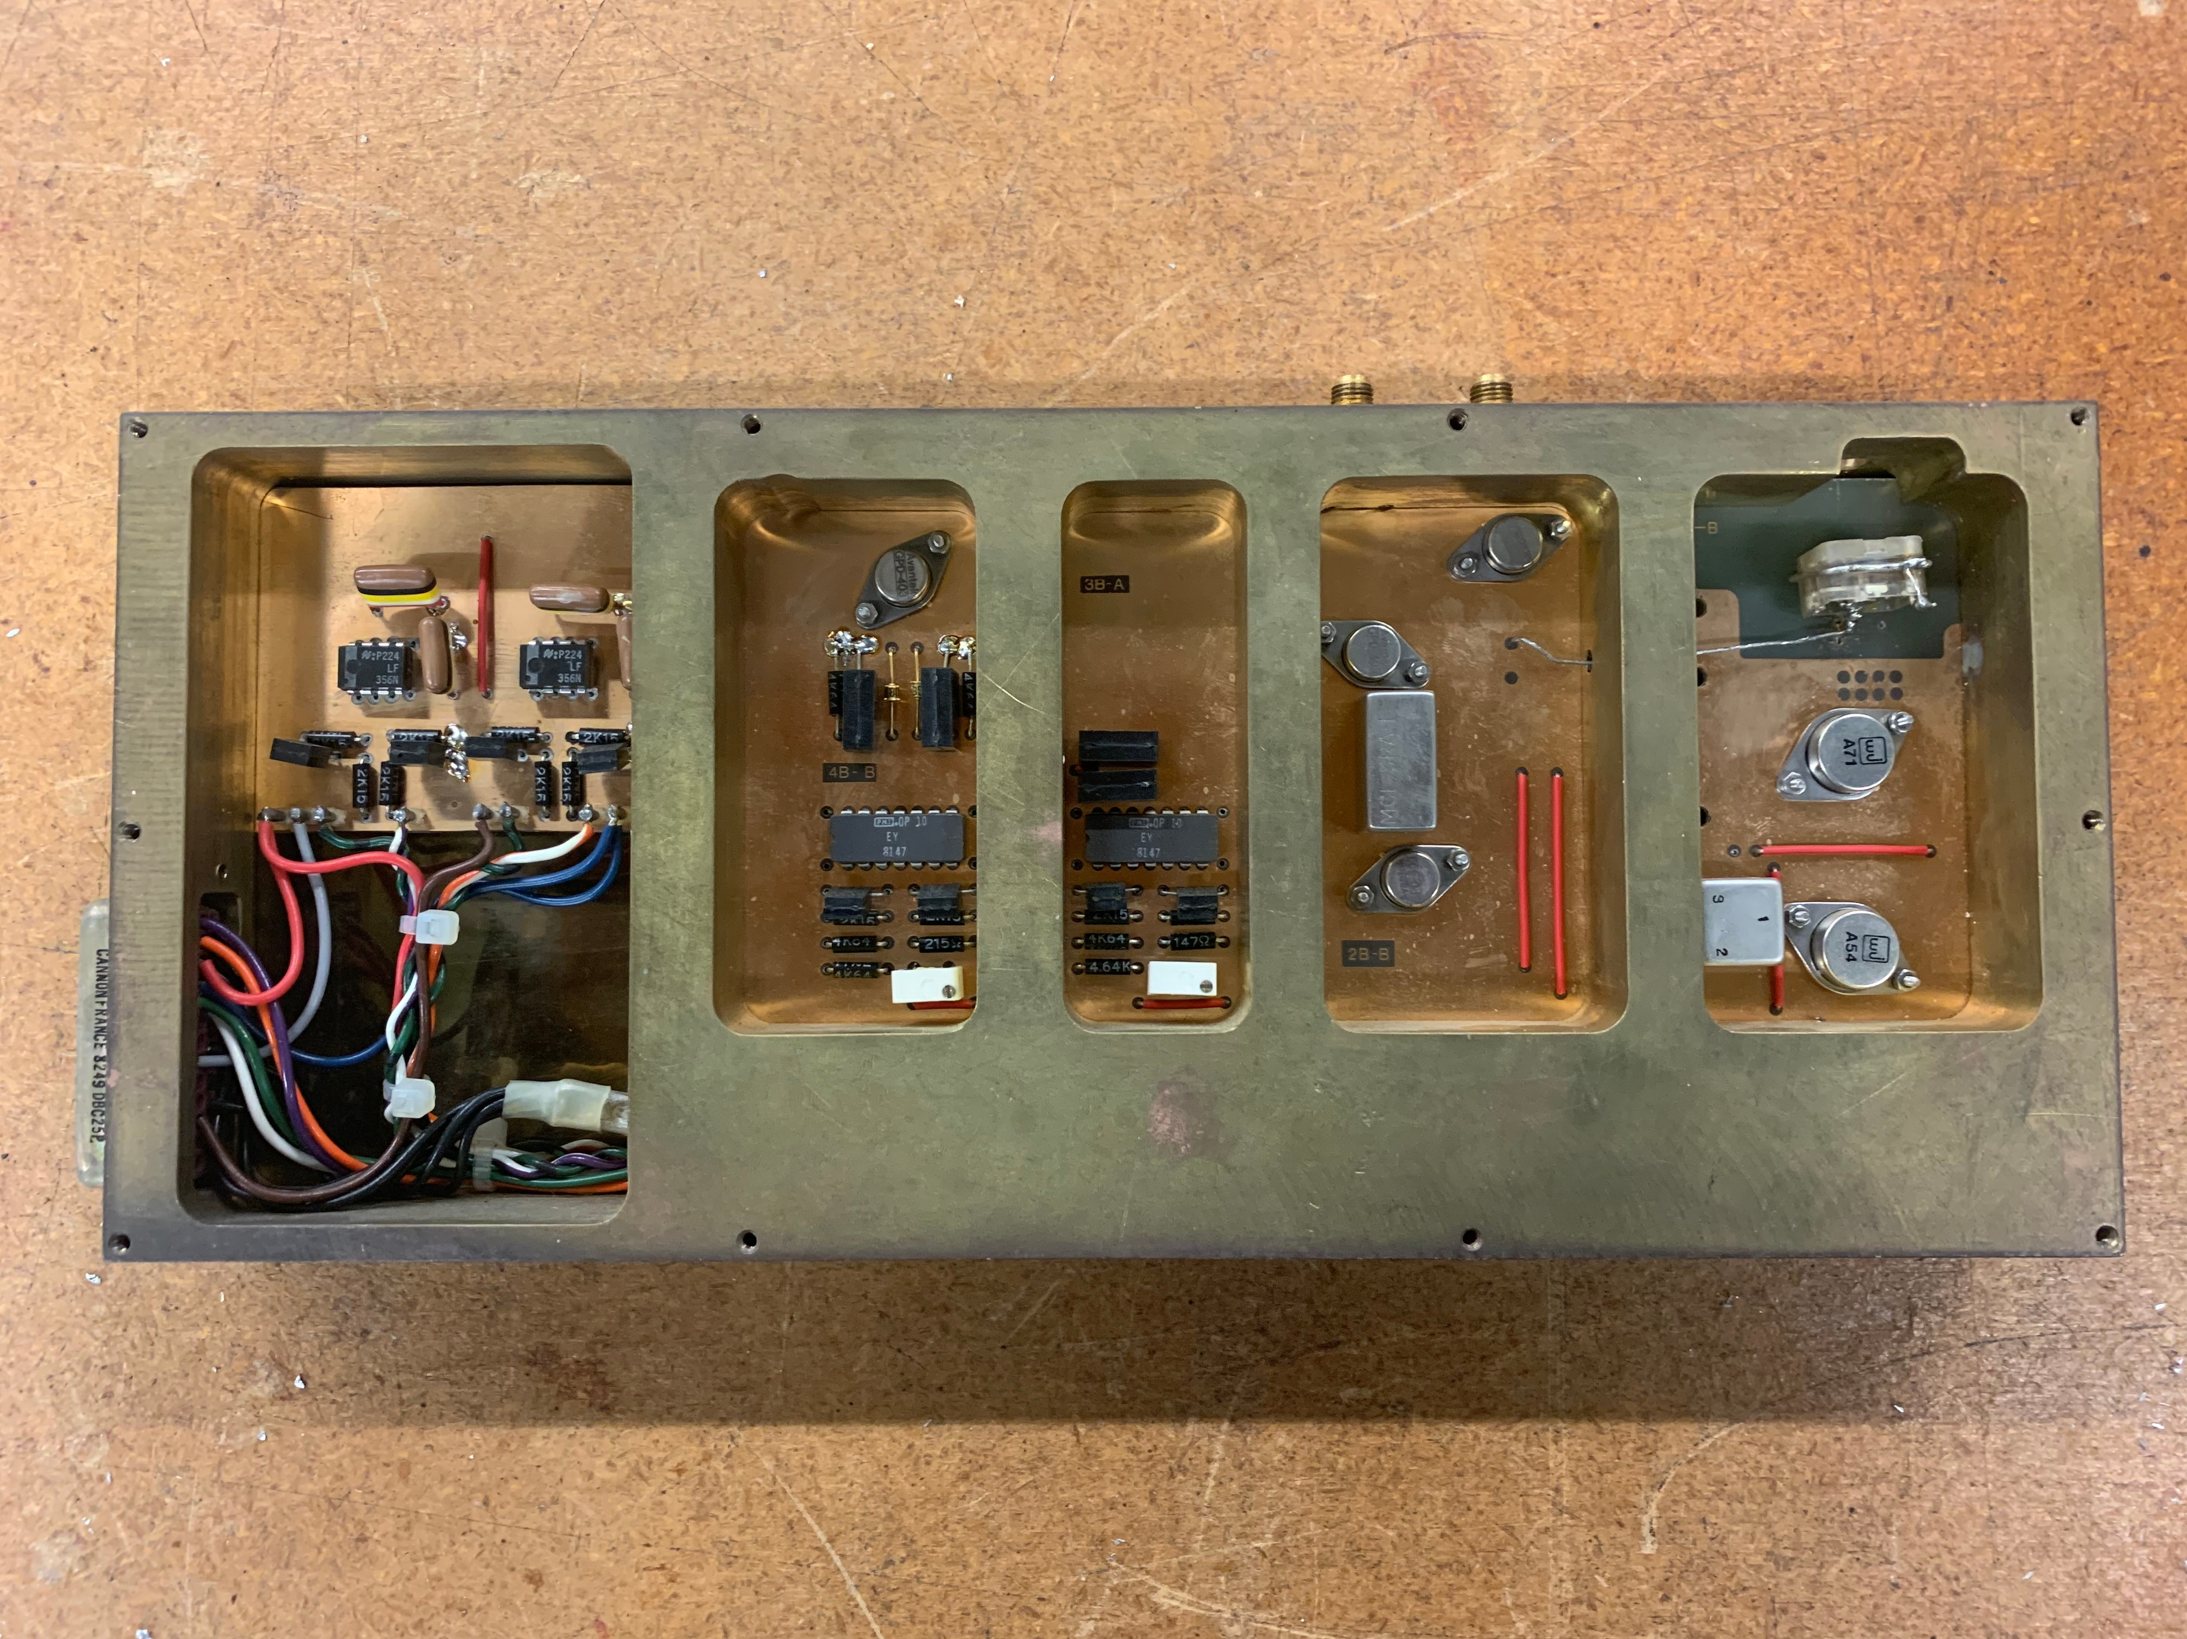
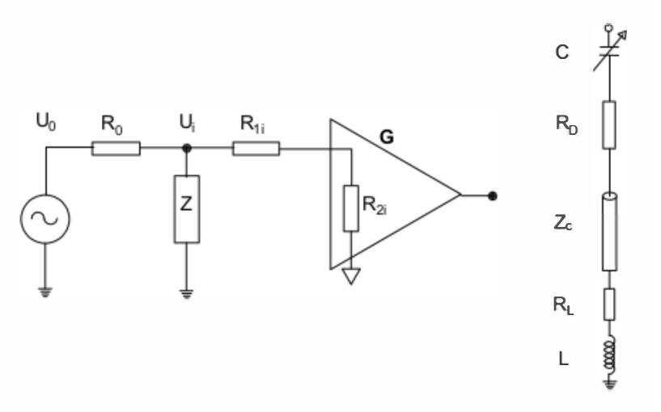
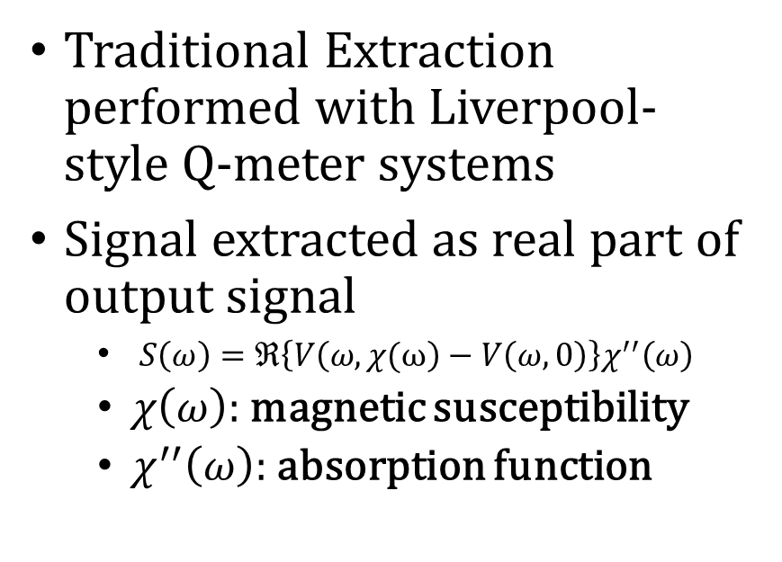
Background
Traditional Extraction performed with Liverpool-style Q-meter systems
Signal extracted as real part of output signal
  $S\left(ω\right)=ℜ\left\{V\left(ω, χ(ω\right)−V\left(ω,0\right)\right\}χ^{′′}\left(ω\right)$
  $χ\left(ω\right)$: magnetic susceptibility
  $χ^{′′}\left(ω\right)$: absorption function

Slide 4
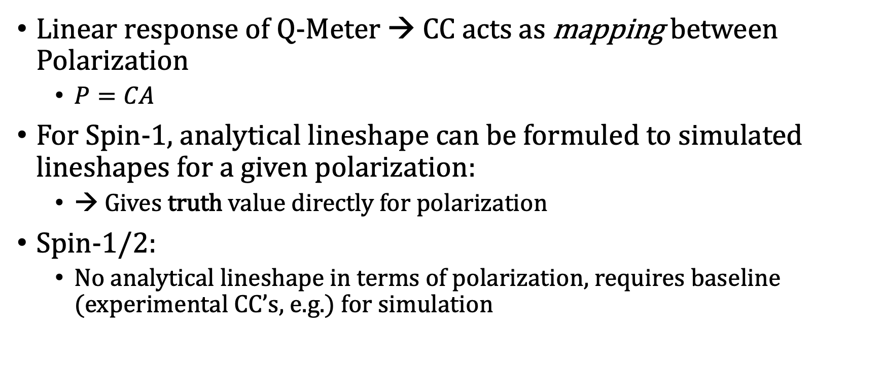
Calibration Constant (CC)
Linear response of Q-Meter → CC acts as mapping between Polarization
  $P=CA$
For Spin-1, analytical lineshape can be formuled to simulated lineshapes for a given polarization:
  → Gives truth value directly for polarization
Spin-1/2:
  No analytical lineshape in terms of polarization, requires baseline (experimental CC’s, e.g.) for simulation

Slide 5
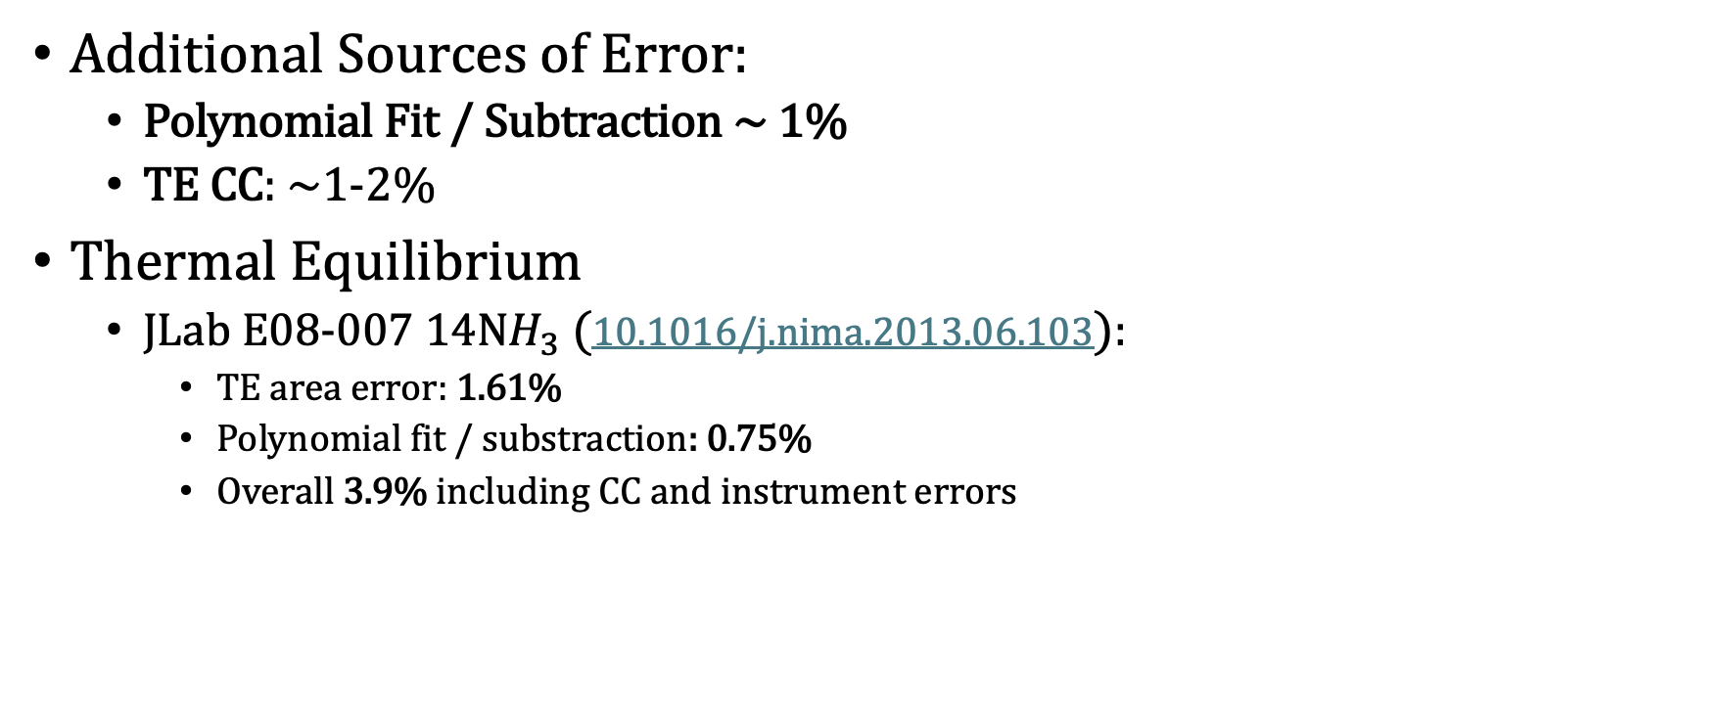
Polarization Extraction (Spin-1/2)
Additional Sources of Error:
  Polynomial Fit / Subtraction ~ 1%
  TE CC: ~1-2%
Thermal Equilibrium
  JLab E08-007 $14NH_{3}$(10.1016/j.nima.2013.06.103):
    TE area error: 1.61%
    Polynomial fit / substraction: 0.75%
    Overall 3.9% including CC and instrument errors

Slide 6
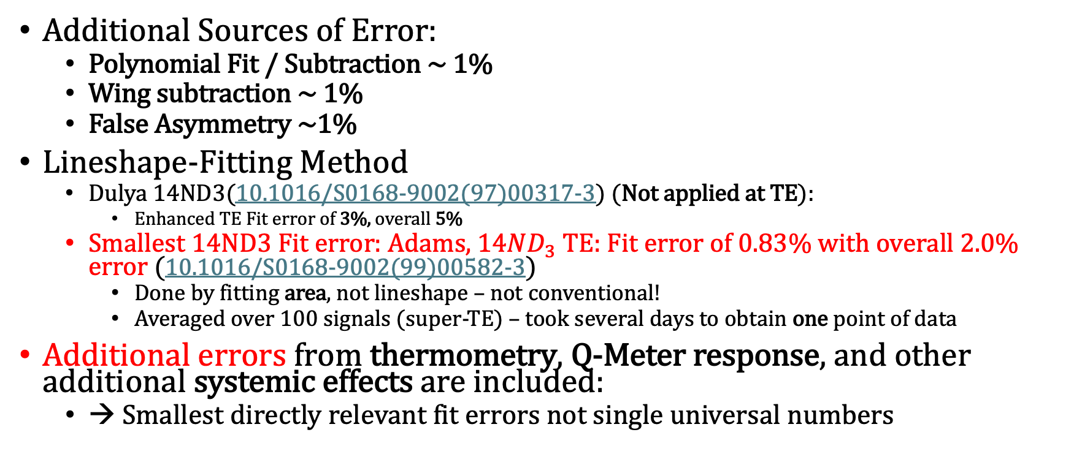
Polarization Extraction (Spin-1)
Additional Sources of Error:
  Polynomial Fit / Subtraction ~ 1%
  Wing subtraction ~ 1%
  False Asymmetry ~1%
Lineshape-Fitting Method
  Dulya 14ND3(10.1016/S0168-9002(97)00317-3) (Not applied at TE):
    Enhanced TE Fit error of 3%, overall 5%
  Smallest 14ND3 Fit error: Adams, $14ND_{3}$ TE: Fit error of 0.83% with overall 2.0% error (10.1016/S0168-9002(99)00582-3)
    Done by fitting area, not lineshape – not conventional!
    Averaged over 100 signals (super-TE) – took several days to obtain one point of data
Additional errors from thermometry, Q-Meter response, and other additional systemic effects are included:
  → Smallest directly relevant fit errors not single universal numbers

Slide 7
Artificial Neural Networks

Slide 8
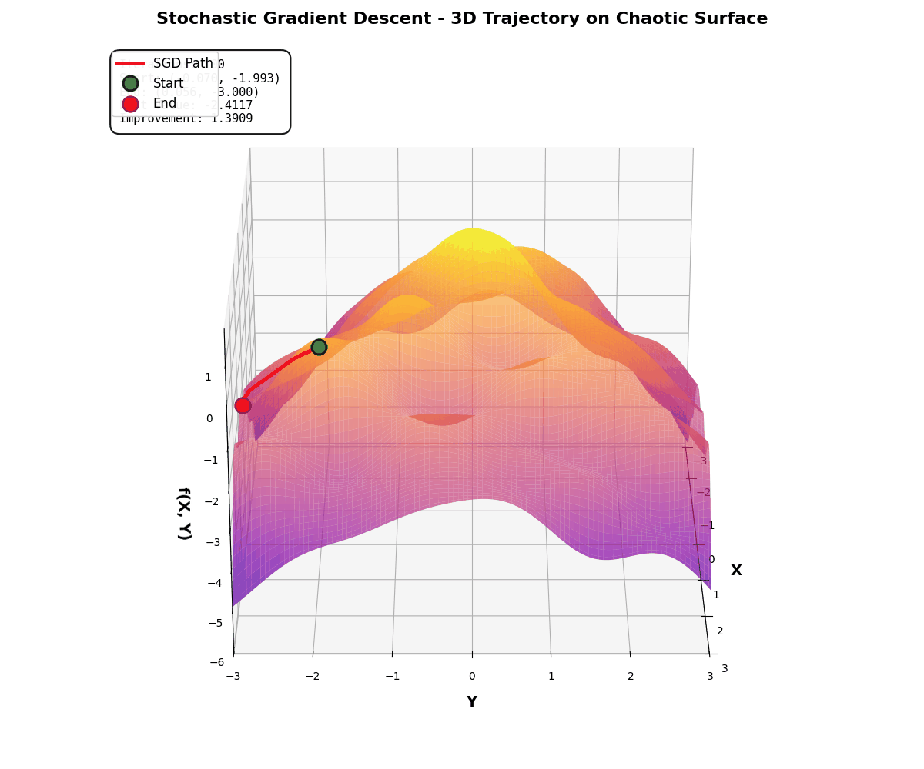
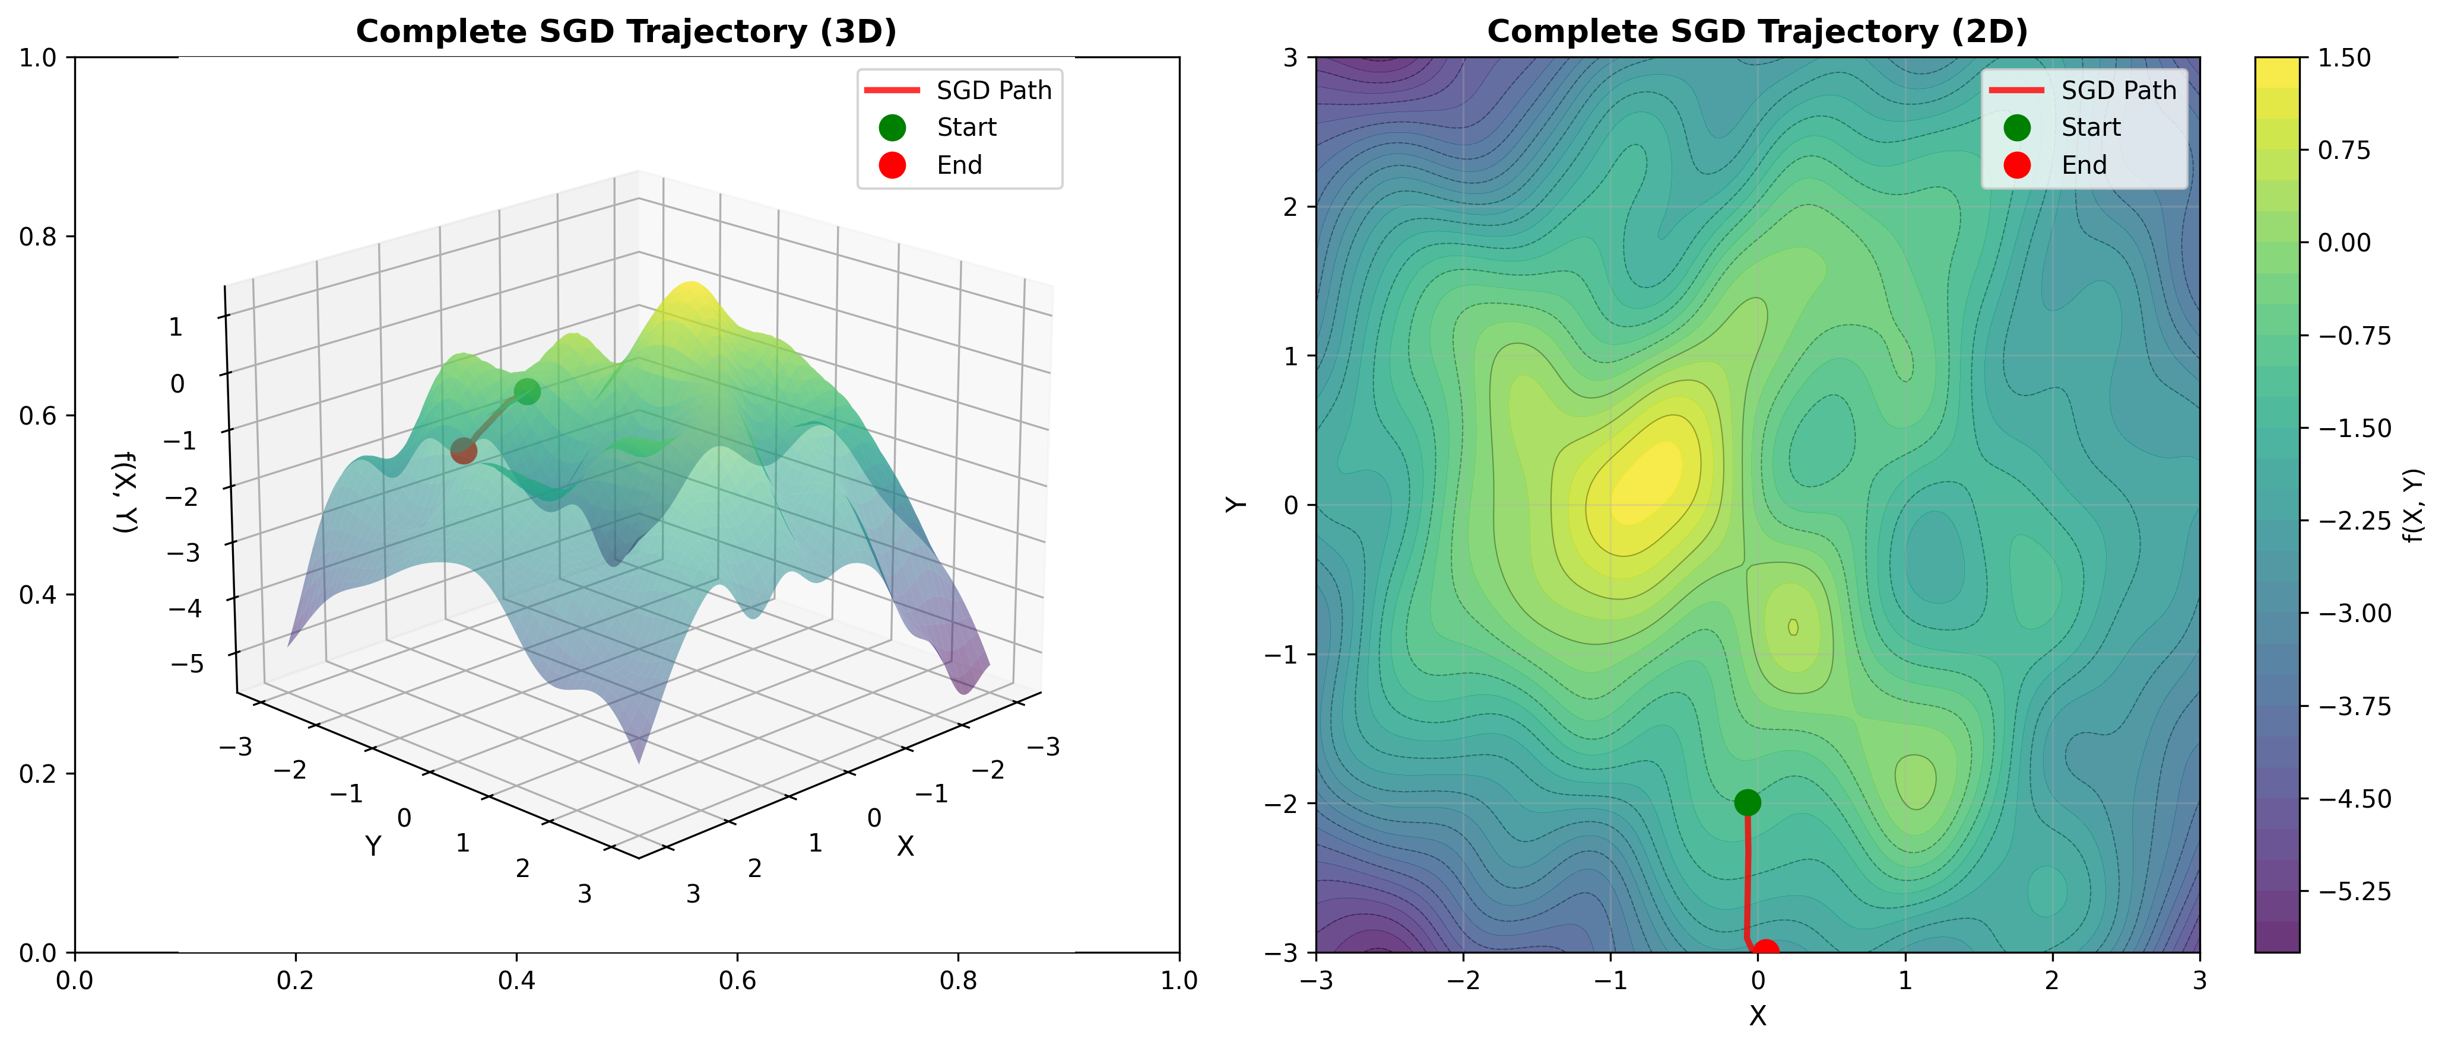

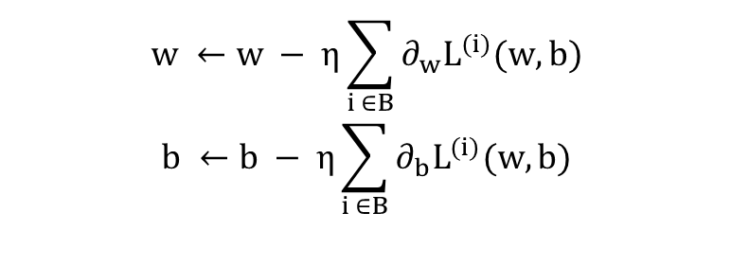

$$\hat{y}=Xw+b, X,w∈ ℝ^{d}$$
Loss Function: $L(w,b) (e.g., MSE, MAE)$
Minimize: $\left(w^{∗},b^{∗}\right)= argmin(L(w,b))$
$$w ←w − η\sum_{i ∈B}{∂_{w}L^{(i)}(w,b)}$$
$$b ←b − η\sum_{i ∈B}{∂_{b}L^{(i)}(w,b)}$$

Slide 9
Goals
Increase accuracy and precision (for spin ½ and 1)
  Reduce extraction errors
    Baseline subtraction
    Polynomial subtraction
    Lineshape fitting
Achieve reliable results even with large range of noise and shifts
Develop flexible software that improves reliability even when working Q-meter outside its design specifications
Enable real-time polarization readings
Apply to ss-RF/AFP type manipulations

Slide 10


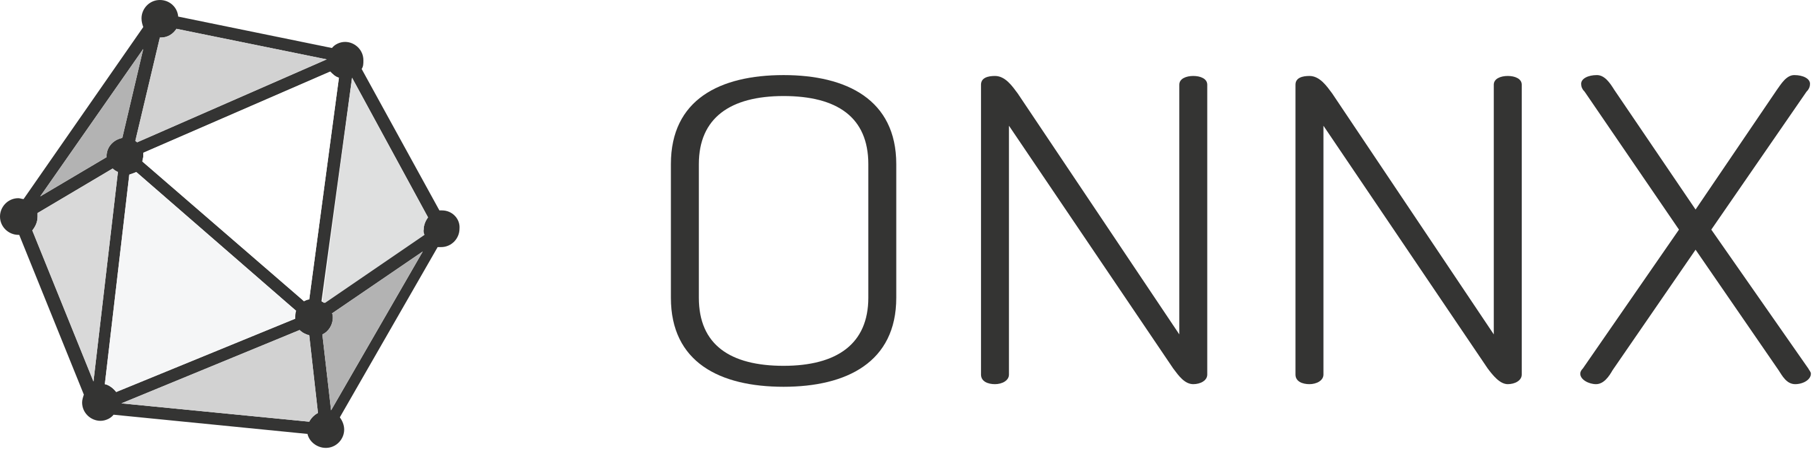
Why Neural Networks?
Most Flexible ML approach to regression problems (UAT)
Very fast inference is possible (~ms scale updates with standard GPU)
  More accurate real-time polarization monitoring
Can do more with multidimensional information
Common libraries help to leverage basic hardware (CUDA, ONNX, Metal, etc.)

Slide 11
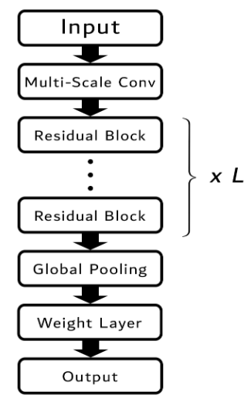
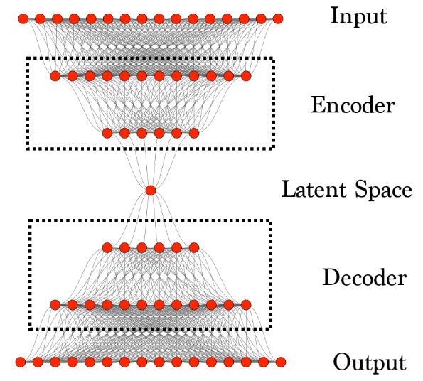
Types of Models Used
For Extraction:
  Spin-1 Polarization:
    TE-2%: CNN-based model
    2-60%: MLP-based model
  Spin-1/2 Area:
    TE-100%: MLP-based model (very simple)
Additional: Denoising
  Use Denoising Autoencoder (DAE) to remove noise from NMR lineshapes (Spin-1 for now)

Slide 12
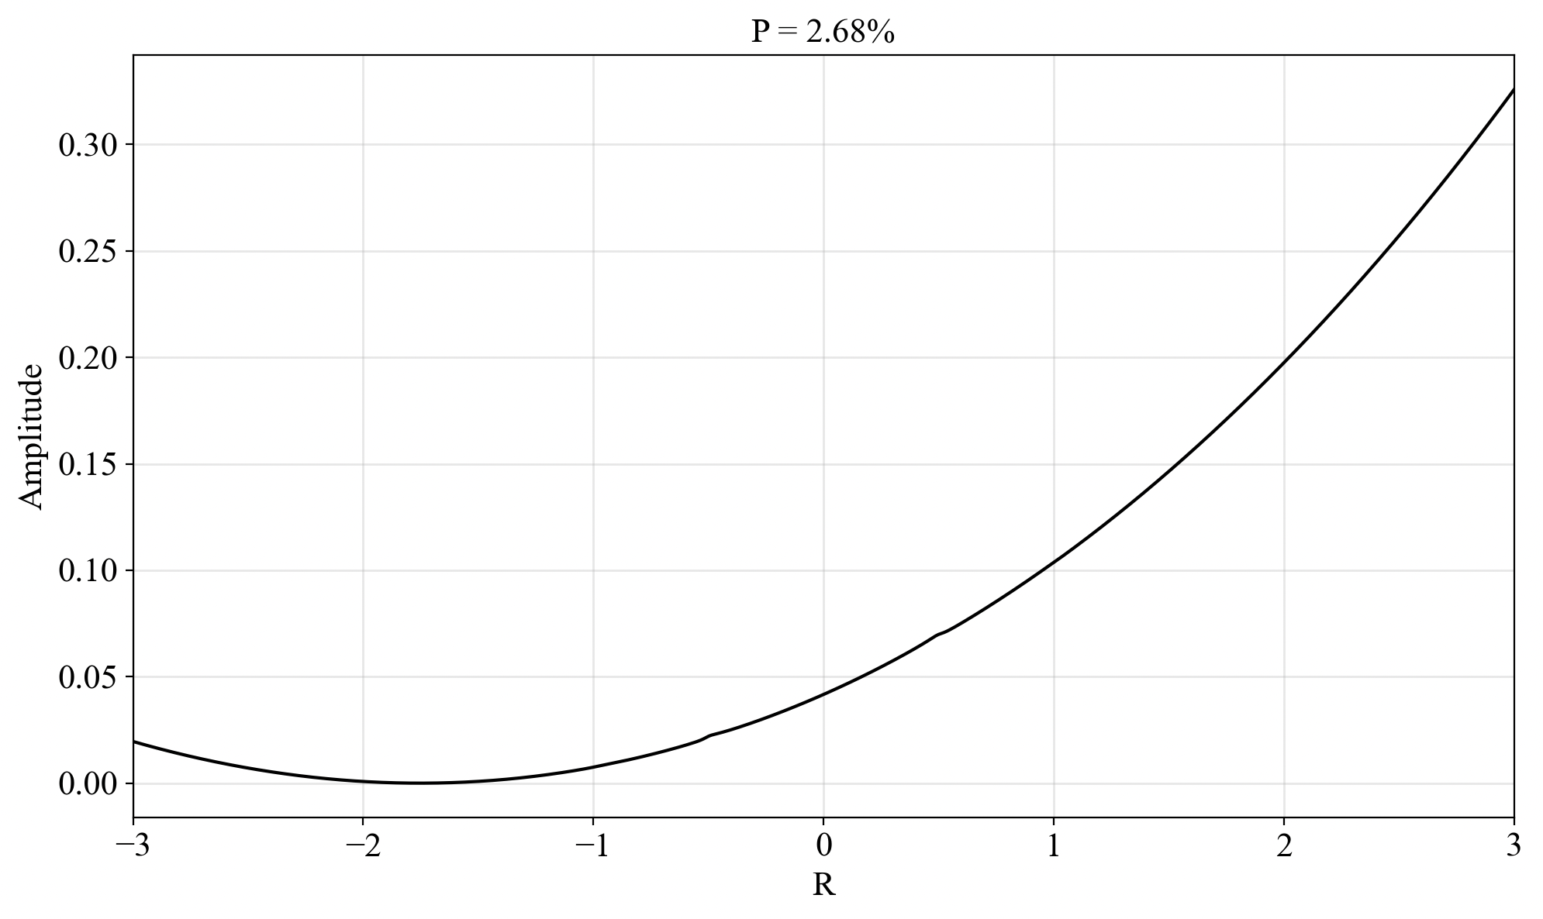
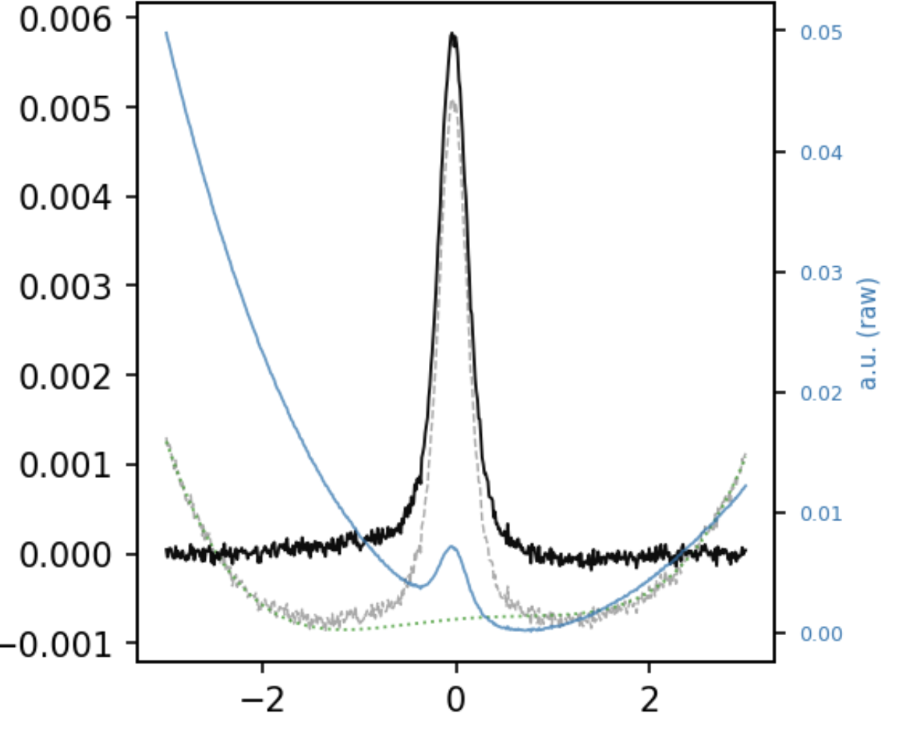
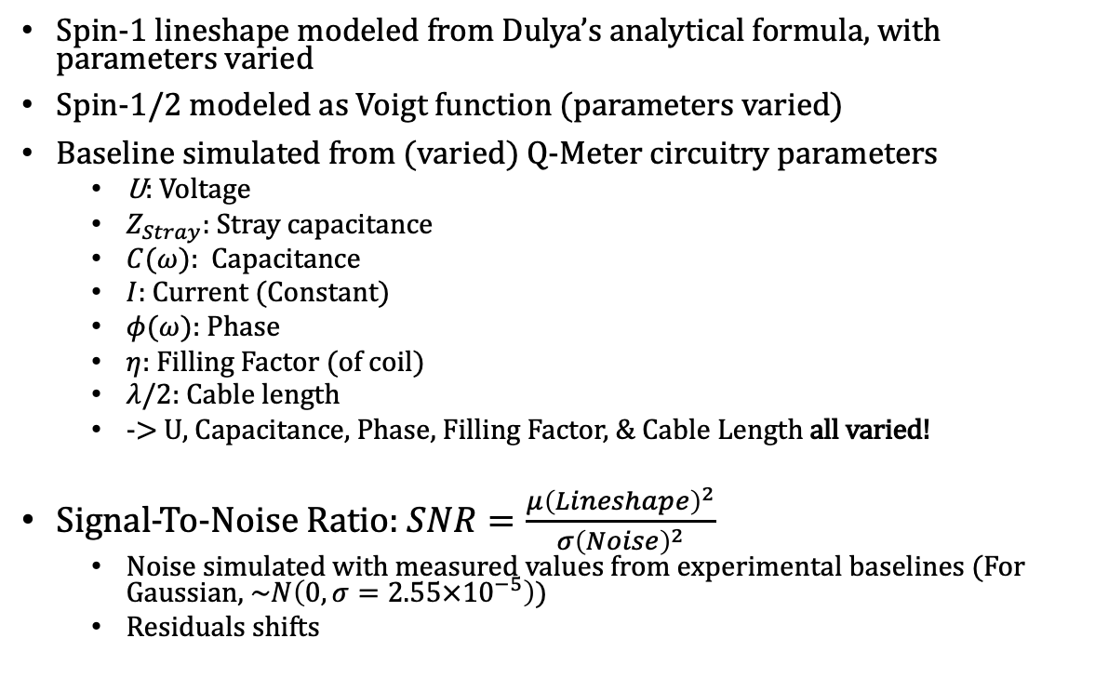
Data Generation
Spin-1 lineshape modeled from Dulya’s analytical formula, with parameters varied
Spin-1/2 modeled as Voigt function (parameters varied)
Baseline simulated from (varied) Q-Meter circuitry parameters
  U: Voltage
  $Z_{Stray}$: Stray capacitance
  $C(ω)$: Capacitance
  $I$: Current (Constant)
  $φ(ω)$: Phase
  $η$: Filling Factor (of coil)
  $λ/2$: Cable length
  -> U, Capacitance, Phase, Filling Factor, & Cable Length all varied!
Signal-To-Noise Ratio: $SNR=\frac{μ{\left(Lineshape\right)}^{2}}{σ{\left(Noise\right)}^{2}}$
  Noise simulated with measured values from experimental baselines (For Gaussian, ~$N\left(0,σ=2.55×{10}^{−5}\right)$)
  Residuals shifts

Slide 13
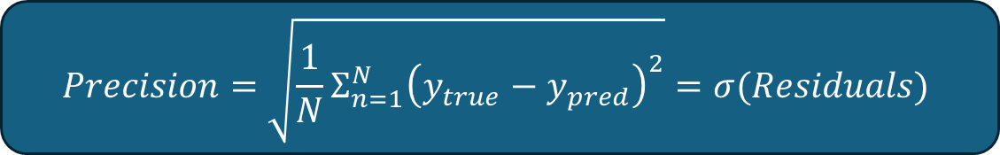
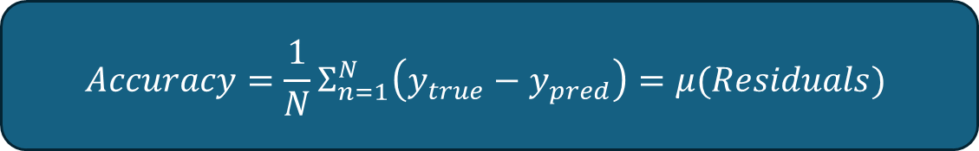
Performance Metrics
$$Accuracy=\frac{1}{N}Σ_{n=1}^{N}\left(y_{true}−y_{pred}\right)=μ(Residuals)$$
$$Precision=\sqrt{\frac{1}{N}Σ_{n=1}^{N}{\left(y_{true}−y_{pred}\right)}^{2}}=σ(Residuals)$$

Slide 14
Results

Slide 15
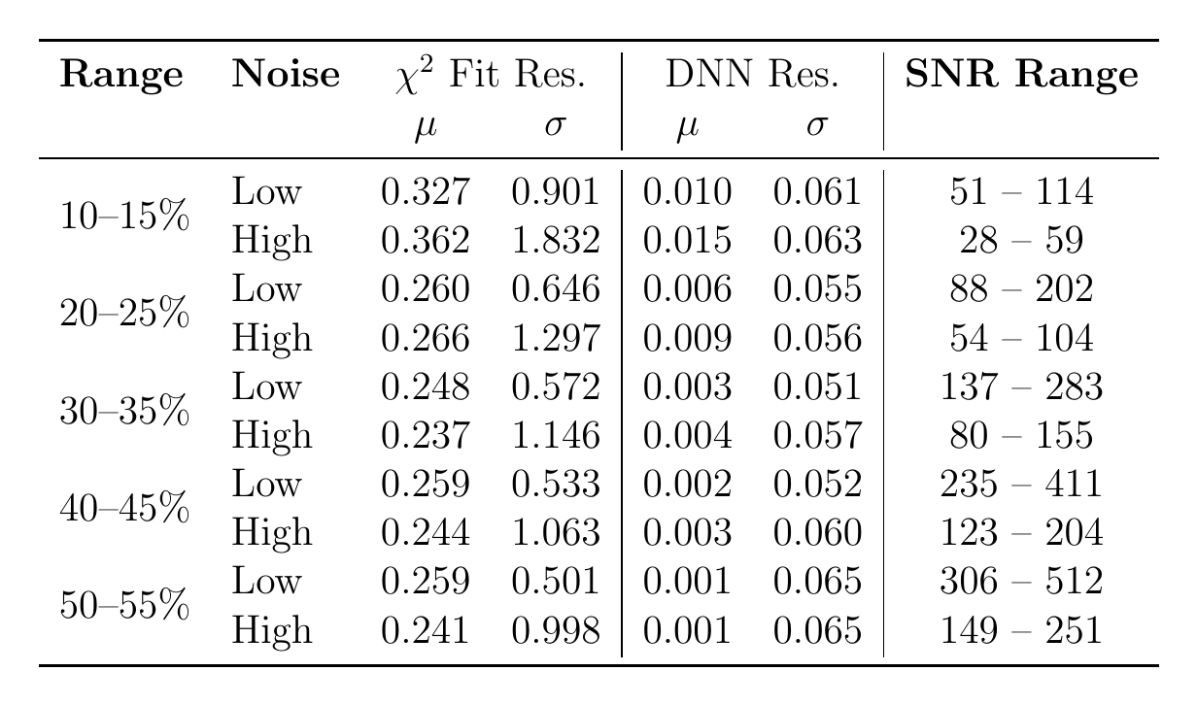
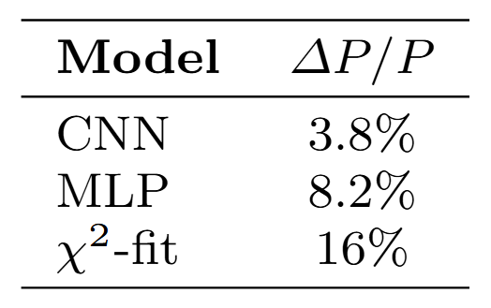
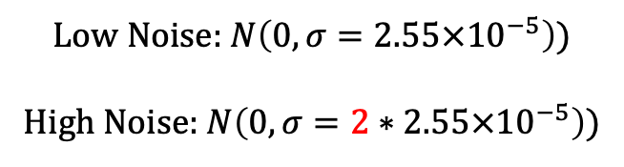

Polarization Extraction (Spin-1)
https://arxiv.org/abs/2603.10146
TE-1% Fit
$$SNR \sim (5.2×{10}^{−5}, 21.5)$$
Low Noise: $N\left(0,σ=2.55×{10}^{−5}\right)$)
High Noise: $N\left(0,σ=2∗2.55×{10}^{−5}\right)$)

Slide 16
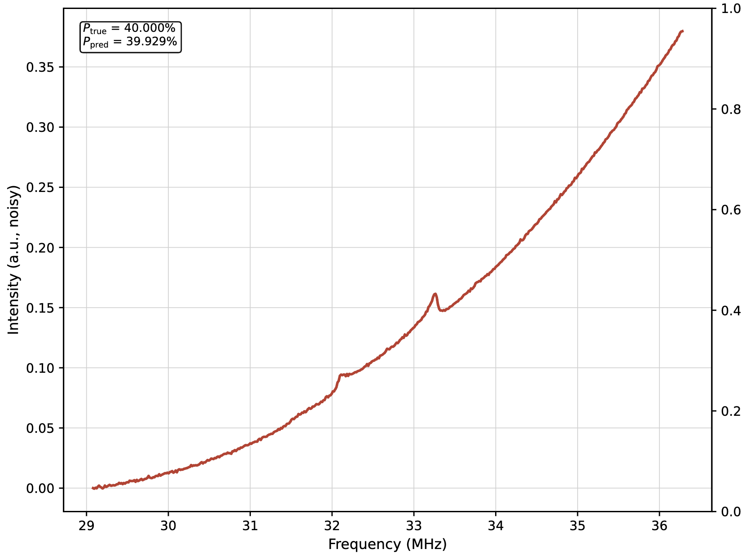
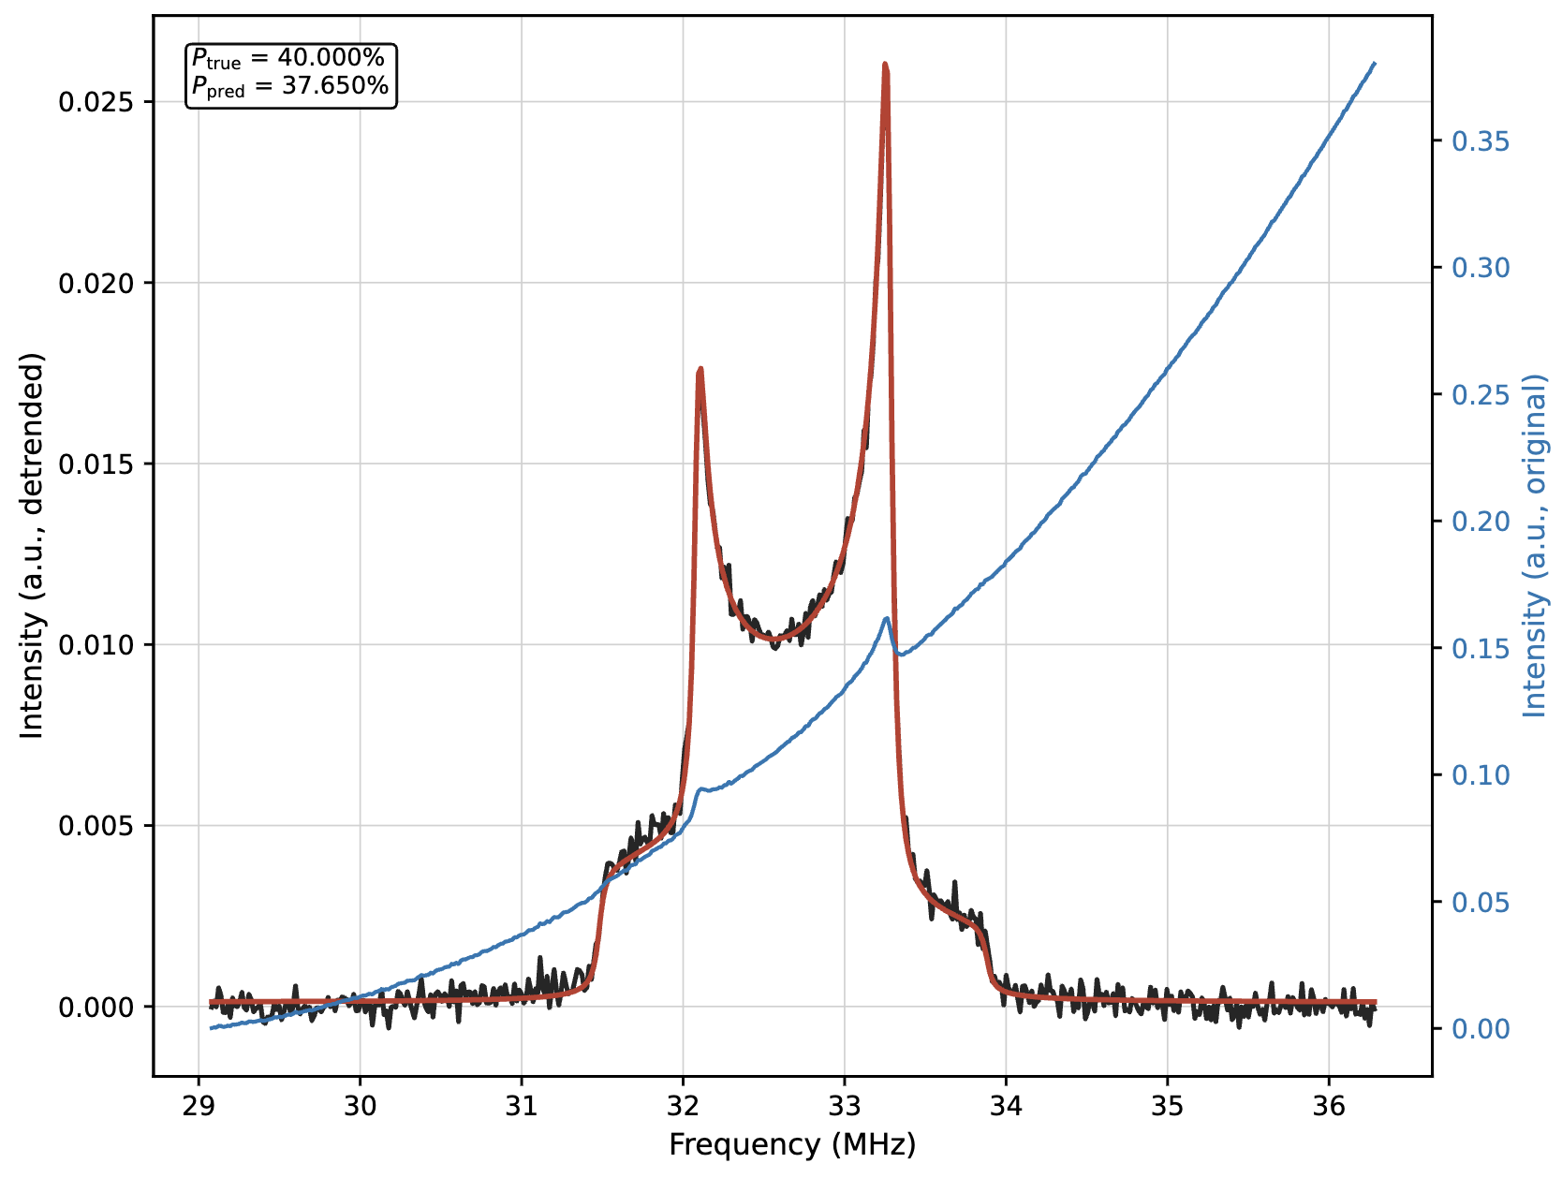
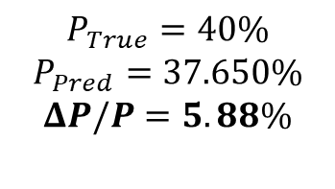
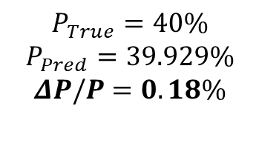

Polarization Extraction (Spin-1)
$$P_{True}=40\%$$
$$P_{Pred}=39.929\%$$
$$ΔP/P=0.18\%$$
$$P_{True}=40\%$$
$$P_{Pred}=37.650\%$$
$$ΔP/P=5.88\%$$
$$SNR=105$$

Slide 17
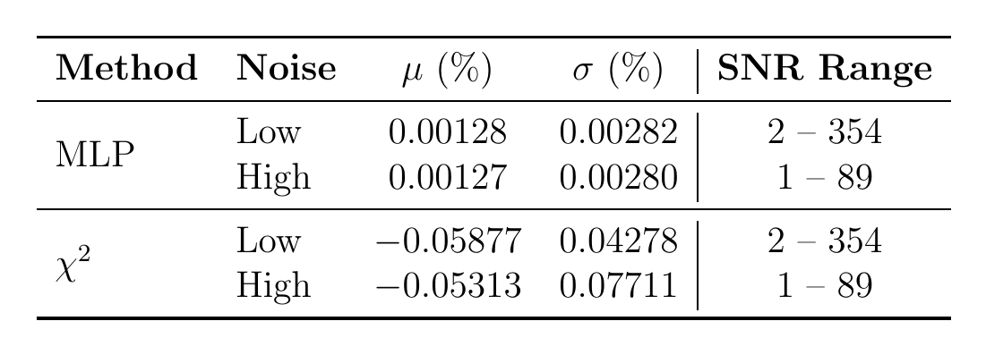
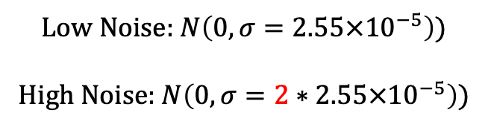
Area Extraction (Spin-1/2)
Only looking at TE region (0.1% - 0.8%)
Low Noise: $N\left(0,σ=2.55×{10}^{−5}\right)$)
High Noise: $N\left(0,σ=2∗2.55×{10}^{−5}\right)$)
(Riemann Sum)

Slide 18
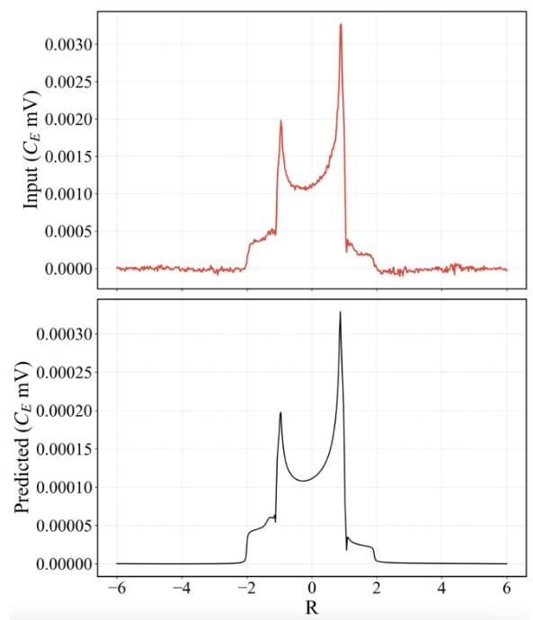
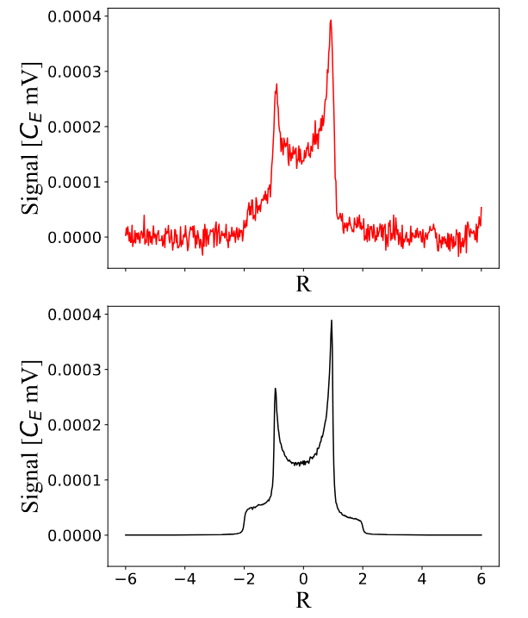
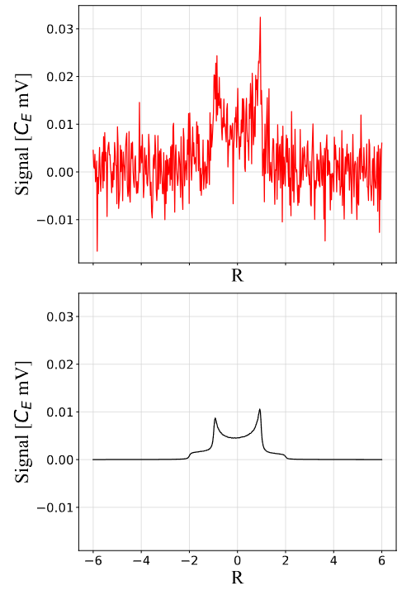


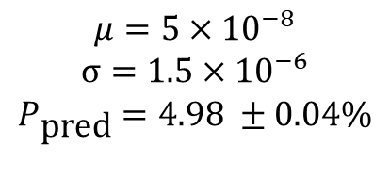
https://arxiv.org/abs/2603.10146
Denoising Autoencoder
$$P_{\text{true}}=5\%$$
$$SNR=0.805$$
$$μ=5×{10}^{−8}$$
$$σ=1.5×{10}^{−6}$$
$$P_{\text{pred}}=4.98 ±0.04\%$$
Experimental

Slide 19
Tensor Polarization

Slide 20
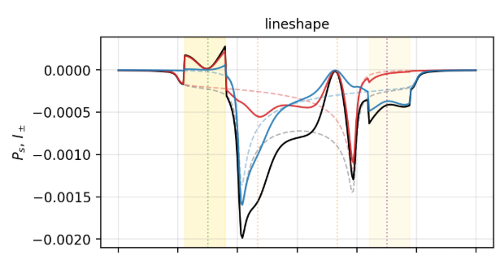
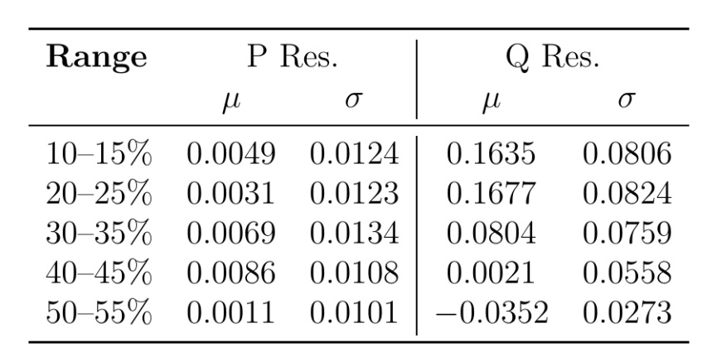
Ongoing
ML Polarization Extraction from manipulated lineshapes:
  Including ss-RF/AFP manipulation
  Enables extraction of both vector and tensor simultaneously

Slide 21
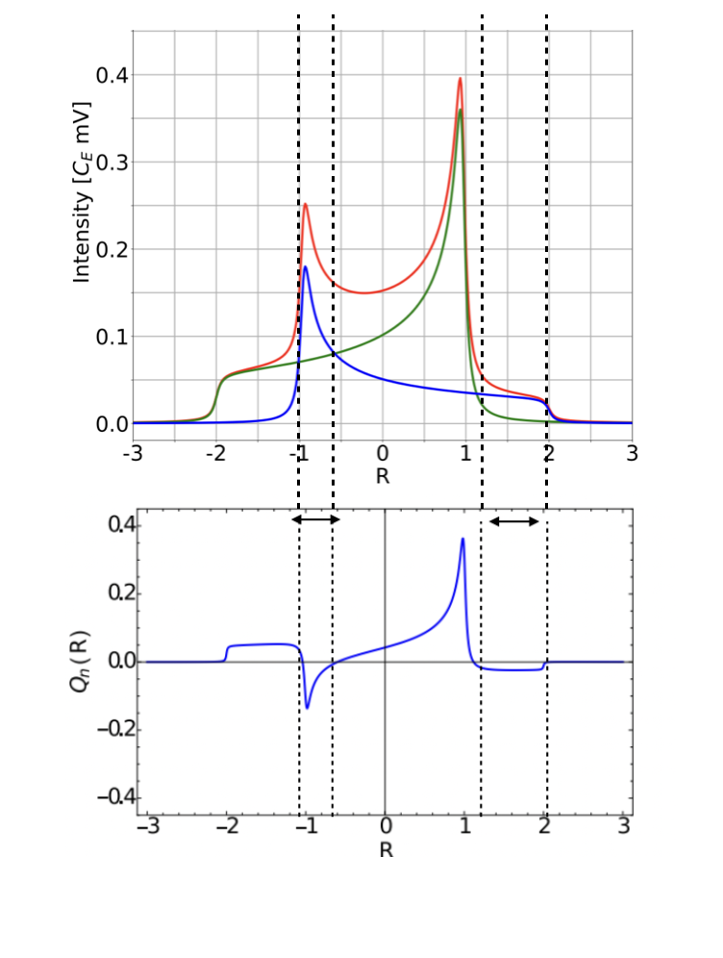
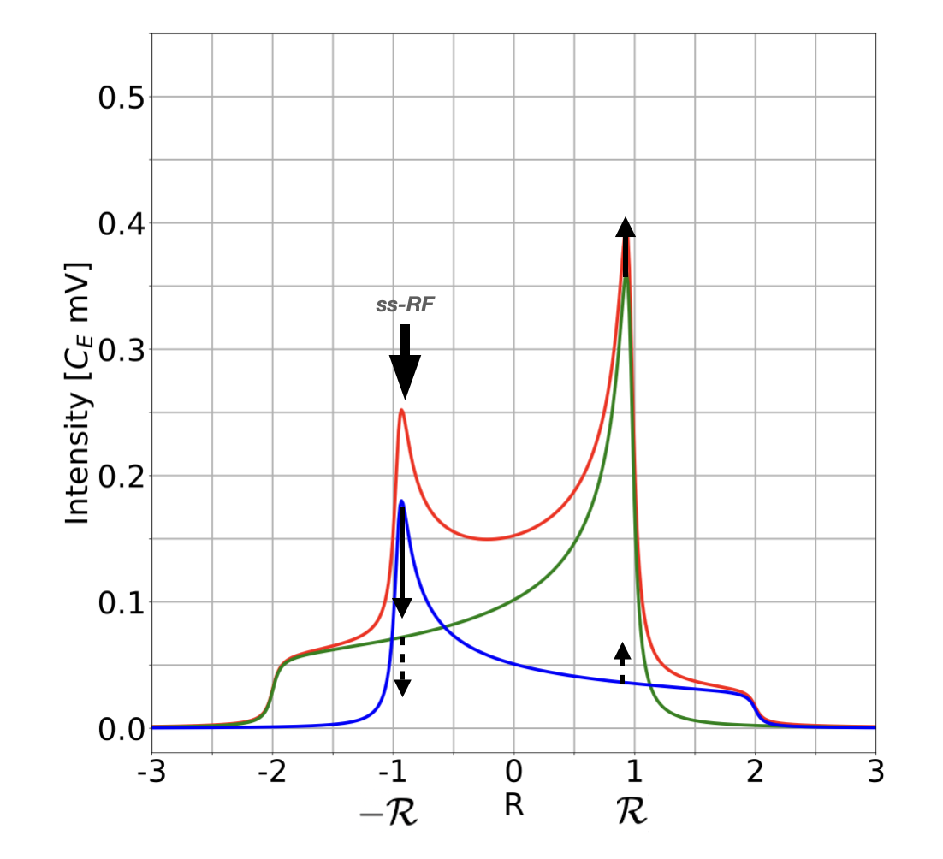
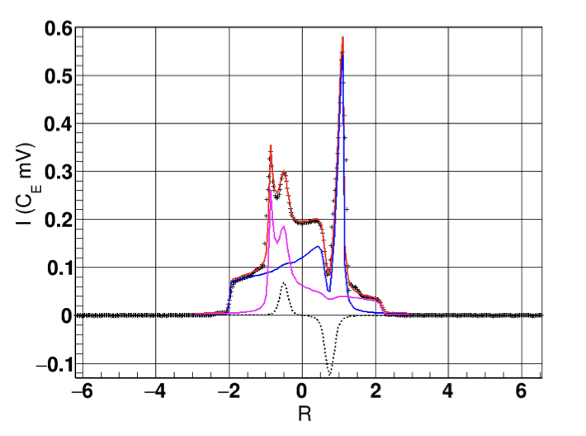
Semi-Saturated Radiofrequency (ss-RF)
https://arxiv.org/abs/1707.07065

Slide 22
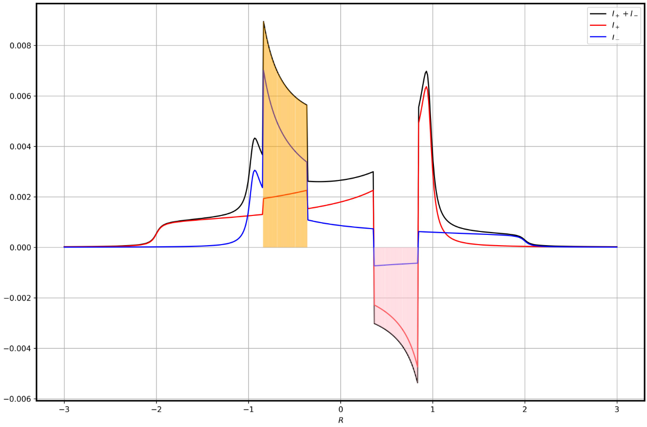
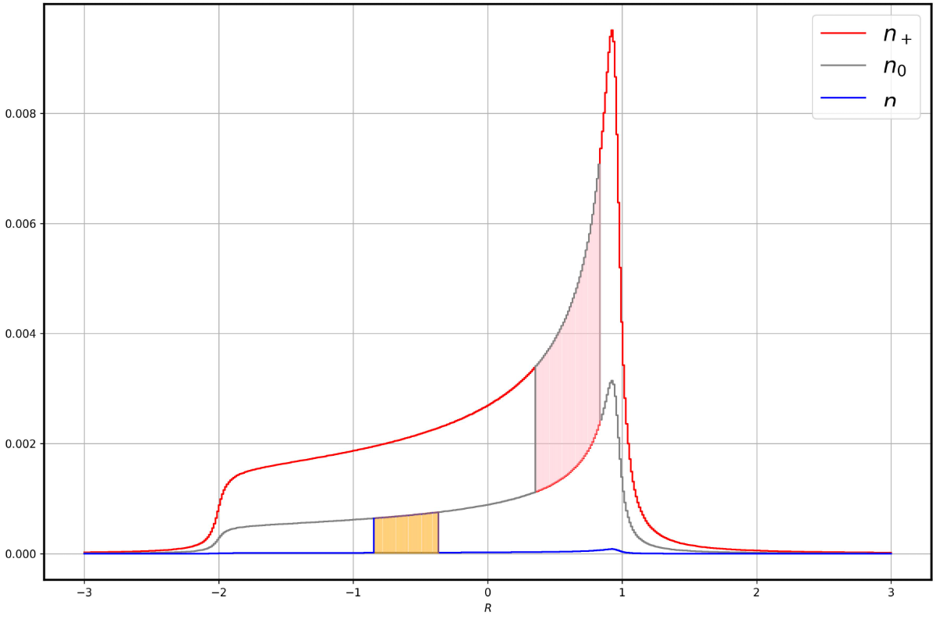
Adiabatic Fast Passage (AFP)
10.1016/j.nima.2023.168177

Slide 23
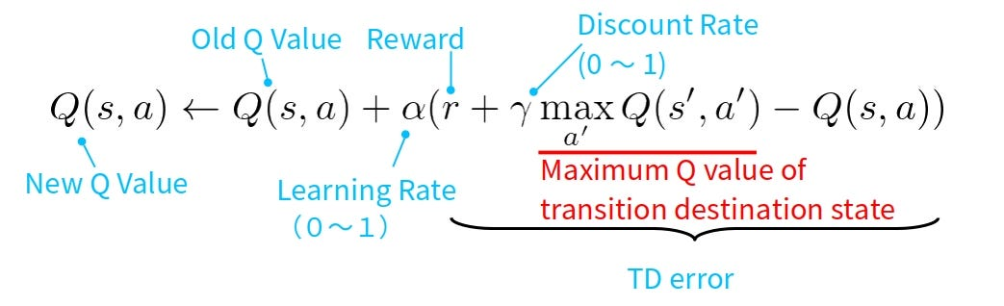
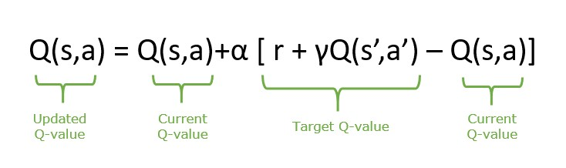
Ongoing
Q-Learning
Reinforcement Learning to optimize tensor polarization (Pzz)
  Using SARSA (State-Action-Reward-State-Action) algorithm
    Modified on-policy Q-Learning algorithm
      Q: Expected long-term return for a given action a in a given state s
ML Polarization Extraction from manipulated lineshapes:
  Including ss-RF/AFP manipualtion
SARSA

Slide 24
Preliminary Results (AFP/ss-RF ML)

Slide 25




A Big Thanks To Everyone!
…and more!

Slide 26
Thank you!
This work was supported by DOE contract DE-FG02-96ER40950.

