Slide 1


Generalized Parton Distributions of Composite Light Nuclei
Matthew D. Sievert
& Antonio Garcia Vallejo
Tensor SIDIS Workshop
Jefferson Lab
6/4/2026
M. Sievert
GPDs of Composite Light Nuclei
1 / 27

Slide 2


Important Information
arXiv: 2510.15838
Ph.D. 2025!
Next talk!
For more details:
To appear in PRD
Thurs. 6/4,
11:25am
Editor’s Suggestion
Antonio Garcia
Vallejo
This work
supported by:
DOE Office of Science,
Award #DE-SC0024560
EXCLAIM Collaboration: DOE Office of Science,
Award #DE-SC0024644
M. Sievert
GPDs of Composite Light Nuclei
2 / 27

Slide 3
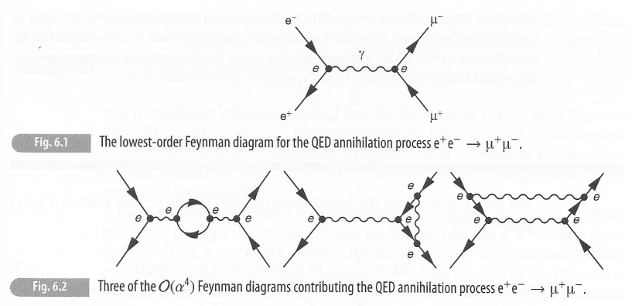
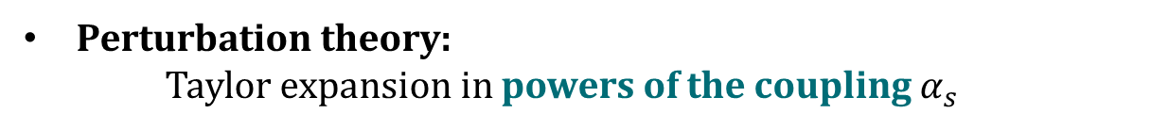
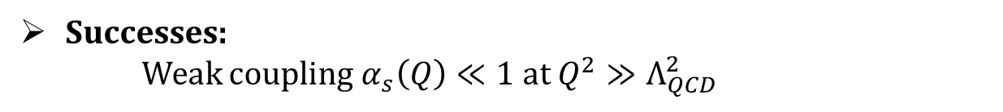
Perturbation Theory: The Textbook Story
$$dσ=dσ^{[0]}+α dσ^{[1]}+α^{2} dσ^{[2]}+α^{3}dσ^{[3]}+⋯$$
Perturbation theory:
Taylor expansion in powers of the coupling $α_{s}$
Successes:
Weak coupling $α_{s}\left(Q\right)≪1$ at $Q^{2}≫Λ_{QCD}^{2}$
Limitations:
Slow convergence
Asymptotic series
Nonperturbative effects
M. Sievert
GPDs of Composite Light Nuclei
3 / 27

Slide 4
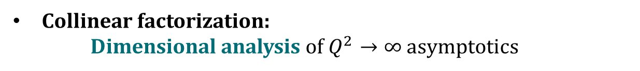



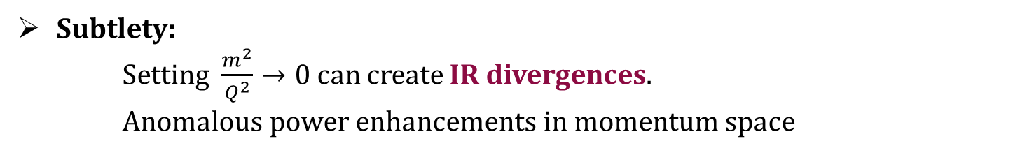

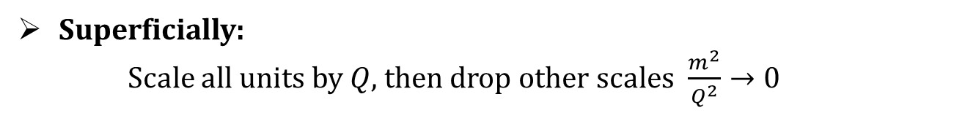
Factorization is a More Powerful Statement
$$p_{A}$$
$$q=p_{A}+p_{B}$$
$$k$$
$$=I_{A, coll}+I_{B, coll}+I_{soft}+I_{A, soft−coll}+I_{B, soft−coll}$$
$$p_{B}$$
Collinear factorization:
Dimensional analysis of $Q^{2}→∞$ asymptotics
A, coll
Superficially:
Scale all units by $Q$, then drop other scales $\frac{m^{2}}{Q^{2}}→0$
H
Subtlety:
Setting $\frac{m^{2}}{Q^{2}}→0$ can create IR divergences.
Anomalous power enhancements in momentum space
H
S
“Foundations of Perturbative QCD,” J. C. Collins, (1989), Cambridge Univ. Press, 2011
Collins, Soper, Sterman, Adv. Ser. Direct. High Energy Phys. 5 (1989)
M. Sievert
GPDs of Composite Light Nuclei
4 / 27

Slide 5

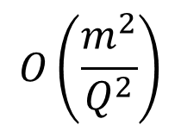
Factorization Theorems, to All Orders in pQCD
H
Hard
scattering
$$O\left(\frac{m^{2}}{Q^{2}}\right)$$
$$⊗$$
Non-pert.
Matx. Elt.
Factorization theorem:
Nonperturbative physics is quarantined into specific, universal matrix elements
Kinematic expansion:
Hadron structure as seen by an infinitely hard probe $Q^{2}→∞$ (“infinite momentum frame”)
Predictive power:
The same universal matrix elements appear in multiple reactions
M. Sievert
GPDs of Composite Light Nuclei
5 / 27

Slide 6

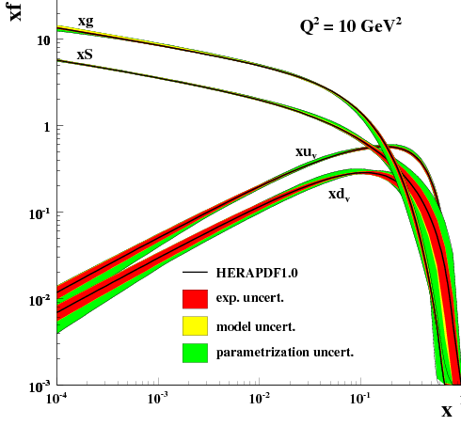
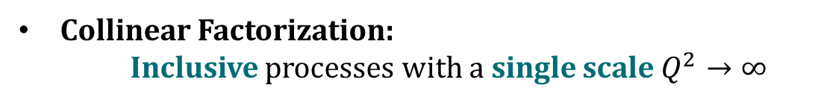
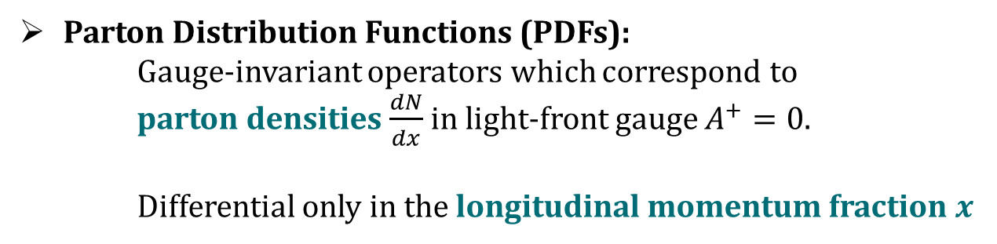
1D Structure: PDFs
Collinear Factorization:
Inclusive processes with a single scale $Q^{2}→∞$
Parton Distribution Functions (PDFs):
Gauge-invariant operators which correspond to
parton densities $\frac{dN}{dx}$ in light-front gauge $A^{+}=0$.
Differential only in the longitudinal momentum fraction $x$
H1 and ZEUS Collaborations, JHEP 01 (2010) 109
Collins, Soper, Sterman, Adv. Ser. Direct. High Energy Phys. 5 (1989)
M. Sievert
GPDs of Composite Light Nuclei
6 / 27

Slide 7
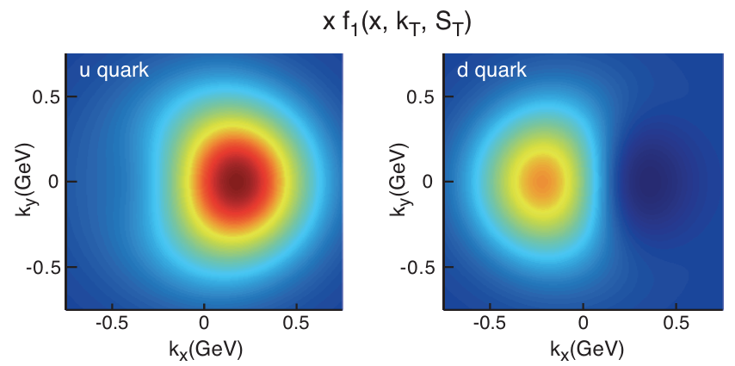
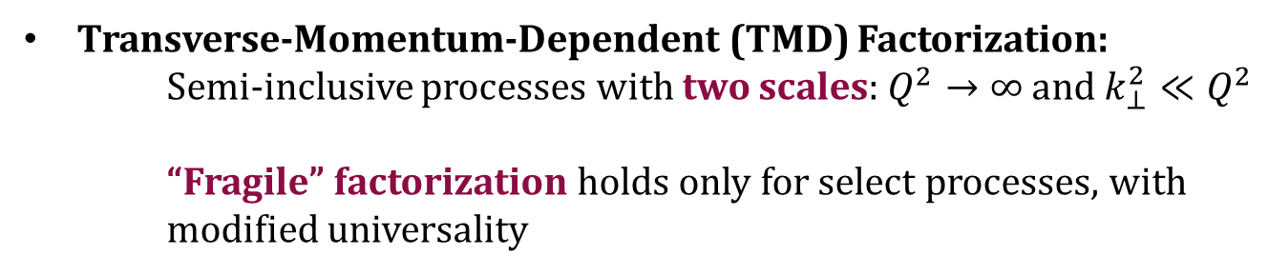
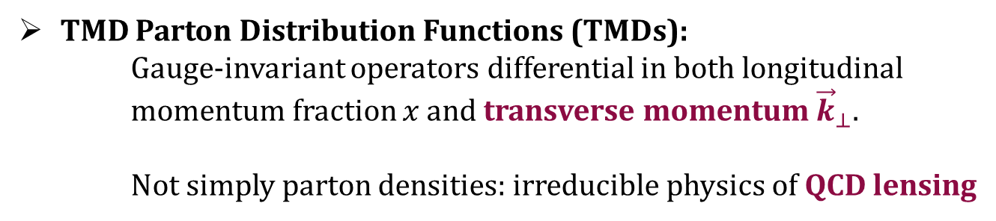
3D Structure: TMDs
Transverse-Momentum-Dependent (TMD) Factorization:
Semi-inclusive processes with two scales: $Q^{2}→∞$ and $k_{⊥}^{2}≪Q^{2}$
“Fragile” factorization holds only for select processes, with modified universality
TMD Parton Distribution Functions (TMDs):
Gauge-invariant operators differential in both longitudinal momentum fraction $x$ and transverse momentum ${\vec{k}}_{⊥}$.
Not simply parton densities: irreducible physics of QCD lensing
Collins, Soper, Sterman, Nucl. Phys. B. 250 (1985)
“Foundations of Perturbative QCD,” J. C. Collins, (1989), Cambridge Univ. Press, 2011
A. Accardi, et al., Eur. Phys. J. A 52 (2016)
M. Sievert
GPDs of Composite Light Nuclei
7 / 27

Slide 8
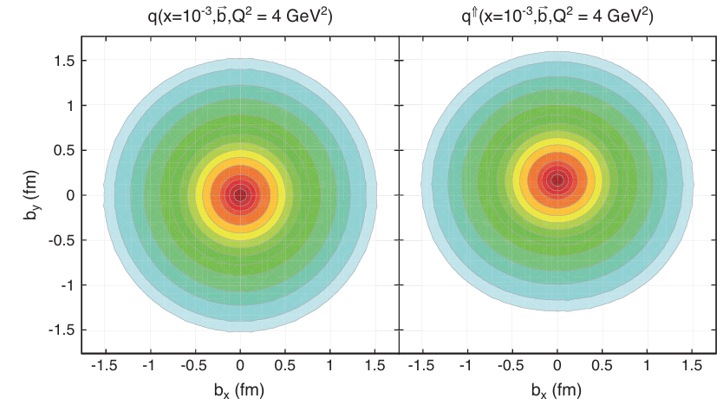
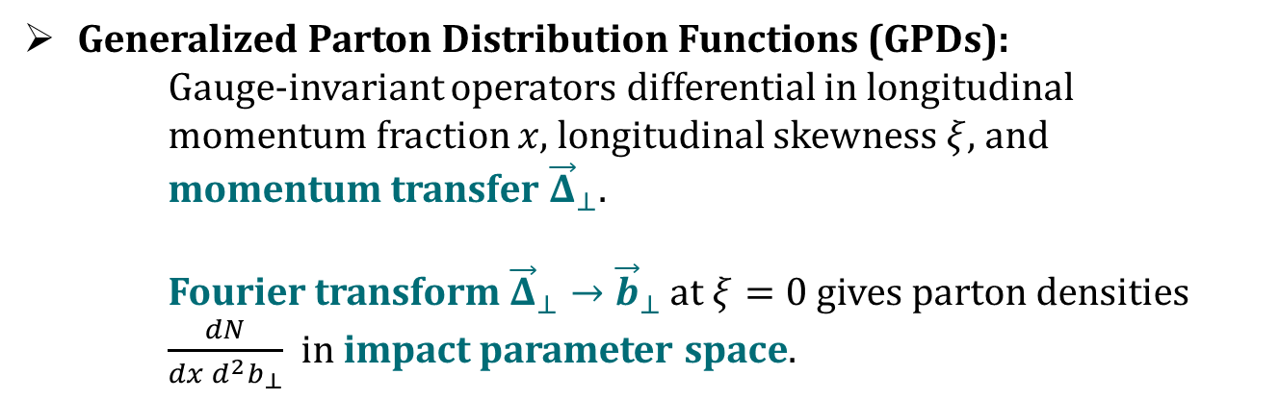
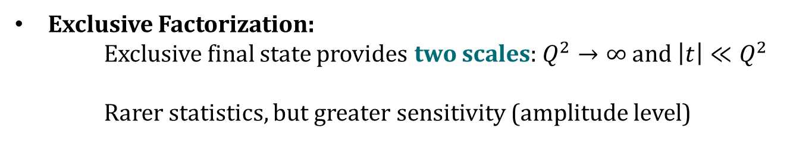
3D Structure: GPDs
Exclusive Factorization:
Exclusive final state provides two scales: $Q^{2}→∞$ and $\left|t\right|≪Q^{2}$
Rarer statistics, but greater sensitivity (amplitude level)
Generalized Parton Distribution Functions (GPDs):
Gauge-invariant operators differential in longitudinal momentum fraction $x$, longitudinal skewness $ξ$, and momentum transfer ${\vec{Δ}}_{⊥}$.
Fourier transform ${\vec{Δ}}_{⊥}→{\vec{b}}_{⊥}$ at $ξ=0$ gives parton densities
$\frac{dN}{dx d^{2}b_{⊥}}$ in impact parameter space.
Muller et al., Fortschritte der. Physik, 42 (1994)
Radyushkin, Phys. Lett. B 380 (1996)
Ji, Phys. Rev. D 55 (1997)
Collins, Freund, Phys. Rev. D, 59 (1999)
A. Accardi, et al., Eur. Phys. J. A 52 (2016)
M. Sievert
GPDs of Composite Light Nuclei
8 / 27

Slide 9
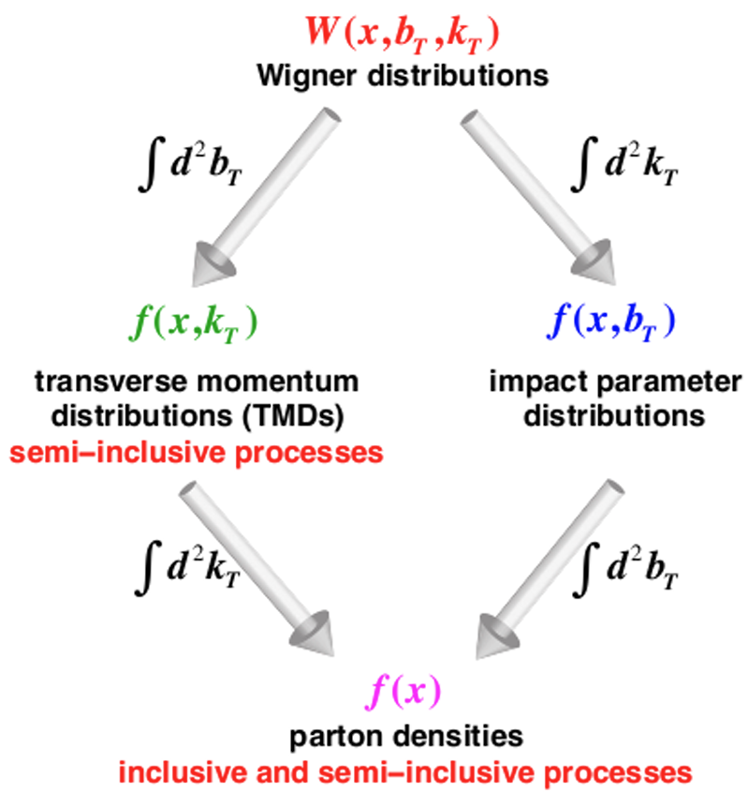
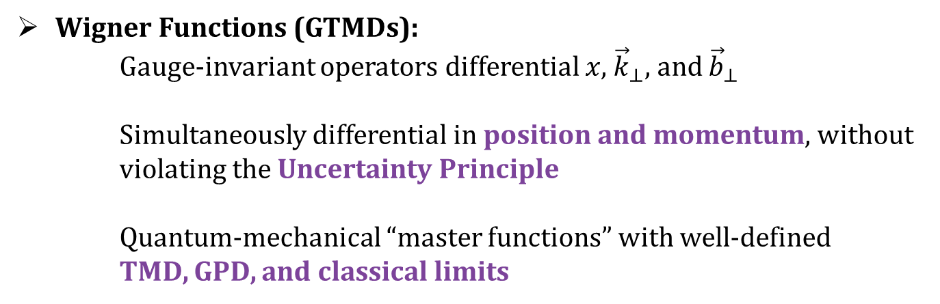
5D Structure: Wigner Distributions
Generalized TMD (GTMD) Factorization:
Rare processes with both a diffractive component and a momentum imbalance (e.g., diffractive dijets in pA)
Wigner Functions (GTMDs):
Gauge-invariant operators differential $x$, ${\vec{k}}_{⊥}$, and ${\vec{b}}_{⊥}$
Simultaneously differential in position and momentum, without violating the Uncertainty Principle
Quantum-mechanical “master functions” with well-defined TMD, GPD, and classical limits
Meissner, Metz, Goeke, Phys. Rev. D, 80 (2009)
A. Accardi, et al., Eur. Phys. J. A 52 (2016)
M. Sievert
GPDs of Composite Light Nuclei
9 / 27

Slide 10
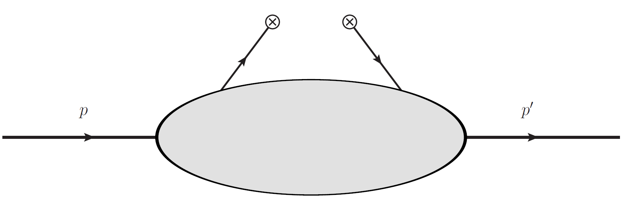
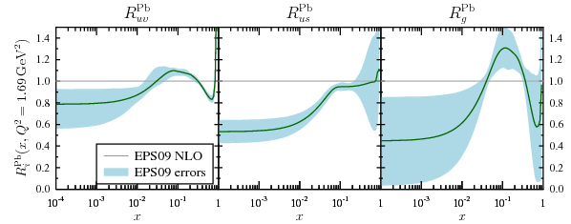
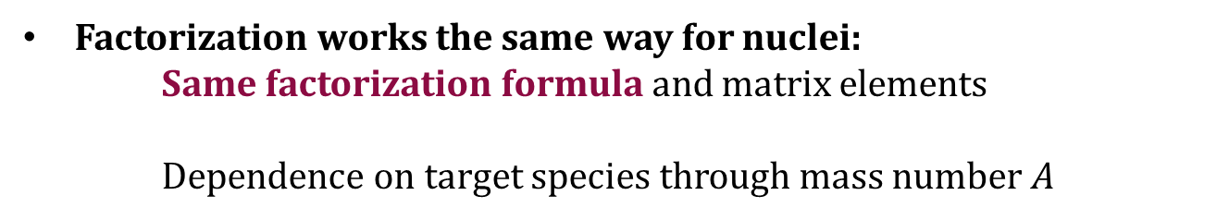
Partonic Structure of Nuclei
p
p
p
p
N
A
Factorization works the same way for nuclei:
Same factorization formula and matrix elements
  Dependence on target species through mass number $A$
Nuclear Modification Factor for PDFs:
Compares the ratio of nuclear PDF to nucleon PDF
Modification of partonic structure of a nucleon due to nuclear environment
Reveals fascinating nuclear modification associated with the EMC effect.
Helenius et al., JHEP 07 (2012)
M. Sievert
GPDs of Composite Light Nuclei
10 / 27

Slide 11




Impulse Approximation: The One-Body Sector
A composite system can be decomposed into its constituents:
Nuclear state is expressed as many-body wave function of
its constituents (spectral function)
Only a single active constituent is treated dynamically
(mean-field approximation), but systematically
improvable
$$P_{N}$$
$$P_{N}^{′}$$
$$p$$
$$p′$$
Multiple variations on implementation
Instant-form wave functions (nonrelativistic)
Light-front wave functions (relativistic)
[Virtual Nucleon Approximation]
Geesaman, Saito, Thomas., Ann.Rev.Nucl.Part.Sci. 45 (1995)
Ericson, Kumano. Phys. Rev. C 67 (2003)
Hirai, Kumano, Saito, Watanabe. Phys. Rev. C 83 (2011)
Cosyn, Dong, Kumano, Sargsian. Phys. Rev. D 95 (2017)
M. Sievert
GPDs of Composite Light Nuclei
11 / 27

Slide 12
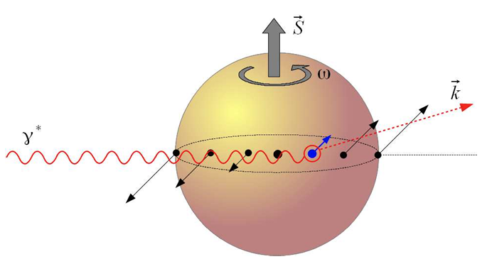




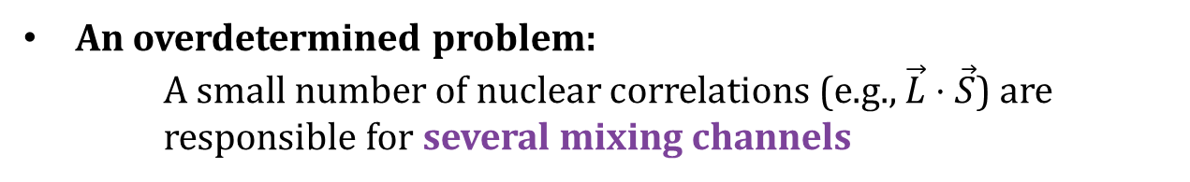


Composite Structure Mixing
$$\vec{L}⋅{\vec{S}}_{A}$$
Orbital motion of constituents mixes 3D partonic structure:
A static nucleus simply smears the partonic structure of the nucleon
Nontrivial orbital motion of the nucleons mixes 3D
structure for, e.g., the Sivers TMD and Boer-Mulders TMD
QCD lensing effects are essential to some mixing channels
Kovchegov, MS, Phys. Rev. D, 89 (2014)
$$\vec{L}⋅{\vec{S}}_{N}$$
$${\vec{S}}_{N}$$
$$\vec{L}$$
An overdetermined problem:
A small number of nuclear correlations (e.g., $\vec{L}⋅\vec{S}$) are
  responsible for several mixing channels
$${\vec{S}}_{N}$$
$$\vec{L}$$
Kovchegov, MS, Nucl. Phys. B, 903 (2016)
M. Sievert
GPDs of Composite Light Nuclei
12 / 27

Slide 13
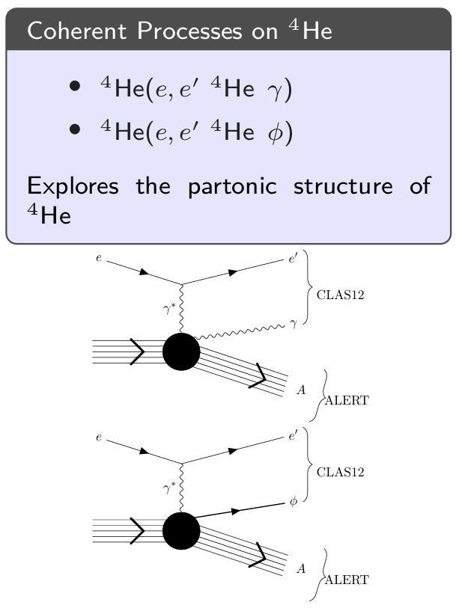

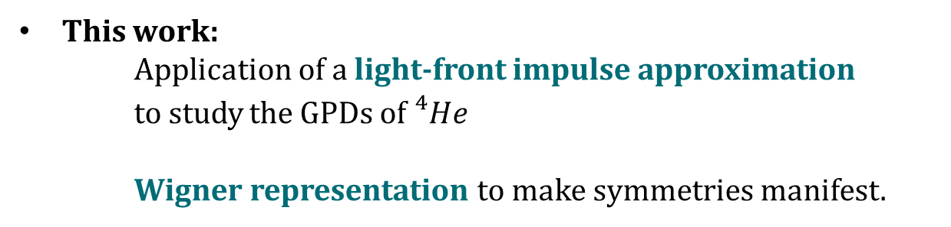
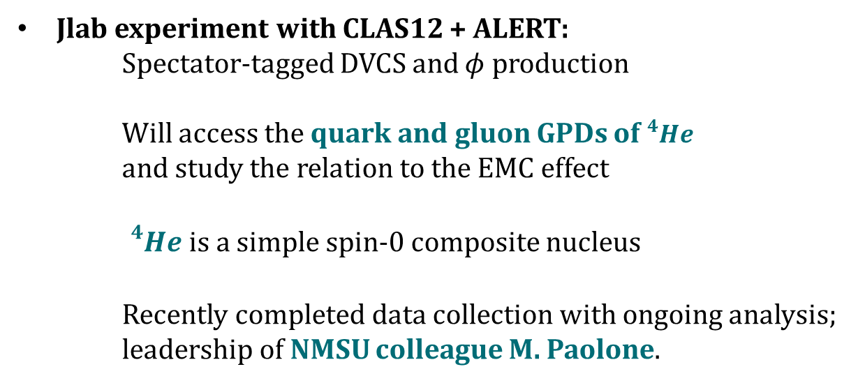

An Application: ⁴He and ALERT
Jlab experiment with CLAS12 + ALERT:
Spectator-tagged DVCS and $φ$ production
Will access the quark and gluon GPDs of ${}_{ }^{4}{He}$
and study the relation to the EMC effect
${}_{ }^{4}{He}$ is a simple spin-0 composite nucleus
Recently completed data collection with ongoing analysis;
leadership of NMSU colleague M. Paolone.
$$e+A→e^{′}+γ+A′$$
$$e+A→e^{′}+φ+A′$$
This work:
Application of a light-front impulse approximation
to study the GPDs of ${}_{ }^{4}{He}$
Wigner representation to make symmetries manifest.
Armstrong et al., arXiv: 1708.00888
M. Sievert
GPDs of Composite Light Nuclei
13 / 27

Slide 14



Derivation: Completeness
$$p$$
$$p′$$
Insert complete sets of free,
on-shell constituent Fock states
Expresses in/out states as wave packets of constituents
M. Sievert
GPDs of Composite Light Nuclei
14 / 27

Slide 15
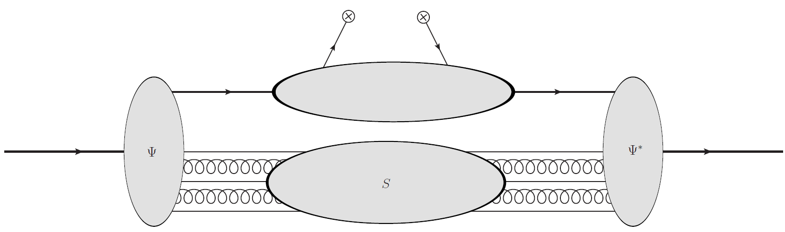









Derivation: Light Front Wave Functions
Relate in/in and out/out matrix elements to light-front wave functions (LFWF)
$$|Y⟩$$
$$|X⟩$$
$$\left\{ \left|P_{n}\right\rangle \right\}$$
$$\left\{ \left|P_{n}^{′}\right\rangle \right\}$$
$$p$$
$$p′$$
LFWF are boost invariant
Integrate out disconnected spectators
Inclusive LFWF remain
$$×$$
Brodsky, Pauli, Pinsky, Phys. Rept. 301 (1998)
M. Sievert
GPDs of Composite Light Nuclei
15 / 27

Slide 16

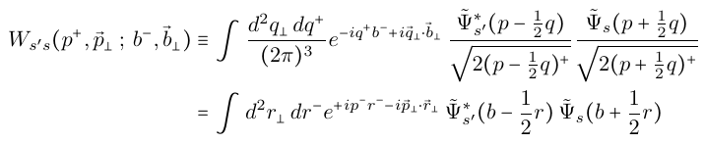





Derivation: Wigner Distribution
Re-express the off-forward product of LFWF in terms of a Wigner distribution
$$=$$
The Fourier transform of the LFWF defines a spacetime position
$$=$$
A Wigner distribution is a mixed Fourier transform that fixes the average momentum and impact parameter
$$=$$
Fully quantum, but semi-classical correspondence
$$×$$
M. Sievert
GPDs of Composite Light Nuclei
16 / 27

Slide 17




Derivation: Mean Field + Correlations
Expand in a series
of mean field +
correlations
$$P_{n}$$
$$P_{n}^{′}$$
$$p$$
$$p′$$
In a large nucleus, dominance of the mean field is guaranteed by $A≫1$
In a small nucleus, must be considered just the first term in a series
Start with the mean field, but correlations may not be small (e.g. SRC)
M. Sievert
GPDs of Composite Light Nuclei
17 / 27

Slide 18
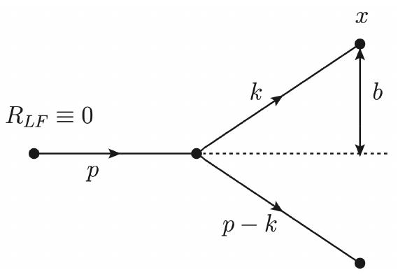
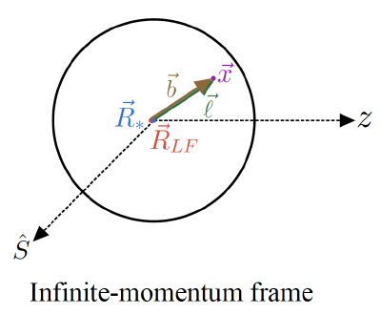
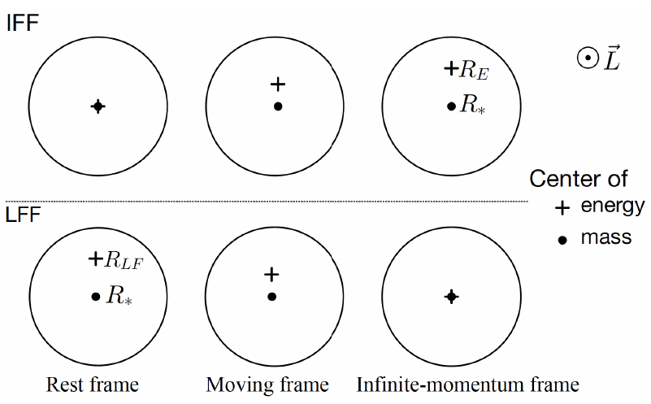
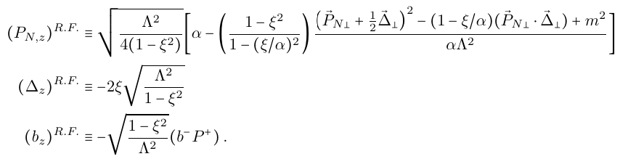


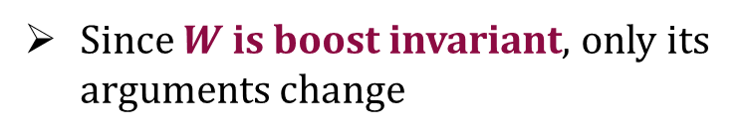


Derivation: Light Front / Rest Frame Dictionary
Exploit boost invariance to
relate IMF Wigner function to RF
$$α_{IMF}=α_{LF}$$
$${(P^{+} b^{−})}_{IMF}={(P^{+} b^{−})}_{LF}$$
$$ξ_{IMF}=ξ_{LF}$$
Since $W$ is boost invariant, only its arguments change
Use boost-invariant products to map to Rest Frame
Caveat: relativistic CoM
M. Sievert
GPDs of Composite Light Nuclei
18 / 27

Slide 19


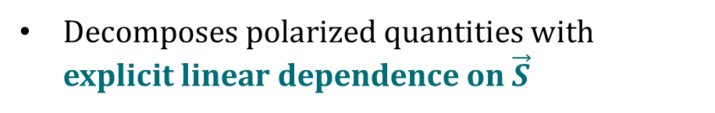
Derivation: Intermediate Spin States
Use a Pauli matrix basis to change from spin projection to spin vector
$$W\left(P_{N},b,S;P, Δ\right)=W_{unp}−{\vec{W}}_{pol}⋅\vec{S}$$
Decomposes polarized quantities with explicit linear dependence on $\vec{S}$
Decomposes the nuclear GPD as a sum over unpolarized, longitudinally-, and transversely-polarized channels
M. Sievert
GPDs of Composite Light Nuclei
19 / 27

Slide 20





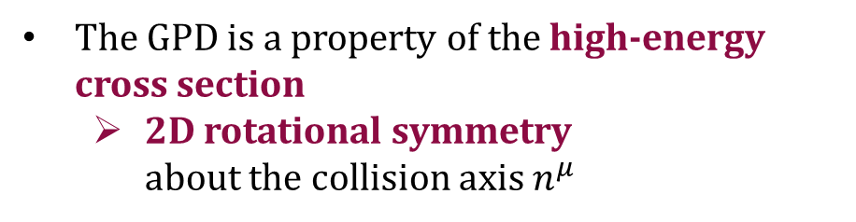





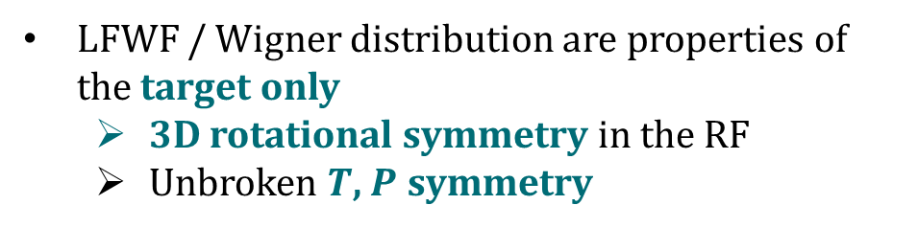
Derivation: Symmetry Constraints
Impose symmetry constraints on the Wigner function
$$γ^{∗}, n^{μ}$$
$$F$$
The GPD is a property of the high-energy cross section
  2D rotational symmetry
  about the collision axis $n^{μ}$
$$P_{N}$$
$$P_{N}^{′}$$
$$p$$
$$p′$$
$$W$$
$γ^{∗}, n^{μ}$ indep
LFWF / Wigner distribution are properties of the target only
  3D rotational symmetry in the RF
  Unbroken $T$, $P$ symmetry
$$ω_{1}$$
$$ω_{2}$$
Only $\left(\vec{L}⋅\vec{S}\right)$ and $\left(\vec{ΔL}⋅\vec{S}\right)$ correlations survive
M. Sievert
GPDs of Composite Light Nuclei
20 / 27

Slide 21

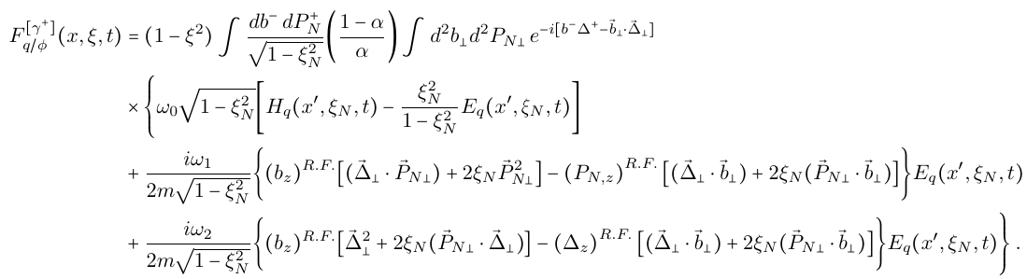


Derivation: Master Formula for ⁴He
Combine with constituent GPDs to obtain nucleon / nucleus “master formula”
Unp
$$\left(\vec{L}⋅\vec{S}\right)$$
$$\left(\vec{ΔL}⋅\vec{S}\right)$$
M. Sievert
GPDs of Composite Light Nuclei
21 / 27

Slide 22
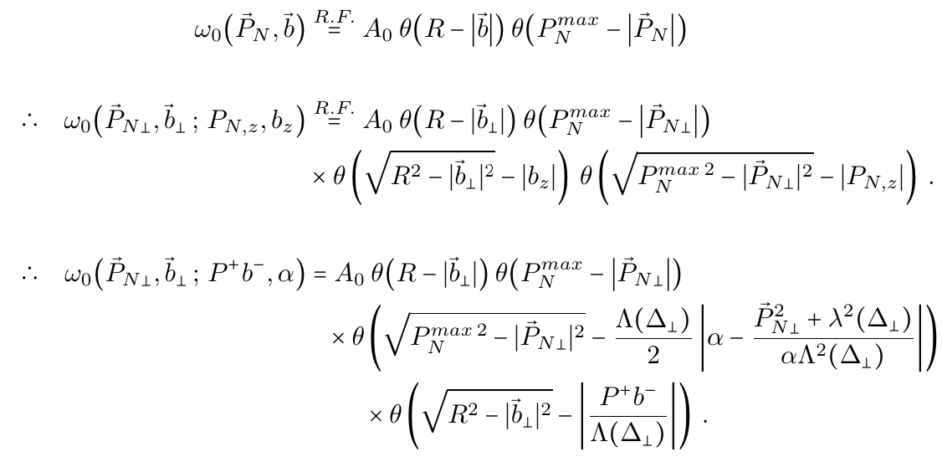
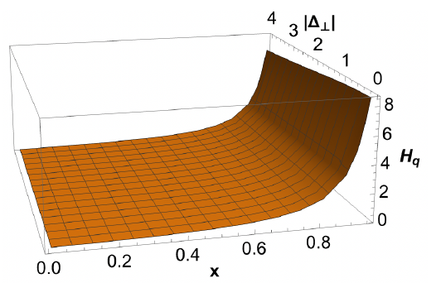
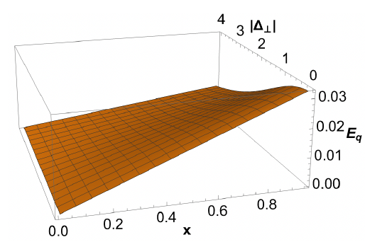





Illustration: A Simple Model for ⁴He
Static, isotropic nucleus
$R=1.7$fm
$m=1.0$GeV
Ballpark ⁴He parameters
$P_{N}^{max}=0.12$GeV
$M=4.0$GeV
Quark Target Model GPDs
at $ξ=0$
Meissner, Metz, Goeke, Phys. Rev. D 76 (2007)
M. Sievert
GPDs of Composite Light Nuclei
22 / 27

Slide 23
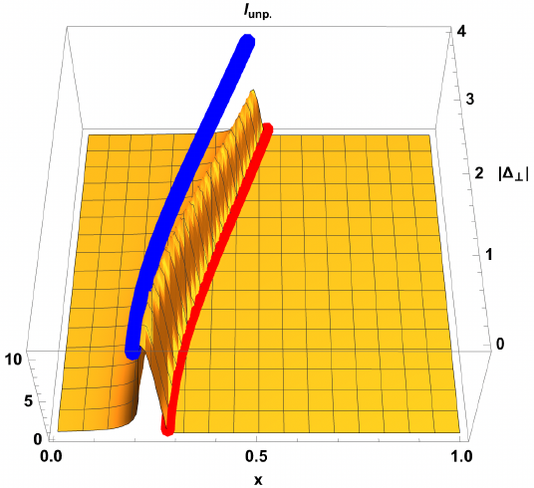
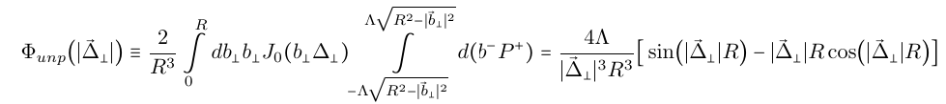

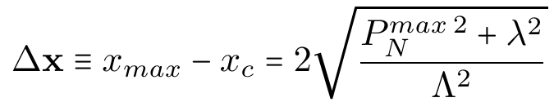
Signatures of Nuclear Effects: Longitudinal Smearing
Nuclear GPD is a product of 2 factors (reflects factorized form of $W$)
Fourier Transform of spatial profile: $R→Δ$ dependence
Longitudinal downshift and smearing: $P_{z}→x$ dependence
M. Sievert
GPDs of Composite Light Nuclei
23 / 27

Slide 24
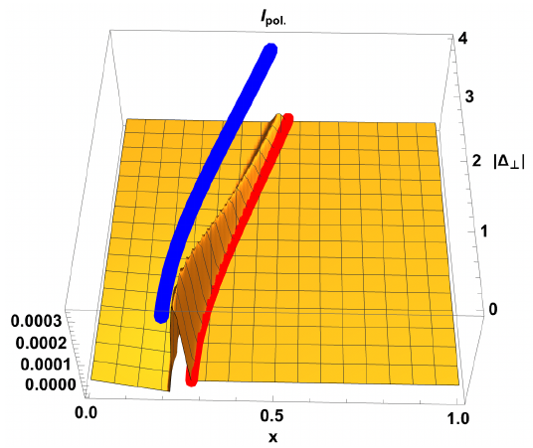
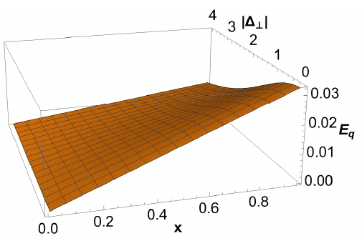
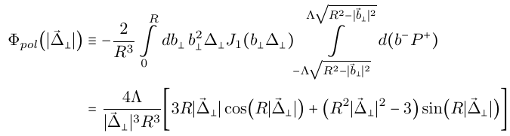

Signatures of Nuclear Effects: Intermediate Polarization
If $\left(\vec{L}⋅\vec{S}\right)$ correlation is present, it couples to GPD E to generate mixing
Different spatial Fourier transform
QTM: $E∝m≪H$
Longitudinal downshift and smearing
M. Sievert
GPDs of Composite Light Nuclei
24 / 27

Slide 25
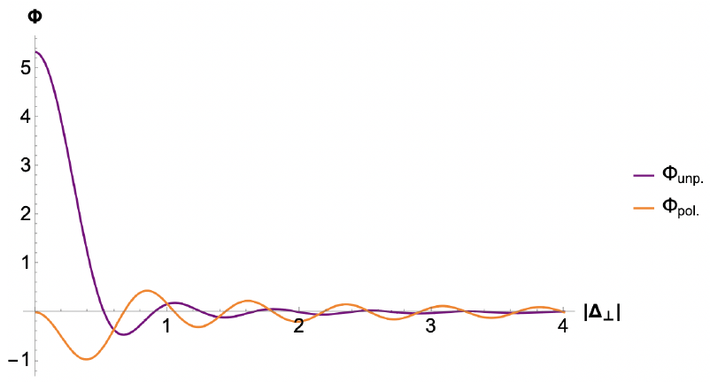
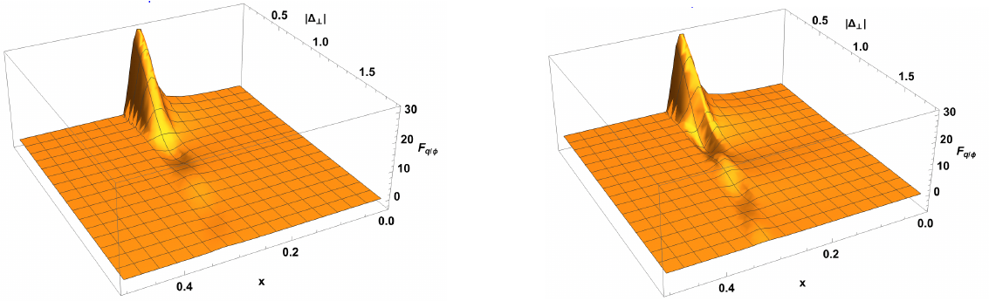

Unpolarized vs. Polarized Channels
$$\left(\vec{L}⋅\vec{S}\right)$$
Unp
Artificially scale up $E∼H$ and compare shapes:
Qualitatively similar: Fourier Transform, downshift, smearing
Spin-orbit correlations change the $Δ$ dependence and shift the nodes
First steps toward theory guidance and interpretation for ALERT
M. Sievert
GPDs of Composite Light Nuclei
25 / 27

Slide 26
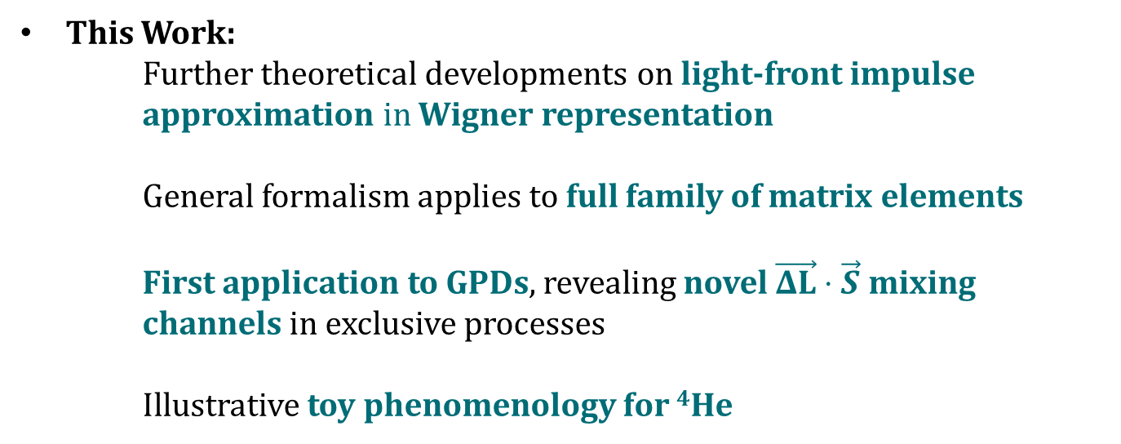
Conclusion
This Work:
Further theoretical developments on light-front impulse approximation in Wigner representation
  General formalism applies to full family of matrix elements
First application to GPDs, revealing novel $\vec{ΔL}⋅\vec{S}$ mixing
channels in exclusive processes
Illustrative toy phenomenology for ⁴He
Ph.D. 2025!
Next talk!
Next Steps:
Application to a TMDs of a composite spin-1 target
for SIDIS on tensor-polarized deuterium
Thurs. 6/4,
11:25am
Antonio Garcia
Vallejo
M. Sievert
GPDs of Composite Light Nuclei
26 / 27

Slide 27

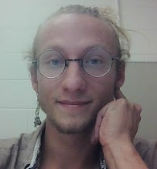









Thank You!
The Sievert Group(s) at NMSU
M.S. 2022!
Hot QCD
Cold QCD
Jeremy Kamin
Ph.D. 2025!
Ph.D. 2026!
Ph.D. 2025!
Ph.D. 2025!
Ph.D. 2025!
M.S. 2024!
Physics Education Research
Hasan
Rahman
Nick
Baldonado
Andrew
Dotson
Antonio Garcia
Vallejo
Jo Bahder
Aksian Tort
M.S. 2026
Ph.D. 2027
Ph.D. 2027
New Member
This Work
Ph.D. 2027
Sam Patterson
Umair Ahmad
Nadeem Altamimi
Princess Ani
Binisha Marahatta
M. Sievert
GPDs of Composite Light Nuclei
27 / 27

Slide 28
Backup Slides
M. Sievert
GPDs of Composite Light Nuclei
28 / 27

Slide 29






Center of Momentum of a Relativistic System
Text
M. Sievert
GPDs of Composite Light Nuclei
29 / 27

Slide 30



Center of Momentum of a Relativistic System
M. Sievert
GPDs of Composite Light Nuclei
30 / 27

