Slide 1
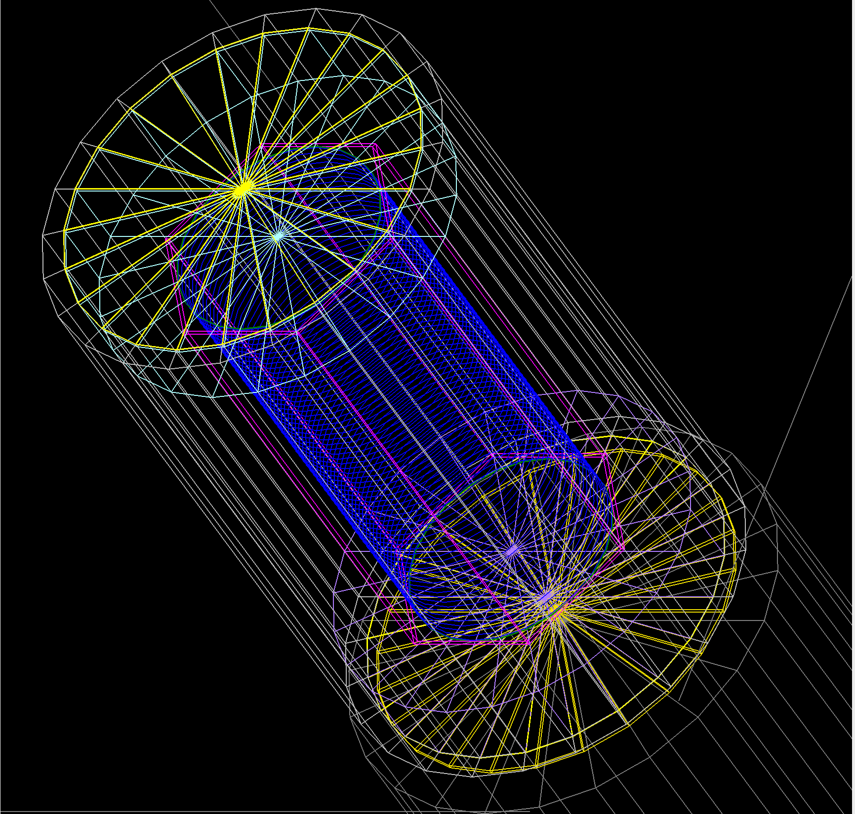

TOPAS Monte Carlo
Simulations – Geant4
Samuel B. Takwirira, Dr. Karl J. Slifer
Tensor SIDIS Workshop & b1/Azz Collaboration
Jefferson Lab, Newport News, VA, Jun 03-06, 2026

Slide 2
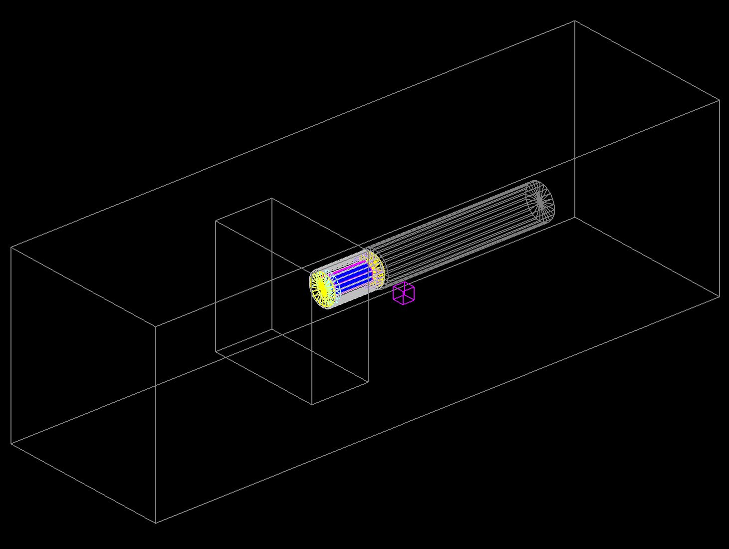
Who uses TOPAS Monte Carlo?
Mostly medical physicists – for advanced treatment planning in intensity modulated radiation therapy (IMRT) .
However, TOPAS is a useful for tool for anyone who wants to simulate particle transport

Slide 3
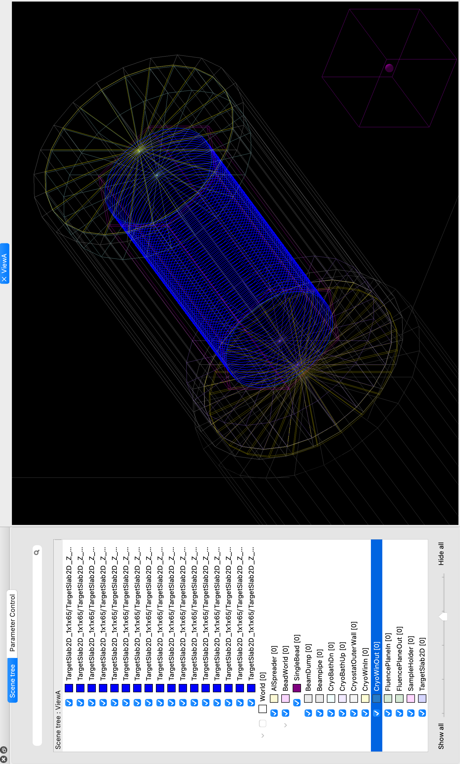


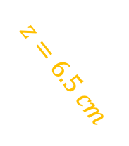
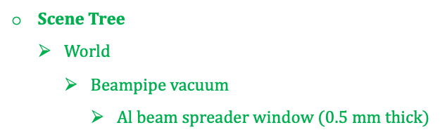
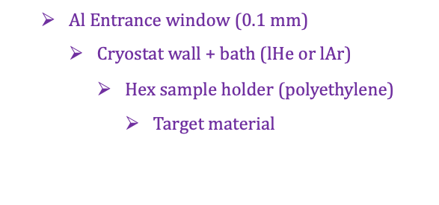
Geometry and Target Positioning
Scene Tree
  $World$
    $Beampipe vacuum$
      $Al beam spreader window (0.5 mm thick)$
$$A= 6.42{cm}^{2}$$
$$r=1.42 cm$$
  $Al Entrance window$ (0.1 mm)
    Cryostat wall + bath (lHe or lAr)
      Hex sample holder (polyethylene)
        Target material
$$z=6.5 cm$$
  Cryostat bath (downstream)
    Al exit window (0.1 mm)
      Beam dump
Notes:
Air severely attenuates an electron beam, so the beam pipe needs to be evacuated.

Slide 4
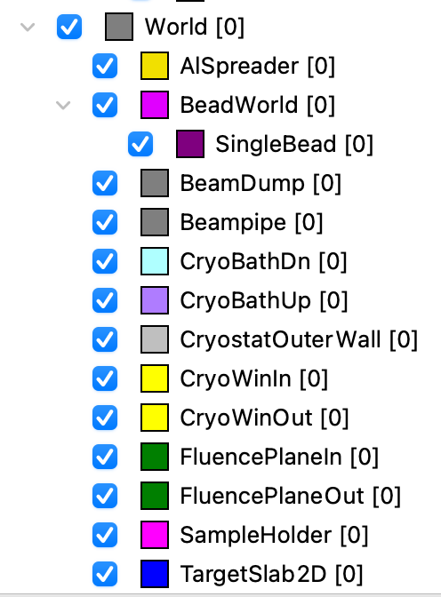
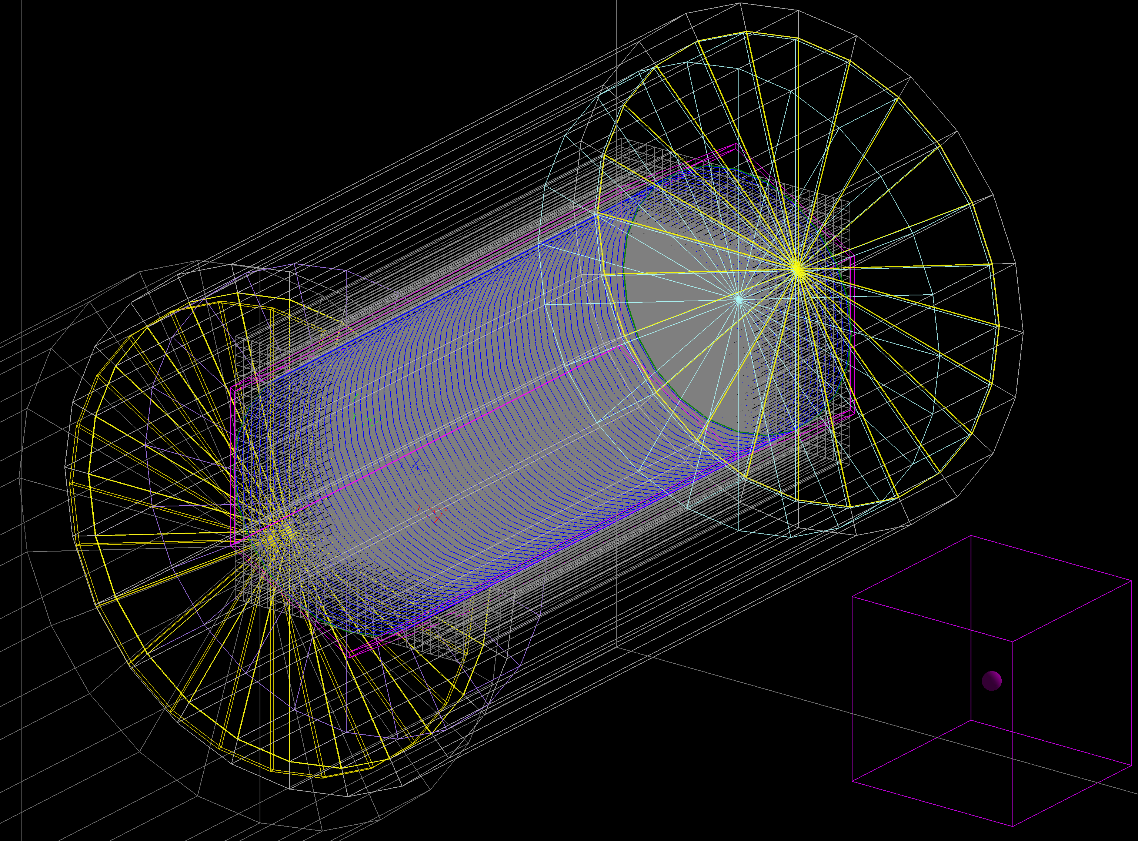
The Scene Tree/ Experimental Set up

Slide 5
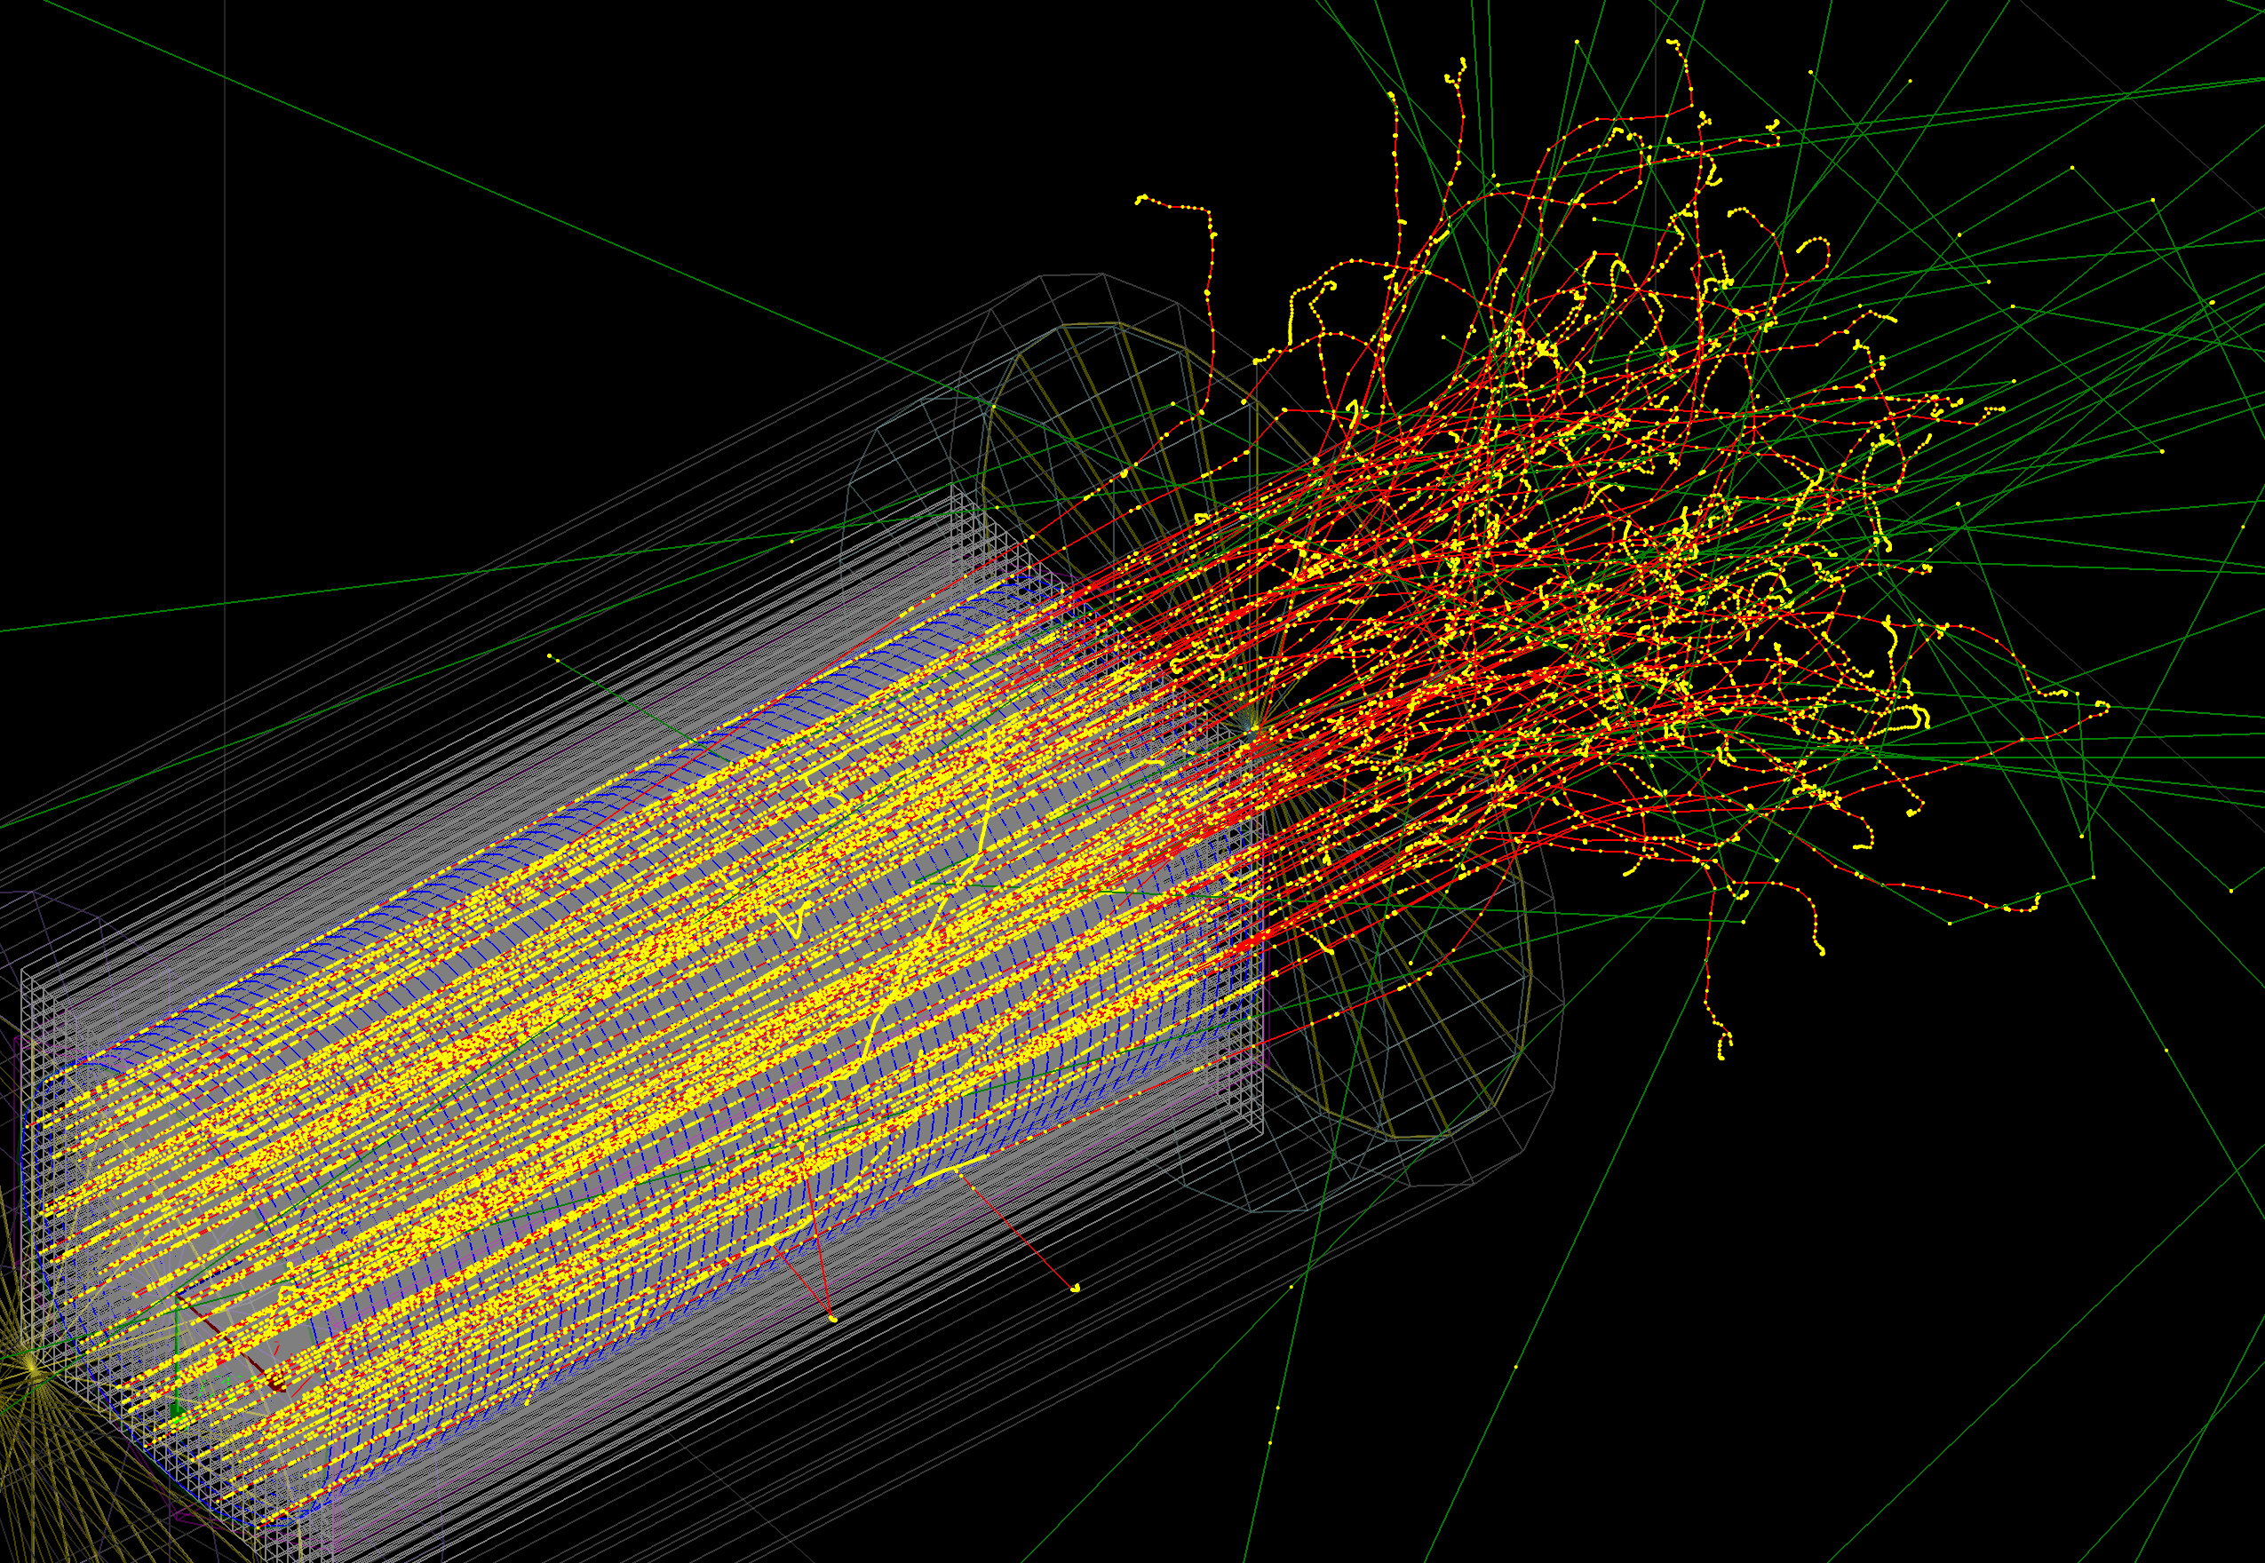
Beam Geometry – Rastered Approximation
Spatial Profile (Beam Shape & Size)
BeamPositionDistribution = "Flat"
  Particles are distributed evenly across the beam surface.
BeamPositionCutoffShape = "Ellipse"
  The boundary shape of the beam is an ellipse.
BeamPositionCutoffX / Y = 14.3 mm
  The horizontal and vertical radius.
  Since they are equal, the beam is a perfect circle with r= 14.3 mm).
Angular Profile (Beam Spread)
BeamAngularDistribution = "Gaussian”
  The direction of the particles follows a bell curve. Most point straight ahead, while fewer spread out at wider angles.
BeamAngularSpreadX / Y = 2.0 mrad
  The standard deviation of the angular spread (2.0 milliradians), defining how fast the beam diverges.
BeamAngularCutoffX / Y = 5.0 mrad
  The maximum allowed divergence angle. Any particle sampled with an angle wider than 5.0 mrad is discarded to cut off the extreme edges of the bell curve.
Notes:
The beam features a flat spatial distribution bounded within a circular radius of 14.3 mm, combined with a Gaussian angular profile having a 2.0 mrad standard deviation spread and a maximum divergence cutoff at 5.0 mrad.

Slide 6
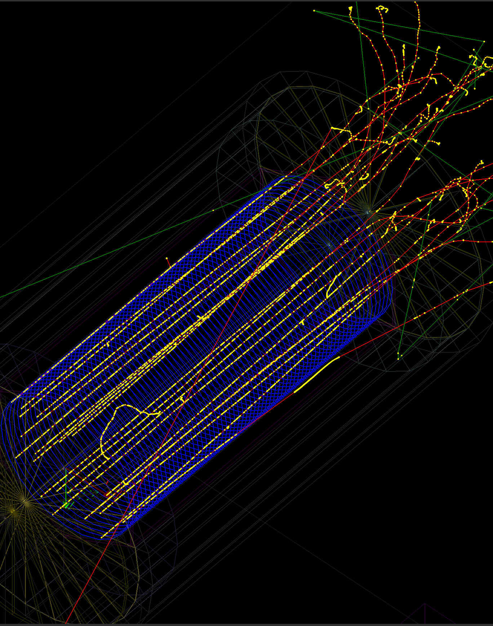

Diagnostics and Model Boundaries
Spectral diagnostics help verify electron transport to the target and contextualize bremsstrahlung at exit.
TOPAS/Geant4 predicts, among other quantities, transport, dose, fluence, spectra, and power on target.
TOPAS/Geant4 does NOT directly predict radical species, radical survival, ESR spectra, annealing, or final DNP polarization.

Slide 7
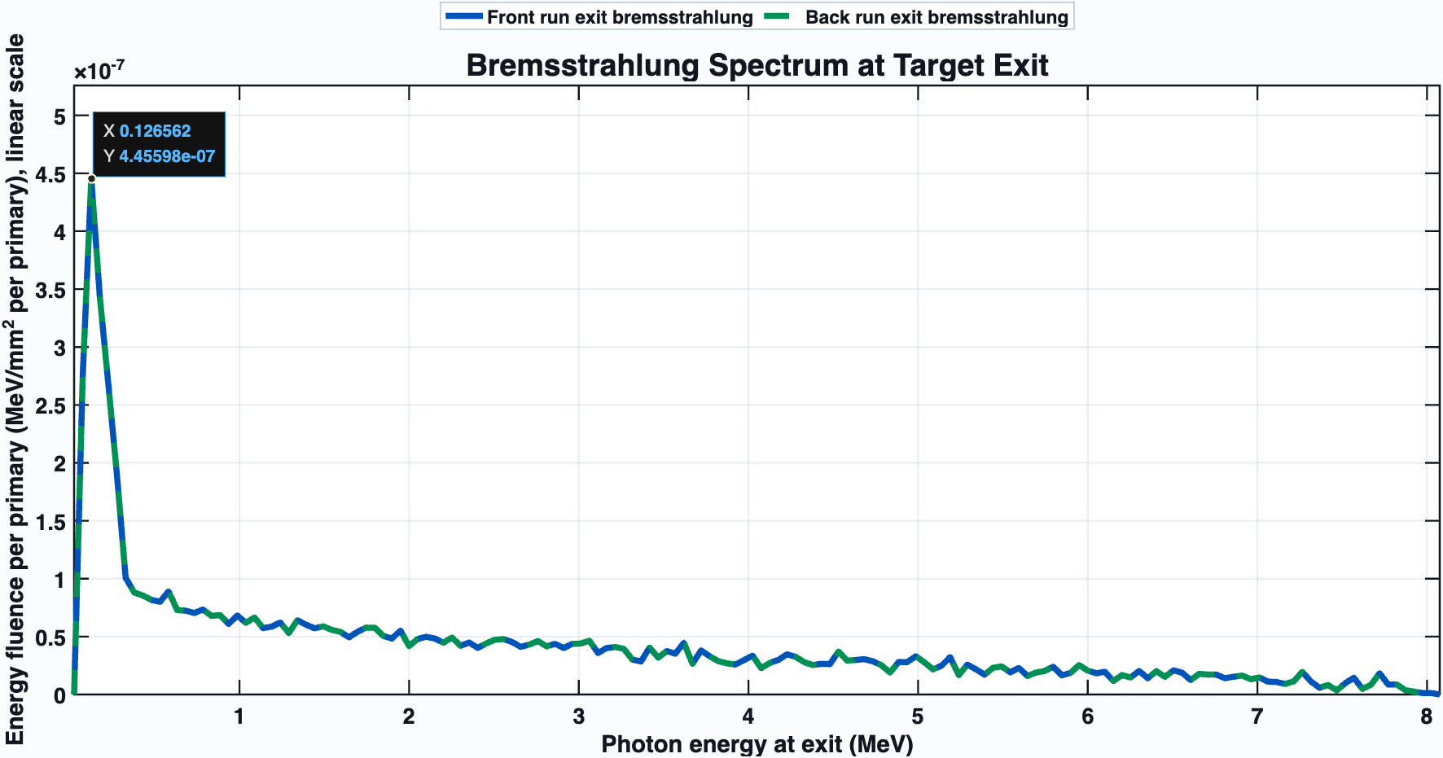
Bremsstrahlung Spectrum at Target Exit
The front and back run curves validate the geometric symmetry and alignment of the simulation setup, while the 8 MeV cutoff confirms the incident electron beam energy.
The sharp peak at 0.125 MeV and low-energy drop-off demonstrate effective filtering of soft radiation
Notes:
The maximum energy of an electron beam can be precisely determined from a bremsstrahlung curve. This is achieved using the Duane-Hunt Law, which states that the maximum energy of the emitted bremsstrahlung photons equals the maximum kinetic energy of the incident electrons.

Slide 8
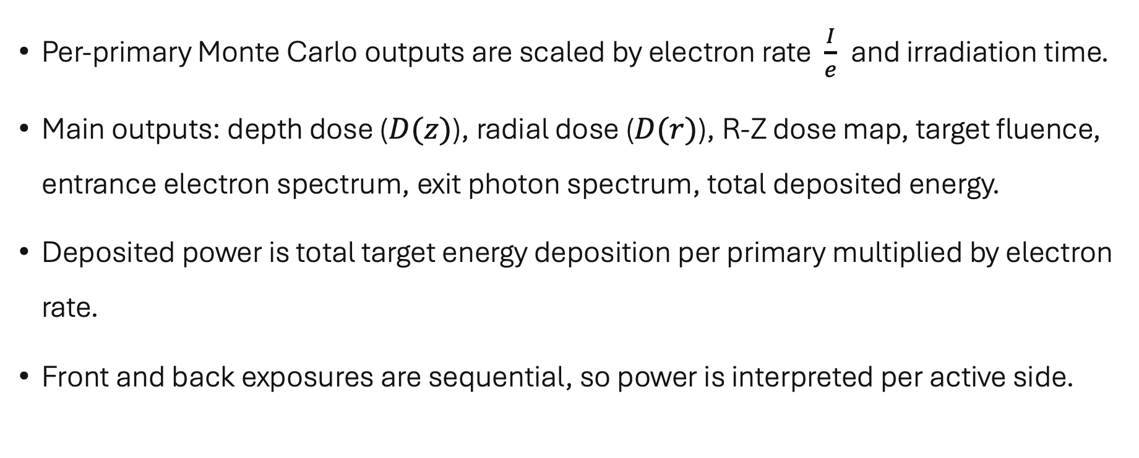
Scoring
Per-primary Monte Carlo outputs are scaled by electron rate $\frac{I}{e}$and irradiation time.
Main outputs: depth dose ($D(z)$), radial dose ($D(r)$), R-Z dose map, target fluence, entrance electron spectrum, exit photon spectrum, total deposited energy.
Deposited power is total target energy deposition per primary multiplied by electron rate.
Front and back exposures are sequential, so power is interpreted per active side.

Slide 9
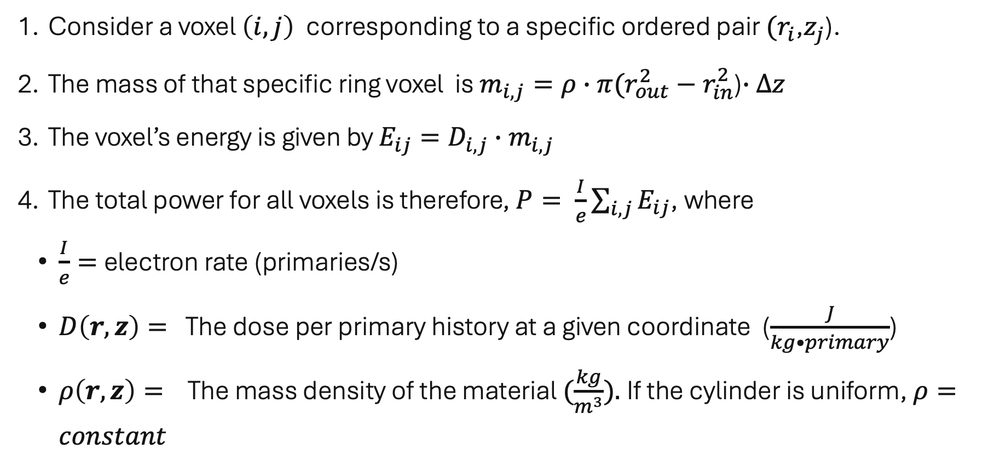
Determining the Power $P$
Consider a voxel $\left(i,j\right)$ corresponding to a specific ordered pair $(r_{i}$,$z_{j}$).
The mass of that specific ring voxel is $m_{i,j}=ρ∙π(r_{out}^{2}−r_{in}^{2}$)$∙∆z$
The voxel’s energy is given by $E_{ij}=D_{i,j}∙m_{i,j}$
The total power for all voxels is therefore, $P= \frac{I}{e}\sum_{i,j}{E_{ij}}$, where
  $\frac{I}{e}=$electron rate (primaries/s)
  $D\left(r, z\right)=$The dose per primary history at a given coordinate ($\frac{J}{kg•primary}$)
  $ρ\left(r,z\right)=$The mass density of the material $(\frac{kg}{m^{3}}).$If the cylinder is uniform, $ρ=constant$

Slide 10
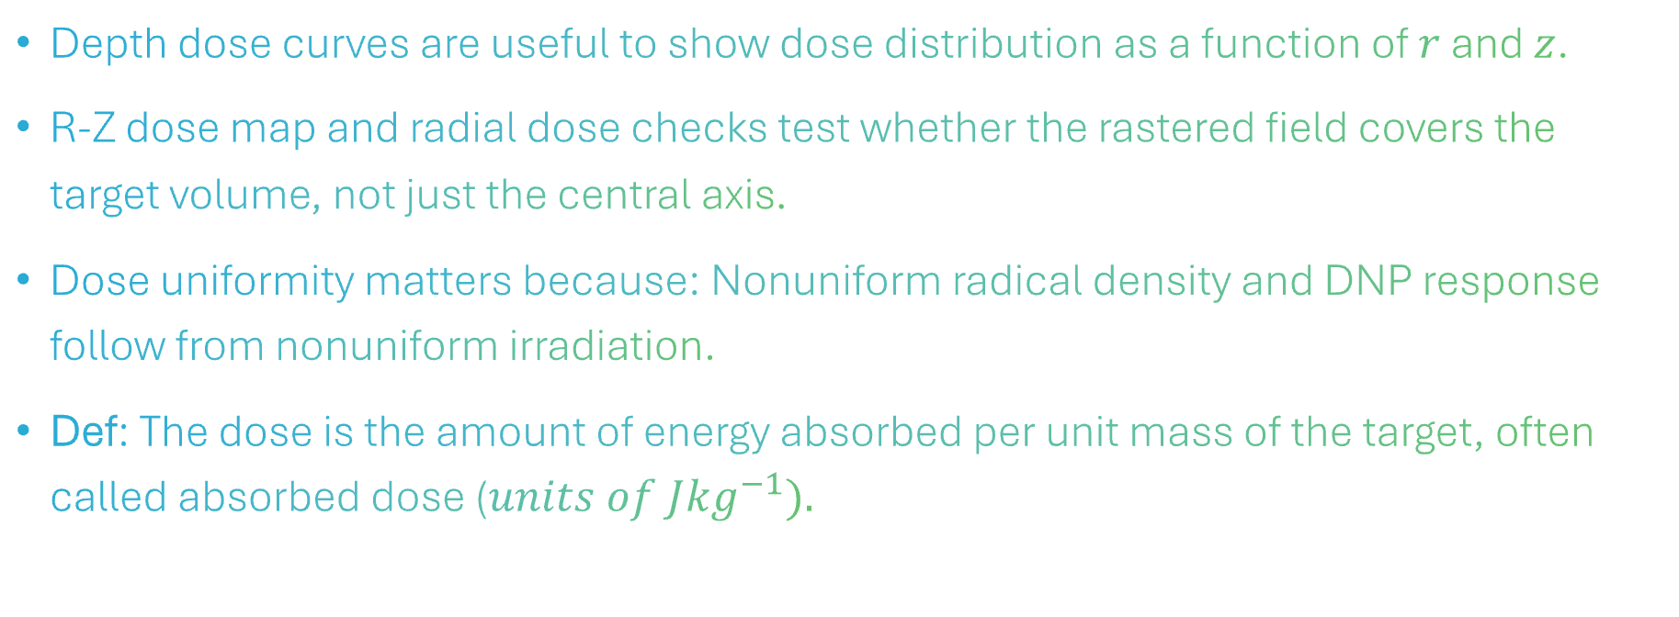
One-sided Irradiations
Depth dose curves are useful to show dose distribution as a function of $r$ and $z$.
R-Z dose map and radial dose checks test whether the rastered field covers the target volume, not just the central axis.
Dose uniformity matters because: Nonuniform radical density and DNP response follow from nonuniform irradiation.
Def: The dose is the amount of energy absorbed per unit mass of the target, often called absorbed dose ($units of J{kg}^{−1}).$

Slide 11
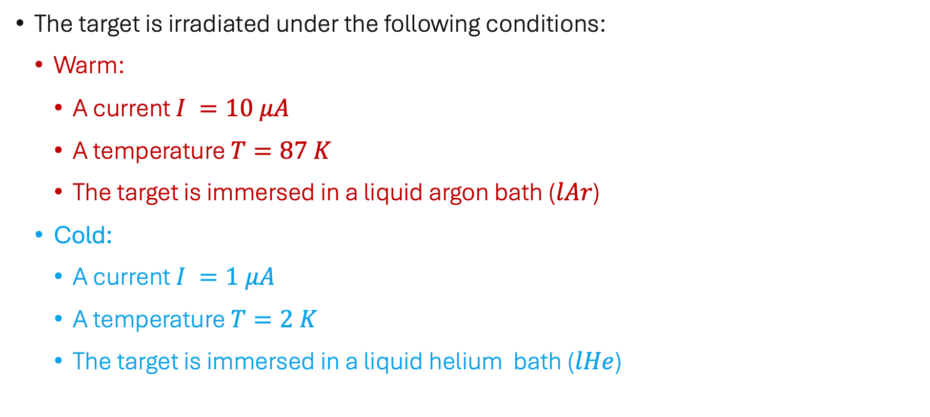
The Warm vs. Cold Irradiation Cases
The target is irradiated under the following conditions:
  Warm:
    A current $I =10 μA$
    A temperature $T=87 K$
    The target is immersed in a liquid argon bath ($lAr$)
  Cold:
    A current $I =1 μA$
    A temperature $T=2 K$
    The target is immersed in a liquid helium bath ($lHe$)

Slide 12
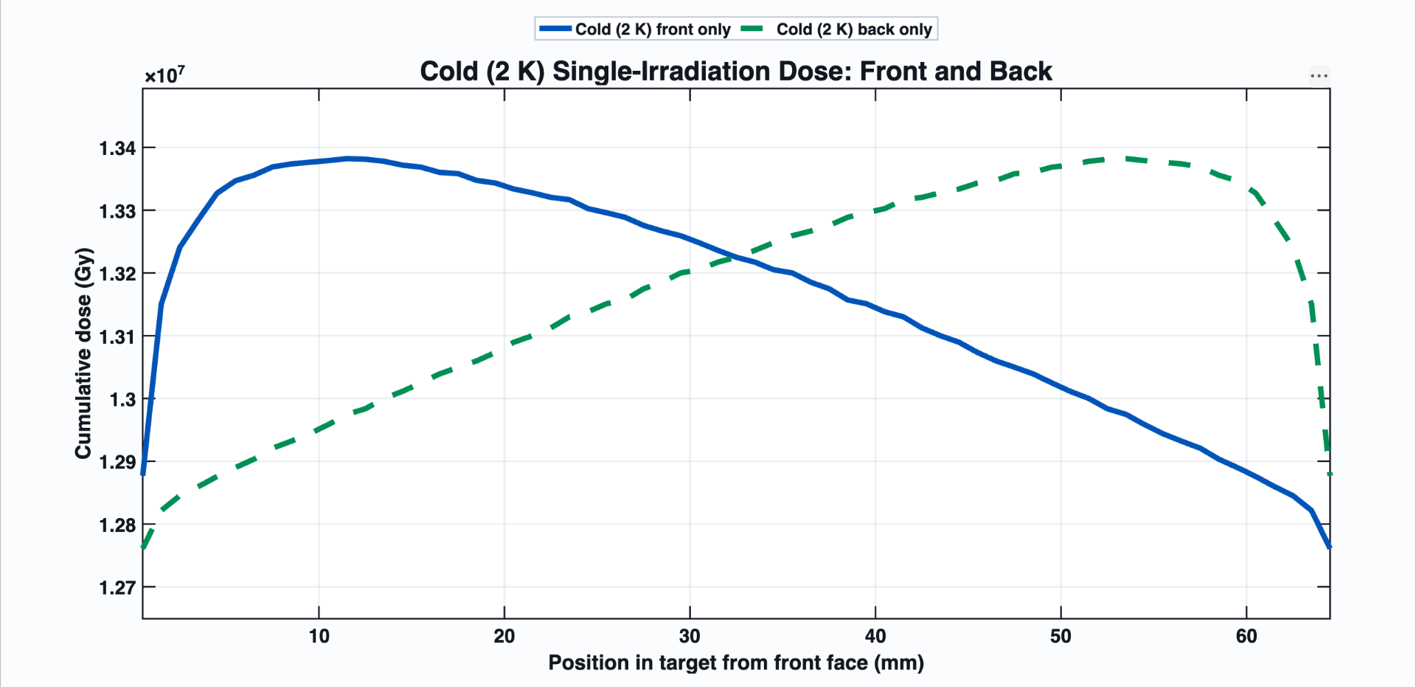
Cold $(2 K)$Irradiation Dose – Front/Back
A single entrance direction creates a directional dose gradient.

Slide 13
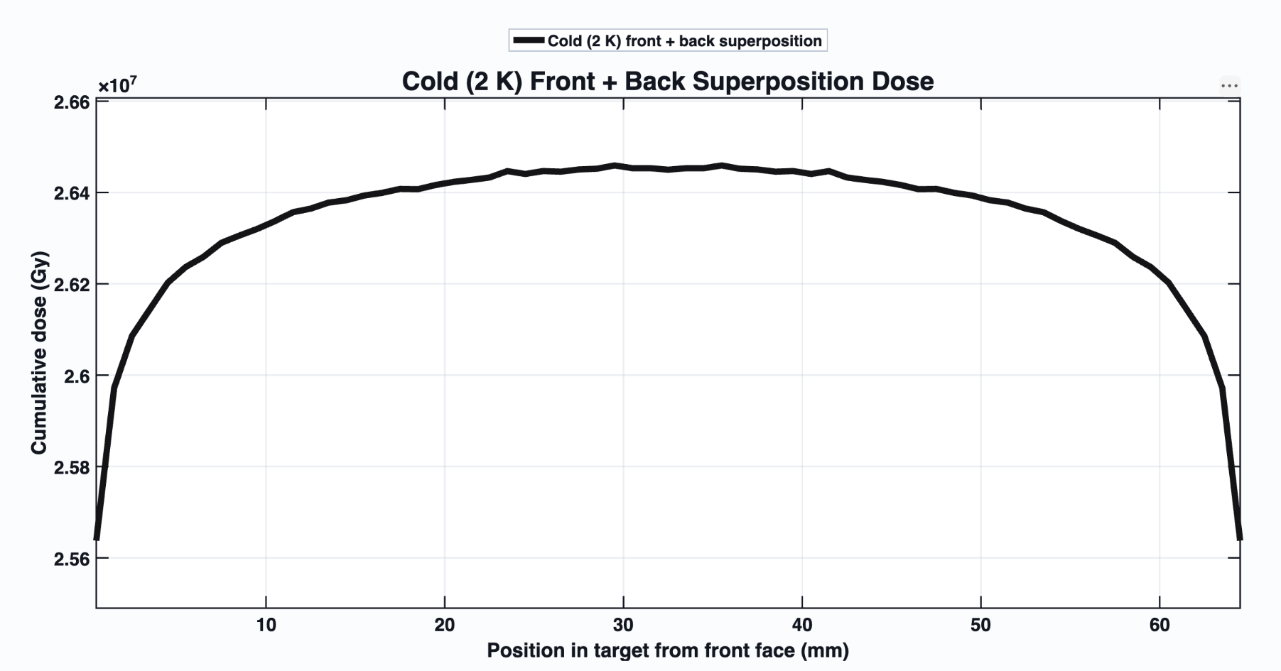
Cold $(2 K)$Front + Back Superposition Dose
The superposed dose distribution looks flatter…

Slide 14
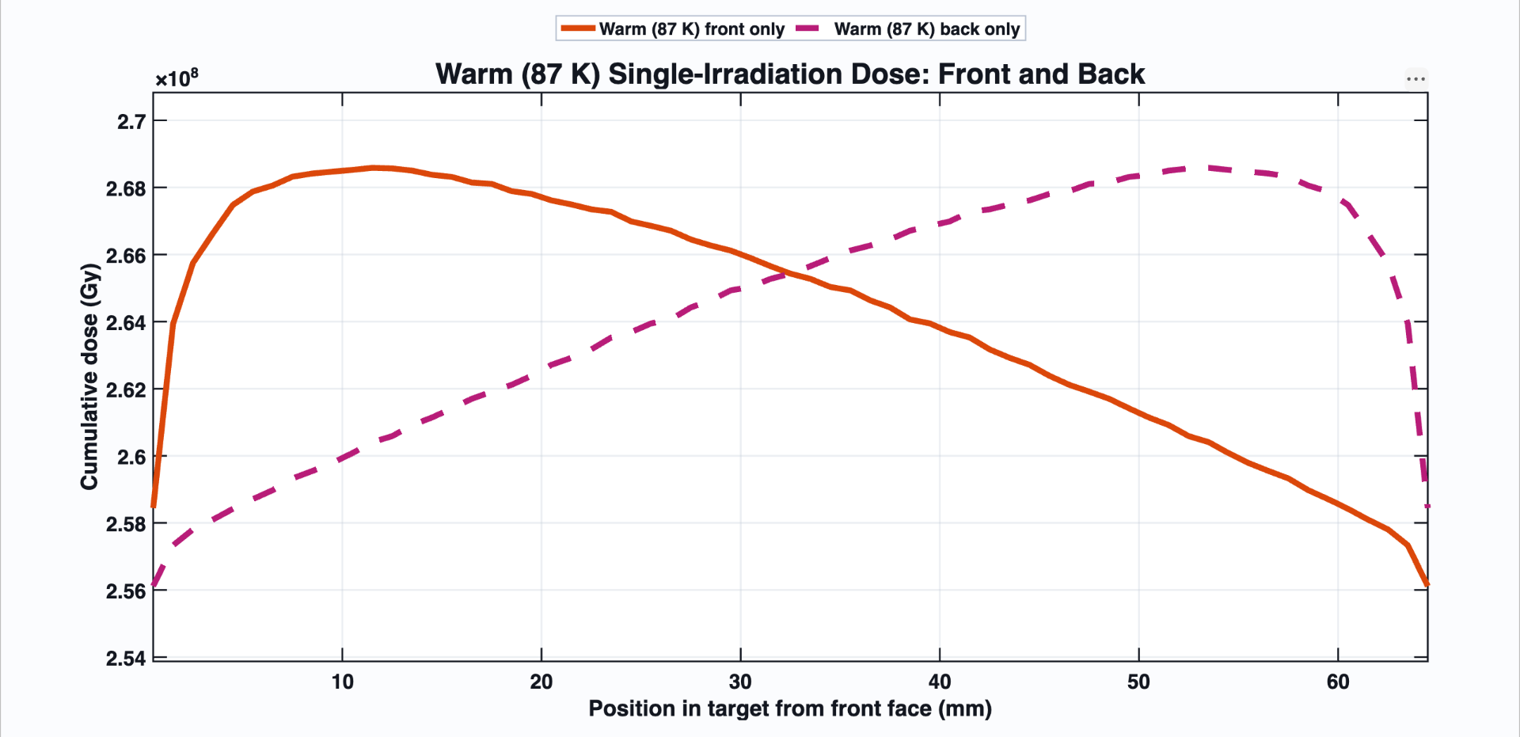
Warm $(87 K)$Front/Back Irradiation
A single entrance direction creates a directional dose gradient...

Slide 15
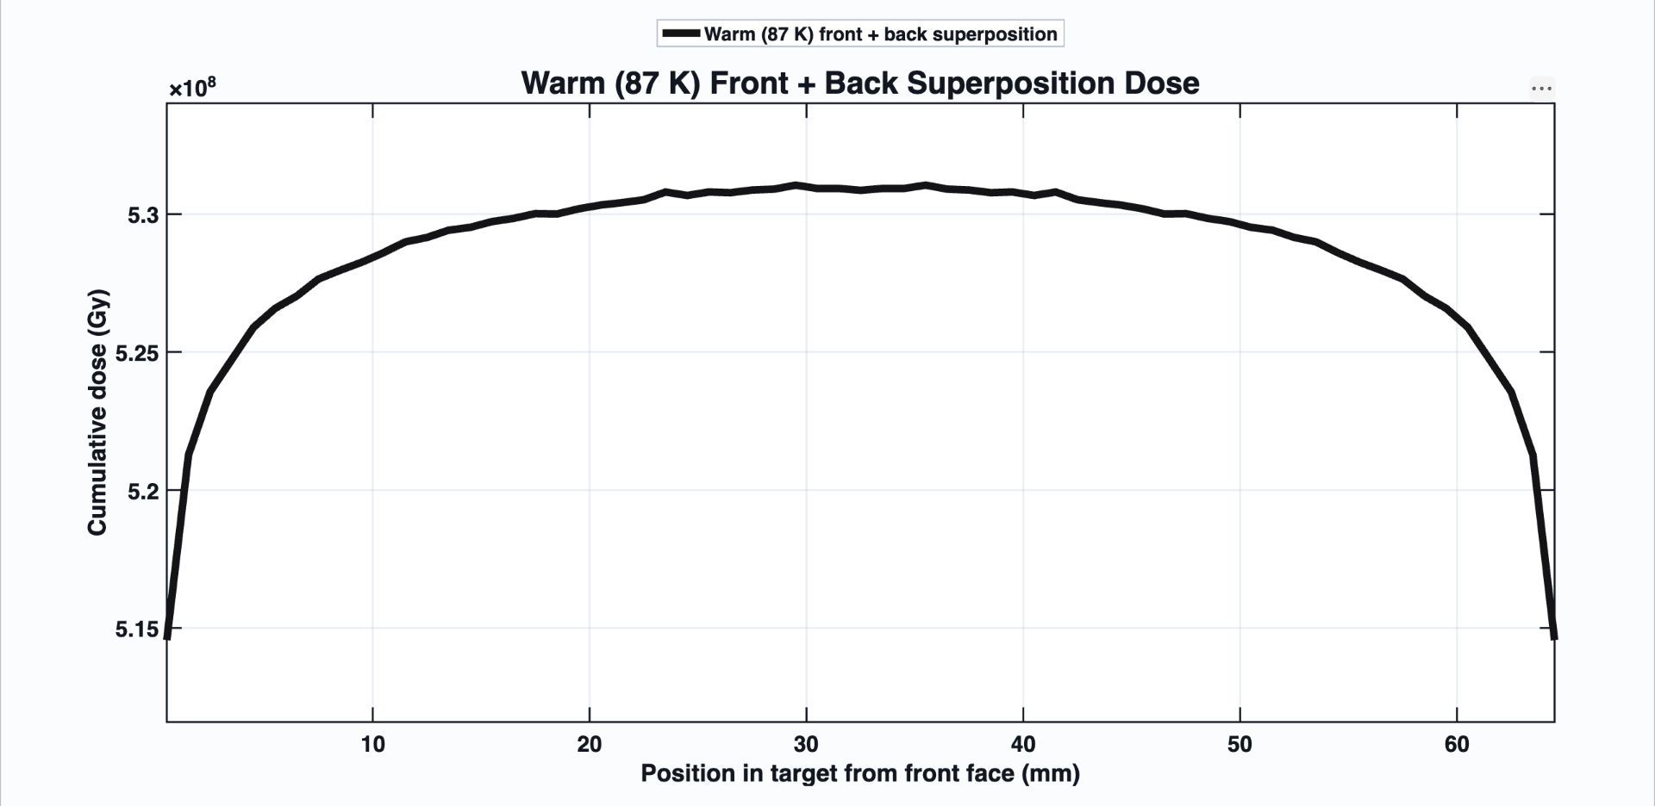
Warm $(87 K)$Front + Back Superposition Dose
A single entrance direction creates a directional dose gradient.

Slide 16
Radial Dose [$D(r)]$Distribution

Slide 17
Warm Case – Radial Dose

Slide 18
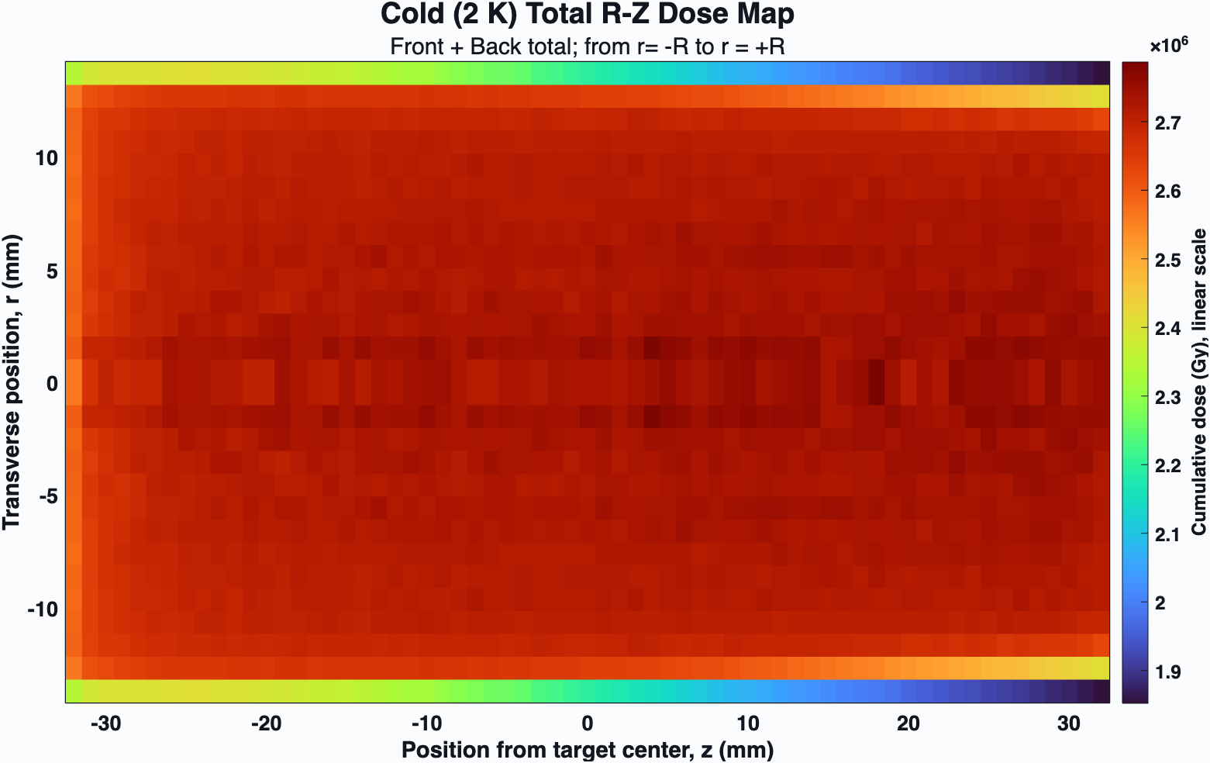
The imagesc function in MATLAB displays a matrix as an image where each element corresponds to a single-colored pixel.

Slide 19
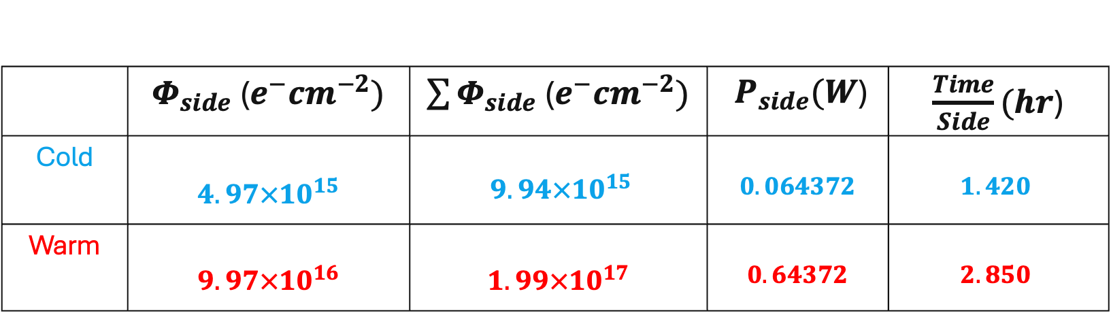
Fluence and Heat Load
 | $Φ_{side}$($e^{−}{cm}^{−2})$ | $\sum{Φ_{side}}$($e^{−}{cm}^{−2})$ | $P_{side}(W$) | $\frac{Time}{Side}(hr$)
Cold | $$4.97×{10}^{15}$$ | $9.94×{10}^{15}$ | $$0.064372$$ | $$1.420$$
Warm | $$9.97×{10}^{16}$$ | $$1.99×{10}^{17}$$ | $$0.64372$$ | $$2.850$$
Delivered fluence is within approximately one percent of proposal targets.
Total irradiation time = 8.54h.

Slide 20
Therefore, we conclude that…
Single-side dose is not the experiment
  Front-only and back-only runs diagnose the transport behavior; neither alone is the final target-delivery claim.
Opposed delivery is the correction
  Superposition is the physics-useful result because the two directions compensate each other's depth gradients.
Beam accounting makes it real
  Current, fluence, time, and deposited power convert TOPAS per-primary scoring into an experimental operating point.

Slide 21
Acknowledgements
Dr. Karl Slifer for mentorship and redirection in this project
UNH Nuclear Physics Group for feedback on my work

Slide 22
What does a TOPAS code look like?
Please visit https://github.com/SamuelBarachel/uitf02 to access the code for this project.
All images in this presentation are results from MC the simulation.
The full report for this project will also be included by 06/10/2025

Slide 23
References
[1] S. Agostinelli et al., “GEANT4 - A simulation toolkit,” Nuclear Instruments and Methods in Physics Research Section A, vol. 506, no. 3, pp. 250-303, 2003. doi: 10.1016/S0168-9002(03)01368-8.
[2] J. Perl, J. Shin, J. Schumann, B. Faddegon, and H. Paganetti, “TOPAS: An innovative proton Monte Carlo platform for research and clinical applications,” Medical Physics, vol. 39, no. 11, pp. 6818-6837, 2012. doi: 10.1118/1.4758060.
[3] D. G. Crabb and W. Meyer, “Solid polarized targets for nuclear and particle physics experiments,” Annual Review of Nuclear and Particle Science, vol. 47, pp. 67-109, 1997. doi: 10.1146/annurev.nucl.47.1.67.
[4] W. Meyer, “Ammonia as a polarized solid target material - a review,” Nuclear Instruments and Methods in Physics Research Section A, vol. 526, issues 1-2, pp. 12-21, 2004. doi: 10.1016/j.nima.2004.03.145.
[5] W. Meyer, K. H. Althoff, W. Havenith, and W. Thiel, “Dynamic deuteron polarization in irradiated D-ammonia (ND3) and its first use in a high energy photon beam,” Nuclear Instruments and Methods in Physics Research Section A, vol. 227, no. 1, pp. 35-44, 1984.doi: 10.1016/0168-9002(84)90098-6.
[6] A. Conover, V. Y. S. Bandara, D. Keller, and F. Bateman, “Bulk irradiation of ammonia for polarized target experiments,” Nuclear Instruments and Methods in Physics Research Section A, vol. 1068, article 169717, 2024. doi: 10.1016/j.nima.2024.169717.

Slide 24
Question Time

Slide 25
Extra Slides

Slide 26
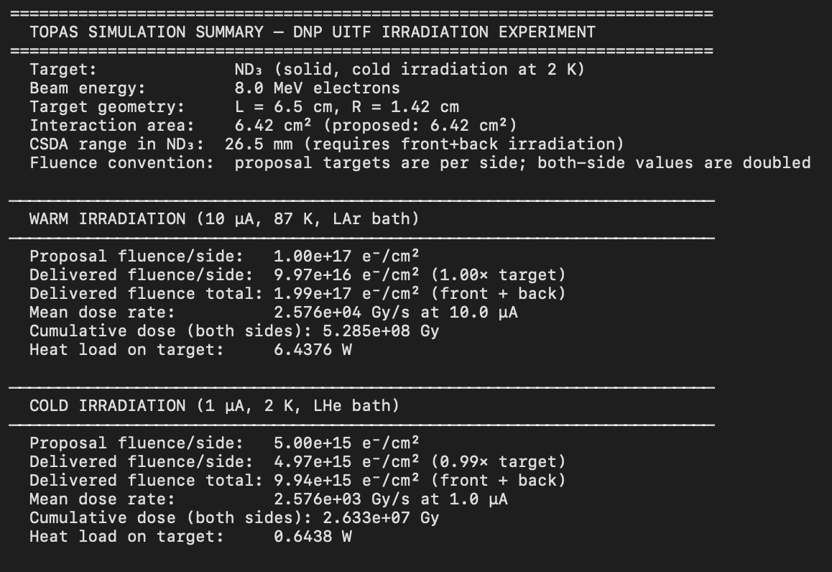

Slide 27
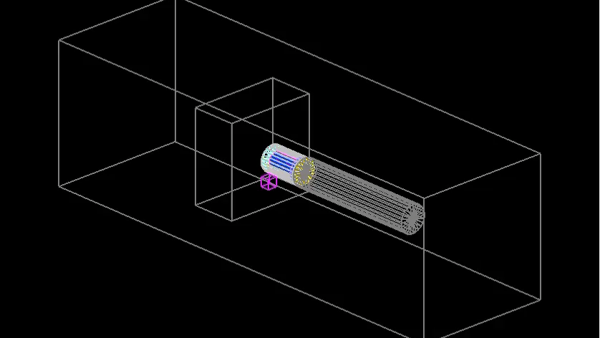

Slide 29
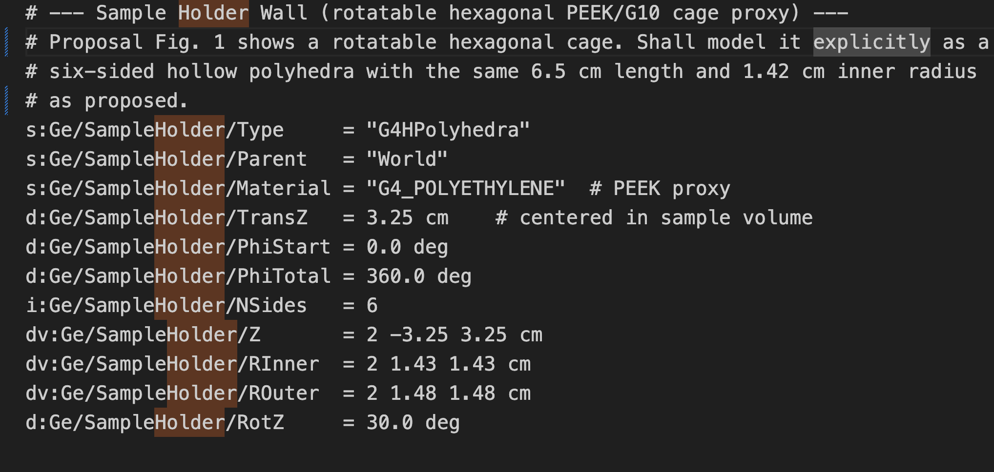
Sample Holder

