Slide 1

ERR Task List Status
Elena Long
b1/Azz Tensor
Collaboration Meeting
June 3rd, 2026

Slide 2
Target Tasks

Slide 3
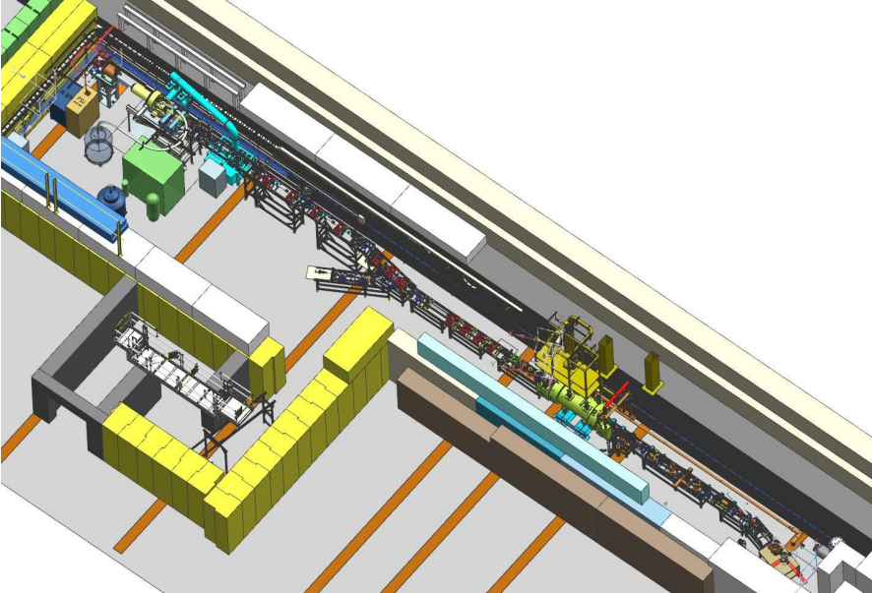
Target Tasks
◦ Maximize ND₃ vector polarization
In Progress
  The JLab Target Group is building a new test lab facility to irradiate ND3
    Irradiation optimization studies with both dose & irrad. Temperature
  Cryostat being built
  Beamline needs shielding for 10uA @ 8 MeV operation
  New: Approved BeamNetUS proposal for irradiation operations in Fall ‘26

Slide 4
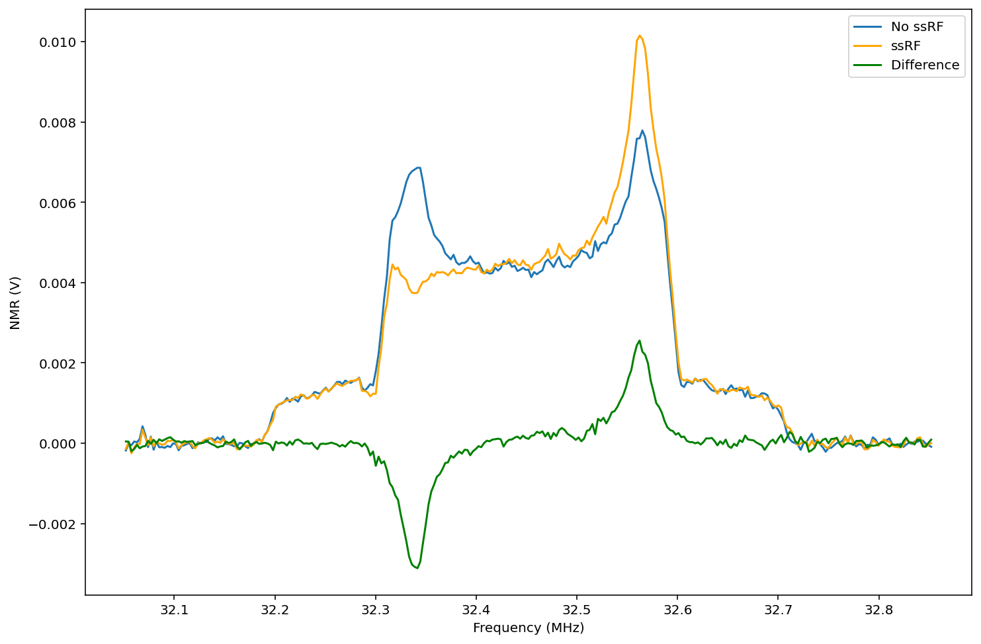
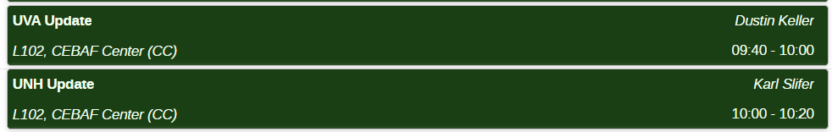
Target Tasks
◦ Demonstrate Tensor Enhancement on ND₃
In Progress
  Initial studies have been done on warm irradiated ND₃
    Compared w/ d-butanol, ssRF is sharper
    & lasts significantly longer
    Low vector pol. due to 84K irrad
  Cold (1-4K) irradiated ND₃ needed
Preliminary

Slide 5
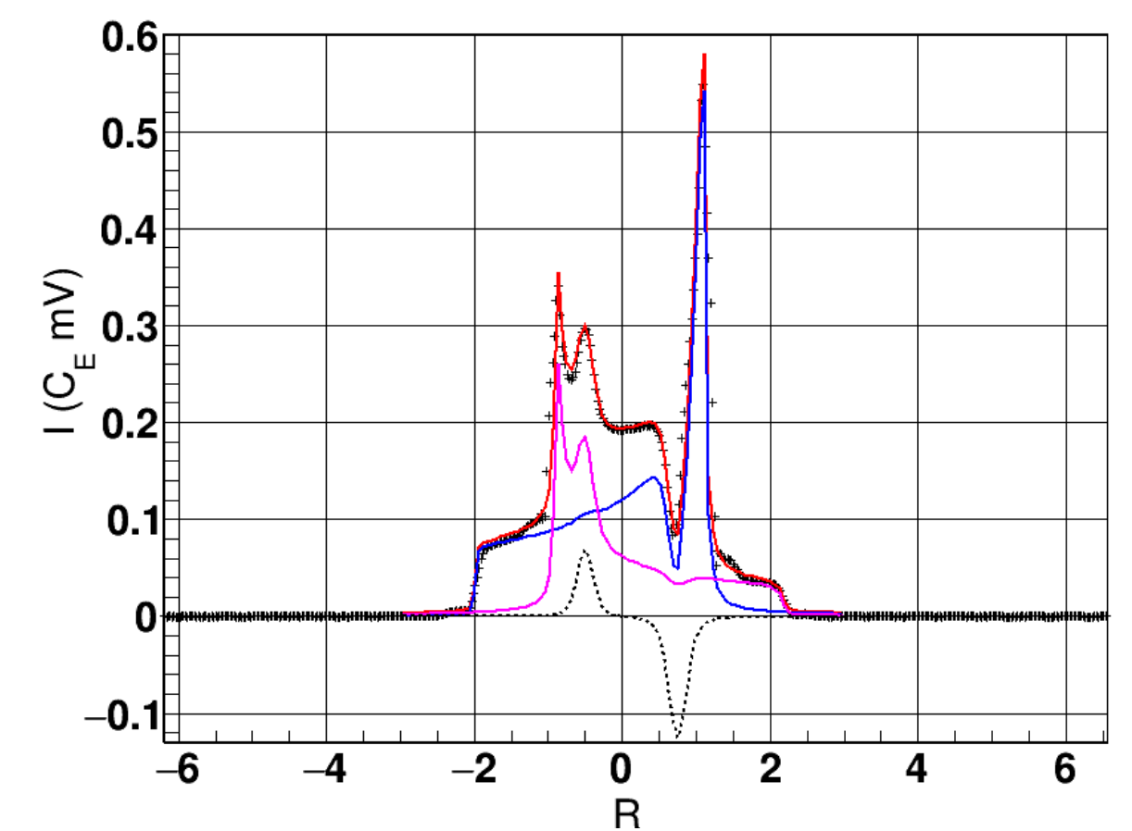
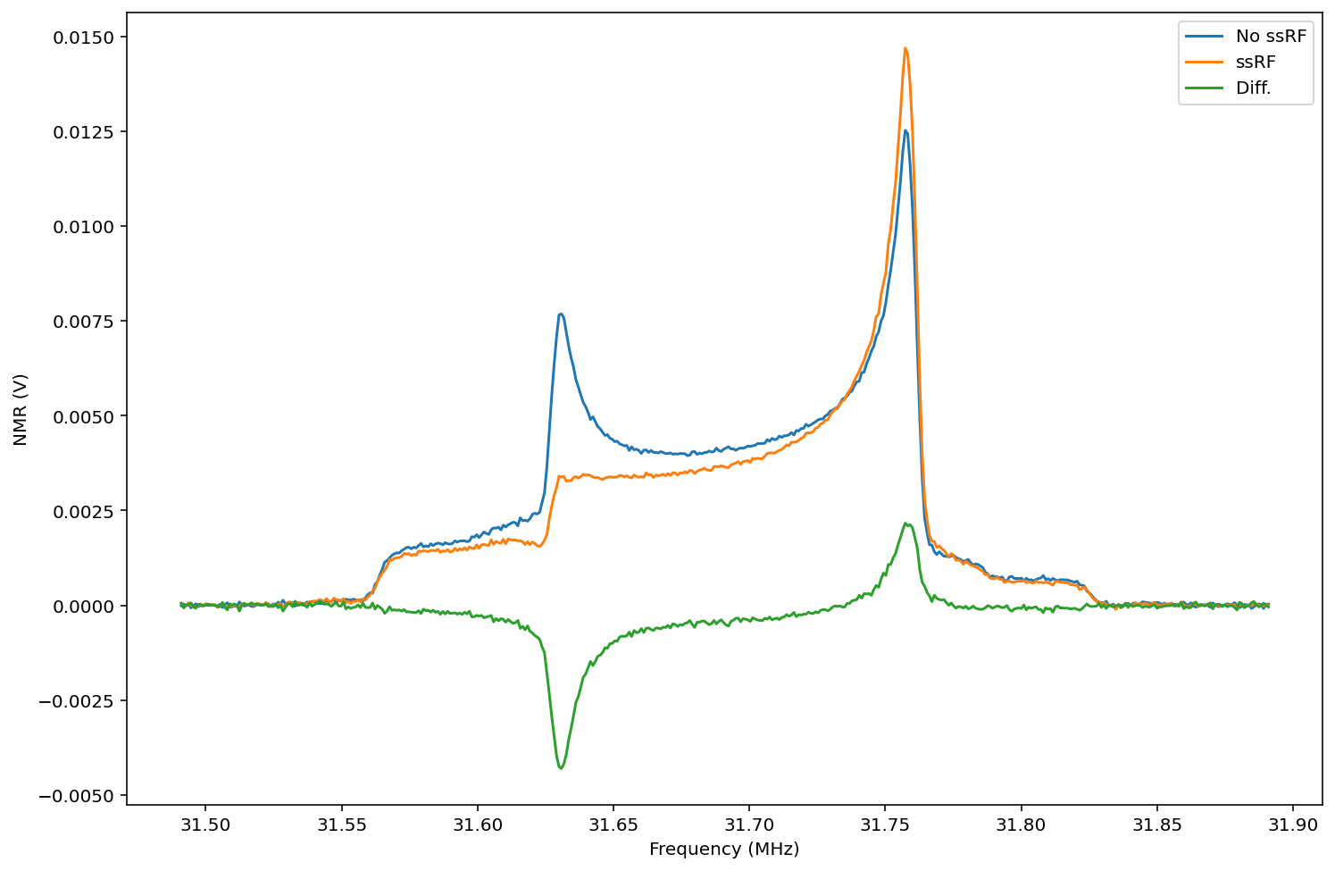
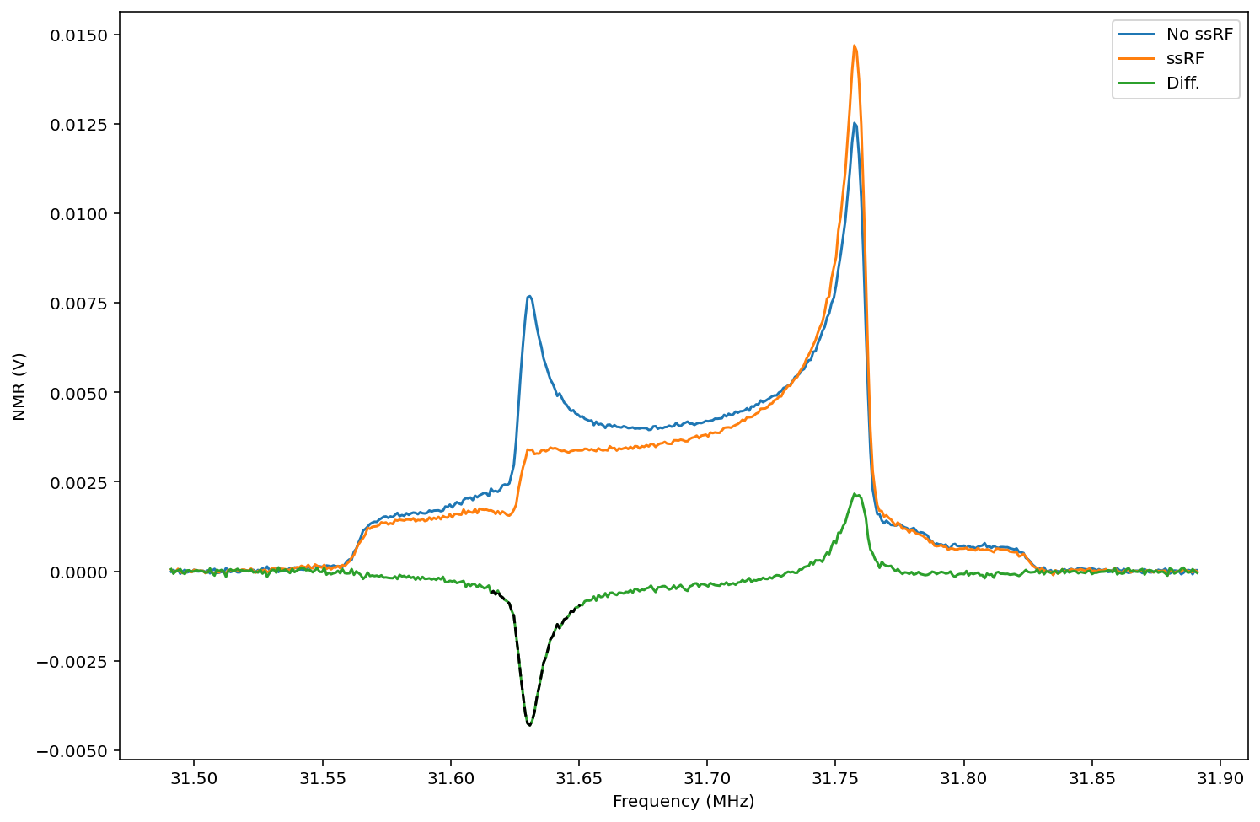
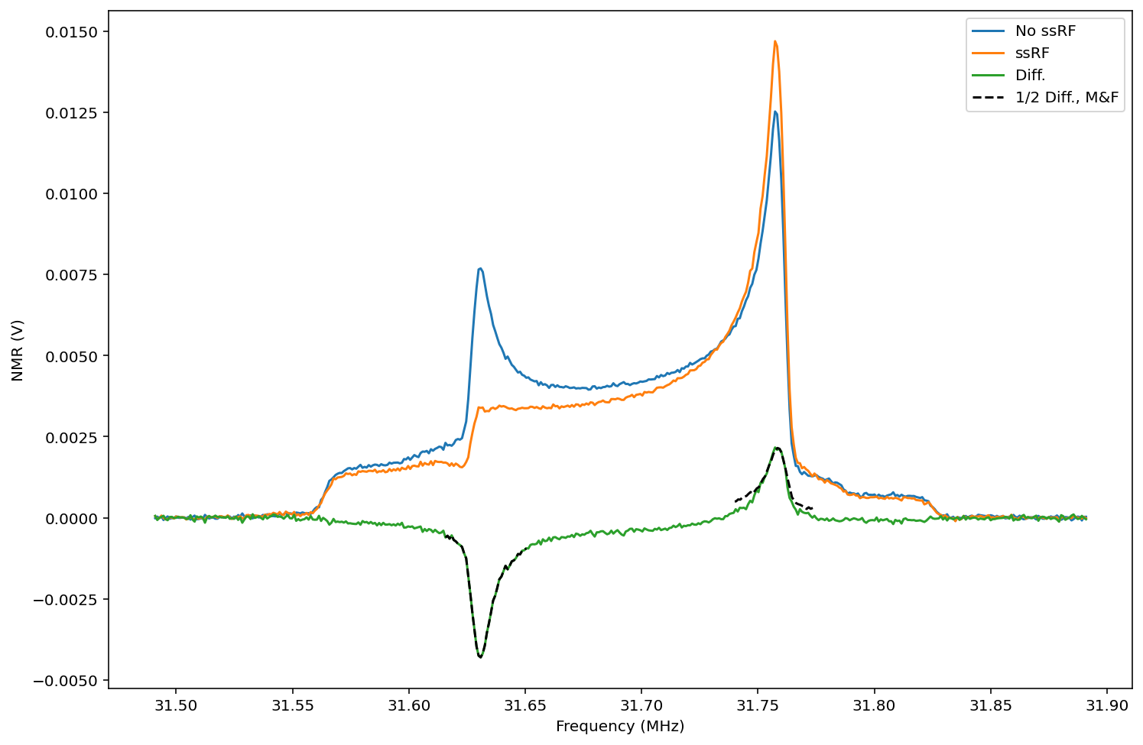

Target Tasks
◦ Demonstrate A_{lost} = 2 A_{gained} w/ ssRF
Complete
  UVA published results
    D. Keller, EPJ A 53, 155 (2017)
    J. Clements, D. Keller, NIM A 1050, 168177 (2023)
  UNH results in agreement
Preliminary
$$×\left(−\frac{1}{2}\right)$$
Mirror

Slide 6
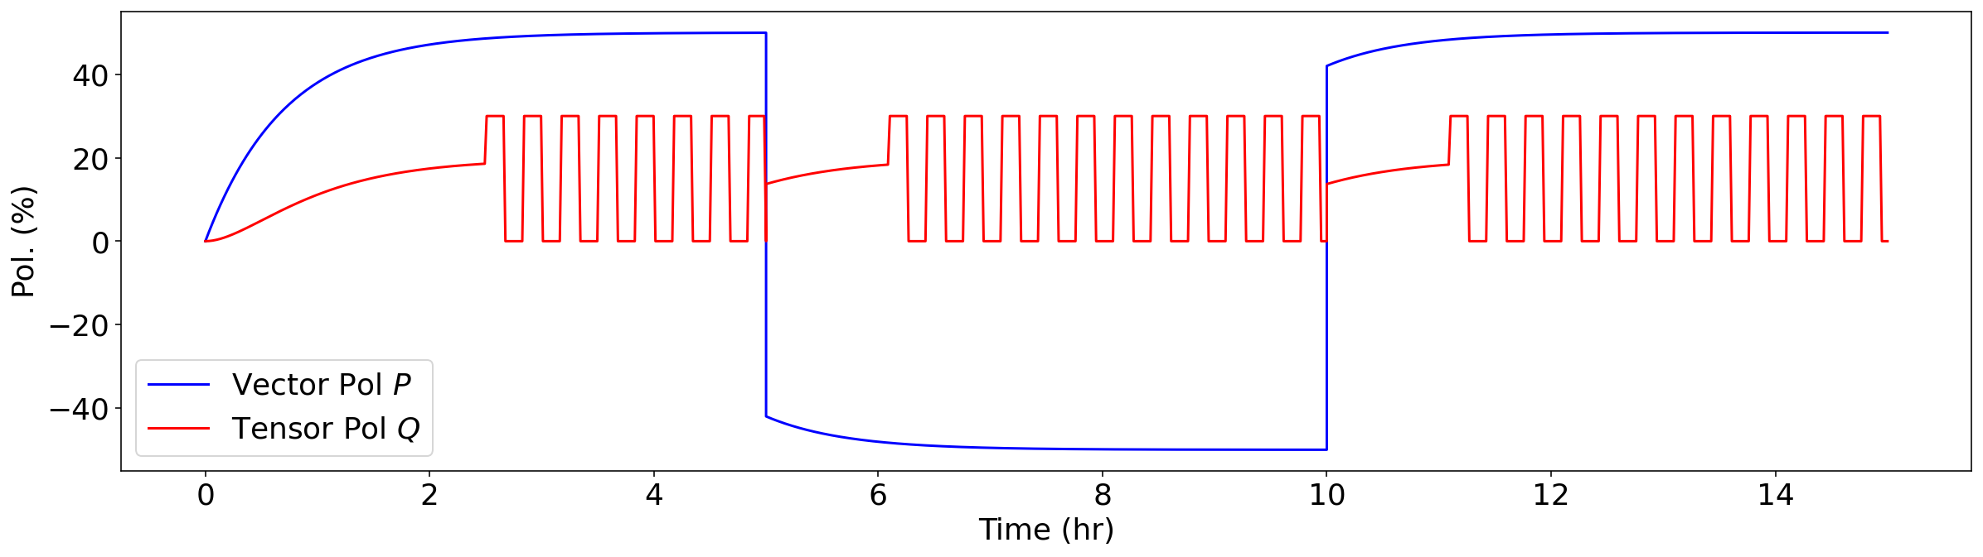
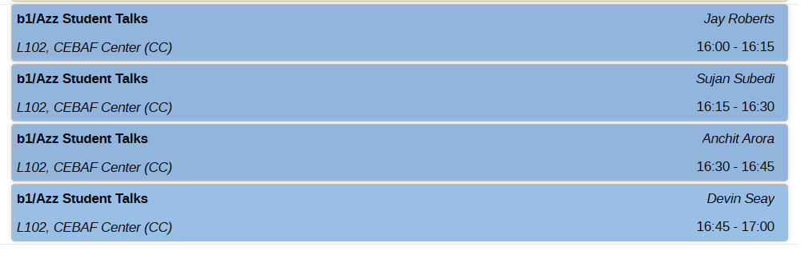
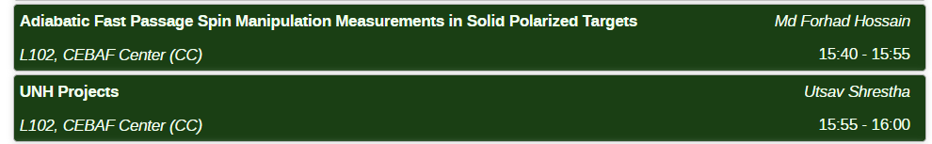
Target Tasks
◦ Design & Optimization of AFP and ssRF
In Progress
  Goal is to create the following plot w/ data:
    Currently working on optimizing & automating ssRF application/measurement cycles + AFP
      Hardware + Software

Slide 7
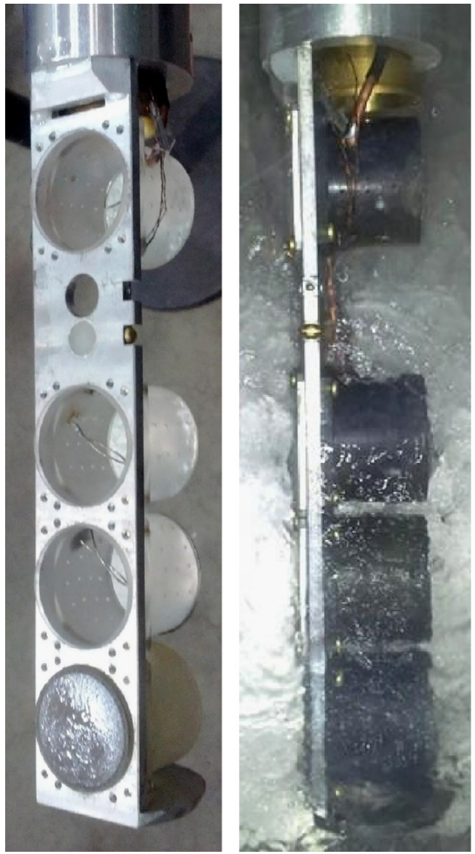
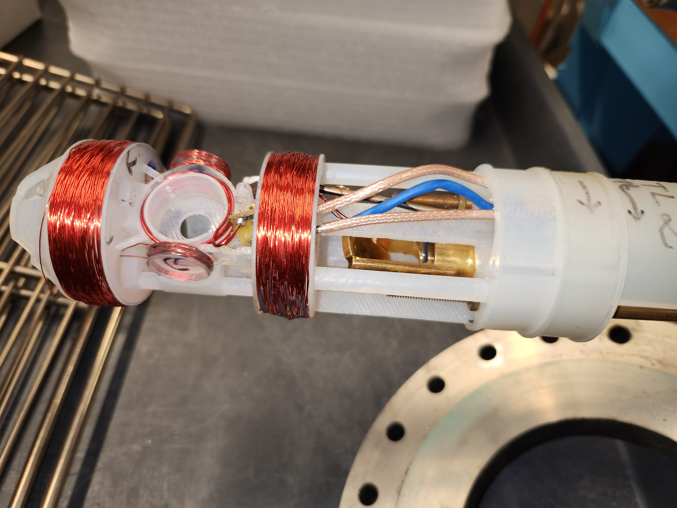
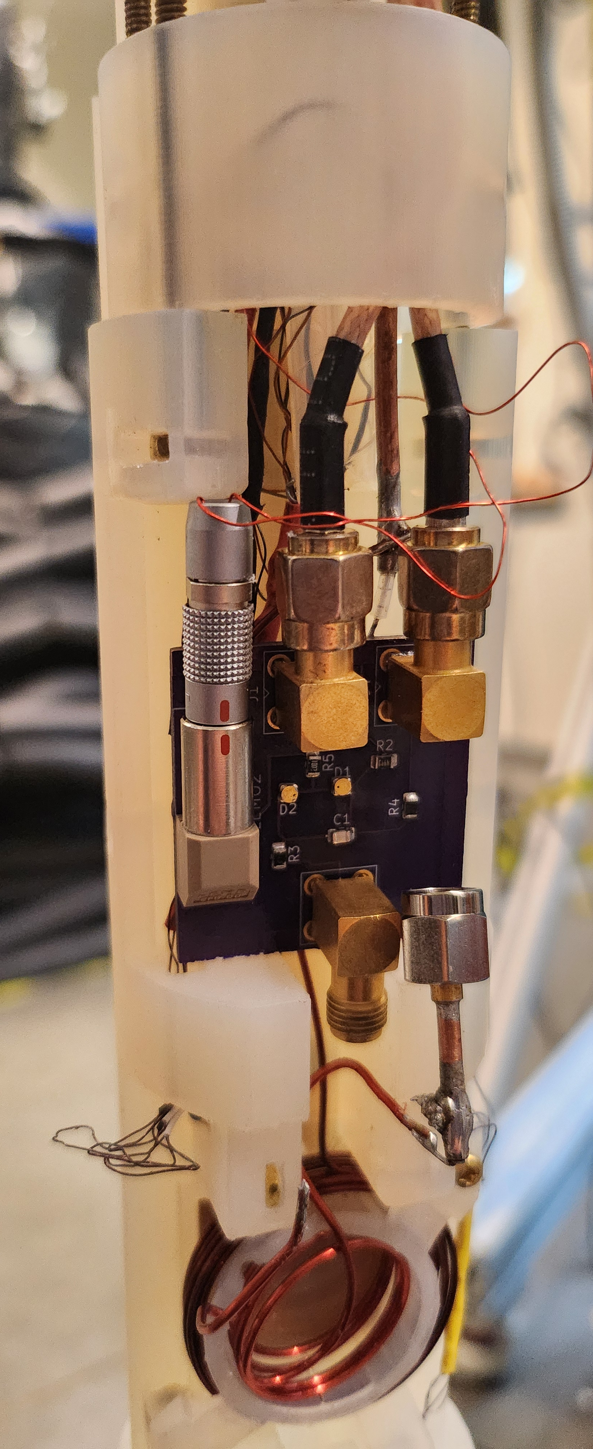
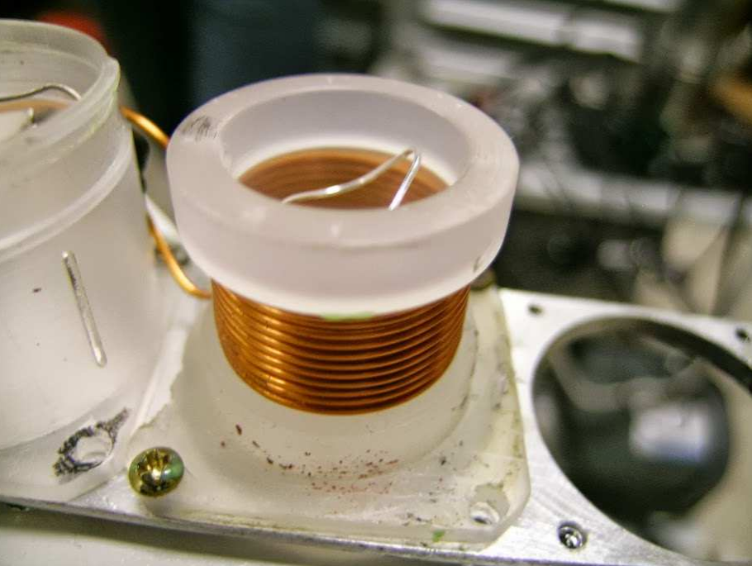
Target Tasks
◦ Final Design of Target Ladder & Coils
In Progress
  Will use target cups similar to g2p
  ssRF/AFP coil design and optimization in progress
    Currently testing in-line and Helmholtz-like configurations
Helmholtz-like
In-Line
J. Pierce, et al, NIM A 738, 54 (2014)

Slide 8
Beamline Tasks

Slide 9
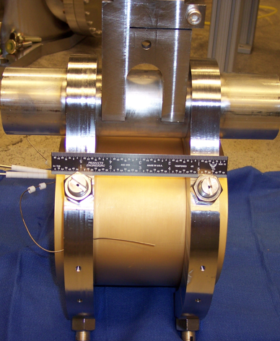
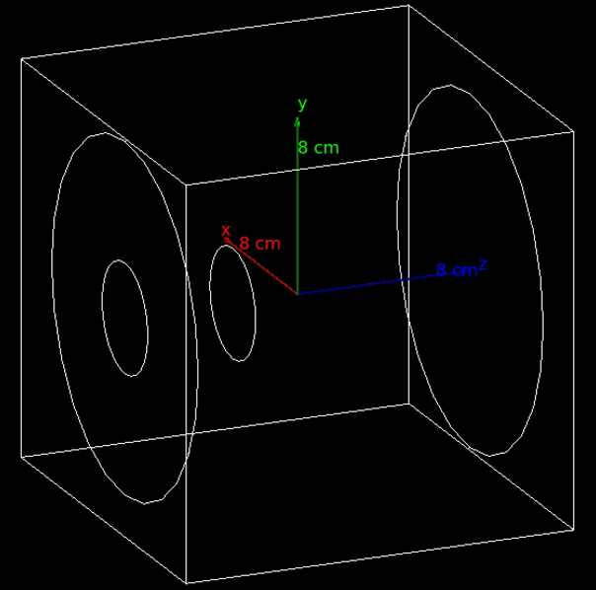
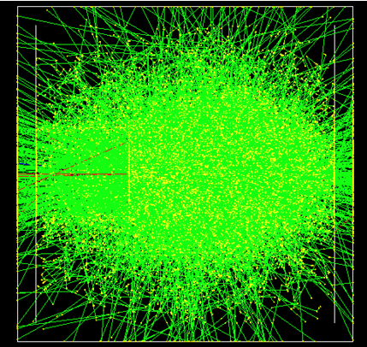
Beamline Tasks:
◦ Build Charge Monitoring Equipment
In Progress
  Need to keep charge uncertainty below the 10⁻⁴ level
  Faraday cup being built & studied for this purpose
    Recommissioned W-Cu calorimeter from Hall A

Slide 10
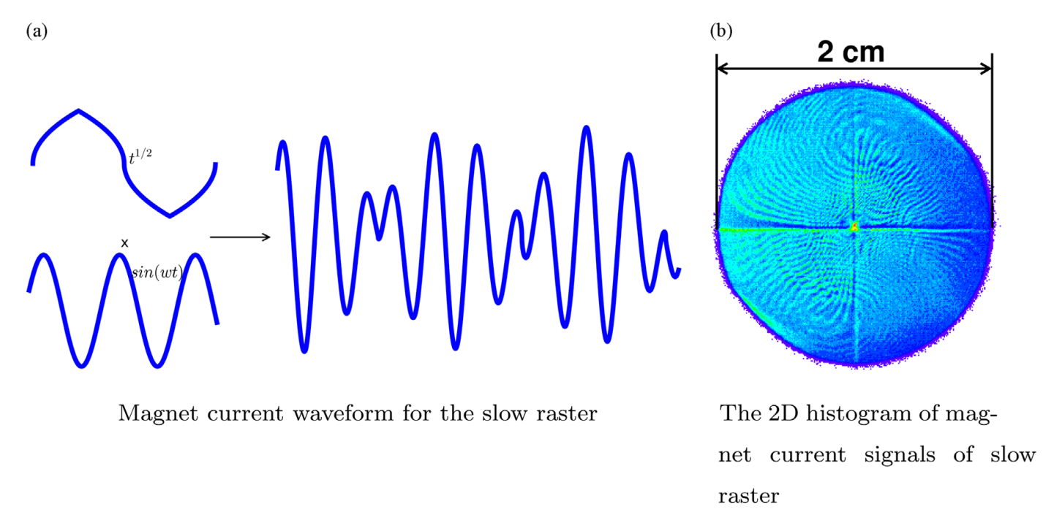
Beamline Tasks:
◦ Commissioning of Slow Raster
  Slow raster of electron beam required for DNP target
Hall A slow raster for g2p
P. Zhu, NIM A 808, 1 (2016)

Slide 11
Beamline Tasks:
◦ List Detector & Trigger Configuration
In Progress
  Draft run plans have been created for both Azz and b1

Slide 12
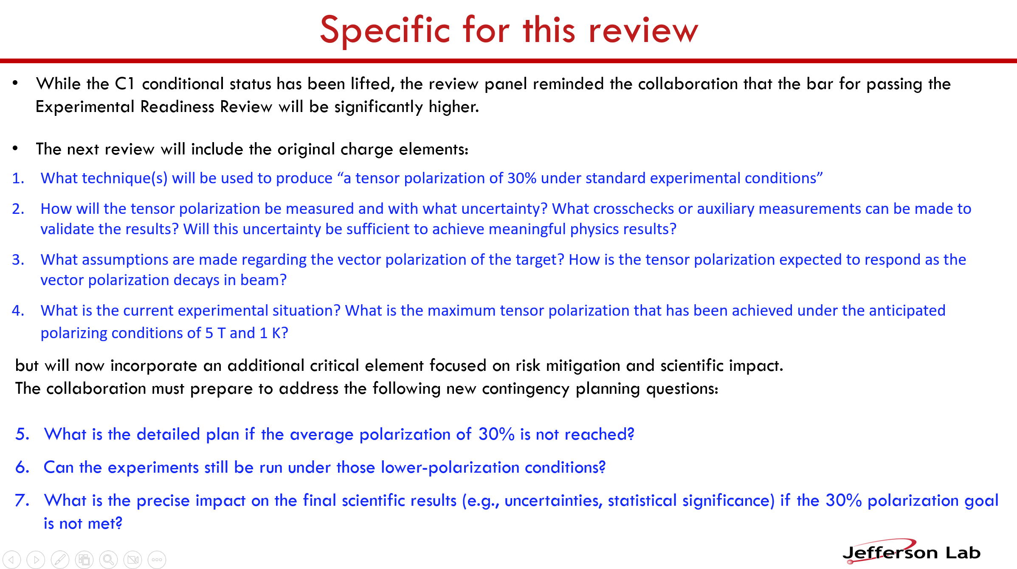
From P. Rossi’s Talk
10/13/2025

Slide 13
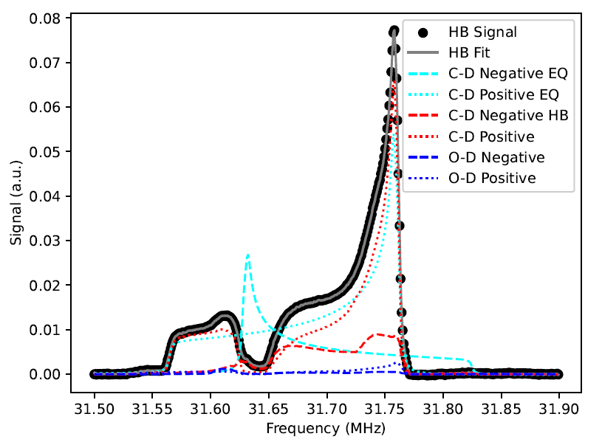
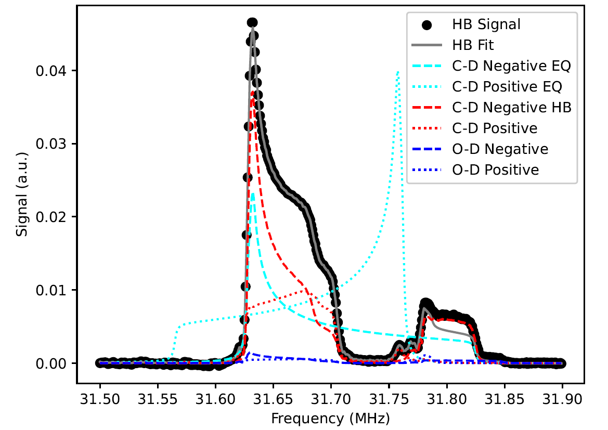
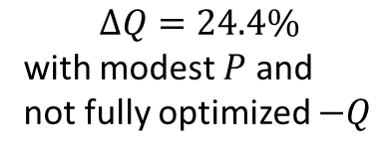


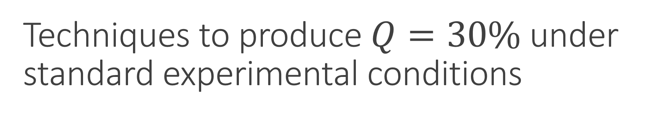

Techniques to produce $Q=30\%$ under standard experimental conditions
  ssRF only
    Recent results indicate $Q≈−10\%$ possible
  ssRF + Shoulder AFP can further increase both positive & negative $Q$
$$∆Q=24.4\%$$
with modest $P$ and
not fully optimized $−Q$
M. McClellan, PhD Thesis (2026)
$$P=35.6\%$$
$$Q=17.6\%$$
$$P=22.5\%$$
$$Q=−6.8\%$$

Slide 14
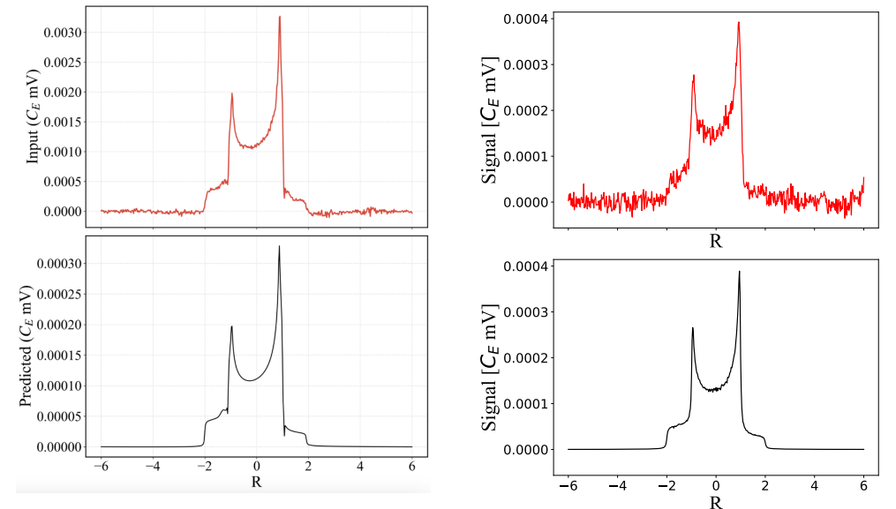
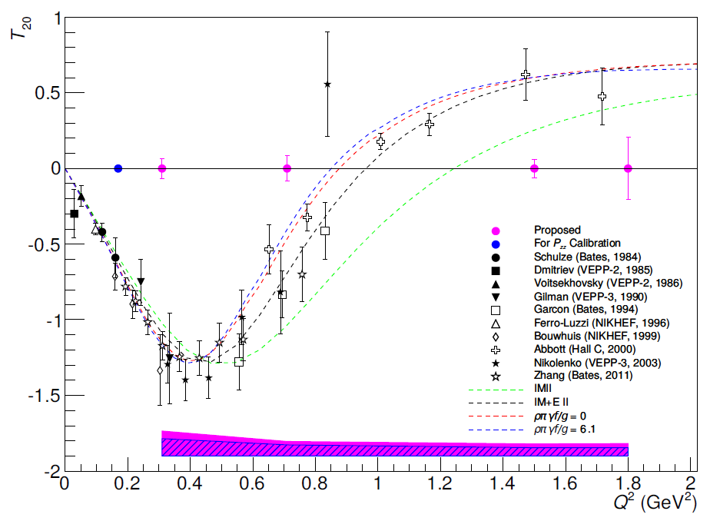
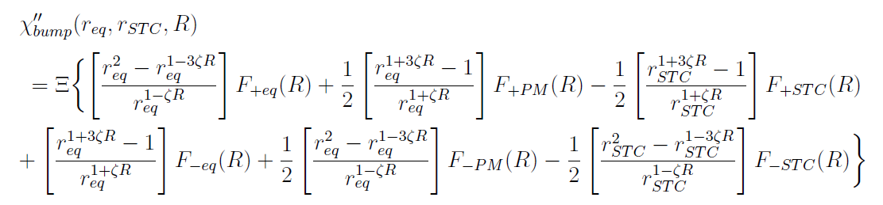
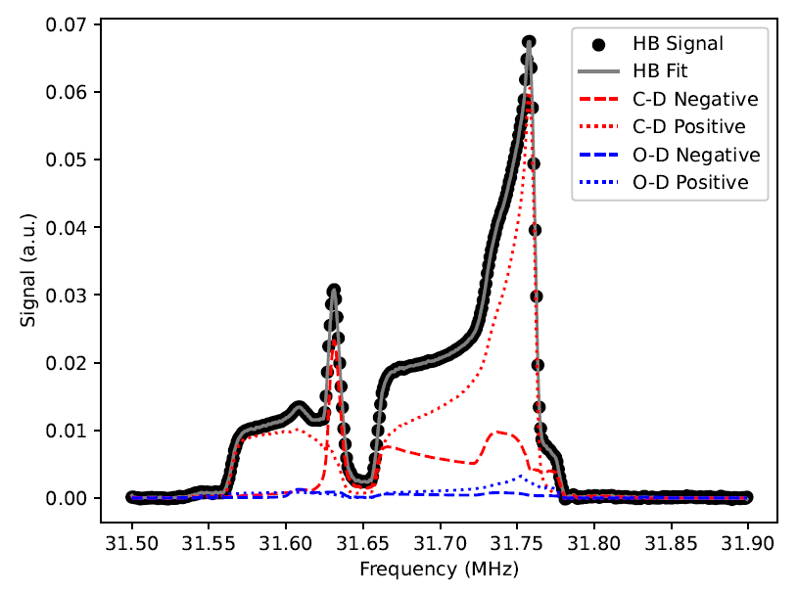
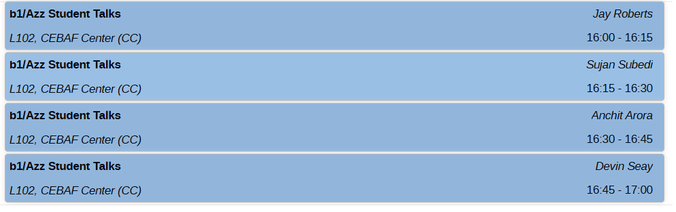
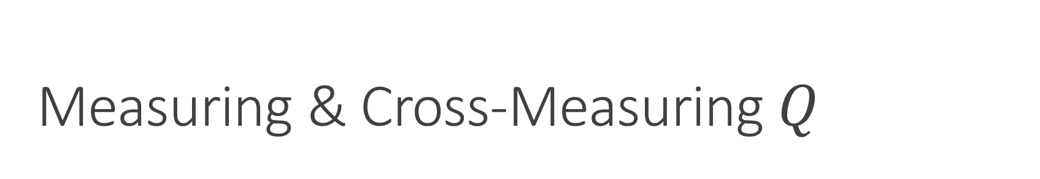
Measuring & Cross-Measuring $Q$
Neural Network Measurements
T20 Scattering
Direct Fitting

Slide 15
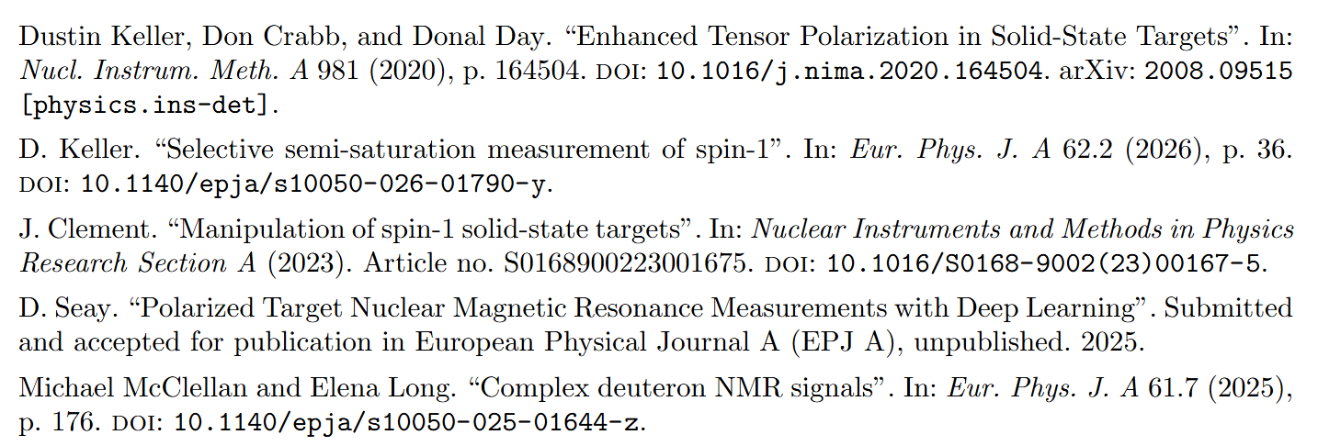
Measuring & Cross-Measuring $Q$

Slide 16
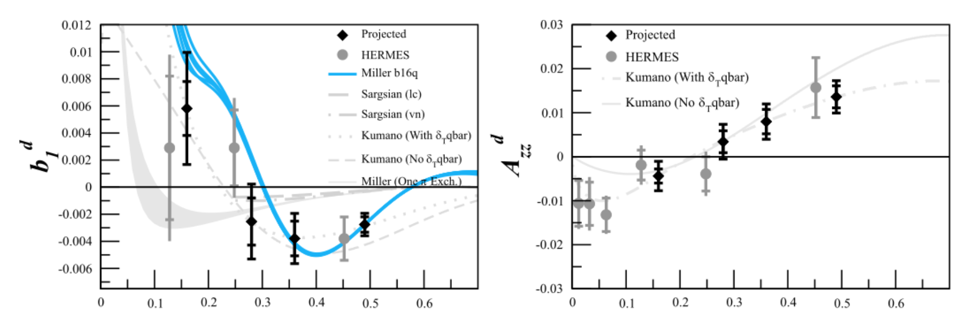
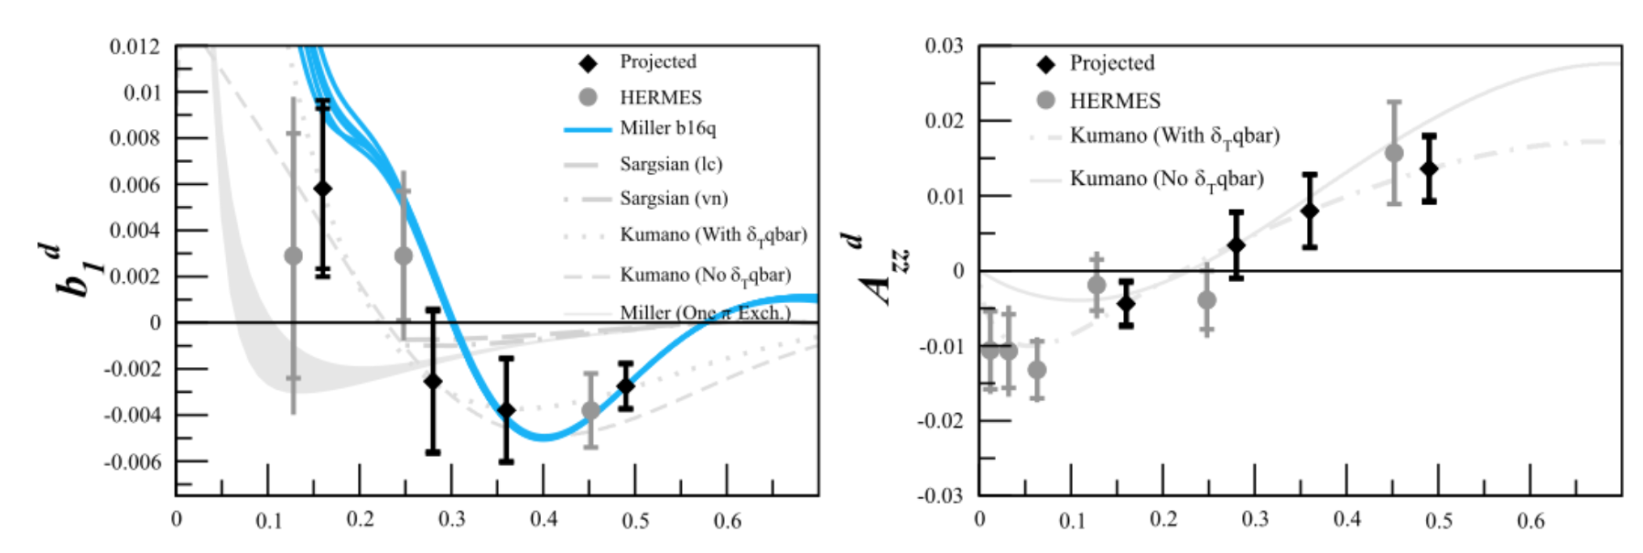
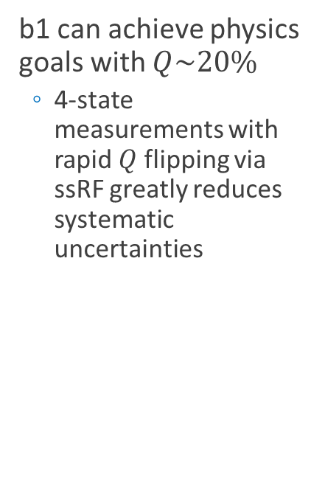
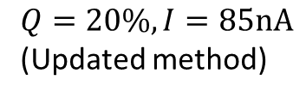
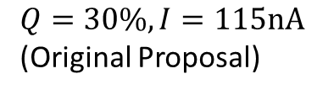
Can the experiments run in lower polarization conditions?
b1 can achieve physics goals with $Q\sim 20\%$
  4-state measurements with rapid $Q$ flipping via ssRF greatly reduces systematic uncertainties
$Q=30\%, I=115nA$
(Original Proposal)
$Q=20\%, I=85nA$
(Updated method)

Slide 17
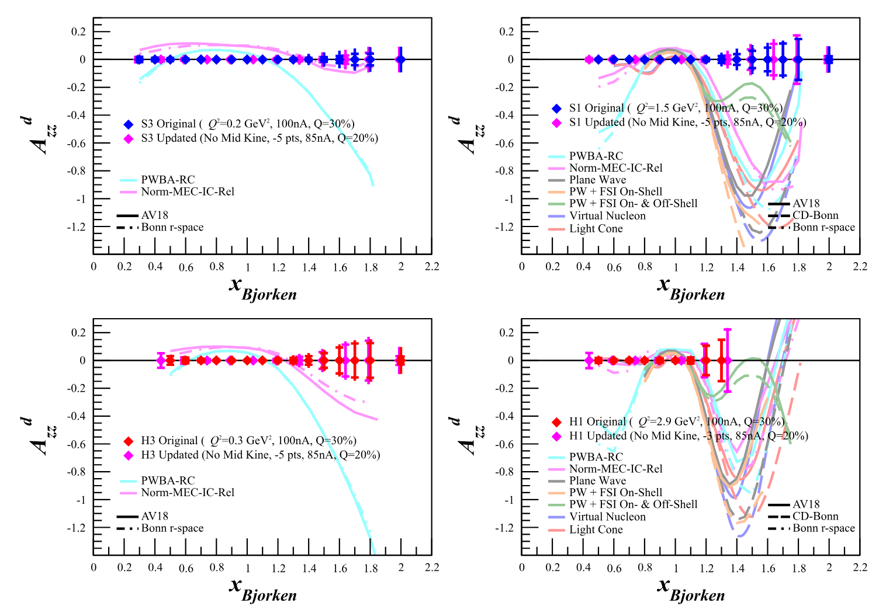
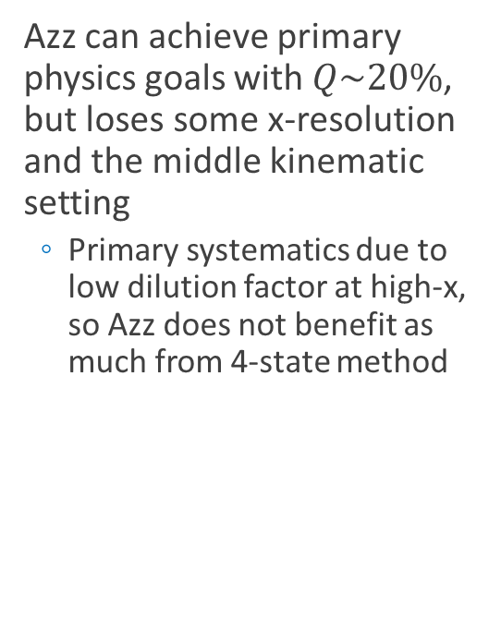
Can the experiments run in lower polarization conditions?
Azz can achieve primary physics goals with $Q\sim 20\%$, but loses some x-resolution and the middle kinematic setting
  Primary systematics due to low dilution factor at high-x, so Azz does not benefit as much from 4-state method

Slide 18
Thank you!

Slide 20
Run Plan

Slide 21

Overhead Assumptions (Real Time)
Based on Hall B RGC Spin-Ups
Beam Assumptions:
Beam Current: 85 nA
Beam Efficiency: 0.5 (Scaled to 1)
Target Configuration Assumptions:
Target Cup Radius: 1.5 cm
Target Cup Configuration: 2 cups
| ||
|/ \ Microwaves
|ND3 Prod. Mat.
|ND3 Prod. Mat.
|C Optics
|EMP Empty Cell
|___
Target Annealing/Material Assumptions:
Dose between anneals: 5.25e+15 e/cm^2
Time Between Anneals for 2 Cups: 3 days, 5:42:46
Time required for Anneal: 1:00:00
Time required for Cup Change: 0:10:00
Time Between Cup Changes: 1 day, 14:51:23
Time required for target material change: 4:00:00
Dose between target material changes: 5.00e+16 e/cm^2
Time between target material changes for 2 Cups: 30 days, 20:07:20
Target Polarization, TE, & PF/Dilution Run Assumptions:
Time constant for vector pol. spin-up: 0:50:00
# of vector pol. time constants before beam: 3.91
Time required for vector pol. spin-ups: 3:15:30
Time between each vector pol. spin-up: 2 days, 0:00:00
Time required for target TE measurements for all 2 cups: 3:00:00
Time between TEs: 15 days, 10:03:40 (2 b/w Each Material Change)
Time required for packing fraction/dilution runs: 3:00:00
# of packing fraction/dilution runs per kinematic setting: 5
Time to Tensor Enhance: 0:00:30
Time to Tensor Unpol: 0:00:10
Time Between Tensor Pol/Unpol Cycles: 0:30:00
Beamline & Hall Configuration Assumptions:
Time required for BCM calibration: 2:00:00
Beam time between BCM calibrations: 7 days, 12:00:00
Time required for each Optics run: 4:00:00
Beam time between Optics runs: 20 days, 0:00:00
Time required for each Linac change: 8:00:00
Time required for each Spectrometer Momentum/angle change: 2:00:00
Based on data from P.M. McKee, NIM A 526, 60 (2004)
Based on UVA & UNH data

Slide 22
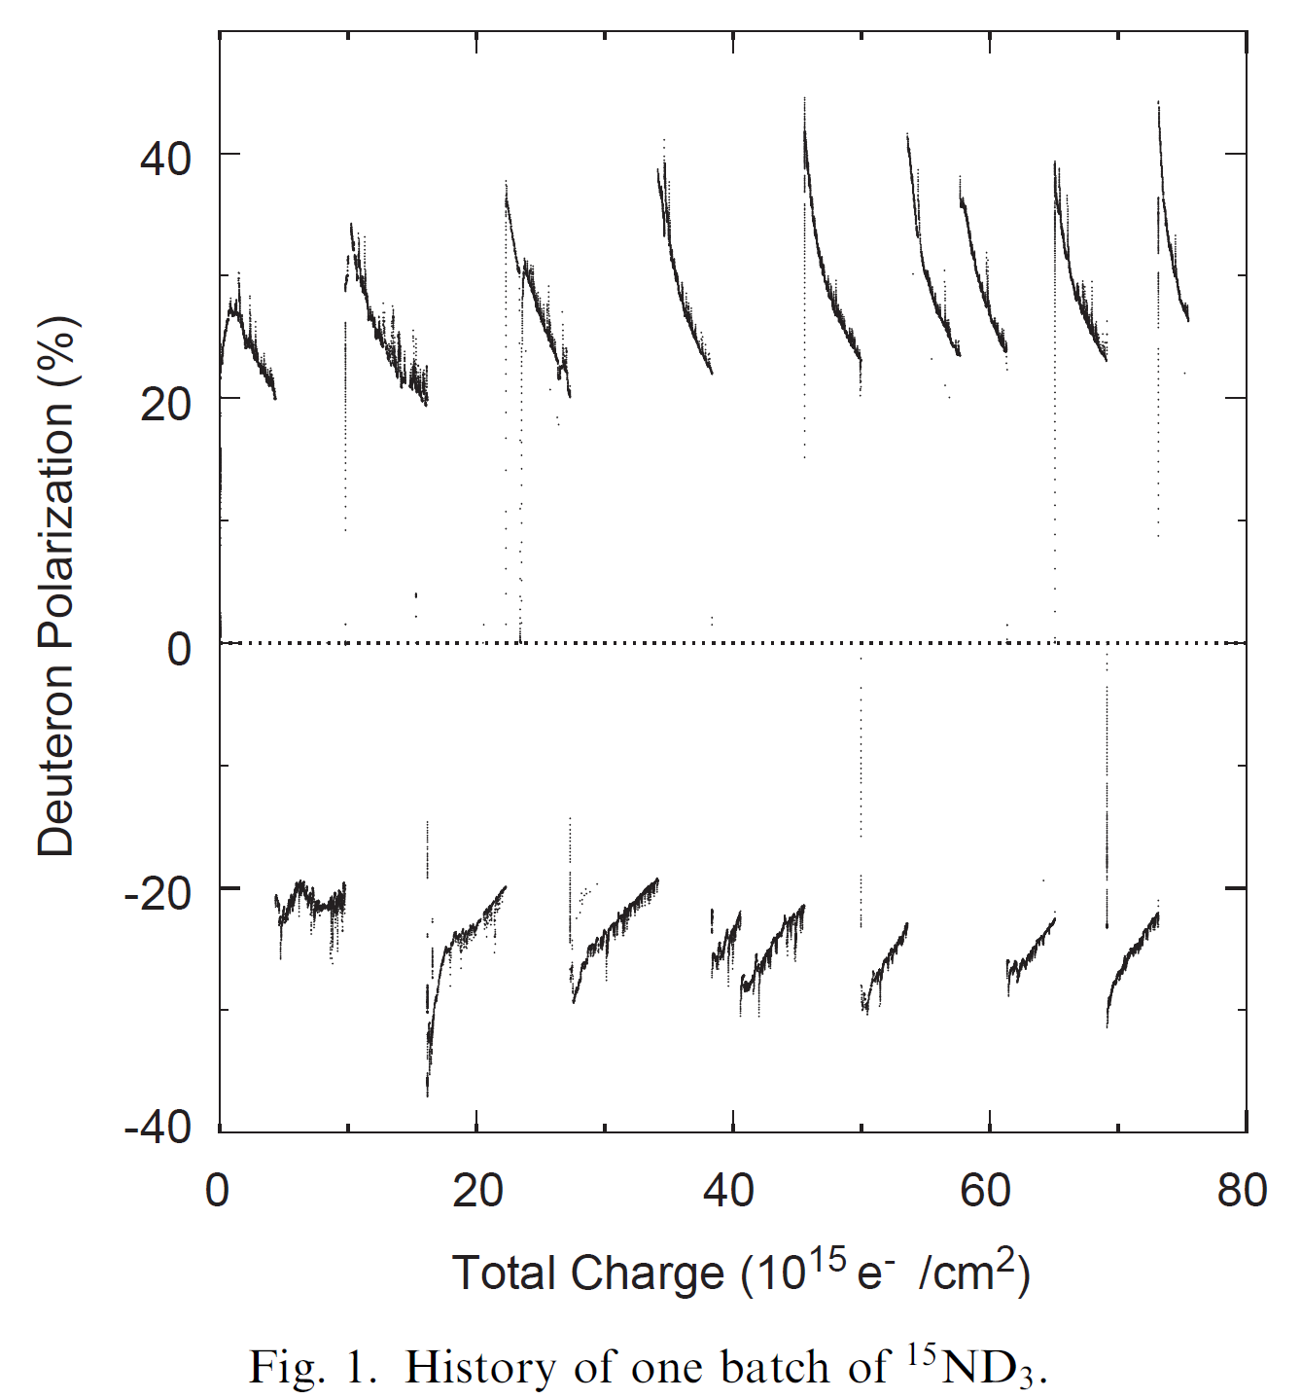














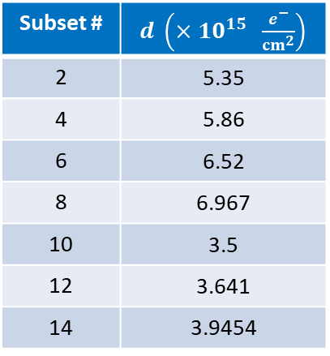








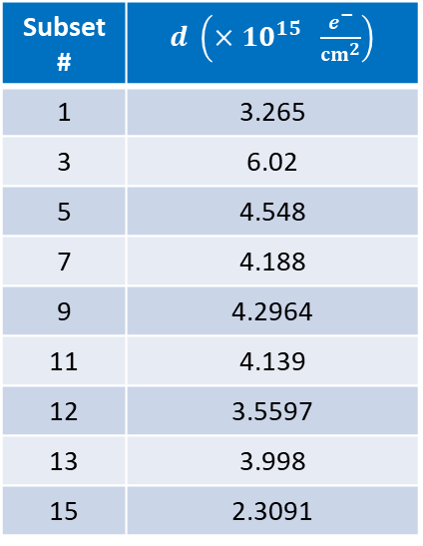
Dose Between Anneals & Mat. Changes
  Analyzed data from P.M. McKee, NIM A 526, 60 (2004)
$$5a$$
$$11a$$
$$15$$
Positive $P$
Negative $P$
$$13$$
$$3$$
$$7$$
$$9$$
Subset # | $d \left(×{10}^{15} \frac{e^{−}}{{cm}^{2}}\right)$
1 | 3.265
3 | 6.02
5 | 4.548
7 | 4.188
9 | 4.2964
11 | 4.139
12 | 3.5597
13 | 3.998
15 | 2.3091
$$1$$
$$5b$$
Subset # | $d \left(×{10}^{15} \frac{e^{−}}{{cm}^{2}}\right)$
2 | 5.35
4 | 5.86
6 | 6.52
8 | 6.967
10 | 3.5
12 | 3.641
14 | 3.9454
$$11b$$
$$2$$
$$4$$
$$6$$
$$8a$$
$$10$$
$$12$$
$$14$$
$$8b$$
Negative $d_{ave}=5.11×{10}^{15} \frac{e^{−}}{{cm}^{2}}$
Positive $d_{ave}=4.04×{10}^{15} \frac{e^{−}}{{cm}^{2}}$

Slide 23
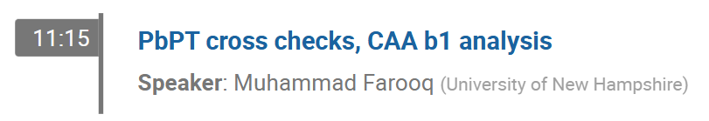
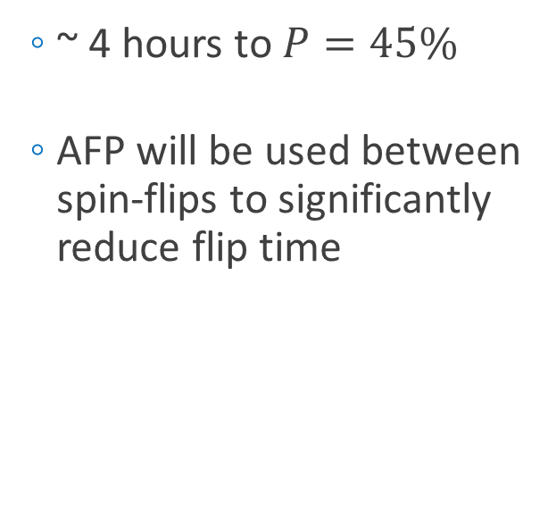
Hall B RGC Spin-Up
  ~ 4 hours to $P=45\%$
  AFP will be used between spin-flips to significantly reduce flip time
10/13

Slide 24
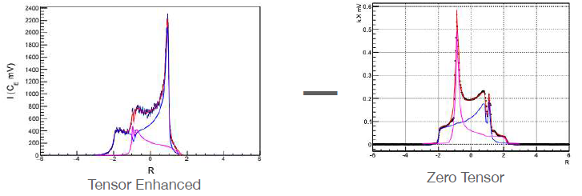
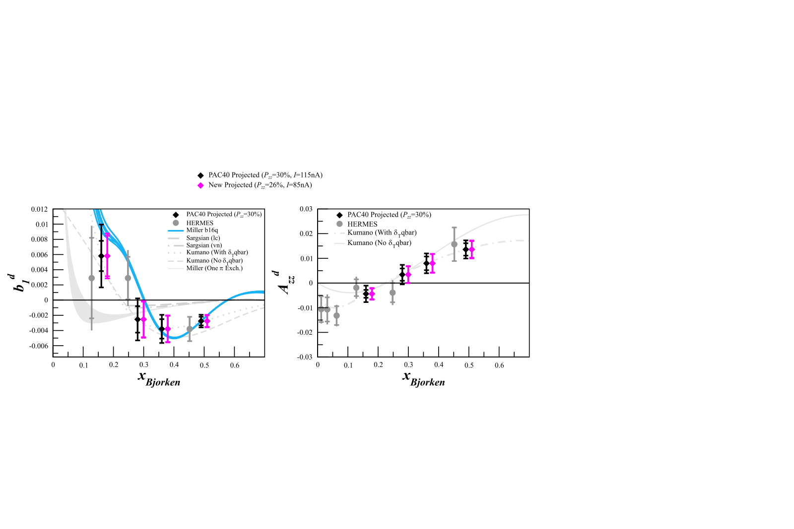
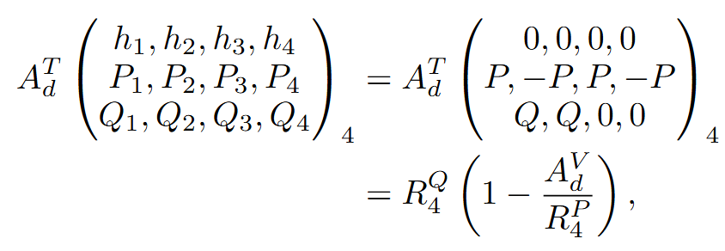
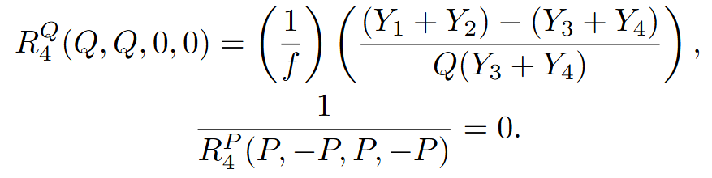
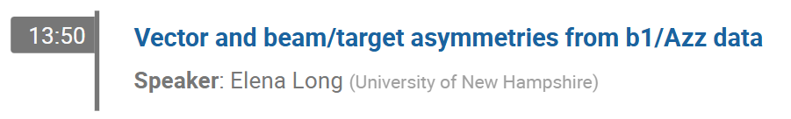

Rapid Tensor Flips: 4 State Measurement
  Rapid tensor enhancement/suppression while maintaining large vector polarization
    Highly suppresses drift effects on systematics
    1 cycle/hour instead of 1 cycle/day
    $δA_{zz}^{drift}∝\frac{1}{\sqrt{N_{flips}}}$ improved by $\frac{1}{\sqrt{24}}$
D. Keller
E. Long, EPJ A (in review)
10/14

Slide 25
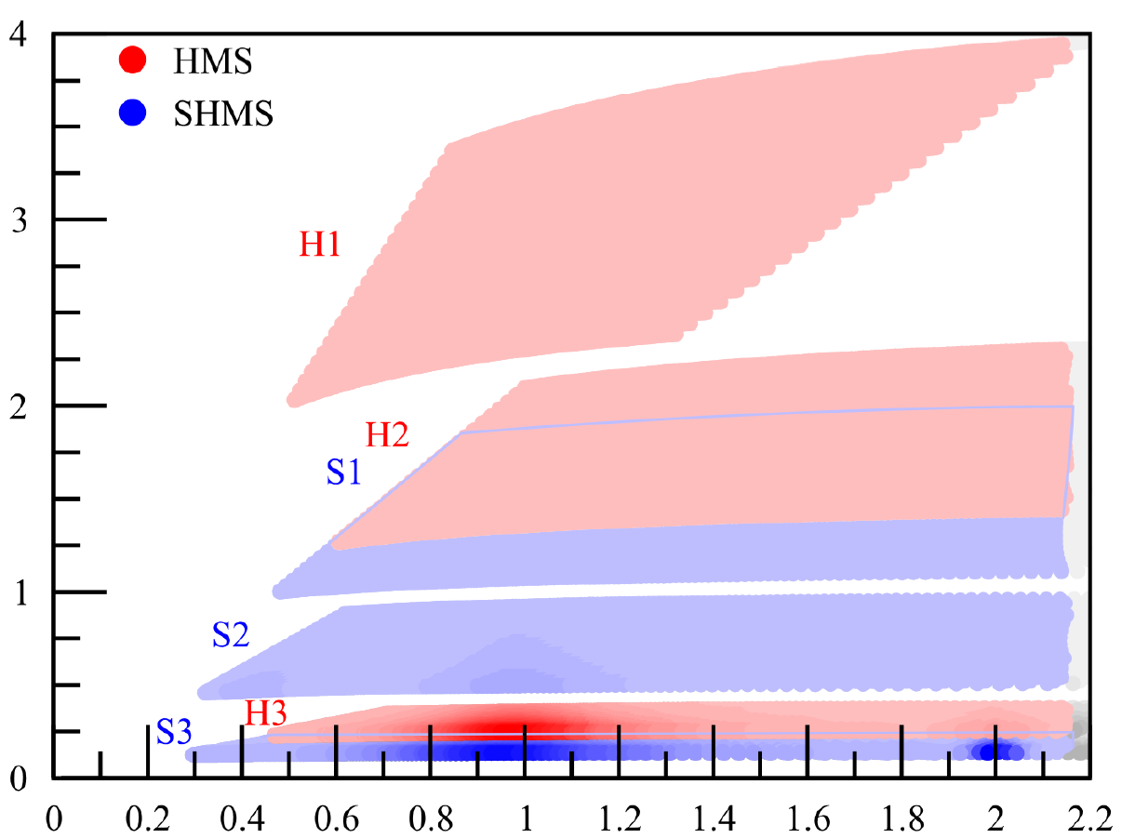




b1/Azz Kinematics Running
$$Q^{2}$$
Azz
Draft run plan from smallest beam/detector energies to highest
$$x$$
b1

Slide 27









$T_{20}$and $P_{zz}$ from Scattering
The elastic cross-section can be used to extract the tensor polarization independently from NMR extraction
# Events w/ $P_{zz}>0$
Dilution factor
# Events w/ $P_{zz}=0$
At $Q^{2}=0.17 {(GeV/c)}^{2},$
$$θ^{∗}=78.8°±1.25°$$
$$φ^{∗}=0°±2.86°$$
Polarization oriented
along beamline
Previously measured observables
(Well-known at low $Q^{2}$)

Slide 28



$T_{20}$and $P_{zz}$ from Scattering
$$N_{Q}=1.29×{10}^{7}$$
$$N_{0}=1.23×{10}^{7}$$
Assuming $P_{zz}=30\%$

Slide 29





$P_{zz}$ from Scattering
At $Q^{2}=0.17 {GeV}^{2}$,
$Q=\frac{\sqrt{0.17 {GeV}^{2}}}{0.197 GeV∙fm}=2.09 {fm}^{−1}$
  $T_{20}=−0.78±0.06$ (7.7%)
    Can shrink to ~5% w/ parameterization as in Zhang, et al.
$Q^{2} ({GeV}^{2})$ (fm)
0.193
0.225
C Zhang, et al, PRL 107 252501 (2011)

Slide 30

$P_{zz}$ from Scattering
At $Q^{2}=0.17 {GeV}^{2}$,
$Q=\frac{\sqrt{0.17 {GeV}^{2}}}{0.197 GeV∙fm}=2.09 {fm}^{−1}$
  $T_{21}=−0.15±0.03$ (20%)
    Can shrink to ~5% w/ parameterization as in Zhang, et al.
$Q^{2} ({GeV}^{2})$ (fm)
0.193
0.225
C Zhang, et al, PRL 107 252501 (2011)

Slide 31



$P_{zz}$ from Scattering
$T_{22}$ strongly dependent on $G_{M}$, which is more cleanly extracted from $B$ form factor
At $Q^{2}=0.17 {GeV}^{2}$,
$Q=\frac{\sqrt{0.17 {GeV}^{2}}}{0.197 GeV∙fm}=2.09 {fm}^{−1}$
  $T_{22}=−0.011±0.001$ (10%)
    Can shrink to ~5% w/ parameterization as in Zhang, et al.
D Abbot, et al, Eur. Phys. J. A 7 421 (2000)

Slide 32






$P_{zz}$ from Scattering – Previous Data Only
Using values mentioned & $P_{zz}=30\%$,
the relative $P_{zz}$uncertainty from elastic scattering is 12.68%
  Similar rel. uncertainty in range $1\%<P_{zz}<100\%$
(Using $Q=P_{zz}$ for easier notation)
2.5%
1.05% 12.64%
10.13% 5.36% 0.45%
3.73% 2.82% 0.04%

Slide 33


$P_{zz}$ from Scattering – Parameterized
Using values mentioned & $P_{zz}=30\%$,
the relative $P_{zz}$uncertainty from elastic scattering is 8.63%
  Similar rel. uncertainty in range $1\%<P_{zz}<100\%$
(Using $Q=P_{zz}$ for easier notation)
2.5%
1.05% 8.57%
6.59% 1.34% 0.25%
3.73% 2.82% 0.04%

