Slide 1
Role as a PDL
Arun Tadepalli
Jefferson Lab

Slide 2
I asked ChatGPT to make an image of a cool Hall C polarized target Physics Division Liaison
Missing:
Jefferson lab jacket
Name plate
Safety

Slide 3
Responsibilities: A PDL..
Makes sure that all the shifters have the right training (TO, Walkthrough etc..)
Makes sure that all the documentation (next page) is up-to-date with the correct subject matter experts (SME) responsible for their subsystem listed
Makes sure that any reference guides or guidelines specific to the halls are discussed with all run coordinators to make data taking smooth
Makes sure that the most accurate information about spectrometer settings, beam current limitations, experimental requirements, is conveyed to all the relevant parties (Physics Division, MCC, Collaboration, Shifters) and everyone is on the same page
Makes suggestions on improving the run plan based on realistic constraints on aforementioned parameters

Slide 4
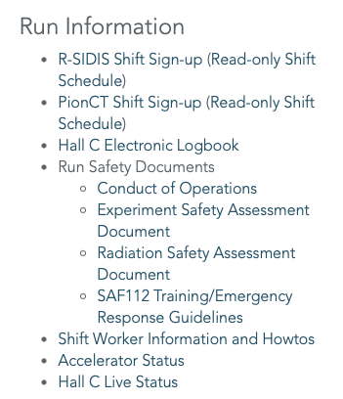
Documentation
RSAD (Radiation safety assessment documentation)
COO (Conduct Of Operations)
ESAD (Experiment Safety Assessment Document)
ERG (Emergency Response Guidelines)
Hall C SEM (Standard Equipment Manual)
Operational manuals (Target related)
Addendum (Target related)
Run certificate (DSO and AD issued)
*RSAD combined for all experiments

Slide 5
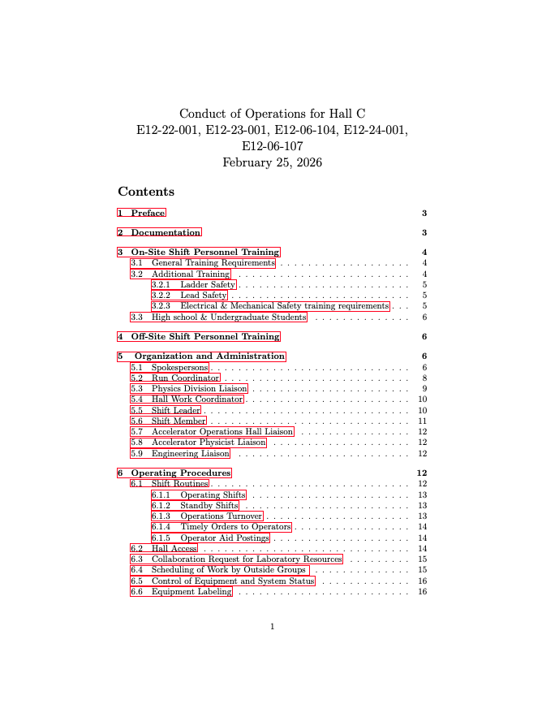
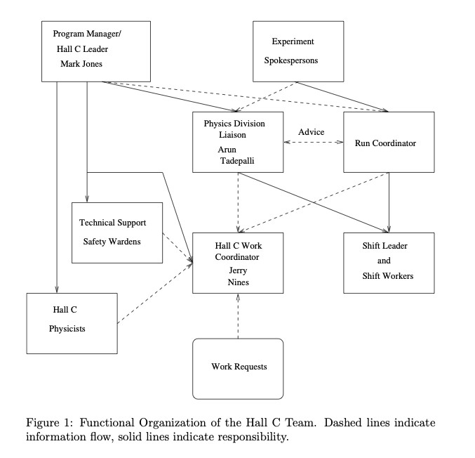
coo
Onsite Shift Personnel Training
  SAF112, ODH, ESC, Ladder training etc..
Organization and Administration
  Spokespersons
  Run Coordinator
  PDL
  Hall Work coordinator
  Shift Leader
  APL (Accelerator Physics Liaison)
  Engineering Liaison
Operating procedures
  Shift routines, rules and guidelines
Special procedures

Slide 6
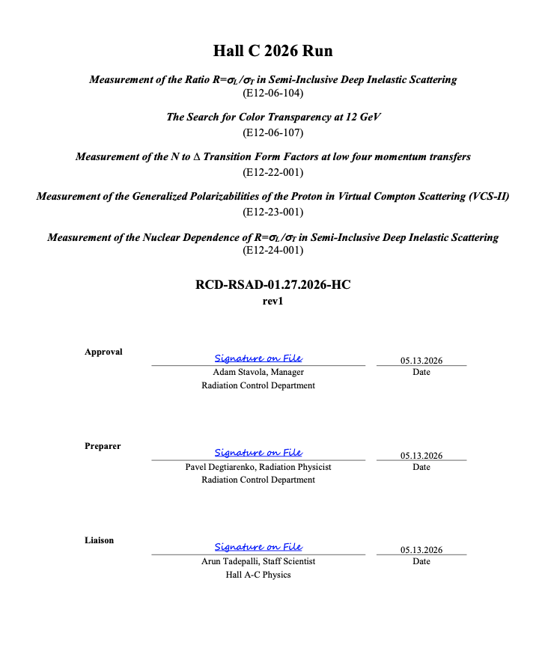
rsad
Experiment number
Targets and associated thickness
Number of PAC days on each target
Beam energy and current
Any other exotic settings/currents at which your experiment chooses to do calibrations
Possible scatterers along the beam (windows, targets, air gaps, etc. with their materials, thicknesses and positions relative to pivot given)
Beam line critical aperture (max scattering angle at which scattered beam electrons go through the beam line without absorption/cascading in the walls and flanges)

Slide 7
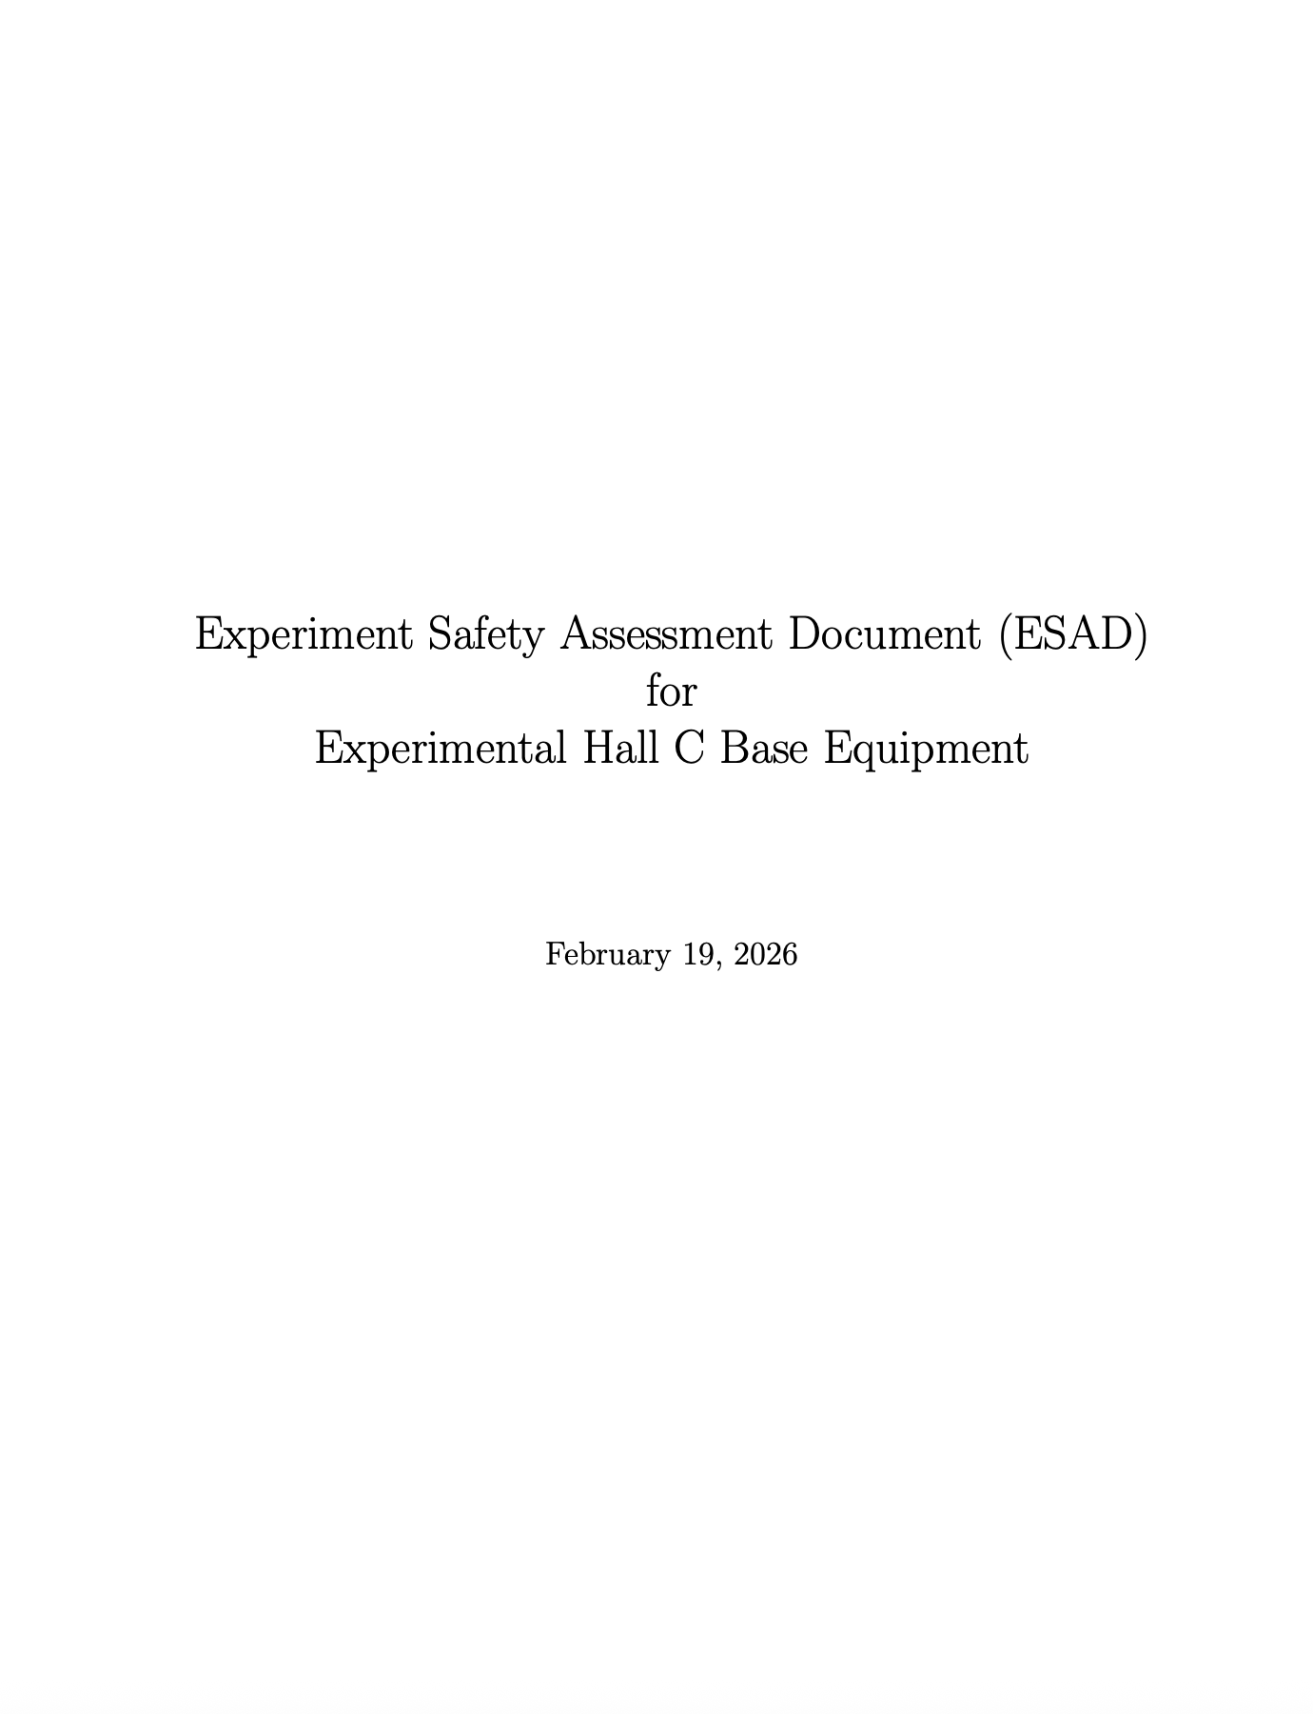
esad
General Hazards
  Electrical Fire, mechanical, strong magnetic fields, lasers etc..
Hall specific equipment hazards and mitigation
Responsible personnel and contact information

Slide 8
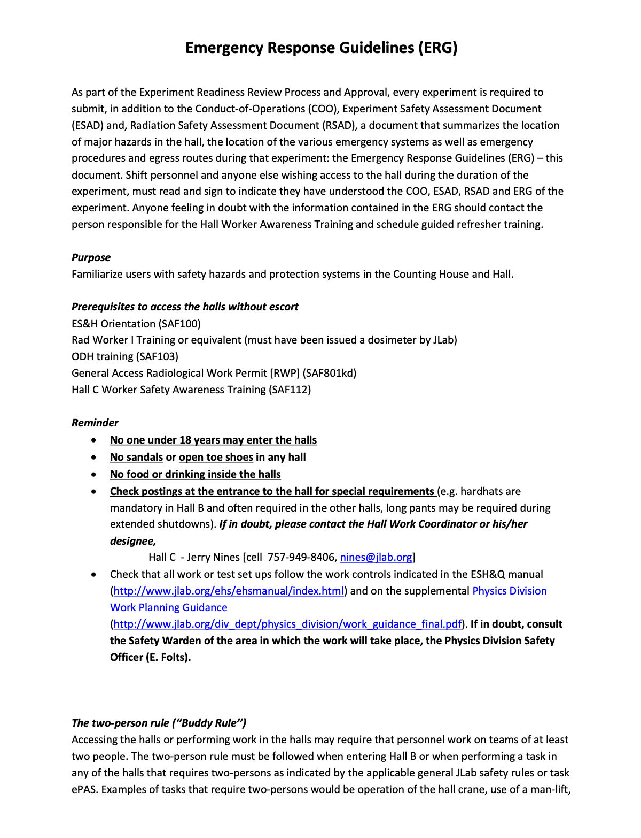
erg
Safety walkthrough
Superficial summary and familiarization with hazards in the hall

Slide 9
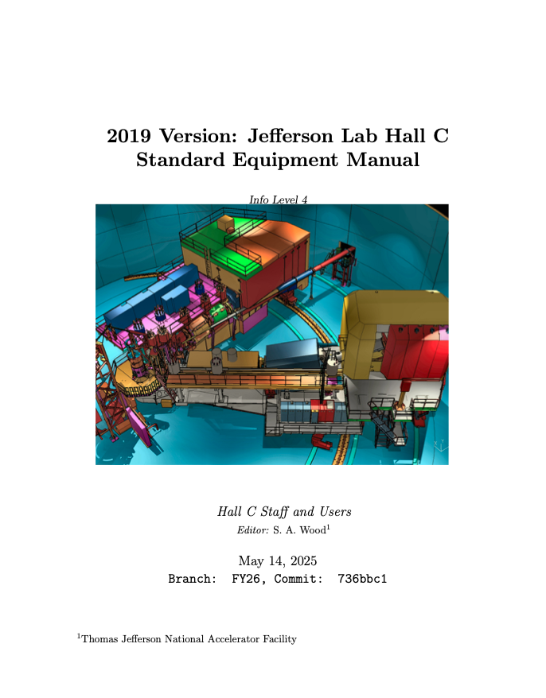
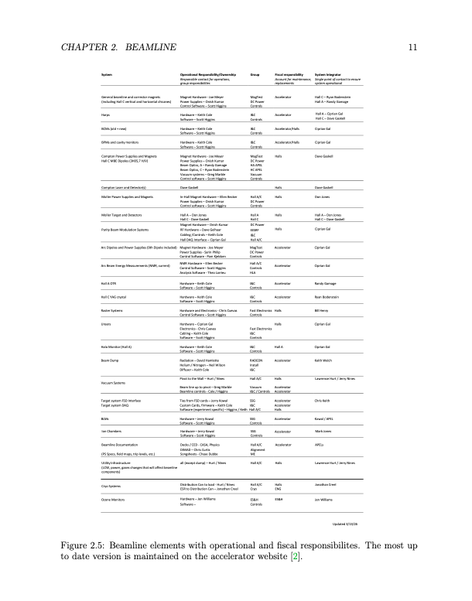
Hall c sem
Elaborate descriptions of
  Beamline instrumentation
  Targets
  Detector systems

Slide 10
DOCUMENTS TIMELINE
RSAD
ESAD
COO, ERG, SEM
ADDENDUM
ERR
RUN CERTIFICATE
Bright Future
Hall C
10

Slide 11
Summary
Need time and coordinated effort from MCC, Hall C Staff, Safety, EH&S and Collaboration to materialize all the documents for a new experiment
Best to have one liaison for the target and physics division
Exact details about who submits what document can be worked out but best to have synergy between MCC, target group, Hall C staff and safety through one focal point

