Slide 1
Physics Operations Overview
Douglas Weadon Higinbotham, Ph.D.
Acting Director CEBAF Experimental Physics
Presented To:
Tensor SIDIS workshop and b1/Azz Collaboration meeting
3 June 2026

Slide 2
Challenging Year But There Are Also New Opportunities
Physics division reduced its workforce by 7% (14 positions ) including 6 scientists.
  2 Hall B, 1 Hall C, 1 Hall D and 2 EIC ( non-project )
  Three of the scientists have become CEBAF users and a fourth is pending.
DOE Research funding reduced by 35% this year ( I know these kind of cuts have affected our users too )
Physics division has received American Science Cloud funding offsetting some of the research reduction and we are competing for GENESIS funding in partnership with many Jefferson Lab user institutions.
This year we increased our reserve to 6 weeks from approx. a couple (this hurt during the gov. shutdown)
  That was a strain on this year's operations & research budgets
  But year we just need to service the account (i.e. keeping the reserve inline with the budgets)
MOLLER project remain a very strong focus for the division.
Jefferson Lab continues to play a key role in the efforts in software and streaming readout where it becomes increasing clear how important AI will be going forward. These efforts benefit both the core mission of CEBAF as well as the EIC.
  Recently was able to train an AI agent to extract the Lamdba peak from Hall D data.
  New dashboard, requested by DOE nuclear physics research, to show publication & thesis record of experiments: https://pages.jlab.org/physdiv/jrdb/exp-dashboard/

Slide 3
Jefferson Lab had an outstanding 2025 Run Period
Hall A finished the SBS form factor measurements with the completion of the GEP-V experiment (E12-07-109) and has now started the assembly of the MOLLER spectrometer (E12-09-105).
Hall B completed the ALERT (E12-17-012 & E12-17-012{A,B,C}) and the ALERT-SRC (E12-23-013) experiments.
Hall C completed the Large Acceptance Device (LAD) experiment (E12-11-107 ) and started part of the color transparency experiment (E12-06-107).
Hall D ran a significant fraction of the GlueX-II / JEF experiments (E12-12-002 & E12-12-002A ).
Links to all JLab experiments available at: https://www.jlab.org/physics/experiments

Slide 4
Dear Colleagues,
On behalf of the entire user community, the JLUO Board of Directors extends its gratitude to you, the staff of Jefferson Lab, for the successful CEBAF run completed on Sept. 3. This run significantly advanced the scientific program of the community, with highlights including:
Completion of the GEp run in Hall A, paving the way for the installation of MOLLER
Installation and operation of A Low Energy Recoil Tracker (ALERT) in Hall B and the completion of the [three] run group experiments [and ALERT-SRC].
Completion of the Large Acceptance Detector (LAD) experiment in Hall C
Commissioning of a new calorimeter in Hall D and acquiring over 5 petabytes of raw data for the JLab Eta Factory (JEF) and GlueX experiments.
We deeply appreciate being able to call on you as engineers, technicians, machine operators, run coordinators and shift workers at any time, even in the middle of the night, and to have you answer that call with such support and enthusiasm for the scientific mission of the lab. You weren’t deterred by the challenges along the way, whether they were caused by the high-water table, the Virginia summertime heat or simply a curious snake!
Congratulations to you for setting a CEBAF reliability record in the 12 GeV era and doing so while operating at higher beam energy and current than in years past. We look forward to continuing to work together to pursue the ambitious future nuclear physics program that draws us to Jefferson Lab from institutions around the world.
With Sincere Thanks,
The Jefferson Lab Users Organization Board of Directors

Slide 5
CEBAF at Multiple Energies
One thing that makes the CEBAF accelerator an amazing tool for fixed target experimental nuclear physics is its large range of possible beam energies and and currents it can simultaneously send to each experimental hall.
Typically, that means 2.2, 4.4, 6.6, 8.8 or 11 GeV to Halls A,B,C and 12 GeV to Hall D with currents up to 80 uA, but CEBAF can be scaled to even lower energies when the science needs it.
For the upcoming run we are going to spend roughly half the time at 0.345 MeV/linac ( 0.7, 1.4, 2.1, 2.8 or 3.6 GeV to A,B,C and 4.3 GeV to Hall D.
For the second part of the run will be restore the machine to its current nominal 1060 MeV/linac.
  0.11284*(linac energy) + Pass*2*(linac energy) = Beam Energy
  where Pass = {1,2,3,4,5,5.5}
With the two different linac energies, we will do TEN different experiments over 22 weeks!

Slide 6
CEBAF Experimental Program For FY26
Hall B
E12-20-004: PRad-II (Contact: A. Gasparian (NCSU), D. Dutta (MS), H. Gao (Due), N. Liyanage (UVA), E. Pasyuk(JLab), C. Peng (ANL). W. Xiong (Shandong), and DWH (JLab))
E12-21-003: X17 Boson Search: (Contact: A. Gasparian (NCSU), D. Dutta (MS), H. Gao (Due), T. Hague (JLab), N. Liyanage (UVA), R. Paremuzyan(JLab), C. Peng (ANL). W. Xiong (Shandong))
Hall C
E12-22-001: N-> Delta (Contact: N. Sparveris (Temple), H. Atac (Temple), A. Camsonne(JLab), M. Jones(JLab), and M. Paolone (NMS)
E12-23-001: VCS (Contact: N. Sparveris (Temple), H. Atac (Temple), A. Camsonne(JLab), M. Jones(JLab) and M Paolone (NMS)
E12-24-001: Nuclear-R SIDIS (Contact: D. Gaskell (JLab), P. Bosted(W&M), W. Brooks (Fed. ST. Maria), R. Ent(JLab), E. Kinney(UC), and H. Mkrtchyan (Yerevan))
E12-06-104: Nucleon R SIDIS (Contact: R. Ent(JLab), P. Bosted(W&M), E.Kinny(UC) and H. Mkrtchyan(Yerevan))
E12-06-107: Color Transparency Search (Contact H. Vance(FIU/ODU/JLab), C. Gayoso(W&M), and D. Dutta(MS))
Hall D
E12-25-005: GlueX with a 1-4 GeV Photon Beam ( contact: M. Dalton(JLab) & F. Afzal (JLab), V. Crude (FSU), P. Hurck (UB), I. Jeagle (ODU), and A. Thiel (UG) )
E12-12-002: GlueX-II (Contact: C. Meyer (CMU) and M. Shepherd (IU))
E12-12-002A: Jefferson Lab Eta Factor (JEF) (Contact: L. Gan (UNCW) & Z. Papandreou, A. Somov(JLab), and S. Tayler(JLab))

Slide 7
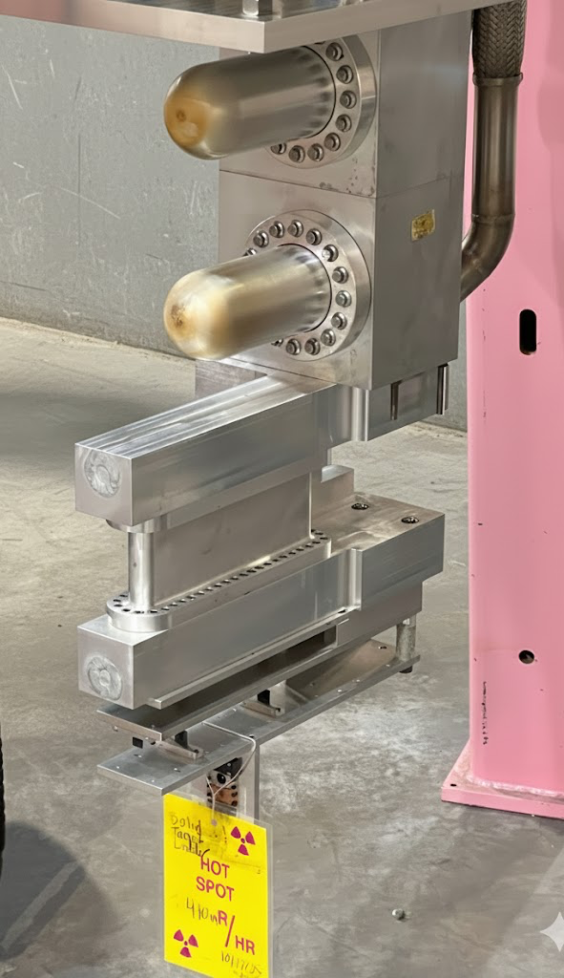
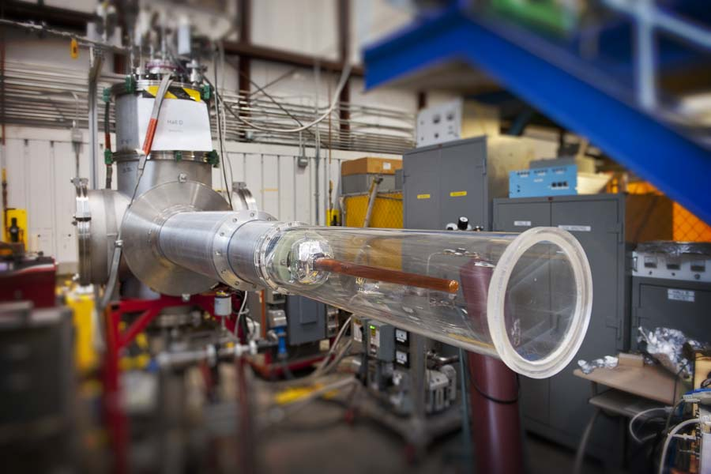
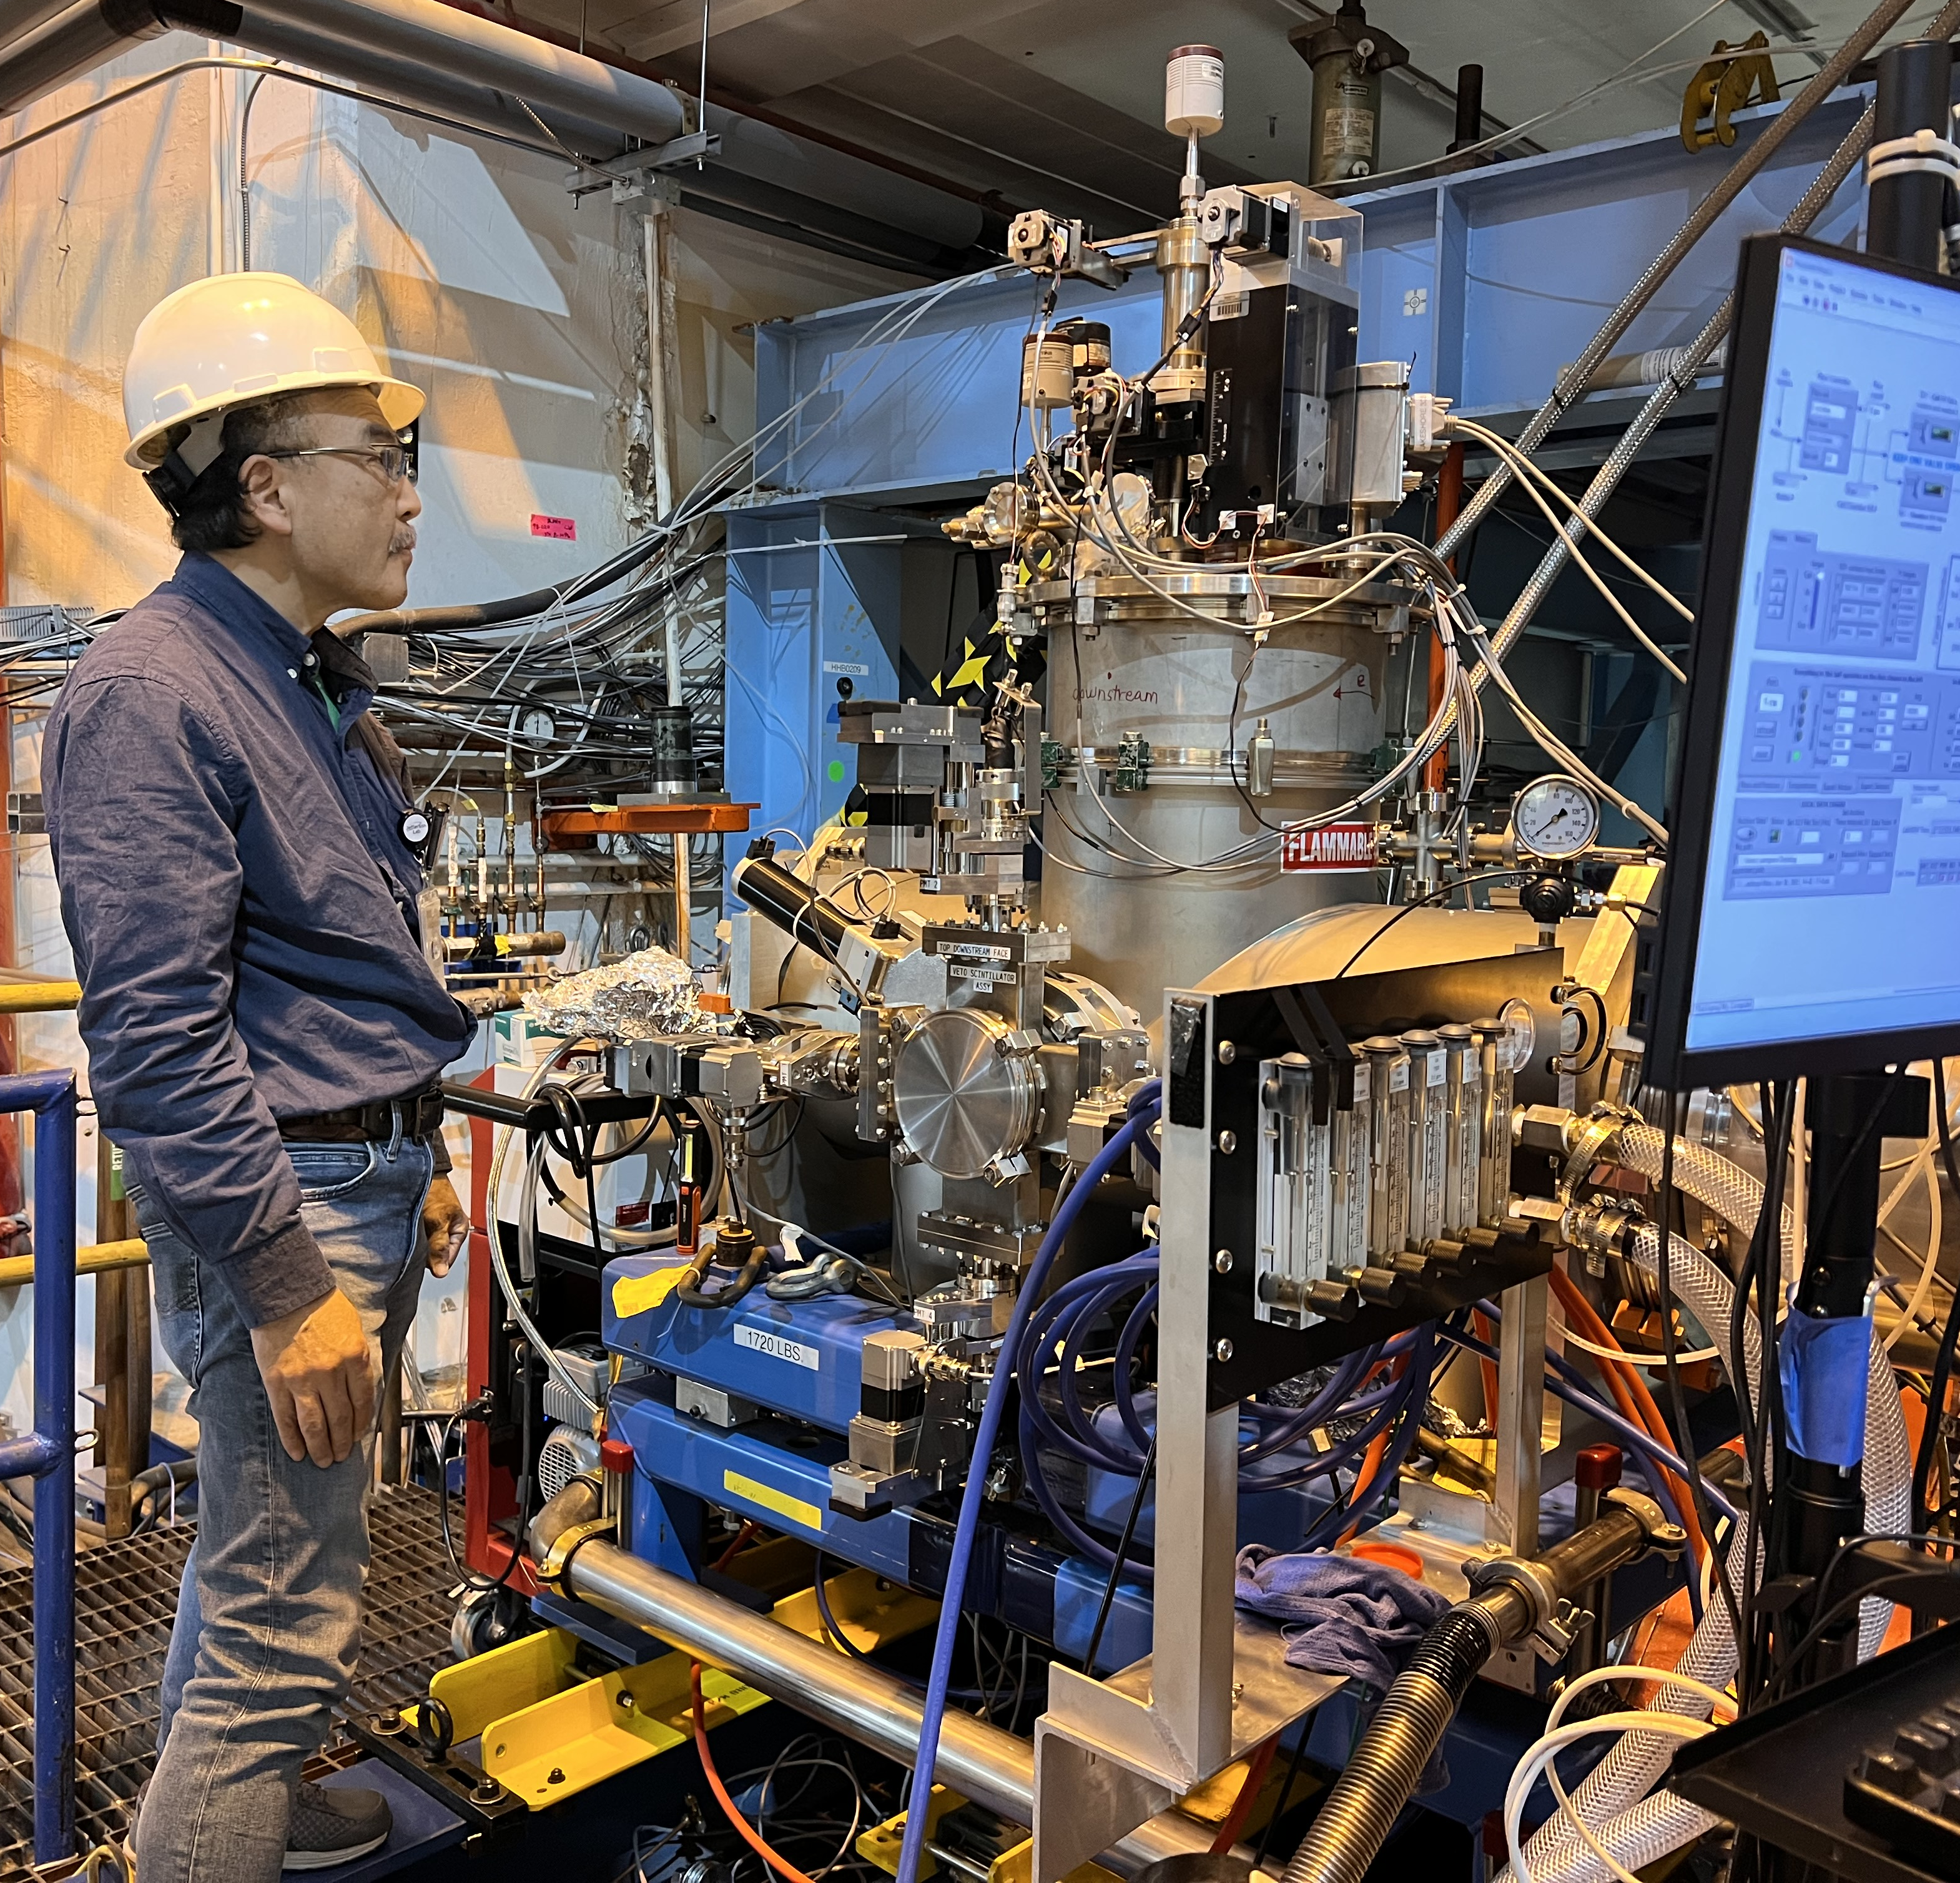
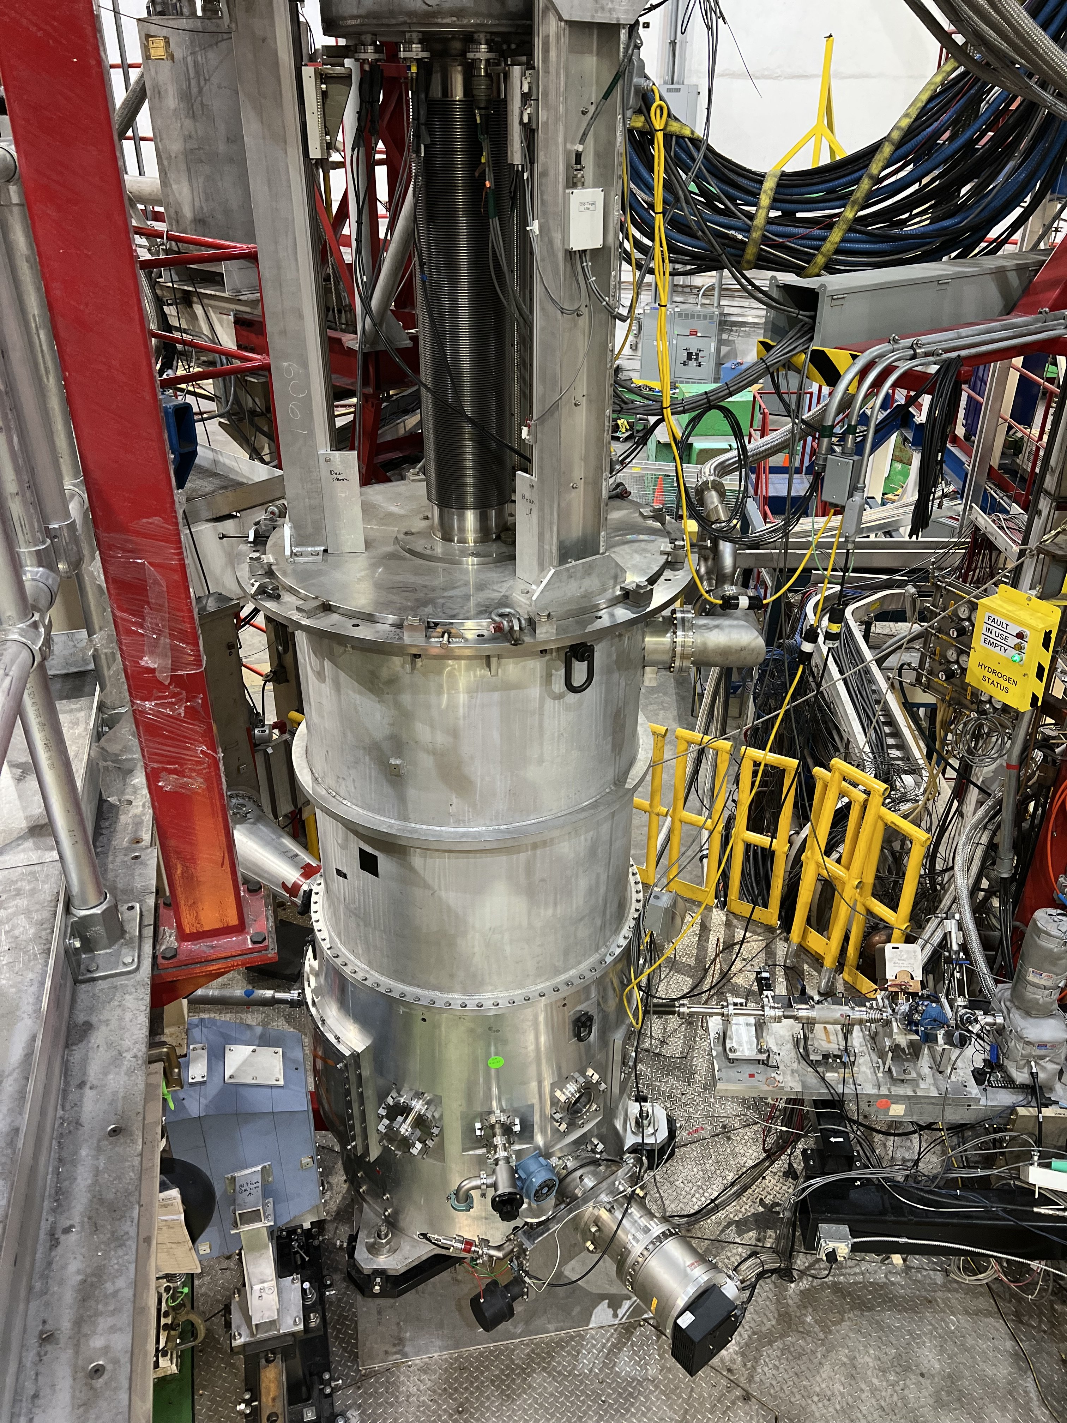
Our Support Groups Are Critical To The Success Of THE CEBAF NP Program
Highlighting here the fixed targets for the FY26 run ( see supplemental material for more highlights )
Hall B: PRad-II H2 gas target
Hall C: LH2/LD2 cryotarget
Hall D: GlueX LH2/LD2 cryotarget

Slide 8
Overview of the Science program of the next 5 years:
Hall A MOLLER Experiment will be completed, and Hall A will start the transition to the next large-scale experiment.
Hall B will complete a number of high impact run group experiments and start running the transversely polarized target SIDIS program.
Hall C will install and run the A-rated Hypernuclear experiments and once that is complete start the Tensor polarized deuteron experiments.
Hall D will run the A-rated GlueX-III & the 2nd generation real photon SRC experiments and then install & run the K-Long experiment.

Slide 9
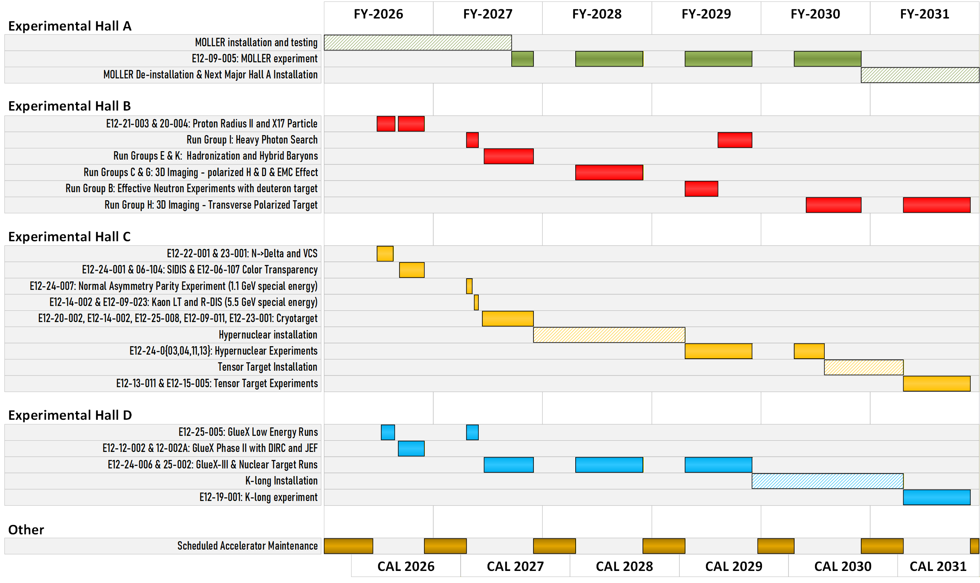
Five year look ahead

Slide 10
Summary and outlook
The operation of CEBAF’s experimental halls continues to produce world class science.
Renewed focus on making sure the support groups have the people and resources they need to carry out the mission.
An area that is bringing renewed attention is our data center where the demands of AI along with the need to store & analysis vast amounts of data is pushing our current limits of power and cooling while at the same time costs are making it challenging to acquire as much new more efficient equipment as we had planned.
Planning for ~30 week runs starting in FY27; though energy and cryogen costs are making that challenging
We are also striving to make CEBAF more reliable (i.e. instead of pushing energy beyond 1060MeV/linac, we are now focused on reliability).
Looking to go from an average of 50% to 60% efficiency for experiments as we used to have with pre-12GeV CEBAF.

Slide 11

Discussion

