Slide 1
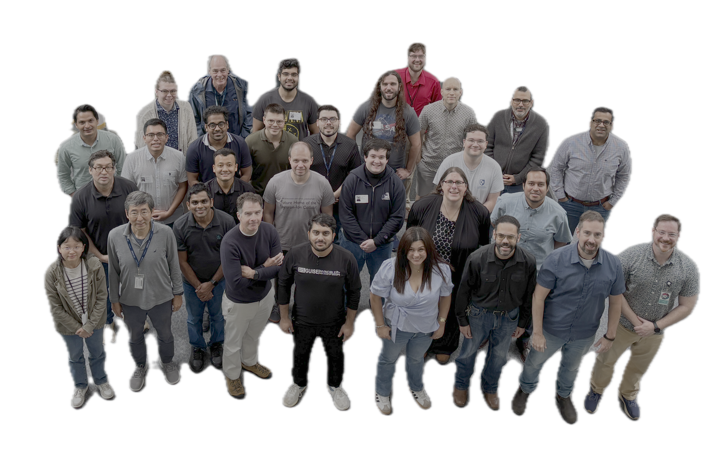
Welcome and Overview
b₁/A_{zz} Tensor Collaboration Meeting
Jefferson Lab
2026-6-03

Slide 2
Organizers
Alessandro Bacchetta
Jian Ping Chen
Ishara Fernando
Dustin Keller
Elena Long
Jiwan Poudel
David Ruth
Nathaly Santiesteban
Karl Slifer

Slide 3
Wednesday
Thursday & Friday
b1/Azz
Collaboration Meeting
Tensor SIDIS Workshop
4:00pm Thursday
More b1/Azz Student talks
Zoom Link is live on Indico
Please note: All talks will be recorded unless requested otherwise

Slide 4


Group Photo Thursday at 11:55 am
Social Event
6:30 PM Thursday
Tradition Brewing Company
700 Thimble Shoals Blvd
Newport News, VA 23606

Slide 5
History
  2010 : LOI-11-003 b1
  2011 : PAC 37 cross section method. Withdrawn
  2013 : PAC 40 PR12-13-001. A- C1 conditional approved
  2014 : 1st Tensor Workshop at Jefferson Lab
  2015 : PAC 43 PR12-15-005 Azz proposal. Conditional approved.
2022 : Full Approval after Conditional Review
2023 : PAC 51 Jeopardy Review of b1/Azz
running conditions modified: P_{zz} from 30 ->26%, I from 115 to 85 nA
  2023 : 2nd Tensor Workshop at ECT*
  2024 : CLAS Approved Analysis of RG-C Deuteron Data
  2025 : EPJA Topical Review
  2025 : Tensor Collaboration Meeting
  2026 : Tensor Collaboration Meeting and SIDIS Workshop

Slide 6
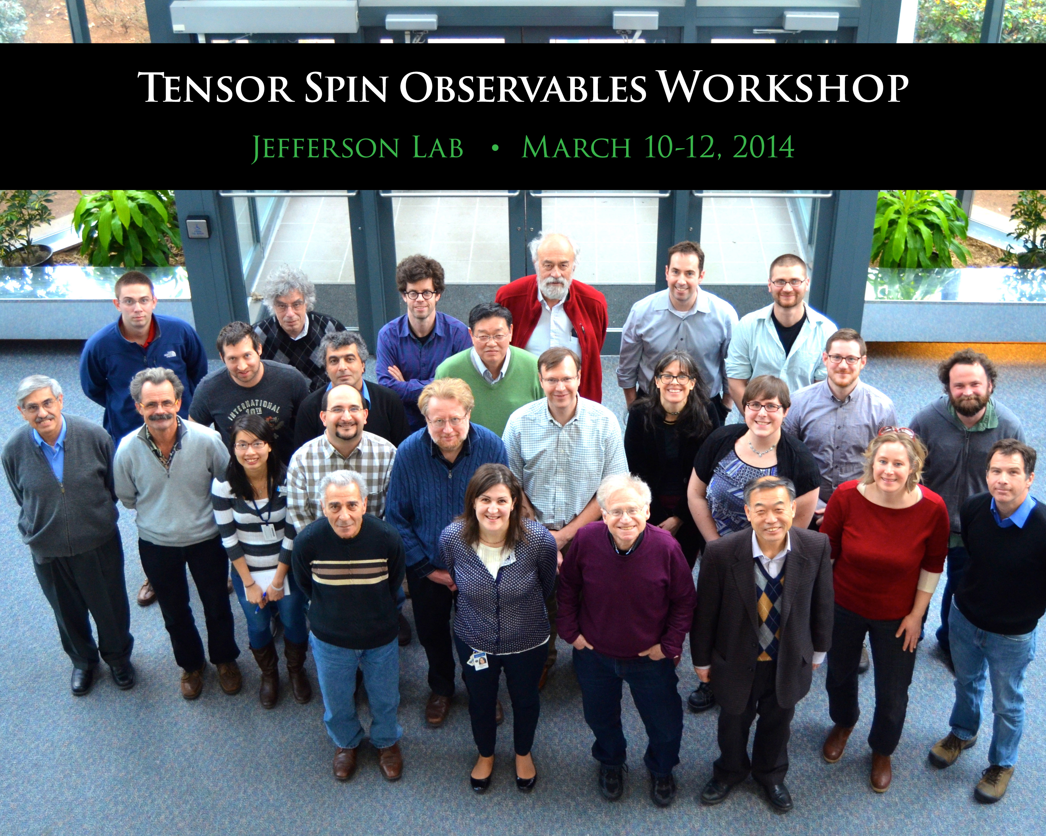

Slide 7

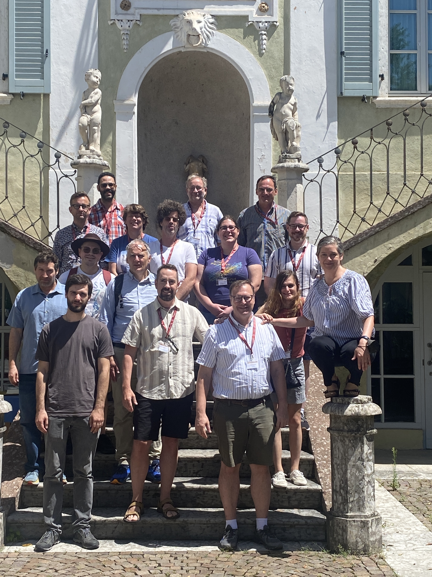
  2023 2nd Tensor Workshop at ECT*

Slide 8
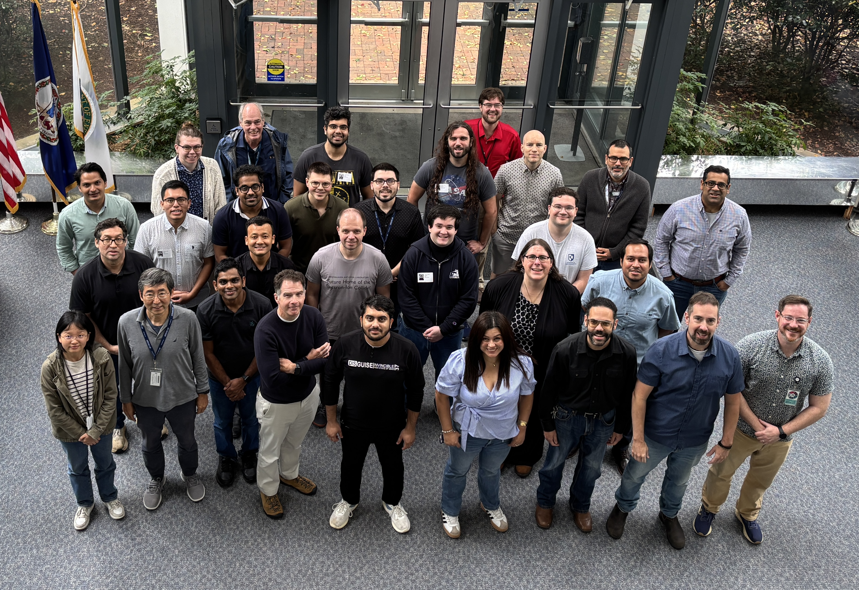
Tensor Collaboration Meeting
October 2025, Jefferson Lab

Slide 9




E12-13-011: The b₁ experiment
E12-15-005: A_{zz} for x>1
41 Days in Jlab Hall C
A⁻ Physics Rating
44 Days in Jlab Hall C
A⁻ Physics Rating
Spokespersons
Chen, Day, Higinbotham, Kalantarians,
Keller, Long, Rondon, Santiesteban, Slifer

Slide 10
Workforce
Grad Students
  Jay Roberts (UVA)
  Sujan Subedi (UVA)
  Muhammad Farooq (UNH)
  Michael McClellan (UNH)
  Hector Chinchay (UNH)
  Chhetra Lama (UNH)
  Anchit Arora (UNH)
  Zoe Wolters (UNH)
  Devin Seay (UVA)
  Aden Whitney (UNH)
  Sam Takwira (UNH)*
Post-docs
  Ishara Fernando
  Jan Vanek
  Forhad Hossain
  Utsav Shrestha*
Jlab Staff
  Jiwan Poudel
  Jian-Ping Chen
  Chris Keith
  James Maxwell
    +whole target group….
  Doug Higinbotham
  Dave Gaskell
  Hanjie Liu
  Mark M. Dalton
  Arun Tadepalli*
+Faculty
  David Ruth
  Carlos Yero
  Dave Mack
Spokespeople
  Jian-Ping Chen
  Donal Day
  Douglas Higinbotham
  Narbe Kalantarians
  Dustin Keller
  Elena Long
  Oscar Rondon
  Nathaly Santiesteban
  Karl Slifer
Undergrads
  Ian Cruz (UVA)
  Eli Phippard (UNH)
  Shane Clements (UVA)
*New since last meeting

Slide 11

Regular Meetings
  Tensor Inclusive Group : Fridays at 1:00 pm. tensor@jlab.org
  Tensor SIDIS: Mondays at 10:30am tensor-sidis@jlab.org

Slide 12
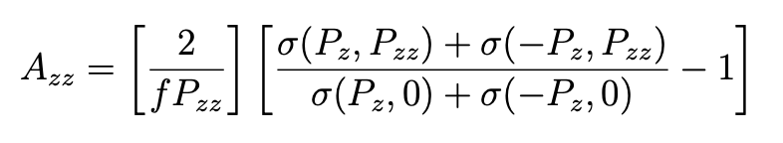
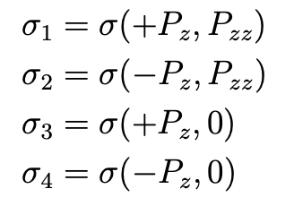
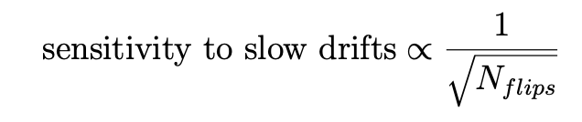

Observable: Tensor Asymmetry Azz
New Information
  Since the original PAC review, we have increased the planned number of polarization state flips from about once per day to about once per hour
  This reduces the sensitivity to slow drifts by about 1/
  And allows reduction in running requirements
  P_{zz} = 26% (originally was 30%)
  I = 85 nA (originally was 115nA)
  Request for Polarized beam (originally assumed unpol)

Slide 13

Tensor polarization allows control of the nuclear spatial configuration

Slide 14
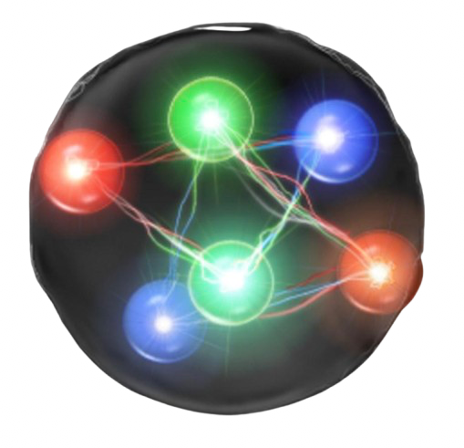
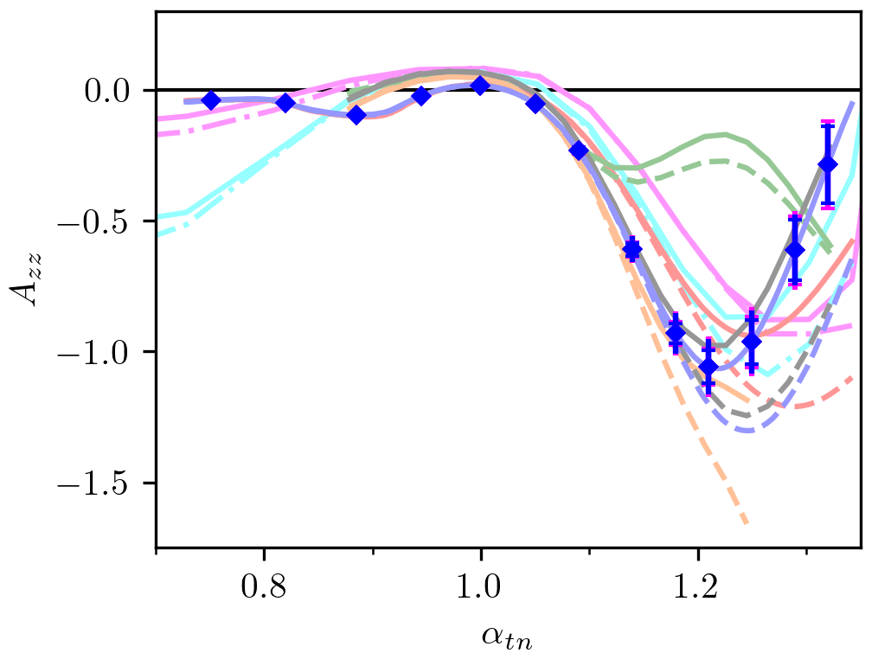
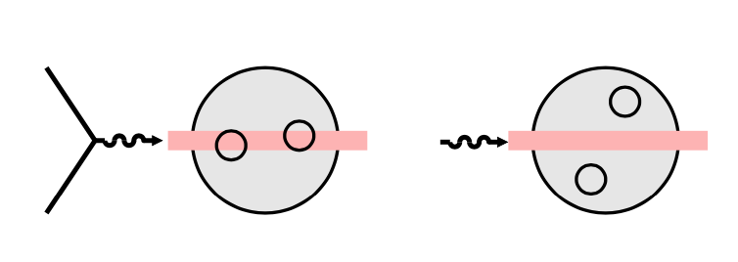
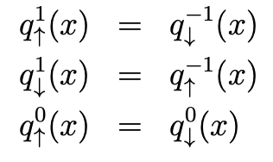
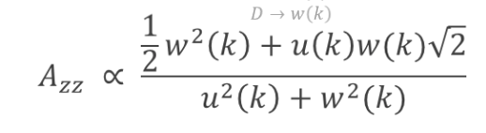
Tensor polarization allows control of the nuclear spatial configuration
Measuring A_{zz} over a broad range in x gives access to :
Nuclear shadowing
at low X
Tensor structure functions &
momentum distributions in nucleus
Possible 6 quark states, Hidden color
S/D Wave components
SRCs at large x
x_{B}

Slide 15
Tensor polarization allows control of the nuclear spatial configuration
Measuring A_{zz} over a broad range in x gives access to :
Nuclear shadowing
at low X
Tensor structure functions &
momentum distributions in nucleus
Possible 6 quark states, Hidden color
S/D Wave components
SRCs at large x
x_{B}

Slide 16
Tensor polarization allows control of the nuclear spatial configuration
Measuring A_{zz} over a broad range in x gives access to :
Nuclear shadowing
at low X
Tensor structure functions &
momentum distributions in nucleus
Possible 6 quark states, Hidden color
S/D Wave components
SRCs at large x
x_{B}

Slide 17
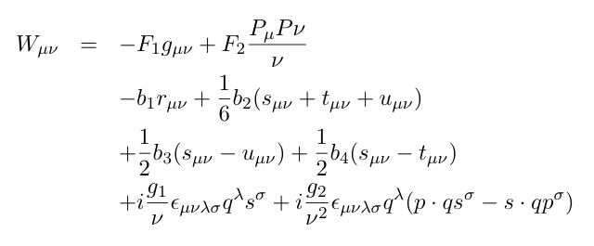
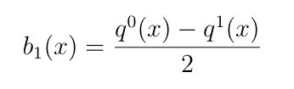
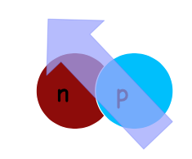
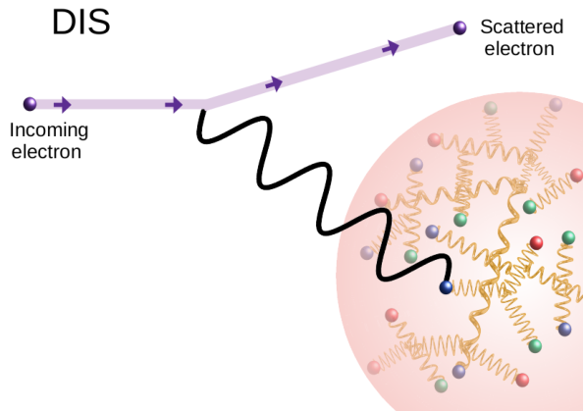
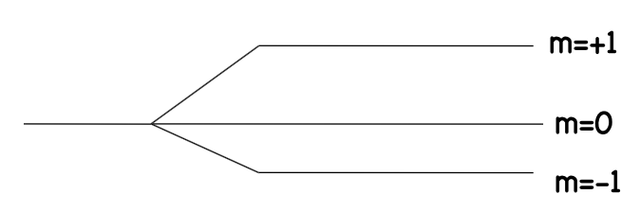
b₁ structure function
difference of spin averaged parton distributions
of a m=0 and m=1 nuclear target
Hoodbhoy, Jaffe & Manohar (1989)
Interpretation in Parton model
DIS (probing partons)
but depends on the Nuclear Spin State

Slide 18
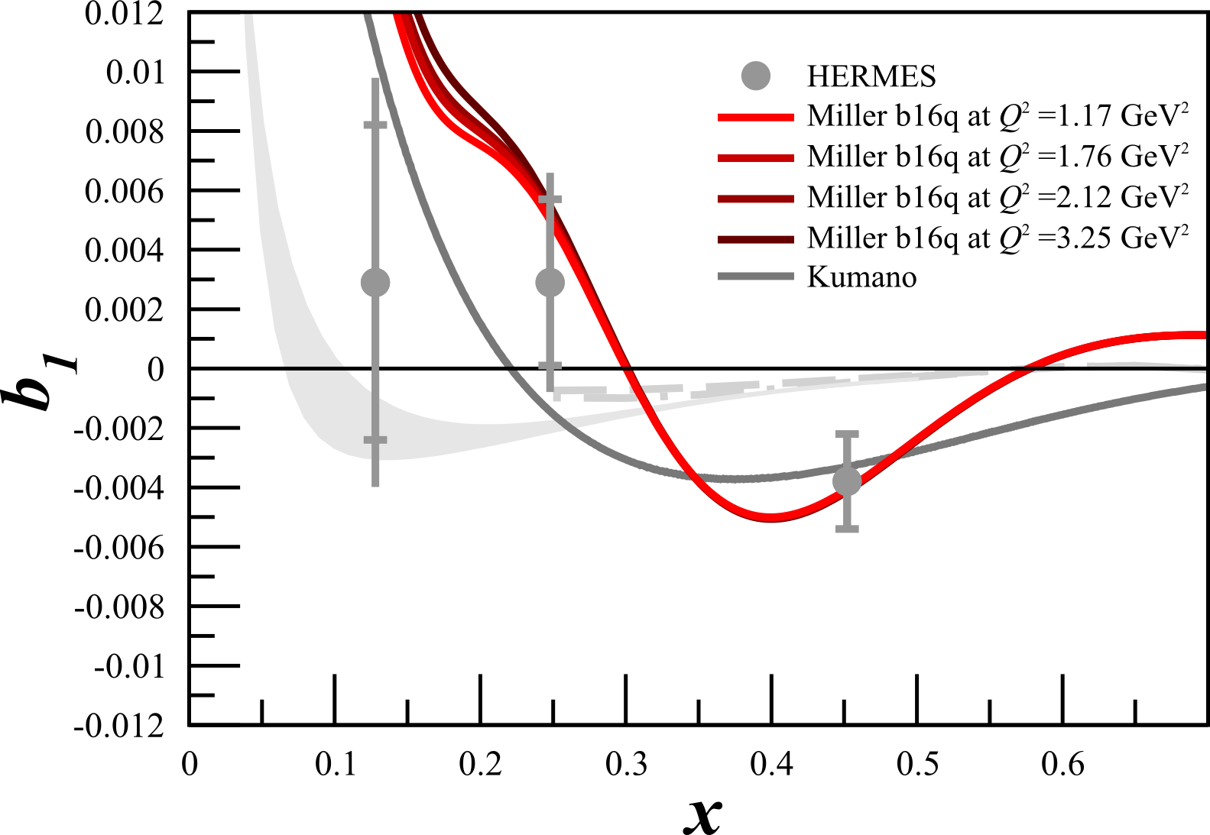

Conventional Nuclear Physics can not reproduce HERMES Data
Khan & Hoodbhoy, PRC 44 ,1219 (1991) : b₁ ≈ O(10⁻⁴)
Relativistic convolution model with binding
Umnikov, PLB 391, 177 (1997) : b₁ ≈ O(10⁻³)
Relativistic convolution with Bethe-Salpeter formalism
W. Cosyn, Y. Dong, S. Kumano, M. Sargsian PRD95 (2017) 074036
Standard Convolution description
“new mechanism [is needed] to explain
large differences between current data
and our theoretical results”
Hermes-DESY measured a large
non-zero value at x$≈0.45$
“room for more advanced or exotic mechanisms
playing an important role”
Cosyn et. al PRD95 (2017) 074036
G. Miller PRC89 (2014) 045203
Pionic and Hidden-Color, Six-Quark Contributions to the Deuteron b1 Structure Function
6-quark probability needed to (P_{6Q}^{= 0.0015) is} ^{small enough}
that it does not violate conventional nuclear physics.

Slide 19

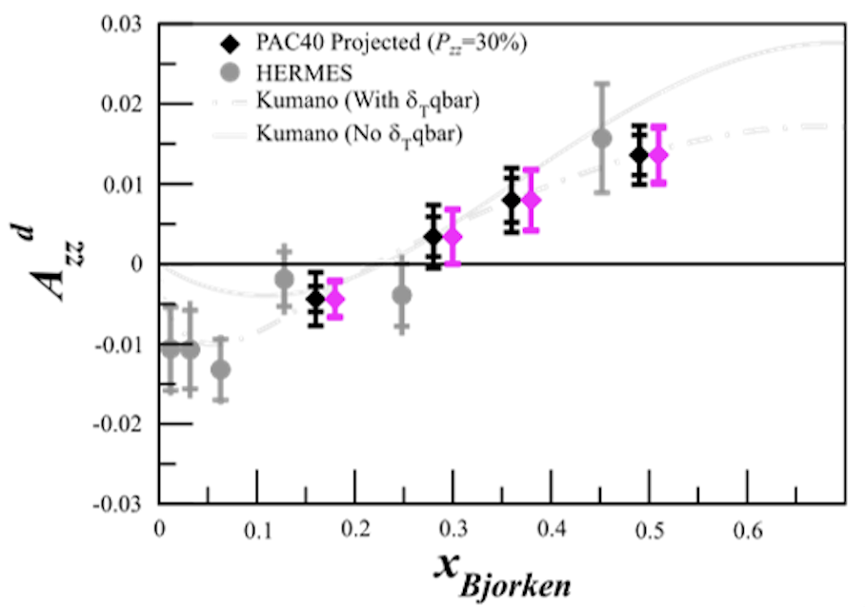
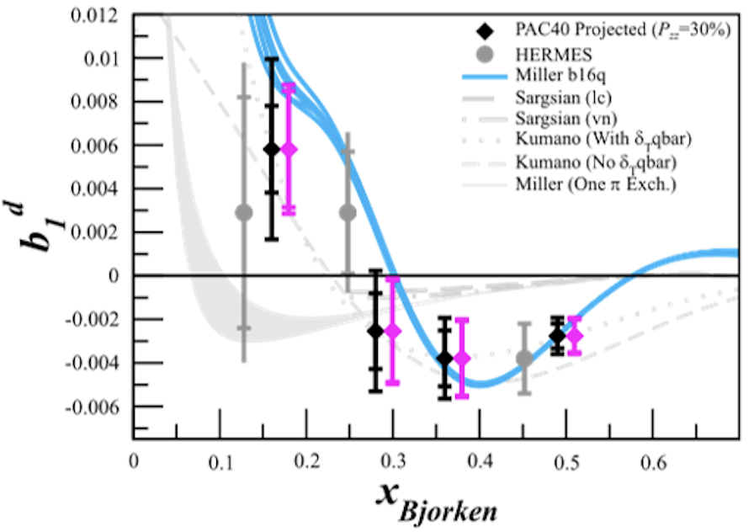
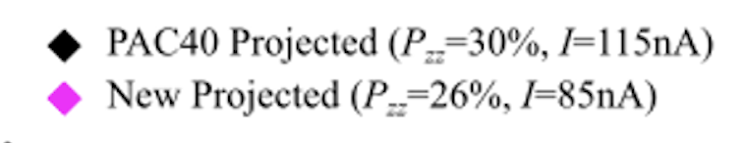
b₁ Projected Results
Measured Observable
  Projections based on
With frequent spin flips

Slide 20
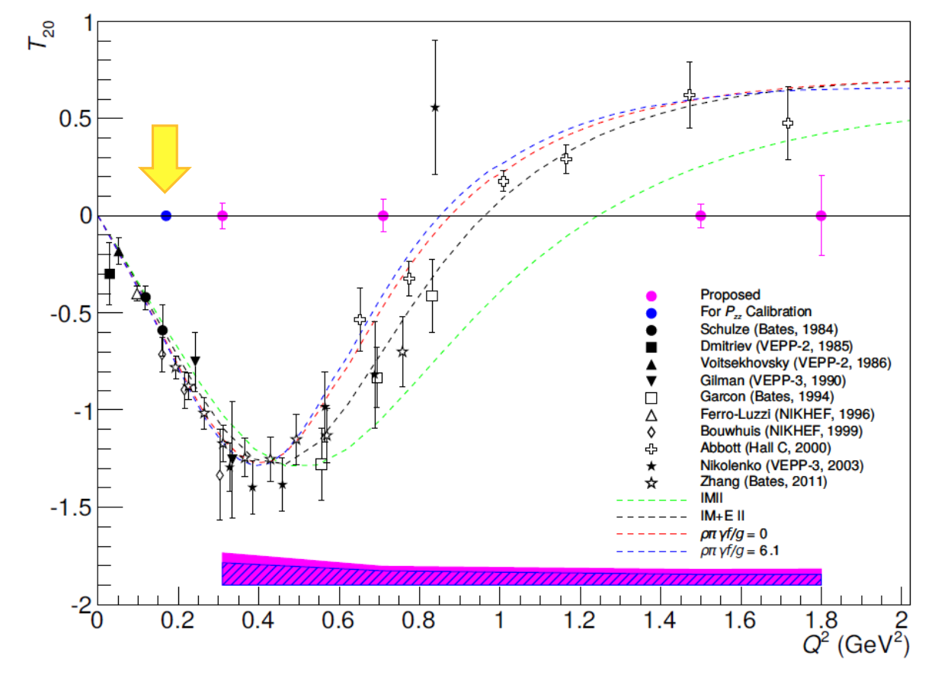
E12-15-005: A_{ZZ} Experiment
A_{zz} in the x>1 Region
Very Large Tensor Asymmetries predicted
Sensitive to the S/D-wave ratio in the
deuteron wave function
4σ discrim between hard/soft wave functions
6σ discrim between relativistic models
“further explores the nature of short-range
pn correlations, the discovery of which was
one of the most important results of the
6 GeV nuclear program.”
T20
PAC44 Theory Report

Slide 21
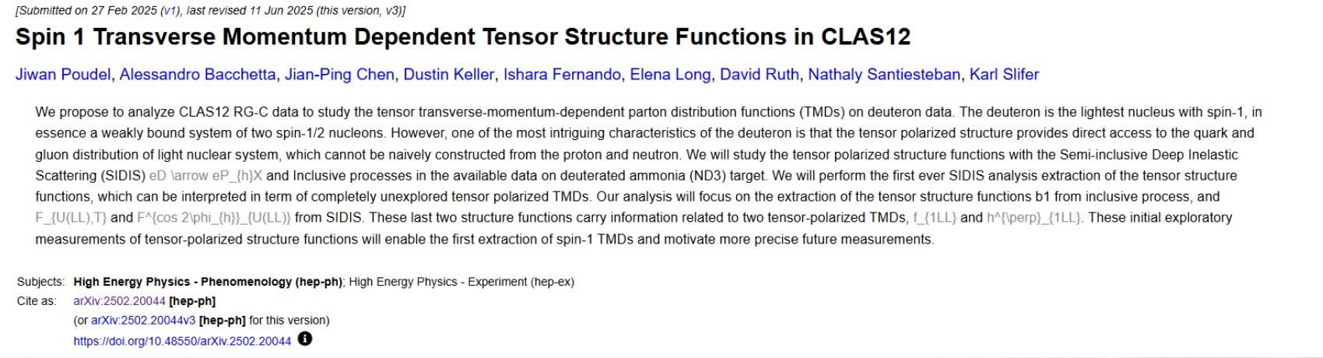
CLAS APPROVED ANALYSIS OF RGC DATA
Phd Students analyzing RGC deuteron data in preparation for b1/Azz
Chhetra Lama : Inclusive Quasi-elastic Tensor Asymmetry
M. Farooq : Inclusive DIS Tensor Asymmetry
Hector Chinchay : Semi-Inclusive DIS Tensor Asymmetry
+Anchit Arora and Utsav Shrestha
Coordinated by
Nathaly S.

Slide 22
Goals of this meeting
1) Assess progress made since October 2025
2) Begin to plan for onsite activities/ERR
3) Advocate for the earliest possible Running

