Slide 1
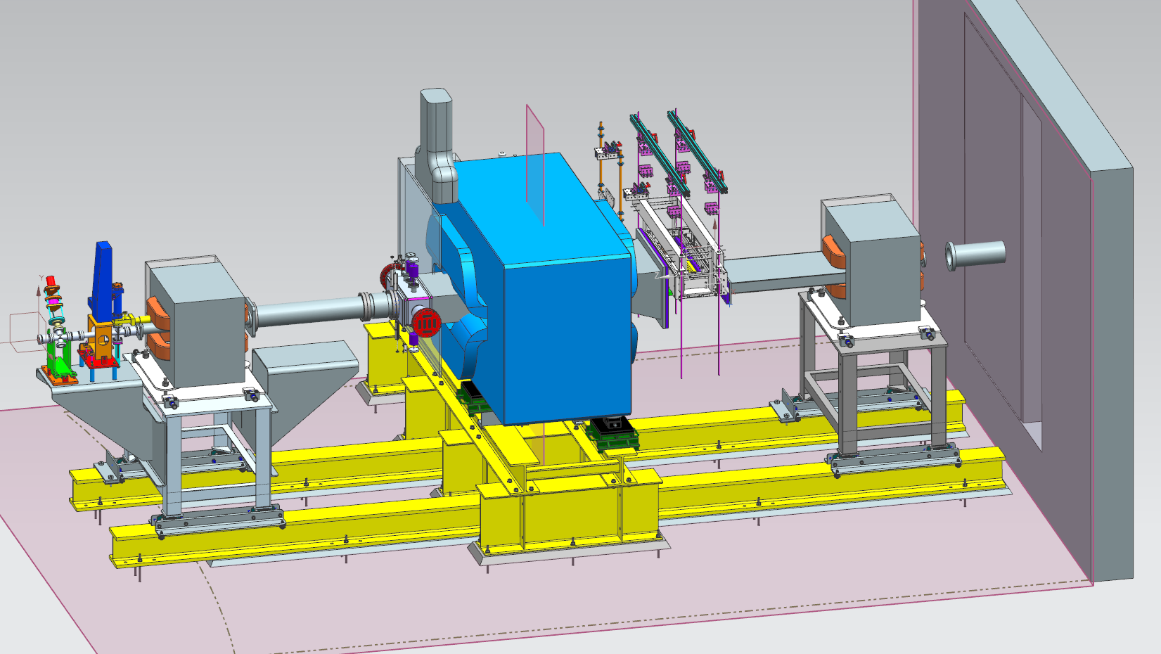
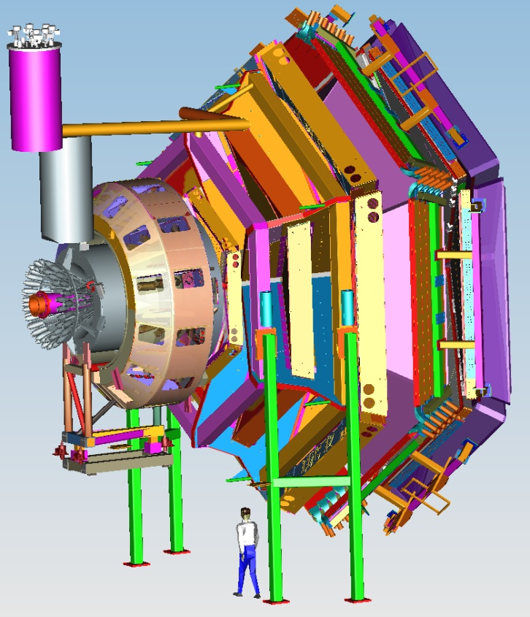
Hall B Proposals and Letter of Intent
CLAS12
Volker D. Burkert
PAC43 Meeting
7 July 2015

Slide 2
Running Hall B experiments
Hall B has 3 types of experiments:
Regular PAC approved proposals that require new beam time
Run Group experiments that can run together with already approved experiments without requiring new beam time
Experiments that are split between run groups, e.g. unpolarized and polarized target measurements of same process.
There are currently 10 Run Groups: RG-A through RG-J.
Run groups take data simultaneously serving all individual experiments that are part of the group.
RG-A includes 859 days of individual experiments that are run in 139 PAC days.
RG-B includes 356 days and is run in 90 PAC days.
RG-C includes 486 days that are run within 185 PAC days.
RG-H includes 330 days and is run within 110 PAC days.
All other run groups contain individual experiments.
The full complement of experiments RG-A to RG-J in Hall B includes 2501 days of experiments to be executed in 936 PAC days.

Slide 3
Hall B CLAS12 experiments – run groups
Proposal | Physics | Contact | Rating | Days | Group | New equipment | Energy | Run Group | Target
E12-06-108 | Hard exclusive electro-production of π⁰, η | Stoler | B | 80 | 139 | RICH (1 sector) Forward tagger | 11 | A F. Sabatié | liquid H₂
E12-06-108A | Exclusive N*->KY Studies with CLAS12 | Carman | NR | (60)
E12-06-112 | Proton’s quark dynamics in SIDIS pion production | Avakian | A | 60
E12-06-112A | Semi-inclusive Λ productiuon in target fragmentation region | Mirazita | NR | (60)
E12-06-112B | Colinear nucleon structure at twist-3 | Pisano | NR | (60)
E12-06-119(a) | Deeply Virtual Compton Scattering | Sabatie | A | 80
E12-09-003 | Excitation of nucleon resonances at high Q² | Gothe | B+ | 40
E12-11-005 | Hadron spectroscopy with forward tagger | Battaglieri | A- | 119
E12-11-005A | Photoproduction of the very strangest baryon | Guo | NR | (120)
E12-12-001 | Timelike Compton Scatt. & J/ψ production in e+e- | Nadel-Turonski | A- | 120
E12-12-007 | Exclusive φ meson electroproduction with CLAS12 | Stoler, Weiss | B+ | 60
E12-07-104 | Neutron magnetic form factor | Gilfoyle | A- | 30 | 90 | Neutron detector RICH (1 sector) Forward tagger | 11 | B K. Hafidi | liquid D₂ target
E12-09-007(a) | Study of partonic distributions in SIDIS kaon production | Hafidi | A- | 30
E12-09-008 | Boer-Mulders asymmetry in K SIDIS w/ H and D targets | Contalbrigo | A- | 56
E12-09-008A | Hadron production in target fragmentation region | Mirazita | NR | (60)
E12-09-008B | Colinear nucleon structuer at twist-3 | Pisano | NR | (60)
E12-11-003 | DVCS on neutron target | Niccolai | A | 90
E12-11-003A | In medium structure functions, SRC, and the EMC effect | Hen | NR | (90)
Beam time partial sum |  |  |  | 765 (1275) | 229
Experiment ending with A or B are run group experiments approved by the CLAS collaboration. They are running parallel to the experiments with same experiment number. Experiments ending with (a) and (b) take data with both run groups.

Slide 4
CLAS12 approved & C1 & non-CLAS12
E12-06-109 | Longitudinal Spin Structure of the Nucleon | Kuhn | A | 80 | 185 | Polarized target RICH (1 sector) Forward tagger | 11 | C S. Kuhn | NH₃ ND₃
E12-06- 119(b) | DVCS on longitudinally polarized proton target | Sabatie | A | 120
E12-07-107 | Spin-Orbit Correl. with Longitudinally polarized target | Avakian | A- | 103
E12-09-007(b) | Study of partonic distributions using SIDIS K production | Hafidi | A- | 80
E12-09-009 | Spin-Orbit correlations in K production w/ pol. targets | Avakian | B+ | 103
E12-06-106 | Color transparency in exclusive vector meson production | Hafidi | B+ | 60 | 60 |  | 11 | D
E12-06-117 | Quark propagation and hadron formation | Brooks | A- | 60 | 60 |  | 11 | E | Nuclear
E12-06-113 | Free Neutron structure at large x | Bueltman | A | 40 | 42 | Radial TPC | 11 | F | Gas D₂
E12-14-001 | EMC effect in spin structure functions | Brooks | B+ | 55 | 55 | Pol. LiH target | 11 | G | _{LiH}
TOTAL CLAS12 run time (approved experiments) |  |  |  | 1466 (1976) | 631
Proposal | Physics | Contact | Rating | Days | Group | Equipment | Energy | Group | Target
C12-11-111 | SIDIS on transverse polarized target | Contalbrigo | A | 110 | 110 | Transverse target | 11 | H | HD
C12-12-009 | Transversity w/ di-hadron on transvere target | Avakian | A | 110
C12-12-010 | DVCS with transverse polarized target in CLAS12 | Elouadrhriri | A | 110
All CLAS12 transverse target proposals |  |  |  | 330 | 110
C12-11-006 | Heavy Photon Search at Jefferson Lab (HPS) | Jaros | A | 180 | 180 | Setup in alcove | 2.2, 6.6 | I | Nuclear
E12-11-106 | High Precision Measurement of the Proton Charge Radius | Gasparian | A | 15 | 15 | Primex | 1.1, 2.2 | J | H2 gas
Beam time request from CLAS12 C1 experiments + non-CLAS12 experiments |  |  |  | 525 | 305
Beam time from approved CLAS12 experiments (from previous table) |  |  |  | 1466 (1976) | 631
TOTAL Beam time for all Hall B experiments |  |  |  | 1991 (2501) | 936

Slide 5
PAC43 – Hall B Proposals and LOIs
PAC Proposal
P12-15-004: Deeply virtual Compton scattering on the neutron at 11 GeV with CLAS12 and a longitudinally polarized deuterium target
(Requested new beam time is 62 days. If PAC approved it can run parallel to E12-06-109 (RG-C) for 63 days.)
RG-A experiment
E12-11-003A: In medium proton structure functions, SRC, and the EMC effect. (Will run parallel to E12-11-003 for 90 days. Can also run parallel to RG-D, E, F).
Letter-of-Intent
LOI12-15-004: Search for Hybrid Baryons with CLAS12 in Hall B.

Slide 6
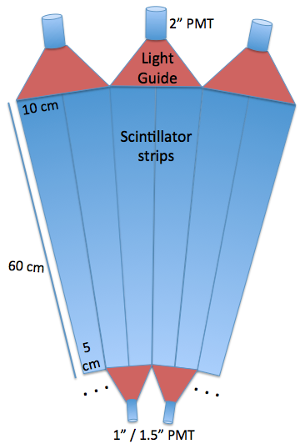
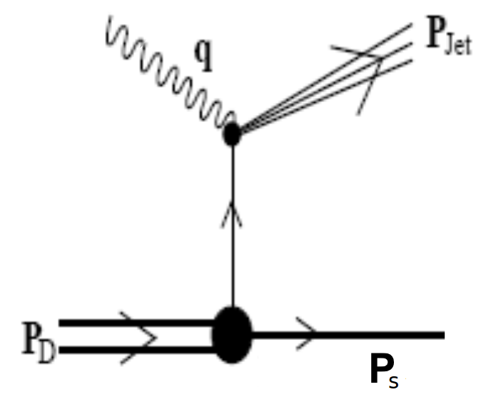
E12-11-003A - In Medium Proton Structure Functions, SRC, and the EMC Effect
Neutron
detector
N_{s}

Slide 7
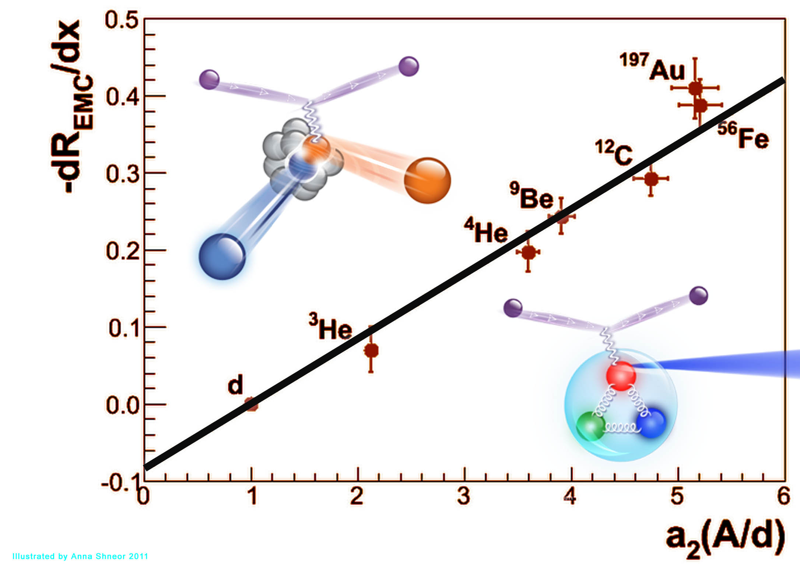
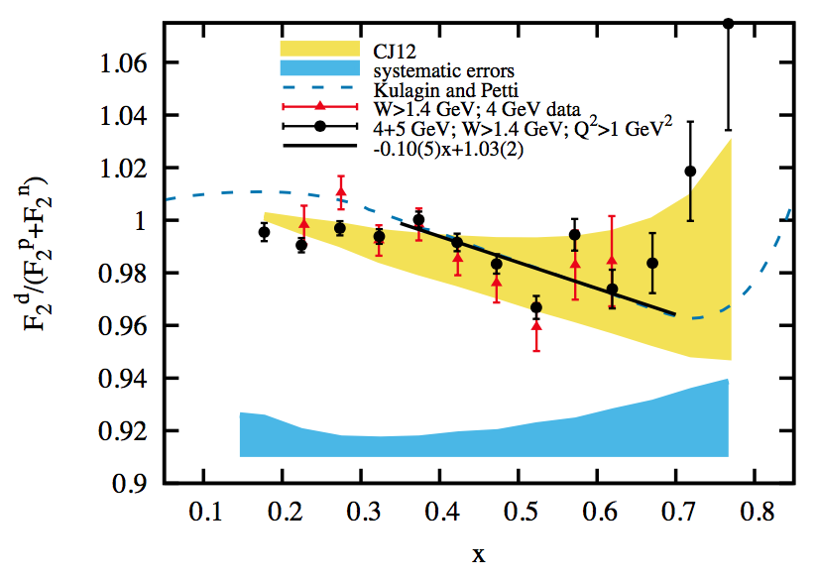
Explore Connection between EMC and SRC
Are high-momentum nucleons modified in the nucleus (the EMC effect)?
EMC Slopes 0.35 ≤ X_{B} ≤ 0.7
Deuteron
Is there an “EMC” effect in the deuteron?
Is there a large “EMC” effect in the high-momentum tail of the deuteron?
Does the structure function F₂ depend on nucleon momentum (virtuality)?
SRC Scaling factors X_{B} ≥ 1.4
BoNuS EMC Effect
arXiv:1506.0871
x

Slide 8
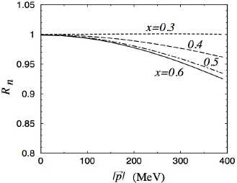
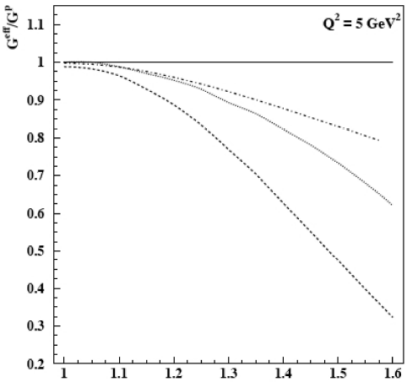
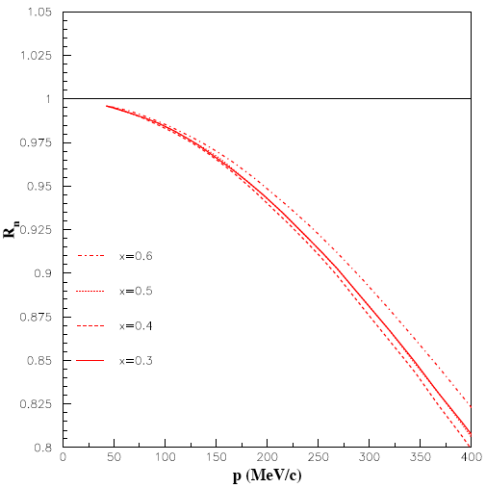
Predicted Dependence of F₂ on Momentum
Dependence on:
Models
Nucleon momentum and x_{B}
Nucleon momentum, not x_{B}
Melnitchouk, Schreiber, Thomas, Phys. Lett. B 335, 11 (1994)
R = F₂’/F₂
Melnitchouk, Sargsian, Strikman, Z. Phys. A 359, 99 (1997)
Binding/
off shell
Gross, Liuti, Phys. Lett. B 356, 157 (1995)
Rescaling
No x-dependence
R = F₂’/F₂
PLC
suppression
R = F₂’/F₂
p (MeV/c)
400

Slide 9
Spectator Tagging
Experimental method
Use deuteron as a target in DIS
Tag high-momentum struck proton with high-momentum backward-recoiling (“spectator”) partner neutron using d(e,e’n_{s})
Minimize experimental and theoretical uncertainties by measuring cross-section ratios
x’ = x from a moving nucleon
FSI correction factor
No EMC is expected

Slide 10
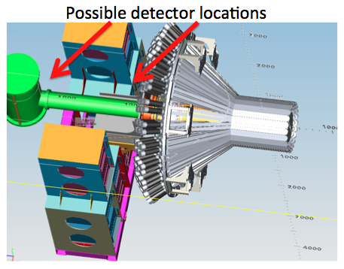
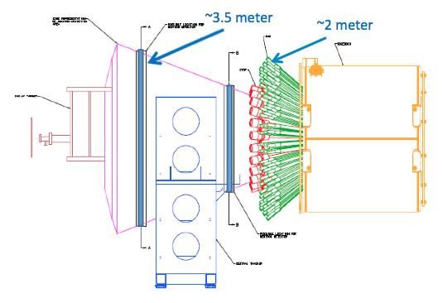
CLAS12 + BAND
Possible BAND locations
Possible BAND locations
Central detector
BAND: annular detector
160º < θ_{n} < 170º
3.5 m from target
0.6 m < r < 1.2 m
Four 6-cm layers of scintillators
24 cm thick

Slide 11
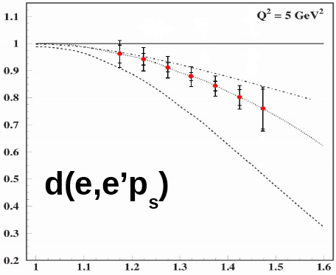
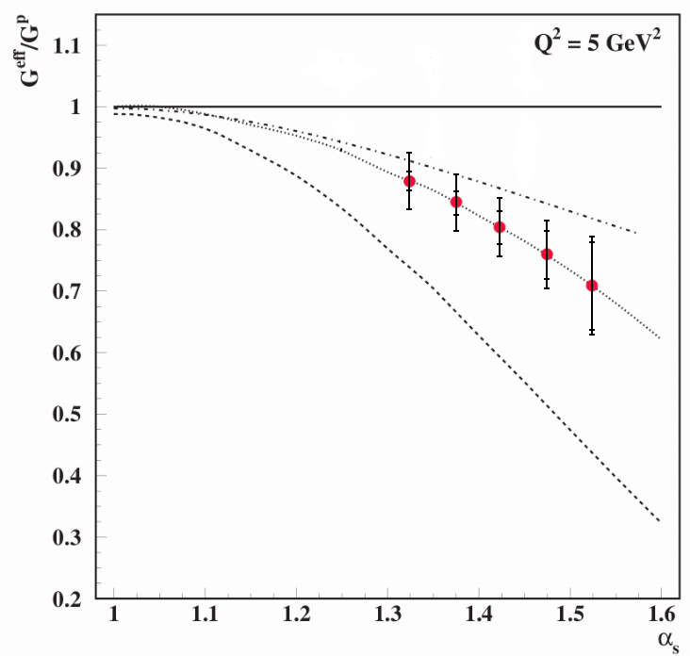
Expected Results
Hall C + LAD
CLAS12 + BAND
G^{eff}/G^{n}
G^{eff}/G^{p}
1
1
0.7
0.7
d(e,e’n_{s})
1
1.5
1
1.5
0
0.4
0
0.4
(GeV/c)
(GeV/c)
(results for 75 days beam time at L=10³⁵cm⁻²s⁻¹)

Slide 12
E12-11-003A Conclusions
Physics:
SRC and EMC are linearly correlated
Both phenomena are likely related to high-momentum nucleons
EMC effect strongly implies that bound nucleons are modified
Experiment d(e,e’n_{s}) with CLAS12 + BAND:
Directly measure the proton structure function in the nuclear medium as a function of momentum (virtuality)
Use spectator tagging to select highly virtual protons in DIS
Minimize systematic uncertainties by measuring ratios
Run with Run Group B (and other deuteron target run groups)
Complements neutron s.f. measurements using d(e,e’p_{s}) E12-11-107 (Hall C + LAD)
Are nucleons modified in the nucleus? If so, how?
Can this explain the EMC effect?
How is this related to short range correlations?

Slide 13
CLAS Collaboration review of E12-11-003A
The CLAS review committee, members S. Stepanyan (chair), Y. Prok, and T. Forest,
conducted the review of the CLAS12 run group during a four week period using email communications and in person (S. Stepanyan) during a meeting with the spokespersons on May 28. Based on the presented additional materials during these discussions the committee concluded that the proposed experiment
“In Medium Proton Structure Functions, SRC, and the EMC Effect” by O. Hen et al.
has a solid theoretical foundation, is important and timely, and complements an already approved experiment in Hall-C,
has sound measurement and analysis strategies, and
can run with CLAS12 run groups: RG- B (E12-07-104, E12-09-007a, E12-09-008, E12-11-003), RG-F (E12-06-113), RG-E (E12-06-117) and RG-D (E12-06-106) without interfering with already approved experiments in those groups,
and should be approved as a CLAS12 run group proposal.
=> The full committee report has been made available to the PAC.

Slide 14
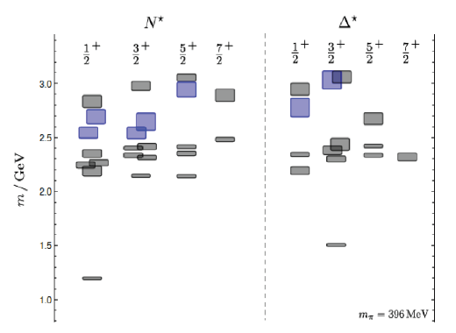
LOI12-15-004: Search for Hybrid Baryons
J.J. Dudek and R.G. Edwards, Phys.Rev. D 85, 054016 (2012)
LQCD
Hybrid Baryons, i.e. Baryons with large gluonic component, are predicted in models and Lattice QCD.
LQCD show lowest HB masses that are 1.3 GeV above ground state nucleon, and reachable with CLAS12.
Complication: HB have same quantum numbers as regular 3-quark states. How can they be identified?
1.3GeV
Hybrid baryons
Nucleon g.s.

Slide 15
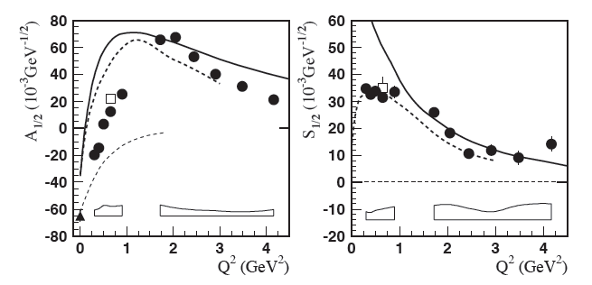
Identifying HB through electrocouplings
Example: Roper resonance initially thought as possible lowest mass hybrid baryon
T. Barnes and F.E. Close, Phys.Lett. B123 (1983) 89
3-quark state and hybrid baryon state with same J^{P} have very different Q² dependences
Z.P. Li, V.Burkert, Z.J. Li, Phys. Rev. D 46, 70 (1992)
q³G
q³G
Q² dependence of electrocoupling amplitudes A_{1/2}, S_{1/2} excludes Roper as hybrid baryon.
I.G. Aznauryan et al., [CLAS collaboration], Phys.Rev.C 80, 055203 (2009)
Apply same technique to states in mass range above 2 GeV.

Slide 16
Excerpt from TAC (Theory)
It appears that the experimental program proposed does not require a theoretical understanding
to be in place in advance of the data-taking and analysis, and as such the embryonic state of theory
should not be held against the effort. The data can be taken and analyzed and the theoretical
interpretation may follow subsequently.
There are some odd omissions in the text that should be addressed in any future full proposal:
While the I = 1/2, J^{P} = 1/2⁺; 3/2⁺ hybrid baryons are presented as the target of the search, no
discussion is given regarding the other predicted hybrid baryons, the I = 1/2 state with J^{P} = 5/2⁺
and the two I = 3/2 states - if they are not accessible in the search, the reader should be presented
with a reason why not.
2) Since the extraction of resonance pole information from amplitude analysis is a vital
step in the program, more detailed discussion and references should be presented,
beyond simply referring to “these advanced tools".
J. Dudek

Slide 17
Response to TAC Report
The mentioned hybrid N_{G} with J^{p} =5/2⁺ and hybrid Δ_{G} with J^{P}=1/ 2⁺ and 3/2⁺ are predicted at considerably higher mass than the J^{P} = 1/2⁺ and 3/2⁺ N_{G} states. We believe we have the best chances of finding the lower mass states first. Our focus is on the lowest mass hybrid baryons simply because baryon spectroscopy is more difficult at high masses where resonances are wider and overlapping and more partial waves can contribute making the partial wave analysis more difficult.
However, all masses up to 3 GeV or higher are within reach of the proposed experiment, and the projected data will be used in the search for all possible new states, including ordinary 3-quark baryons, as there are many “missing” baryon states predicted in the mass range above 2 GeV.
2) We agree with the comment that the extraction of resonances parameters such as poles is a vital step in the program and more details will be included in a future proposal. In addition to extending our own single pion [1] and double pion [2] channel analyses and working within the JPAC group, we plan to work with analysis groups such as the Bonn-Gatchina group and GWU group in their already rather sophisticated multi-channel analysis employed in the CLAS photo-production data analysis. The inclusion of the CLAS data together with data from other groups has already led to the discovery and much improved evidence of eight N* and Δ* states that are included in the RPP 2012. These analyses need to be extended to include the electro-production data as well. For the proposal we plan to include more details on this important part of the project.
[1] I.G. Aznauryan et al., Phys.Rev. C80 (2009) 055203
[2] V. Mokeev et al., Phys.Rev. C80 (2009) 045212

