Slide 1
PR12-15-005:
Measurement of the Quasi-Elastic and Elastic Deuteron Tensor Asymmetries
Elena Long
On behalf of Donal Day, Douglas Higinbotham, Dustin Keller, Karl Slifer, Patricia Solvignon
Jefferson Lab PAC43
July 8th, 2015

Slide 2
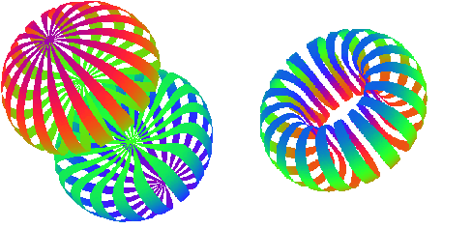
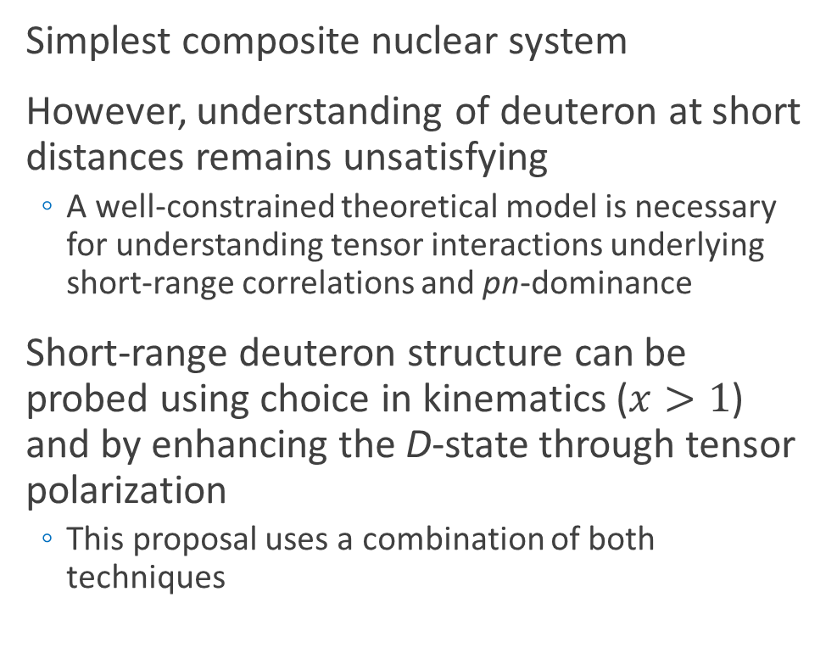
Deuteron
Simplest composite nuclear system
However, understanding of deuteron at short distances remains unsatisfying
  A well-constrained theoretical model is necessary for understanding tensor interactions underlying short-range correlations and pn-dominance
Short-range deuteron structure can be probed using choice in kinematics ($x>1$) and by enhancing the D-state through tensor polarization
  This proposal uses a combination of both techniques
J Forest, et al, PRC 54 646 (1996)

Slide 3
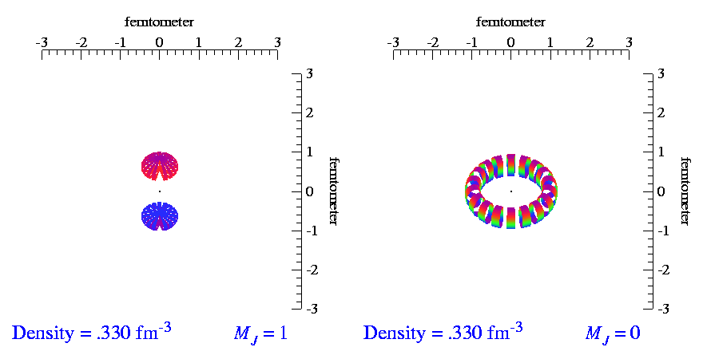
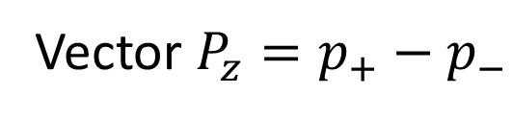
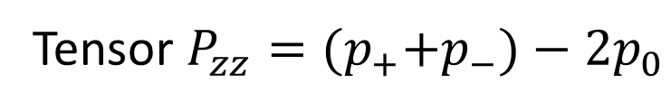
Tensor Polarization
For tensor polarization, need spin-1 particles
Spin-1
System
Spin-½
System
m = +1
Development of a high luminosity, high tensor polarized target has promise as a novel probe of nuclear physics
m = +½
m = 0
m = -½
m = -1
Vector $P_{z}=p_{+}−p_{−}$
Tensor $P_{zz}={(p}_{+}+p_{−})−2p_{0}$
-
( + )-2
Animations by SC Pieper, et al, http://www.phy.anl.gov/theory/movie-run.html

Slide 4
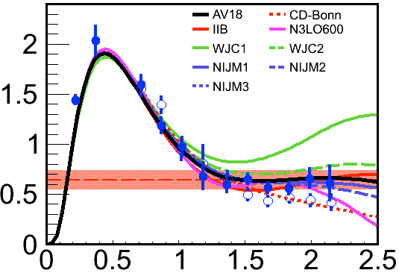
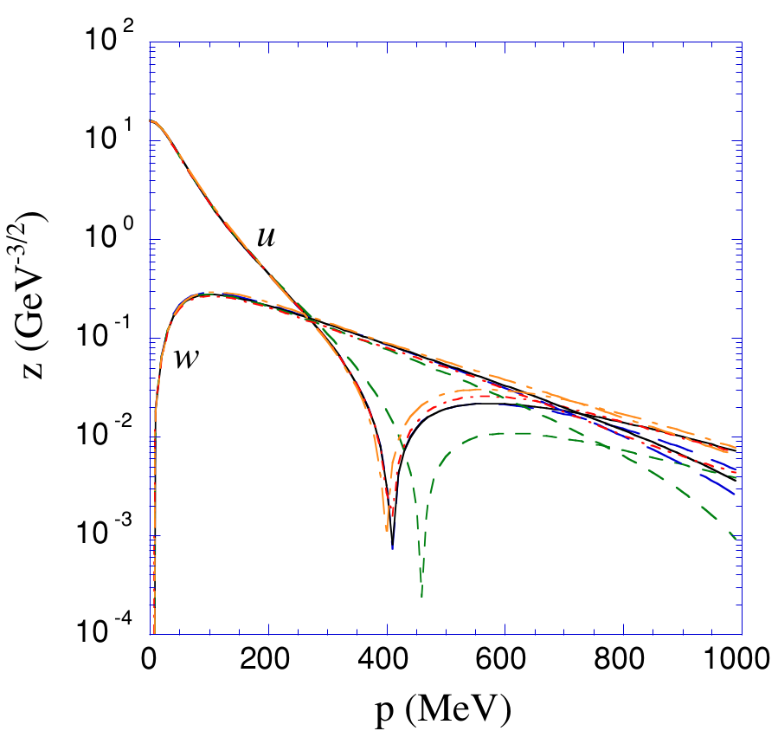

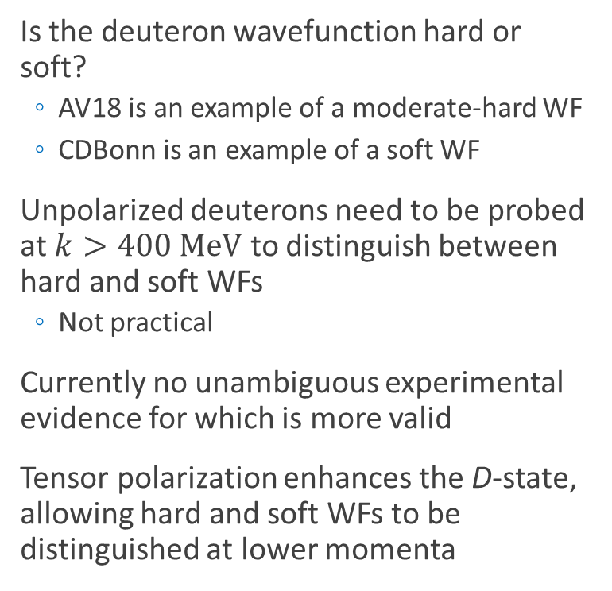



Deuteron Wavefunction
Is the deuteron wavefunction hard or soft?
  AV18 is an example of a moderate-hard WF
  CDBonn is an example of a soft WF
Unpolarized deuterons need to be probed at $k>400 MeV$ to distinguish between hard and soft WFs
  Not practical
Currently no unambiguous experimental evidence for which is more valid
Tensor polarization enhances the D-state, allowing hard and soft WFs to be distinguished at lower momenta
$${k^{′}}^{4}∙n(k^{′})$$
$$D\left(e,e^{′}p\right) θ_{nq}=35°$$
$$θ_{nq}=45°$$
O. Hen, et al, arXiv:1407.8175
$$k^{′}=k/k_{F}$$

Slide 5
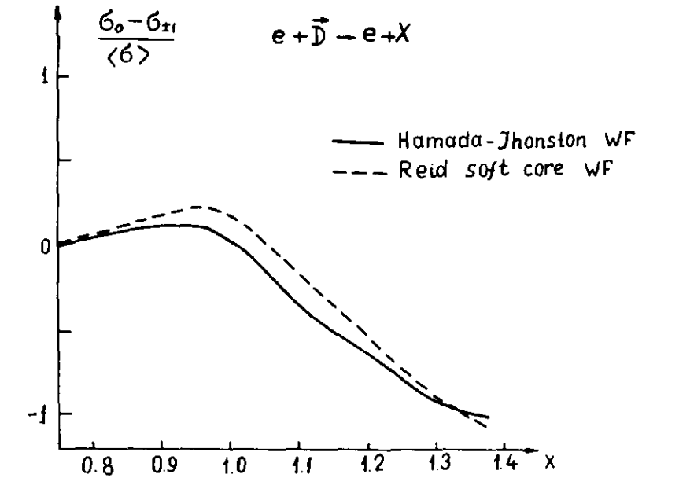
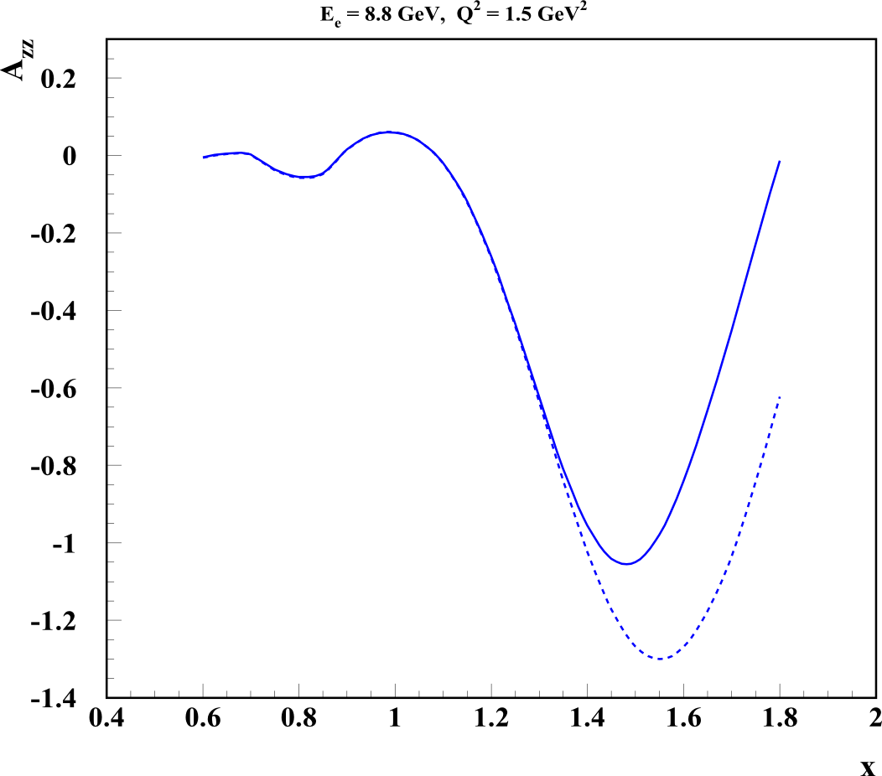
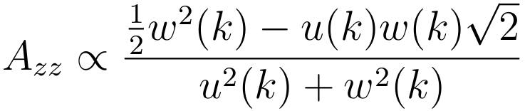
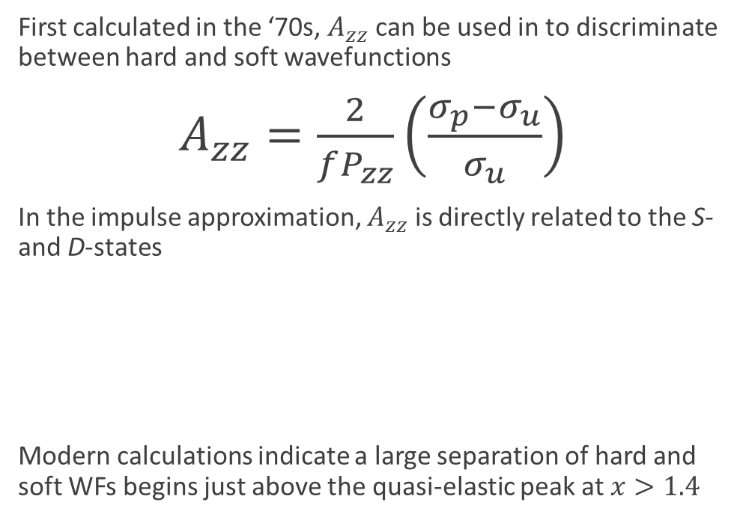
Deuteron Wavefunction
First calculated in the ‘70s, $A_{zz}$ can be used in to discriminate between hard and soft wavefunctions
$A_{zz}=\frac{2}{fP_{zz}}\left(\frac{σ_{p}−σ_{u}}{σ_{u}}\right)$
In the impulse approximation, $A_{zz}$ is directly related to the S- and D-states
Modern calculations indicate a large separation of hard and soft WFs begins just above the quasi-elastic peak at $x>1.4$
AV18
CDBonn
L.L. Frankfurt, M.I. Strikman, Phys. Rept. 76 (1981) 215
M. Sargsian

Slide 6
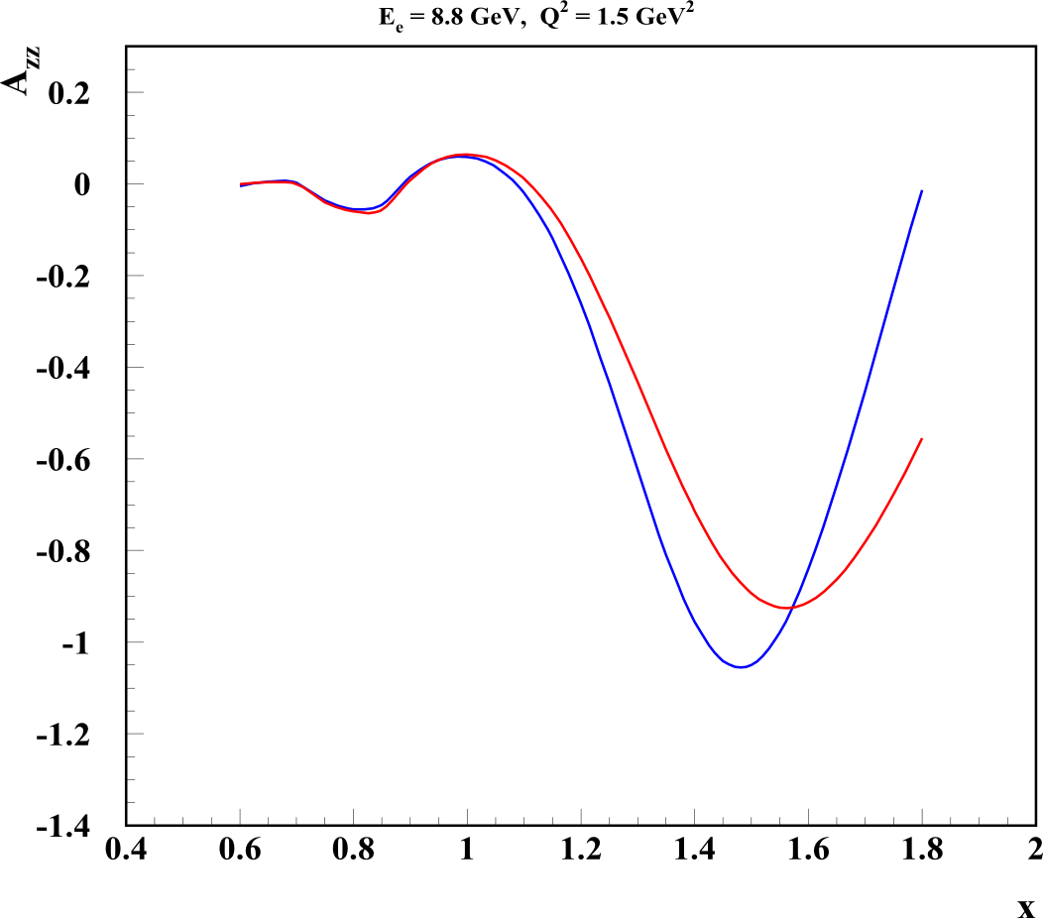
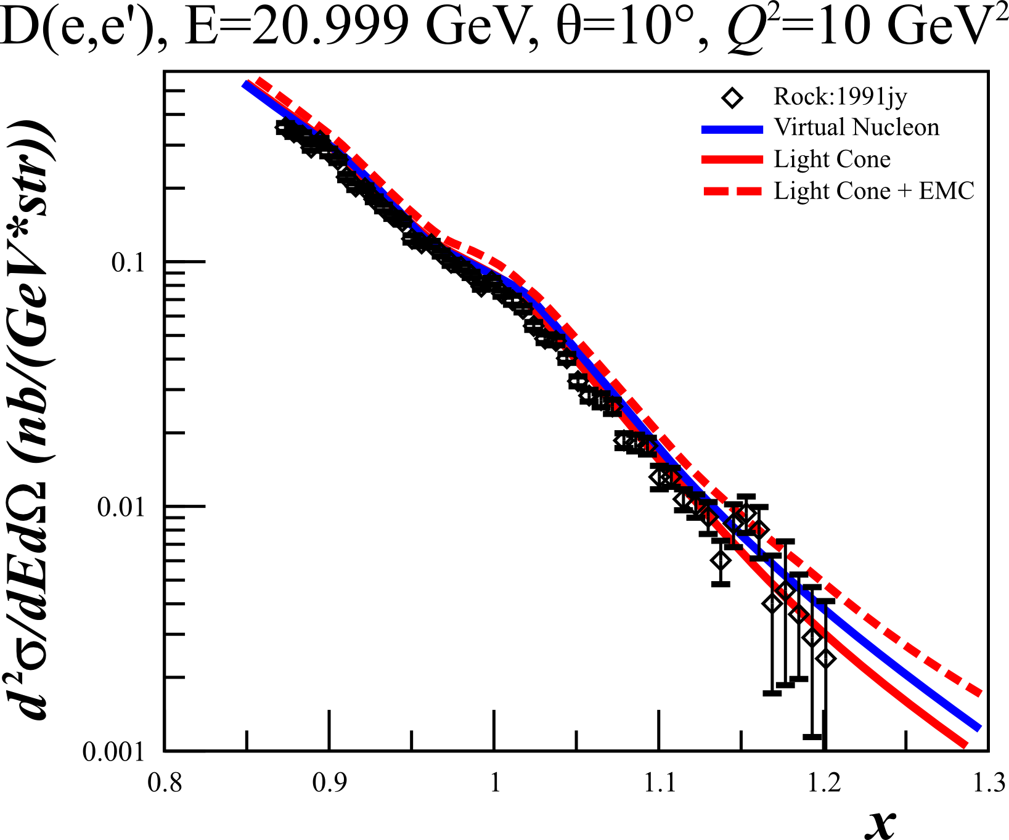
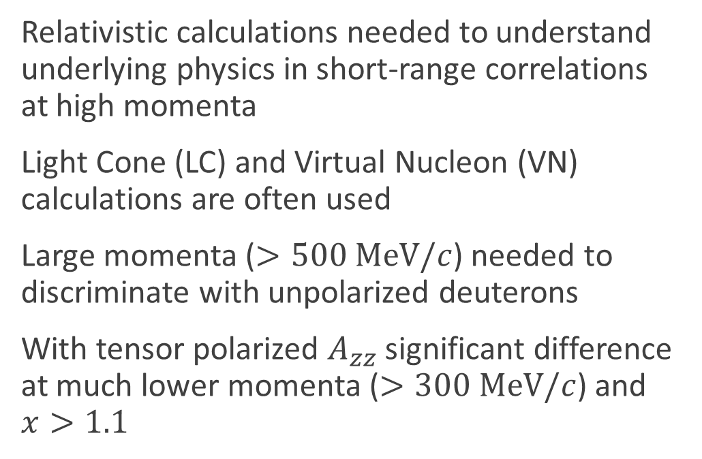
Relativistic NN Bound System
Relativistic calculations needed to understand underlying physics in short-range correlations at high momenta
Light Cone (LC) and Virtual Nucleon (VN) calculations are often used
Large momenta ($>500 MeV/c$) needed to discriminate with unpolarized deuterons
With tensor polarized $A_{zz}$ significant difference at much lower momenta ($>300 MeV/c$) and $x>1.1$
Light
Cone
Virtual
Nucleon
M Sargsian, Tensor Spin Observables Workshop (2014)

Slide 7
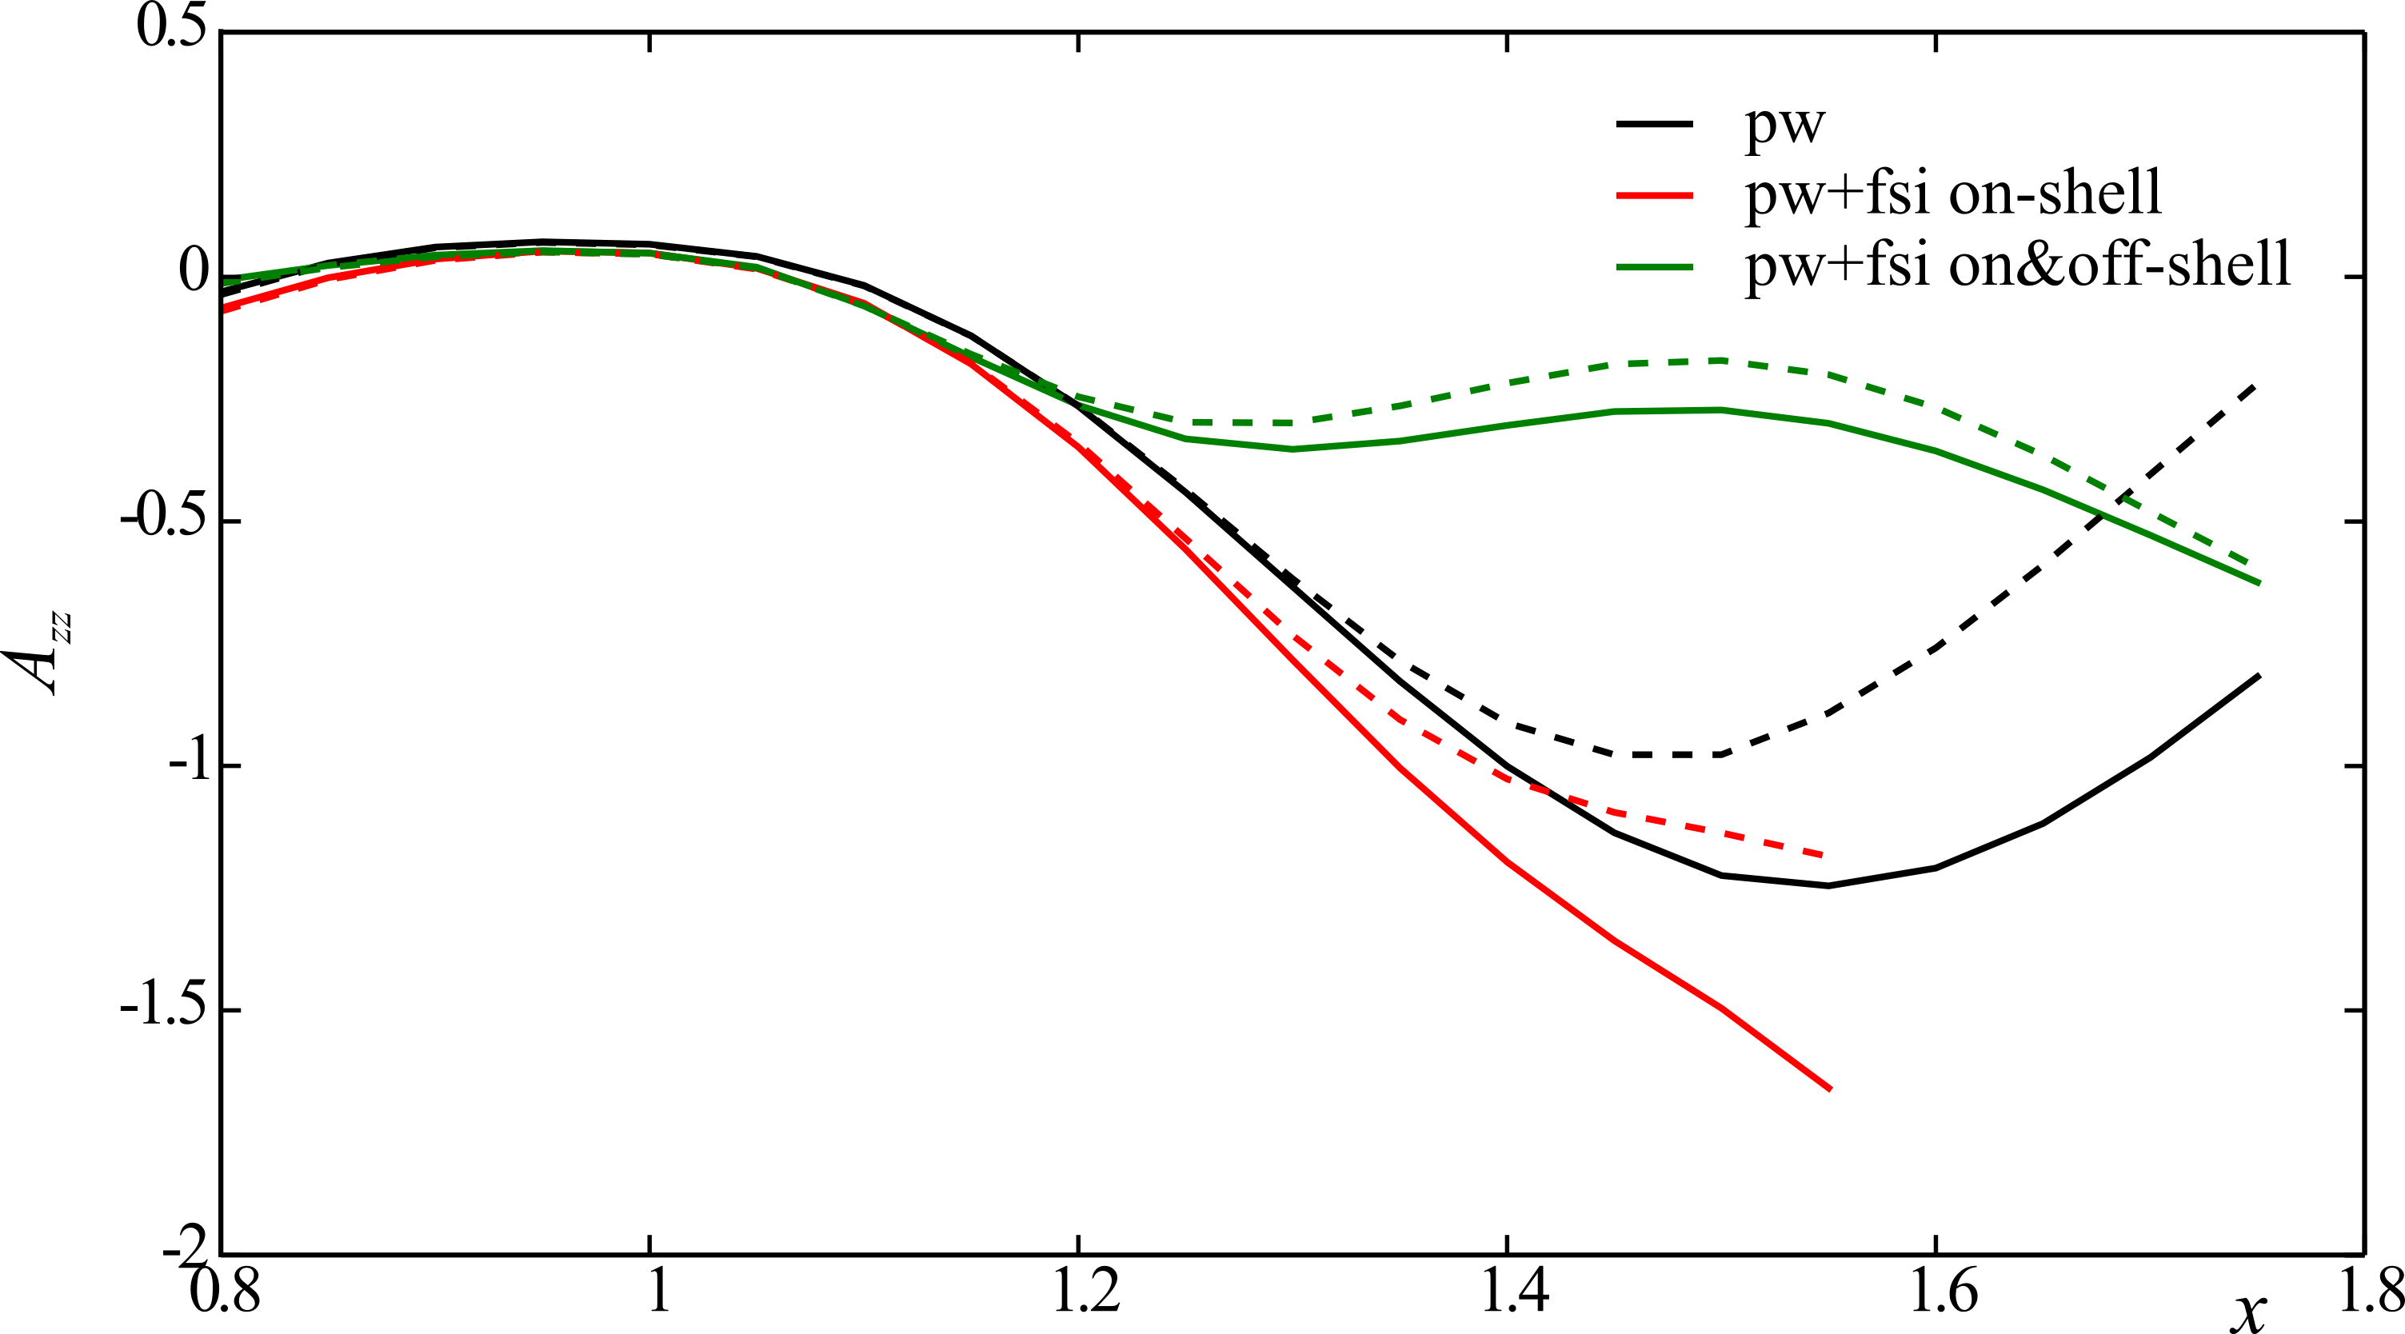
Final State Interactions
To determine nucleonic components of the deuteron WF, FSI must be understood
Minimum and maximum effects from FSI have been calculated by W. Cosyn
Even with FSI, large discrepancy based on WF input
AV18
CDBonn

Slide 8
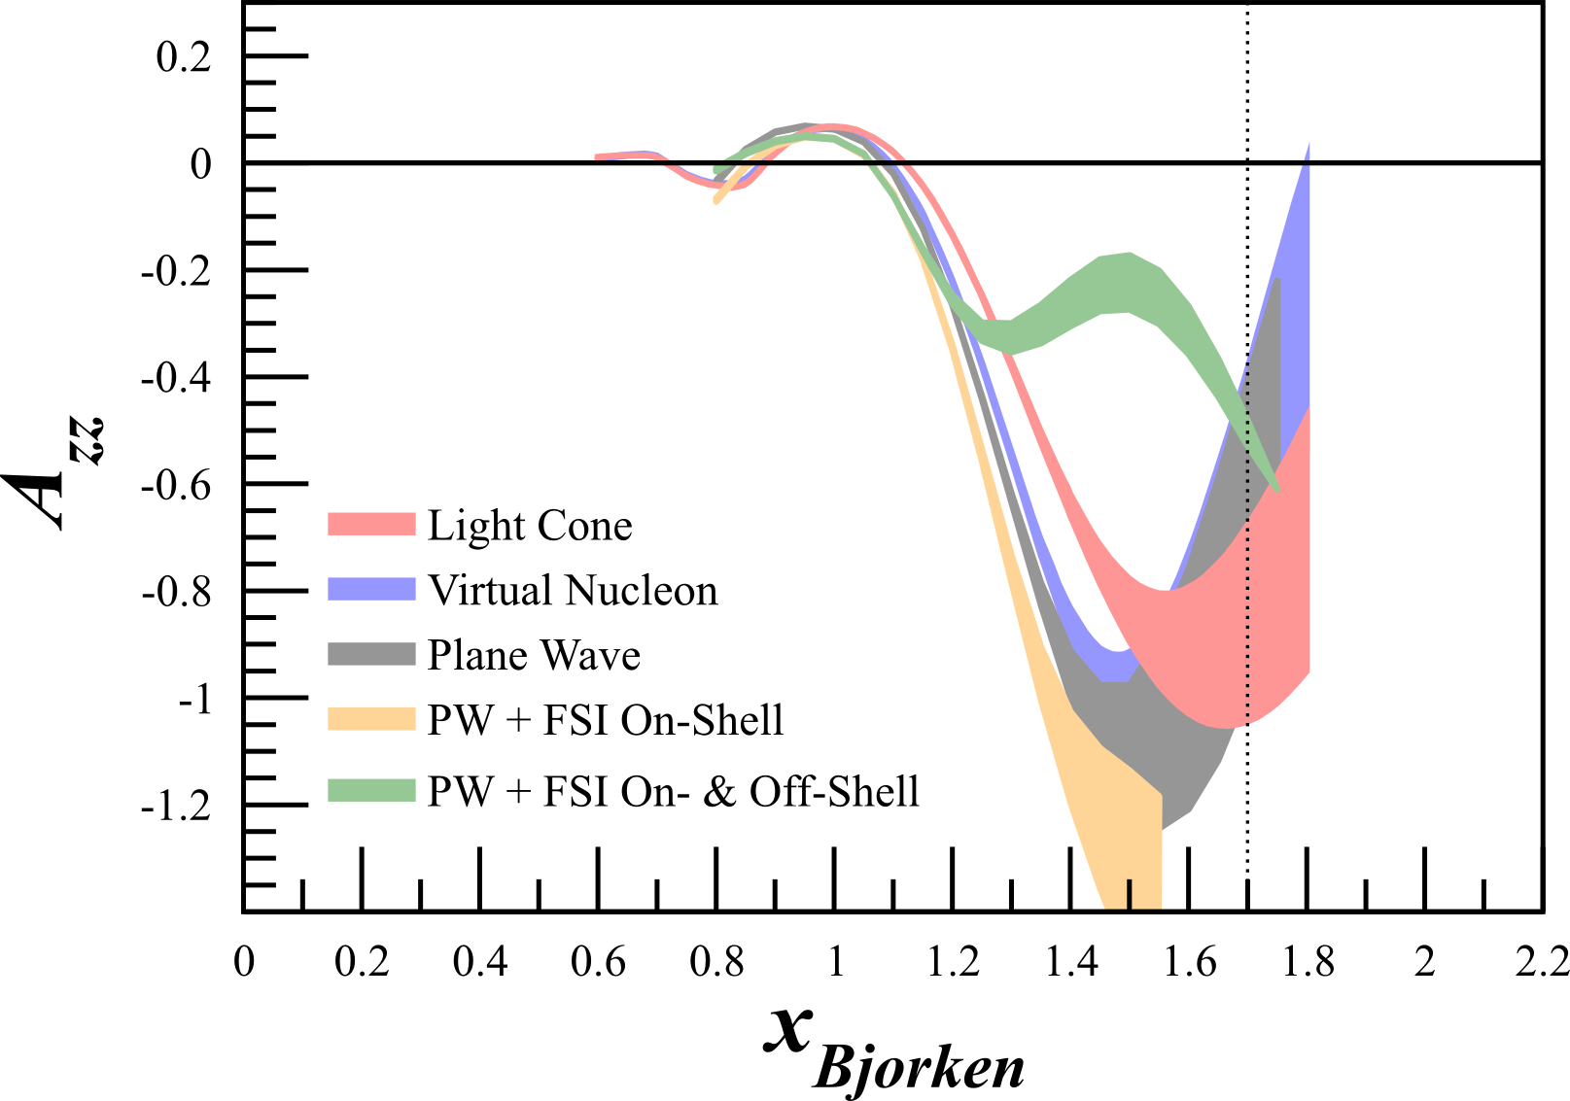

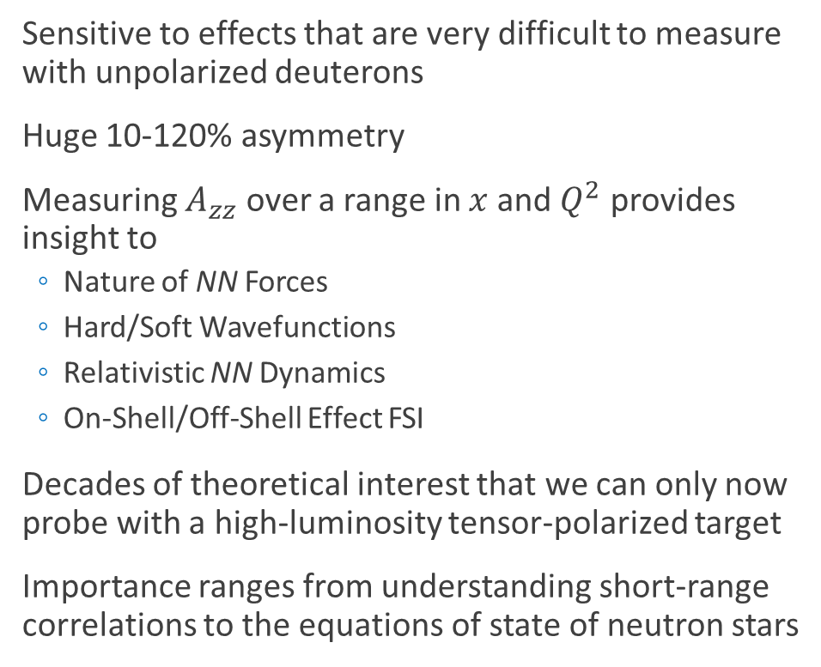
First Measurement of Quasi-Elastic $A_{zz}$
Sensitive to effects that are very difficult to measure with unpolarized deuterons
Huge 10-120% asymmetry
  Measuring $A_{zz}$ over a range in $x$ and $Q^{2}$ provides insight to
  Nature of NN Forces
  Hard/Soft Wavefunctions
  Relativistic NN Dynamics
  On-Shell/Off-Shell Effect FSI
Decades of theoretical interest that we can only now probe with a high-luminosity tensor-polarized target
Importance ranges from understanding short-range correlations to the equations of state of neutron stars

Slide 9



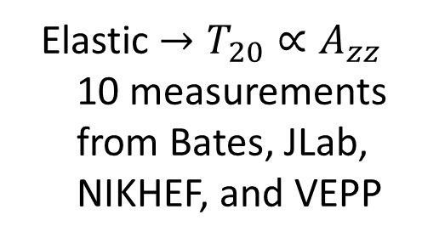




First Measurement of Quasi-Elastic $A_{zz}$
  A measurement of quasi-elastic $A_{zz}$ will fill a gap in tensor polarized deuteron experiments
  QE ${→A}_{zz}$
  No current or planned measurements
  Elastic $→T_{20}∝A_{zz}$
  10 measurements from Bates, JLab, NIKHEF, and VEPP
  DIS ${→b}_{1}∝F_{1}A_{zz}$
  HERMES, upcoming at JLab
$$<0.5$$
$$0.8−1.8$$
$$2$$
$$x$$

Slide 10
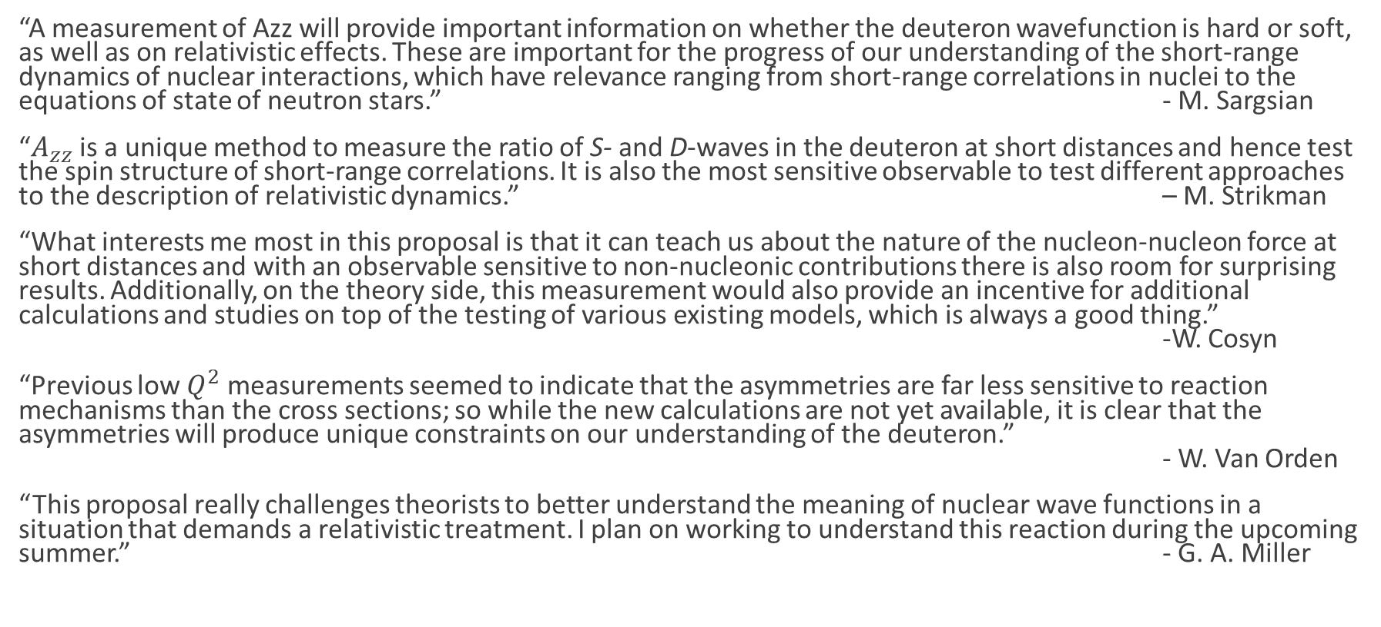
Theoretical Interest
“A measurement of Azz will provide important information on whether the deuteron wavefunction is hard or soft, as well as on relativistic effects. These are important for the progress of our understanding of the short-range dynamics of nuclear interactions, which have relevance ranging from short-range correlations in nuclei to the equations of state of neutron stars.” - M. Sargsian
“$A_{zz}$ is a unique method to measure the ratio of S- and D-waves in the deuteron at short distances and hence test the spin structure of short-range correlations. It is also the most sensitive observable to test different approaches to the description of relativistic dynamics.” – M. Strikman
“What interests me most in this proposal is that it can teach us about the nature of the nucleon-nucleon force at short distances and with an observable sensitive to non-nucleonic contributions there is also room for surprising results. Additionally, on the theory side, this measurement would also provide an incentive for additional calculations and studies on top of the testing of various existing models, which is always a good thing.”
-W. Cosyn
“Previous low $Q^{2}$ measurements seemed to indicate that the asymmetries are far less sensitive to reaction mechanisms than the cross sections; so while the new calculations are not yet available, it is clear that the asymmetries will produce unique constraints on our understanding of the deuteron.”
- W. Van Orden
“This proposal really challenges theorists to better understand the meaning of nuclear wave functions in a situation that demands a relativistic treatment. I plan on working to understand this reaction during the upcoming summer.” - G. A. Miller

Slide 11

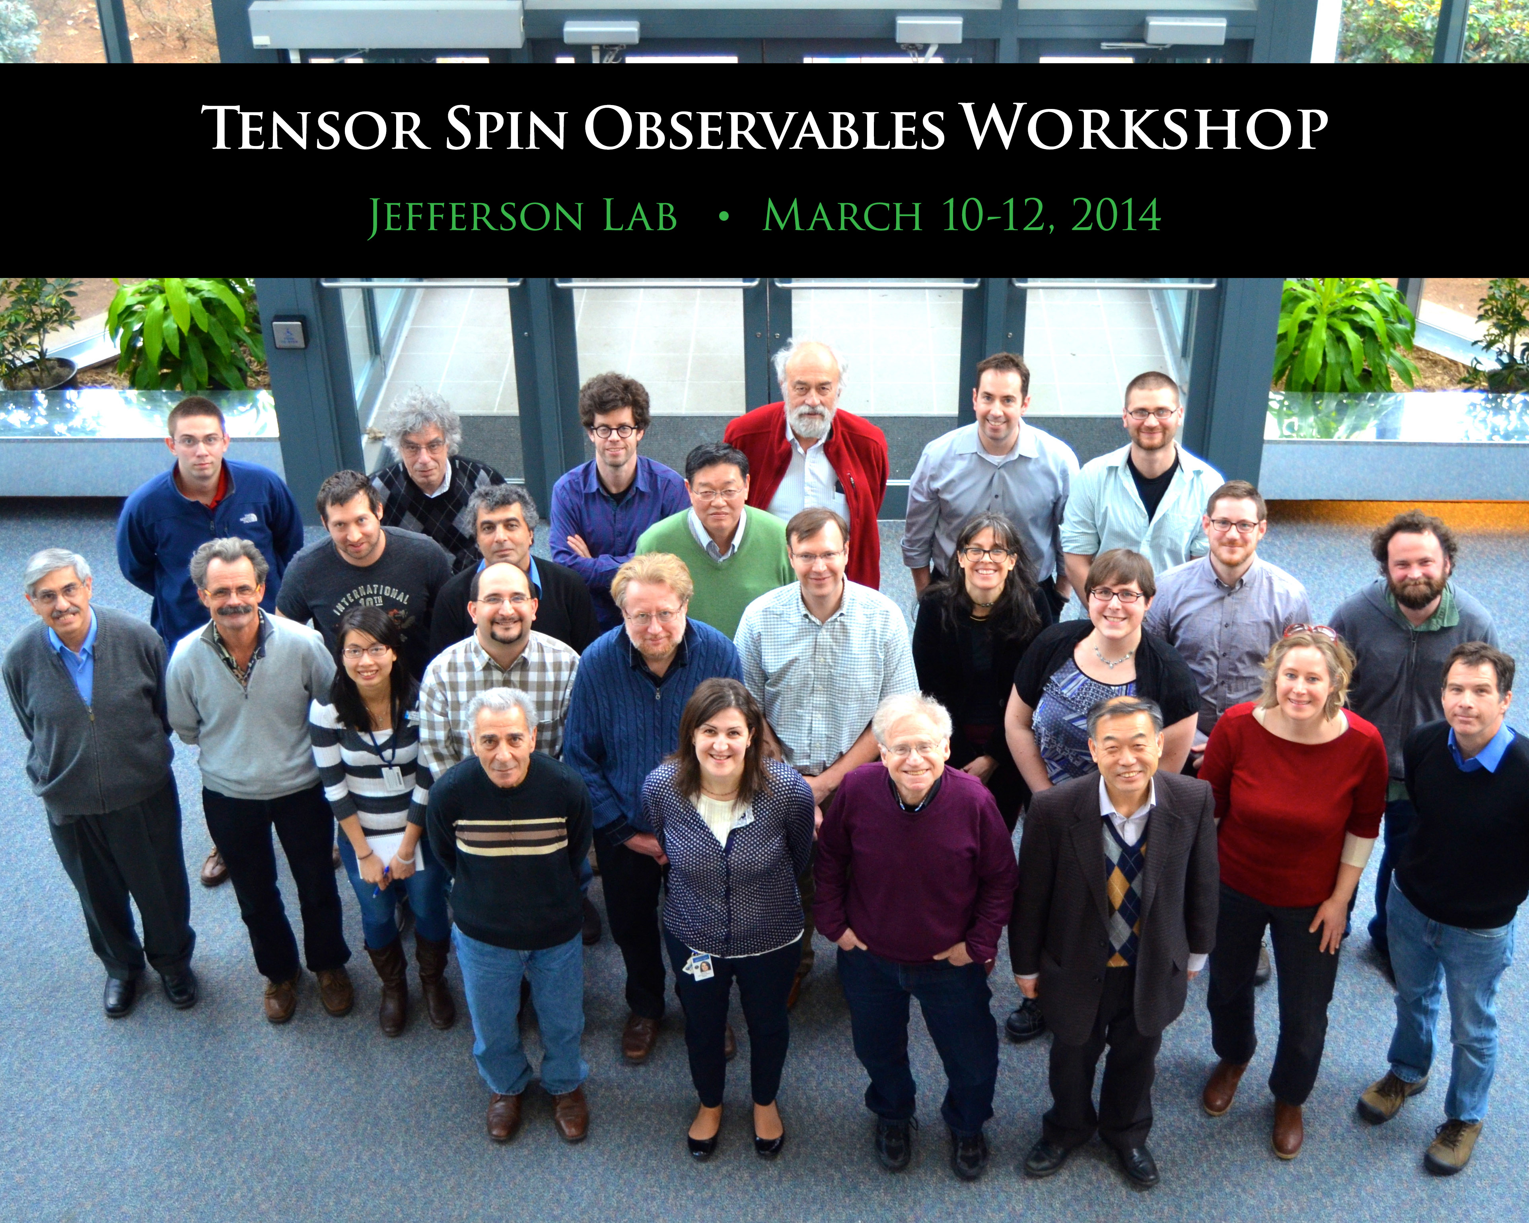
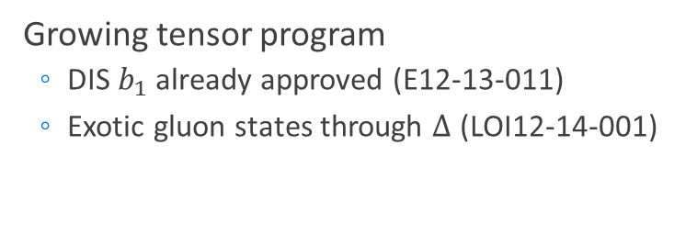
Part of a Growing Tensor Program
Growing tensor program
  DIS $b_{1}$ already approved (E12-13-011)
  Exotic gluon states through $∆$ (LOI12-14-001)
Physics accessible with a tensor polarized target:
    Deuteron wave function
    Close-Kumano Sum Rule
    Orbital Angular Momentum
    & Spin Crisis
    Gravitomagnetic Form Factors
    6-Quark, Hidden Color
    Pionic Effects
    Polarized Sea Quarks
    Short Range Correlations and p-n Dominance
    Differentiate Light Cone and Virtual Nucleon Models
    Final State Interactions
    Gluonic Effects
    …and more!

Slide 12
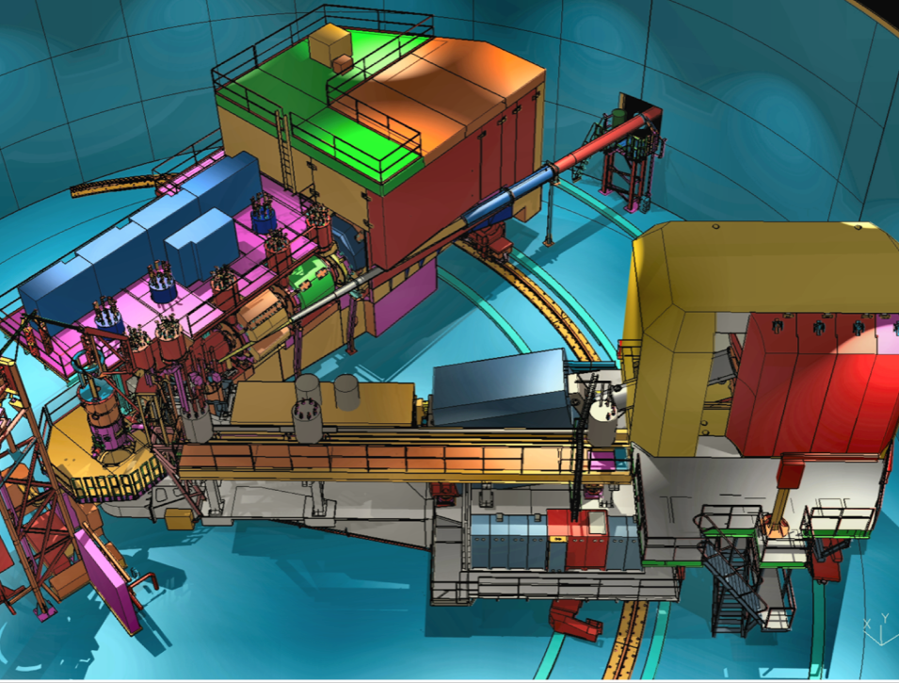

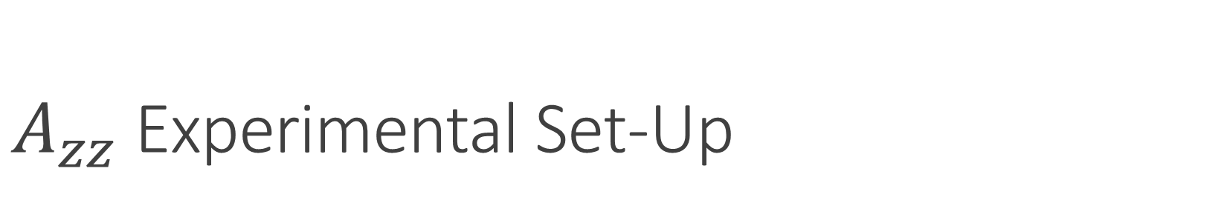
$A_{zz}$ Experimental Set-Up
  Hall C with HMS & SHMS
  Identical equipment and technique as $b_{1}$ (E12-13-011)
SHMS
Longitudinally
Polarized
Target
SHMS
Slow
Raster
Faraday
Cup
Unpolarized
Beam
Lumi
Fast
Raster
HMS

Slide 13
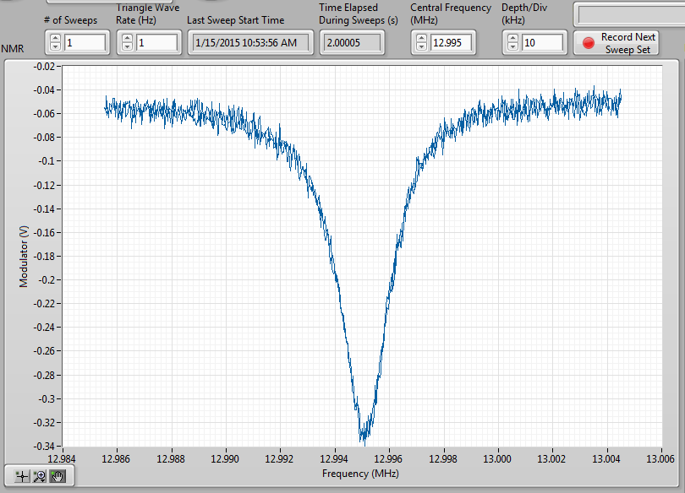
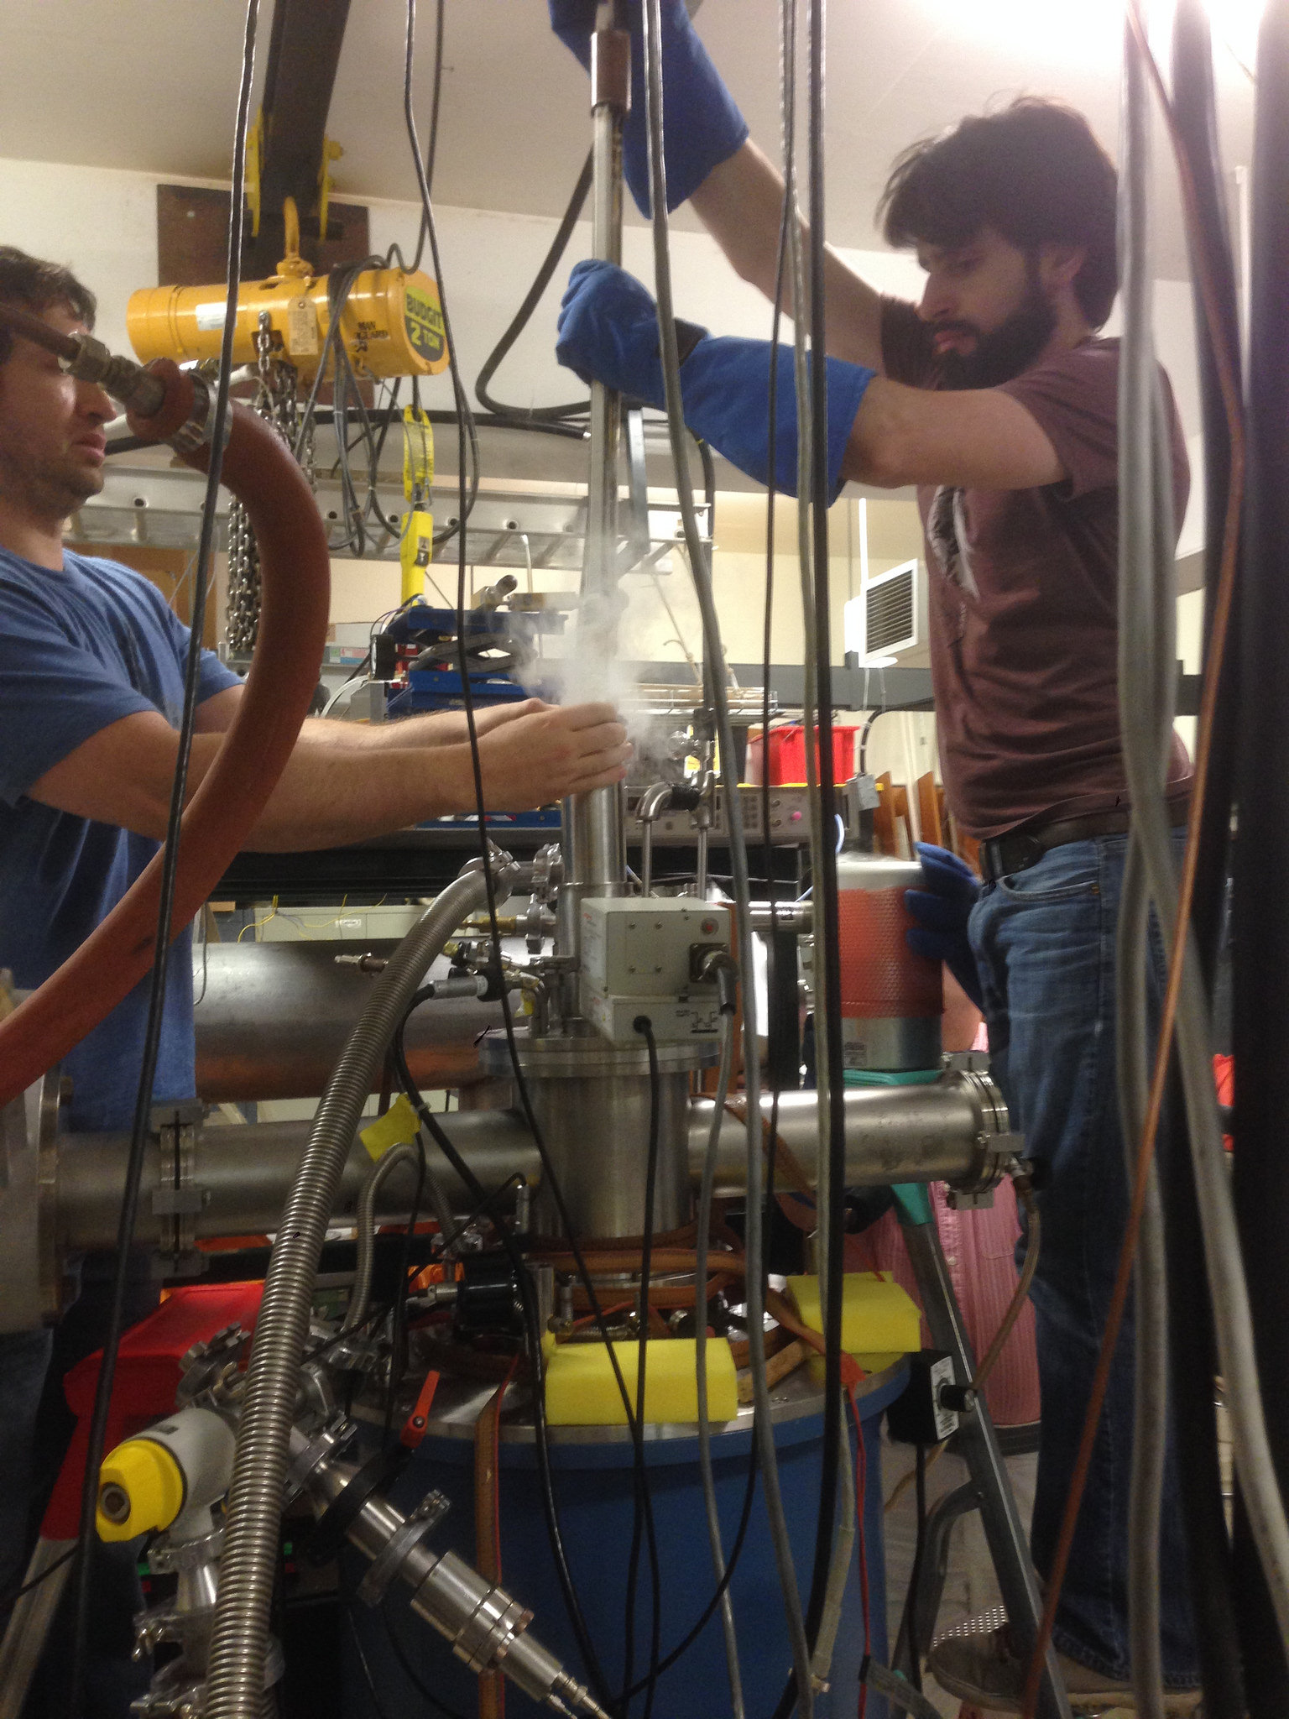
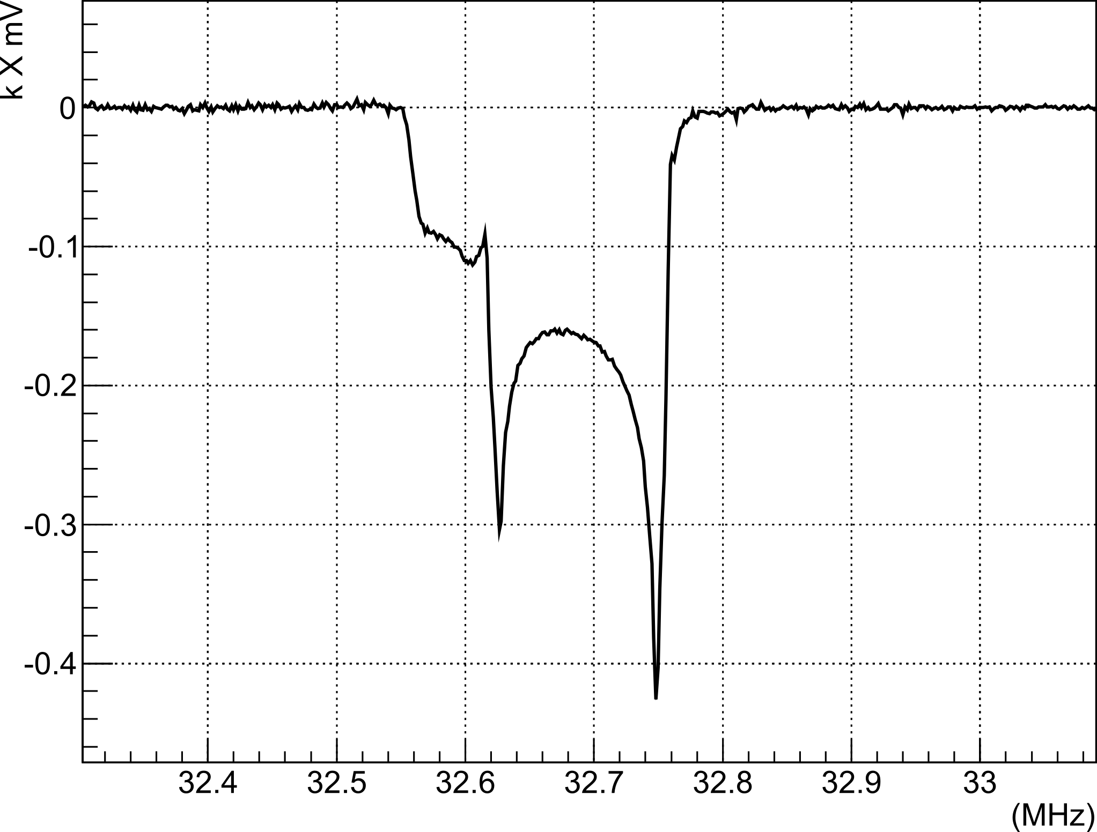
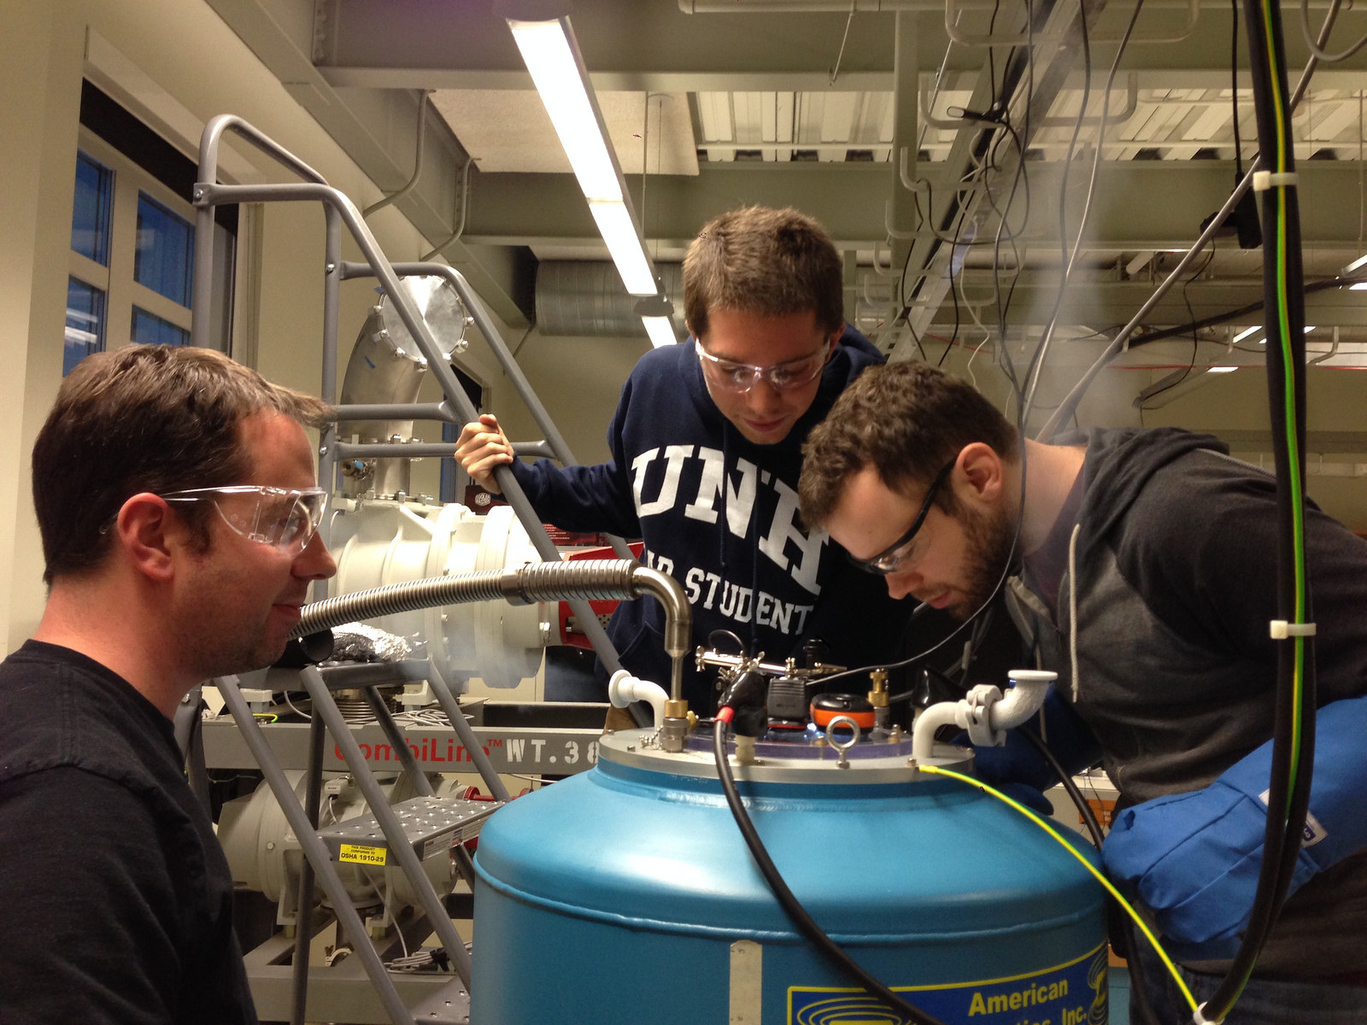
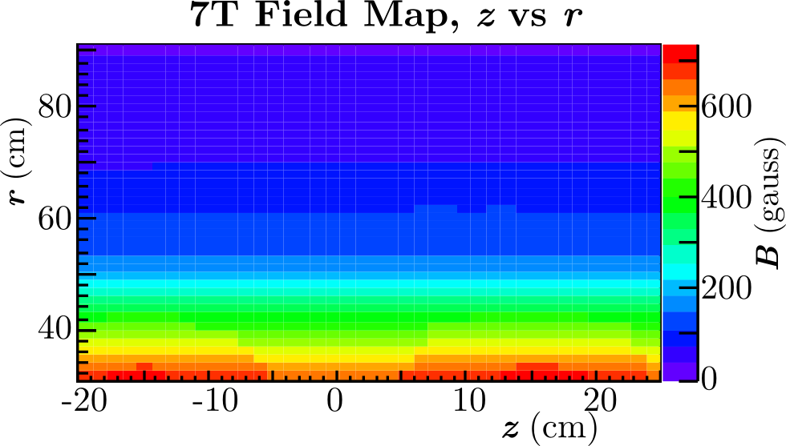
Target Status Update
  Techniques in R&D:
    1) Selective Semi-Saturation
    2) Time Dependence of Sample
    Rotation
    3) Material Crystallization
    4) Alternative Materials
  Results from UVA are promising, preliminary Pzz=30% recently achieved with full analysis in progress
  UNH target lab is nearing complete, successfully tested magnet & NMR, first He fridge cool-down and proton TE scheduled for end of July
D Keller, PoS(PSTP 2013) 010
D Keller, HiX Workshop (2014)
D Keller, J.Phys.:Conf.Ser. 543, 012015 (2014
UVA Tensor Enhancement on Butanol (2014)

Slide 14
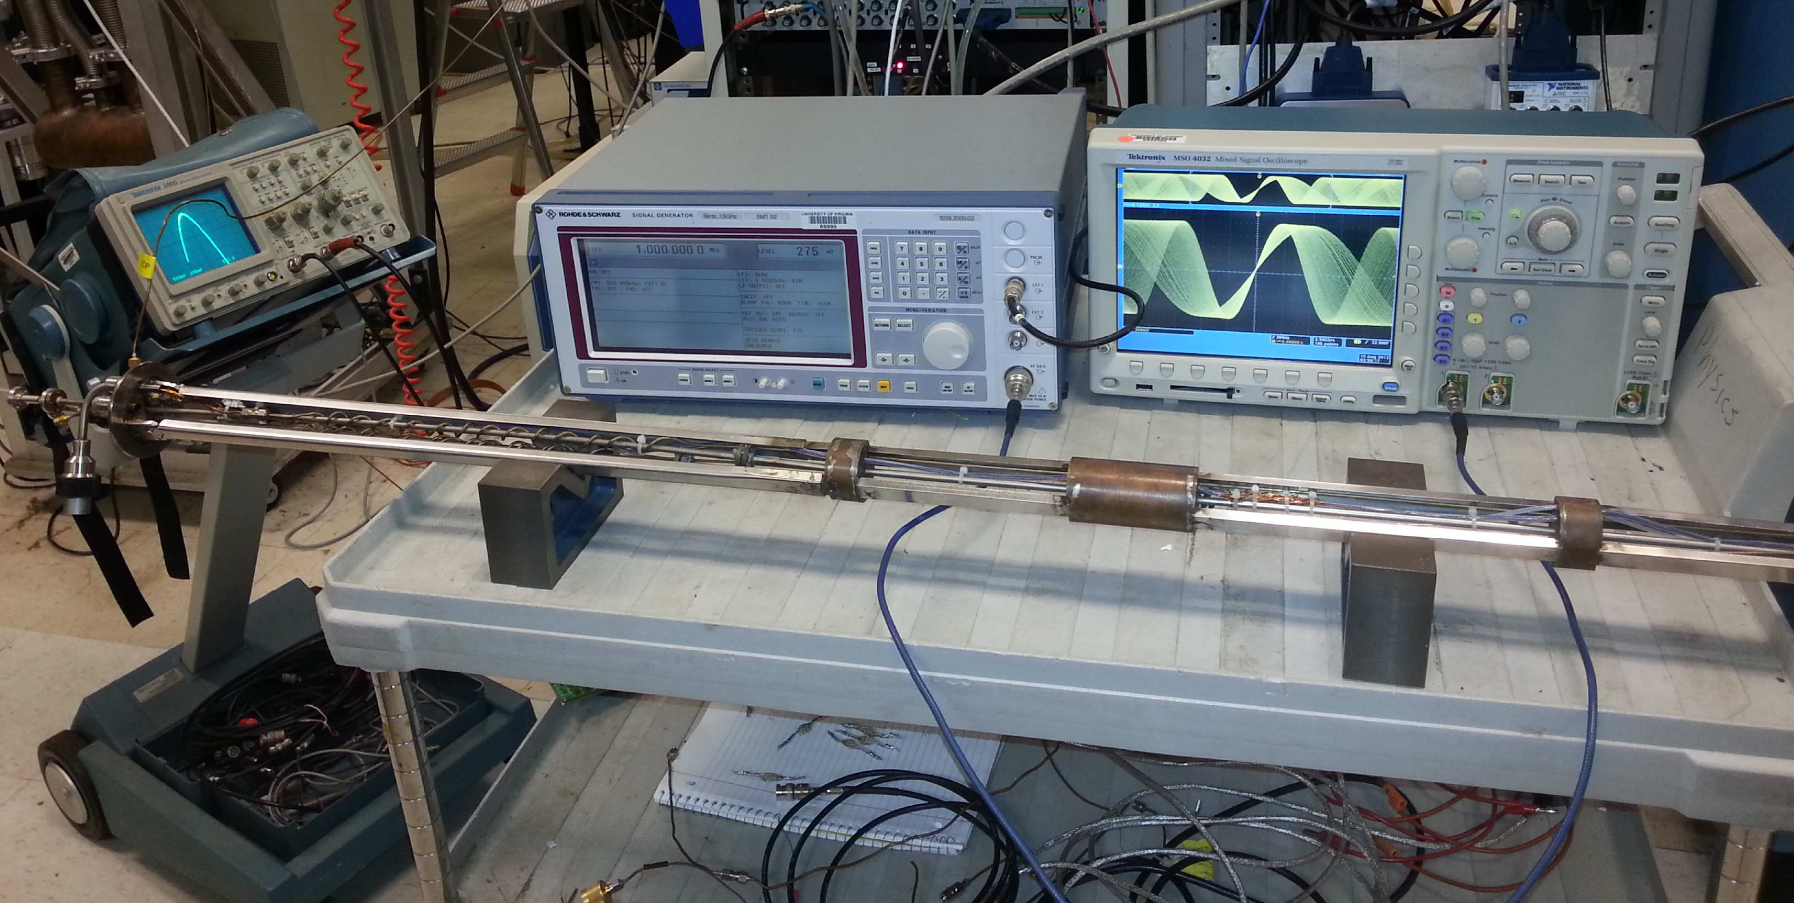
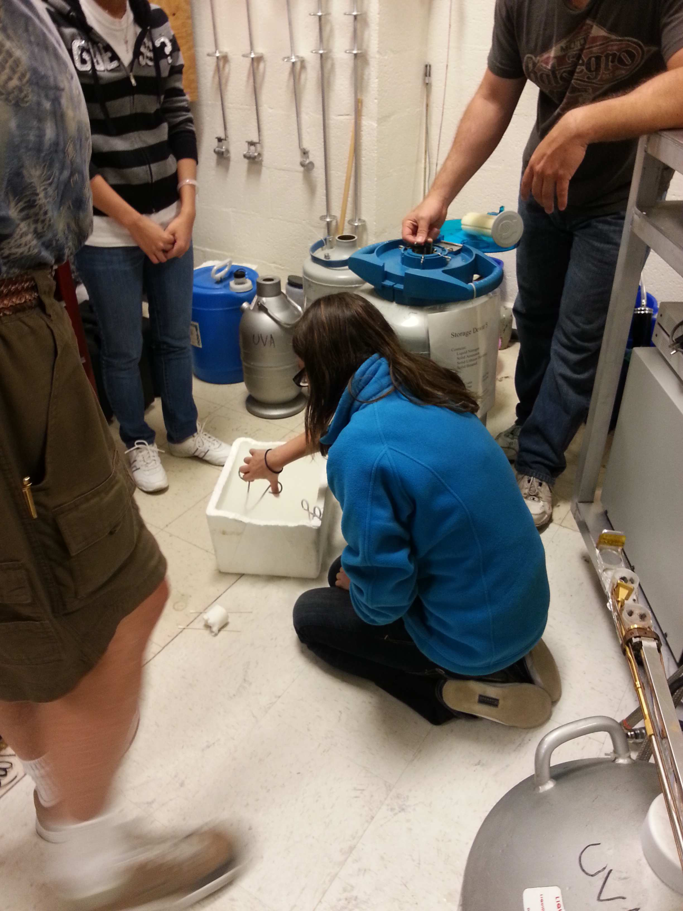
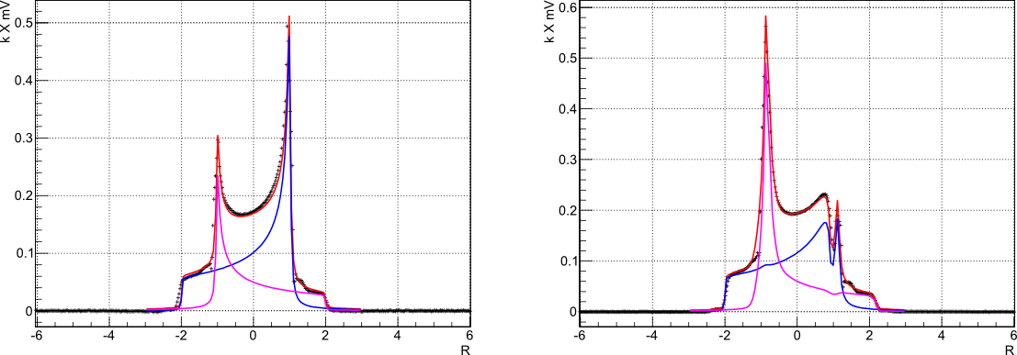

Target Status Update
D Keller, PoS(PSTP 2013) 010
D Keller, HiX Workshop (2014)
D Keller, J.Phys.:Conf.Ser. 543, 012015 (2014
UVA Tensor Enhancement on Butanol (2014)
Progress made on measuring $P_{zz}$ through NMR line-shape analysis
Solid-state NMR $P_{zz}$ can be confirmed with elastic scattering ($T_{20}$)

Slide 15
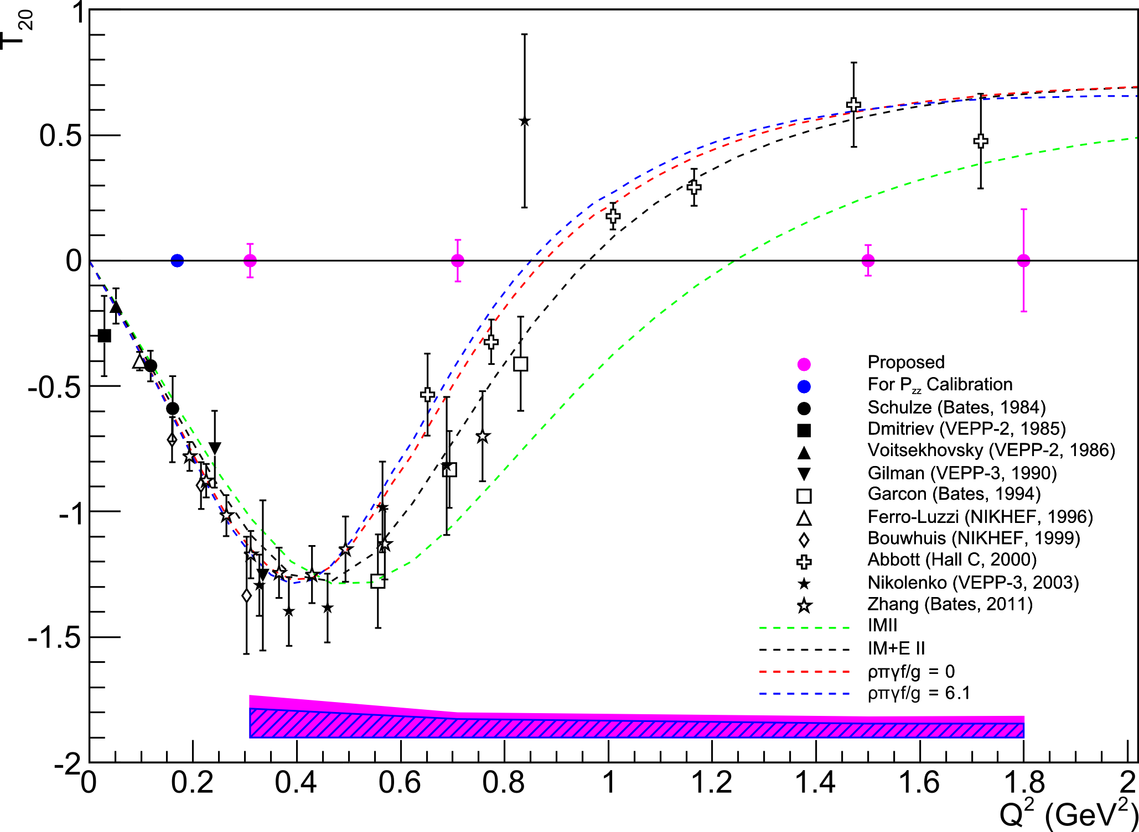

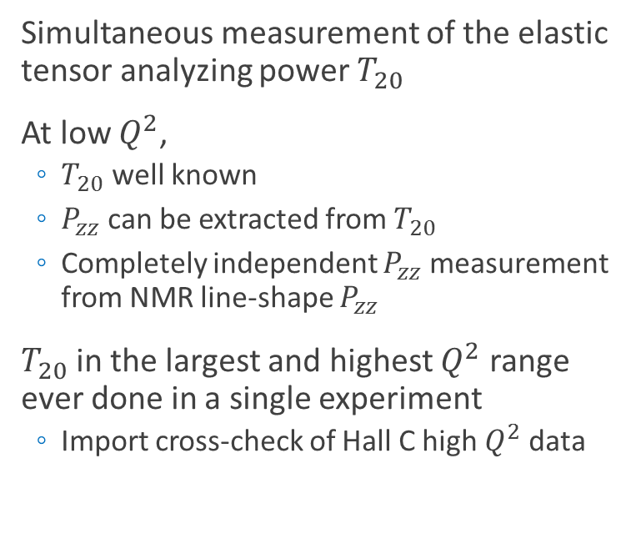
Elastic $T_{20}$ - Calibration & Measurement
Simultaneous measurement of the elastic tensor analyzing power $T_{20}$
At low $Q^{2}$,
  $T_{20}$ well known
  $P_{zz}$ can be extracted from $T_{20}$
  Completely independent $P_{zz}$ measurement from NMR line-shape $P_{zz}$
$T_{20}$ in the largest and highest $Q^{2}$ range ever done in a single experiment
  Import cross-check of Hall C high $Q^{2}$ data

Slide 16
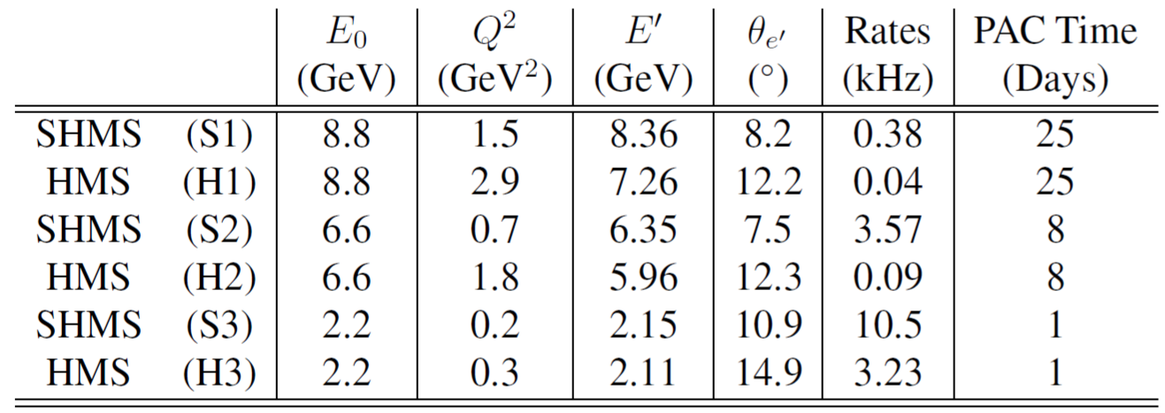
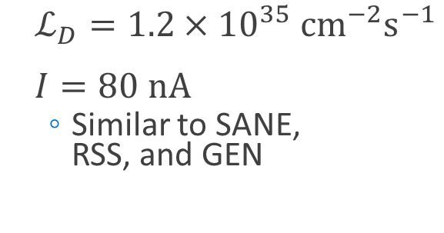
Kinematics
$ℒ_{D}=1.2×{10}^{35} {cm}^{−2}s^{−1}$
$I=80 nA$
  Similar to SANE,
  RSS, and GEN

Slide 17
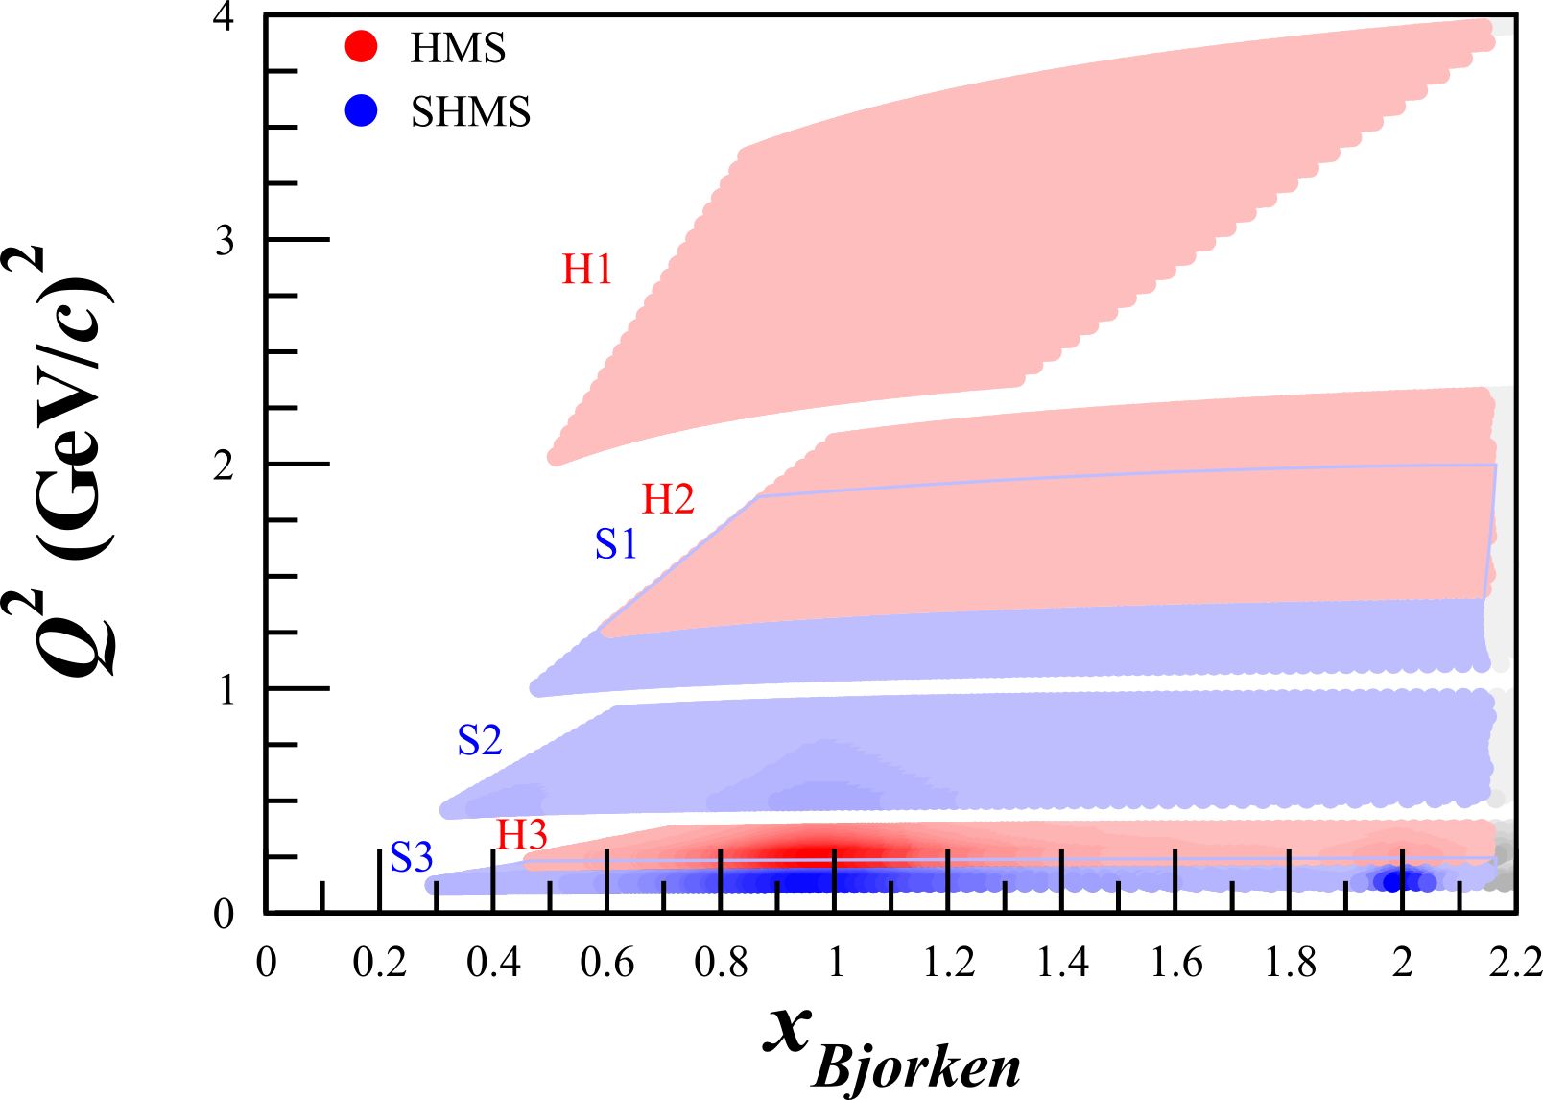
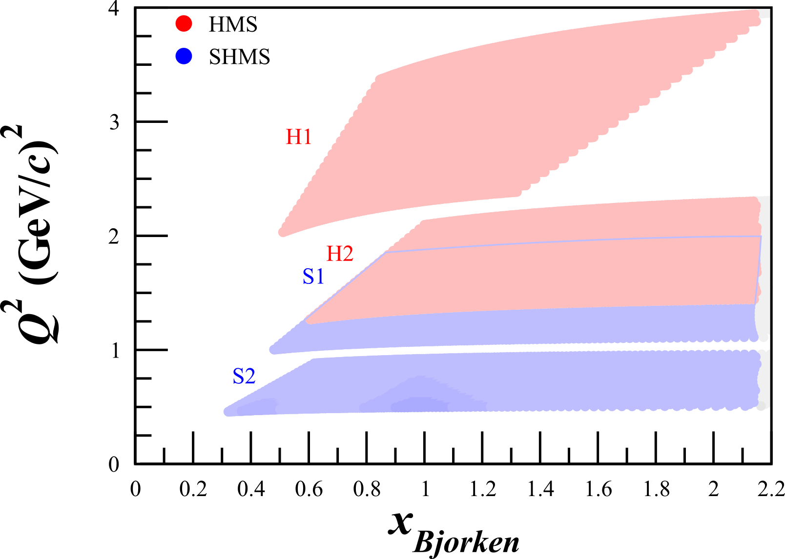
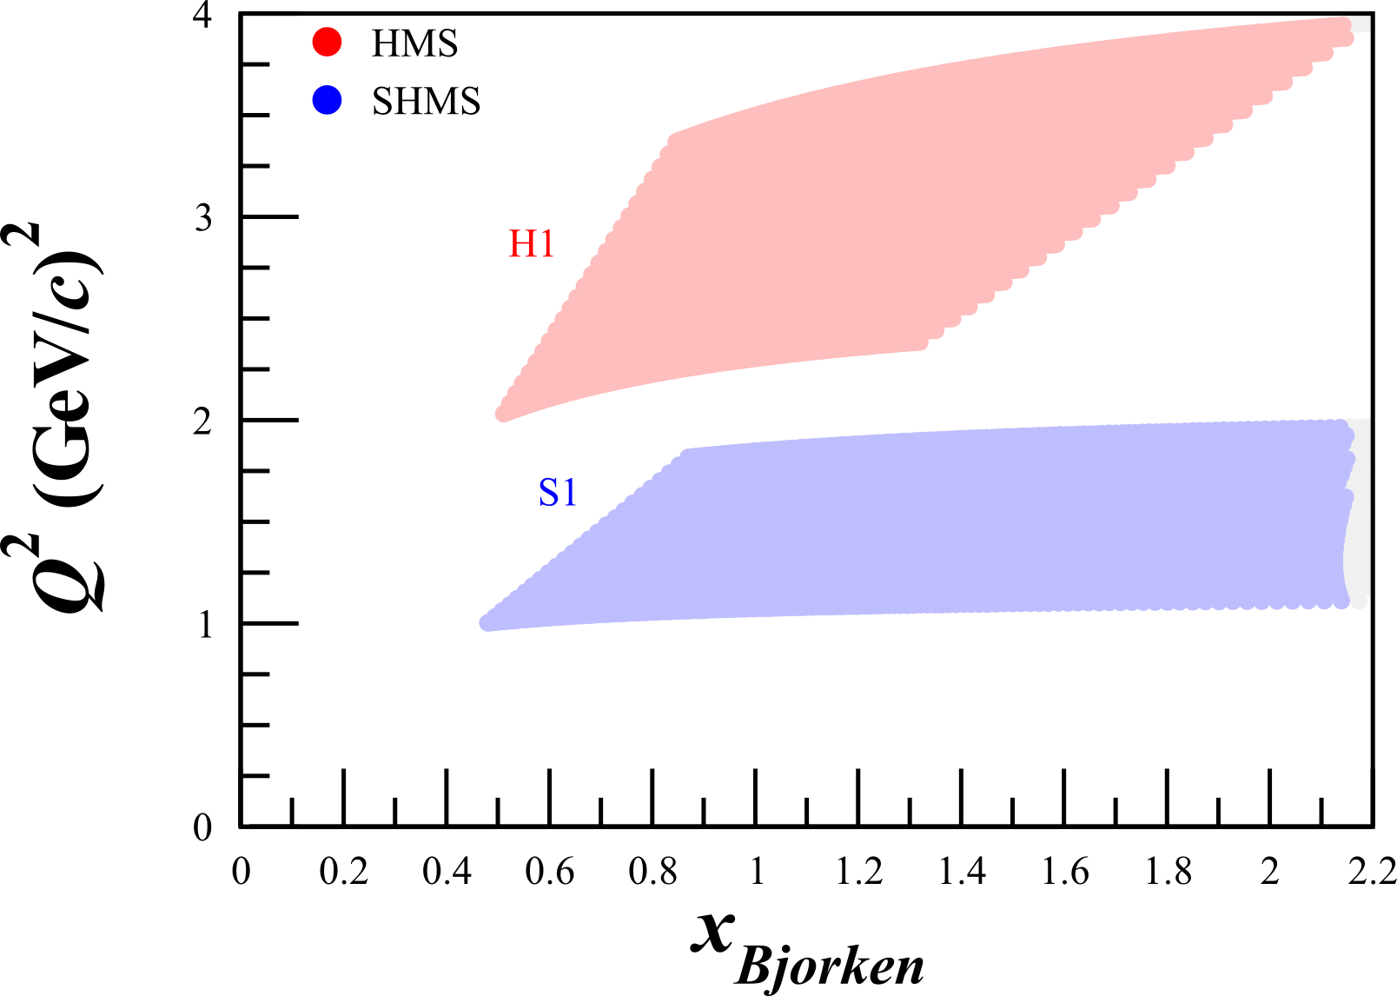
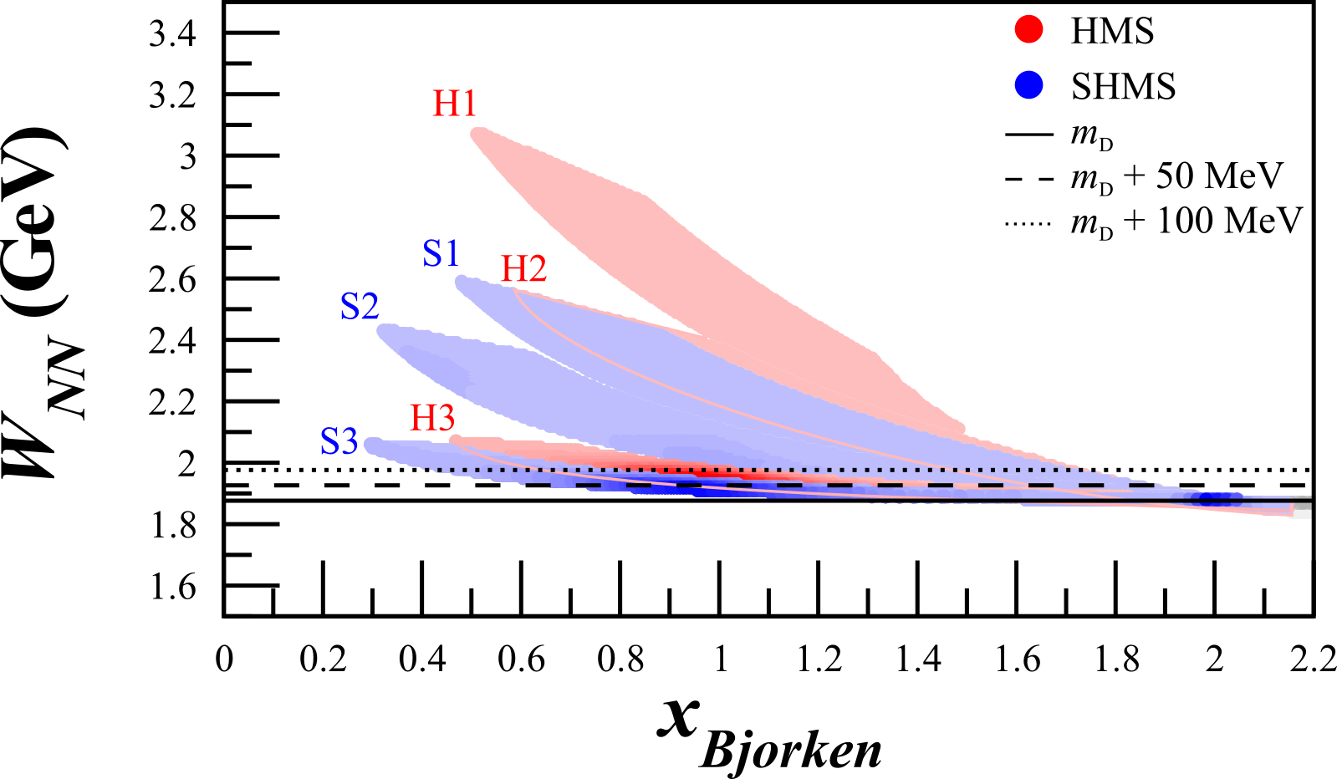
Kinematics
25 Days
8 Days
25 Days
8 Days
1 Day

Slide 18
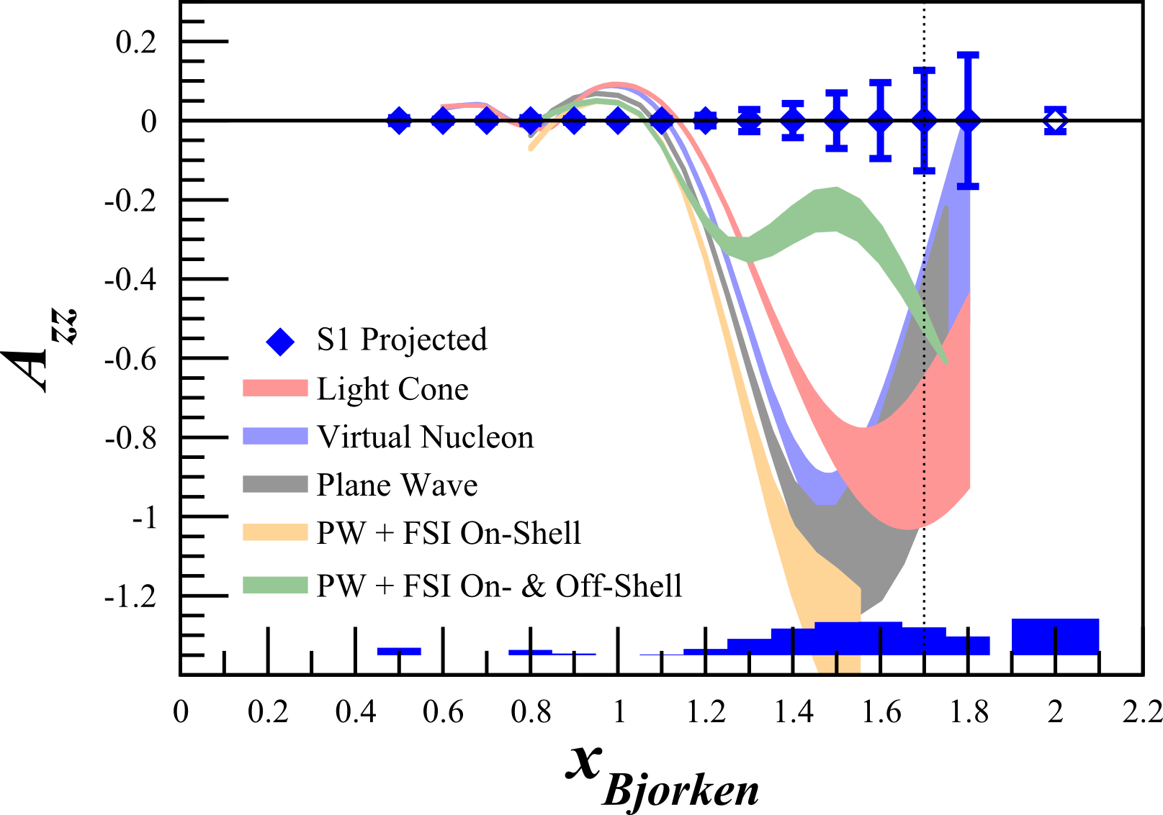
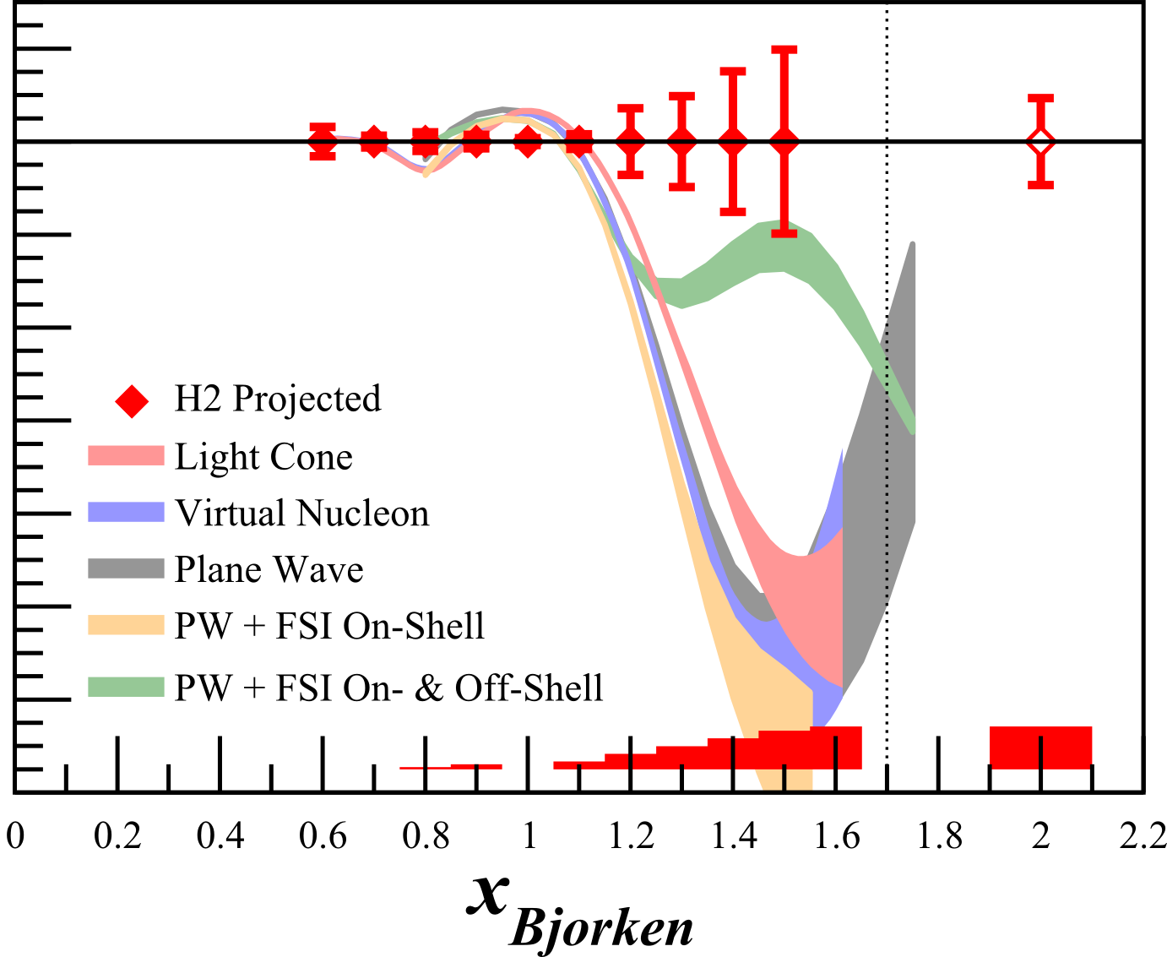
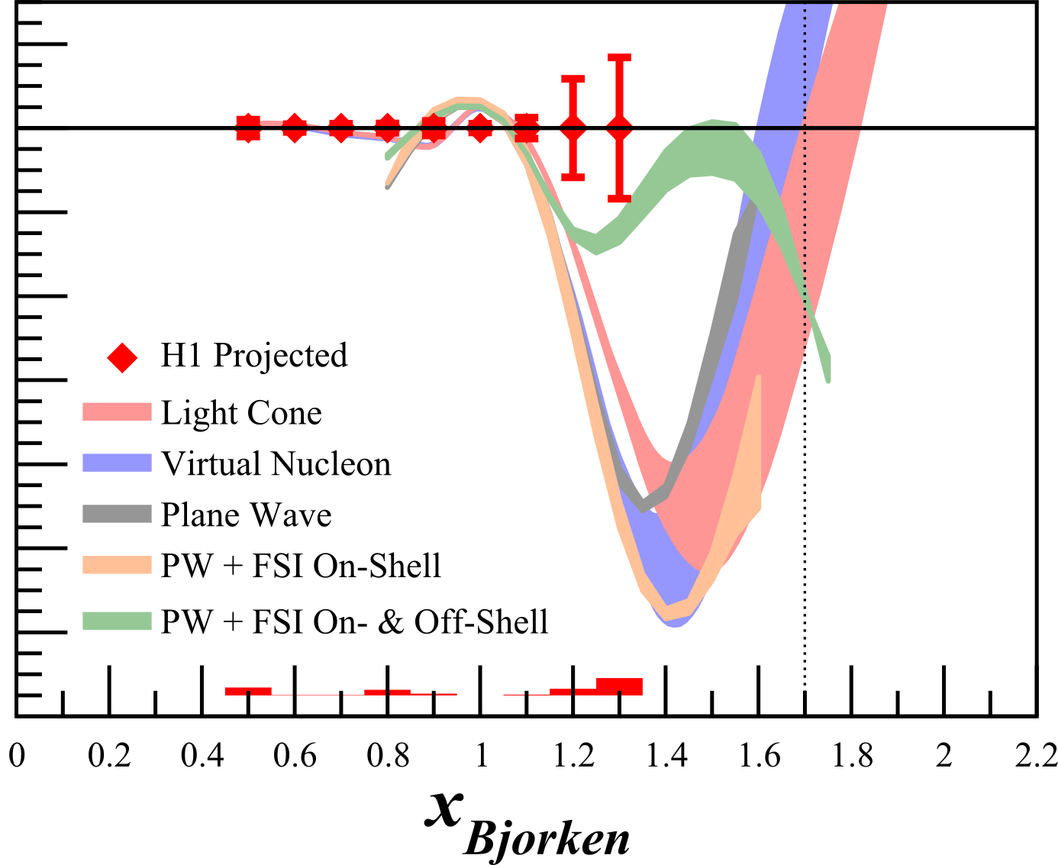


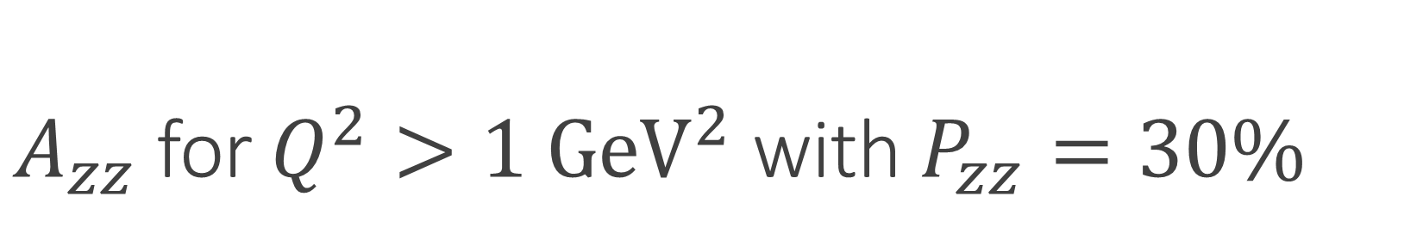

$A_{zz}$ for $Q^{2}>1 {GeV}^{2}$ with $P_{zz}=30\%$
$$Q^{2}=1.5 {GeV}^{2}$$
$$Q^{2}=1.8 {GeV}^{2}$$
$$Q^{2}=2.9 {GeV}^{2}$$
Solid = Quasi-elastic
Open = Elastic
LL Frankfurt, et al, PRC 48 2451 (1993)

Slide 19
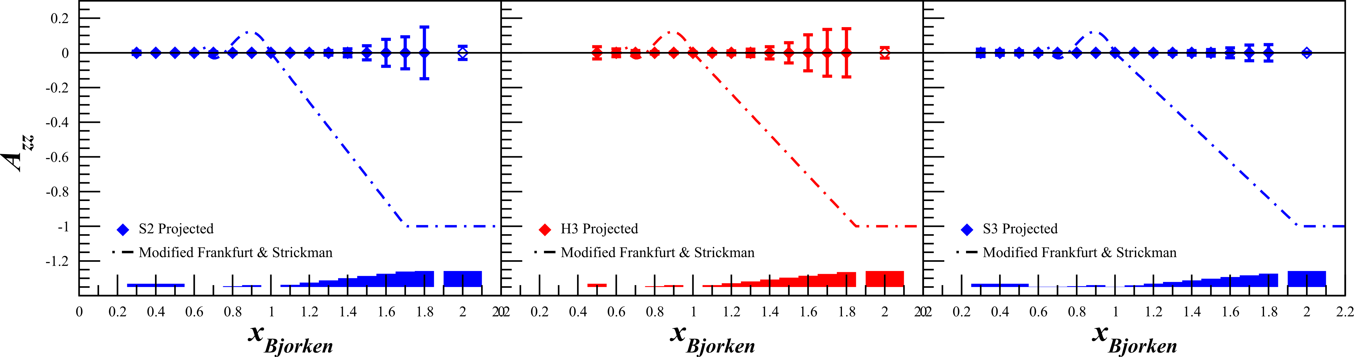




$A_{zz}$ for $Q^{2}<1 {GeV}^{2}$ with $P_{zz}=30\%$
$$Q^{2}=0.7 {GeV}^{2}$$
$$Q^{2}=0.3 {GeV}^{2}$$
$$Q^{2}=0.2 {GeV}^{2}$$
Solid = Quasi-elastic
Open = Elastic
* More calculation coming soon…

Slide 20


Systematics
More than 10x less sensitive to systematics than $b_{1}$

Slide 21

Overhead

Slide 22

Challenges and Opportunities
  Tensor polarized target in development with dedication from multiple labs
  Stray SHMS fields will have negligible effect on target
  Data recoverable in rare event of target material shifting
  Very large $A_{zz}$ asymmetry (10-120%)
  Identical equipment and technique as $b_{1}$
  More than an order of magnitude less dependent on systematics than $b_{1}$
    Perfect testing ground for fully understanding and controlling systematics

Slide 23

Summary
Beam Request: 34 PAC Days
1 PAC Day @ 2.2 GeV, 8 @ 6.6 GeV, 25 @ 8.8 GeV,
+ 10.3 Overhead Days
First measurement of QE $A_{zz}$ will give insight into:
Relativistic LC and VN models^{[1,2]}
Hard or soft NN potentials^{[4]}
SRCs & pn dominance^{[3]}
Final state interaction models^{[5]}
Bonus: $T_{20}$ for largest $Q^{2}$ range ever measured in a single experiment, region of systematic discrepancy, highest $Q^{2}$ measured
^{[1]} E. Long, et al, JLab PR12-15-005
^{[2]} Sargsian, Strikman, J. Phys.: Conf. Ser. 543, 012099 (2014)
^{[4]} L Frankfurt, M Strikman, Phys. Rept. 160, 235
^{[5]} W Cosyn, M Sargsian, arXiv:1407.1653
^{[3]} J Arrington et al, Prog. Part. Nucl. Phys. 67, 898 (2012)

Slide 24
Summary
“The measurement proposed here arises from a well-developed context, presents a clear objective, and enjoys strong theory support. It would further explore the nature of short-range pn correlations in nuclei, the discovery of which has been one of the most important results of the JLab 6 GeV nuclear program.”
-JLab PAC42 & PAC43 Theory TACs
(C. Weiss, R. Schiavilla, J.W. Van Orden)
E. Long, et al, JLab PR12-15-005
Sargsian, Strikman, J. Phys.: Conf. Ser. 543, 012099 (2014)

Slide 25

Tensor $A_{zz}$ Collaboration
A. Camsonne, J.P. Chen, S. Covrig Dusa, D. Gaskell,
D. Higinbotham, C. Keith, P. Nadel-Turonski
Jefferson Lab
T. Badman, M. Holtrop, S. Li, E. Long, K. McCarty, C. Meditz, M. O’Meara, P. Paremuzyan,
S. Santiesteban, K. Slifer, P. Solvignon, B. Yale, R. Zielinski
University of New Hampshire
D. Crabb, D. Day, D. Keller, S. Liuti, O.A. Rondon, V. Sulkowsky, J. Zhang
University of Virginia
Z. Ye
Duke University
W. U. Boeglin, M. Sargsian, P. Markowitz
Florida International University
W. Cosyn
Ghent University
B. Dongwi, N. Kalantarians, M. Kole, A. Liyanage, J. Nazeer
Hampton University
J. Bericic, T. Brecelj, S. Sirca, S. Stajner
Jozef Stefan Institute and University of Ljublijana
B. Bertozzi, S. Gilad
MIT
K. Adhikari
Mississippi State University
A. Ahmidouch, S. Danagoulian
North Carolina A&T State University
K.J. Park
Old Dominion University
M. Strikman
Pennsylvania State University
R. Gilman
Rutgers University
M. Elaasar
Southern University
W. van Oers
University of Manitoba
G.A. Miller
University of Washington
D. Androic
University of Zagreb

Slide 27
Backup Slides

Slide 28
$A_{zz}$ for $Q^{2}>1 {GeV}^{2}$ with $P_{zz}=30\%$
$$Q^{2}=1.5 {GeV}^{2}$$
$$Q^{2}=1.8 {GeV}^{2}$$
$$Q^{2}=2.9 {GeV}^{2}$$
E. Long, et al, JLab PR12-15-005

Slide 29




$A_{zz}$ for $Q^{2}>1 {GeV}^{2}$ with $P_{zz}=20\%$
$$Q^{2}=1.5 {GeV}^{2}$$
$$Q^{2}=1.8 {GeV}^{2}$$
$$Q^{2}=2.9 {GeV}^{2}$$
E. Long, et al, JLab PR12-15-005

Slide 30
$A_{zz}$ for $Q^{2}<1 {GeV}^{2}$ with $P_{zz}=30\%$
$$Q^{2}=0.7 {GeV}^{2}$$
$$Q^{2}=0.3 {GeV}^{2}$$
$$Q^{2}=0.2 {GeV}^{2}$$
E. Long, et al, JLab PR12-15-005
* More model predictions coming soon…

Slide 31




$A_{zz}$ for $Q^{2}<1 {GeV}^{2}$ with $P_{zz}=20\%$
$$Q^{2}=0.7 {GeV}^{2}$$
$$Q^{2}=0.3 {GeV}^{2}$$
$$Q^{2}=0.2 {GeV}^{2}$$
E. Long, et al, JLab PR12-15-005
* More model predictions coming soon…

Slide 32


Polarization Cycle
Each polarization cycle is an independent measurement of $A_{zz}$
  Annealing and target motion only at the start of a new cycle
  Any issues from annealing or material shifts will be isolated to a single cycle
    Dilution/packing fraction runs at the beginning and end of each cycle can recover data surrounding a material shift event
  Doubled the number of cycles for the lowest $Q^{2}$ measurement

Slide 33


Target Magnet and Horizontal Bender
  TOSCA results^{[1]} indicate <5 G on target material from HB
  ~0.2 G/cm gradient on target
  Maximum 12ppm effect on target material
    Well within required 100ppm target field stability
1.75m from center
of target to
3T HB
Typical Strength
of Refrigerator Magnet
^{[1]} MH Moore, et al, arXiv:1406.7856

Slide 34

Target Magnet and Horizontal Bender
  TOSCA results^{[1]} indicate <5 G on target material from HB
  ~0.2 G/cm gradient on target
  Maximum 12ppm effect on target material
    Well within required 100ppm target field uniformity
1.75m from center
of target to
3T HB
Typical Strength
of Refrigerator Magnet
^{[1]} MH Moore, et al, arXiv:1406.7856

Slide 35





Tensor Polarized Target
  Dynamic Nuclear Polarization of ND₃
  $P_{zz} \sim 30\%$
  5 Tesla at 1 K
  3cm Target Length
  $p_{f} \sim 0.65$
  $f_{dil} \sim 0.27$
  UVA Techniques in R&D:
    Selective Semi-Saturation
    Time Dependence of Sample
    Rotation
    Material Crystallization
    Alternative Materials
Tensor Polarization by Vector Polarization

Slide 36





Tensor Polarized Target
  Dynamic Nuclear Polarization of ND₃
  $P_{zz} \sim 30\%$
  5 Tesla at 1 K
  3cm Target Length
  $p_{f} \sim 0.65$
  $f_{dil} \sim 0.27$
  UVA Techniques in R&D:
    Selective Semi-Saturation
    Time Dependence of Sample
    Rotation
    Material Crystallization
    Alternative Materials
RF Saturation Tensor Enhancement
32.4
32.5
32.6
32.7
32.8
32.9
MHz
-0.4
-0.3
-0.2
-0.1
$k∙$ mV
0.0
D Keller, HiX Workshop (2014)
UVA Tensor Enhancement on Butanol (2014)
$$υ_{D}−3υ_{D}$$
$$υ_{D}+3υ_{D}$$

Slide 37

Target Development in Progress
Selective Semi-Saturation
  Fitting measurements only minimally dependent on relaxation rates
  Tensor enhancement unrelated to area lost ($∆P_{zz}≠−3∆P_{z}$)
  Spin diffusion can help spread enhancement
  Solid-state NMR $P_{zz}$ can be confirmed with elastic scattering ($T_{20}$)

Slide 38
Target Magnet and Horizontal Bender
  TOSCA results^{[1]} indicate <5 G on target material from HB
  ~0.2 G/cm gradient on target
  Maximum 12ppm effect on target material
    Well within required 100ppm target field stability
1.75m from center
of target to
3T HB
Typical Strength
of Refrigerator Magnet
^{[1]} MH Moore, et al, arXiv:1406.7856

Slide 39

Target Magnet and Horizontal Bender
Hall A g2p had similar configuration
  1.5T septa placed 1.58m from center of solid NH₃ target
TOSCA study agreed very well with field mapping
  Septa was shown to have negligible coupling on the target magnet
Even during a catastrophic failure of the septa, the target field maintained a <100ppm stability
1.75m from center
of target to
3T HB

Slide 40





Diluting Asymmetries
With an unpolarized beam and a longitudinally polarized target,
  $h=0$
  $φ_{d}=0$
  $\sin{φ_{d}}=0$
0
0
0
0
0
0
0
$$σ=σ_{0}\left[1+P_{2}^{d}α_{d}^{T}\right]=σ_{0}\left[1+P_{zz}A_{zz}\right]$$
W Leidemann, et al, PRC 43, 1022 (1991)

Slide 41


Dilution Factor
“…the background from interaction with nuclei increases as $α(x)$ increases. For example, for a D¹²C target the ratio of the cross sections $σ_{A}$ for A=¹²C and A=D is of the order of 40 for $x\sim 1.3$ and increases with $x$.”
- L.L. Frankfurt, M.I. Strikman,
Phys. Rept. 160 (1988) 235
$f_{dil}=\frac{ℒ_{D}σ_{D}}{ℒ_{N}σ_{N}+ℒ_{He}σ_{He}+ℒ_{D}σ_{D}+\sum{ℒ_{A}σ_{A}}}$
With the 12 GeV upgrade and the new SHMS, this measurement becomes possible even with the low dilution factor at high $x$

Slide 42


Connection to
Short Range Correlations
Short range correlations caused by tensor force – why not probe it through tensor polarization?
N. Fomin et al., Phys. Rev. Lett. 108 (2012) 092505
L.L. Frankfurt et al., Int. J. Mod. Phys. A23 (2008) 2991-3055

Slide 43




Rates for D(e,e’)X
Assumptions:
$$P_{zz}=30\%$$
$$p_{f}=65\%$$
$$z_{tgt}=3 cm$$
P.E. Bosted, V. Mamyan, arXiv:1203.2262
M. Sargsian, Private Communication
N. Fomin, et al., Phys. Rev. Lett. 108 (2012) 092502
N. Fomin, et al., Phys. Rev. Lett. 105 (2010) 212502
$R_{Pol}=𝒜\left[ℒ_{He}σ_{He}^{u}+ℒ_{N}σ_{N}^{u}+ℒ_{D}σ_{D}^{u}\left(1+\frac{1}{2}P_{zz}A_{zz}\right)\right]$
$R_{Unpol}=𝒜\left[ℒ_{He}σ_{He}^{u}+ℒ_{N}σ_{N}^{u}+ℒ_{D}σ_{D}^{u}\right]$
$N=Rt$
$A_{zz}=\frac{2}{f_{dil}P_{zz}}\left(\frac{N_{Pol}}{N_{Unpol}}−1\right)$
$δA_{zz}^{stat}=\frac{2}{f_{dil}P_{zz}}\sqrt{{\left(\frac{1}{N_{Unpol}}\sqrt{N_{Pol}}\right)}^{2}+{\left(\frac{N_{Pol}}{N_{Unpol}^{2}}\sqrt{N_{Unpol}}\right)}^{2}}$
  Used combination of P. Bosted and M. Sargsian code to calculate unpolarized cross sections
Compared with data similar to Azz range
  $E_{0}=5.766 GeV$
  $E′=4.8 GeV$
  $θ_{e′}={18.0}^{∘}$
E. Long, Technical Note, JLAB-TN-13-029

Slide 44


Elastic Tensor Observables
0.20
0.39
0.59
0.79
0.99
1.18
Q (GeV)
RJ Holt, R Gilman, Rep. Prog. Phys. 75 086301 (2012)
C Zhang, et al, PRL 107 252501 (2011)

Slide 45


Possible New Target Configuration – Extended or Multiple Cells
$FOM=n_{t}f^{2}P_{zz}^{2}$
b1 PAC condition with $z=3cm$ and $P_{zz}=0.3$,
  $n_{t}=\left(5.913×{10}^{22}\frac{1}{{cm}^{3}}\right)∙3 cm=1.77×{10}^{23}\frac{1}{{cm}^{2}}$
  $FOM=f^{2}(0.159×{10}^{23}\frac{1}{{cm}^{2}}$)
With $z=3cm$ and $P_{zz}=0.2$,
  $FOM=f^{2}(0.071×{10}^{23}\frac{1}{{cm}^{2}}$)
With $z=6 cm$ and $P_{zz}=0.2$,
  $n_{t}=3.54×{10}^{23}\frac{1}{{cm}^{2}}$
  $FOM=f^{2}(0.141×{10}^{23}\frac{1}{{cm}^{2}}$)
Preliminary Study in O.A. Rondon, J.Phys.Conf.Ser. 543 (2014) 1, 012013

