Slide 1


Timelike Compton Scattering at SoLID
Run Group Proposal with
E12-12-006 (SoLID JPsi)
P. A. Souder, for the SoLID Review Committee
Spokespersns: Zhiwen Zhao, Marie Boer,
Pawel Nadel-Turonski , Jixie Zhang
2015/6

Slide 2
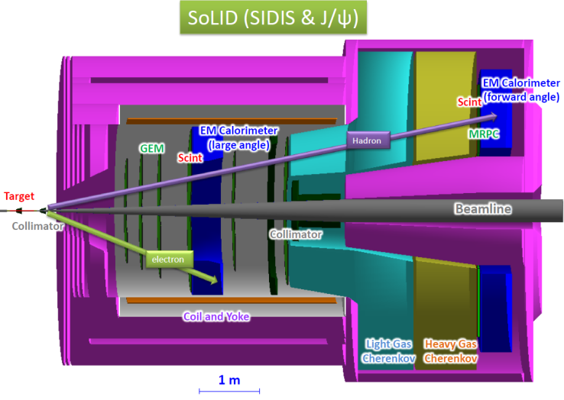
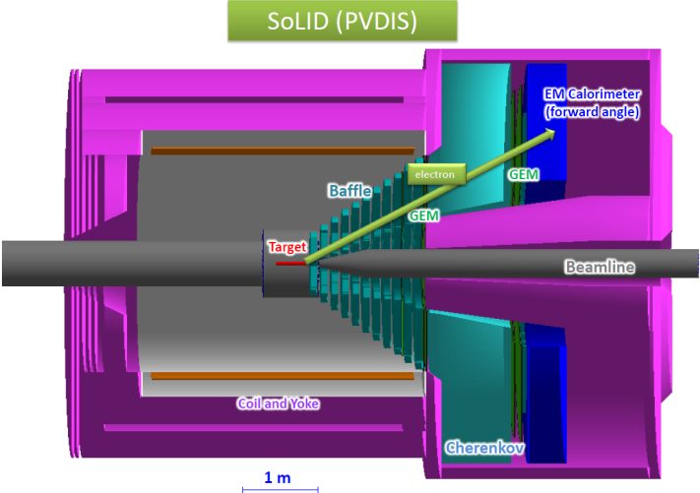
Overview of SoLID
Solenoidal Large Intensity Device
Full exploitation of JLab 12 GeV Upgrade
A Large Acceptance Detector AND Can Handle High Luminosity (10³⁷-10³⁹)
Take advantage of latest development in detectors and data acquisitions
  Reach ultimate precision for SIDIS (TMDs), providing three-dimensional imaging of nucleon in momentum space
  PVDIS in high-x region providing sensitivity to new physics at 10-20 TeV, and QCD
  Threshold J/ψ, probing strong color field in the nucleon, trace anomaly
5 highly rated experiments approved
Three SIDIS experiments, one PVDIS, one J/ψ production
Run group experiments: di-hadron, Inclusive-SSA, and much more …
Strong collaboration (250+ collaborators from 70+ institutes, 13 countries)
Significant international (Chinese) contributions and strong theoretical support

Slide 3
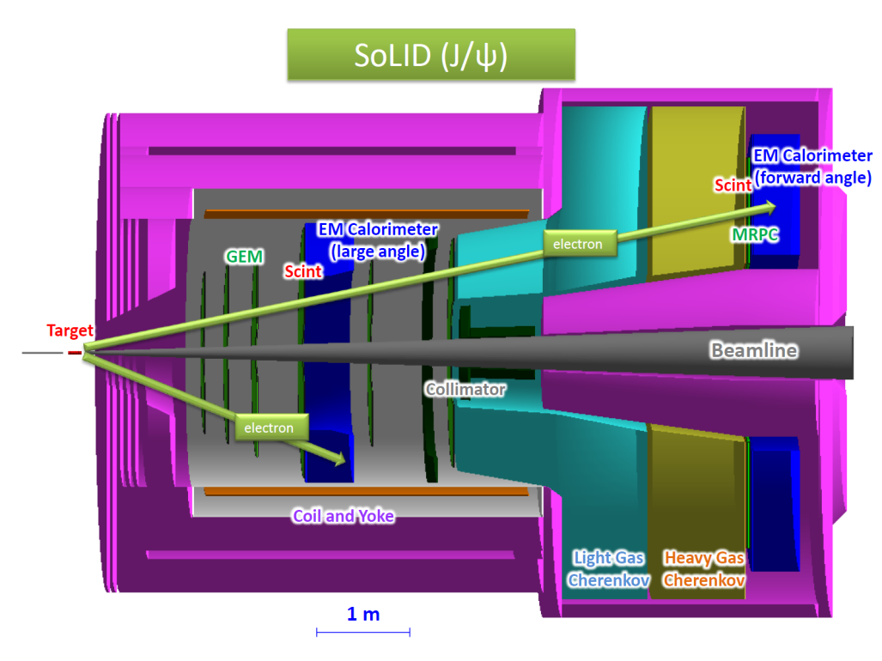
J/ψ @ SoLID
e p → e′ p′ J/ψ(e⁻ e⁺)
γ p → p′ J/ψ(e⁻ e⁺)
  15cm LH2 target 315cm upstream from solenoid coil center, 35cm downstream relative to SIDIS He3 target center
  3uA current, 1e37/cm2/s luminosity for 50+10 days
  forward angle coverage about 8.5-16 degree large angle coverage about 17-24.5 degree
  Trigger on e⁻e⁺e⁻: secondary trigger – e⁺e⁻ pair

Slide 4
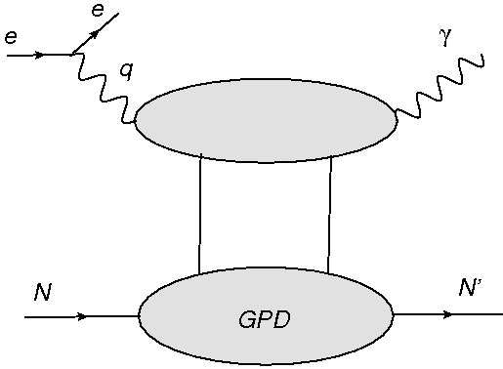
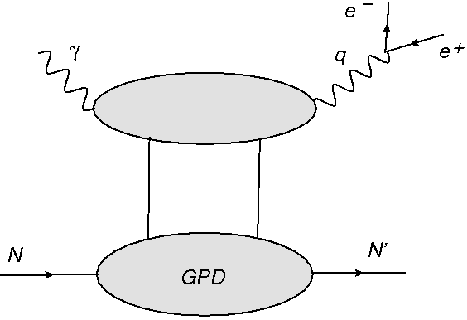
DVCS and TCS access the same GPDs
Spacelike Deeply Virtual Compton Scattering
Timelike Compton Scattering
γ*p → γ p′
γ p → γ*(e⁻ e⁺) p′
Like γp➔J/Ψ
The amplitudes of these two reactions are related at Born order by a simple complex conjugation but they significantly differ at next to leading order (NLO)

Slide 5
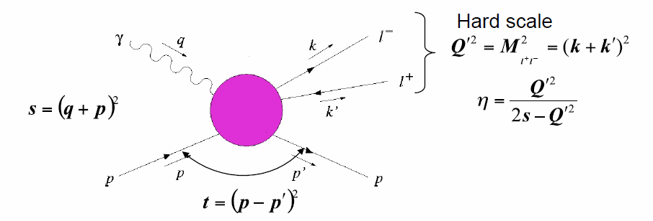




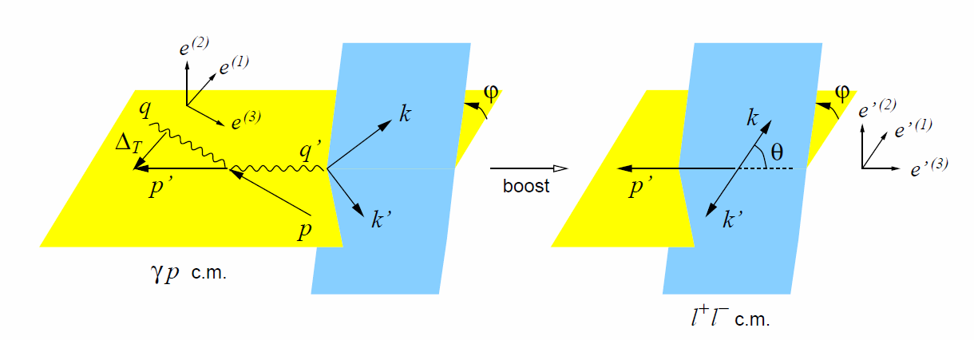
TCS
Information on the real (imaginary) part of the Compton amplitude can be obtained from photoproduction of lepton pairs using unpolarized (circularly polarized) photons
TCS
DVCS

Slide 6
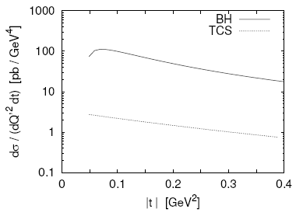
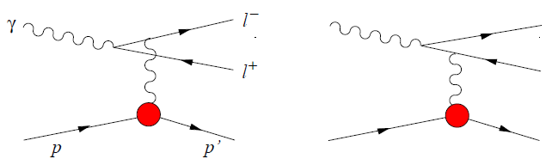
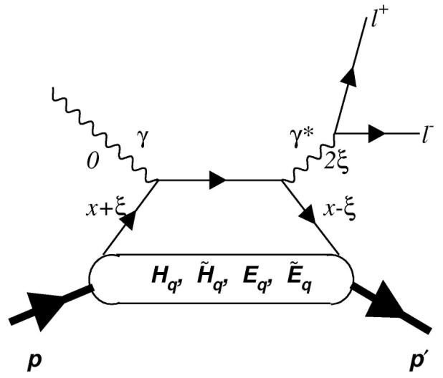
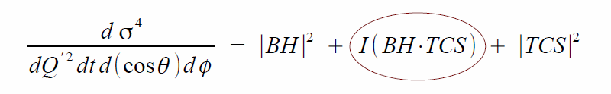
TCS and Bethe-Heitler (BH) Interference
BH
TCS
E. Berger et al., Eur. Phys. J. C23, 675 (2002)
For lepton charge conjugation, TCS and BH amplitudes are even, while the interference term is odd
Direct access to interference term through angular distribution of the lepton pair (cosine and sine moments)

Slide 7
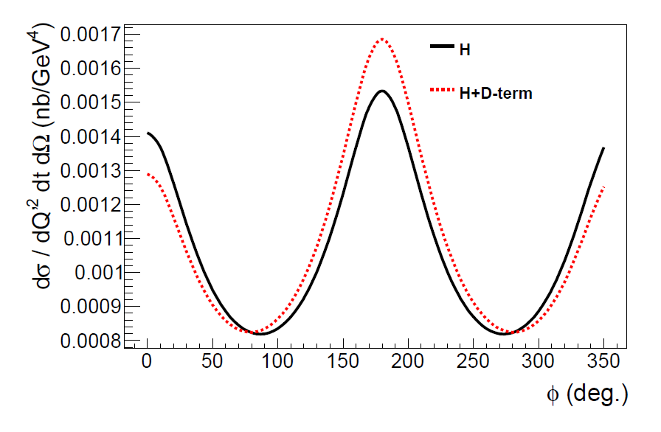
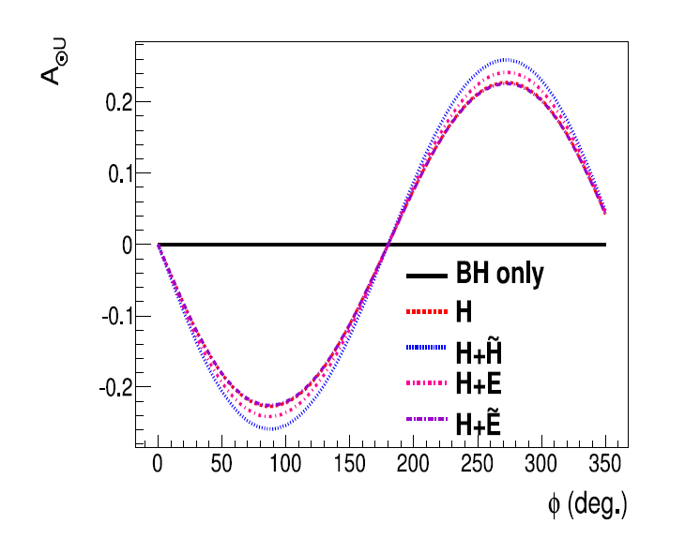
Cross section and
Circular Bean Spin Asymmetry
Access to both observables
Sensitive to real and imaginary CFF (H dominant)

Slide 8
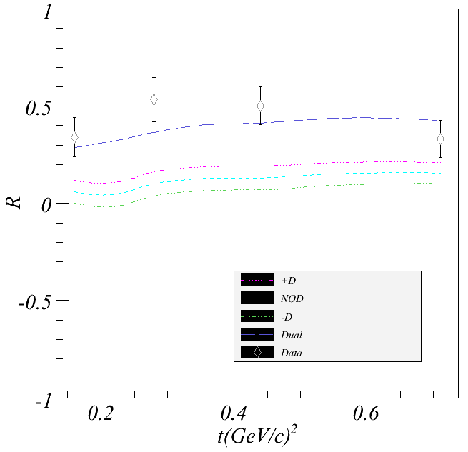
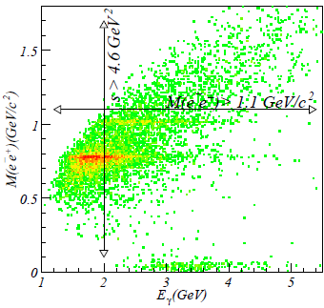
TCS at JLab 6GeV
Cosine moment of weighted cross sections
6 GeV data were important for developing methods
But its kinematics are limited to M_{e+e-} < 2 GeV
R can be compared directly with GPD models
Comparison of results by R. Paremuzyan et al from CLAS e1-6/e1f with calculations by V. Guzey.
Analysis of CLAS g12 with tagged real photons is ongoing

Slide 9
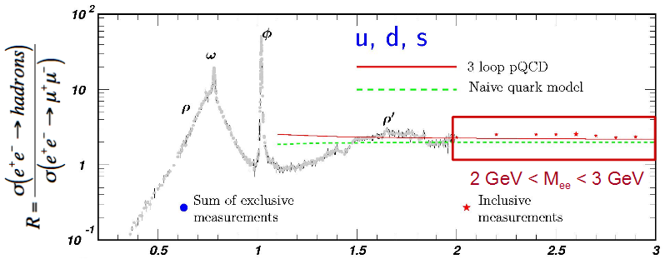
TCS at JLab12 (CLAS12 & SoLID)
11 GeV beam extends s to 20GeV²
M_{e+e-} (Q') reaches about 3.5GeV and this allows the access to the resonance free region from 2GeV to 3GeV
τ can reach from 0.2 to 0.6, eta reaches from 0.1 to 0.45
Higher luminosity and thus more statistics for multi-dimensional binning

Slide 10
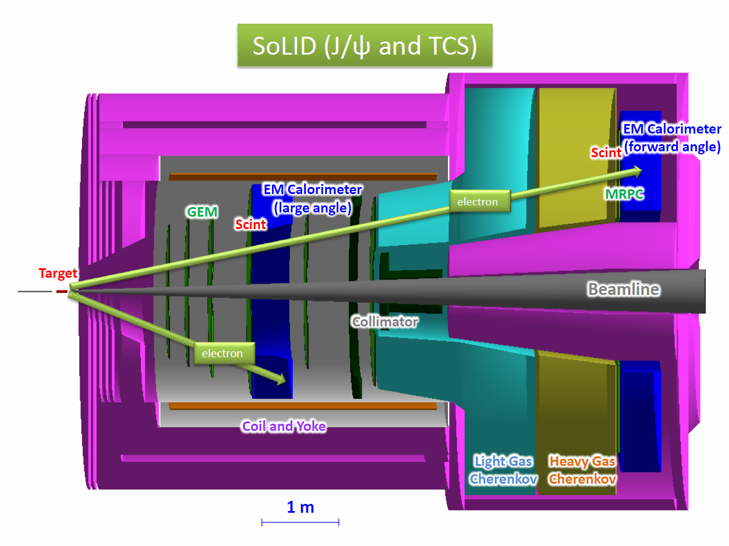
SoLID JPsi and TCS Setup
  Setup same as J/Ψ.
    3uA current, 1e37/cm2/s luminosity for 50+10 days
    forward angle coverage about 8.5-16 degree
    large angle coverage about 17-24.5 degree
  Trigger on decay lepton pair. Need level 3 farm to reduce data.
  Use small angle MRPC and large angle SPD to identify protons.

Slide 11
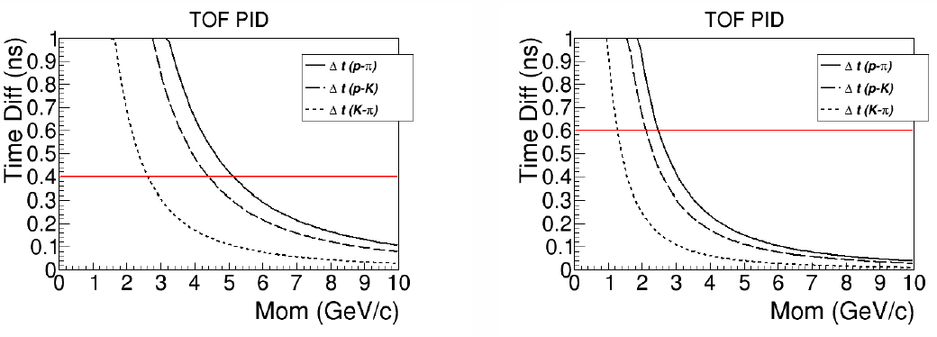
Proton PID
  Recoil p:
  100 ps TOF(MRPC): 4 σ separation p/K up to 4.4 GeV and p/pi up to 5GeV @ forward angle
  150 ps TOF(Scint): 4 σ separation p/K up to 2 GeV p/pi up to 2.7GeV @ large angle
FA
LA

Slide 12
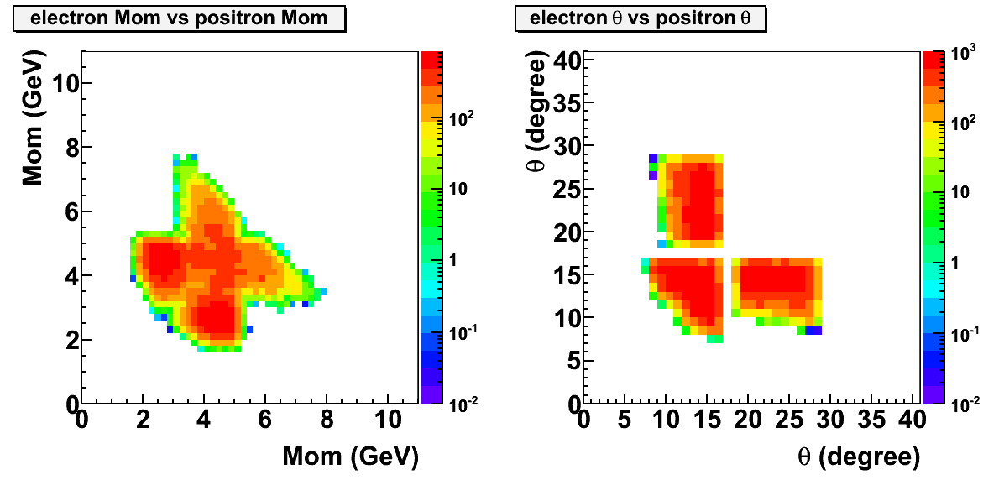
Electron PID
Require at least one electron/positron in LGCC and below 4.9GeV threshold to help reject pions

Slide 13
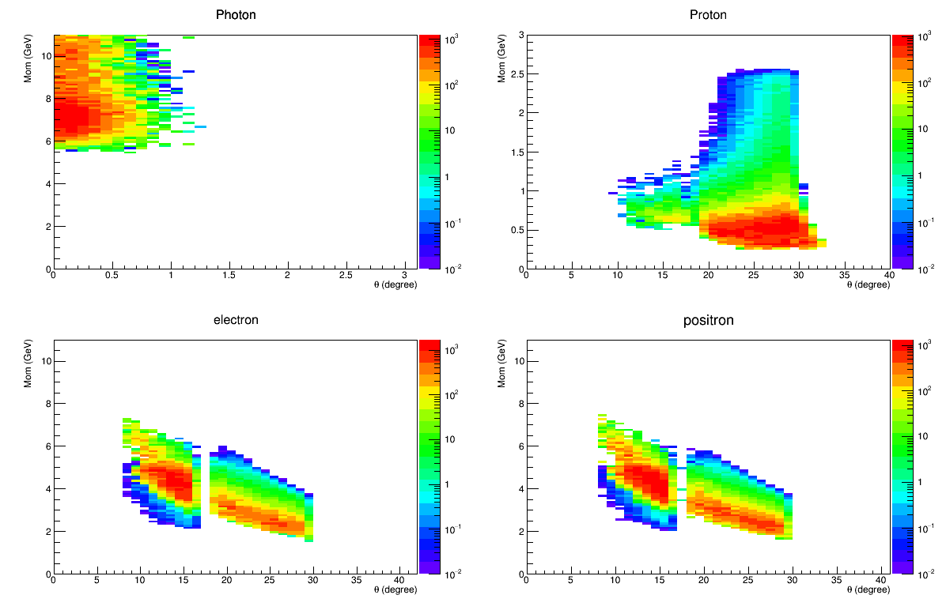
Acceptance and Trigger
BH (photo + quasi-photoproduction)
Require proton and decay pair
Trigger on decay electron and positron
Allow both electroproduction and photoproduction in data
EC has radial dependent trigger threshold from 4 – 2GeV (stars)
LGCC, MRPC, SPD help reject other hadrons and photons
Same trigger works for Jpsi and TCS as run group
Single electron trigger including both FA (682kHz) and LA(446kHz) is about 1.13MHz
Random coincidence of two electron trigger within 30ns time window is 1.13e6*1.13e6*30e-9 = 40kHz
SIDIS event as background is estimated to be 3kHz by using same trigger and assuming ~10 total pion rejection
Total ~50kHz, which is below 100kHz SIDIS Setup limit

Slide 14
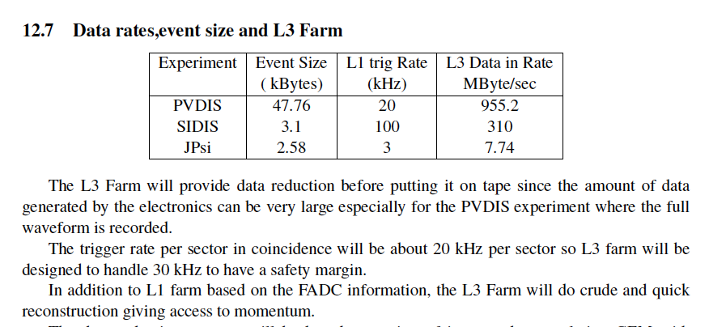
L3 Farm in the PreCDR

Slide 15
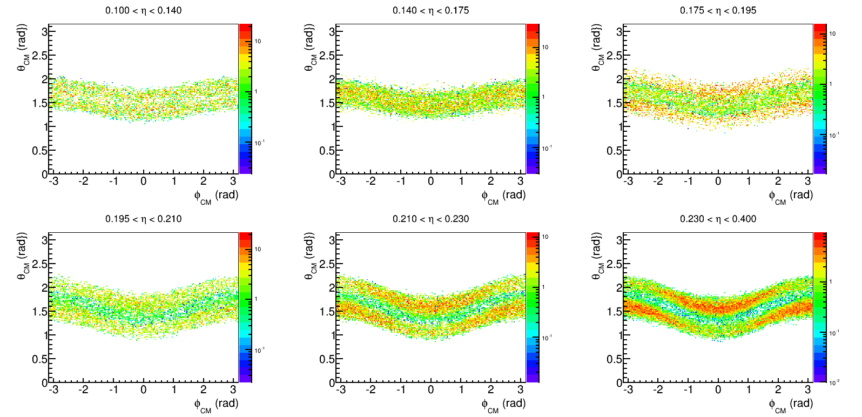
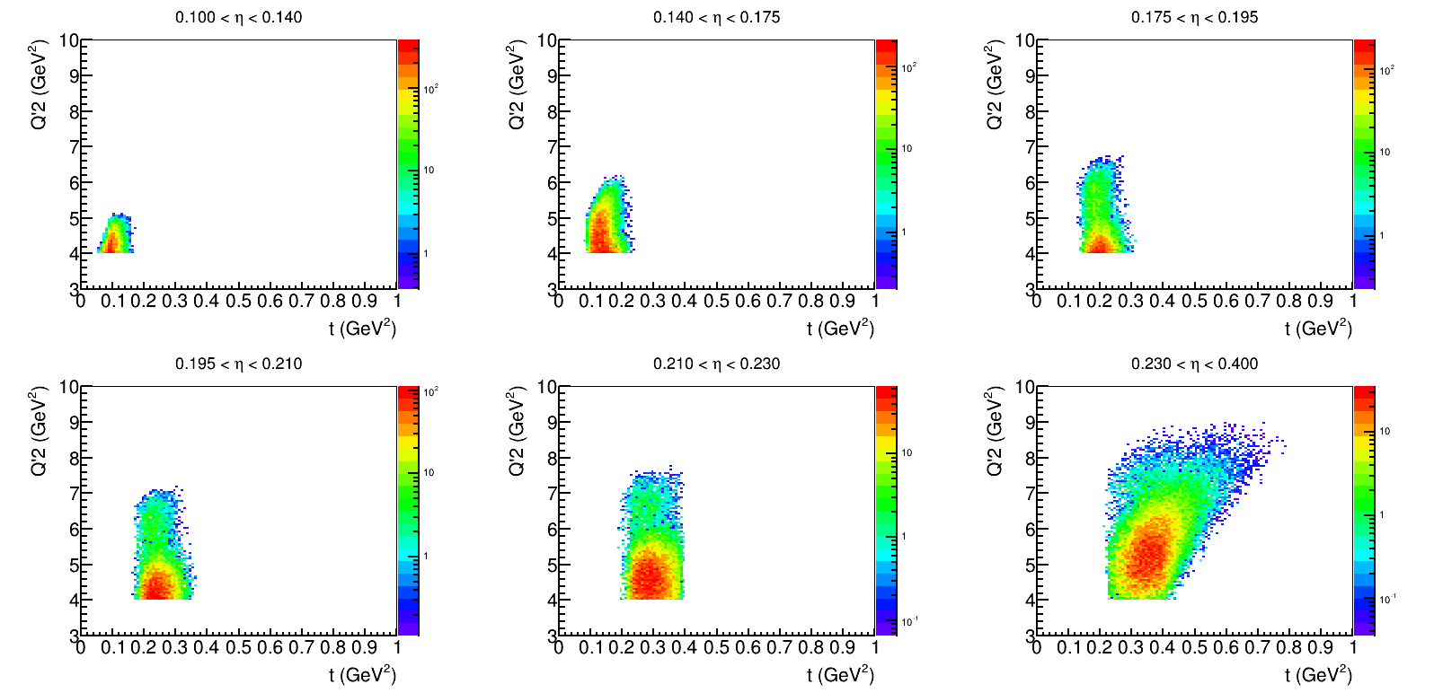
SoLID TCS projection

Slide 16
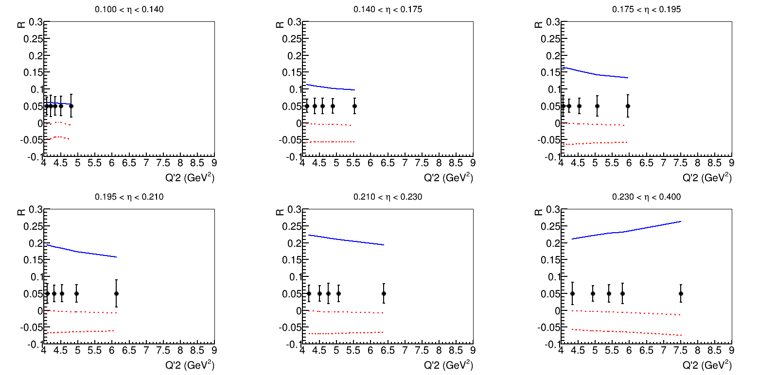
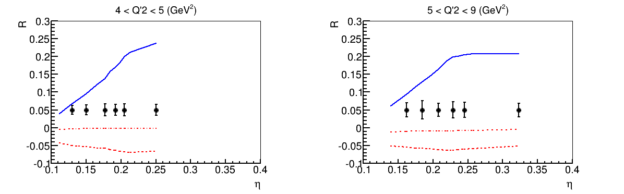
SoLID TCS projection
Blue solid line, dual parameterization model
Red dash-dot line, double distribution with D-term model
Red dash line, double distribution without D-term model

Slide 17
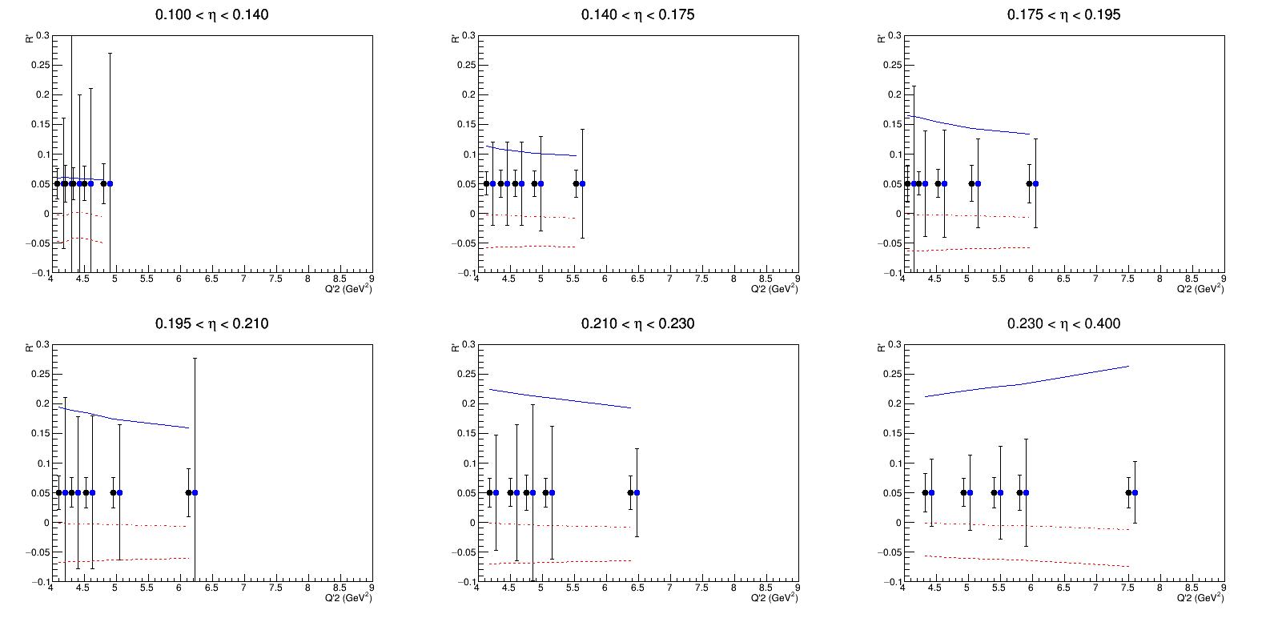
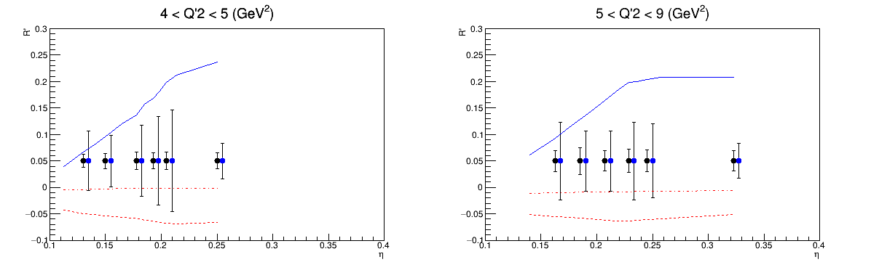
CLAS12-SoLID Comparison
Blue solid line, dual parameterization model
Red dash-dot line, double distribution with D-term model
Red dash line, double distribution without D-term model

Slide 18
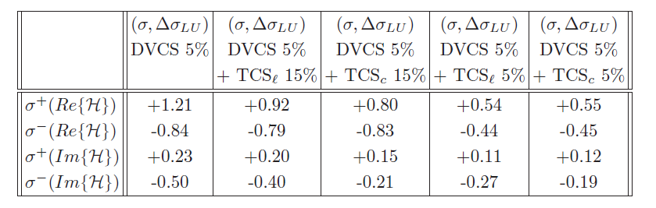
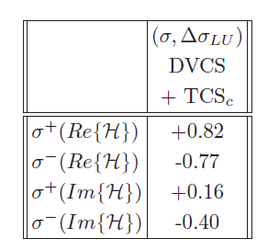
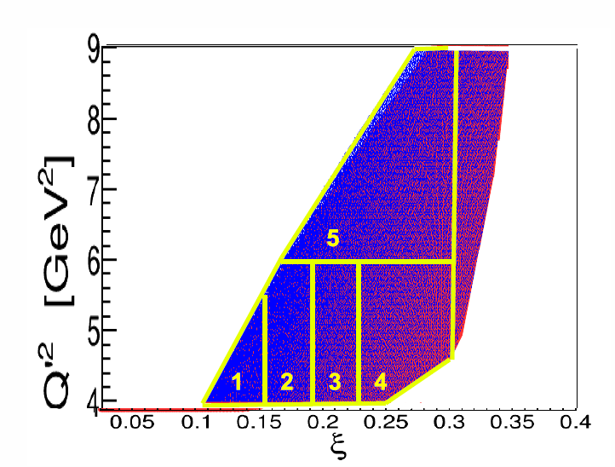
GPD fit
Fit exercise (general)
Fit exercise (SoLID TCS)
Go through SoLID simulation to get acceptance and counts for 50 days of running, then fit it

Slide 19
Summary
SoLID TCS will provide higher statistics and different acceptance than CLAS12 TCS, and thus provide better fit to CFF and explore kinematic space with more details to help constrain on GPD models.
CLAS12 and SoLID form a nice complementary program both in detector and in timeline.
SoLID TCS can be a run group with SoLID J/Ψ

Slide 20
SoLID Committee Report
Physics: Complementary to DVCS, check factorization, NLO corrections..., GPD fitting.
Feasibility: Compatible with J/Ψ.
Issues
  Trigger rate higher; need level 3 farm which is planned for PVDIS and SIDIS.
  Background should be fully simulated.
Recommendation: Approval

Slide 21
Backup

Slide 22
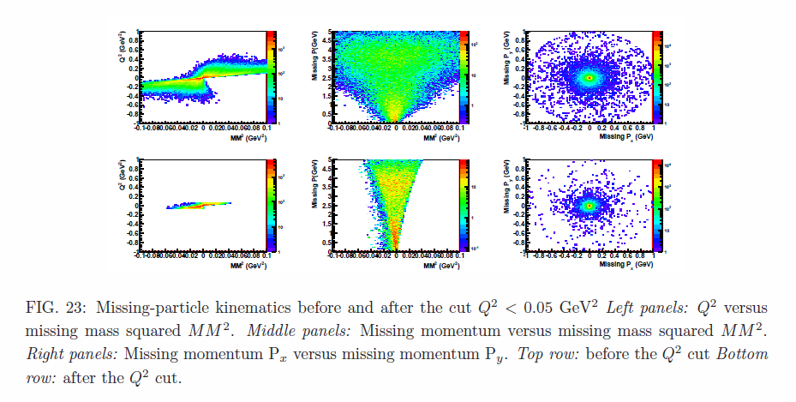
Cut on quasi-real and real photon

Slide 23
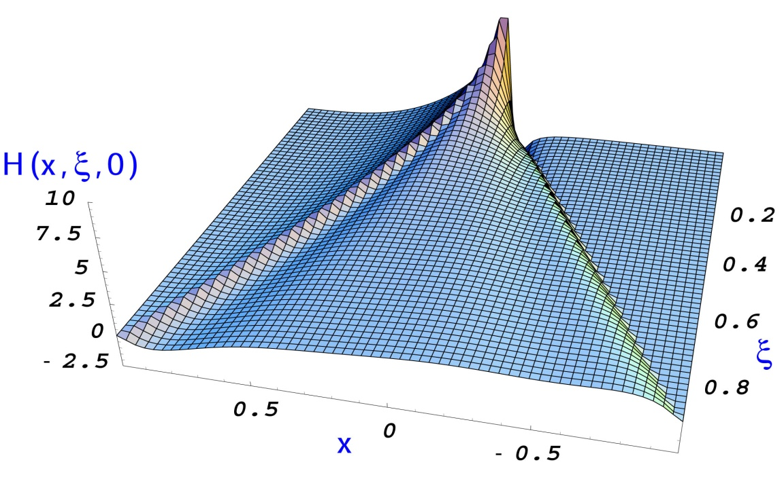
General Compton Process
Accessing GPDs
(Im, x=ξ)
DVCS: spin asymmetries
TCS with polarized beam
(Re)
TCS: crosssection, lin beam asymmetry
DVCS: charge asymmetry
(Im, x ≠ ξ, x < |ξ| )
Double DVCS
(|Im|²+|Re|²)
DVCS: cross section

Slide 24
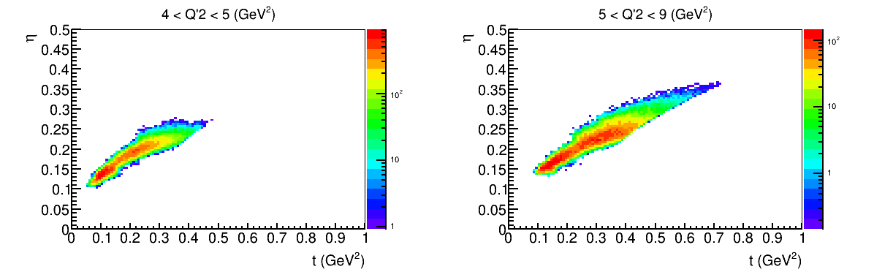
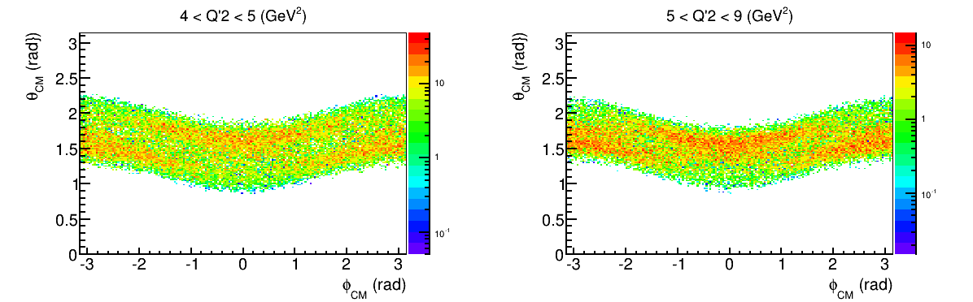
SoLID TCS projection

Slide 25
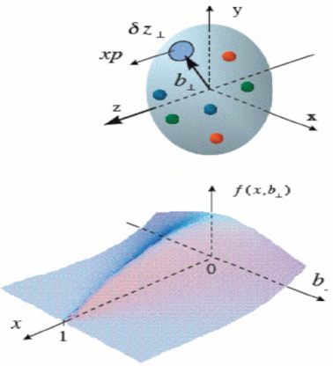
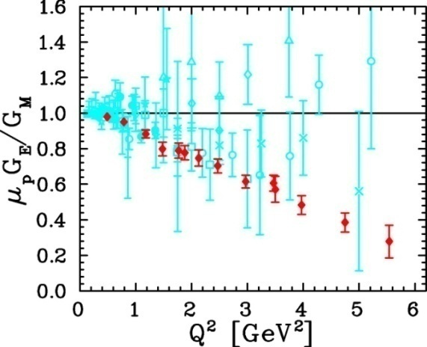
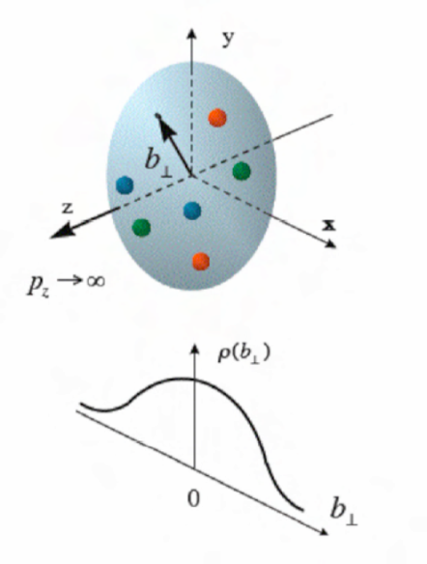
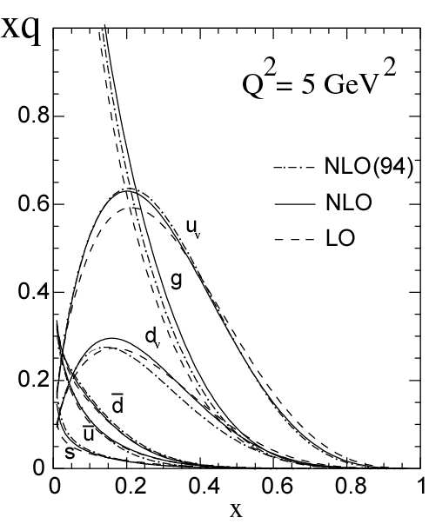
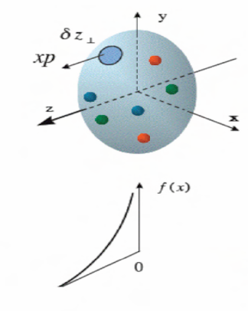
Generalized Parton Distribution (GPD)
A unified descriptions of partons (quarks and gluons) in the momentum and impact parameter space
Elastic form factors Transverse spatial distributions
Parton Distribution Functions Longitudinal momentum distributions

Slide 26
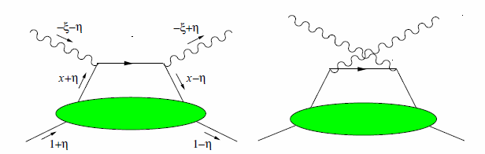
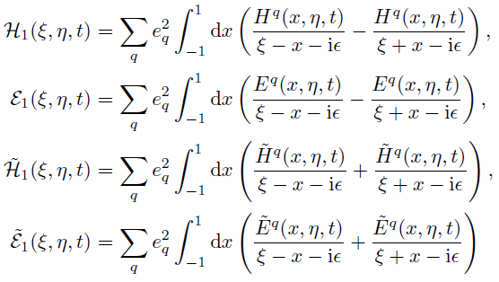
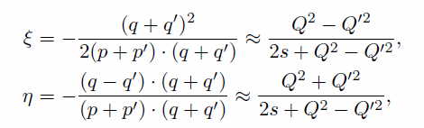

General Compton Process accessing GPDs
γ(q) + p(p) → γ(q′) + p(p′)
Compton Form Factor (CFF)
E.R. Berger et al. Eur. Phys. J. C 23, 675–689 (2002)

Slide 27
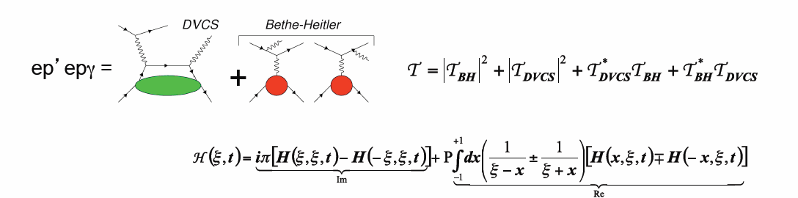
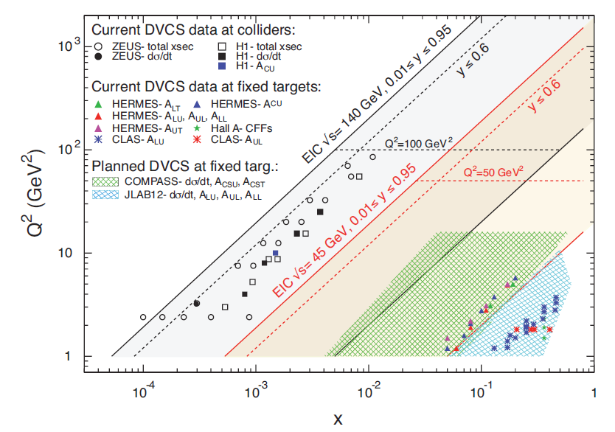
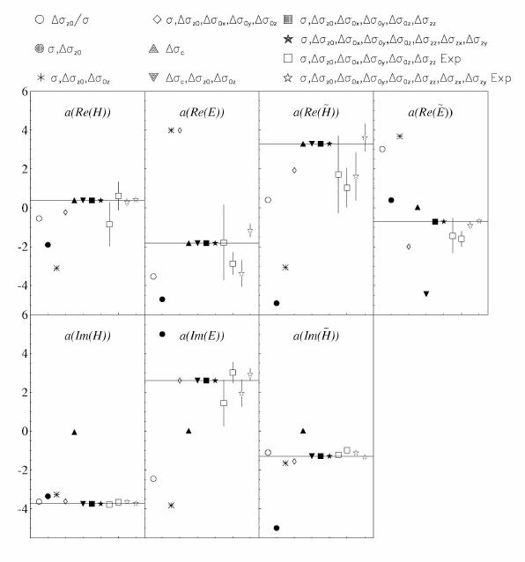
DVCS
An overview of existing and planned measurements of DVCS
Global fit to the DVCS data
M. Guidal, Eur.Phys.J. A37, p319 (2008)

Slide 28
Timelike Compton Scattering (TCS)
γ p → p′ γ*(e⁻ e⁺)
Test spacelike-timelike correspondence and the universality of GPDs
  Input for global analysis of Compton Form Factors
  access through azimuthal asymmetry of lepton pair
Explore GPDs of quarks and gluons at different kinematics

Slide 29



TCS crosssection

Slide 30
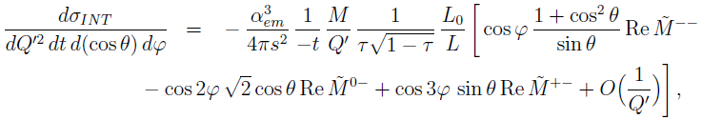
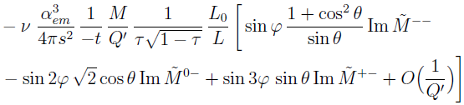
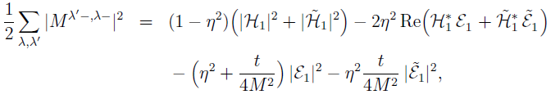
Interference term
In terms of helicity amplitudes:
ν: circular polarization of incoming photon also gives access to imaginary part

Slide 31
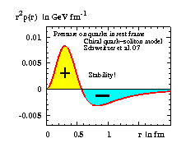
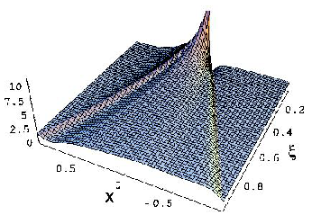

The D-term and the pressure balance in the nucleon
GPD with D-term
GPD without D-term
The D-term contributes only to the real part of the Compton amplitude

Slide 32

TCS NLO

Slide 33

DVCS NLO

Slide 34



CLAS12 and SoLID: Acceptance
 | CLAS12 | SoLID
e⁻ and e⁺ coverage | θ(5º – 36º) φ (~ 80% full) Asymmetric | θ(8º – 17º) θ(18º – 28º) φ(full) Symmetric
proton coverage | θ(5º – 36º) Θ(38º – 125º) φ (~ 80% full) | θ(8º – 17º) θ(18º – 28º) φ(full)
Luminosity | 10³⁵/cm²/s | 10³⁷/cm²/s
CLAS12 positive
CLAS12 negative
CLAS12 larger CC coverage
CLAS12 large TOF (proton PID) coverage
SoLID positive and negative

Slide 35


CLAS12 and SoLID: Resolution
CLAS12
SoLID

Slide 36


CLAS12 and SoLID: BH Detection (Lab Frame)
BH events in the resonance free region are used for simulation
CLAS12 and SoLID have similar overall coverage
CLAS12 acceptance is slightly larger SoLID, but within a factor of 2
CLAS12
SoLID

Slide 37


CLAS12 and SoLID: BH Detection (γ* CM Frame)
4GeV² < Q’2 < 9GeV²
17.5GeV² < s < 19.5GeV²
4 t-bins within 0.1GeV² < t < 0.9GeV²
CLAS12 has φ structure which has to be corrected by acceptance
SoLID is smooth over φ, but has θ gap
CLAS12
SoLID

Slide 38
Approved ep → e'pe⁺e- program for CLAS12
Proposal | Physics | Contact | Rating | Days | Group | Energy | Target
E12-06-108 | Hard exclusive electro-production of π0, η | Stoler | B | 80 | 119 days + 20 days with reversed torus field | 11 GeV | Liquid H₂
E12-06-112 | Proton’s quark dynamics in SIDIS pion production | Avakian | A | 60
E12-06-119 | Deeply Virtual Compton Scattering | Sabatie | A | 80
E12-09-003 | Excitation of nucleon resonances at high Q2 | Gothe | B+ | 40
E12-11-005 | Hadron spectroscopy with forward tagger | Battaglieri | A- | 119
E12-12-001 | Timelike Compton Scatt. & J/ψ production in e+e- | Nadel-Turonski | A- | 100 +20
E12-12-007 | Exclusive φ meson electroproduction with CLAS12 | Stoler, Weiss | B+ | 60
Unpolarized proton target will be first to run
Experiment E12-12-001 for e+e- physics was approved at the last PAC meeting
Spectroscopy (119 PAC days) and e+e- (100+20 days) experiments drive the total beam time for proton running (119+20 days), which can be shared by all.
Approved beam time corresponds to more than a year of actual running

Slide 39


CLAS12 TCS Projected Result
CLAS12
Statistical uncertainties for 100 days at a luminosity of 10³⁵ cm⁻²s⁻¹
Uncertainties for cosine moment R', integrated over the CLAS12 acceptance, for two bins in photon energy, for the lowest Q'² bin above the ρ' resonance.
Different values of the D-term are only shown for the double distribution

Slide 40

SoLID TCS
estimated 100k events for 1e37cm⁻²s⁻¹ lumi and 50 days
Higher statistics enables multi-dimension binning (Q2, s, t , eta… )
  e.g. study the change over eta and search for NLO (gluonic)
(0.1 , 0.45)

Slide 41

SoLID TCS projection
GK model (blue), MSTW model (red)
Solid line, LO; dotted line, NLO

Slide 42


Slide 43


GEM rate
SIDIS He3, 7e36/cm2/s, target at -350cm
Jpsi, 1.2e37/cm2/s, target at -315cm

Slide 44


Slide 45

CLAS 6, missing particle cut

