Slide 1

Vibe Coding
The gap between your idea and working code just collapsed
Raiqa Rasool - EPSCI Computer Scientist - CST Division
May 15, 2026 | rasool@jlab.org

Slide 2
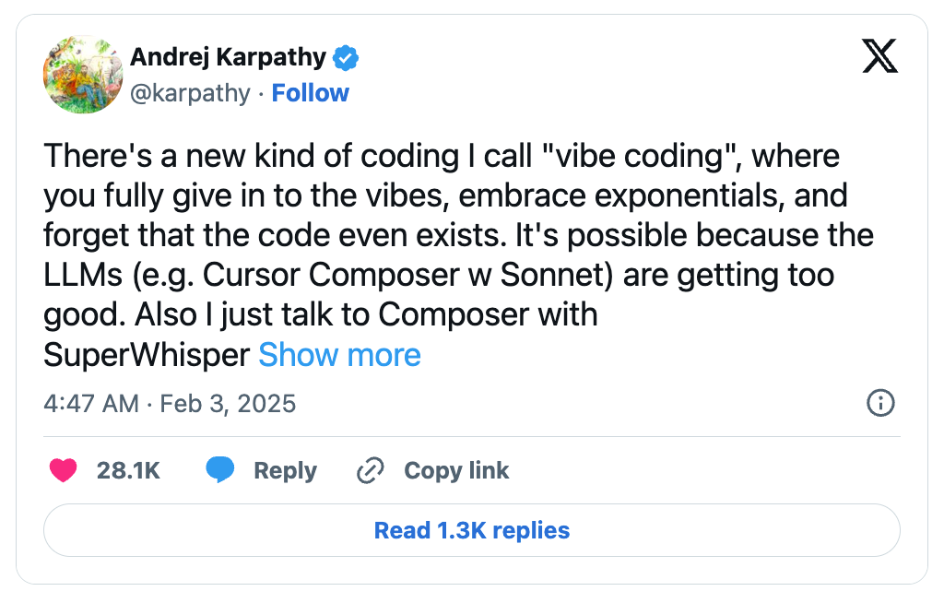

“Vibe Coding” — Where it all began
The term was first coined by Andrej Karpathy in a February 2025 social media post:
Andrej Karpathy - AI researcher, OpenAI co-founder, former Tesla AI Director
https://karpathy.ai/
It went viral almost overnight, signaling a new shift in how we code
A shift comparable to:
Assembly → Python / Java
From writing code → expressing intent
https://x.com/karpathy/status/1886192184808149383

Slide 3
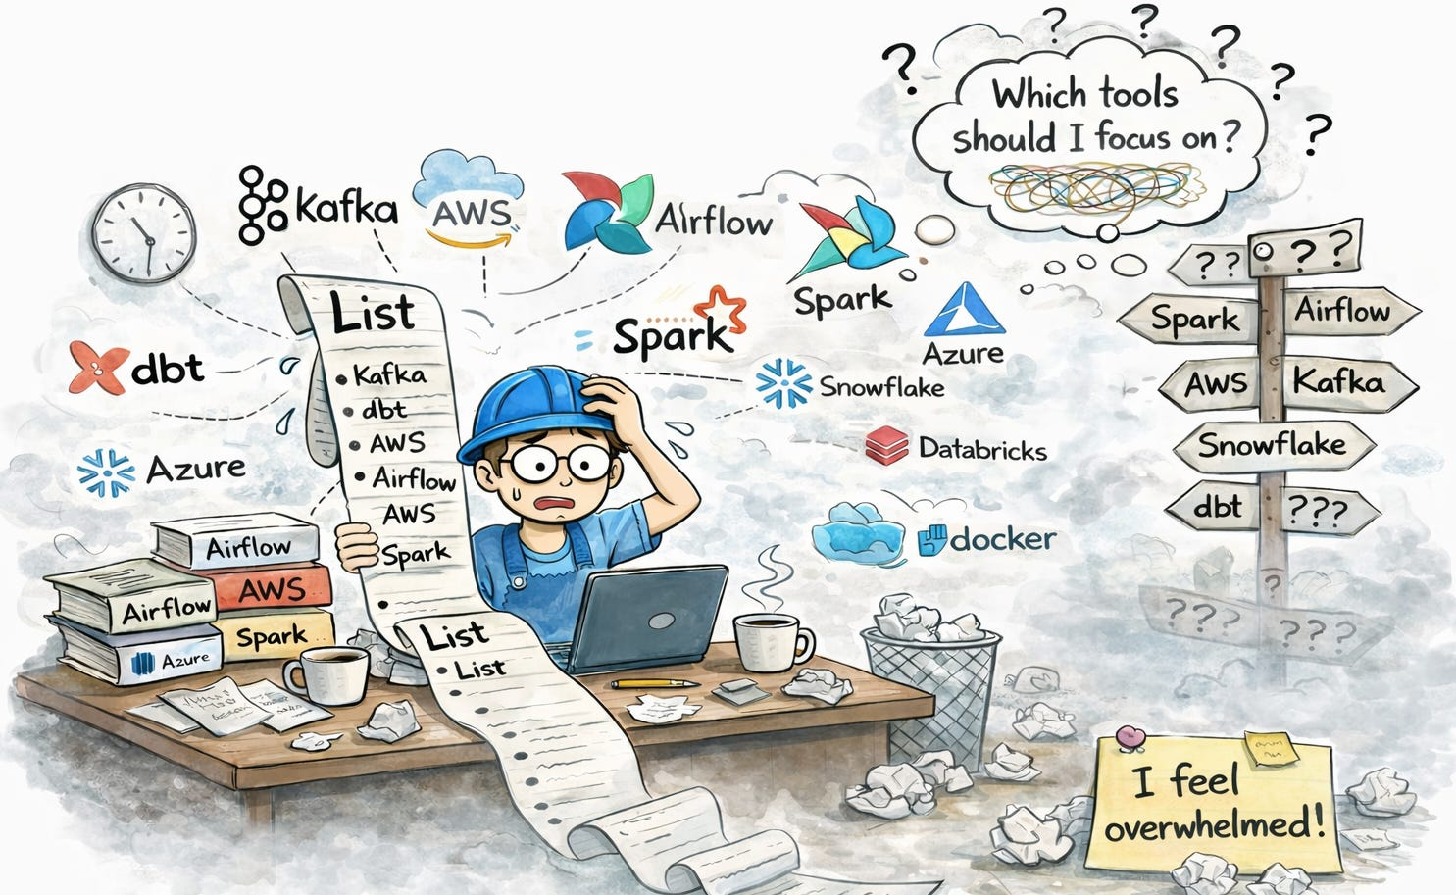
Traditional Coding (Old Way)
You have a great idea → but first:
decide on framework
learn:
new languages
new tools etc.
fight syntax and debugging
The idea waits…
while tooling slows you down.

Slide 4
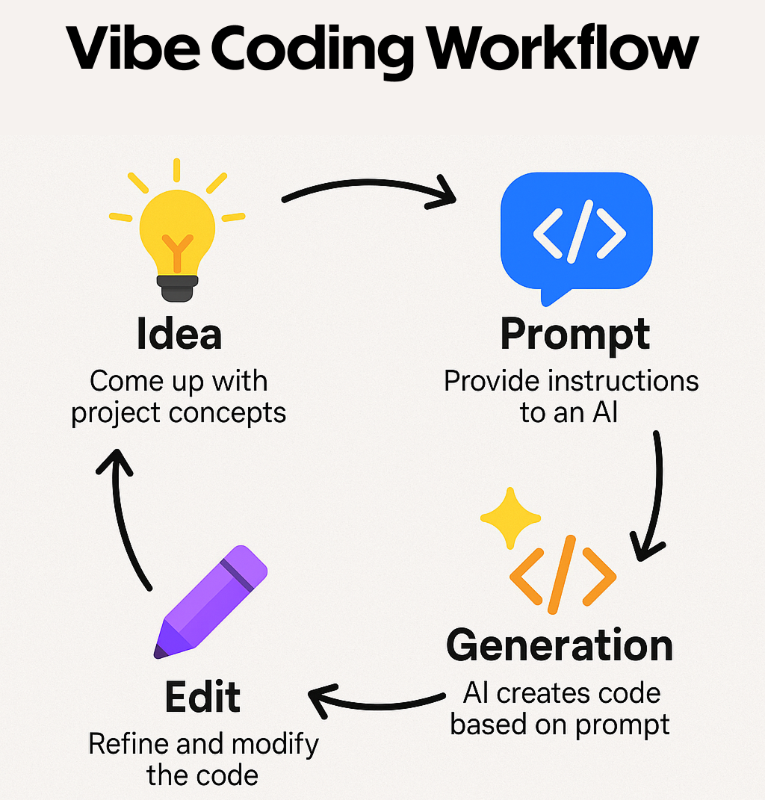
Vibe Coding (New Way)
Just need one skill:
Clearly explaining what you want to AI
Ideas go straight from mind → execution
Languages & tools fade into the background
Focus shifts from how to code → what to build
https://tinyurl.com/4c73rvr5

Slide 5
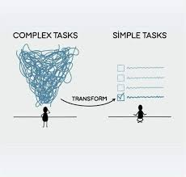
Why Physicists Win Here
Physicists already think in the language AI understands:
Break complex systems into simple parts
Define relationships precisely
Work from models, not syntax
That’s essentially prompt engineering.
Your mental models map directly to AI systems.
Good Physicist = Great AI Collaborator

Slide 6

So the conclusion is..
Vibe coding removes engineering friction.
You focus on intent, not implementation.
Less coding. More thinking.
Which is exactly why this is so powerful for physicists.
Let’s look at what they’ve already built with it.

Slide 7


When Physicists Vibe
Accelerator physics collision simulator
Simulates electron–positron beam collisions in a particle accelerator.
Beam offset interactions
Focusing forces
Instability behavior
Why tiny misalignments can destabilize entire collisions
https://www.linkedin.com/in/andrei-seryi/
https://tinyurl.com/yeym9u29

Slide 8
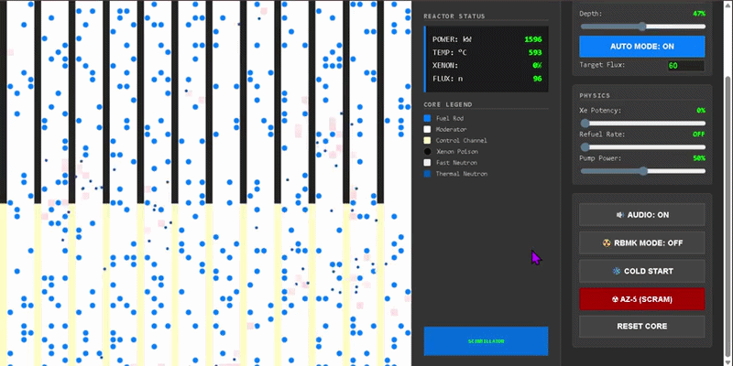
When Physicists Vibe
Nuclear reactor simulation tool
A vibe-coded browser-based sandbox simulating nuclear fission in real time.
Models neutron movement, fuel rods, moderation, and chain reactions
Lets users control reactor behavior via control rods, coolant flow, and fission rate
Visual, interactive system for exploring reactor dynamics
https://tinyurl.com/y5u2666u

Slide 9

When Physicists Vibe
Three-body orbital simulator
A vibe-coded simulation inspired by The Three-Body Problem.
Models three stars interacting under gravity
Lets you vary mass, size, and initial conditions
Shows how small changes can lead to stability or chaos
Explores why some celestial systems remain stable while others collapse
https://tinyurl.com/53h743b4

Slide 10

When Physicists Vibe
Quantum Mechanics Visualizer
A vibe-coded platform that makes quantum mechanics visually explorable.
Visualizes superposition, entanglement, tunneling, and wave–particle duality
Real-time animations for intuitive learning
Turns abstract quantum theory into interactive experience
https://tinyurl.com/2j42ybe2

Slide 11

When Physicists Vibe
Vibe physics: The AI grad student
An AI-assisted research workflow followed by a high-energy physicist Matthew Schwartz
AI helped with derivations, simulations, and paper drafting
Rapid research iteration with AI assistance
Continuous human verification and scientific oversight was required
Fast acceleration of research, but not independent scientific reasoning
https://www.anthropic.com/research/vibe-physics

Slide 12
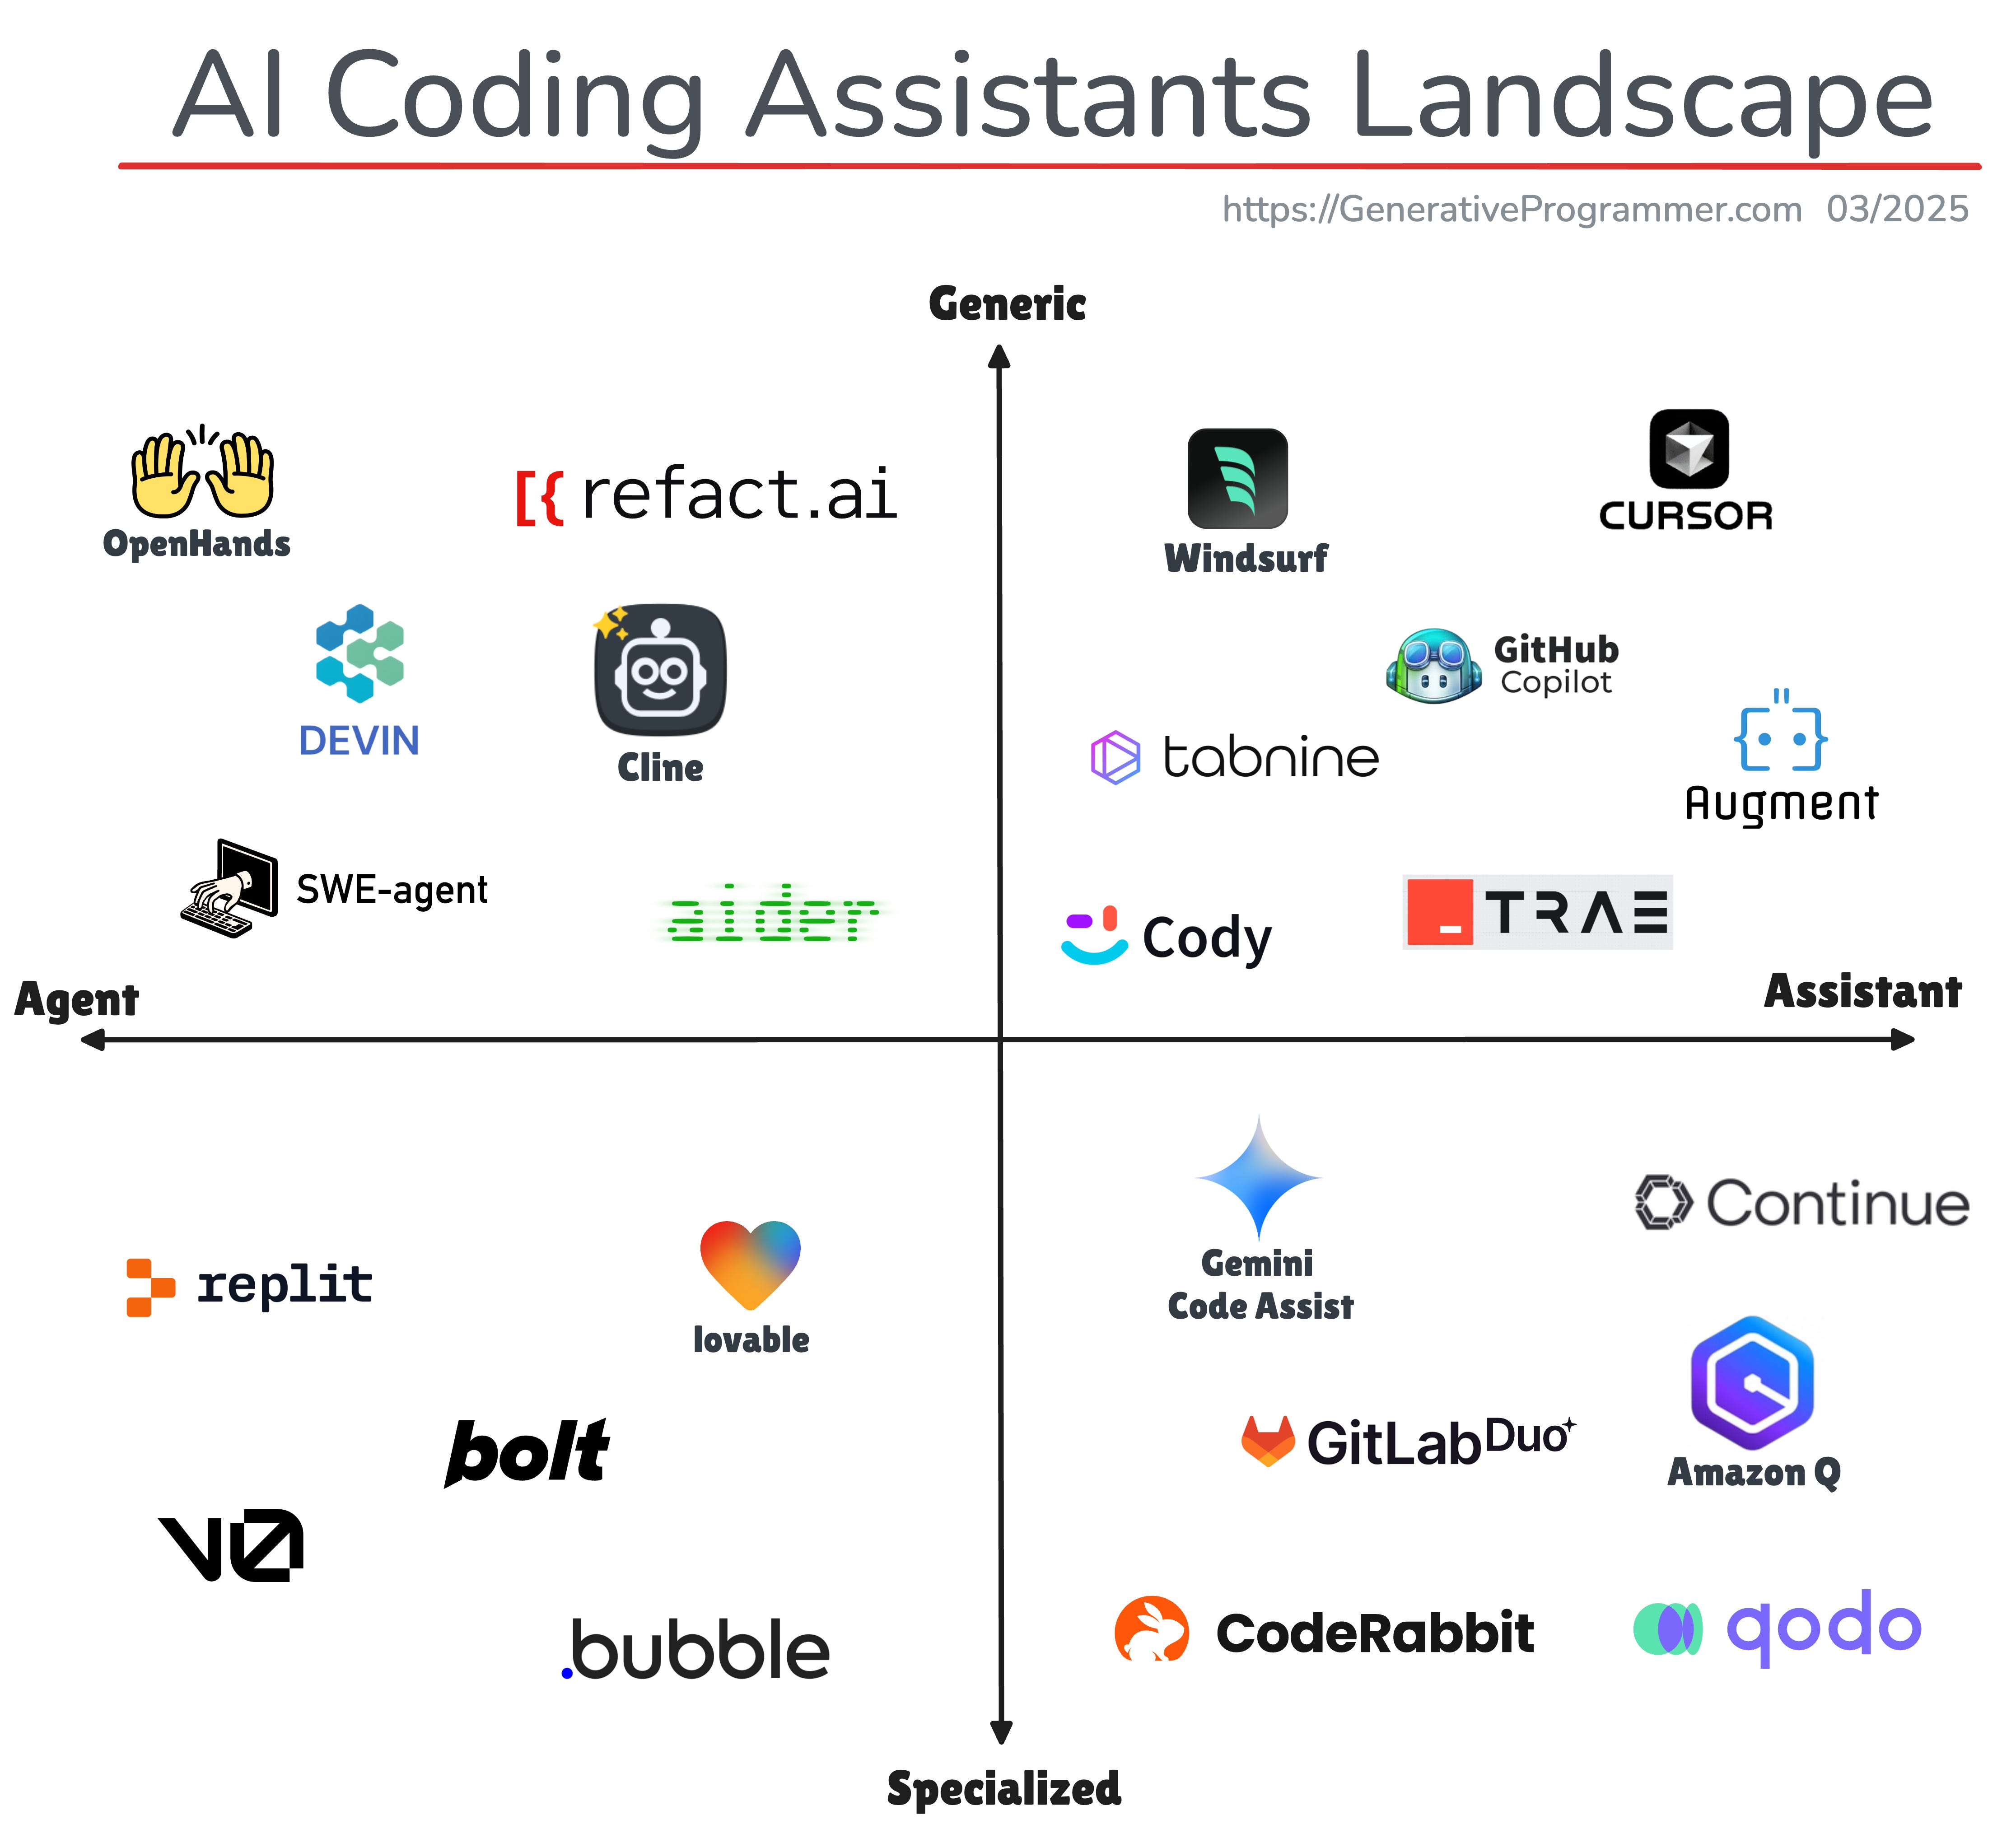
AI Coding tools - Classification
AI coding tools are evolving rapidly
New ones appear almost daily
There’s no single “correct” classification
However, these two broad dimensions can help you pick tools based on your workflow needs:
Specialized vs. Generic
Autonomous vs. Assistant
https://generativeprogrammer.com/p/ai-coding-assistants-landscape March 3, 2025

Slide 13
AI Coding Tools- Classification
1. Specialized vs. Generic
Specialized Tools
Built for specific tasks
Examples: test generation, PR reviews, UI scaffolding, cloud workflows
Best when you need to solve a narrow problem quickly
Generic Tools
Broad, all-purpose assistants (IDE, CLI, chat)
Support: completion, refactoring, search, explanations
Best for day-to-day development across projects
https://generativeprogrammer.com/p/ai-coding-assistants-landscape March 3, 2025

Slide 14
AI Coding Tools - Classification
2. Autonomous vs. Assistant
Autonomous (Agentic) Tools
Execute tasks end-to-end with minimal input
Can fix issues, run commands, validate code
Behave like a self-operating developer
Assistant Tools
Reactive and collaborative
Suggest, explain, and generate code
Require human guidance and decision-making
https://generativeprogrammer.com/p/ai-coding-assistants-landscape March 3, 2025

Slide 15
AI Coding Tools - Classification
2. Autonomous vs. Assistant
Reality: It’s a Spectrum
Many tools blend both models
Example: IDE assistants that can also run autonomous workflows
(e.g., Cursor, Windsurf)
The trend is increasingly moving toward agentic systems:
Tools can independently handle larger parts of the workflow while the user provides high-level guidance.
https://generativeprogrammer.com/p/ai-coding-assistants-landscape March 3, 2025
Notes:
More and more tools are moving towards agentic already GitHub Copilot and Cursor can do a lot of things on their own with small intervention

Slide 16
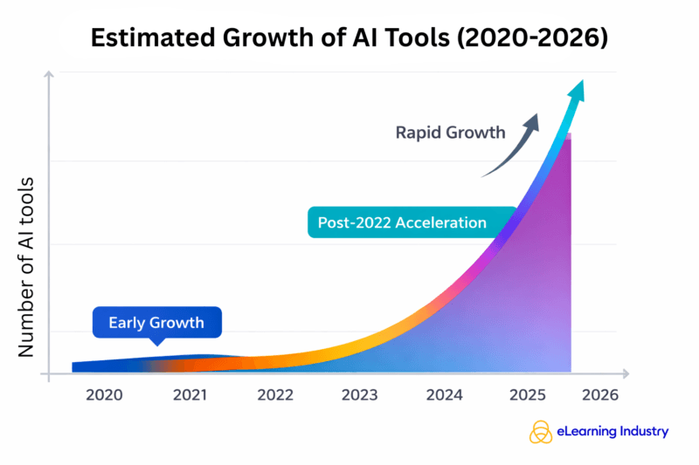
AI Coding Tools - Choosing the Right One
The AI coding tools landscape is evolving extremely fast
New tools emerge constantly — any list is outdated almost immediately
Even tools shown earlier (from March 2025) no longer reflect the current state
Tool Rankings:
Different blogs and benchmarks rank tools differently
Rankings depend heavily on the evaluation criteria used
There is no universal definition of the “best” tool
https://tinyurl.com/2k9z42a4

Slide 17
AI Coding Tools - Choosing the Right One
What This Means for You
Rankings and lists provided here are reference points, not answers
There is no one-size-fits-all tool
Key Takeaway
The “best” tool depends on:
Your workflow
Your use case
Your comfort with control vs. automation
Your job isn’t to find the best tool
It’s to find what works best for you
https://tinyurl.com/2k9z42a4

Slide 18
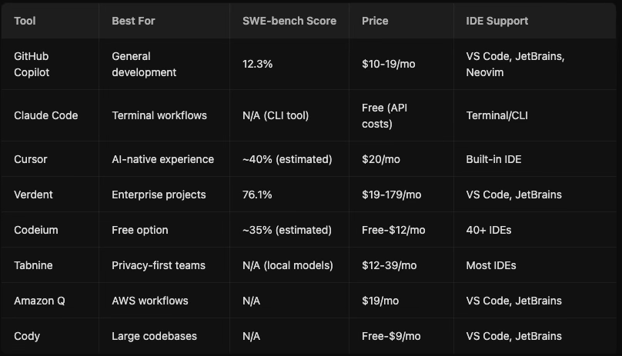
AI coding tools – 2026 (Verdent)
https://www.verdent.ai/guides/best-ai-coding-assistant-2026 - Feb 5, 2026

Slide 19
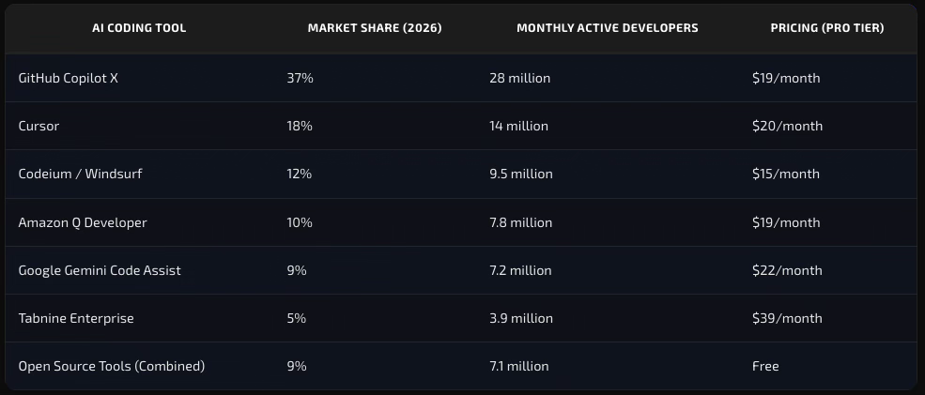
AI coding tools – 2026 (Tech insider)
https://tech-insider.org/ai-coding-tools-2026-transforming-software-development/ - March 15, 2026

Slide 20
AI coding tools – 2026 (Launchpad)
Tool | Type | Key selling point | Exists as | Free plan | Price
Launchpad | Platform | Pre-built enterprise infrastructure for B2B SaaS | Cloud platform | Yes | $900/mo
GitHub Copilot | Coding Tool | Microsoft-backed with tight VSCode integration | IDE extension | Yes | $10/mo
Cursor | Coding Tool | Agent-first IDE supporting 8 simultaneous agents | Standalone IDE | Yes | $20/mo
Windsurf | Coding Tool | Clean UI with Cascade interface for agentic workflows | Standalone IDE + Extensions | Yes | $15/mo
Claude Code | Coding Tool | Terminal-based agentic coding with full autonomy | Command-line tool | No | $20/mo
Tabnine | Coding Tool | Privacy-first with local execution | IDE extension | Yes | $59/user per month
https://launchpad.io/blog/22-best-ai-coding-tools-speed-development-2026 - Jan 21, 2026

Slide 21
AI coding tools – 2026 (Launchpad)
Tool | Type | Key selling point | Exists as | Free plan | Price
OpenAI Codex | Coding Tool | Strong at understanding complex prompts | ChatGPT, API | No | $20/mo
Google Gemini | Coding Tool | Embedded across Google tools | Cloud API + IDE integrations | Yes | $22.80/user per mo
Replit | Platform | Cloud IDE with autonomous agent | Cloud IDE + Platform | Yes | $25/mo
Cline | Coding Tool | Open-source VSCode extension | IDE extension | Yes | $20/user per month
Amazon Q Developer | Coding Tool | Deep AWS integration | IDE extension + AWS Console | Yes | $19/user per month
Zed | Coding Tool | Ultra-fast (120 fps) Rust-based editor | Standalone IDE | Yes | $10/mo
https://launchpad.io/blog/22-best-ai-coding-tools-speed-development-2026 - Jan 21, 2026

Slide 22
AI coding tools – 2026 (Launchpad)
Tool | Description
Aider | Command-line AI coding assistant that edits code in your local git repository
Bolt.new | Browser-based full-stack app builder
Qodo | AI-powered code review platform with 15+ agentic workflows
JetBrains AI Assistant | Native AI integration across JetBrains IDEs
Codiga | Static code analyzer and snippet manager powered by AI
AskCodi | AI coding assistant with task-specific agents
CodeGPT | Bring-your-own-API-key AI coding assistant for IDEs
CodeRabbit | AI code review tool
Kiro | Agentic AI-powered IDE
Devin AI | First fully autonomous AI software engineer
https://launchpad.io/blog/22-best-ai-coding-tools-speed-development-2026 - Jan 21, 2026

Slide 23
jlab llm updates

Slide 24
AI Models Hosted on JLab Resources
delphi.jlab.org provides details on current LLM models deployed on JLab infrastructure.
Current Status
Platform is currently in beta / active development
Heavy multi-user load handling is still being evaluated
Because of this, we are not relying on it for today’s live demo
Access is currently limited to JLab systems only
How to Access Delphi
Login to VDI (https://vdi.jlab.org/)
Open terminal
Run command: `firefox`
Once firefox is open, enter this url:
https://delphi.jlab.org
Future Goal:
Once performance and scalability are fully validated, broader external access might be enabled outside JLab systems.
Acknowledgment
Special thanks to Casey Morean, Physics AI / ML Data Scientist, for delphi.

Slide 25
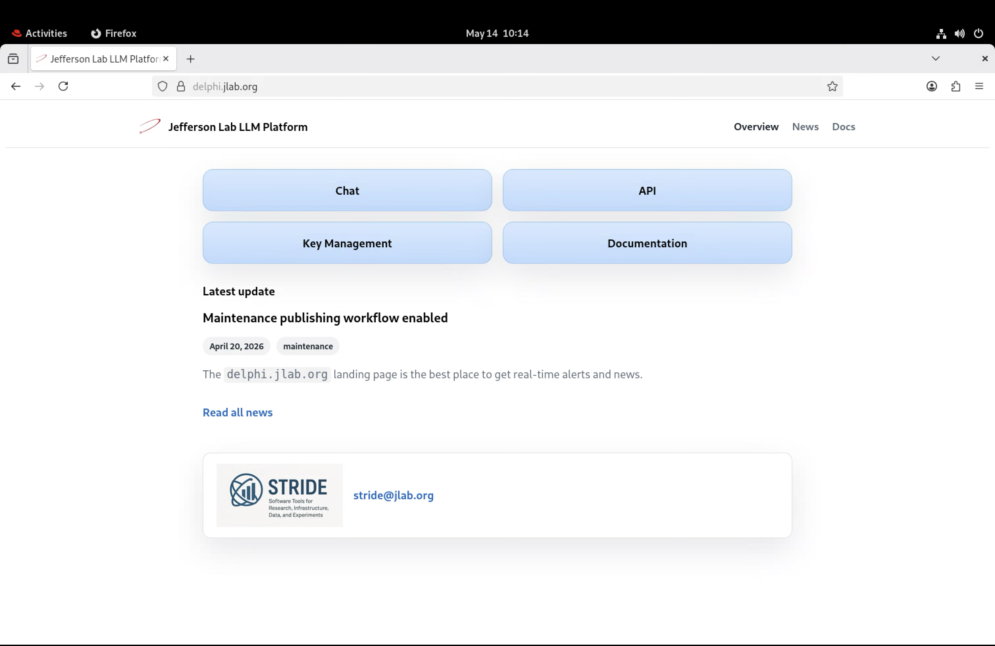
Delphi.jlab.org — Quick Overview
Main Dashboard
After logging into delphi.jlab.org, you will land on the main dashboard.
What’s Available
Central access point for deployed LLM models
Chat interface for interacting with models
API access for development workflows
Documentation and key management
Deployed models’ status and outage updates

Slide 26
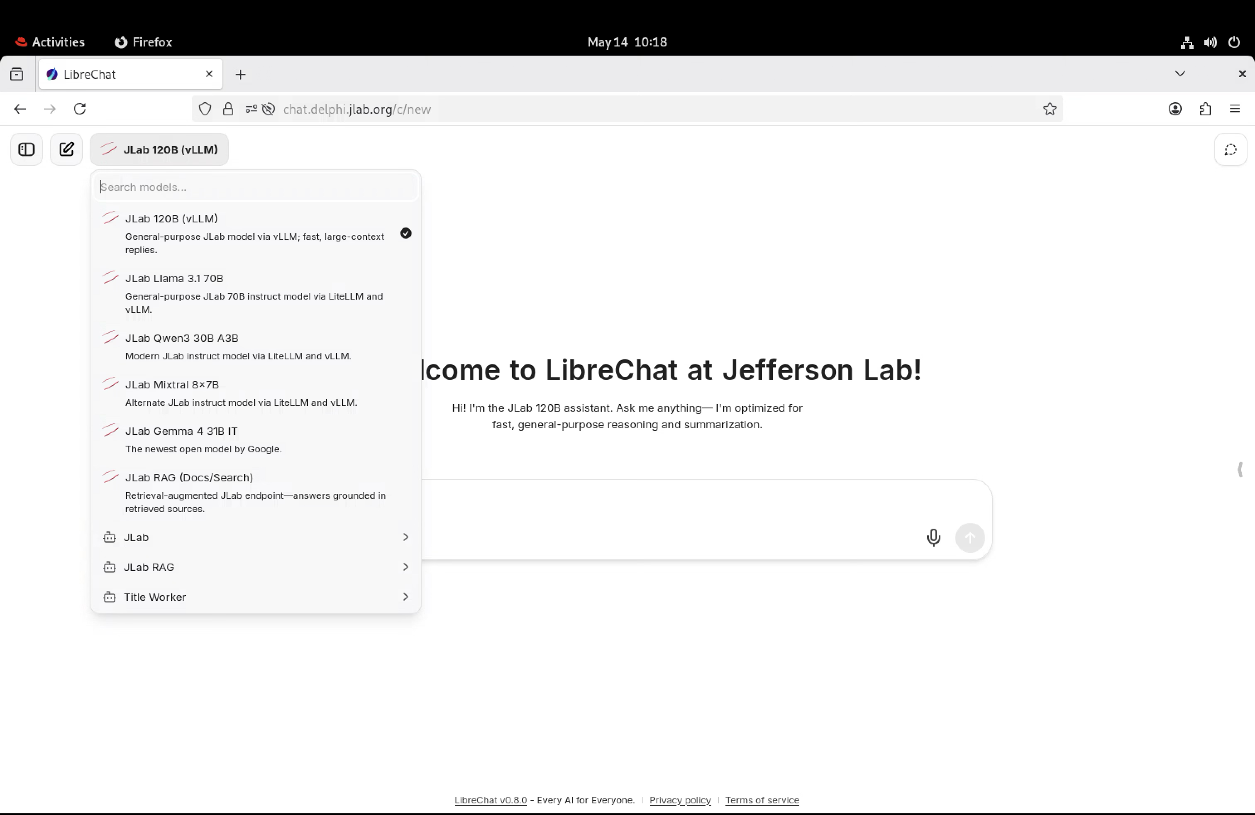
Delphi.jlab.org — Quick Overview
Chat Interface & Models
Clicking “Chat” opens the AI chat interface with currently deployed models.
Latest Available Model
Gemma 4 31B IT
Released by Google DeepMind
Part of the Gemma family of open-weight language models
“31B IT” = 31 billion parameter Instruction-Tuned model
First deployed model at JLab with image understanding capabilities

Slide 27
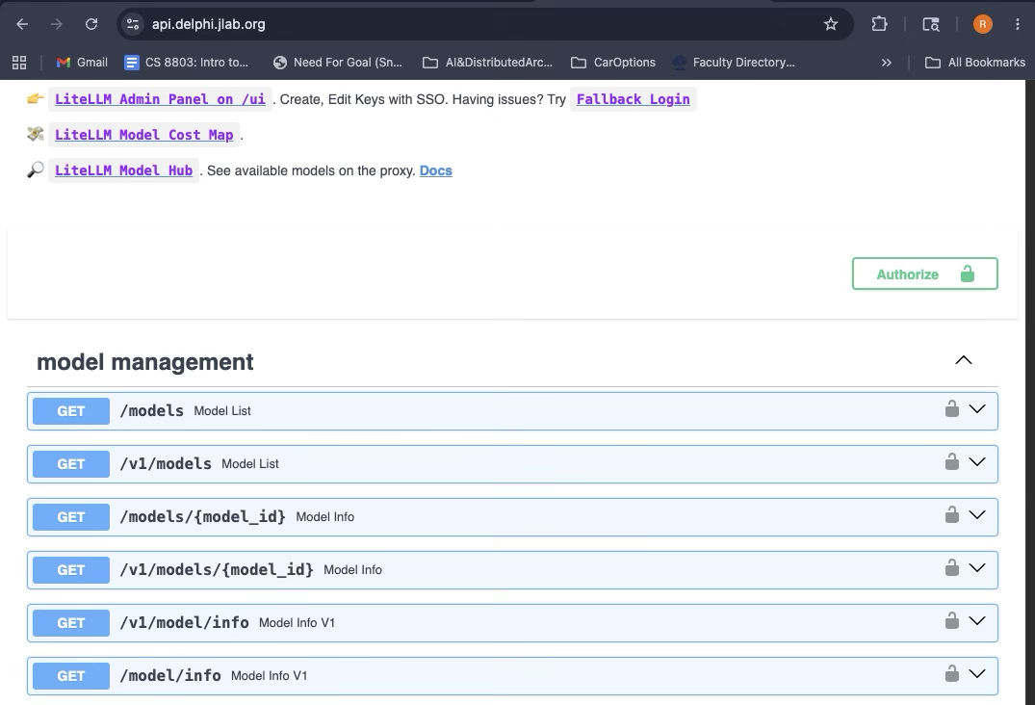
Delphi.jlab.org — Quick Overview
API Access
Delphi can also be accessed programmatically through APIs, enabling integration into development workflows and automation tools.
Key Resources
API reference
Key Management
Documentation
These sections provide everything needed for setup, authentication, and integration.

Slide 28
Delphi.jlab.org — Quick Overview
API Access & VS Code Integration (Agent Workflow)
You can connect the API directly into VS Code to use models as coding assistants or agents during development.
Resources
Roo Code Documentation
Roo Code GitHub
VS Code Insiders Download
What This Enables
AI-assisted coding directly inside VS Code
Agent-style workflows (multi-step coding tasks)
Faster iteration during development
Integration with JLab-hosted models via API

Slide 29
To Sum up…
delphi.jlab.org is currently a beta platform
Performance may differ from industry tools like GitHub Copilot
Expect occasional limitations in:
speed
stability
user experience
This is normal, the system is actively evolving
Reporting Issues
If something looks wrong or broken:
Email: stride@jlab.org
Efforts are also ongoing toward access to top-tier industry models.
Example: Google Gemini models
Stay Updated
To keep up with future updates, and new deployments, subscribe to: JLab SciComp Briefs

Slide 30
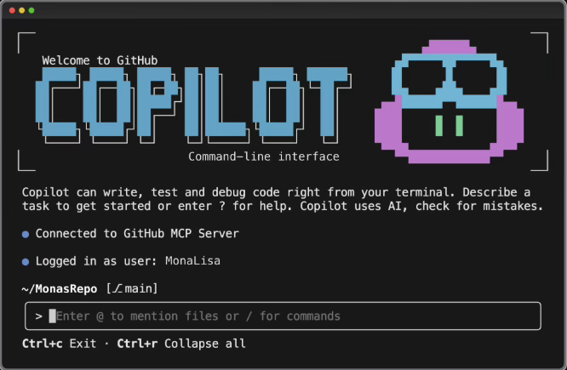
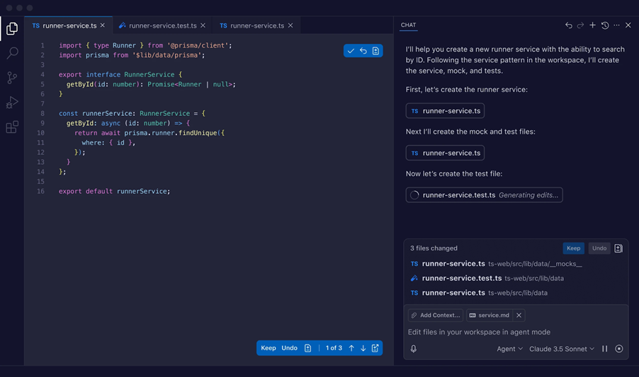
Where to start
As you can already see, there are many AI coding tools out there, and it can feel overwhelming.
To make it easier, here are three commonly used tools today:
GitHub Copilot
Cursor
Claude Code
Where We Will Start Today
We will start with GitHub Copilot in VS Code because:
It’s great for daily development
Easy to install, easy to use, zero friction.
Next slides will focus on setting it up in VS Code.
For Terminal Users
GitHub Copilot CLI is also available https://github.com/github/copilot-cli
However, for this session, we will use the VS Code chat interface for hands-on practice.
GitHub Copilot CLI
GitHub Copilot VsCode

Slide 31
Hands-on setup session

Slide 32
Get set up to vibe
Before we are ready for vibe coding, we need to complete the required setup.
We will be doing all coding after SSH’ing into ifarm, since it already has Git installed (which will be our best friend during iterative coding and changes).
We will mainly go through these steps:
Install VS Code
Sign in to GitHub Copilot
Understand GitHub Copilot Chat Interface
Install VS Code Remote SSH Extension
Configure SSH
Connect to ifarm
Open folder on ifarm
Open chat in the folder
X11 Forwarding
Required for working on ifarm
We will briefly cover SSH access to ifarm during this session but for detailed instructions, refer to the previous session: https://indico.jlab.org/event/1069/attachments/13992/22682/AccessingAndNavigatingIFarm.pdf

Slide 33
step 1: install vscode

Slide 34
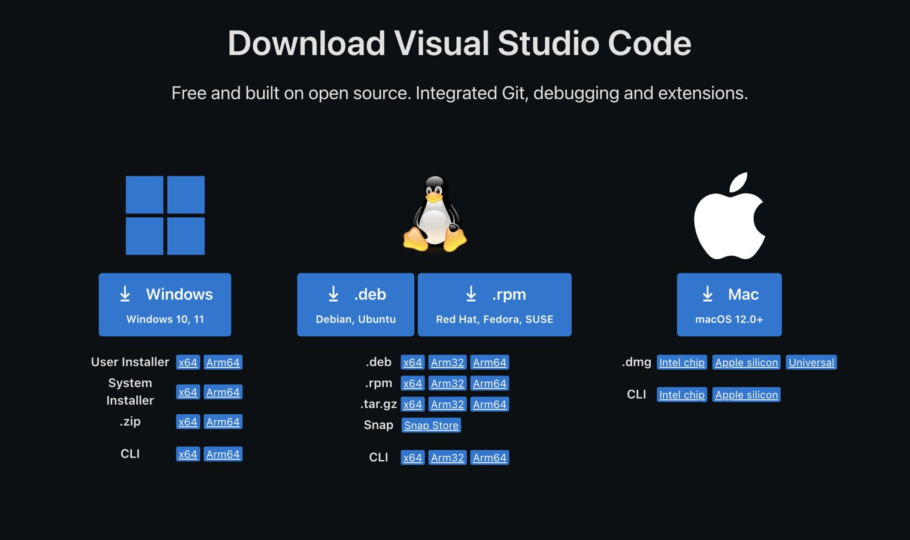
Get set up to vibe - step 1: install vs code
Download VS Code based on your OS: https://code.visualstudio.com/download
Install it by clicking the downloaded file and following the setup instructions
Click one of these with download icon based on your OS

Slide 35
step 2: sign in to Github copilot

Slide 36
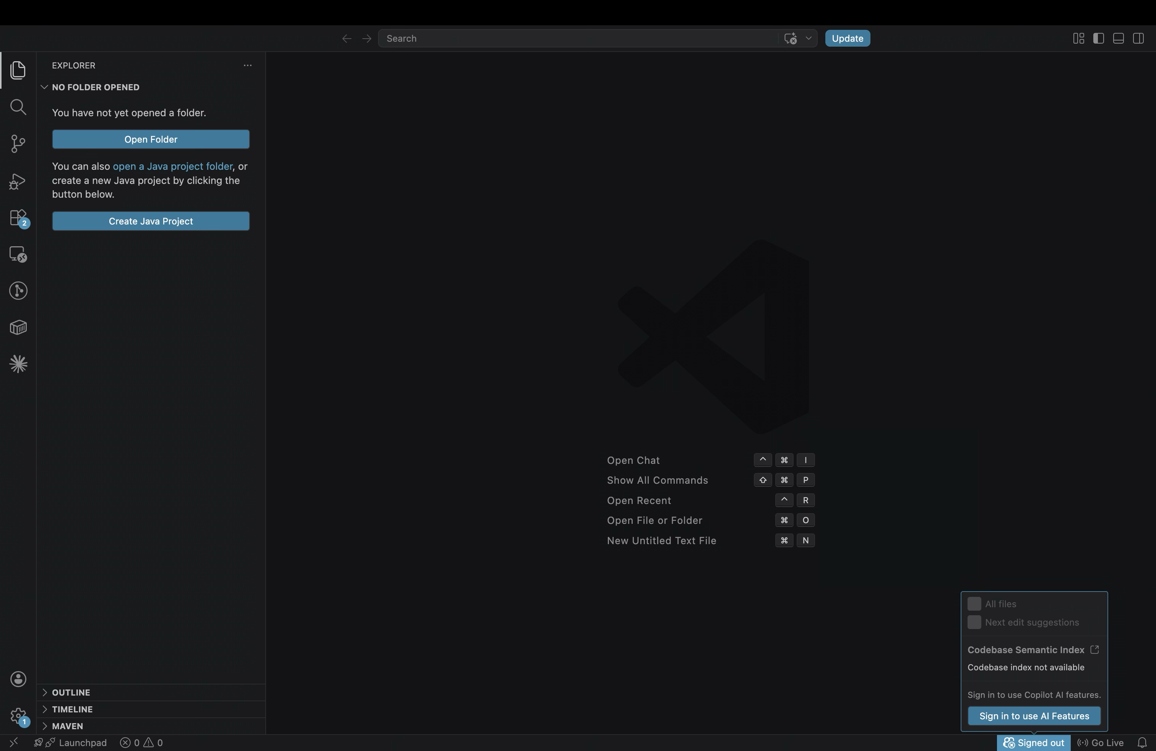
Get set up to vibe - step 2: sign in to Github copilot
VS Code already has GitHub Copilot available, so no installation is needed.
However, before you can start using GitHub Copilot, you need to sign in.
Go to the bottom-right corner of VS Code
Hover over the GitHub Copilot icon
A prompt will appear: “Sign in to use AI features”. Click it and complete the sign-in process

Slide 37
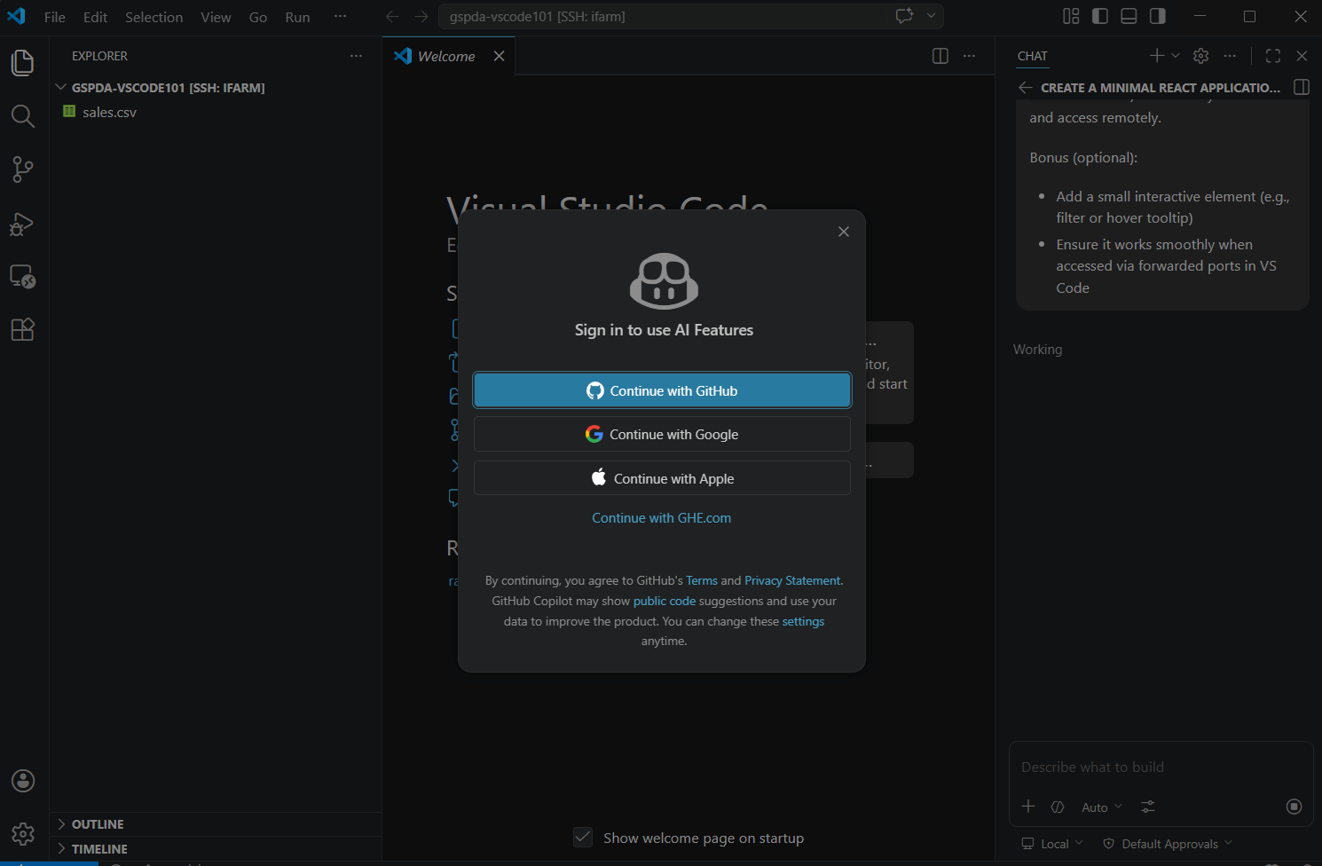
Get set up to vibe - step 2: sign in to Github copilot
Sign in using any method you prefer
Recommended: Sign in with GitHub (we will use this in the next slides)
Note for Students: If you are a student, make sure to use a GitHub account associated with your student email. This can give you access to the free GitHub Copilot Pro. Setup instructions and eligibility details: https://docs.github.com/en/copilot/how-tos/copilot-on-github/set-up-copilot/enable-copilot/set-up-for-students
Important: Starting April 20, 2026, new sign-ups for Copilot Pro, Copilot Pro+, and student plans are temporarily paused.

Slide 38
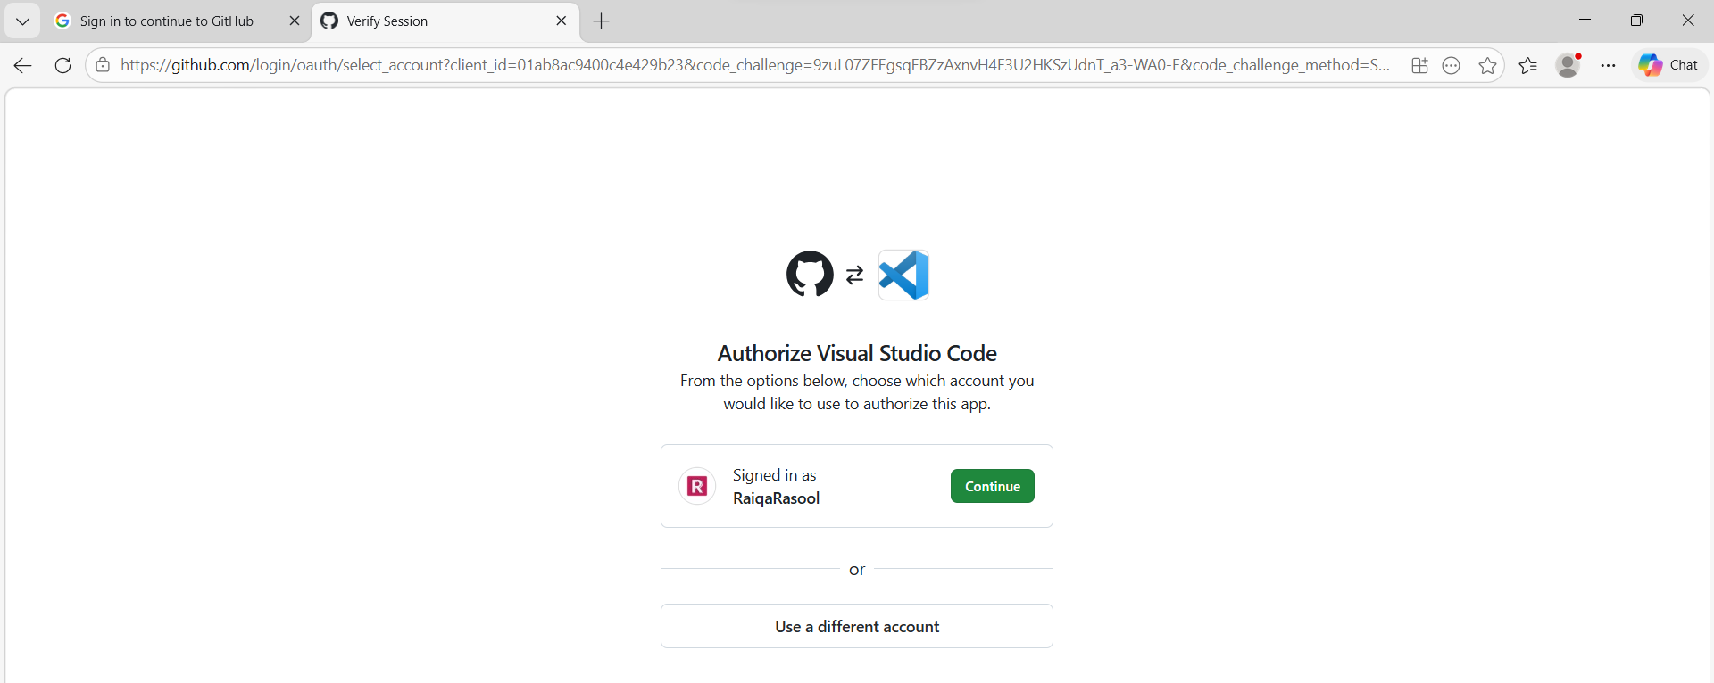
Get set up to vibe - step 2: sign in to Github copilot
Sign in using your GitHub account by clicking “Continue”
If you don’t have a GitHub account yet, you will be redirected to quickly create one
Once created, you can link it and continue the sign-in process

Slide 39
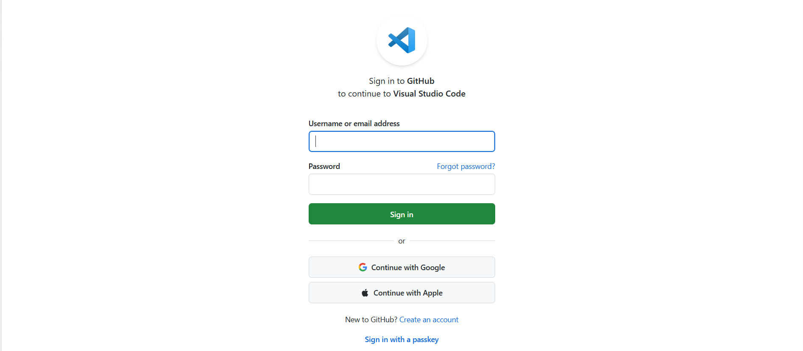
Get set up to vibe - step 2: sign in to Github copilot
Enter your username and password if prompted
If you don’t already have an account, create a new one and link it

Slide 40
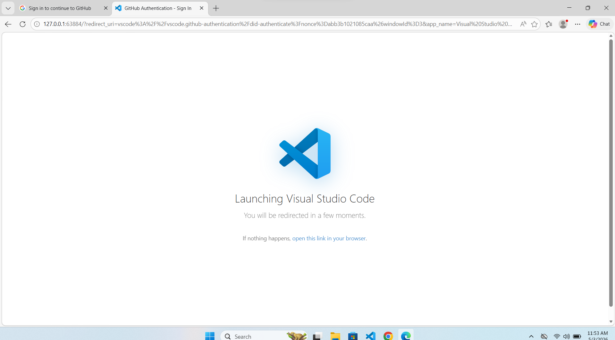
Get set up to vibe - step 2: sign in to Github copilot
Once linked you will be redirected to VS Code

Slide 41
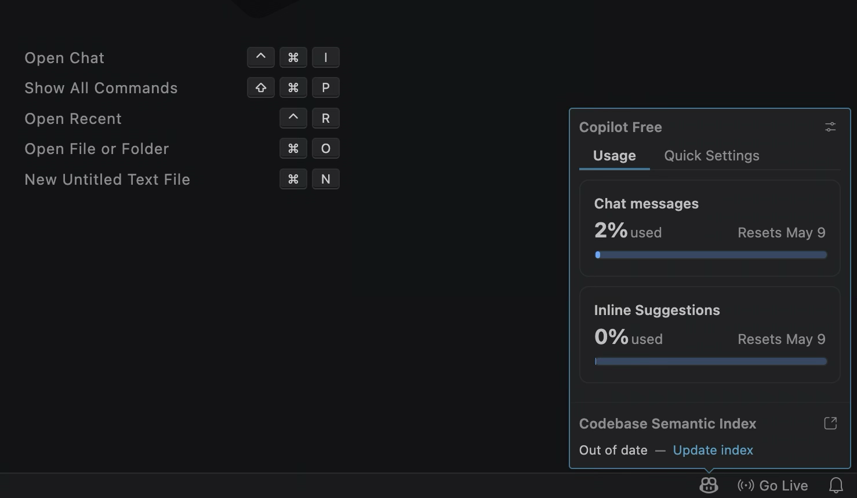
Get set up to vibe - step 3: sign in to Github copilot
After getting redirected, hover over the GitHub Copilot icon again. You should now see your usage status / activity stats. This confirms Copilot is successfully enabled in VS Code

Slide 42
step 3: Understand chat interface

Slide 43
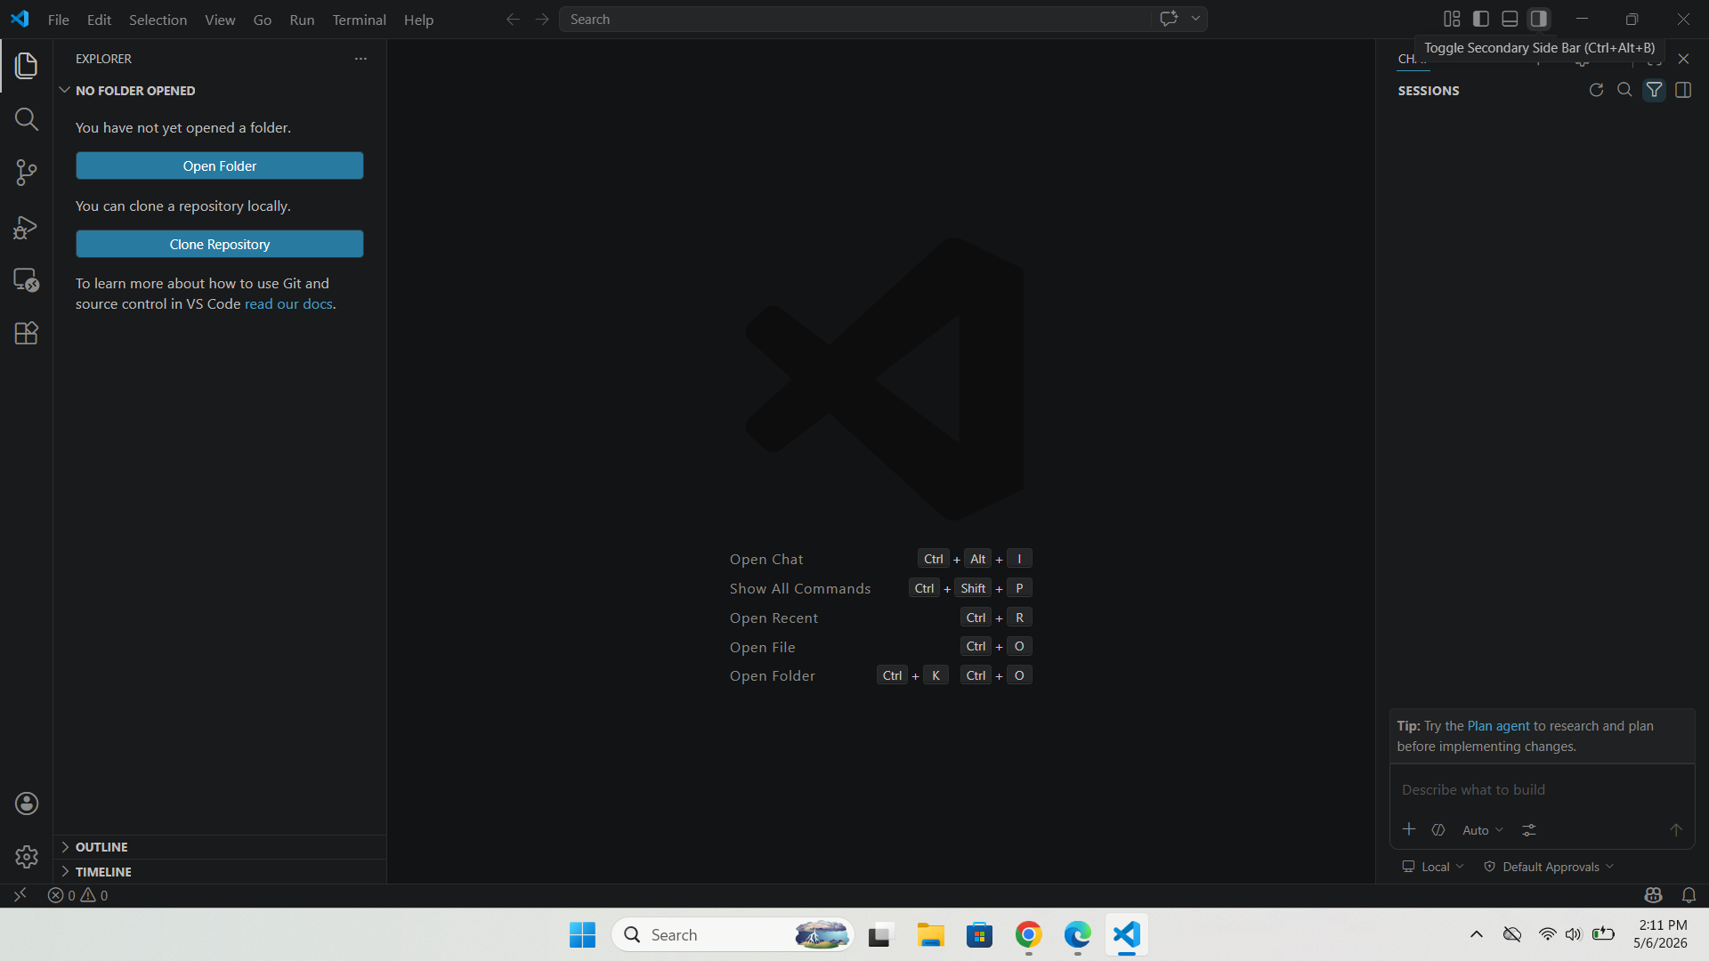
Get set up to vibe - step 3: Understand chat interface
Now Click the Secondary Sidebar toggle icon in the top-right corner or use the shortcut: Ctrl/Cmd + Alt + B
This will open the GitHub Copilot chat interface in VS Code.

Slide 44
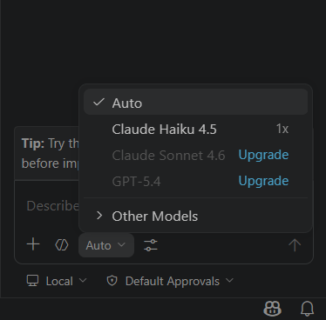
Get set up to vibe - step 3: Understand chat interface
1. Changing the Model
Click the “Auto” dropdown in the chat interface
Select the AI model you want to use for coding
Refer to: https://arena.ai/leaderboard/text to choose models based on your use case

Slide 45
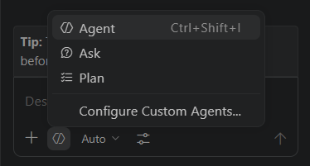
Get set up to vibe - step 3: Understand chat interface
2. Changing the Mode
You can switch between different working modes:
Agent Mode
Makes changes directly in your files based on the prompt
Ask Mode
Used for questions and discussion
Does not modify any files
Useful for exploring ideas before making changes
Plan Mode
Used in early stages of development
Helps brainstorm and structure your approach before implementation

Slide 46
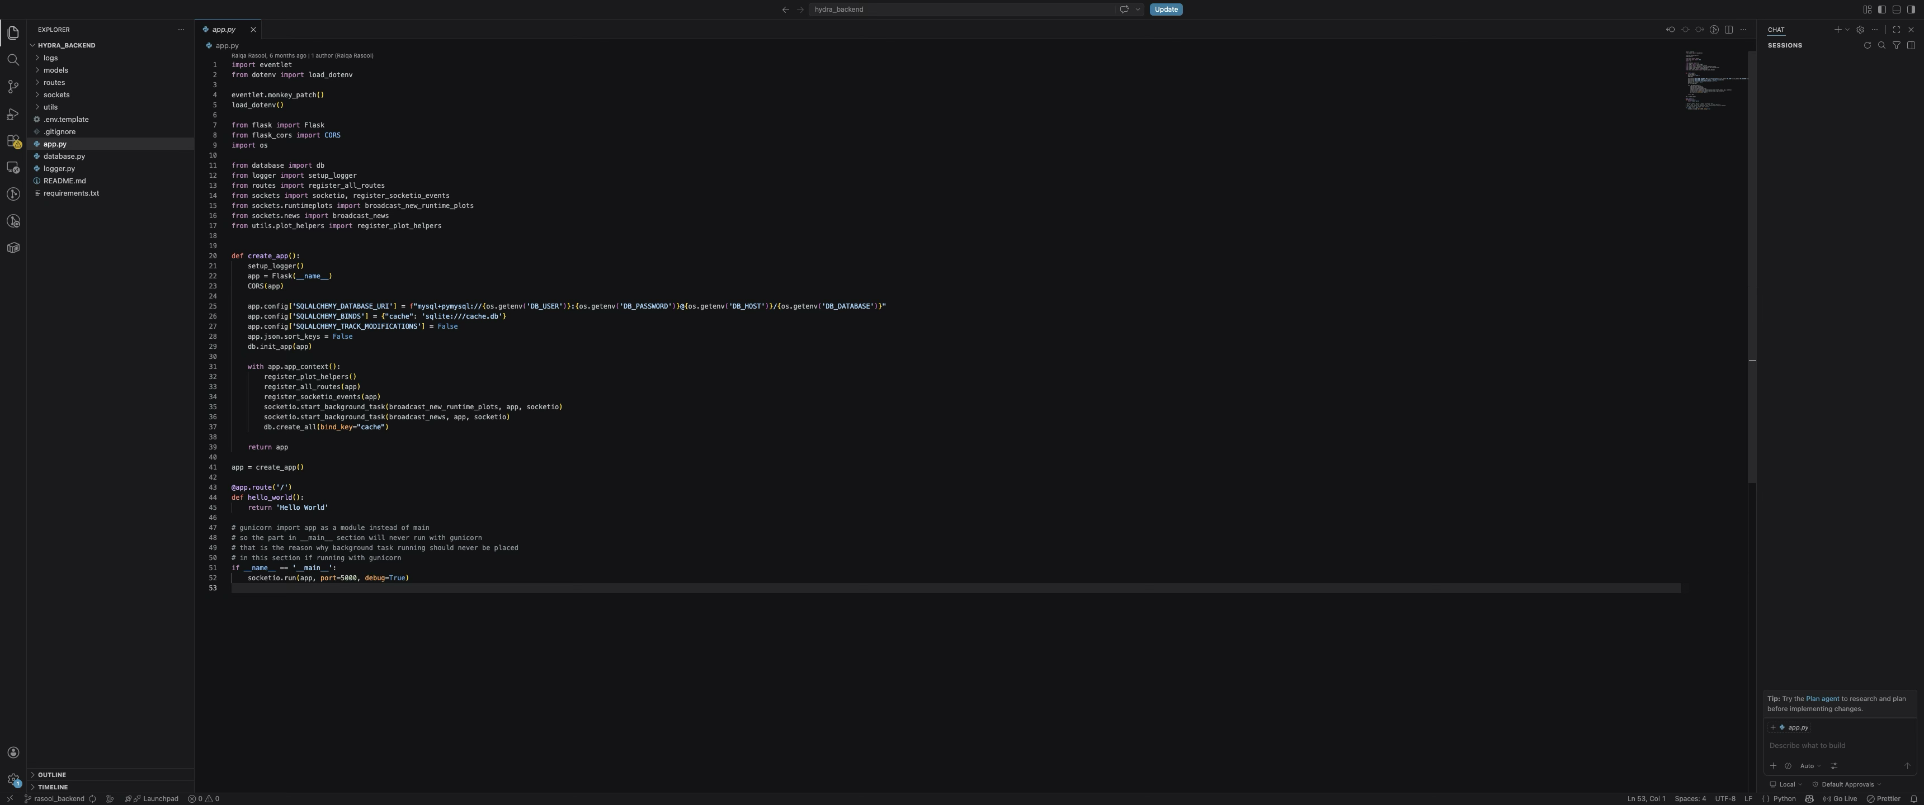
Get set up to vibe - step 3: Understand chat interface
3. Adding Context
Once you open a folder in Visual Studio Code, your workspace becomes available to Copilot as context.
However, explicitly referencing files or code helps the AI focus on the exact parts relevant to your task.
1. Opened files are automatically added as active context

Slide 47
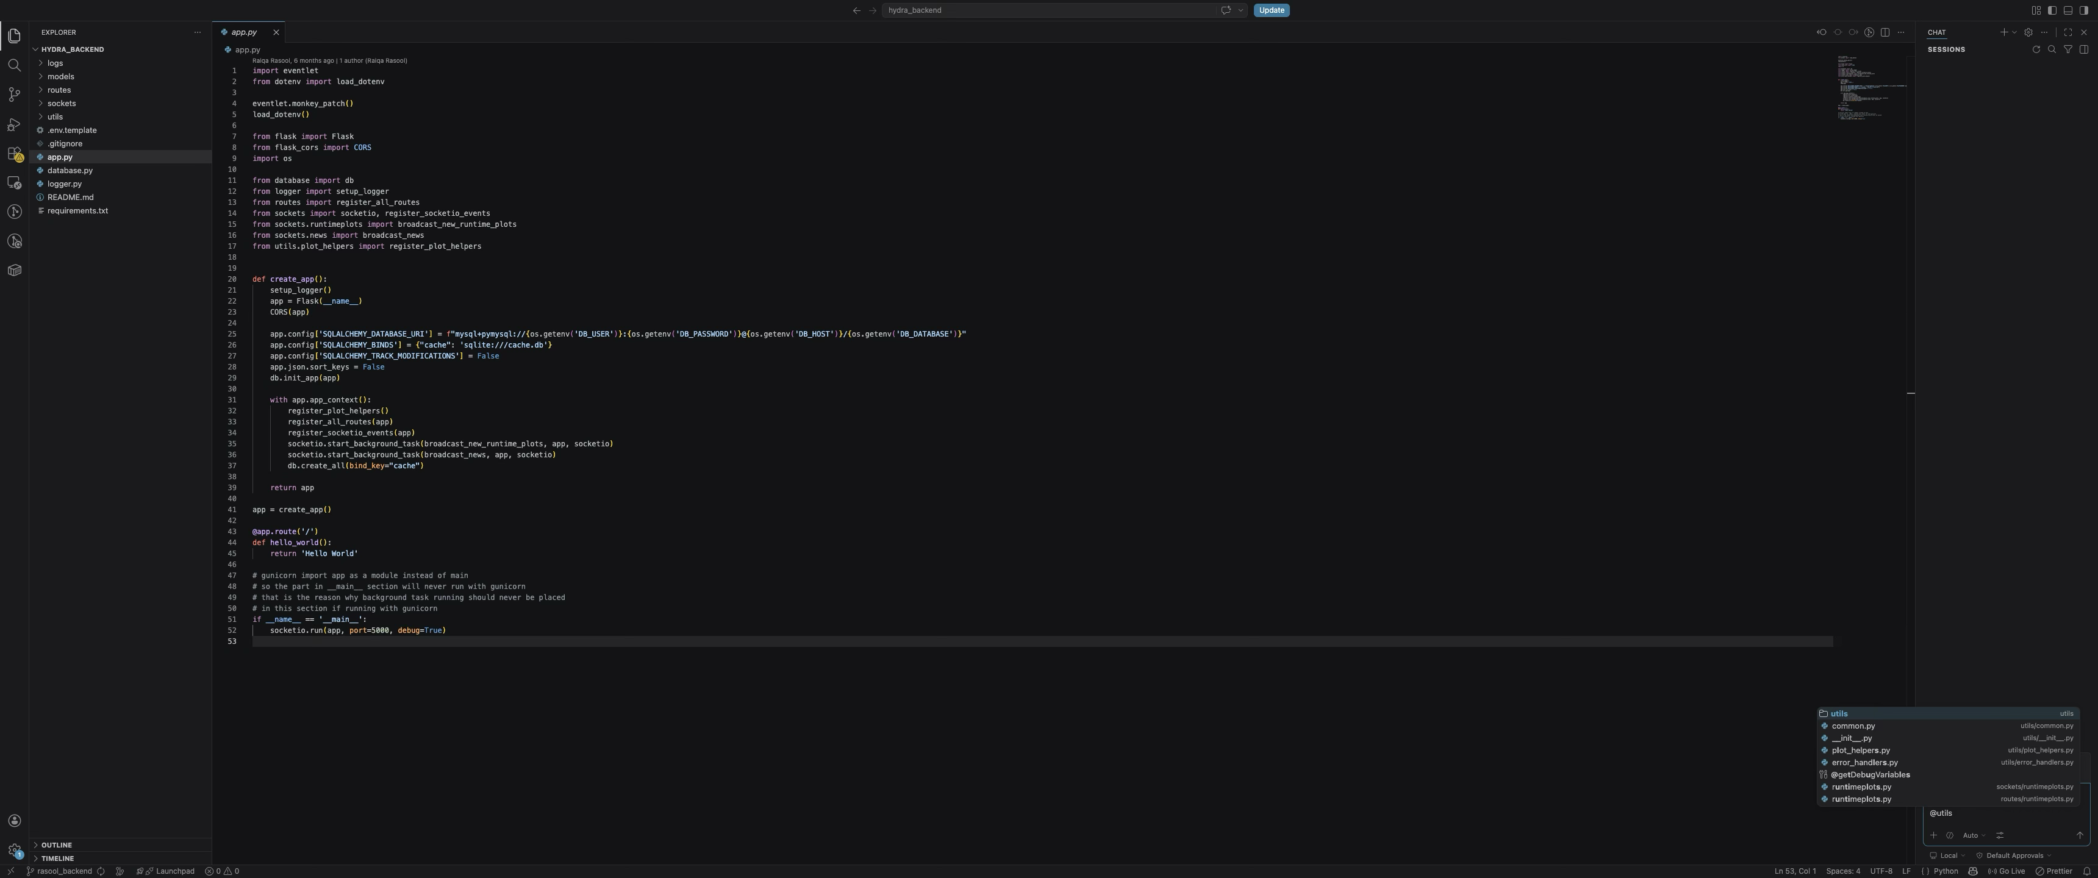
Get set up to vibe - step 3: Understand chat interface
3. Adding Context
Once you open a folder in Visual Studio Code, your workspace becomes available to Copilot as context.
However, explicitly referencing files or code helps the AI focus on the exact parts relevant to your task.
2. Reference specific files/folders directly in chat using #/@ followed by the name
Example: #app.py, @app.py or @utils, #utils
Copilot will understand which file/folder you are referring to.

Slide 48
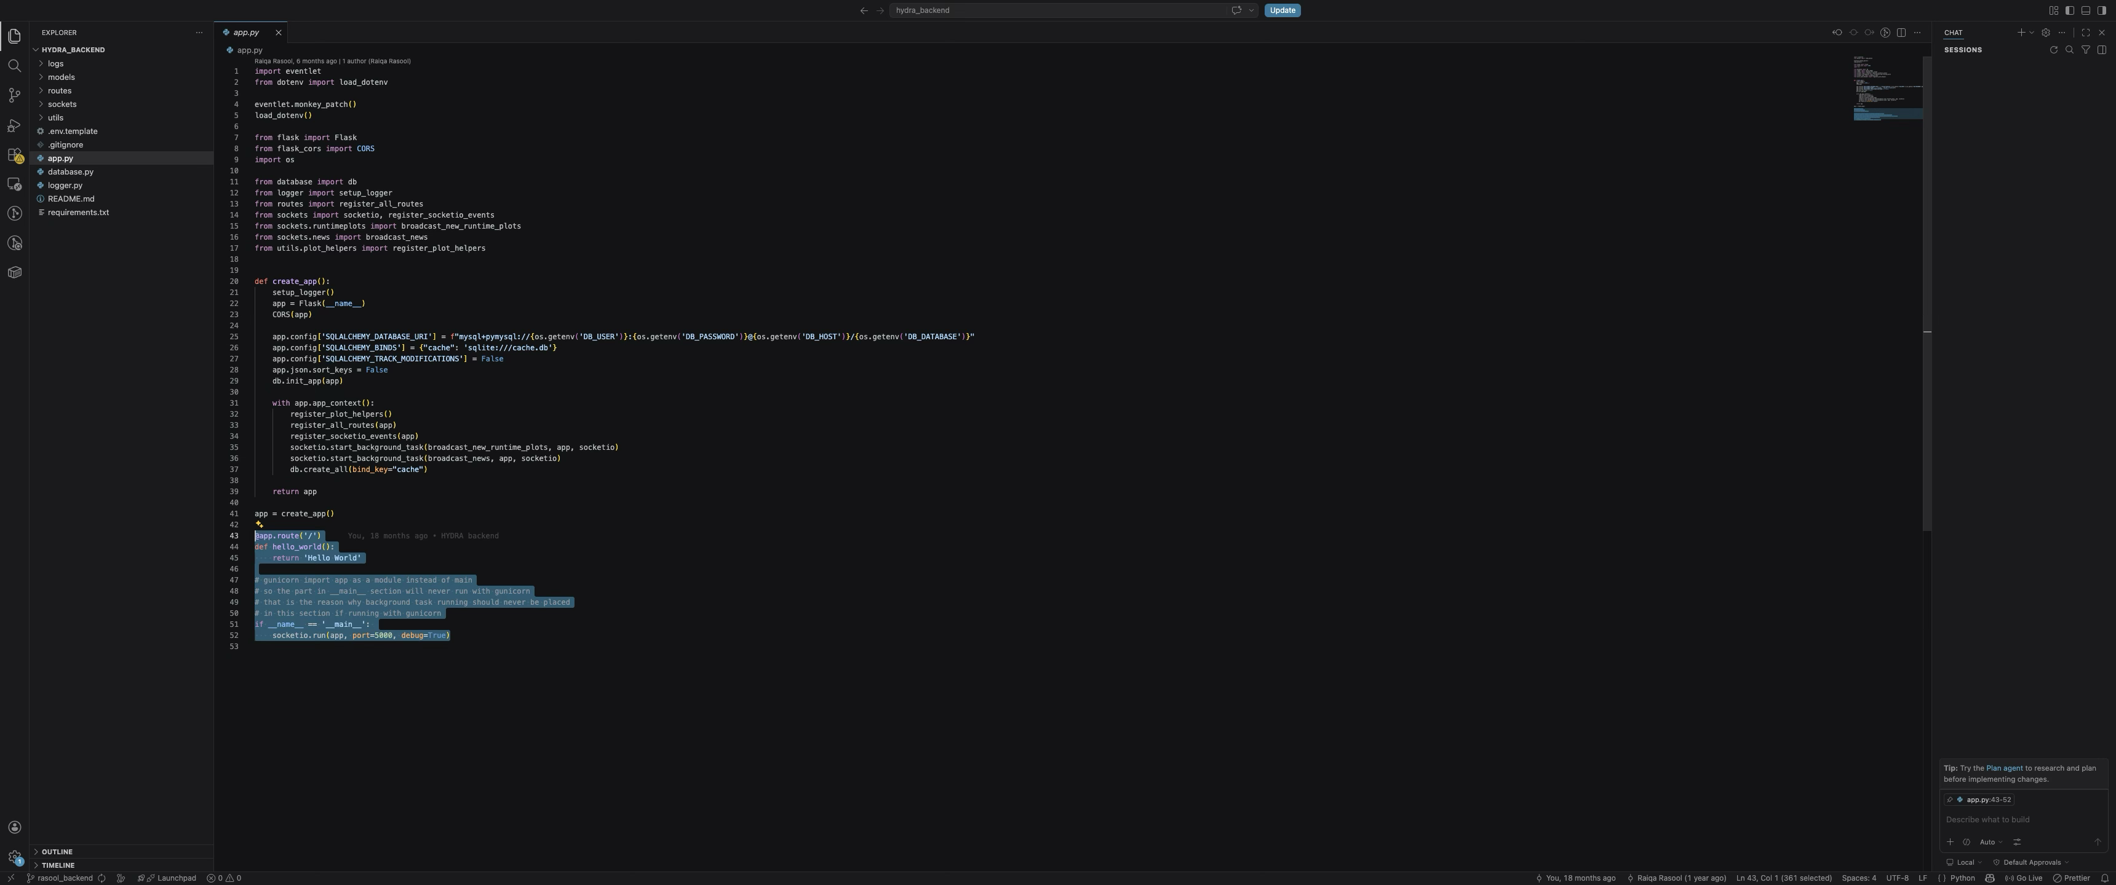
Get set up to vibe - step 3: Understand chat interface
3. Adding Context
Once you open a folder in Visual Studio Code, your workspace becomes available to Copilot as context.
However, explicitly referencing files or code helps the AI focus on the exact parts relevant to your task.
3. Highlight specific lines of code to focus the AI on a particular section

Slide 49
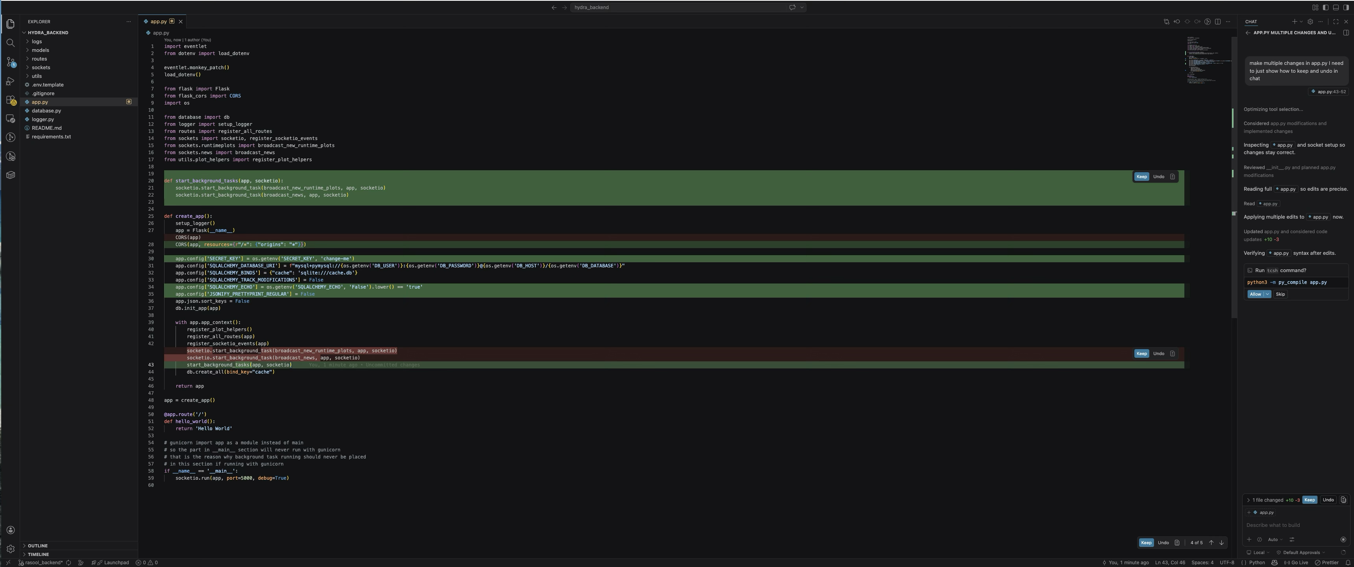
Get set up to vibe - step 3: Understand chat interface
3. Undo / Keep Changes
When you use Copilot Chat (Agent mode) for changes, it edits your files and highlights all modifications:
Green lines = added code
Red lines = deleted code
You can review and control changes in multiple ways:
1. Per line: Hover over changes to keep or undo individual edits

Slide 50
Get set up to vibe - step 3: Understand chat interface
3. Undo / Keep Changes
When you use Copilot Chat (Agent mode) for changes, it edits your files and highlights all modifications:
Green lines = added code
Red lines = deleted code
You can review and control changes in multiple ways:
2. Per file: Use the Undo/Keep in the bottom-right corner to accept or reject all changes within single file

Slide 51
Get set up to vibe - step 3: Understand chat interface
3. Undo / Keep Changes
When you use Copilot Chat (Agent mode) for changes, it edits your files and highlights all modifications:
Green lines = added code
Red lines = deleted code
You can review and control changes in multiple ways:
3. All changes: Use the Keep / Undo option near the chat box to accept or reject all the changes across multiple files

Slide 52
step 4: install remote ssh extension

Slide 53
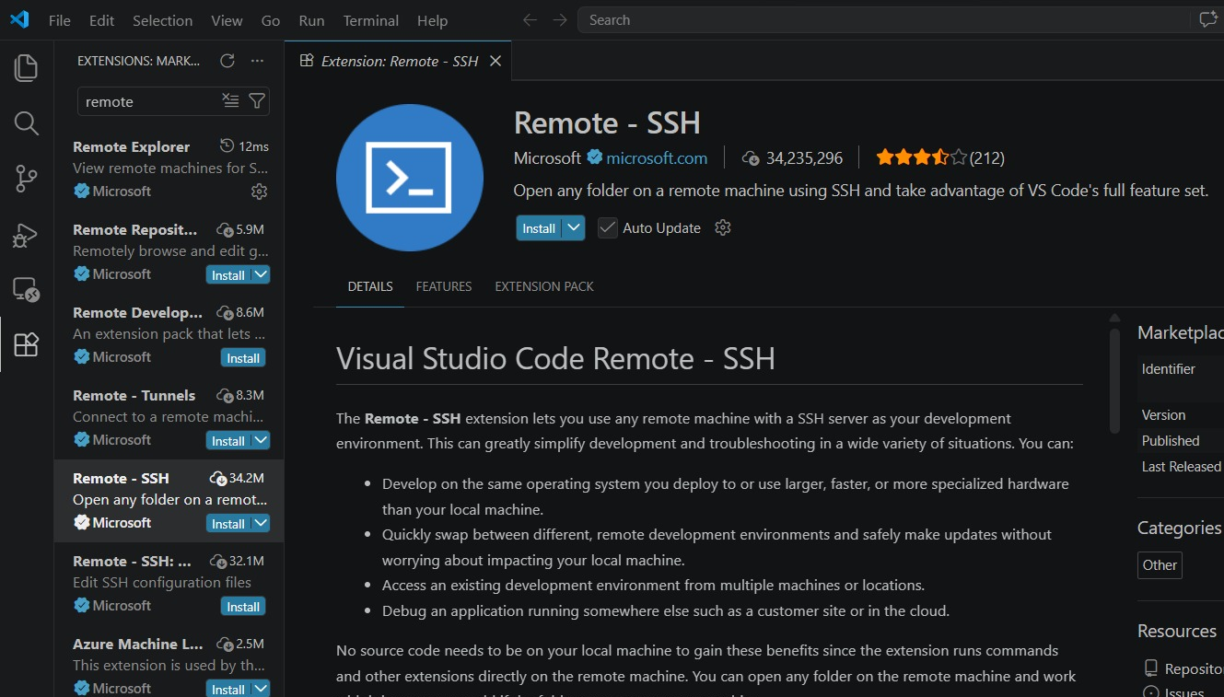
Get set up to vibe - step 4: install remote ssh extension
Open VS Code
Go to Activity Bar and switch to extensions panel and install Remote-SSH extension (search remote)
Extensions
Click here
53

Slide 54
step 5: configure ssh

Slide 55
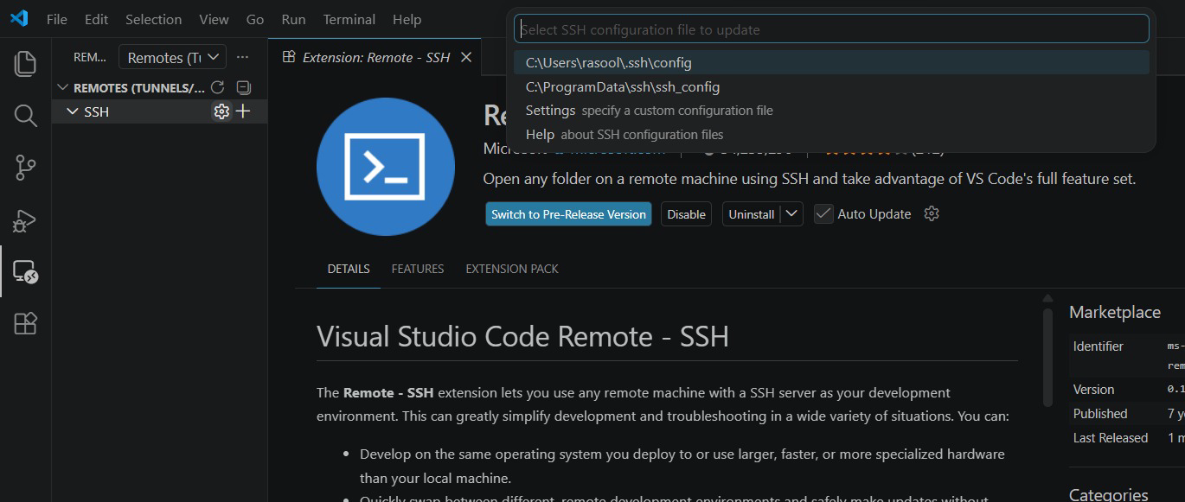
Get set up to vibe - step 5: configure ssh
Go to Remote Explorer panel using Activity Bar and click on settings icon. Now hit enter selecting ~/.ssh/config file

Slide 56
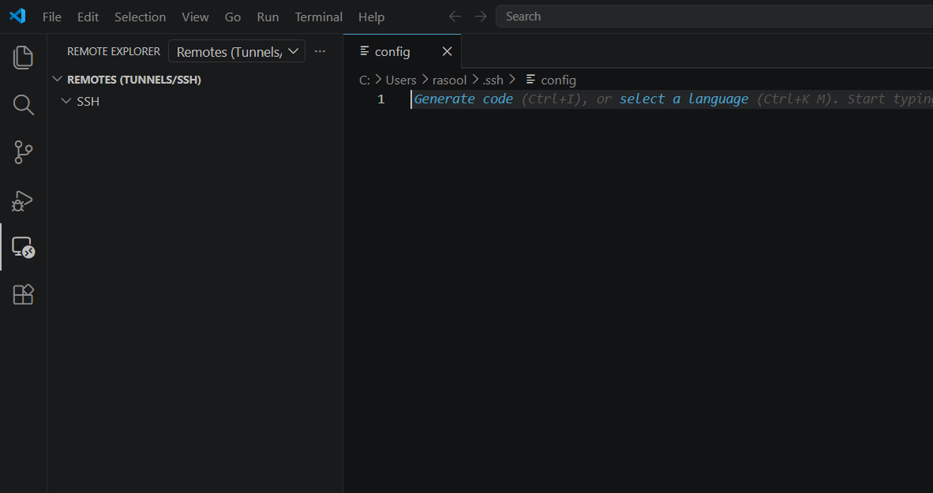
Get set up to vibe - step 5: configure ssh
This will open an empty ~/.ssh/config file to edit:

Slide 57
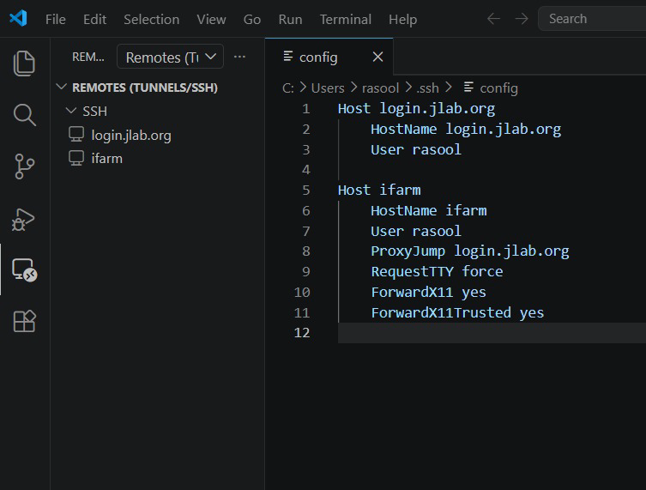
Get set up to vibe - step 5: configure ssh
Paste the exact content into the config file, then press Ctrl/Cmd + S to save. Make sure the indentation (tabs and spacing) is correct.
Host login.jlab.org
HostName login.jlab.org
User <your_jlab_username>
Host ifarm
HostName ifarm
User <your_jlab_username>
ProxyJump login.jlab.org
RequestTTY force
ForwardX11 yes
ForwardX11Trusted yes
You will start seeing host names in the Remote Explorer Panel
Note: Replace <your_jlab_username> with your actual JLab username in the file.

Slide 58
step 6: connect to ifarm

Slide 59
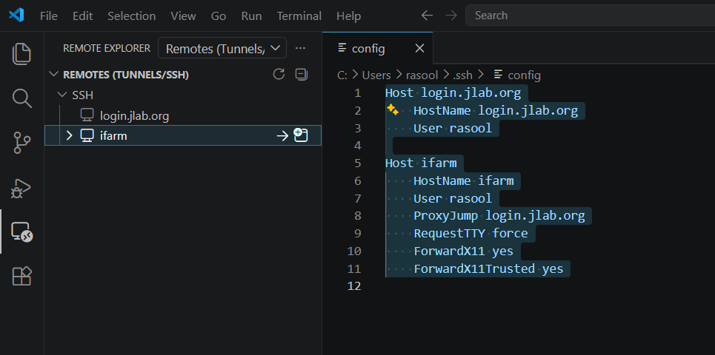
Get set up to vibe - step 6: connect to ifarm
Go to Remote Explorer and click on open in new window icon:

Slide 60
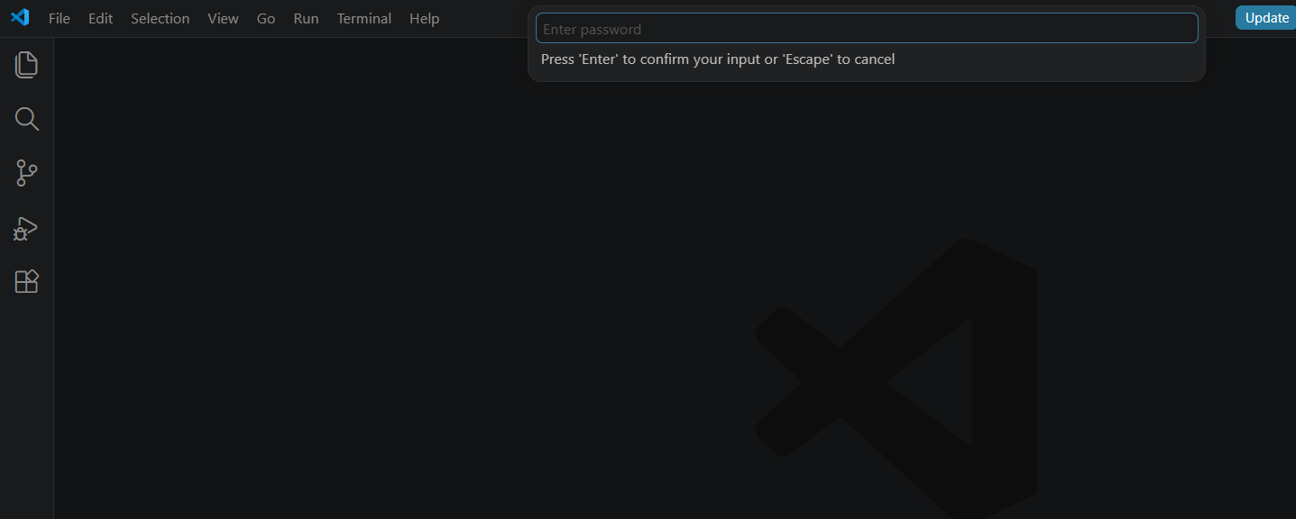
Get set up to vibe - step 6: connect to ifarm
A new window will open with a password prompt.
Enter your 6-digit PIN + MobilePass/USB token.
You are logging into login.jlab.org, which acts as the gateway to access ifarm.
The ProxyJump login.jlab.org setting in the config automatically handles this intermediate step.

Slide 61
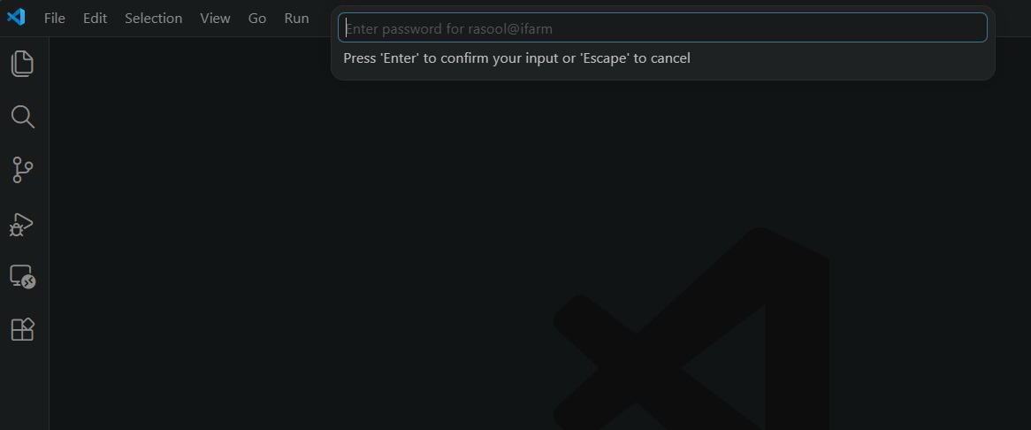
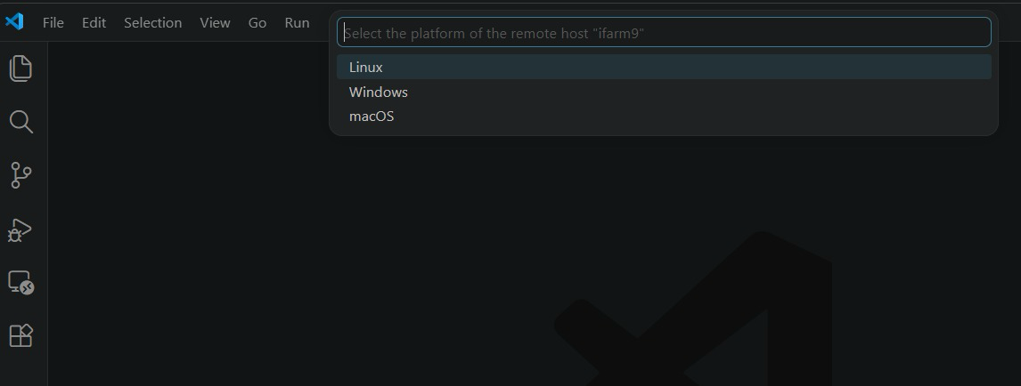
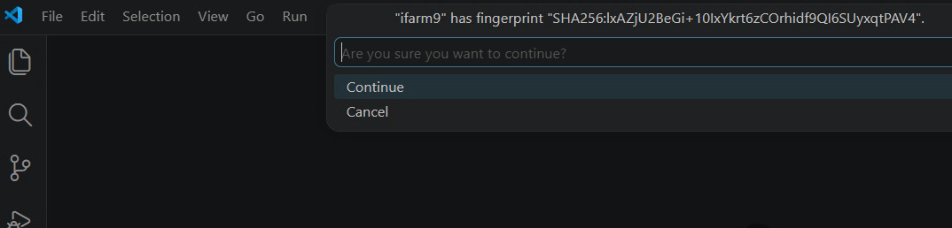
Get set up to vibe - step 6: connect to ifarm
After entering your password for login.jlab.org, a second prompt will appear for @ifarm. Enter your CUE (JLab) account password to complete the login.
For any additional pop-ups, simply select the default trusted option such as “Linux” or “Continue”, depending on what is shown.

Slide 62
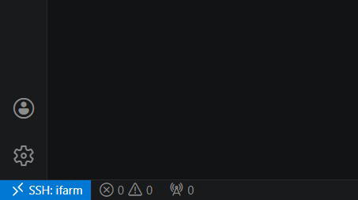
Get set up to vibe - step 6: connect to ifarm
After completing all the prompts, you will be successfully connected to ifarm. You should now see “SSH: ifarm” displayed in the bottom-left corner of VS Code, confirming the connection is active.
62

Slide 63
step 7: open a folder on ifarm

Slide 64
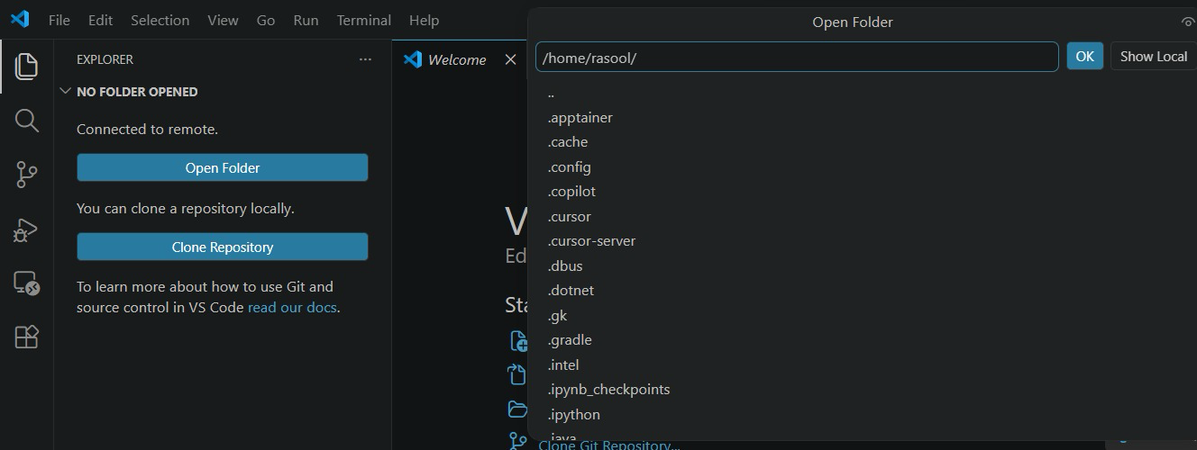
Get set up to vibe - step 7: open a folder
To open a folder on ifarm, go to the Explorer panel in the Activity Bar and click “Open Folder”.
A prompt will appear at the top where you can enter a directory path.
Navigate to the folder where you will be working
Prefer working under /w (assigned by your group/hall)
Note: Avoid using your home directory. It fills up quickly and can cause issues like: VS Code connection failure due to disk quota exceeded errors (Refer to “Navigating ifarm” slides 51–58 for details)
64

Slide 65
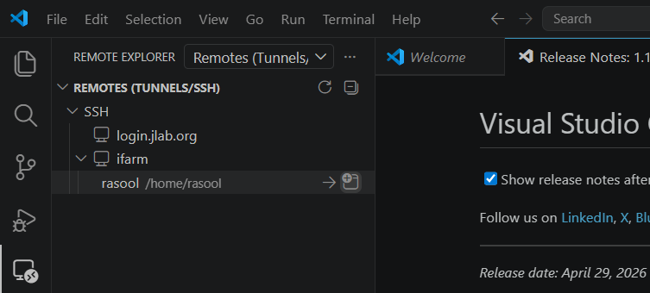
Get set up to vibe - step 7: open a folder
After connecting to a folder once on a host that path get saved and next time you can directly connect to host on that path by just clicking on that path
Open remote folder in current window
Open remote folder in new window
65

Slide 66
step 8: open chat in the folder on ifarm

Slide 67
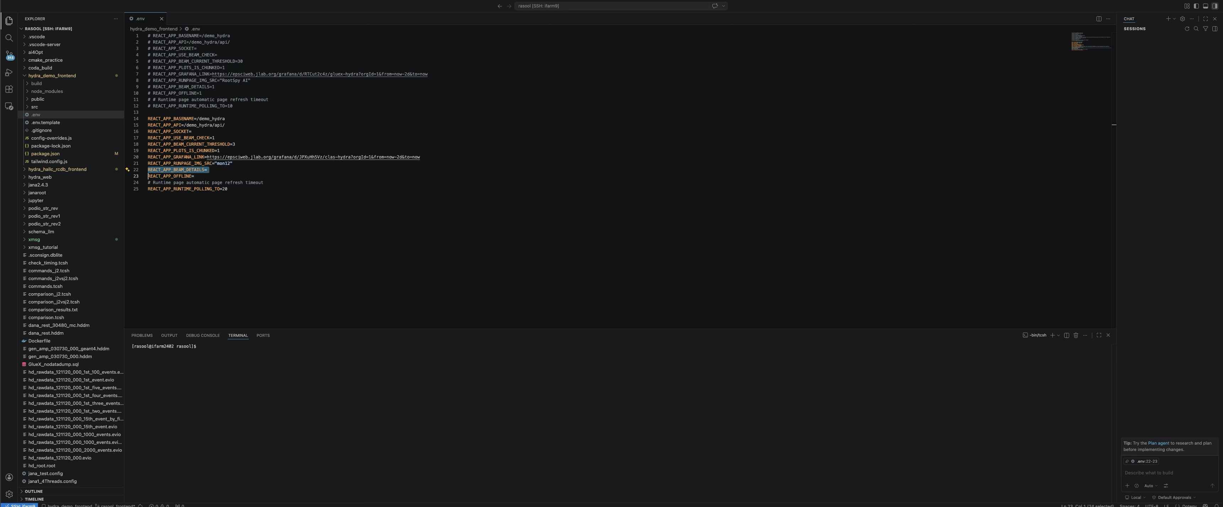
Get set up to vibe - step 8: open chat in the folder
Once you are on ifarm and have navigated to your folder, you can open the side chat panel and start using Copilot to make changes, generate code, or get help with anything in the project.
As mentioned earlier, the entire folder is now available as AI context, so you can reference files, code lines, and other parts of the project directly in your prompts.
Tip: Using Git while vibe coding is a cheat code—you can commit working versions and easily roll back to them if new changes break anything.
67

Slide 68
step 9: X11 forwarding

Slide 69
Get set up to vibe - step 9: X11 forwarding
Running GUI Applications on ifarm
During the hands-on session, we will build and run a GUI application on ifarm while displaying it on your local machine. This requires X11 forwarding.
A detailed explanation of X11 forwarding and multiple setup options are covered in the “Accessing & Navigating farm” session.
https://indico.jlab.org/event/1069/attachments/13992/22682/AccessingAndNavigatingIFarm.pdf
Here, we will use the method with the simplest setup that works across all operating systems.
Steps
Log in to the VDI
Open a Terminal
SSH into ifarm using the -Y flag for X11 forwarding
Navigate to your project directory
Run your application
69

Slide 70


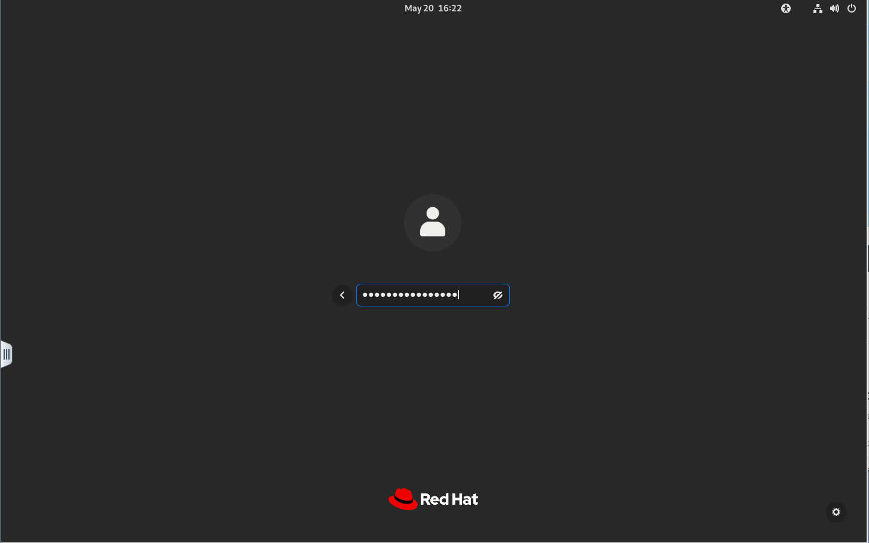

Get set up to vibe - step 9: X11 forwarding
Log in to the VDI
2.
1.
4.
Enter CUE Username​
(Password = MobilePASS SAS MFA PIN+Code​)
Log in with CUE Username and Password​
3.
https://vdi.jlab.org
Select RHEL9 machine (Windows requires SmartCard!!)​
Web access

Slide 71
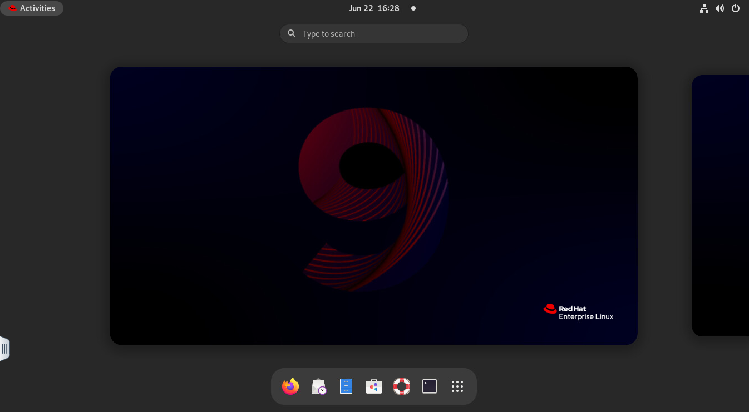
Get set up to vibe - step 9: X11 forwarding
2. Open the terminal
1.
Click activities button
2.
Click Terminal Icon

Slide 72
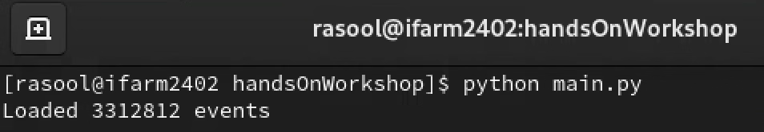
Get set up to vibe - step 9: X11 forwarding
3. SSH into ifarm :
SSH command:
ssh -Y -J <username>@login.jlab.org <username>@ifarm.jlab.org
-Y = X11 forwarding with encryption
-J = ProxyJump
4. Navigate to your project directory
5. Run your app
Enter PIN + USB/MobilePass Token
Enter JLab Account Password
SSH to ifarm

Slide 73
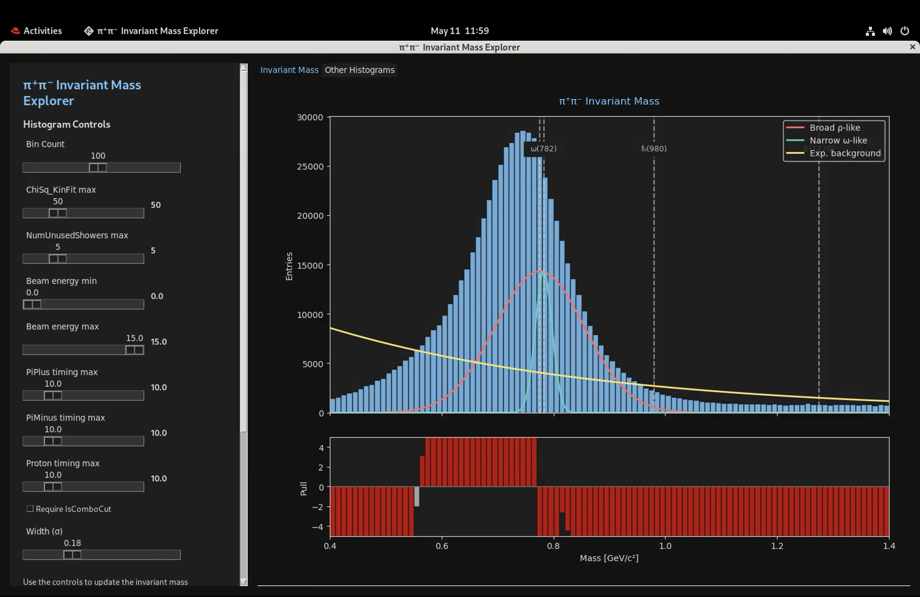
Get set up to vibe - step 9: X11 forwarding
Exiting the GUI Application
The GUI application may open in full-screen mode. To close it, you can use either of the following methods:
Click the close (✕) button on the application window
Or:
Open Activities from the top-left corner
Return to the terminal window
Press Ctrl + C
Wait a few seconds for the application to terminate properly

Slide 74
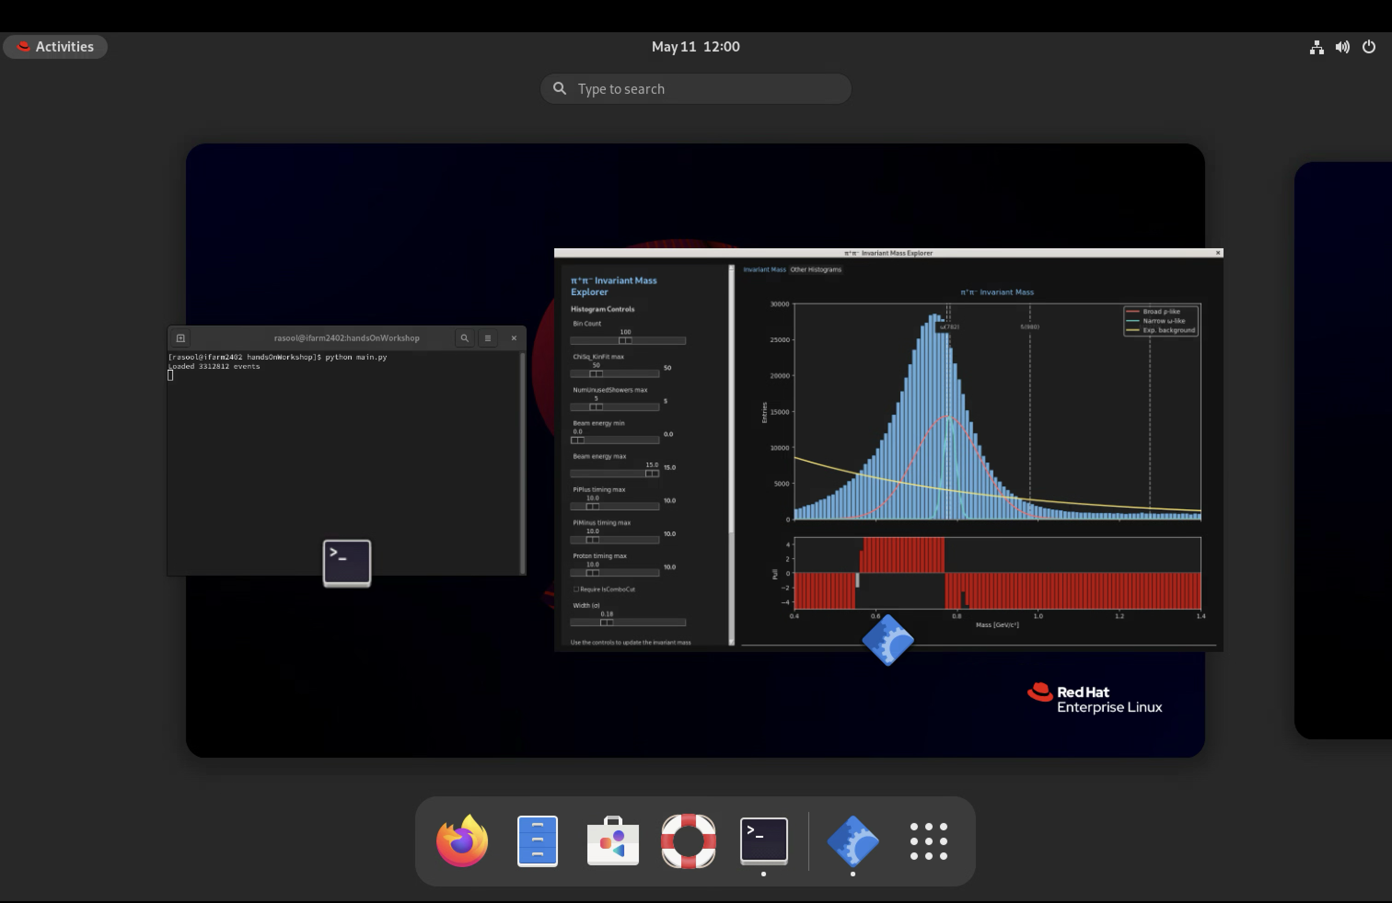
Get set up to vibe - step 9: X11 forwarding
1. Click the Activities on top
Exiting the GUI Application
The GUI application may open in full-screen mode. To close it, you can use either of the following methods:
Click the close (✕) button on the application window
Or:
Open Activities from the top-left corner
Return to the terminal window
Press Ctrl + C
Wait a few seconds for the application to terminate properly
2. Select the terminal to select it
3. Enter Ctrl + C in the terminal

Slide 75
Continuing Your AI Learning Journey

Slide 76
AI Community & Meetups
@ JLab
Weekly informal LLM/AI agent discussions
Wednesdays | 12:00–1:00 PM (lunch)
Scientists share projects, ideas, and new learnings
Contact Thomas Britton for invite: 📧 tbritton@jlab.org
May occasionally be skipped depending on schedule
Not necessarily beginner-focused
@ Peninsula
Peninsula Builders / Developers Study Group
Every other Tuesday | 6:00–7:30 PM
Location: CNU (Luter 170)
Format: 1 hr AI Study + 30 min sharing interesting findings
Hosted by: Raiqa Rasool (rasool@jlab.org)
Details & RSVP: Meetup Link
@ Hampton
The AI Collective Hampton Roads
Free online + in-person AI events (Norfolk & Virginia Beach)
Covers AI tools, workflows, and practical usage
Peninsula Builders Study Group is also part of this network
More info: AI Collective Hampton

Slide 77
Thanks
Any Questions?
May 15, 2026 | rasool@jlab.org

