Slide 1


Why Nuclear Physics Needs Quantum Computers
and What it’s doing with them
Daniel Sierra-Sosa

Slide 2
Outline
Motivation
Why quantum computing?
Hardware landscape: quantum technologies, NISQ devices, and fault tolerance
Quantum basics: qubits, gates, circuits, measurement, and sampling
Simulation workflow: encode → prepare → evolve → measure
Algorithms and noise: QPE, VQE, SQD/QSCI, and error mitigation
Fragment-based quantum simulation and nuclear-physics applications
Hybrid QC-ML
Notes:
Quantum-Selected Configuration Interaction: classical diagonalization of Hamiltonians in subspaces selected by quantum computers

Slide 3
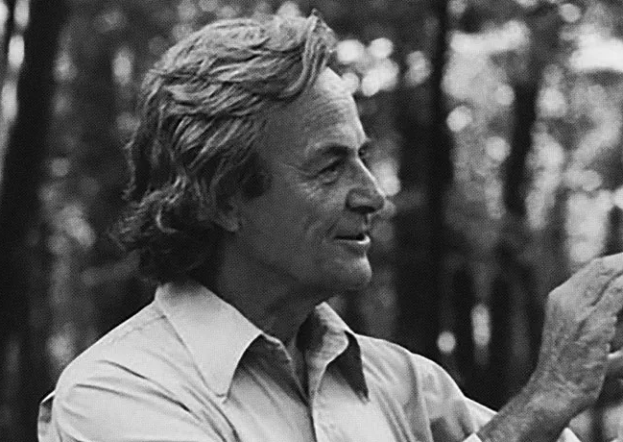
Feynman’s 1982 vision
"… nature isn't classical, dammit, and if you want to make a simulation of nature, you'd better make it quantum mechanical, and by golly it's a wonderful problem, because it doesn't look so easy."
— R. P. Feynman, Int. J. Theor. Phys. 21, 467 (1982)

Slide 4
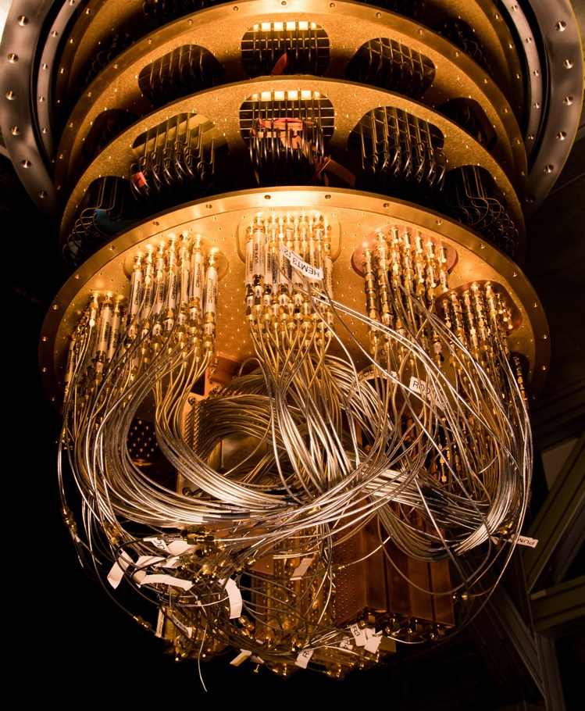
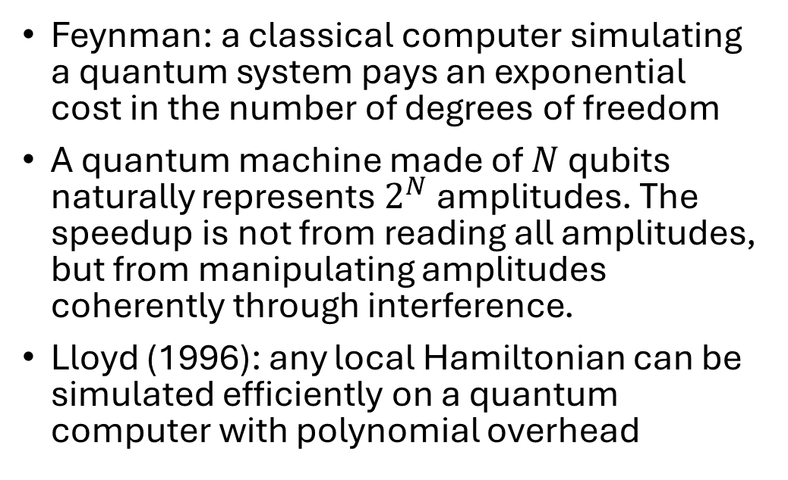
Why Quantum Computers?
Feynman: a classical computer simulating a quantum system pays an exponential cost in the number of degrees of freedom
A quantum machine made of $N$ qubits naturally represents $2^{N}$ amplitudes. The speedup is not from reading all amplitudes, but from manipulating amplitudes coherently through interference.
Lloyd (1996): any local Hamiltonian can be simulated efficiently on a quantum computer with polynomial overhead
Notes:
In Lloyd’s quantum-simulation theorem, a Hamiltonian is “local” if it can be written as a sum of terms where each term acts only on a constant number of degrees of freedom, independent of how large the whole system

Slide 5
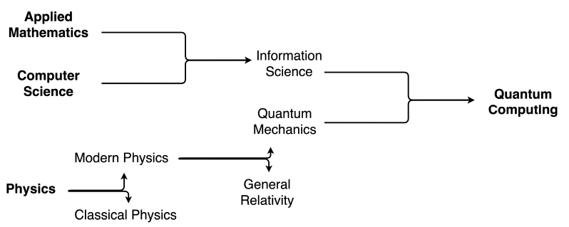
Where quantum computing sits
Taken from: Ayoade, O., Rivas, P., & Orduz, J. (2022). Artificial Intelligence Computing at the Quantum Level. Data, 7(3), 28.

Slide 6
“It is no longer a physicist’s dream—it is an engineer’s nightmare.”
Isaac Chuang

Slide 7
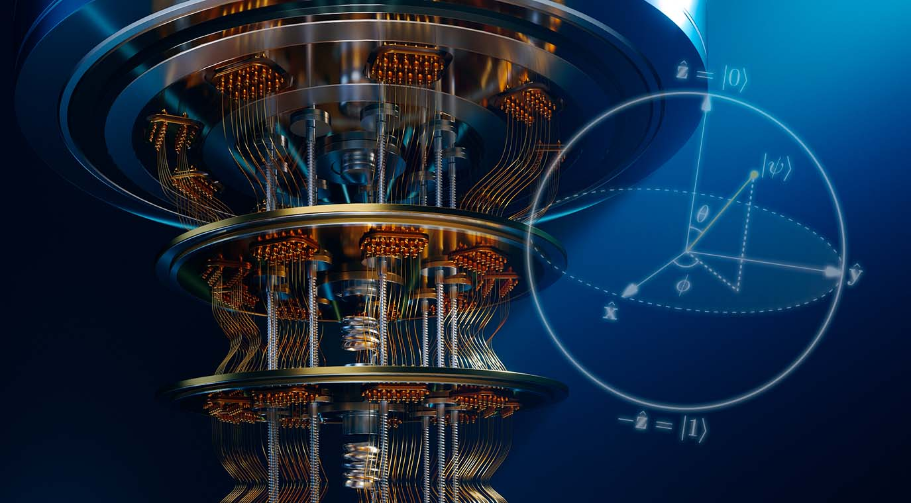
Why now?

Slide 8
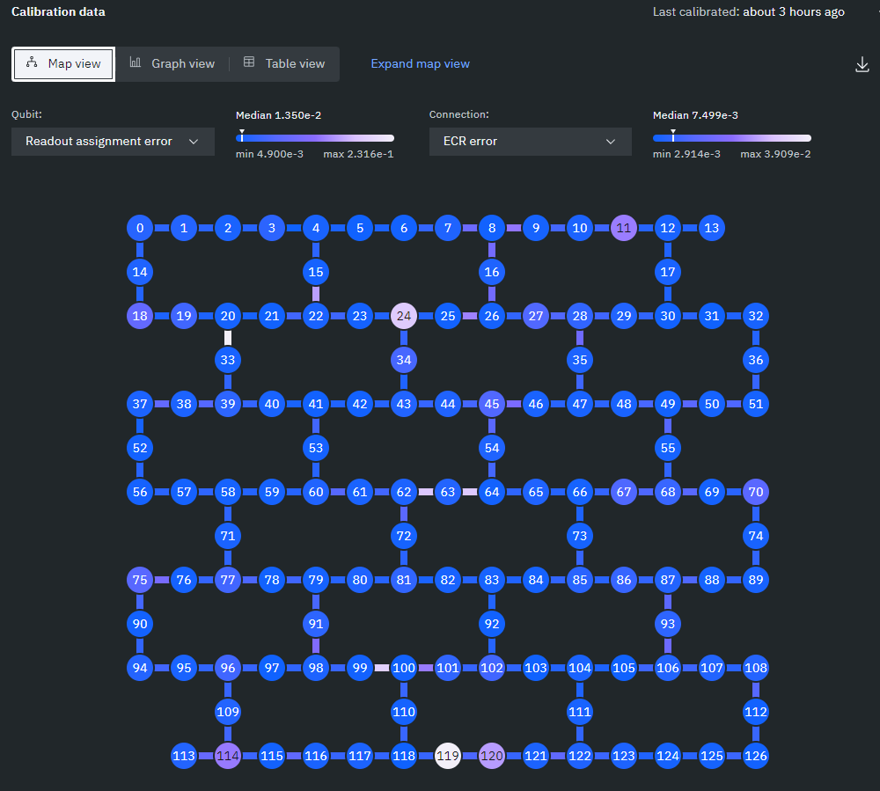
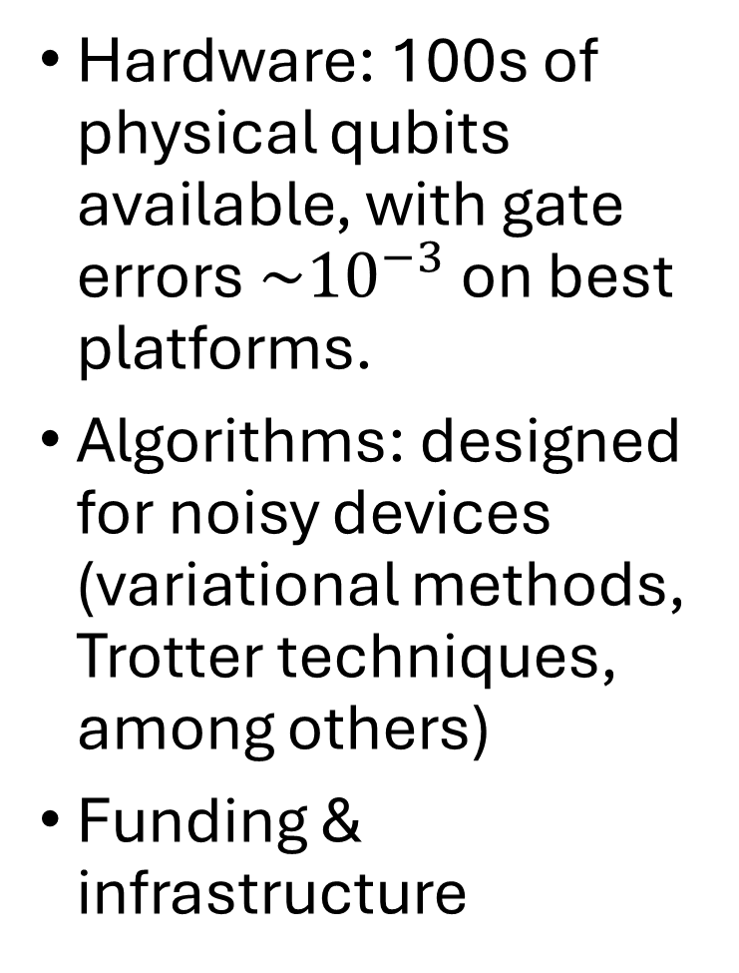
Hardware: 100s of physical qubits available, with gate errors $\sim {10}^{−3}$ on best platforms.
Algorithms: designed for noisy devices (variational methods, Trotter techniques, among others)
Funding & infrastructure
Notes:
[BACKGROUND] The acronyms: NQI = National Quantum Initiative (2018 US law). IQuS (U. Washington, Savage's institute), SQMS (Fermilab), QSC (Oak Ridge), InQuBaTE (Argonne... if asked, these are DOE quantum centers/testbeds; your hosts may belong to one — check the lab's affiliation beforehand and name-drop it).
FIGURE: vendor-announced physical qubit counts; stress that the field is pivoting from counts to fidelity + logical qubits — you are the expert here, own this slide.

Slide 9

Notes:
https://www.qureca.com/quantum-initiatives-worldwide/

Slide 10
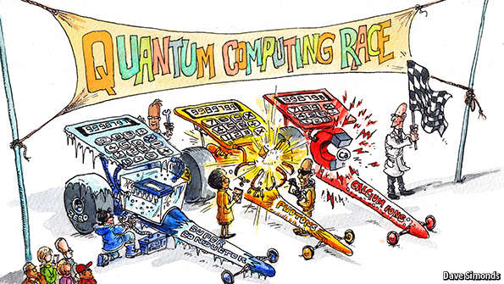







Quantum Technologies
Superconducting Architecture
Trapped Ions
Topological
Photonic
Notes:
Trapped Ions
Ion trap quantum computing typically operates on a qubit register formed by a linear string of ions confined in a radio frequency trap. Each physical qubit is based on two internal levels of a single ion. Gate operations use microwave or laser fields (Fail Scalability)
Superconducting Circuits
Special electrical circuits can behave like ‘artificial atoms’. These circuits are made from superconducting materials (such as aluminium and niobium), cooled to very low temperatures and operated with microwave radiation (Designing and fabricating large scale superconducting circuits addressing all circuit elements without crosstalk is challenging)
Impurity Spins
In this scheme, defects in a material such as diamond or silicon are used as qubits.
Example: Diamond is made up of a regular lattice of carbon atoms. If a carbon atom is missing this forms a vacancy. If a nitrogen atom is sitting in the lattice in place of a carbon atom and happens to be next to a vacancy, then this forms a special defect called a ‘nitrogen-vacancy’ (NV) center. The electrons associated with this center when subjected to a magnetic field, the electronic spin can be up, down or in a superposition of the two. This then forms a qubit.

Slide 11
NISQ vs fault-tolerant quantum computing
NISQ (today → ~5 yr)
Fault-tolerant (10+ yr horizon)
10² – 10³ physical qubits
Two-qubit gate error 10⁻³ – 10⁻²
Shallow circuits, hybrid with classical
Variational, error mitigation
Demonstrations, benchmarks, small problems
10⁶+ physical qubits → 10³ logical
Effective error 10⁻¹⁰ or better
Deep circuits with error correction
QPE, Trotterized dynamics, HHL
Quantitative ab initio nuclear physics
Roadmaps are targets, not guarantees.
Preskill, Quantum 2, 79 (2018): "Quantum Computing in the NISQ Era and Beyond".
Notes:
SAY: The two-column slide that sets the timeline honesty for everything after. NISQ: variational + error mitigation, demos. FT: QPE + Trotter, quantitative ab initio physics.
[BACKGROUND] Anchor numbers to remember if asked: surface-code overhead ~1000 physical/logical at current error rates; recent logical-qubit demos (Harvard/QuEra neutral atoms, Google Willow below-threshold) are the first steps on the right column.
Let them locate their own problem on this divide; slide 48 does it explicitly.

Slide 12
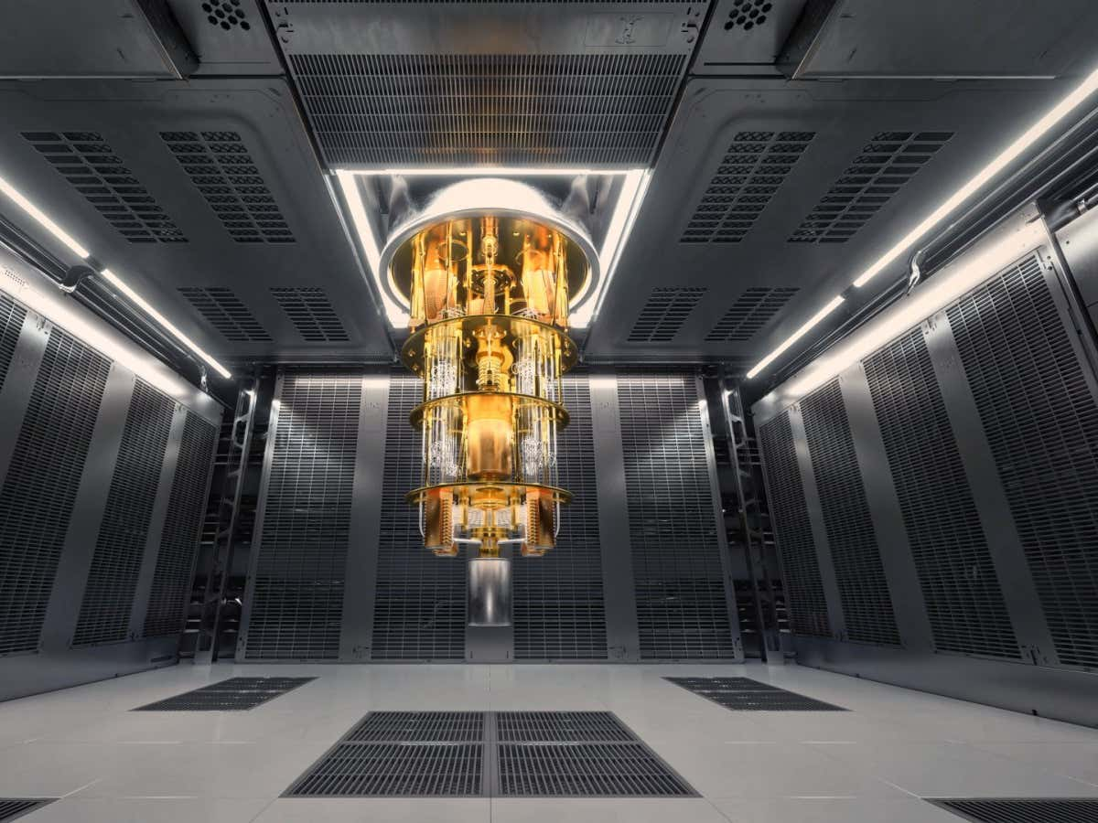
The Basics

Slide 13
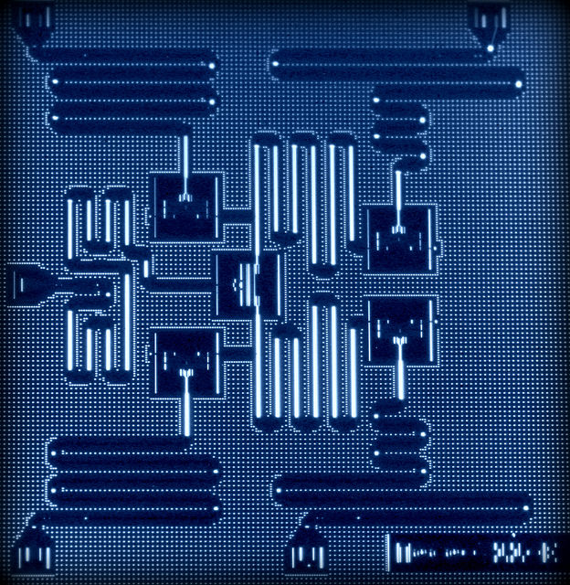
Requirements for a Quantum Computer
A scalable physical system with well characterized qubits
The ability to initialize the state of the qubits to a simple state
Long decoherence times, much longer than the gate operation time
A “universal” set of quantum gates
A qubit-specific measurement capability
Two criteria requiring the possibility to transmit information:
The ability to interconvert stationary and flying qubits.
The ability to faithfully transmit flying qubits between specified locations.
Layout of IBM’s five superconducting quantum bit device. (credit: IBM Research)
DiVincenzo, D. P. (2000). The physical implementation of quantum computation. Fortschritte der Physik: Progress of Physics, 48(9‐11), 771-783.

Slide 14
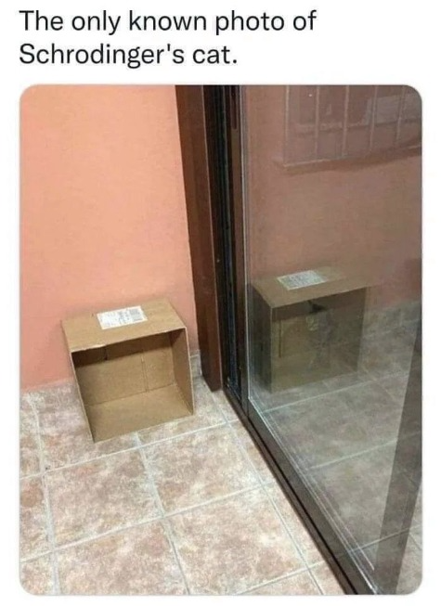
Postulates of Quantum Mechanics
State Space: Describes the state of a closed system.
Evolution: describes the evolution of a closed system.
Measurement: describes how information is extracted from a closed system via interactions with an external system.
Composite systems: describes the state of a composite system in terms of its component parts

Slide 15
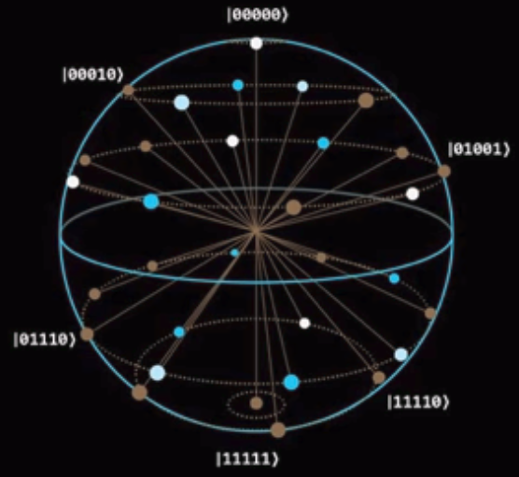
Quantum algorithms
A quantum algorithm consists of three basic steps:
  Encoding of the data, which could be classical or quantum, into the state of a set of input qubits.
  A sequence of quantum gates applied to this set of input qubits.
  Measurements of one or more of the qubits at the end to obtain a classically interpretable result.

Slide 16
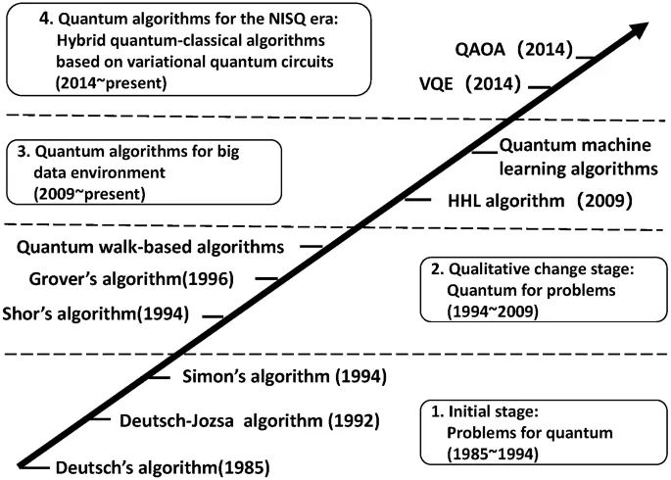
Zhang, S., & Li, L. (2022). A brief introduction to quantum algorithms. CCF Transactions on High Performance Computing, 4(1), 53-62.

Slide 17
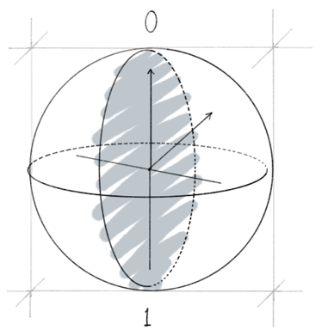

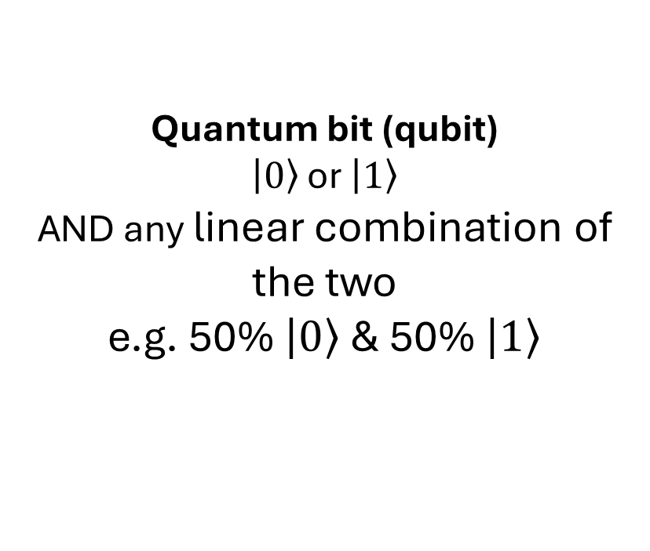
Classical vs quantum bits
Quantum bit (qubit)
$\left.\left|0\right.\right\rangle$ or $\left.\left|1\right.\right\rangle$
AND any linear combination of the two
e.g. 50% $\left.\left|0\right.\right\rangle$ & 50% $\left.\left|1\right.\right\rangle$
Classical bit (bit)
Only two possible states​
0 and 1​
Like the two faces of a coin
Heads or tails

Slide 18
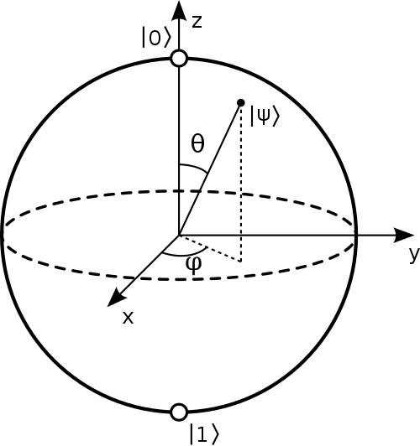
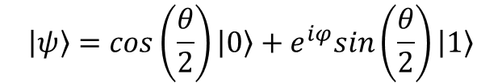

Quantum State (qubit)
Mathematically represented as a vector, or a point on the surface of the Bloch sphere:
$$\left.\left|ψ\right.\right\rangle =cos\left(\frac{θ}{2}\right)\left.\left|0\right.\right\rangle +e^{iφ}sin\left(\frac{θ}{2}\right)\left.\left|1\right.\right\rangle$$
$${\left|α\right|}^{2}+{\left|β\right|}^{2}=1$$
α
β
Measurement = projection of state to a basis vector (changes the state – superposition is destroyed)
Quantum gate is a transformation from one qubit state to another. Single-qubit gate = rotation around Bloch sphere. Reversible.
Represented by a matrix (unitary, …) acting on the vector.

Slide 19
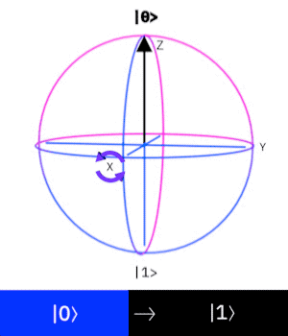
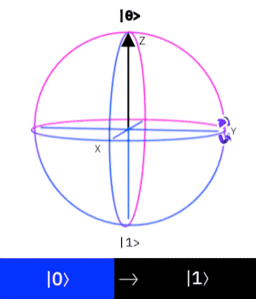
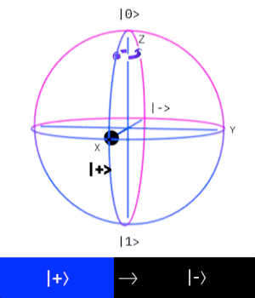



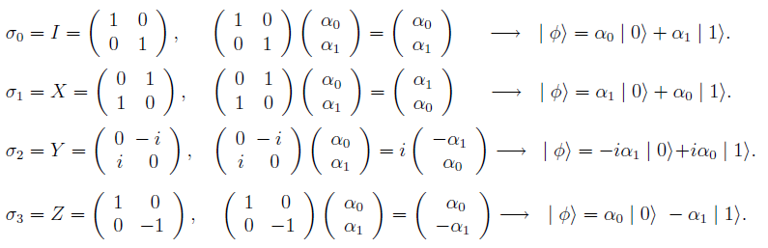
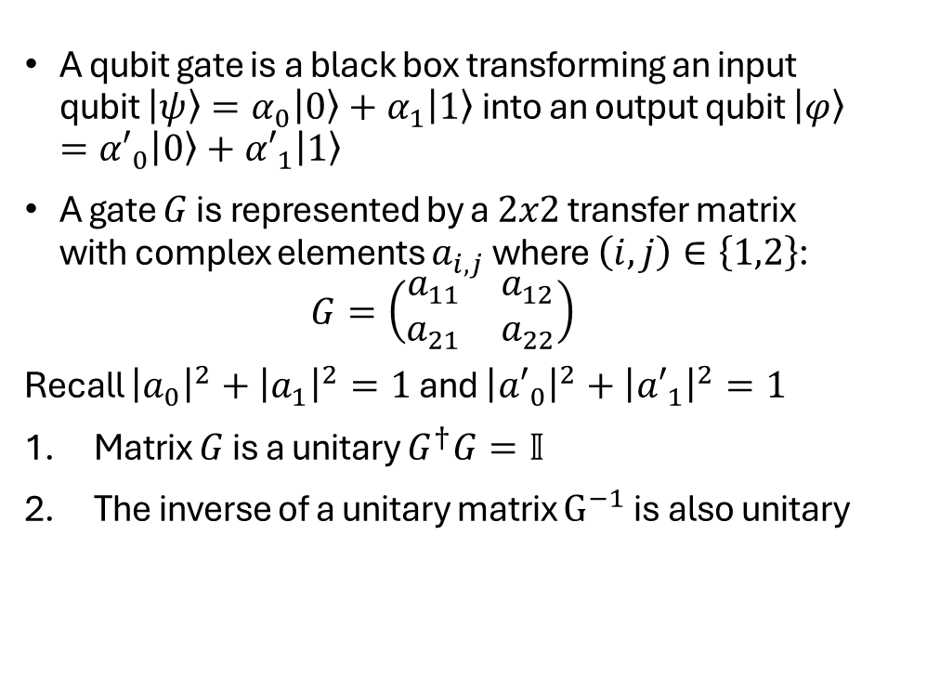
Qubit Gates
A qubit gate is a black box transforming an input qubit $\left|\left.ψ\right\rangle \right.=α_{0}\left|\left.0\right\rangle \right.+α_{1}\left|\left.1\right\rangle \right.$ into an output qubit $\left|\left.φ\right\rangle \right.={α′}_{0}\left|\left.0\right\rangle \right.+{α′}_{1}\left|\left.1\right\rangle \right.$
A gate $G$ is represented by a $2x2$ transfer matrix with complex elements $a_{i,j}$ where $\left(i,j\right)∈\left\{1,2\right\}$:
$$G=\left(\begin{matrix}a_{11} & a_{12} \\ a_{21} & a_{22}\end{matrix}\right)$$
Recall ${\left|a_{0}\right|}^{2}+{\left|a_{1}\right|}^{2}=1$ and ${\left|{a′}_{0}\right|}^{2}+{\left|{a′}_{1}\right|}^{2}=1$
Matrix $G$ is a unitary $G^{†}G=𝕀$
The inverse of a unitary matrix $G^{−1}$ is also unitary

Slide 20
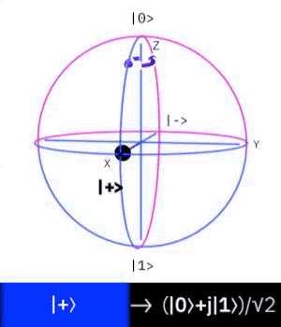
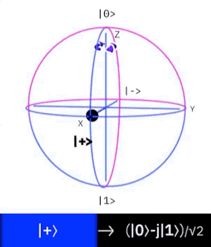


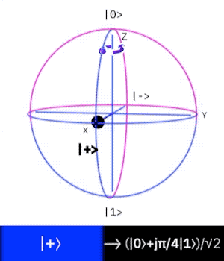



Qubit Gates Phase: Z, S, T

Slide 21
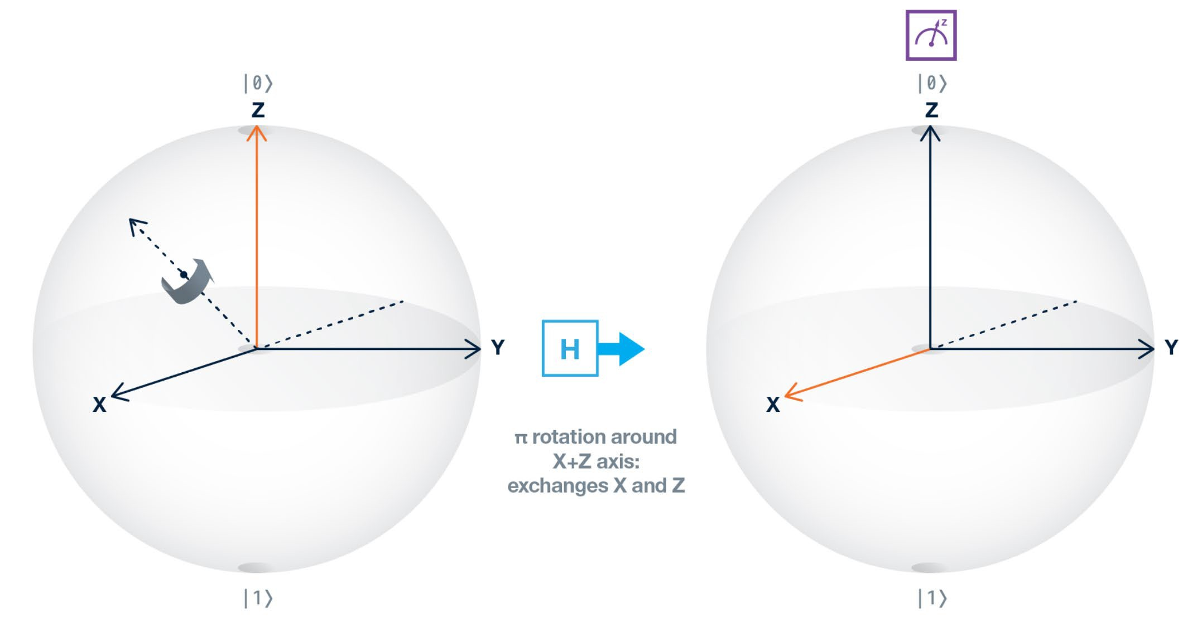
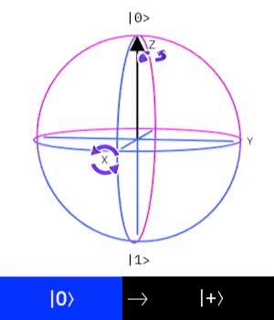
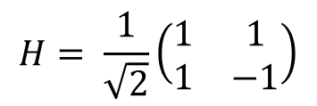
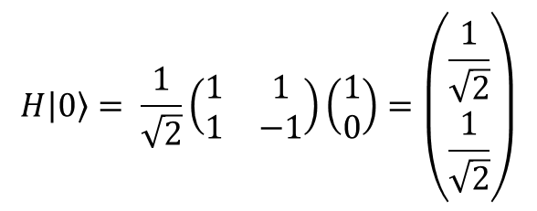
Hadamard (H) Gate: Superposition
$$H\left.\left|0\right.\right\rangle = \frac{1}{\sqrt{2}}\left(\begin{matrix}1 & 1 \\ 1 & −1\end{matrix}\right)\left(\begin{matrix}1 \\ 0\end{matrix}\right)=\left(\begin{matrix}\frac{1}{\sqrt{2}} \\ \frac{1}{\sqrt{2}}\end{matrix}\right)$$
$$H= \frac{1}{\sqrt{2}}\left(\begin{matrix}1 & 1 \\ 1 & −1\end{matrix}\right)$$

Slide 22
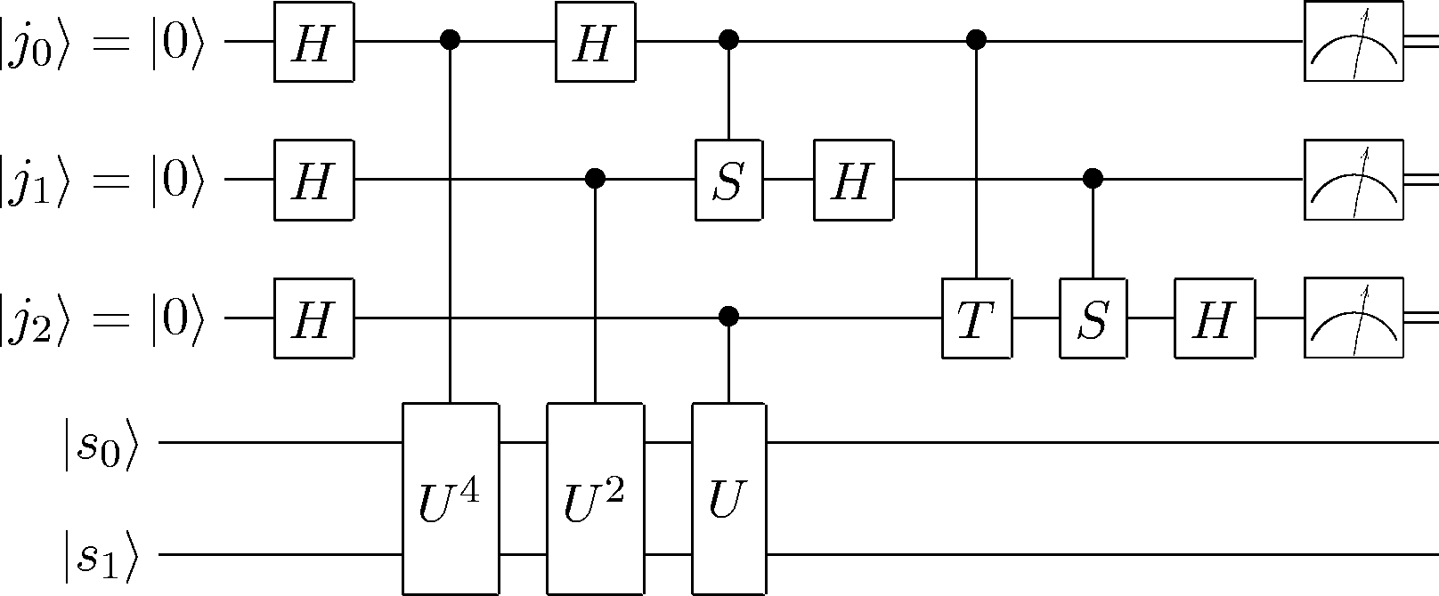
Quantum Circuits
Time flows left to right.
Quantum gates (operators) are applied sequentially to qubit states, with result shown on the right.
Measurement:
  Double line represents classical bit.
  Measurement is in the standard basis
Any quantum transformation can be realized in terms of the basic gates of the standard circuit model.

Slide 23
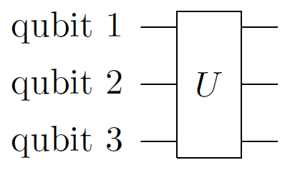
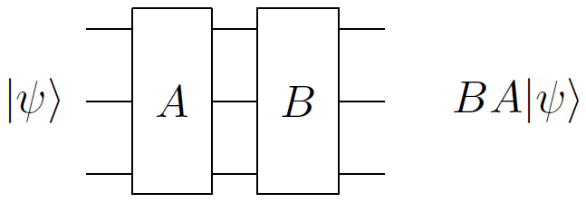
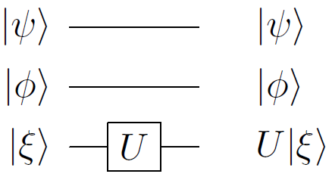
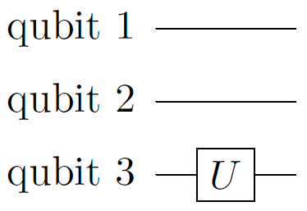
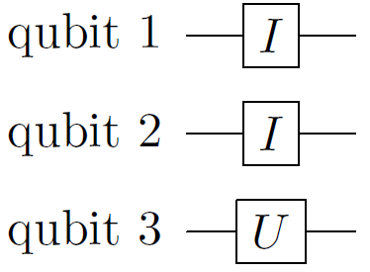
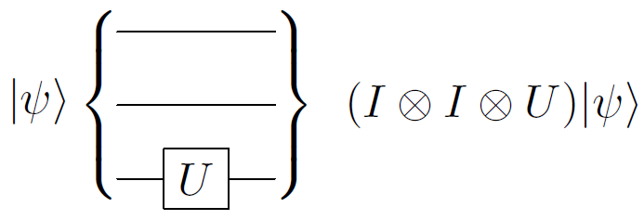
Notation for quantum circuits
=
=

Slide 24
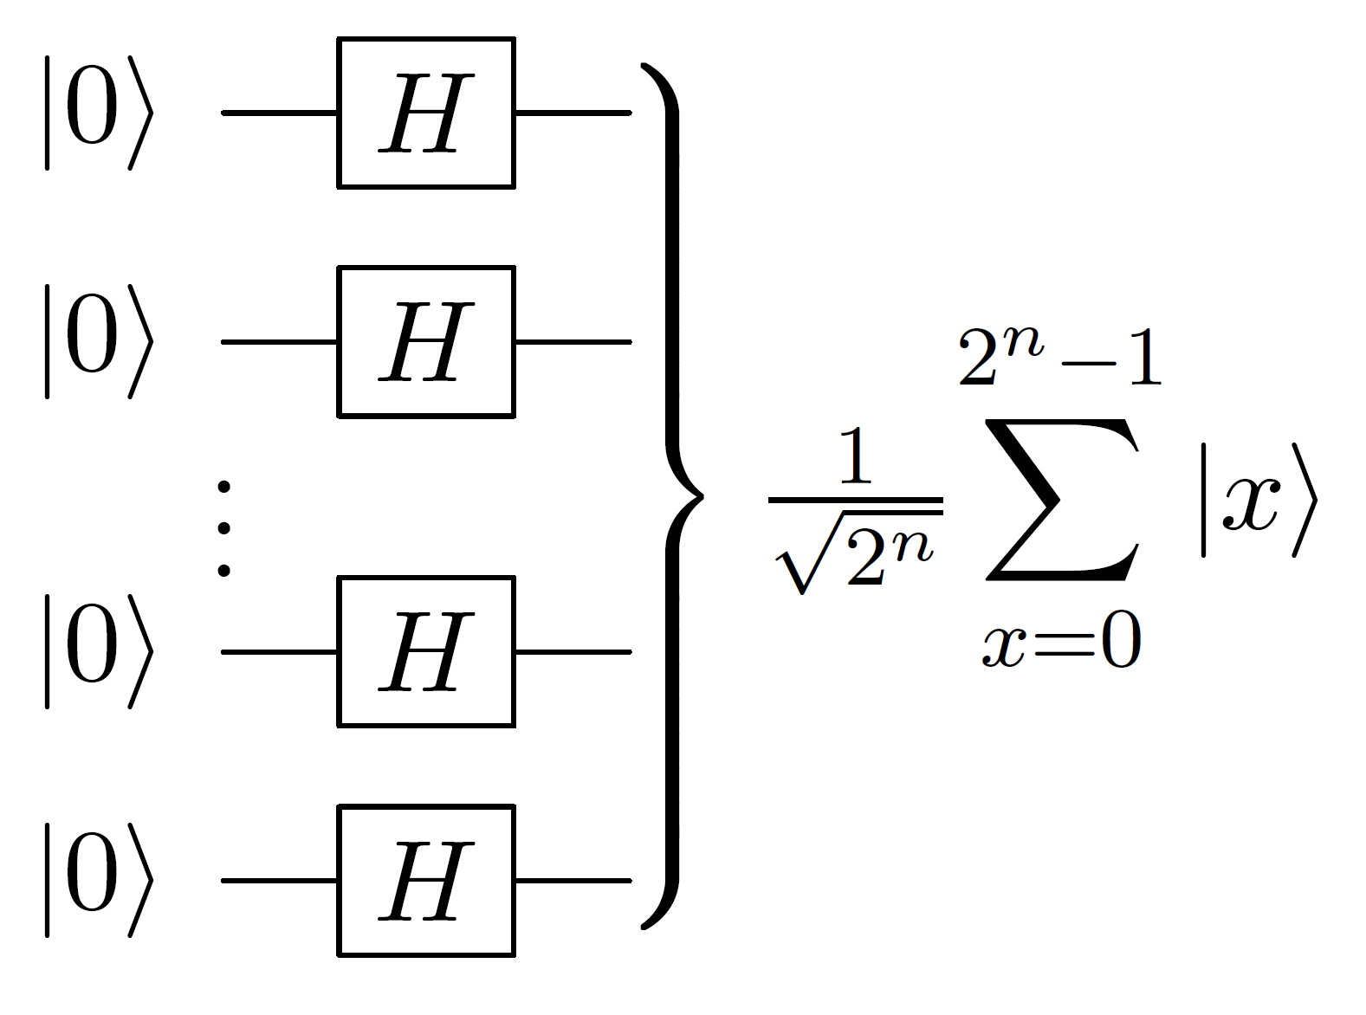
Walsh-Hadamard Transform
Used in the setup phase of algorithms, to create a superposition of all inputs.
Transformations occur on all components of the superposition. This is the source of quantum parallelism.

Slide 25

Quantum Simulation

Slide 26

Two styles: digital vs analog
Digital (gate-based): write the evolution as a circuit of discrete gates; universal, programmable, and compatible with error correction
  Almost every nuclear-physics result so far is digital, on superconducting or trapped-ion hardware
Analog: engineer a physical device whose natural Hamiltonian is the one you want (cold atoms, ion crystals, Rydberg arrays)
  Fewer knobs, but far less overhead: a strong match for lattice gauge theories and spin models
Hybrid digital-analog approaches are an active middle ground
Daley et al., Nature 607, 667 (2022): practical quantum advantage via analog simulation.
Notes:
Keep it crisp. Digital = programmable circuit, what almost all nuclear demos use. Analog = build the Hamiltonian physically, great for gauge theories and the neutrino spin model in Part III. Plant that forward reference.

Slide 27
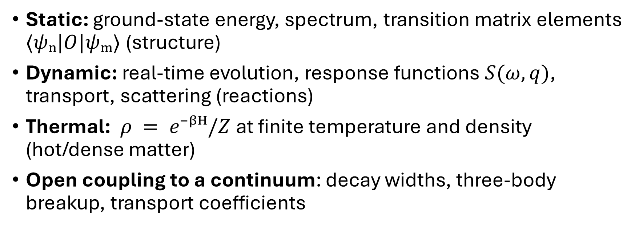
Four questions you can ask a Hamiltonian
Static: ground-state energy, spectrum, transition matrix elements $⟨ψₙ|O|ψₘ⟩$(structure)
Dynamic: real-time evolution, response functions $S(ω,q)$, transport, scattering (reactions)
Thermal: $ρ = e⁻ᵝᴴ/Z$at finite temperature and density (hot/dense matter)
Open coupling to a continuum: decay widths, three-body breakup, transport coefficients
Classical methods are excellent at the first and progressively fail down the list, quantum advantage grows in the same order
Carlson et al., Rev. Mod. Phys. 87, 1067 (2015).
Notes:
https://www.jlab.org/news/stories/quantum-computing-tackles-calculations-collisions

Slide 28
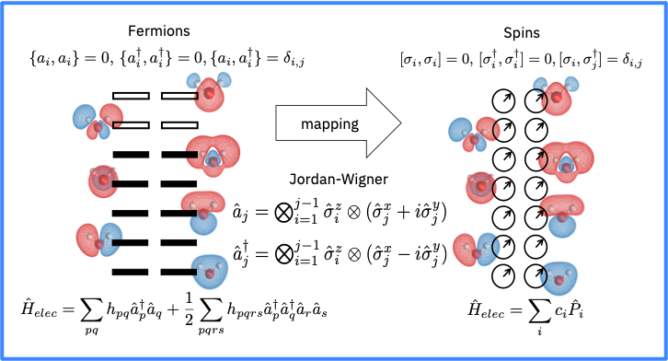
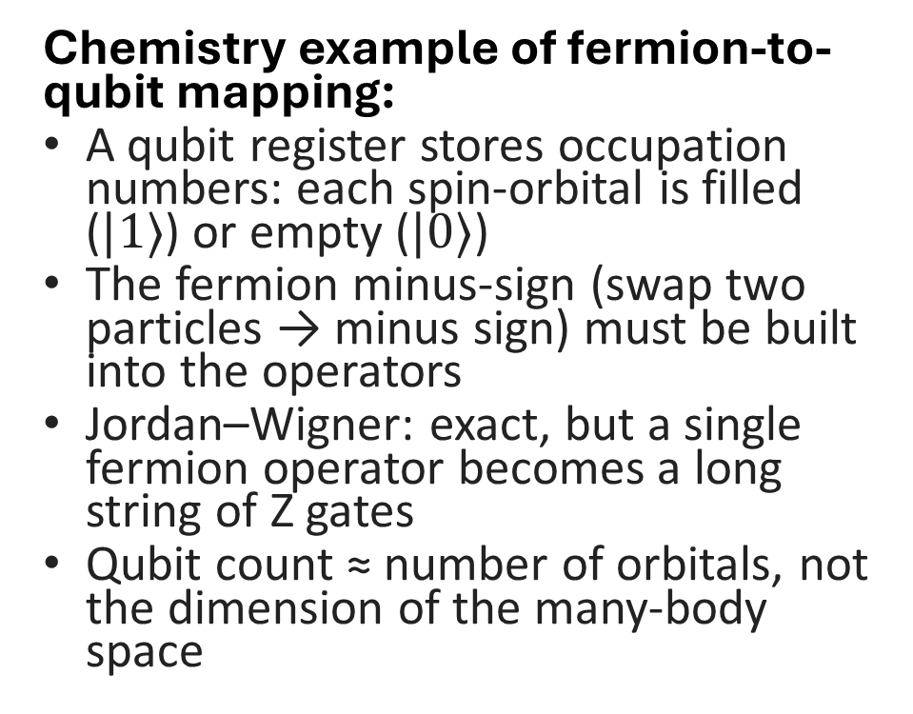
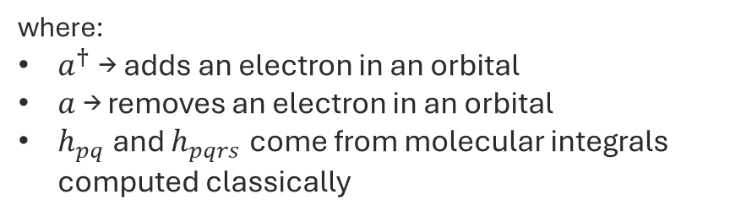

Step 1: encoding fermions as qubits
Chemistry example of fermion-to-qubit mapping:
A qubit register stores occupation numbers: each spin-orbital is filled ($|1⟩$) or empty ($|0⟩$)
The fermion minus-sign (swap two particles → minus sign) must be built into the operators
Jordan–Wigner: exact, but a single fermion operator becomes a long string of Z gates
Qubit count ≈ number of orbitals, not the dimension of the many-body space
$$\hat{H}=\sum_{pq}^{​}{h_{pq}}a_{p}^{†}a_{q}+\frac{1}{2}\sum_{pqrs}^{​}{h_{pqrs}}a_{p}^{†}a_{q}^{†}a_{r}a_{s}.$$
where:
$a^{†}$→ adds an electron in an orbital
$a$ → removes an electron in an orbital
$h_{pq}$and $h_{pqrs}$come from molecular integrals computed classically
Jordan & Wigner, Z. Phys. 47, 631 (1928); Whitfield et al., Mol. Phys. 109, 735 (2011).
https://qiskit-community.github.io/qiskit-nature/tutorials/06_qubit_mappers.html
Notes:
First real subtlety. A qubit register stores occupation numbers; the hard part is the fermion minus-sign. Walk the figure: an operator on site 5 drags a Z-string across every site below it (Jordan-Wigner). Punchline: qubits scale with ORBITALS, not the many-body dimension - the single most important scaling fact in the talk.
Bravyi–Kitaev: same physics, Pauli weight drops to O(log N) — preferred for many-orbital problems
Parity, ternary-tree, generalized-superfast encodings pick different points on the trade-off
Bosons (phonons, gauge modes): binary/unary occupation, or native bosonic qubits (cat, GKP)
Gauge fields are infinite-dimensional per link and must be truncated (discrete subgroups, field cutoffs)

Slide 29
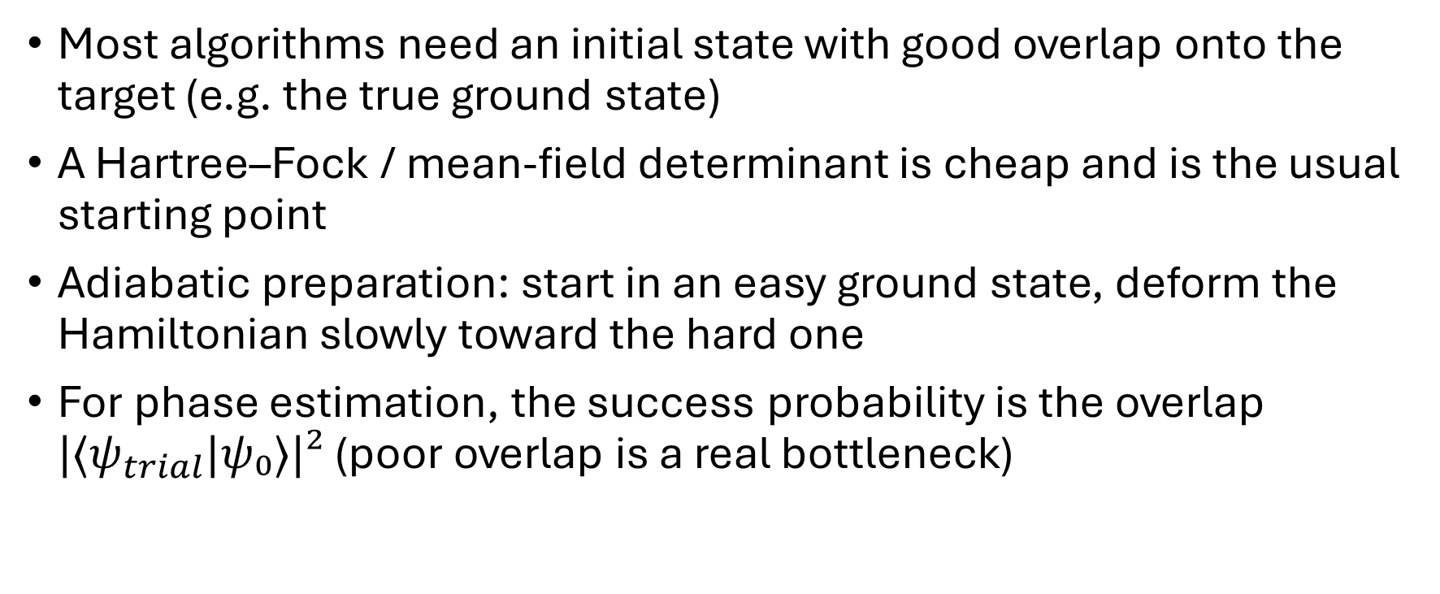
Step 2: preparing the starting state
Most algorithms need an initial state with good overlap onto the target (e.g. the true ground state)
A Hartree–Fock / mean-field determinant is cheap and is the usual starting point
Adiabatic preparation: start in an easy ground state, deform the Hamiltonian slowly toward the hard one
For phase estimation, the success probability is the overlap $|⟨ψ_{trial}|ψ₀⟩|²$ (poor overlap is a real bottleneck)
Tubman et al., arXiv:1809.05523 (2018); Lee et al., PRX Quantum 4, 020331 (2023).

Slide 30
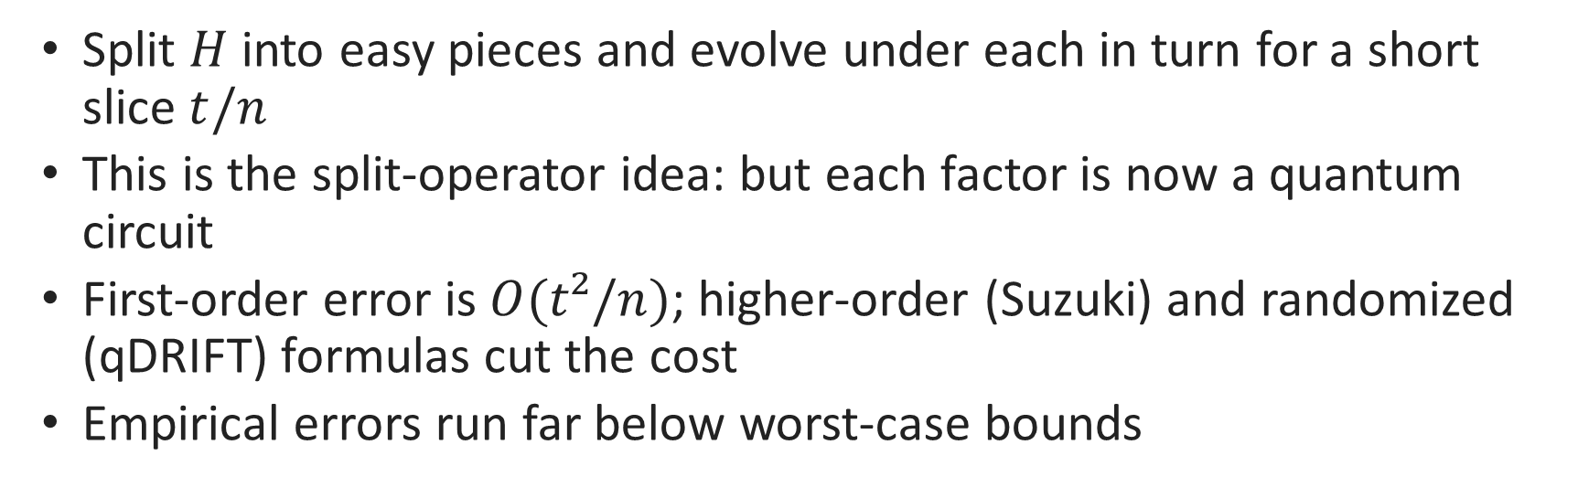
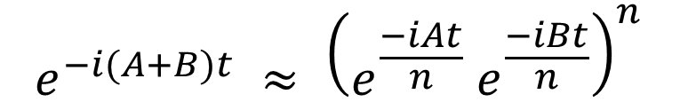
Step 3: time evolution by Trotterization
$$e^{−i(A+B)t} ≈ {\left(e^{\frac{−iAt}{n}} e^{\frac{−iBt}{n}}\right)}^{n}$$
Split $H$ into easy pieces and evolve under each in turn for a short slice $t/n$
This is the split-operator idea: but each factor is now a quantum circuit
First-order error is $O(t²/n)$; higher-order (Suzuki) and randomized (qDRIFT) formulas cut the cost
Empirical errors run far below worst-case bounds
Childs et al., PNAS 115, 9456 (2018); Campbell, PRL 123, 070503 (2019).
Notes:
https://quantum.cloud.ibm.com/learning/en/courses/quantum-computing-in-practice/simulating-nature
Linear Combination of Unitaries (LCU): write e⁻ⁱᴴᵗ as a weighted sum of simple unitaries, applied probabilistically
Qubitization / quantum signal processing: optimal scaling in both time and accuracy
These need fault-tolerant hardware, but they set the resource targets the field aims at
Why it matters here: nuclear response and scattering are real-time problems where these shine
qDRIFT is a randomized Hamiltonian-simulation method.
Instead of applying every Hamiltonian term in a fixed deterministic order, qDRIFT randomly samples terms according to their importance, usually based on the size of their coefficients.

Slide 31
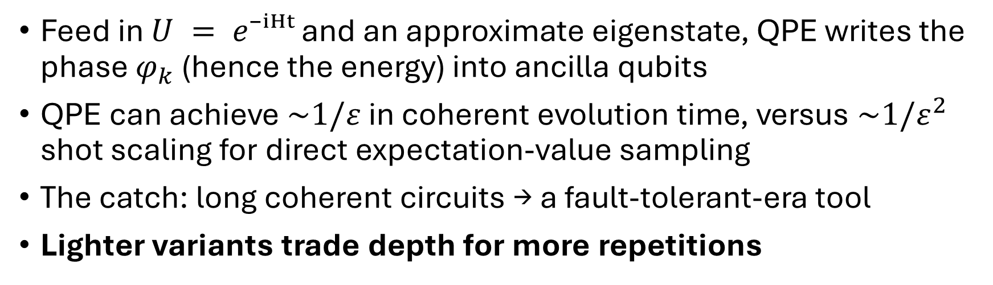
Reading out energies:
Quantum Phase Estimation
$$U|ψ_{k}⟩ = e^{2πi φ_{k}}|ψ_{k}⟩$$
Feed in $U = e⁻ⁱᴴᵗ$ and an approximate eigenstate, QPE writes the phase $φ_{k}$ (hence the energy) into ancilla qubits
QPE can achieve $\sim 1/ε$ in coherent evolution time, versus $\sim 1/ε^{2}$ shot scaling for direct expectation-value sampling
The catch: long coherent circuits → a fault-tolerant-era tool
Lighter variants trade depth for more repetitions
Kitaev, arXiv:quant-ph/9511026 (1995); Abrams & Lloyd, PRL 83, 5162 (1999).

Slide 32
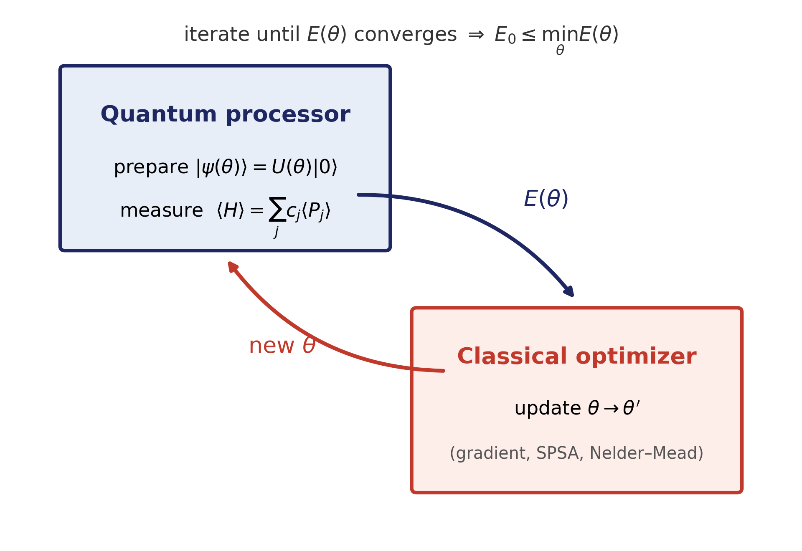
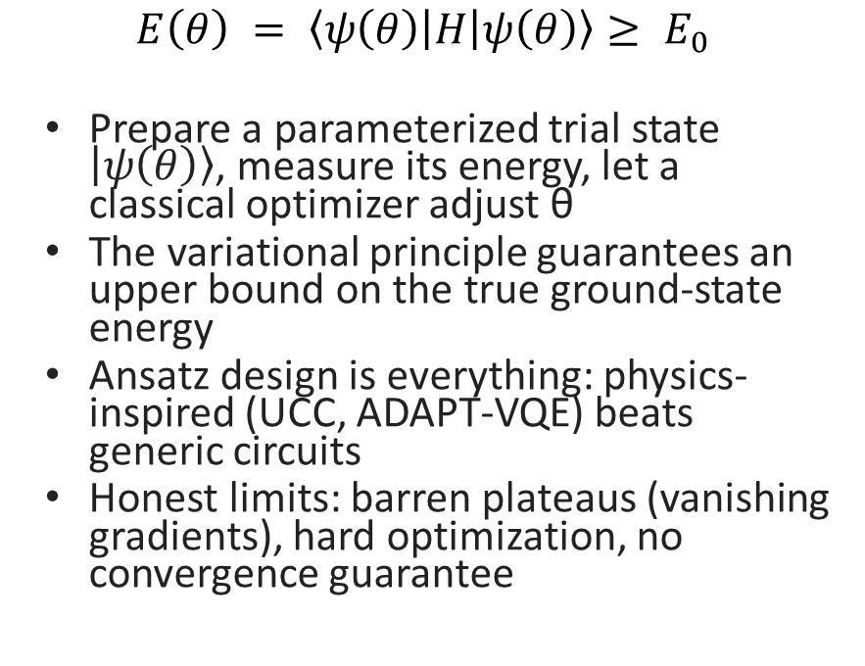
The current era workhorse: VQE
$$E\left(θ\right) = \left\langle ψ\left(θ\right)\left|H\right|ψ\left(θ\right)\right\rangle ≥ E_{0}$$
Prepare a parameterized trial state $\left|ψ\left(θ\right)\right\rangle$, measure its energy, let a classical optimizer adjust θ
The variational principle guarantees an upper bound on the true ground-state energy
Ansatz design is everything: physics-inspired (UCC, ADAPT-VQE) beats generic circuits
Honest limits: barren plateaus (vanishing gradients), hard optimization, no convergence guarantee
Peruzzo et al., Nat. Commun. 5, 4213 (2014); Tilly et al., Phys. Rep. 986, 1 (2022).

Slide 33
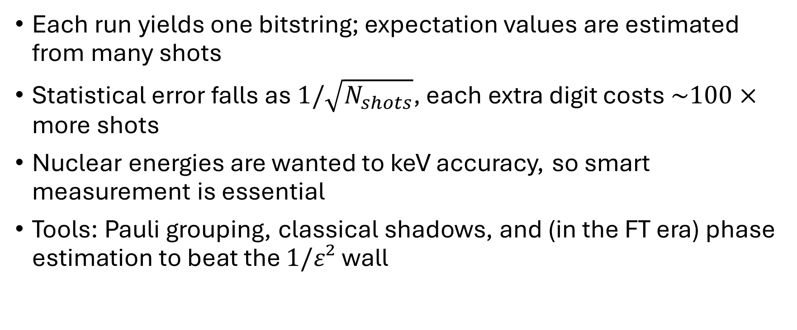
Everything is sampling
Each run yields one bitstring; expectation values are estimated from many shots
Statistical error falls as $1/\sqrt{N_{shots}}$, each extra digit costs $\sim 100×$ more shots
Nuclear energies are wanted to keV accuracy, so smart measurement is essential
Tools: Pauli grouping, classical shadows, and (in the FT era) phase estimation to beat the $1/ε²$wall

Slide 34
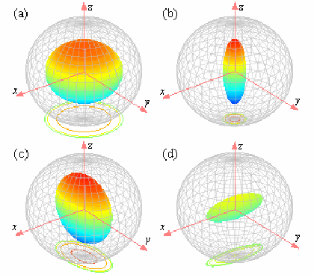
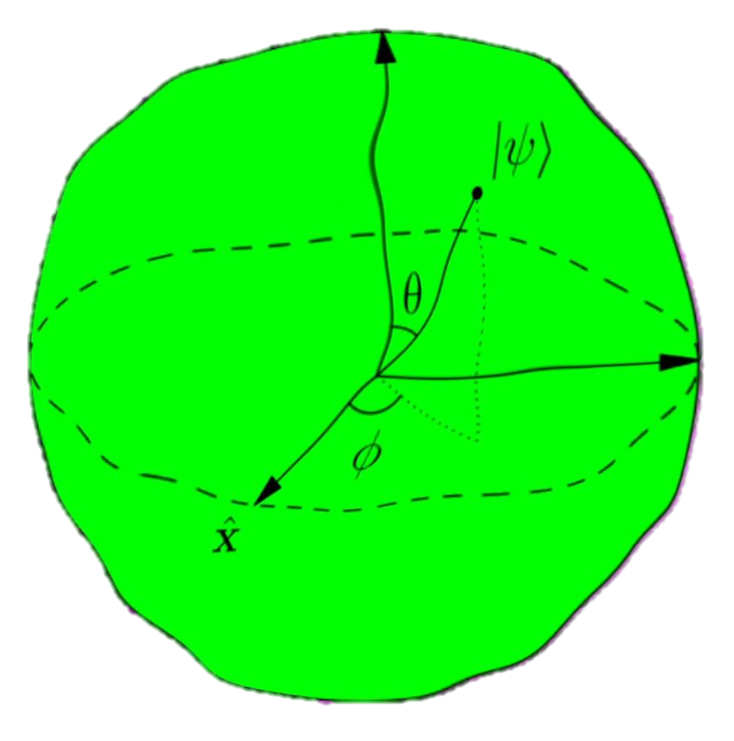
Living with noise
Zero-noise extrapolation: amplify the noise, then extrapolate back to the zero-noise limit
Probabilistic error cancellation: characterize the noise channel and invert it statistically
Symmetry verification: discard any shot that violates a conserved quantity (number, J, parity)
Teleportation of the one-qubit state in decoherence environments November 2011, Journal of Physics B Atomic Molecular and Optical Physics 44(2)
Notes:
PEC can have exponential sampling overhead with noise strength and circuit volume
ZNE and symmetry verification are cheaper but less general

Slide 35

Fragment-Based quantum simulation

Slide 36

Radical-fragment MBE2
Linear alkane CₙH₂ₙ₊₂ needs q = 14n + 4 qubits (JW, STO-3G): 368 qubits for C₂₆H₅₄, beyond any device
Homolytic C–C cleavage → open-shell radical fragments (CH₃•, CH₂••): ROHF, no caps, no embedding
MBE2 assembly: monomer energies + bonded-pair corrections; translational symmetry → only 4 unique fragments for any chain length
Constant 30-qubit ceiling: 12.3× qubit reduction and 12.8× fewer unique calculations at C₂₆
O(n) → O(1): the fragment, not the molecule, sets the quantum hardware budget
D. Sierra-Sosa, J. Saavedra, S. Solares, G. Toscano-Pulido — The Catholic University of America; run on IBM Quantum hardware.
Notes:
SAY: The punchline is O(n) -> O(1). Walk it: alkanes need 14n+4 qubits; we cut C-C bonds HOMOLYTICALLY (split the electron pair), getting open-shell radicals treated honestly with ROHF — no hydrogen caps, no embedding. Two monomer types + two bonded-dimer types = 4 unique calculations whether the chain has 4 or 26 carbons; the largest fragment is 30 qubits, period.
FIGURE: full-molecule qubit line vs the flat 30-qubit MBE2 ceiling; 12.3x reduction at C26.
[FOR NP AUDIENCE] Emphasize the principle, not the chemistry: identical repeating subunits + locality = constant quantum cost. Nuclei have analogous structure (pairing, clusters, valence spaces).

Slide 37
VQE, ADAPT-VQE, and SQD inside MBE2
Five solvers across 11 alkanes (C₄ → C₂₆): RHF and CCSD references vs VQE, ADAPT-VQE, SQD
MBE2-SQD on IBM Heron (ibm_pittsburgh): full 14–30-qubit fragment Hamiltonians track MBE2-CCSD within +1.4 to +5.2 kcal/mol
Fragmentation, not the quantum solver, dominates the error budget; quantum results faithfully preserve the classical baseline
Cautionary tale: ADAPT-VQE converged monomers tighter than dimers; the MBE2 formula amplifies the imbalance ×(n−3) → +457 kcal/mol by C₂₆
Lesson: balanced accuracy across fragments beats maximal accuracy per fragment

Slide 38
What this suggests for nuclear physics
Same goal as valence-space downfolding: keep the quantum register fixed while the physical system grows
SQD is the chemistry twin of the QSCI methods in shell-model demos (cf. slide 34): sample configurations on hardware, diagonalize classically
The balanced-convergence lesson transfers: any assembly formula (MBE, cluster expansion) amplifies uneven solver errors
Open-shell fragments with correct spin, no artificial caps: a natural mindset for pairing and odd-A subsystems
An invitation: port the radical-fragment playbook to nucleon clusters and pairing Hamiltonians
Notes:
Sample-based quantum diagonalization (SQD) overview
https://quantum.cloud.ibm.com/docs/en/guides/qiskit-addons-sqd
Now, why am I showing chemistry to a nuclear audience? Because the structure transfers, point for point. Keeping the quantum register fixed while the physical system grows is exactly the goal of valence-space downfolding. Sample-based diagonalization is the chemistry twin of the QSCI subspace methods you've seen in shell-model demos — sample configurations on hardware, diagonalize classically. The balanced-convergence lesson carries straight over: any assembly formula, any cluster expansion, amplifies uneven solver errors. And open-shell fragments with correct spin and no artificial caps are a natural mindset for pairing and odd-A subsystems. So this is genuinely an invitation: port the radical-fragment playbook over to nucleon clusters and pairing Hamiltonians.

Slide 39
Our ongoing directions
Template-driven hybrid algorithms (IBM Quantum): pre-optimized fragment wavefunctions assembled into long chains, then globally refined — from ~20 toward 50–100 qubits
From σ to π: alkanes → polyacetylene; delocalized, strongly correlated electrons as the stress test (conducting polymers)
Pipelines: VQE, VarQITE, QAOA — with machine-learning-guided encodings and ansatz selection
Quantum optimization taxonomy (IEEE Access survey): hardware / pipeline / kernel / order / continuity / metaheuristics — a map for choosing the right tool
The nuclear analog of all of the above is unwritten — collaboration welcome

Slide 40

Future Directions

Slide 41
Nuclear Problem Map
Target | Classical bottleneck | Quantum-computing role | Likely era
Bound states / spectra | Hilbert-space growth; correlation; sign structure | Small benchmarks now; QPE later for sharp energies | NISQ → FT
Response / scattering | Real-time dynamics and continuum coupling | Natural unitary time evolution; phase estimation / LCU / qubitization in FT era | Mostly FT
Finite density / hot matter | Monte Carlo sign problem and analytic continuation | Thermal-state preparation and real-time correlators | FT / analog
Gauge dynamics / QCD | Large local Hilbert spaces; gauge constraints; non-equilibrium dynamics | Digital or analog lattice-gauge simulation with symmetry-preserving encodings | Co-design now, FT later
Neutrinos / spin models | Collective many-body dynamics can grow rapidly with modes | Analog/digital simulators can directly implement spin Hamiltonians | NISQ demos → FT
Notes:
Quantum-Selected Configuration Interaction: classical diagonalization of Hamiltonians in subspaces selected by quantum computers
Trotterization splits the Hamiltonian into smaller pieces and applies short time steps.
LCU, or Linear Combination of Unitaries, expresses the time-evolution operator using a weighted combination of simpler unitary operations.
Qubitization and quantum signal processing are more advanced fault-tolerant techniques that can simulate Hamiltonian dynamics with very good scaling
“Bound states and spectra are the natural starting point. They ask for nuclear energy levels. Classical computers struggle because the number of many-body configurations grows very fast and correlations are strong. Today quantum computers can do small benchmarks, while future fault-tolerant machines could use phase estimation to obtain sharp nuclear energies.
“Response and scattering are harder than bound states because they require real-time dynamics and coupling to the continuum. A quantum computer is naturally suited to real-time unitary evolution, but the circuits are usually deep, so this is mostly a fault-tolerant-era application.”
“Finite-density and hot-matter problems are central for neutron stars, supernovae, and heavy-ion physics. Classical Monte Carlo methods can fail because of the sign problem, and imaginary-time data are hard to convert to real time. Quantum computers may prepare thermal states and measure real-time correlators directly, but the most useful applications are likely fault-tolerant or analog.”
“Gauge dynamics and QCD are the most fundamental but also among the hardest targets. The challenge is that gauge fields have large local Hilbert spaces and strict symmetry constraints. Quantum computers could simulate lattice gauge theories while preserving those symmetries, but realistic QCD is mostly a fault-tolerant-era goal. Today the field is in a co-design stage.
“Dense neutrino systems and some nuclear pairing models can be written as interacting spin Hamiltonians. The many-body Hilbert space grows quickly with the number of modes, so classical methods rely on approximations. Quantum devices are naturally good at representing spin systems, making this a good area for NISQ demonstrations, with more accurate large-scale work in the fault-tolerant era.”
“This table is a map of nuclear-physics targets. Bound states and spectra are the starting point: we can benchmark small systems now, and in the fault-tolerant era phase estimation could give precise energies. Response and scattering are harder because they require real-time evolution and continuum coupling, so they are mostly fault-tolerant applications. Finite-density and hot matter are important for neutron stars and heavy-ion physics, but classical Monte Carlo methods face sign problems and analytic-continuation issues; quantum computers may help by preparing thermal states and measuring real-time correlators. Gauge dynamics and QCD are the most fundamental targets, but they require symmetry-preserving lattice-gauge encodings and likely fault tolerance for realistic calculations. Finally, neutrino and spin models are promising near-term demonstrations because they map naturally to qubits or analog simulators.”

Slide 42
Beyond simulation
Hybrid quantum ML replaces a targeted neural-network layer with a parameterized quantum circuit (PQC), exploiting Hilbert-space feature maps and entanglement-based correlations
The open question is a confounder: does the quantum layer genuinely help, or was a single circuit simply hand-picked well? Most studies cannot separate the two
This bites hardest in nuclear / hadronic physics, where detector-level classification (particle ID) directly limits the precision of extracted QCD observables
Any advantage claim must beat a strong classical baseline and a fair sample of circuit designs, not one hand-designed ansatz

Slide 43
Removing the human from circuit design
Quantum Neural Architecture Search: a reinforcement-learning agent edits a candidate PQC step by step: encoding, ansatz depth, gate insert/delete, qubit rewiring, entanglement pattern
A graph-neural-network surrogate predicts a candidate’s performance from its circuit structure, scoring ~50× faster than training
Train classical, validate quantum: every candidate is trained on statevector simulation; scarce QPU time (IBM Heron via Qiskit Runtime) is reserved for final validation of top models

Slide 44
Summary
Nuclear physics is a quantum many-body problem; classical methods face exponential Hilbert-space growth.
The key hard regimes also include sign problems, real-time dynamics, continuum/open-system physics, and dense matter.
Quantum computers represent amplitudes natively and can simulate few-body/local Hamiltonians with polynomial overhead.
Near-term value: small demonstrations, hybrid solvers, SQD/QSCI-style subspace methods, and error mitigation.
Fault-tolerant value: QPE and long real-time evolution for response, scattering, gauge dynamics, and QCD.
First real advantage will likely come from real-time or finite-density problems, not easy small ground-state calculations.
Notes:
Quantum computers are not equally useful for every nuclear problem today; near-term devices are best for small benchmarks and spin/subspace methods, while the deepest nuclear applications — scattering, real-time response, dense matter, and QCD — likely require fault-tolerant or carefully designed analog quantum simulators.

Slide 45

Questions?

