Slide 1
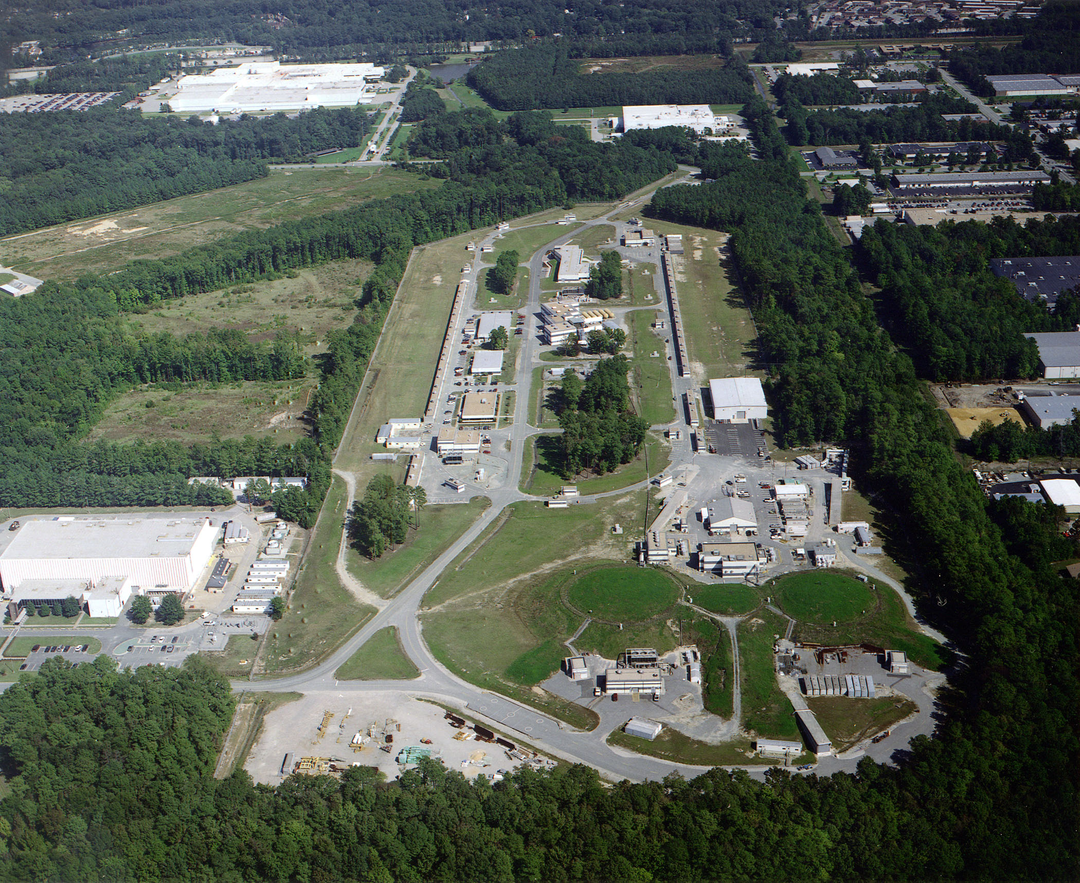


Hall-A/C Summer Collaboration Meeting
June 17th -18th, 2026
Hypernuclear Spectroscopy II:
ΛN Interactions across a Wide Mass Range
Ken Nishida (The University of Tokyo)
for the JLab Hypernuclear Collaboration
Notes:
OK, I’m Ken Nishida from the University of Tokyo, and I’ll talk about the second half of the upcoming hypernuclear experiment in Hall-C. The previous speaker, Sho has already explained the fundamental aspects of the hypernuclear program. So, in this second half, I’ll focus on the mass spectroscopy of medium-to-heavy hypernuclei, including some details of experimental techniques and apparatus.
(0:30)

Slide 2
Introduction
Notes:
OK, so let me start with a brief overview of $Λ$ hypernuclear spectroscopy.

Slide 3
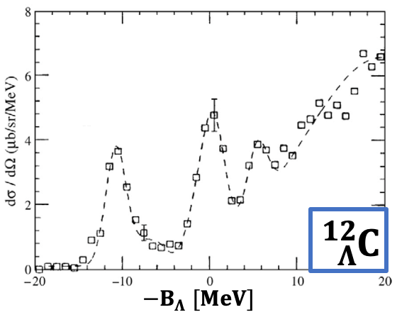
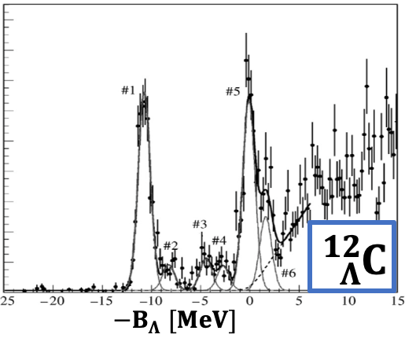
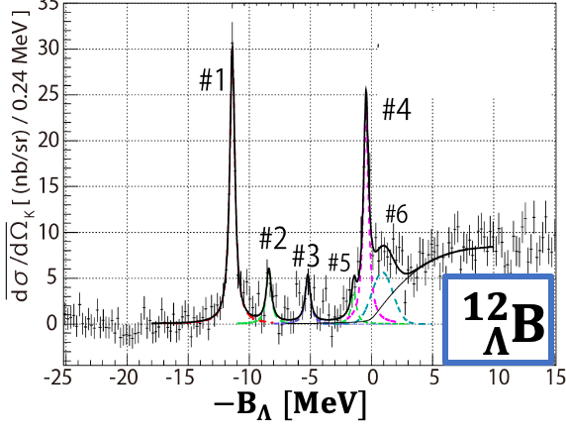





Evolution of Hypernuclear Spectroscopy toward 2029
1991
2001
Heavy ion collision femtoscopy
Decay pion spectroscopy
2010s$\sim$
BNL, USA
${{}_{}^{12}C(π}^{+},K^{+}){}_{Λ}^{12}C$
$ΔE=3 MeV$
2009
KEK, Japan
${{}_{}^{12}C(π}^{+},K^{+}){}_{Λ}^{12}C$
$ΔE=1.5 MeV$
2029
JLab, USA
${}_{}^{12}C(e,e′K^{+}){}_{Λ}^{12}B$
$ΔE=0.5 MeV$
Next-generation at JLab
Expand $(e,e^{′}K^{+})$ spectroscopy& decay pion spectroscopy
Wider accessible mass region to medium-to-heavy $Λ$ hypernuclei
High resolution: $\sim 0.5 MeV$
High precision: $<100 keV$
Notes:
Historically, mass spectroscopy of $Λ$ hypernuclei has been carried out for decades in Japan and the US, beginning at Brookhaven in 1990s. In the early stage, these studies mainly focused on $Λ$ hypernuclei produced with ${ (π}^{+},K^{+})$ reaction. And in 2000s, our collaboration successfully developed $(e, e′K^{+})$ missing mass spectroscopy at JLab, and this new technique significantly improved the energy resolution to about 0.5 MeV and precision to 100 keV. Of course, this was enabled by the high-intensity and highly stable electron beam provided by CEBAF.
And here, I should also mention that hypernuclear studies based on heavy ion collision femtoscopy and decay pion spectroscopy started about 15 years ago and have reported several important results.
Based on our achievements at JLab, the 2029 experiment will further expand the accessible mass region of $(e, e′K^{+})$ spectroscopy to much wider mass range. So, our goal is to achieve the high-resolution spectroscopy of medium-to-heavy hypernuclei for the first time.
(1:50, 2:10)

Slide 4
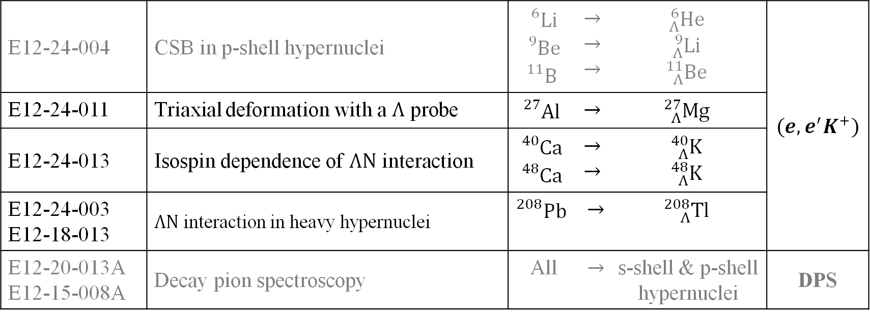
5 Approved Experiments in One Package
E12-24-004 | CSB in p-shell hypernuclei | $${}_{}^{6}{Li}$$ $${}_{}^{9}{Be}$$ $${}_{}^{11}B$$ | $$→$$ $$→$$ $$→$$ | $${}_{Λ}^{6}{He}$$ $${}_{Λ}^{9}{Li}$$ $${}_{Λ}^{11}{Be}$$ | $$(e,e^{′}K^{+})$$
E12-24-011 | Triaxial deformation with a $Λ$ probe | $${}_{}^{27}{Al}$$ | $$→$$ | $${}_{Λ}^{27}{Mg}$$
E12-24-013 | Isospin dependence of $ΛN$ interaction | $${}_{}^{40}{Ca}$$ $${}_{}^{48}{Ca}$$ | $$→$$ $$→$$ | $${}_{Λ}^{40}K$$ $${}_{Λ}^{48}K$$
E12-24-003 E12-18-013 | $ΛN$ interaction in heavy hypernuclei | $${}_{}^{208}{Pb}$$ | $$→$$ | $${}_{Λ}^{208}{Tl}$$
E12-20-013A E12-15-008A | Decay pion spectroscopy | All | $$→$$ | s-shell & p-shell hypernuclei | DPS
Medium-mass and heavy hypernuclei
Notes:
And here is a brief summary of the 2029 hypernuclear program. This program consists of five approved experiments using various targets across wide mass range, from lithium to lead. These two topics, charge symmetry breaking and decay pion spectroscopy in light hypernuclei, were already discussed in the previous talk, so this talk will focus on the remaining three topics related to medium-mass and heavy hypernuclei. The first topic on ${}_{Λ}^{27}{Mg}$, is an interesting topic because it aims to study nuclear structure using a $Λ$ hyperon as an internal probe, and this is quite different approach from the conventional hypernuclear research.
(0:50, 3:00)

Slide 5
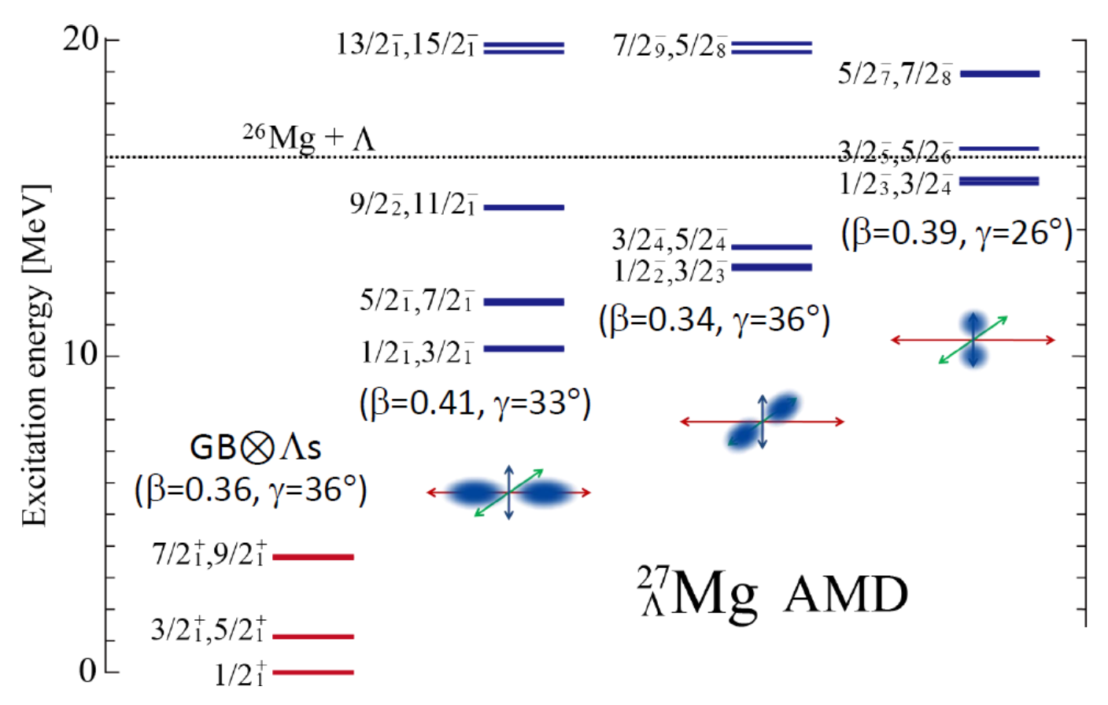
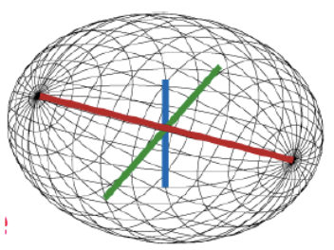




Topic1: Observation of Nuclear Deformation with $Λ$ Probe
$${}_{}^{27}{Al} \left(e,e^{′}K^{+}\right) {}_{Λ}^{27}{Mg}$$
Triaxially deformed ${}_{}^{26}{Mg}+Λ$
Short axis
Shallow binding
Middle axis
Medium binding
Long axis
Deep binding
Separable with $0.5 MeV$ resolution
[M. Isaka, Hypernuclear WS at JLab (2023)]
Notes:
Experimental studies of nuclear structure or nuclear deformation have been one of the fundamental research topics especially in low energy nuclear physics. However, we can also investigate nuclear deformation using the technique of hypernuclear spectroscopy.
${}_{Λ}^{27}{Mg}$ can be electro-produced from solid aluminum target, and the core nucleus of ${}_{Λ}^{27}{Mg}$, namely ${}_{}^{26}{Mg}$, is expected to have a triaxial deformation. On the other hand, the $Λ$ hyperon in ${}_{Λ}^{27}{Mg}$ is free from Pauli blocking by nucleons and can move deeply inside the core nucleus. As a result, the overlap between p-orbit $Λ$ hyperon and core nucleus depends on direction of the core deformation.
AMD calculations predict a splitting of the $Λ$ binding energy depending on the overlap of p-orbit $Λ$ hyperon and core nucleus. And because the predicted energy splitting is around a few MeV, the deformation should be observable with $(e, e′K^{+})$ spectroscopy thanks to its high energy resolution of about 0.5 MeV.
(1:40, 4:40)

Slide 6
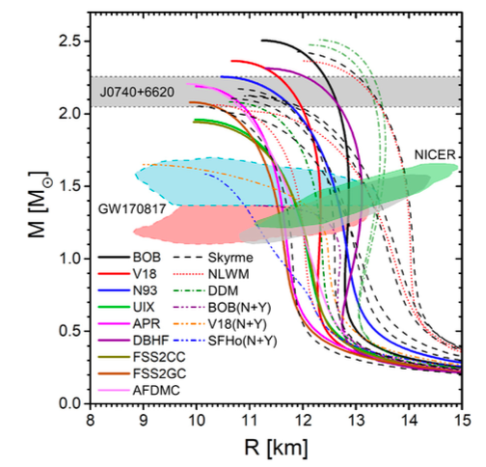

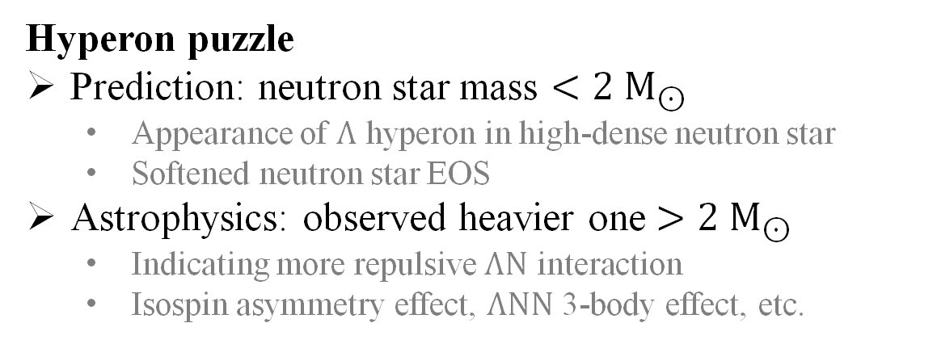
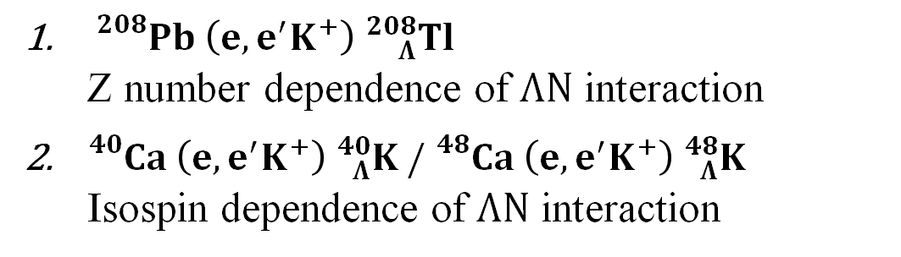
Topic2: $ΛN$ Interaction in Neutron Star
Hyperon puzzle
Prediction: neutron star mass $<2 M_{⊙}$
  Appearance of $Λ$ hyperon in high-dense neutron star
  Softened neutron star EOS
Astrophysics: observed heavier one $>2 M_{⊙}$
  Indicating more repulsive $ΛN$ interaction
  Isospin asymmetry effect, $ΛNN$ 3-body effect, etc.
$ΛN$ interaction in neutron-star-like nucleus
${}_{}^{208}{Pb} \left(e,e^{′}K^{+}\right) {}_{Λ}^{208}{Tl}$
  Z number dependence of $ΛN$ interaction
${}_{}^{40}{Ca} \left(e,e^{′}K^{+}\right) {}_{Λ}^{40}K / {}_{}^{48}{Ca} \left(e,e^{′}K^{+}\right) {}_{Λ}^{48}K$
Isospin dependence of $ΛN$ interaction
Notes:
The second and third topics are related to hyperon puzzle, which was also introduced in the previous talk.
The hyperon puzzle is, in short, a conflict between astrophysical observations and neutron-star EOS based on the current ΛN interaction. However, experimental data of ΛN interaction is still largely limited to light hypernuclei, and data in the medium-to-heavy mass region are not yet sufficient to establish a realistic interaction model for neutron stars.
So, for further discussion on the hyperon puzzle, we need to investigate the ΛN interaction in environments closer to neutron stars. One important aspect is the isospin dependence of ΛN interaction, which can be studied by comparing ${}_{Λ}^{40}K$ and ${}_{Λ}^{48}K$. And another point is the behavior of ΛN interaction in heavy nuclei, which can be investigated using lead-target data.
(1:10, 5:50)

Slide 7
Equipment and Method
Dedicated high resolution spectrometers
Detector packages and preparation status
Beam monitoring with SLI
Momentum calibratrion with proton target
Notes:
Then, let’s move on to the detailed experimental setup and techniques.

Slide 8
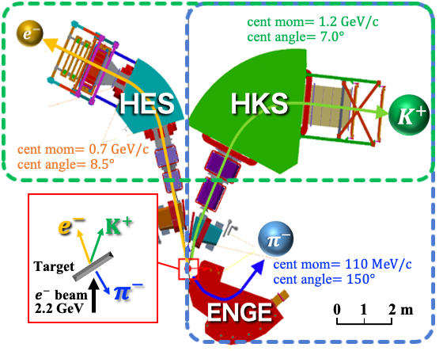
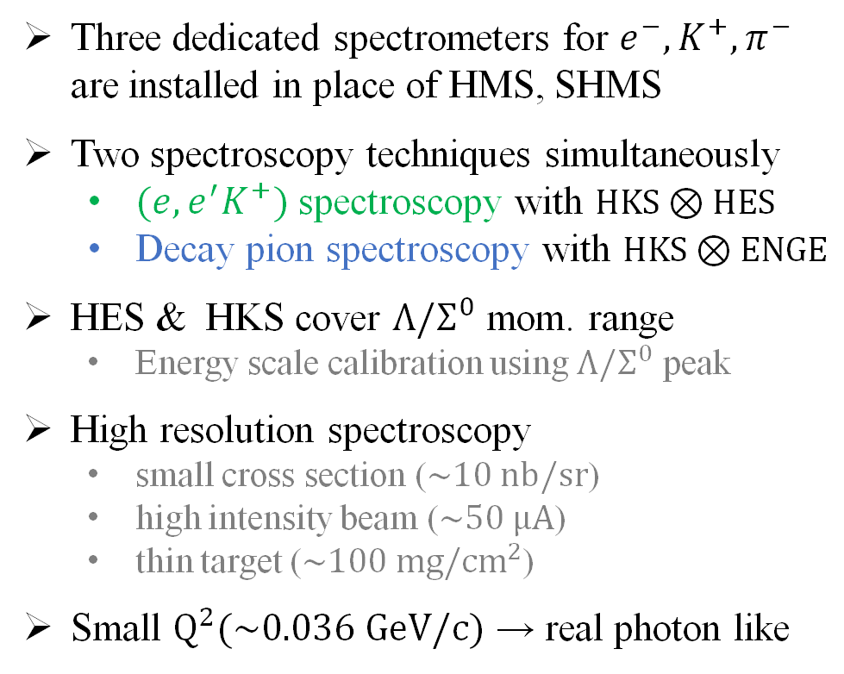
Experimental Setup and Kinematics
Three dedicated spectrometers for $e^{−},K^{+},π^{−}$ are installed in place of HMS, SHMS
Two spectroscopy techniques simultaneously
  $(e,e^{′}K^{+})$ spectroscopy with $HKS⊗HES$
  Decay pion spectroscopy with $HKS⊗ENGE$
HES & HKS cover $Λ/Σ^{0}$ mom. range
  Energy scale calibration using $Λ/Σ^{0}$ peak
High resolution spectroscopy
  small cross section ($\sim 10 nb/sr$)
  high intensity beam ($\sim 50 μA$)
  thin target ($\sim 100 mg/cm^{2}$)
Small $Q^{2}(\sim 0.036 GeV/c)$ → real photon like
Notes:
First, this is a top view of our experimental setup in Hall C. For this program, we will install three dedicated high-resolution spectrometers in place of the existing HMS and SuperHMS.
Target chamber is here, and 2.2 GeV and up to 50 uA beam is delivered on target. The electron arm, HES, and kaon arm, HKS, are located at forward angles while avoiding huge background of bremsstrahlung photon. The central momentum is 0.7 GeV/c for HES and 1.2 GeV/c for HKS. These momentum ranges cover not only hypernuclear production but also $Λ$ and $Σ^{0}$ production, which are used for energy scale calibration.
Meanwhile, ENGE spectrometer is located at a backward angle to measure low-momentum pion in decay pion spectroscopy. So, $(e, e′K^{+})$ spectroscopy is performed using HES-HKS coincidence, while decay pion spectroscopy uses HKS-ENGE coincidence. Therefore, the two spectroscopy techniques can be operated simultaneously throughout the beam time, and this is one of the major advantages of this hypernuclear program.
(1:50,7:40)

Slide 9
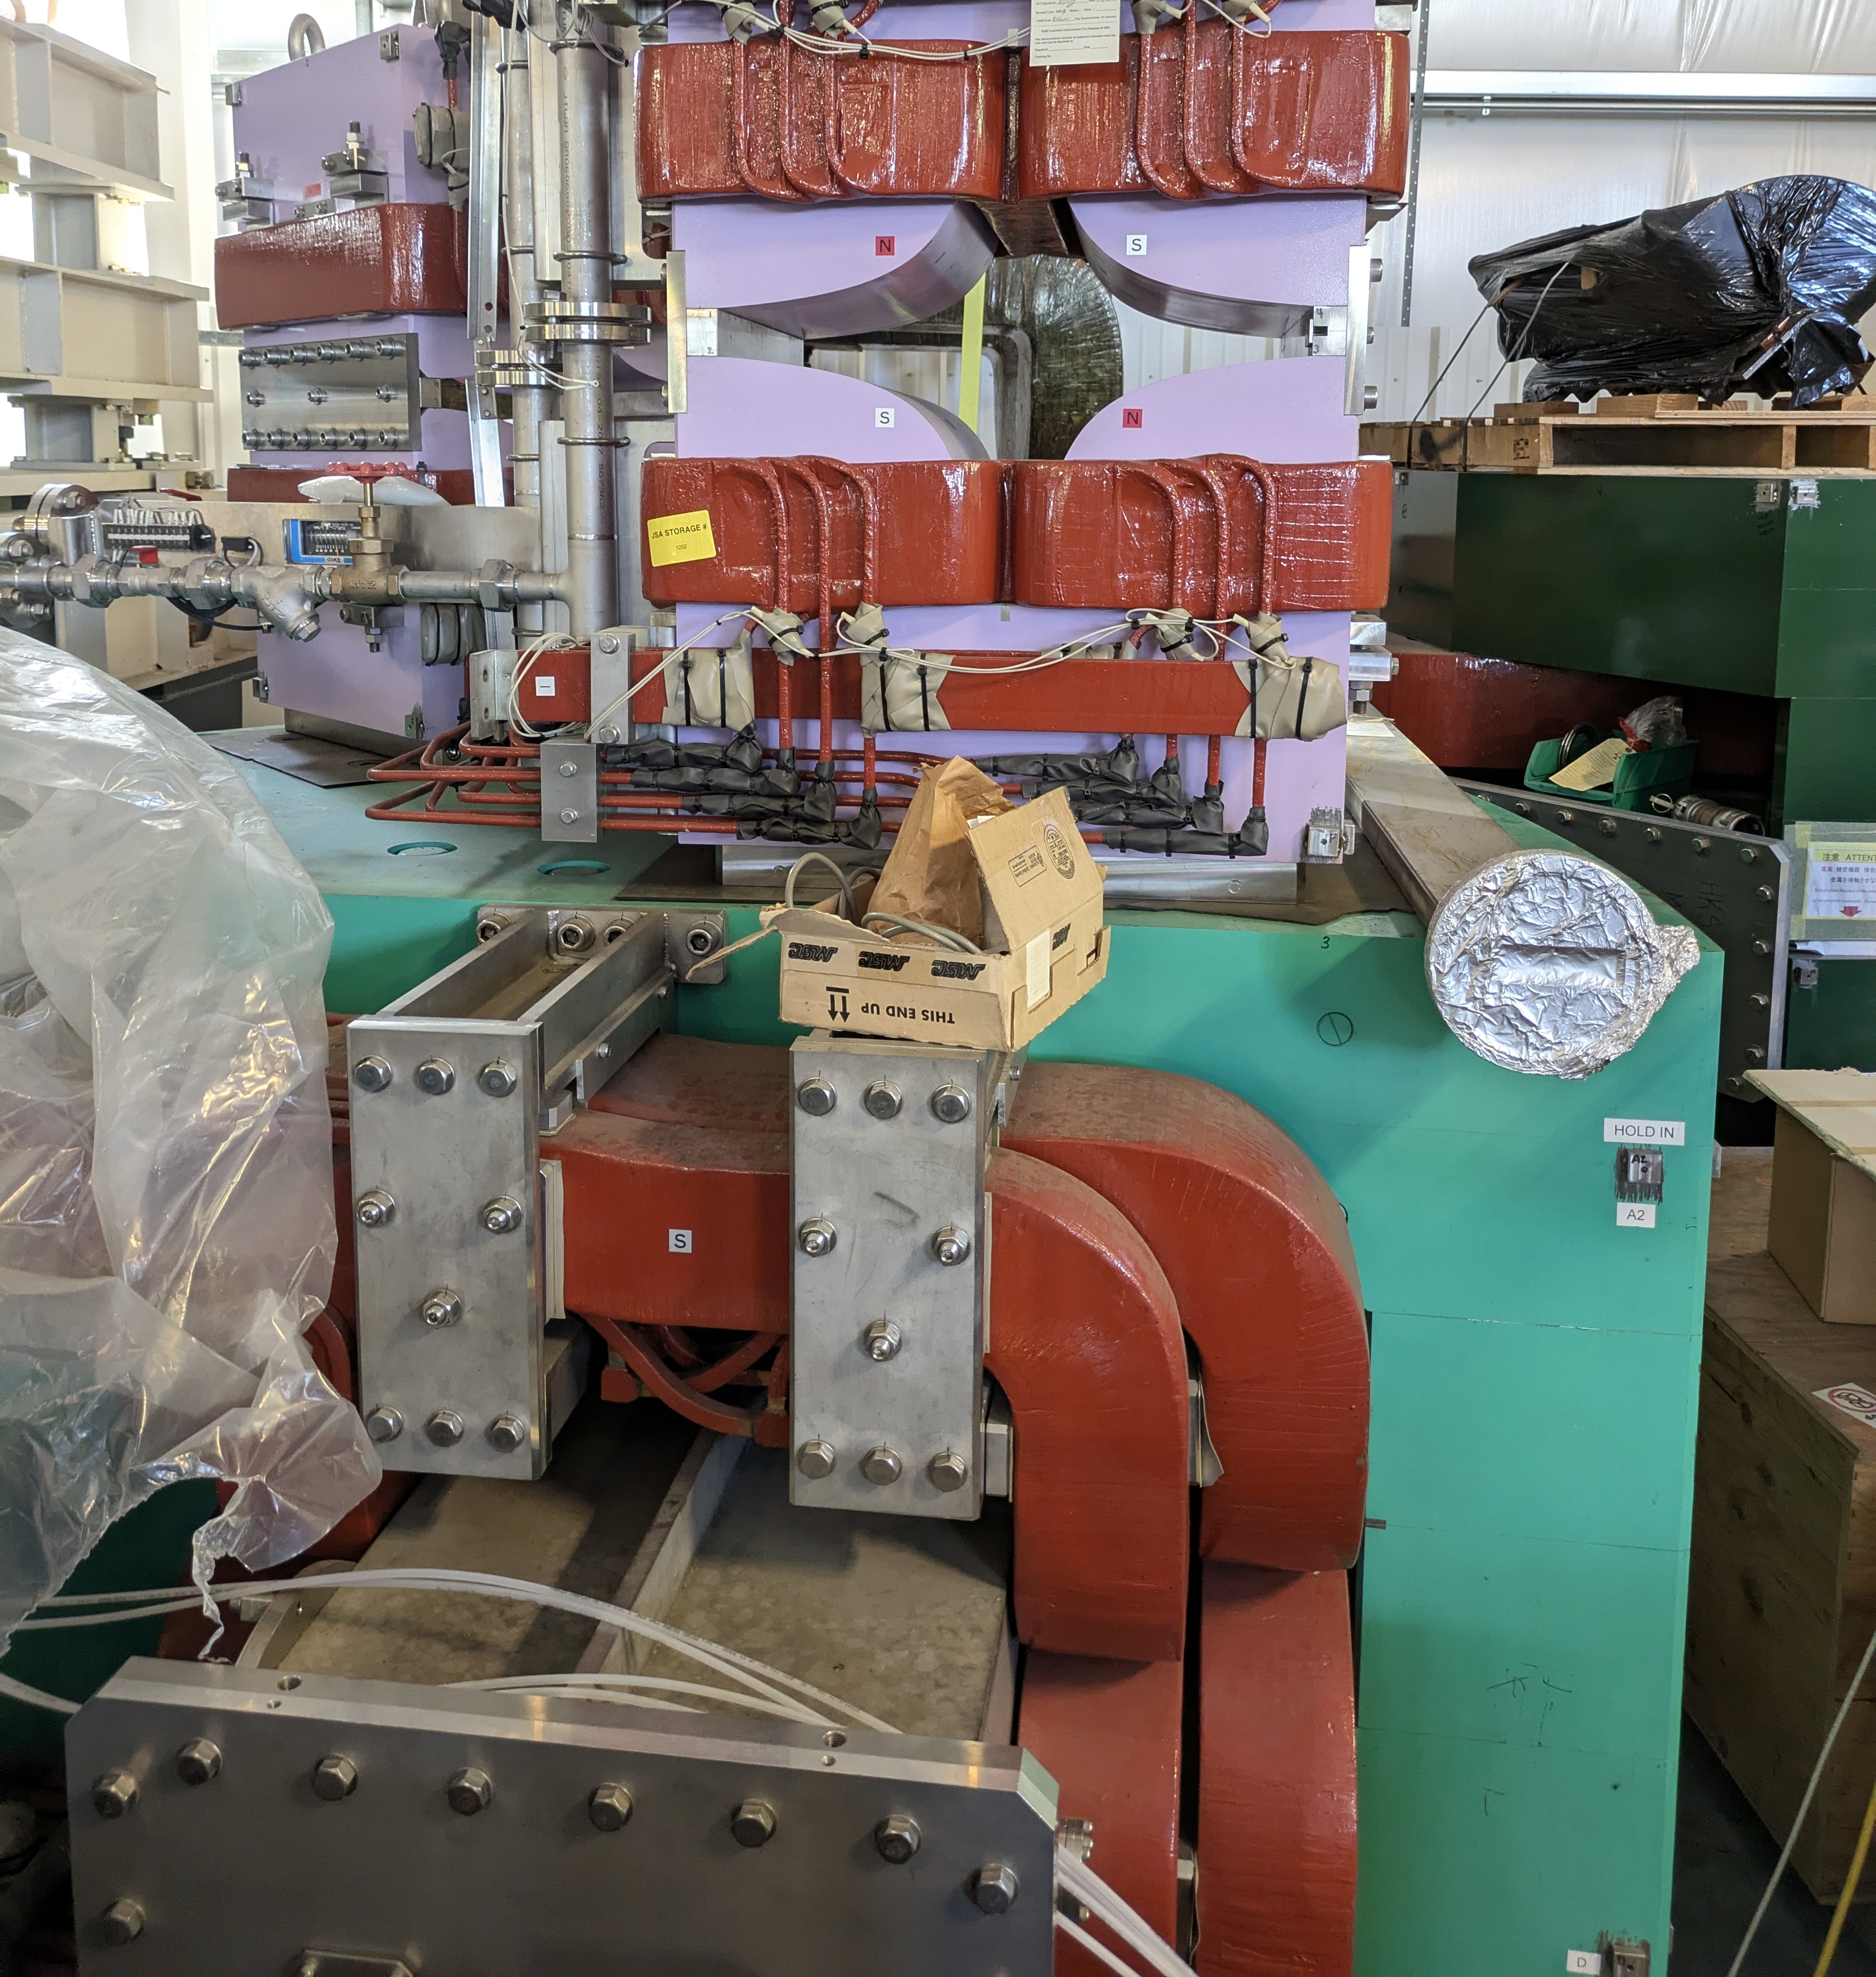
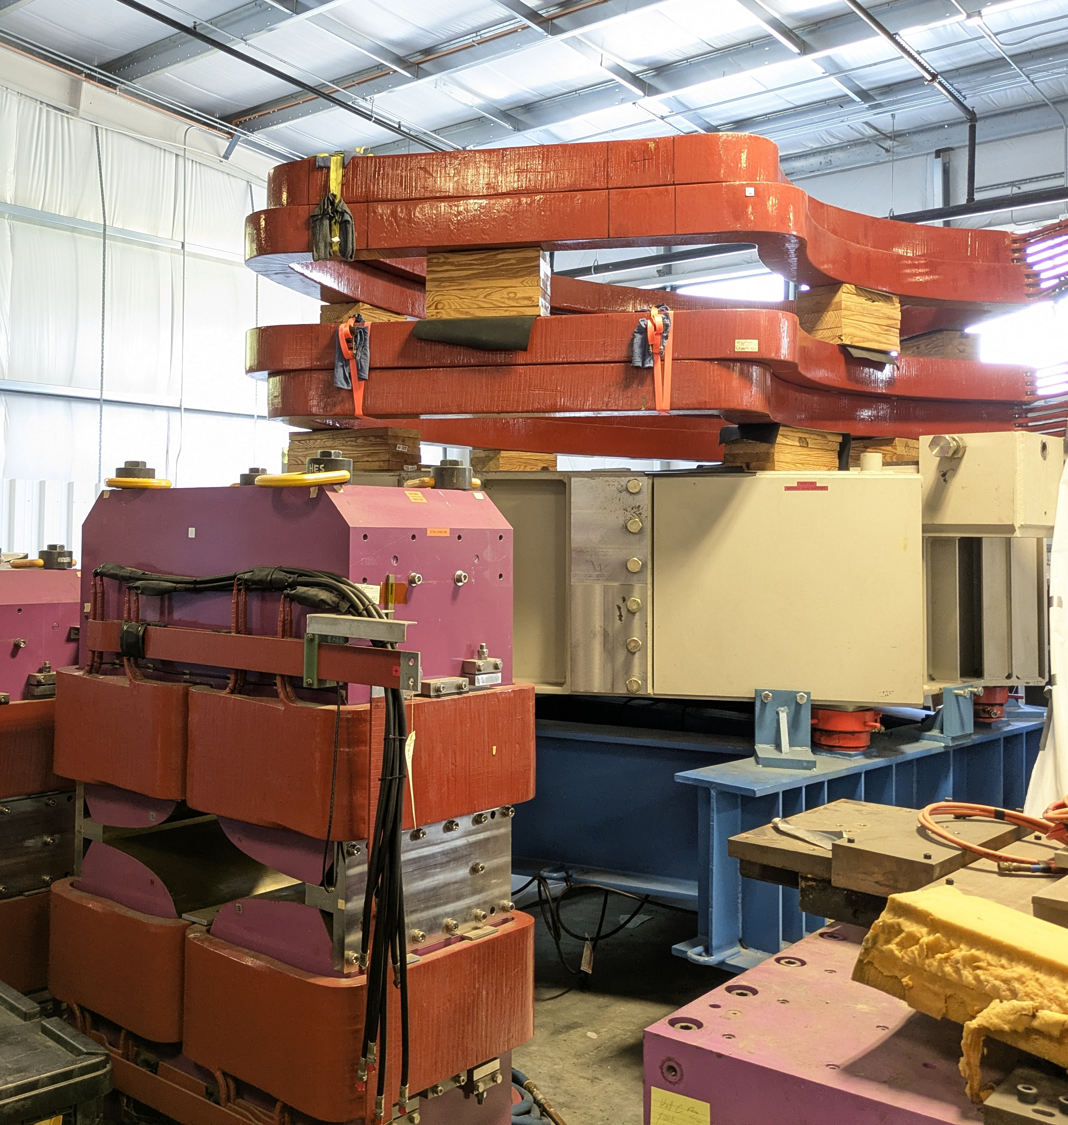
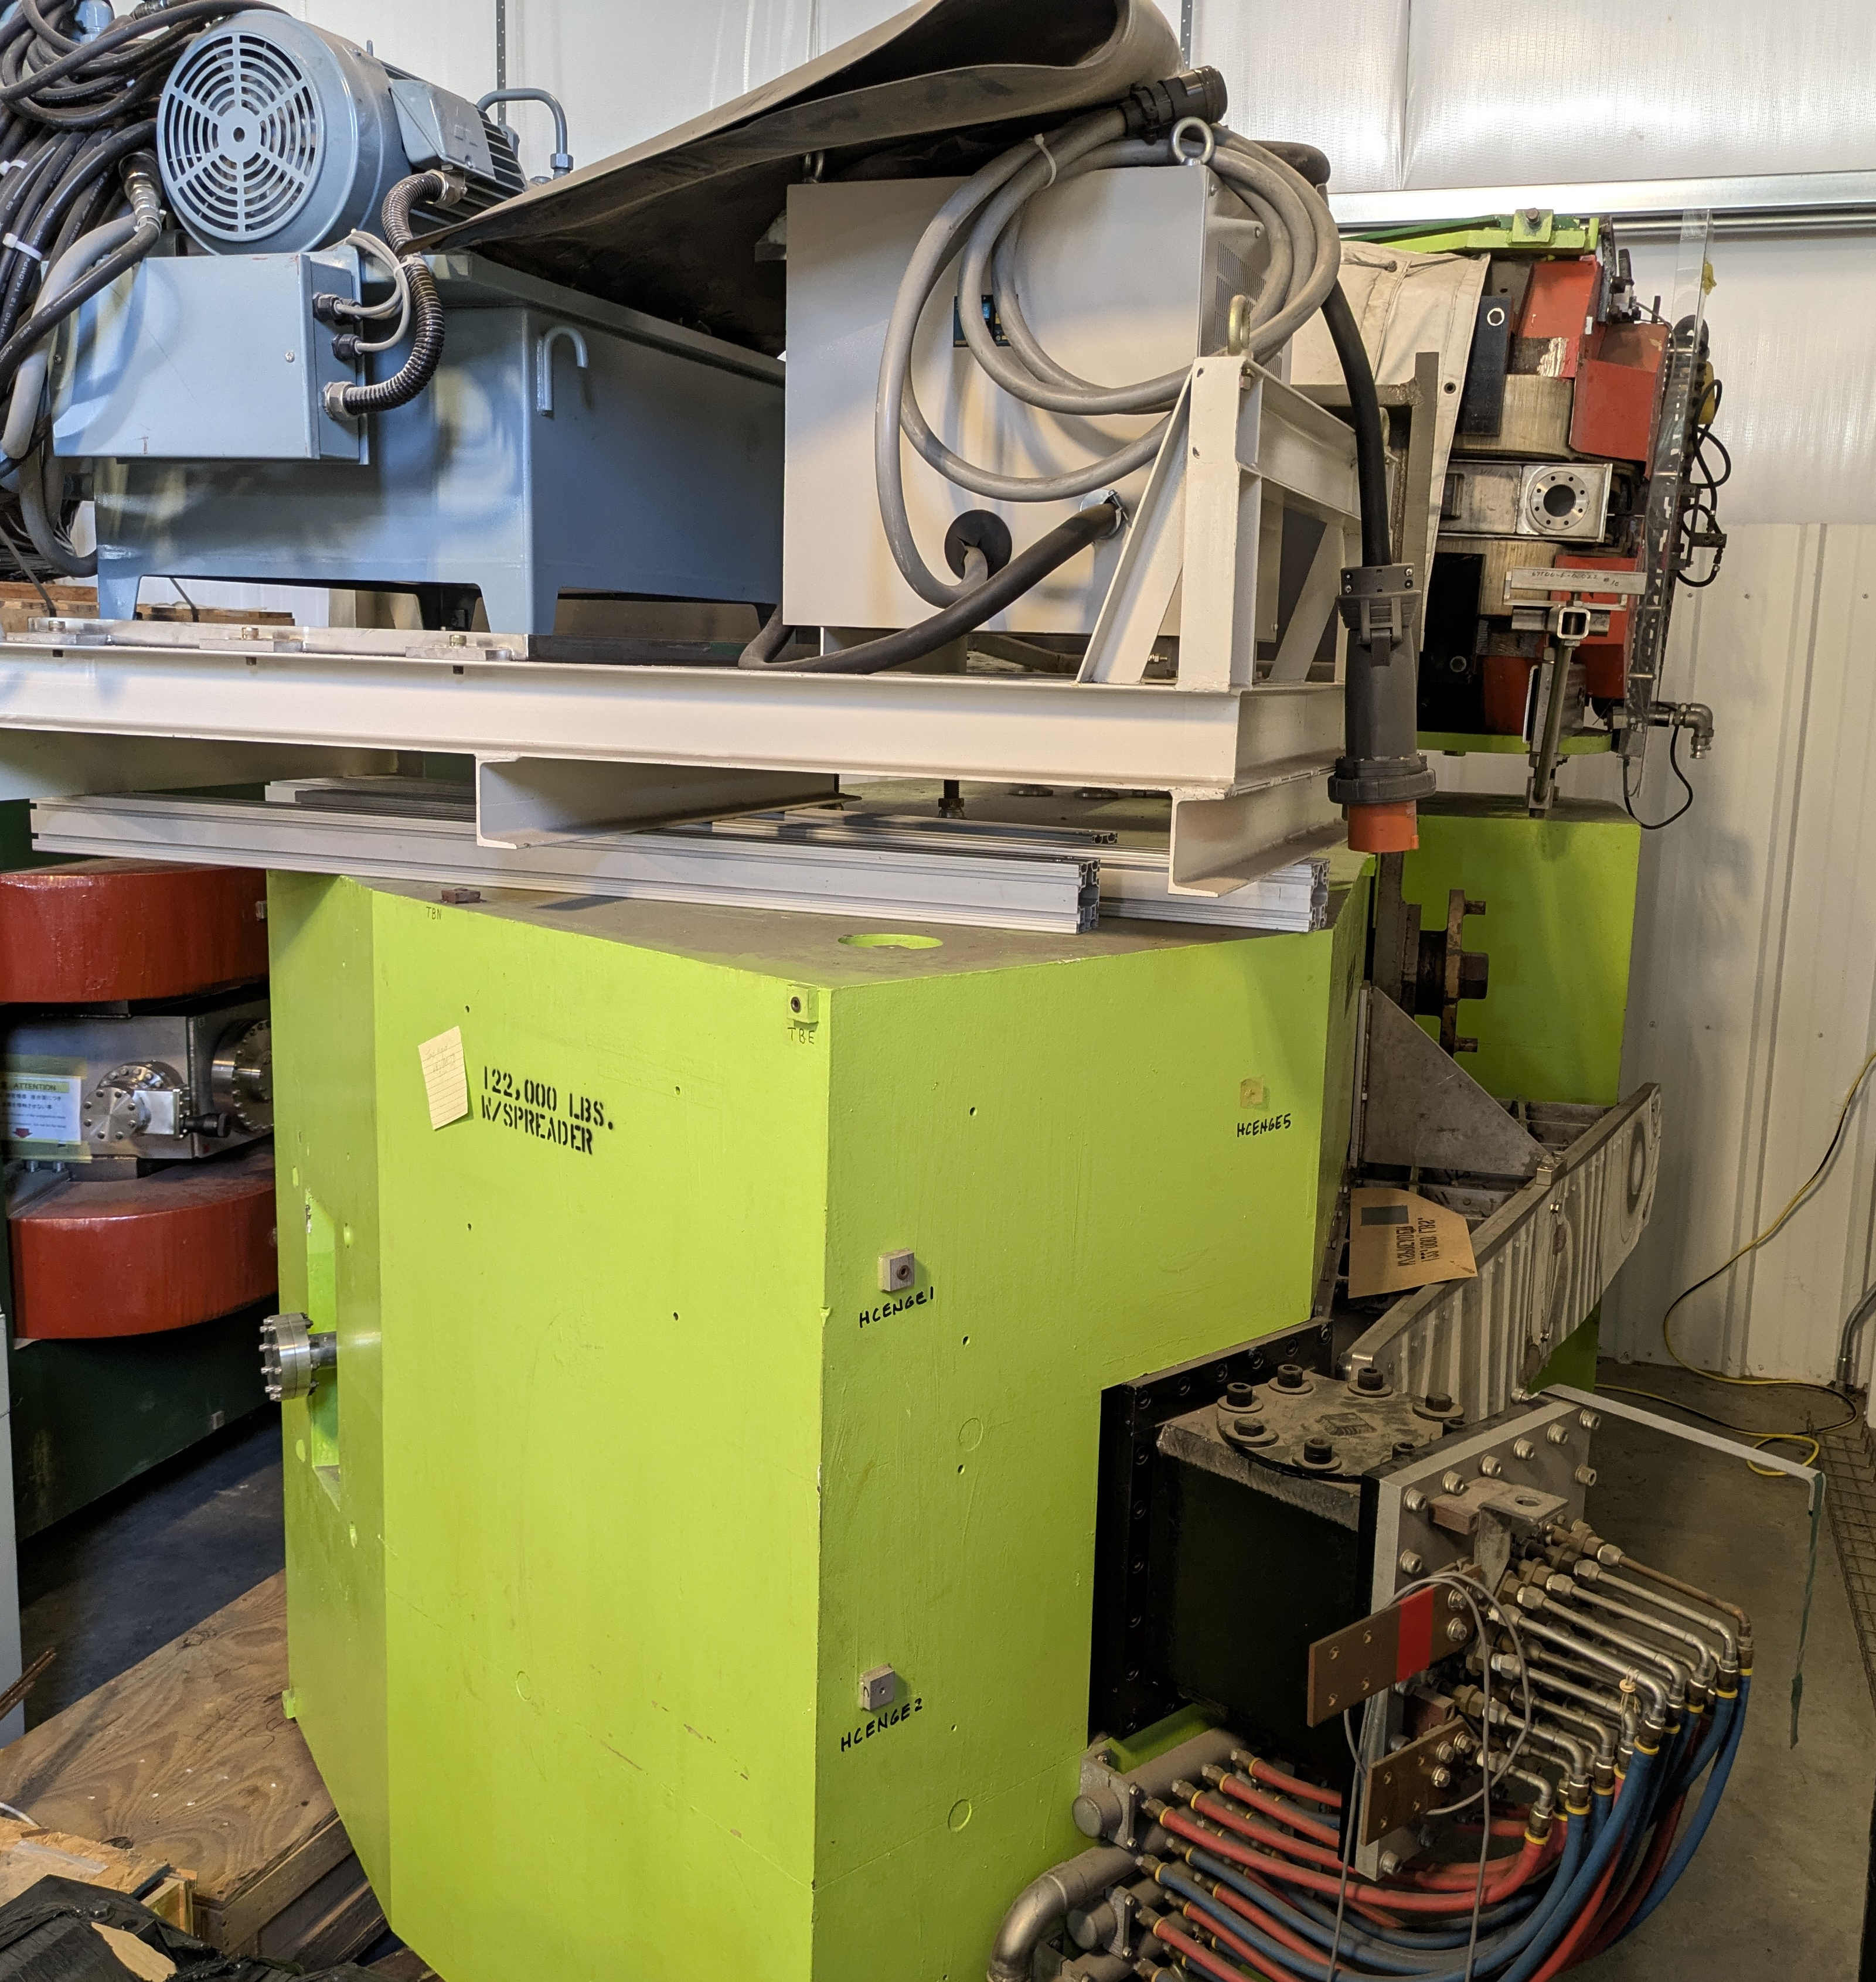
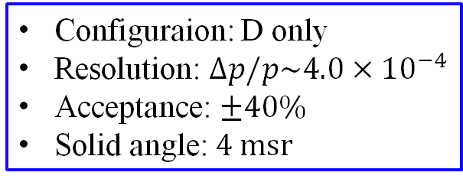
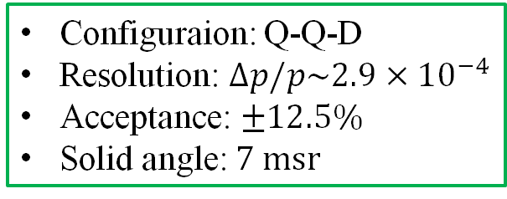
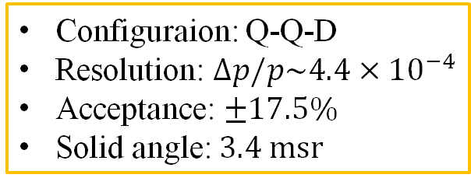
High Resolution Spectrometers
HES spectrometer
HKS spectrometer
ENGE spectrometer
Configuraion: Q-Q-D
Resolution: $∆p/p\sim 4.4×{10}^{−4}$
Acceptance: $±17.5\%$
Solid angle: $3.4 msr$
Configuraion: Q-Q-D
Resolution: $∆p/p\sim 2.9×{10}^{−4}$
Acceptance: $±12.5\%$
Solid angle: $7 msr$
Configuraion: D only
Resolution: $∆p/p\sim 4.0×{10}^{−4}$
Acceptance: $±40\%$
Solid angle: $4 msr$
Notes:
The three spectrometers, HES, HKS, and ENGE, are now sitting in ESB and waiting for the installation. HES and HKS were originally developed in Japan for the hypernuclear spectroscopy at JLab. They have Q-Q-D configuration and high momentum resolution of about ${10}^{−4}$. ENGE spectrometer is a split-pole-type magnet, and it has very clean focal plane. ENGE also has high momentum resolution of about ${10}^{−4}$ and large momentum acceptance. Because all these spectrometers were used in previous hypernuclear experiments performed in 2005 and 2009 in JLab Hall-C, their performance were already well explored.
(1:00, 8:40)

Slide 10
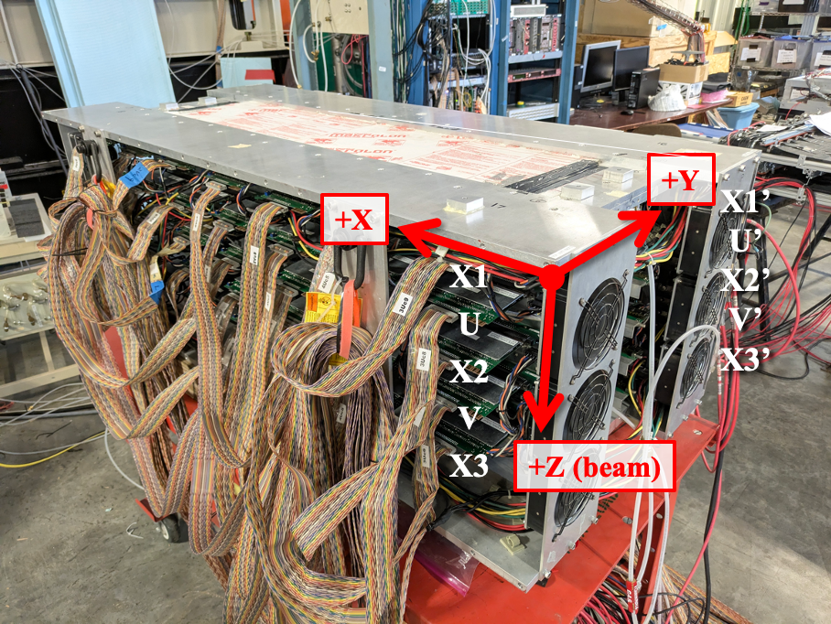
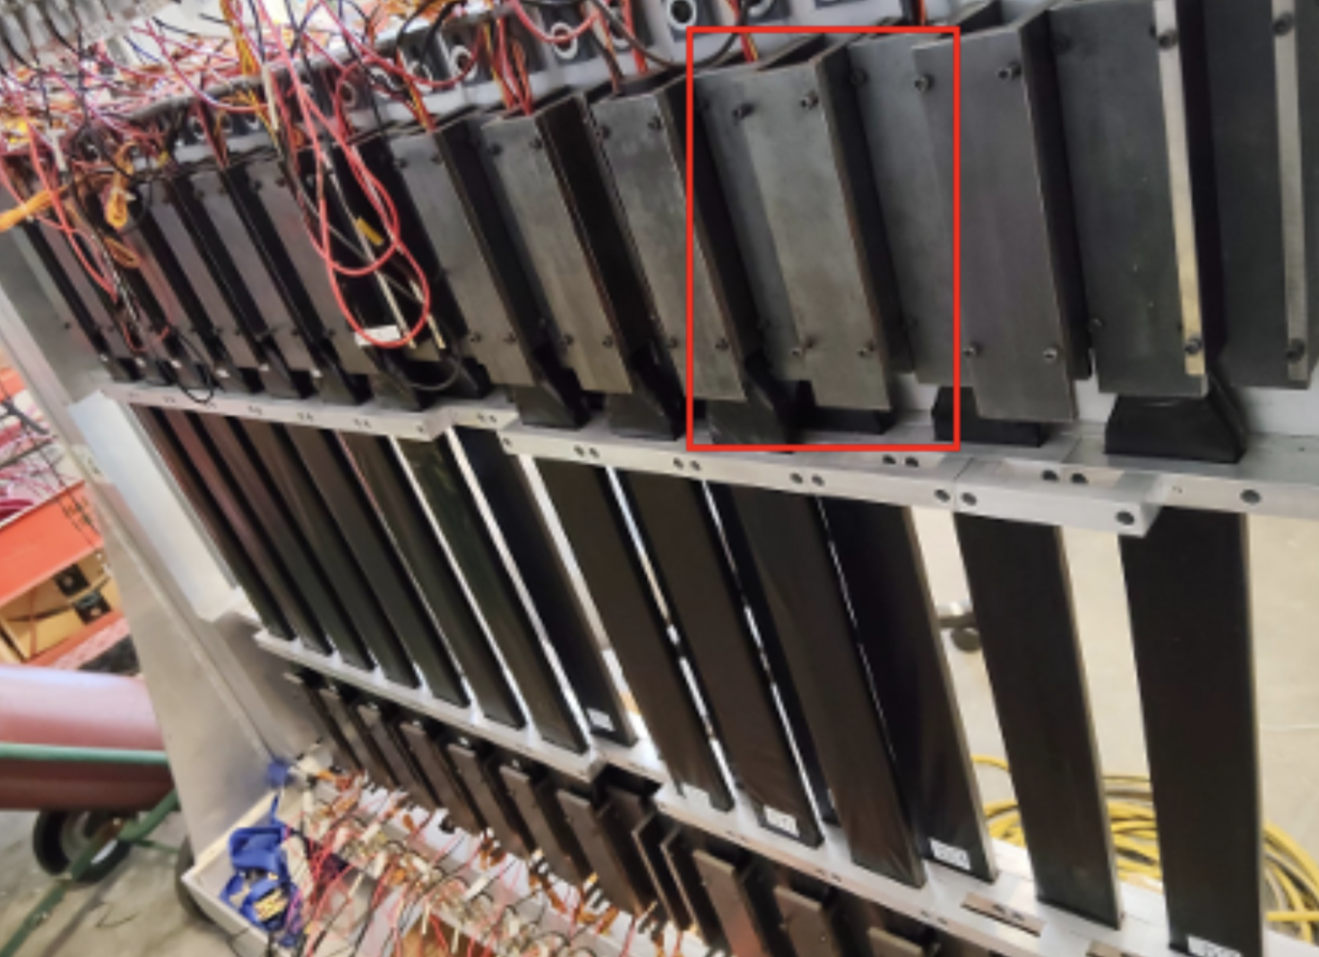
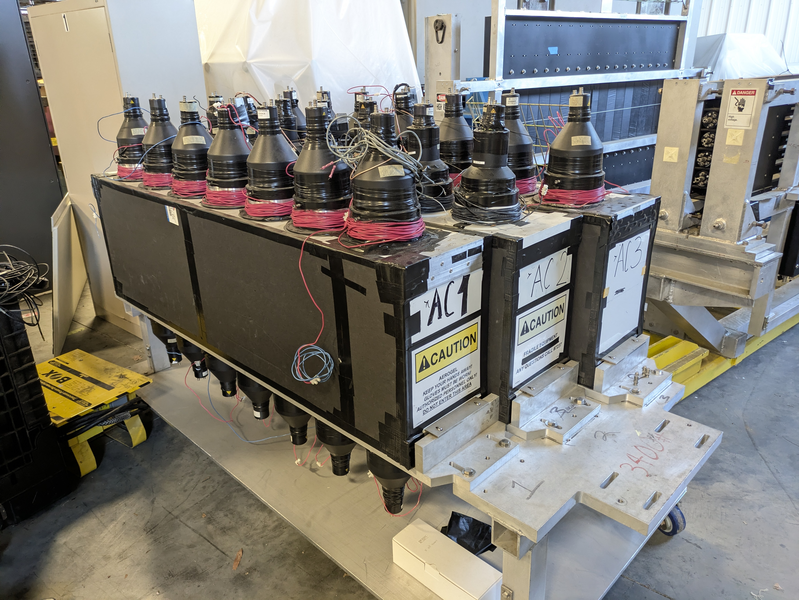
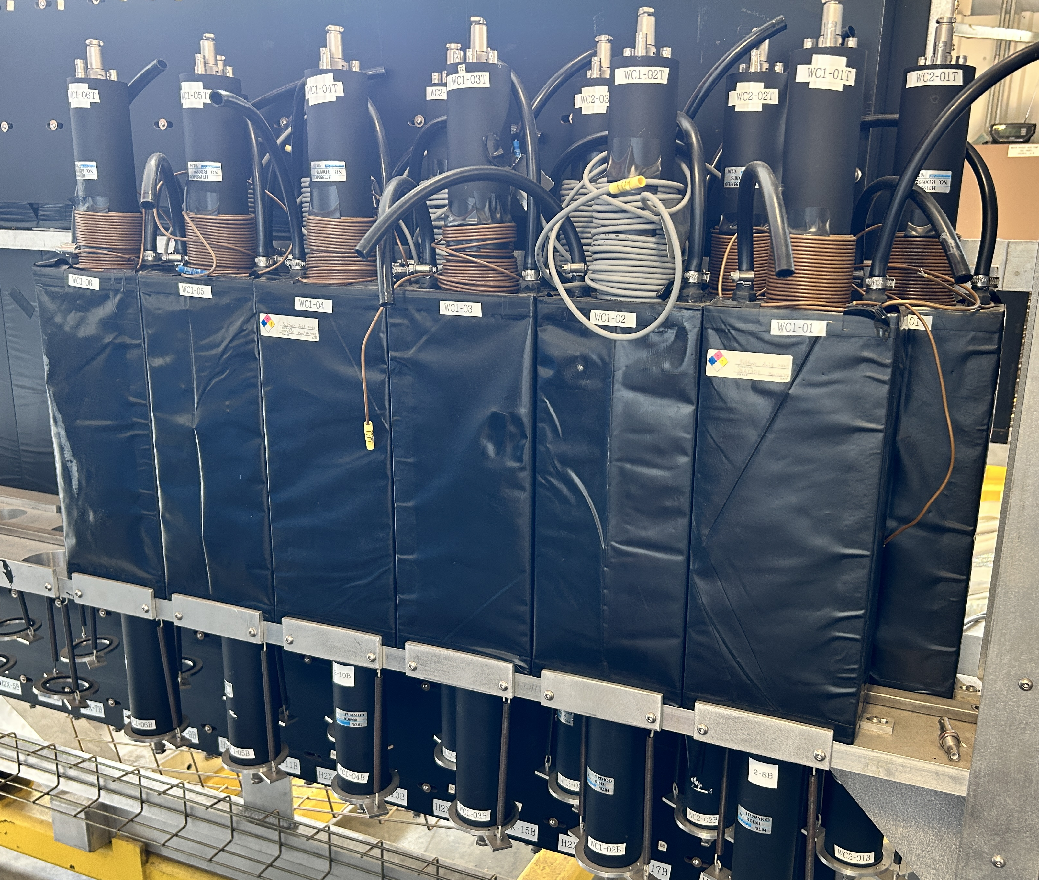
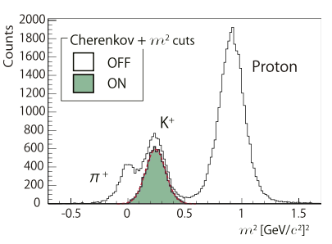
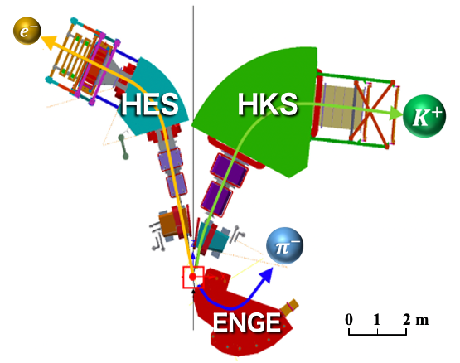
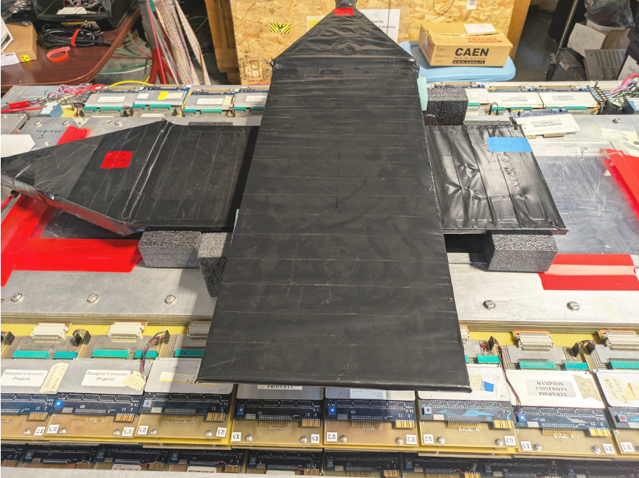
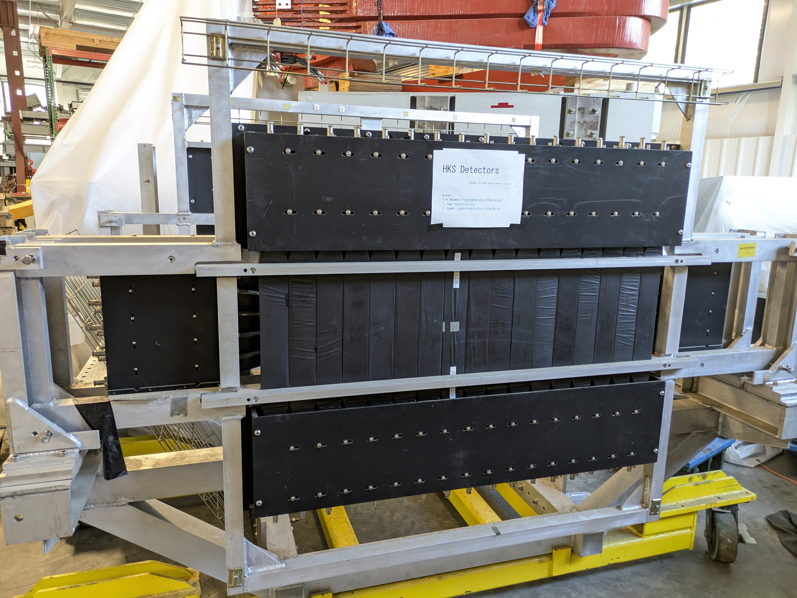
Detector Package: HKS and HES
Honeycomb drift chamber
Electron TOF
Aerogel Cherenkov
Water Cherenkov
Planer drift chamber
Kaon TOF
Notes:
Detector packages of HKS and HES are also existing and sitting in ESB. And last year and this year, we put all our effort into these detectors’ maintenance and performance testing. HES detectors are composed of honeycomb drift chamber and scintillator TOF counters. HKS detectors are composed of planer drift chambers, scintillator TOF counters, aerogel and water Cherenkov counters. The planer drift chamber here is completely same type as the one in SuperHMS.
For the HKS side, kaon events can be properly selected from huge background of positive pion and proton by applying Cherenkov cut and mass square cut. All these detectors were also used in the previous hypernuclear experiments and their performance were well explored, but some of them have hardware issues after long time sitting in ESB and need to be repaired or completely replaced.
(1:20, 10:00)

Slide 11
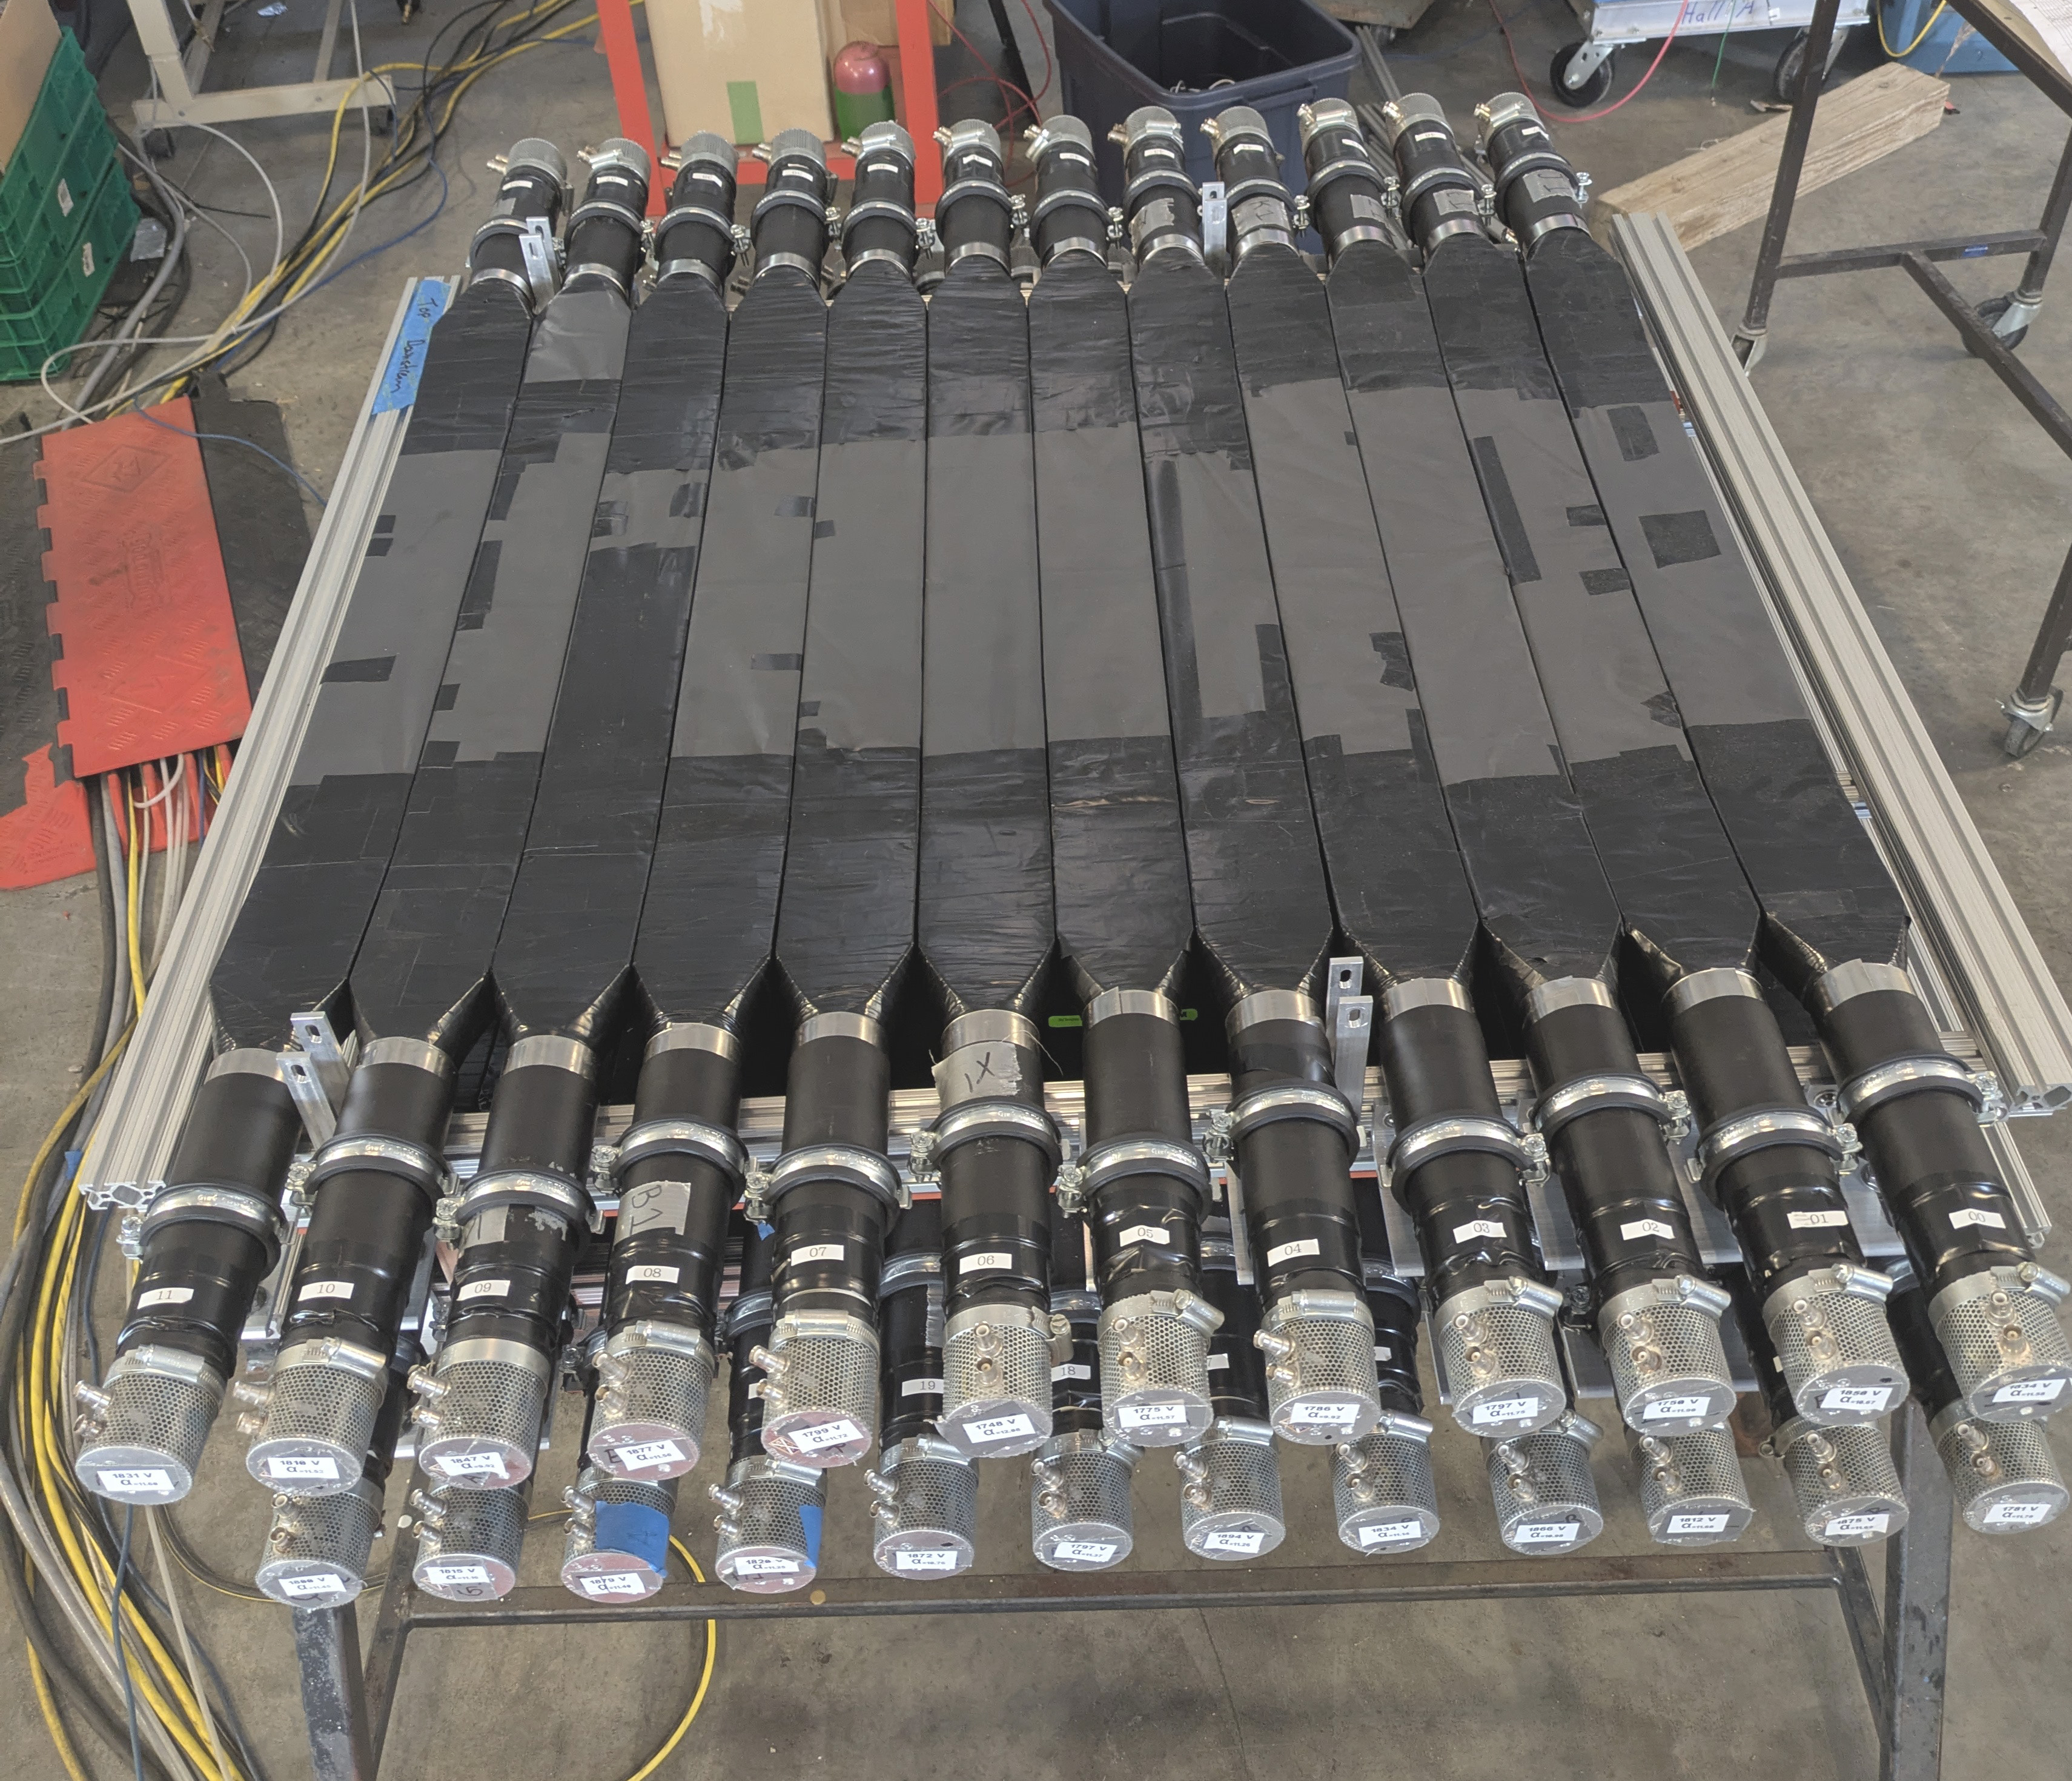
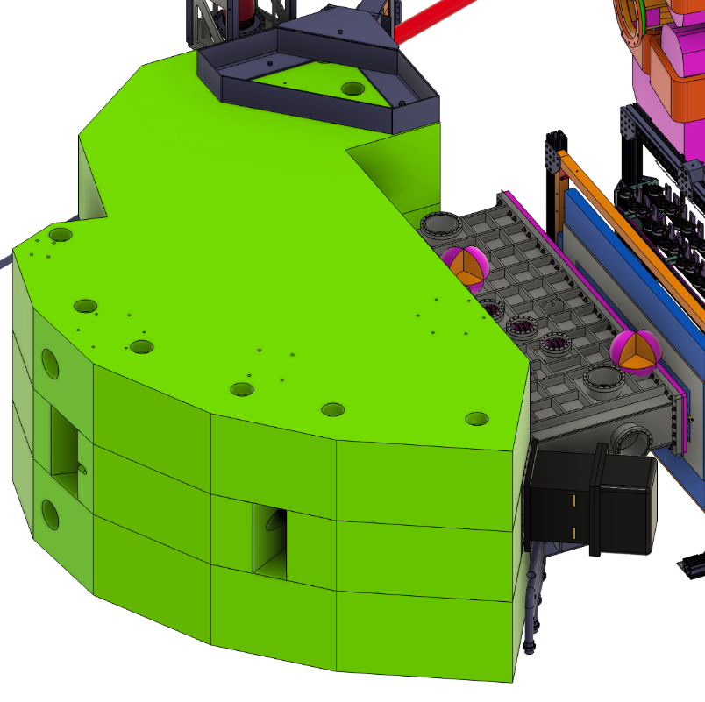
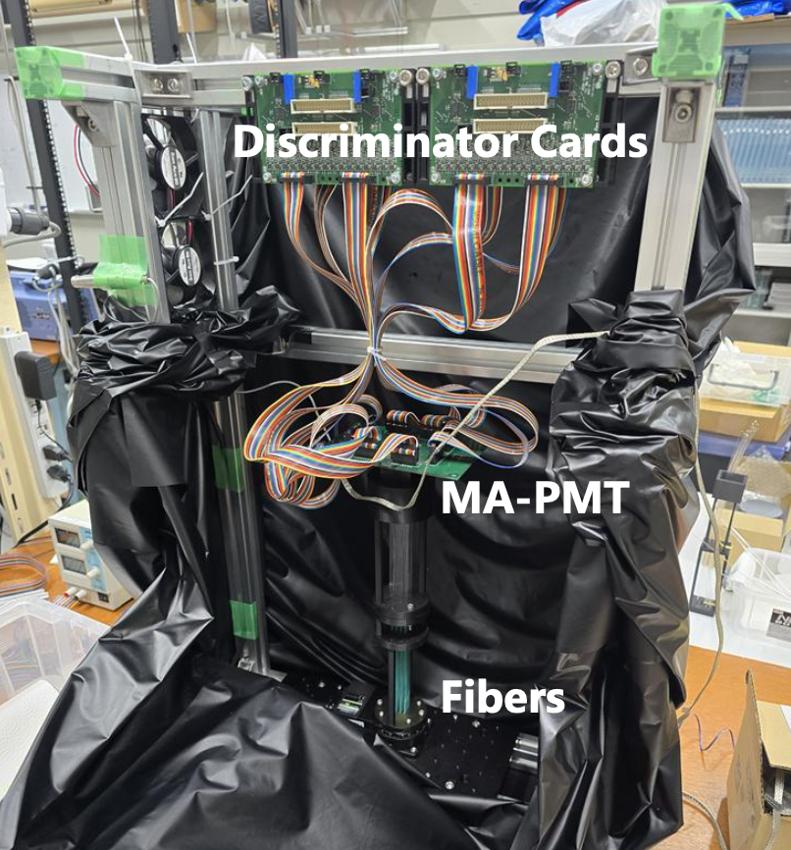
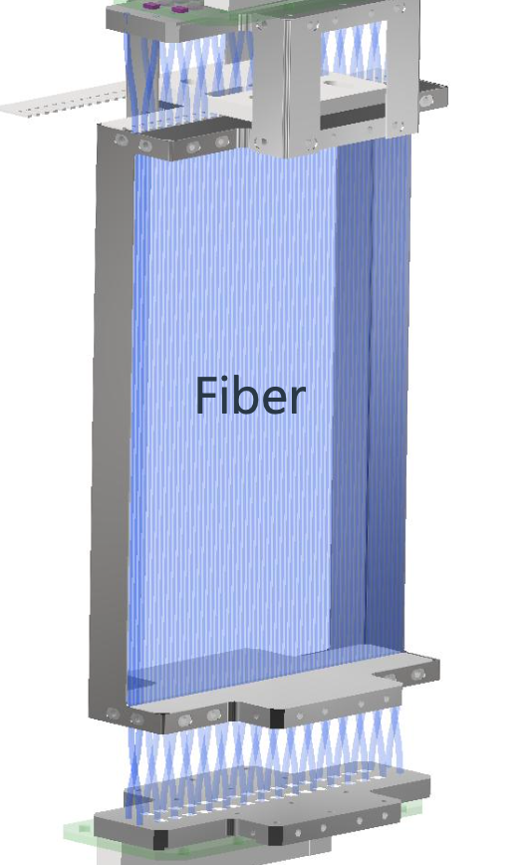
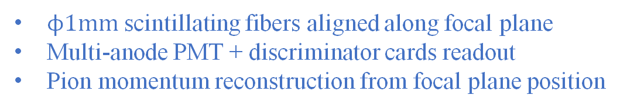
Detector Package: ENGE
Drift chamber
Pion TOF
Pion position detector → under development in Japan
ENGE
Focal plane
Vaccum extension
Test bench in Japan
$ϕ1mm$ scintillating fibers aligned along focal plane
Multi-anode PMT + discriminator cards readout
Pion momentum reconstruction from focal plane position
Notes:
ENGE has three detector components. The planer drift chamber and scintillator TOF counters are almost same as the one in HKS and HES. On the other hand, the pion position detector is a completely new detector dedicated to decay pion spectroscopy. This detector consists of thousands of scintillating fibers with 1mm diameter, and these fibers are aligned along the focal plane of ENGE spectrometer. And each channel is readout with multi-anode PMT and following discriminator cards.
These detector sets are installed in the vacuum extension and operated in vacuum. Basically, because ENGE spectrometer has very clean focal plane, pion momentum can be reconstructed from the corresponding hit position on the focal plane. This position detector is still under development in Japan, and after beam testing and final assembly, it will be shipped to JLab in the second half of this year.
(1:15, 11:15)

Slide 12
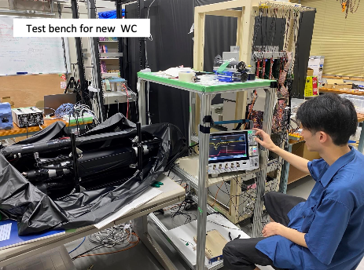
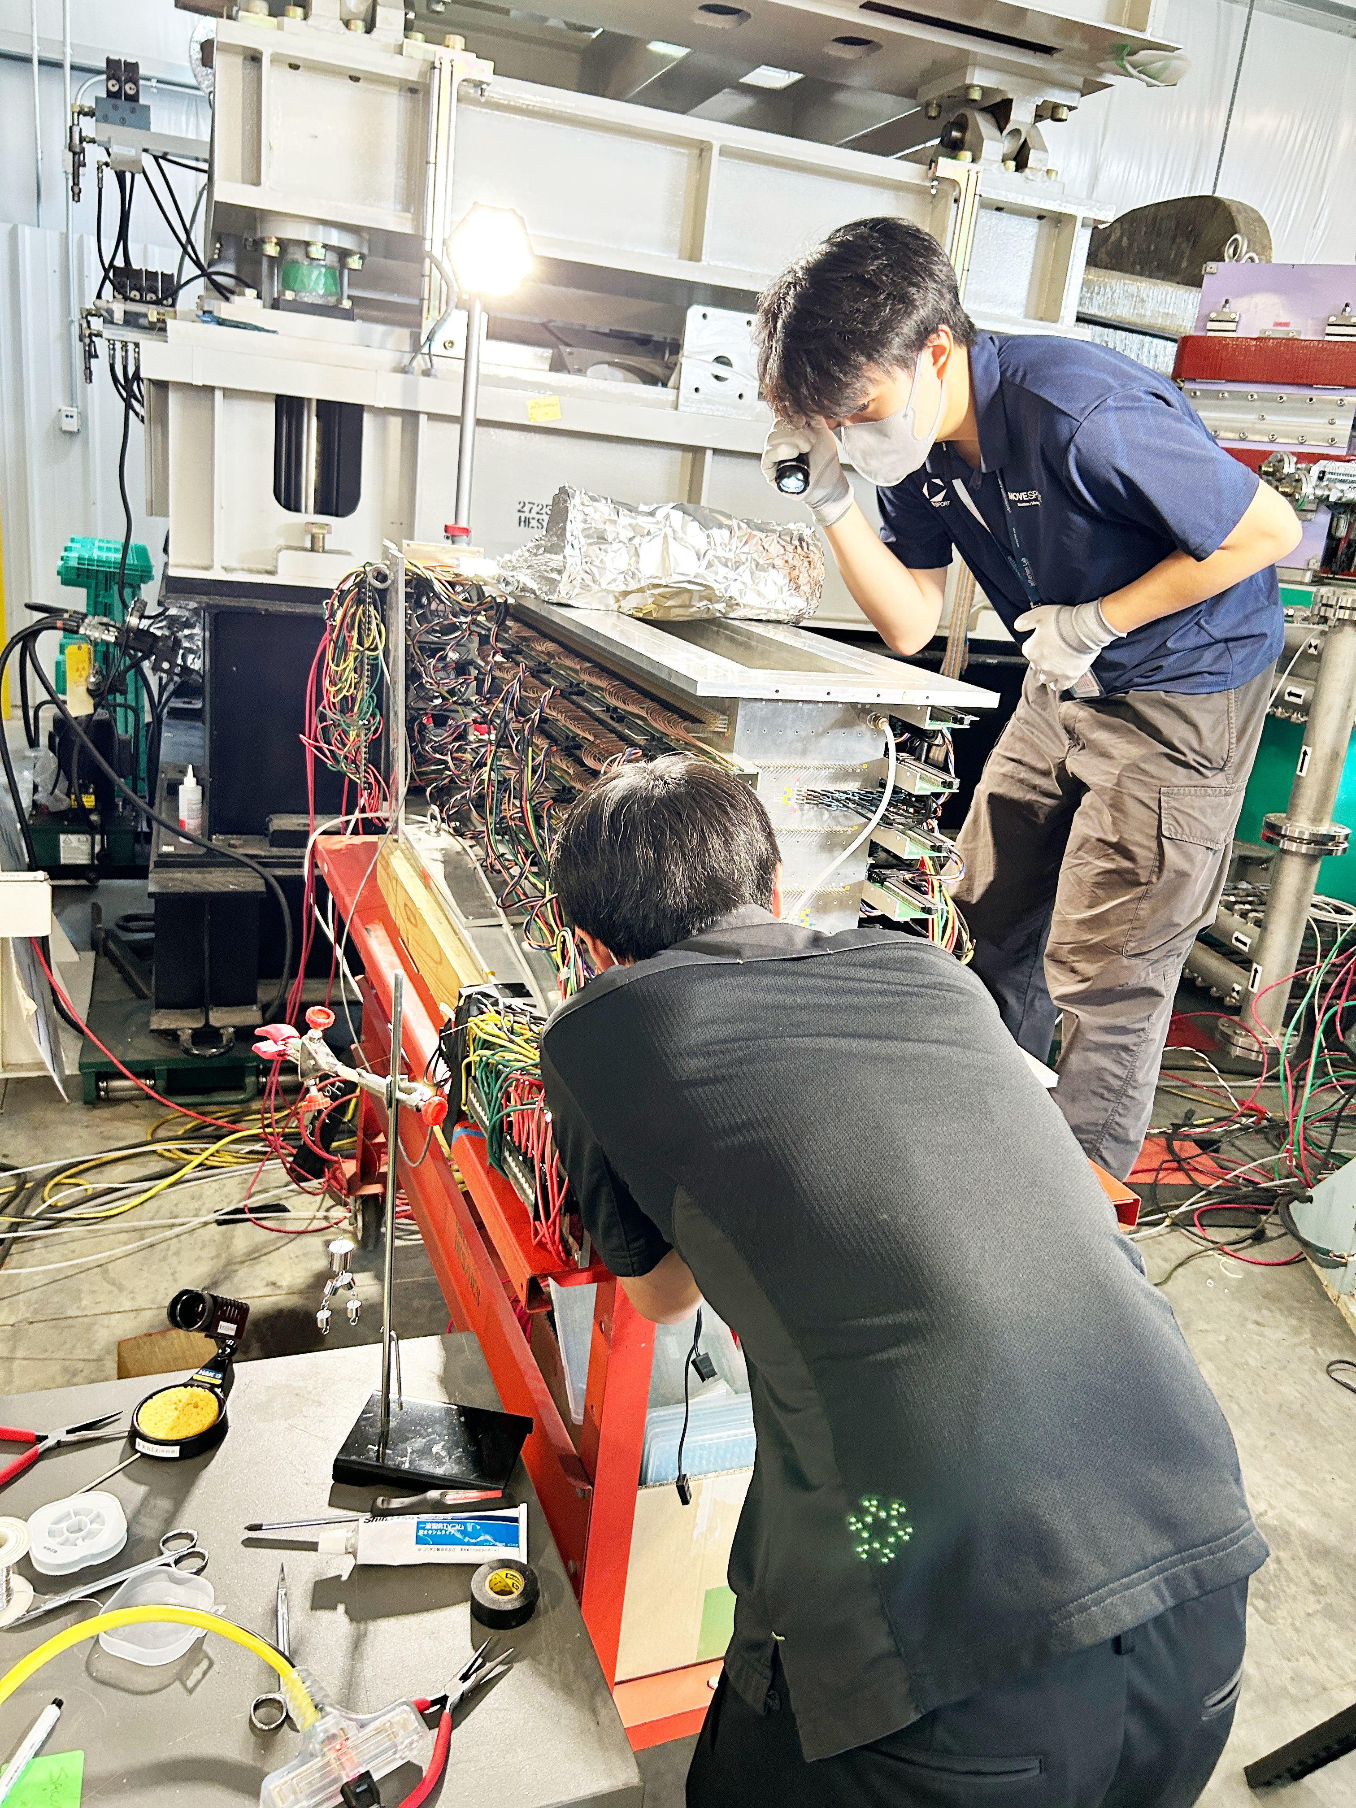
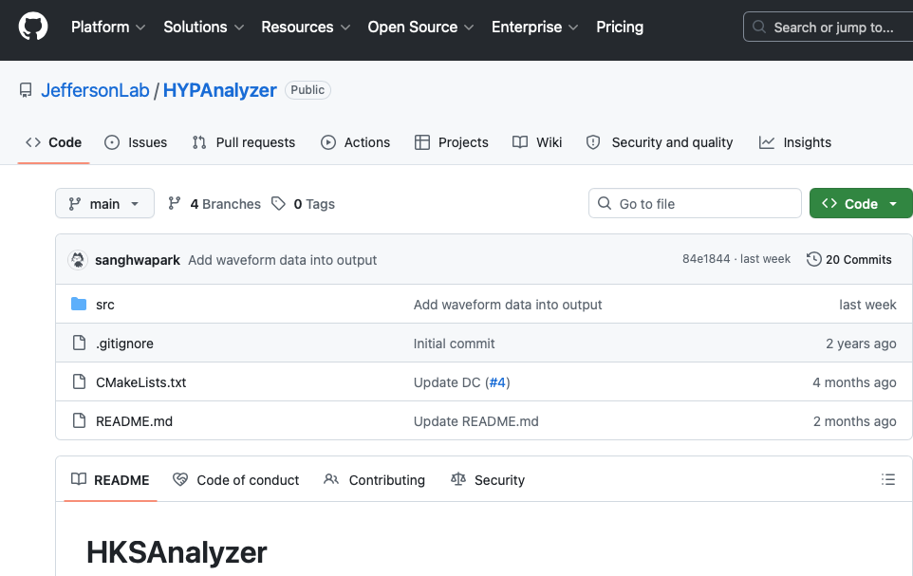
Detector Preparation Status
Honeycomb drift chamber
Planer drift chamber
DAQ & electronics
Maintenance done
Performance test done
Partly maintenance needed
Setting up & debugging
vfTDC
FADC
VTP trigger
Aerogel Cherenkov
Electron TOF
Water Cherenkov
Kaon TOF
Partly maintenance needed
Lead by Alex Cammsone
Hanjie Liu
Maintenance done
Perfomance test on-going
Software & analyzer
Planer drift chamber
Maintenance done
Performance test done
Pion TOF
Perfomance test on-going
Pion position detector
Under development in Japan
Lead by Sanghwa Park
Notes:
And here is a brief summary of detector preparation status. As I mentioned, we have been working on detector preparation in ESB over the past year. And currently, most of the existing detectors have completed maintenance or performance test. Also, along with the detector work, we are preparing DAQ system with Alex Cammsone and developing the dedicated hypernuclear analysis software with Sanghwa Park and other Hall-A/C members.
I was personally dedicated to the honeycomb drift chamber for HES over the past year, and fixed all broken wires, completed commissioning test, and got it ready to install in Hall-C. Also, redesign and replacement of water Cherenkov counters were addressed by another Japanese student, and the pion position detector, which is the key detector for the decay pion spectroscopy, is now being developed by another grad student from the university of Tokyo.
(1:10, 12:25)

Slide 13
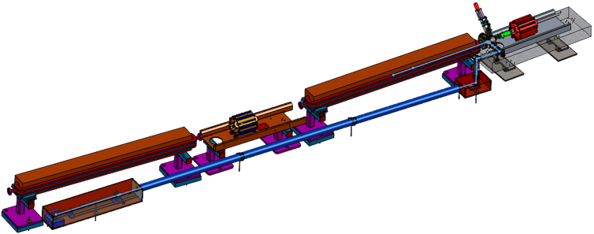
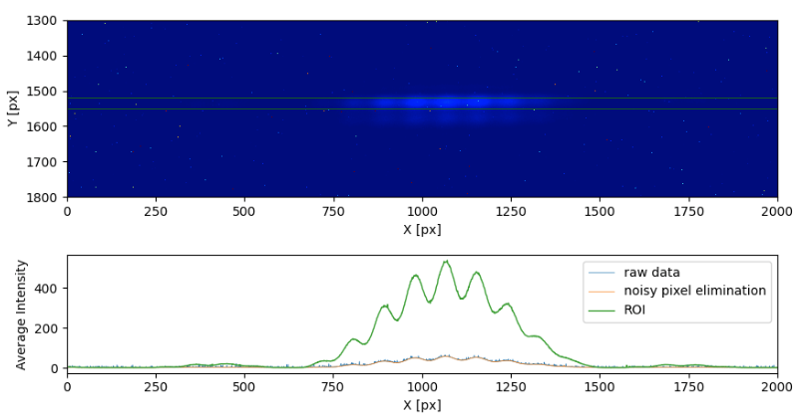
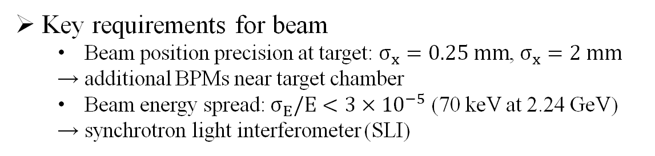
Beam Monitoring with SLI
Key requirements for beam
  Beam position precision at target: $σ_{x}=0.25 mm$, $σ_{x}=2 mm$
  → additional BPMs near target chamber
  Beam energy spread: $σ_{E}/E<3×{10}^{−5}$ (70 keV at 2.24 GeV)
  → synchrotron light interferometer (SLI)
Interferometory pattern during beam test in June
Turning mirror
Camera
Notes:
Along with the detector preparation in ESB, we are also developing a beam-monitoring system using a synchrotron light interferometer, or SLI. To achieve high-resolution and high-precision spectroscopy, we have two main requirements for the beam. One is precise beam-position monitoring at the target, which is essential for decay pion spectroscopy. This can be achieved by simply adding existing BPMs.
The other requirement is that the beam-energy spread must be sufficiently small so that its contribution to the final energy resolution is negligible. And to continuously monitor the beam energy spread, we are introducing SLI system. And during the Hall-C beamtime since this April, we tested an existing SLI system and successfully obtained interferometry pattern like this.
(1:05, 13:30)

Slide 14
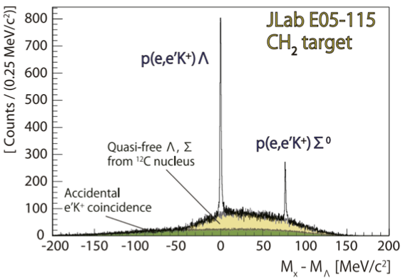
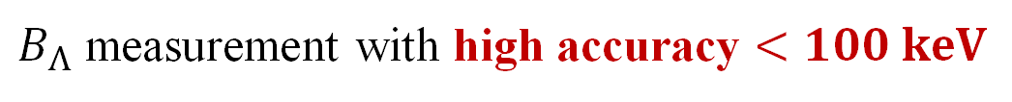
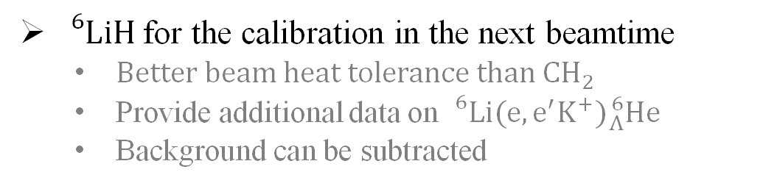
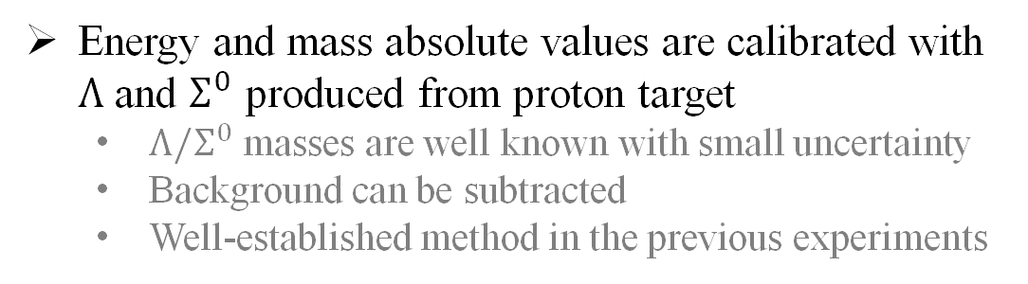
Energy Scale Calibration with $Λ/Σ^{0}$ Spectrum
Energy and mass absolute values are calibrated with $Λ$ and $Σ^{0}$ produced from proton target
  $Λ/Σ^{0}$ masses are well known with small uncertainty
  Background can be subtracted
  Well-established method in the previous experiments
${}_{}^{6}{Li}H$ for the calibration in the next beamtime
  Better beam heat tolerance than $CH_{2}$
  Provide additional data on ${}_{}^{6}{Li}(e,e^{′}K^{+}){}_{Λ}^{6}{He}$
  Background can be subtracted
[TG et al., NIMA 900, 69-83 (2018)]
$B_{Λ}$ measurement with high accuracy $<100 keV$
Notes:
Here, I’ll also mention the energy scale calibration using electro-production of $Λ$ and $Σ^{0}$. This energy scale calibration is one of the key requirements to achieve the high precision in $(e, e′K^{+})$ spectroscopy. By using proton target, we can electro-produce pure $Λ$ and $Σ^{0}$ hyperons and reconstruct their masses in the same way as for $Λ$ hypernuclei. And since the masses of these hyperons are precisely known, their peaks can be used to calibrate the binding-energy scale.
For this calibration, $CH_{2}$ target was used in the previous experiment, and this time, we will use ${}_{}^{6}{Li}H$ target instead. The use of ${}_{}^{6}{Li}H$ can provide additional data on ${}_{Λ}^{6}{He}$ hypernuclei, while the pure ${}_{}^{6}{Li}$ target data can be used for background subtraction in the calibration analysis. With this calibration method, we expect to achieve high accuracy better than 100 keV in $(e, e′K^{+})$ spectroscopy.
(1:20, 14:50)

Slide 15
Expected Results
Notes:
Then, finally, I’ll show some expected results based on Geant4 simulation.

Slide 16
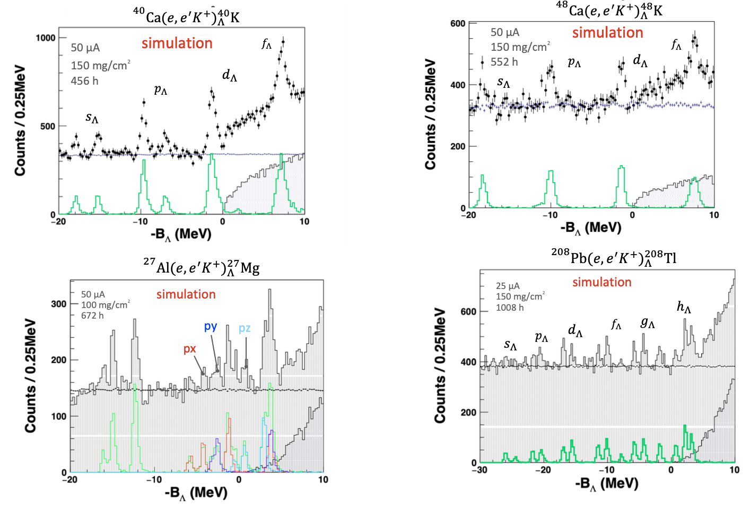




${}_{Λ}^{27}{Mg}$ Spectrum: triaxial nucleus deformation
$Λ in px$
$Λ in py$
$Λ in pz$
Good separation with sub-MeV resolution
Notes:
First, this shows the simulated ${}_{Λ}^{27}{Mg}$ spectrum. And these three states of px, py, pz, correspond to p-orbit $Λ$ hyperon overlapping with long, middle, and short axis of triaxially deformed core nucleus. And thanks to the sub-MeV resolution of $(e, e′K^{+})$ spectroscopy, these three states can be observed as clearly separated peaks in the spectrum.
(0:50, 15:40)

Slide 17
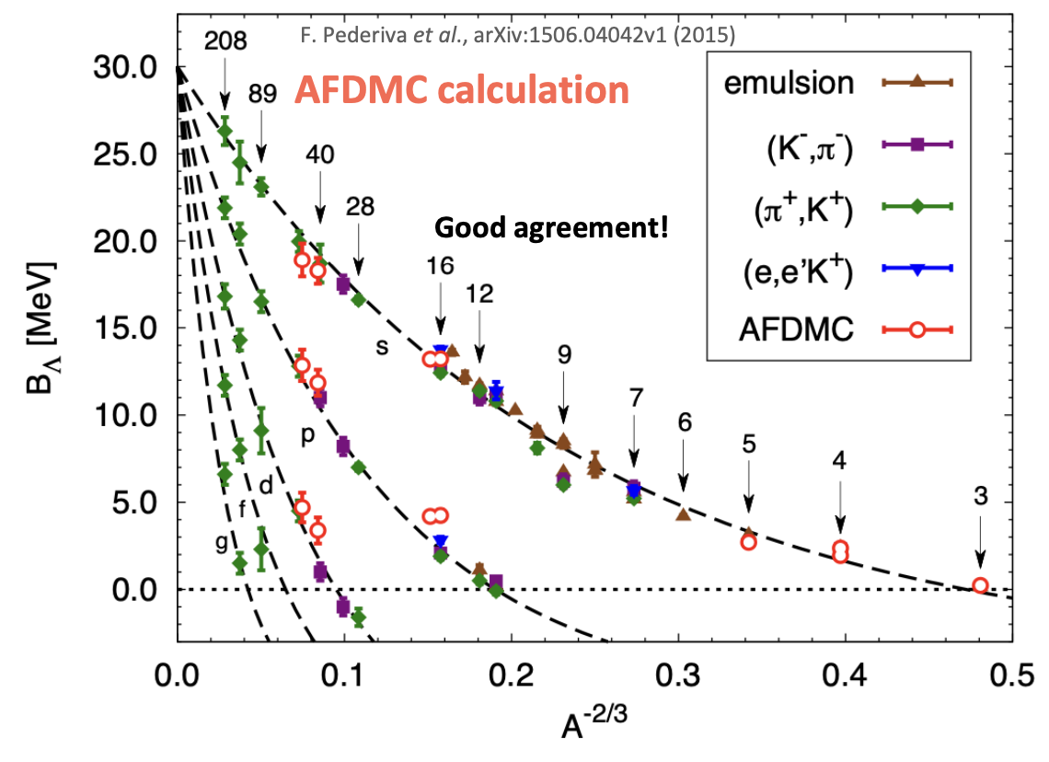
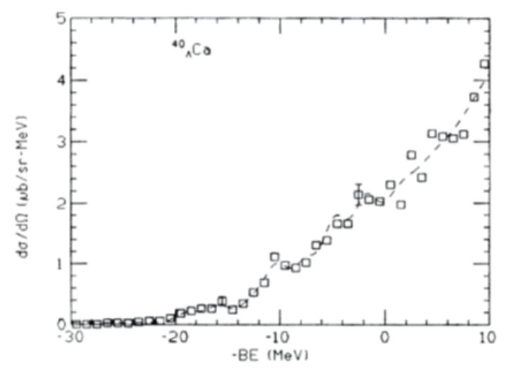
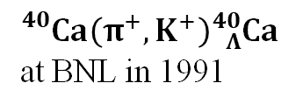

${}_{Λ}^{40}K, {}_{Λ}^{48}K$ Spectrum: hyperon puzzle
Add plots with sub-MeV resolution
Add isospin dependent data
${}_{}^{40}{Ca}\left(π^{+}, K^{+}\right){}_{Λ}^{40}{Ca}$
at BNL in 1991
Better resolution
[F. Pederiva et al., arXiv:1506.04042v1 (2015)]
[P. Pile et al. , Phys. Rev. Lett. 66 (1991) 2585]
Notes:
And next, the top two panels show simulated spectrum of ${}_{Λ}^{40}K$ and ${}_{Λ}^{48}K$. Comparing the ${}_{Λ}^{40}K$ spectrum with the corresponding ${ (π}^{+},K^{+})$ spectroscopy data, we can clearly see the significant improvement in energy resolution. As a result, we can add new data points to this mass-number dependence plot with improved resolution, while also providing completely new information on the isospin dependence of the $ΛN$ interaction, especially in medium mass region.
(0:50,16:30)

Slide 18
Schedule and Timeline
Notes:
So, timeline and schedule toward the beamtime.

Slide 19
Timeline toward the Beamtime
Passed the ERR in June 2026
Detector preparation in ESB
  Complete by the end of 2026
2026
2027
Installation to Hall C
  For 16 months, starting in September 2027
  Perform ENGE calibration
2028
Physics beam time
  Start in January 2029
  Total 149 PAC days, 42 weeks, 2 run periods
  MOLLER will be running in Hall A during the time
2029
Notes:
Just two weeks ago, we successfully passed the experimental readiness review, and now the physics beam time is scheduled in 2029. At this point, we are preparing detectors so that we can complete all detector work in ESB by the end of this year. And Hall-C installation will start in September 2027, for 16 months. During this 16 months installation, we need to establish and complete the momentum calibration of ENGE spectrometer.
After the Hall-C installation is completed, physics beam time will start in January 2029. For this hypernuclear program, 149 PAC days are approved in total, which is about 42 weeks beamtime assuming 50% efficiency. During the hypernuclear beam time in Hall-C, the MOLLER experiment will be running in Hall-A.
(1:15, 17:45)

Slide 20
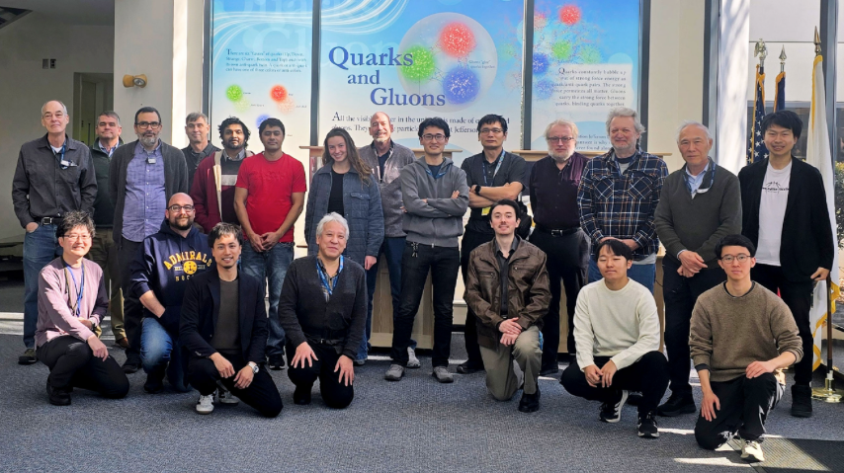
We Welcome New Collaborators
Collaboration meeting, Feb. 2026
Current collaborators
US: JLab, Hampton Univ, FIU, CNU
Japan: UTokyo, Kyoto Univ, Tohoku Univ
Italy: INFN
6+ PhD candidates
We are eager to strengthen our collaboration!
Visit wiki: hallcweb.jlab.org/wiki/index.php?title=Hypernuclear_Experiment_in_Hall_C
or join our mailing list: hks@jlab.org
Notes:
At the end of this talk, we welcome new collaborators. Currently, our JLab Hypernuclear Collaboration consists of 8 institutes from Japan, Italy, and the US, and has about 6+ PhD candidates. However, we need to accelerate the preparation, including current detector work, simulation wok and so on so force, and so we want much more collaborators to work together toward the beamtime. So, if you are interested in joining our collaboration, please contact our spokesperson, or join the hks mailing list, or just visit the hypernuclear wiki page.
(0:45, 18:40)

Slide 21

Summary
The 2029 $Λ$ hypernuclear experiment in JLab Hall-C
  Expand $(e,e^{′}K^{+})$ spectroscopy to medium-to-heavy $Λ$ hypernuclei
  Approach to triaxially deformed nucleus, hyperon puzzle
Experimental setup and apparatus
  Three dedicated high-resolution spectrometers → Ready for installation
  Detector packages → Getting ready, with DAQ and analysis software
  Beam monitoring with SLI → Beam test performed in FY2026 beam time
  Energy scale calibration with ${}_{}^{6}{Li}H$ target
Schedule and timeline toward the beamtime
  16 months Hall-C installation starting in Sept 2027
  Physics beam time of 149 PAC days will start in Jan 2029
  We welcome new collaborators!!
Notes:
And that is all of my talk today. Thank you for your attention.
(0:30,10:30)

Slide 22
Backup Slides

Slide 23




Topic2: $ΛN$ Interaction in Neutron Star
“Hyperon puzzle”
  Indicates the importance of $ΛNN$ 3-body interaction in nuclear matter
  AFDMC (Auxiliary-Field Dﬀusion Momte Carlo) calculations
${}_{}^{40}{Ca}\left(π^{+}, K^{+}\right){}_{Λ}^{40}{Ca}$
at BNL in 1991
${}_{}^{208}{Pb} \left(e,e^{′}K^{+}\right) {}_{Λ}^{208}{Tl}$
  Z number dependence of $ΛN$ interaction
${}_{}^{40}{Ca} \left(e,e^{′}K^{+}\right) {}_{Λ}^{40}K / {}_{}^{48}{Ca} \left(e,e^{′}K^{+}\right) {}_{Λ}^{48}K$
Isospin dependence of $ΛN$ interaction
Notes:
The second and third topics are related to hyperon puzzle, which was also introduced in the previous talk.
The hyperon puzzle is, in short, a conflict between astrophysical observations and neutron-star EOS based on the current ΛN interaction. However, as I mentioned before, experimental data of ΛN interaction is still largely limited to light hypernuclei, and data in the medium-to-heavy mass region are not yet sufficient to establish a realistic interaction model for neutron stars.
So, for further discussion on the hyperon puzzle, we need to investigate the ΛN interaction in environments closer to neutron stars. One important aspect is the isospin dependence of ΛN interaction, which can be studied by comparing ${}_{Λ}^{40}K$ and ${}_{Λ}^{48}K$. And another point is the behavior of ΛN interaction in heavy nuclei, which can be investigated using lead-target data.
(1:10, 8:30)

Slide 24







Spectroscopy of $Λ$ Hypernuclei
$Λ$ hypernucleus
Nuclear system containing a $Λ$ hyperon
Presence of $Λ$ hyperon enables broader investigations of nuclear/baryonic systems
  $Λ$ hyperon ($Λ$) - Nucleon (N) interaction
  Probing internal structure of nuclei
flavor SU(3)
Mid-heavy/heavy
Measurement of $Λ$ binding energy
using mass spectroscopic techniques
Experimental mass data are very limited
  No data are available in mid-heavy/heavy region
  Precision and resolution are also limited
Notes:
A $Λ$ hypernucleus is a nuclear system in which one nucleon is replaced by a $Λ$ hyperon. The $Λ$ hyperon is the third baryon composed of up, down, and strange quarks, and by assuming the flavor SU(3) symmetry of these quarks, the nuclear chart can be naturally expanded to a three-dimensional chart including the strangeness degree of freedom, as shown here.
And because of the presence of $Λ$ particle, experimental studies of $Λ$ hypernuclei provide us valuable information on baryonic interaction beyond the conventional nucleon-nucleon interaction. To extract $Λ$-nucleon interaction, mass spectroscopy is one of the most powerful techniques. And $Λ$ binding energy derived from the measured mass indicates how deeply the $Λ$ hyperon interacts with core nucleus.
However, as you can see in this chart, most experimental data, especially in medium-to-heavy mass region, are still unavailable or have only limited resolution and precision. Therefore, in the next hypernuclear experiment, we aim to measure the Λ binding energies of various hypernuclei over a wide mass range, from light to heavy nuclei.
(1:50. 2:20)

Slide 25






Previous $(e,e^{′}K^{+})$ Spectroscopy at JLab
2009
p-shell (${}_{Λ}^{7}{He}$,${}_{Λ}^{9}{Li}$,${}_{Λ}^{10}{Be},{}_{Λ}^{12}B$ ) + ${}_{Λ}^{52}V$
2005
p-shell (${}_{Λ}^{7}{He}$,${}_{Λ}^{9}{Li}$,${}_{Λ}^{12}B$,${}_{Λ}^{16}N$ ) + ${}_{Λ}^{28}{Al}$
2000
First observation of ${}_{}^{12}C(e,e^{′}K^{+}){}_{Λ}^{12}B$
2018
$${}_{}^{3}H(e,e^{′}K^{+})nnΛ$$
Notes:
Since the first (e,e′K⁺) spectroscopy experiment in 2000, a series of hypernuclear experiments have been carried out at JLab. In particular, the 2005 and 2009 experiments successfully measured several p-shell hypernuclei, and the 2009 experiment extended (e,e′K⁺) spectroscopy to medium-mass hypernuclei for the first time.
Based on these achievements, the 2029 experiment will further expand the accessible mass region from light to medium-mass and heavy hypernuclei, reaching the heavy-mass region for the first time. In addition, by performing systematic measurements over such a wide mass range, we can study not only the physics of each mass region, but also the global features of the ΛN interaction across the nuclear chart.
(1:10,5:00)

Slide 26





Hypernuclear Experiments at Jefferson Lab
Experimental Hall C
zzzzzzzzzz
HES (High-res. Electron Spectrometer)
HKS (High-res. Kaon Spectrometer)
ENGE (High-res. Pion
Spectrometer)
Hall A
Hall C
$$30 m$$
$$2.2 GeV$$
Jefferson Lab, VA
$12 GeV$ electron beam
Notes:
This experiment will be carried out in Experimental Hall C at Jefferson Lab. In the Hall C setup, 2 GeV electron beam is delivered on fixed targets here and $Λ$ hypernuclei is produced from target nucleus via electron scattering. And mass information of the electro-produced $Λ$ hypernuclei is reconstructed from momentum of scattered electrons, Kaon, and pion measured with these three high-resolution spectrometers, HES, HKS, and ENGE.
(0:35, 4:05)

Slide 27




Comparison with Heavy Ion Collision
Hypertriton puzzle
Deeply bound?
Short lifetime?
Shallowly bound?
Long lifetime?
or
STAR $B_{Λ}=0.41±{0.12}_{(stat)}±{0.11}_{(syst)} MeV$
ALICE $B_{Λ}=0.10±{0.06}_{(stat)}±{0.07}_{(syst)} MeV$
MAMI $B_{Λ}=0.52±{0.01}_{(stat)}±{0.07}_{(syst)} MeV$
→ Binding energy and lifetime
with small systematic error
Notes:
In the (e,e’K) spectroscopy, four programs were approved in total using multiple targets to address variety of physics topics, like hyperon puzzle, charge symmetry breaking, and nuclear deformation.
One interesting study with Al target is an observation of triaxially deformed nucleus using a $Λ$ prove. The core nucleus of ${}_{Λ}^{27}{Mg}$, namely ${}_{}^{26}{Mg}$ nucleus, is expected to be triaxially deformed and so, considering the overlap of p-orbit wavefunction of $Λ$ and core nucleus along the short, middle, and long axis, these excitation energies are expected to be separated by a few MeV. So, the (e,e’K) spectroscopy with sub-MeV resolution allows us to clearly observe the energy separation and core nucleus deformation.
(1:10, 5:20)

Slide 28


Kinematics for Missing Mass Spectroscopy
TOF counter

Slide 29









New Challenges in Invariant Mass Spectroscopy
Simultaneous lifetime measurement
Comprehensively measure the lifetime of light $Λ$ hypernuclei $(\sim 200 ps)$
$T_{π^{−}} − T_{K^{+}}$
Production time: Kaon time
High res. HKS TOF ($σ\sim 70 ps$) + reconstruction
Decay time: Pion time
High res. ENGE TOF ($σ\sim 80 ps$) + reconstruction
World-leading accuracy with new calibration method
$p_{π^{−}}$ is measured via momentum – focal plane position relationship (one-on-one)
New method of momentuam calibration using $α$-source $({}_{}^{230}{Th},{}_{}^{241}{Am},{}_{}^{244}{Cm})$
TOF counter
Focal plane detector
Momentum is well known
($<1 keV$ accuracy, $<20 keV$ resolution)
ENGE
$B_{Λ}$ with accuracy of a few $10 keV$
Notes:
And in addition, we will introduce two new challenges to widen the scope of decay-pion spectroscopy.
First thing is a measurement of hypernuclear lifetime, estimating the production time from Kaon and the decay time from pion.
We’ve already shown that the TOF counters on HKS and ENGE have sufficient resolution to observe the typical lifetime of approximately 200 ps.
This would be very useful approach to light hypernuclei because their mass and lifetime can be measured simultaneously.
Second thing is a new calibration method of ENGE spectrometer using $α$-source.
In decay-pion spectroscopy, minimizing the uncertainty of calibration source is essential to suppress systematic error.
So, we can achieve the world-leading accuracy of a few 10 keV by using $α$-source for calibration because its energy is precisely known.
(1:05, 8:30)

Slide 30


Charge Symmetry Breaking of $ΛN$ Interaction
Charge symmetry holds in normal nuclei
Large charge symmetry breaking (CBS) was observed in s-shell $Λ$ hypernuclei
Uncertainty of p-shell $Λ$ hypernuclei is still large for CSB discussion
Notes:
A great advantage of the decay-pion spectroscopy at JLab is that we can use all targets used in the (e,e’K) , and light hypernuclear data can be comprehensively obtained.
Especially, high statistical data of hypertriton would resolve the so-called hypertriton puzzle. Hypertriton is the simplest $Λ$ hypernuclei and is the benchmark of $ΛN$ interaction research, but the picture of its bound state and lifetime is still controversial. So, the hypertriton data taken in this program with high accuracy would be a great clue to this fundamental puzzle.
In addition, for further discussion on the charge symmetry breaking of $ΛN$ interaction, precise experimental data of p-shell $Λ$ hypernuclei is not sufficient.
So, the comprehensive mass measurement with high accuracy can provide a basis for the discussion.
(1:00, 9:30)

Slide 31





Electro-Production of $Λ$ Hypernuclei
TOF counter
Electro-production of $Λ$
Electro-production of various $Λ$ hypernuclei
  Targets over wide mass range $A=7\sim 208$
Three dedicated spectrometers
  $e^{−}$ (HES), $K^{+}$ (HKS), $π^{−}$ (ENGE)
Small cross section of $a few 10 nb/sr$, but high intensity electron beam of up to $50 μA$
  Thin target
  Small emittance & small energy spread
  → high resolution & precision mass measurement
Notes:
In our case, the $Λ$ hypernuclei are electro-produced from various targets over wide mass range. Namely, a proton in the target nucleus is changed to $Λ$
hyperon via $s\overline{s}$ pair creation caused by the virtual photon. And as a result,
And to track this events, three dedicated spectrometers for scattered electron,

