Slide 1



Extraction of the Strange Form Factors of the Proton
Characterization of Calorimeters to Measure Parity Violating Asymmetry
Chris Palyok, Louisiana Tech University

Slide 2
Acknowledgments
National Science Foundation – This work is supported by the NSF Award Number: 2413002, Project Title: The Parity Violating Electron Scattering Program of Louisiana Tech University
Thomas Jefferson National Accelerator Facility (JLab) and the SFF Collaboration

Slide 3
The Strange Form Factor Collaboration
R.Beminiwattha, S.P.Wells, N.Simicevic, C. Palatchi, K.Paschke, S.Ali, X.Bai, G.Cates,
R.Lindgren, N.Liyanage, V.Nelyubin, X.Zheng, B.Wojtsekhowski, S.Barcus, A.Camsonne,
R.Carlini, S.Covrig Dusa, P.Degtiarenko, D.Gaskell, O.Hansen, D.Higinbotham, D.Flay, D.Jones,
M.Jones, C.Keppel, D.Meekins, R.Michaels, B.Raydo, G.Smith, H.Szumila-Vance, A.S.Tadepalli,
T.Horn, E.Cisbani, E.King, J.Napolitano, P.M.King, P.A.Souder, D.Hamilton, O.Jevons,
R.Montgomery, P.Markowitz, E.Brash, P.Monaghan, T.Hobbs, G.Miller, J.Lichtenstadt, T.Kolar,
E.Piasetzky, G.Ron, D.Armstrong, T.Averett, S.Mayilyan, H.Mkrtchyan, A.Mkrtchyan,
A.Shahinyan, V.Tadevosyan, H.Voskanyan, W.Tireman, P.Datta, E.Fuchey, A.J.R.Puckett, S.Seeds, C.Munoz-Camacho
LaTech, Indiana, UVa, JLab, CUA, INFN - Roma, Temple, Ohio, Syracuse, Glascow, FIU, CNU, Fermilab, U Washington, Tel Aviv U, Hebrew U, W&M, AANL Yerevan, Northern Michigan, UConn, Orsay
Notes:
Give soft introduction about myself – Student of Rakitha, seeking PhD

Slide 4
Physics and Experiment Overview
Why do we want to do this?

Slide 5
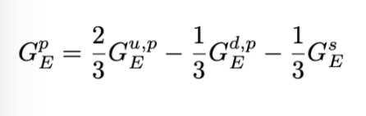
Search for a Non-Zero Strange Form Factor of the Proton at Q² = 2.5 (GeV/c)²
Proposal approved during PAC 51 (PR12-23-004)
Charge symmetry violation potentially masks the contribution of strange quarks to the electromagnetic form factors of the proton
Proposes to extract the electromagnetic strange form factors of the proton through measuring parity violating asymmetry in elastic ep scattering
Notes:
We assume that charge symmetry inside the proton is conserved as an approximation. Underlying small asymmetry masks the strange quark contribution to the form factors.

Slide 6
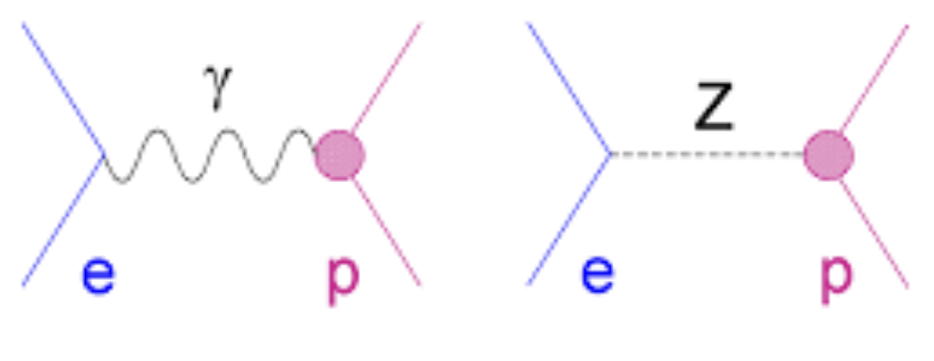
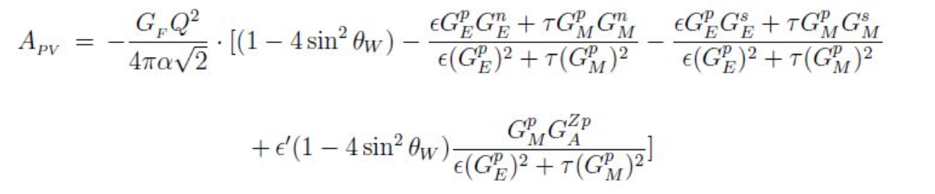
Parity Violating Asymmetry from the Electron-Proton Scattering Cross Section
Helicity dependent elastic ep cross section rises due to photon/Z⁰ interference in the scattering amplitude giving rise to parity violation
Notes:
At tree level, single photon and z exchange occurs
Left handed electrons exchange Z boson with quarks in the proton
What we are measuring is the difference in scattering rates between right and left-handed electrons in elastic ep
We are extracting the third term, all other terms are known to high precision

Slide 7
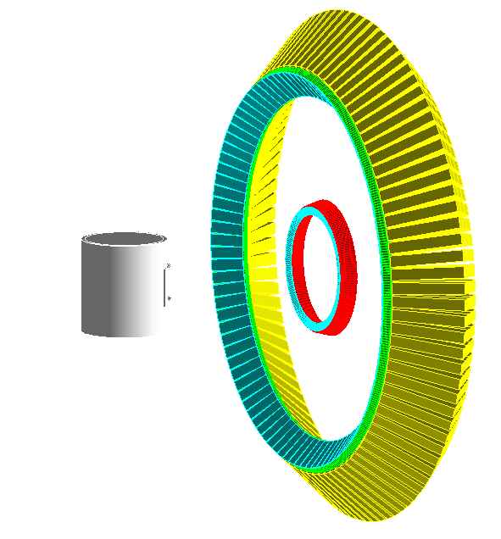
Experiment Details
65 𝜇A beam current
6.6 GeV beam energy
85% beam polarization
10 cm liquid hydrogen target
Electron Arm
  1200 PbWO₄ crystals
  Scattering angle: 15.5±1∘
Proton Arm
  288 Iron/Plastic scintillators
  Scattering angle: 42.4±3.5∘
  Highly segmented hodoscope for proton coordinate resolution
Notes:
Experiment will require 45 days of beam time
Method elastic event selection will be through coincidence counting

Slide 8
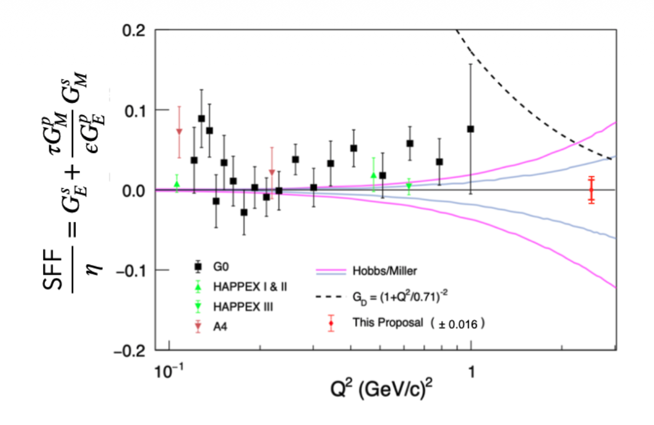
Current World Data - Motivation
Data suggest a small, non-zero strange form factor at increasing Q²
  G0 forward reported small, non-zero SFF at 1 (GeV/c)²
To best current knowledge, there have been no strange form factor measurements beyond 1 (GeV/c)²
Current lattice QCD calculations suggest Q² dependence on strange form factors– Alexandrou et. al. 2026
Notes:
Talk about the y-axis – this is the third term in Apv which we are extracting
Our proposal purports the highest precision

Slide 9
Calorimeter Characterization
How we think the calorimeters will respond to elastic events

Slide 10
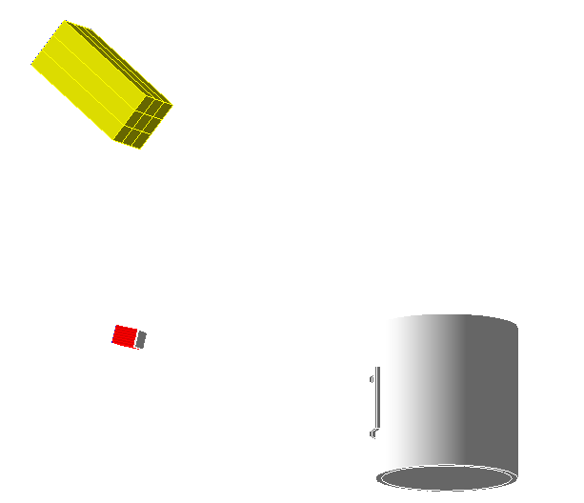
Approach to Characterization
Geant4 single module simulation
  Generate single module geometry
  Generate scattering events
  Filter elastic electron and recoiled protons from events
  Place particles in center of calorimeters
  Shower simulation and analysis
Notes:
Building on the work of the collaboration we…
Simulated 50K events
About 9.3 K of the 50K events were elastic events

Slide 11
Analysis Assumption
Only elastic events selected
Does not include second order/radiative effects
Simulation performed with 5x5 ECAL and 3x3 HCAL aligning with proposal
ECAL energy cluster calculated using 3x3 seed algorithm
Applied scattering angle acceptance for ECAL and HCAL
Notes:
We chose the 3x3 seed cluster to ensure we capture leakage that could happen into the 5x5 actual array

Slide 12
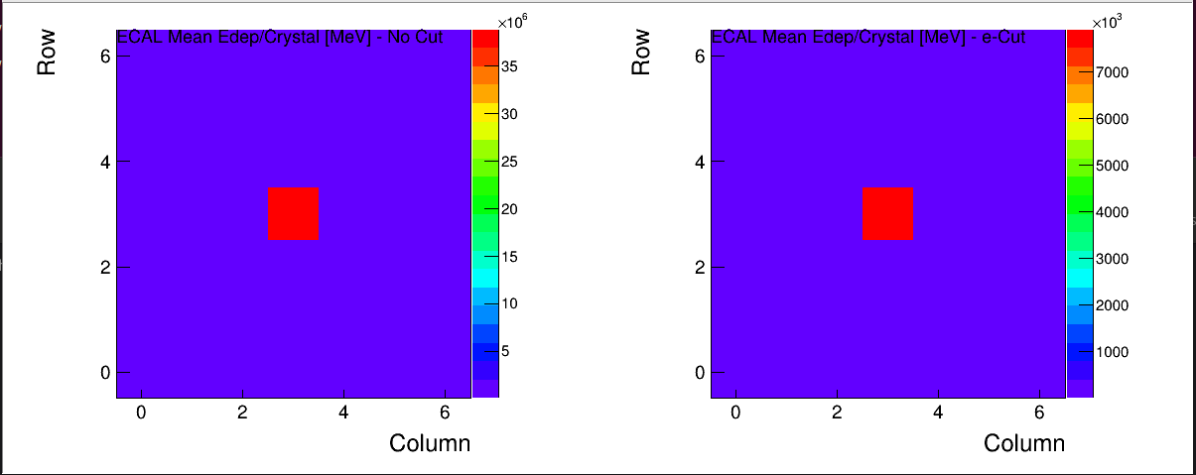
Shower Containment
Electromagnetic shower is centered and contained in the ECAL
Acceptance cuts significantly reduces the number of events by about 3 orders of magnitude
Log scale would probably be better to show shower profile
Notes:
Also note we perfectly centered the electron in front of the ECAL

Slide 13
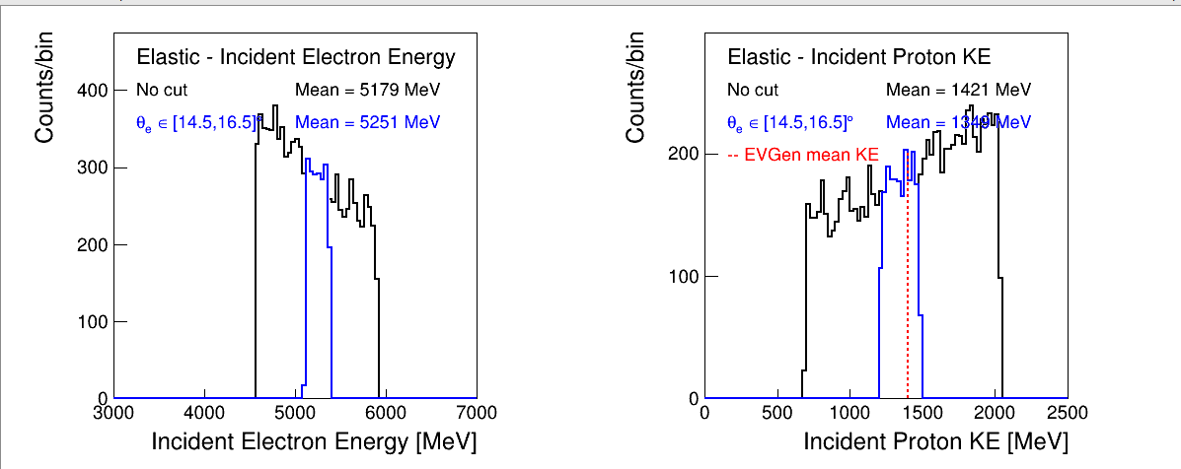
Incident Particle Energy
Detectors show large distribution of energy prior to applying scattering angle cuts
Applying electron scattering cuts alone narrows the kinematics for both the electron and proton
Notes:
It is of note that elastic events even outside the scattering angle cut are largely above the trigger threshold. Applying the scattering cuts drastically narrows the energy distribution

Slide 14
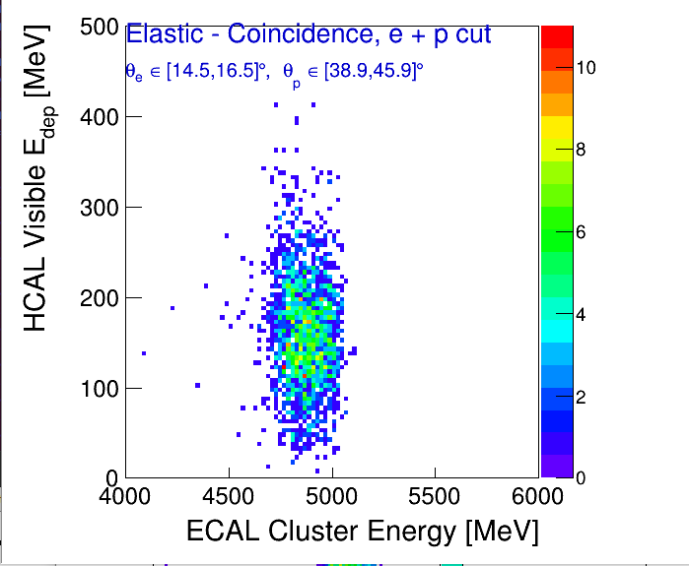
Coincidence Energy
Applying scattering cuts to the ECAL and HCAL isolate a well-defined elastic signal region
Notes:
Elastic events give a well defined, isolated elastic event region

Slide 15
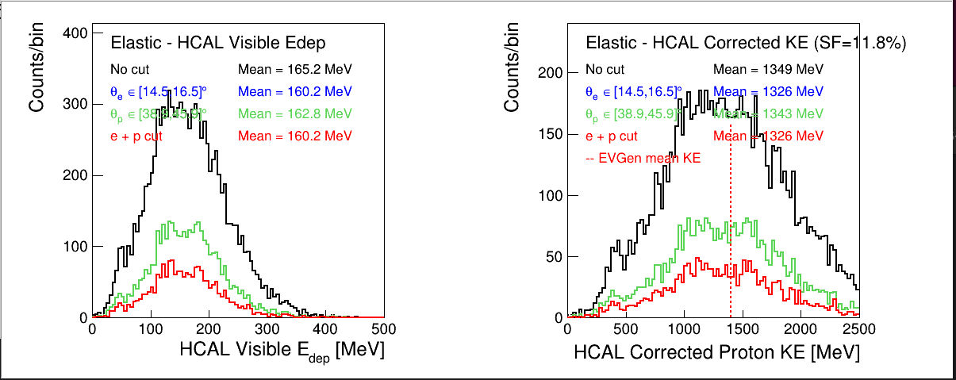
Proton Energy Deposit
The ECAL scattering angle cuts drives HCAL energy resolution – HCAL provides additional signal purity

Slide 16
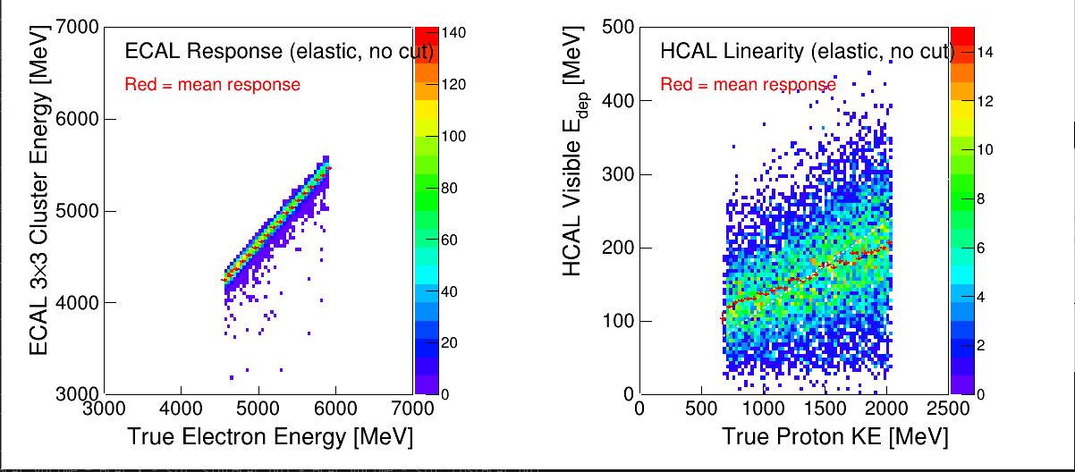
ECAL/HCAL Response
ECAL shows excellent linearity and energy resolution
HCAL has larger scatter due to the nature of hadronic showers. May need to find an energy-dependent sampling fraction rather than constant sampling fraction

Slide 17
Conclusions from Current State of Cluster Energy Study
Event generator creates events correctly
Electrons and protons are hitting the calorimeter in the correct location
Elastic events have narrow energy distribution above the trigger threshold (4.5 GeV)
Energy is being calculated correctly

Slide 18
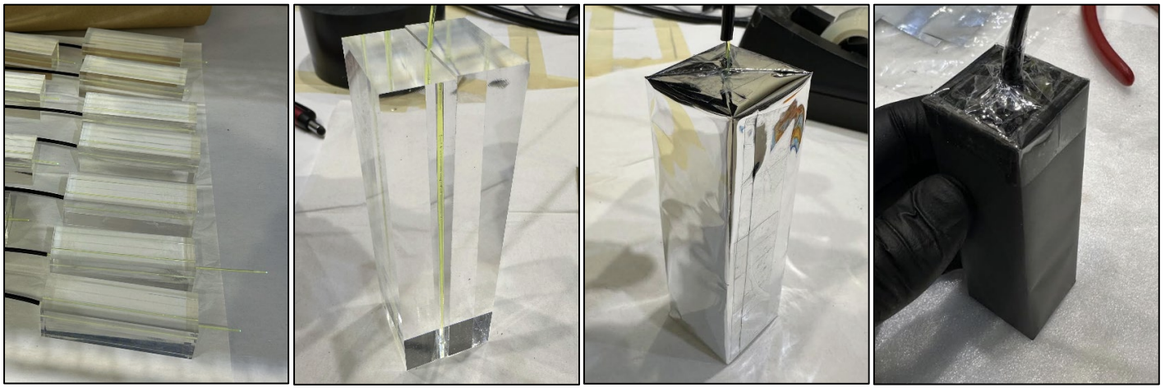
HCAL Prototype Construction
Prototype construction from Eljen 208 polyvinyl toluene with wavelength shifting fiberoptic cable at JLab is underway
Noted challenges include air contamination
Next steps include building enough scintillator blocks to install PMT for data collection

Slide 19
Going Forward
Progress toward a simulation model that allows for optimizing experimental set up: collimation, shielding, radiation dose, and detector optimization
Detector prototyping and parasitic beam test for bench marking
Challenges ahead:
  Additional funding is needed for the final experiment. Louisiana Tech has submitted a DOE EPSCoR grant for additional funding towards the experiment. Currently pending
  Experiment is planned for Hall C with an uncertain schedule
However… the path forward is clear

Slide 20

Thank you for your attention!

