Slide 1



Electrical characteristics for SiPM for direct method for luminosity measurement
Bc. Lada Radmacherová ¹
¹ Czech Technical University in Prague
11.-12.7.2026
Supervisor: Ing. Jaroslav Adam, Ph.D.

Slide 2
Theory overview

Slide 3
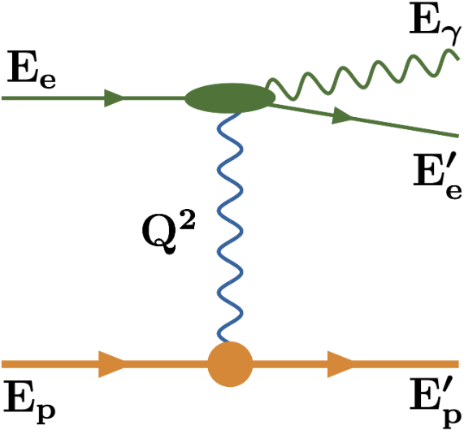
Luminosity measurement by bremsstrahlung photons
Luminosity allows us to calculate electron-hadron cross-sections
𝑅 = 𝐿𝜎, where 𝑅 is the collision rate, 𝐿 the luminosity, and 𝜎 a cross-section
Luminosity is essential for
measurement normalisations
Its measurement is based on counting
bremsstrahlung photons
e + p → e + p + γ
Piotrzkowski, “Challenging luminosity measurements at the Electron-Ion Collider,” Journal of Instrumentation, 2021.
Fig. 1. Feynman diagram for the electron-proton bremsstrahlung.

Slide 4
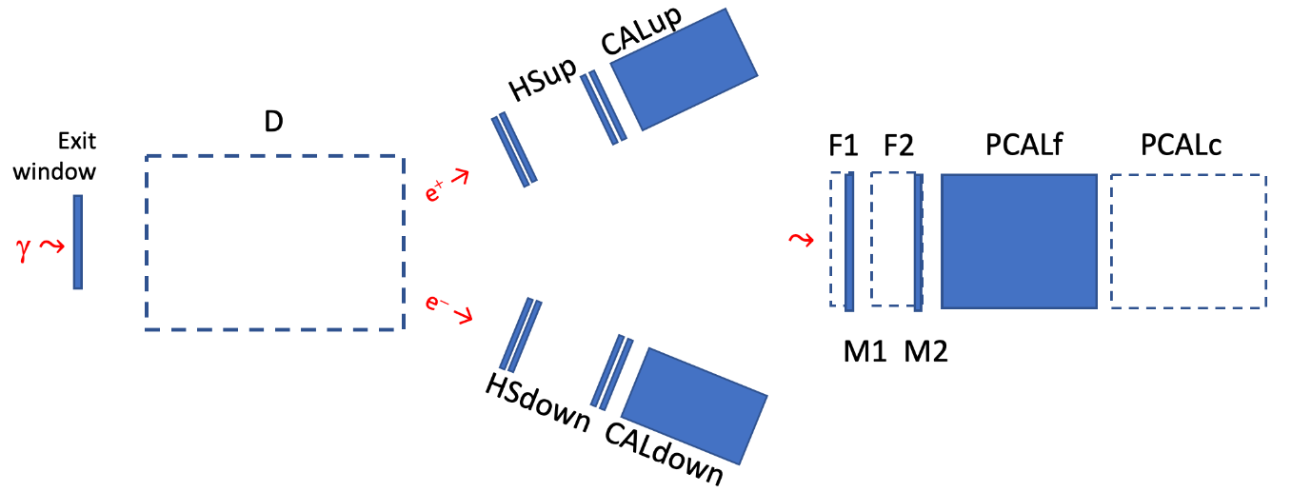
Methods for luminosity measurement
Direct and indirect method
Piotrzkowski, “Challenging luminosity measurements at the Electron-Ion Collider,” Journal of Instrumentation, 2021.
Fig. 2. Layout of the bremsstrahlung photons detection system (side view).

Slide 5
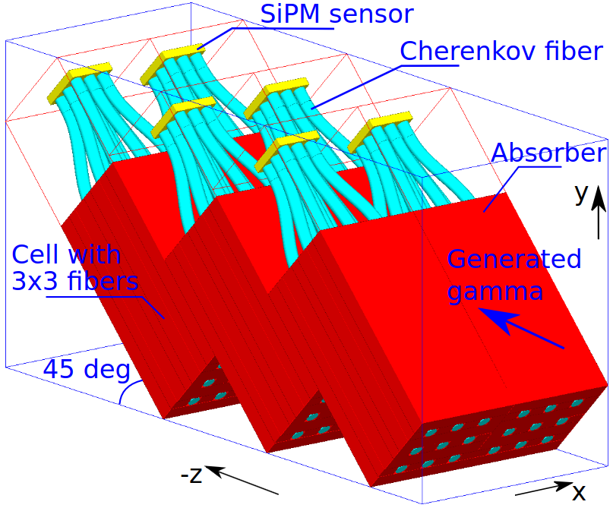
Direct calorimeter
At nominal luminosity a calorimeter with copper absorber and longitudinally embedded quartz fibers
Sampling calorimeter
Based on Cherenkov effect
Cherenkov photons guided along
the fibers and collected
by silicon photomultipliers
J. Adam, "DPD Update," presentation at the ePIC Luminosity Group Weekly Meeting, Brookhaven National Laboratory, June 11, 2026. [Online]. Available: https://indico.bnl.gov/event/33158/contributions/125732/attachments/70715/121210/JA-Direct_photon_det_20260611.pdf.
Fig. 3. Cells of 12.2×12.2×264 mm, 3×3 fibers, absorber and SiPMs at 45º.

Slide 6
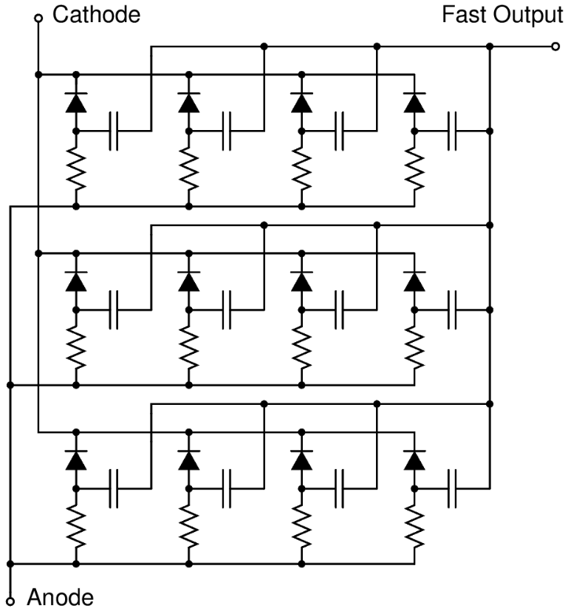
Silicon Photomultiplier (SiPM)
Single-photon-sensitive detector
Matrix of single photon avalanche diodes
(SPADs) in Geiger mode
SPAD coupled to a quenching resistor - a microcell
Operates in reverse bias
Depleted region with high electric field
Impact ionization -> avalanche
Avalanche quenched by quenching resistor
Capacitively-coupled fast output terminal
onsemi, “Introduction to the Silicon Photomultiplier (SiPM).” https://www.onsemi.com/pub/Collateral/AND9770-D.pdf, 2023.
Fig. 4. Schematics of an SiPM circuit.

Slide 7
Methods

Slide 8
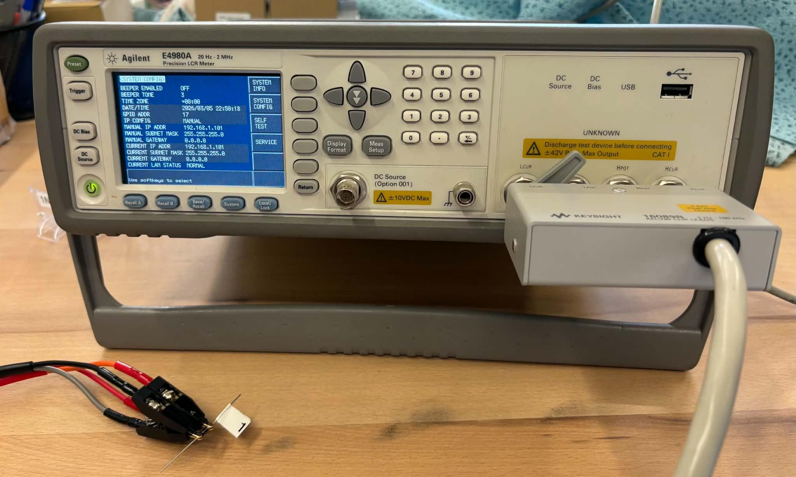
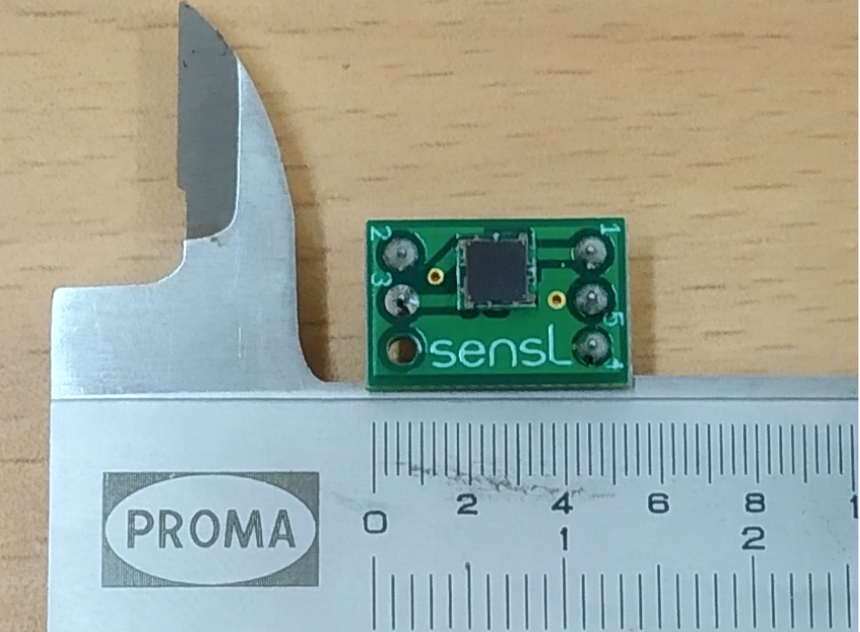
Electrical characteristics for a Onsemi SiPM
Done for C-series 30035 and 60035 SiPMs by onsemi
(3×3, and 6×6 mm² total area, 35×35 μm² cell size)
Complex impedance measured for SiPM electrical characteristics by an LCR meter
Fig. 5. Agilent E4980A LCR meter.
Fig. 6. onsemi C-series 30035 SiPM.

Slide 9
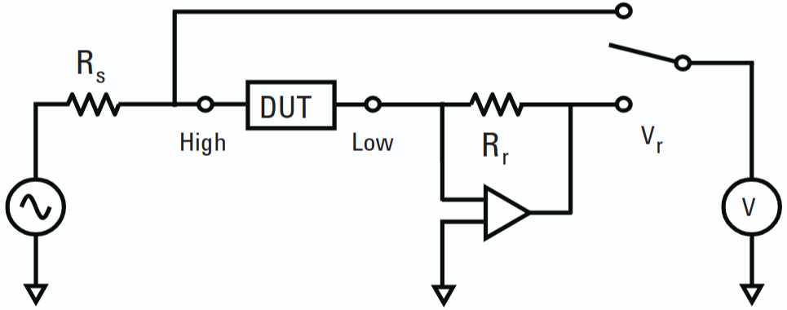
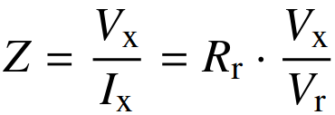
Auto-balancing bridge method
Measuring the current I_{X} through device under testing (DUT) and the voltage across it V_{X}
Signal of a defined amplitude and frequency
Capacitance, resistance and leakage current
Automated by telnet connection
Each value an average of 12 measurements
Light tight enclosure
Keysight Technologies, “Impedance Measurement Handbook: A Guide to Measurement Technology and Techniques, 4th Edition.”https://pearl-hifi.com/06_Lit_Archive/15_Mfrs_Publications/20_HP_Agilent/HP_App_Notes-Handbooks/Z_Measurement_H-book_4th_Ed.pdf.
Fig. 7. Auto-balancing bridge.

Slide 10
Results

Slide 11
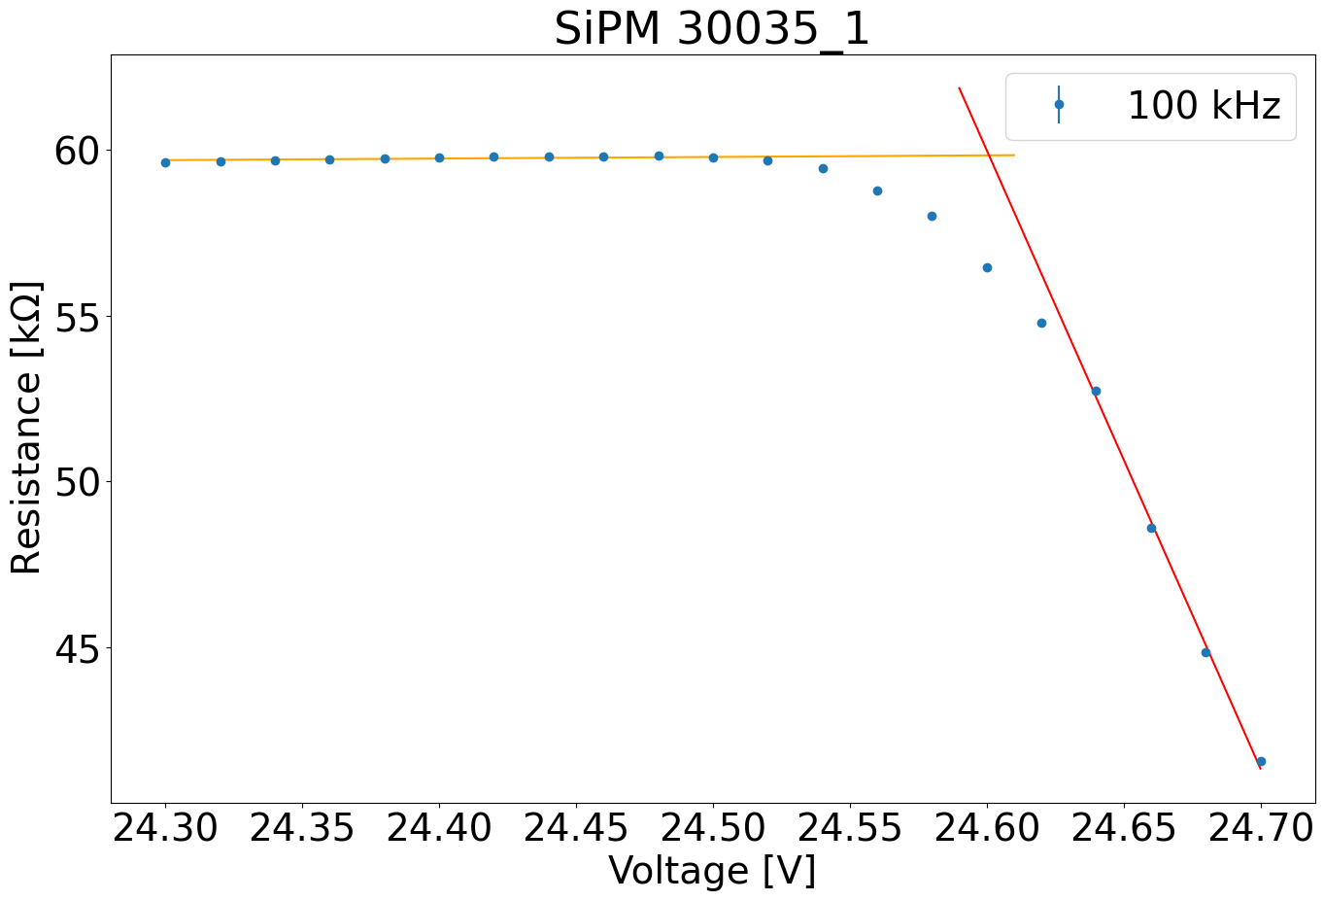
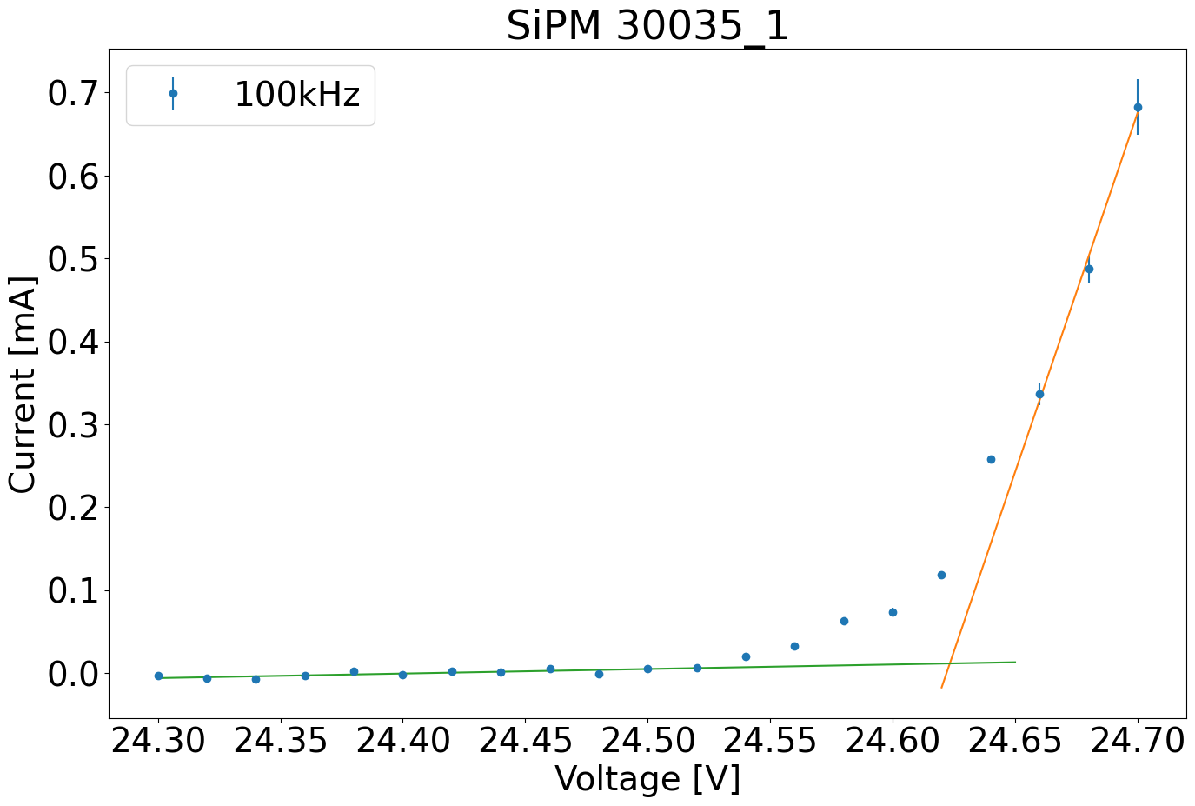
Resistance and leakage current as functions of bias voltage
Breakdown voltage determined from resistance and leakage current
V_{br} = (24.601 ± 0.003) V
V_{br} = (24.623 ± 0.004) V
Fig. 8. Resistance vs bias voltage.
Fig. 9. Leakage current vs bias voltage.

Slide 12
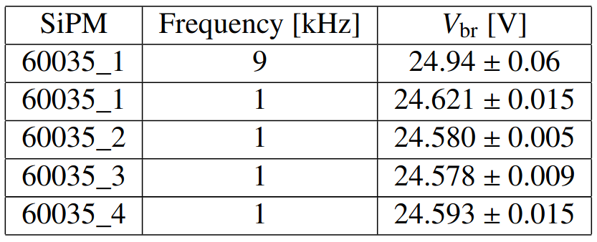
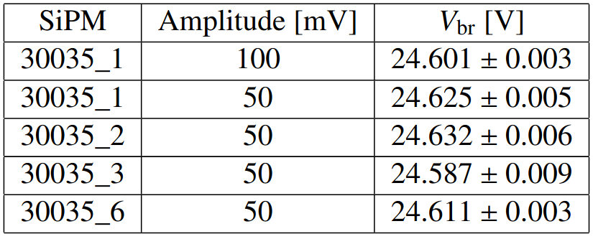
Breakdown voltage
60035 and 30035 types of SiPM measured
4 different devices - the same conditions, 1 - changed amplitude or frequency
60035 - 1 & 9 kHz, 50 mV; 30035 - 100 kHz, 50 & 100 mV
Same conditions - weighted average falls within 3𝜎 interval for all 60035, for all 30035 except 30035_3
Change in frequency - increase in V_{br} (>3𝜎)
Change in amplitude - decrease in V_{br} (>3𝜎)

Slide 13
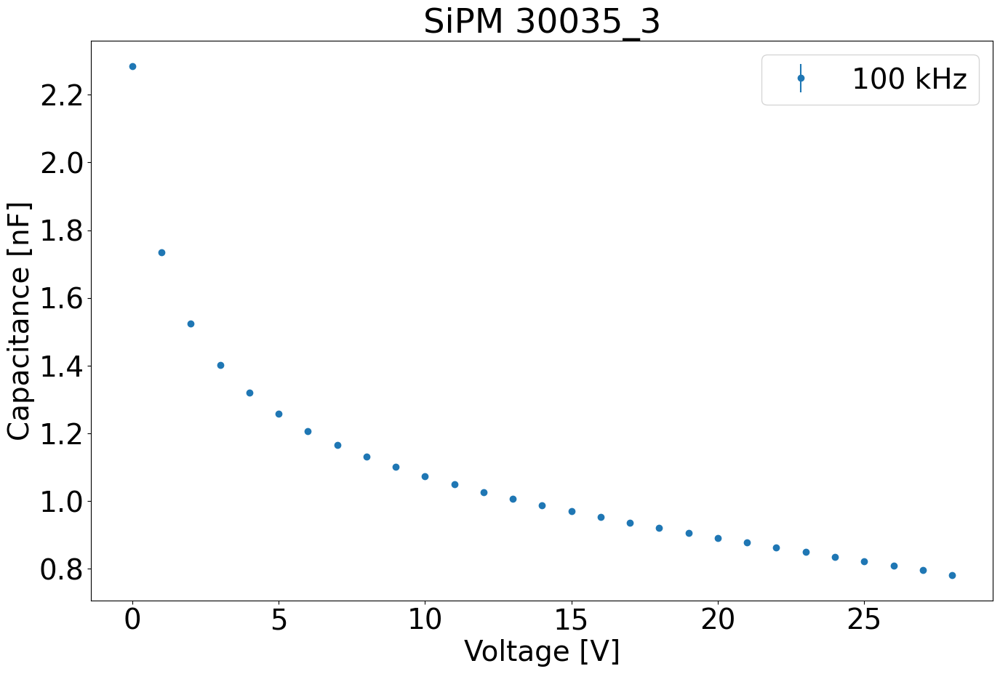
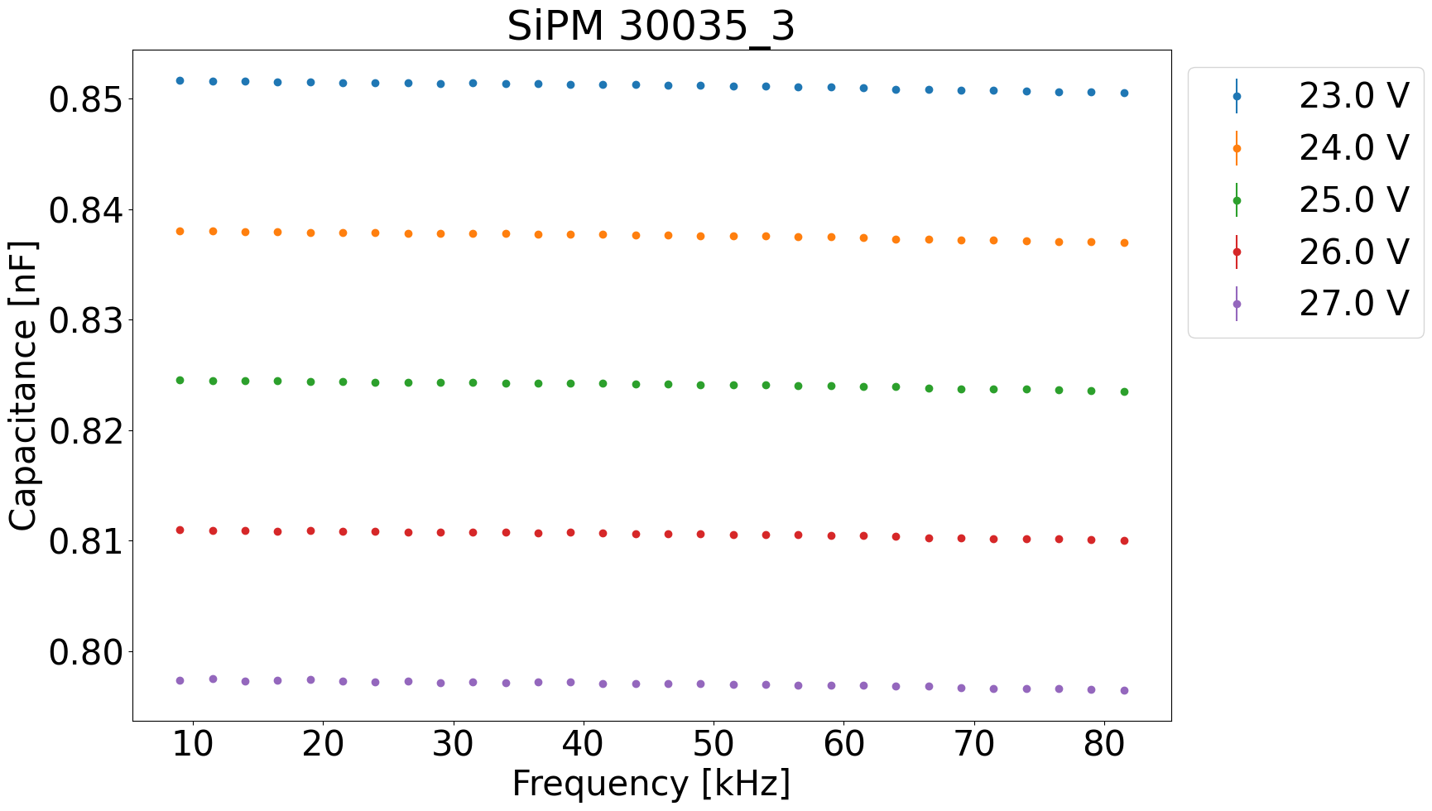
Capacitance as a function of bias voltage and frequency
Capacitance decreases with bias voltage, as the width of the depleted region increases
Slight decrease of capacitance with test signal frequency (~ pF)
Fig. 10. Capacitance vs bias voltage.
Fig. 11. Capacitance vs frequency.

Slide 14
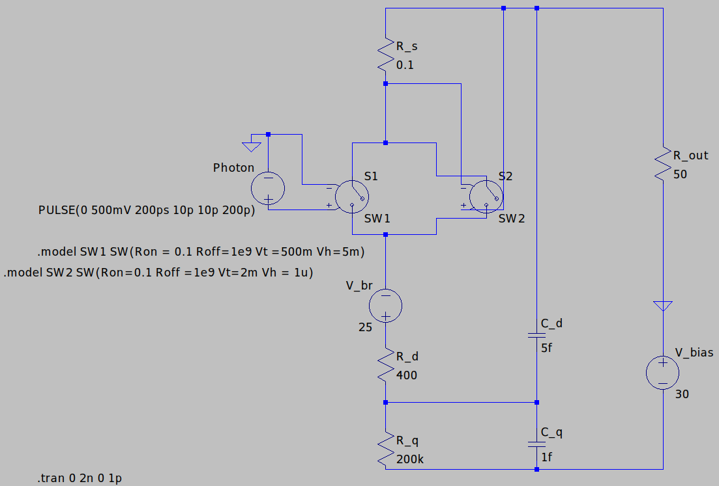
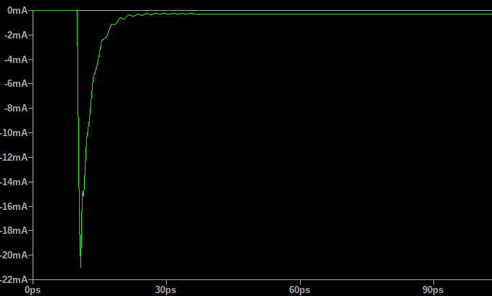
Electrical simulation of an SiPM microcell in LTspice
Avalanche current build-up and avalanche quenching
SPAD part, quenching part
Correct shape of the output signal
Villa, Federica and Zou, Yu and Dalla Mora, Alberto and Tosi, Alberto and Zappa, Franco,“SPICE Electrical Models and Simulations of Silicon Photomultipliers,” IEEE Transactions on Nuclear Science, 2015.
Fig. 12. Model of an SiPM microcell.
Fig. 13. Simulation of an SiPM output.

Slide 15
Future plans
Thank you for your attention!
Re-do the measurements for more SiPM specimens
More types of measurements, e.g., resistance vs frequency, dependance of capacitance on signal amplitude
Refine the simulation
Compare the simulation to experimental results

