Slide 1


Beam Test of a SiPM-on-Tile ZDC Prototype with 5.3 GeV Positrons at Jefferson Laboratory
Sean Preins
2026 EIC Early Career (EC) Workshop

Slide 2
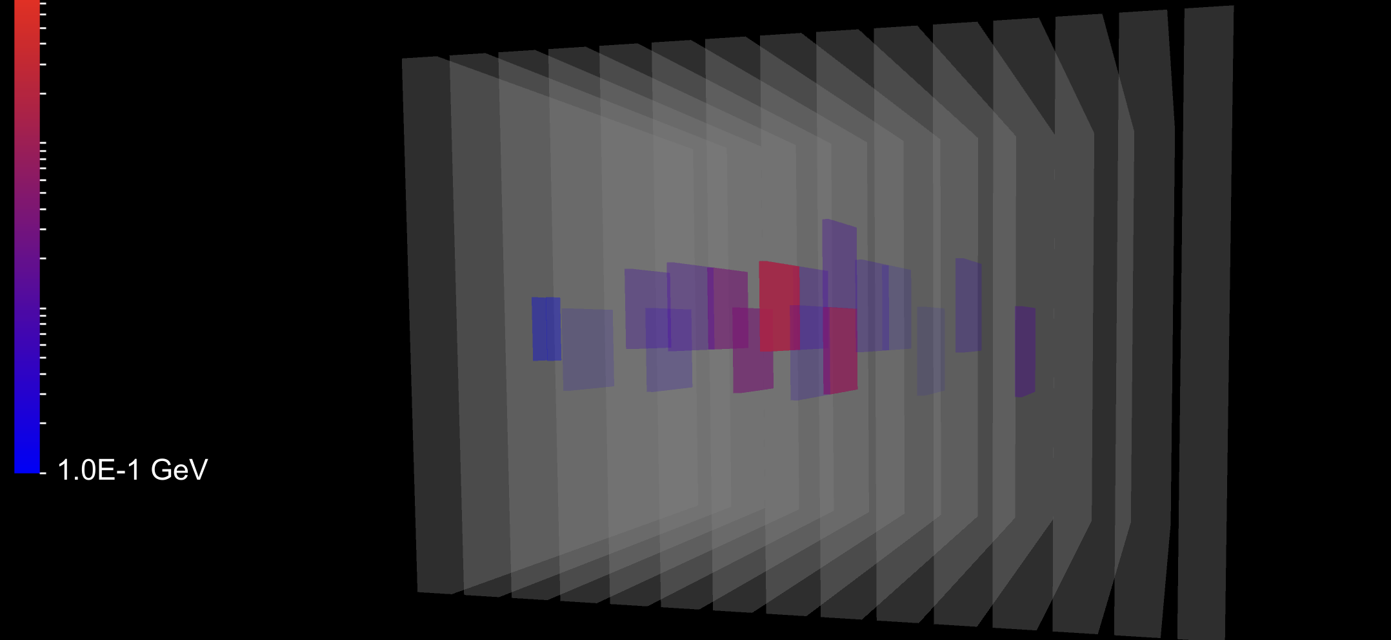
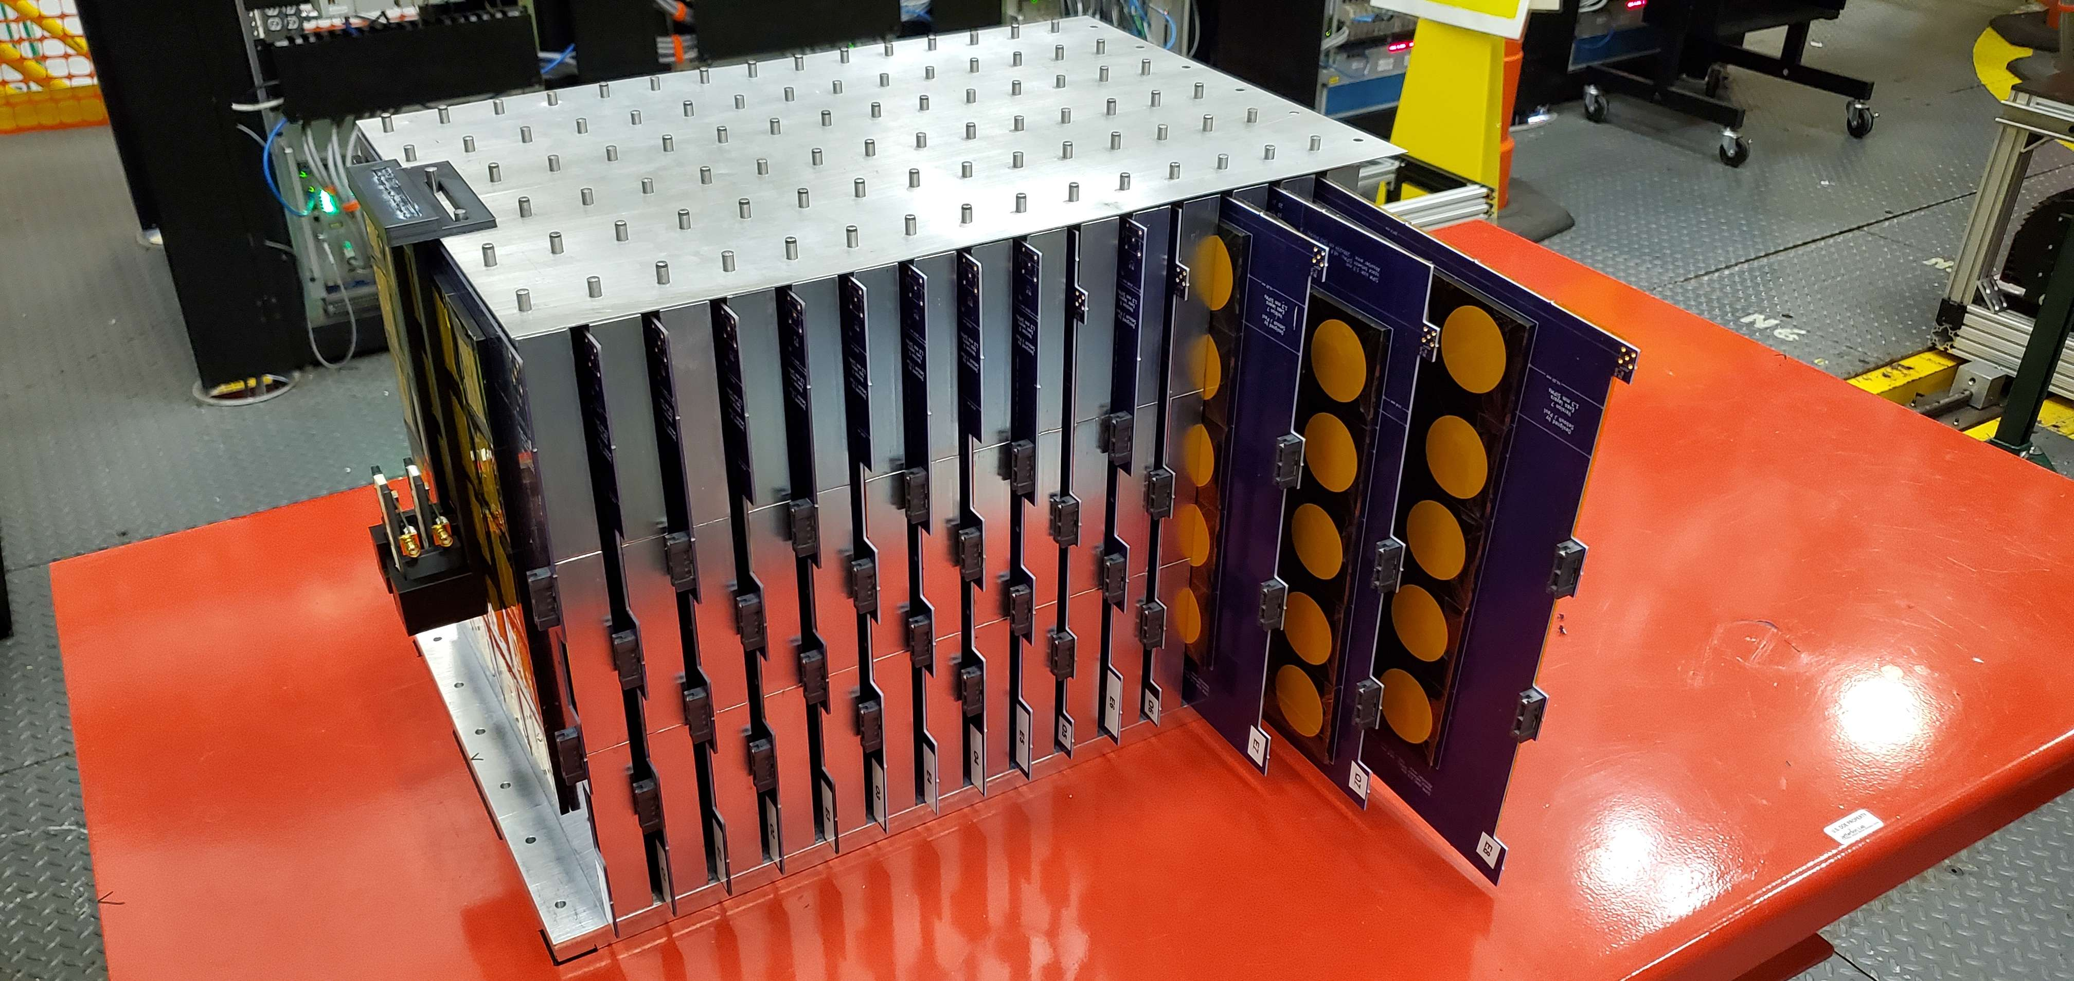
Outline
ePIC Zero Degree Calorimeter
15-layer SiPM-on-tile prototype
Jefferson Lab beam test
Event reconstruction and calibration
Comparison with simulation
  Position resolution
  Shower shapes
  Energy resolution
Impact on the final ZDC design

Slide 3
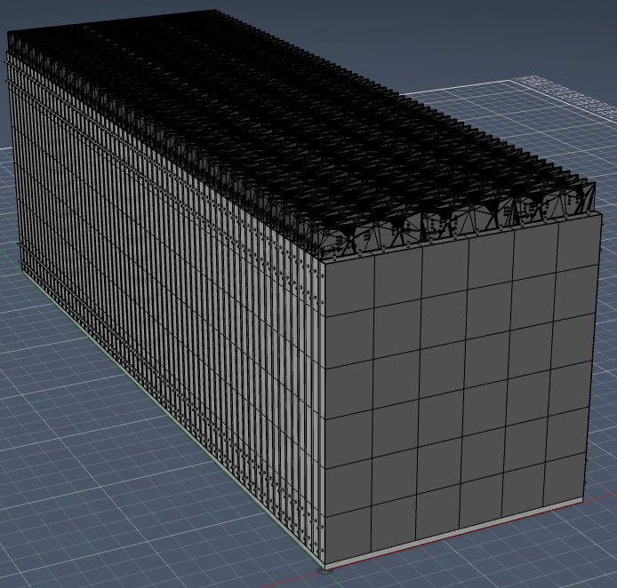
ZDC HCAL Design Overview
64-layer SiPM-on-tile iron sampling calorimeter
ASIC-away-of-SiPM readout architecture
1.3 mm SiPMs with 48.8 × 48.8 mm scintillator tiles
8096 channels (121/132 per layer)
Alternate layers shifted by half a cell
Removable layers for SiPM annealing

Slide 4
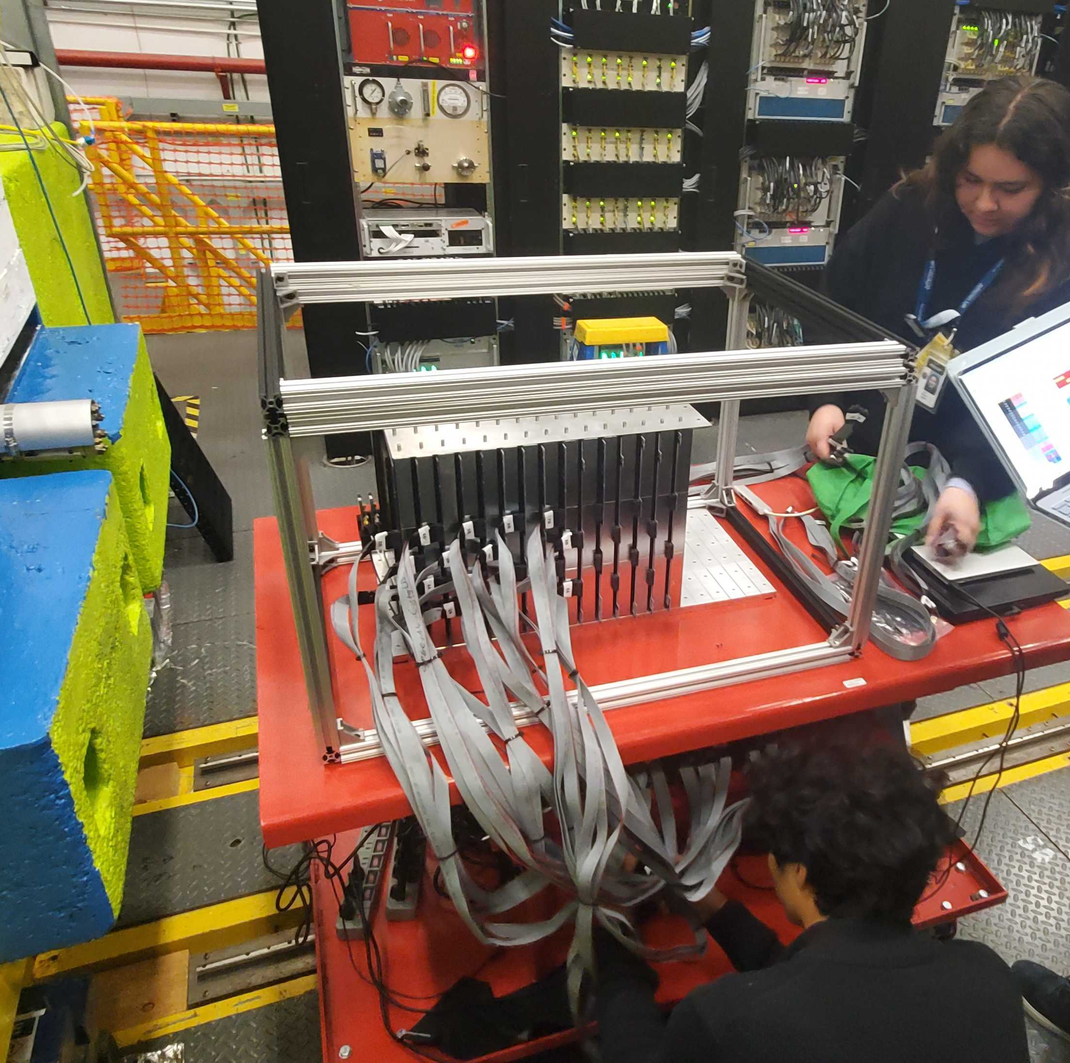
Prototype Overview
15-layer SiPM-on-tile prototype
Installed at Jefferson Lab Hall D Pair Spectrometer (April 2025)
5×5 tiles per layer with staggered geometry
370 instrumented channels (~10% of final detector)
5.3 GeV positron beam
6.6 million events, 98.7% channels operational

Slide 5
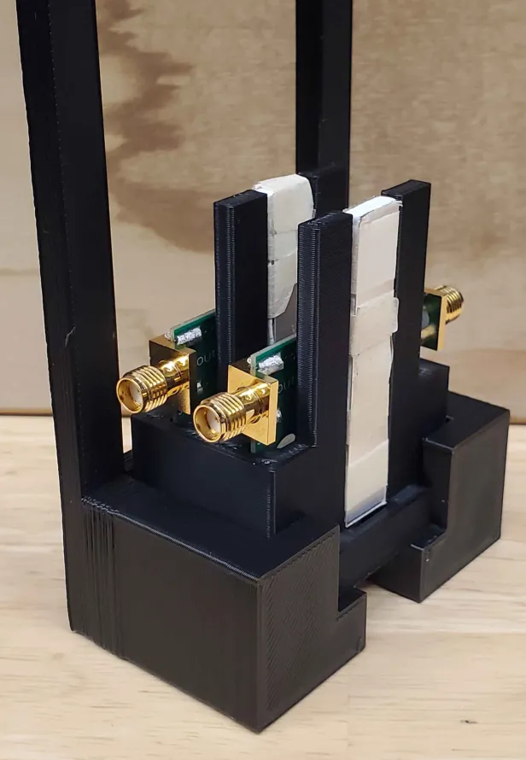
DAQ System
Six CAEN DT5202 digitizers
DT5215 concentrator board
DRS4 trigger readout
Two scintillator trigger counters
3D-printed trigger mount

Slide 6
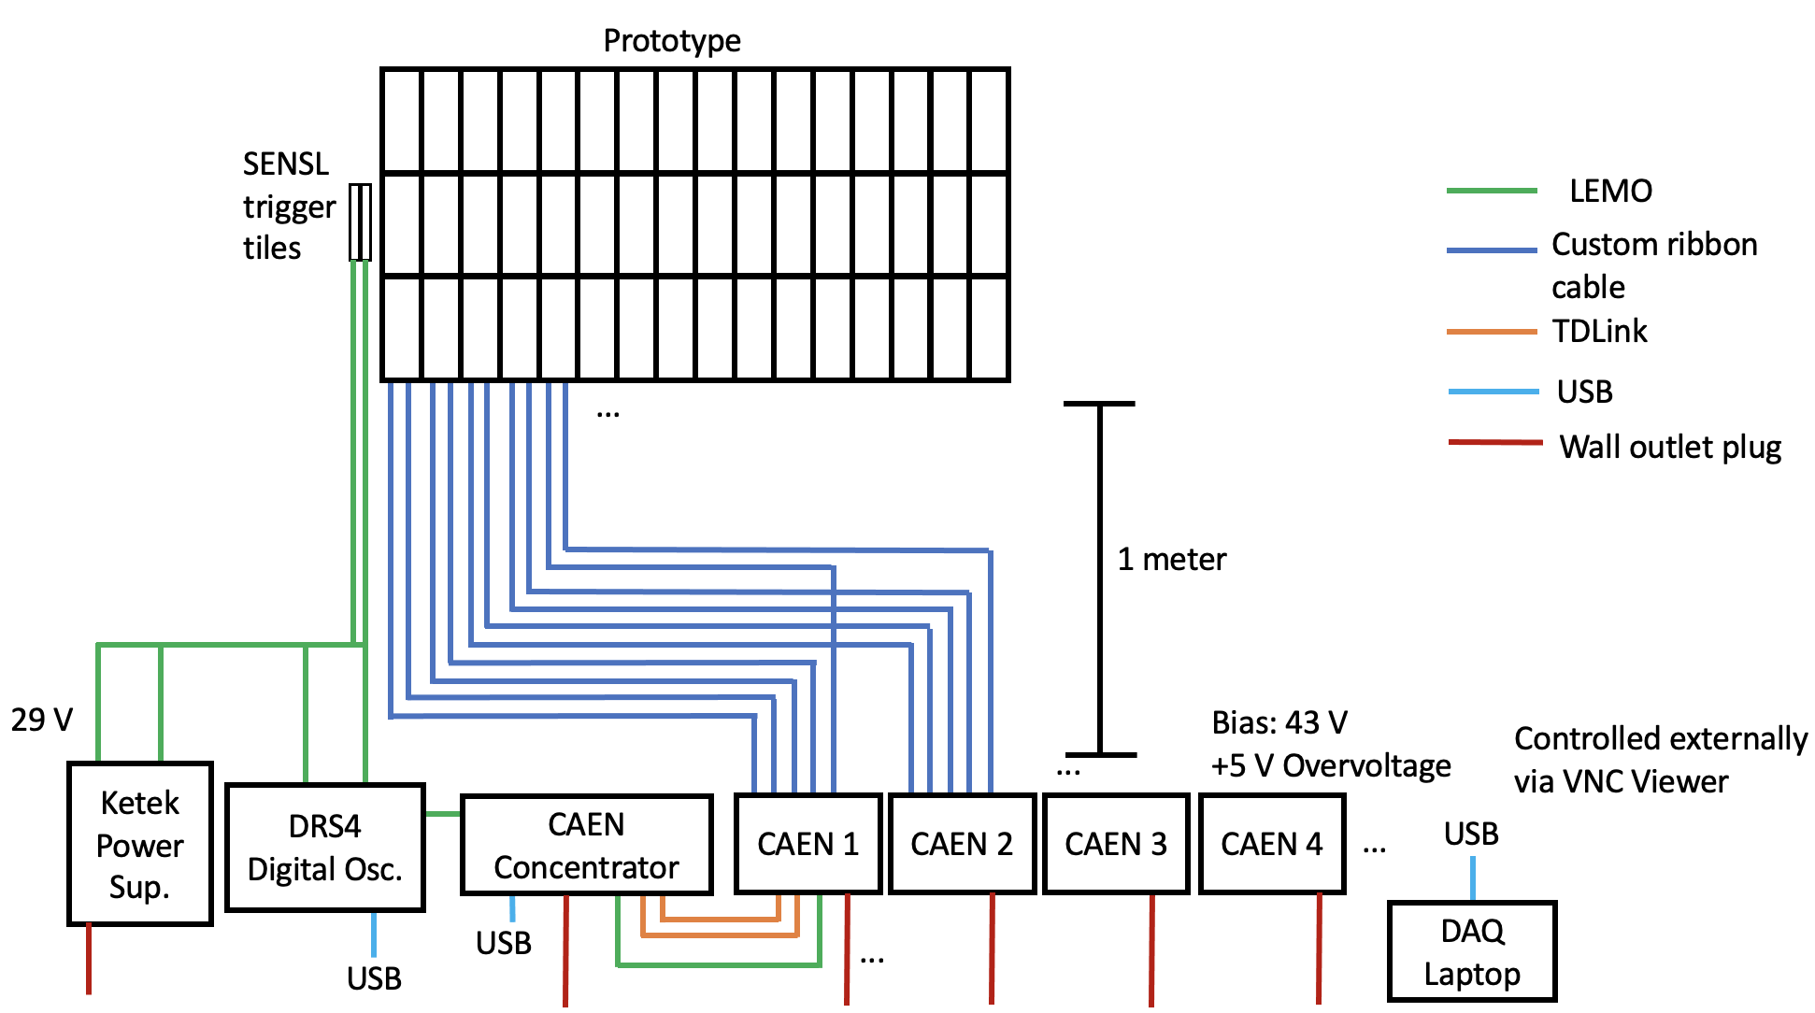

Slide 7
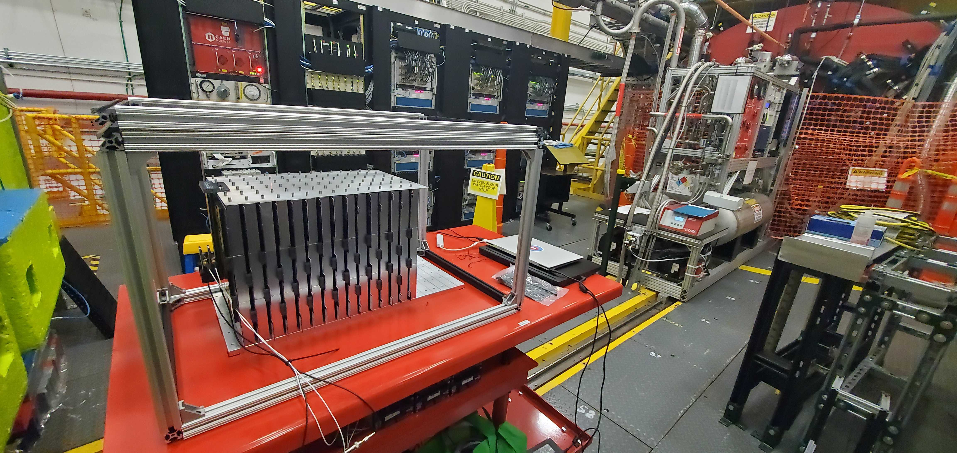
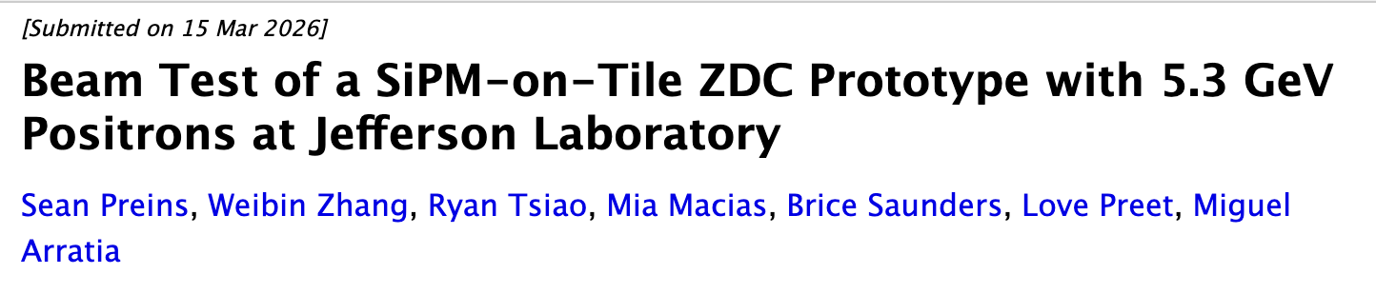
Beam Test Goals
Measure energy response
Study shower development
Measure position resolution
Compare with GEANT4 simulation
Guide the final ZDC design

Slide 8
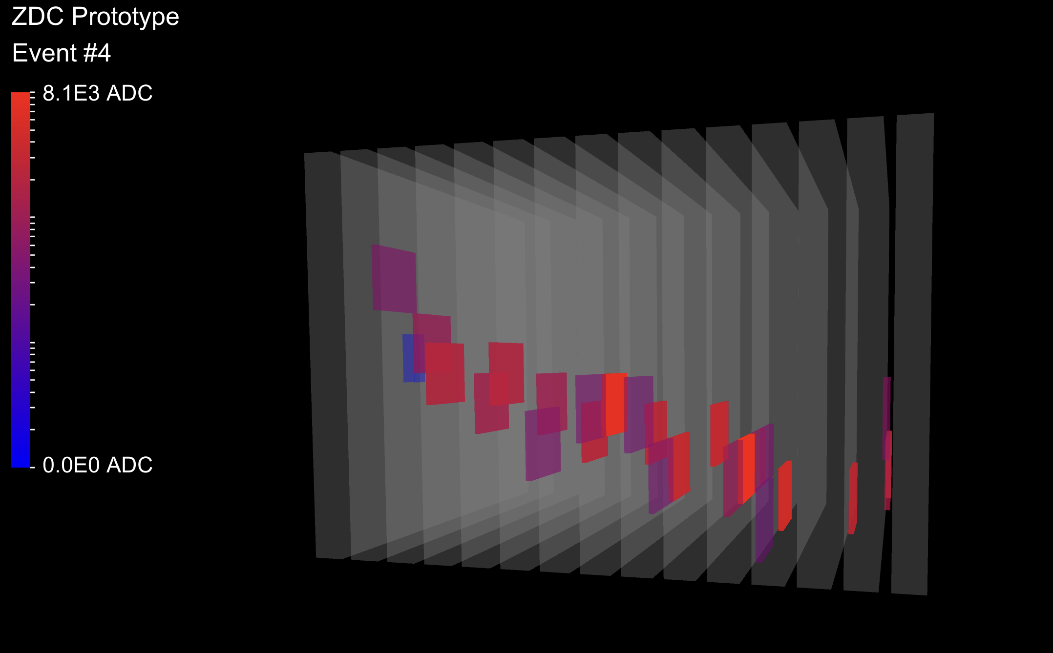
Event Building
Subtract channel pedestals
Suppress hits within 3σ of pedestal
Equalize channels using cosmic rays
Determine HG/LG gain ratio from beam data
Apply global energy calibration
Verify channel mapping and synchronization

Slide 9
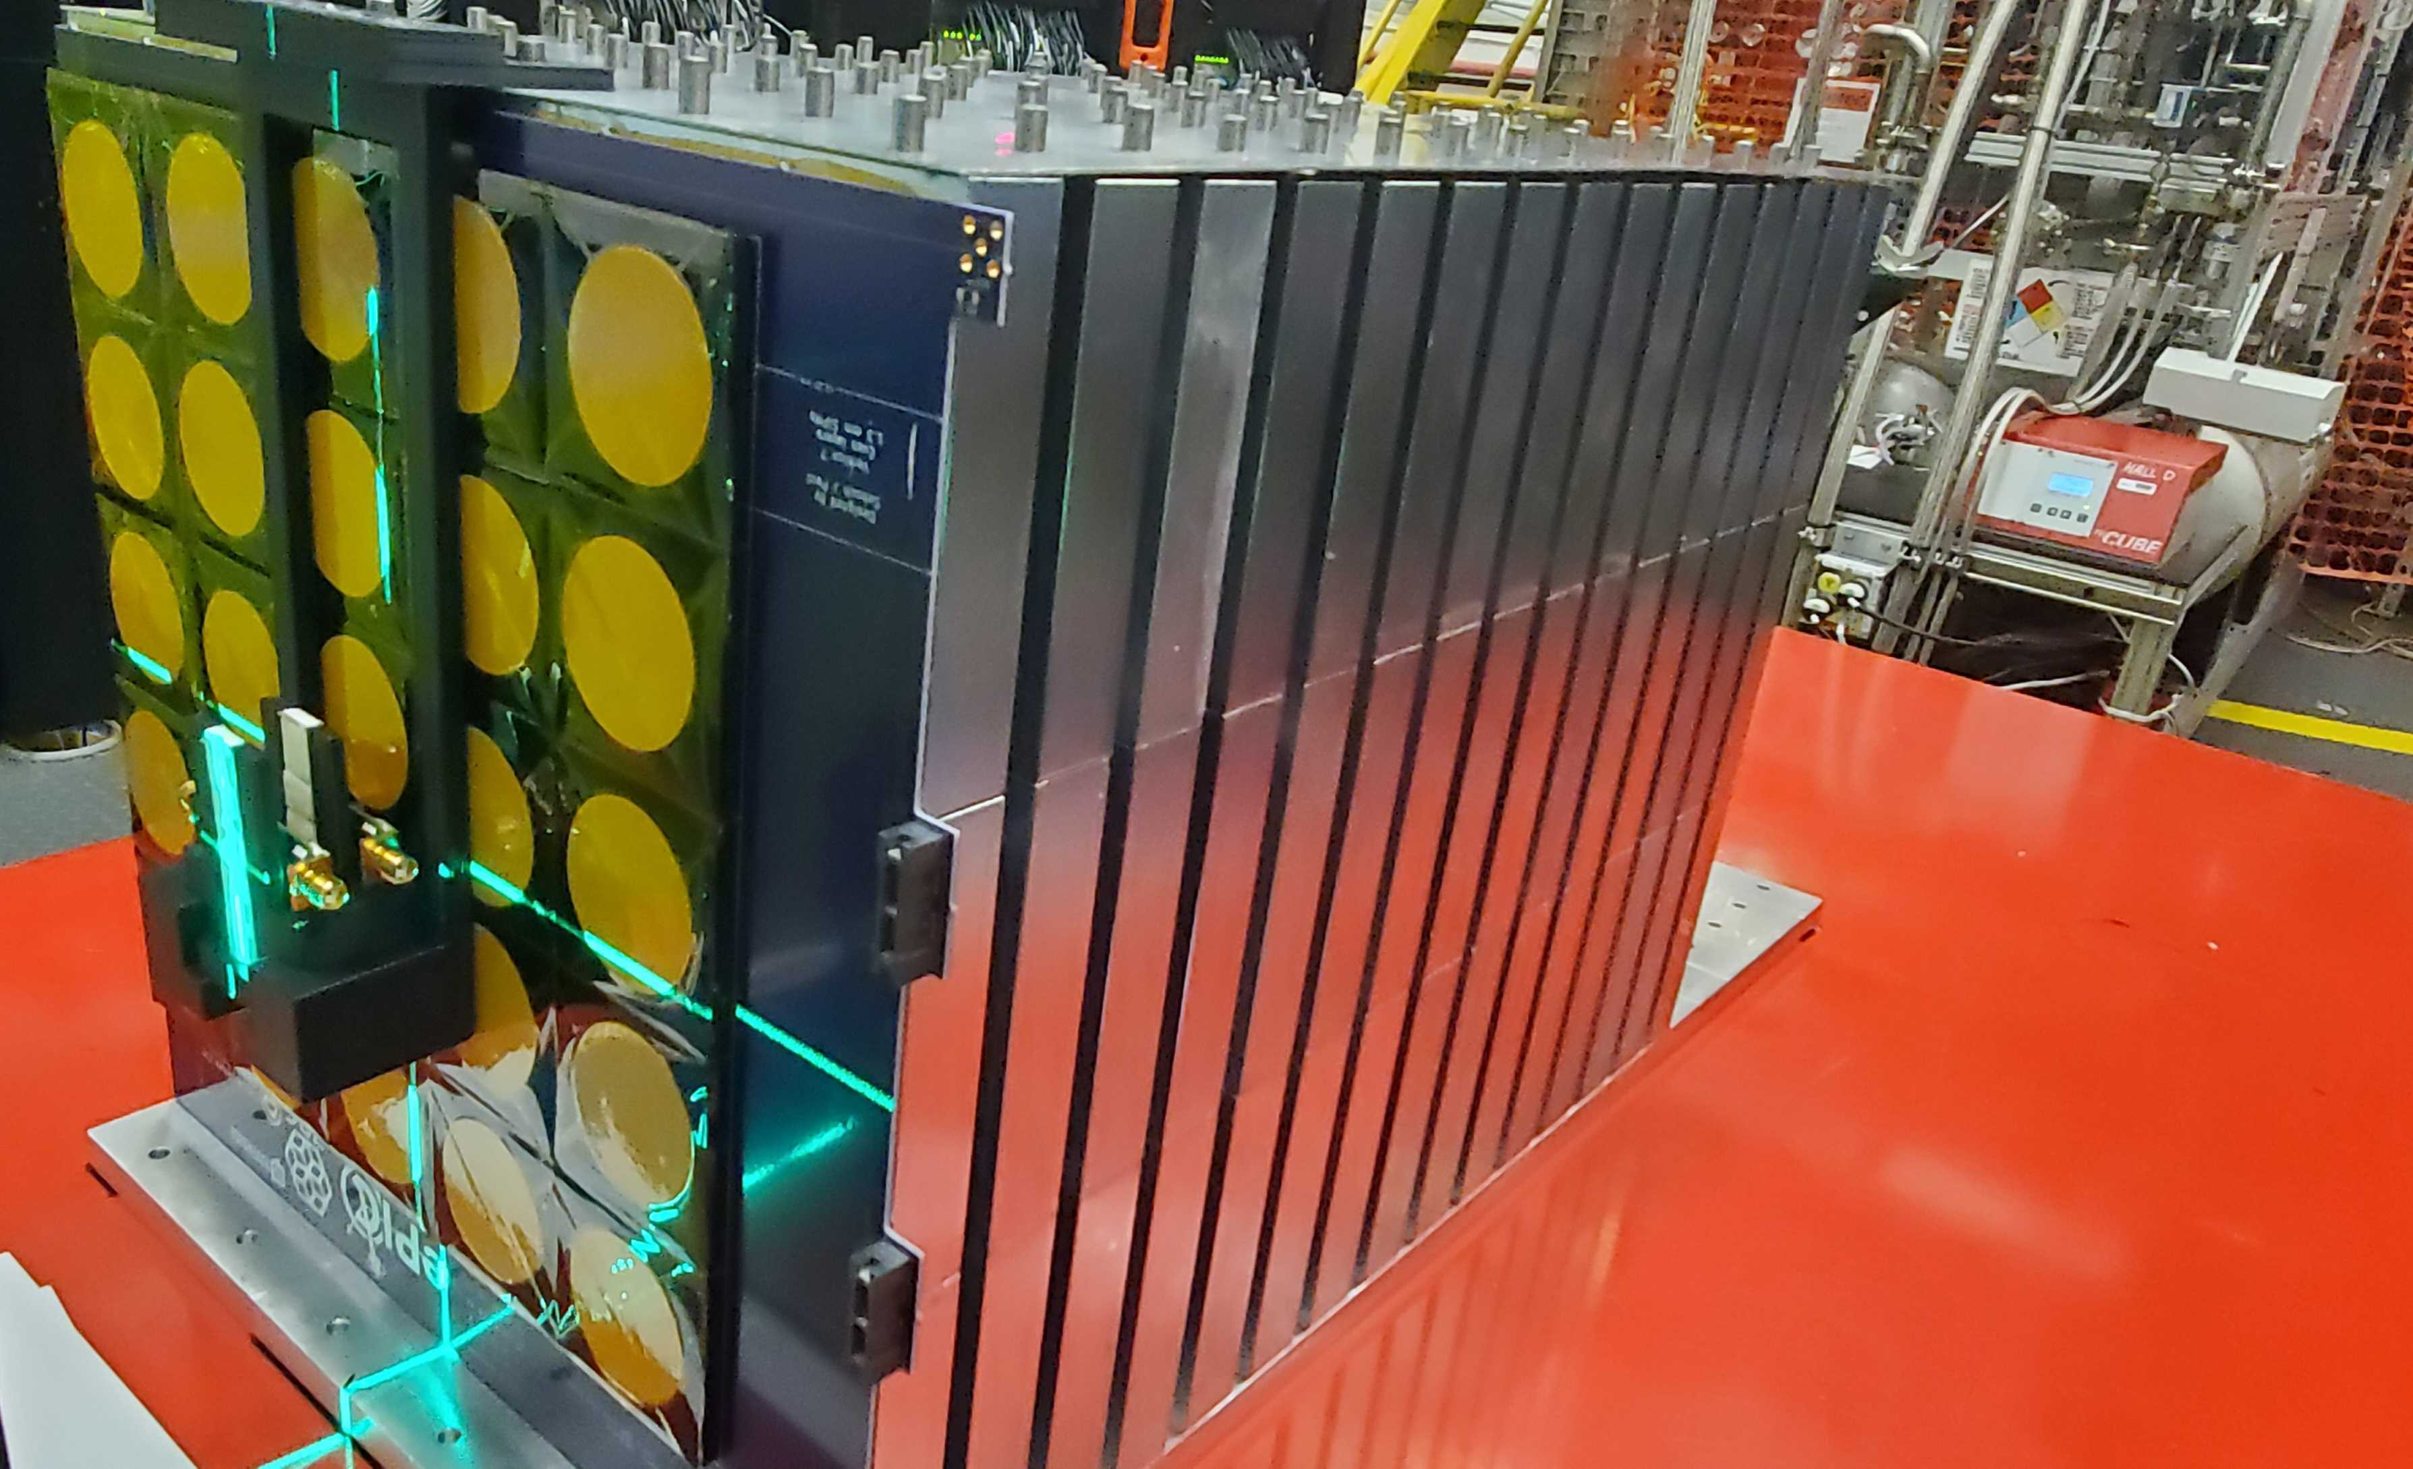
Systematic Errors
Beam position uncertainty: ±1.3 cm, resulting in a total beam energy uncertainty of ±2%
Two alternative datasets were formed with energy scaled by ±2%
Alternative dataset was formed without equalization
This produced a −0.9% impact on the energy resolution , a −2.1% impact on the 𝑦 pos. resolution , and a +8.1% impact on the 𝑥 pos. resolution

Slide 10
Center of Gravity Results
Results were compared with a GEANT4 simulation of 5.3 GeV positrons
The shower center of gravity and shower angle distributions were used to determine the beam orientation

Slide 11
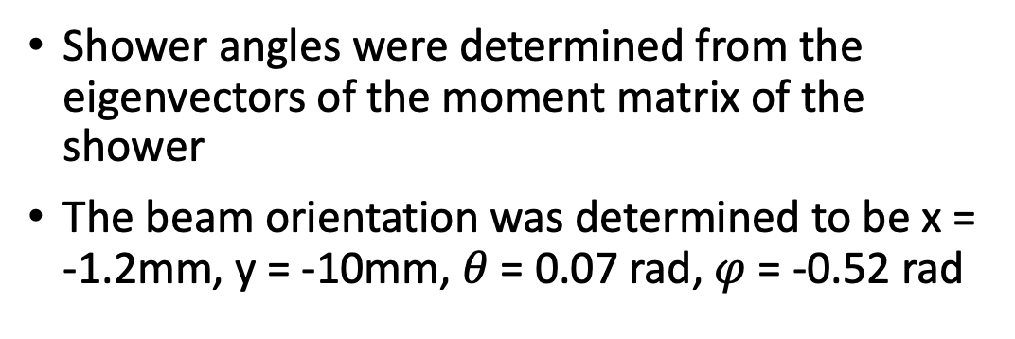
Shower Angle
Results
Shower angles were determined from the eigenvectors of the moment matrix of the shower
The beam orientation was determined to be x = -1.2mm, y = -10mm, $θ$ = 0.07 rad, $φ$ = -0.52 rad

Slide 12
Position Res.
Results
The beam impact position was determined by projecting the moment matrix eigenvectors from the COG to the front face of the detector
Beam spread effects were subtracted in quadrature from the data

Slide 13
Position Res.
Results
Expected energy dependance for position resolution for the ZDC prototype, with the measured position resolution

Slide 14
Shower Shape
Results
Summed event energy distribution for each layer characterize longitudinal shower shape

Slide 15
Shower Shape
Results
Mean and standard deviation of layer event energy distributions

Slide 16
Energy Res.
Results
Total event energy distribution compared to simulation
Energy spread effects not represented in simulation have a negligible impact on energy resolution

Slide 17
Energy Res.
Results
Expected energy dependence on energy resolution for the ZDC prototype, with the measured energy resolution
Significant difference may be attributed to detector effects not included in simulation (electrical cross-talk, non-ideal equalization)

Slide 18
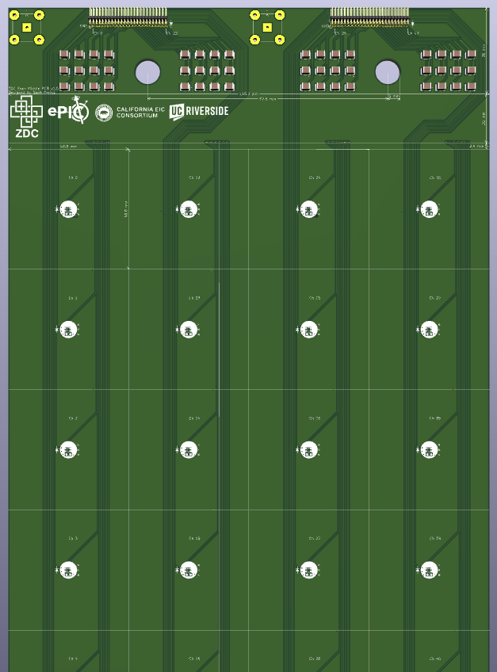
Final ZDC Design
Prototype informed updated mechanical design
Three removable PCBs per layer
New connectors improve construction and reliability
LEDs integrated for calibration
Shielded ribbon cables reduce crosstalk

Slide 19
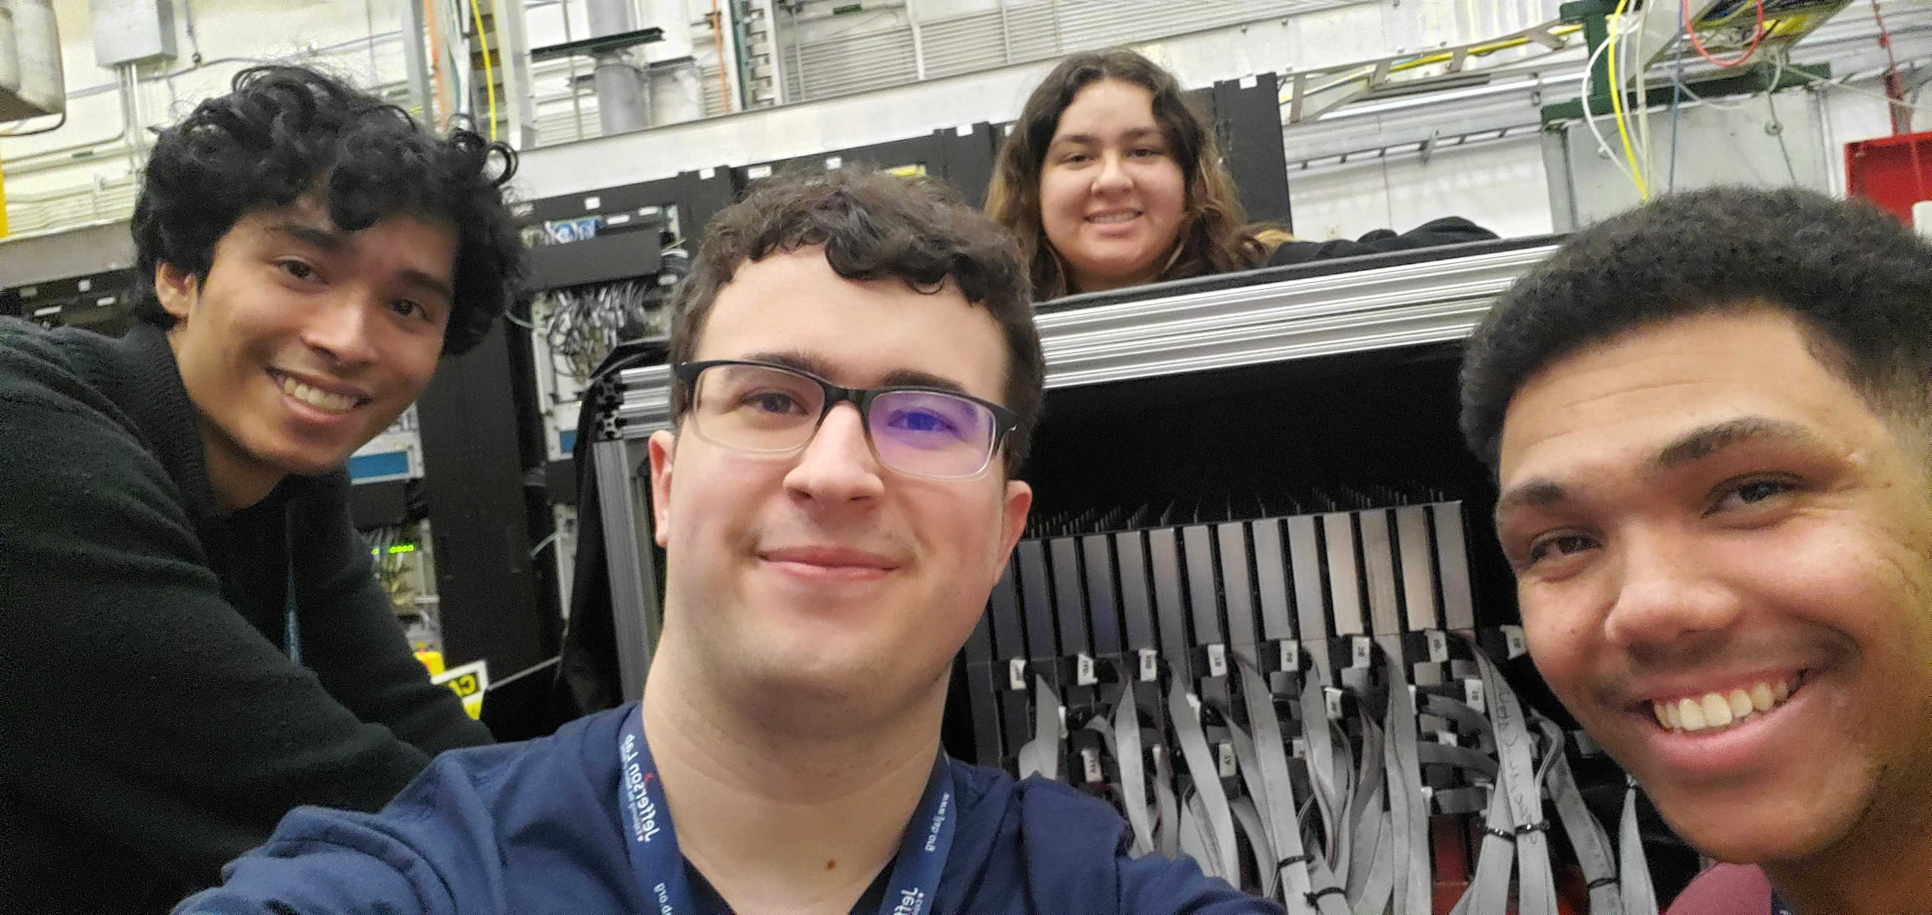
Conclusions
We successfully constructed and operated our third generation SiPM-on-tile sampling calorimeter at the Jefferson Lab Hall D Pair Spectrometer
Shower shape and spatial reconstruction are reasonably reproduced by simulation, and we have identified sources of remaining discrepancies
This experience gave us valuable insight into the design, construction methods, calibration procedure, and operation that informs the final design of the ePIC ZDC
Thank you!

