Slide 1




Tutorials, Tungsten and t
Stephen Kay
University of York
ePIC/EICUG Joint Meeting, July 2026
Glasgow, UK
Early Career Researcher Meeting, 12/07/26

Slide 2
Overview
This talk is to give you a brief flavour of a few of the EIC related things I do:
Tutorials – User Learning
Tungsten – Luminosity Monitoring Calorimeters
(Mandelstam) t – Studies of Meson Structure at the EIC
  Where t is a critical variable!

Slide 3
Tutorials – User Learning

Slide 4
User Learning
What is User Learning?
Software and computing WG responsible for:
  Onboarding EIC and ePIC colleagues
  Continued learning and development
Designing and developing tutorials, improving software accessibility, driving community engagement
Work closely with colleagues Sasha Prozorov and Holly Szumila-Vance

Slide 5
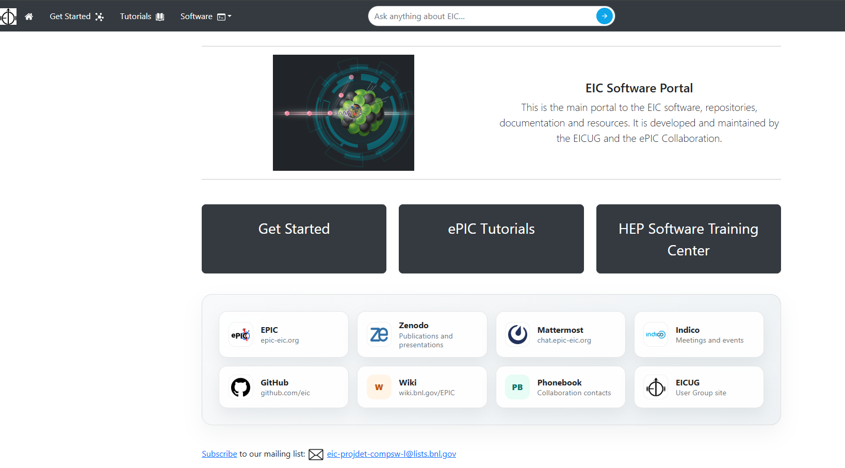
Landing Page
Key piece of onboarding material is the landing page – eic.github.io
A central hub for EIC/ePIC software resources
  Signposting to relevant resources
Major revamp recently from Sasha
  Huge raft of updates and improvements
AI enhanced Search Bar
Mobile friendly, scales smoothly. Modern look and feel!
Streamlining of key resources
Additional repository of references

Slide 6
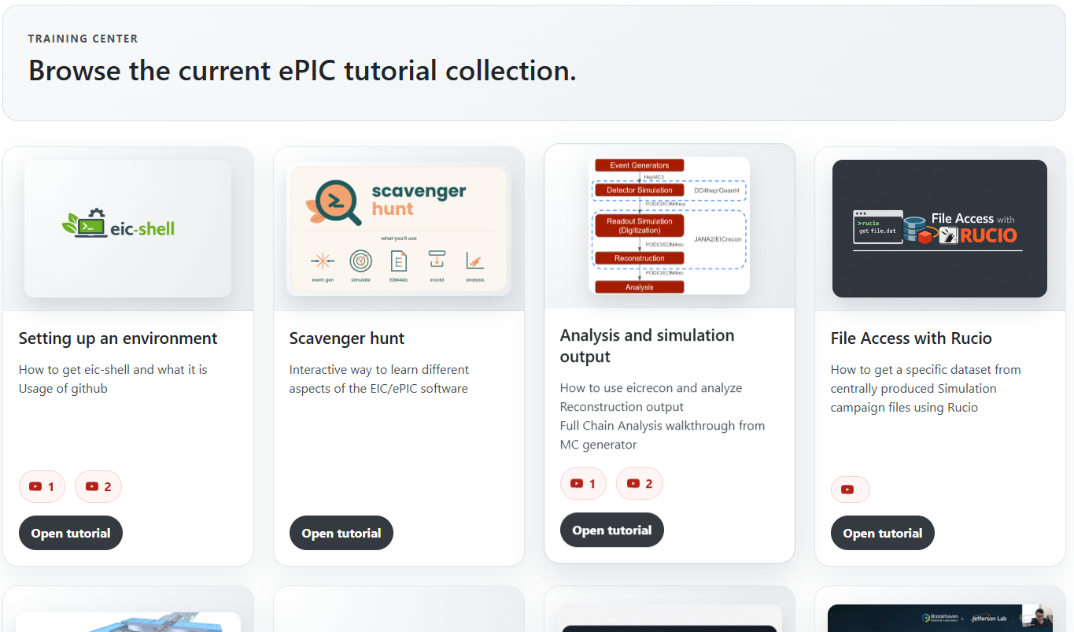
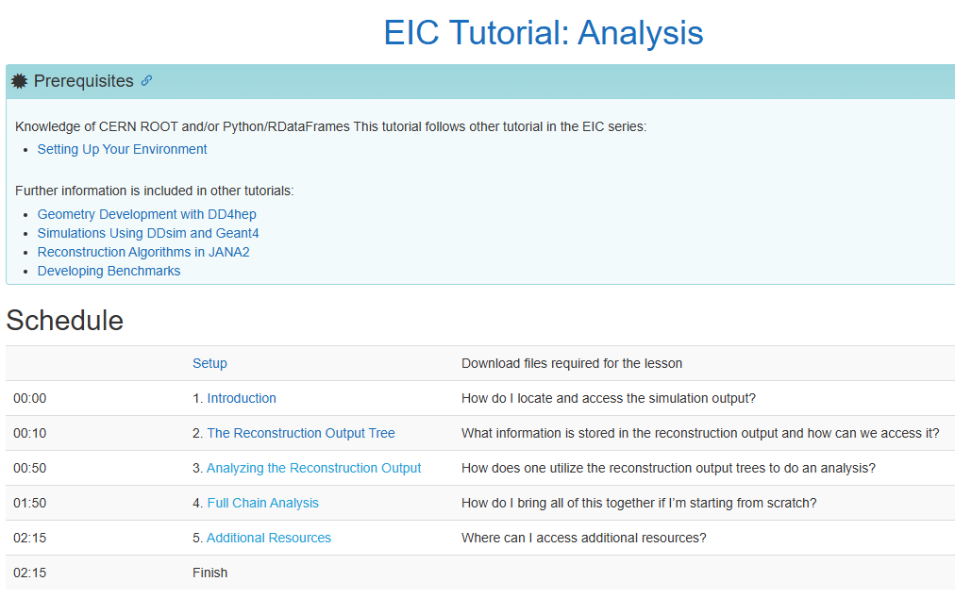
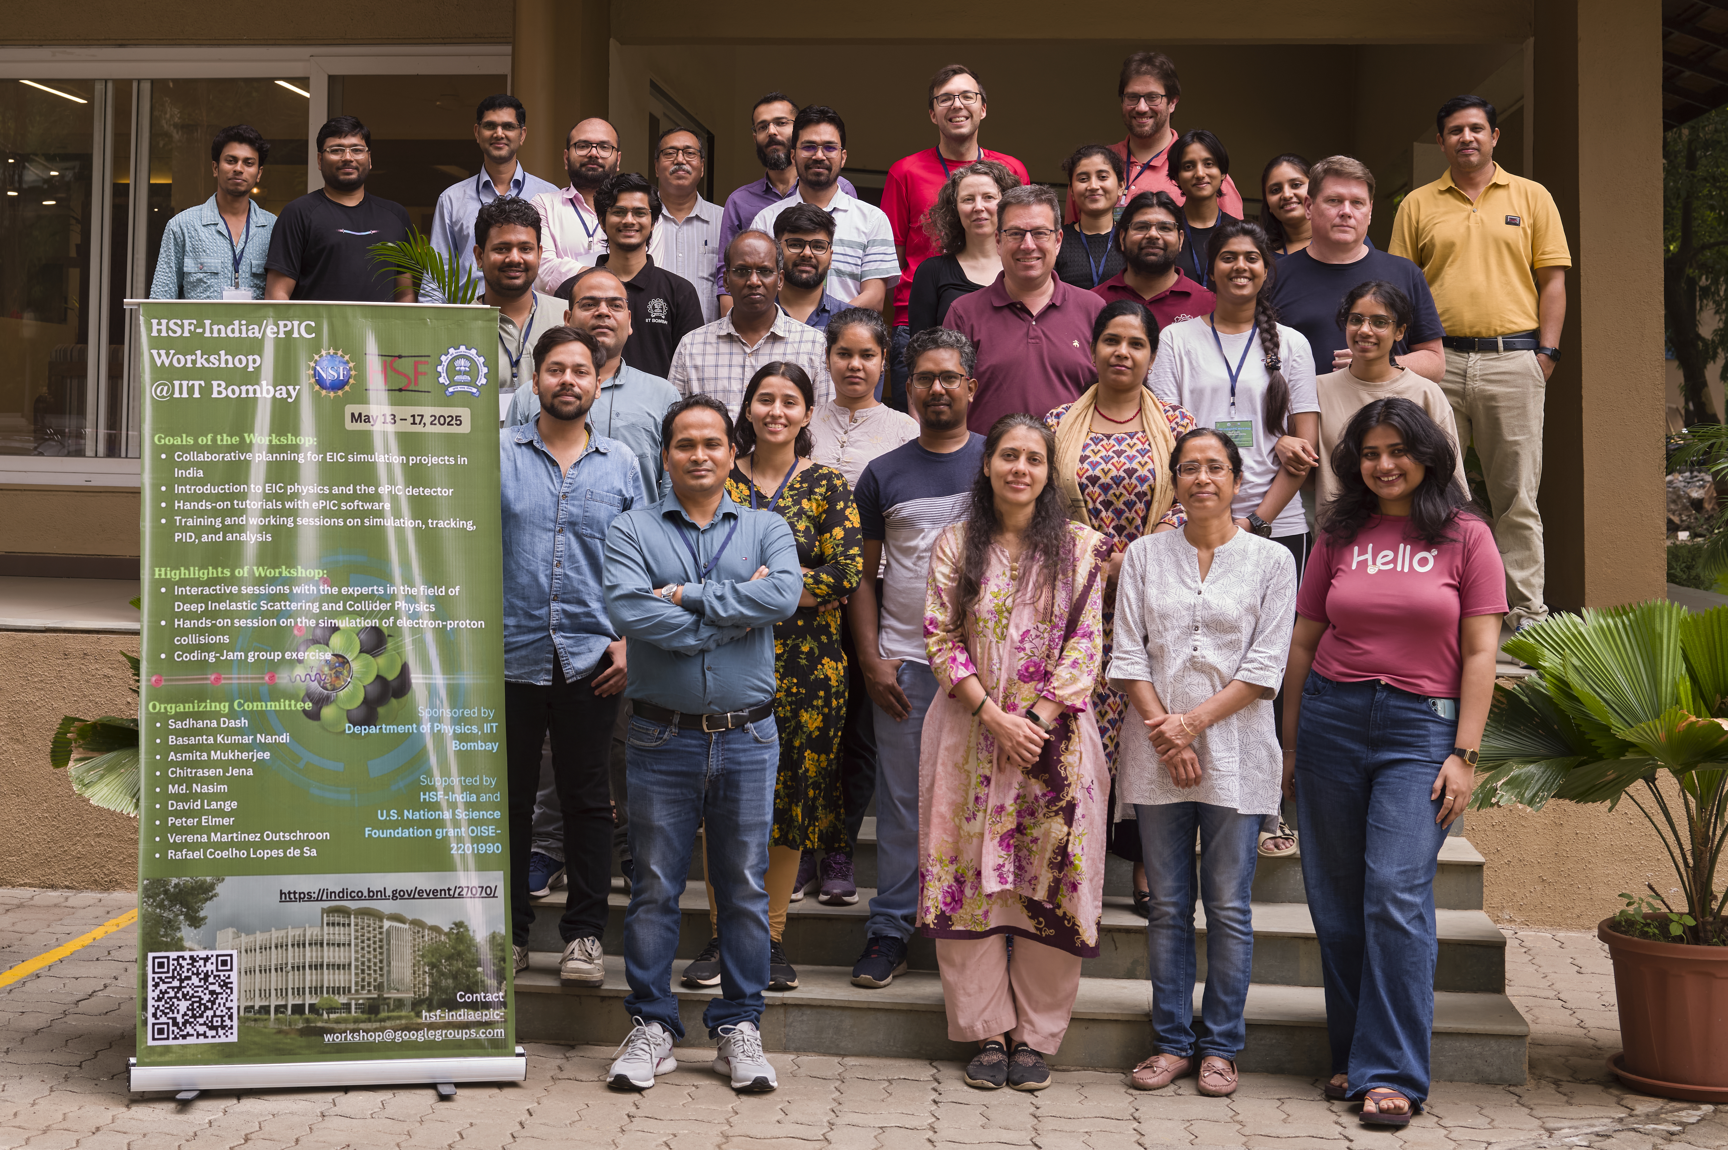
Tutorials
Organising, planning and running tutorials a key part of the role
Update/improve existing tutorials, scope out new topics
Key starting point for new collaborators
Also an opportunity to engage new collaborators and share exciting EIC work
  HSF-India/ePIC Workshop
With thanks to the HSF-India team as well as Charlotte and Chandra for delivering tutorials at this excellent workshop!

Slide 7
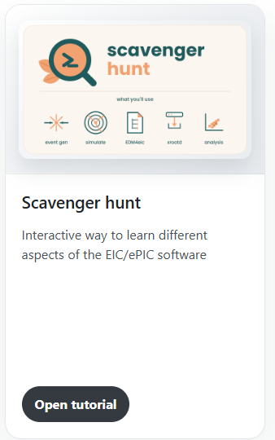
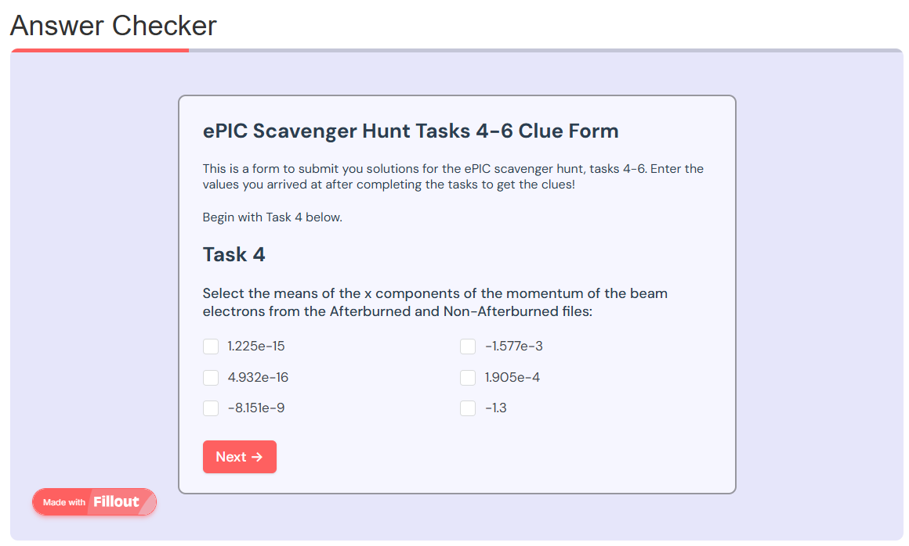
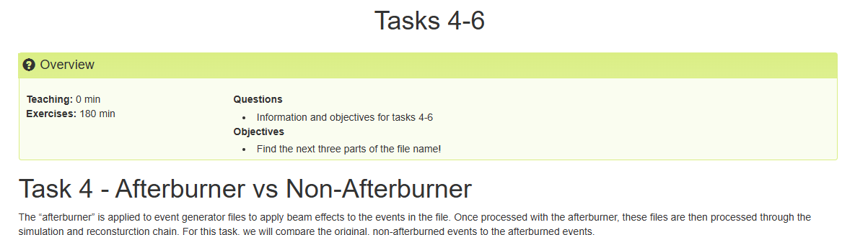
Scavenger Hunt
Recent onboarding/discoverability initiative
  The ePIC/EIC Software Scavenger Hunt
Designed as an interactive way for users to engage with the software
  Excellent starting point for new users…
  But also some tips, tricks and new things for experienced ones!
Series of tasks walking through software aspects
Final challenge to solve and submit
Prize for participation and getting the correct result!
A huge thank you to
Gema Villegas for improving and testing the alpha version!

Slide 8
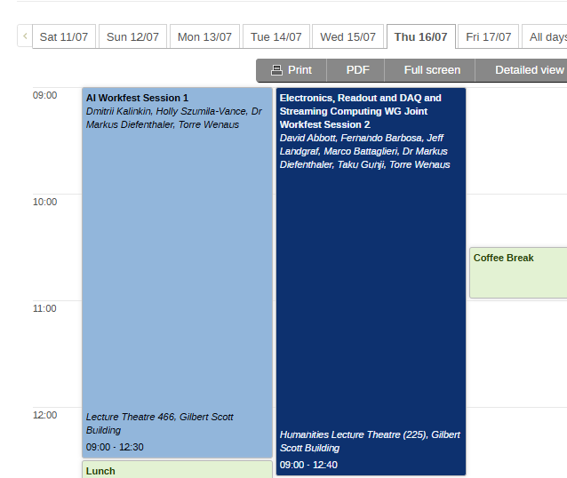
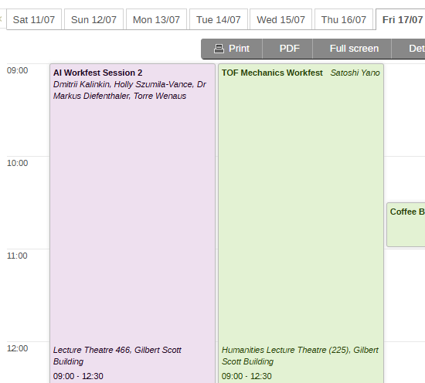
Future
Interface between real data and software will become more pressing
  Provide training and support to facilitate this
Machine BG in simulations, how do we deal with this?
  Will need training to get users up to speed on dealing with this in software
Discoverability and regular training will remain key topics
Integrating AI effectively into analysis and simulation workflows
Workfests touching on many of these topics this week!

Slide 9
Tungsten – Calorimeters for Luminosity Monitoring

Slide 10
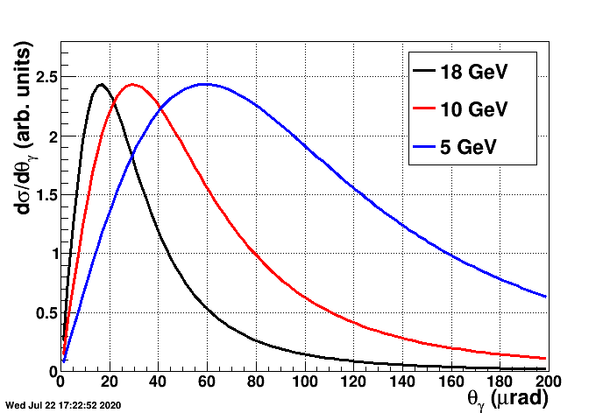
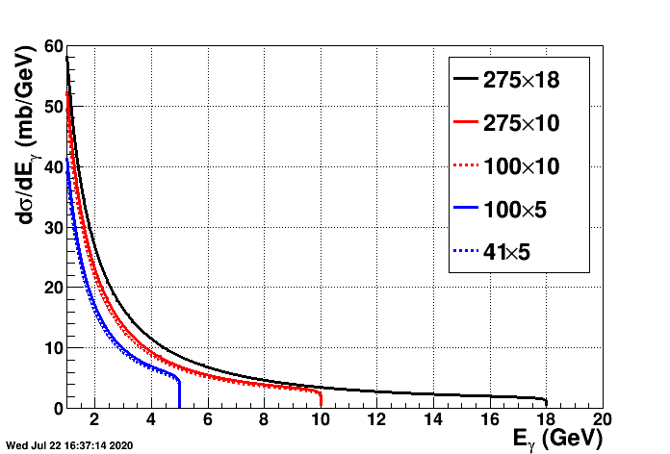
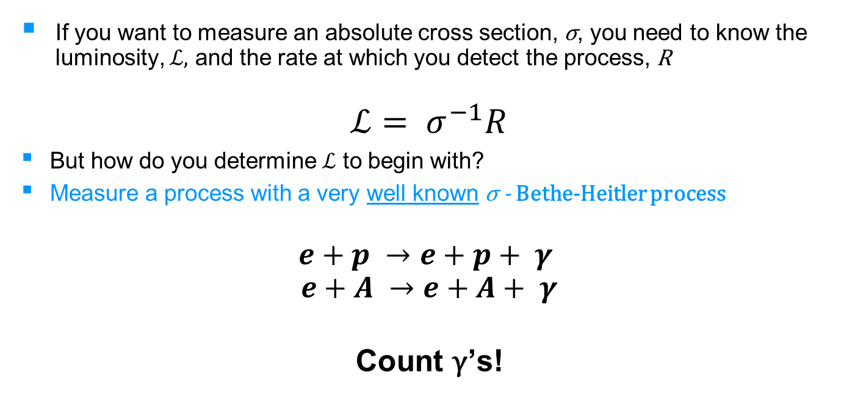
Luminosity Monitoring at a Collider
If you want to measure an absolute cross section, σ, you need to know the luminosity, $ℒ,$ and the rate at which you detect the process, R
$$ℒ= σ^{−1}R$$
But how do you determine $ℒ$ to begin with?
Measure a process with a very well known σ - Bethe-Heitler process
$$e+p →e+p+ γ$$
$$e+A →e+A+ γ$$
Count γ’s!
Figures - EIC Yellow Report - Section 11.7.1, p575

Slide 11
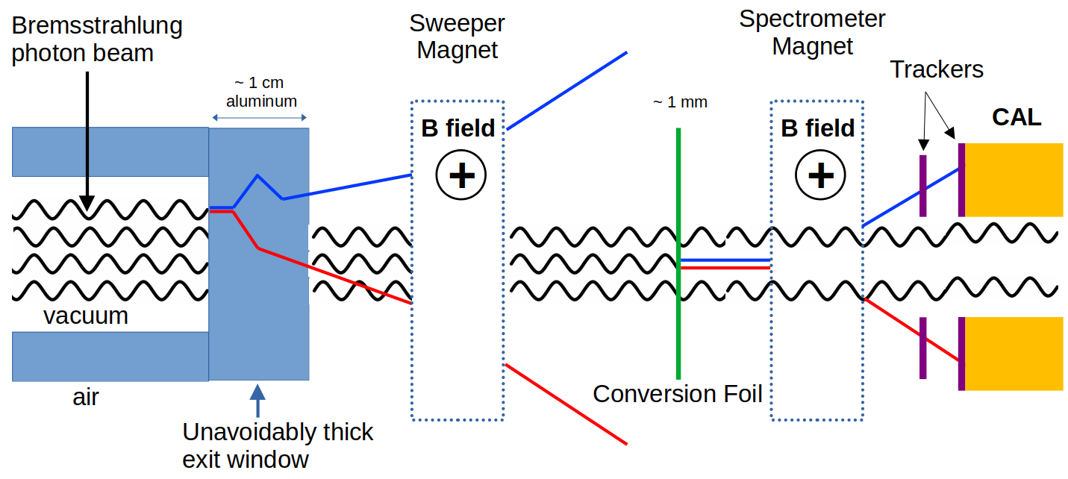
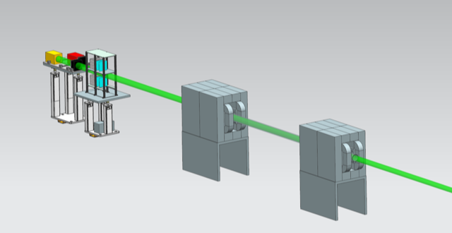
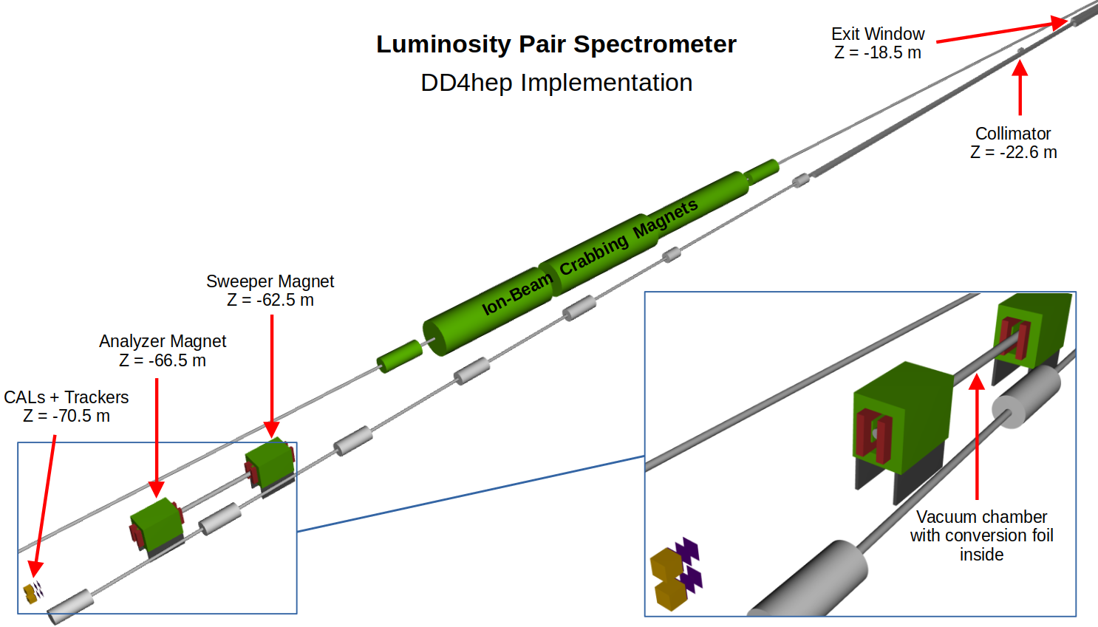
ePIC Luminosity Monitors
At the EIC, a lot of γ’s from this process!
Need a dedicated set of monitoring detectors
  Position in Far-Backward Region of ePIC

Slide 12
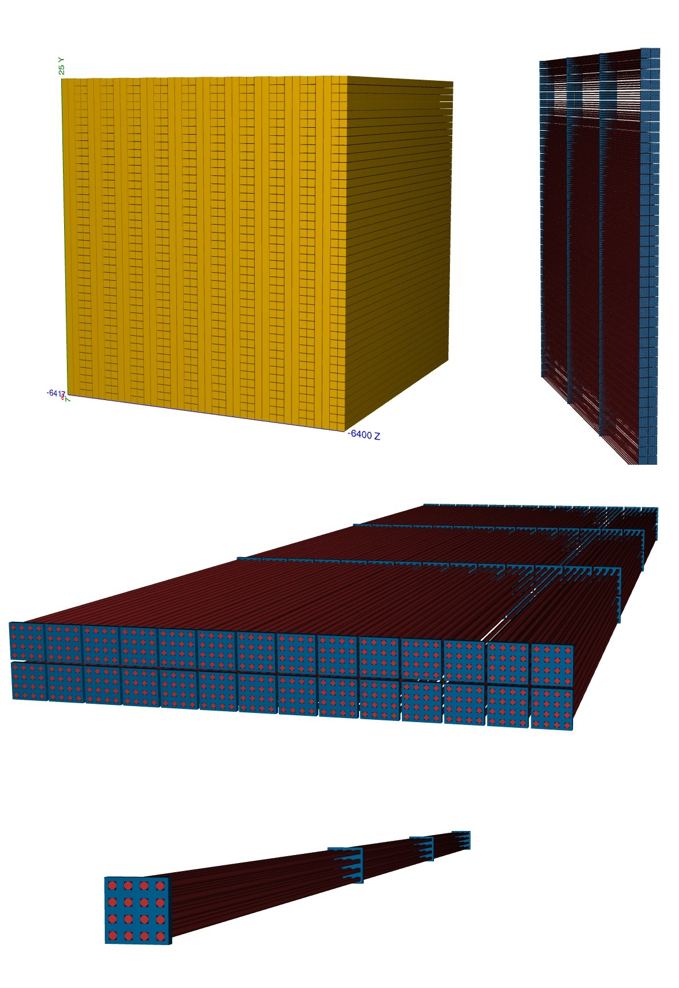
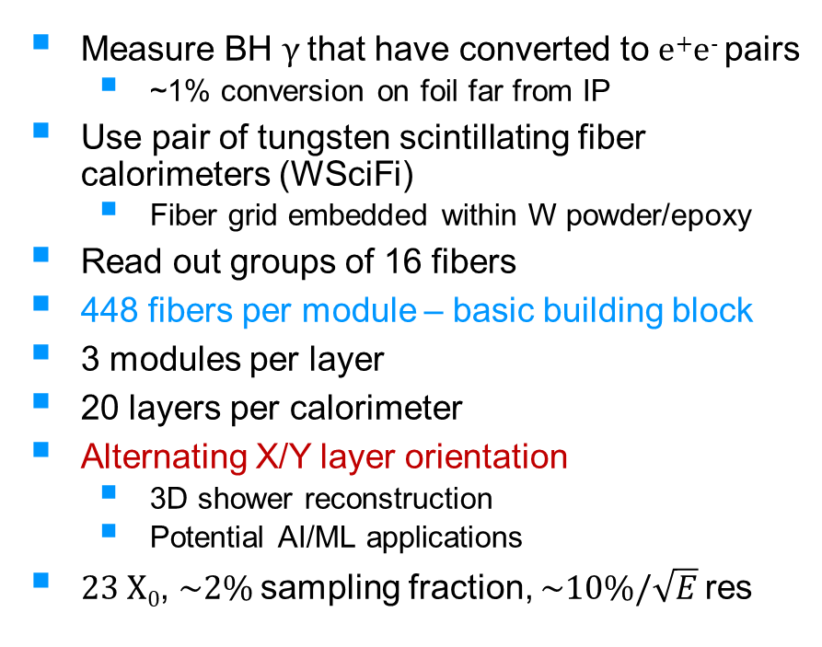
WSciFi Calorimeter Design
Measure BH γ that have converted to e⁺e⁻ pairs
  ~1% conversion on foil far from IP
Use pair of tungsten scintillating fiber calorimeters (WSciFi)
  Fiber grid embedded within W powder/epoxy
Read out groups of 16 fibers
448 fibers per module – basic building block
3 modules per layer
20 layers per calorimeter
Alternating X/Y layer orientation
  3D shower reconstruction
  Potential AI/ML applications
23 X₀, ~2% sampling fraction, ~10%/$\sqrt{E}$ res

Slide 13
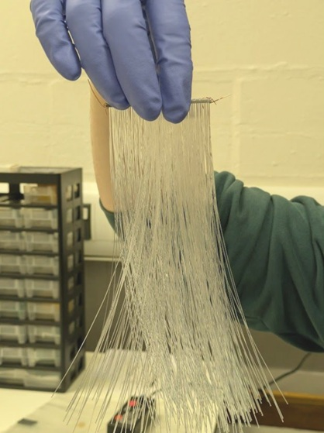
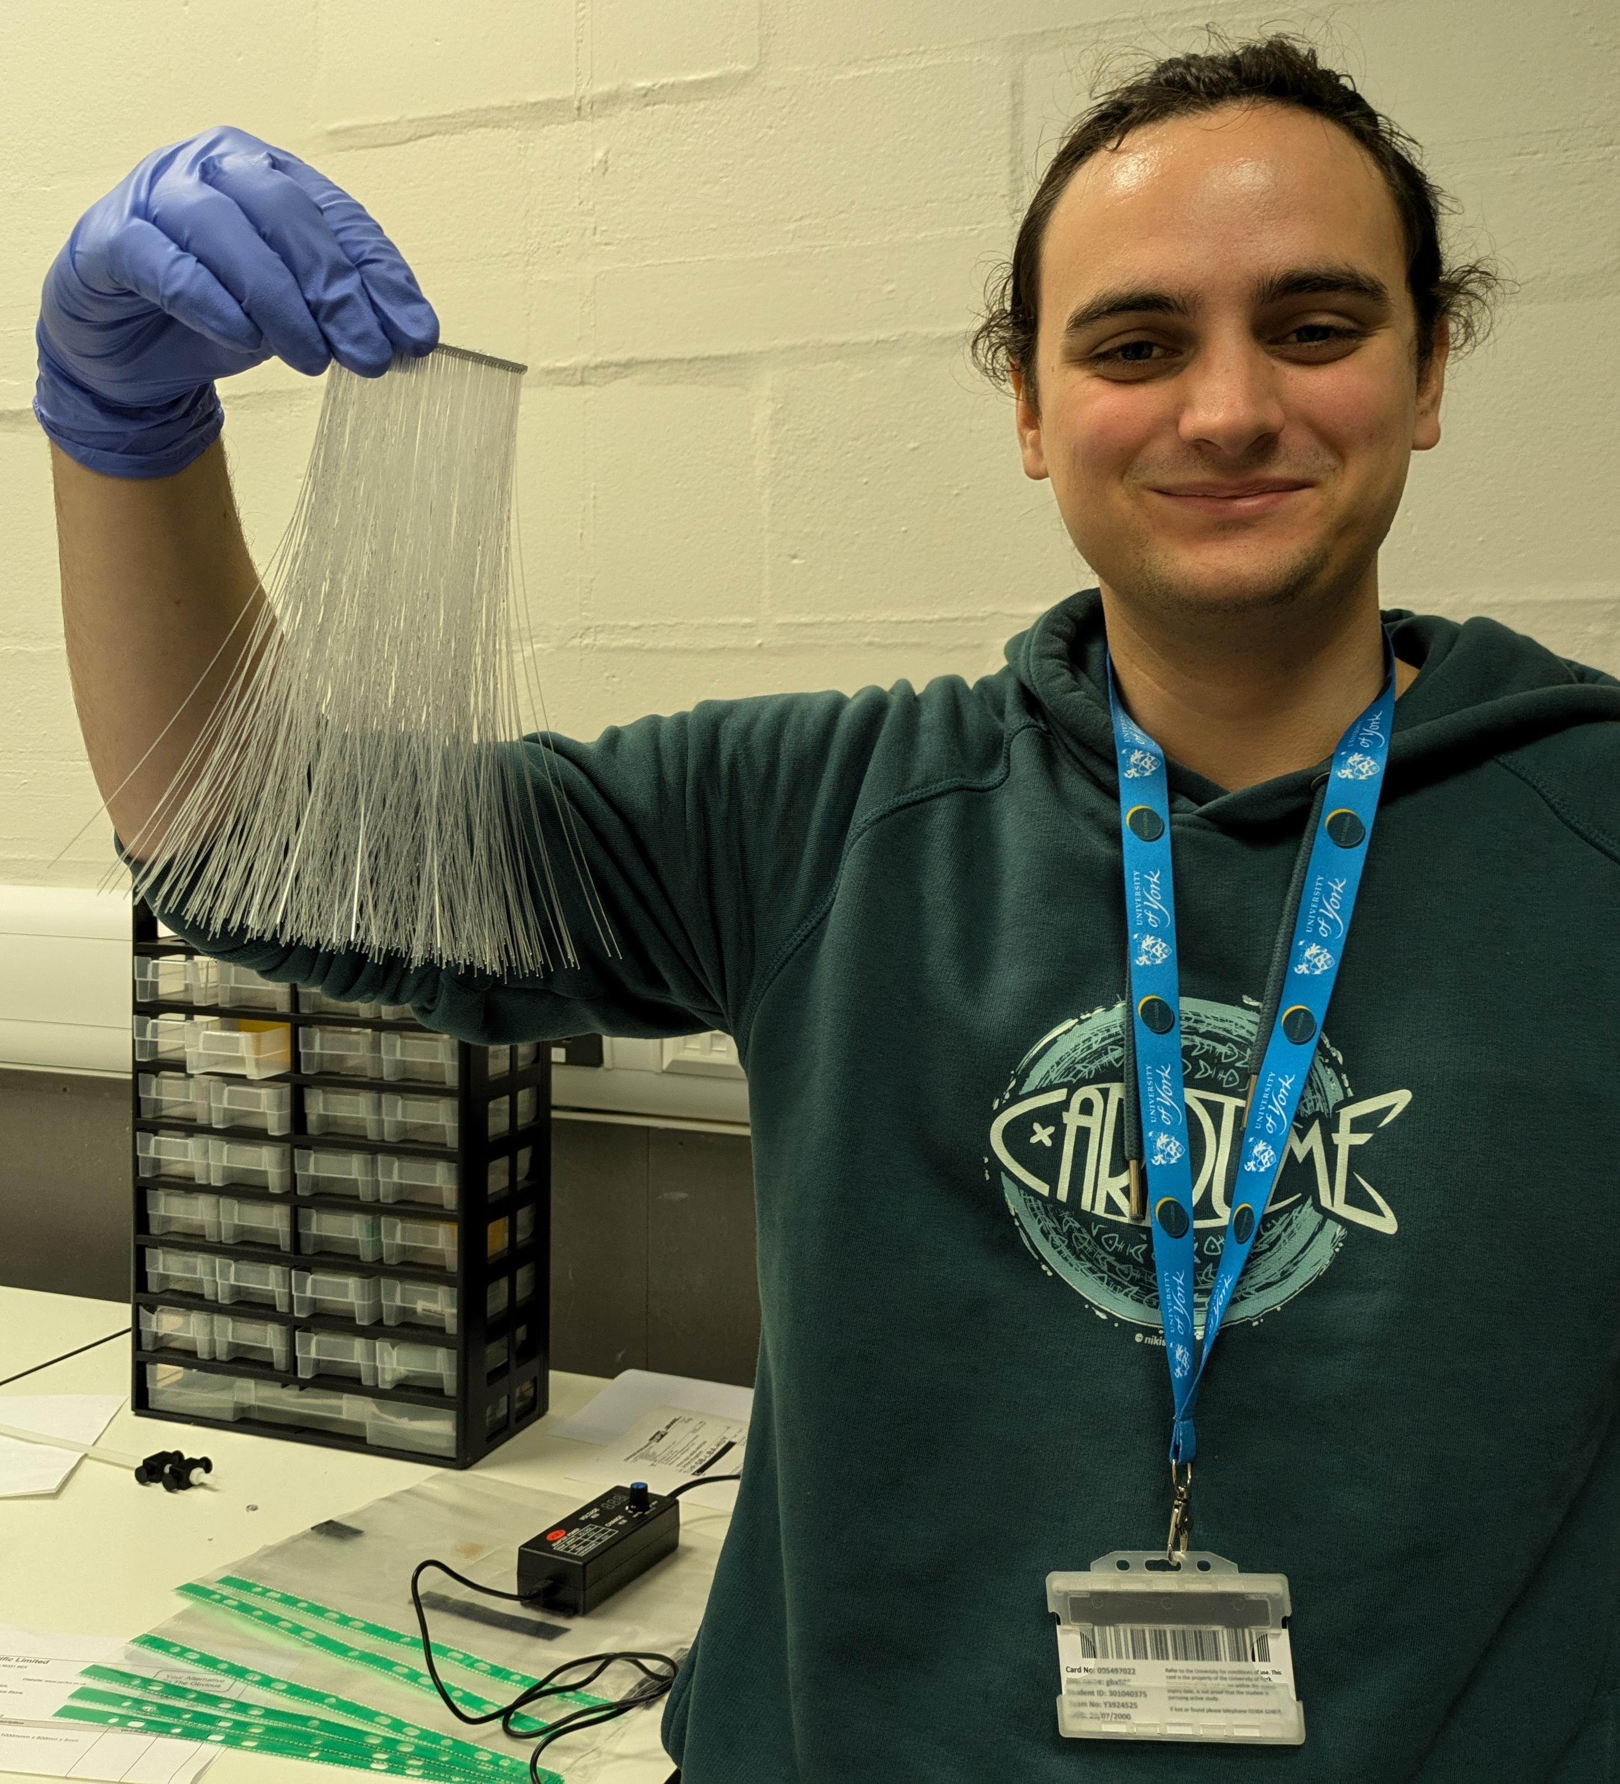
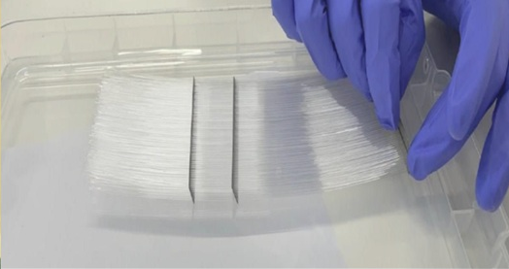
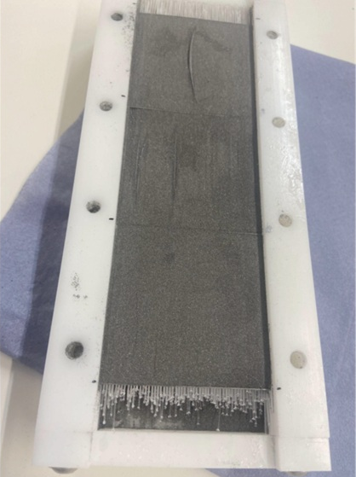
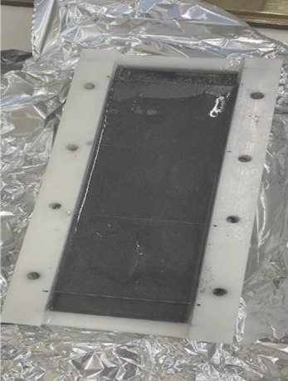
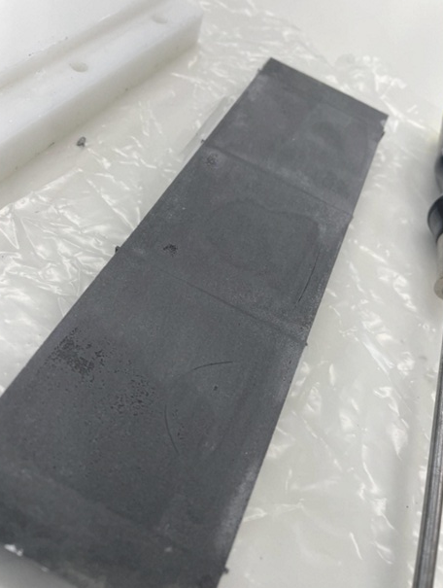
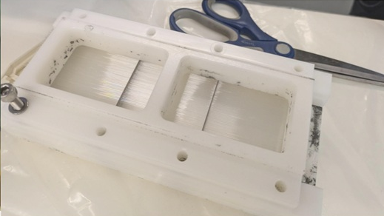
WSciFi Calorimeter Prototype Construction
Insert meshes into slots in mould
  Lesson learned, seal ends of mould
Mix and pour epoxy over tungsten + fiber array
  Mix and pour in 25ml batches, use a vibrating table
Cure epoxy for ~2 hours at 50-60ºC, remove from mould
Lesson learned – Place under vacuum before curing
Pour tungsten over fiber array
Separate meshes (Alex’s favourite part)
  Must be done extremely carefully!
Populate stack of meshes with fibers
  Now use a dedicated fiber holder/dropper
The prize catch!
Local PhD Student, Alex Smith, shows off his prize winning and unprecedented 540 fiber catch.
“I can’t wait to separate these meshes” said Alex as he showed off his prize.

Slide 14
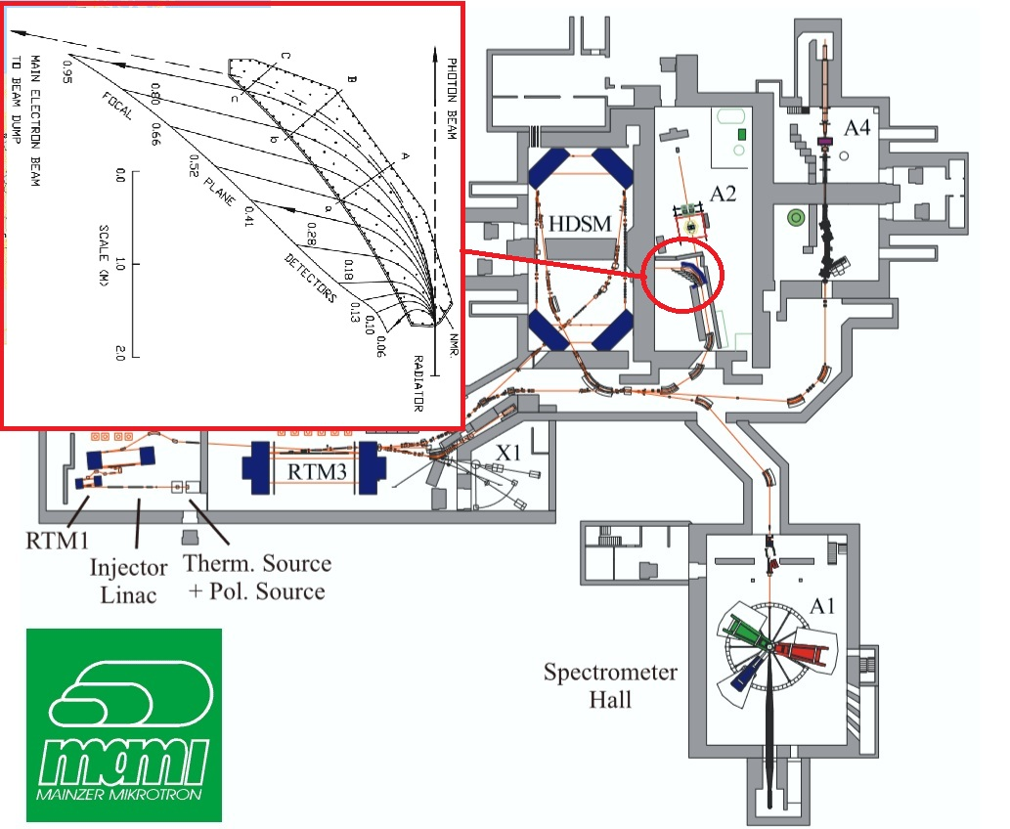
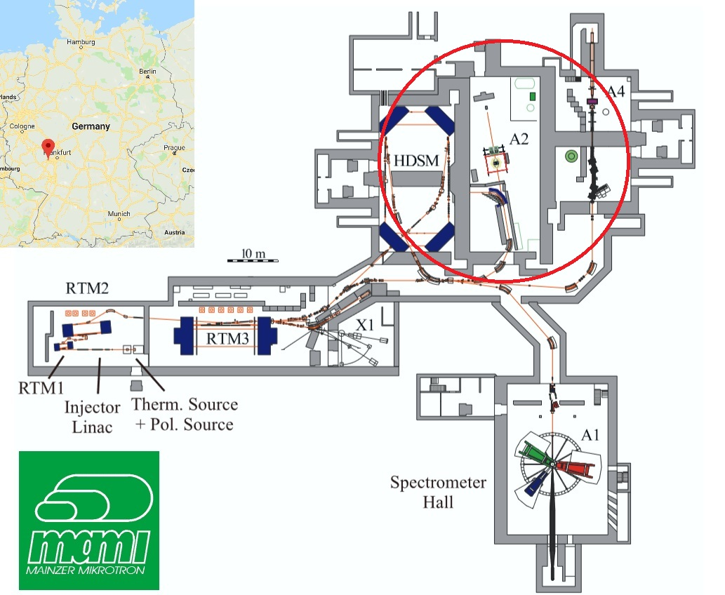
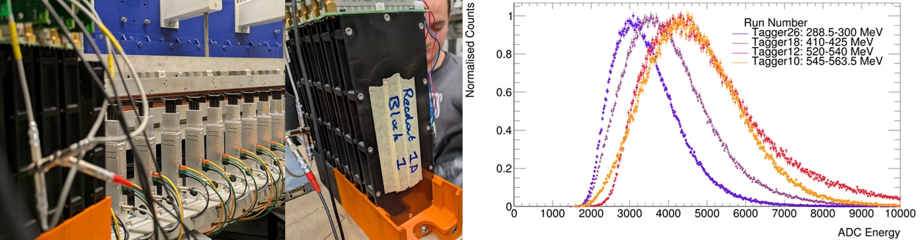
WSciFi Calorimeter Testing
Ran parasitic tests in A2 Hall at MAMI, Mainz in July 2025
  Detector placed at electron tagger - ~100’s of MeV e⁻
Goal: Establish energy dependence, see shower profile
From testing at different tagger positions (different energies), established clear energy dependence in signal

Slide 15
t - Studies of Meson Structure at the EIC

Slide 16
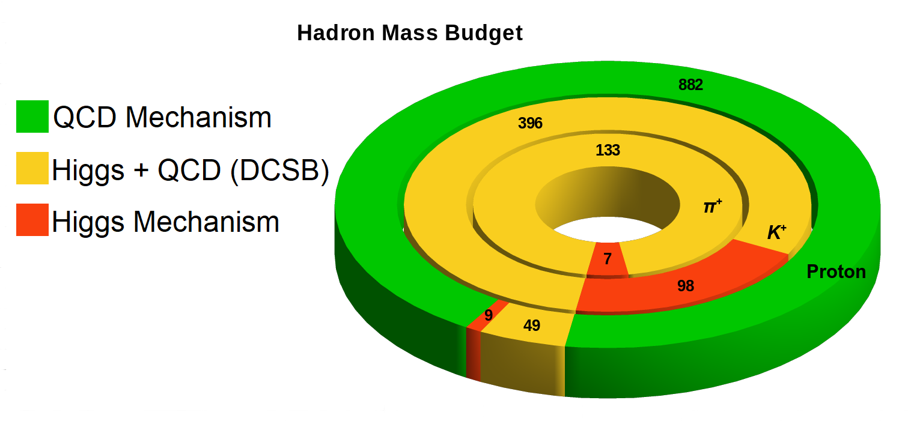
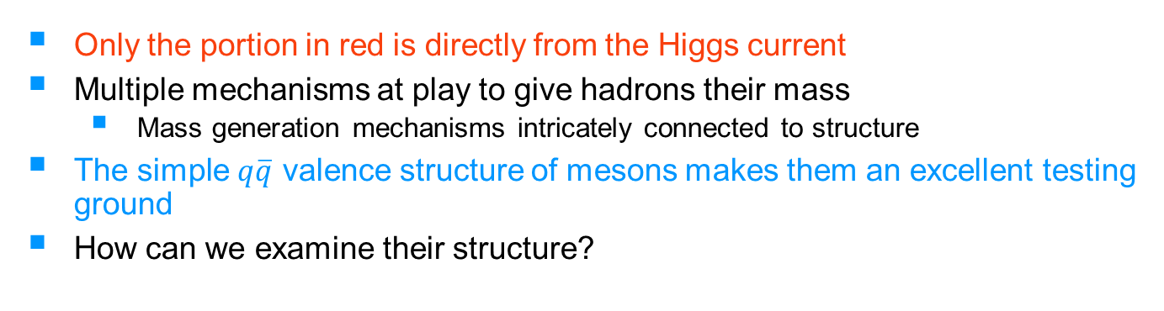
Why Meson Structure?
Image - G. Huber, modified figure from https://doi.org/10.1088/1361-6471/abf5c3
Only the portion in red is directly from the Higgs current
Multiple mechanisms at play to give hadrons their mass
  Mass generation mechanisms intricately connected to structure
The simple $q\overline{q}$ valence structure of mesons makes them an excellent testing ground
How can we examine their structure?

Slide 17
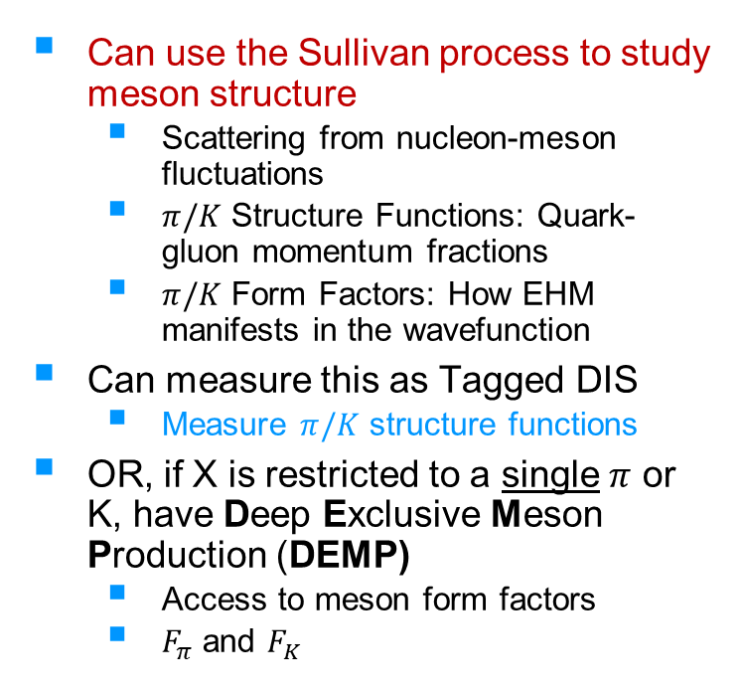
Meson Structure with the Sullivan Process
Can use the Sullivan process to study meson structure
  Scattering from nucleon-meson fluctuations
  $π/K$ Structure Functions: Quark-gluon momentum fractions
  $π/K$ Form Factors: How EHM manifests in the wavefunction
Can measure this as Tagged DIS
  Measure $π/K$ structure functions
OR, if X is restricted to a single $π$ or K, have Deep Exclusive Meson Production (DEMP)
  Access to meson form factors
  $F_{π}$ and $F_{K}$

Slide 18
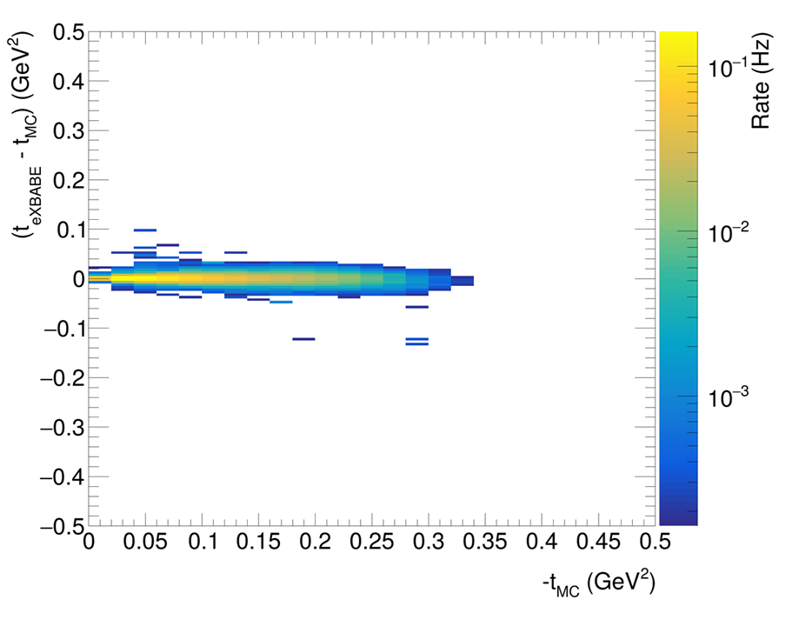
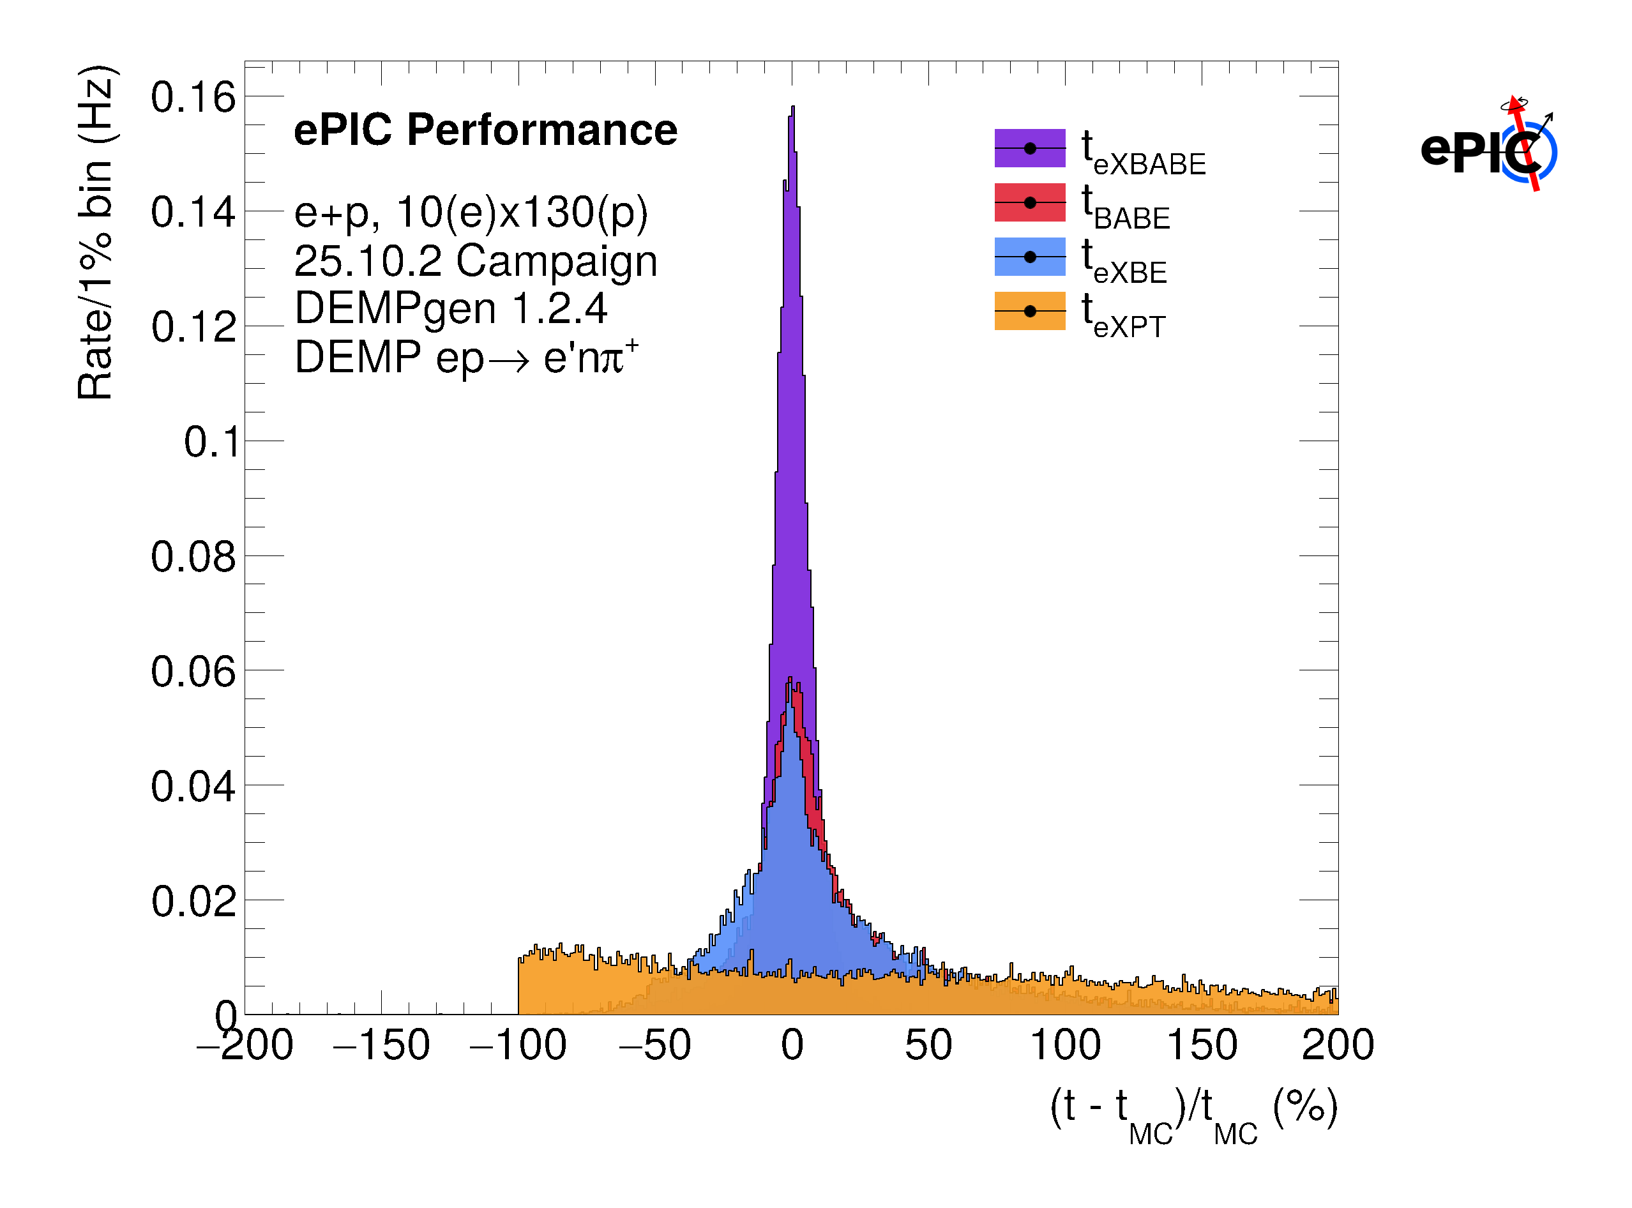
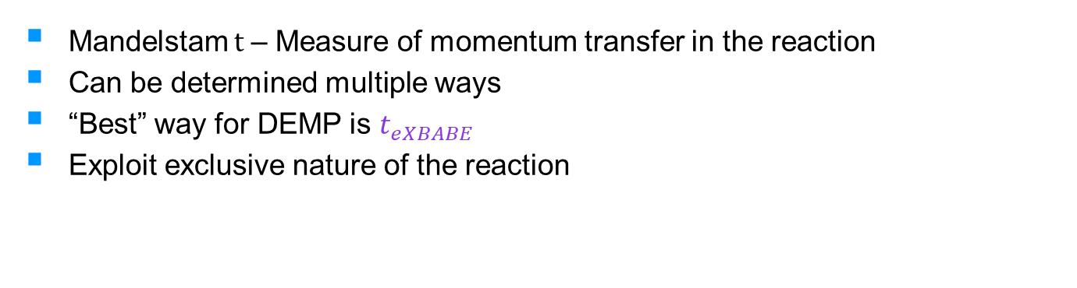
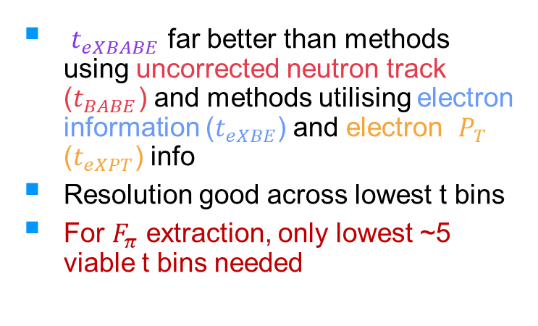
Determining t
Mandelstam t – Measure of momentum transfer in the reaction
Can be determined multiple ways
“Best” way for DEMP is $t_{eXBABE}$
Exploit exclusive nature of the reaction
$t_{eXBABE}$ far better than methods using uncorrected neutron track ($t_{BABE}$) and methods utilising electron information ($t_{eXBE}$) and electron $P_{T}$ ($t_{eXPT}$) info
Resolution good across lowest t bins
For $F_{π}$ extraction, only lowest ~5 viable t bins needed

Slide 19
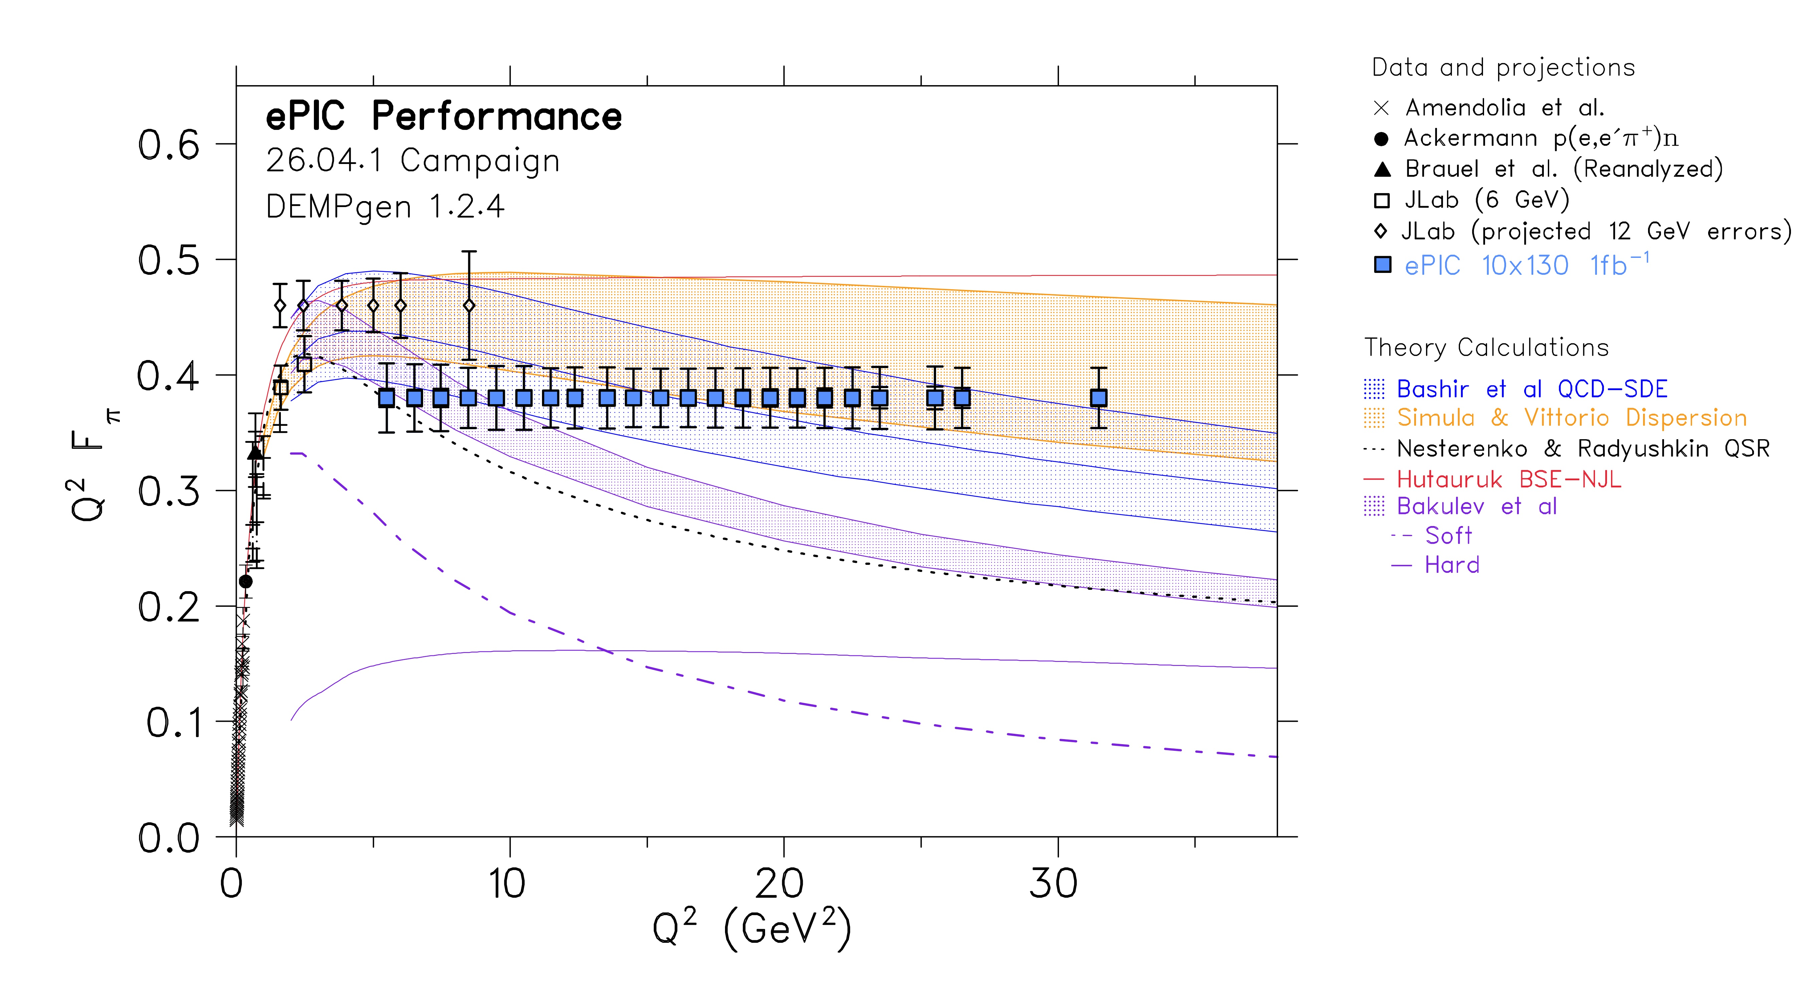
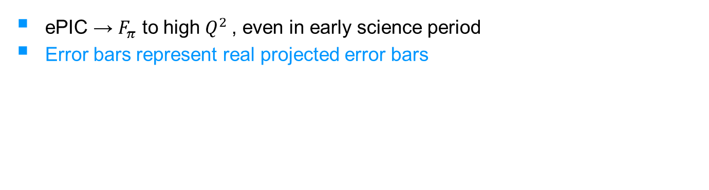
Pion Form Factors at the EIC
ePIC → $F_{π}$ to high $Q^{2}$, even in early science period
Error bars represent real projected error bars
More details on analysis in Analysis Note
Results featured in Early Science Report
Results to be updated with latest 9x130 and 9x275 configs very soon!

Slide 20


Thanks for listening, any questions?
With thanks to the Meson Structure WG
This research was supported by UK Research and Innovation: Science and Technology Facilities Council
(UKRI:STFC) grant ST/W004852/1 and the Natural Sciences and Engineering Research Council of Canada
(NSERC) grant SAPPJ-2025-00040

