Slide 1
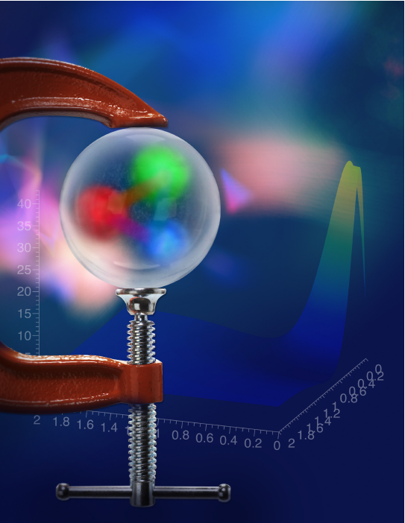
Pressure and forces in the proton
The pressure
distribution
inside the
proton
What we learn from experiment
Volker D. Burkert
Jefferson Lab
CNF/ThCtr Workshop - Vector Quarkonia as Pressure Gauges, 3/26-27/2026
Notes:
The theme of this workshop is "Vector Quarkonia as Pressure Gauges".
In the sense of the Vector Dominance Model, the photon is like the "Mother of all Vector quarkonia" as the photon fluctuates in all qq-bar vector mesons.
So, in this first presentation it may be quite appropriate to begin with using the photon to measure the pressure in the proton.

Slide 2
Short Prehistory
Gravitational Interaction of Fermions,
I.Yu. Kobzarev, L.B. Okun, Sov. Phys. JETP 16 (1963)
… any massless spin-2 field gives rise to a force indistinguishable from gravitation…
S. Weinberg, 1972, Misner, K. Thorne, Weehler, 1973
Energy-Momentum Structure Form Factors of Particles,
Heinz Pagels, Phys. Rev. 144 (1966) 1250
Generalized parton distributions and strong forces inside nucleons and nuclei,
M.V. Polyakov, Phys.Lett.B 555 (2003) 57-62
“… there is very little hope of learning anything about the detailed mechanical structure of a particle, because of the extreme weakness of the gravitational interaction” H. Pagels
First experiment-based result.
The pressure distribution inside the proton,
V.D. Burkert, L. Elouadrhiri, F.X. Girod,
Nature 557, 7705 (2018) 396-399
Notes:
The gravitational structure of particles was theoretically discussed in the mid 1960's.
However, the use of gravity as a probe of mechanical properties of particles was dismissed as a practical impossibility.
In the early 1970's, researchers in gravity, among them Nobel prize winners, came out with such statements........, that pointed towards possibly defining spin-2 field to study mechanical properties of particles.
It took another 30 years, with other steps in between, before a path towards possible measurements was outlined, and .....
another 15 years until first results from experimental data on a mechanical property of the proton.
`

Slide 3
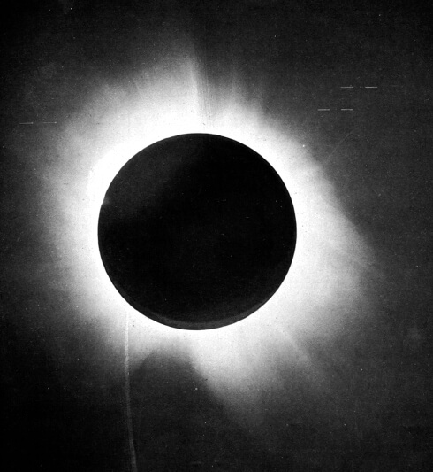
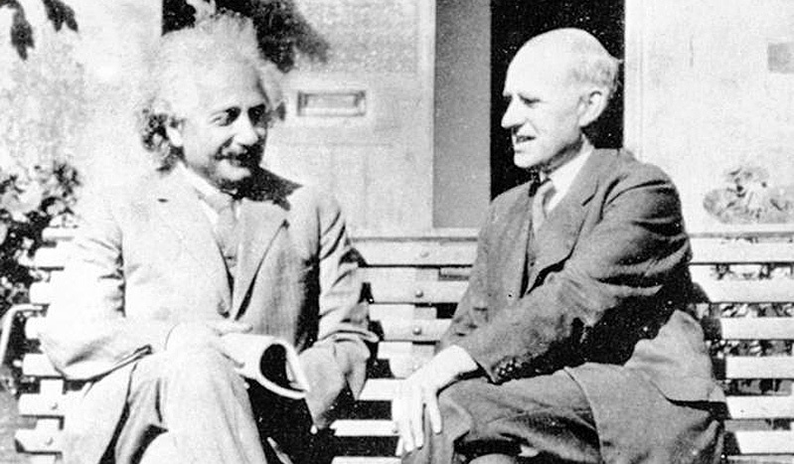
Probing the strong interaction
The proton’s internal structure has been studied through electromagnetic and weak interaction for over 70 years.
What more could we learn if gravity could be used as a probe?
March 29, 1919
Proton
Electro-magnetism
Gravity-like
Vector
Tensor
Electric charge: Q
Magnetic moment: μ
Mass/energy M
Spin J
Forces/pressure D
Axial
g_{A} g_{P}
Gravity couples to starlight, massless energy, confirming
theory of general relativity.
Weak interaction
Notes:
The proton’s internal structure has been studied since the 1950’s through electromagnetic vector exchange coupling to charge and magnetic moment, and through weak axial interactions.
What more could we learn if we could use gravity as a probe ? From Newtonian gravity we knew its coupling to mass.
It took the observation of light from distant stars to be attracted by the mass of the sun to confirm Einsteins general theory of relativity.
Gravity then probes mass and (massless) energy, angular momentum J, and pressure and forces characterized by the D term. How do we get information about these gravitational form factors?

Slide 4
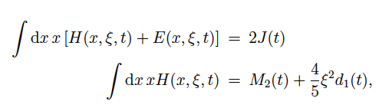

GPDs – GFFs Relations
Proton QCD matrix element of the Energy-Momentum Tensor contains three gravitational form factors (GFF) and can be written as:
M₂(t) : Mass & energy
J (t) : Angular momentum
d₁(t) : Pressure, shear stress
3 quark + 3 gluon GFFs
X. Ji, Phys. Rev. D55, 7114 (1997)
Maxim Polyakov
1966 - 2021
GPDs not directly accessible → integrate over the x-dependence → Compton FFs (CFFs)
Notes:
The GFFs appear in the proton’s matrix element of the energy momentum tensor.
That contains 3 GFF M2(t), J(t), and d₁(t).
The GFFs are written here for the quark part, but they apply to the gluon content of the proton as well. Studying the GFFs becomes a very broad program as a minimum of 6 GFFs are needed to fully describe the proton gravitational structure.
The GFFs are related through these x-moments of GPDs.
As we do not know the x-dependence of GPDs experimentally, we define different observables by integrating out the x-dependence and call them Compton Form Factors CFF.

Slide 5

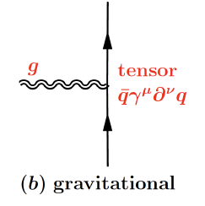
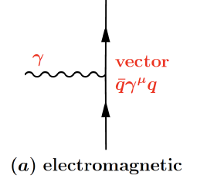
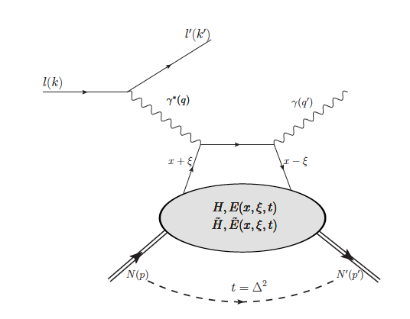
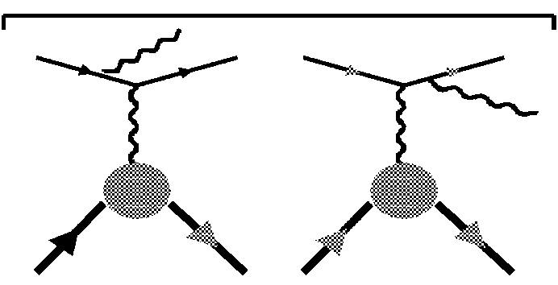
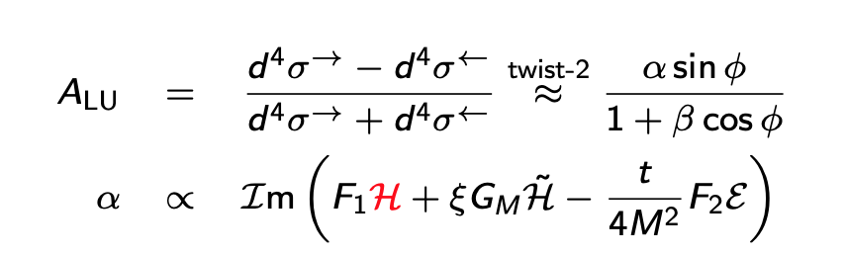
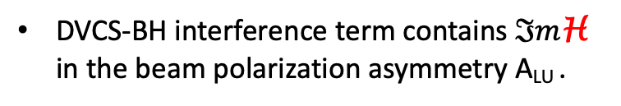


Compton FFs & DVCS
M.V. Polyakov, Phys.Lett.B 555 (2003) 57-62
GPDs and strong forces inside nucleons and nuclei.
https://arxiv.org/pdf/hep-ph/0210165
X. Ji, PRD 55 (1997) 7114
A. Radyushkin, PRD 56 (1997) 5524
Gravity & gravity-like couplings
p
p
p
γ
g_{v}
Complex valued Compton Form Factors H and E appear in the DVCS observables.
J=2
J=2
G
J=2
γ_{v}
g_{v}
p
p
p
DVCS
Bethe-Heitler
Gravity
DVCS
φ, J/ψ
DVCS-BH interference term contains $ℑm$H in the beam polarization asymmetry A_{LU} .
hard scattering
factorization
Elastic Form Factors
soft part
x_{B}
p
ξ $≈$
$$ℑm$$
p
2 - x_{B}
$ℜe$H appears in the differential cross section.
Notes:
This is the convolution integral. The Compton FF become now complex-valued quantities and appear as the observables in the DVCS process shown below:
In addition to DVCS we have the competing Bethe-Heitler process, which interferes with the DVCS amplitude.
Why DVCS may be used as a gravity-like process is shown with this cartoons. Gravity couples as a spin-2 field, and DVCS with two spin-1 photons contains components of spin-2.
BH is determined by the e.m. form factors that are measured up to high Q^{2'} . The interference term contains the imaginary part of the CFF H.
Im H can be experimentally extracted from the azimuthal phi dependence of the electron beam-spin asymmetry.
The real part of H appears in the differential cross section.
Here I want to note that vector quarkonia like s-sbar and c-cbar can be suitable gravity-like probes for gluon GFF.
Click

Slide 6


Compton FFs & DVCS
M.V. Polyakov, Phys.Lett.B 555 (2003) 57-62
GPDs and strong forces inside nucleons and nuclei.
https://arxiv.org/pdf/hep-ph/0210165
X. Ji, PRD 55 (1997) 7114
A. Radyushkin, PRD 56 (1997) 5524
Gravity & gravity-like couplings
p
p
p
γ
g_{v}
Complex valued Compton Form Factors H and E appear in the DVCS observables.
J=2
J=2
G
J=2
γ_{v}
g_{v}
p
p
p
DVCS
Bethe-Heitler
Gravity
DVCS
φ, J/ψ
DVCS-BH interference term contains $ℑm$H in the beam polarization asymmetry A_{LU} .
hard scattering
factorization
Elastic Form Factors
soft part
x_{B}
p
ξ $≈$
$$ℑm$$
p
2 - x_{B}
$ℜe$H appears in the differential cross section.

Slide 7
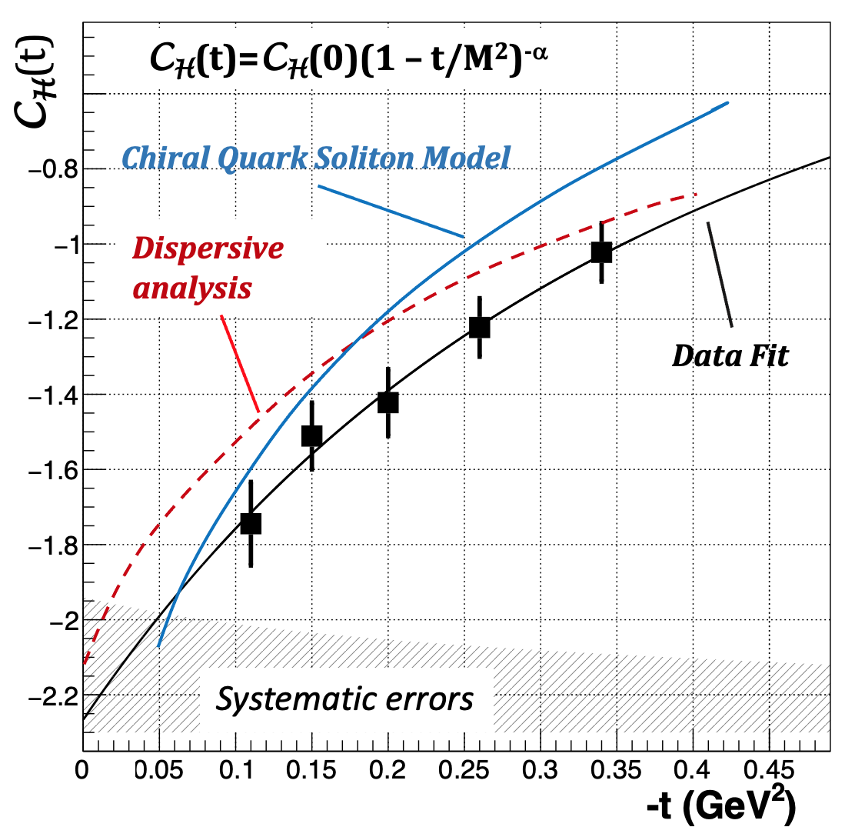


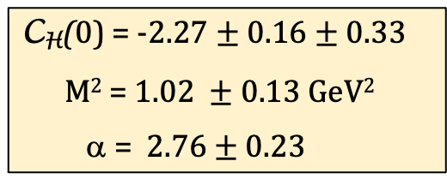

First extraction of C_{H}(t) and the proton D-term
VB, L. Elouadrhiri, F.X. Girod, Nature 557, 396 (2018)
B. Pasquini, et al, PLB 739 (2014) 133,
K. Goeke et al., Phys.Rev.D 75 (2007) 094021
Fixed-t subtracted Dispersion Relation:
C_{H}(t) +
C_{H}(0) = -2.27 $± 0.16±$ 0.33
M² = 1.02 $±$0.13 GeV²
α = 2.76 $±$ 0.23
d₁^{Q}(0) = - 2.04$± 0.14±0.30$
-t/Q² $≤$ 0.2
z= x/ξ
C_{H}(t) =
D^{Q}(0) = - 1.6$3±0.11±0.24$
→ The D-term is negative
Notes:
Using the fixed-t dispersion relation connecting the imaginary and real part of CFF H and a parameterization for the subtraction term Ch yields the results shown in the figure and the fit parameter shown here.
From this we can determine the d1(t) term by relating CH(t) to the d^{q}₁(t) GFF resulting in the first extraction of the quark D-term.
The graph shows a comparison with two prediction, that agree with the data within the systematic uncertainties shown by the shaded band.
One important result is that the D-term is negative,
Next, we relate the D-term to the energy-stress tensor and determine the pressure and sheer stress in the proton

Slide 8
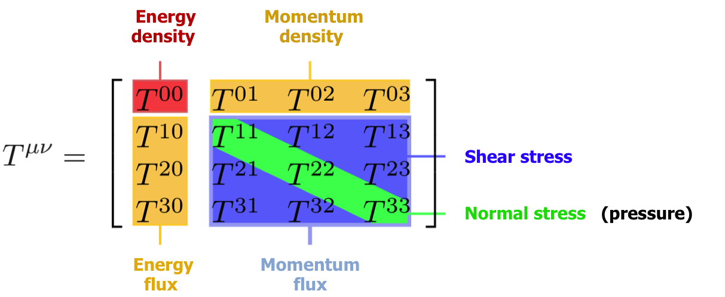
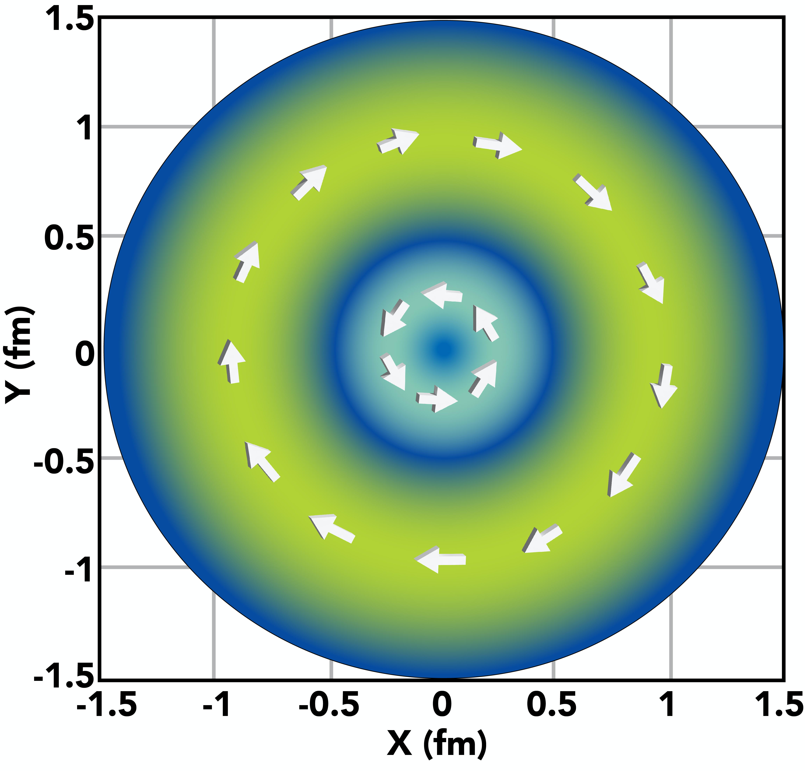
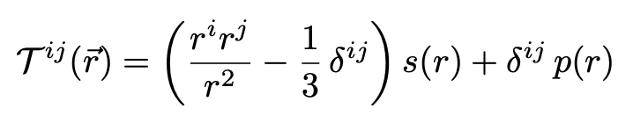

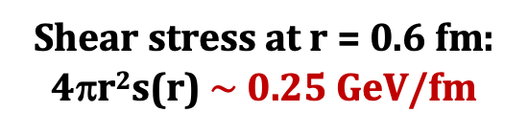

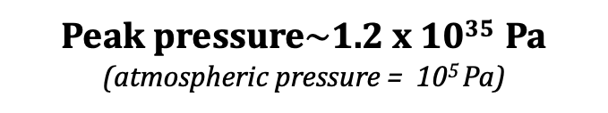
Proton pressure and shear
this result
Tangential stress
χQSM
p_{t} = -1/3 s(r) + p(r)
repulsive
Shear stress at r = 0.6 fm: 4πr²s(r) $\sim$ 0.25 GeV/fm
confining
$\sim$ 40,000 N
Peak pressure$\sim$1.2 x 10³⁵ Pa
(atmospheric pressure = 10⁵ Pa)
Van Laue condition: $∫r2p\left(r\right)dr$ = 0
Notes:
To obtain the mechanical properties represented by the D-term, we need to relate it to the energy-stress tensor of mechanics.
The spatial 3x3 matrix contains the pressure and shear terms, the former as the trace Tii and the latter through the off-diagonal elements Yij, (I skip the details here) The pressure changes sign near r=0.5-0.6 fm. The peak value is near 10^35 Pascal, 30 orders stronger compared with atmospheric pressure.
This graph shows the shear stress, which is positive at all r. The graph to the right show the tangential stress, which is more appropriate for a spherical object as the proton.
We see the tangential stress to change sign near r=0.5fm.
For a closed mechanical system, the van Laue condition must hold.

Slide 9
Forces in the proton – what do we learn?
Experiments probe now what was impossible before (revolutionary!)
How quarks are mechanically confined
How color forces of QCD generate internal stresses
How protons are mechanically stable
The role of shear forces
They balance local forces
They resist deformations and ensures mechanical stability
They play a role similar as surface tension in a liquid drop (Maxim Polyakov).
Strength of mechanical shear forces
~ 0.25 GeV/fm
Color forces on quarks ~1 GeV/fm similar to flux tube forces from LQCD of stationary quarks, X. Ji, C. Yang, research.1155.
→ Discussion session
Notes:
What do we learn from the forces inside the proton?
Let me first state that "experiments probe now what was impossible before", so I would call this "revolutionary". We learned
- How quarks are mechanically confined
- How color forces of QCD generate internal stresses
- How protons are mechanically stable
What is the role of shear force?
- It balances local forces
- it resists deformations and ensures mechanical stability
- it plays a role similar as surface tension in liquid drops.
Strength of shear force ~ 0.25 GeV/fm
--> this should be discussed in the discussion session

Slide 10
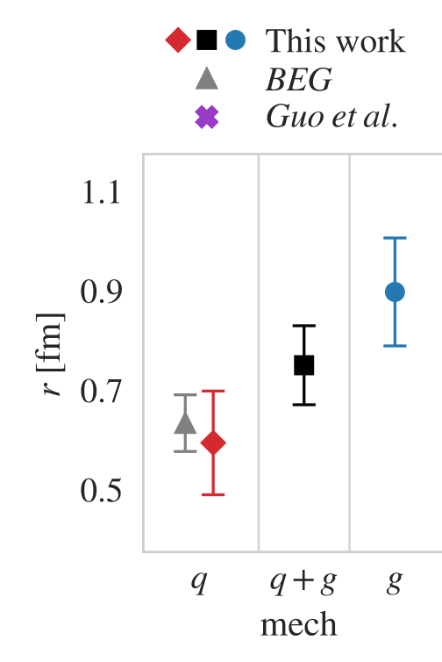
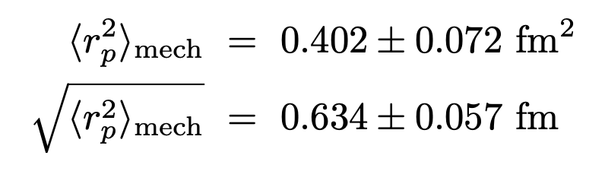
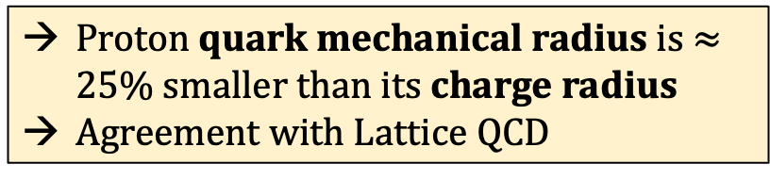
Quark-mechanical radius of proton
Mechanical radius:
D.C. Hackett et al., PRL 132 (2024)
VB, L. Elouadrhiri, F.X. Girod, 2310.11568
→ Lattice QCD is now computing GFF, mass and mechanical radii with precision, and in wide –t range.
Proton quark mechanical radius is $≈25$% smaller than its charge radius
Agreement with Lattice QCD
Notes:
From the t-dependence of the GFF one can extract the corresponding radii.
The mechanical radii are displayed on the right side. The gray one is the quark radius from the data I described earlier. The red one is the quark radius from the LQCD simulation.
The blue point is the gluon part from LQCD (no data yet), the black one is the combined quark and gluon contribution from LQCD.

Slide 11
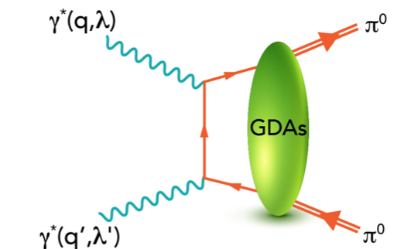
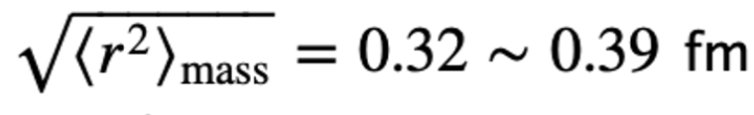
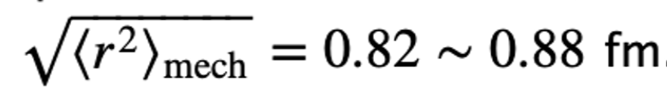
π⁰ − Quark gravitational radii
S. Kumano, Q.T. Song, O. Teryaev; PRD 97 (2018) 1, 014020
The process γ*γ* → π⁰π⁰ has been studied at e⁺e⁻ colliders. It is described in terms of generalized distribution amplitudes (GDAs) that correspond to GPDs analytically continued from the t- to the s-channel.
GDAs access information on GFFs in the time-like region (t > 0) employing data from Belle.
Quark D-term: D^{q}(π⁰) ≈ −0.75,
Mass radius, mechanical radius.
“The large difference relates to the different distribution of shear and pressure to the distribution of mass.” (KST)
Notes:
Here we depart briefly from discussion of the proton’s GFF and mention a way of accessing the gravitational structure of the πι⁰.
The process shown on the left has been studied at electron-positron colliders and is described by generalized distribution amplitudes GDAs.
GDAs correspond to GPDs analytically continued from the t-channel to the s-channel.
GDAs access GFF in the time-like region, i.e. for t > 0,
Part of the very interesting results is the different pi0 radius for its mass and for its mechanical properties.

Slide 12
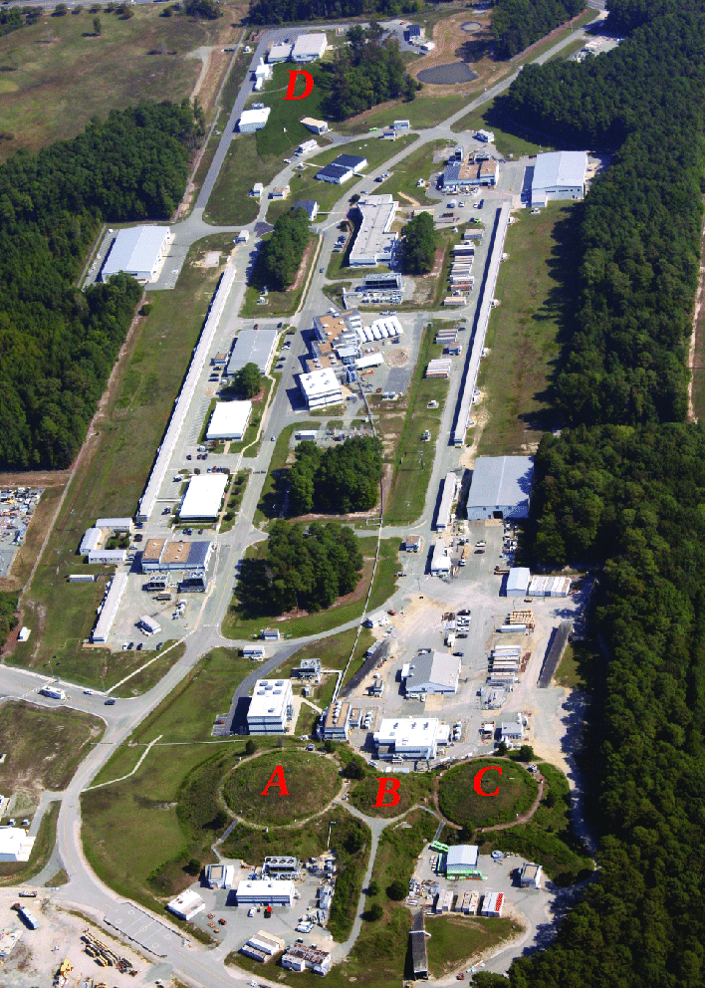
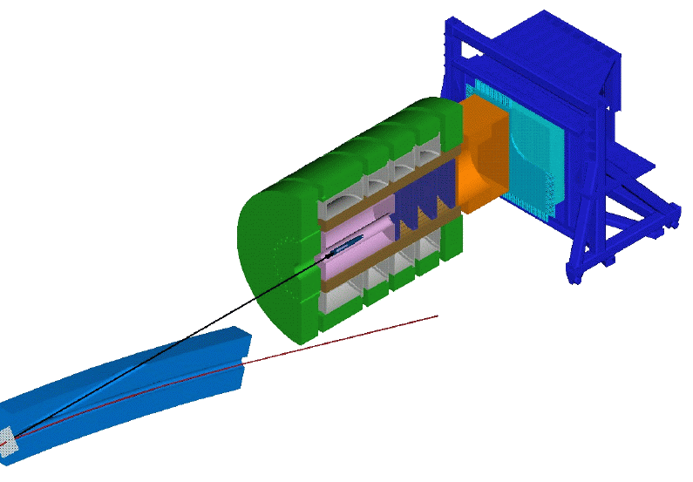
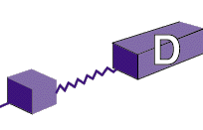
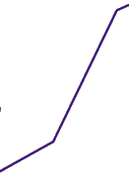
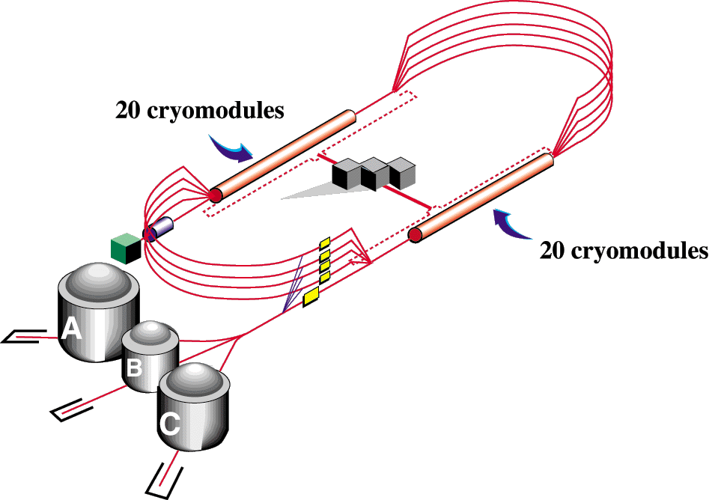


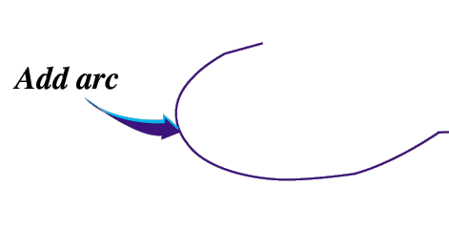

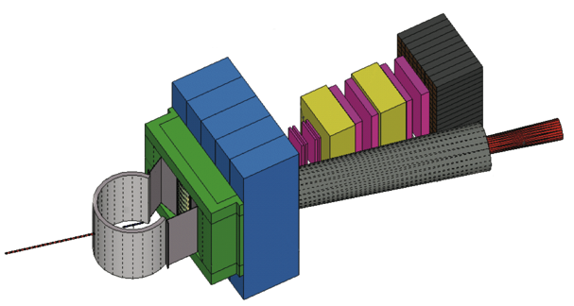

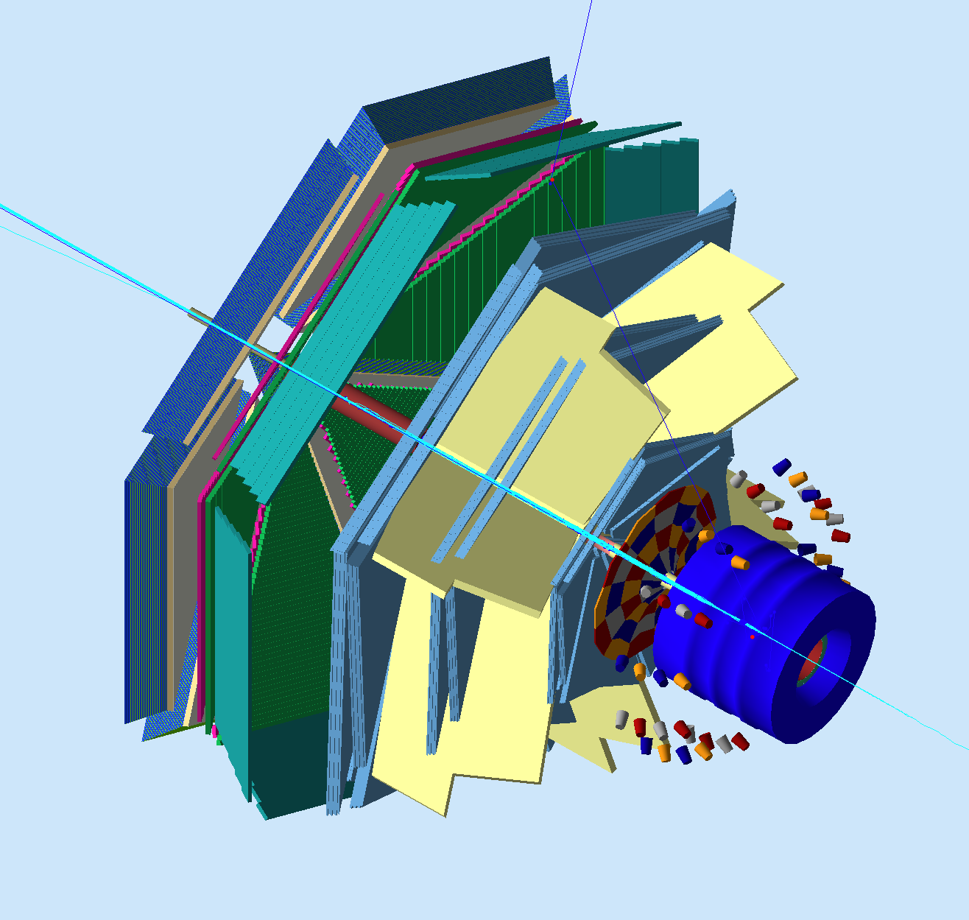
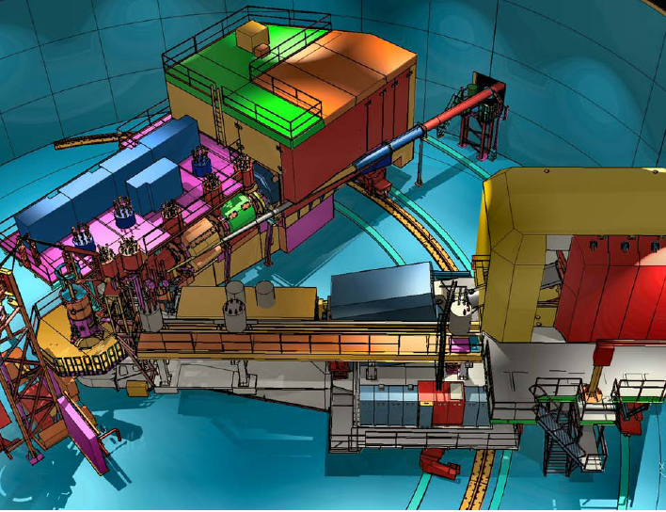
The Jefferson Lab Energy Upgrade
Maximum energy 12 GeV
New Experimental Hall D
CLAS12 in Hall B
SHMS in Hall C
SBS in Hall A
Plans for positron beam
GlueX
CHL-2
HRS² + SBS
CLAS12
HMS + SHMS
Notes:
In 2018 the energy upgrade was completed . The new Hall D GlueX experiment was operational and a major spectrometer upgrades happened in Hall C . In Hall B the CLAS12 became operational and the SBS spectrometer in Hall A.

Slide 13

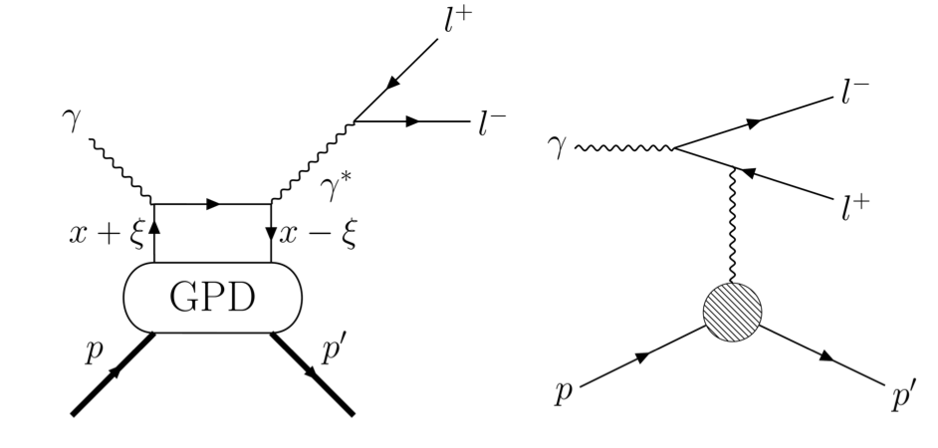
The D-term in TCS γp e⁺e⁻p
P. Chatagnon et al. (CLAS), PRL 127 (2021) 26, 262501
Forward-Backward asymmetry
M² = 3 GeV²
-t/M² < 0.2
J/ψ
D^{q}(t)
M² = 5 GeV²
ω
φ
M(e⁺e⁻)cut
A_{FB} confirms contribution of the D-term to ReH consistent with the measured value from DVCS.
Notes:
Among the first experiments after the energy upgrade was a result from time-like Compton scattering, the time-reversed version of DVCS shown here with the equivalent of the Bethe-Heitler process.
In TCS one can define a forward-backward asymmetry of the e+e- pair to directly accesses the real part of CFF H, shown in these two graphs at different e+e- masses.
Both show clear and large contributions from the D-term, marked by the orange-colored areas. Their contributions are consistent with the results obtained at 6 GeV
I showed earlier.
Error bars are large because the TCS process is suppressed compared to DVCS and was measured as a byproduct parallel to other reactions.

Slide 14
Exploring the gluon GFFs in J/ψ production
Near threshold J/ψ photoproduction
B. Duran, Z-E Meziani, S. Josten et al., Nature 615 (2023) 7954 (Hall C)
S. Adhikari et al., Phys.Rev.C 108 (2023) 2, 025201 (Hall D)
L. Pentchev and E. Chudakov (2025) , Phys.Rev.D 112, 052009 (2025) (Hall D)
S. Joosten et al., 2602.14416 (2026) (Hall C)
P. Chatagnon et al., 2602.22128 (2026) (Hall B)
Notes:
Switching briefly to J/psi photoproduction which has been studied during the past 5 years or so, where the heavy J/psi vector meson production near threshold is used to access the gluonic part of the GFFs.
Here I show a series of publications from experiments in Hall C, Hall D and Hall B.
The next speaker will cover that part, so I will just show one of the first results covering the gluonic aspect of the GFFs.

Slide 15
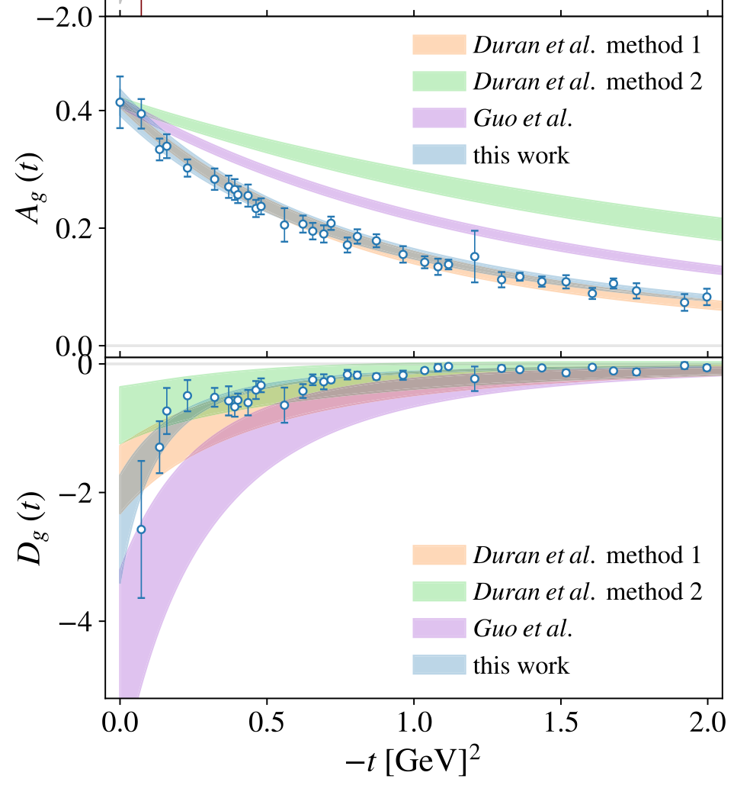
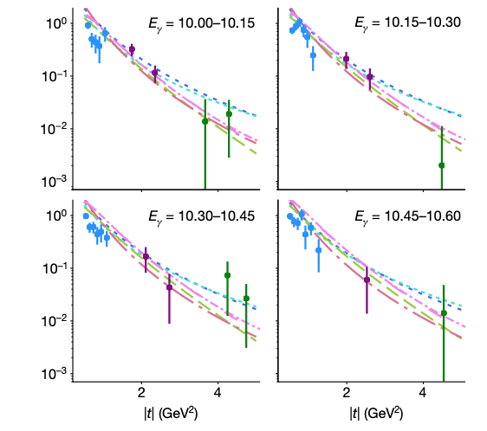
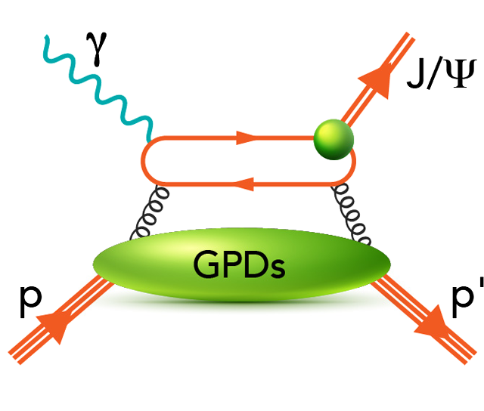

Gluon GFF A^{g}(t) and D^{g}(t)
B. Duran et al., Nature 615 (2023) 7954, 813
D.C. Hackett et al., PRL 132 (2024) 25, 251904
D. E. Kharzeev, PRD 104, 054015 (2021)
c
Gravity-like
exchange
c
_
-1.80$±0.55$
Exclusive J/ψ photo-production at threshold sensitive to gluon GFFs.
Yields of J/ψ photoproduction near threshold for different energies vs |t|, fitted with model approaches to determine GFF A^{g}(t) and D^{g}(t)
Gluonic GFF A_{g} and D_{g} using holographic QCD, Lattice QCD and the GPD approach.
Notes:
The graphs on the left show the t-dependence of the yield for different photon beam energies. With the help of some model approaches the gluon mass form factors A^{g}(t) has been extracted using a tripole formulation, and the gluon D-GFF has also been determined.
Note the arrow that I added to highlight the value extracted by the group for the gluon D-term at t=0. I will use this value in one of the next slides.
The gravity-like 2-gluon exchange diagram is assumed dominant at threshold.

Slide 16
“the measurements of this (mass) distribution, combined with measurements of other “mechanical” properties of the proton, such as the pressure distribution, will definitely advance our understanding of the quantum origin of mass”
Dmitri E. Kharzeev

Slide 17
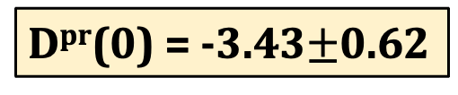

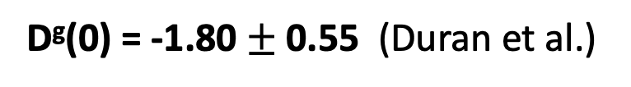
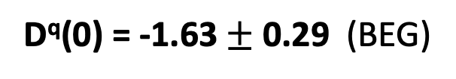
The proton’s global D-term
The proton gravitational formfactors D^{q}(0) and D^{g}(0) have been determined experimentally as follows:
D^{q}(0) = -1.63 $±$ 0.29 (BEG)
D^{g}(0) = -1.80 $±$ 0.55 (Duran et al.)
The total gravitational formfactor of the proton D^{pr}(0) = D^{q}(0) + D^{g}(0)
D^{pr}(0) = -3.43$±$0.62
Dth(0) = -3.38$±0.35$
Model-independent theory prediction
X.H. Cao, F.-K. Guo, Q.Z. Li, D. Liang Yao, Nature Communications, July 2025.
Notes:
Here I briefly summarized the achievement from different experiments at JLab on the gravitational structure of the proton.
The D-term at t=0 for both quarks and gluons have been determined.
We can therefore form the total D-term of the proton, which including its combined error bars is shown here.
The comparison with a model-independent theory prediction show excellent agreement.
That leads me to the statement below: The interpretation of JLab experiments resulted in the determination of the last fundamental global property of the proton ist D-term.

Slide 18
Ongoing experimental program
Hall B:
LH₂, 4 different beam energies, BSA for highest energy published, PRL 130 (2023) 21, 211902), cross sections in review
LD₂, neutron BSA published, PRL 133 (2024), 21, 211903, proton BSA in preparation
~
Long. pol. NH₃, ND₃ , CFF H , analysis in progress
Trans. Pol. NH₃ , New target and beamline in design. Sensitivity to CFF E_{p} , essential for GFF J^{q}(t)
⁴He gas, A_{LU} , BSA, cross sections, CFF H_{He} analysis in progress (ALERT)
Hall A/C:
LH₂ high x_{B}, BSA & CFF, PRL 128 (2022) 25, 252002
Hall B/C:
LH₂, positron beam, charge asymmetry A_{C.} measures ReH CFF directly.
Notes:
- Large batches of DVCS data have been taken at energies from 6.4 to 10.6 GeV have been taken on liquid hydrogen and deuterium, the latter to study neutron CFF.
- Data on long. polarized target have been taken providing sensitivity to H-tilde.
- Transverse polarized is important for CFF E , conditional approval, target and detectors being developed.
- DVCS on He 4 took data in 2025, sensitivity to He CFF H.
- DVCS measurements on positrons and electron have been approved, providing charge asymmetry measurement with direct access to real part of CFF H

Slide 19
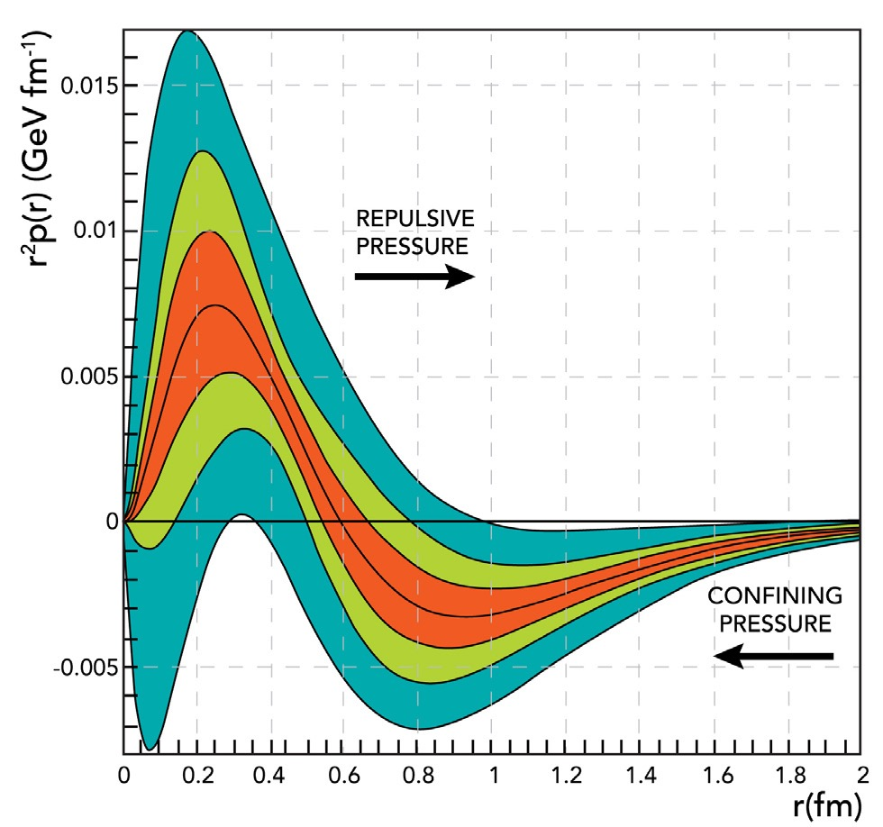
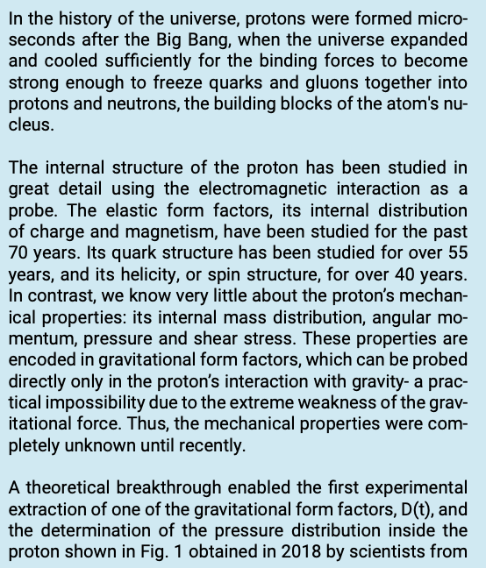
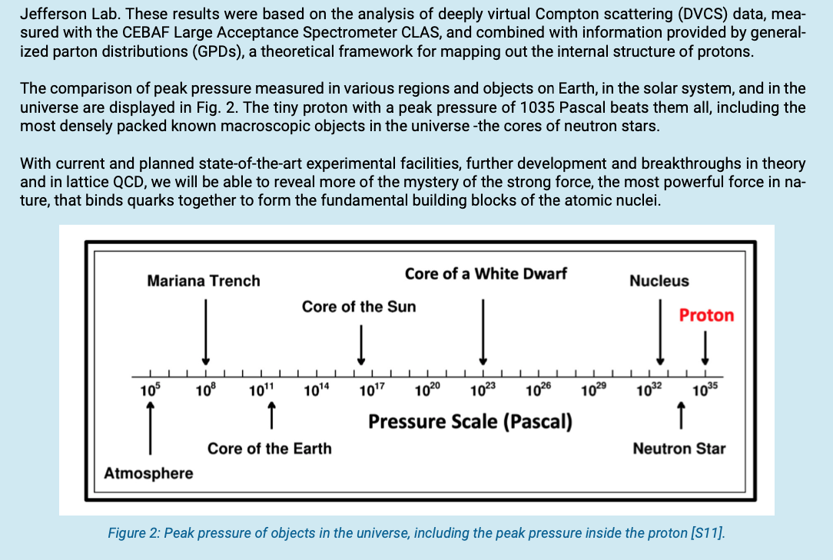
NSAC LRP 2023
Sidebar 3.2 The Pressure Inside the Proton
Figure 1: Pressure distribution in the proton weighted as r2 p(r). The peak pressure at r = 0 corresponds to 1035 Pascal. The green shaded bands represent uncertainties if only initial world data (dark) or more recent high statistics data (light) are included. The red band represent projections of future experiments [S10].
Notes:
The gravitational structure of particles is prominently included as a separate sidebar as shown here. .

Slide 20
The proton’s D^{q}(t) and pressure at 22 GeV
Fitting the dispersion relation to ImH, ReH
-t/Q² < 0.2
Fourier
transform
10⁻³
22 GeV
-t/Q² < 0.2
22 GeV
11 GeV
6 GeV
22 GeV will cover a large range in -t and may discover existence of pressure domains.
Notes:
The quark D-term has been extracted from the CLAS12 simulated and reconstructed data for energies up to 22 GeV.
The entries are limited for t-values if –t/Q2 < 0.2 as a safe range to limit higher twist contributions.
A large range in -t is important to probe existence of possible pressure domains.
That is why the range in t is very important to discover those domains.

Slide 21
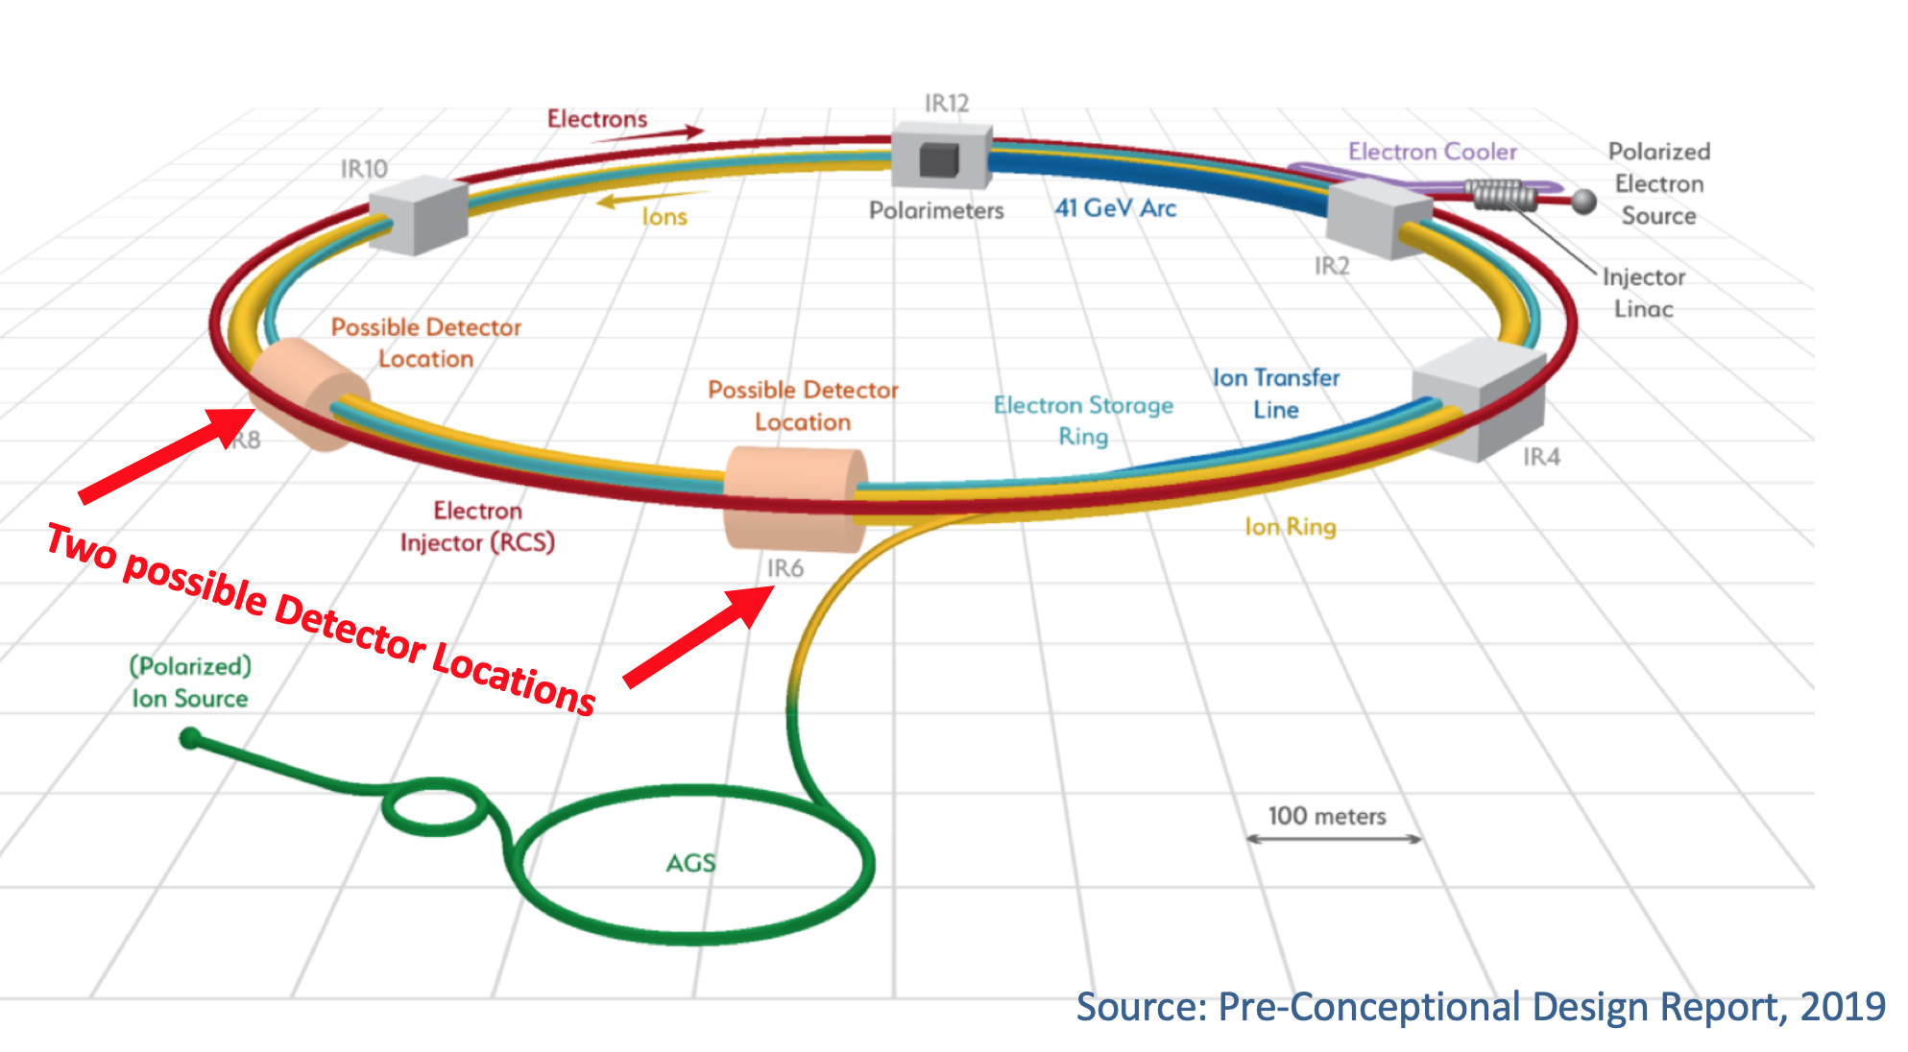
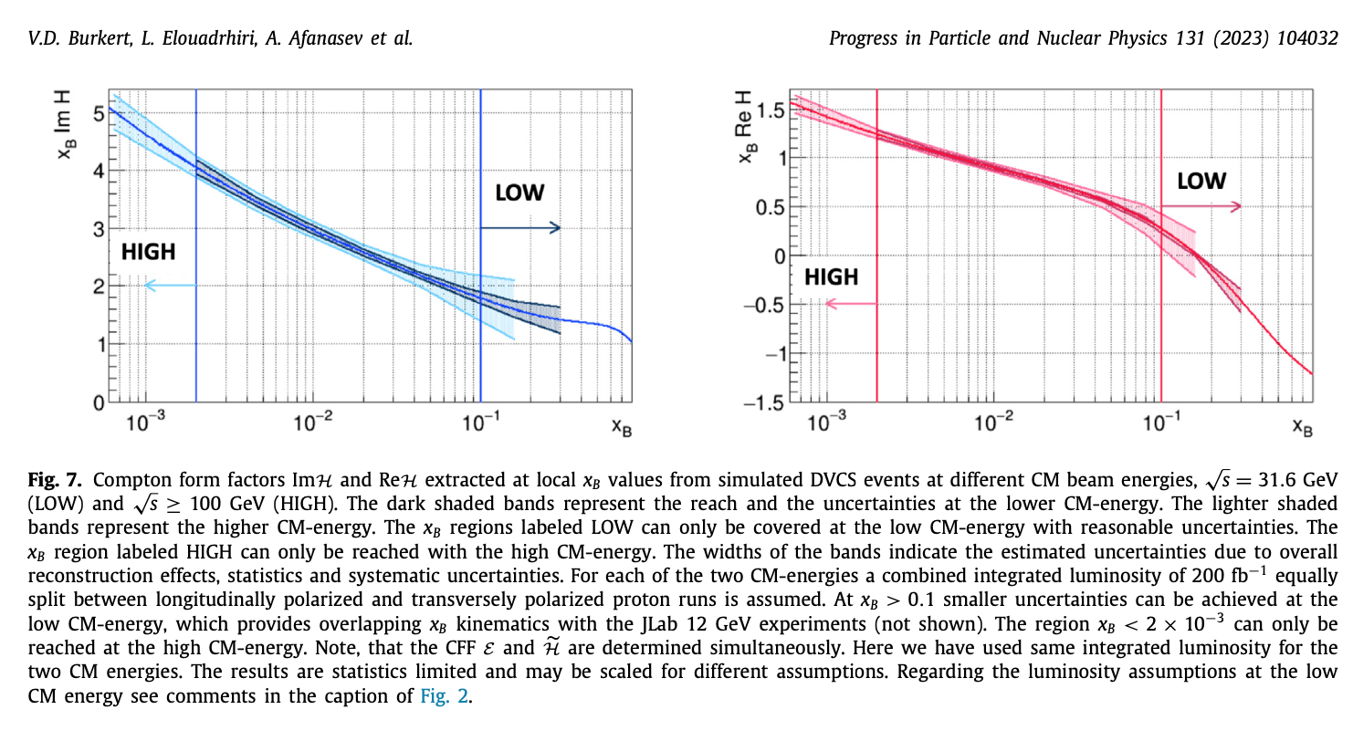
US Electron Ion Collider
Simulated DVCS CFF on protons at the EIC at CM 31.6 GeV and at 100 GeV.
CM Energy: 25 – 140 GeV
Luminosity: up to 10³⁴s⁻¹cm⁻²
Prog.Part.Nucl.Phys. 131 (2023) 104032
Notes:
The US EIC collider will provide further extension into the gluon dominated part of the phase space.
DVCS simulation have been made to cover two kinematic ranges of 31.6 and 100 GeV CM energy both with polarized electrons and with transverse polarized protons of luminosity 100fb-1 for each of the two CM energies.

Slide 22
Outlook
The first results of a mechanical property of the proton have inspired a broad experimental and theoretical program of studying the gravitational properties of hadrons.
This workshop is very timely and should inspire the new generation of scientists to advance the research in this new field.

Slide 23
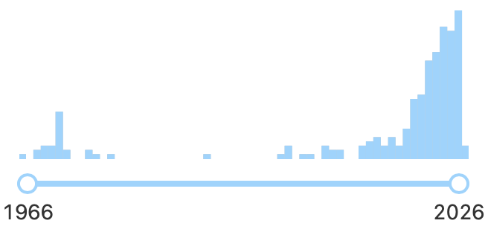
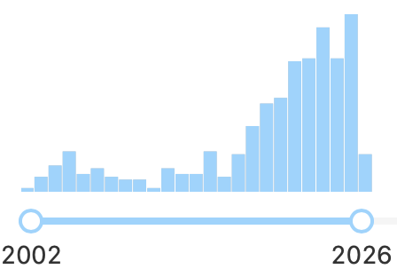
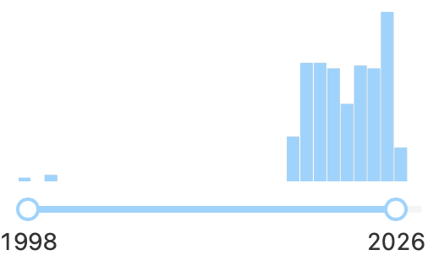
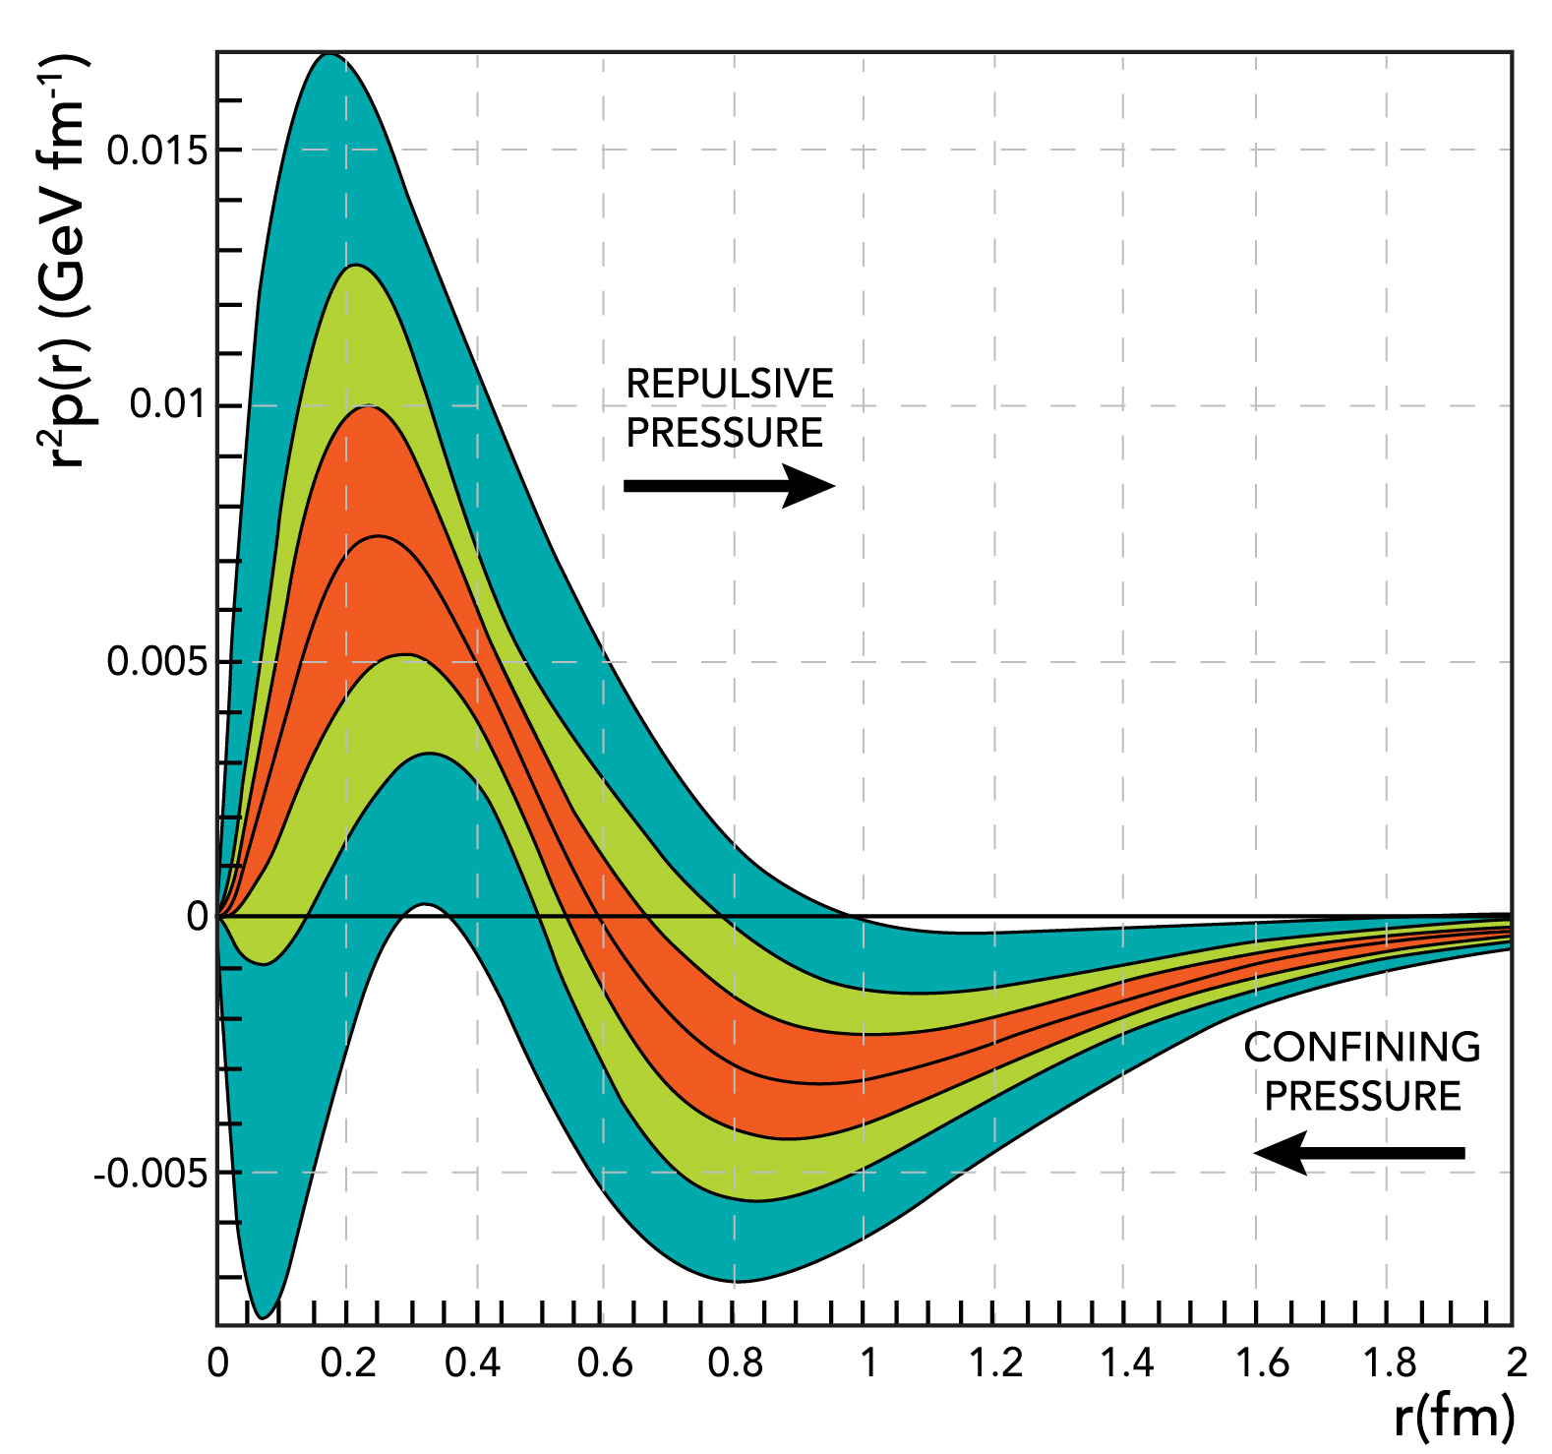
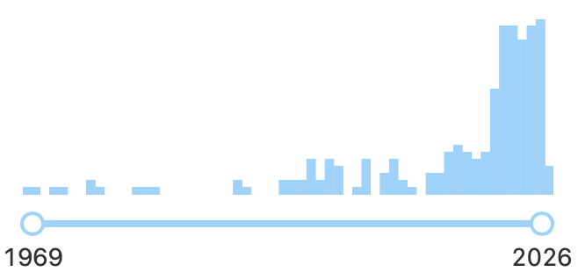
Citations of pioneering theory papers on proton GFF and BEG result
H. Pagels, 1966
M. Polyakov, 2003
2018
470 cit.
2018
248 cit.
Kobzarev, Okun, 1962
Burkert, Elouadrhiri, Girod, 2018
2018
2018
228 cit.
331 cit.
Updated 3/22/2026
Notes:
The impact of these results on the community may be illustrated best by the annual citation rate the experimental paper down right and the effect on the citation rate of the pioneering theory paper on GFF.

Slide 25
Questions for Discussion
LQCD computation for higher order terms in the Gegenbauer expansion of CFFs
Interpretation of radial and sheer stress - is the mechanical stress ~0.250GeV/fm (from DVCS) or is it ~ 1 GeV/fm as from glue flux tube and from Lorentz forces?
Pressure in astrophysical objects
z= x/ξ
C_{H}(t) =

Slide 26
Pressure in the proton and in astrophysical structures
The extreme pressure and forces measured inside the proton has been compared (by us) with the estimated pressure in the core of neutron stars.
While these two pressures are of similar magnitude, their respective origins are completely different
The pressure in the core of neutron stars is the result of external gravity forces in massive, dying stars crushing the atomic repulsive pressure.
The origin of the pressure distribution in nucleons is due to the internal color forces of QCD
→ In black holes, the gravitational pressure may overcome color forces leading to a singularity, i.e. R_{black-hole} = 0.
→ This view has been challenged based on the repulsive pressure in the core of protons.
T-H Pei, The Black Hole with a Finite-Sized Core Structure in: Symmetry 2025, 17, 1431 https://doi.org/10.3390/sym17091431
Notes:
At the end I want to bring up briefly a possible misunderstanding when comparing the pressure inside the proton and the pressure in the core of neutron stars.
These pressures are of similar magnitude and have very different origins.
The pressure in the core of neutron stars is the results of external gravity forces.
The pressure in the proton has it origin in the internal color forces of QVD.

Slide 27
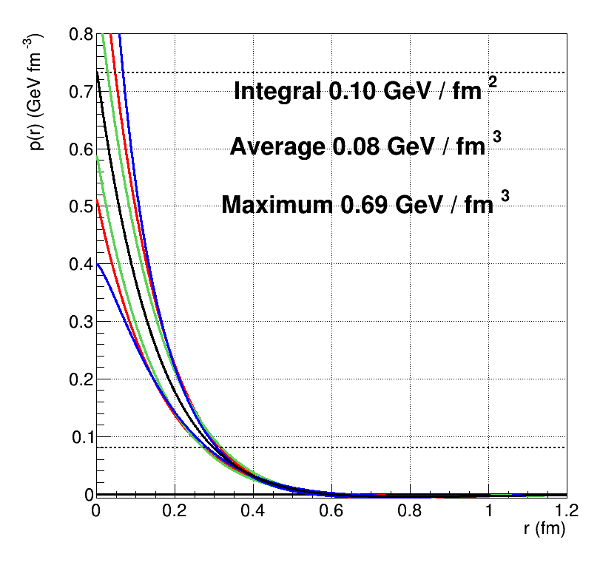
Quark pressure in the proton
Pressure-full range
https://www.nature.com/articles/s41586-018-0060-z
repulsive
pressure
χQSM
Data fit
Peak pressure 0.73 GeV/fm³
confining
pressure
p(0.6fm)
Peak pressure at r=0 corresponds to ~1.2x10³⁵ Pascal

