Slide 1
Jefferson Lab Updates and the Genesis Mission
David J. Dean
Deputy Director for Science and Technology
Presented To:
JLUO Meeting Denver, 2026
March 18, 2026

Slide 2
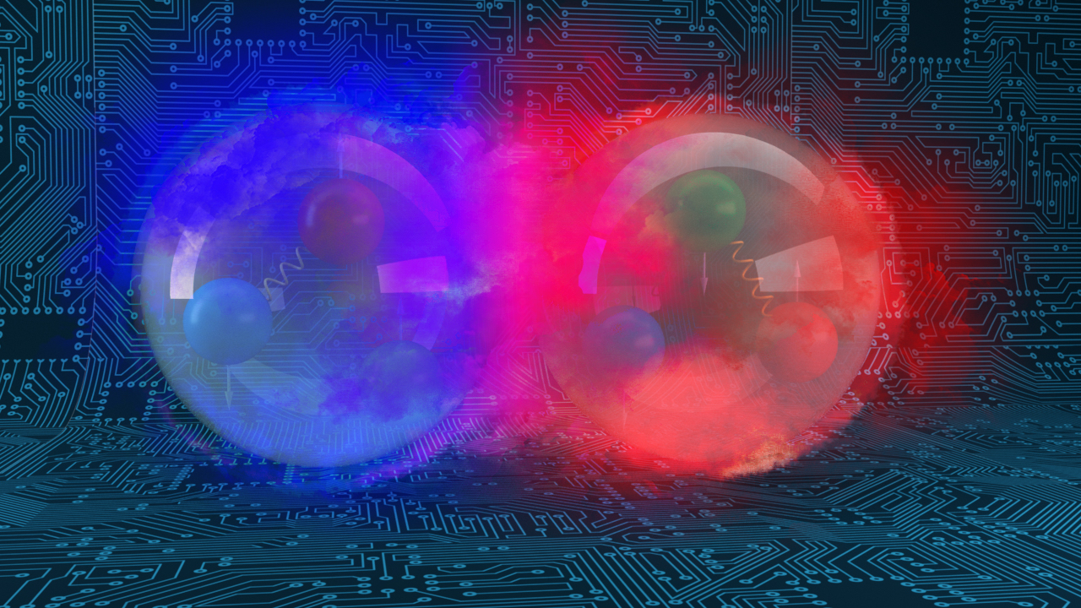
Outline
Brief update on JLab status
Discussion of Genesis Mission activities at Jefferson Lab
Provide an update on AI activities funded through NP, other SC programs, and LDRD funding and the potential short- and long-term benefits to the CEBAF accelerator and CEBAF science program.

Slide 3
News from Jefferson Lab
We await the contract competition outcome
  March 31 is the last possible day for an announcement.
  Transition period of 60 days. New contract starts on June 1.
The contract change will not affect normal operations at the laboratory nor will it affect our mission
We are about ready to start running physics on March 27.
  Low-energy run followed by high-energy run.
We have no information on the FY2027 President’s Budget Request
We look forward to a smooth transition as HEP and NP merge.

Slide 4
Cross cutting team developed a strategy for AI at the Lab
Jefferson Lab’s innovations in AI and data infrastructure lead to
world-leading advances in nuclear physics and scientific computing.
Vision
Data as a Catalyst for AI Innovation
Femtoscale Imaging
Integrated Compute-Detector Systems for Streaming Data
HPDF: Multiscale Data Management Orchestration
HPDF: Reconfigurable Optimization and Design
Autonomous Accelerator Operations
Scientific Opportunities
FAIR Data Interoperability Prototypes
Demonstrate capabilities of streaming readout, AI, and distributed data management for femtoscale imaging
MCC demonstration to showcase measurable improvements in accelerator operations
Strategic Thrusts
R&D projects for automated, optimized resource scheduling
Added Major Benefit: a cross lab team ready to respond to proposal calls

Slide 5
LDRD Program Areas of Emphasis
Move the portfolio toward data science areas

Slide 6
The LDRD Portfolio and Laboratory Strategy (FY 2026)
Holding $300k for 1-2 strategic hires in Data Science
Overall program: $3.7M

Slide 7
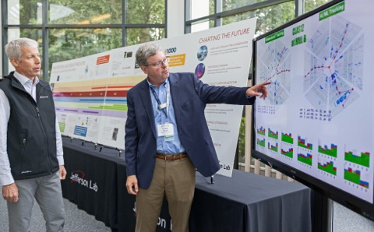
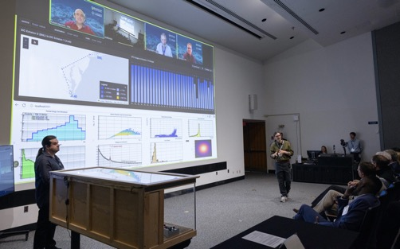
Data Science LDRD Return on Investment
Through the strategic planning in Data Science we built the laboratory team that is ready to pursue American Science Cloud activities
LDRD investment in Data Science:
  FY23: $180k ($2M)
  FY24: $483k ($2.2M)
  FY25: $681k ($2.5M)
  FY26: $1,617k ($3.4M)
American Science Cloud funding (FY26): ~$7.3M (7 of 8 funded proposals)
LDRD ROI (through FY25): 5.43
Many talented scientists: about 20
S&T Leaders: Biven, Lawrence, Baldin, Edwards

Slide 8
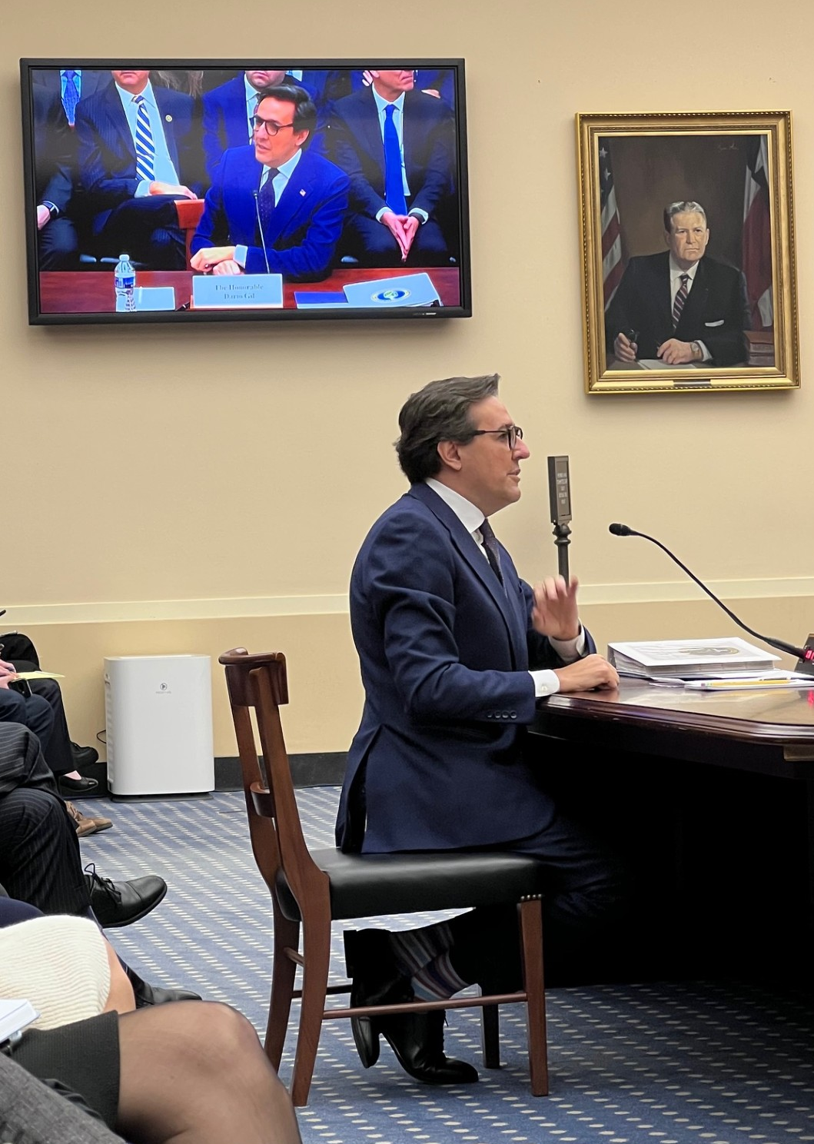
The Genesis Mission: Prioritizing American Science and Technology Leadership
“The Genesis Mission …platform will connect the world’s fastest supercomputers, AI systems, and next-generation quantum computers with the most exquisite scientific instruments and data in the Nation…
This mission embodies our ambition to dramatically accelerate scientific discovery and to significantly increase the productivity and impact of R&D in the United States, which we aim to double within a decade.”
Under Secretary for Science, Darío Gil (December 10, 2025)
From testimony before the House Committee on Science, Space, and Technology
The Genesis Mission will create “…the world’s largest and highest-quality scientific data sets to train the next generation of AI systems"
https://www.energy.gov/science/articles/under-secretary-gils-letter-community
February 25, 2026

Slide 9

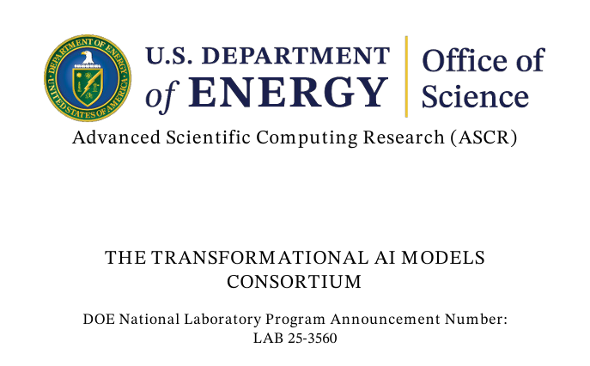
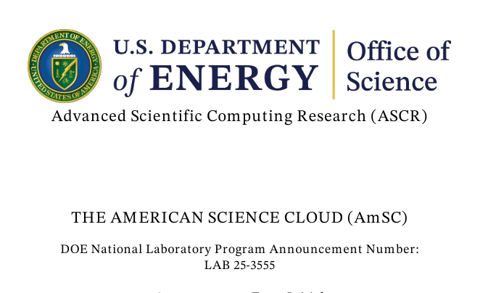
The AI Mission Activities from DOE-SC
Model Teams
Model Teams [will] develop self-improving AI models across various science and engineering domains as part of the consortium. These AI Model teams are expected to span… discovery science and engineering… AI Model Team will be expected to develop an AI technology with state-of-the-art reasoning capabilities in their target domains… AI Model Teams may also develop capabilities for active experimental control for automated laboratories and experiments.
The Transformational AI Models Consortium will mobilize National Laboratories to partner with industry sectors within the U.S. to curate the scientific data of the DOE across the National Laboratory complex so that the data is structured, cleaned, and preprocessed in a way that makes it suitable for use in artificial intelligence and machine learning models; guide the generation of new AI-ready data to accelerate DOE’s mission; develop self-improving AI models for science and engineering powered by DOE’s data and scientific capabilities; and establish best practices for the use of those AI models across DOE’s scientific and engineering enterprise....
LAB 25-3560
The AmSC will serve as the enabling software and hardware infrastructure for DOE’s AI data and model development efforts in furtherance of SC’s mission and in fulfillment of Section 50404 of the OBBB Act.
LAB 25-3555

Slide 10
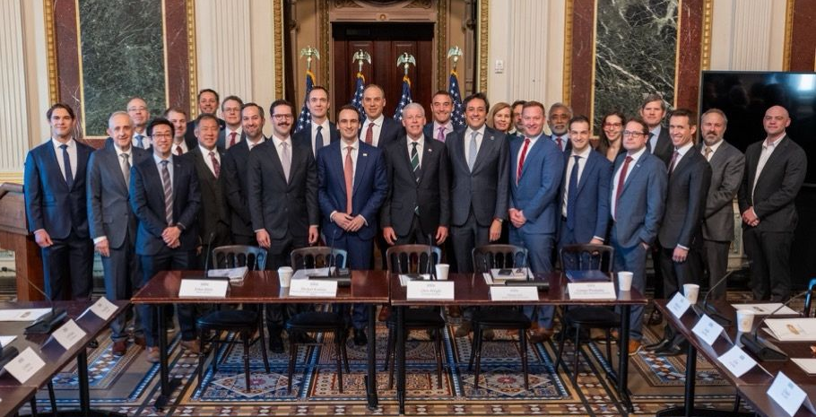
Partnerships are Critical to the Success of Genesis
Public-Private Collaboration is
essential for scaling AI infrastructure.
Partnerships are mutually beneficial:
Access to AI models
Shared HPC resources
Workforce development
Challenges --> Opportunities:
Moving at the speed of business
All-lab collaborations, working from the same pages (literally)
Open science = open doors – understanding risk and reward
Notes:
Guidelines: 6-8 bullets per slide; Use sentence fragments for bullets

Slide 11

JLab has important roles at all levels of Genesis
AI for Particle Physics and Cosmology
AI for Accelerators
Model Teams
Leadership in Data, Workflows, AI Safety, & Industry Partnerships
Scientific User Facilities (incl. CEBAF)
HAIDIS
(Hardware-enabled AI Distributed Inverse Solver)
QCD (FemtoMind)

Slide 12
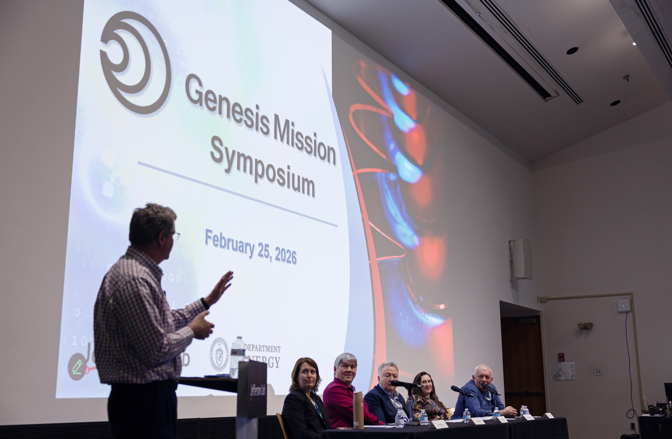
Lab wide Genesis symposium – ~160 participants

Slide 13
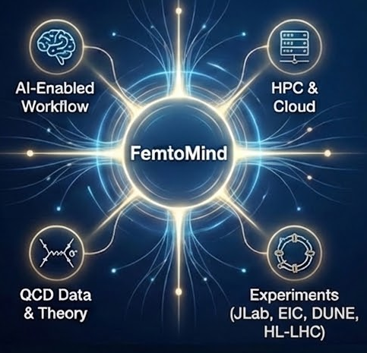
Core idea of the FemtoMind Project
Develop a scalable, cloud-native computational interface for QCD phenomenology:
Integrate global analyses, perturbative & lattice QCD, and related toolkits into a unified, AI-enabled workflow for femtoscale science
Transformative impact
Lower barrier to HPC, accelerate theory-data integration, and enable community-wide access
Supports DOE Missions:
HEP & NP programs, and major experiments (JLab, EIC, DUNE, HL-LHC)
Notes:
Guidelines: 6-8 bullets per slide; Use sentence fragments for bullets
To change the photo: Right-click on photo and select change photo

Slide 14
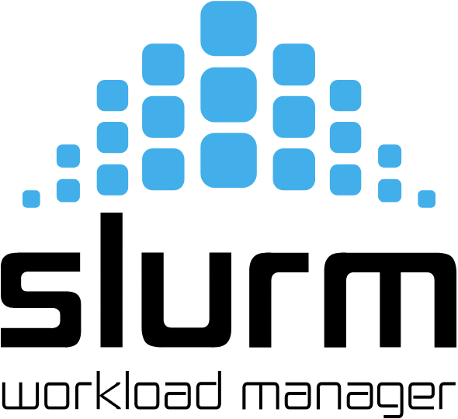
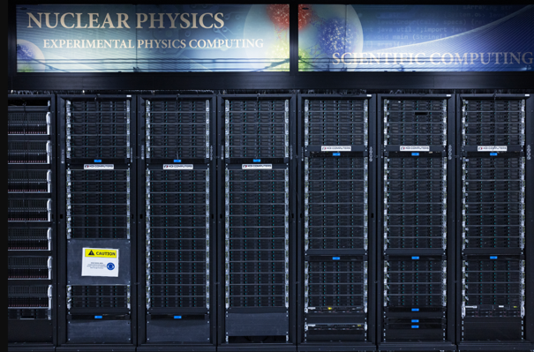
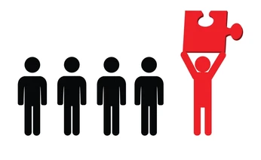

sssss
The QCD theory infrastructure of today …
The rate of data availability is faster than theory/pheno analysis
Bottlenecks are limiting scalability of non-linear workflows
Typically one person takes the heavy lifting of the end-to-end analysis (grads, pdocs) supervised by staff
Unable/impractical to reproduce the end-to-end analysis
Theory/pheno analysis take multi-years to complete
Overall, small bandwidth to process research opportunities
Impact studies for new experiments
New theory calculation available
New experimental
data to analyze
Research Opportunities
-----------------------
Research plan
Submit computing tasks
Queue
Jobs @ HPC
Typically multiple computing campaigns lead by one key person
Code/analysis setups per computing campaign
Days/weeks to process depending on resource availability
Multi days to weeks of compute processing availability
analyze results, make plots, consistency checks, only doable by expert domain scientist

Slide 15



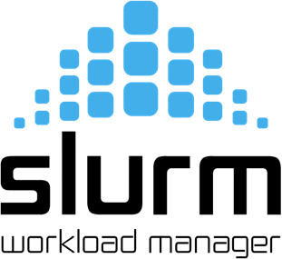

sssss
The QCD theory infrastructure of tomorrow
AI will help with designing the research plan (co-scientist)
AI will prep all the codes/setups for large scale computing (codex)
AI will match the compute task to resource availability
AI will remove the need of having ONE person leading the end-to-end analysis
AI agents will learn from domain scientist how to reproduce the end-to-end analysis
AI will make analysis take less time to complete
AI will increase the bandwidth to process research opportunities
Impact studies for new experiments
New
theory calculation available
New experimental
data to analyze
Research Opportunities
-----------------------
Research plan
Submit computing tasks
Queue
Jobs @ HPC
Everyone will be contributing
Code/analysis setups per computing campaign all orchestrated by AI
AI optimizes queue process by matching the computing needs to hardware availability
Multi days to weeks of compute processing availability
analyze results, make plots, consistency checks, only doable by expert domain scientist

Slide 16
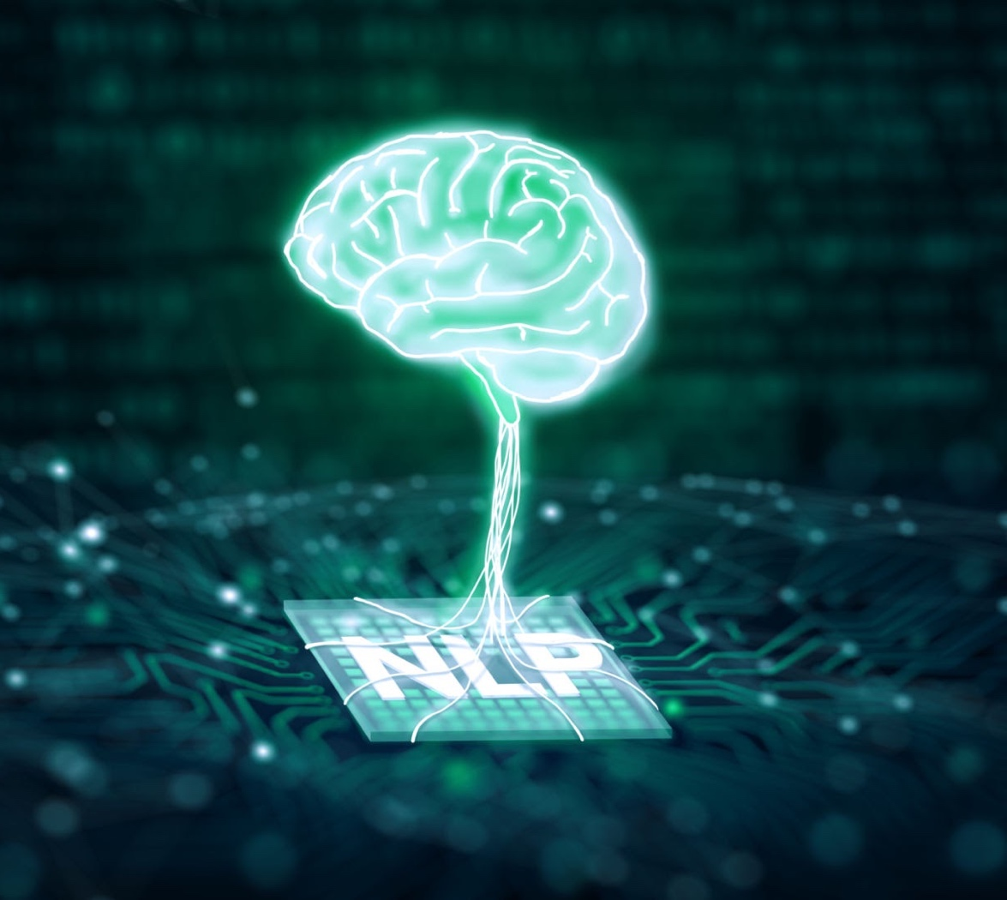

AI-ready infrastructure for QCD Discovery Science
AI research assistant
(Google co-scientist, Argoloom,
URSA)
Our project scope:
LQCD simulation MCP server: Chroma, Grid, ...
pQCD MCP server: collection of curated numerical libraries
QCD data/simulation database: LQCD gauge simulation,
experimental data from experiments
Agentic workflows: slurm orchestrator, data transfer …
First MCP for HPC proxy running!
Compute Orchestration
QCD Discovery Science
Femtoscale imaging,
BSM searches,
Prediction of rare processes,
Origin of confinement and visible matter,
Critical inputs for HNP experimental program (LHC/DUNE/CEBAF…)

Slide 17

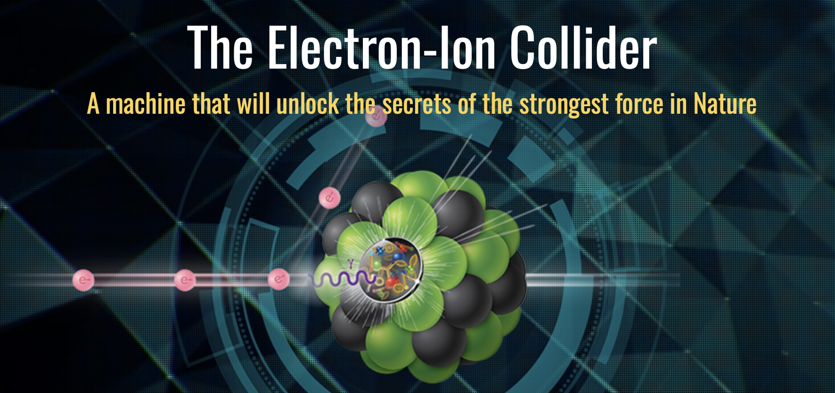
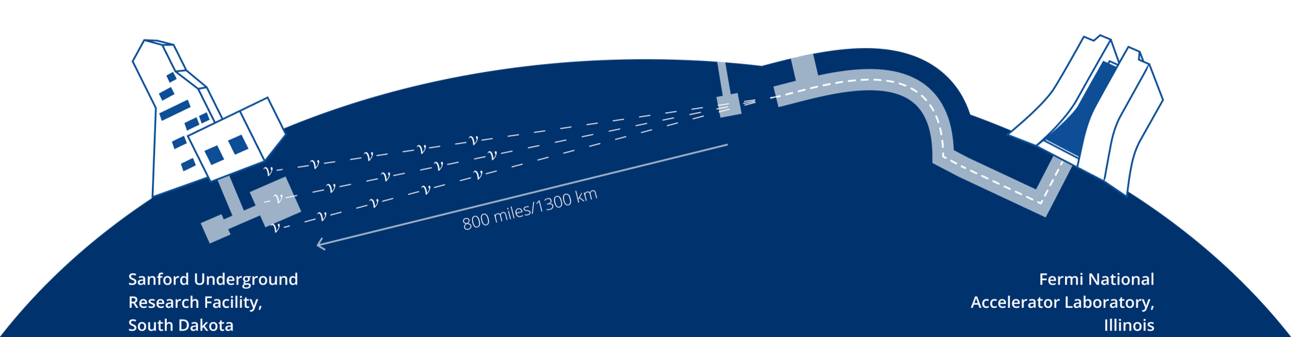
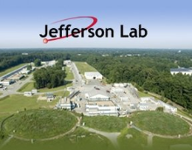

QCD AI Infrastructure for the Intelligence Frontier
New frontiers in high-energy/nuclear physics (e.g. many-particle systems) come within reach

Slide 18
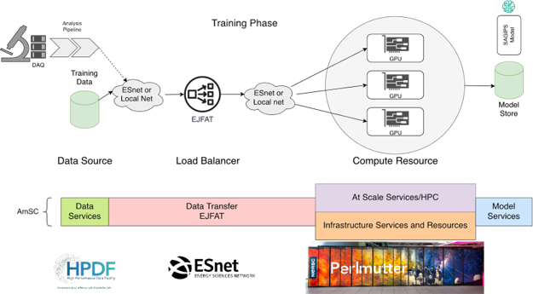
Hardware-Accelerated AI-Based Distributed Inverse Solver
Motivation
Extracting fundamental physics observables from large-scale nuclear physics data sets is time consuming, typically tailored to one specific experiment, and invasive of the data set.
Approach
Combine streaming data service (EJFAT) among different facilities with scalable inverse problem solver (SAGIPS)​.
Efficiently feed continuous data stream into solver.
Explore solution space via generative AI.
Use full computational representation of experimental pipeline​.
Impact
Extract physics observables non-invasively.​
Analyze multiple datasets across facilities simultaneously. ​
Reduce time to scientific discovery across domains while enhancing the quality of extracted results.
Schematic representation of HAIDIS: Data coming from an experiment located at Jefferson Lab is sent via EJFAT to Perlmutter where SAGIPS extracts unknown observables
S&T Challenge
Aligns with “Unifying Physics from Quarks to Cosmos”

Slide 19
JLab has important roles at all levels of Genesis
AI for Particle Physics and Cosmology
AI for Accelerators
Model Teams
AI Accelerator Control
Leadership in Data, Workflows, AI Safety, & Industry Partnerships
Scientific User Facilities (incl. CEBAF)
HAIDIS
(Hardware-enabled AI Distributed Inverse Solver)
QCD (FemtoMind)
Todd’s role in Genesis today: PI for NARAD (Nuclear AI-Ready Accelerator Data), a funded AmSC Data Provider Project
Close relationship with MOAT (Multi-Office Accelerator Team), a funded ModCon Model Team; NP/JLab POC Chris Tennant

Slide 20
American Science Cloud (AmSC) and NARAD
https://american-science-cloud.github.io/amsc-site/
AmSC will be a secure, federated, and science-optimized cloud infrastructure
  integrates DOE computing, experimental facilities, data resources, and networks
AmSC will provide:
  Data Services: FAIR and AI-ready assets
  Model Services for science discovery
  At-Scale Computing Services: DOE leadership-class computing access for
  extreme-scale model training and inference
  Infrastructure Services: Secure, uniform, federated access to compute, storage, and networking across DOE and cloud partners.
NARAD: Nuclear AI-Ready Accelerator Data
Long-Term Objective: Make DOE accelerator facility control and operations data interoperably “AI-Ready”
Develop
  Middle layer abstraction infrastructure
  Associated standards for accelerator description, interrogation, operations, and ontology
Managed through DOE NP, with partners
in BES and HEP (BNL, LBNL, PNNL)
Fundamentally synergistic with MOAT
  MOAT will provide the AI/models that use NARAD

Slide 21
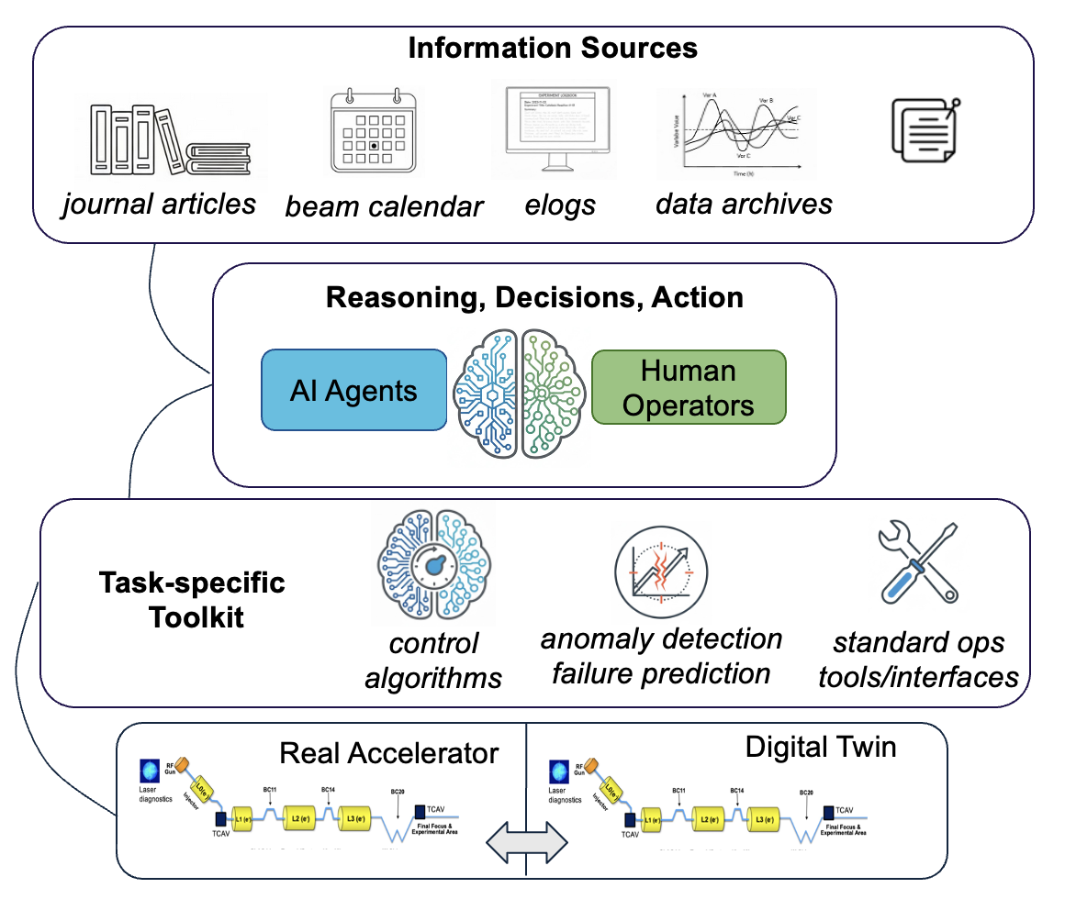
MOAT, NARAD, and Accelerator Operations
Agentic AI workflows
Operator Q/A (backend interface to information sources)
Verbal triggering of tasks (e.g. tuning tasks)
Report generation tools (metrics, shift summary)
Access and use other tools (e.g., monitor accelerator performance → trigger AI/ML subsystem optimization)
Digital twins with physics and AI/ML models
Insight into operation (virtual diagnostics, speculative tuning)
Continual adaptation to maintain accuracy
Enable precise model-based control, rapid setup / stabilization (e.g., feedforward corrections, RL)
AI/ML tools for individual tasks
AI/ML optimization/control
Anomaly detection (e.g. JLab SRF experience)
Slide credit: MOAT Team

Slide 22
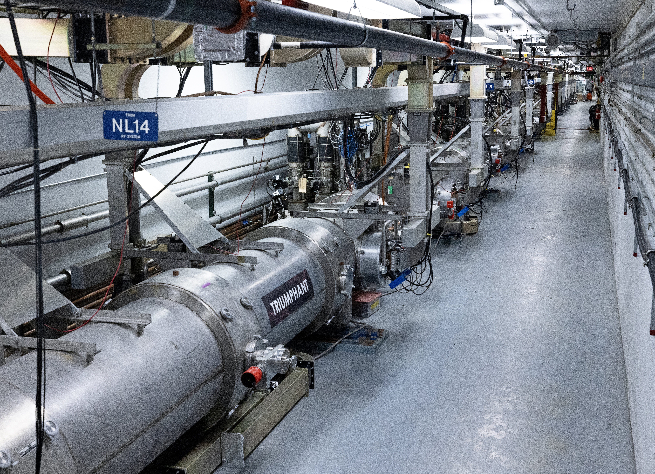
Unleashing AI for More Powerful and Efficient Particle Accelerators
Motivation
Powerful research particle accelerators provide insight into our visible universe, but these highly sophisticated machines are difficult to operate and maintain at peak efficiency.
Approach
Identifying and predicting faults before they interrupt operations.
Lowering levels of a damaging type of radiation.
Load-balancing components to prevent anomalies.
Impact
Increasing uptime and reliability of research accelerators.
Revolutionizing design of next-gen machines for applications in medical care, materials science, and energy production.
S&T Challenge
Aligns with “Enhancing Particle Accelerators for Discovery” and "Unifying Physics from Quarks to the Cosmos"
Three of the nation’s most powerful particle accelerators rely on superconducting radiofrequency (SRF) accelerator technology, including the Continuous Electron Beam Accelerator Facility, shown here. This research is ensuring such machines operate at peak efficiency now and into the future.

Slide 23
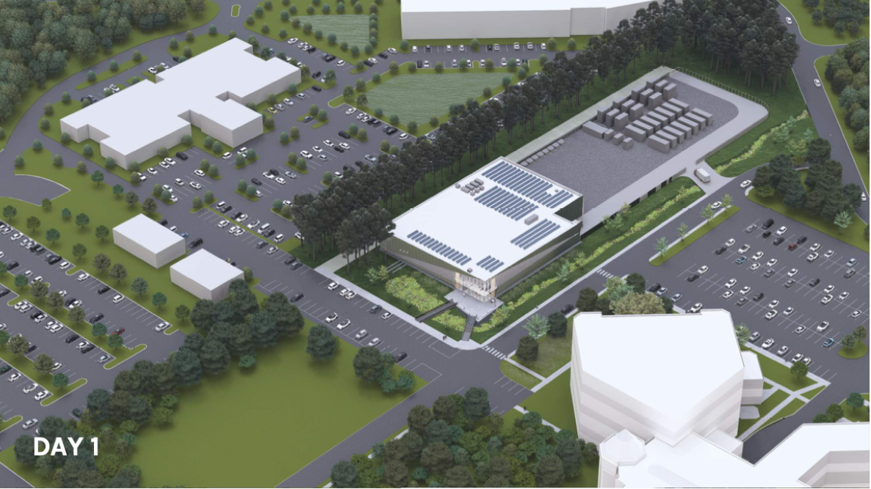
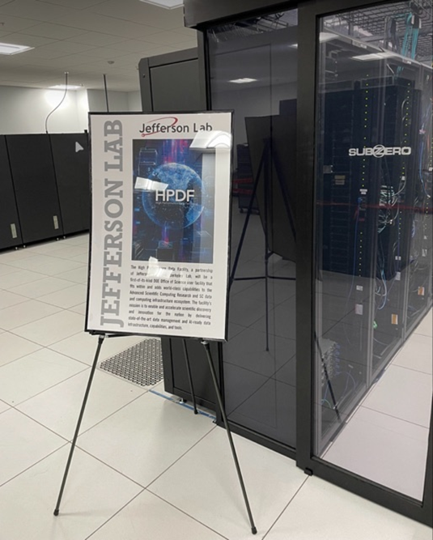

HPDF and Genesis
Notes:
Guidelines: 6-8 bullets per slide; Use sentence fragments for bullets

Slide 24
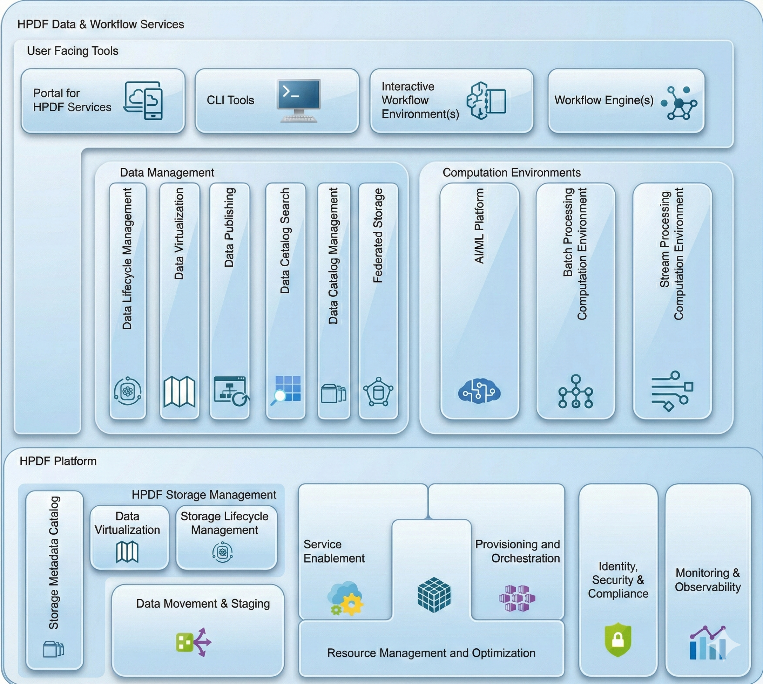
What is the HPDF Project
Project to develop the software and hardware infrastructure for a data focused ASCR facility
Envisaged as a distributed facility across many sites with a resilient two site “hub” providing key tools and services upon which science relies
We are at the pre-CD-1 phase of the project
Developing and documenting conceptual design (high level sw design is on the right)
Requirements gathering and partnerships to refine design and scope

Slide 25
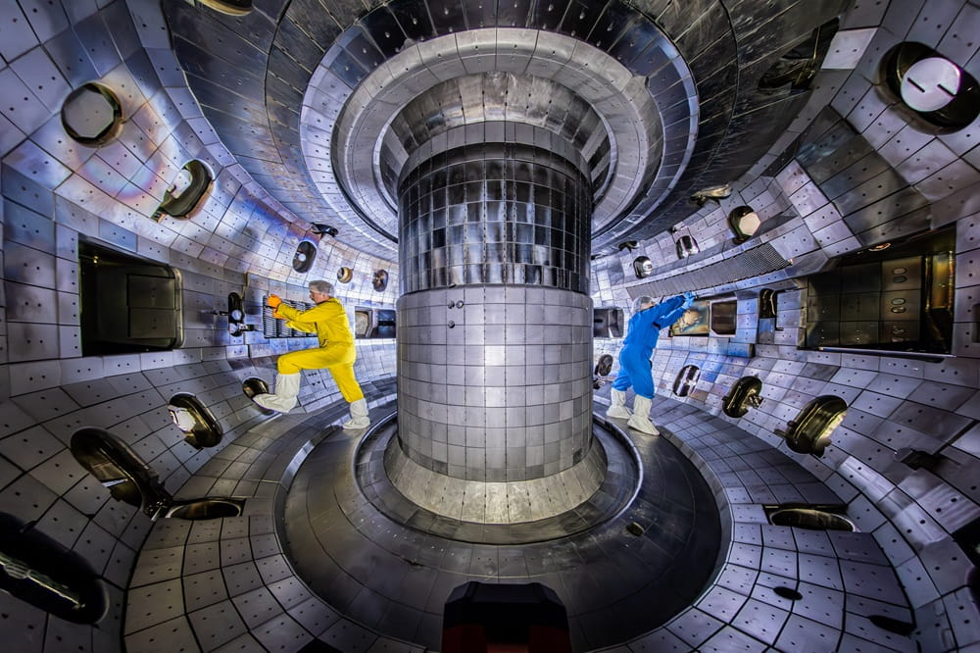
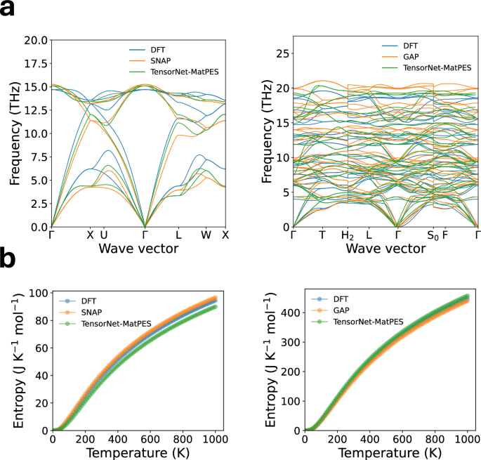
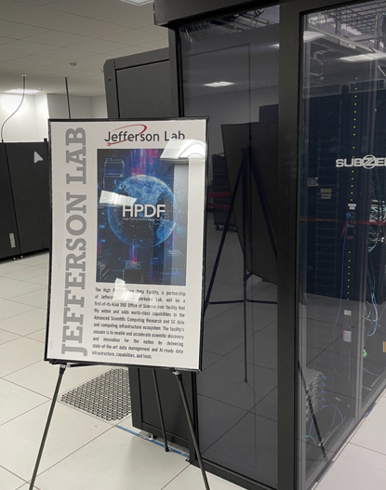
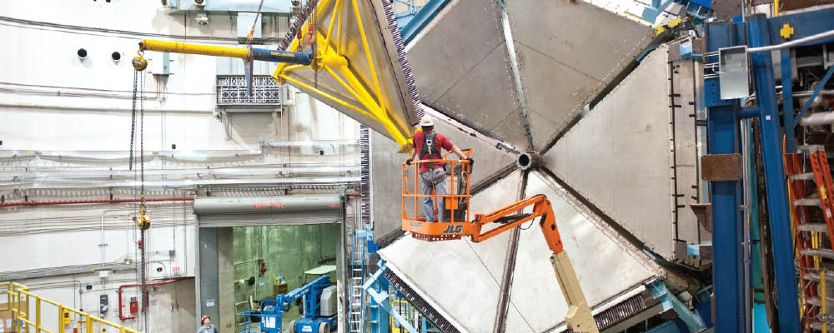
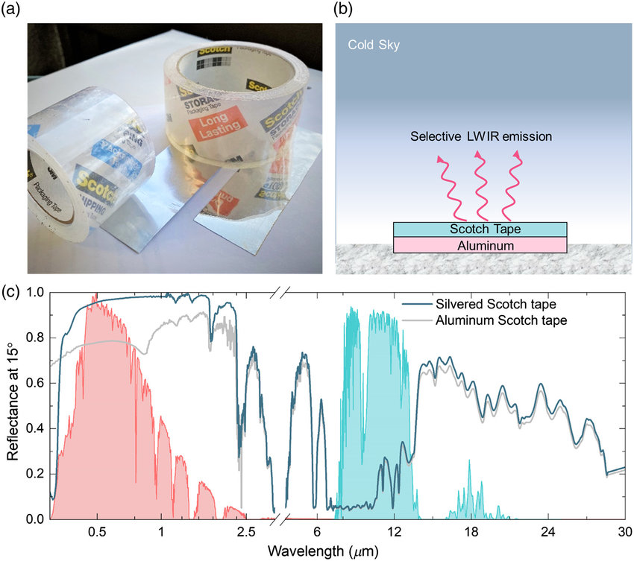
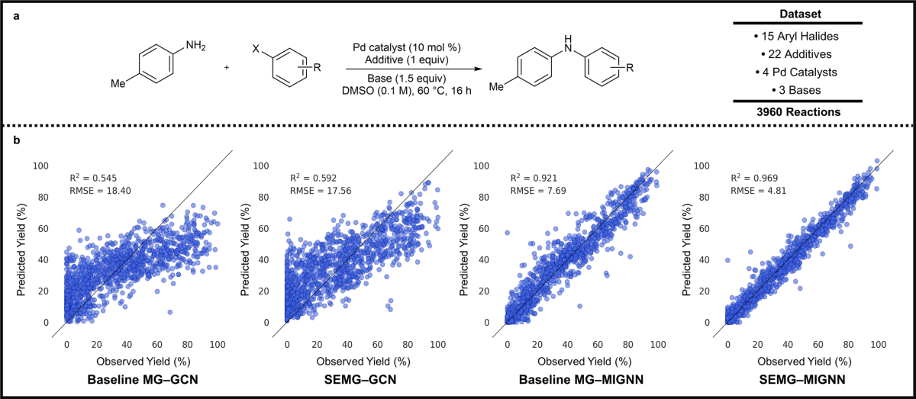
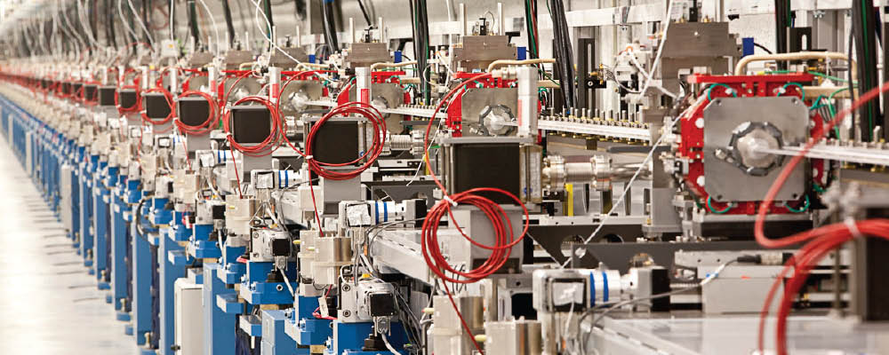
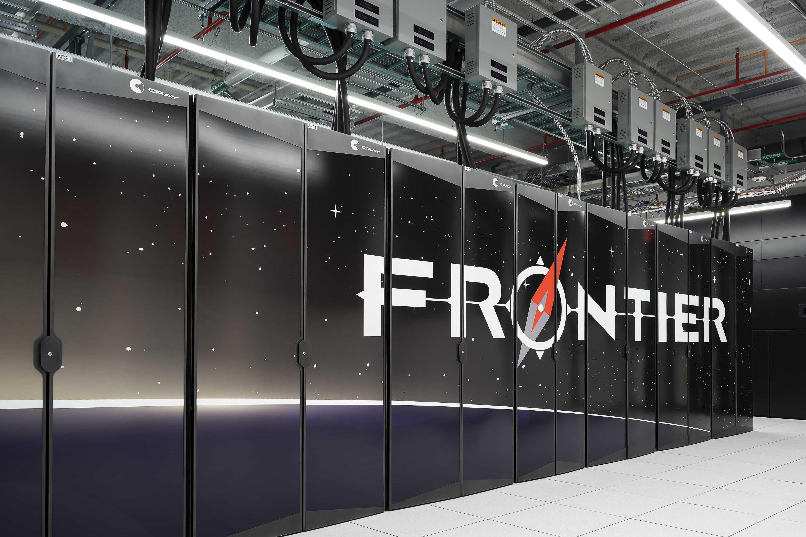
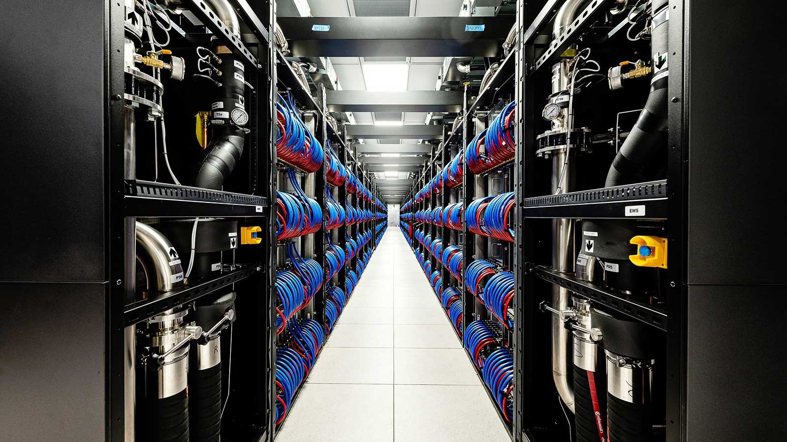
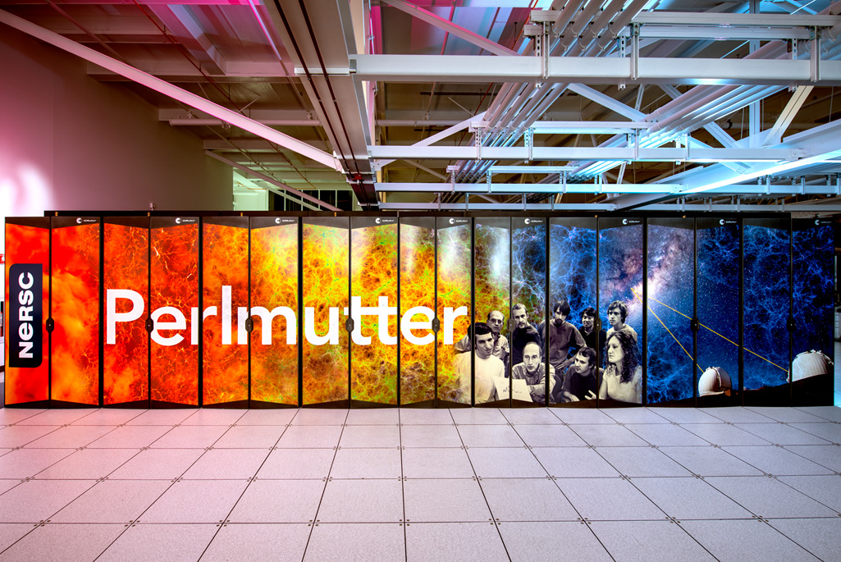
HPDF Provides Data Services and Integration
HPDF Data & Workflow Services
HPDF Platform
Impactful Science
Office of Science Facilities
(28 total)
ASCR Computing Facilities
HPDF seamlessly integrates secure, agile, and distributed hardware at scale into a user-centric data infrastructure
The combination ASCR facilities (including HPDF) provides an AI powerhouse for DOE science instruments and facilities

Slide 26
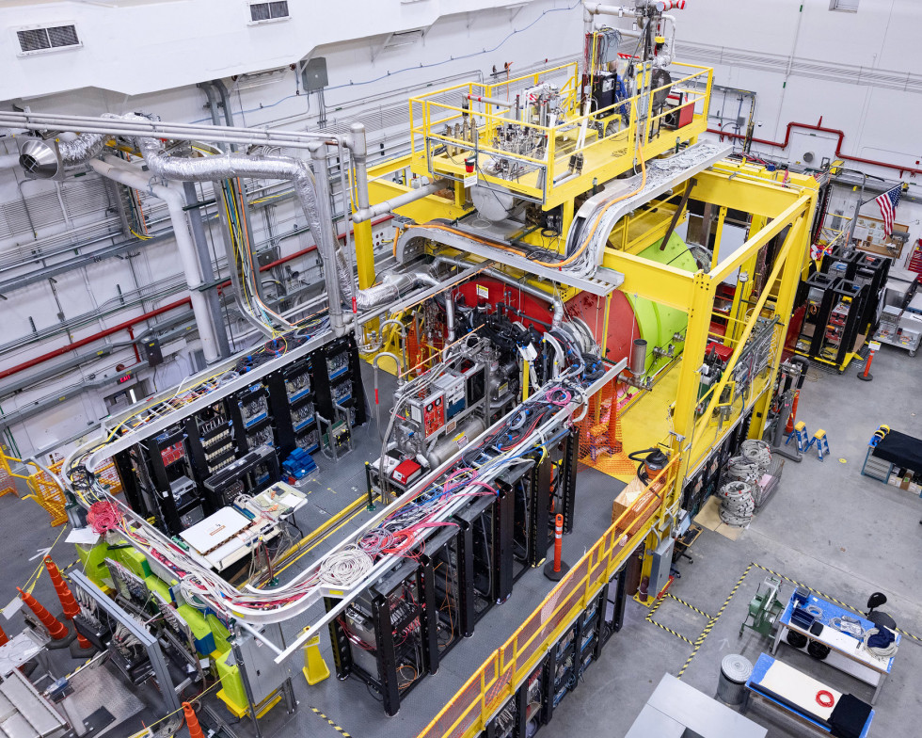
Automating Particle Detector Calibration with RoboCDC
Motivation
Drift Chamber detectors are a core technology used in accelerator-based nuclear physics experiments, but accelerator beam and atmospheric conditions affect their operation.
Approach
Automate fine adjustments of the detector's high voltage input using AI to stabilize operation, vastly reducing the need for calibration of the data after it is acquired.
Impact
Calibration time for the GlueX Central Drift Chambers reduced from months to moments.
Better data stability along with a reduction in latency between data acquisition and physics analysis.
S&T Challenge
Aligns with "Achieving AI-Driven Autonomous Laboratories" and "Unifying Physics from Quarks to the Cosmos"
The GlueX Central Drift Chamber (installed inside the cylindrical red and lime-green magnets) enable studies of the particles and forces that build our visible universe.

Slide 27
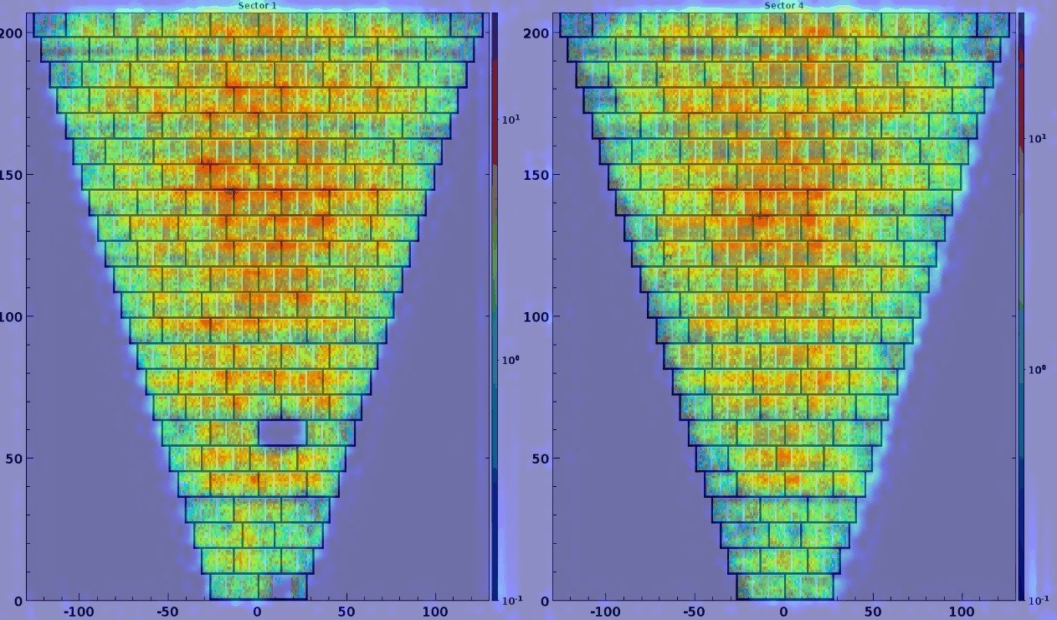
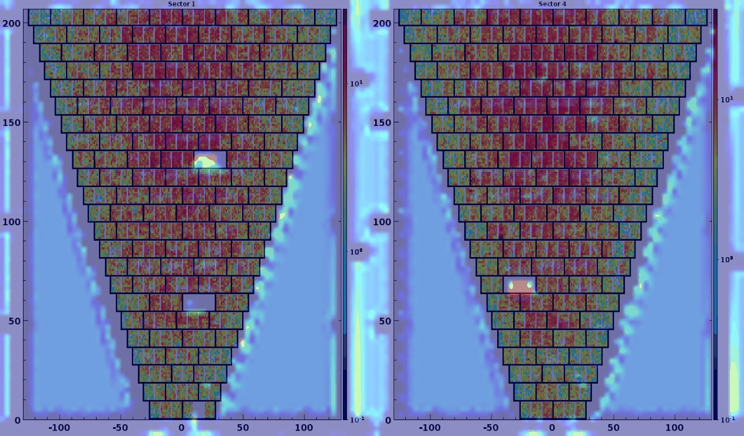
AI Data Quality Monitoring with Hydra
Good Monitoring Image
Motivation
Collection of high-speed experimental nuclear physics data must be monitored to ensure proper particle detector operation during valuable research accelerator beam time.
Approach
Train AI models to view monitoring plots to detect anomalies with high precision and at high rates.
Visually identify location of anomalies by inspecting inner layers of AI models.
Impact
Problems identified much quicker (minutes vs. hours) and much more consistently compared to current monitoring.
Allows scientists to focus on new data rather than operations.
S&T Challenge
Aligns with “Achieving AI-Driven Autonomous Laboratories” and "Unifying Physics from Quarks to the Cosmos"
Bad Monitoring Image
The Experimental Physics Software and Computing Infrastructure (EPSCI) group develops and maintains Hydra, an AI-driven monitoring framework for image-based data quality management in particle accelerator and experimental facilities.

Slide 28
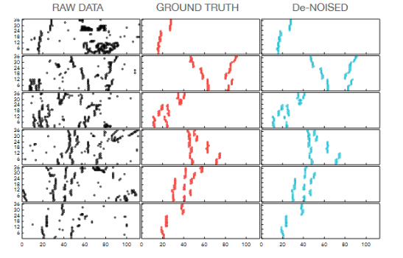
Clean Particle Tracking in Nuclear Physics Experiments
Motivation
In nuclear physics experiments, sensitive particle detectors collect hits from both real particles and so-called background particles that are not of interest. It is imperative to remove these background hits for maximum efficiency and resolution.
Approach
Train an AI auto-encoder model to filter identified background hits, while allowing all real signal hits from tracks to pass.
Identify real particle tracks through the detector using a second AI model.
Impact
Delivers cleaner data sets for analysis, saving research time.
Strengthens the link between AI model development and scientific outcomes.
S&T Challenge
Aligns with "Unifying Physics from Quarks to the Cosmos"
These data plots show what the raw data look like compared to real signal hits as cleaned manually by a nuclear physicist (orange) and the same raw data that have background hits removed by a trained AI model (teal).

Slide 29
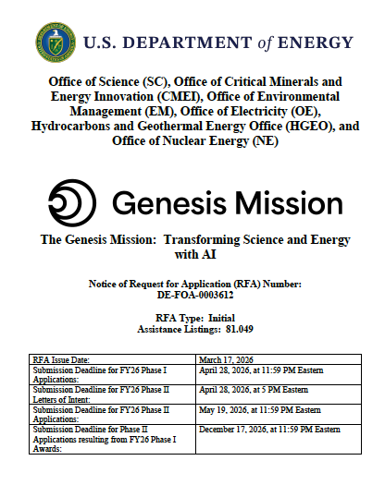
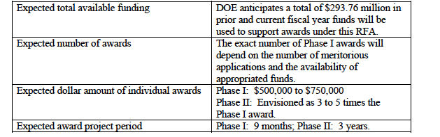
Genesis Call
Institution can lead one proposal per focus area. Can partner on many
Focus areas where NP is involved:
  Quantum Advantage for nuclear and hadronic systems
  AI for control of quantum systems
  AI for quantum imaging and sensing
  AI driven accelerator facilities
  Foundational models of particle interactions and particle physics
  Expedited discovery from high-complexity and petascale data sets
Please contact Doug, Jianwei, Mike Spata, Laura Biven if you would like to lead a proposal and have JLab as partner

Slide 30
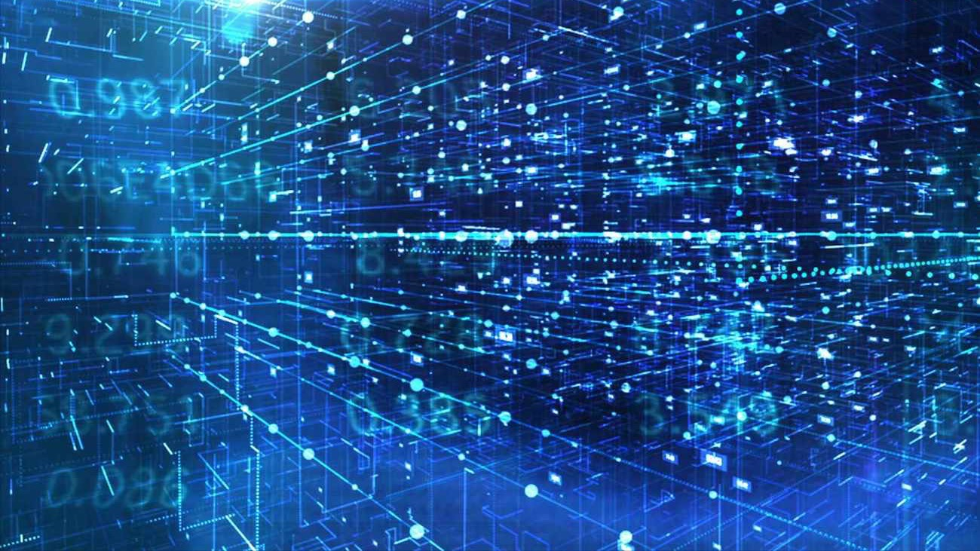
Discussion

