Slide 1

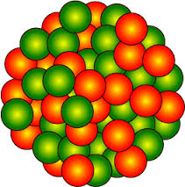


Anti-Shadowing Exploration Opportunities with F₂^{A}
N. Kalantarians (Virginia Union Univ.)
FemtoWorkshop 24 July 2026
*Work supported by NSF Award 2310076

Slide 2
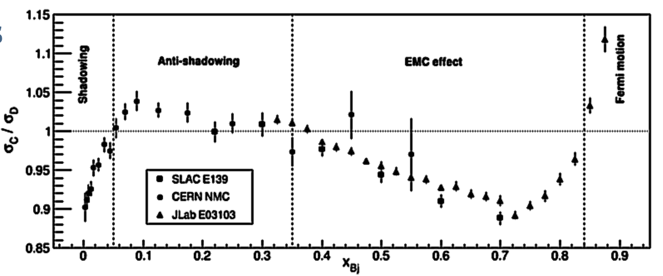
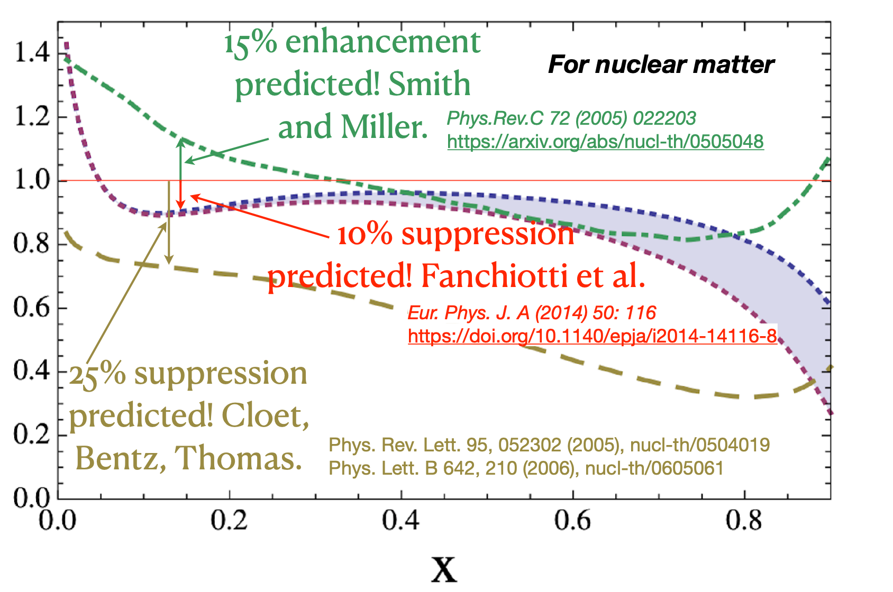
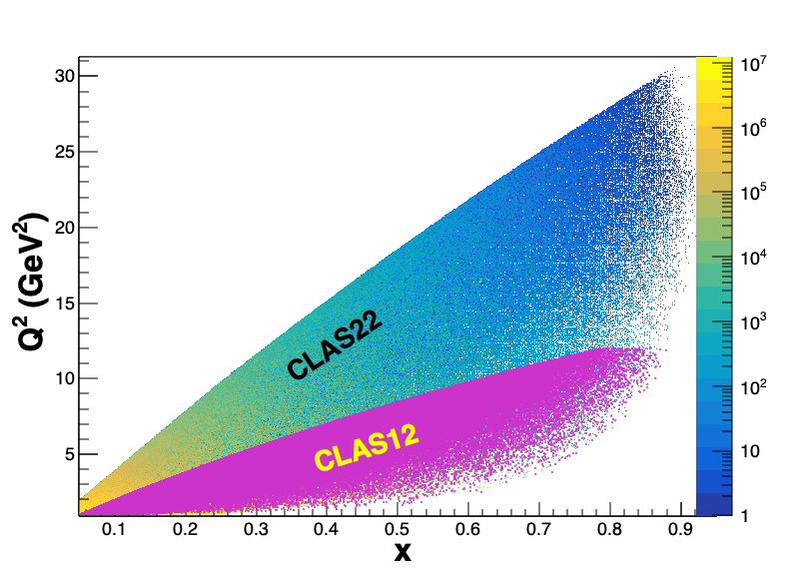
Anti-shadowing: solving a multi-decade puzzle
Small!
With ~20 GeV e- can access the anti-shadowing region (x~0.1-0.3) at moderate Q²
Region extremely interesting, near-equally dominated by valence quarks, sea-quarks, and gluons → many many models!!
Anti-Shadowing is the least studied nuclear structure function effect experimentally – small effect requiring precision and high luminosity
  flavor dependence essentially uncharted
  spin dependence essentially uncharted (~50% differences in predictions)
  no tagged measurements
  no L/T separations
Theory predictions for polarized structure function A/D ratios
A rigorous testing ground between shadowing, EMC regimes – models and theory must describe ALL
2

Slide 3
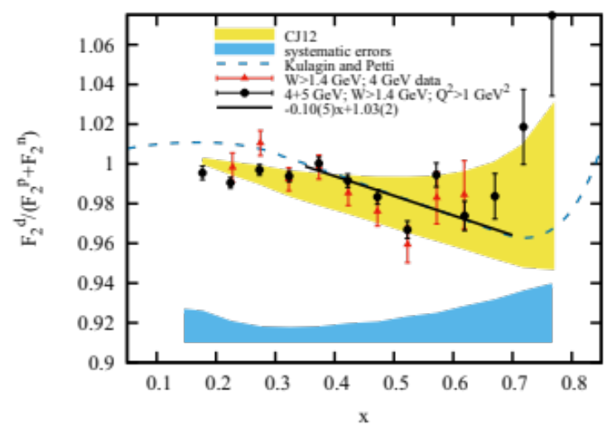
EMC Effect and Nuclear Dependence
Phys. Rev. C 92 015211 (2015)
Representative EMC Ratio
BONuS6
Seen numerous times.
Deuteron also has a nuclear dependence

Slide 4
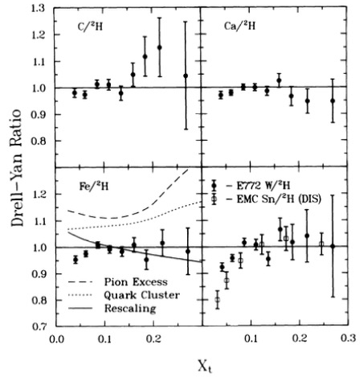
EMC and Anti-shadowing
PRL 64, 2479 (1990)
Hard probe with x in the anti-shadowing region is sensitive to the inter-nucleon distance in a nucleus. J. Qiu, 2023 Workshop
A hard probe at small-x can interact with multiple nucleons (partons from multiple nucleons) at the same impact parameter coherently
No anti-shadowing seen in sea quarks (DY, E772): strong flavor dependence? Calculations needed!

Slide 5
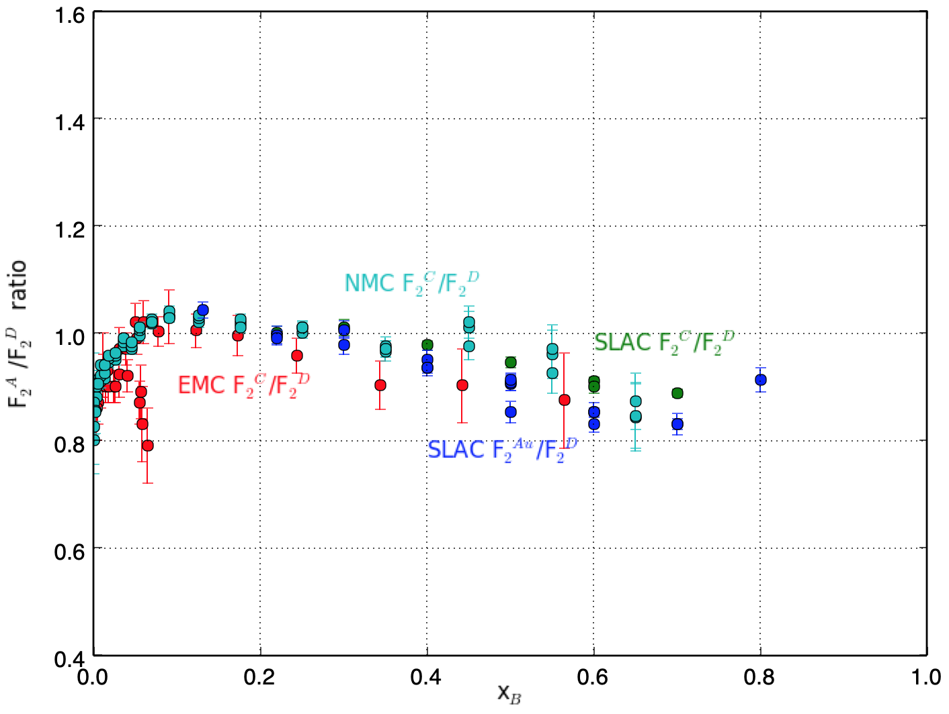
EMC data-mining effort
Cuts: Q² > 2 GeV/c², W² > 4 GeV²
SLAC (E139) published cross-sections – Phys. Rev. D 49 4348 (1994).
Used R1990* parameterization (assumes no nuclear dependence of R) to obtain F₂^{A}.
* L. Whitlow, et al., Phys.Lett.B 282 (1992)
Phys. Rev. C 103 015201

Slide 6
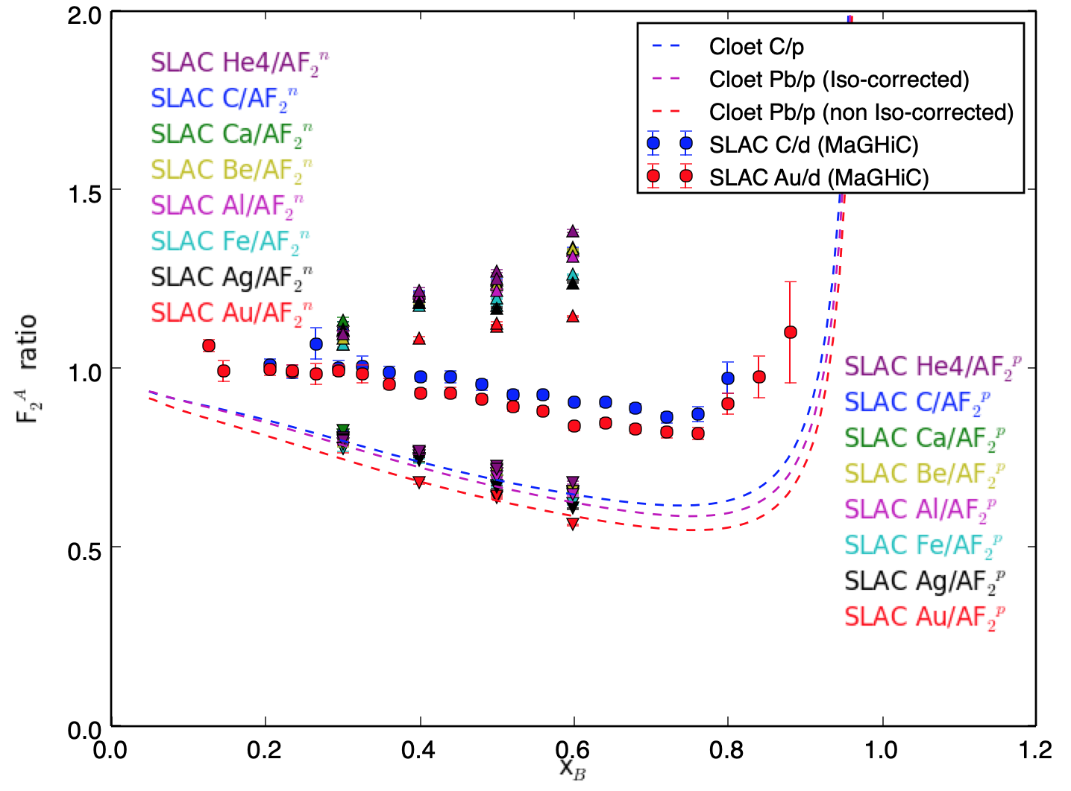
F₂^{A}/F₂^{N} ratios per nucleon
We don’t apply iso-scalar corrections for this analysis.
Theory curves from I. Cloet.
F₂^{p} from NMC parameterization. Checked with CJ15 fit.
F₂^{A}/ F₂^{p} seem to agree with theory.
F₂^{A}/ F₂^{n} seem to have broader spread between nuclei.
Expect some spread with nuclear asymmetry.
“MaGHiC” Intl. Journ. Mod. Phys. E 23 8 (2014).
F₂^{A}/F₂^{N}
F₂^{A}/F₂^{n}
F₂^{A}/F₂^{d}
F₂^{A}/F₂^{p}
Phys. Rev. C 103 015201
x_{B}

Slide 7
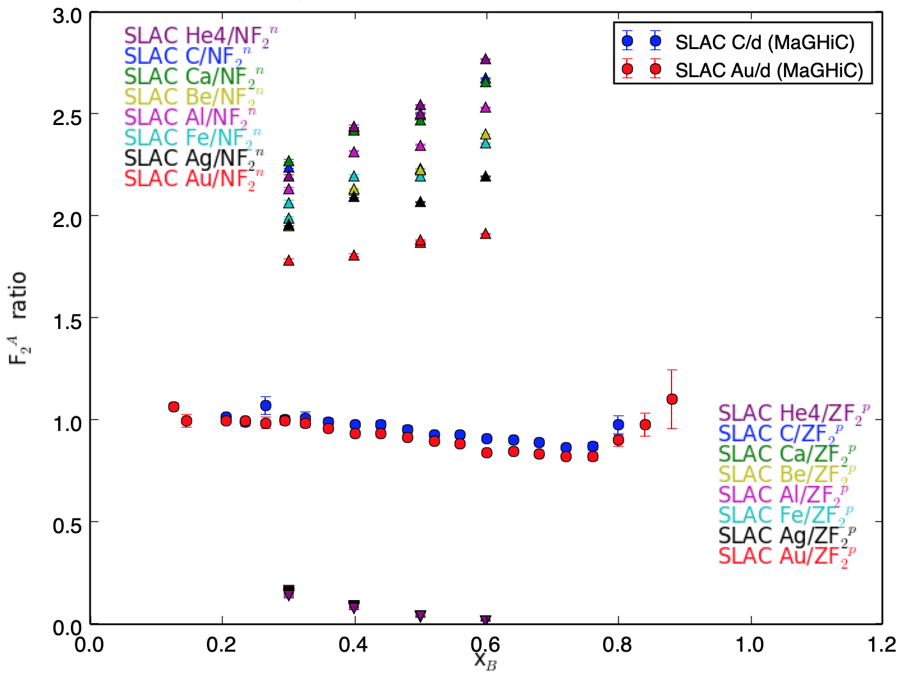
Comparing F₂^{A} per free neutron, proton.
Typically observed nucleon spread.
Starts below 1; approximately 10%.
Large spread in A/n compared to A/p
Expect some spread with nuclear asymmetry.
“MaGHiC” Intl. Journ. Mod. Phys. E 23 8 (2014).
F₂^{A}/NF₂^{n}
F₂^{A}/F₂^{d}
Phys. Rev. C 103 015201
N = A - Z
F₂^{A}/ZF₂^{p}

Slide 8
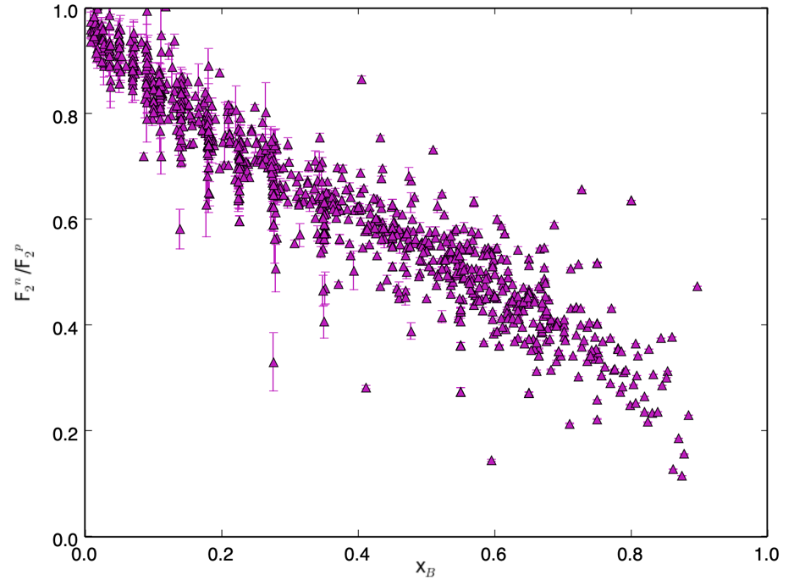
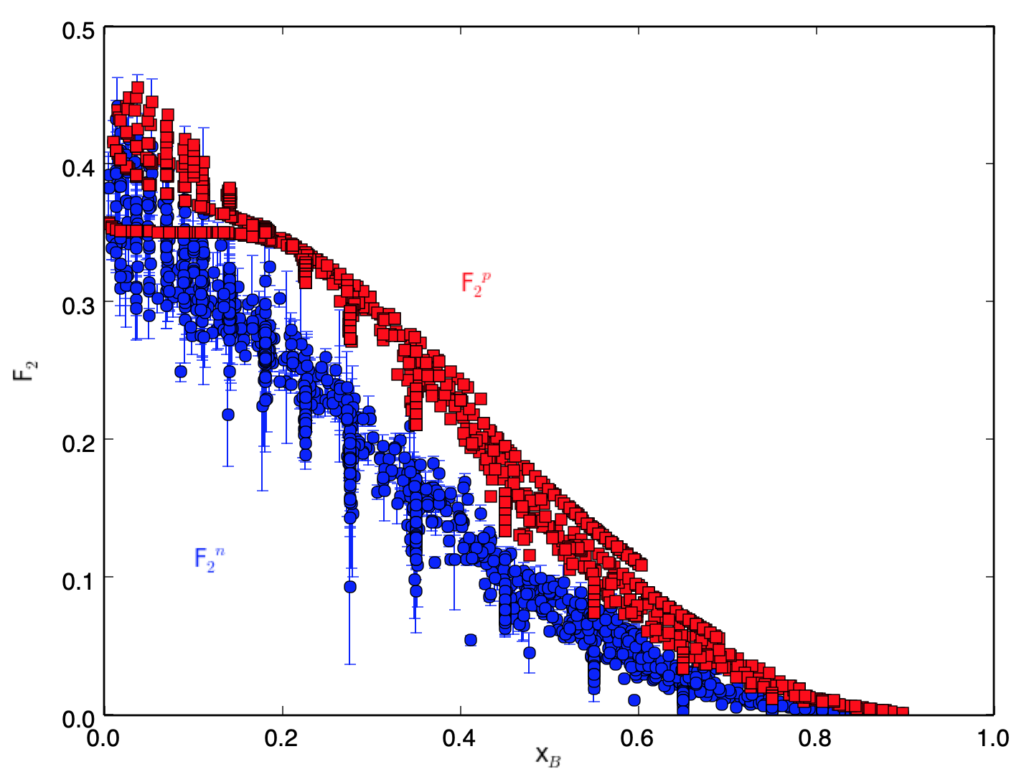
Looking at F₂^{n}/F₂^{p} via data
F₂
F₂^{n}/F₂^{p}
F₂^{p}
F₂^{n}
x_{B}
x_{B}
F₂^{n} from world data: S. Li’s analysis using CJ15 nuclear corrections for deuteron Phys. Rev. D 93 114017 (2016). Data publication being drafted.
F₂^{p} (at same x and Q²) using SFTM - J. Phys. G 35 053101 (2008).

Slide 9
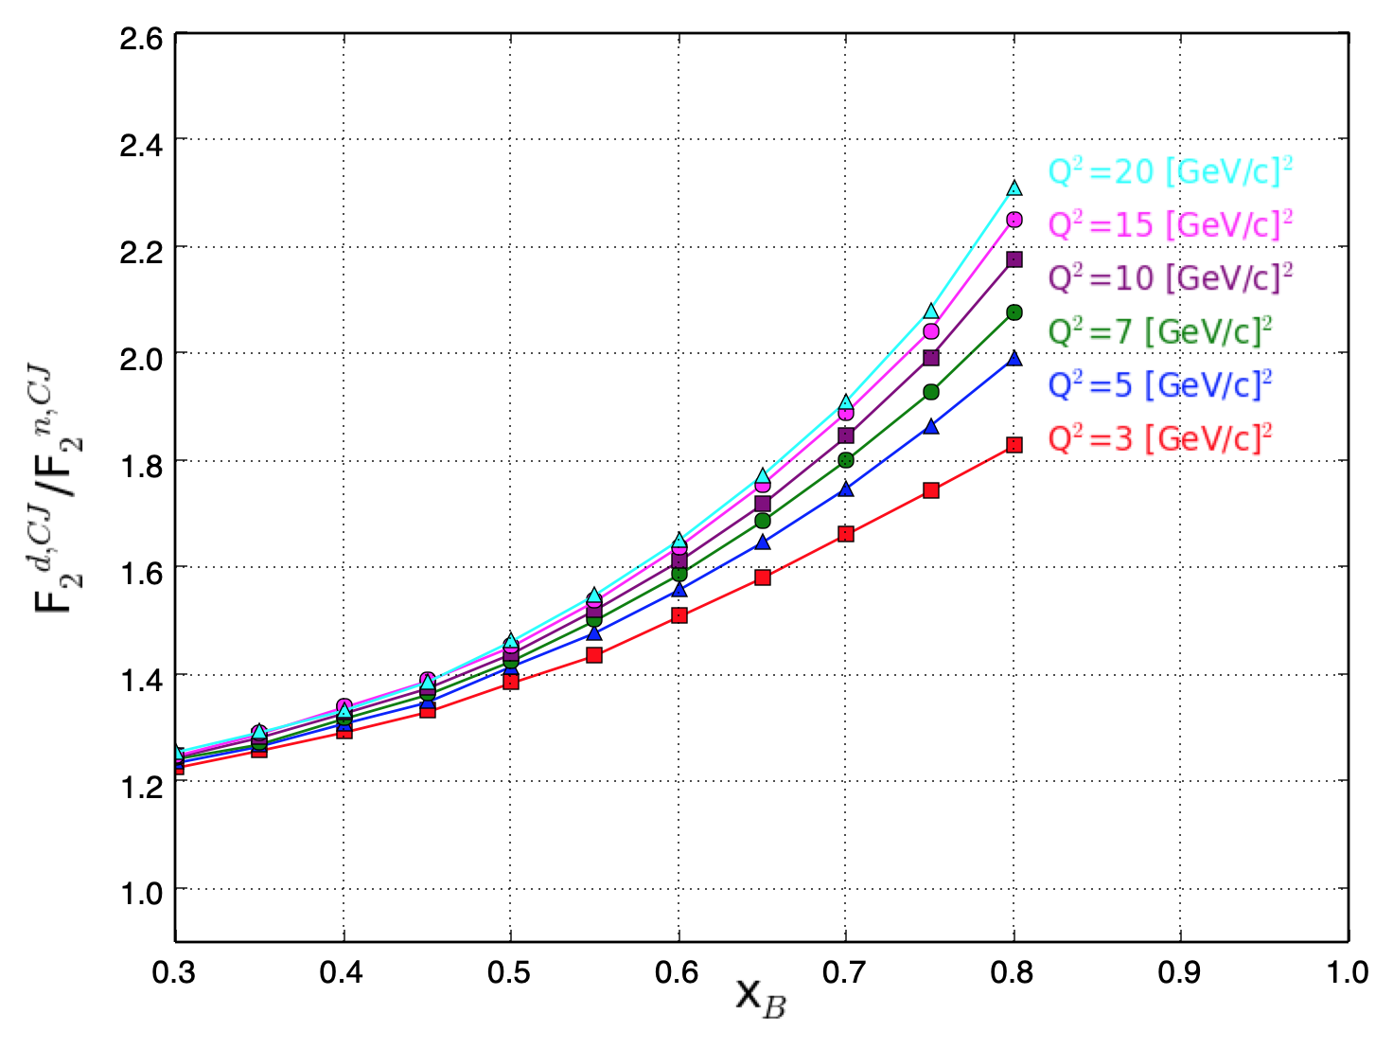
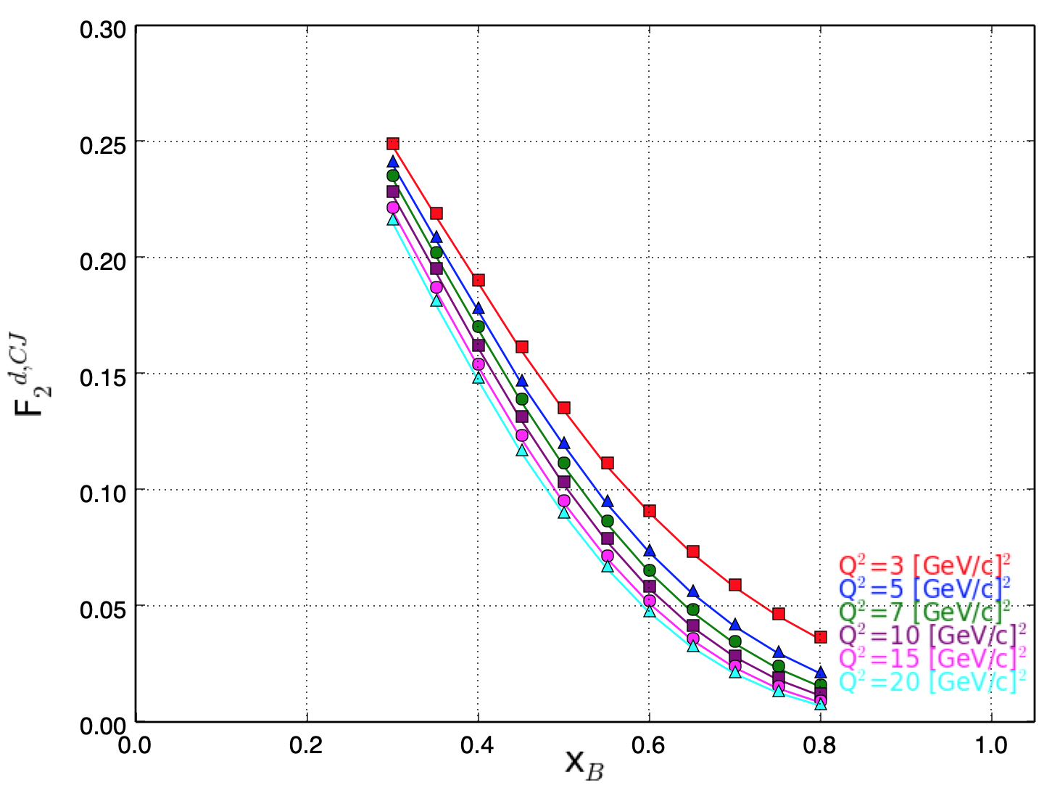
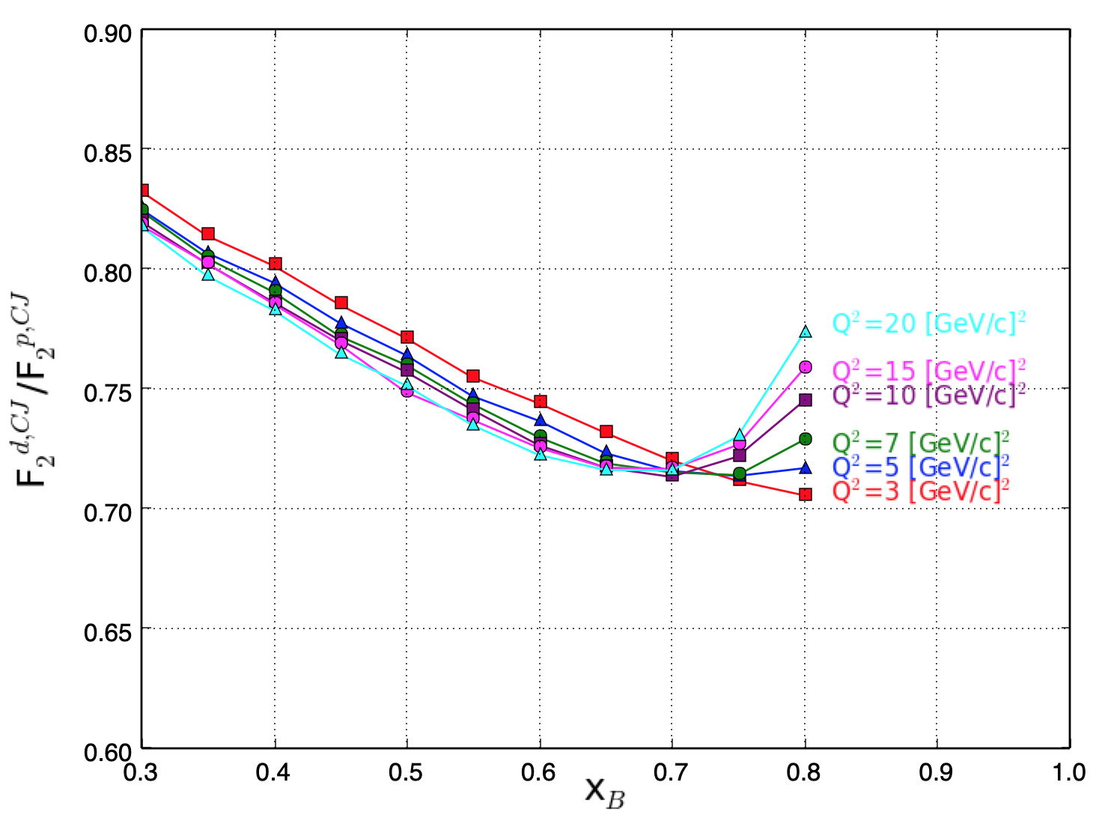
Looking at F₂^{D}/F₂^{n,p} via CJ15
D/n
Deuteron
D/p
Neglecting uncertainties on purpose to highlight behavior in the plot.
There is Q² dependence, in particular at large x.
Phys. Rev. D 93 114017 (2016)

Slide 10
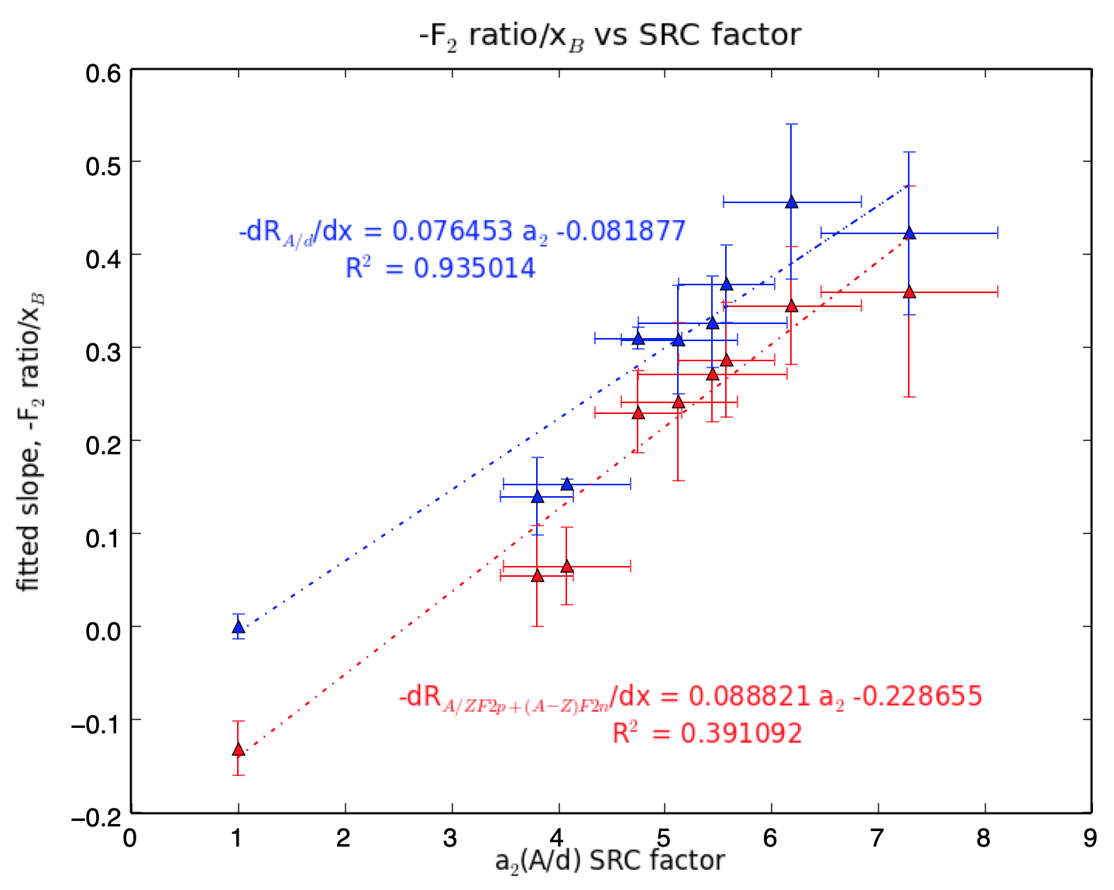
Comparison of F₂^{A}/F₂^{n,p} to SRC factor a₂ (A/d)
a₂(A/d) scaling factor: PRL 106 052301 (2011). Blue points are for A/d; Red points are for A/n+p.
Slope of near -0.08 (with deuteron point set to 0) consistent with previous studies.
Difference in these 2 sets seems to come from nuclear effects from deuteron.
R² orth. distance regression (goodness of fit).
a₂ probability nucleon belongs to a pair (represented as ratio for A/d)

Slide 11
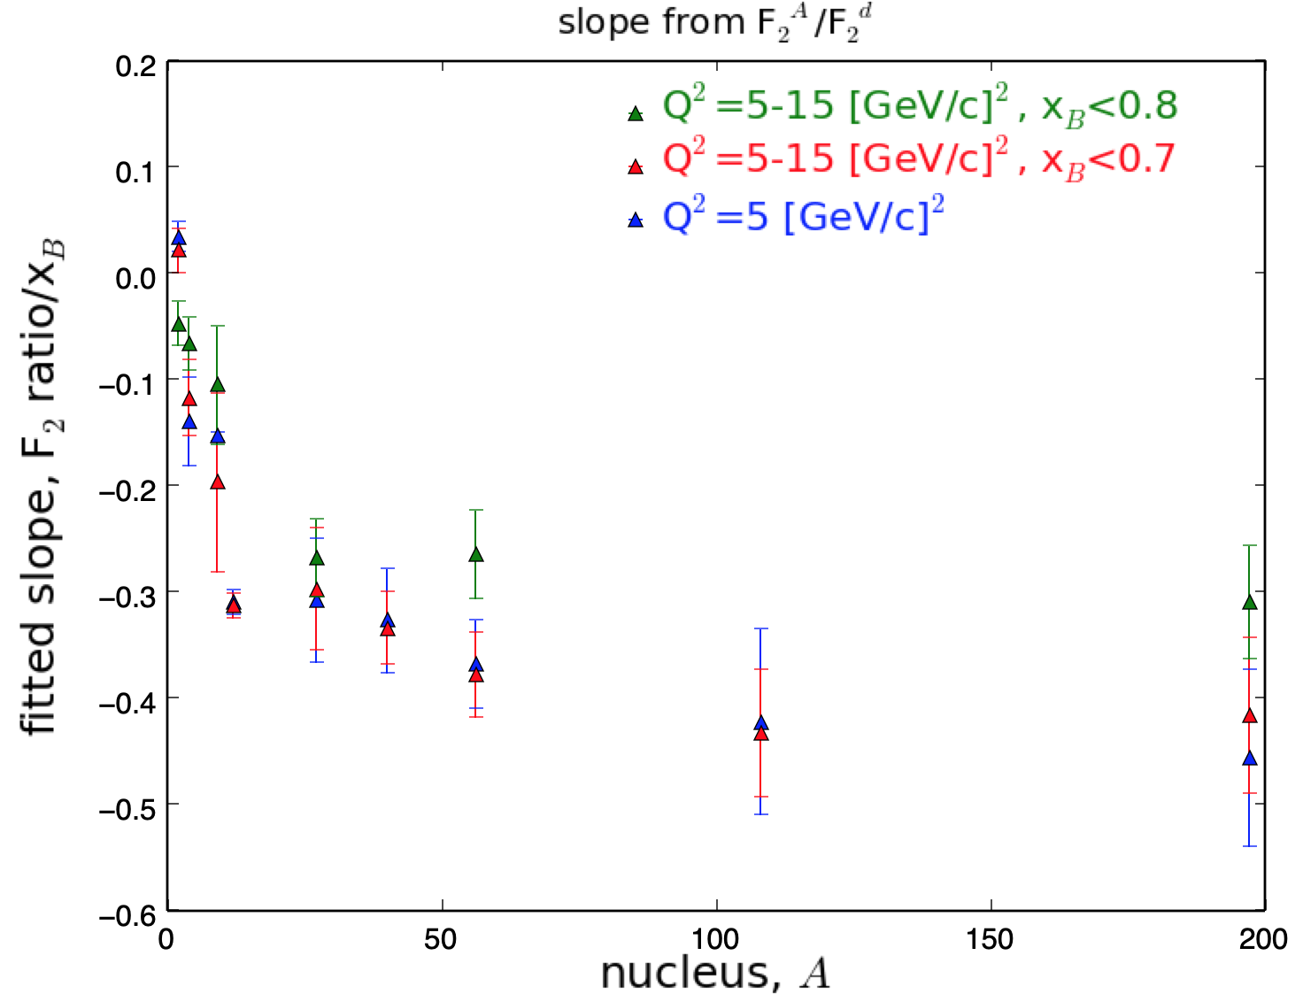
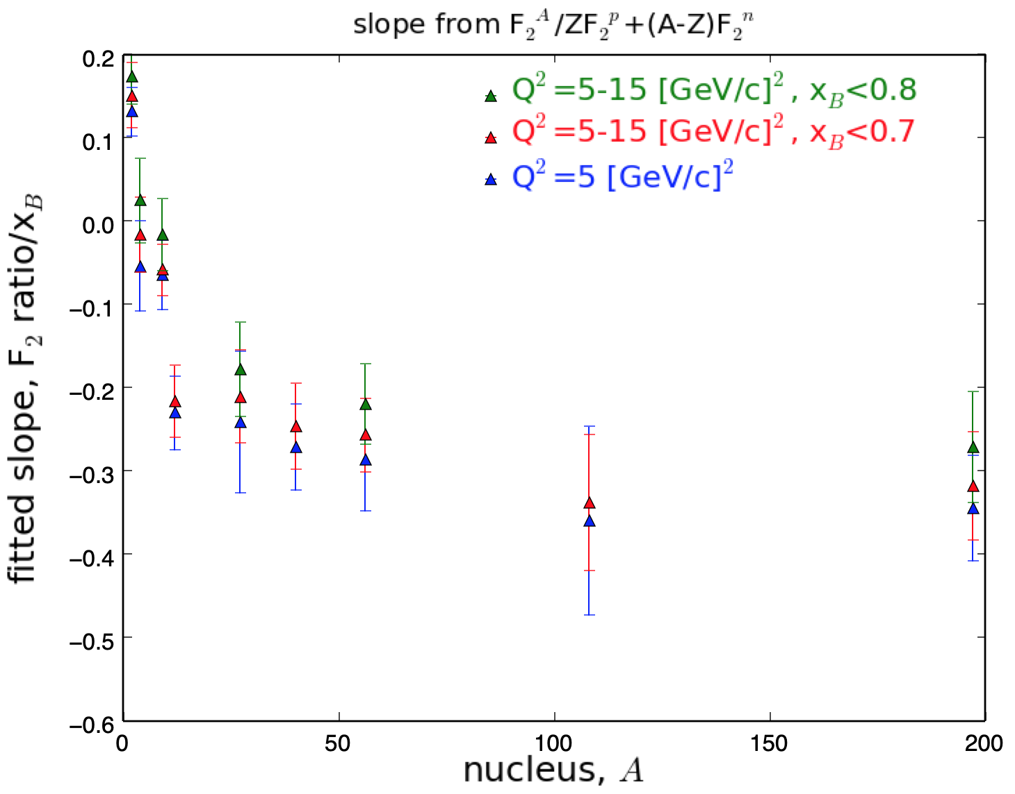
Fitting Slopes of Ratios.
Fits done in region 0.3 < x < 0.6, with 0.7 included
Non-negligible nuclear effects in x 0.6-0.7 for extracting EMC Effect in meaningful way.
Not trivial to disentangle between x and Q².
Inclusion of higher x and Q² generates somewhat shallower slopes from rise in nuclear effects.

Slide 12
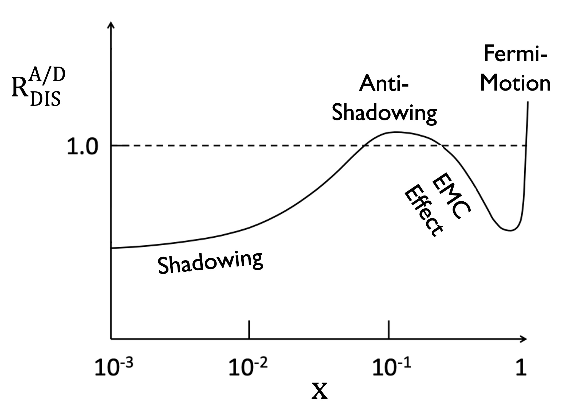
Summary: ~20 GeV could access anti-shadowing regime
e-A (x, Q²) “transition” range accessible for the first time in decades
High precision required: perfect for JLab beam, spectrometers, ability to change targets quickly,…
Polarized beam and target mapping across A, N, Z
Nuclear tagging, mirror nuclei,.. – ALL POSSIBLE at Jlab-EIC

Slide 13
Backup Slides

Slide 14
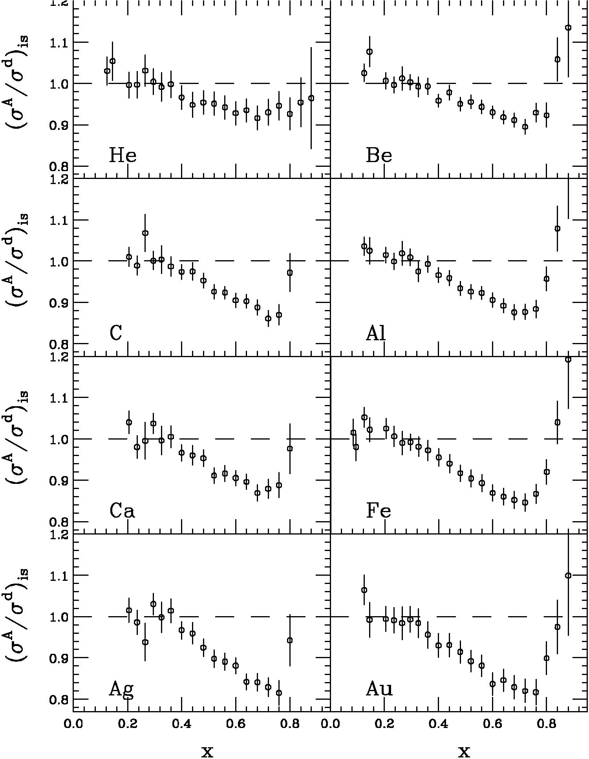
Effect Reproduced many times
  PLB 123 (1983) 275.
  Simple Parton Counting Expects One
  MANY Explanations
SLAC E139
  Phys. Rev. D 49 (1994) 4348.
  Precise large-x data
  Nuclei from A=4 to 197
Conclusions from SLAC data
  Nearly Q²-independent
  Universal x-dependence (shape)
  Some A dependence

Slide 15
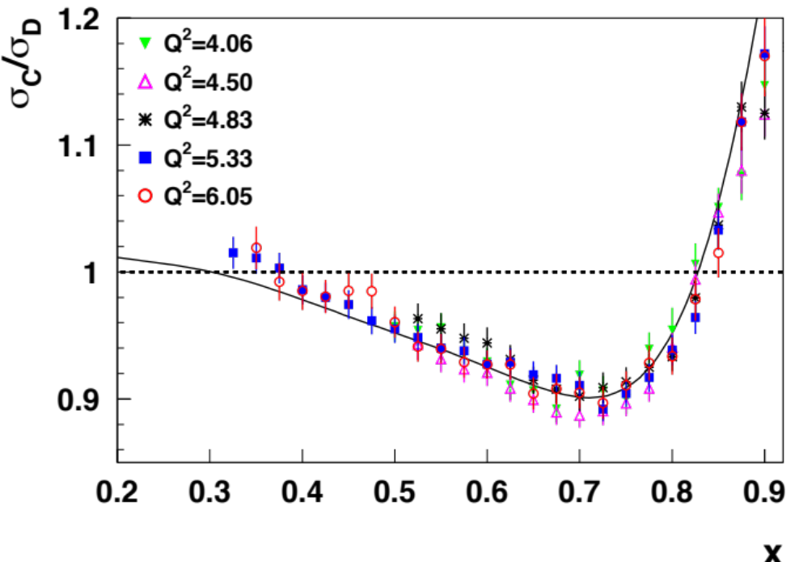
JLab EMC Data
Phys, Rev. Lett. 103 (2009) 202301.

Slide 16
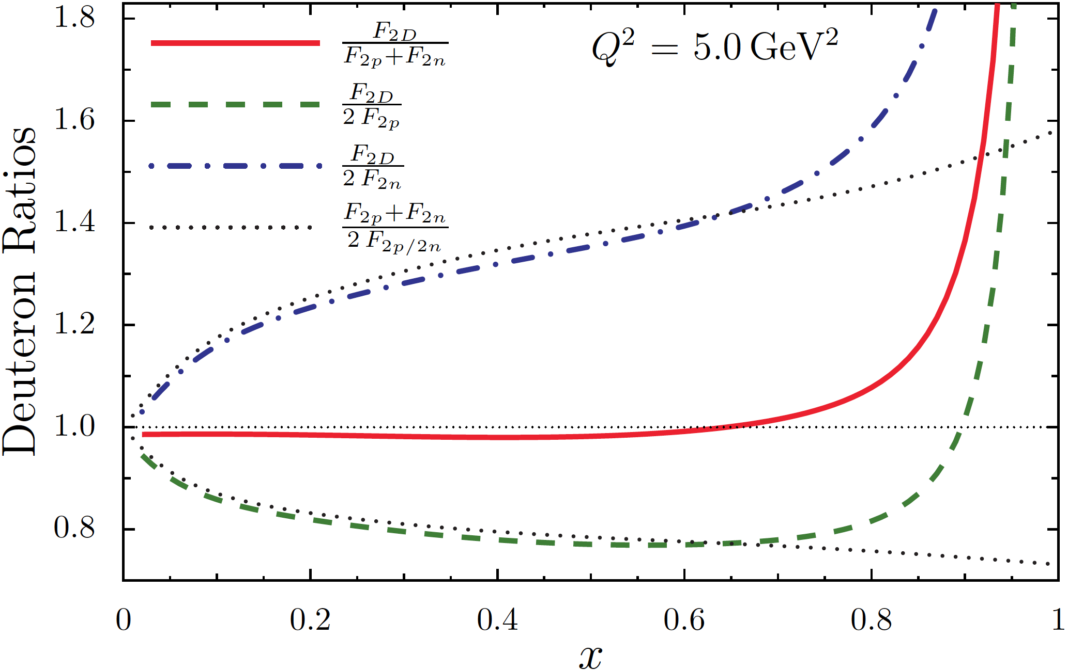
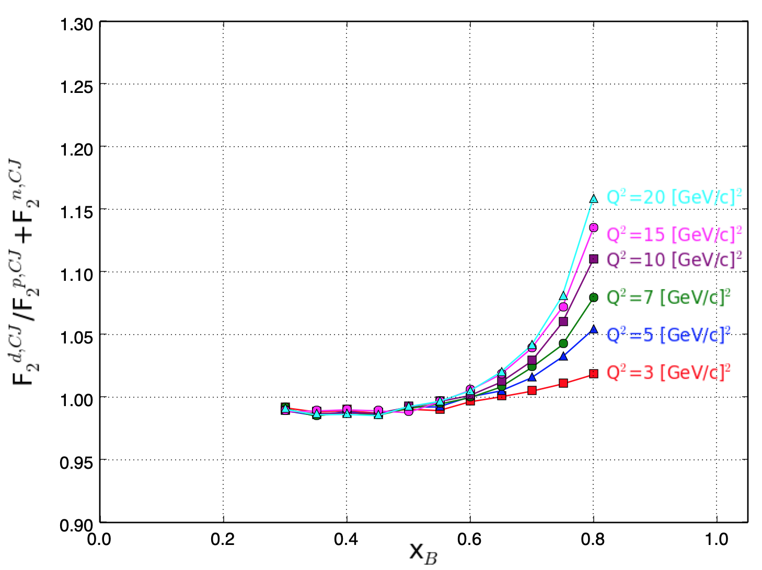
Looking at F₂^{D}/F₂^{n+p}
Theory-driven
CJ15
Theory-driven deuteron to sum of free neutron and proton ratio (in red) dips just below unity in EMC region.
F₂^{D}/2F₂^{p} well below unity with similar shape. F₂^{D}/2F₂^{n} well above unity with positive slope.
Phys. Rev. D 93 114017 (2016)

Slide 17
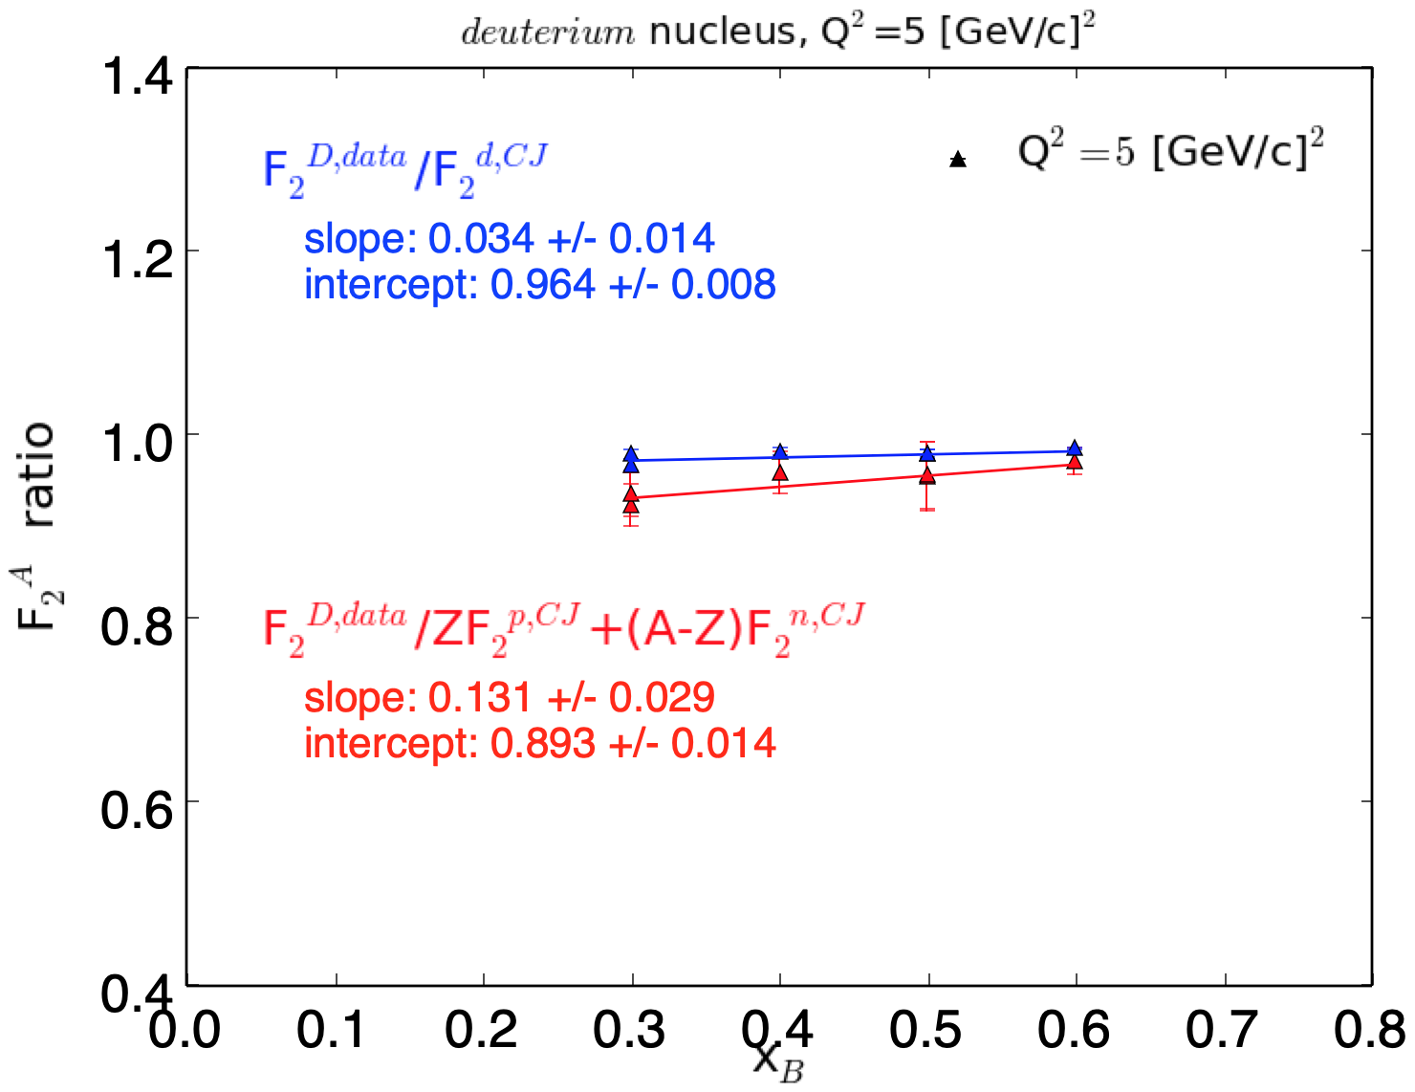
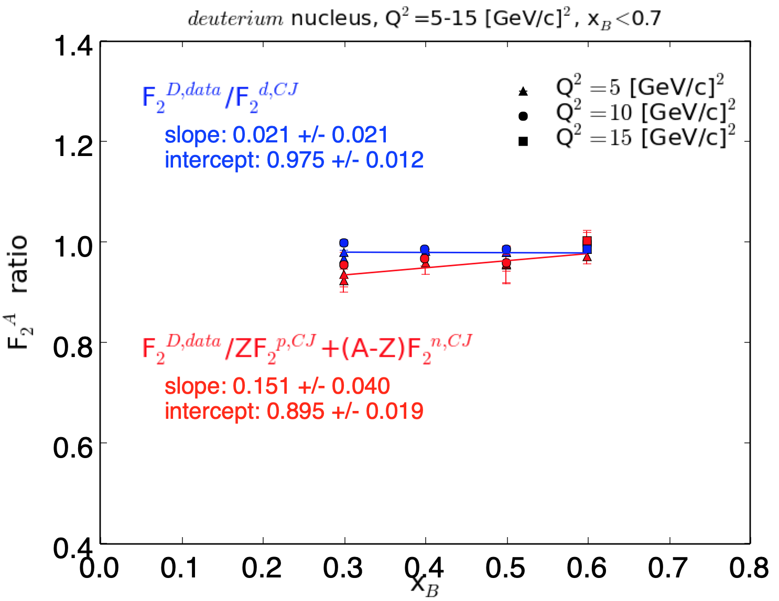
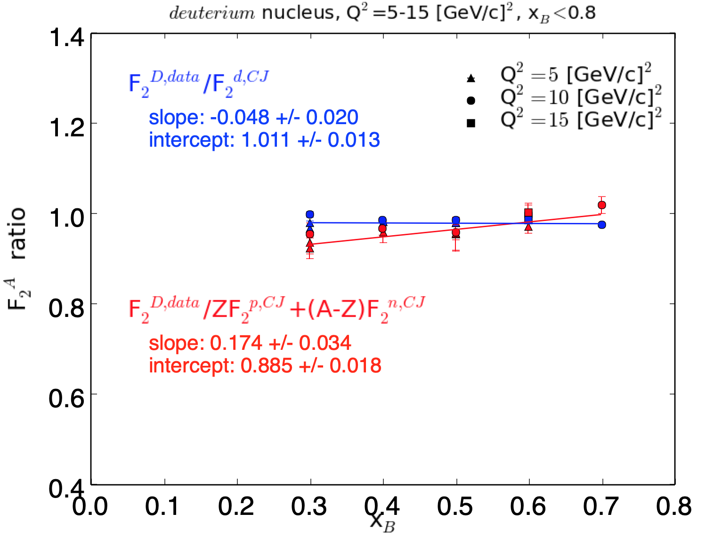
Fitting Slopes of Ratios: Deuteron
F₂^{A}/F₂^{N}
Linear fits to deuterium data, with cuts on Q² and x_{B}.
Blue points are ratio of E139 data to deuterium from CJ15.
Red points are ratio of E139 data to sum of free (CJ15) neutron and proton, without nuclear effects.

Slide 18
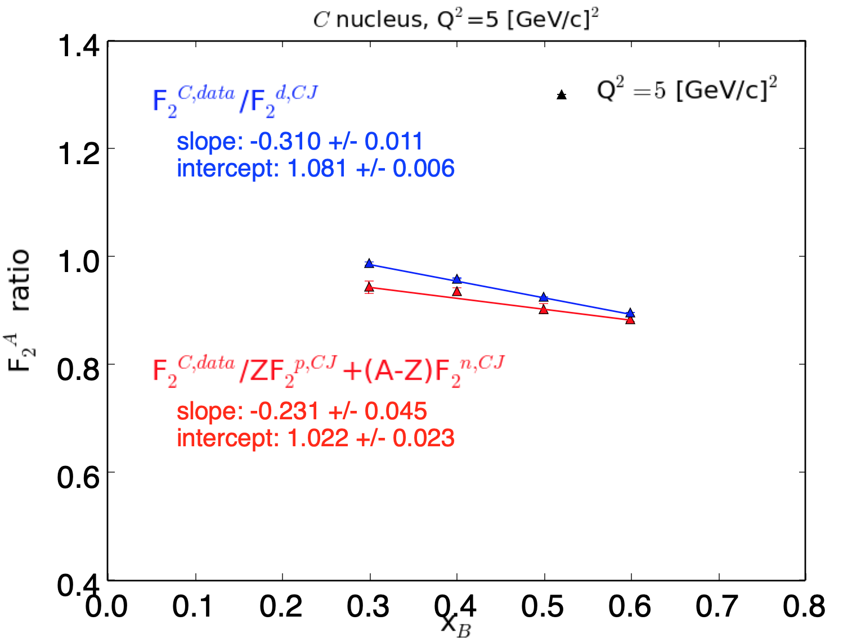
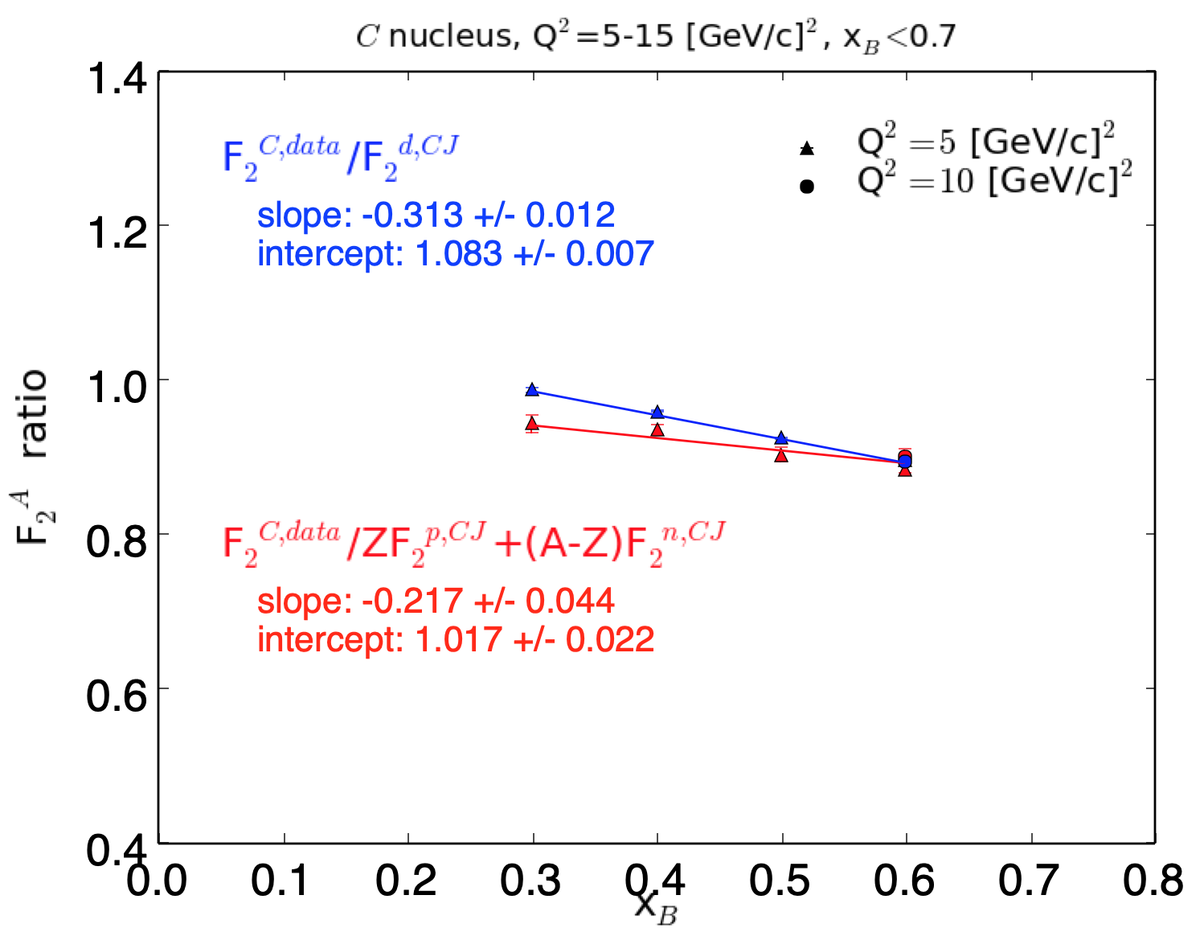
Fitting Slopes of Ratios: Carbon
F₂^{A}/F₂^{N}
Linear fits to deuterium data, with cuts on Q² and x_{B}.
Blue points are ratio of E139 data to deuterium from CJ15.
Red points are ratio of E139 data to sum of free (CJ15) neutron and proton, without nuclear effects.
E139 Carbon data didn’t go to x_{B} > 0.6.

Slide 19
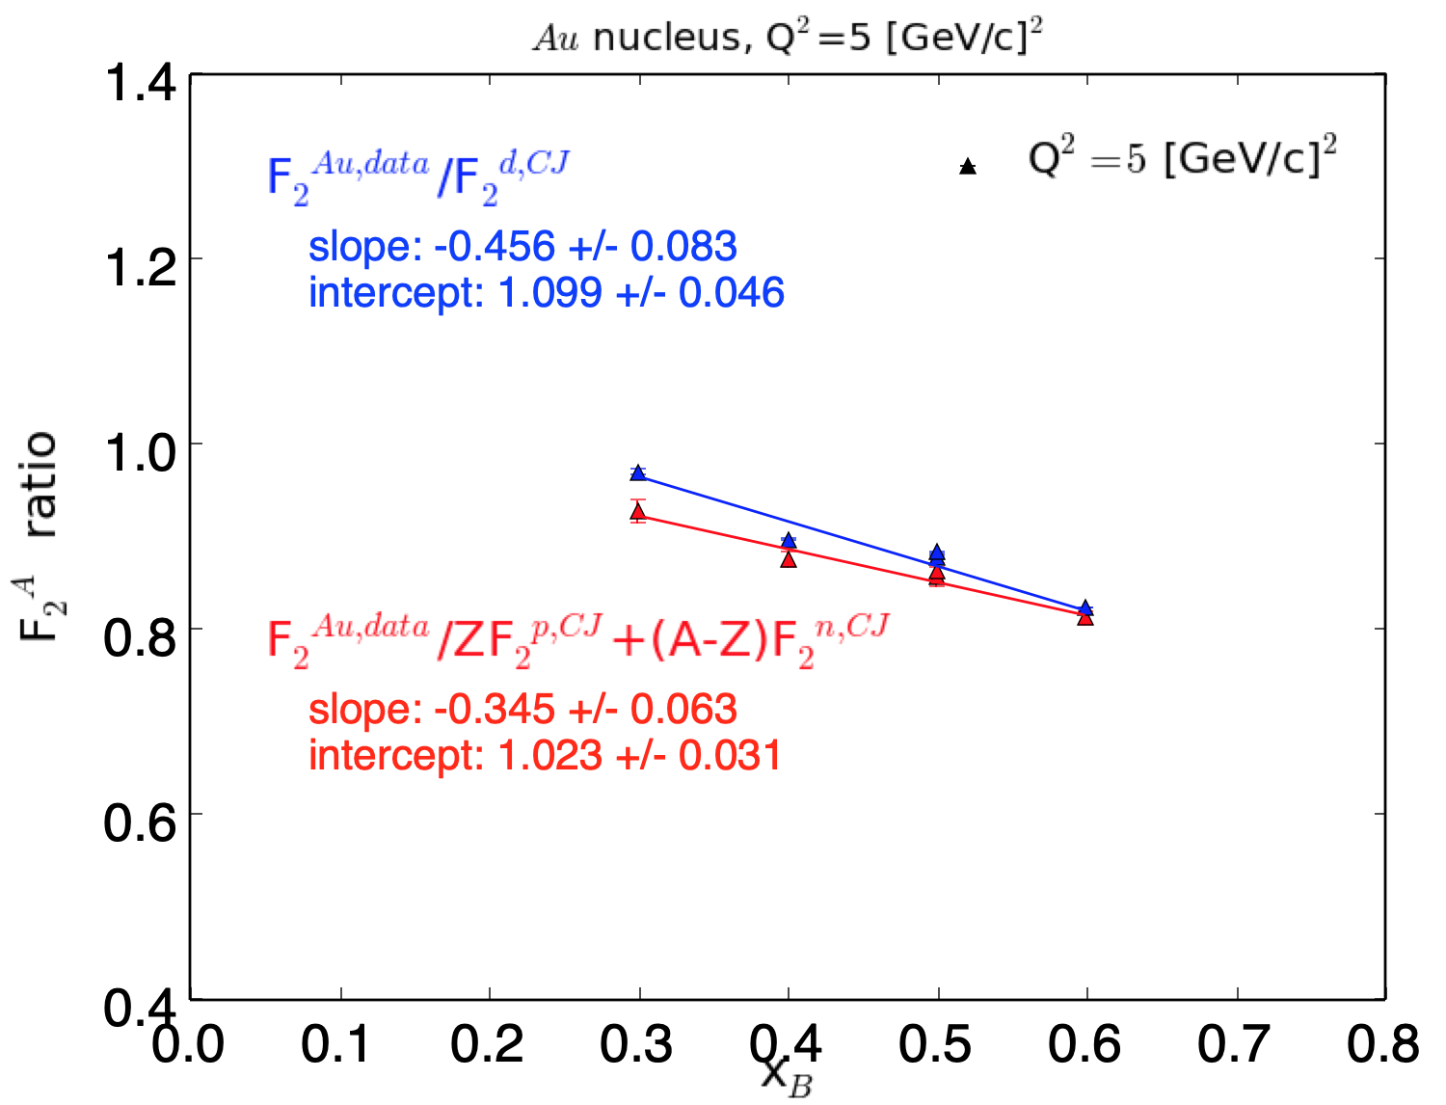
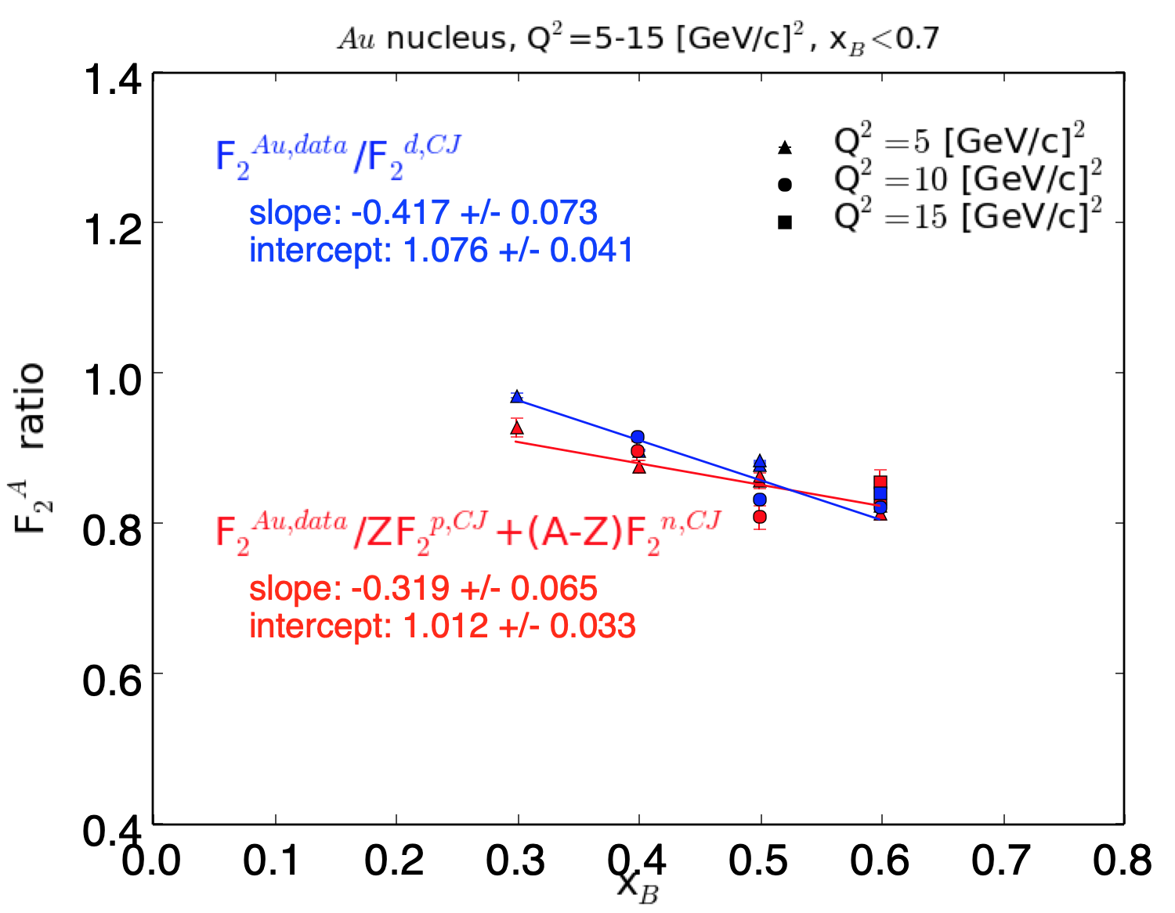
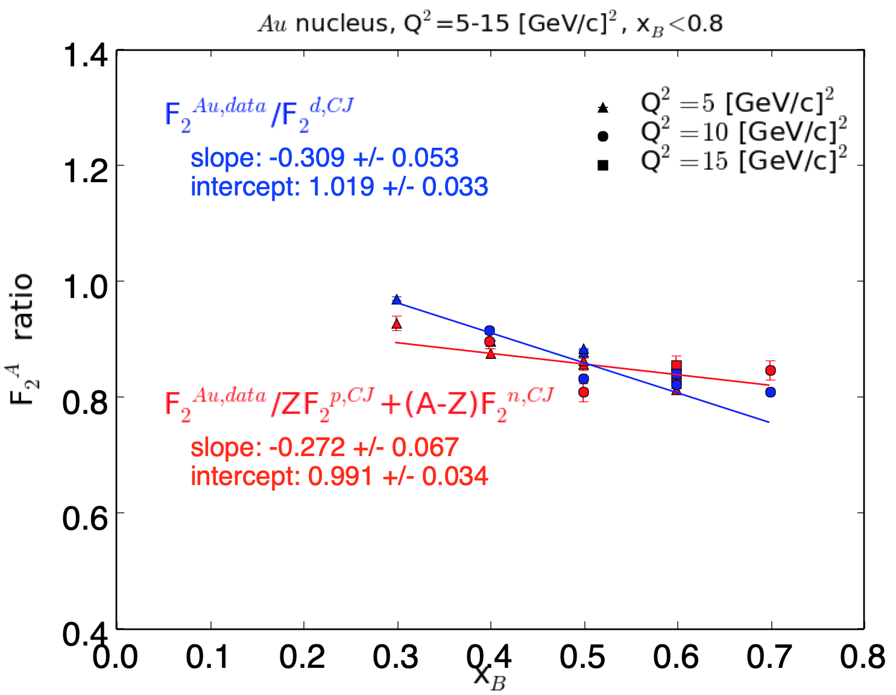
Fitting Slopes of Ratios: Gold
F₂^{A}/F₂^{N}
Linear fits to deuterium data, with cuts on Q² and x_{B}.
Blue points are ratio of E139 data to deuterium from CJ15.
Red points are ratio of E139 data to sum of free (CJ15) neutron and proton, without nuclear effects.

Slide 20
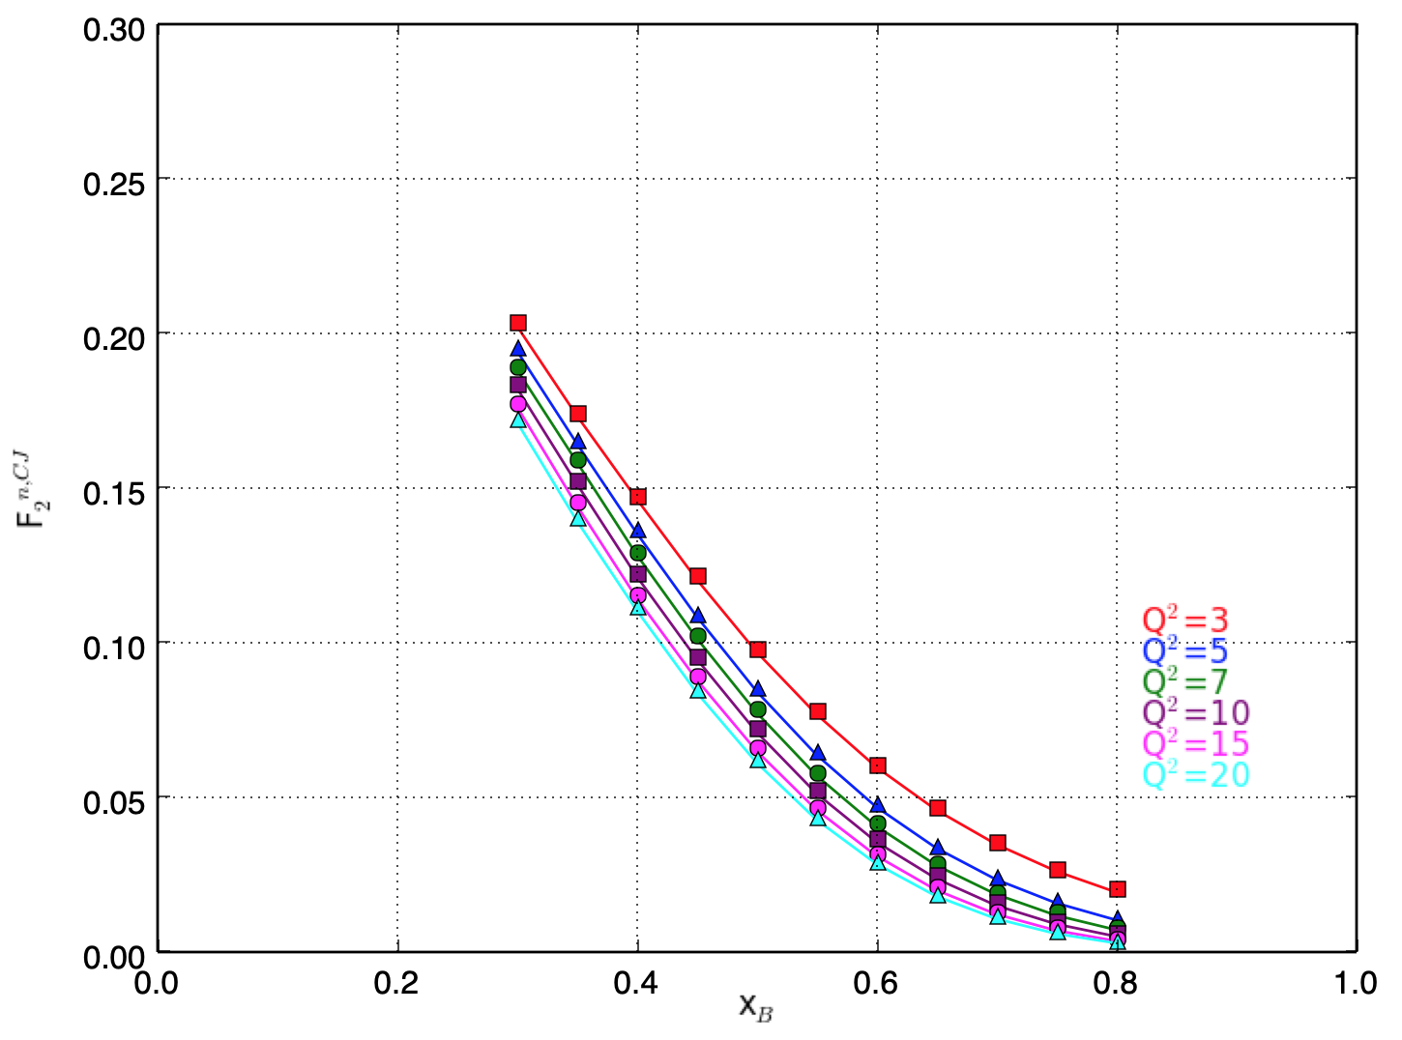
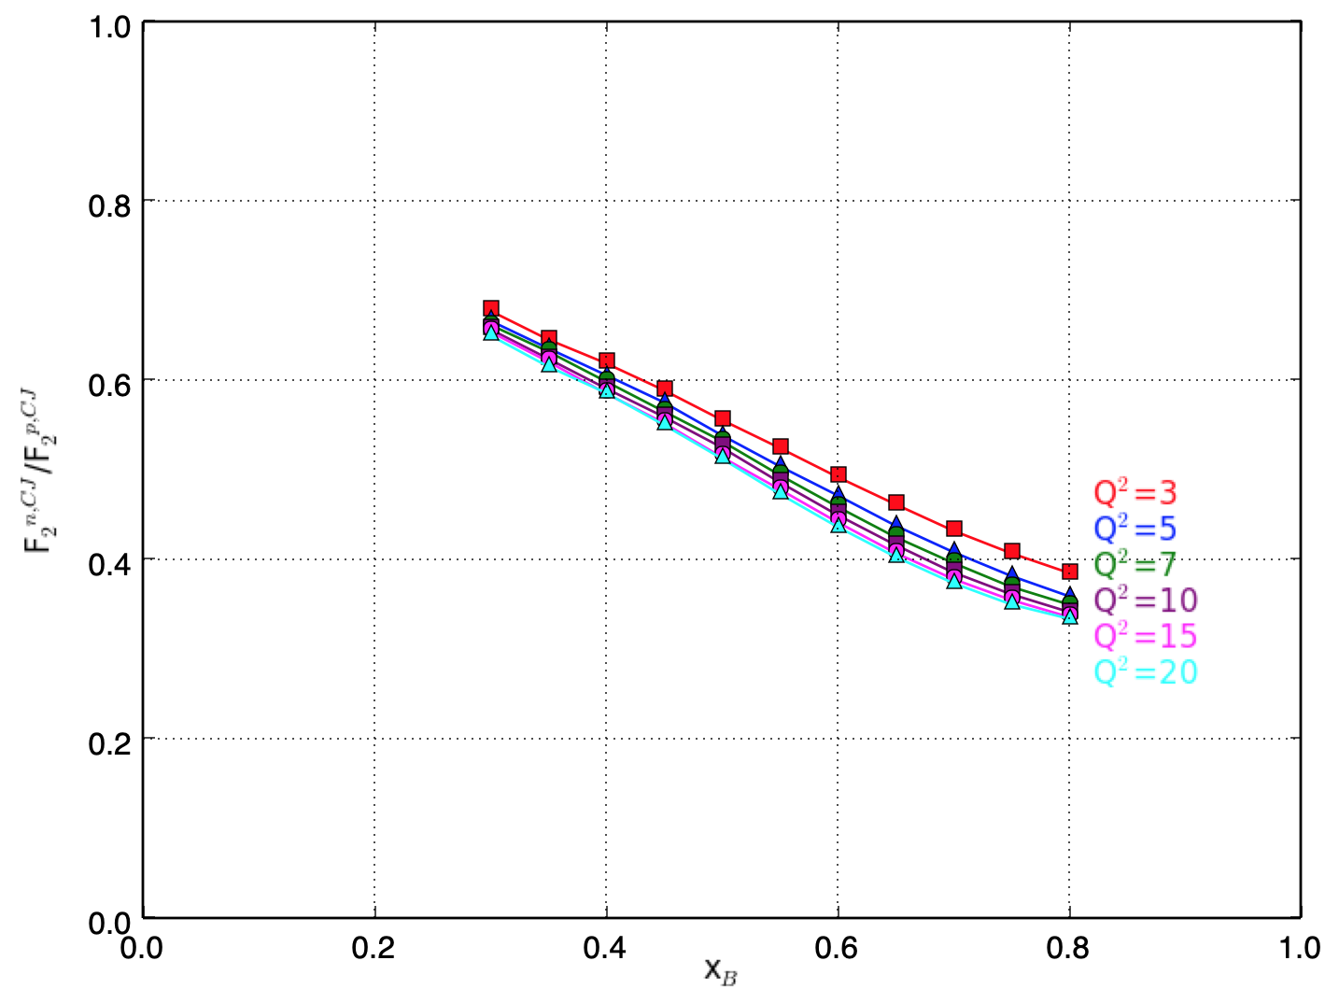
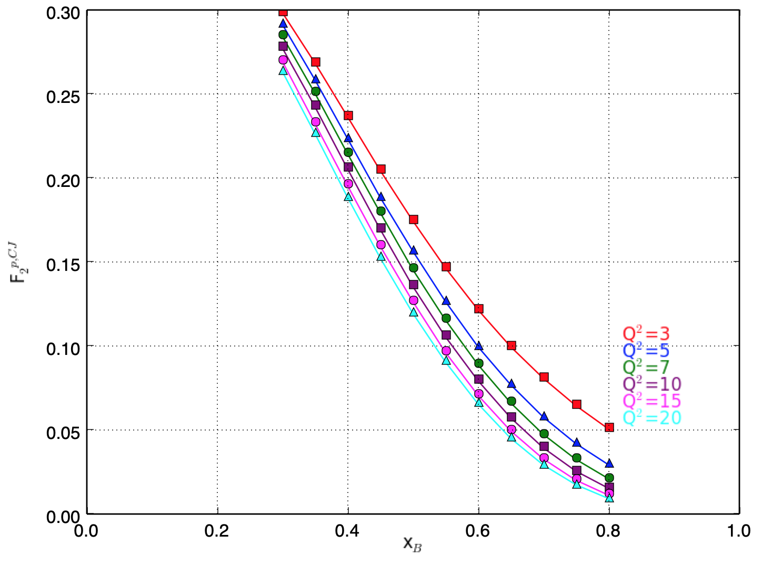
Looking at F₂^{n}/F₂^{p} via CJ15
F₂^{n,CJ}
Neutron
F₂^{n,CJ}/F₂^{p,CJ}
F₂^{p,CJ}
Proton
x_{B}
Neglecting uncertainties on purpose to highlight behavior in the plot.
There is Q² dependence, in particular at large x and low Q.
Phys. Rev. D 93 114017 (2016)
x_{B}

Slide 21
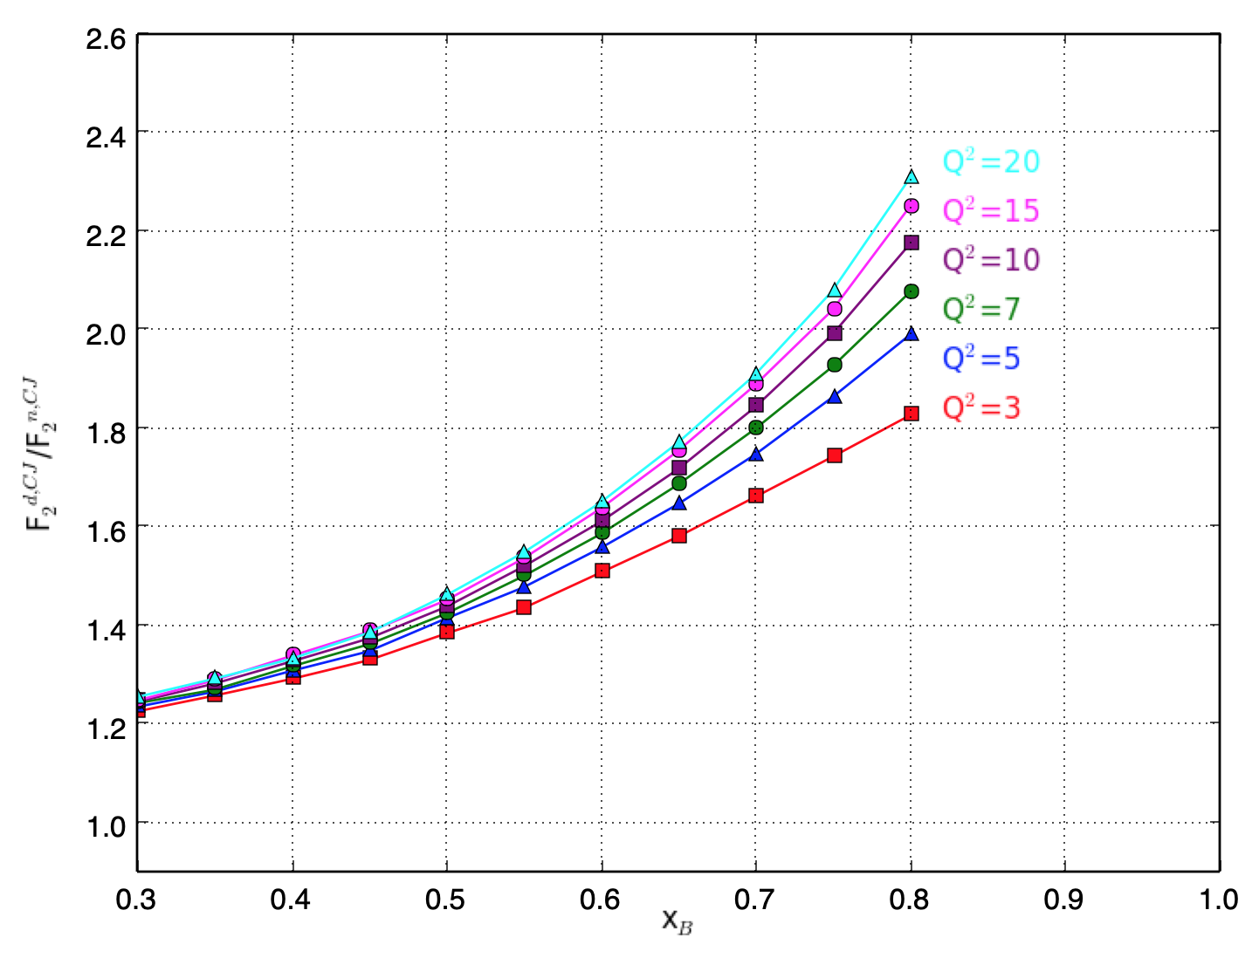
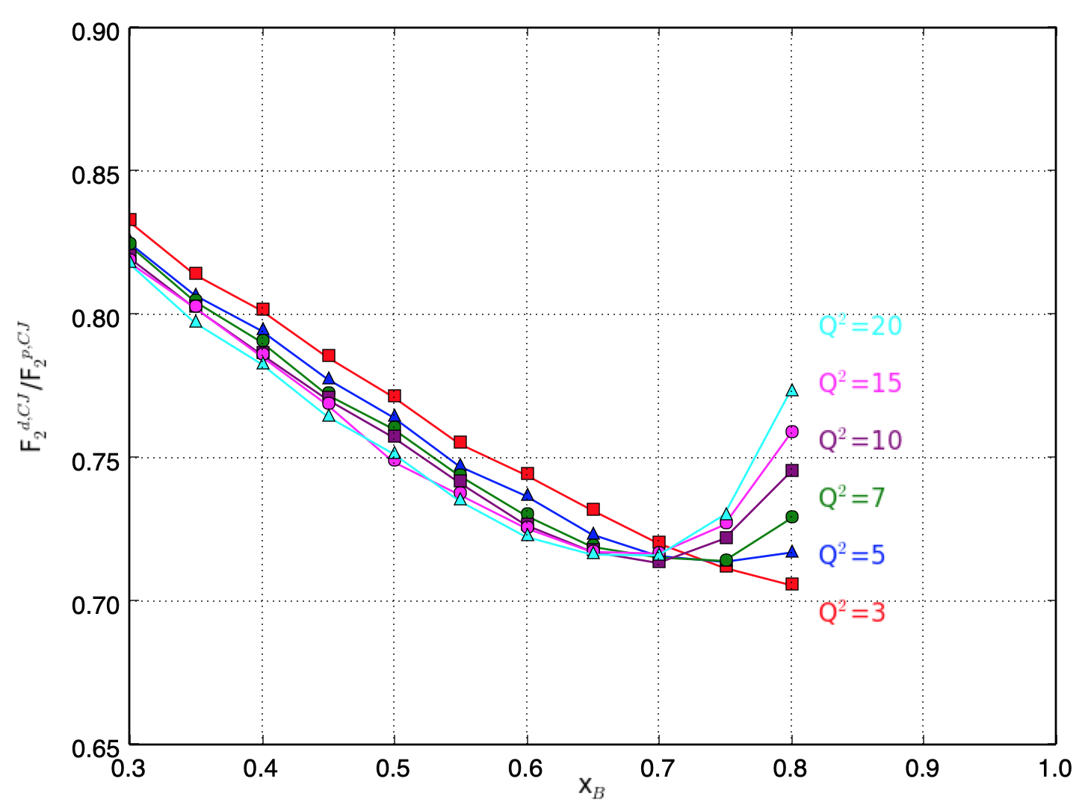
Looking at F₂^{d}/F₂^{n,p} via CJ15
d/n
d/p
Phys. Rev. D 93 114017 (2016)

Slide 22
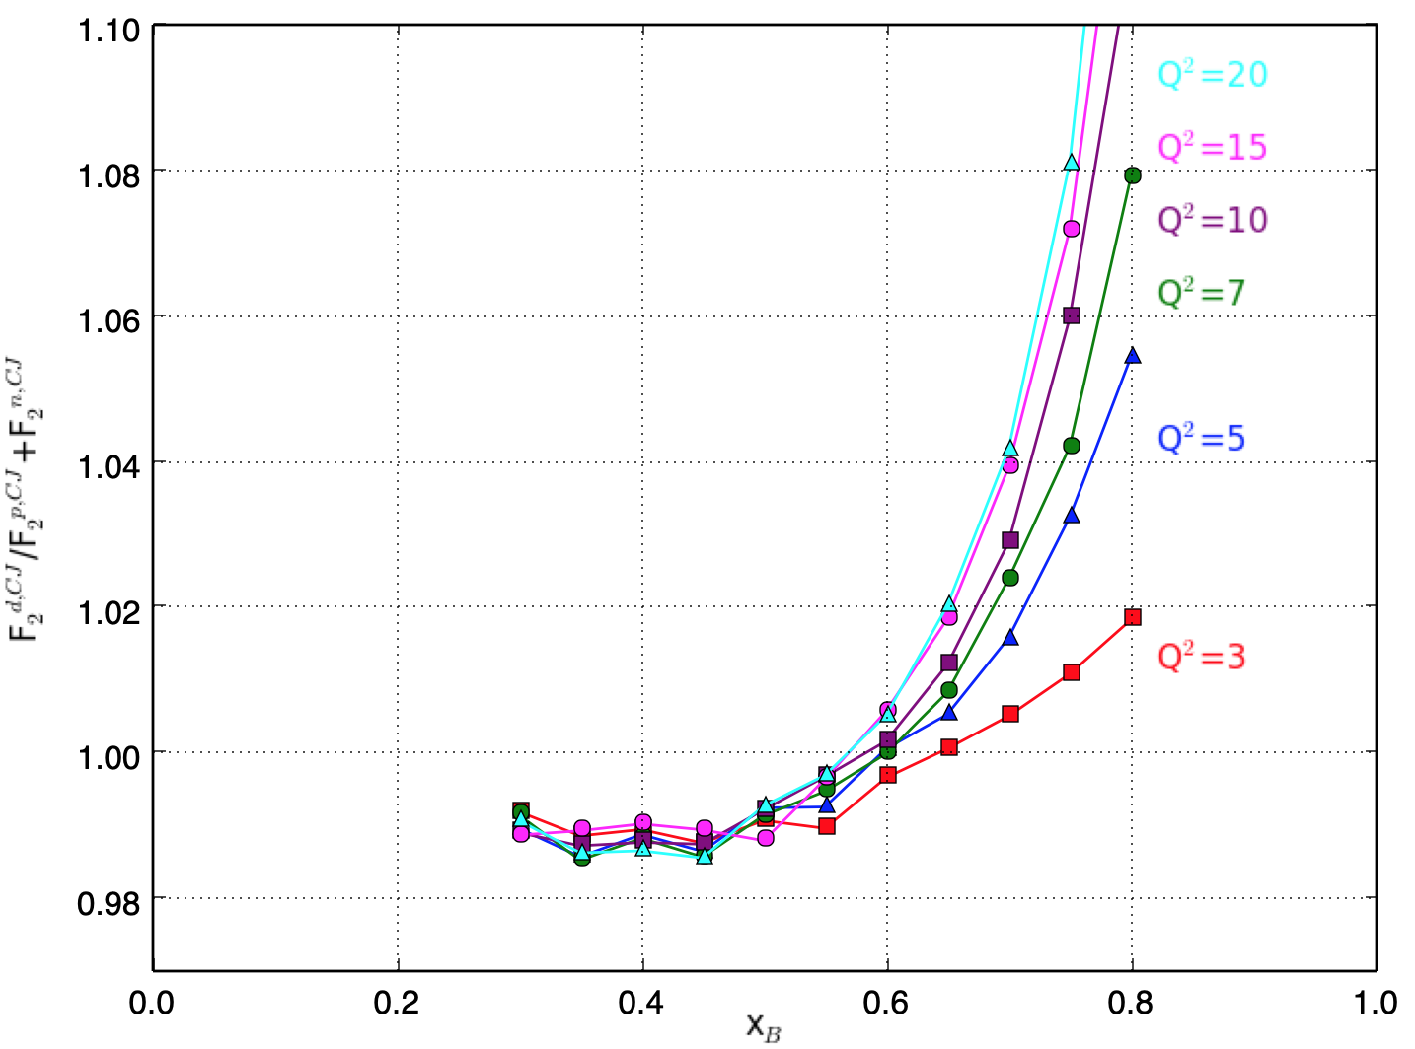
Looking at F₂^{d}/F₂^{n+p} via CJ15
Phys. Rev. D 93 114017 (2016)

Slide 23
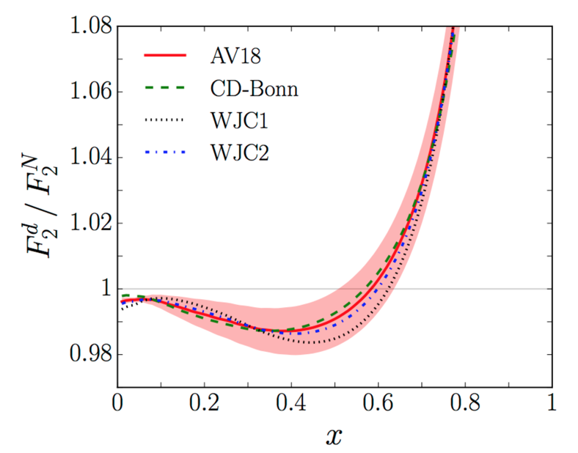
Looking at F₂^{d}/F₂^{N} Theory
Theoretical extraction of F₂^{d}/F₂^{N}.
Some x dependence -> ~2% effect in 0.3-0.7 x region.
Phys. Rev. D 93 114017 (2016)

