Slide 1
Fundamental Tensor Charge from Experiments
Stefan Baeßler
  University of Virginia and Oak Ridge National Lab

Slide 2

Outline
Test of the unitarity of the CKM matrix in the first row with neutron beta decay
Hints for a tensor charge at the nucleon level from neutron beta decay
How to interpret a non-zero tensor charge at the nucleon level
e⁻
p
n
$$\overline{ν_{e}}$$

Slide 3

Speaker
Stefan Baeßler
Dr. rer. nat from Ruprecht Karls Universität Heidelberg
Professor at University of Virginia, with Joint Faculty Appointment with Oak Ridge National Laboratory

Slide 4
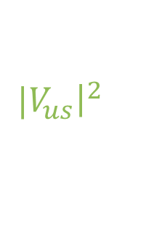
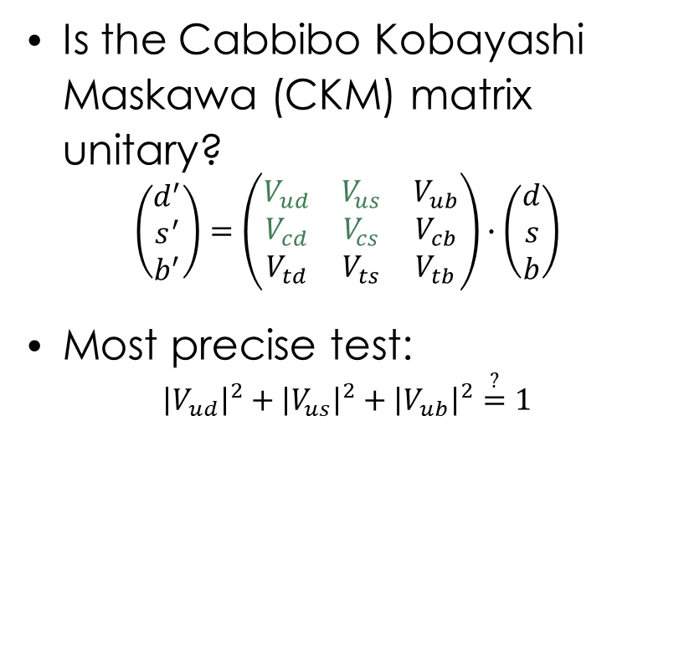
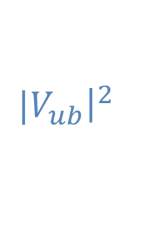
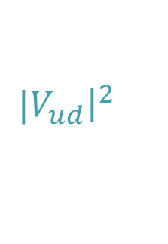
Beyond-standard model: Quark mixing
Is the Cabbibo Kobayashi Maskawa (CKM) matrix unitary?
$$\left(\begin{matrix}d^{′} \\ s^{′} \\ b^{′}\end{matrix}\right)=\left(\begin{matrix}V_{ud} & V_{us} & V_{ub} \\ V_{cd} & V_{cs} & V_{cb} \\ V_{td} & V_{ts} & V_{tb}\end{matrix}\right)∙\left(\begin{matrix}d \\ s \\ b\end{matrix}\right)$$
Most precise test:
$${\left|V_{ud}\right|}^{2}+{\left|V_{us}\right|}^{2}+{\left|V_{ub}\right|}^{2}\overset{?}{=}1$$
${|V}_{ub}{\left.​\right|}^{2}$
d’-quark:
${|V}_{ud}{\left.​\right|}^{2}$
${|V}_{us}{\left.​\right|}^{2}$

Slide 5



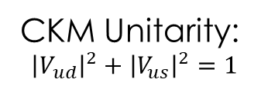

Standard model physics: Quark mixing
Is the Cabbibo Kobayashi Maskawa (CKM) matrix unitary?
$$\left(\begin{matrix}d^{′} \\ s^{′} \\ b^{′}\end{matrix}\right)=\left(\begin{matrix}V_{ud} & V_{us} & V_{ub} \\ V_{cd} & V_{cs} & V_{cb} \\ V_{td} & V_{ts} & V_{tb}\end{matrix}\right)∙\left(\begin{matrix}d \\ s \\ b\end{matrix}\right)$$
Most precise test:
$${\left|V_{ud}\right|}^{2}+{\left|V_{us}\right|}^{2}+{\left|V_{ub}\right|}^{2}\overset{?}{=}1$$
CKM Unitarity:
$${\left|V_{ud}\right|}^{2}+{\left|V_{us}\right|}^{2}=1$$
$$V_{us}$$
$$K_{μ2}/π_{μ2}$$
$$K_{e3}$$
$$V_{ud}$$
negligible
Beta decay

Slide 6


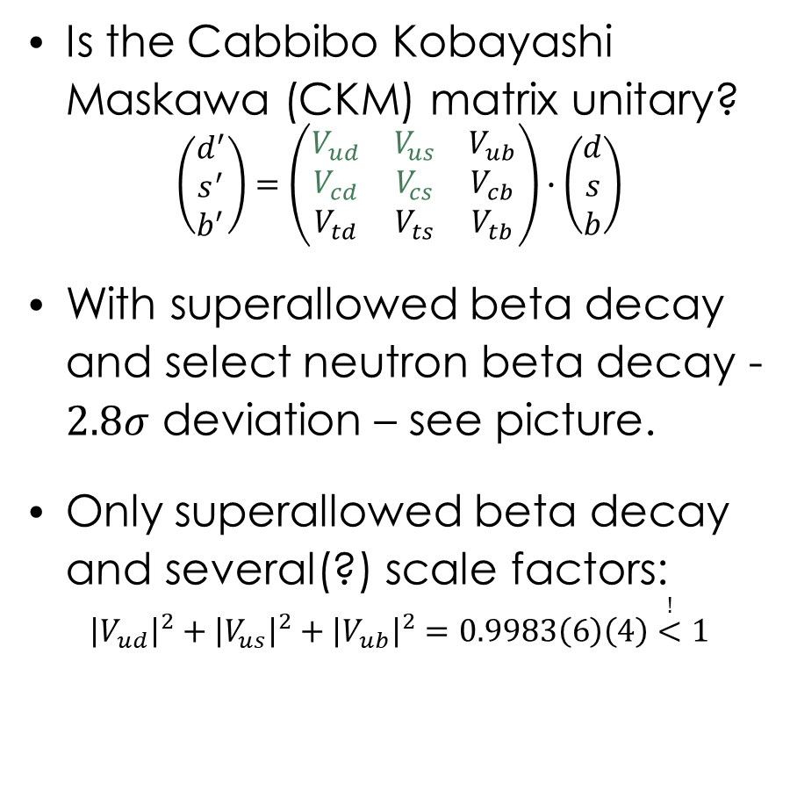

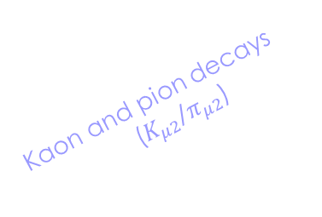


Standard model physics: Quark mixing
Is the Cabbibo Kobayashi Maskawa (CKM) matrix unitary?
$$\left(\begin{matrix}d^{′} \\ s^{′} \\ b^{′}\end{matrix}\right)=\left(\begin{matrix}V_{ud} & V_{us} & V_{ub} \\ V_{cd} & V_{cs} & V_{cb} \\ V_{td} & V_{ts} & V_{tb}\end{matrix}\right)∙\left(\begin{matrix}d \\ s \\ b\end{matrix}\right)$$
With superallowed beta decay and select neutron beta decay - $2.8σ$ deviation – see picture.
Only superallowed beta decay and several(?) scale factors:
$${\left|V_{ud}\right|}^{2}+{\left|V_{us}\right|}^{2}+{\left|V_{ub}\right|}^{2}=0.9983\left(6\right)\left(4\right)\overset{!}{<}1$$
Neutron beta decay (selected)
0.226
Kaon decays ($K_{e3}$)
0.224
$$V_{us}$$
Kaon and pion decays
($K_{μ2}$/$π_{μ2}$)
0.222
Unitarity
Superallowed nuclear decays
0.220
0.960
0.965
0.970
0.975
$$V_{ud}$$
From: 2023 Nuclear Physics Long Range Plan for Nuclear Science,
similar to Cirigliano et al., Phys. Lett. B 838 (2023) 137748
negligible
From: PDG 2025

Slide 7


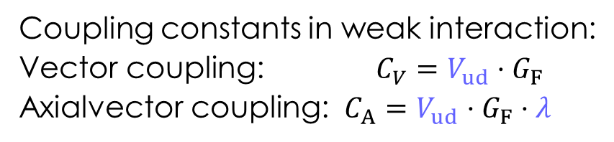


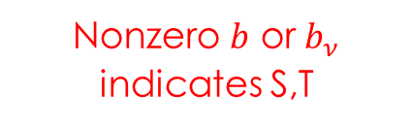
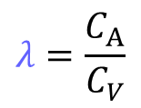

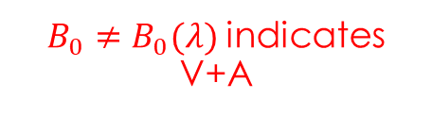


Observables in Neutron beta decay
p
$$e^{−}$$
Coupling constants in weak interaction:
Vector coupling: $C_{V}=V_{ud}⋅G_{F}$
Axialvector coupling: $C_{A}=V_{ud}⋅G_{F}⋅λ$
$$W^{±}$$
$$λ=\frac{C_{A}}{C_{V}}$$
$C_{V}$, $C_{A}$
$${\overline{ν}}_{e}$$
n
Fermi constant $G_{F}$ is precisely known from muon lifetime
Observables in neutron beta decay, as a function of coupling constants:
Nonzero $b$ or $b_{ν}$ indicates S,T
$B_{0}≠B_{0}(λ)$ indicates V+A
$$τ_{n}^{−1}∝\left(C_{V}^{2}+3C_{A}^{2}\right)=V_{ud}⋅G_{F}\left(1+3λ^{2}\right)$$
$$\frac{d^{3}Γ}{dE_{e}dΩ_{e}dΩ_{ν}} ∝ρ(E_{e})\left[1+a\frac{p_{e}}{E_{e}}\cos{({\vec{p}}_{ν},{\vec{p}}_{e})}+b\frac{m_{e}}{E_{e}}+A\frac{p_{e}}{E_{e}}\cos{({\vec{σ}}_{n},{\vec{p}}_{e})}+\left(B_{0}+b_{ν}\frac{m_{e}}{E_{e}}\right)\cos{({\vec{σ}}_{n},{\vec{p}}_{ν})}\right]$$
J.D. Jackson et al., PR 106, 517 (1957)
$$a=a\left(λ\right)$$
$$A=A\left(λ\right)$$
SM analysis: Combine neutron lifetime with either beta asymmetry $A$ or neutrino electron correlation $a$ to determine $V_{ud}$ and test unitarity of CKM matrix.
BSM analysis: determine Fierz term $b$ or neutrino Fierz term $b_{ν}$ (THIS CONFERENCE!)

Slide 8
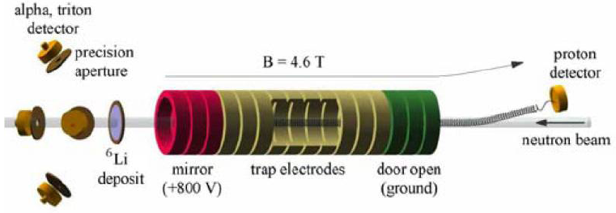
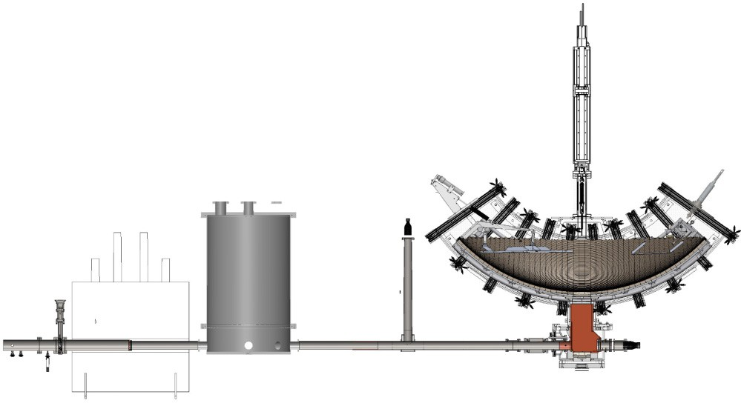








Experiments: Neutron Lifetime
Beam: Decay rate: $\frac{dN}{dt}=\frac{N}{τ_{n}}$
Bottle: Neutron counts: $N= N_{0}e^{−\frac{t}{τeff}}$
with $\frac{1}{τeff}=\frac{1}{τ_{n}}+\frac{1}{τ_{wall }}+\frac{1}{τ_{gas}}$
NIST-BL1/2/3
UCNτ
J.S. Nico et al., PRC 71, 055502 (2005)
$$τ_{n,beam−average}=888.0\left(20\right) s$$
R. Musedinovic et al., PRC 111, 045501 (2025)
$$τ_{n,bottle−average}=878.4\left(5\right) s$$

Slide 9
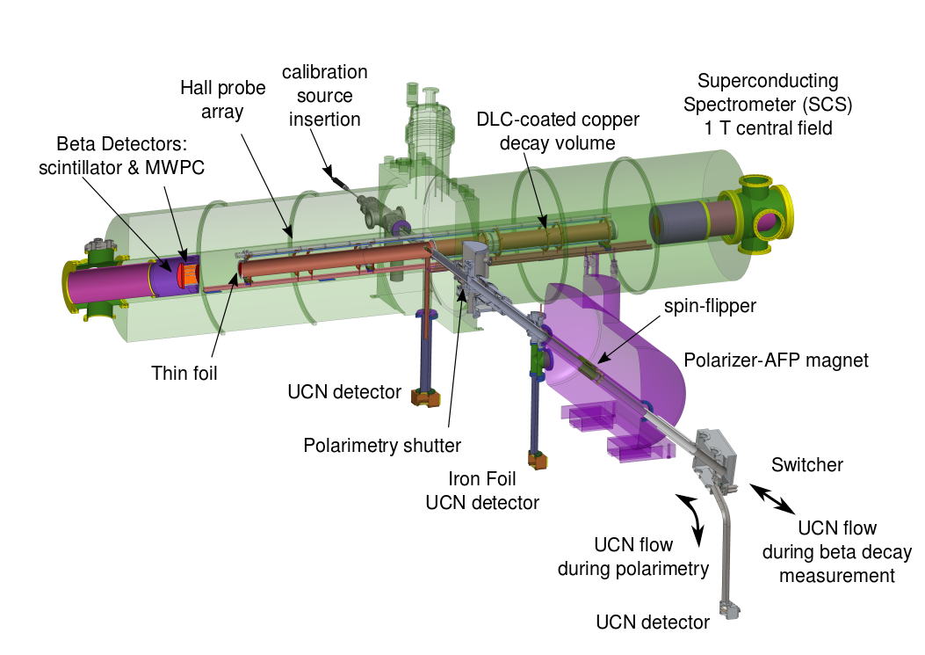
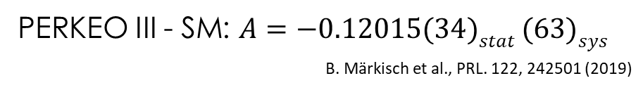




Experiments: The beta asymmetry $A$
PERKEO III - SM: $A=−0.12015(34)stat (63)sys$
B. Märkisch et al., PRL. 122, 242501 (2019)
Detector 1
$${\vec{σ}}_{n}$$
e⁻
electrons
Detector 2
neutrons
p
n
$$\overline{ν_{e}}$$
Neutron
Beamstop
UCNA - SM: $A=−0.12015(34)stat (63)sys$
M. Brown et al., PRC 97, 035505 (2018)
$$\frac{d^{2}Γ}{dE_{e}dΩ_{e}} ∝ρ(E_{e})\left[1+A\frac{p_{e}}{E_{e}}\cos{({\vec{σ}}_{n},{\vec{p}}_{e})}\right]$$
.

Slide 10
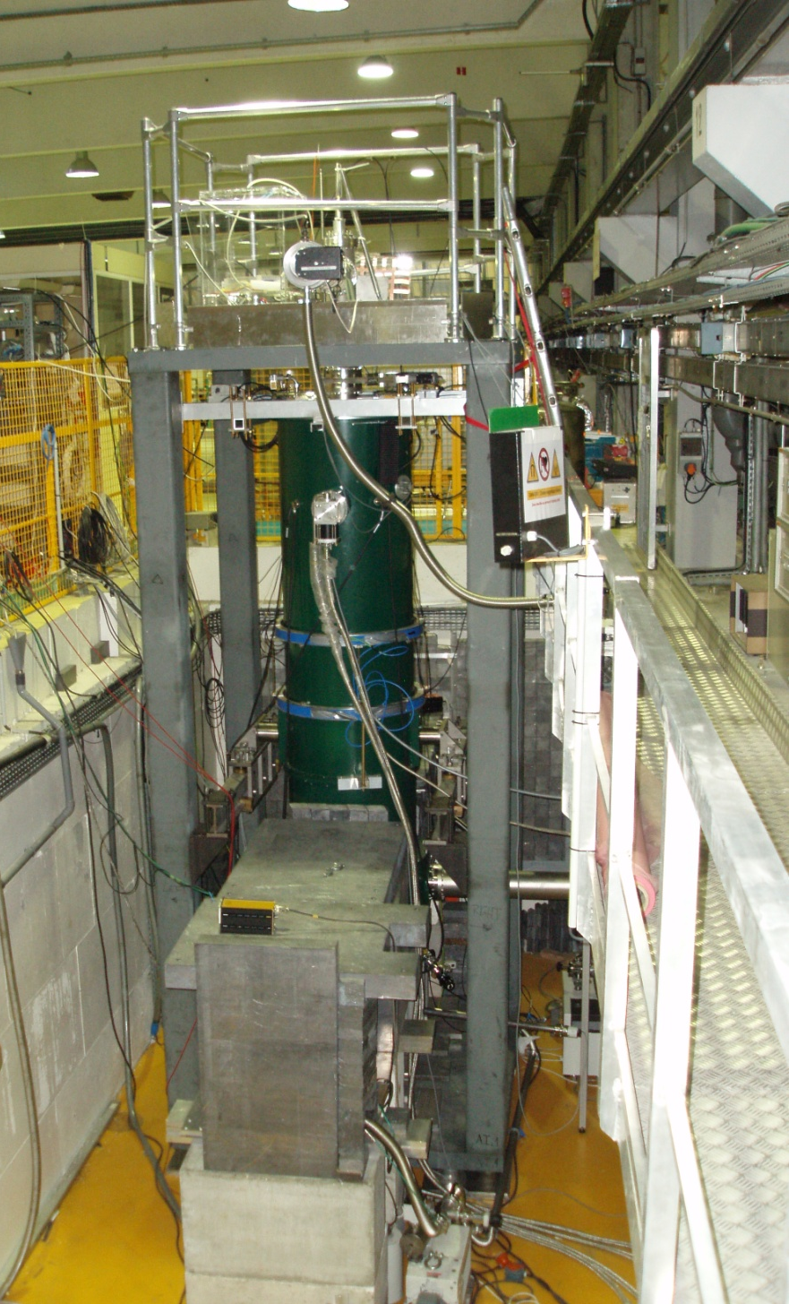

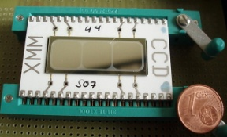


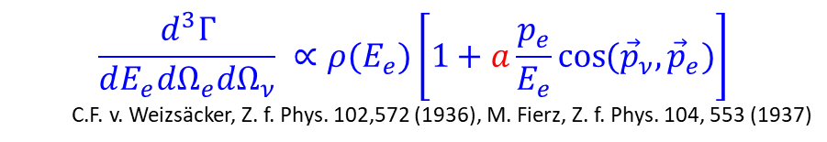

The neutrino electron correlation coefficient $a$
e⁻
p
n
$${\overline{ν}}_{e}$$
Proton Detector
Magnetic
field
$$\frac{d^{3}Γ}{dE_{e}dΩ_{e}dΩ_{ν}} ∝ρ(E_{e})\left[1+a\frac{p_{e}}{E_{e}}\cos{({\vec{p}}_{ν},{\vec{p}}_{e})}\right]$$
C.F. v. Weizsäcker, Z. f. Phys. 102,572 (1936), M. Fierz, Z. f. Phys. 104, 553 (1937)
Retardation
Electrode
Protons
Decay rate $ω_{p}(E_{p})$
Neutron Decay
Spectrum for a = +0.3
… for a = -0.103 [PDG2016]
0
200
400
600
Proton kinetic energy $E_{p}$ [eV]

Slide 11

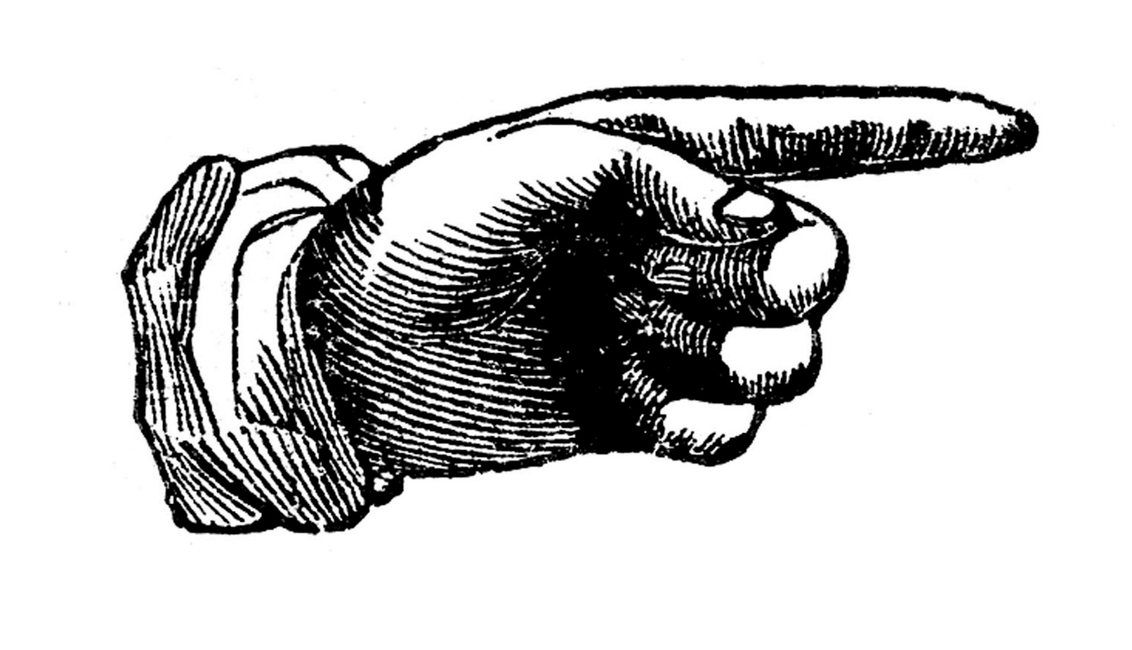

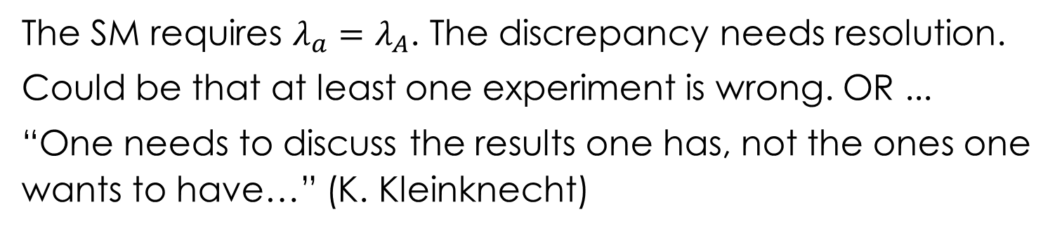
















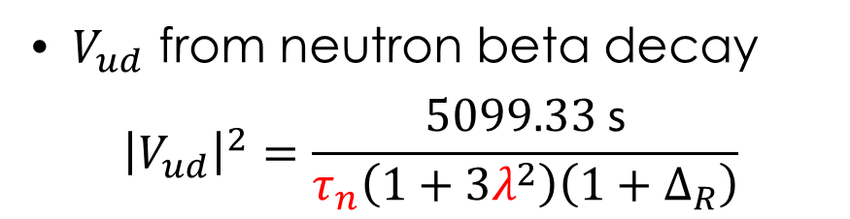
Status of $V_{ud}$ from neutron beta decay
(data up to 2025)
$V_{ud}$ from neutron beta decay
$${\left|V_{ud}\right|}^{2}=\frac{5099.33 \text{s}}{τ_{n}\left(1+3λ^{2}\right)\left(1+Δ_{R}\right)}$$
$$0.977$$
Nab goal
$$0.976$$
$$0.975$$
CKM unitarity ($V_{ud}=\sqrt{1−V_{us}^{2}}$)
$$0.974$$
Neutron beta decay data inconsistent (in SM).
$$V_{ud}$$
$$0.973$$
Superallowed nuclear decays
$$0.972$$
$$τ_{n, bottle}$$
$$τ_{n, beam}$$
$$λ_{A}$$
$$λ_{a}$$
$$0.971$$
$$−1.280$$
$$−1.270$$
$$−1.260$$
$$λ=g_{A}/g_{V}$$
The SM requires $λ_{a}=λ_{A}$. The discrepancy needs resolution.
Could be that at least one experiment is wrong. OR ...
“One needs to discuss the results one has, not the ones one wants to have…” (K. Kleinknecht)

Slide 12
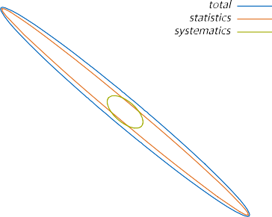

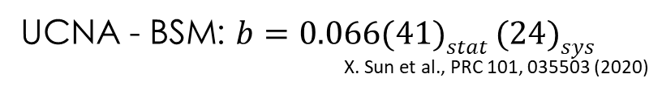
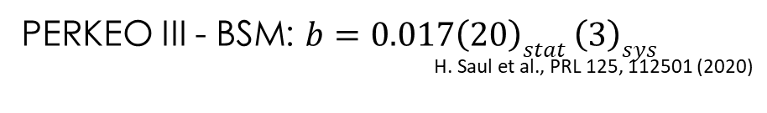
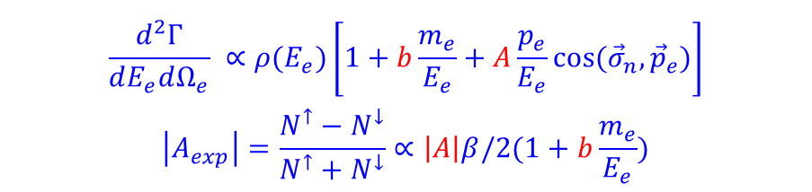



BSM analysis: The beta asymmetry $A$
PERKEO III - BSM: $b=0.017\left(20\right)stat \left(3\right)sys$
H. Saul et al., PRL 125, 112501 (2020)
$${\vec{σ}}_{n}$$
e⁻
p
n
$$\overline{ν_{e}}$$
$$\frac{d^{2}Γ}{dE_{e}dΩ_{e}} ∝ρ(E_{e})\left[1+b\frac{m_{e}}{E_{e}}+A\frac{p_{e}}{E_{e}}\cos{({\vec{σ}}_{n},{\vec{p}}_{e})}\right]$$
$$\left|A_{exp}\right|=\frac{N^{↑}−N^{↓}}{N^{↑}+N^{↓}}∝\left|A\right|β/2(1+b\frac{m_{e}}{E_{e}})$$
$Δχ^{2}=1$ contours
UCNA - BSM: $b=0.066(41)stat (24)sys$
X. Sun et al., PRC 101, 035503 (2020)
Takeaway: More negative $A$ looks similar to positive $b$

Slide 13
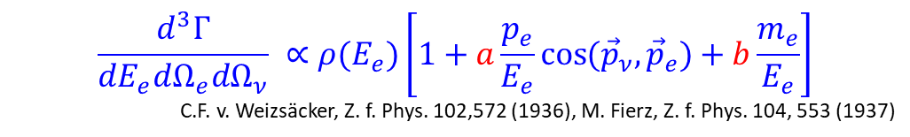









The neutrino electron correlation coefficient $a$
$$\frac{d^{3}Γ}{dE_{e}dΩ_{e}dΩ_{ν}} ∝ρ(E_{e})\left[1+a\frac{p_{e}}{E_{e}}\cos{({\vec{p}}_{ν},{\vec{p}}_{e})}+b\frac{m_{e}}{E_{e}}\right]$$
C.F. v. Weizsäcker, Z. f. Phys. 102,572 (1936), M. Fierz, Z. f. Phys. 104, 553 (1937)
e⁻
p
n
$${\overline{ν}}_{e}$$
Sensitivity of the proton spectrum to $a$ and $b$:
Neutron decay phase space (Dalitz plot)
Proton kinetic energy $E_{p}→$
Decay rate $ω_{p}(E_{p})$
Proton spectrum for $a=0$, $b=0$
Electron kinetic energy $E_{e}→$
… and for $a=−0.103$, $b=0$
… and for $a=−0.103$, $b=1$
Positive $b$ means more low energy electrons, and more low and mid-energy protons
0
200
400
600
Proton kinetic energy $E_{p}$ [eV]
Takeaway: More negative $a$ looks similar to positive $b$

Slide 14
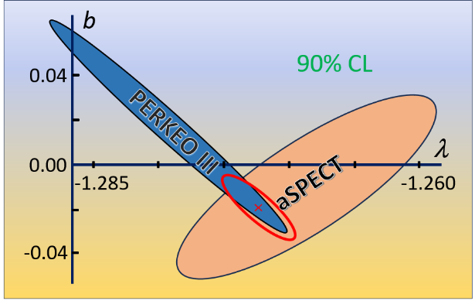
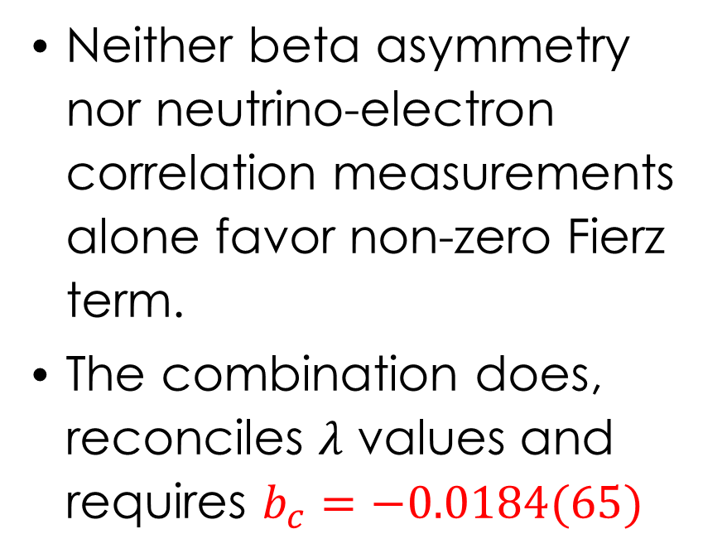
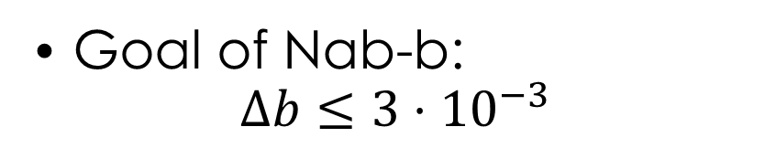
Possible resolution / Search for tensor currents
Neither beta asymmetry nor neutrino-electron correlation measurements alone favor non-zero Fierz term.
The combination does, reconciles $λ$ values and requires $b_{c}=−0.0184(65)$
Nab goal
Goal of Nab-b:
$$Δb≤3⋅{10}^{−3}$$
Plot from: W. Heil (Mainz)
Re-analyzed aSPECT result: M. Beck et al., PRL 132, 102501 (2024)

Slide 15
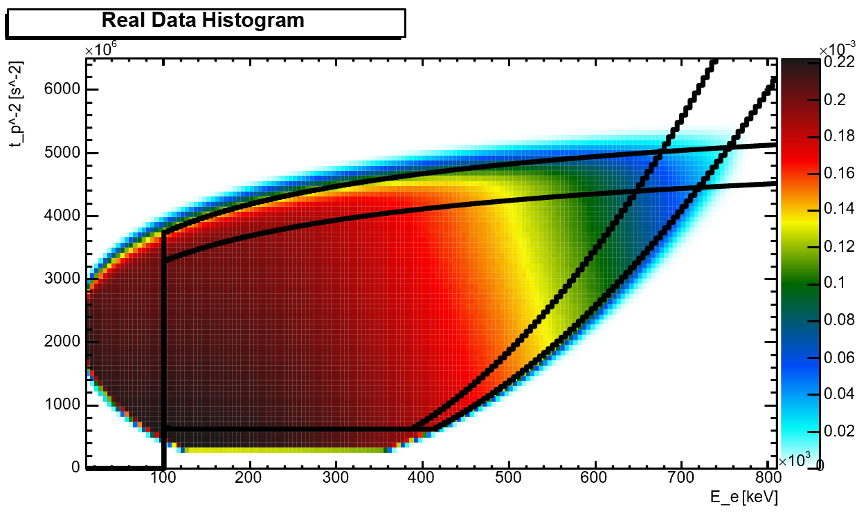

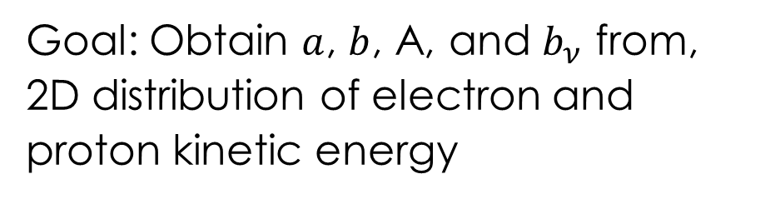


New experiments confirm or refute physics interpretation
Goal: Obtain $a$, $b$, A, and $b_{ν}$ from, 2D distribution of electron and proton kinetic energy
Nab and pNab @ SNS @ ORNL
Spectrometer Magnet
8 meters
Detector
Systems
Decay Volume
Yield $→$
Reconstructed $E_{p} →$
Beam Stop
Neutron Beam
Spin flipper / Collimation System
Reconstructed $E_{e} →$
New measurement technique gives independent (and much more precise, see last slide) result.

Slide 16
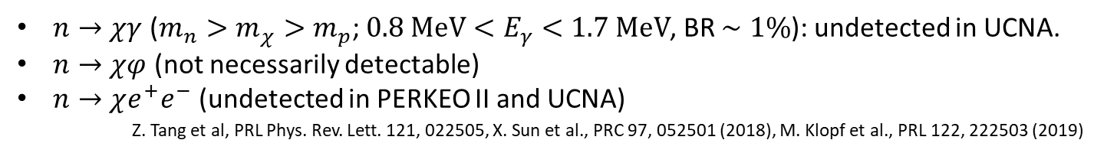
Discussion of ($λ_{c}$, $b_{c}$): Neutron lifetime puzzle
Joint analysis allows to compute $τ_{c}=894.2\left(42\right) s$ from $λ_{c}$, $b_{c}$, $V_{ud}$
Could be exiting solution of neutron lifetime puzzle. too. There is a series of papers about the possibility that the trap lifetime is really lower than the beam lifetime due to neutron decay into dark particles: Fornal & Grinstein, PRL 120, 191801 (2018)
$n→χγ$ ($m_{n}>m_{χ}>m_{p}$; $0.8 MeV<E_{γ}<1.7 MeV$, BR $∼1\%$): undetected in UCNA.
$n→χφ$ (not necessarily detectable)
$n→χe^{+}e^{−}$ (undetected in PERKEO II and UCNA)
Z. Tang et al, PRL Phys. Rev. Lett. 121, 022505, X. Sun et al., PRC 97, 052501 (2018), M. Klopf et al., PRL 122, 222503 (2019)
In SM analysis, $V_{ud}$ and $λ$ favor the lower neutron lifetime from bottles, inconsistent with the simpler dark decay explanations.
Alternative fix:
Neutron oscillations into mirror neutrons, may be turned off (or on) with magnetic field
    Z. Berezhiani, EPJC 79,484 (2019), A. Serebrov et al., PLB 663, 181 (2008), L.J. Broussard et al., PRL 128, 212503 (2022), …

Slide 17
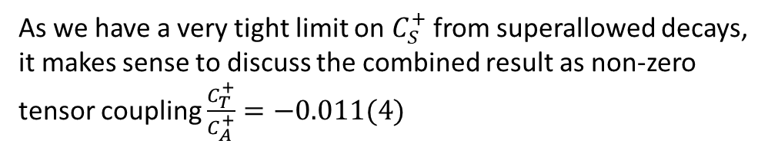
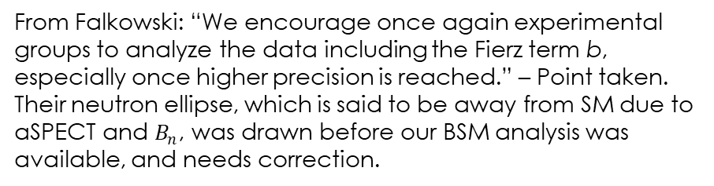
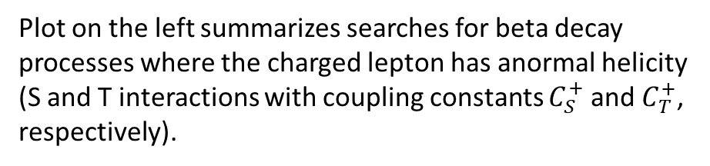
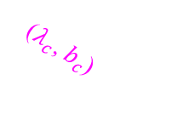
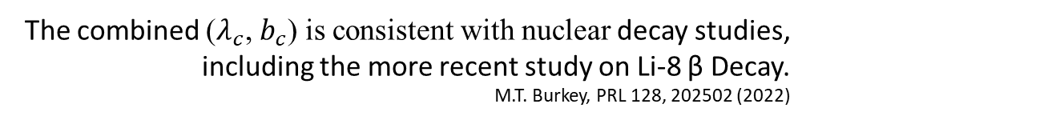
Discussion of ($λ_{c}$, $b_{c}$): Possible tensor charge
Plot on the left summarizes searches for beta decay processes where the charged lepton has anormal helicity (S and T interactions with coupling constants $C_{S}^{+}$ and $C_{T}^{+}$, respectively).
From Falkowski: “We encourage once again experimental groups to analyze the data including the Fierz term b, especially once higher precision is reached.” – Point taken. Their neutron ellipse, which is said to be away from SM due to aSPECT and $B_{n}$, was drawn before our BSM analysis was available, and needs correction.
SM
We add a corrected pink band for $b_{c}≈0.34\frac{C_{S}^{+}}{C_{V}^{+}}+1.66\frac{C_{T}^{+}}{C_{A}^{+}}$.
The combined ($λ_{c}$, $b_{c}$) is consistent with nuclear decay studies, including the more recent study on Li-8 β Decay. M.T. Burkey, PRL 128, 202502 (2022)
($λ_{c}$, $b_{c}$)
As we have a very tight limit on $C_{S}^{+}$ from superallowed decays, it makes sense to discuss the combined result as non-zero tensor coupling $\frac{C_{T}^{+}}{C_{A}^{+}}=−0.011(4)$
From A. Falkowski et al, JHEP 04, 126 (2021)

Slide 18
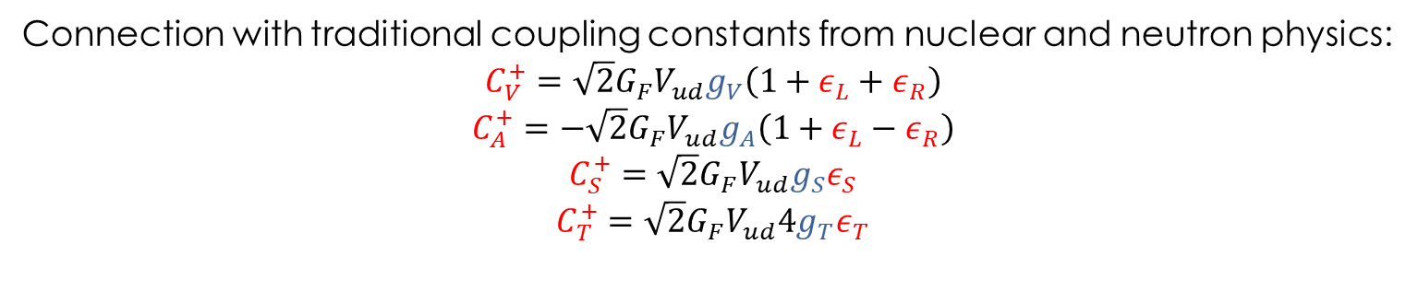
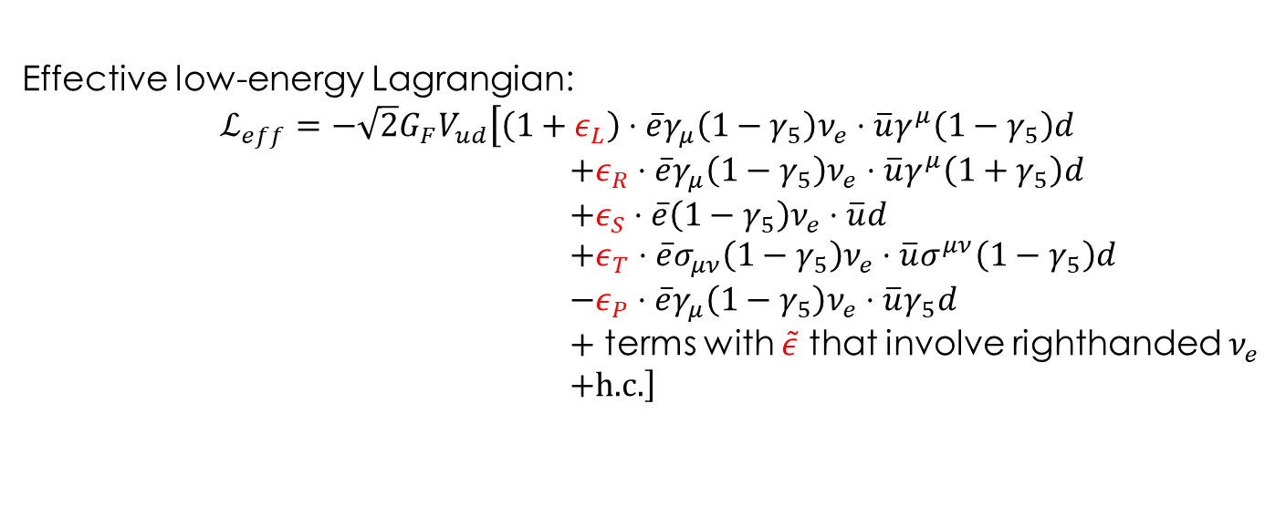
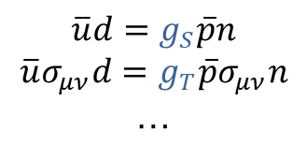
Effective field theory for beta decay at quark level
Effective low-energy Lagrangian:
$$ℒ_{eff}=−\sqrt{2}G_{F}V_{ud}\left[\left(1+ε_{L}\right)⋅\overline{e}γ_{μ}\left(1−γ_{5}\right)ν_{e}⋅\overline{u}γ^{μ}\left(1−γ_{5}\right)d\right.$$
$+ε_{R}⋅\overline{e}γ_{μ}\left(1−γ_{5}\right)ν_{e}⋅\overline{u}γ^{μ}\left(1+γ_{5}\right)d$
$+ε_{S}⋅\overline{e}\left(1−γ_{5}\right)ν_{e}⋅\overline{u}d$
$+ε_{T}⋅\overline{e}σ_{μν}\left(1−γ_{5}\right)ν_{e}⋅\overline{u}σ^{μν}\left(1−γ_{5}\right)d$
$−ε_{P}⋅\overline{e}γ_{μ}\left(1−γ_{5}\right)ν_{e}⋅\overline{u}γ_{5}d$
$+$ terms with $\tilde{ε}$ that involve righthanded $ν_{e}$
$\left.+\text{h}\text{.}\text{c}\text{.}\right]$
Unobservable, due to limits from pion decay
Unobservable, all corr. coeff. only sensitive in second order
Connection with traditional coupling constants from nuclear and neutron physics:
$$C_{V}^{+}=\sqrt{2}G_{F}V_{ud}g_{V}\left(1+ε_{L}+ε_{R}\right)$$
$$C_{A}^{+}=−\sqrt{2}G_{F}V_{ud}g_{A}\left(1+ε_{L}−ε_{R}\right)$$
$$C_{S}^{+}=\sqrt{2}G_{F}V_{ud}g_{S}ε_{S}$$
$$C_{T}^{+}=\sqrt{2}G_{F}V_{ud}4g_{T}ε_{T}$$
$$\overline{u}d=g_{S}\overline{p}n$$
$$\overline{u}σ_{μν}d=g_{T}\overline{p}σ_{μν}n$$
…
Note that some authors omit this factor 4

Slide 19
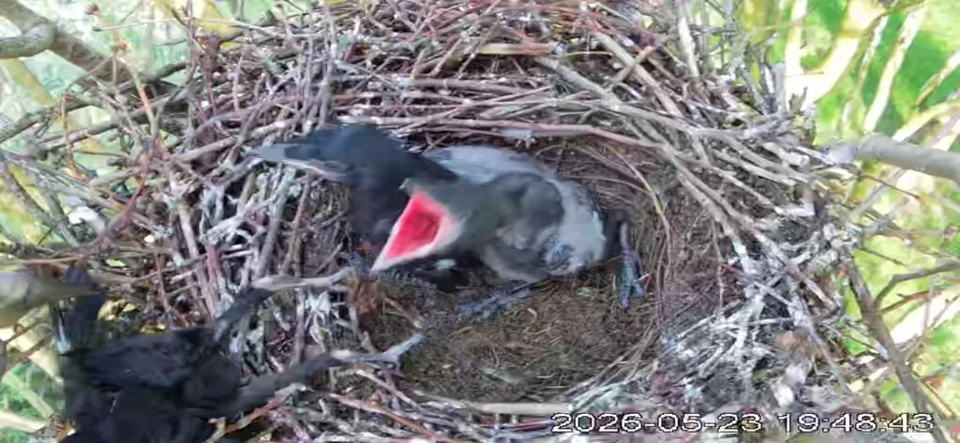
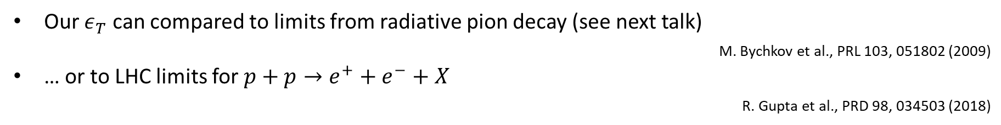
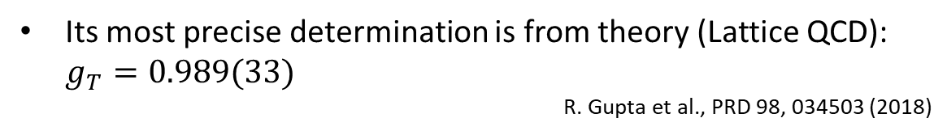
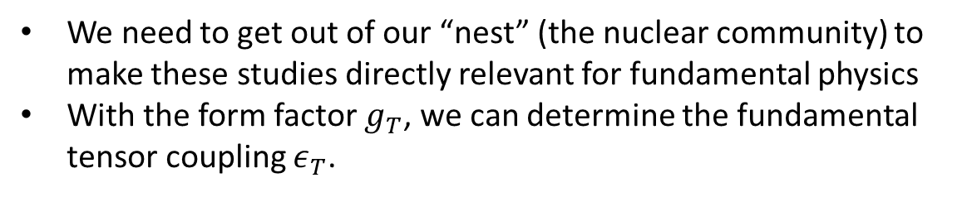
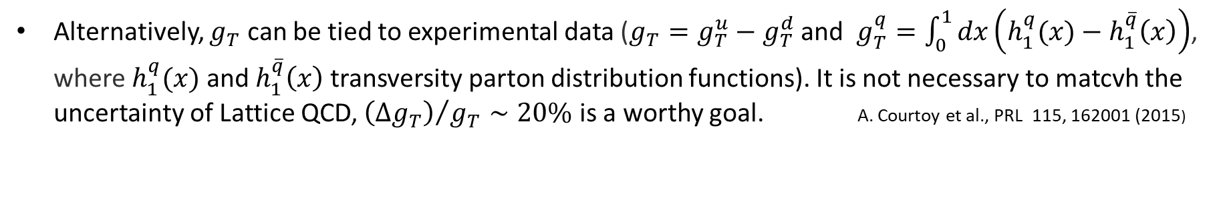
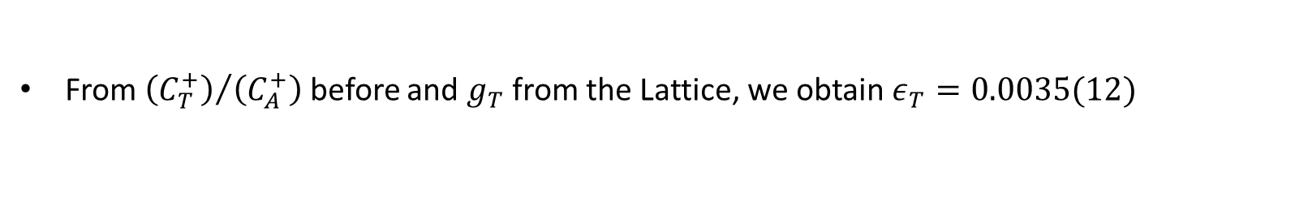
Discussion of fundamental tensor charge
We need to get out of our “nest” (the nuclear community) to make these studies directly relevant for fundamental physics
With the form factor $g_{T}$, we can determine the fundamental tensor coupling $ε_{T}$.
Its most precise determination is from theory (Lattice QCD): $g_{T}=0.989(33)$
                R. Gupta et al., PRD 98, 034503 (2018)
Alternatively, $g_{T}$ can be tied to experimental data ($g_{T}=g_{T}^{u}−g_{T}^{d}$ and $g_{T}^{q}=\int_{0}^{1}{dx\left(h_{1}^{q}(x)−h_{1}^{\overline{q}}\left(x\right)\right)}$, where $h_{1}^{q}(x)$and $h_{1}^{\overline{q}}\left(x\right)$transversity parton distribution functions). It is not necessary to matcvh the uncertainty of Lattice QCD, ${\left(Δg_{T}\right)}/{g_{T}}∼20\%$ is a worthy goal. A. Courtoy et al., PRL 115, 162001 (2015)
From ${\left(C_{T}^{+}\right)}/{\left(C_{A}^{+}\right)}$ before and $g_{T}$ from the Lattice, we obtain $ε_{T}=0.0035(12)$
Our $ε_{T}$ can compared to limits from radiative pion decay (see next talk)
M. Bychkov et al., PRL 103, 051802 (2009)
… or to LHC limits for $p+p→e^{+}+e^{−}+X$
R. Gupta et al., PRD 98, 034503 (2018)
Both of those favor the absence of a tensor charge at this level.

Slide 20
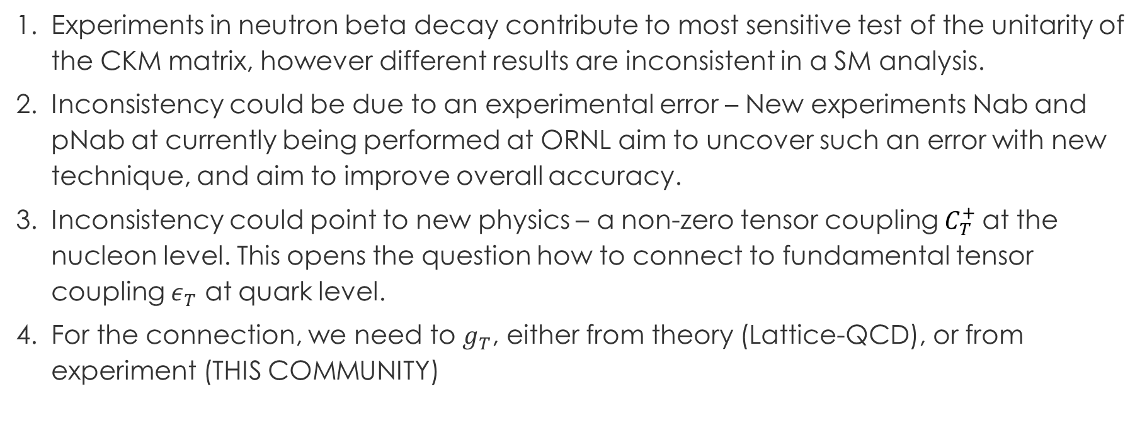
The take-away
Experiments in neutron beta decay contribute to most sensitive test of the unitarity of the CKM matrix, however different results are inconsistent in a SM analysis.
Inconsistency could be due to an experimental error – New experiments Nab and pNab at currently being performed at ORNL aim to uncover such an error with new technique, and aim to improve overall accuracy.
Inconsistency could point to new physics – a non-zero tensor coupling $C_{T}^{+}$at the nucleon level. This opens the question how to connect to fundamental tensor coupling $ε_{T}$ at quark level.
For the connection, we need to $g_{T}$, either from theory (Lattice-QCD), or from experiment (THIS COMMUNITY)

