Slide 1

Click to CLAS12 Simulation and Analysis Plans
Veronique Ziegler
CLAS12 Software Project Manager
Science & Technology Review
Breakout Session II
July 29, 2015

Slide 2
Introduction
PhD at the University of Iowa – BaBar experiment (May 2007)
  Hyperon and Hyperon Resonance Properties From Charm Baryon Decays At BaBar (SLAC-R-868)
Postdoc at SLAC – BaBar experiment (2007- 2011)
  charm & quarkonium spectroscopy
  co-convener of the BaBar Quarkonium Analysis Working Group (2009 – 2011)
Hall B staff scientist (since November 2011)
  leading the development of CLAS12 event reconstruction software
  tracking software development
  hadron spectroscopy

Slide 3


CLAS12
Base equipment
Forward Detector (FD)
  - TORUS magnet (6 coils)
  HT Cherenkov Counter
  Drift Chamber system
  LT Cherenkov Counter
  Forward ToF system
  Pre-shower Calorimeter
  E.M. Calorimeter
Central Detector (CD)
  SOLENOID magnet
  Silicon Vertex Tracker
  Central ToF system
Beamline
  Targets
  Moller polarimeter
  Photon Tagger
Tracking
PID
(K/p up to 4.5 GeV)
PID
(p/ π up to 1.2 GeV)
(K/ π up to 0.65 GeV)
Tracking
RICH
MM
FT
CND
Upgrade to base equipment
- MicroMegas
  Central Neutron Detector
  Forward Tagger
  RICH detector (1 sector)
  Polarized target (long.)
PID
(e/ π ~5 GeV π threshold)
Neutrals
(γ reco. & 2-γ separation up to 9 GeV)
Complex detector system requires an integrated framework to write efficient, modular and robust data processing application
PID
(K/π from 3.5 to 9 GeV)
http://www.jlab.org/Hall-B/clas12-web/
3
Notes:
To meet the physics requirements of high statistics measurements for exclusive processes, the equipment underwent major upgrades. CLAS12 has two major parts to its base equipment with different functions, the Forward Detector (FD) and the Central Detector (CD). The FD covers polar angle range of 5◦ to 35◦ and the CD from about 35◦ to 125◦.
The TORUS has six superconducting coils symmetrically arranged around the beam line, and provides six sectors for charged particle detection. Each sector has its own tracking and particle identification detectors. Tracking is accomplished with a set of 3 regions of drift chambers with 12 layers of hexagonal drift cells arranged in a pattern optimized to provide measurements for pattern recognition and subsequently track reconstruction; then PID (K/p separation up to 4.5 GeV) is obtained using the time-of-flight system from beta measurements. For improved PID, measurements from 2 Cherenkovs are employed: a high threshold counter for e-/pi separation and a low threshold counter for K/pi separation. Neutral reconstruction done using the calorimeters; physics program require the identification of single high energy photons and separation from π0 → γγ up to 9 GeV achieved by adding a preshower calorimeter (PCAL) in from of the electromagnetic calorimeter. For tracks produced at angles larger than 35◦ tracking is done using the Silicon Vertex tracker (up to 4 space points) and PID from beta measurement obtained from C. Time of Flight scintillator barrel. Several upgrades including the micromega detectors are aimed at improving tracking resolutions; the RICH with improve charged particle ID, the CND give neutron ID. A quasi-real photon forward tagging system (FT) will measure electrons at scattering angles from 2◦ - 4◦ .

Slide 4
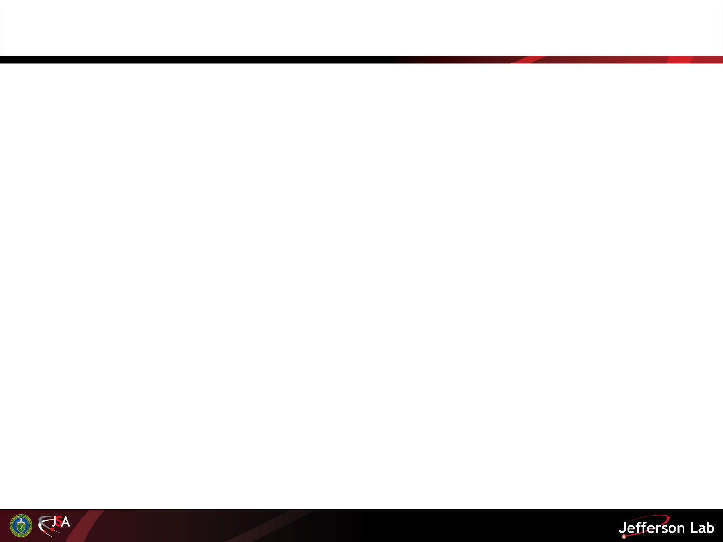
Overview
Current Status of CLAS12 Software
  Model and Architecture
  Simulation
  Reconstruction
  Manpower and Code Management
Summary
4

Slide 5
Computing Model and Architecture
ClaRA (CLAS12 Reconstruction & Analysis framework)
  Framework implementing a Service Oriented Architecture: develop, deploy and manage loosely coupled software components. Designed to do thread-based event level parallelism ➔ optimal use of new multicore machines.
  Supports both traditional (centralized batch processing) and distributed cloud computing models.
Reconstruction code framework: (Clas Offline Analysis Tools [coat-java])
  Detector reconstruction and event building framework written in Java.
  Common Tools packages.
Report on the 12 GeV Software and Computing Review
Jefferson Laboratory
November 25-26 2013
Committee: David Nathan Brown (LBL/BaBar), Sergei Gerassimov (TU Muenchen/COMPASS), Elizabeth Sexton-Kennedy (FNAL/CMS) , Martin Purschke (BNL/PHENIX), and Torre Wenaus (BNL/ATLAS) (chair).
Observation
The CLAS12 data management was very impressive and forward thinking.
Report on the 12 GeV Software and Computing Review
Jefferson Laboratory
February 10-11, 2015
Committee: Sergei Gerassimov (TU Muenchen/COMPASS), Martin Purschke (BNL/PHENIX), Elizabeth Sexton-Kennedy (FNAL/CMS) and Torre Wenaus (BNL/ATLAS) (chair).
Findings
We commend the development of common framework tools including common geometry across all geometry consumers.
5

Slide 6
CLAS12 Software Overview
Common Tools Packages in Integrated Framework
  Geometry package: detector constants & geometry algorithms
  I/O common library
  Calibration constants database access tools
  Histogramming and fitting (jMinuit) libraries
  Calibration and Monitoring suite
Simulation (Geant4 Monte Carlo)
  Compliant with current version of GEANT4
Event Reconstruction
  Central & Forward Tracking
  Time-of-Flight Particle Identification
  Cerenkov counters and Electromagnetic shower counters
Visualization Tools
  Clas12 Event Display: tracking, calorimetry, TOF reconstruction information; detailed magnetic field information
  2-D & 3-D views
6

Slide 7
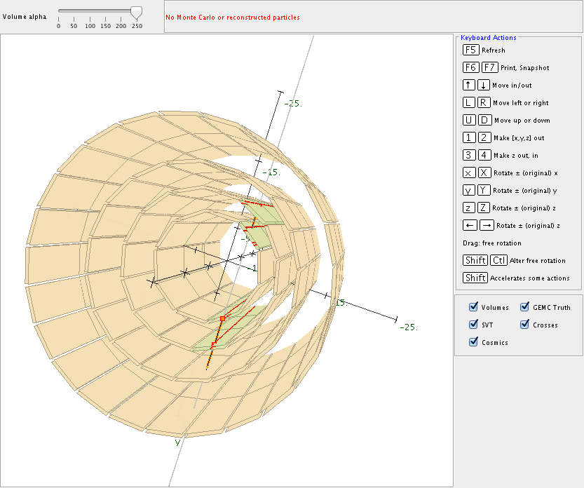
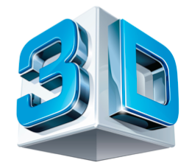
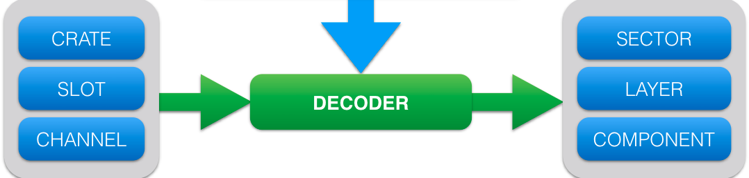
Common Tools Packages
Geometry package
I/O common library
Plotting package
Detector Geometry Package
provides detector geometry
for :
Forward Time-of-Flight, Calorimeters, Drift Chambers, Silicon Vertex Tracker, Central Neutron Detector
geometry tools and utilities:
Drawing package for 2D detector representation
3D shapes for event display 3D viewer
Detector components for Fast Monte Carlo
TRANSLATION TABLE
✓ Plotting Library:
histogram & graph classes, n-tuple class for analysis
plotting emulating ROOT API
7

Slide 8

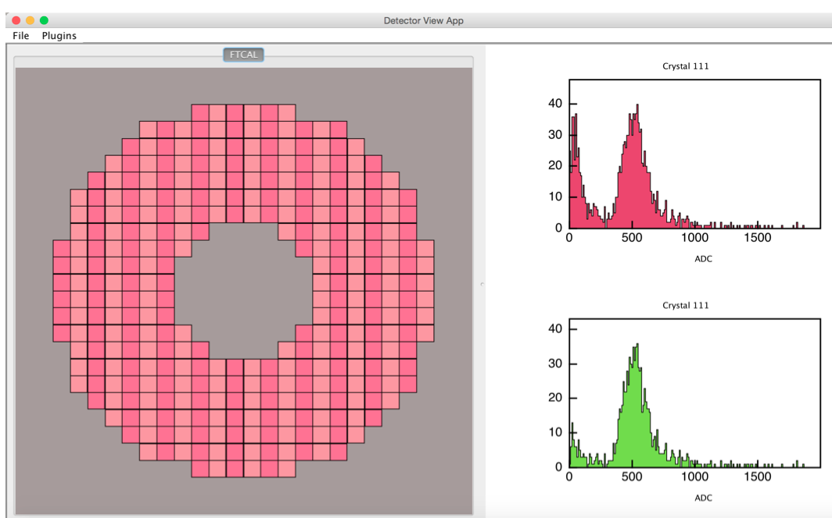
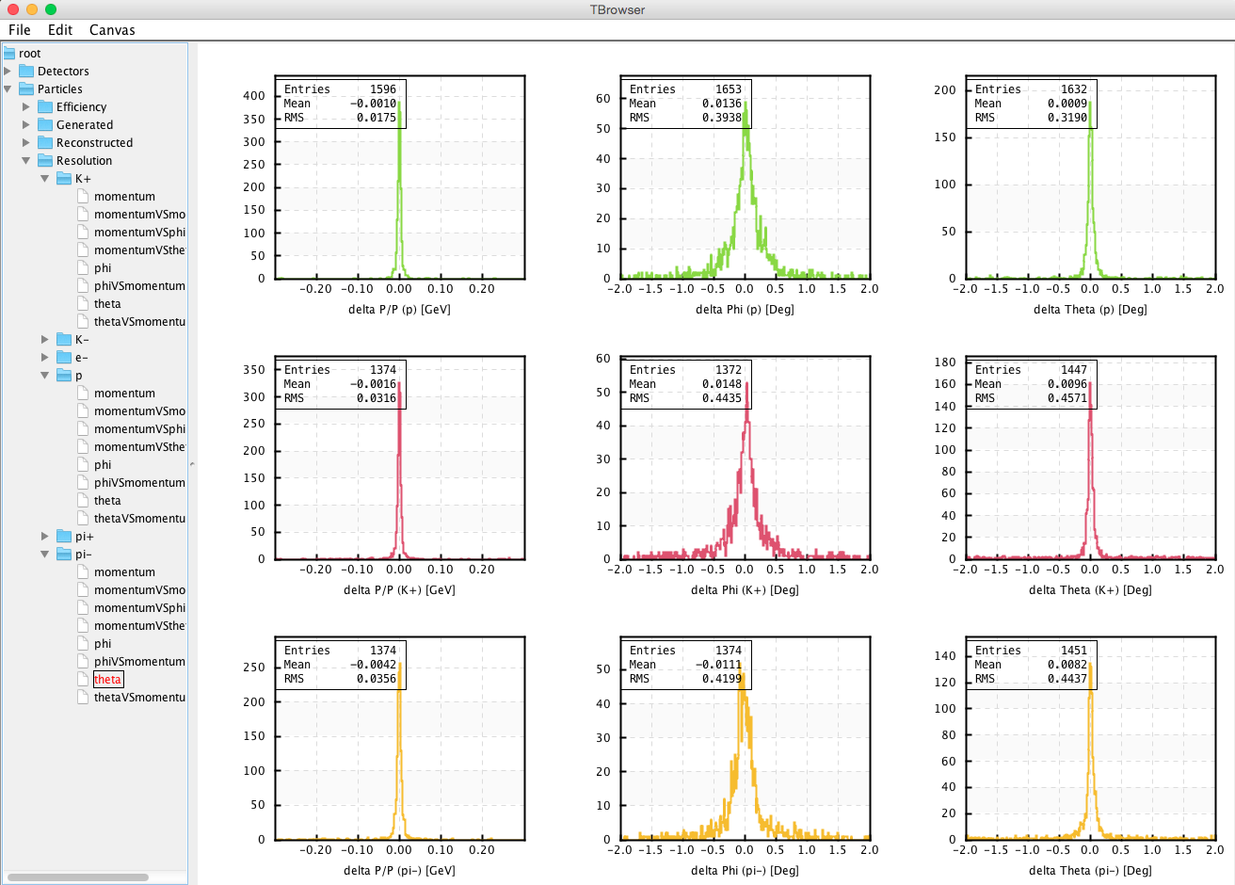

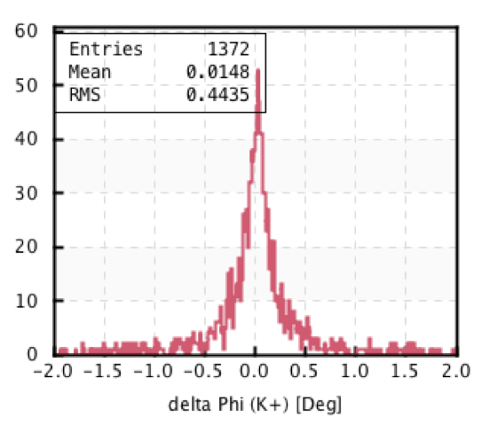
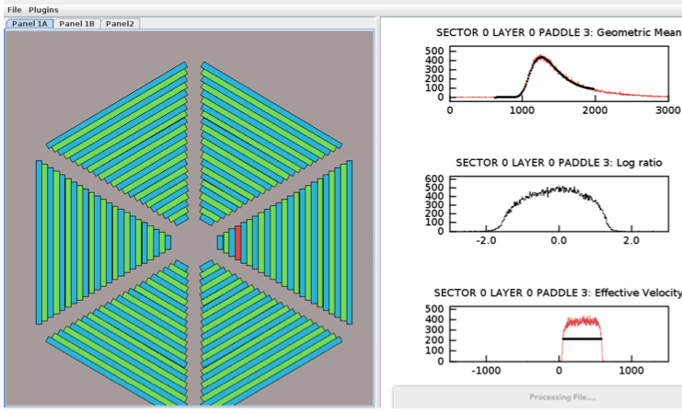
Common Tools Packages
  Calibration and Monitoring package
  Standard representation of detector components
  Standard interface for data processing and for drawing calibration and monitoring histograms for each detector component
  Plugin-based software framework (modularity and maintainability)
  Monitoring GUIs for code validation
tracking resolution plots
^{p}
^{K}
^{π}
8

Slide 9
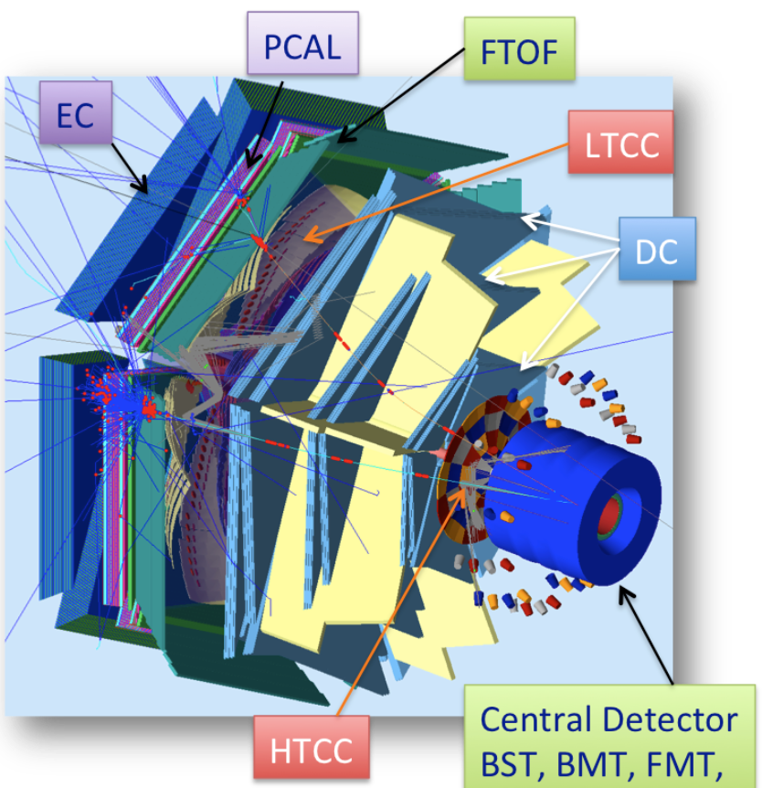
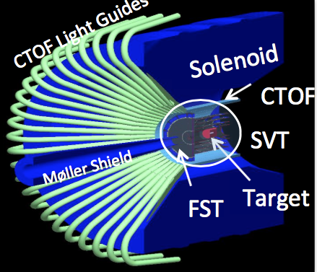
Simulation
Report on the 12 GeV Software and Computing Review
Jefferson Laboratory
June 7-8, 2012
…GEMC is their very flexible Geant4 based data simulation package in use since 2007. GEMC derives its geometry information from a database, thereby making it easy to share one geometry description between the simulation and reconstruction.
GEant4 Monte-Carlo (GEMC)
M. Ungaro
Developed at J-Lab
Object Oriented Design
  C++ classes, Standard Template Libraries
Includes the complete baseline & all detectors upgrades to CLAS12
Digitization and Optical properties in place
In use for:
  event reconstruction
  high level physics analysis
  beam background studies
FMT
9

Slide 10
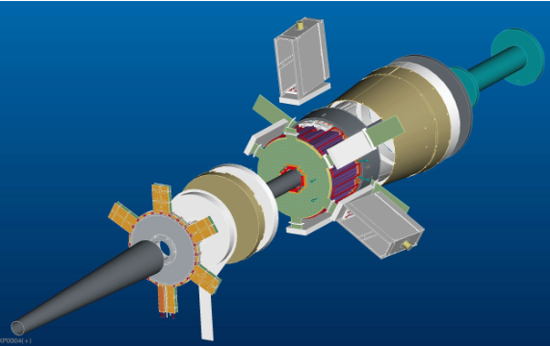
Event Reconstruction Status
Central Tracking
Silicon Vertex Tracker → helical tracks
Central Time Of Flight → β (track pathlength from SVT to CTOF)
Forward Tracking
Drift Chambers Hit-Based & Time-Based Tracking → Kalman Filter fitting method to reconstruct tracks
Forward Micromegas Tracker pattern recognition → refit DC tracks with FMT 3-D points (resolution improvement)
Forward Time Of Flight → β (track pathlength from DC to FTOF)
Forward Tagger calorimeter and hodoscope →id low angle electrons and reconstruct π⁰’s
Electromagnetic Calorimeter/Preshower CALorimeter → detector responses for PID, reconstruction of neutrals
High Threshold Cherenkov Counter → e- ID
FT
LTCC
⬆ hodoscope
⬆ calorimeter
10

Slide 11
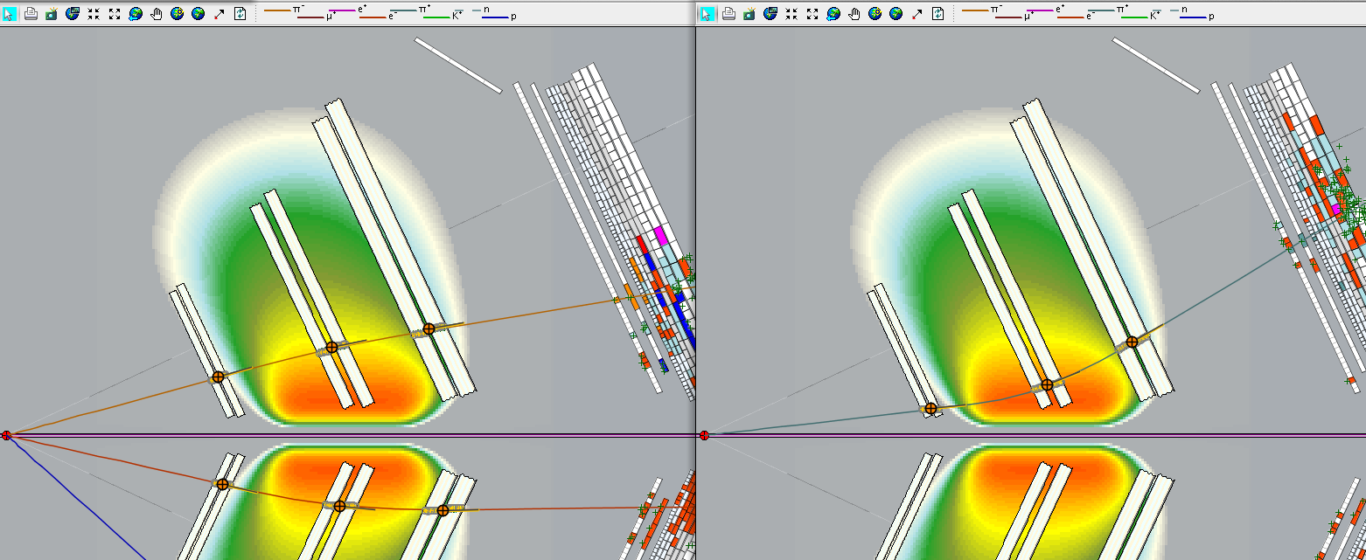
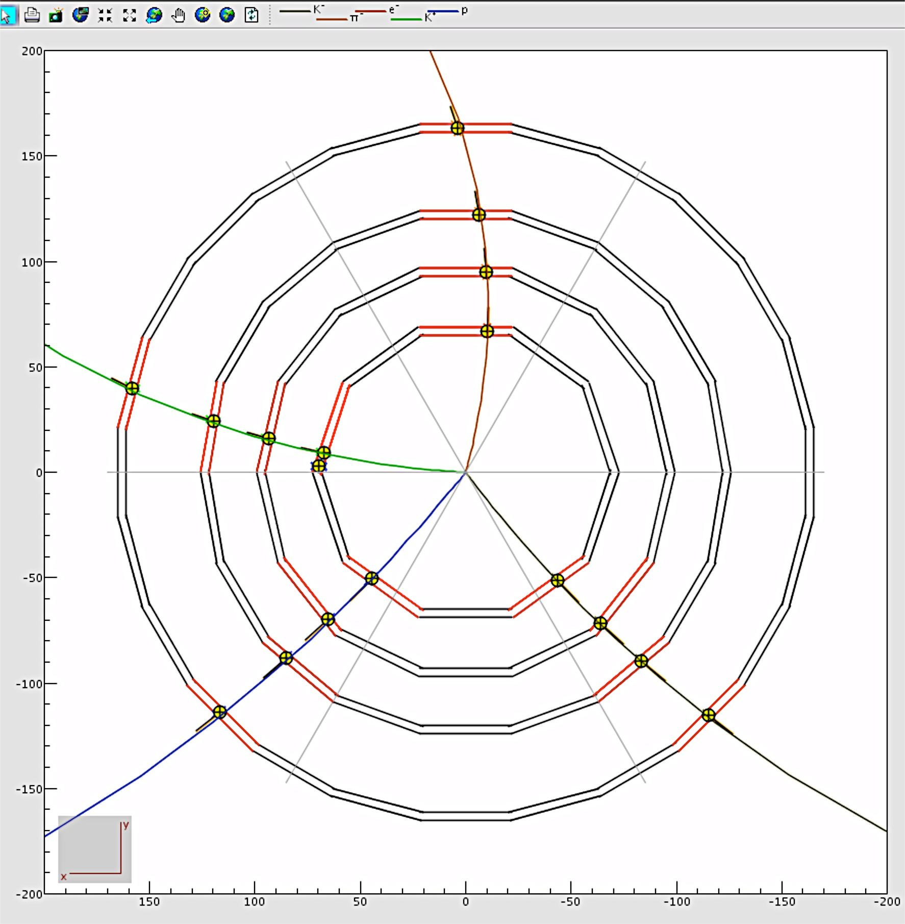
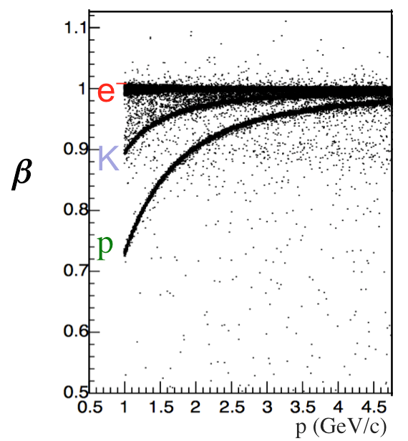
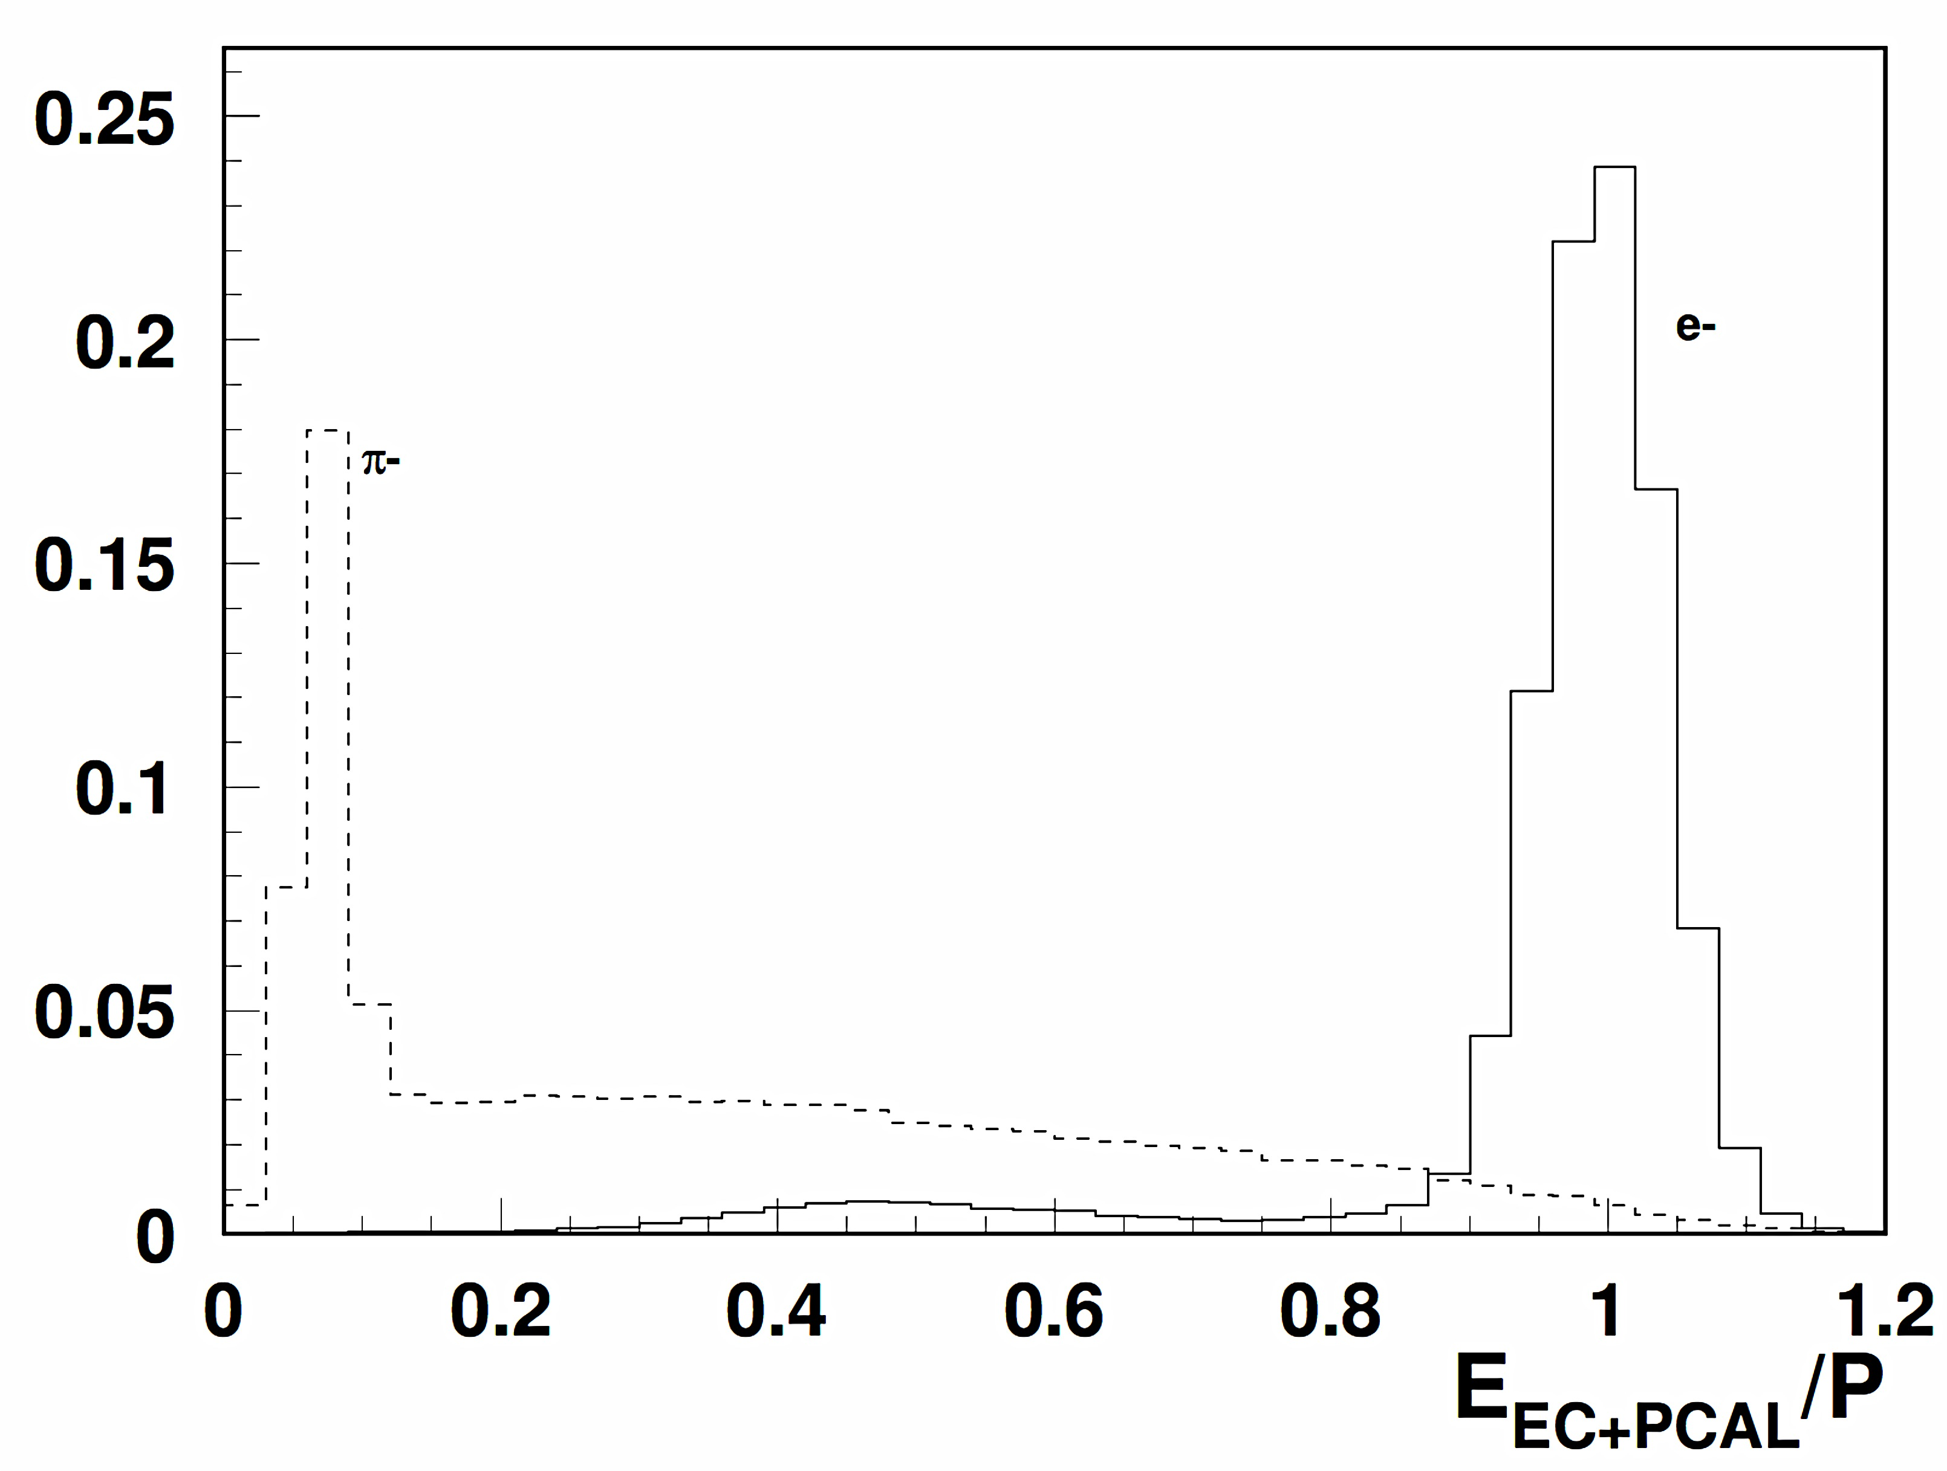
Event Reconstruction
Charged Particle Tracking
FORWARD→
CENTRAL→
Clas12 Event Display
EC/PCAL
Clas12 Event Display
π ⁻
π ⁺
e⁻
  PID
  HTCC (electron tagging)
  FTOF → & EC/PCAL responses →
e⁻
π⁻
11

Slide 12
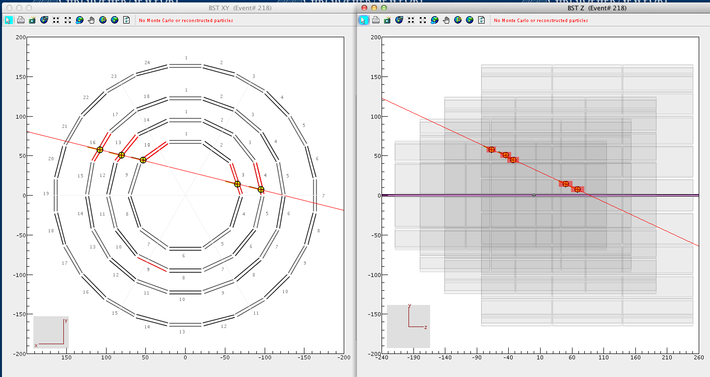
SVT Cosmic Data Analysis
Viewing reconstructed cosmic data using 3 assembled SVT regions
Clas12 Event Display
4th region not mounted
δz
4th region not mounted
12

Slide 13
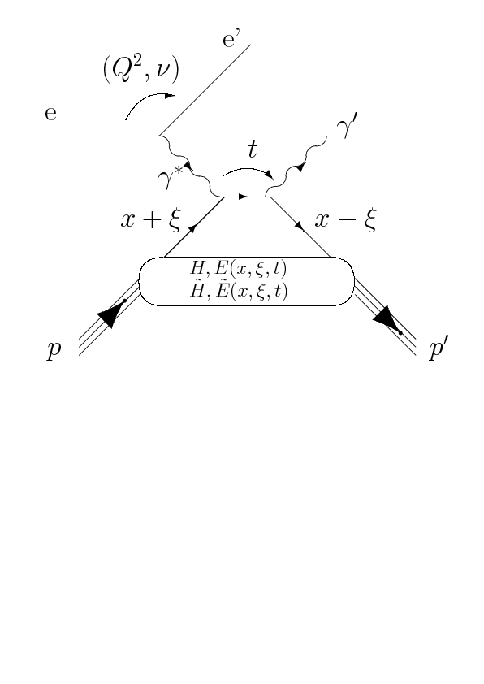
Analysis Example
DVCS: key reactions for CLAS12 physics program
Dominant source of background is e⁻p → e⁻’p’ π⁰ (π⁰ → γγ)
Photon selection criteria to reject this background
DVCS & e⁻p → e⁻’p’ π⁰ background simulation
Reconstruction
Analysis

Slide 14
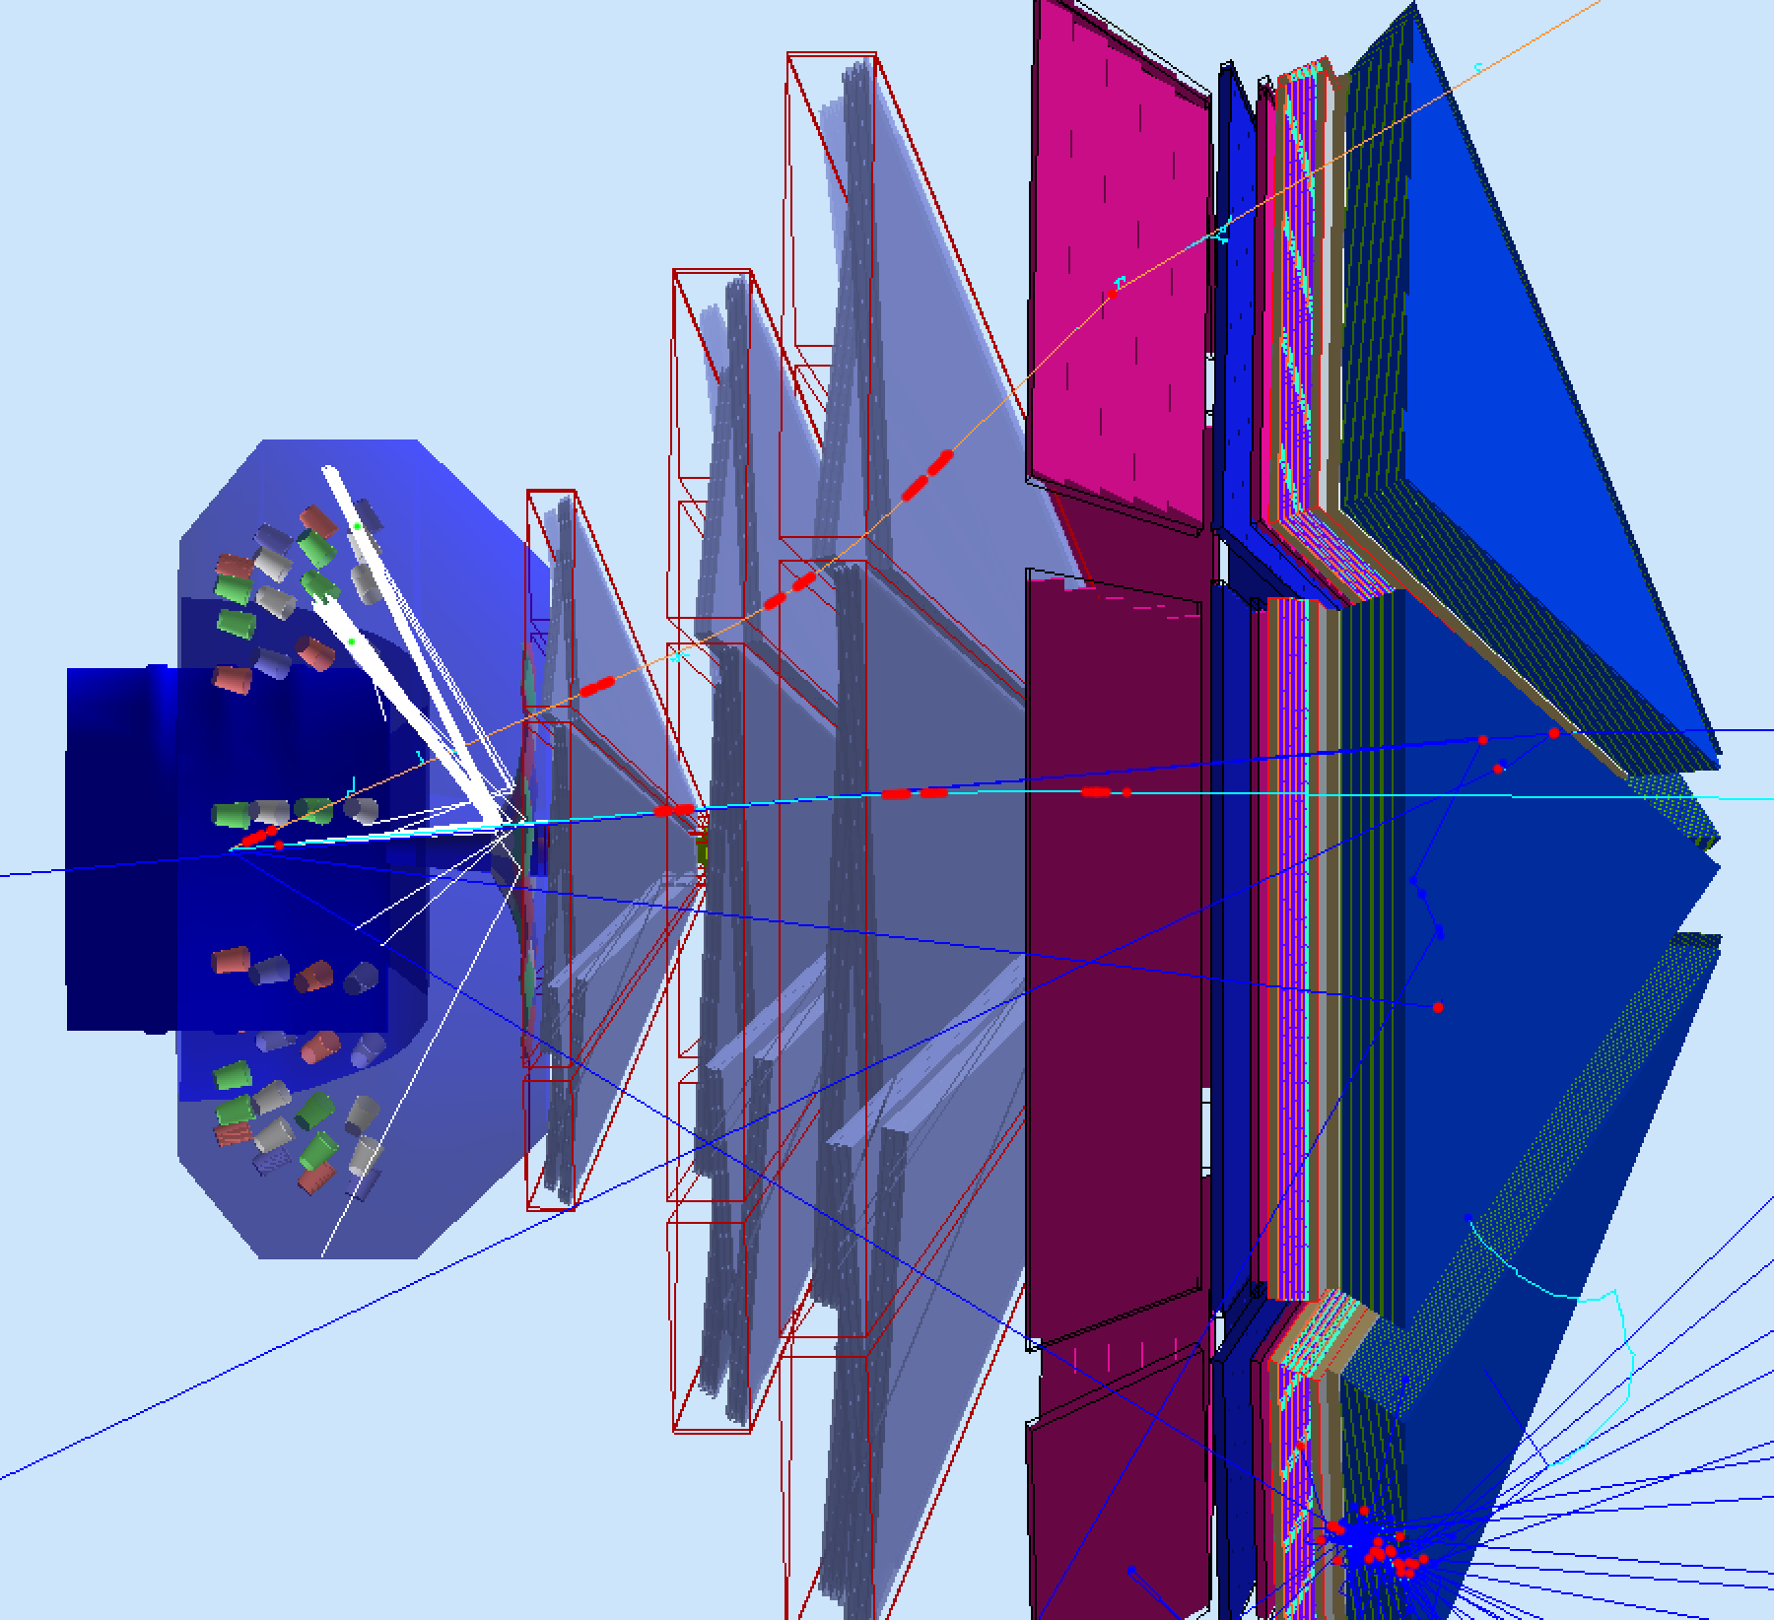
Physics Event Simulation
DVCS background reaction :
e⁻ p
e⁻ p π⁰
( π⁰
γ γ )
GEMC:
fully digitized detector systems
proton
electron
π⁰
γ γ

Slide 15
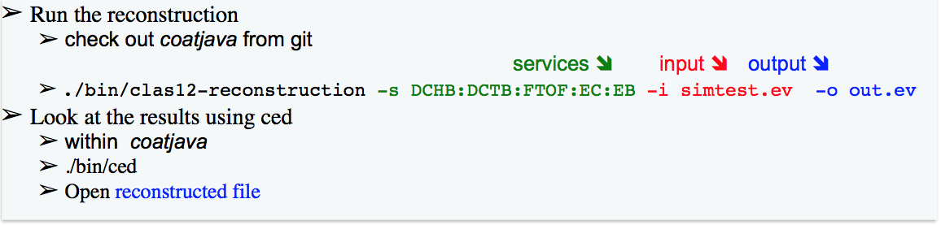
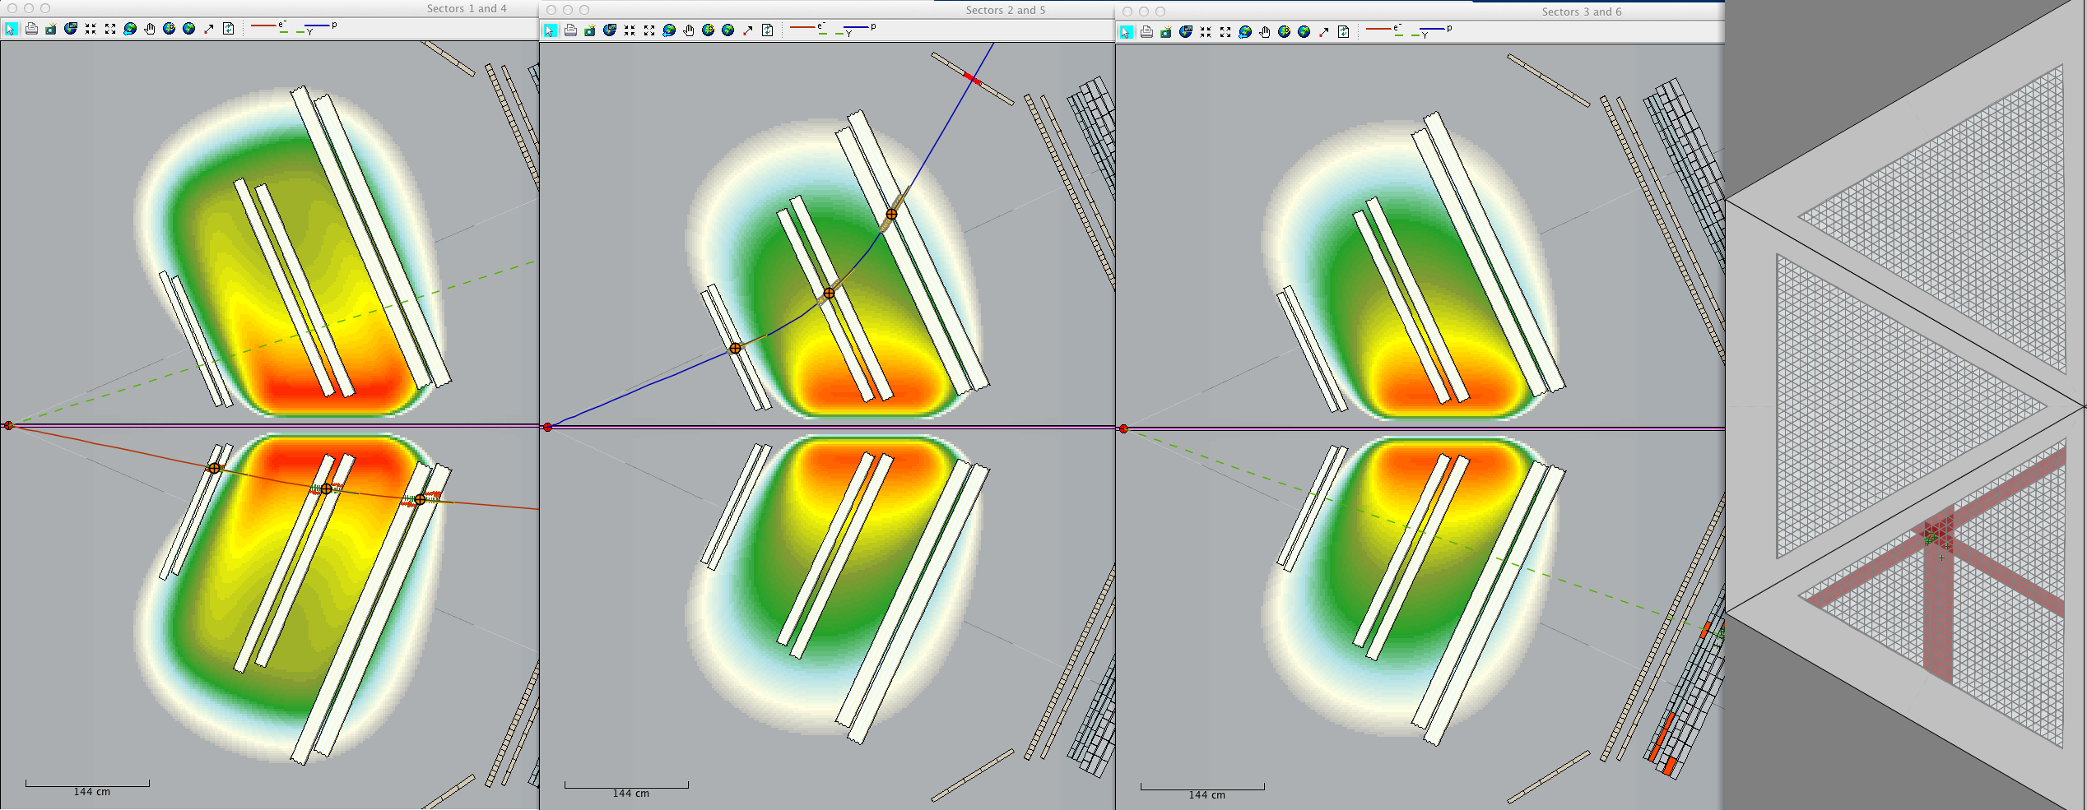
Physics Event Reconstruction
DVCS background reaction :
e⁻ p
e⁻ p π⁰
( π⁰
γ γ )
p
γ
e-
γ
Visualization Tools: Clas12 Event Display (ced)

Slide 16
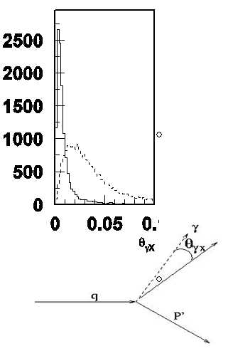
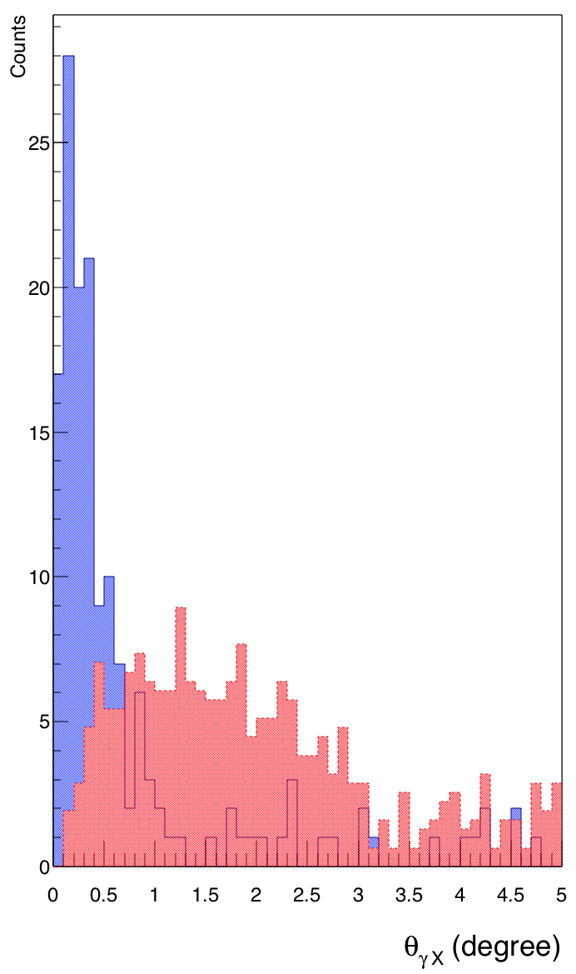

Analysis of π⁰ Contamination in epγ Sample
Harut Avakian
Using
Reconstructed events,
simulated with GEMC
e⁻ p
e⁻ p γ
e⁻ p
e⁻ p π⁰
( π⁰
γ γ )
γ
γ
π⁰
π⁰
missing momentum
At large angles detected photon can be used as veto (epX-sample)
Cut on the direction of the measured photon (detection of proton)
significantly reduces the contamination (of epγ-sample)
16

Slide 17
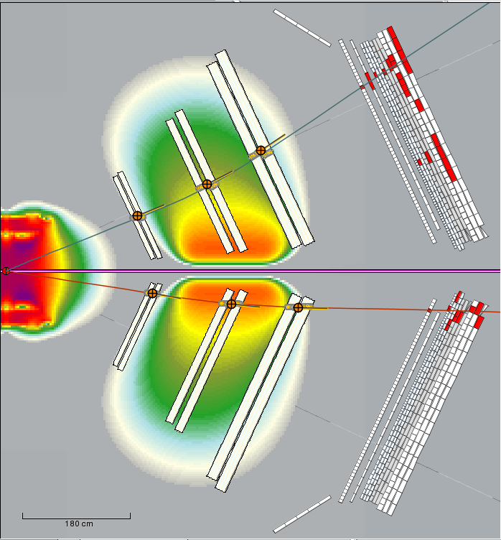
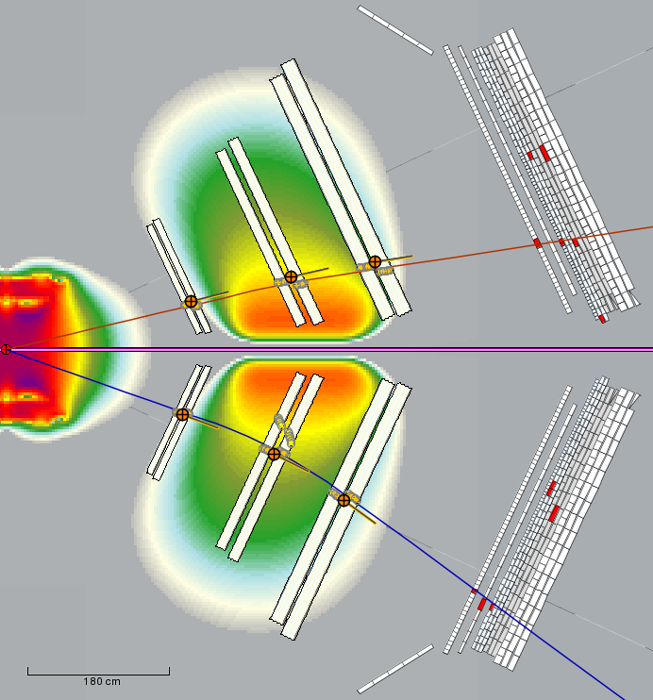
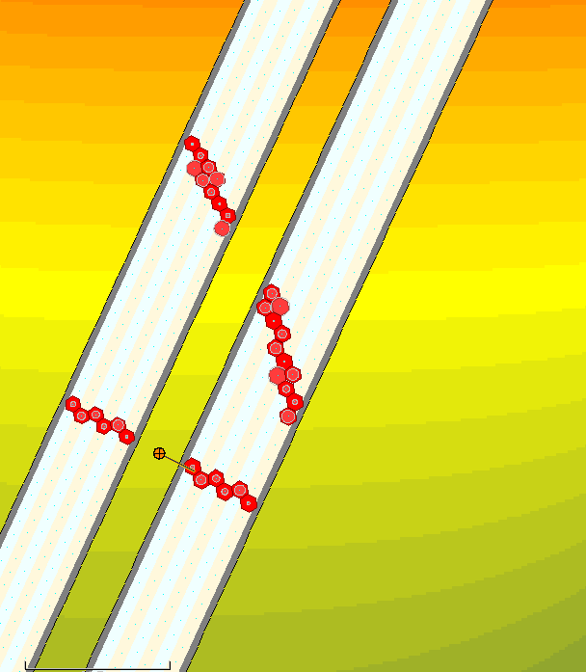
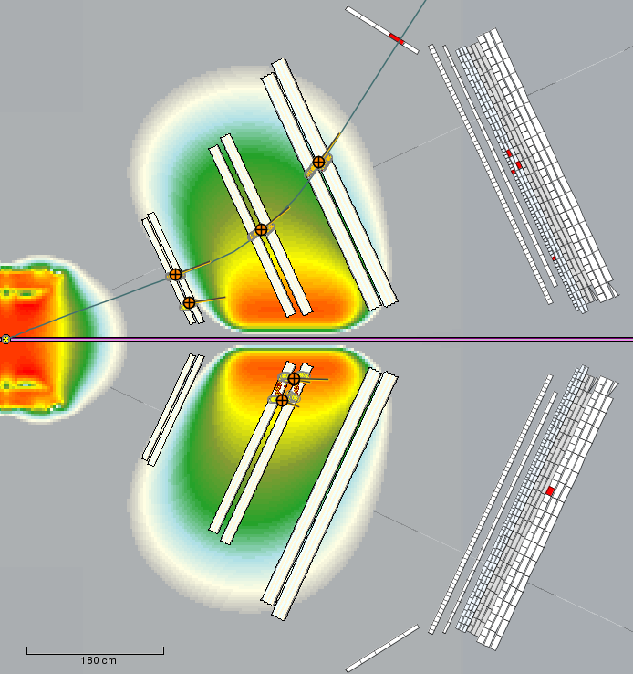
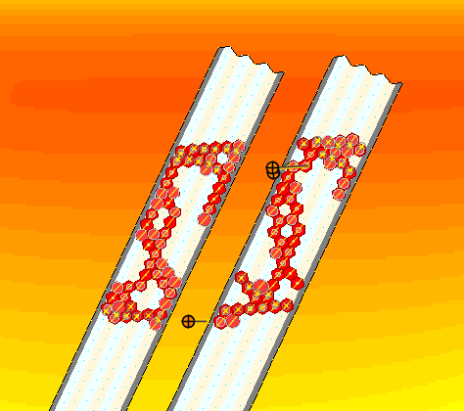
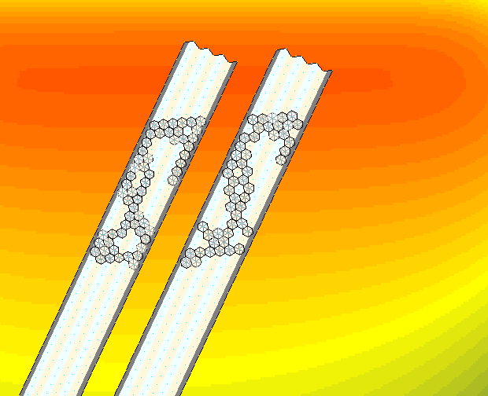
Study: Beam Background Effects on Event Reconstruction
Tracks with torus and solenoid at full field
without beam background
with full luminosity beam background
Segments due to e- background
pion
electron
electron
proton
Tracks with torus at full field, solenoid at half field (full lumi beam background)
pion
Additional hits due to background to higher Moeller rates
Removed by noise rejection algorithm
17

Slide 18
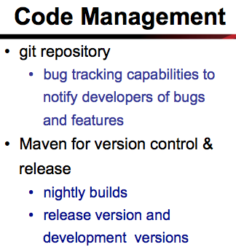
Manpower
All Major projects covered
Geometry package
Magnetic field libraries
Simulation & event generators
Event monitoring
Event reconstruction
Validation and monitoring
Calibration
I/O libraries
Databases
Alignment and Vertexing
Higher level analysis
Data challenges
Documentation
18

Slide 19
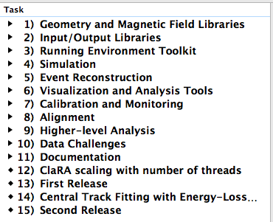
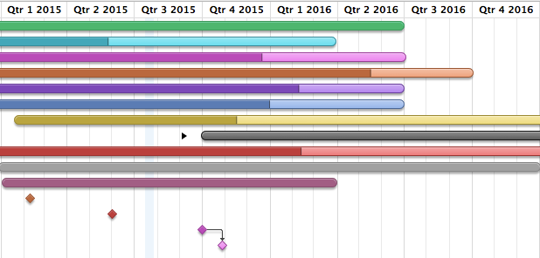
Offline Software - 2015 Milestones
CLAS12 Software
Ready well before data taking
12/2016
today
ongoing projects
2015 Milestones
January: ClaRA linear scaling with number of thread
    May: First Release of CLAS12 software package including simulation, reconstruction, analysis and visualization applications
    June: Calibration and Monitoring suite (FTOF, FT, EC using suite)
        September-October: Planned second release
19

Slide 20
Path to First CLAS12 Paper
  Software ready well before data taking
      second release planned for 4th quarter 2015
      fine-tuning continues
  Algorithms for event corrections and fiducial cuts in place by start of data taking
      tools available within framework to analyze reconstructed data events: filters, particle selectors, abilities to implement cuts and do detailed analyses
  ClaRA framework used for data distribution - taking full advantage of collaborating institutions data-centers and computing resources

Slide 21
Summary
Framework in very good shape
  Multi-threaded framework support distributed computing model
  Common tools facilitate development
  Release mechanism in place
Realistic Simulation
  Geometry and digitization in advanced stage, realistic event generators (i.e. Pythia-based), ongoing speed optimization
Event Reconstruction advanced
  Charged particle tracking, time-of-flight, calorimetry well along
  Studying luminosity-dependent limits to track efficiency
Mature Event Visualization software
  Added 3-D viewing
  Used to validate and tune the software
Calibration software well underway
  GUI environment for running calibration, well underway for Cal, FTOF, Forward Tagger
Higher Level Analysis in progress and to be fully in place before data taking
  Fiducial volume definitions, momentum and energy corrections, kinematic fitting started
  Software to be fully ready for analysis & first paper in advance of data taking

Slide 22
Software Projects
Project |  |  | Contributors
Geometry package
 | Development |  | G. Gavalian (J-Lab)
 | Algorithms |  | Detector Groups, M.Mestayer, J.Goetz, Y. Prok, V.Ziegler
 | Framework Development |  | G. Gavalian, J. Hankins (D.H. student)
 | Implementation |  | J. Hankins, ODU students
Magnetic Field libraries
 | Development |  | Dave Heddle (CNU)
 | Validation |  | Krishna Adhikari (U. Mississipi)
Simulation (GEMC)
 | Framework |  | M. Ungaro (J-Lab)
 | Det. Implementation |  | Detector Groups (J-Lab, University Groups)
Event Generators |  |  | H. Avakian
Event Displays & monitoring |  |  | Dave Heddle, (Det. Groups to contribute to monitoring), G. Gavalian
Event Reconstruction
 | Event Builder |  | G. Gavalian, H. Avakian (J-Lab)
 | Detector Components
 |  | SVT | V. Ziegler
 |  | BMT | (V. Ziegler)
 |  | CND | Daria Sokhan (U. of Glascow)
 |  | CTOF | Evgeny Golovach (U. Moscow), Jerry Gilfoyle (U. Richmond)
 |  | HTCC | (A. Puckett = original developer), J. Hankins
 |  | FT | R. de Vita (Genova Group)
 |  | FMT | (Saclay = original developer for MicroMegas reco.), V. Ziegler
 |  | DC | V. Ziegler
 |  | FTOF | Evgeny Golovach, Jerry Gilfoyle
 |  | EC/PCAL | S. Mancilla (Universidad Técnica Federico Santa María), M. Wood (Canisius College)
Project |  | Contributors
Reconstruction Validation Suite
 | Framework Development | G. Gavalian, A. Kim
 | Detector implementation | A. Kim, J.Ruger (Catholic University)
 | Analysis | R. Mendez, O. Cortez, M. Mestayer, V.Ziegler
Calibration
 | Framework Development | CALCOM Group, G. Gavalian
 | Detector implementation | J. Ruger (Catholic U.), Cole Smith (U. Virginia), H. Lu (U. Iowa), U. Glascow
EvIO I/O libraries |  | G.Gavalian
Databases
 | Framework Development | Hall-D
 | Implementation | Y. Prok, J. Goetz
Alignment |  | J. Gilfoyle, J. Ruger
Vertex Fitter package |  | (v. Ziegler)
Higher level analysis |  | Run groups, V. Ziegler
Data Challenges
 | Scaling Studies | S. Mancilla, R. Oyarzun
 | Large scale challenges | Universidad Técnica Federico Santa María group, J-Lab group

