Slide 1
Science and Technology Review
July 28-30, 2015
Detector Technology and Applications
Radiation Detector and Imaging Group
Nuclear Physics Division
Drew Weisenberger

Slide 2
Outline
Brief Overview of the Radiation Detector & Imaging (RD&I) Group
Nuclear Physics Detector Development & Support Examples
Electron Ion Collider (EIC) Generic R&D projects
eRD04 – Detector of Internally Reflected Cerenkov light (DIRC) – assist with high B field tests of microchannel plate photomultiplier tubes (MCP-PMTs)
eRD11 – characterize early Large Area Pico second Photon Detector (LAPPD) prototype (5x5 cm²)
Electro-Optically Coupled Detector (EOCD): analog detector pulses through fiber optics
Tech Transfer: Applications of RD&I Group Technology to Nuclear Imaging
Collaboration with Dilon – new camera prototype based on SiPM technology
Awake Animal SPECT – novel small animal brain bioimaging research
Handheld gamma camera – SiPM technology – 2D, 3D -> wireless
Radioisotope based Plant bioimaging – collaboration with Triangle Universities Nuclear Laboratory (TUNL) & Duke University

Slide 3
Radiation Detector & Imaging Group
Drew Weisenberger – group leader
Brian Kross – detector mechanical design & construction / gas systems /materials
Seungjoon Lee – advanced image recon algorithms / mechanical / detectors
John McKisson– software / data acquisition / electronics
Jack McKisson– high speed electronics / PMTs / SiPMs / solid state detectors
Wenze Xi – detector concepts / electronics / SiPMs / electro-optics
Carl Zorn – SiPMs / scintillators / photo multipliers /radiation damage / optics
Support design and construction of new detector systems
Technical consultants for the lab scientists and users
Development and use of imaging and non-imaging detector systems
Expertise in nuclear particle detection:
solid state and gas based detectors
photon multipliers: PMTs, PSPMTs, SiPMs
scintillation, optical and light guide techniques and characterization
fast analog readout electronics and data acquisition
on-line image formation and analysis
3D image reconstruction algorithm development
compact detectors
Group makes use of expertise in:
Fast Electronics Group
Data Acquisition Group

Slide 4
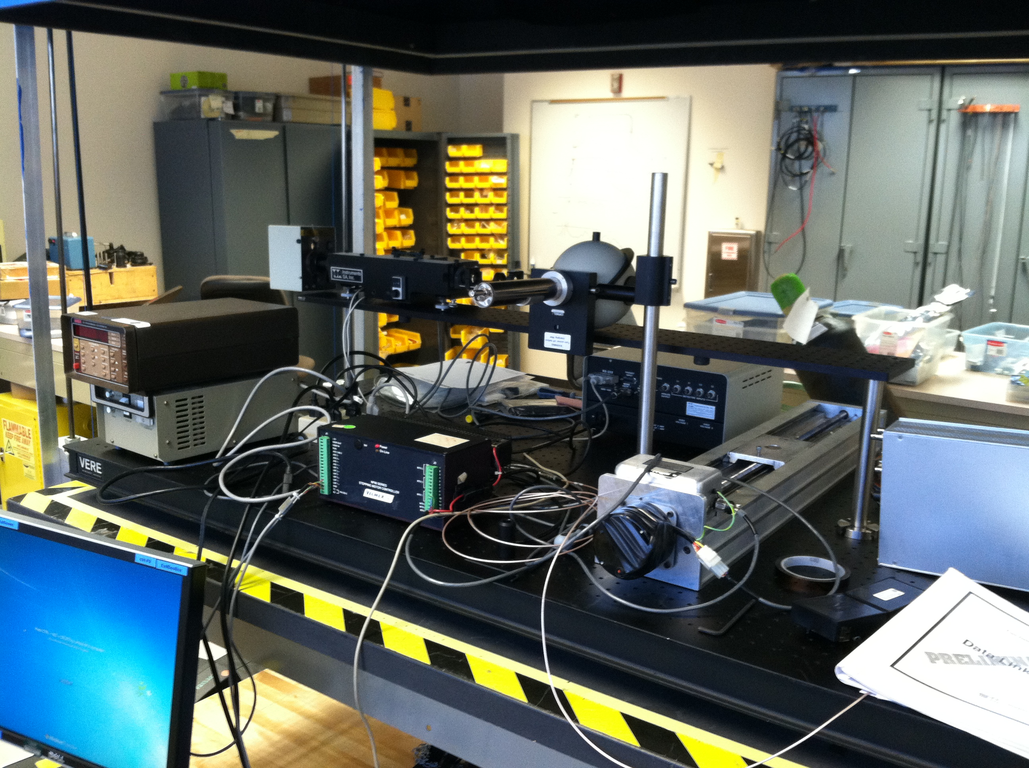
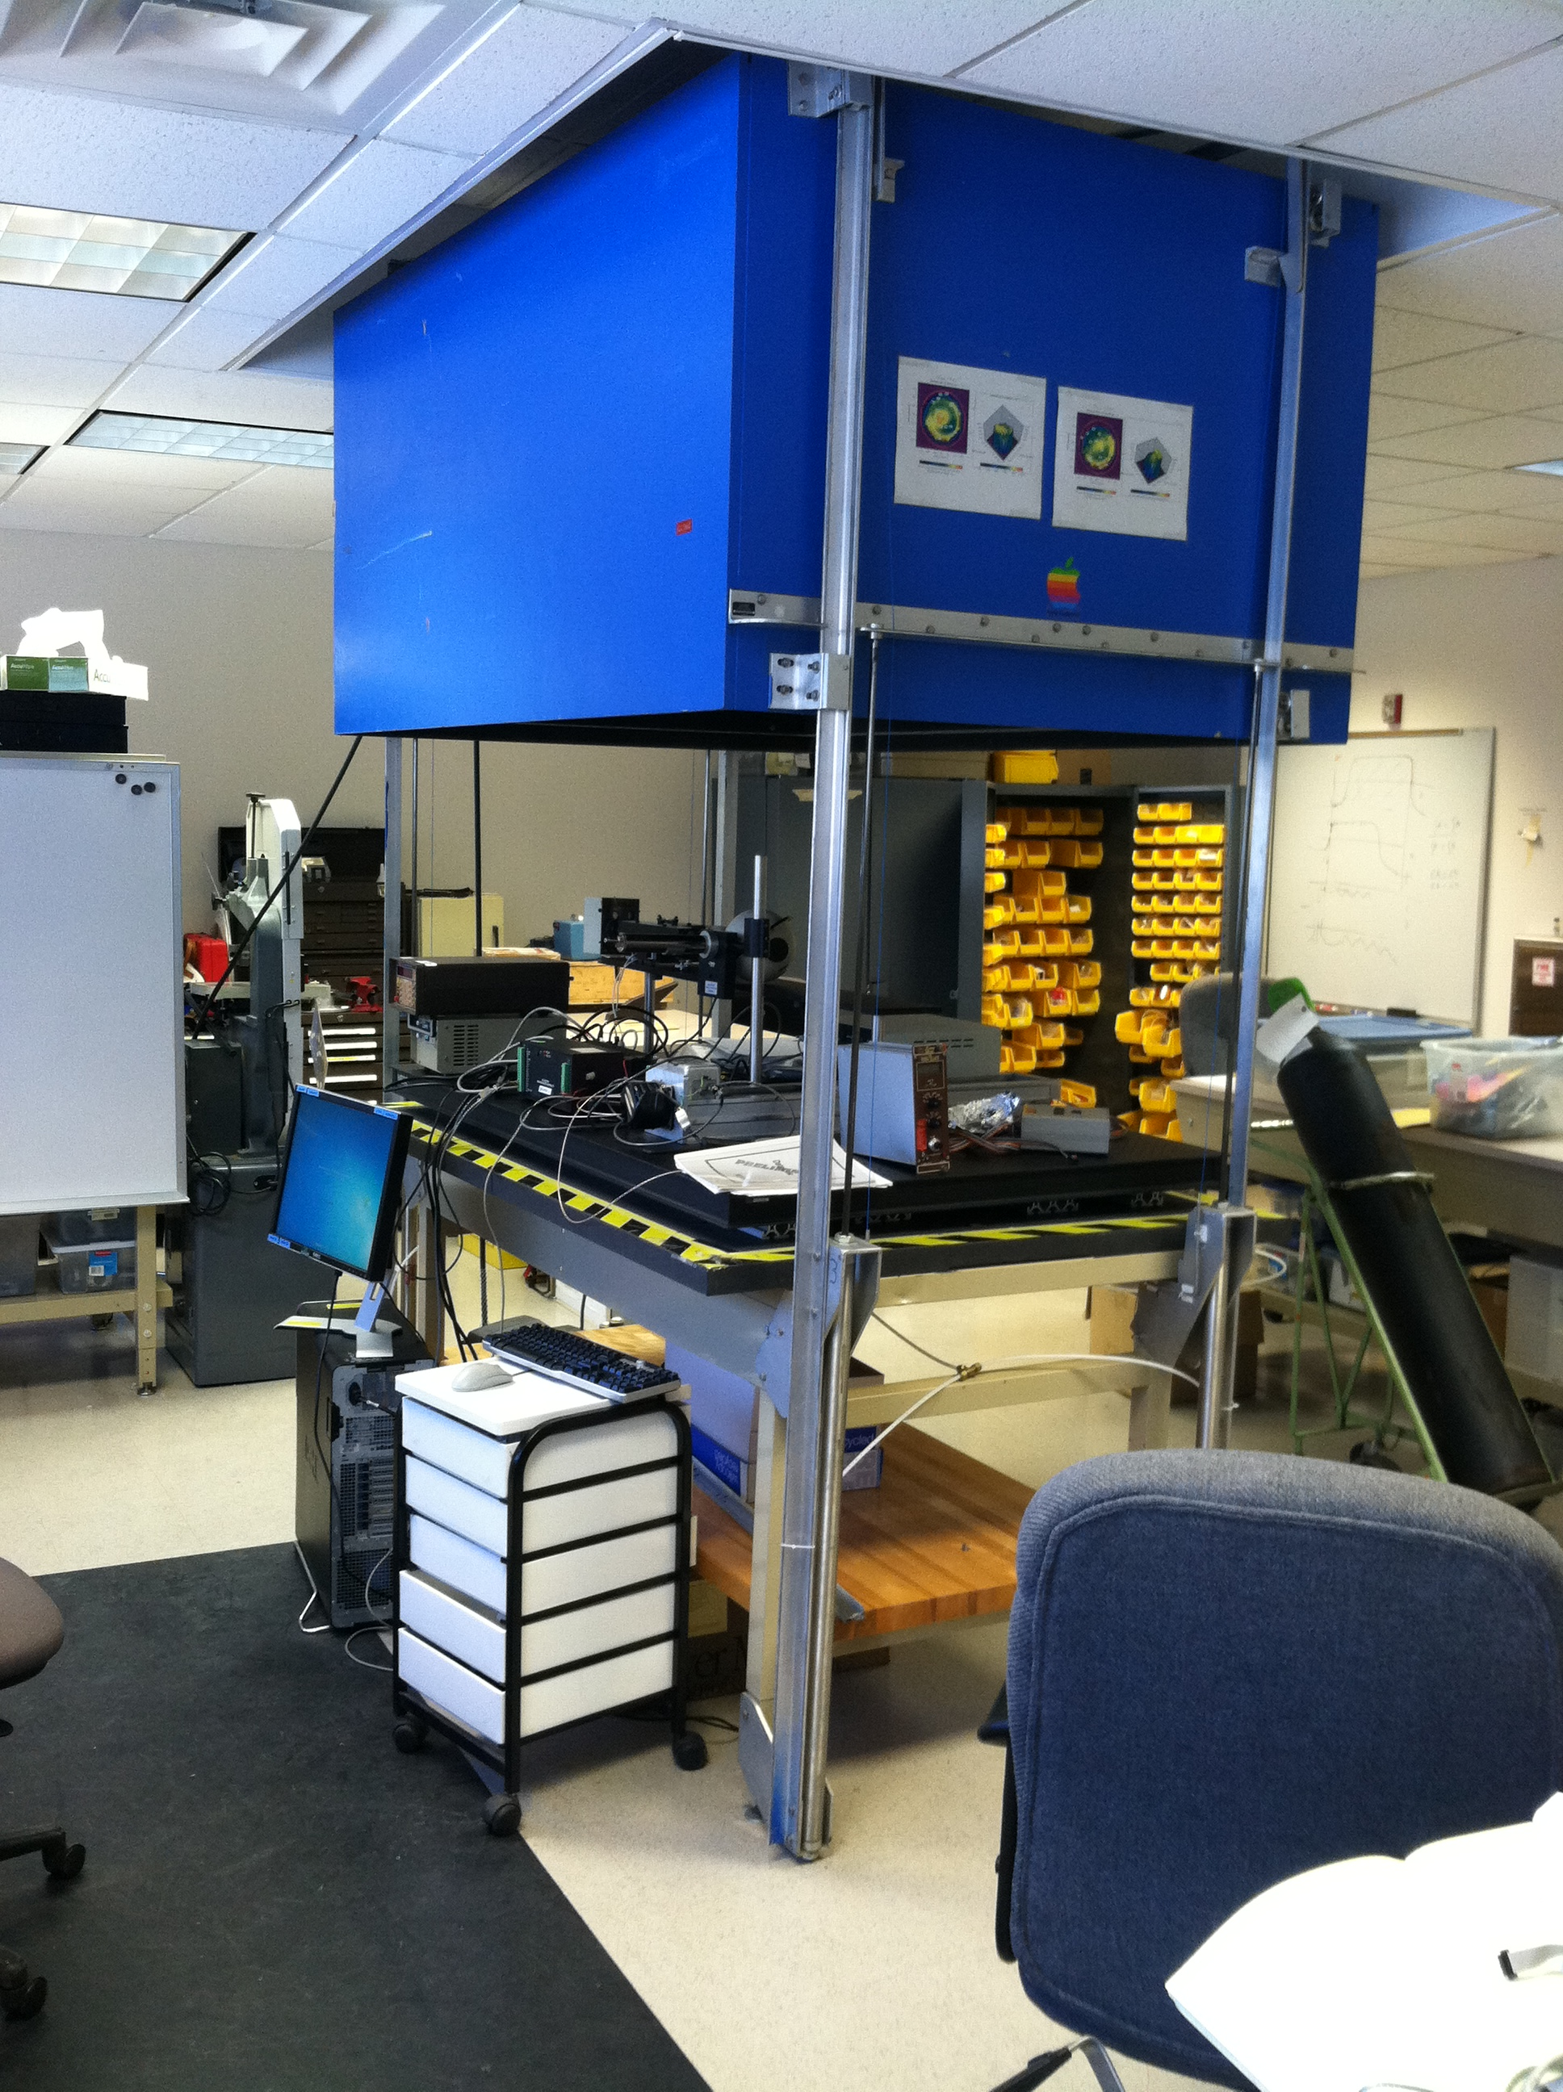
Samples of Detector Group Facilities
A large area (4’x6’) enclosed dark box with many optical test setups possible. Equipped with custom UV-VIS spectrophotometer including xenon lamp, monochromator, optics, motorized position slide
In past – used for variety of tasks
Transmission measurements of large size lead glass blocks
Used to scan photocathode uniformity of 5” PMTs
Initial response scan of GØ water-cut scintillators
UV reflectivity of Hall B cerenkov mirror samples
Liquid light guide development
Groups using recently
Hall A/C – Charles Perdrisat, Carlos Ayerbe-Gayoso
Hall A/C/EIC – Hamlet Mkrtchyan, Tanja Horn, Arshak Asaturyan, Arthur Mkrtchyan, Vardan Tadevosyan
Hall A/C – Bogdan Wojtsekhowski
Recent projects
Transmission studies of lead glass and lead tungstate – pre/post irradiation / UV curing / temperature-induced curing
UV/VIS Transmission studies of candidate epoxies

Slide 5
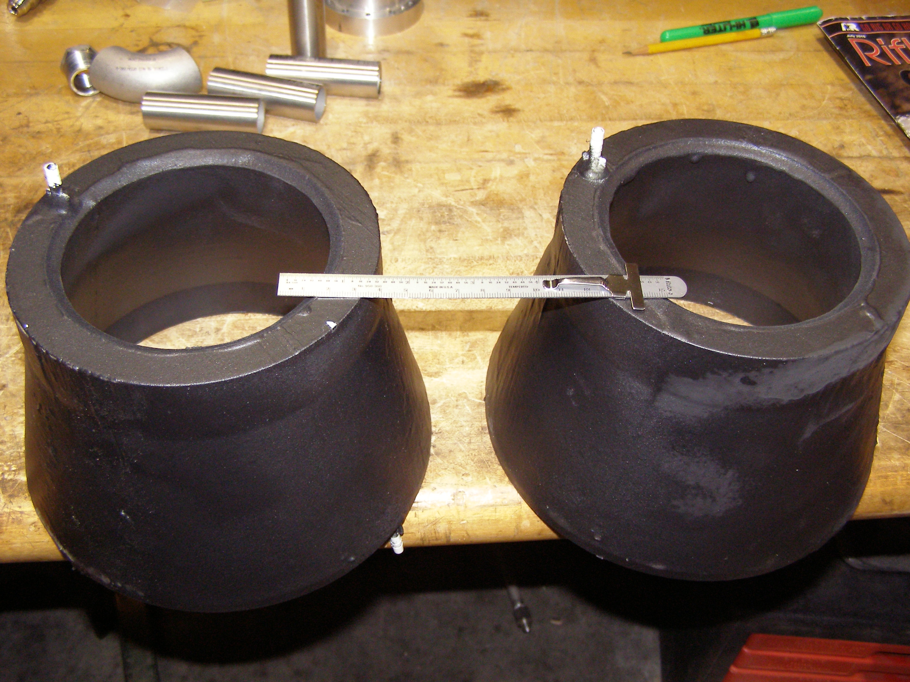
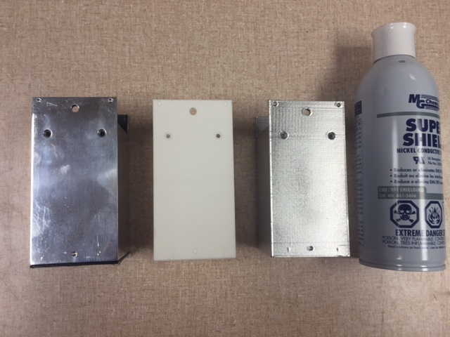
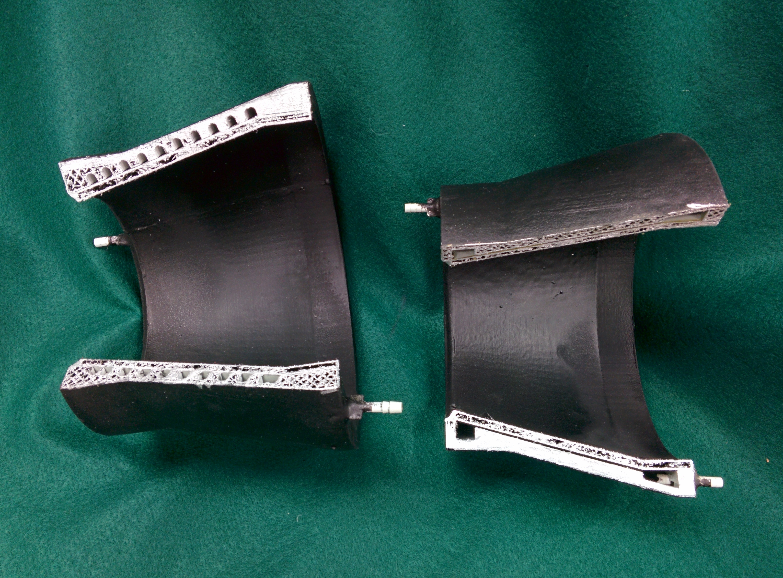
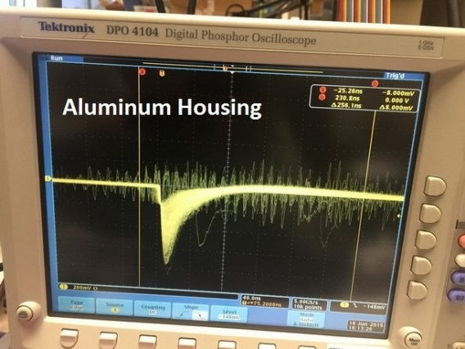
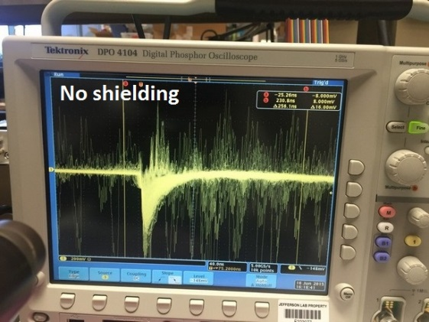
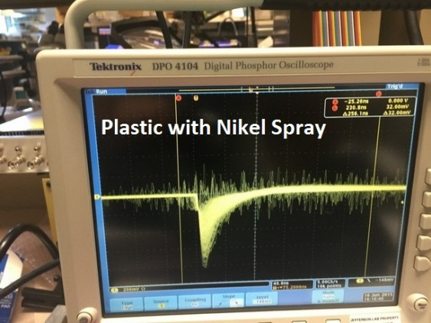
Bench Top 3D Printing
Ability to quickly make cheap, robust plastic custom parts for a variety of projects
Two 3D printed heat exchangers geometries tested for the 12GeV polarized target for Hall B
Not detector related but shows depth of the group
3D printed plastic MCP-PMT housings w/ painted EM shield
Aluminum
Plastic from 3D printer
Plastic w/ EM shield spray

Slide 6
Nuclear Physics Detector Development & Support Examples

Slide 7
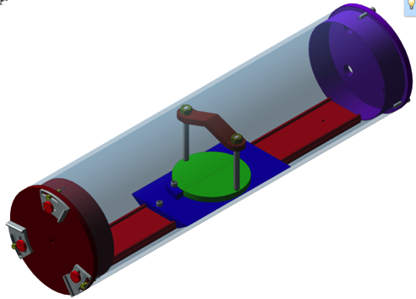
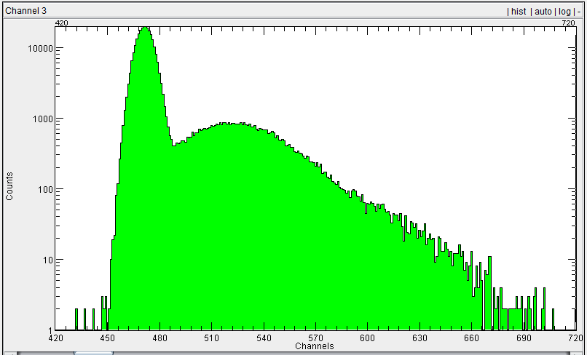
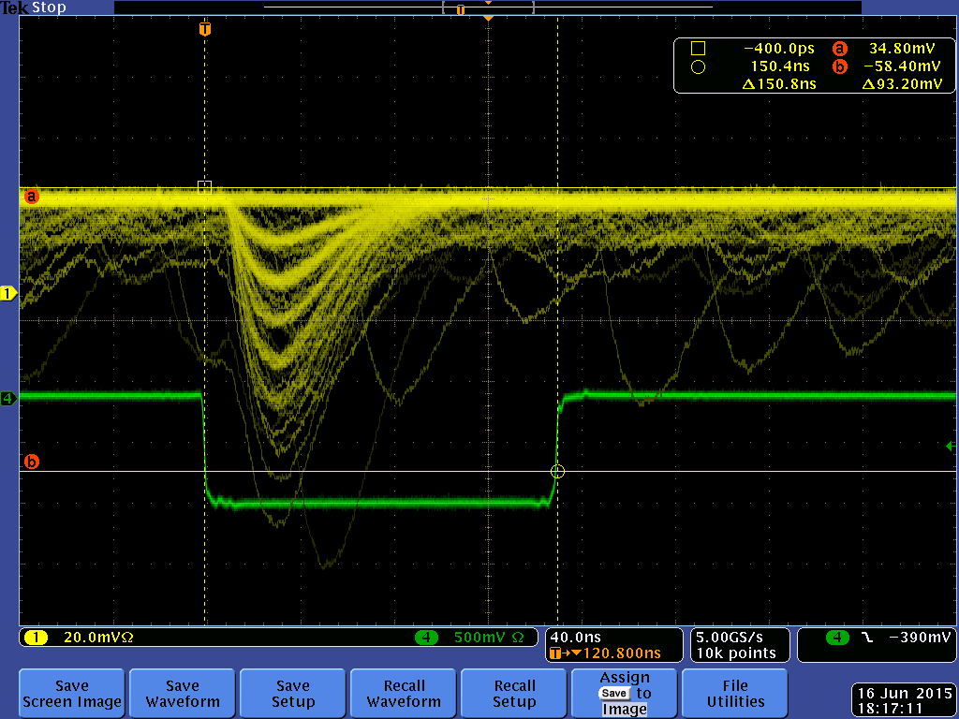
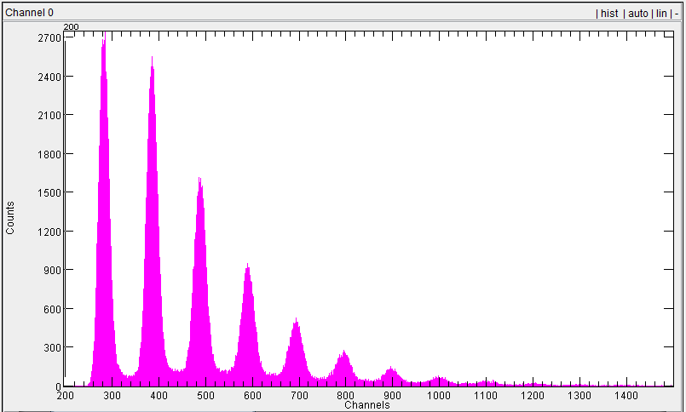
EIC (eRD04) Project – MCP-PMTs in High B field
LED reference intensity monitor based on SiPM
Voltage dividers for Katod and Photek MCP-PMTs
PMTs illuminated with pulsed fast blue LED
Need independent intensity monitor
Pulse generator
Bifurcated fiber
While MCP-PMT sees single photons SiPM monitors multiphoton intensity
5 meter fiber optic
SiPM light monitor
Dark Box
MCP-PMT
QDC spectrum
“photon counting”
SPE spectrum
Notes:
- Having been collaborating with eRD04 – group based at JLAB doing development of a DIRC detector for future EIC
They need to test MCP-PMTs as their candidate (FAST!) photodetector in high B fields - EIC detector has very compact design – need photodetectors to deal with high B fields
They are using FROST magnet for producing up to 5 tesla field
We have designed and built a non-magnetic “Dark Tube” to house PMTs – linear and rotary positioning of PMT possible within field
Use UV or blue pulsed LED as light source pumped through 5 meter fiber optic
SPECIFICALLY FOR THIS RUN (RUNNING NOW!) – needed independent monitoring of light from LED – built SiPM detector – easy to monitor intensity
Needed multiphotons going to SiPM while only single photoelectron level at test MCP-PMT

Slide 8
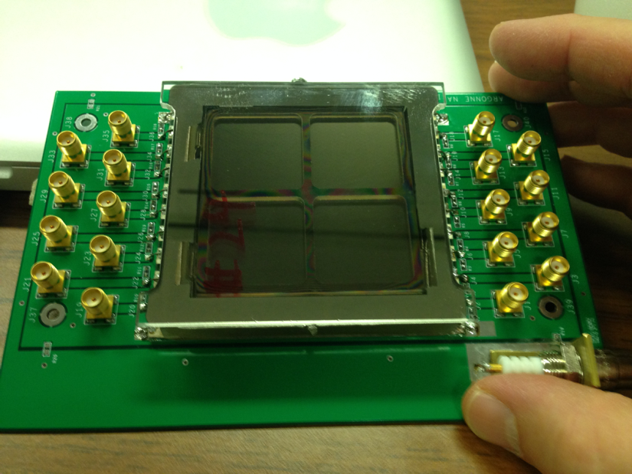
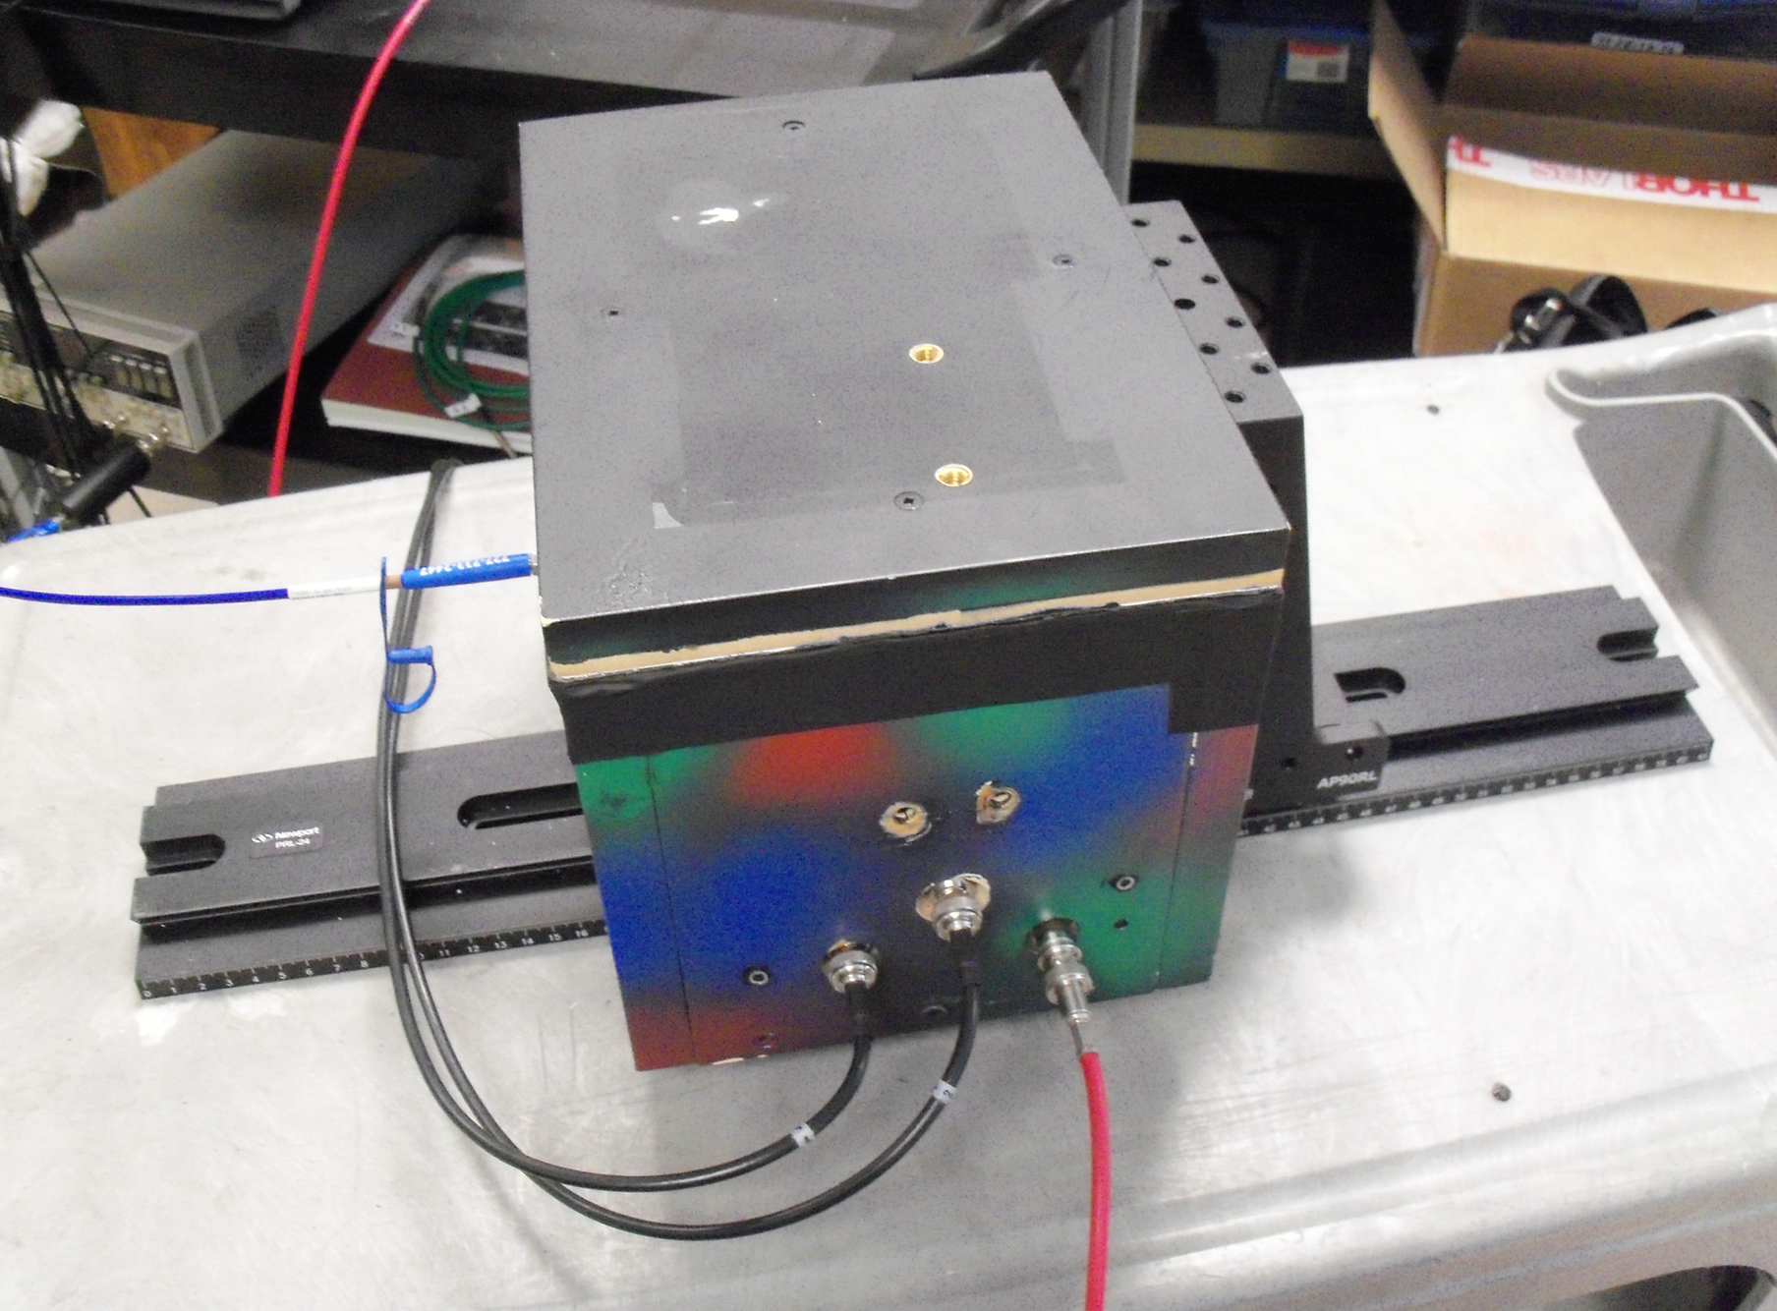
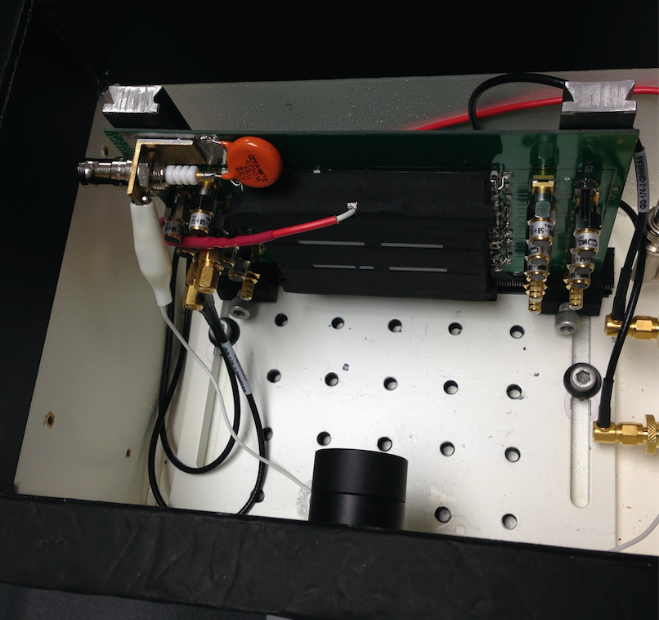
LAPPD (eRD11) Testing Project
In Oct. 2014 obtained 1st sample from Argonne National Laboratory, expecting to get another sample soon
Gain testing in high B field (≤ 3T) MRI last week- sample fails ~ 1T (initial results)
Location: UVA Biomedical Engineering Dept.
Assistance: Prof. Mark Williams and Wilson Miller
Part of eRD11 collaboration for generic EIC R&D – development of modular RICH detector
We knew this sample had problems – very low QE (2%) and non-uniform photocathode
Obtained single photoelectron spectra from 5 of 9 channels
LAPPD sample
(non-magnetic itself!)
Installed in non-magnetic test box
Both linear and horizontal rotation possible
8
Notes:
Part of eRD11 collaboration for generic EIC R&D – development of modular RICH detector
Specifically at JLAB – one of institutions receiving an early small size prototype of MCP-PMT developed as part of LAPPD project
Already know that this sample has problems – very low (2%) and non-uniform photocathode – internal voltage divider has changed
But we can get single photoelectron spectra from 5 of 9 channels (3 are blocked and 1 has poor output signal) – test 2 in high B field
NOTE- LAPPD is non-magnetic itself – NO COMMERCIAL MCP-PMT is like this – effect of this in B field - ???? – we shall see

Slide 9
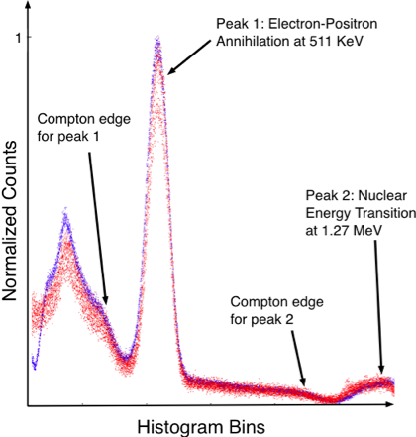
A Radiation Tolerant High-Magnetic Field Immune High-Signal Fidelity Electro-Optically Coupled Detector (EOCD) for Nuclear Physics
Applications:
electromagnetic calorimeters (EMCs)
detectors of internal-reflected Cerenkov light (DIRCs)
EOCD
multiplexed channels of detector analog current pulses ( e.g. PMTs, SiPMs) drive LED lasers of various wavelengths
identical analog multi-wavelength laser pulses transmitted down communications grade single mode fiber optics
laser detectors near remote DAQ convert/de-multiplex light pulses back to electrical for ADCs
signal pulse preserved: shape, timing & phase
reduced complexity
no copper
fewer cables: >200 analog channels/fiber
high-radiation and high-magnetic field tolerant
SiPM-LYSO: ²²Na pulse spectra overlay-
Red- pulse height spectrum via copper.
Blue- Spectrum acquired with EOCD.
W. Xi, J.E. McKisson, A.G. Weisenberger, S. Zhang, C. Zorn, “Externally-Modulated Electro-Optically Coupled Detector Architecture for Nuclear Physics Instrumentation,” IEEE Trans. Of Nuclear Science, vol. 61, issue 3, pp 1333—1339, June 2014.
Notes:
Detector system with EOCD : SiPM signals convert simultaneously to multi-wavelength optical signals, optically amplified (10dB) and then multiplexed into a single mode fiber by wavelength division. Receiver demultiplexs the signal and converted back for remote DAQ. Erbium doped fiber which is laser pumped provides amplification.

Slide 10
Tech Transfer: Applications of RD&I Group Technology to Nuclear Imaging

Slide 11
Tech Transfer- Radioisotope based Nuclear Imaging
Radioisotopes that emit high energy photons and beta particles are incorporated into molecules that have a biological function of interest. The tagged molecules are then injected or introduced in vivo into biological systems:
people
animals
plants
microbes
Molecular Imaging: The bio-distribution of tagged molecules is imaged externally by devices capable of detecting the emitted particles. Typically the high energy photons are highly penetrating thus can be detected and imaged externally. Two molecular imaging techniques:
Single Photon Emission Computed Tomography (SPECT)
Positron Emission Tomography (PET)

Slide 12
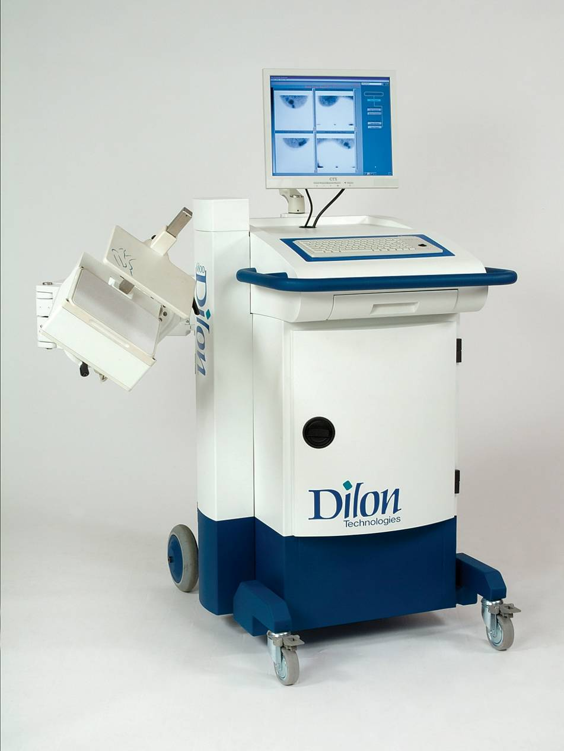
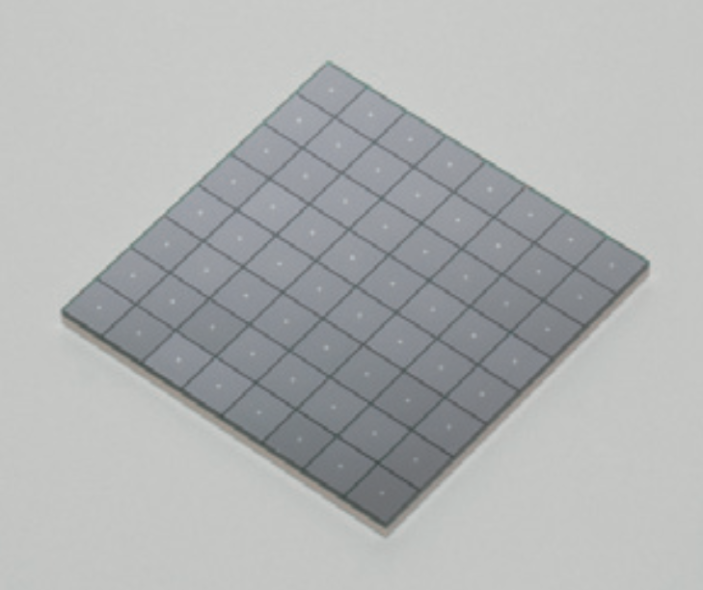
Gamma Camera for Breast Cancer Detection
Dilon Technologies, Inc. Newport News, VA
~20 employees, >250 units sold internationally imaging performed on >250,000 patients
Nuclear physics detector technology used in the Dilon camera - helps detect breast cancers that conventional mammograms may miss, saving lives.
Recently: CRADA with Hampton University, Dilon & JLab initiated to enhance gamma camera performance using NP silicon photomultiplier technology.
Several patents licensed from JLab.

Slide 13
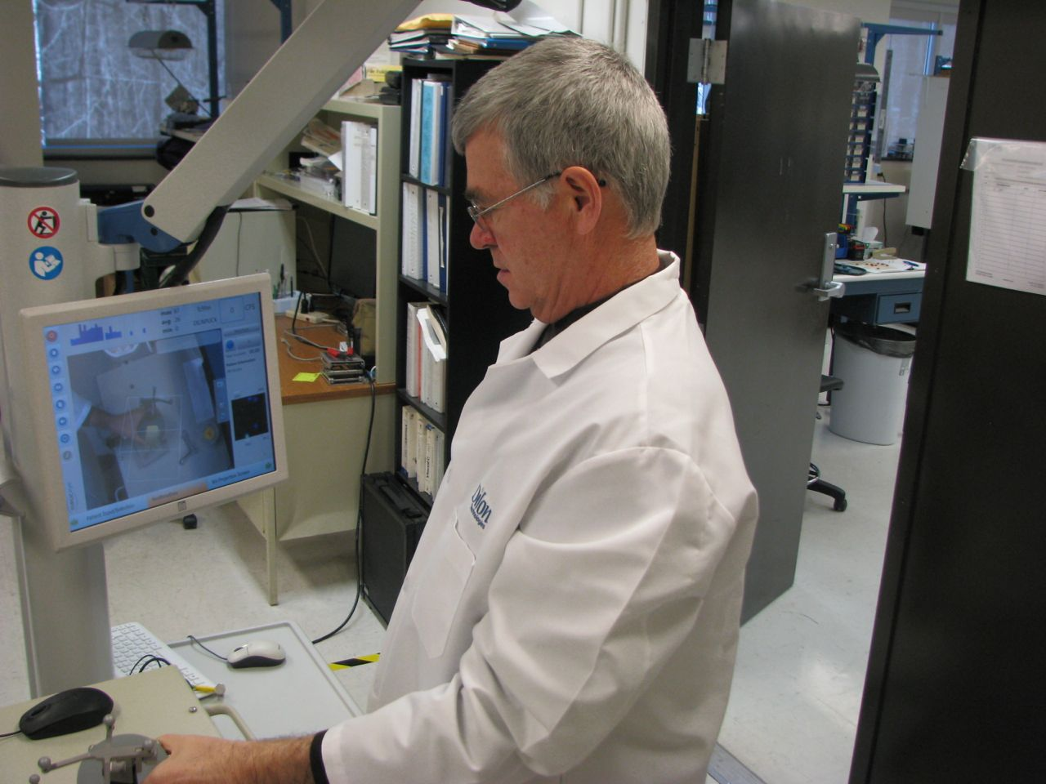
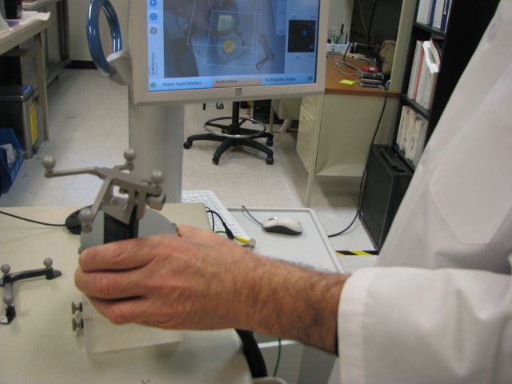
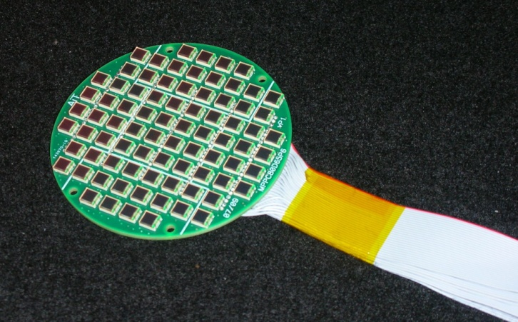
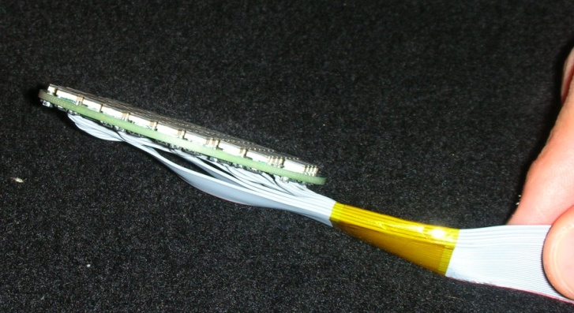
Technology Transfer: Nuclear Medicine Imaging
Imaging for Mammography & Real Time Surgery
Nuclear physics detector technology in a hand-held gamma camera through a CRADA with University of Virginia and Dilon Technologies, Inc now has 3D optical tracking ability to generate “free-hand” SPECT images in real-time to aid cancer surgery.
Silicon photomultiplier (SiPM) based detectors necessary for the experiments at Jefferson Lab have been developed for applications in medical imaging.
This technology is being further developed to allow wireless operation.
Array of 80 SiPMs

Slide 14
Technology Transfer: Nuclear Medicine Imaging
3D Brain Scans of Moving Mice
AwakeSPECT System is based on technology developed by Jefferson Lab, with contributions from ORNL, Johns Hopkins University and University of Maryland. It is presently being upgraded by JLab.
Utilizes custom-built gamma cameras, image processing system, infrared camera motion tracking system and commercial x-ray CT system.
Three IR markers attached to the head of a mouse enable the AwakeSPECT system to obtain detailed, functional images of the brain of a conscious mouse as it moves around inside a clear burrow.
Acquires functional brain images of conscious,
unrestrained, and un-anesthetized mice.
Documents for the first time the effects of anesthesia on the action of dopamine transporter imaging compound, and shows the drug was absorbed less than half as well in awake mice than in anesthetized mice: Journal of Nuclear Medicine, vol. 54, no. 6, pp. 969-976, Jun. 2013.
Can aid research into Alzheimer’s, dementia, Parkinson’s, brain cancers traumatic brain injury and drug addiction.

Slide 15
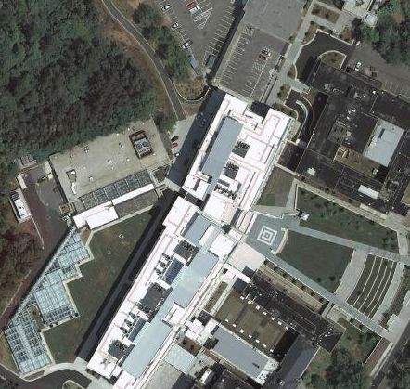
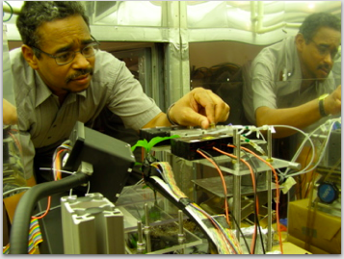
Detector Development for Plant Biology with Triangle Universities Nuclear Laboratory / Duke University
TUNL
Phytotron
Duke University Phytotron plant research facility with environmentally controlled growth chambers for plant ecophysiological and microbial research using radionuclides
Radioisotope generation using TUNL tandem Van de Graaff

Slide 16
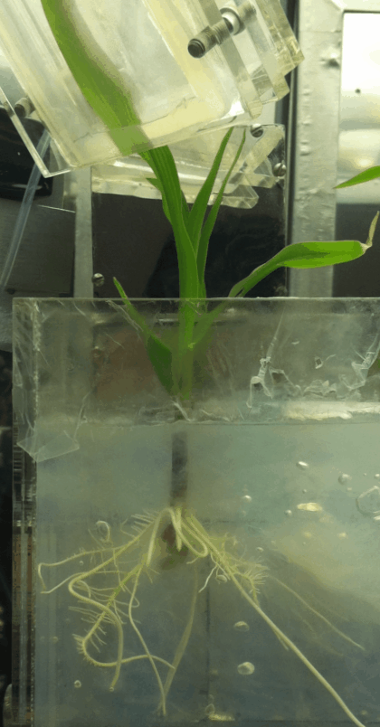
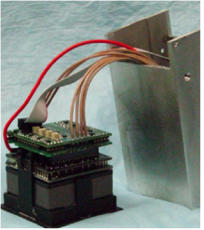
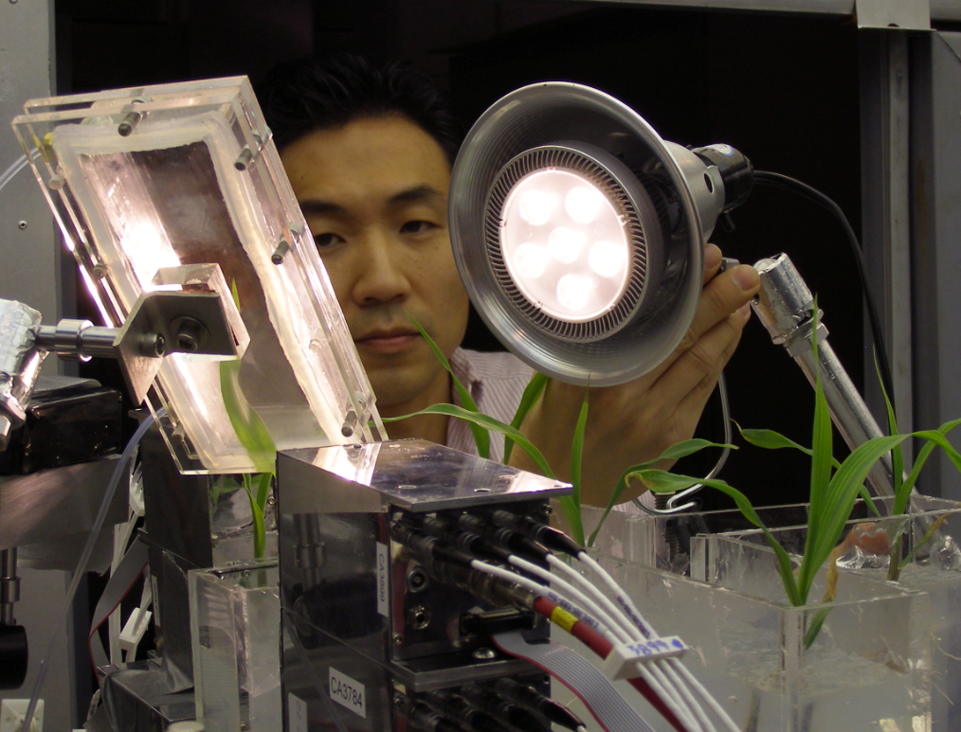
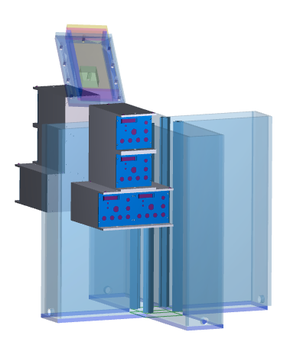
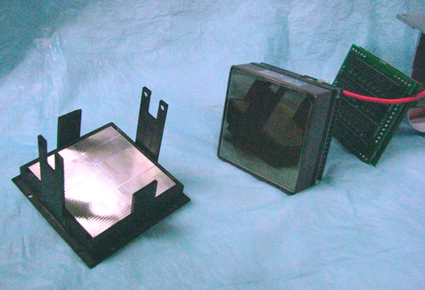
PhytoPET-Duke University/Jefferson Lab
leaf cuvette for ¹¹CO₂
leaf cuvette for ¹¹CO₂
corn seedling
leaf
PhytoPET detector modules
PhytoPET detector modules
Positron emission tomography (PET) detector systems to image the process of carbon transport through plants during photosynthesis under different conditions, using the PET radioisotope ¹¹C.
Notes:
Positioning the PhytoPET detectors and plant in preparation for PET imaging.

Slide 17
PhytoPET to Measures ¹¹C Sugar Translocation
PhytoPET system ( 8 detector modules, 4 detectors on each side of cuvette) used for a maize split root dynamic imaging of ¹¹C sugar uptake down to roots from the leaf.
Exploring soil/root/fungi interaction. Identifying fungi that aid plant root growth.
Infected
Sterile
Temporal changes in sugar translocation to maize roots infected with fungus (left) & sterile (right). Grown in a dual-chambered root cuvette using potting soil.

Slide 18
Summary
Radiation Detector and Imaging (RD&I) Group Overview
Technology development group within Physics Division
Resource for Physics Div., Accelerator Div. & Users
Current RD&I Group Fundamental Nuclear Physics Detector Development
Silicon PM technology – implement in Nuclear Physics and Bio-Imaging
Collaborators in EIC studies (EIC-PID consortium)
RD&I Group Tech Transfer (TT) Applications
Clinical: cancer diagnostics and surgery
SiPM-based detectors - Dilon Technologies Inc. collaboration
pre-clinical: small animal research tool for bio-medical research
plant biology: ¹¹C imaging for photosynthesis based studies
Strong synergy between nuclear physics technology development and TT Applications

