Slide 1
Injector R&D S&T Review 2015
M. Poelker, P. Adderley, D. Bullard, J. Grames, J. Hansknecht,
C. Hernandez-Garcia, M. Stutzman, R. Suleiman, S. Zhang
Graduate student: Md. Abdullah A. Mamun
contributions from E. Forman, Y. Wang, D. Moser, F. Hannon
Recent past members: M. BastaniNejad, J. McCarter, R. Mammei

Slide 2
Outline
CEBAF Injector R&D
Bunchlength monitor using harmonically-resonant cavity (SBIR-related)
High Polarization Photocathodes (SBIR-related)
Polarized Positron Production (“PEPPo” – a PAC approved Experiment)
Bubble Chamber Experiment (photo-disintegration of oxygen into helium and carbon – a PAC approved experiment)
Improving vacuum (funded via Research and Development for Next Generation Nuclear Physics Accelerator Facilities)
Preparing for new parity-violation experiments:
Precision Mott Polarimeter, striving for accuracy at ~ 1% level
200 kV gun + new “booster” to eliminate x/y coupling, providing better beam envelope matching, and smaller helicity correlated position asymmetries
350 kV load-locked gun and related field emission studies (funded in part via Research and Development for Next Generation Nuclear Physics Accelerator Facilities)

Slide 3
Outline
CEBAF Injector R&D
Bunchlength monitor using harmonically-resonant cavity (SBIR-related)
High Polarization Photocathodes (SBIR-related)
Polarized Positron Production (“PEPPo” – a PAC approved Experiment)
Bubble Chamber Experiment (photo-disintegration of oxygen into helium and carbon – a PAC approved experiment)
Improving vacuum (funded via Research and Development for Next Generation Nuclear Physics Accelerator Facilities)
Preparing for new parity-violation experiments:
Precision Mott Polarimeter, striving for accuracy at ~ 1% level
200 kV gun + new “booster” to eliminate x/y coupling, providing better beam envelope matching, and smaller helicity correlated position asymmetries
350 kV load-locked gun and related field emission studies (funded in part via Research and Development for Next Generation Nuclear Physics Accelerator Facilities)

Slide 4
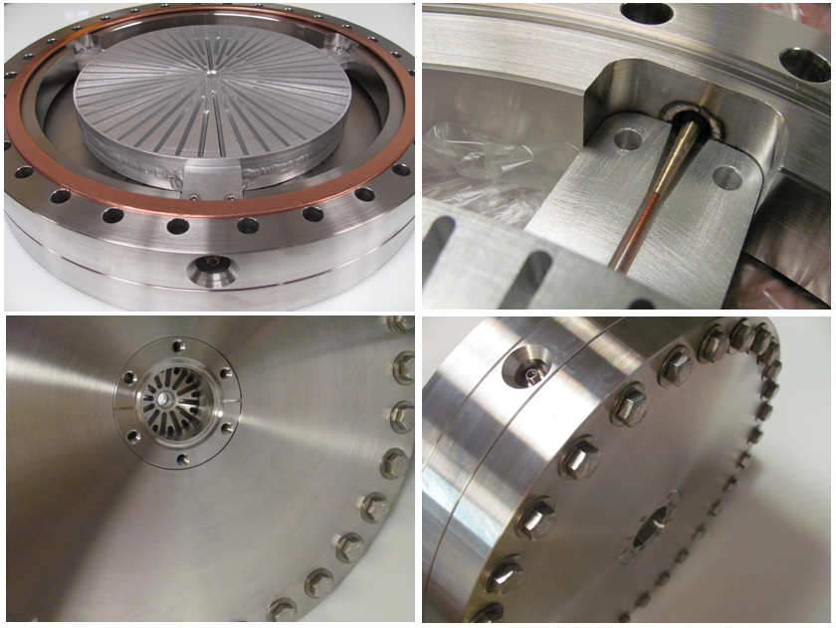
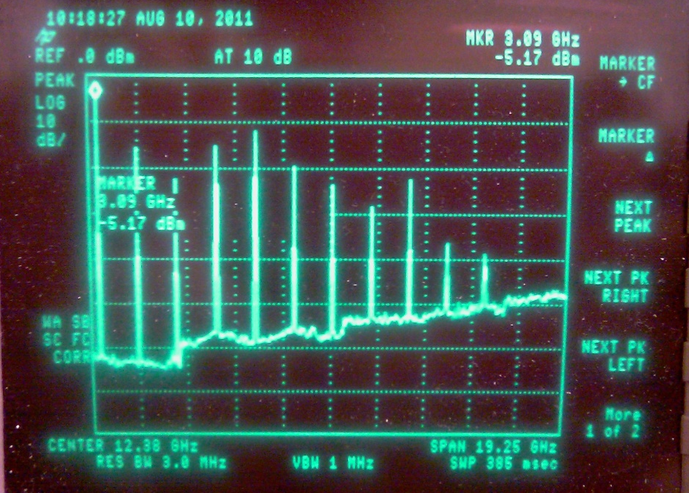
Harmonically-resonant cavity: only TM_{ONO} modes!
I(t) = a₀ + a₁ cos (ω_{o}t + θ₁),
+ a₂ cos (2ω_{o}t + θ₂),
+ a₃ cos (3ω_{o}t + θ₃) …
The cavity output represents the Fourier transform of the beam
Brock Roberts, Electrodynamic, DOE SBIR DE-SC0009509 Phase II

Slide 5
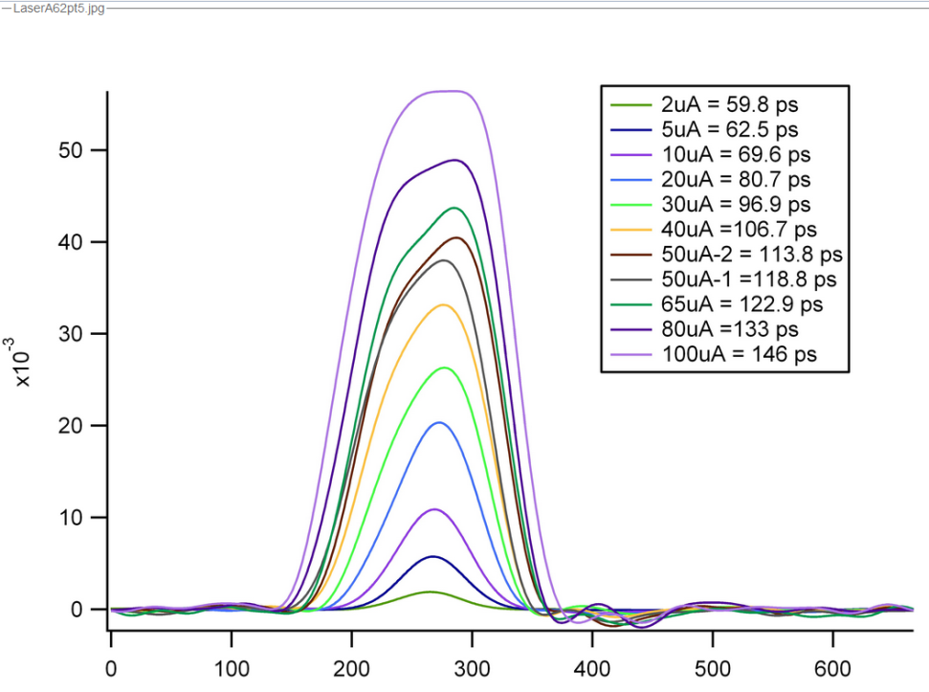
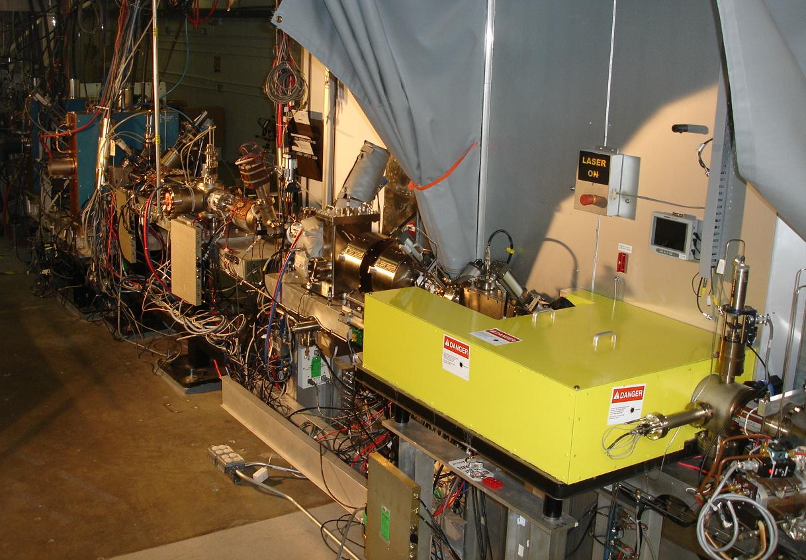
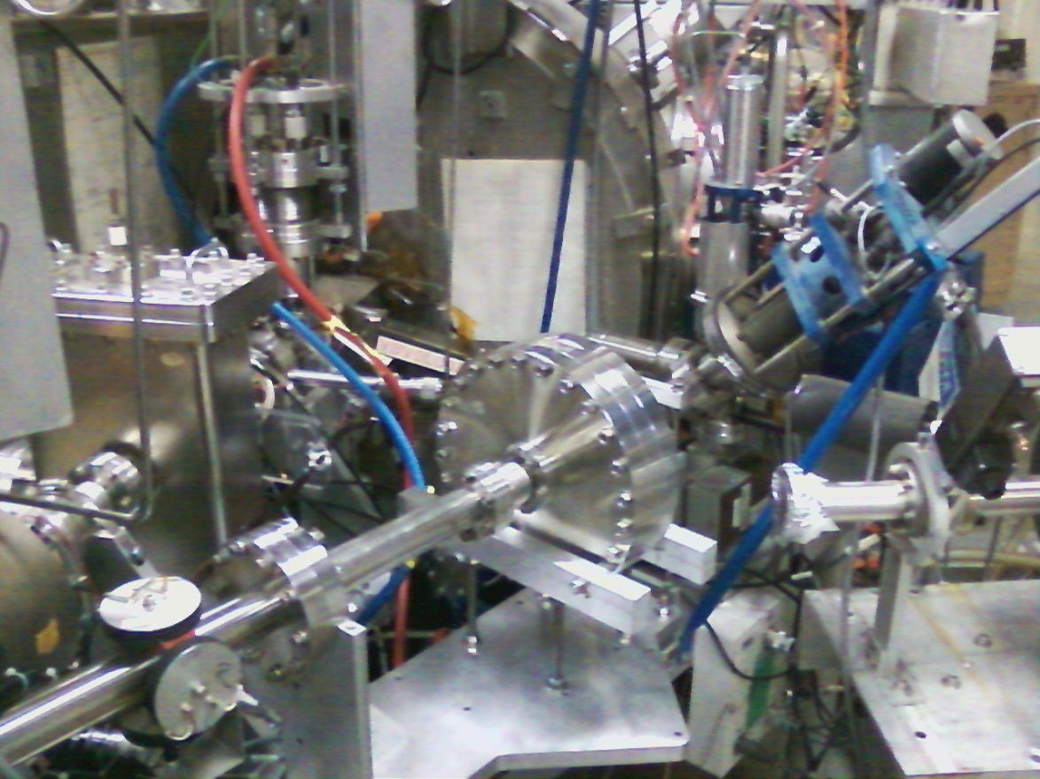
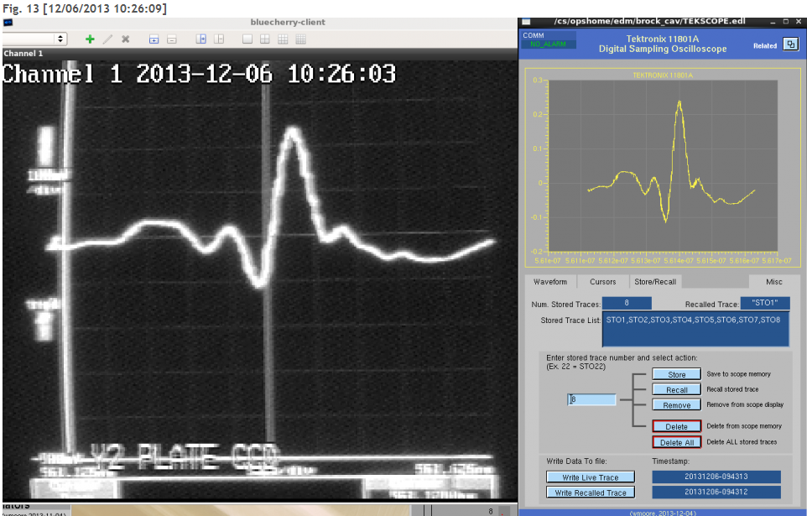
Bunchlength monitor at CEBAF
Near real-time bunchlength monitor for bunches > ~ 35 ps
Can be used to accurately set phases of lasers and prebuncher
Simple tool to help validate our particle tracking code models
Fast Kicker?
Useful when placed at higher energy locations of machine?
Brock Roberts, Electrodynamic, DOE SBIR DE-SC0009509 Phase II

Slide 6
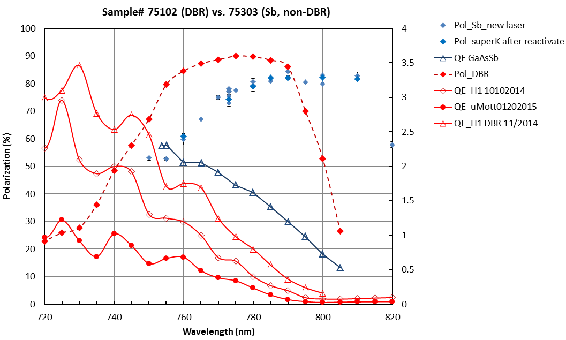
High Polarization Photocathodes
90% polarization!! Need to shift QE resonance peak for CEBAF lasers
Partners with SVT Associates: three phase2 sbir proposals
Distributed Bragg Reflector (DBR) enhancement designed @760nm
Need to shift DBR resonance to 780nm !
GaAsSb/AlGaAsP not bad, need to test at high voltage

Slide 7
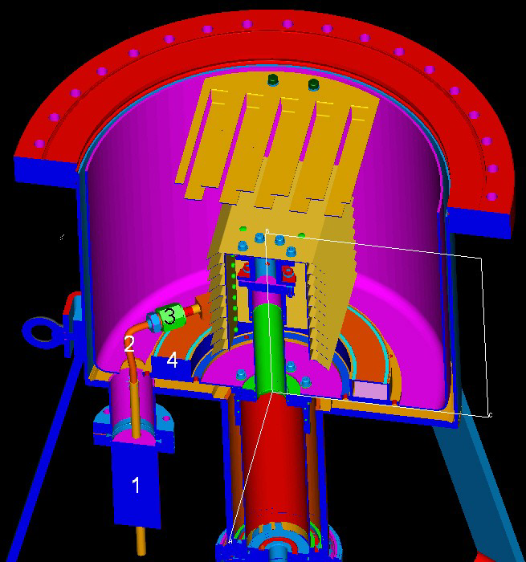
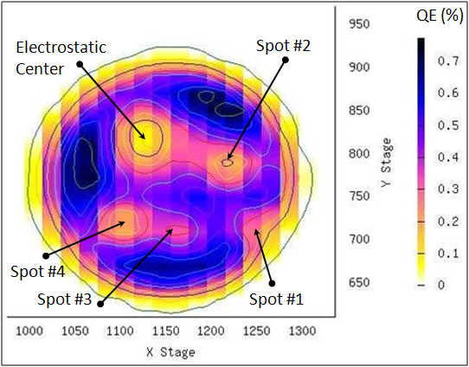
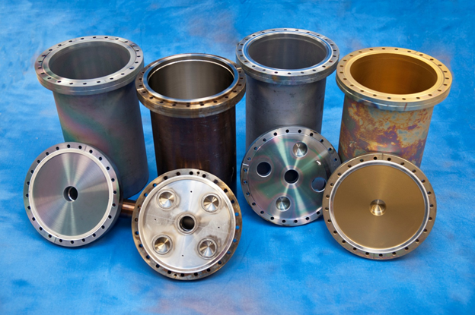
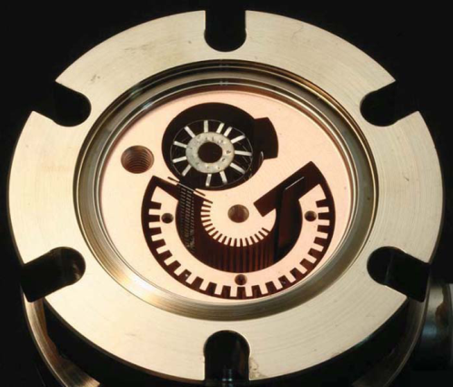
Improving Photogun Vacuum
Ion bombardment limits photogun operating lifetime
Better vacuum pumps:
Cryopumping?
Better vacuum gauges
Coatings and heat treatments to limit outgassing
funded by Research and Development for Next Generation Nuclear Physics Accelerator Facilities
Matt Poelker, Jefferson Lab
Notes:
Interior Page Design 2

Slide 8
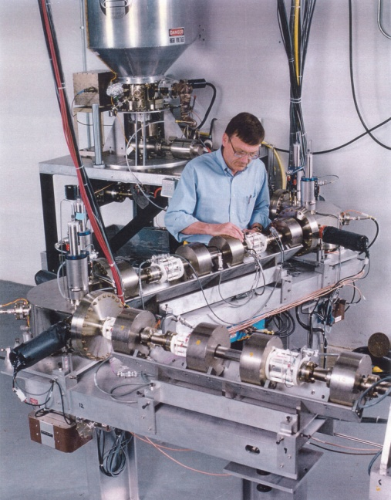
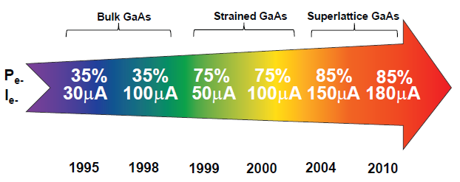
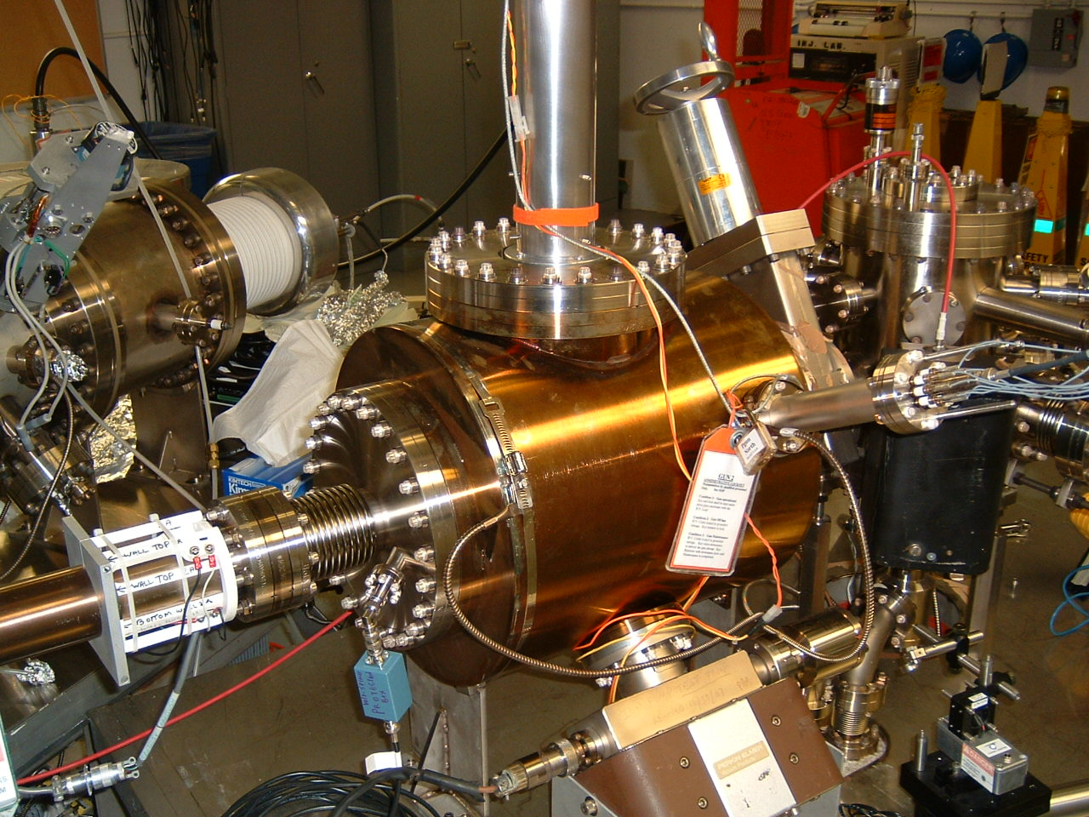
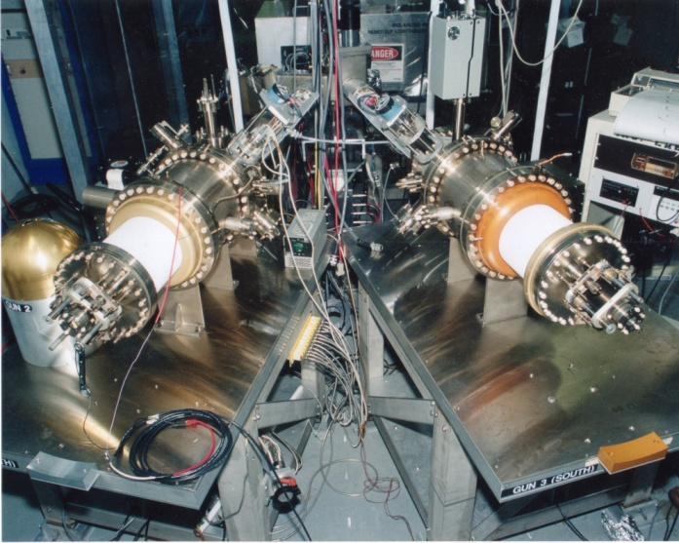
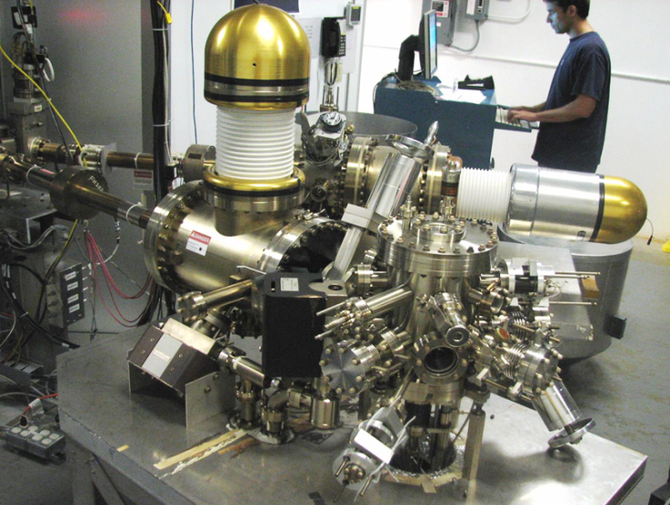
Always Tweaking the Gun Design
1
Text goes here
4
Endless (?) quest for perfection
2
3
Matt Poelker, Jefferson Lab
Notes:
Interior Page Design 1

Slide 9
Experiment | Energy (GeV) | Pol (%) | I (µA) | Target | A_{pv} (ppb) | Maximum Charge Asym (ppb) | Maximum Position Diff (nm) | Maximum Angle Diff (nrad) | Maximum Size Diff (δσ/σ)
HAPPEx-I (Achieved) | 3.3 | 38.8 | 40 | ¹H (15 cm) | 15,050 | 200 | 12 | 12
G0-Forward (Achieved) | 3.0 | 73.7 | 40 | ¹H (20 cm) | 3,000-40,000 | 300±300 | 7±4 | 3±1
HAPPEx-II (Achieved) | 3.0 | 87.1 | 55 | ¹H (20 cm) | 1400 | 400 | 1 | 0.2
HAPPEx-III (Achieved) | 3.484 | 89.4 | 100 | ¹H (25 cm) | 16900 | 200±100 | 3±3 | 0.5±0.1 | 10⁻³
PREx-I (Achieved) | 1.056 | 89.2 | 100 | ²⁰⁸Pb (0.5 mm) | 657±60 | 100±130 | 2±3 | 1 | 10⁻⁴
QWeak-I (Achieved) | 1.155 | 89.0 | 180 | ¹H (35 cm) | 281±46 | 8±15 | 5±1 | 0.1±0.02 | 10⁻⁴
QWeak | 1.162 | 90 | 180 | ¹H (35 cm) | 234±5 | 100±10 | 2±1 | 30±3 | 10⁻⁴
PREx-II | 1.0 | 90 | 70 | ²⁰⁸Pb (0.5mm) | 500±15 | 100±10 | 1±1 | 0.3±0.1 | 10⁻⁴
Møller | 11.0 | 90 | 85 | ¹H (150 cm) | 35.6±0.74 | 10±10 | 0.5±0.5 | 0.05±0.05 | 10⁻⁴

Slide 10
Testing the new “¼” Cryomodule
200 kV gun + buncher + SRF “capture” + SRF “7-cell”
Demonstrate acceptable performance at bldg. 58 Injector Test Cave before installation at CEBAF
No x/y coupling, better envelope matching, more adiabatic damping, smaller helicity correlated position asymmetries

Slide 11
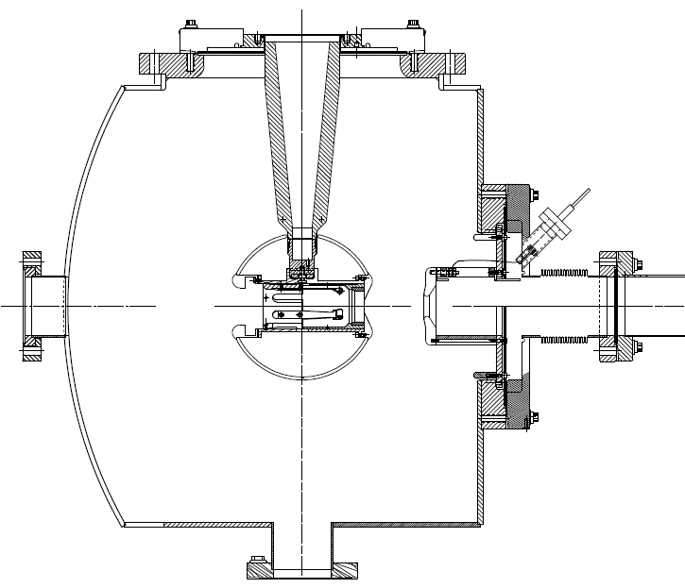
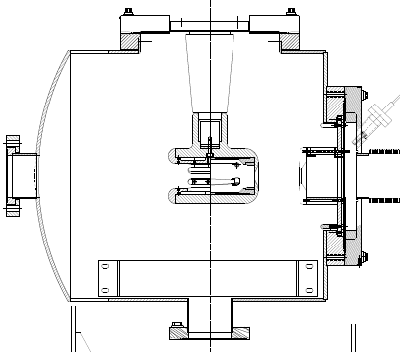
Operating Photoguns > 100 kV
CEBAF 130kV Inverted Gun
The spare gun has operated at 200kV
…prefer more voltage headroom
Other JLab initiatives will benefit from higher voltage
funded in part via Research and Development for Next Generation Nuclear Physics Accelerator Facilities
Matt Poelker, Jefferson Lab
Notes:
Interior Page Design 2

Slide 12
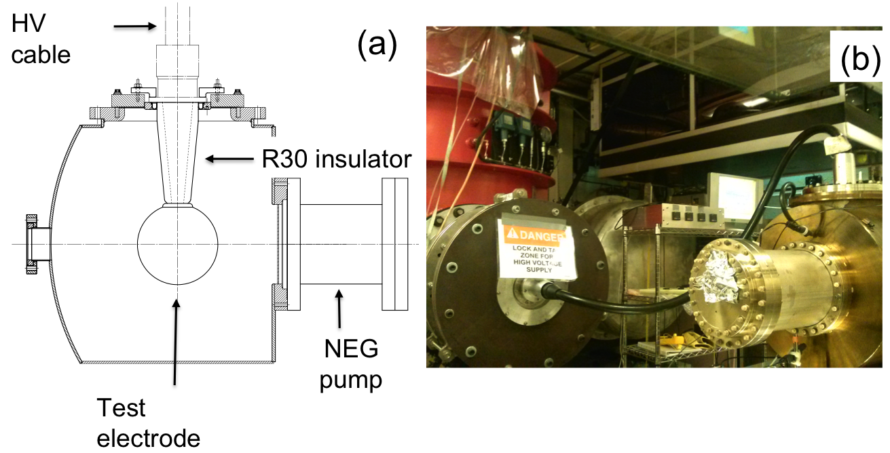
Building the 350 kV Gun
Start with “dummy” electrodes and test different insulators and cathode screening electrode
Notes:
Interior Page Design 2

Slide 13
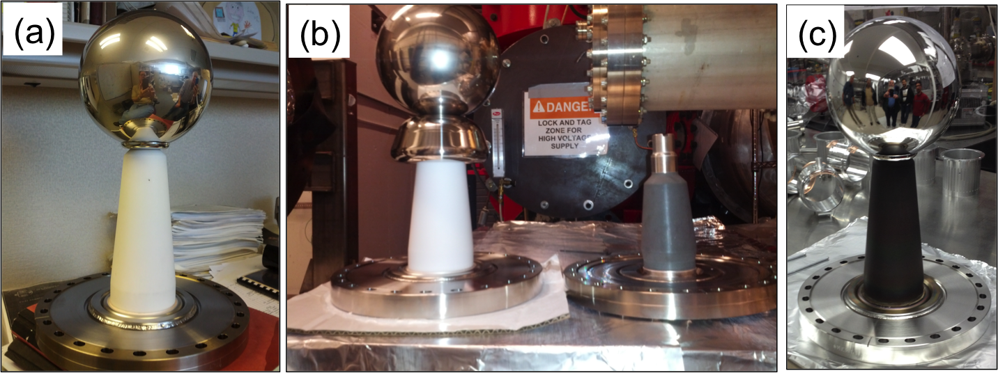
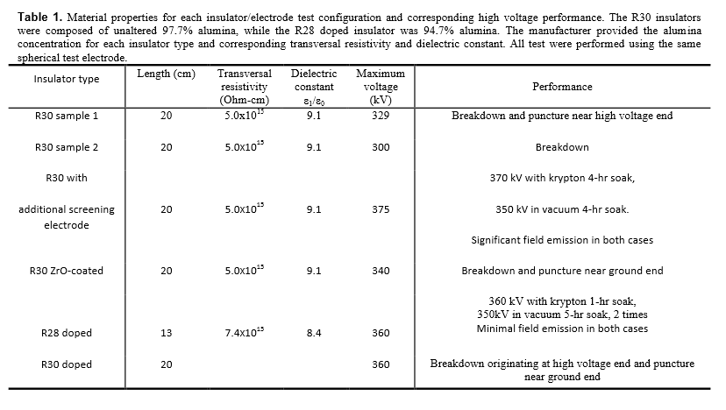
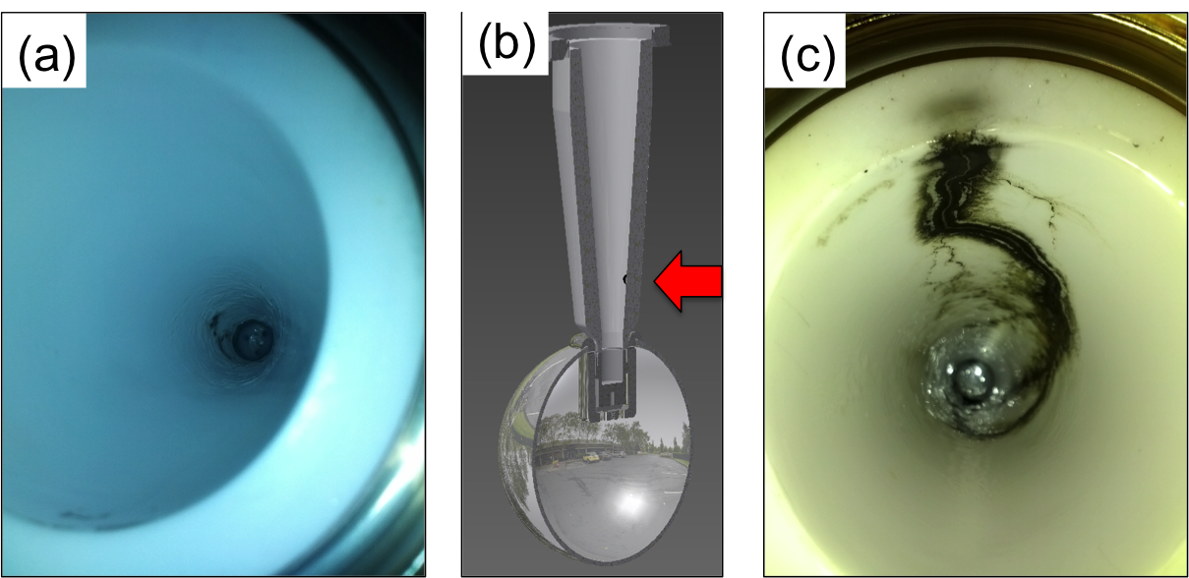
Notes:
Interior Page Design 2

Slide 14
Summary
Injector-related R&D: improve reliability, develop new hardware, demonstrate new capabilities
We hope this leads to new physics opportunities at JLab, and sometimes it supports the broader DOE science mission
We owe you (i.e., DOE) a report on “cryopumping the photogun”
We promise enthusiastic evaluation of new photocathodes from SVT Associates: new graduate student on site, and looking for a post-doc

