Slide 1

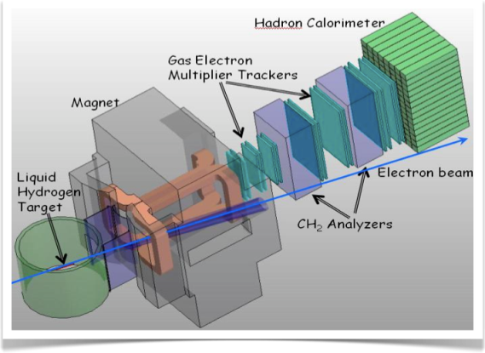
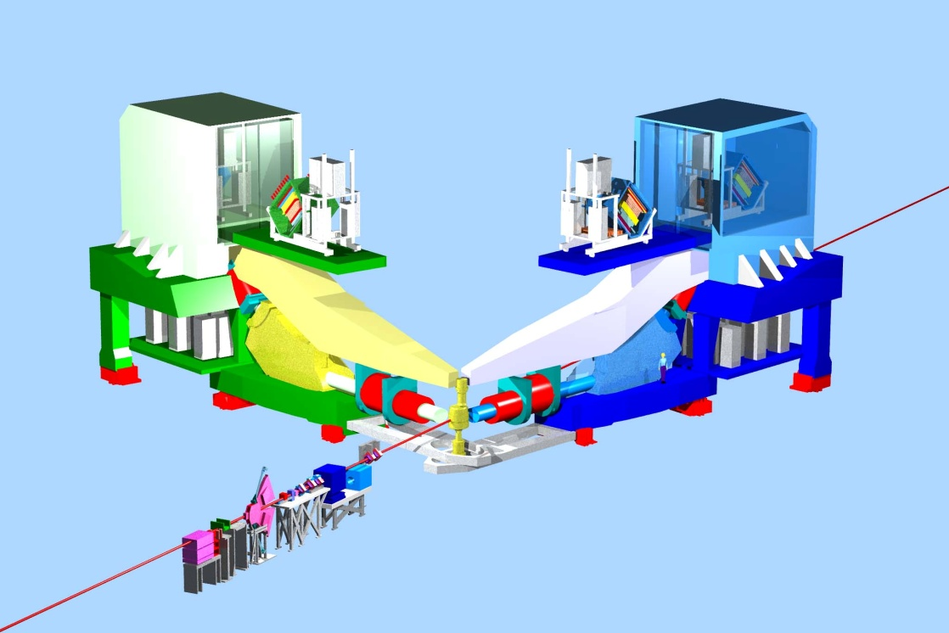
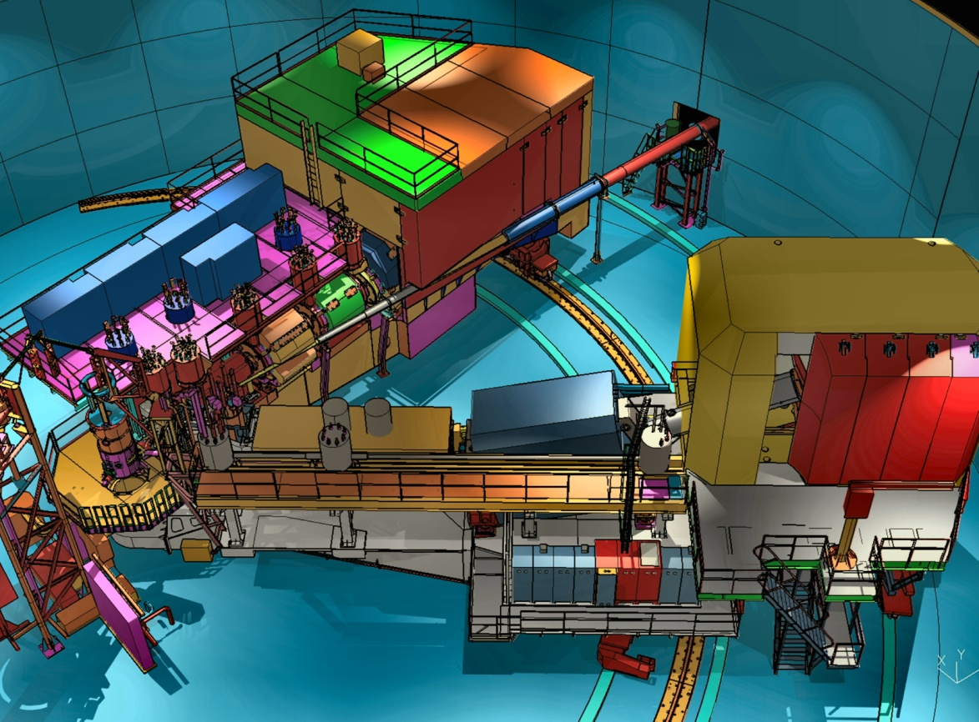

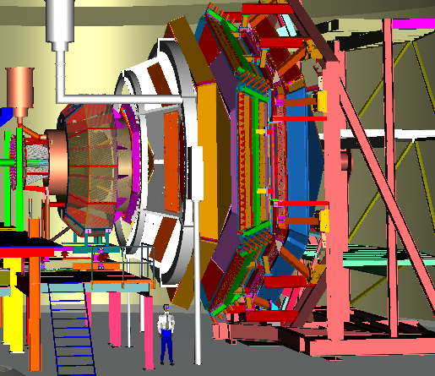
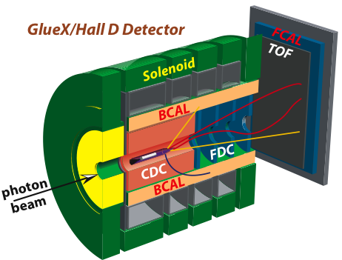
Other Physics CE projects
Patrizia Rossi
JLab S&T Visit – July 28-30, 2015

Slide 2
Outline
Capital Equipment Projects
Targets : Tritium, ³He, NH₃ /ND₃, HD-Ice
Detectors : RICH, DIRC, High Res. Calorimeters, LAD
Controls: HRS magnet controls
Integrated Cost FY13-FY19
Assessment/Selection/Oversight
Conclusion
2

Slide 3

Hall | Capital Equipment Under DOE guidance | FY13 | FY14 | FY15 | FY16 | FY17 | FY18 | FY19
A | SBS Basic
 | SBS Neutron
 | SBS Proton
 | Solid Magnet relocated/refurb.
 | ³H target
 | HRS magnet Controls
 | High Luminosity Polarized 3He
 | Tagged DIS
B | Polarized Target
 | HD Ice Transverse Target
 | RICH detector
 | DC Readout
 | Beam Line Upgrade
C | Beamline/Compton Upgrade
 | ³He Polarized Target
 | Large Acceptance Detector
 | GEn
D | Forward Calorimeter Upgrade
 | DIRC detector
 | Polarized Target for photon beam
ALL | High Resolution Calorimeter (NPS)
 | Fast electronics
As compared to proposed
INCLUDED
DELAYED
DESCOPED
3

Slide 4
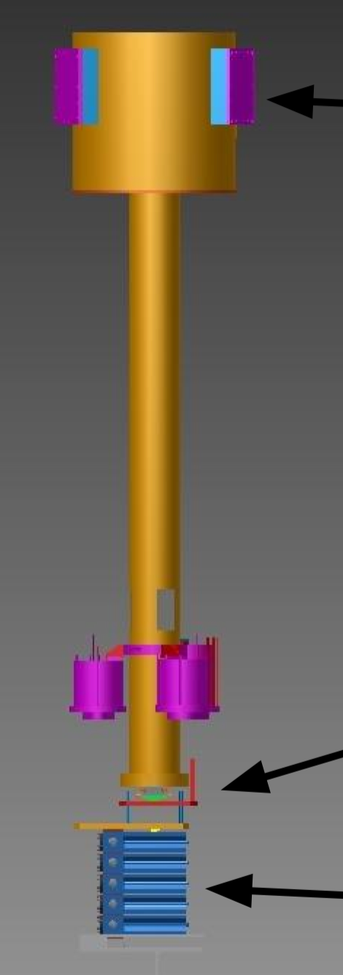
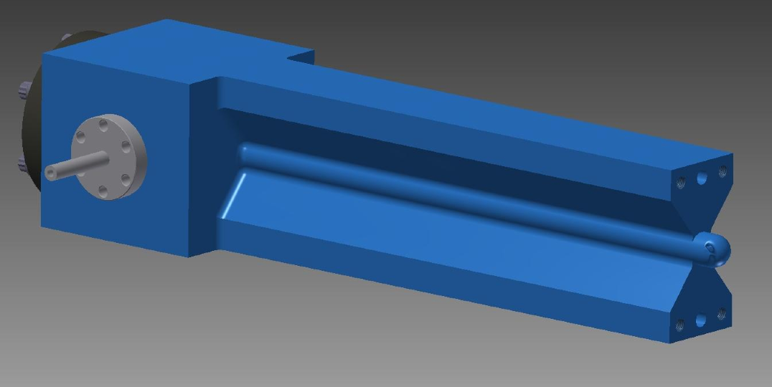
Hall A – Tritium Target
The Tritium Target enables
Two approved “High Impact” Experiments:
i) F₂^{n}/F₂^{p} structure function ratio at large x ; ii) Short range correlated NN pairs
Basic Design
Target cell
Vent system: Safely remove T2 from scattering chamber/hall
Beamline: Isolation windows and collimators
JLab CE project: development and construction of a transportable, sealed cell, containment and venting infrastructure, and related diagnostics and instr.
    SRS: Cell filling and recovery, consulting on T2 detection/monitoring, consulting on safety reviews, material testing for T2 compatibility
Status
Target cell design complete and prototype tested
T2 Stack design to be finalized
Cell handling and shipping procedures being addressed
Beamline design and fabrication started
NEPA compliance process underway
  4 total gas cells (T2, H, D, ³He) + 1 empty
Experiment Readiness Review for the final design in preparation and foreseen for September 2015
4

Slide 5
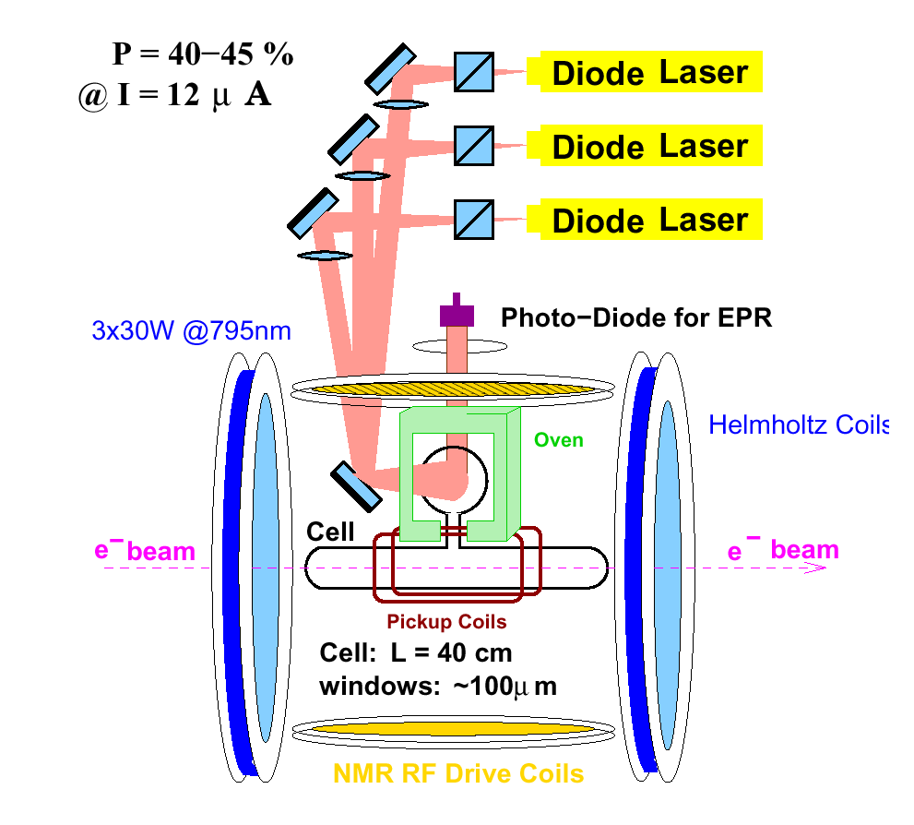
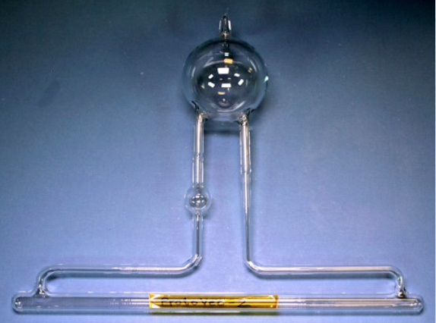
Hall A/C: Polarized ³He Target
 | Stage I | Stage II
Current | 30 μA on 40 cm | 60 μA on 60 cm
Luminosity | L ~ 2.2x10³⁶ cm⁻²s⁻¹ | L ~ 6.6x10³⁶ cm⁻²s⁻¹
Polarization | ~60% | ~60%
Cell | Glass cell | Glass cell metal window
 | convection gas flow pumping chamber 3.5” | convection gas flow pumping chamber 4.4”
Polarimetry (~ 3%) | Pulse NMR/AFP NMR | Pulse NMR/AFP NMR
Hall A/C compatibility | Significant engineering needed to fit into Hall C | Large gradient from SBS fringe field ➔ Magnet shield box
Experiments | A₁^{n} Hall A d₂^{n} Hall C | A₁^{n} Hall C G_{E}^{n} Hall A
“High Impact” Exp.”
JLab CE projects includes:
Stage I) Lasers, optical fibers from laser house to Hall C, NMR for polarization measurements
Stage II) mechanical work to modify for a higher-FOM target
UVA/W&M : developing target cell, filling target cell, contribution to precision polarimetry
UVA convection gas cell successfully tested

Slide 6
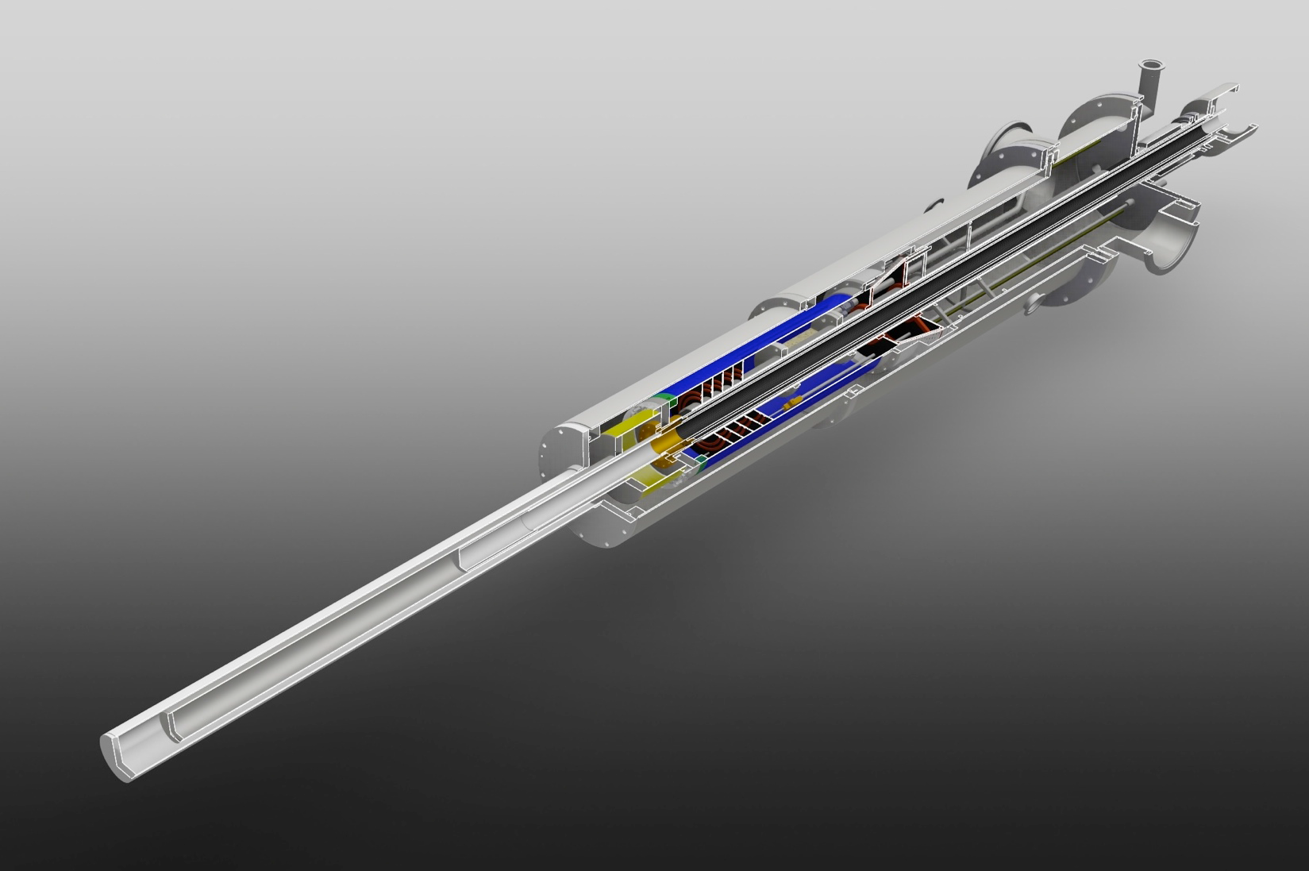
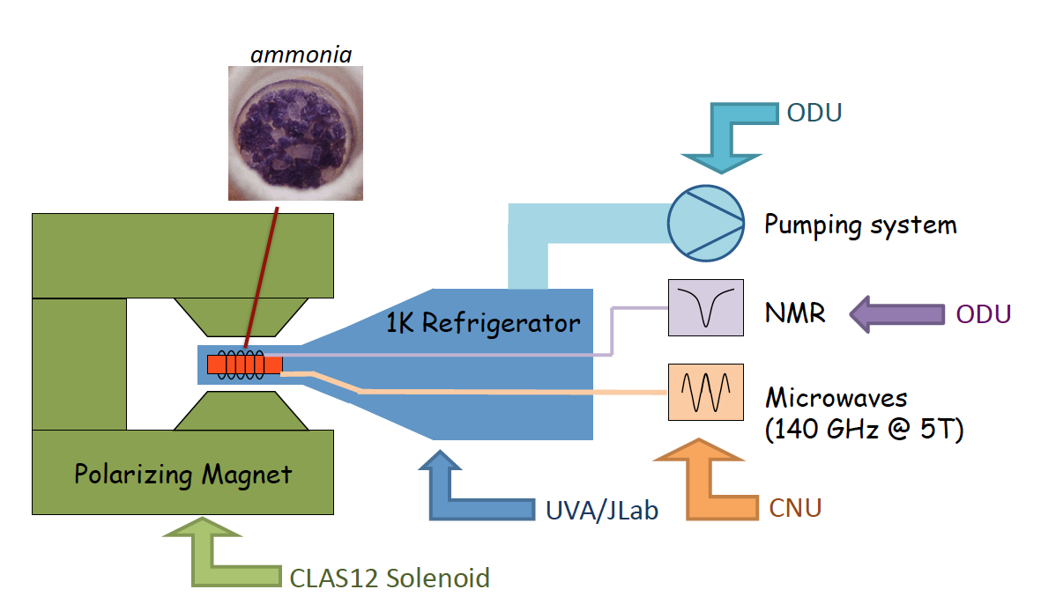
Hall B – Long. Polarized Target
DNP polarized NH₃ /ND₃ using the 5T magnetic field of the CLAS12 solenoid as a holding field
The base target components are developed with an NSF/MRI grant by ODU/CNU/UVA
It will serve 5 approved experiments (240 PAC days)
Target design highly modular ➔ either single or double cells (with opposite pol.) can be utilized with little or no modification to the rest of the system
Expected polarization:
≥ 90% (p); ≥ 40% (d)
Electron beam current operation up to 30 nA.
JLab CE project: infrastructure to integrate the target into CLAS12 + design and engineering of the cryogenic system
Status
Procurement of microwave, NMR, and pumping systems is complete (NSF/MRI)
Construction of outer vacuum chamber is complete
Design of refrigerator is 75% complete
Estimated completion date Spring 2017
6

Slide 7
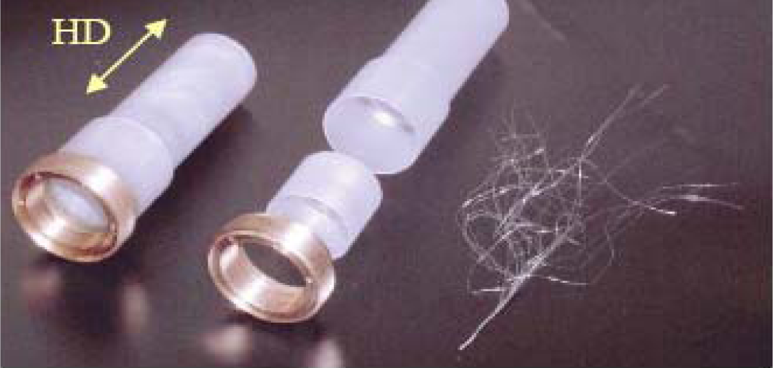
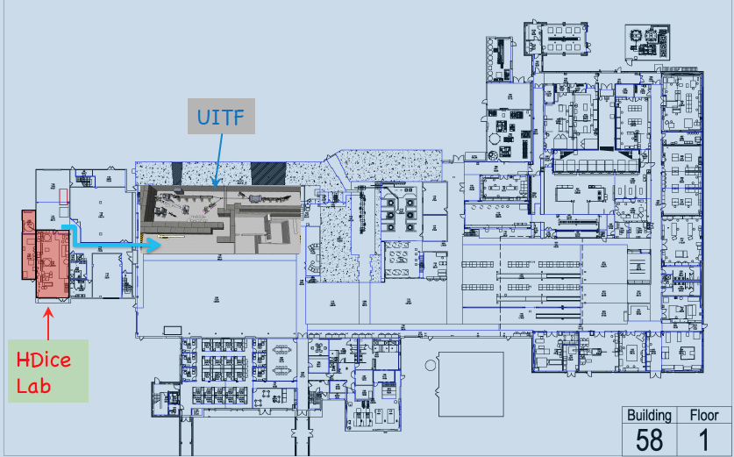
Hall B – HDice Target for transverse config.
Solid HD material placed into a frozen spin state
- requires only modest (~1 T)•short (~15 cm) field
to hold spin in-beam ➔ minimizes sheet of flame
Operating performance with electrons beams requires further beam tests ➔plan to use upgrade of the injector test facility: E_{e} =5 – 10 MeV (~10 MeV beam will test the HD performance at 11 GeV!)
It will serve three C1 approved “High Impact” Experiments
JLab CE project: modifications required to operate the target in transverse polarization mode in the CLAS12 Solenoid, whose strong long. magnetic field must be locally repelled.
Status of ongoing work:
Transport design for 10 MeV rastered ITF beam
R&D for a new “passive” SC diamagnetic shield
to hold spin transverse to beam within solenoid
Improving NMR system for target polarization
measurement
• Design and build new HD gas purification factory
7

Slide 8
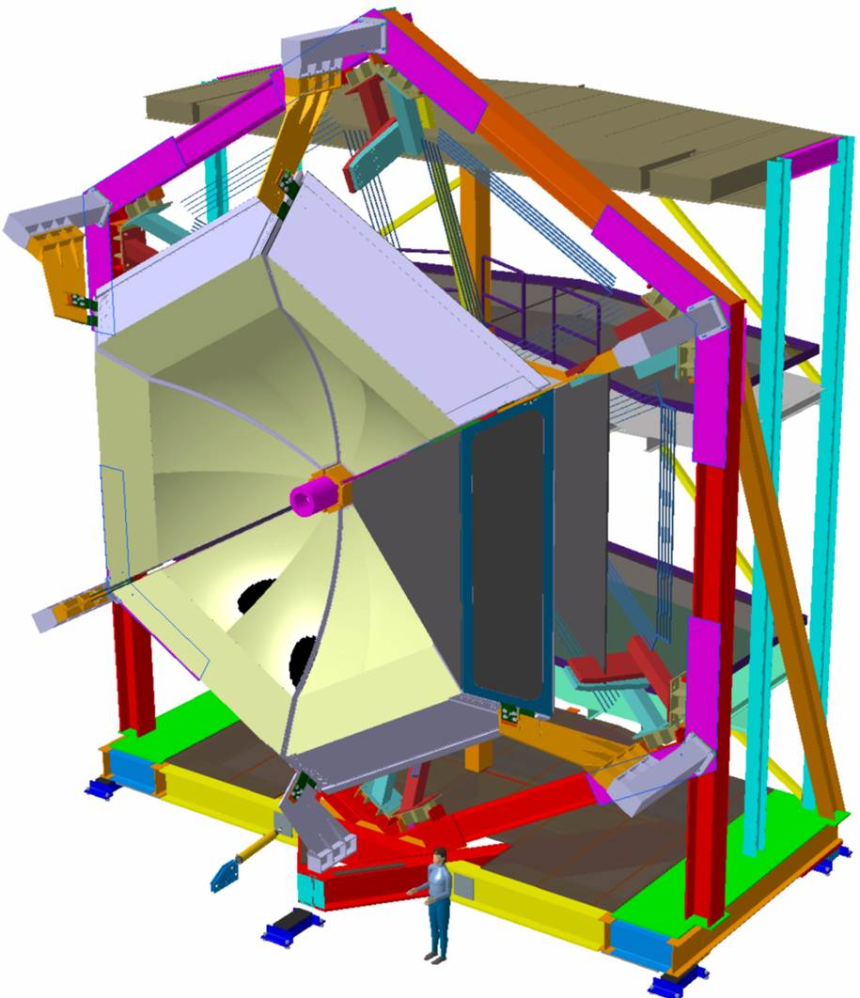
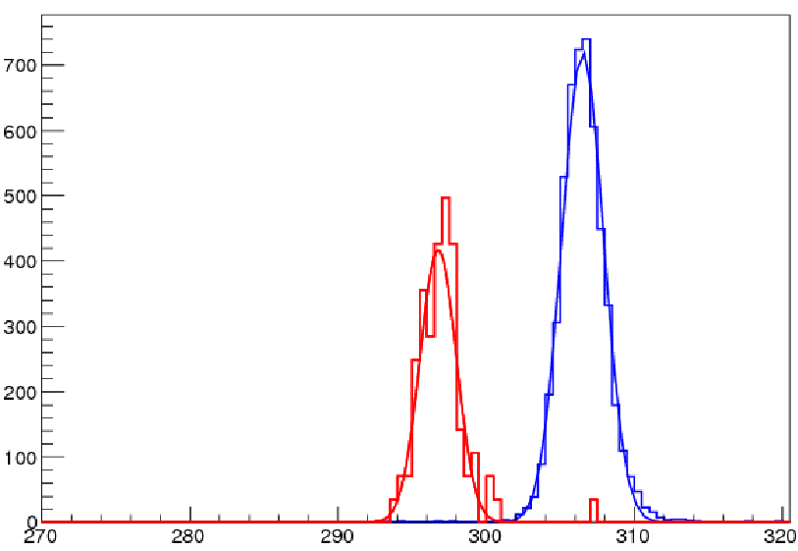
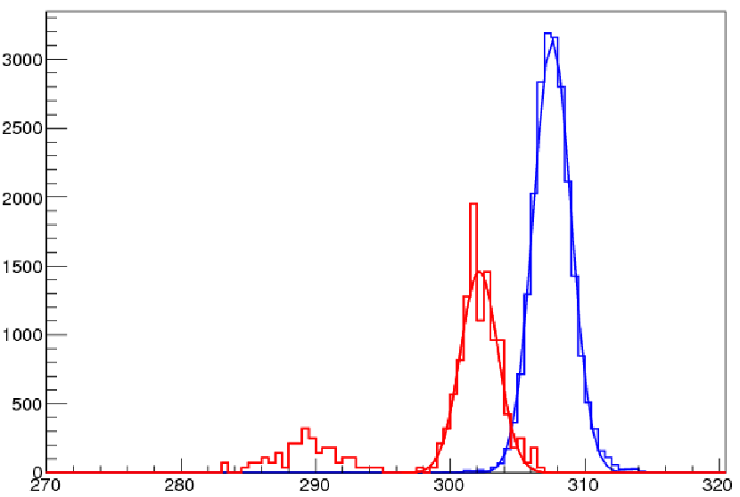
Hall B – RICH
Construction of a Ring Imaging Cherenkov (RICH) detector to replace one sector of the LTCC in CLAS12
Goal: ID of kaons vs π and p with momentum 3-8 GeV/c
with a π/K rejection factor 1:500
RICH
Hybrid solution: proximity gap plus focusing mirrors
π K(x60)
spherical
mirror
CERN test results
Large polar angle Kaon
p=6 GeV/c
plane
mirror
p=8 GeV/c
6 cm
Cherenkov photons
Small polar angle Kaon
International Collaboration
INFN(Italy), JLab, Argonne National Lab, Duquesne University, Kyungpook National University (Republic of Korea), J. Gutenberg Universitat Mainz (Germany), Universidad Tecnica Federico Santa Maria (Chile), University of Connecticut, University of Glasgow (UK)
2 cm
Cherenkov photons
photon detectors:
MA-PMTs
aerogel
8

Slide 9
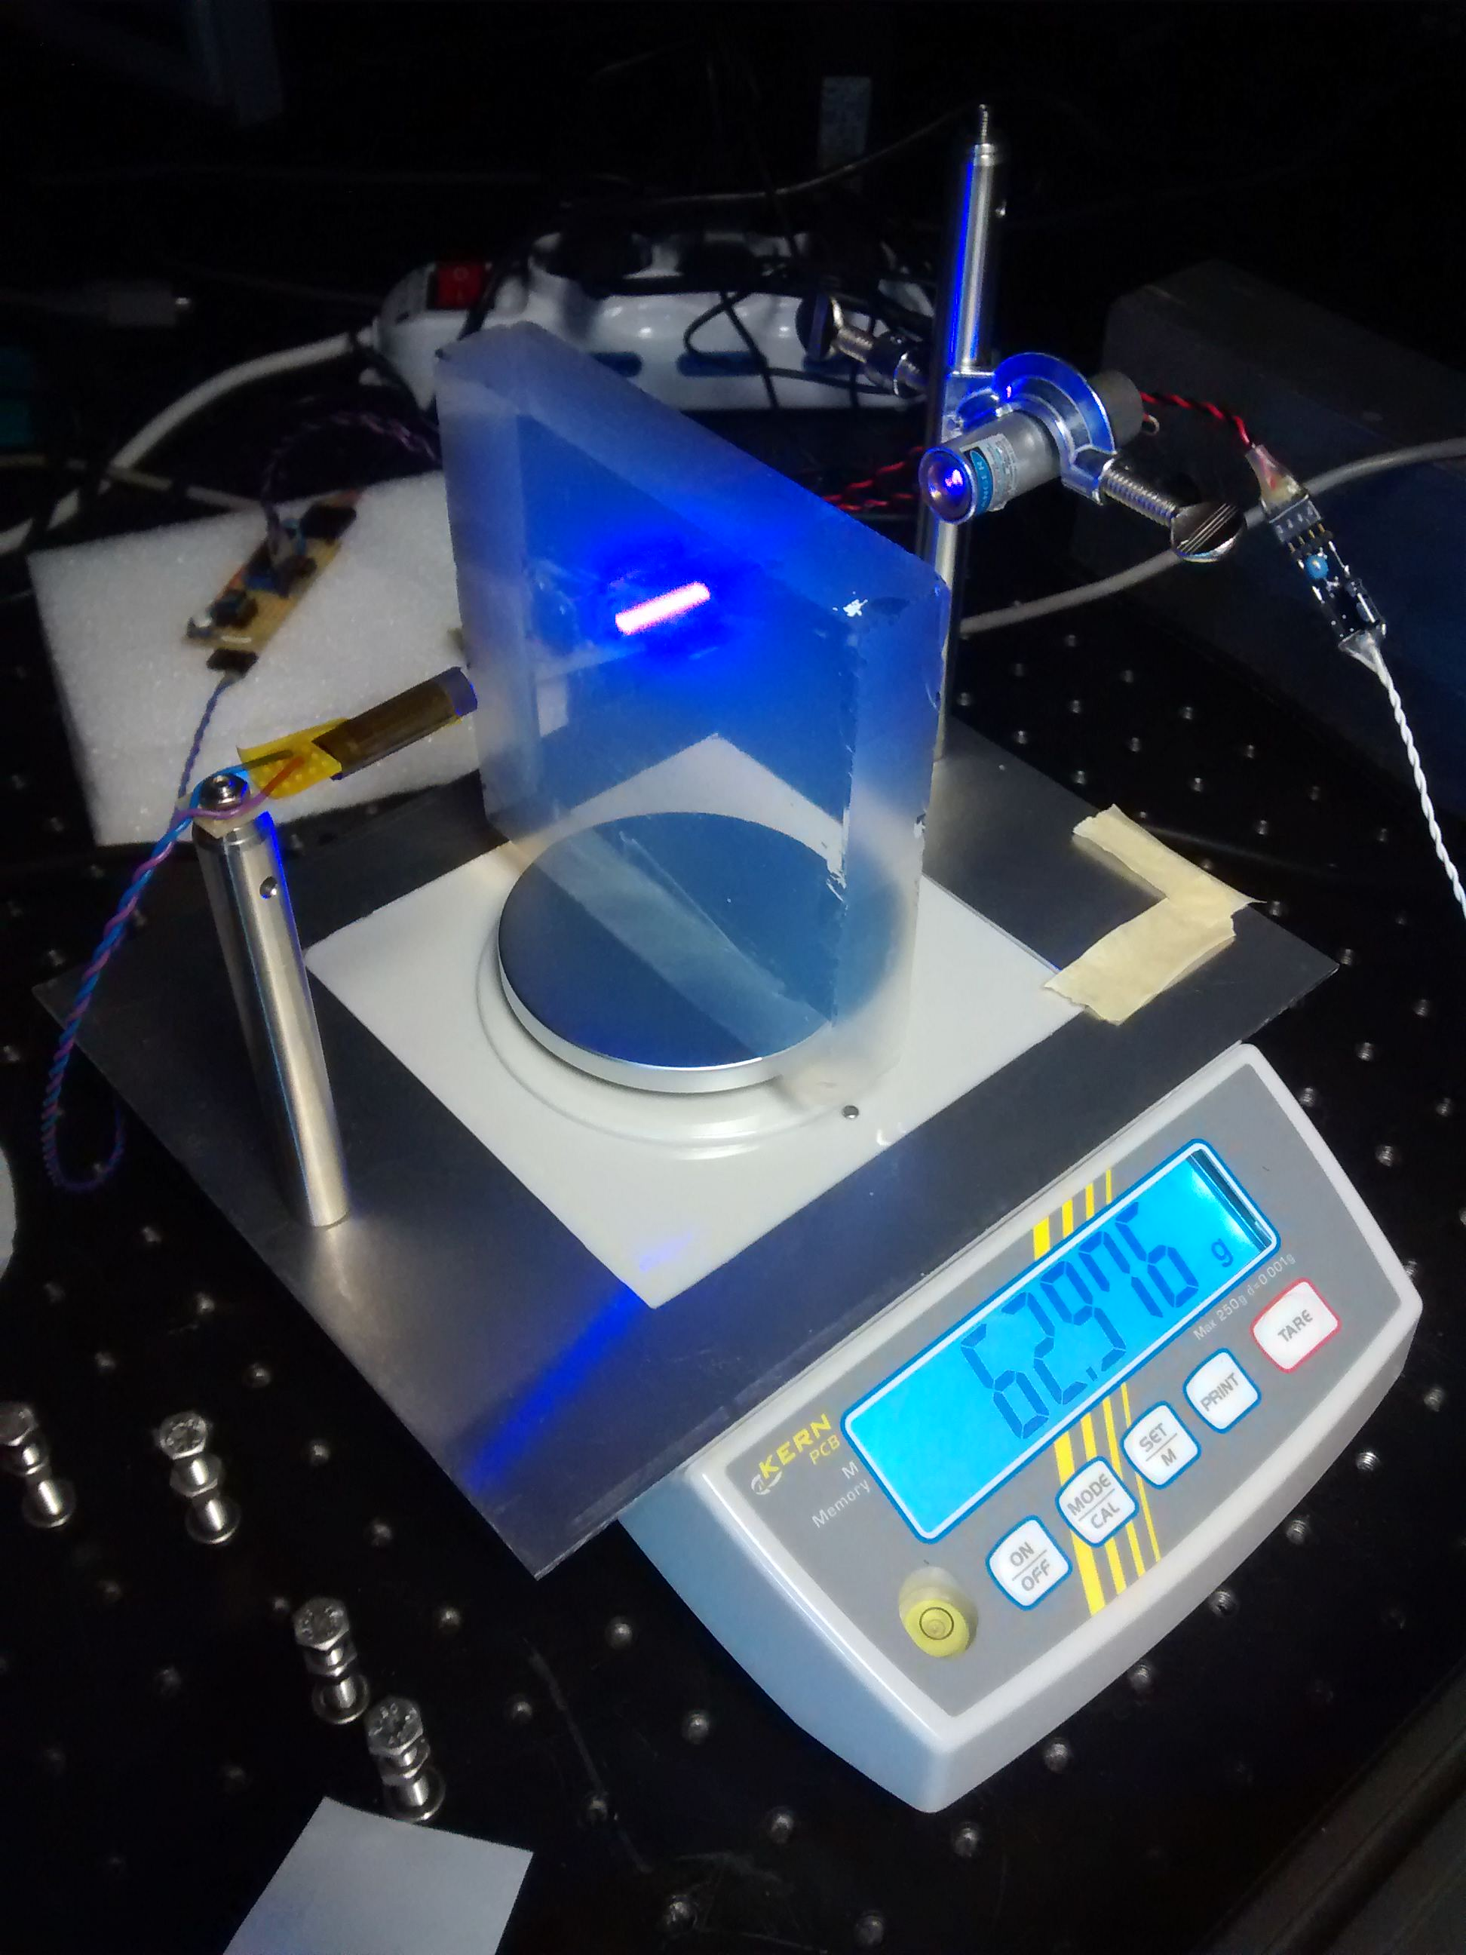
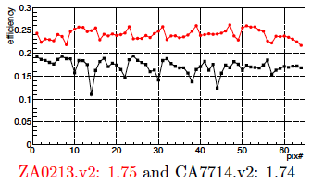
Hall B – RICH
Some important milestones:
September 2013: JLab Physics Division review
  DOE/ONP approved (PMP/Quarterly reports)
  First sector funded by INFN, DOE/JLab; second sector (~2.3M$) funded by INFN/Italian MIUR
End 2013/Beginning 2014: start of construction
June 2015: internal mid project review
October 2015: mid project review with DOE in attendance
March 2017: start installation of the first sector
Large aerogel tile (20x20 cm²)
Production on going, long term
stability tests ongoing
DOE/JLab scope of the program:
purchasing and testing MA-PMTs
purchasing and testing part of the aerogel
manpower to guarantee successful integration in CLAS12
Status
- 65% of JLab funds spent
80 H8500 +170 H12700 =250 MA-PMTs (out of 380) arrived at JLab and tested. All passed the QA tests.
RICH installation plan at JLab finalized
H12700
H8500
H12700 with enhanced SPE spectrum
9

Slide 10
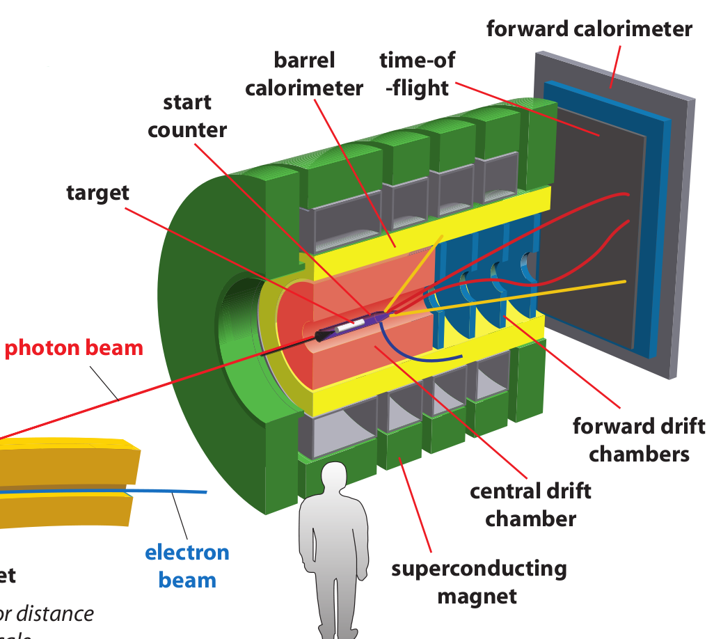
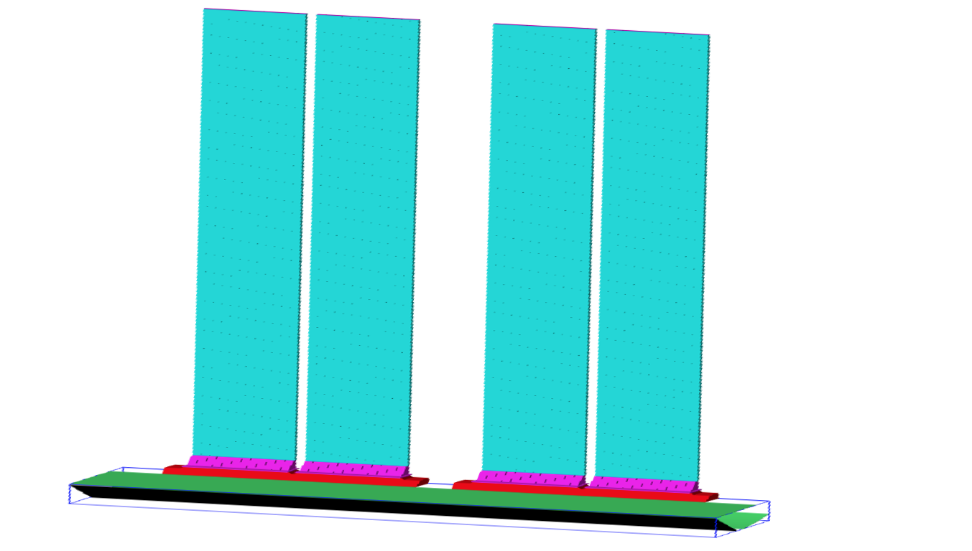
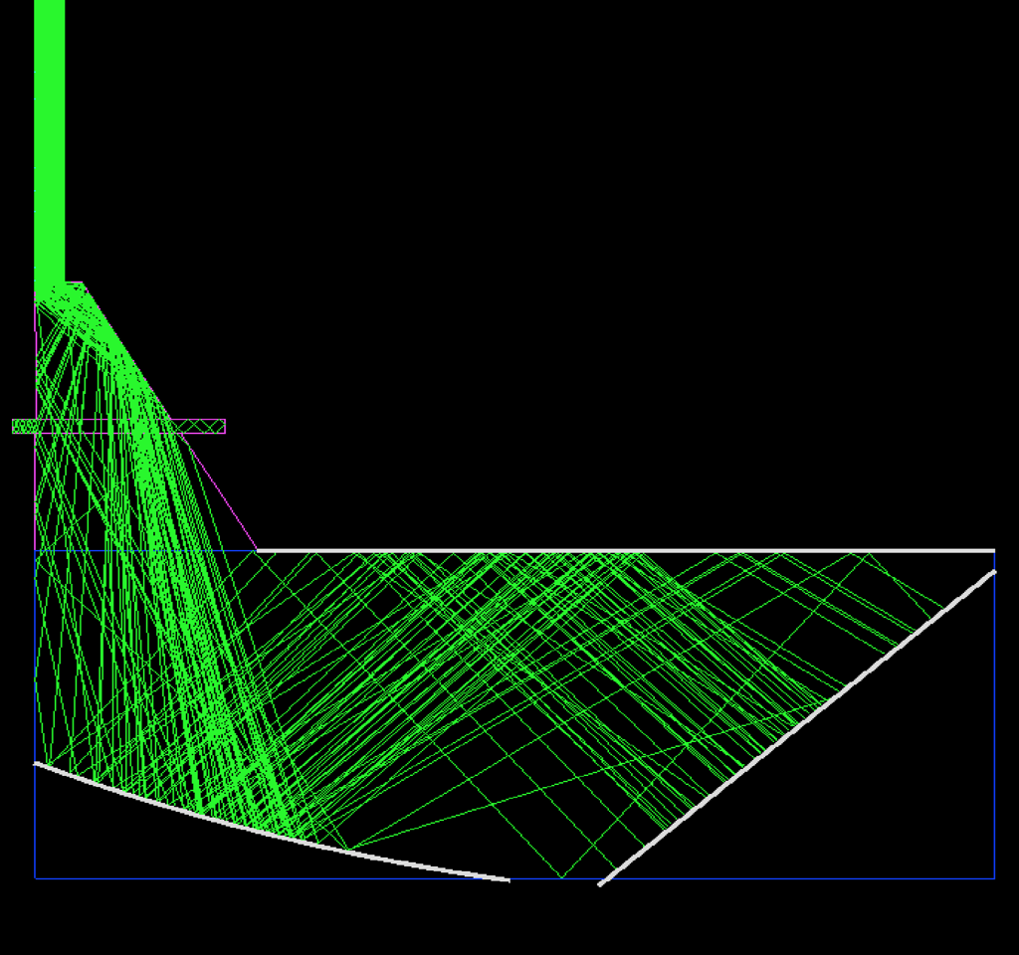
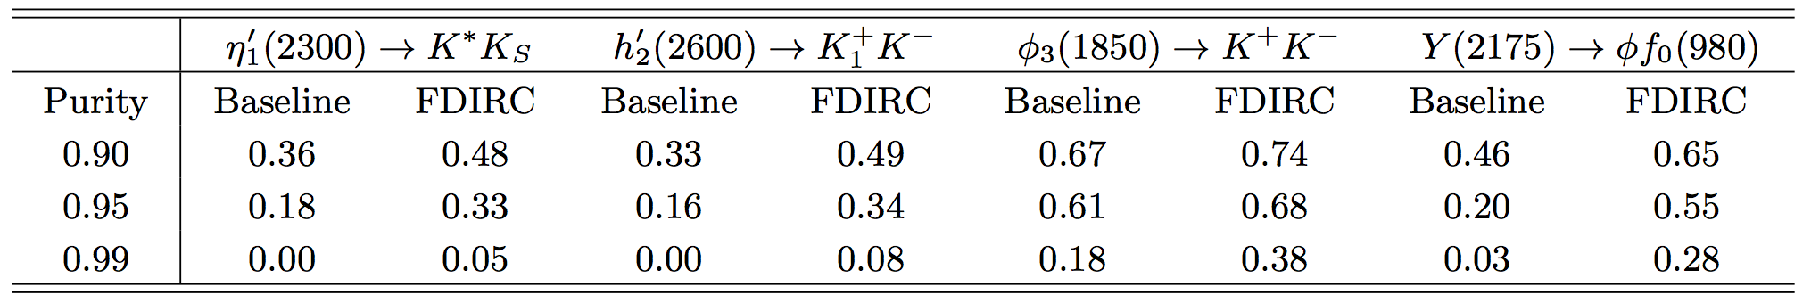
Hall D - Cherenkov Detector (DIRC)
Improved π/K separation (3σ up to 4 GeV/c) extends the physics program to study mesons and baryons containing strange quarks
Received approval from SLAC to use BaBar DIRC component: Four modules (12 quartz bars each) + 1 common Focusing Oil Box
Implementing a compact, focusing optics System
Synergy with CLAS12 RICH MaPMT readout and electronics
~15K readout channels integrated into standard Hall D DAQ system
Install DIRC here
Beam axis
Silica bar boxes oriented horizontally
Baseline Vs FDIRC efficiencies:
Focusing Optics
Notes:
Red Interior Page Design

Slide 11
Hall D - Cherenkov Detector (DIRC)
JLab CE project:
light collection system; ii) photo-detectors (MA-PMTs); iii) Readout system; iv) Support frame
Status
Focusing optics
-The prototype focusing box design is complete (mirrors contained in a bath of distilled water)
-The mirrors are currently at a vendor being lapped before testing their performance at MIT
-The design for the full scale detector is ongoing
Mechanical
-The IU group has developed a shipping crate to ship the bars from SLAC to JLab.
-A full scale prototype of the bar box has been constructed and tested in the shipping crate instrumented with accelerometers to measure the stress on the bars in a shipping truck.
Readout
-The CLAS12 RICH readout is planned to be used for the DIRC
-A full block diagram for the required components (FPGA, DAQ electronics, HV, LV, cables, etc.) has been developed
Physics Division Review with DOE in attendance scheduled for October 2015
Notes:
Red Interior Page Design

Slide 12
Hall D - Cherenkov Detector (DIRC)
JLab CE project serves two functions:
to replace the radiation-damaged modules at the center of FCAL after initial years of ops.
to provide high-energy resolution calorimeter required for the approved Primakoff experiment and for the η factory.
Measurements using 20 MeV e⁻
FCAL: 2800 40x40x450mm³ F8 lead glass
Expected dose (center) 100kRad/10Y at “high intensity” (100MHz in coherent peak) – order of magnitude estimate
Rad. damage of F8 glass measured
100kRad → x1.8 deterioration of the resolution
Insert: 60x60cm² - about 900 crystals PbWO
(similar “hybrid” calorimeter as PRIMEX)
Radiation hard
Improving the resolution in energy and position x2
Improving the hit separation
300 kRad
700 kRad
500 kRad
Calculations, in kRad/Year at “low intensity”
60 cm
Notes:
Red Interior Page Design

Slide 13
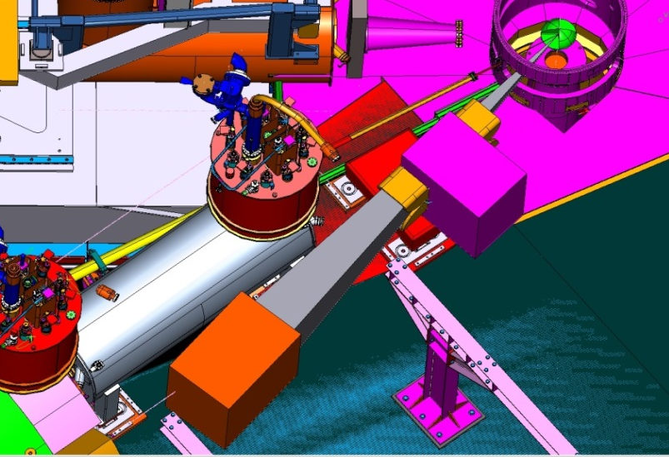
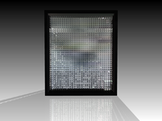
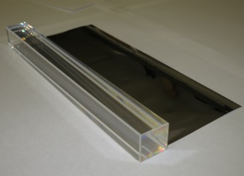
Hall C: Neutral Particle Spectrometer (NPS)
In Hall C 5 approved experiments require measurements of neutral particles (γ and π⁰) ➔ Neutral-Particle Spectrometer (NPS) between 5.5 and 60 degrees (~25 msr ) consisting of a highly segmented EM calorimeter preceded by a sweeping magnet
NPS on SHMS platform
Detector
Magnet
NPS General Design Concept
1116 PbWO₄ crystals in a temperature-controlled frame including gain monitoring and curing systems
~ deadtime-less digitizing electronics to independently sample the entire pulse form for each crystal
A new sweeping magnet
NPS angle range: 25 – 60 degrees
NPS
PbWO₄
Status of the project
NSF/MRI awarded to provide NPS infrastructure, including the magnet
15 PbWO4 crystals produced by SICCAS have been tested for optical properties and radiation hardness; 30 more crystals on order
JLab CE project: provide ~ 1200 high-quality PbWO4 calorimeter blocks
13

Slide 14
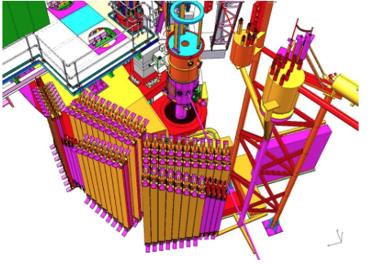
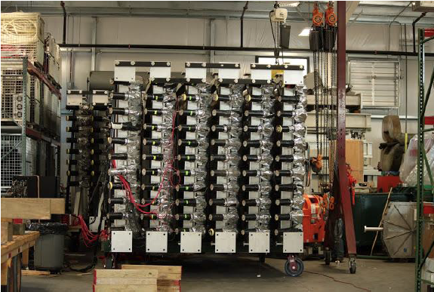
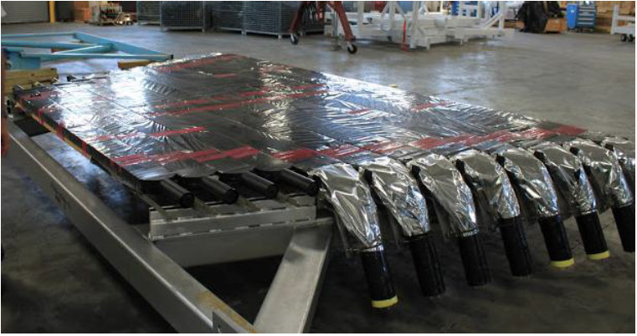
Hall C: Large Acceptance Detector (LAD)
The Large Acceptance Detector (LAD) consists of a large set of scintillator paddles previously used as time-of-flight detectors in CLAS .
The LAD is envisioned to detect spectator protons and neutrons in studies of the relation of the nuclear EMC effect and short range correlations.
Status of the project
LAD
Three ( out of six) panels moved to ODU
Two completely refurbished
JLab CE project: provide the infrastructure (cabling, stands, etc.) to reuse the scintillators
14

Slide 15
HRS Magnet Controls
Some components of the Hall A magnetic spectrometers are very old, some barely functioning, and there are parts for which we have no spares.
Yet, there is a substantial science program approved for the standard equipment (PREX-II, APEX, CREX, parts of the 3H run group, DVCS-II,...).
Some replacement, refurbishment and modernization of the basic Hall spectrometer systems needed to complete the approved science program in the 12 GeV era
JLab CE project: magnet control systems and software for HRSs full functionality and standardized (with Hall C HMS/SHMS)
15

Slide 16
CE Projects Integrated Cost FY13-FY19
K$
Hall A TOT = 9795 K$
Hall B TOT = 6264 K$
Hall C TOT = 4023 K$
Hall D TOT = 2771 K$
Phys. Div. TOT = 2530 K$
JLab Capital Equipment ≅ $25.4M
16

Slide 17
Assessment & Selection
The Capital Equipment project assessment and selection criteria are based on the JLab scientific strategic goals and critical success factors
1st step: identify proposals that represent high quality physics
➔ PAC
2nd step: evaluate the technical feasibility and the resources available (including MRI and funds from foreign funding agencies)
17

Slide 18
Oversight
Capital Equipment Projects for FY13-FY19 consist of mix of:
1) Projects supporting general Physics Infrastructure/Targets, like:
Hall B Longitudinally Polarized Target
Hall B Transverse HDIce Target
Hall A Tritium Target
Halls C/A Polarized ³He Target
Halls C/D: High Resolution Calorimeter
2) Larger-Scale Physics Infrastructure/Major Physics Experiments
Hall A SBS DOE/JLab managed
Hall B one-sector RICH with DOE observers
Hall D Cherenkov Detector with DOE observers
JLab managed
18

Slide 19
Conclusions
A varied Capital Equipment portfolio is managed by JLab to support Physics Infrastructure of medium and larger-scale, Targets and Major Physics Experiments.
The Capital Equipment project assessment and selection criteria are based on the JLab scientific strategic goals (PAC) and critical success factors (technical feasibility, external funding resources).
The projects oversight is made by the JLab management, by JLab and DOE as observer, or by the DOE/ONP, depending on the scale of the project.
19

