Slide 1
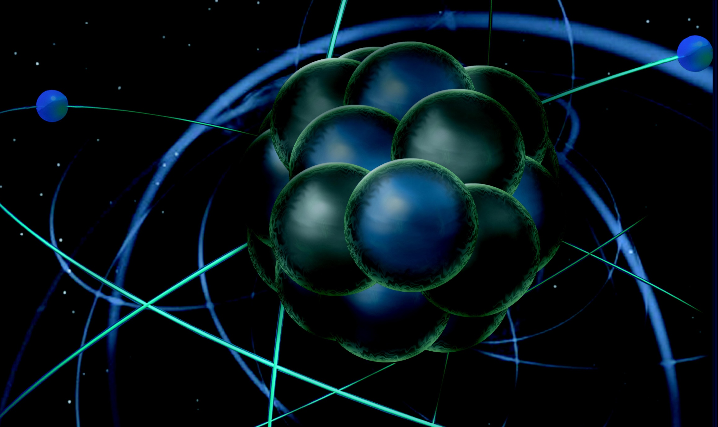
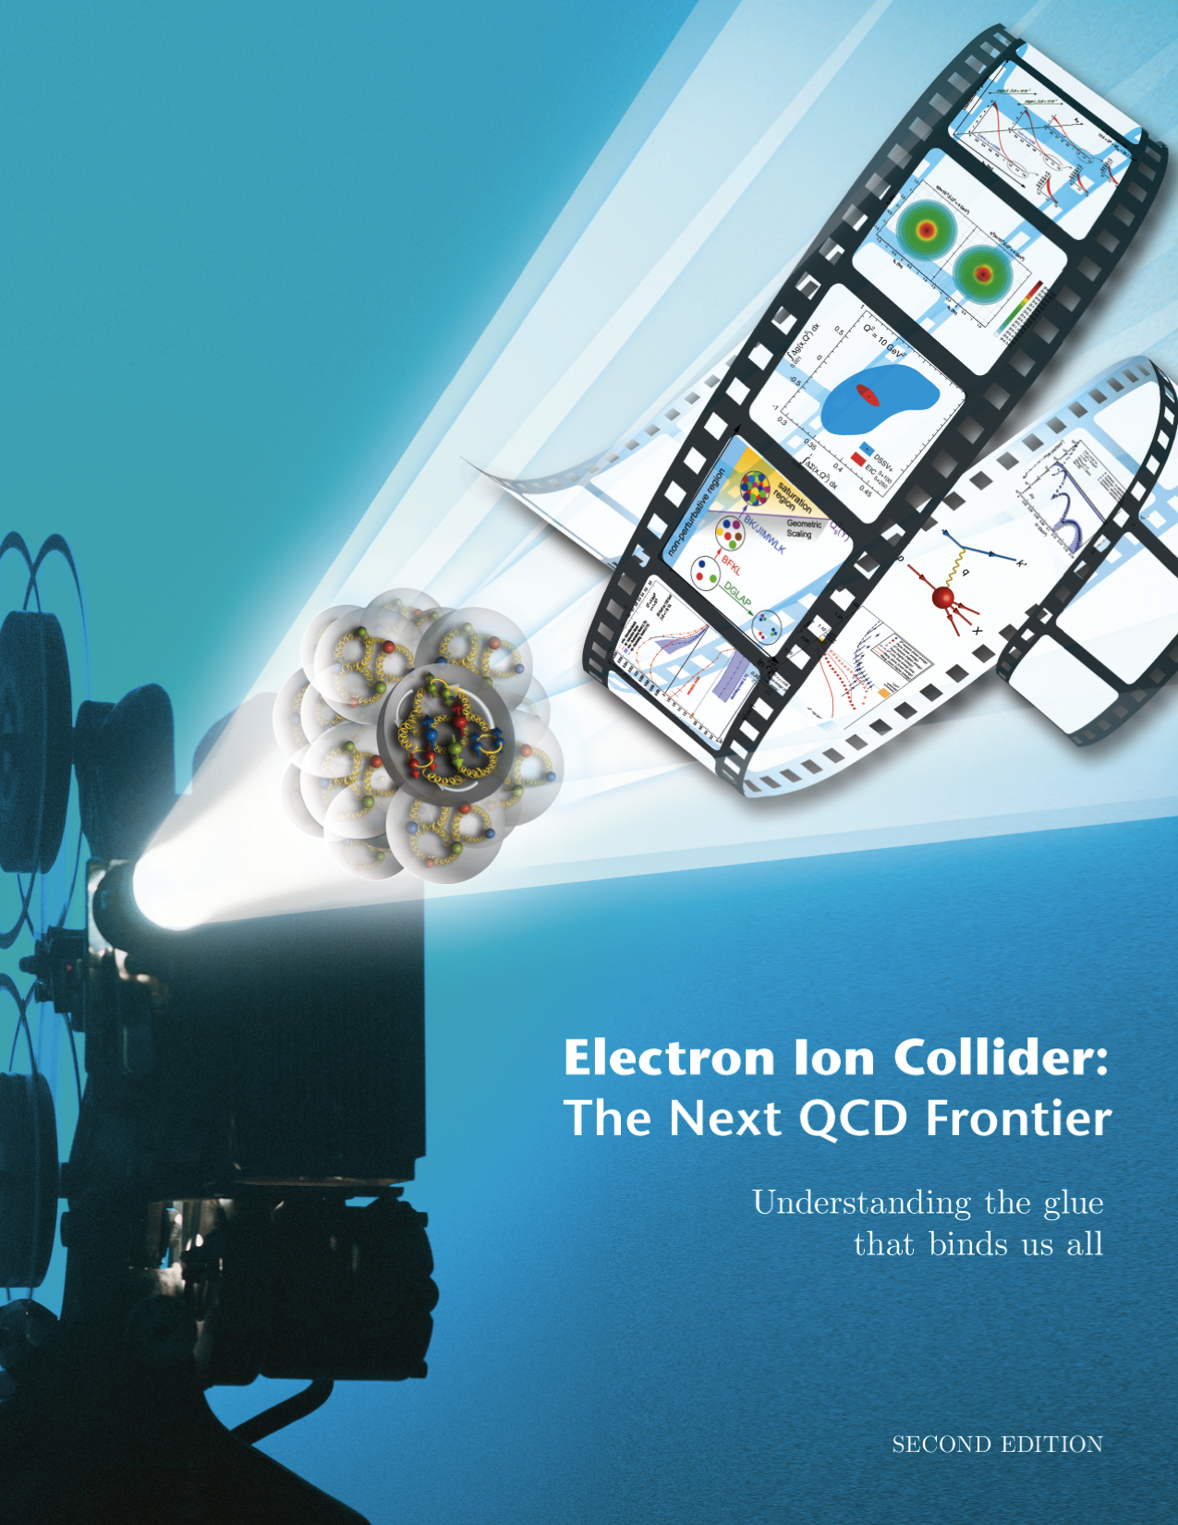
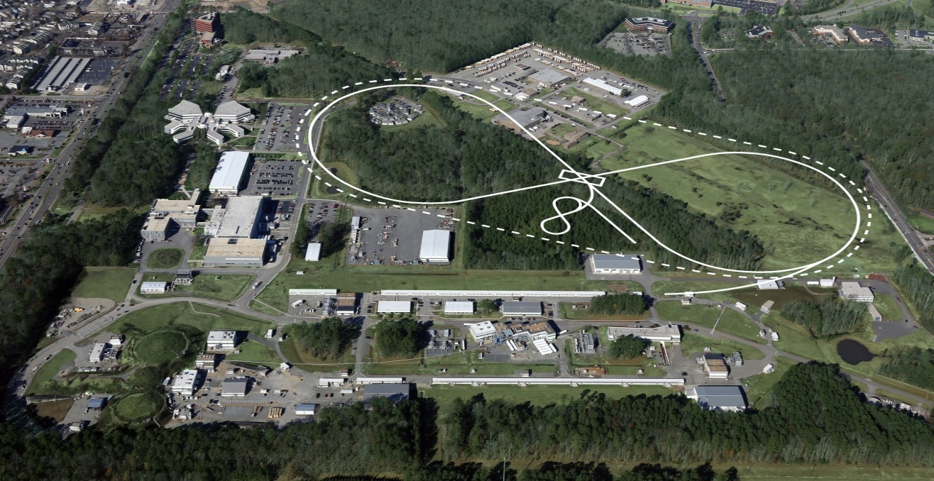
MEIC Physics and Design
Rolf Ent

Slide 2
EIC Science Questions – Cool QCD View
What is the transverse spatial and momentum structure of the gluons and sea quarks? Are there non-perturbative structures and can one image them?
How much do the gluons contribute to the nucleon spin? Is there significant orbital momentum?
How is the gluon distribution in nuclei different than in the nucleon? How does this relate to nuclear binding or short range nucleon-nucleon correlations?
Can one find evidence for saturation of the gluon density?
How do quarks and gluons propagate in nuclear matter and join together to form hadrons?

Slide 3
Recent EIC Events (since ~ May 2014)
Event | Date | Name (if applicable)
Presentation on EIC & LHeC to INFN Long-Term Strategy Meeting | May 2014 | R. Ent
EIC users meeting – about 160 participants | Jun. 2014
Joint DNP/JPS Workshop on Future Directions in High-Energy QCD | Oct. 2014 | R. Ent, P. Rossi
MEIC redesign (see next slide) | Jun. - Dec. 14
Internal cost review | Dec. 2014
Revision of EIC White Paper – v2 & v3 | Dec. 2014
NSAC cost review | Jan. 2015
Joint (w. users, BNL) preparation of EIC talk for the LRP process | Jan. - Mar. 15 | R. Ent B. McKeown
Joint (w. BNL) Meeting at SURA to prepare for LRP | Mar. 2015
NSAC LRP Working Group | Apr. 2015
Scientific American article on Gluons – authors Rolf Ent, Thomas Ullrich and Raju Venugopalan | May 2015 | R. Ent
Participation in LHeC meeting | June 2015 | B. McKeown
Presentation on EIC at U Torino and at INFN Headquarters | June 2015 | B. McKeown
Discussion with Orsay & Saclay on French involvement in EIC | July 2015
Article on “Physics of Future Electron-Hadron Colliders” submitted to Advanced Science – authors Max Klein and Rolf Ent | July 2015 | R. Ent
Notes:
Added collaborators

Slide 4
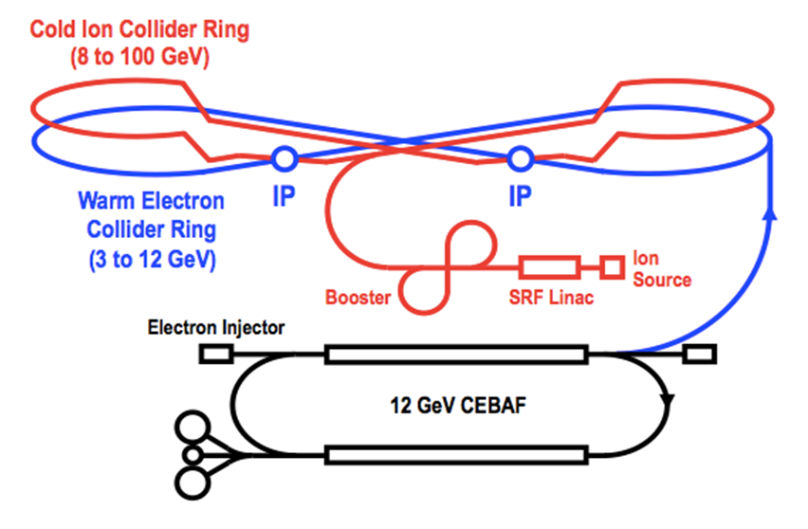
MEIC Baseline Design
arXiv:1209.0757 (Sept. 2012)
arXiv:1504.07961 (April 2015)
Features:
Collider ring circumference: ~2100 m
Electron collider ring and transfer lines : PEP-II magnets, RF (476 MHz) and vacuum chambers
Ion collider ring: super-ferric magnets
Booster ring: super-ferric magnets
SRF ion linac
Goals:
Balance of civil construction versus
magnet costs and risks
Aim overall for low technical risks
Collaborators:
ANL, Fermilab, SLAC
Texas A&M
Notes:
Added collaborators

Slide 5
Overview R&D for the MEIC baseline (Accelerator R&D, as shown at EIC cost review as part of the assigned homework)
Needed R&D | Risk level | Mitigating strategies | Mitigated risk level
Bunched beam electron cooling ERL only | MEDIUM | Test of bunched beam cooling at IMP (LDRD) Experience from RHIC low energy cooling Development of a 200 mA unpolarized e- gun | LOW
Low β* ion ring | MEDIUM | Chromatic and IR nonlinear correction schemes DA tracking with errors and beam beam Operational experience at hadron colliders | LOW
Space charge dominated beams | MEDIUM | Simulation DC cooling in Booster Operational experience at UMER and IOTA rings Study of space charge compensation at eRHIC | LOW
Figure 8 layout | MEDIUM | Spin tracking simulations | LOW
Super ferric magnets | MEDIUM | Existing prototypes (SSC, GSI) Early MEIC prototype (FY15-16) Operational experience at GSI Alternative cosθ designs | LOW
Crab cavities | MEDIUM | Prototypes Operational experience at KEK-B and LHC Test of crab cavity in LERF (FEL) | LOW
SRF R&D | LOW | 952 MHz RF development | LOW

Slide 6
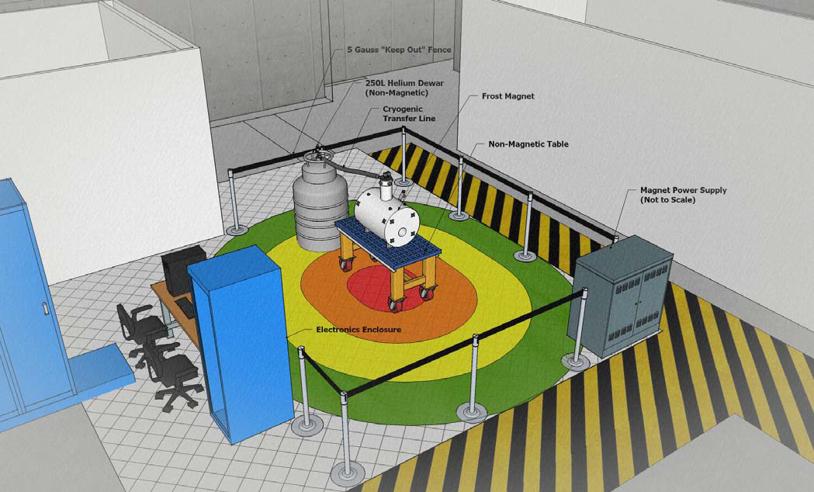
Strong Involvement in (EIC-Related) Detector R&D
JLab provides support for staff and users taking part in the Generic EIC Detector R&D program (well run through BNL)
Provide organization for users
Assist in proposal preparation
Provide infrastructure for R&D topics, e.g. 5T sensor test facility re-using existing magnets
Often synergy with 12-GeV related pre-R&D (like SiPMs, DIRC, PbWO4 crystals)
High-B-field sensor test facility at JLab (utilizes FROST magnet)
Many R&D proposals are collaborative (BNL/JLab/users)
Strong interest from institutions with large involvement at JLab
Catholic University of America
CEA Saclay, France
College of William & Mary
INFN, Italy
IPN Orsay, France
Mississippi State University
Old Dominion University
Temple University
UTFSM, Chile
University of South Carolina
University of Virginia
+ Collaborations with GSI/FAIR and U. Giessen, Germany

Slide 7
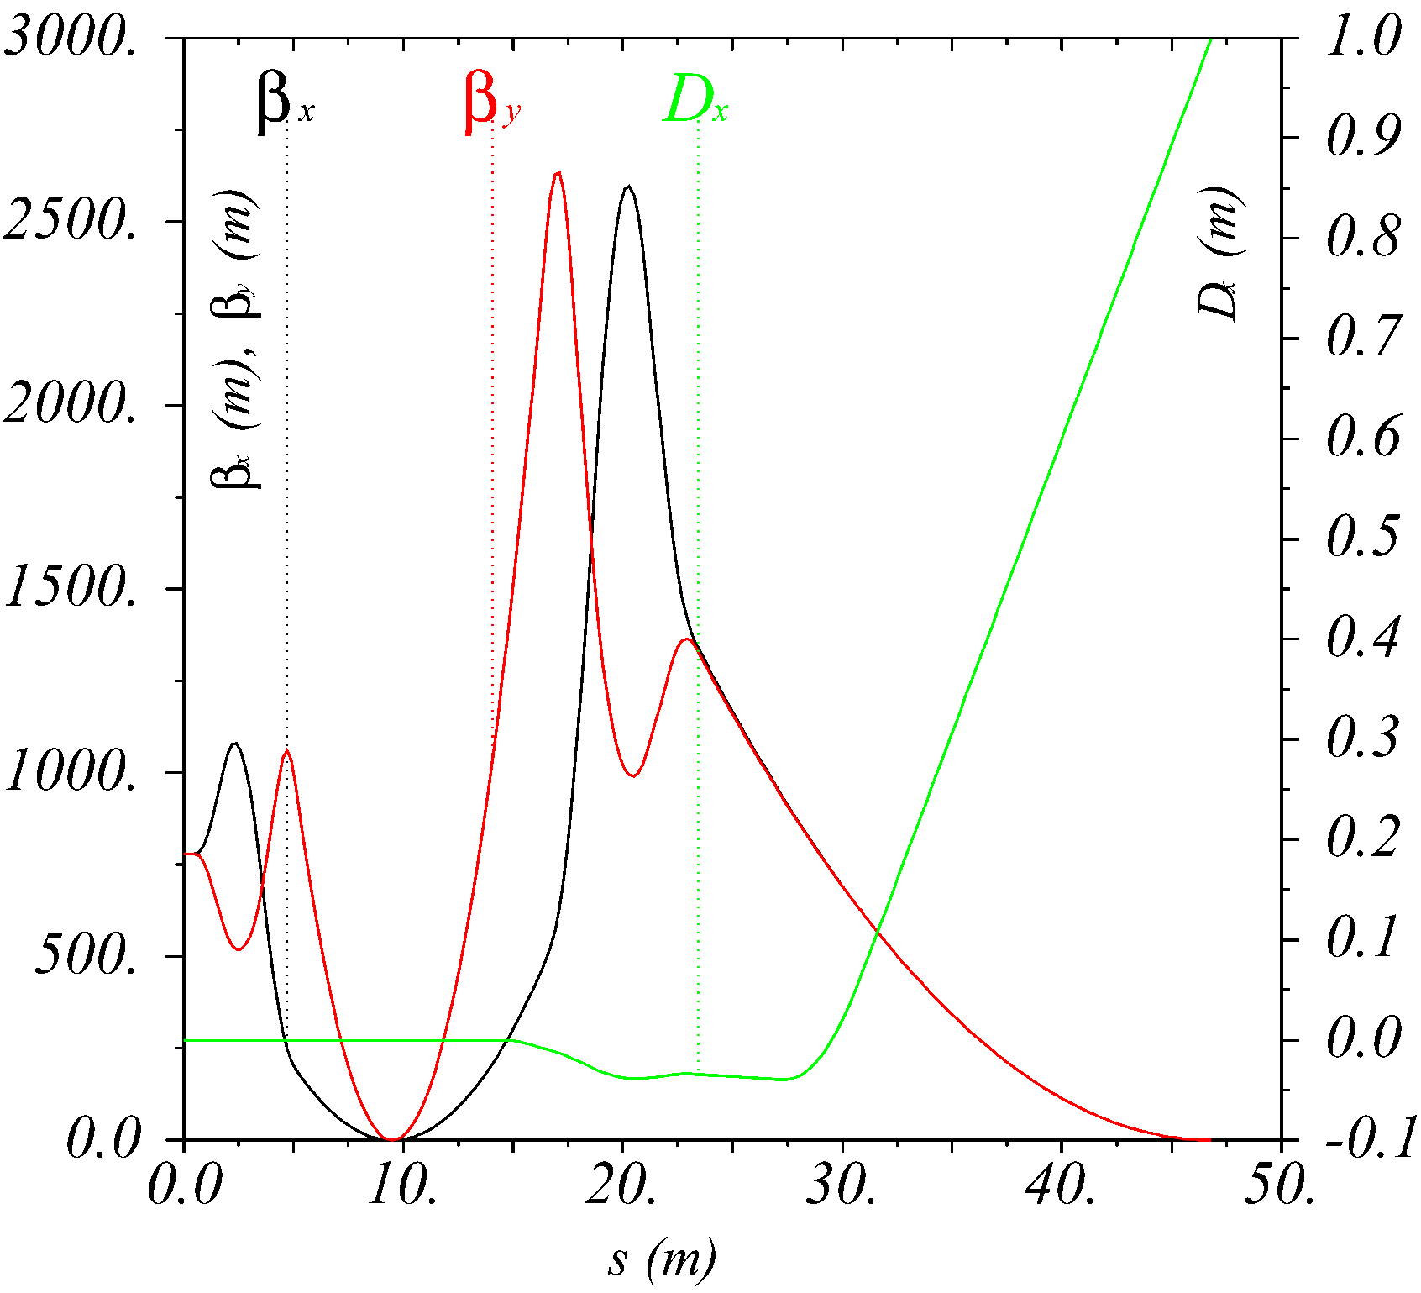
Integration of Main Detector – Full-Acceptance Detector
Design emphasis on polarization (figure-8) and on integrated detector/interaction region
Design goals:
Hadron detection in three stages
Detection/identification of complete final state
Endcap with 50 mrad crossing angle
Spectator p_{T} resolution << Fermi momentum
Small dipole covering angles to a few degrees
Low-Q² electron tagger for photoproduction
Ultra-forward up to one degree, for
particles passing accelerator quads
Compton polarimeter with e⁻ and γ detection
Beam line functions as spectrometer: dp/p < 3x10⁻⁴
IP
FP
- 10 m

Slide 8
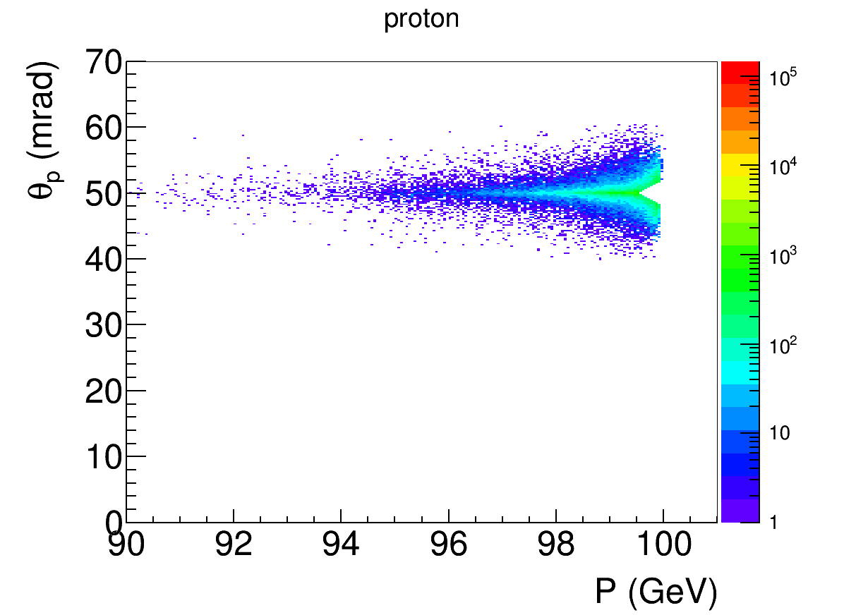
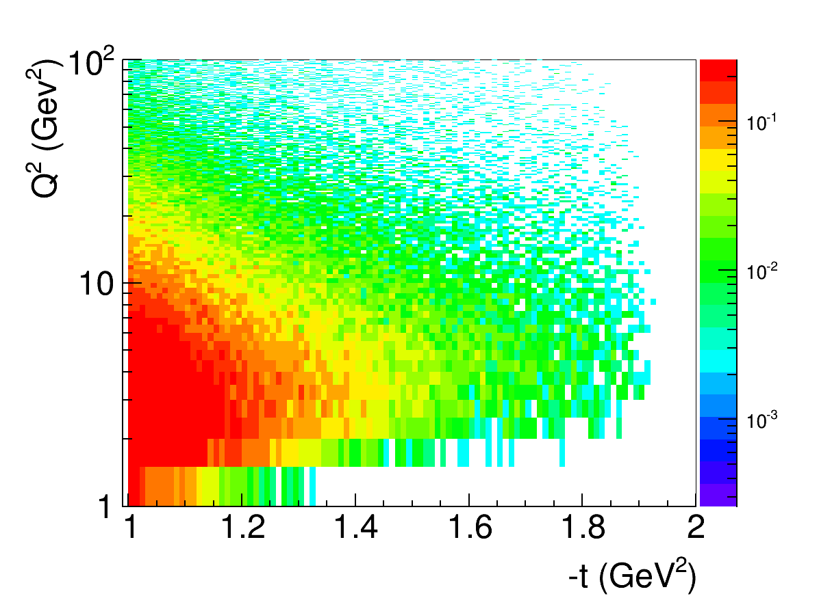
MEIC Example: DVCS Recoil Proton Acceptance
Kinematics: 5 GeV e⁻ on 100 GeV p at a crossing angle of 50 mrad.
Cuts: Q² > 1 GeV², x < 0.1, E’_{e} > 1 GeV, recoil proton 10σ outside of beam
DVCS generator: MILOU (from HERA, courtesy of BNL)
GEANT4 simulation: tracking through all magnets done using the JLab GEMC package
low-t acceptance
high-t acceptance
MEIC integrated detector & extended interaction region put in GEANT4-based GEMC package now, ready for realistic detector concept development
p beam at 50 mrad
High-t acceptance limited by magnet apertures
10σ beam size cut:
p < 99.5% of beam for all angles
θ > 2 mrad for all momenta
-t = 1.9 GeV² ±14 mrad
Proton angle at IP
e⁻ beam at 0 mrad
Recoil proton angle is independent of electron beam energy: θ_{p} ≈ p_{T}/E_{p} ≈ √(-t)/E_{p}
A wider angular distribution at lower energies makes precise tracking easier

Slide 9
MEIC Physics and Design - Summary
MEIC Physics and Design moving forward:
Recent updated EIC white paper
Strong interest and involvement from JLab users
Strong player in generic detector R&D program
Original MEIC science and design: arXiv:1209.0757
Recent updated MEIC design: arXiv:1504.07961
Design well developed and low risk, with modest (pre-)R&D
Optimized for high ion beam polarization
Allows for polarized deuterons
Maybe essential for the spin program (see C. Weiss talk)
Time scale following 12 GeV program is “natural”
Multiple and successful efforts to engage community
Concern: additional MEIC pre-R&D funds needed

