Slide 1
Experimental Facilities & Operational Metrics
J. Gomez
Metrics
Restoring Physics Operations

Slide 2
Metrics
Quality of Science (this S&T Review…)
Completed experiments/Hall availability Nothing to report due to ongoing 12 GeV Upgrade project instead - brief status of the experiments being completed at the time of the 2012 S&T Review (pubs rely heavily on theses analysis of Ph.D. students)
Number of publications
Ph.D. theses

Slide 3
Exp. being completed at time of 2012 S&T Review
Hall | Experiment | Title | Spokespersons
A | E08-027 | A Measurement of g₂^{p} and the Longitudinal-Transverse Spin Polarizability | Slifer/Camsonne/Chen
A | E08-007 | Measurement of the Proton Elastic Form Factor Ratio at Low Q² | Ron/Arrington/Day/Gilman/Higinbotham/ Sarty
B | E06-101 ( member of g14/HDice run group ) | N* Resonances in Pseudoscalar-meson photo-production from Polarized Neutrons in polarized H & D and a complete determination of the γn→Κ⁰Λ amplitude | Klein/Sandorfi
C | E08-016 | The Qweak Experiment: A Search for New Physics at the TeV scale via a Measurement of the Proton's Weak Charge | Carlini/(Finn) Kowalski/Page
Inj. | E11-105 | Polarized electrons for Polarized Positrons | Grames/Voutier

Slide 4
E08-007/E08-027
Proton Elastic low-Q² (E08-007) status,
Anticipated Ph.D.s,
2015: Moshe Friedman
2017: Jessica Campbell
Expect to submit for PRL following completion of Moshe Friedman thesis
g₂^{p} (E08-027) status
Anticipated Ph.D.s:
2015: Melissa Cummings, Min Huang, Pengjia Zhu
2016: Toby Badman, Chao Gu, Jie Liu, Ryan Zielinski
Entire new suite of beamline diagnostics for operation at 50nA
Pub in Nucl. Instrum. Meth. (In Review)
Average target polarizations ~ 70% (15%) 5.0 T (2.5 T)
Nucl. Instrum. Meth. A738 54 (2014)

Slide 5
g14/HDice
Theses,
Polarimetry of the Polarized Hydrogen Deuteride Hdice Target under an Electron Beam. Vivien Laine, U. Blaise Pascal, Clermont-Ferrand FR (2013).
Polarization Observables from two-pion and rho meson photoproduction on polarized HD target at Jlab. Irene Zonta, U. Roma-II "tor Vergata", Rome IT (2014)
Measurements of Helicity E Polarization Observables for γn → π⁻p, K₀ Λ and π+π⁻D using CLAS g14 data at Jefferson Lab. Dao Ho, Carnegie-Mellon U, Pittsburgh PA (in progress)
Spin asymmetries in two-pion photoproduction from polarized HD. Peng Peng, U Virginia, Charlottesville VA (in progress)
(Analysis of K+ Sigma- photoproduction). James Flemming, U. Edinburgh, Edinburgh UK
Physics analysis - expect two pubs in the short term,
PRL on the beam+target double polarization asymmetry “E” for γ+n -> π⁻ p
double π⁺π⁻ production & extraction of three polarization asymmetries from polarized protons and neutrons
Target related pubs (so far),
NIM A737 (214) 107
draft of 2nd being circulated

Slide 6
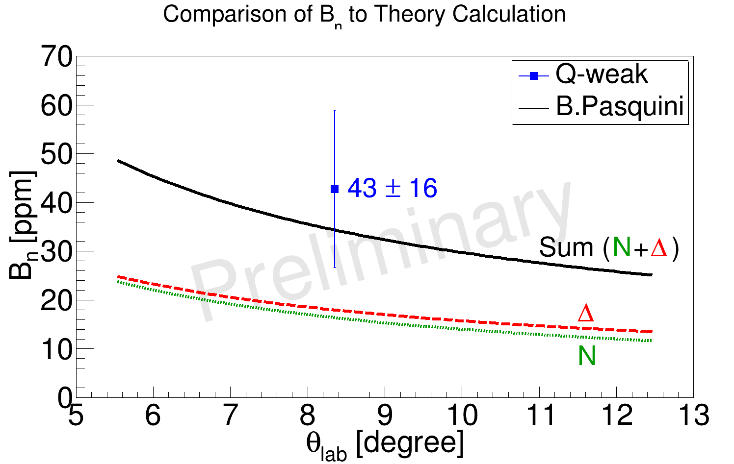
Qweak
Theses completed,
2011: P. Wang, J. Leckey
2012: K. Myers, J. Pan, J. Leacock
2013: R. Beminiwatha, B. Waidyawansa
2014: N. Nuruzzaman, A. Subedi
2015: A. Narayan, J. Hoskins
Theses in progress: thirteen
Instrumentation,
2015: NIM A781, 105 (2015)
Physics analysis,
2013: PRL 111,141803 (2013)
2015: final results
2016 →: publication of various ancillary/calibration measurements, e.g.
Parity-violating and allowed analyzing powers on H in the N→∆(1232) region (see plot)
Non-resonant inelastic measurement at 3.3 GeV to constrain γ-Z Box uncertainty.
Transverse asymmetry in the PV inelastic scattering region (3.3 GeV).
Example: Beam normal N→Δ asymmetry B_{n} (parity allowed) at 1165 MeV

Slide 7
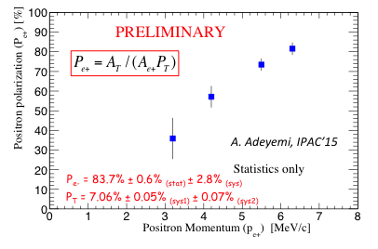
PEPPo: Polarized Electrons for Polarized Positrons
Theses,
A. Adeyemi, Hampton University (expected Dec. 2015)
J. Dumas, University Joseph Fourier, Grenoble (2010)
Positron Polarization > 80%
Plans (Fall 2015 and on …)
A short pub to a journal like Science highlighting a new and novel method to produce positrons
A Phys. Rev. pub
A Nuclear Instruments & Methods pub with emphasis on the Compton Transmission Polarimeter

Slide 8
Publications (Users/Staff) - 7/23/15
Publication | Calendar Year |  |  |  |  | Total
 | 11 | 12 | 13 | 14 | 15
Phys. Rev. Lett. Phys. Lett. | 13 | 10 | 6 | 8 | 5 (+3) | 204
Other Refereed Journals | 37 | 29 | 24 | 31 | 16 (+7) | 460
Invited Talks in Conf. Proc. | 28 | 29 | 18 | 22 | 1 (+0) | 340
Instrumentation Papers | 5 | 6 | 8 | 5 | 7 (+2) | 104
Contributed Papers | 42 | 98 | 68 | 33 | 12 (+20) | 839
In parenthesis, papers submitted but not yet published.

Slide 9
Nuclear Physics Ph.D.s - JLab Research
~30 Ph.D.s/year

Slide 10
Restoring Physics Operations
Experiment Readiness Review (ERR) process
Safety Documentation and Procedures
Accelerator Readiness Reviews (ARR), Phases 2 & 3
Experiment scheduling process Opportunistic & early physics
See “Early Physics Program” by R. Ent

Slide 11
Experiment Readiness Review (ERR)
A process to ensure that both equipment and experiments are ready and safe to operate.
Managed by the Deputy Associate Director (AD) for Experimental Nuclear Physics (P. Rossi).
In use since the mid-90’s: (a) hall equipment was reviewed before first operation/commissioning, (b) applied then to all experiments.
Updated and streamlined process with lessons learned from the 6 GeV era - e.g., who decides which devices can be added to the “standard equipment’’ (already reviewed) list of a hall. requirements to include an experiment on the beam schedule
Complexity of device or experiment determines the number of reviews and time that takes to complete the process. See,https://www.jlab.org/user_resources/PFX/NP-PFX/

Slide 12
ERR… @ 12 GeV
Repeat procedure… 2015-07-14 Hall D Solenoid 2nd Quench Review * 2015-03-24 Hall C SHMS HB Magnet Readiness Review * 2015-01-21 Hall C SHMS Q1 Magnet Readiness Review 2014-08-08 Hall D Photon Beam Commissioning Review 2014-07-10 HPS Experiment Readiness Review (Hall B) 2014-07-01 GlueX Experiment Readiness Review (Hall D) 2014-05-08 Hall D Hydrogen Target Safety Review 2013-12-09 DVCS/GMp Experiment Readiness Review (Hall A) 2013-12-03 Hall D Tagger Magnet Mapping Review 2013-07-18 Hall D Solenoid 1st Quench Analysis Review 2013-01-09 Hall D Solenoid Power-up Commissioning Review 2012-11-06 Hall D Solenoid Cool-down Commissioning Review * in progress

Slide 13
SHMS Horizontal Bender (HB) Magnet Review (SHMS = Super High Momentum Spectrometer)
Committee - same for all SHMS magnet reviews, including Q1,
Jonathan Creel (JLab) …. cryogenics
John Domingo (JLab - retired) …. acceptance testing
Robert Flora (FNAL) …. power & protection
Probir Ghoshal (JLab) …. superconducting magnets
Robert May (JLab) …. EHS&Q, documentation & procedures
Joseph Minervini (MIT) - chair …. superconducting magnets
Charge - same as Q1 but with small changes to improve flow of review.
See HB_Charge.docx (Indico site/this presenter) for copy of charge.
Summary of recommendations,
Complete Eddy current calculations on the thermal shield
Show that quench detection/dump time keeps peak magnet T < 150K
Implement hardware & software monitoring of inter-coil splices
Calibrate strain gauges for magnetic field/add Voltage to Ground measurement
Complete relevant TOSPs before testing
Work progressing in a. & b., others done.

Slide 14
Hall D Solenoid 2nd Quench Review
2015-05-02, after ~22h at 1300A, coil 4D quenched (note that in 2013, it was coil 1 that quenched at 1460A)
Internal ad-hoc Quench#2 Working Group assessed new quench data - “no smoking gun” could be found.
Gathered a review panel on 2015-07-15 to advise on how to proceed,
Bob Flora (FNAL - retired) chair, Probir Ghoshal (JLab), Leigh Harwood (JLab), Yukikazu Iwasa (MIT), Soren Prestemon (LBNL)
Summary of selected findings/comments/recommendations (preliminary report),
The cryostats have a high static heat load (different from SLAC?) which maybe the source of, or exacerbate, the bubble formation (leading candidate for the breakdown of cryostability.)
All indications are that the magnet can safely quench at the currents envisioned by the physics program (~80K hot-spot➔minimal thermal stresses)
Magnet quenching appears random, with no evident correlation with operating current or magnet ramp. Prediction of behavior at this point is impossible.
Operate magnet at 1300-1450A (perform physics until it quenches). Search for correlations, find optimal operating point.
Several suggestions given to instrument magnet (e.g. acoustic sensors) and/or study magnet stability under additional heat loads.

Slide 15
Safety Documentation and Procedures
Lessons learned from activities performed by staff & users were used to guide revisions to the safety documentation and procedures used by the division or implement new ones. For example,
Hall Safety Awareness Trainings (required for unescorted access to the halls),
Canceled existing training of all staff/users of Halls A, B and D.
Implemented new training emphasizing response to emergencies for these halls (only for the HPS experiment in case of Hall B)
Running experiments are now required to have an experiment specific Emergency Response Guidelines document.
Hall C and B to follow
Constraint scope creep by requiring that any low risk exp. setup lasting > 2 weeks must have a description of the test/risk written (paper/electronic) & approved by subject matter experts.
Implemented guidance for student (high school, undergraduate and graduate) supervision, mentoring and activity tracking (still in progress).

Slide 16
Accelerator Readiness Review (ARR)
“An ARR is a structured method for verifying that hardware, personnel, and procedures associated with commissioning or routine operations are ready to permit the activity to be undertaken safely.”
Meets the requirements in 420.2C, Safety of Accelerator Facilities. Some of the required elements include:
An approved accelerator safety envelop (ASE)
Safety assessment document
An ARR program to include an ARR Plan
Contractor Assurance System (CAS)
Configuration management
Used the most recent guide - Accelerator Facility Safety Implementation Guide for DOE O 420.2C, SAFETY OF ACCELERATOR FACILITIES

Slide 17
ARR (cont’d)
Jefferson Lab Approach
Conduct structured, performance-based set of assessments to verify that hardware, personnel, and procedures are in place to permit safe commissioning and operations
Develop Criteria Review and Approach Documents (CRADs) and Lines of Inquiry (LOIs) to identify what constitutes readiness and provides questions designed to verify readiness as defined in DOE O420.2C, Safety of Accelerator Facilities
Use team members from across the DOE accelerator complex with recognized experience in accelerator safety, installation, EHS management, experimental physics, computing, system safety, and accelerator operations
Incorporate Lessons Learned (LL) from internal and external sources
Conduct reviews in a phased approach as each element (accelerator and experimental halls) are ready to be commissioned

Slide 18
ARR (cont’d - 2)
Phased Approach
Phase 1A (Aug 2013) Focus:
Core processes of ISM and Contractor Assurance (CAS)
Pre-planning of hot checkout and commissioning
Field observations/demonstrations/discussions
Phase 1B (Oct 2013) Focus:
Status of processes and equipment for the start of commissioning
Field observations/demonstrations/discussions
Phase 2 (Jan 2014) Focus:
Verification of that processes and equipment are in place to support CW multi-pass beam to Hall A and tune beam to Hall D Tagger vault
Review of Experimental Readiness Review Process

Slide 19
ARR (cont’d - 3)
ARR Phase 3 (August 2014) Focus:
Commissioning and operation of Experimental End Station (Hall) D and its experimental equipment with multi-pass CW beam
Deliver a multi-pass CW electron beam from the upgraded accelerator to Hall B and the HPS experiment

Slide 20
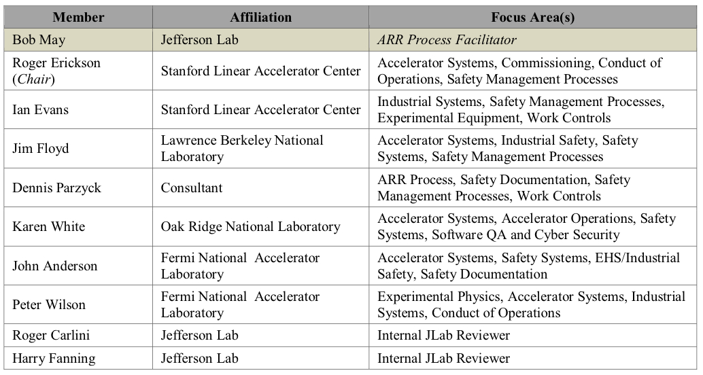
ARR (cont’d - 4)
ARR team (phase 2 & 3),

Slide 21
Summary
Most Ph.D. theses of the 2012 experiments near-final or already completed. Some physics and technical results published, some in draft form.
We start to see the roll-off in Ph.D.s and PRLs (but not yet archival papers), not surprising since the last experiments of the 6-GeV era stopped in 2012. We hope to see a turn-up again with the imminent start of 12-GeV physics operations.
Restarted Experiment Readiness Review process to ensure equipment and experiments are safe & efficient to run. Brunt to come is Hall B & C equipment followed by the experiments with their increasing complexity.
Safety documentation and procedures used by the division have/are been revised to reflect lessons learned from past operations and activities.
Halls A & D together with limited scope in Hall B for the HPS experiment went successfully through the Accelerator Readiness Review, phases 2 & 3 - “hardware, personnel, and procedures associated with commissioning or routine operations are ready to permit the activity to be undertaken safely.” Halls B & C are next.

