Slide 1

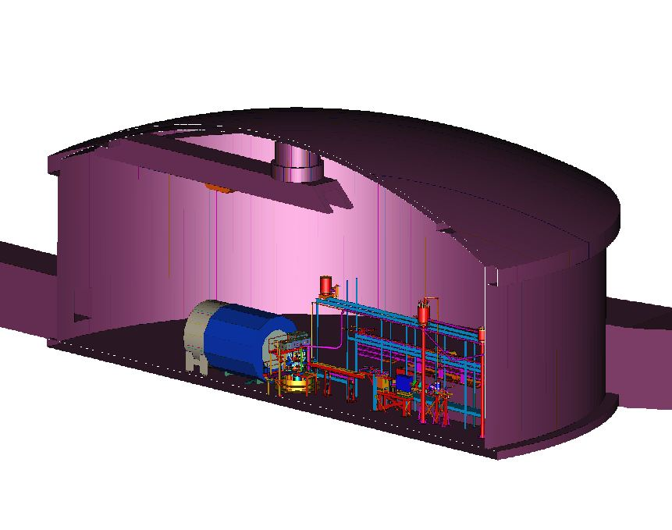
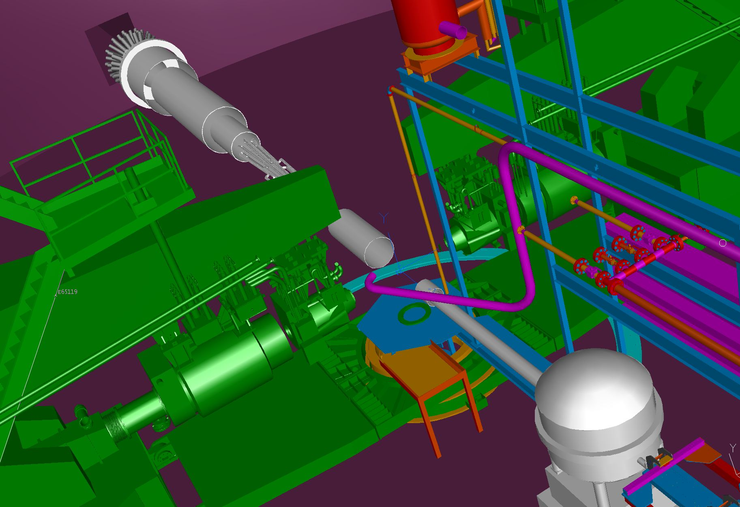
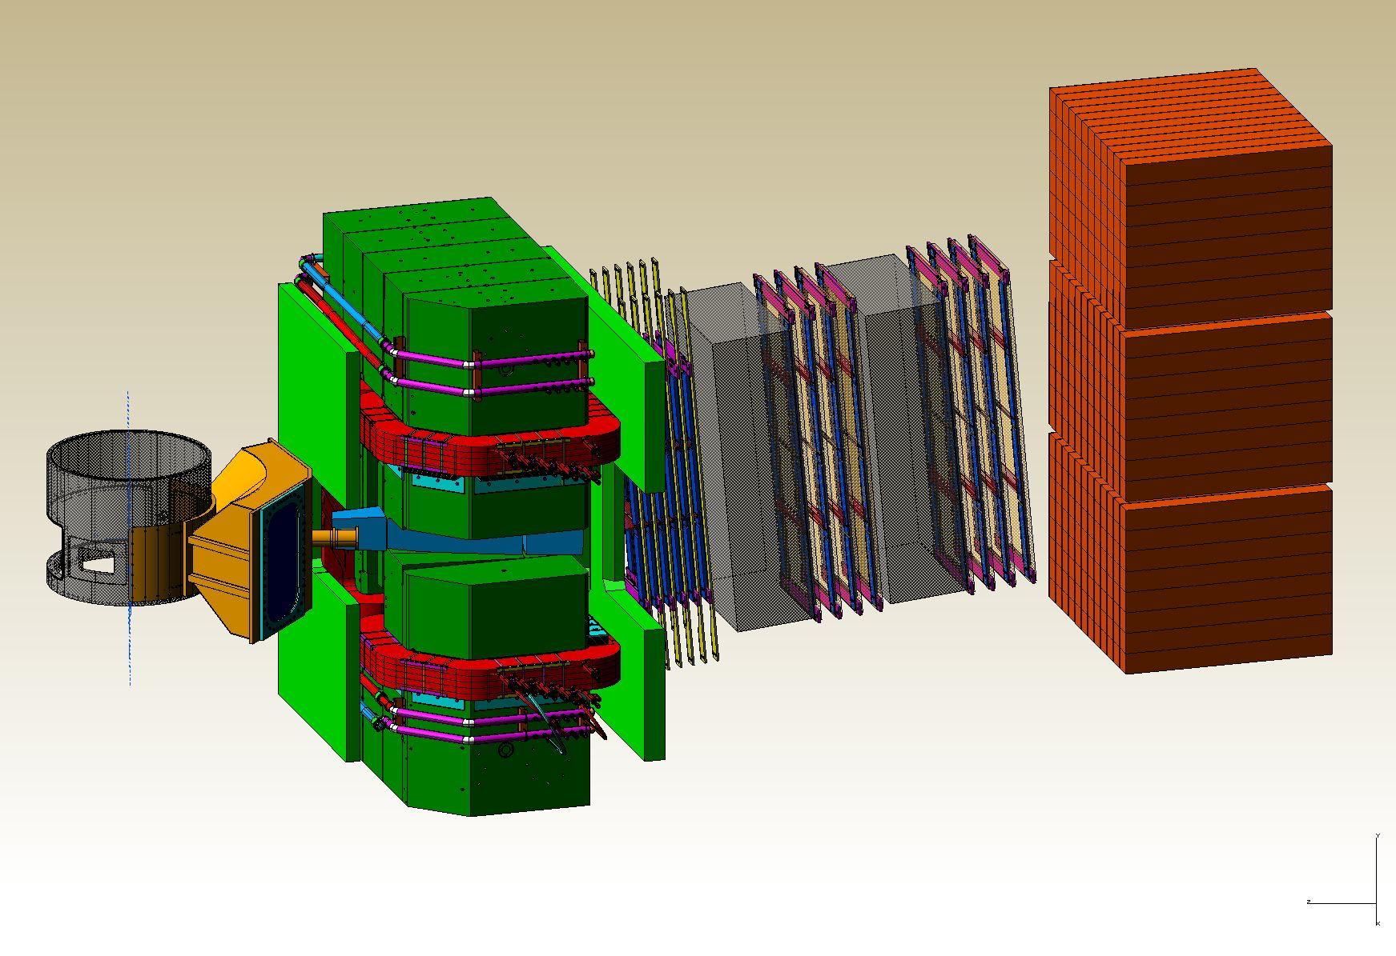
Hall A SBS, MOLLER, SoLID Experiments
Thia Keppel
S&T Review
July 2015

Slide 2
SBS Physics Program
New Spectrometer Optimized to Measure Nucleon Form Factors at High Q²
Determination of the charge form factors G_{E}^{n} and G_{E}^{p} up to 10-12 GeV²
Precision measurements of the magnetic form factors G_{M}^{n} and G_{M}^{p} up to 13.5-15 GeV²
Uncovering the nature of the G_{E}^{p}/G_{M}^{p} fall-off with increasing momentum transfer
And beyond…
Semi-inclusive single spin asymmetry measurement to access Collins and Sivers Functions on neutron
Tagged deep inelastic measurement of the Pion Structure Function
high
impact
Notes:
2

Slide 3
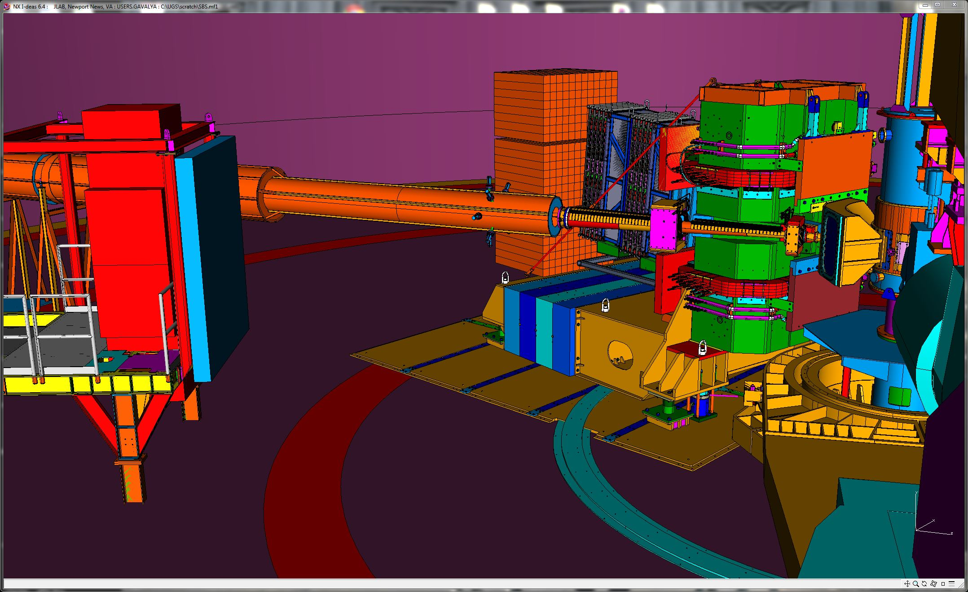
SBS Program General Overview
G_{E}^{p} Configuration
WBS 1 Basic
Spectrometer magnet, vacuum, beamline, support…. (JLab)
$1,694k
Reporting Structure
Weekly meetings with Hall Leader
Monthly meetings with Physics AD
Monthly reports to DOE
Quarterly phone call
Annual Review
WBS 2 Neutron Form Factor
- Coordinate Detector, here shown in front of ECAL calorimeter (ISU)
- $1,573k
WBS 3 Proton Form Factor
- GEM Trackers (UVA)
- $1,582k

Slide 4
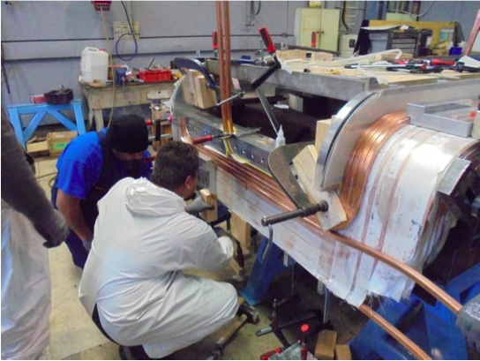
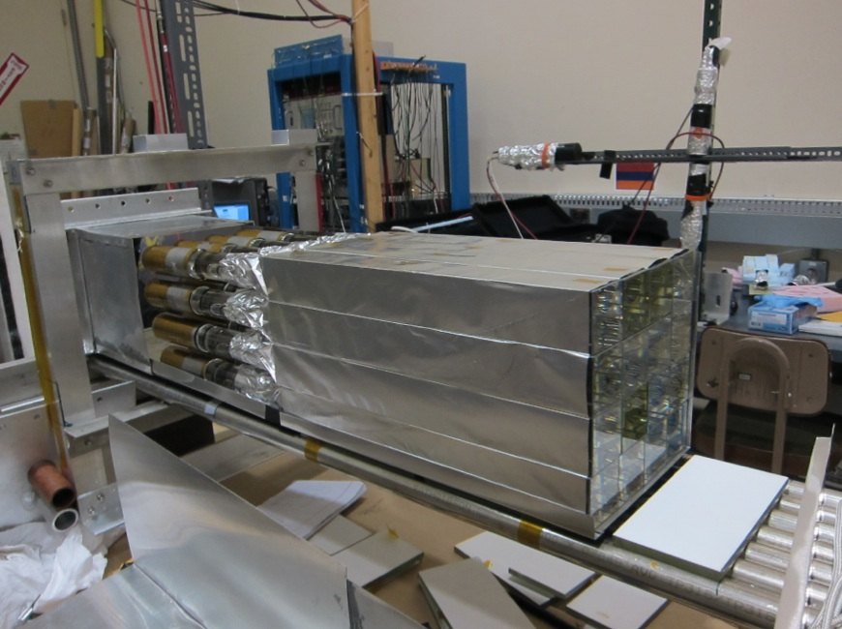
SBS Overview
10/12 SBS project started
11/13 First annual DOE review
2/14 Internal coordinate detector* review
9/14 Internal GEM readout review
  11/14 Second annual DOE review
  5/14 Updated PMP with PMT-based coordinate detector* accepted
Off project and SBS dependencies
  Pre R&D GEM construction (Jlab/UVA)
  GEM front tracker (INFN)
  Hadron calorimeter (CMU)
  Electron calorimeter (SBU & JLab)
  BigBite Cerenkov (W&M)
  ³He polarized target development (UVA)
ECAL module assembly at JLab
Saddle coil under construction
Hadron calorimeter module at CMU, production started in April 2015.

Slide 5
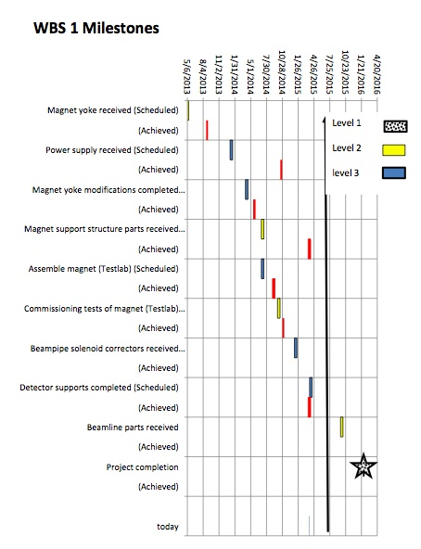
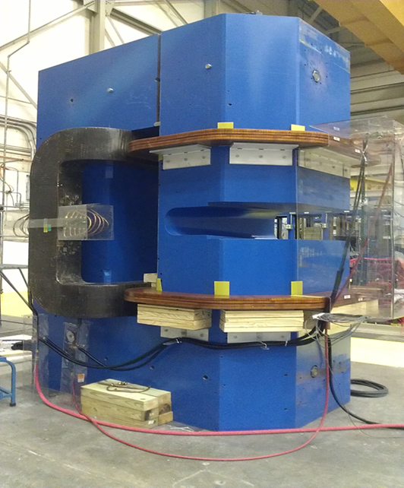
SBS Progress to Date – WBS1 “Basic”
SBS Progress to Date – WBS1
Basic
Highlights:
Magnet iron fully assembled at JLab, (low level) powered.
Platform and counterweight are on site.
Power supply on site, acceptance tested
On track for near term/on time completion

Slide 6
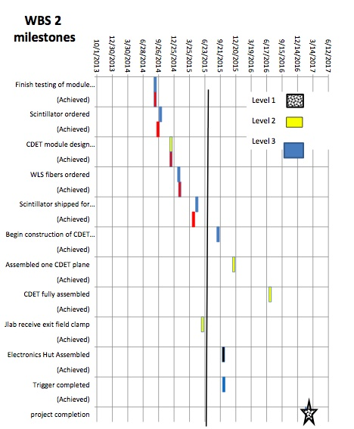
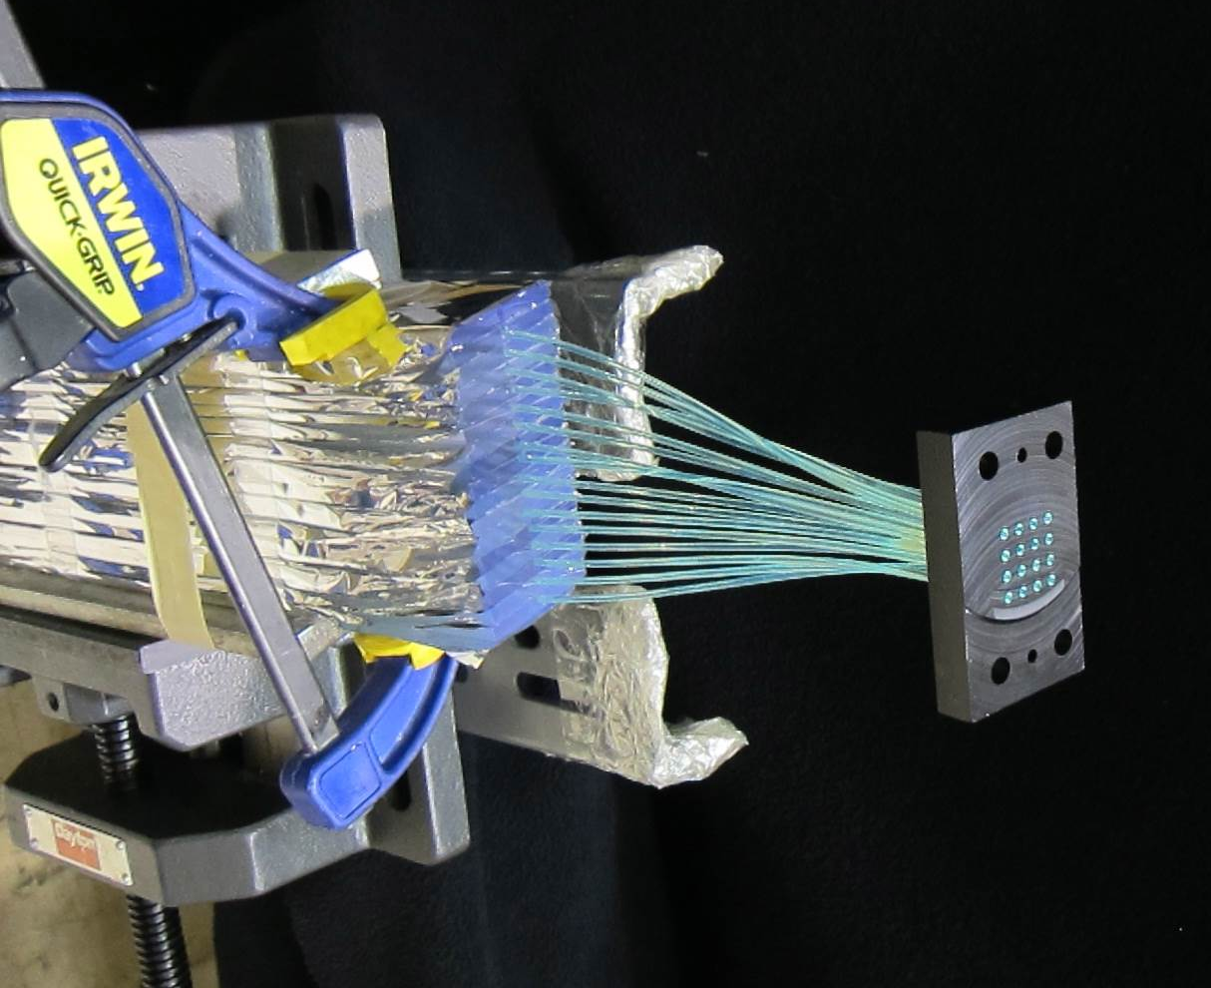
SBS Progress to Date – WBS1 “Basic”
SBS Progress to Date – WBS2
Neutron Form Factor
Highlights:
All scintillator bars for the CDET have been manufactured
WLS fibers are at JLab
Preparation of the WLS fiber bundles is beginning
Expect production construction of CDET modules to begin in Sept 2015

Slide 7
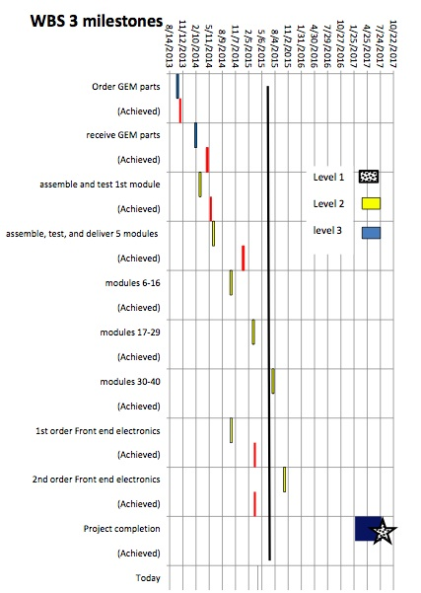
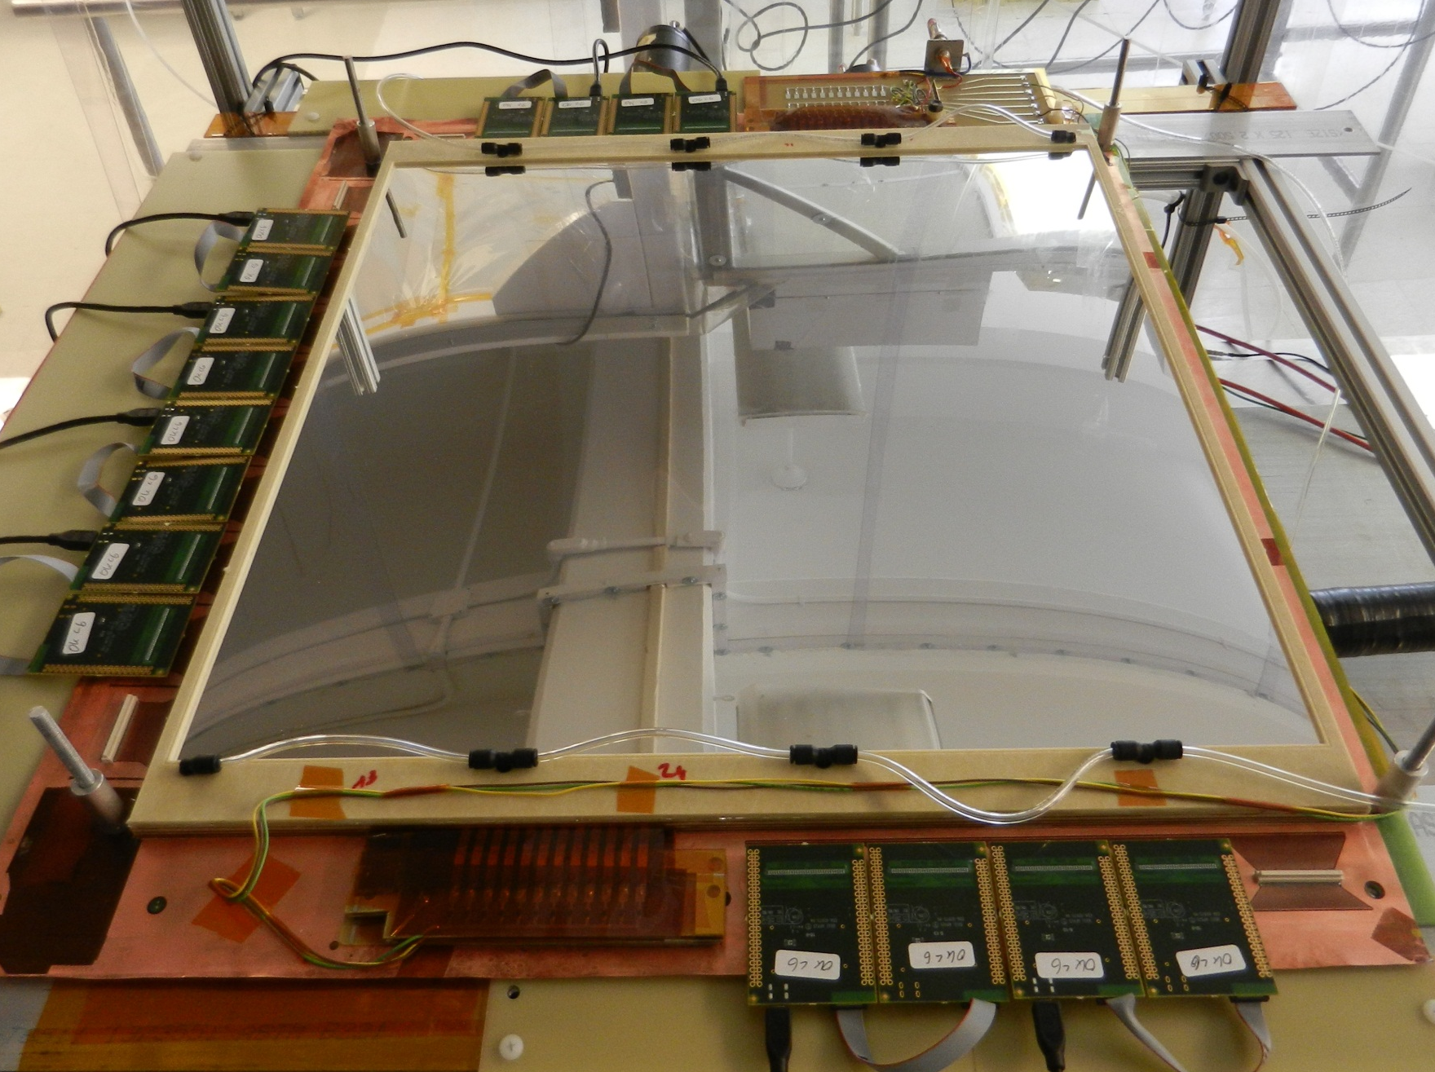
SBS Progress to Date – WBS1 “Basic”
SBS Progress to Date – WBS3
Proton Form Factor
Highlights:
14 of the 40 GEM rear tracker modules have been constructed
Currently constructing the requisite 2 modules per month
Built a high rate X-ray source test stand
Internal review determined decision to use INFN front tracker readout electronics, procurement has begun.
Fully equipped GEM with readout electronics (APV25)

Slide 8
Other SBS Highlights
Other SBS Highlights
DOE review in Nov 2014, 2 recommendations:
  Test the concept of constant heat annealing of the lead glass.
  A test was done using a 4x4 prototype in Spring 2015, demonstrated that the concept worked.
  Update the WBS2 project deadline to reflect the revised CDET detector approach and schedule.
  The Program Management Plan has been updated.
Dependencies
  Based on review suggestion, now track dependencies with milestones
  INFN has shipped one GEM chamber (3 modules in a chamber) to JLab. Have constructed 3 additional GEM modules which are undergoing Q&A testing. Expect second chamber in Sept 2015.
  HCAL module production started in April 2015 and expect delivery of 60 modules Summer 2015. Test of prototype in Fall 2014 showed that the HCAL modules will meet the timing characteristics needed by the experiments.
  ³He target design was selected
In summary
Well on track!

Slide 9
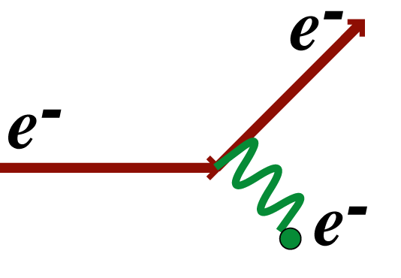
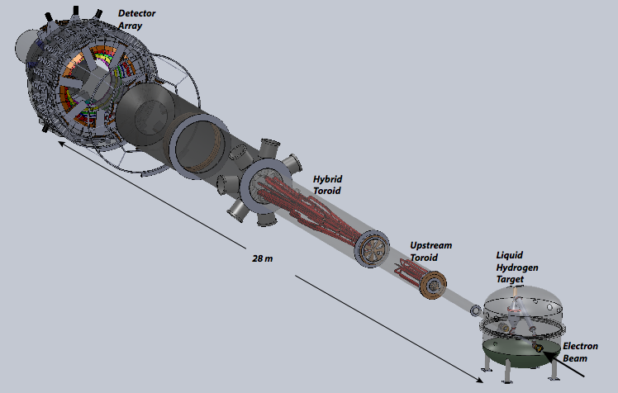

MOLLER at 11GeV JLab
Precision electroweak measurement
11 GeV Møller scattering
δ(sin²θW) = ± 0.00026 (stat.) ± 0.00012 (syst.)
~ 0.1%
Matches best collider (Z-pole) measurements!
best contact interaction reach for leptons at low OR high energy
To do better for a 4-lepton contact interaction would require:
Giga-Z factory, linear collider, neutrino factory or muon collider
APV = 35.6 ppb
Luminosity: 3x10³⁹ cm²/s
75 μA
80% polarized
SUSY, heavy Z’, doubly-charged scalars, electron compositeness, light Z’ (dark photon)...
δ(APV) = 0.73 parts per billion
δ(Q^{e}W) = ± 2.1 % (stat.) ± 1.0 % (syst.)

Slide 10
MOLLER Timeline and Status
MOLLER Timeline and Status
2009: Approved by PAC
2010: Assigned A rating and awarded full beam time request of 344 PAC days
2010: Director's Review, Strong Endorsement
2011: Jefferson Lab submitted MIE Proposal to DOE NP
2014: DOE Science Review
2015: Anticipated Director’s Technical Cost, Schedule and Feasibility Review
  Active collaboration, ~100 physicists from 30 institutions
  Work proceeding to prepare for next (Director’s) Review late 2015
  - Updating chapters to verify technical feasibility
  - Costing details
  - Project management plan

Slide 11
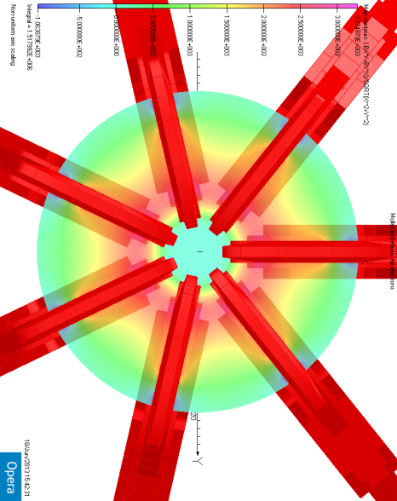
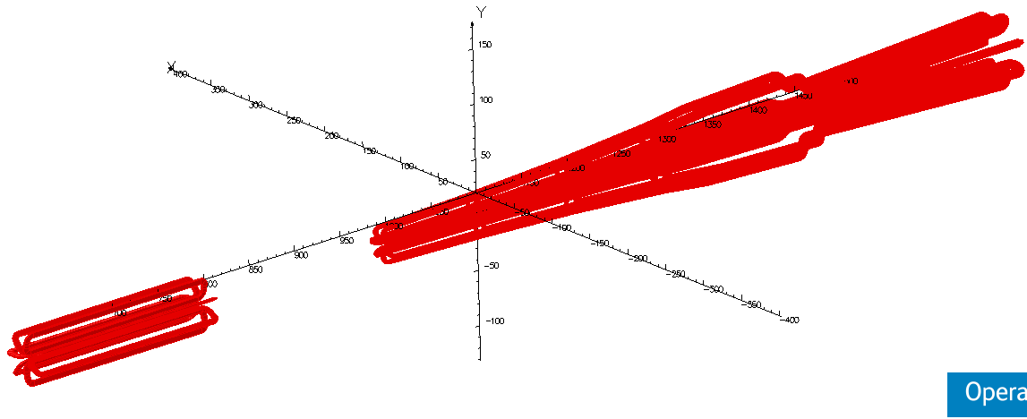
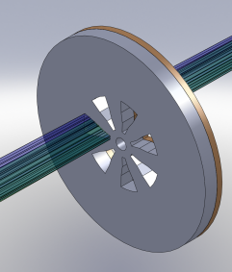
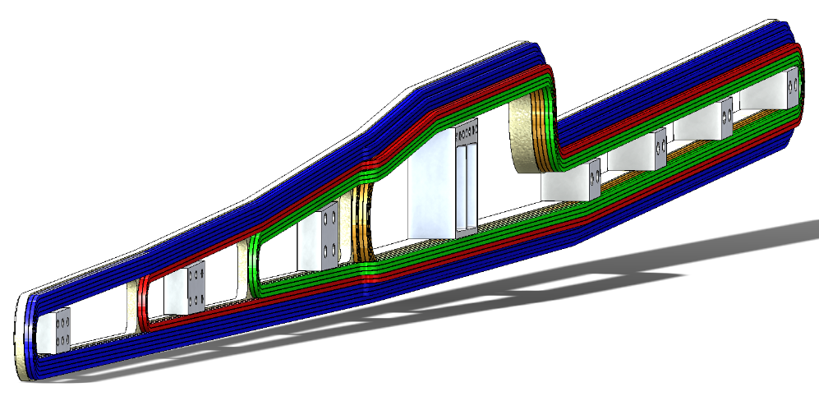
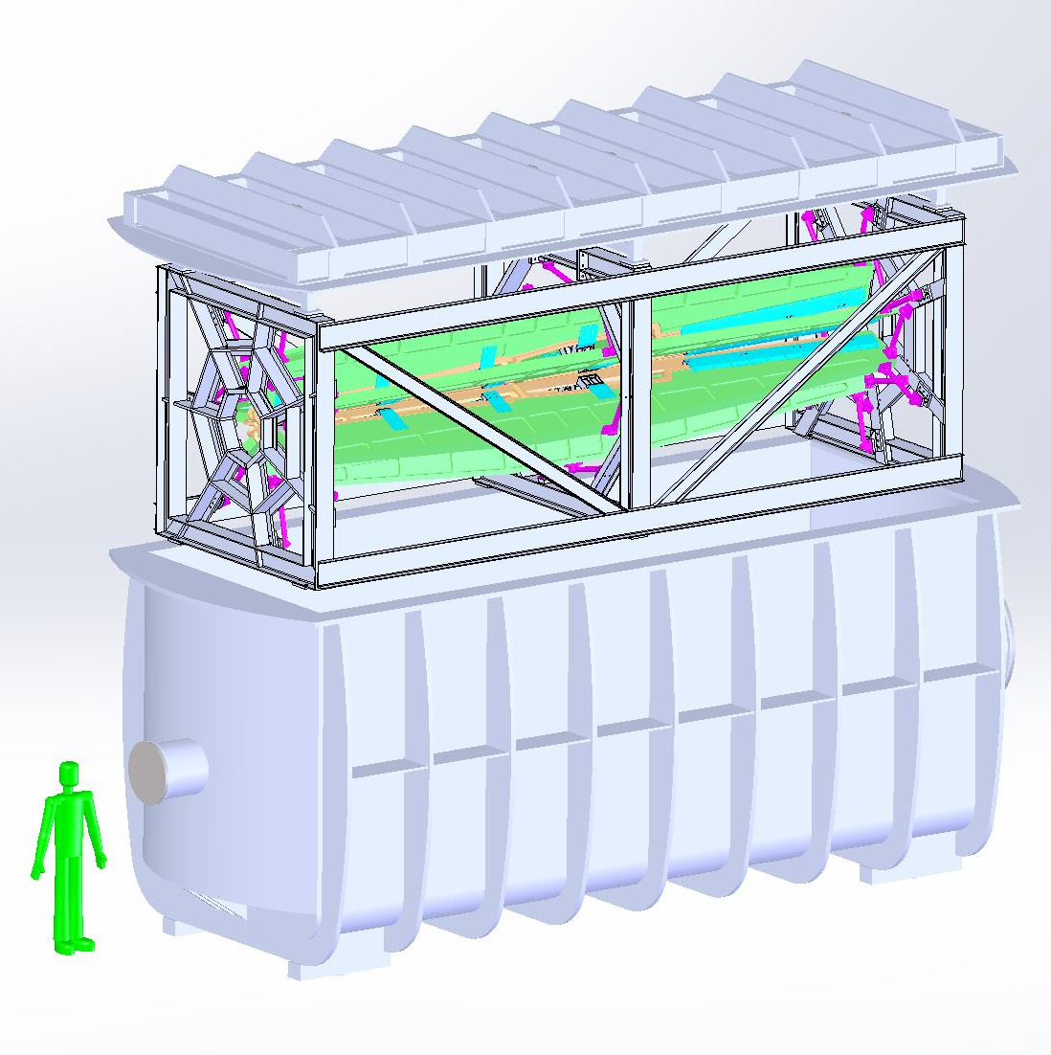
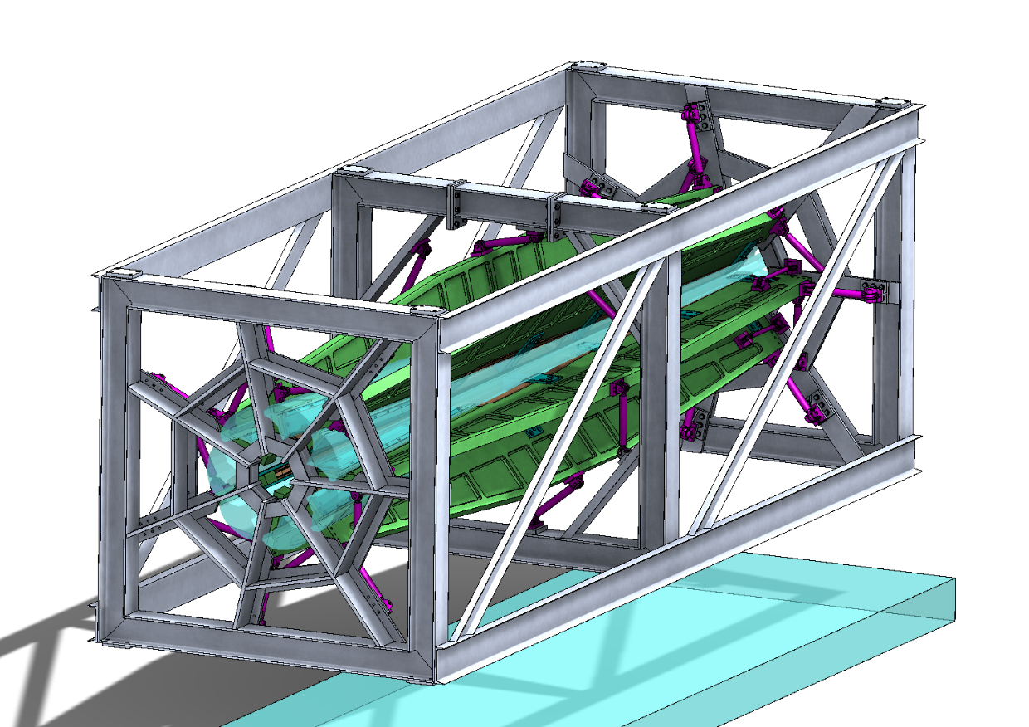
Dual Toroid Magnet Concept (JLab, MIT, Manitoba)
3-D Layout of all 14 coils
Acceptance
collimator
Full Azimuthal Acceptance
Warm copper coils
Water cooling
Field Profile
Vacuum Tank
Concept
Fine-tuning optics
Collimator optimization
Position sensitivity studies
Magnet
  Water-cooling
  Support structure
  Force calculations

Slide 12
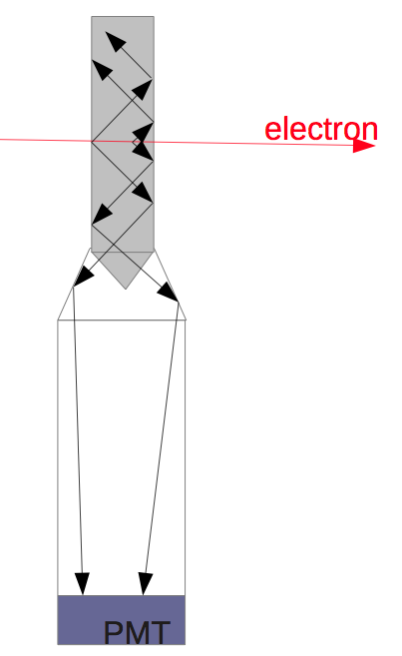
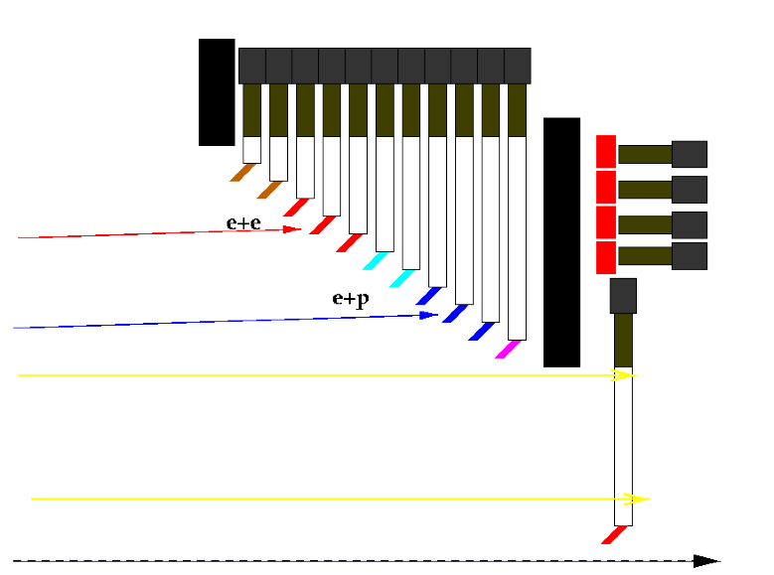
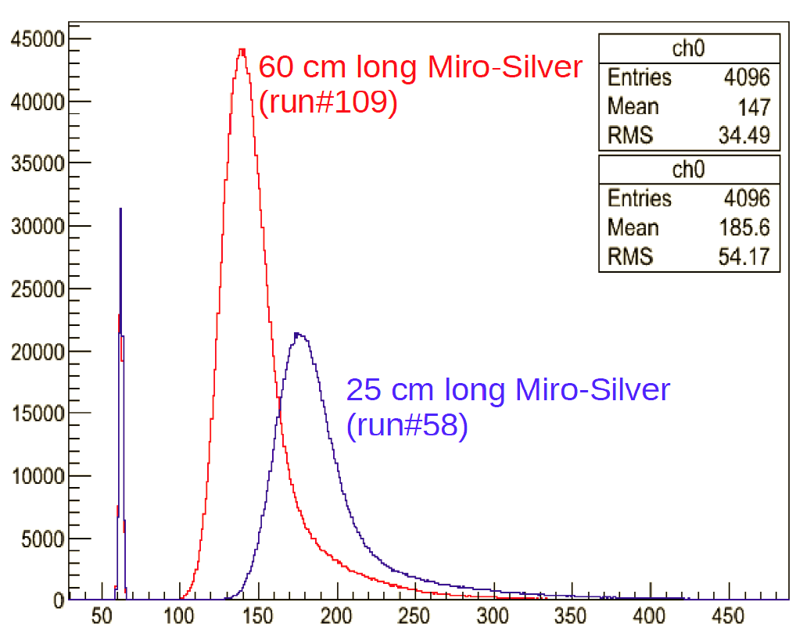
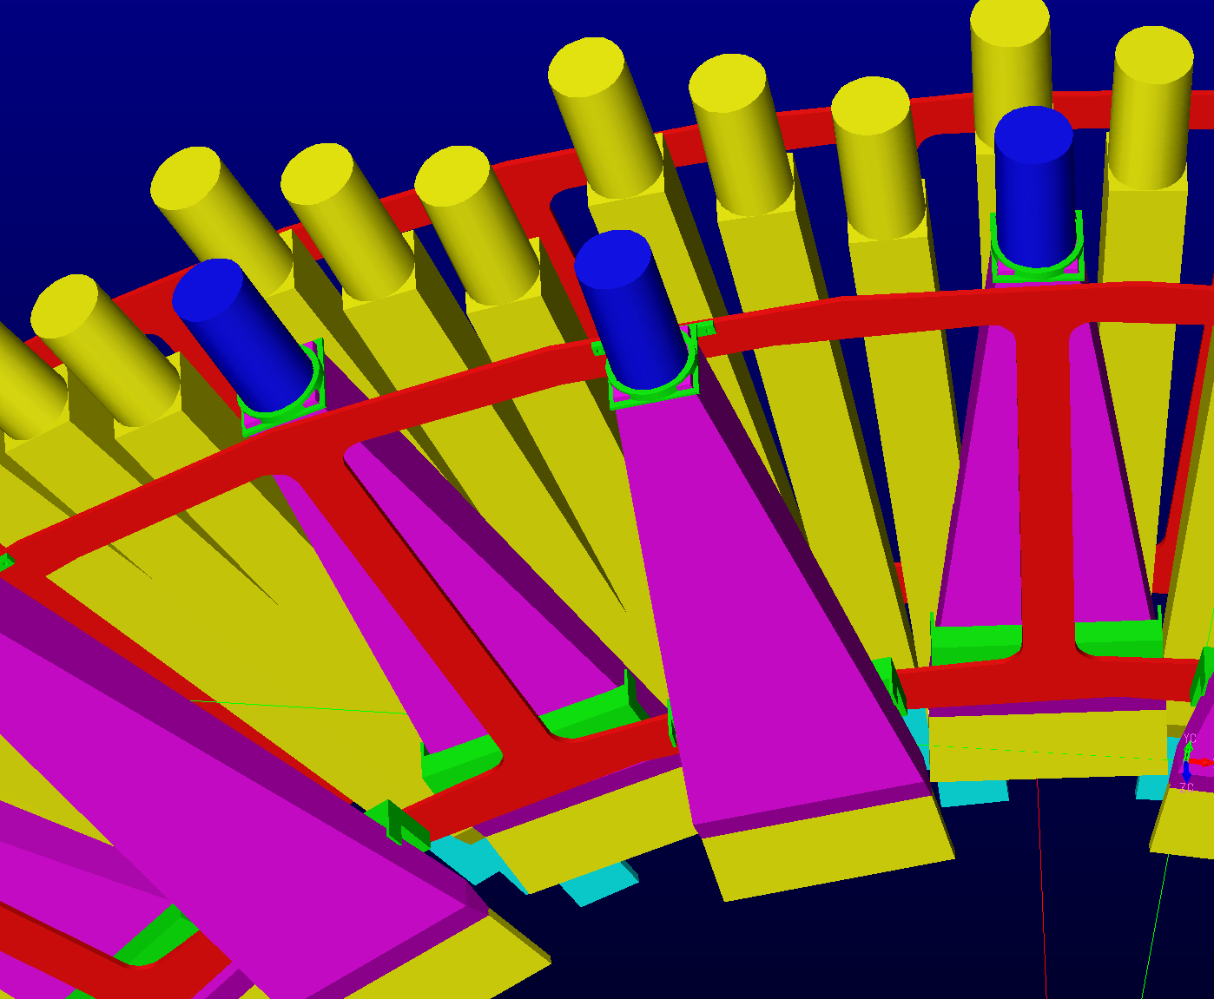
MOLLER Detectors (SBU, Manitoba, W&M, Mainz, Idaho State)
ee’s
ep’s
Conceptual design
Test beam of prototype at Mainz
‘pion’
Single
channel
Conceptual design with long light guide validated
Mounting/alignment concept
neutrals
luminosity
Integrating Detectors
  Moller and e-p electrons:
    radial and azimuthal segmentation
    quartz with air lightguides & PMTs
  Pions and muons:
    quartz sandwich behind shielding

Slide 13
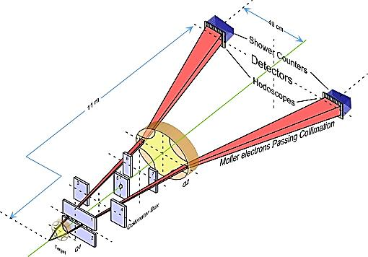
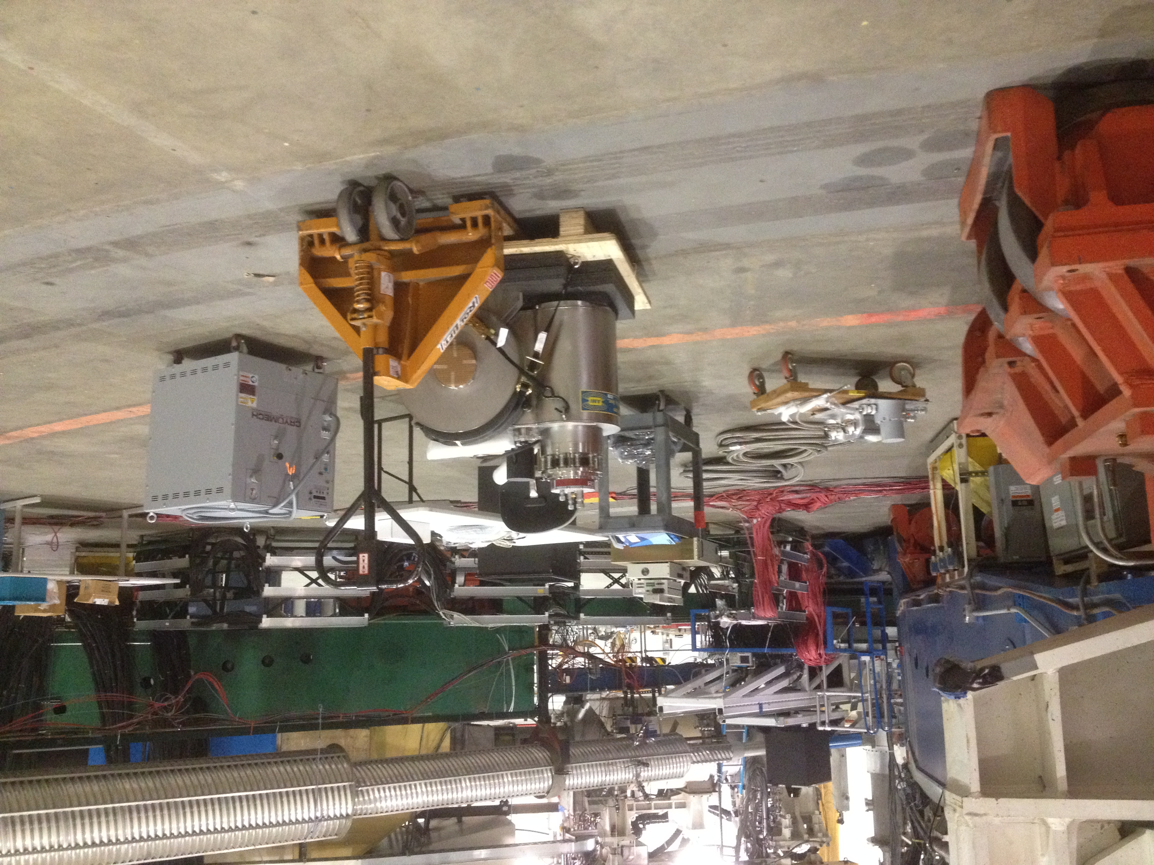
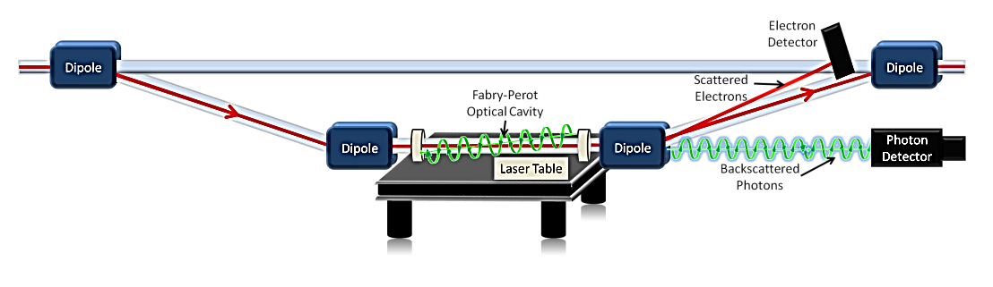
Precision Polarimetry in Hall A - MOLLER, SOLID require precision ≤ 0.5%
Qweak achieved design goal of ΔP/P ≤ 1%
Larger analyzing power at higher energy, ΔP/P < 0.5% within reach at 11 GeV
Strategy: use 2 independent polarimeters
Existing < 1% Hall C Møller polarimeter:
- Low beam currents, invasive.
- Known analyzing power provided by Fe foil in a 3.5 T field
- Create duplicate capability in Hall A (Temple, Kharkhov), new magnet at JLab
Compton polarimetry, new developments and recent running:
- Continuous, non-invasive.
- New high-gain optical cavity for improved resolution and analyzing power
- Diamond microstrip detectors (Qweak)
- Integrating photon analysis (PREX)

Slide 14
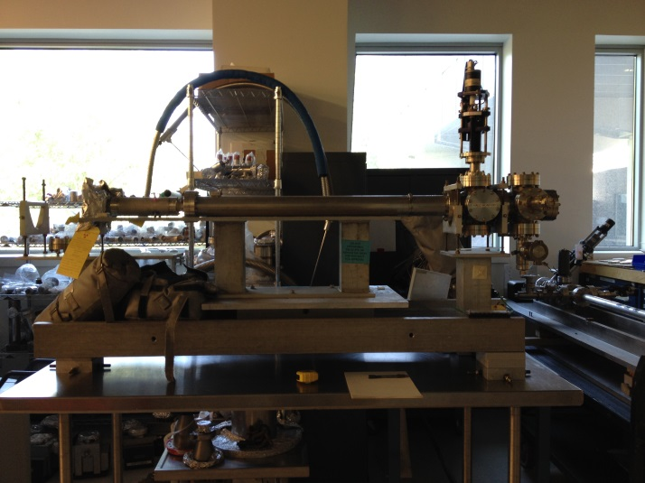
Precision Beamline Instrumentation
Parity quality beam working group formed (JLab physics and accelerator, VaTech, UVa)
Hall A beam modulation system
  Air core coils in multiple positions along the beam line, verifying electronics
2 “XYQ” (Q_{weak}) cavities recently installed near the target, equipped with new electronics and temperature controls.
Imported Q_{weak} halo monitor
Planning to test starting Fall 2015

Slide 15
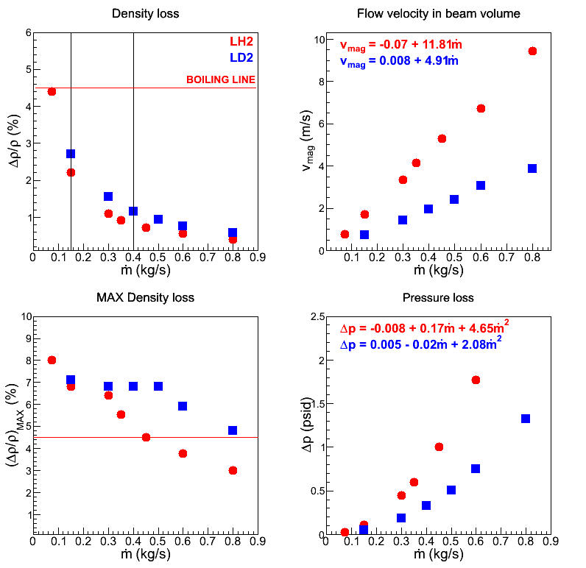
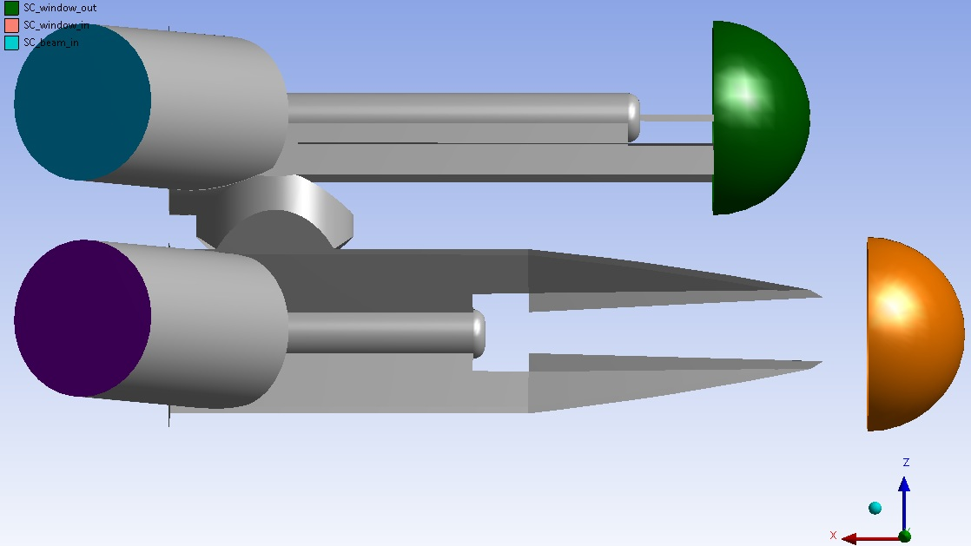
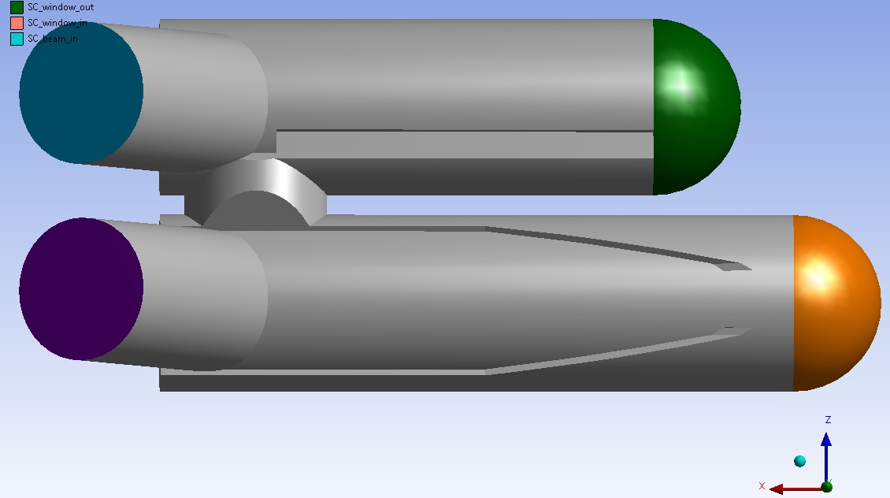
Computational Fluid Dynamics Facility Established
CFD calculations led to the success of the 2.5 kW power target used for the Qweak experiment - world’s highest power cryogenic target (< 0.8% density loss @ 2,500 W)
The CFD facility will be used to develop a 5 kW cryogenic target for MOLLER
CFD will aid in development and integration of ³He polarized target, SoLID, SBS, PREX-II, APEX targets.
CFD-based design of 2 target cells in one cell-block and predicted performance

Slide 16
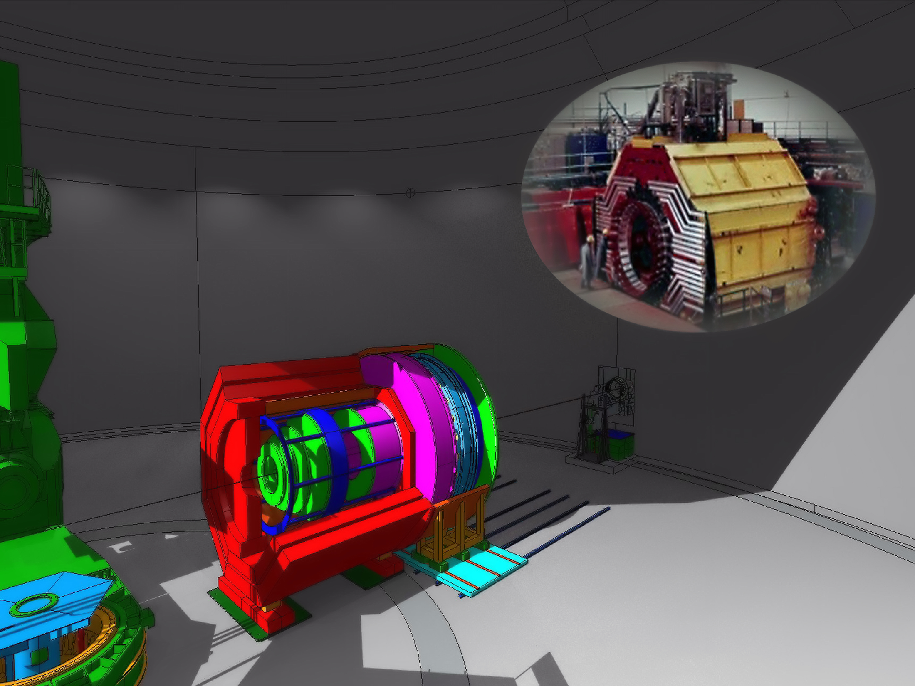
SoLID
Uniquely leverages high luminosity PLUS large acceptance capabilities at JLab
8 countries, 50+ institutes and 190+ collaborators
CLEO-II magnet delivery to JLab in Summer 2016
CLEO-II at Cornell
SoLID at JLab

Slide 17
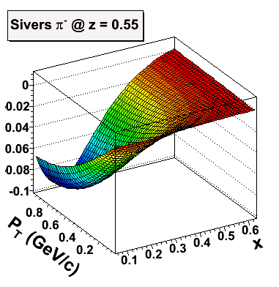
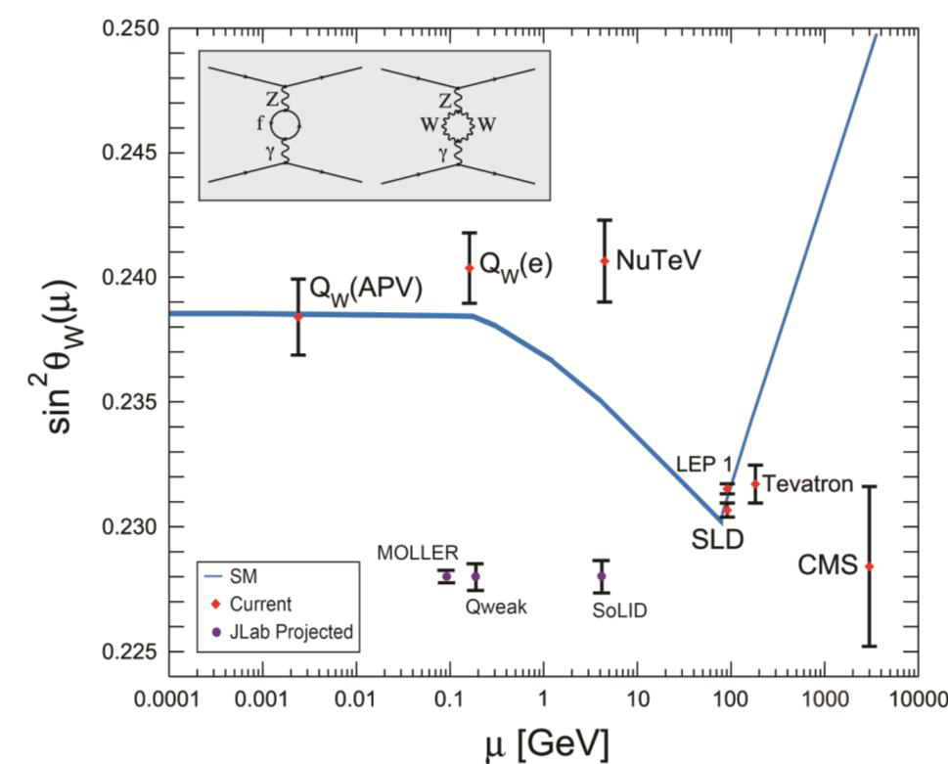
Solenoidal Large Intensity Device (SoLID)
Parity-violating Deep Inelastic Scattering:
<1% errors Test of Standard Model
Quark structure:
  - charge symmetry violation
Semi-inclusive Deep Inelastic Scattering:
4-D mapping of Collins, Sivers, and pretzelocity asymmetries
Tensor charge of quarks, transversity distributions, TMDs…
b(x): weak coupling
a(x): quark structure information
Expanded Program: J/Ψ, Timelike Compton

Slide 18
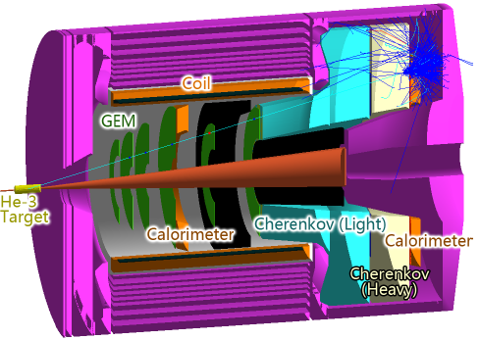
Evolution of the SoLID Program
2009-2012: Initial 5 approved experiments (4 A, 1 A-)
2013: JLab/CLASSE CLEO-II magnet transfer agreement
2012-2015: 3 additional “rungroup” experiments approved
2014: pre-CDR Complete
2015: Directors Review
      “Overall the Committee members were very impressed…”
      “The collaboration should be commended on the international nature of their effort.”
      “The Committee felt that SoLID was in a good state to move forward..”
2015: Ongoing Investigations to address recommendations
2015-2016: CLEO-II magnet disassembly/reassembly

Slide 19
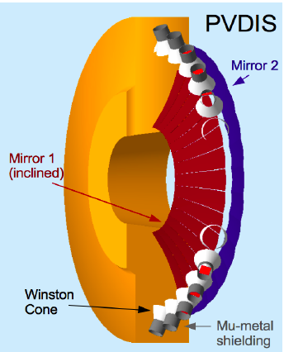
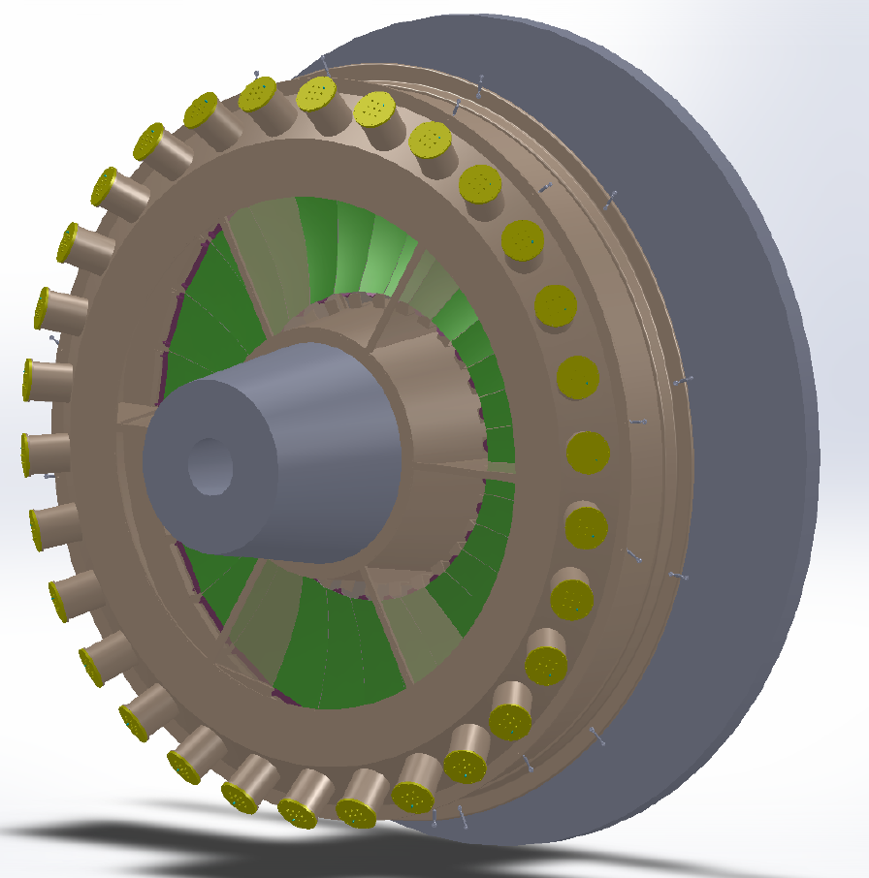
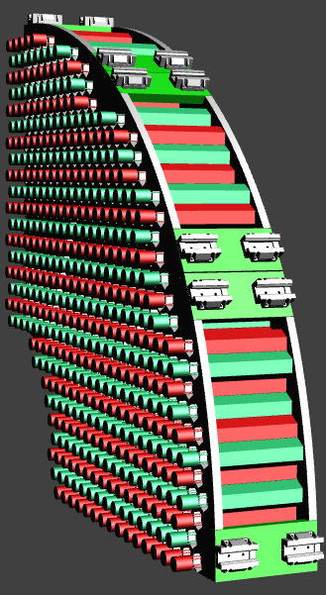
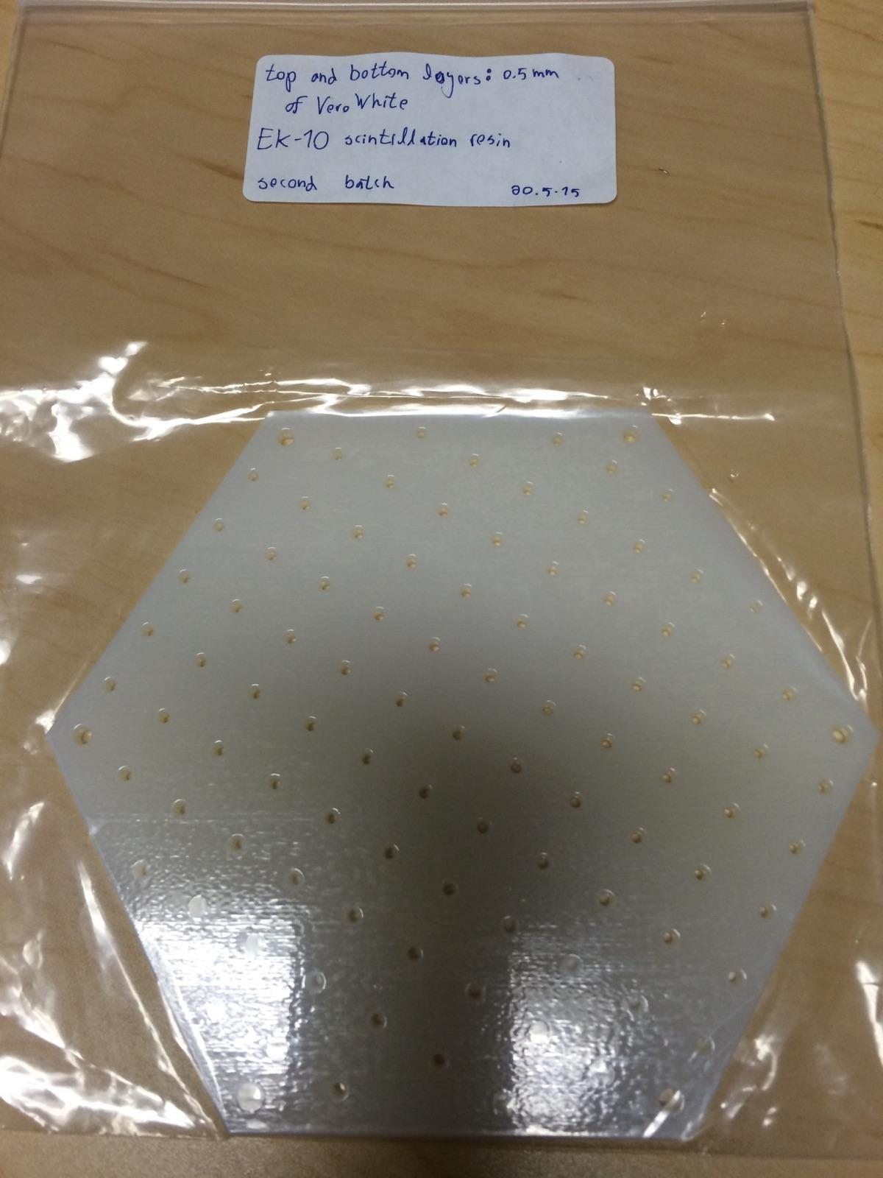
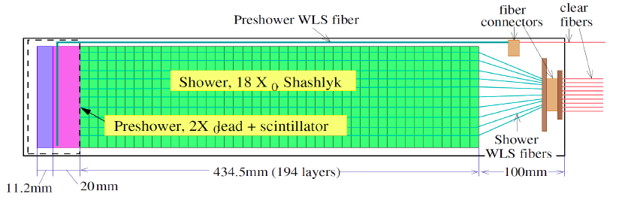
SoLID Detector Development
Heavy Gas Cerenkov (Temple)
Light Gas Cerenkov (Duke, Regina)
Published in JINST 8 (2013) P09004
Ecal Module (UVa, W&M, Shandong)
Ecal Mounting Design (ANL)

Slide 20
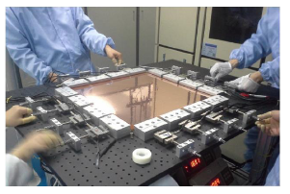
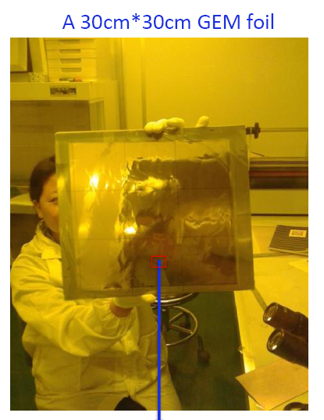
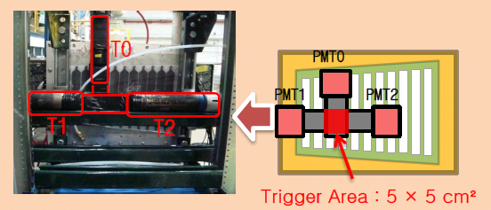
  SoLID Detector R&D in China
  2 grants from NSFC (~$1M), + R&D funding (~$1M) for 7 groups working on GEMs, MRPC and ECal detectors
Produced 30cmX30cm GEM foil with double masking
and 40cmx40cm with single masking (CIAE)
Fabricated 45 cm X 45 cm GEM chamber (Tsinghua and IMP)
Timing resolution
~ 85 ps
MRPC test in beam at JLab in 2011
Successfully tested GEM chambers with INFN readout (CIAE)
R&D on readout system (USTC/Tsinghua)
A MRPC prototype for SOLID-TOF in JLab
Y. Wang, X. Fan JINST 8 (2013) P03003
Tsinghua University, Duke, University of Zaragoza

Slide 21
Summary
SBS, MOLLER, and SoLID enhance the JLab 12 GeV facilities and enable continued, high impact science from JLab into the future
SBS: optimized for nucleon form factors
MOLLER: unprecedented test of the standard model
SoLID: unique science at high luminosity and large acceptance
SBS
    - On track for successful (third) DOE annual review in November 2014
MOLLER
  Successful Science Review September 2014
  Moving towards Director’s Cost, Schedule, and Technical Feasibility Review and subsequent DOE Technical Feasibility Review
SoLID
  Director’s Review Fall FY2014
  Working on finalizing pre-CDR

