Slide 1
Jefferson Lab Users Group Report
John Arrington (Past Chair, UGBoD)
Argonne National Laboratory
for Haiyan Gao (Chair)
TJNAF Science and Technology Review, July 28, 2015

Slide 2
Users Group, UG Board of Directors (UGBoD)
Represents users to JSA, JLab Management, and outside stakeholders
Board meets twice annually with JLab leadership, JSA representatives
Follow up on user questions, comments, complaints, suggestions…
Manage five Initiative Fund proposals: mainly meetings and awards (Thesis Prize, Postdoc Prize, Poster Prize…)
Organize the Annual User Meeting and two satellite meetings (APS April and DNP Fall meetings)
User voice in evaluating JSA Initiative Fund requests

Slide 3
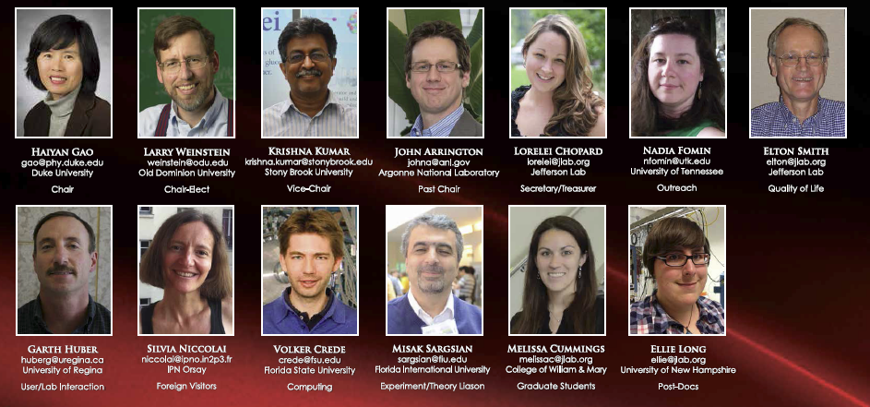
Users Group Board of Directors (UGBoD)
New this year: Board went from 2-person chair line to 4-person
Haiyan Gao (Chair), John Arrington (Past Chair), Larry Weinstein (Chair Elect), Krishna Kumar (Vice Chair)
Greater support for Chair, Improved continuity on the board

Slide 4
UGBoD Activities (most supported by JSA-Initiative Fund)
Submit several continuing initiative fund proposals
Provide rankings of user-submitted proposals to JSA program committee
Judge candidates for JSA Postdoc Research Award, JSA Thesis Prize
Satellite meeting at the APS April Meeting in Baltimore, MD
Satellite meeting at the DNP Fall Meeting, Hawaii
Presentations by UG Chair, lab management, physics, accelerator
Annual Users Meeting
During the Meeting: Selected and award Poster Prize winners
User Group presentations at SURA and JSA board meetings
Identify/recommend candidates for DNP Executive Committee
Serve on JSA committees [program committee, graduate student fellowship evaluation, JLab PAC, etc…]
Suggest names for PAC, provide other input to lab management (Safety)
Help organize Nuclear Physics Day visits to DC

Slide 5
2015 JSA Postdoctoral Research Prize
Raul Briceno (JLab) ”Exotic mesons, resonances and transition rates from QCD”
Criteria: Record of accomplishment in physics, planned high-impact JLab physics program, promise of further accomplishments in the Jefferson Lab research fields in the future
Presentation at the Users Meeting
Profiled in upcoming “On Target” story
Thanks to UGBoD (judges) and to Jefferson Science Associates for funding this award

Slide 6
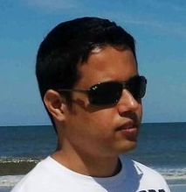
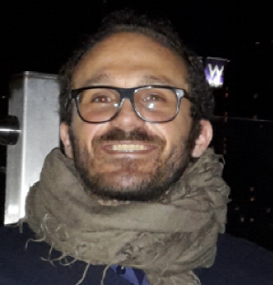
2015 JSA Thesis Prize
Adesh Subedi (Indiana University) ”Determination of the weak charge of the proton through parity violating asymmetry measurements in elastic e+p scattering” – PhD Thesis, Mississippi State University
Cristiano Fanelli (Universita La Sapienza, Rome / INFN, Sezione di Roma) “Measurements of Polarization Transfers in Real Compton Scattering by a proton target at JLAB: a new source of information on the 3D shape of the nucleon” – PhD Thesis, Sapienza - Universita di Roma
UGBoD selected 3 finalists, final judges: Roy Holt, Haiyan Gao, Ioana Niculescu
Presentations at the Users Meeting
Profiles in upcoming “On Target” stories
Thanks to the UGBoD members, guest judges, and to JSA for funding this award

Slide 7
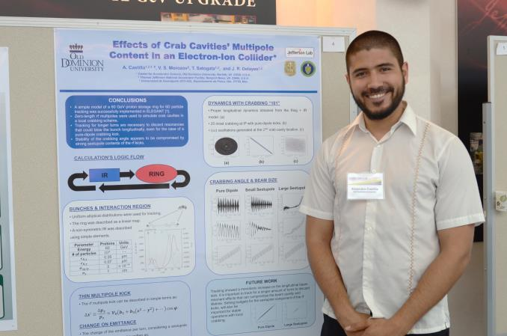
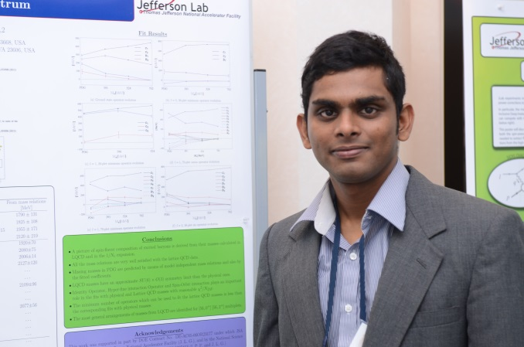
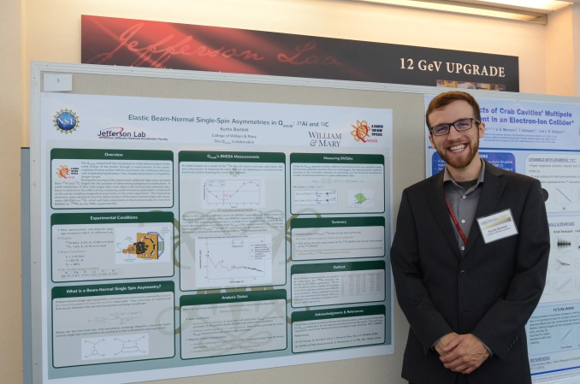
2015 UGM Poster Prizes
Held annually during Users Meeting: 18 entries this year
Judges: Alexi Prokudin, Kalyan Allada, Mac Mestayer [Melissa Cummings - organizer]
2015 winners: Alejandro Castilla (1st), Kurtis Bartlett (2nd), and Ishara Fernando (3rd)
Honorable mention: Holly Szumila-Vance, Sheren Alsalmi
Thanks to the judges, all of the entrants, and to JSA for funding
Criteria: Poster quality (40%), presentation to judges (40%), total impact of work (20%)
This year: prize is $500/$250/$100, plus $500 travel support for all winners

Slide 8
JSA Graduate Student Fellowships
Supported by JSA Initiative Fund (JSA generated initiative)
The 2015-2016 fellowship winners are:
Melissa Beebe, College of William & Mary (Advisor: Rosa Lukaszew)
Marco Pannunzio Carmignotto, The Catholic University of America (Tanja Horn)
Kayla Craycraft, The University of Tennessee (Nadia Fomin)
Jie Liu, University of Virginia (Xiaochao Zheng)
Chao Peng, Duke University (Haiyan Gao)
Cheng-Ying Tsai, Virginia Polytechnic Institute and State University (Mark Pitt)
The students’ research proposals cover a broad scientific spectrum, including experimental physics and accelerator physics and technology

Slide 9
User Group activities/updates over last three years
Changes to users Group bylaws [2014]
Change of chair line
2 person line (4 year cycle: vice, chair, chair, past) became 4 person (vice chair, chair elect, chair, past chair)
More experience before becoming chair, more support for chair, more continuity
Broadened non-discrimination statement, e.g. to include sexual orientation and gender identity
New “JLab Alumni Group”: networking, mentoring
Organized by postdoc representative (Ellie Long)
Facebook and LinkedIn groups
Collecting names of people interested in participating more actively (mentoring, presentations at JLab meetings, etc…)

Slide 10
User Group activities/updates over last three years
Efforts to improve visibility of physics program
JLab has broad program of hadronic physics, nuclear structure, fundamental symmetries, etc… not connected to a single central theme
Identify/promote speakers who can provide broader perspective, aimed at the broader physics community (e.g. for your institutions colloquia)
Work with lab to collect highlights, encourage publicizing new results
Involvement in long-range planning exercises for the field
Organized hadronic physics town hall meeting [S. Kuhn] in preparation for NSAC report on implementation of the 2007 long range plan
Encouraged JLab user participation in all of the 2014 long-range planning meetings

Slide 11
User Group activities/updates over last three years
Improved communication with users
Brief UGBoD presentations at Hall Collaboration meetings
Soliciting input from Hall collaborations, steering committees on user issues
Looking into various user concerns
User space and conference room above the counting house
User registration, foreign user visits, etc…
Teleconferencing facilities
Director’s Safety Council
Ed Brash is user representative (suggested by UGBoD)
Council strongly focused on safety
Reports significant ‘data analysis’ behind changes
Moving towards more openness to help understand changes
Provided important input on new student supervision policy

Slide 12
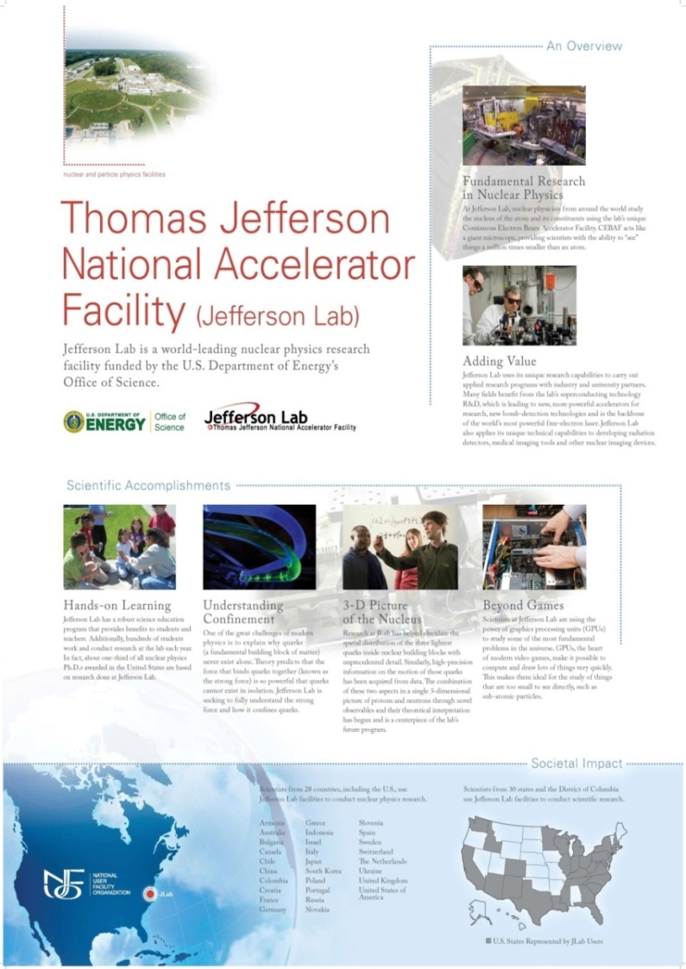
Outreach Efforts [Nadia Fomin, Dipangkar Dutta (previous)]
Inform users of important issues
Nuclear Physics day Capitol Hill visits (March) NUFO Science exhibition Capitol Hill (June)
Support contact between users and their representatives in congress
New initiative fund proposal to provide travel support Nuclear Physics day on Capitol Hill
NP day: 2013 – 7 JLab participants
2014 – 14 JLab participants
2015 – 20 JLab participants
Additional information available on wiki:
https://wiki.jlab.org/cugwiki/index.php/Nuclear_Physics_Day_on_the_Hill

Slide 13
Areas of user concern
Restructuring
Lab focused on informing staff - led to many users being surprised
Much of the initial information people heard was incomplete or incorrect
PAC41: “Prioritization PAC”
Questions/concerns about how it would be handled, extra work involved
Happy with work lab put into informing users and addressing concerns
User community happy with overall approach, execution
Operations during commissioning
Users appreciative of attempts to provide beam for hall commissioning, opportunistic physics; early commissioning extremely important
Need to be ready for beam with no formal physics planned has been burden for some users, but need to be ready was understood
Hopeful that projections for improved operations pan out

Slide 14
Positive feedback
Lab has actively worked with UG to solicit user opinion, provide updates
User representative on Director’s Safety Council
Updates on Tech Center, EIC plans, etc…
Plans for PACs
The JSA Initiative Fund: critical for User Group activities
~$450k per year in FY12, $400 per year for last three years
JSA Program Committee working to optimize/focus Initiative Fund
Important efforts to stretch resources
User Liaison Office [Lorelei Chopard]
Active and invaluable contributions to UGBoD
ULO/international services newsletters, focus on updating procedures (and increasing accessibility to procedures), managing user space,…
Notes:
[$400k/year, $450k in FY12, closer to $500k earlier] - get details on contract. Check issues with raising amount?

