Slide 1

Transverse Momentum Densities: A foundation for early 12 GeV physics
Ted Rogers
Jefferson Lab and Old Dominion University
S&T Review: July 29, 2015

Slide 2
Introduction
Background:
  Ph.D. Pennsylvania State University (August 2006).
  Postdoc Pennsylvania State University (2006-2008).
  Postdoc Vrije Universiteit, Amsterdam (2008-2011).
  Postdoc Stony Brook University (YITP) (2011-2014).
  Postdoc Southern Methodist University (2014).
  Joint position Jefferson Lab / Old Dominion University (present).
Research in theory group:
  Perturbative QCD and its interface with non-perturbative methods.
  Factorization theorems.

Slide 3
Factorization Theorems
Physical Processes: Large and small time/distance scales.
Large scales: Hadronic binding, non-perturbative interactions.
Small scales: Perturbative QCD. High energy gluon radiation.
How do they go together to describe interactions?
  Much progress over the last 10 years!

Slide 4
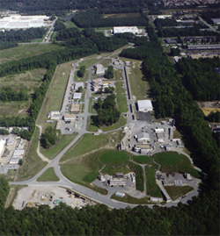
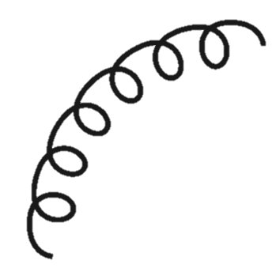
Semi-Inclusive Deep Inelastic Scattering
l₂
Small Scales
l₁
Hall A
Hall B
Hall C
JLab
Proton
X
H
4

Slide 5
Factorization
Factorization needed for 12 GeV program.
Notes:
Much progress in the last few years.
Spin dependence.

Slide 6
Factorization
Transverse Momentum Dependent Factorization needed for 12 GeV program.
Usual
approximation not
good enough for us.
Notes:
Much progress in the last few years.
Spin dependence.

Slide 7
Transverse Momentum Dependence
JLab Hall C: Phys. Rev. C 85 015202 (2012)

Slide 8
TMD functions Are Universal
The same TMD functions appear in multiple process.
But… some TMD functions change sign when comparing processes.
  E.g. The Sivers function.
Also… dependence on scale (resolution): Evolution.
Notes:
Sign change follows from the factorization theorem.

Slide 9
Progress With Evolution
Cross Section
Evolution
+ Large transverse
momentum
(Y-term)
Scale dependence of
the SHAPE
9
Notes:
Other progress.

Slide 10
Progress With Evolution
Recent work
with John Collins
(Phys.Rev. D91 (2015) 7, 074020)
Notes:
Other progress.

Slide 11
Large Transverse Momentum
l₂
l₁
Electron
P
X
H
Notes:
Transverse momentum dependent.
Much progress over last few years.
Relationship to spin.

Slide 12
Large Transverse Momentum Dependence
Blue: Fewz2
Red: ResBos
Perturbative radiation
Intrinsic transverse momentum
CDF Coll., PRD 86, 052010, 2012 Fig.7
Notes:
Other progress.

Slide 13
Large Transverse Momentum Dependence
Preliminary
Perturbative radiation
Higher scale
Intrinsic transverse momentum
Lower scale
Notes:
Other progress.

Slide 14
Summary
Non-Perturbative Theory
Perturbative Theory
Computation
Experimental Extractions
Experimental Tests
3D
Hadron
Structure

Slide 15
Summary
Transverse momentum densities.
  Major component of the new program.
Factorization Theorems and theoretical QCD.
  New factorization theorems to be exploited to extract 3D picture from Jlab 12 GeV program.
Large and small transverse momentum
  Perturbative QCD.
  Non-perturbative QCD.
    Lattice
    Chiral symmetry
Thank You!

Slide 16


TMD Factorization and Spin
Sivers
Proton
Unpolarized
Longitudinally
polarized
Transversely
polarized
Quark
Unpolarized
Longitudinally
polarized
Transversely
polarized
Boer-Mulders
“Worm Gear”
“Pretzelocity”

