Slide 1
CEBAF Commissioning Homework
Arne Freyberger

Slide 2
Accelerator Homework: Question 2
What is the list of beam requirements by Hall needed to implement the Day 1 physics program? Indicate the current status of those parameters, and planned date to demonstrate the performance; identify which beam parameters have been achieved simultaneously, to date.

Slide 3
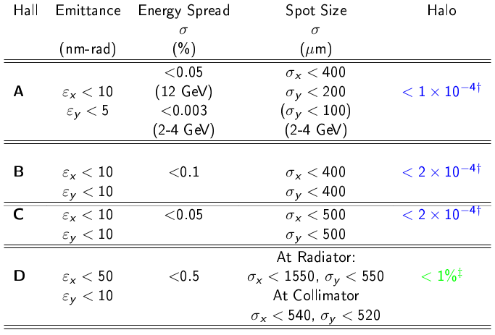
Initial Years Beam Requirements
5.0 pass, 11GeV requirements
5.5 pass
12GeV
Physics beam requirements transmitted to CASA in 2007.

Slide 4
Emittance measurements
All measurements performed at 10.5GeV 5pass configuration, measurements at 12GeV are planned for Fall 2015
A,B,C emittances inferred from measurements in the 5th pass extraction line, AE region. This is the input to the hall transport lines.
D emittances measured in the Hall-D transport line.
All measurements on March 23rd, a few days before the lights went out.
 | Measured ε_{x} (nm) | Requirement ε_{x} (nm) | Measured ε_{y} (nm) | Requirement ε_{y} (nm)
AE (A,B,C) | 2.4 | <10 | 1.7 | <5
5C (D) | 5.2 | <50 | 2.6 | <10

Slide 5
Energy Spread
Energy spread measurements on 5th and 5.5 pass beams have not been performed to date.
Plan to measure Fall 2015 at full energy.
Energy spread on 5th pass will be dominated by synchrotron radiation.
 | E_{synch} (MeV) Expected | E_{RF} (MeV) Worst case | E_{combined} (MeV) Expected | E/E (%) Expected | E/E (%) Requirement
A,B,C | 1.6 | 0.6 | 1.7 | 0.015 | <0.05
D | 2.0 | 0.7 | 2.1 | 0.017 | <0.5

Slide 6
Beam Size
 | σ_{x} (μm) Measured | σ_{x} (μm) Requirement | σ_{y} (μm) Measured | σ_{y} (μm) Requirement | Date
A(5-pass) | 520 | <400 | 640 | <200 | 2015-Mar
A(2-pass) | 160 | <400 | 170 | <200 | 2015-April
B | 300 | <400 | 40 | <400 | 2015-May
D | 1000 | <1550 | 780 | <550 | 2015-Mar
A&D beam lines were in the process of setup and optimization at the time of the 2015-Mar measurements.

Slide 7
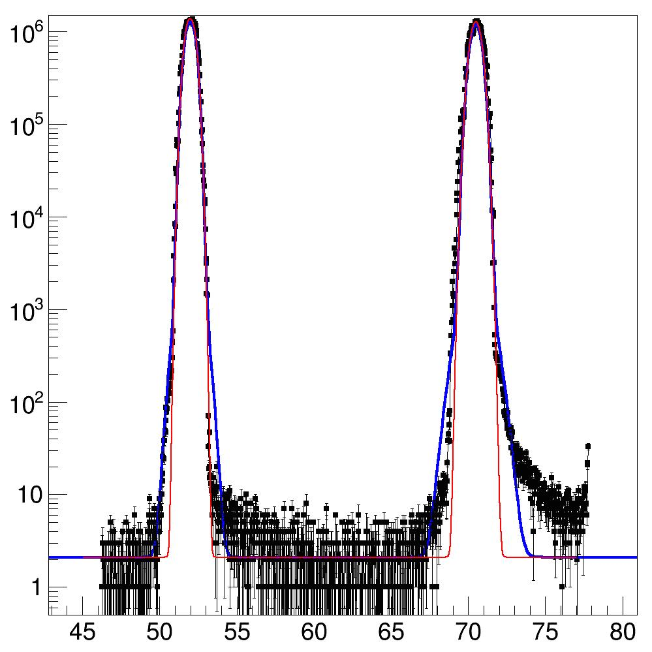
Hall-B: 1-pass Halo
B/P<10-4
F-X Girod OPS 2015 StayTreat

Slide 8
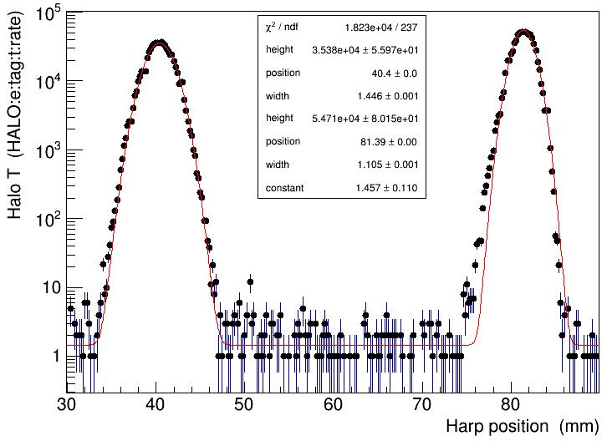
Hall-D: 5.5 pass halo
< 1%
H. Egiyan OPS 2015 StayTreat

Slide 9
Initial Years Beam Requirements
5.0 pass, 11GeV requirements
5.5 pass
12GeV
Demonstrated at 10.5GeV setup March 2015
Demonstrated at 5.5GeV setup, Hall-A 2-pass April 2015
Not yet verified, but CEBAF energy spread dominated by synchrotron radiation

