Slide 1
CEBAF Commissioning and Operations
Arne Freyberger
Operations Dept.
Accelerator Div.
Jefferson Lab

Slide 2
Outline
CEBAF Operations Overview
12GeV Upgrade
Overview
Beam Commissioning to date
Plans for Beam Operations at Design Energy
Summer 2015 Shutdown Tasks
Gradient Maintenance and Helium Processing
Fall 2015 Beam Plan
Long Term AIP plans
Summary

Slide 3
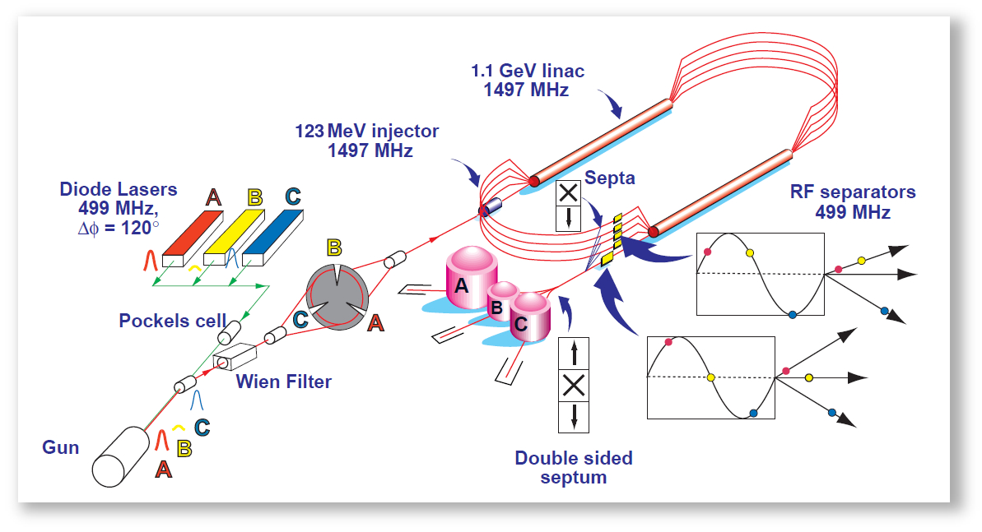
Accelerator Mission
Operate and upgrade the JLab accelerator facilities
JLab accelerator facilities:
CEBAF, Continuous Electron Beam Accelerator Facility
LERF, Low Energy Recirculator Facility (formerly called the FEL).

Slide 4
12GeV Project and Operations Goals
12GeV Project Accelerator Deliverables and Key Performance Parameters (KPP):
Complete the accelerator upgrade and transport beam (>2nA) for one-pass with E=2.2GeV.
Establish a working accelerator to be handed over to Operations.
Full Performance Operations Goals
Build upon the 12GeV Project deliverables.
Establish high current CW beam operations
Establish multi-pass, multi-user operations
Establish Physics quality beams for the users
Develop tools and procedures for safe robust operations

Slide 5
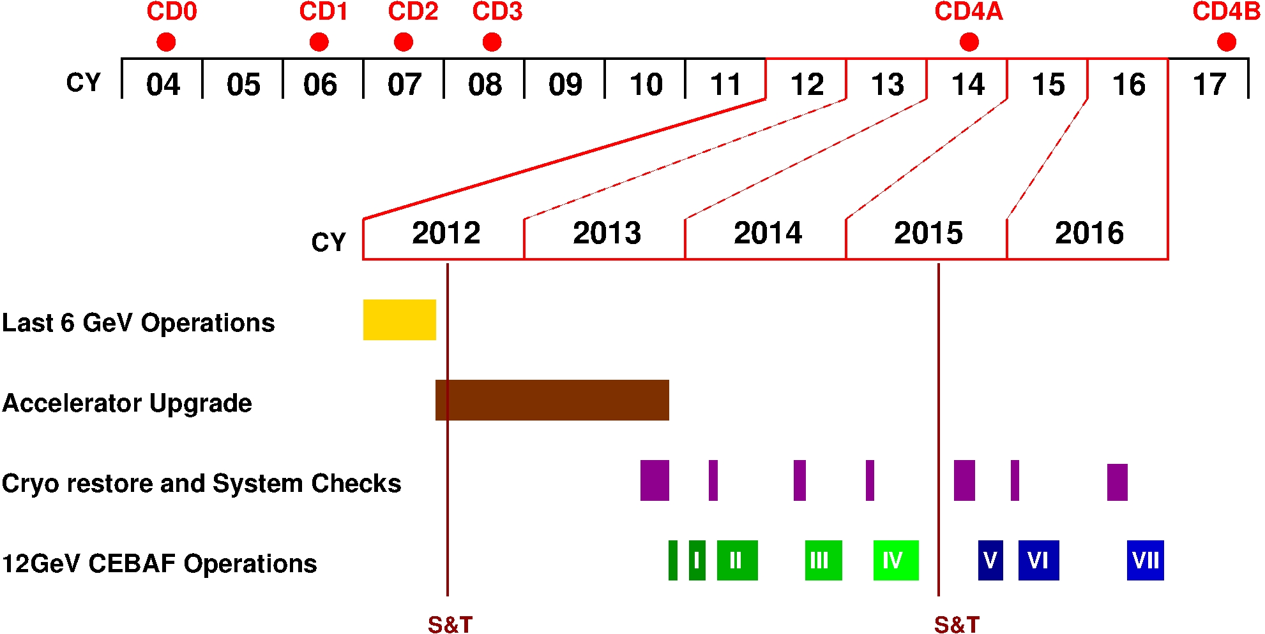
12GeV Timeline

Slide 6
Accelerator Readiness Reviews (ARR)
Phased Approach:
Phase 1A (Aug 2013) Focus:
Core processes of ISM and Contractor Assurance (CAS)
Pre-planning of hot checkout and commissioning
Field observations/demonstrations/discussions
Phase 1B (Oct 2013) Focus:
Status of processes and equipment for the start of commissioning
Field observations/demonstrations/discussions
Phase 2 (Jan 2014) Focus:
Verification of that processes and equipment are in place to support CW multi-pass beam to Hall A and tune beam to Hall D Tagger vault
Review of Experimental Readiness Review Process
Phase 3 (August 2014) Focus:
Commissioning and operation of Experimental End Station (Hall) D and its experimental equipment with multi-pass CW beam
Deliver a multi-pass CW electron beam from the upgraded accelerator to Hall B and the HPS experiment

Slide 7
ARR: Phase 3 Outcome
Recommendation to handle remaining work with internal processes.

Slide 8
First Beam Operations
Run I (E_{pass} = 2.2GeV)
2013-Dec-13 to 2014-Feb-06
Establish 1-pass beam
12GeV Project KPP: 2.2 GeV/pass of energy gain
Run II (E_{pass} = 2.0GeV)
2014-Mar-07 to 2014-May-11
12GeV Project KPP: 5.5 pass beam to the Hall-D dumplet
Operations Goal: Demonstrate full injection energy (123 MeV)
Operations Goal: First multi-pass beams in the 12 GeV era
Operations Goal: CW operations to Hall-A, 3-pass beam with E>6 GeV
Notes:
OK, the tunnel work is complete, systems are checked. Let’s send some beam!!!
First run, is a short run to establish that the RF gradient has sufficient energy gain to achieve 12GeV on 5.5 passes.
The second run was to establish full energy from the Injector, multipass operation, CW beam to end-station A on 3pass and 5.5 pass beam to Hall-D

Slide 9
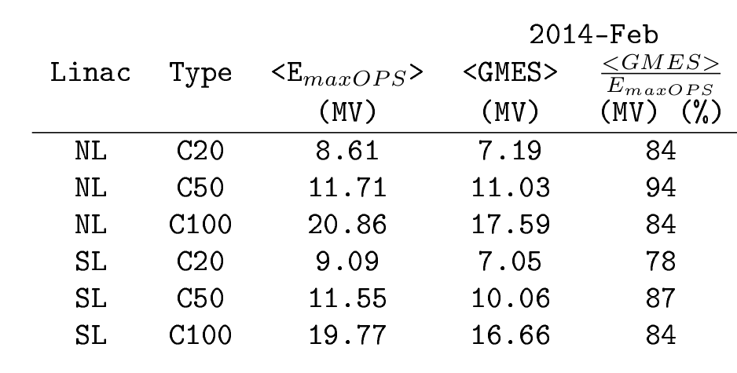
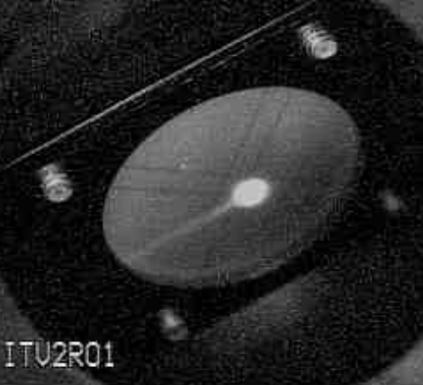
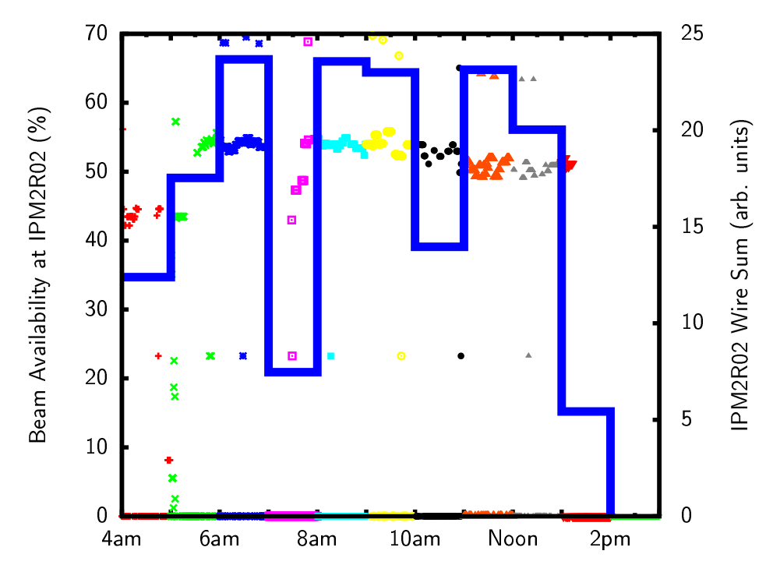
Run I Highlights
2.2 GeV/pass
2014-02-05
12GeV Project KPP Achieved
Beam Arc2 viewer
Availability > 50%, 8h run
E_{maxOPS}: maximum gradient during commissioning
GMES: Operational gradient
Majority of downtime due to C20 trips
Based on this and other data from Spring2014 operations, the estimated maximum 5.5 pass energy with less than 10 trips per hour is:
11.25 GeV, or 6% below design, or 2.05GeV/pass
Notes:
We hit our marks!!!
One-pass beam at 2.2GeV, what does this mean? Cryo plants are operating and stable at 2K with the RF system at full gradient. The RF gradients and phases are stable and maintaining the target one-pass energy of 2.2GeV/pass, 1100MeV/linac
6GeV to Hall-A: First multi-pass CW beam operations. Pathlength is under control, although the machine circumference shrunk by about 2cm during the installation requiring the master oscillator frequency to be changed by 22kHz. The machine has since relaxed back to nominally length. CW beam !!! And the users are engaged and starting their detector commissioning.
5.5pass beam to Hall-D: New Arc10 and Hall-D transport lines transport beam for the first time. The north linac transport SIX beams. Pathlength is under control. Full model loaded for the first time!

Slide 10
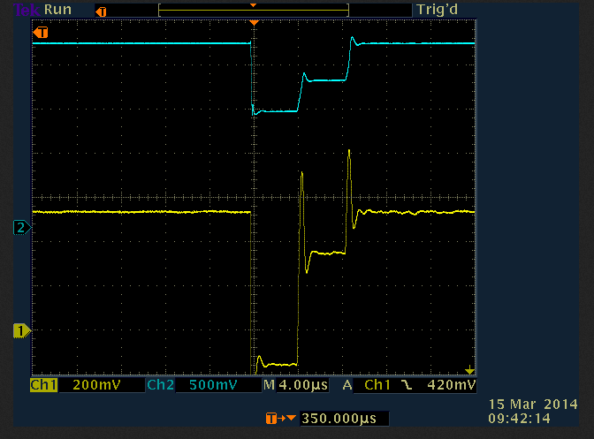
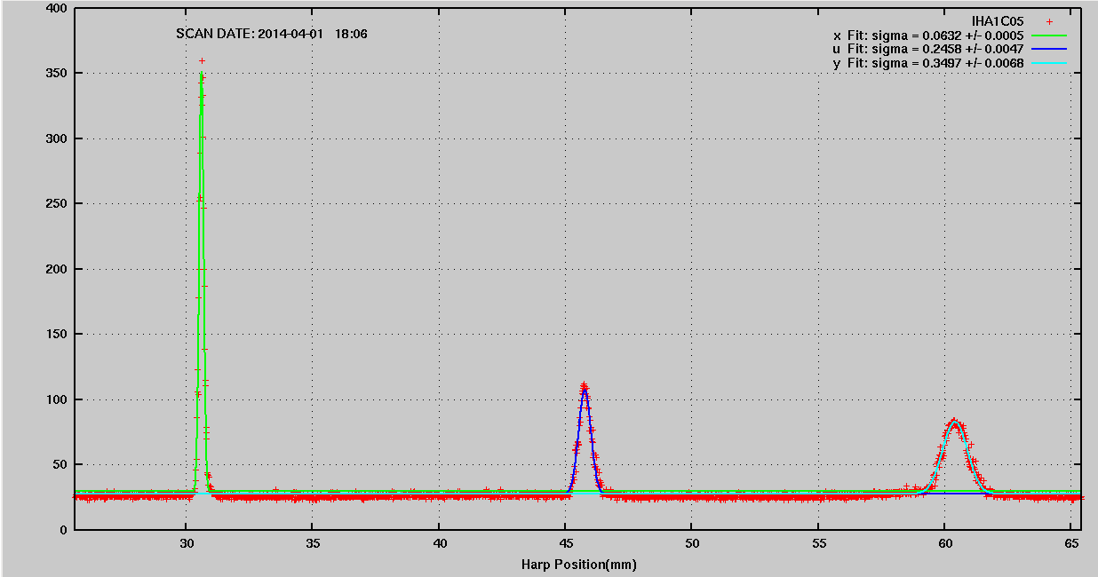
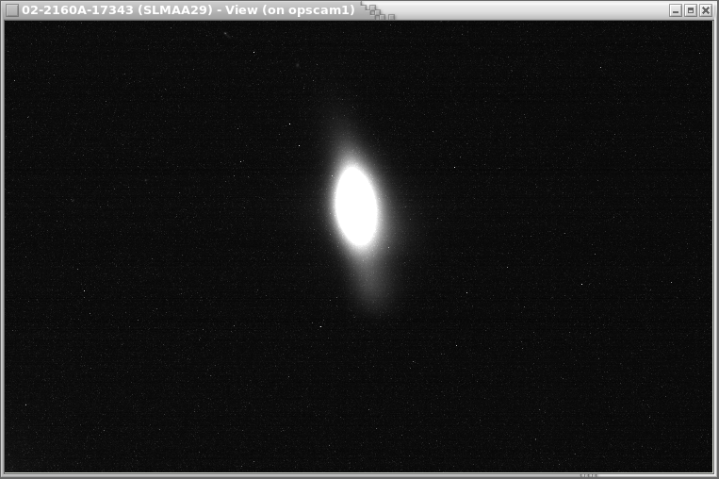
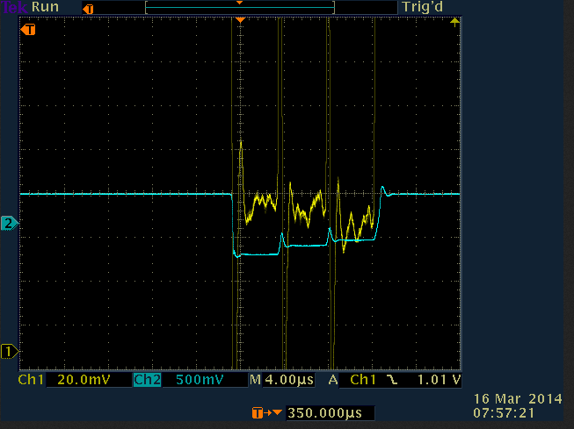
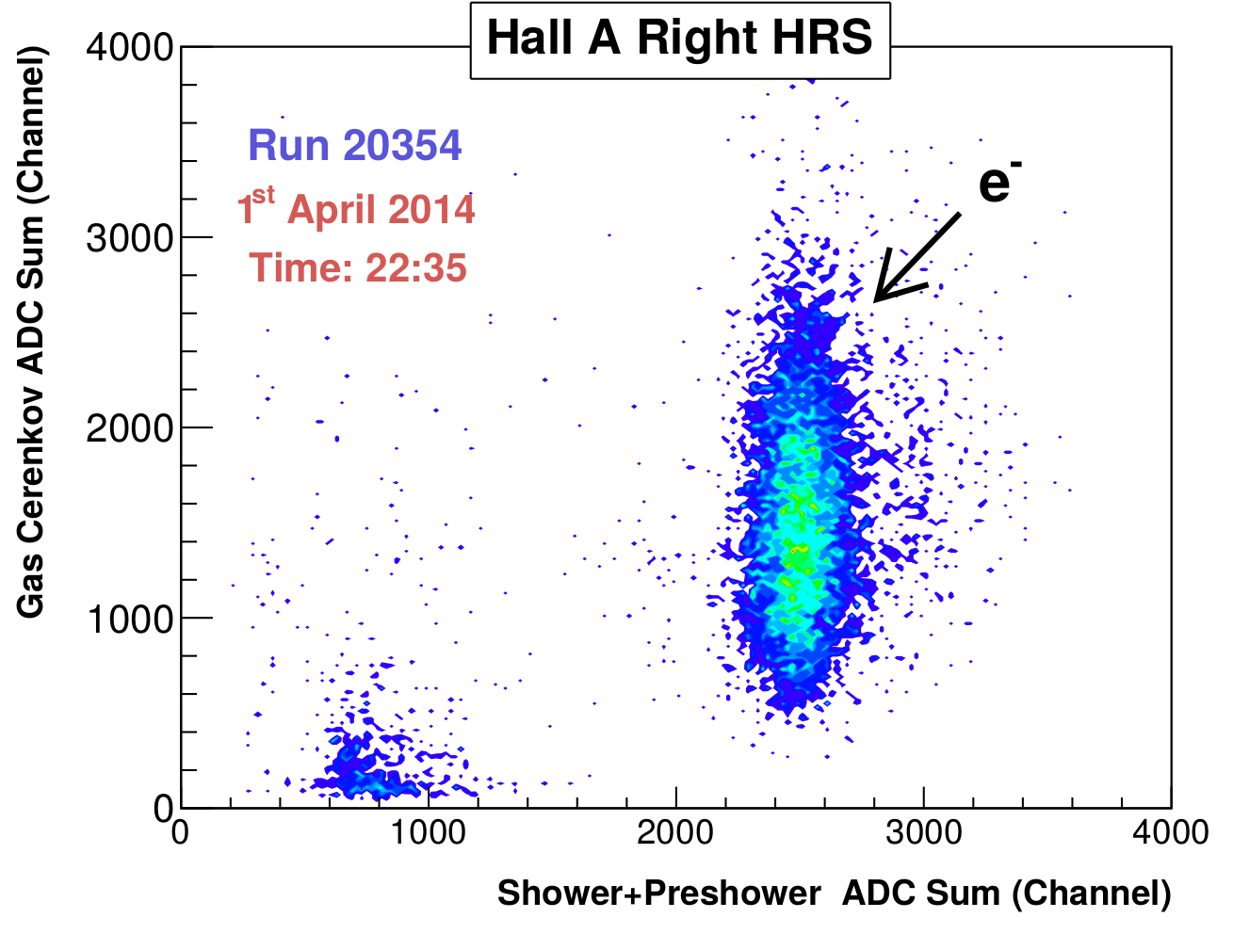
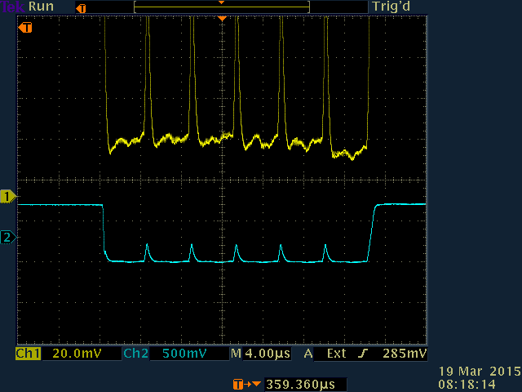
Run II Highlights
Multi-pass (3-passes)
2014-03-15
>6 GeV to Hall A
2014-04-01
5.5 Pass Beam
2014-05-09
Initial 1st to 2nd pathlength difference
Beam profile in A line
Synchrotron Light in Arc10
1st,2nd,3rd pass pathlength difference after MO adjustment + arc offsets
Elastic events in A Spectrometer
6-beams in North Linac
Notes:
We hit our marks!!!
One-pass beam at 2.2GeV, what does this mean? Cryo plants are operating and stable at 2K with the RF system at full gradient. The RF gradients and phases are stable and maintaining the target one-pass energy of 2.2GeV/pass, 1100MeV/linac
6GeV to Hall-A: First multi-pass CW beam operations. Pathlength is under control, although the machine circumference shrunk by about 2cm during the installation requiring the master oscillator frequency to be changed by 22kHz. The machine has since relaxed back to nominally length. CW beam !!! And the users are engaged and starting their detector commissioning.
5.5pass beam to Hall-D: New Arc10 and Hall-D transport lines transport beam for the first time. The north linac transport SIX beams. Pathlength is under control. Full model loaded for the first time!

Slide 11
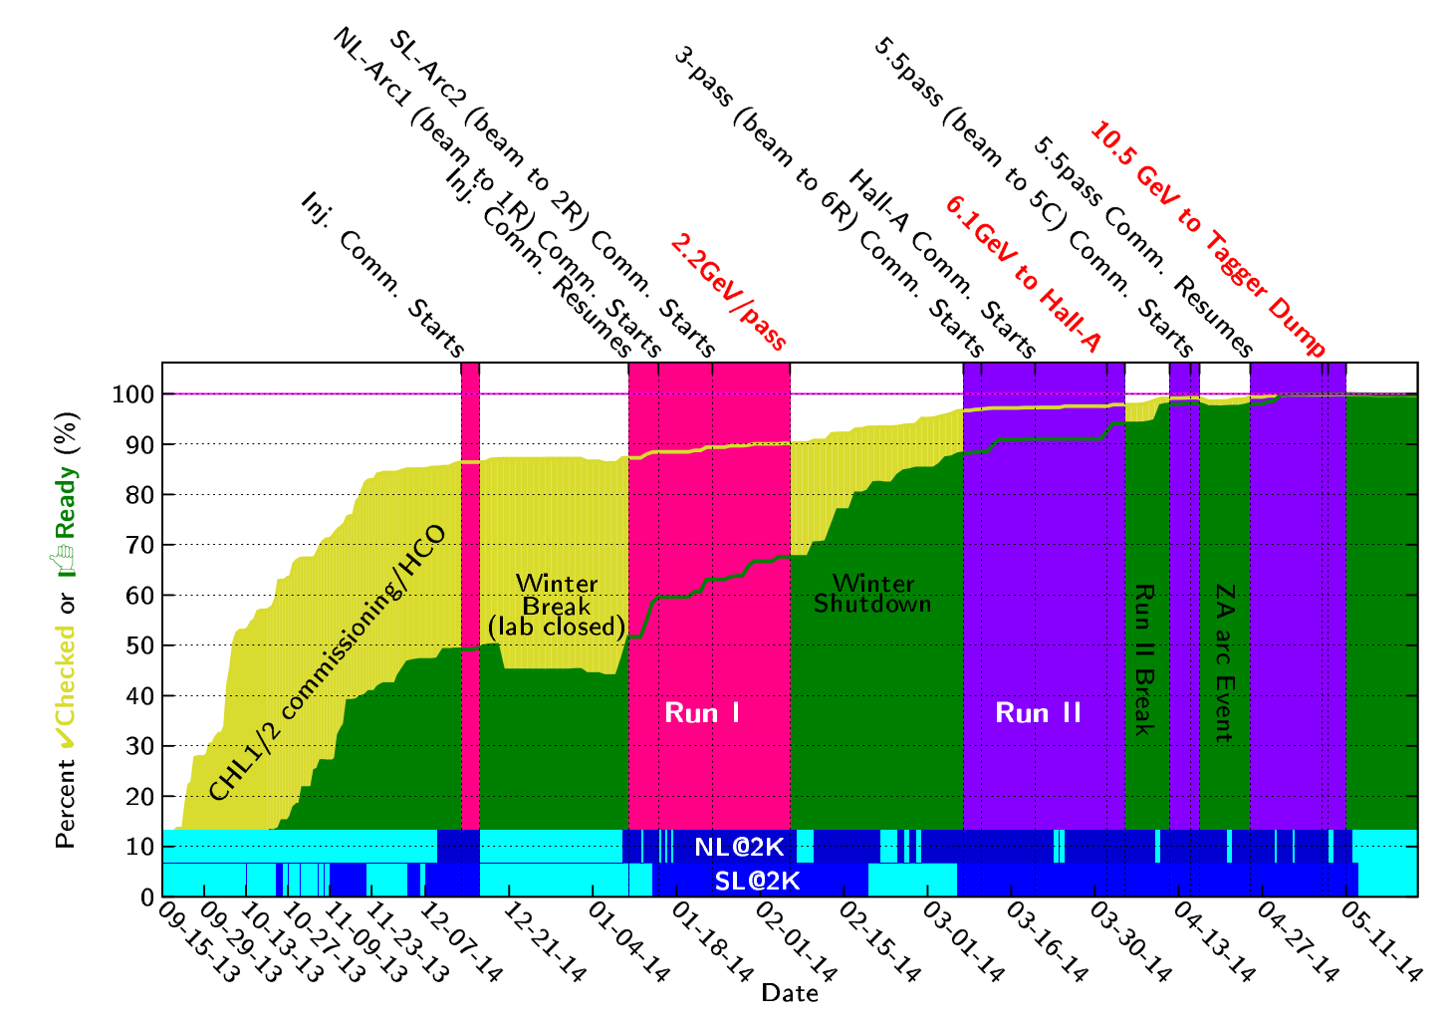
Run I and II Progression
Notes:
This slide shows progression of three activities during Fall 2013 to Spring 2014. Cryogenics commissioning, HCO and beam commissioning.
Cryogenics was commissioning the new CHL2 and the new configuration. Dark blue represents that the Linacs were at 2K.
The yellow curve shows the percent complete of the HCO elements into the checked state. Note that HCO activities are going on in parallel with beam activities.
Green curve shows the percent complete of the elements into the READY state.
And the upper tics show the beam activities and the vertical bands show when the tunnel was locked up for beam operations.

Slide 12
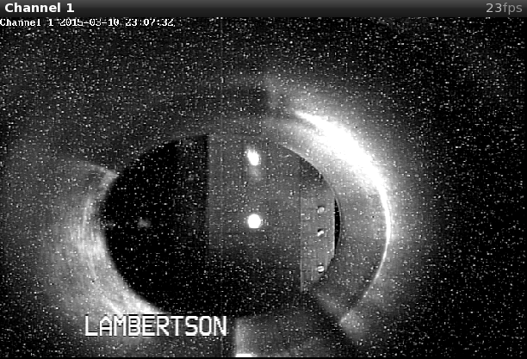
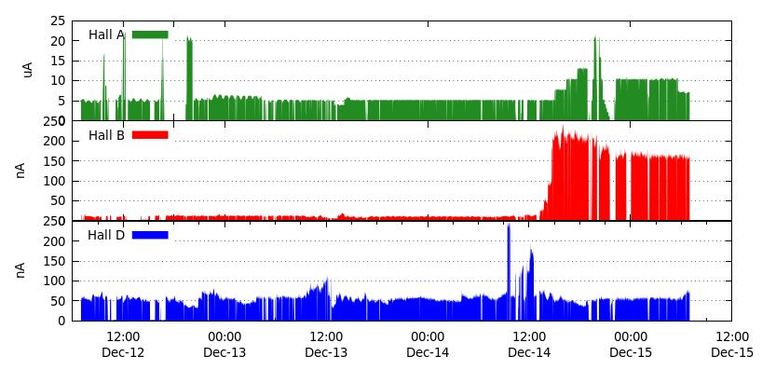
Run III Highlights
2014-Oct-08 to 2014-Dec-21
E=1.8GeV/pass
CW beam, E>10 GeV, 5.5pass beam to Hall-D
First photons into the new experimental hall
12GeV Project KPP: Hall-D detector commissioning
RF separation (1-4 pass), first simultaneous multiple users in the 12GeV era
Established 3-hall operation
Separated beams on beam viewer
Sustained 3-Hall operations
4-pass, RF separated
A-beam (4-pass)
1-pass, RF separated
B-beam (1-pass)
5.5-pass
Notes:
During the Summer 2014: hall-D completed their detector installation and checkout. And an “early physics” experiment was installed in Hall-B.
The two main goals for the Fall2014 was to establish CW beam to the Hall-D tagger dump and to generate photons for the first time. This was to support the commissioning of the new Hall-D detector.
In addition the upgraded RF-separation was to be commissioned.
The images at the bottom show the separating beams on 1st and 4th pass to halls B and A.
And the plot to the right shows a sustained three day period with all three halls receiving beam with high availability.

Slide 13
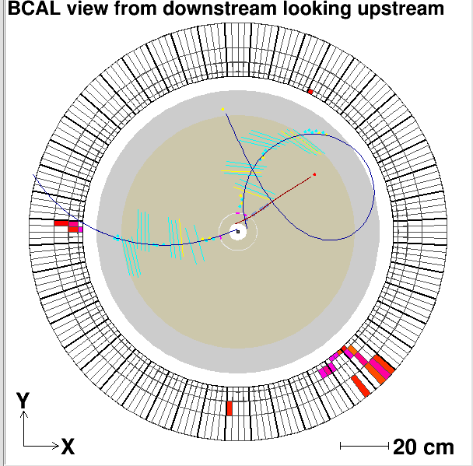
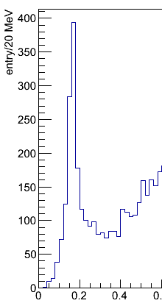
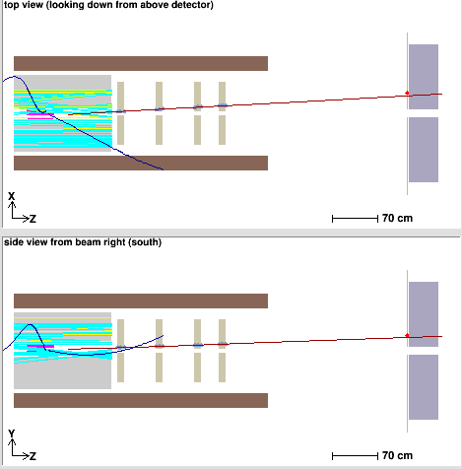
Hall D Commissioning
Hall D: facility for experiments using linearly polarized photon beam
Main goal: search for gluonic excitations in light meson spectra (GlueX experiment)
Photon beam line + large acceptance spectrometer for charged particles & photons
Commissioning with beam Nov. & Dec. 2014
Charged particles tracking
Neutral particles reconstruction
Results with preliminary detector calibration and alignment
Vertex
reconstruction
π°→γγ
Event Display
Drift chambers
Target location
Electromagnetic calorimeters
Spectrometer in solenoidal magnetic field
γγ mass, GeV
Z,cm
Notes:
The main program goal was the commissioning of the Hall-D detector.
With the beams delivered in Nov/Dec of 2014, the program goals with demonstrated with tracks in their tracking system, pi0s in their calorimeter and even a vertex reconstruction.

Slide 14
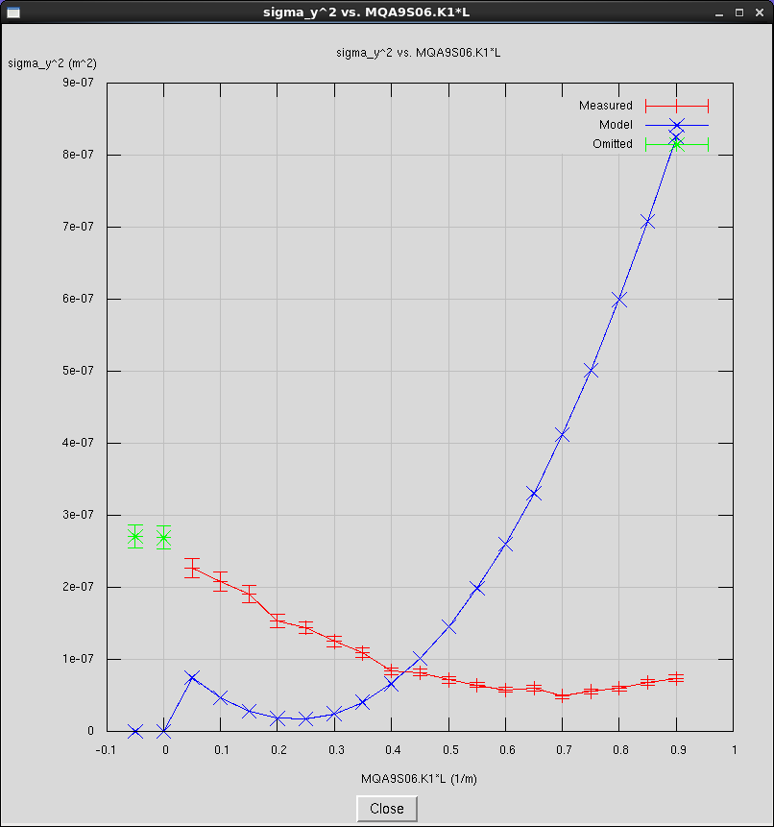
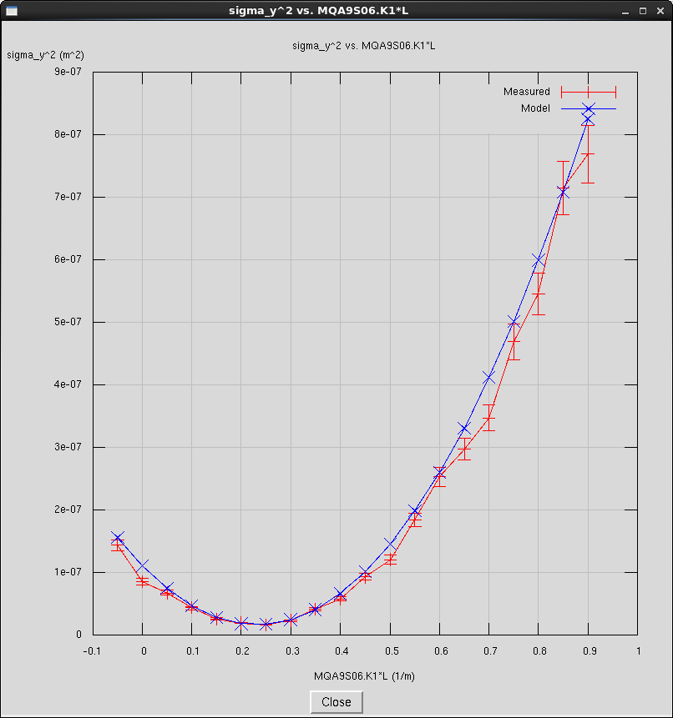
Run IV Highlights
2015-Feb-13 to 2015-May-18
E=1.9GeV/pass
Commission new 249.5 MHz laser/injector configuration
Commission new 750 MHz 5-pass separators
Exercise new setup process and associated tools: New beam matching process
Establish baseline emittance and bunch length evolution
Support ~5wk “early Physics” Operation
Quad Scan: Before match
Quad Scan: After match
$$σ_{y}^{2}$$
$$σ_{y}^{2}$$
Measured
Model
K1*L (1/m)
K1*L (1/m)
Notes:
The run presently in progress, included the commissioning of the new 5th pass separation system which are on the following slides.
Interleaved with the RF separation commissioning was optics tool development and measuring some baseline beam parameters.
CEBAF was setup as per the procedure developed during the design phase. Orbit offsets in the arc were minimized if not nulled. The MO was adjusted to achieve this, it is now only 2KHz off nominal. The beam was matched and set on design at the entrance to each arc. The Arcs and recombiners quadrupoles were set to design and did not require any significant changes going forward, confirming that the model is converging.
More on this in Todd Satogata’s talk on Wednesday.

Slide 15
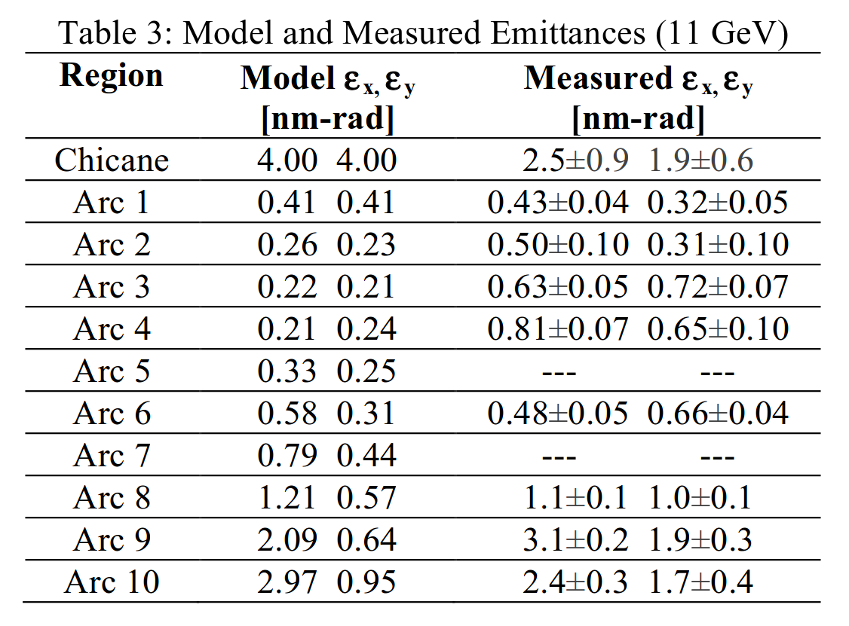
Beam Emittance Evolution at 1.9GeV/pass
Presented at IPAC15: Satogata (WEBD1)

Slide 16
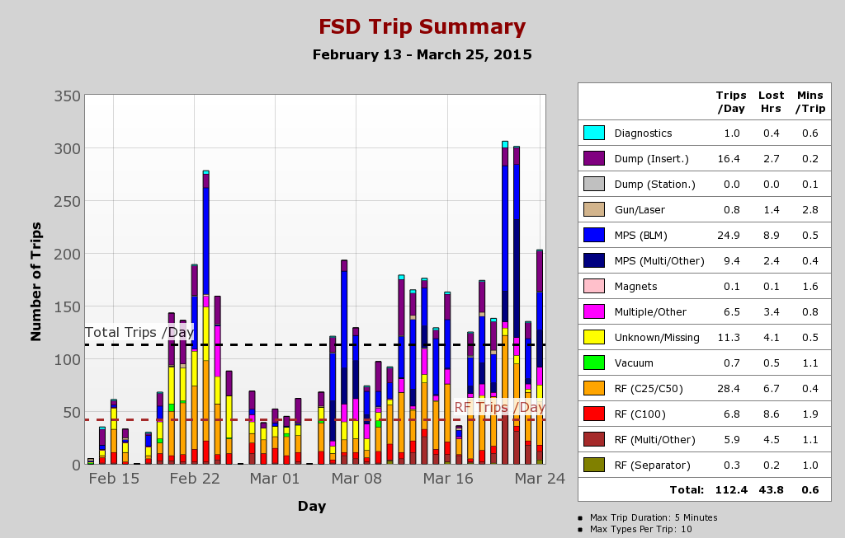
Tracking Performance: Beam Trips

Slide 17
March 25th Power Event: Technical Stop
Offsite power failure, CEBAF Site without power
ALL systems affected, including cryo plants
Power restored in a couple of hours
4K operations resumed immediately (Helium inventory management)
Restoring 2K operations problematic:
CHL2->SC2->NorthLinac cannot achieve stable 2K operations due to contamination issues.
CHL1->SC1->SouthLinac cannot start due to issue with cold compressor 4 (CC4) in SC1.
12GeV cryogenic configuration

Slide 18
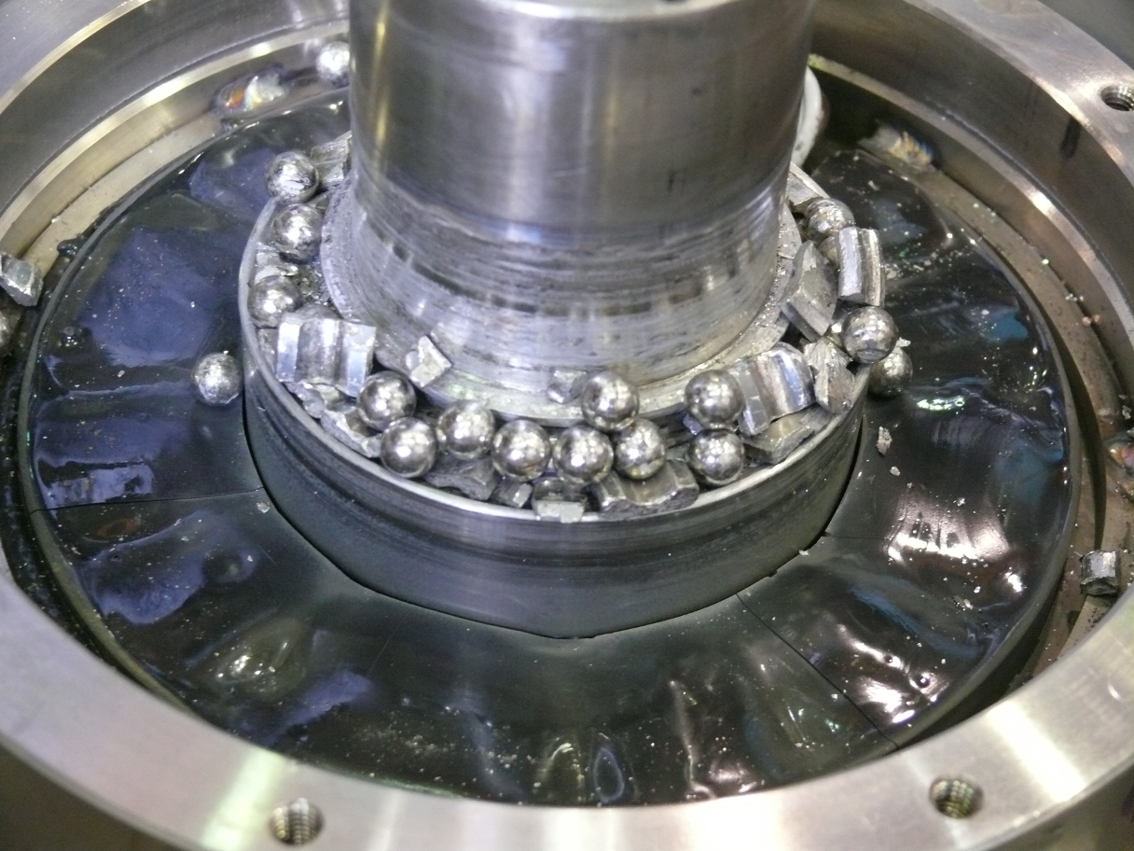
Power Event Impact
CEBAF Down hard: 2015-03-25 – 2015-04-15
Warm up SC2 to remove contaminants, purge/pump cycles.
SC1 CC4 Failure
Compressor wheel stuck, will not rotate, seized, not good.
CC4 safe shutdown system found not working.
Compressor wheel had a hard landing at full speed (>30000 rpm).
Reconfigure cryo-plants/CEBAF with both linacs connected to CHL2->SC2.
CC4 disassembled in June:
Return to CEBAF Ops with one CHL plant
Limited cooling capacity
Limited beam energy
Multi-user Physics program continued with an alternative program at 1GeV/pass.

Slide 19
Summer 2015 Shutdown Tasks
Preparing for 12GeV Operations:
Utilities Infrastructure Modernization upgrade
Power grid, cooling towers, communications
Helium Processing
Energy Reach
750MHz Separator Cavities
Modifications to achieve design, enable RF separation at 11GeV.
Cryogenic plant repair and maintenance
SC1 repair possible in this short time frame made possible by the generous loan of the SNS spare cold compressor. Thank you SNS!
Pathlength chicane upgrade
Restoring the range of the pathlength chicane to the 6GeV equivalent.
Tunnel Air Conditioning
Control temperature rise in tunnel, maintain T< 35 C. Worker safety during tunnel access.
Vacuum system hardening
Preparing for synchrotron radiation induced vacuum loads
Operations StayTreat

Slide 20
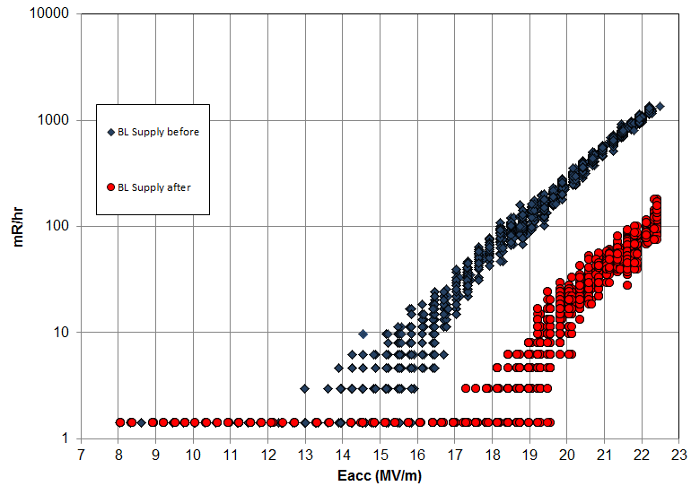
Helium Processing
Utilized during 6GeV era to improve maximum operating gradient of SRF cavities (to reach 6GeV).
Insert small amount of gaseous He into the cavity.
Process cavity with RF power, watch for the radiation signature to drop (field emitters extinguished).
Cryo-cycle the cavity to remove the He.
Determine the new maximum operating gradient
Before HeProc
mR/h
Representative gain (~4MV/m) on one C100 cavity recently Helium processed.
Gradient (MV/m)
After HeProc

Slide 21
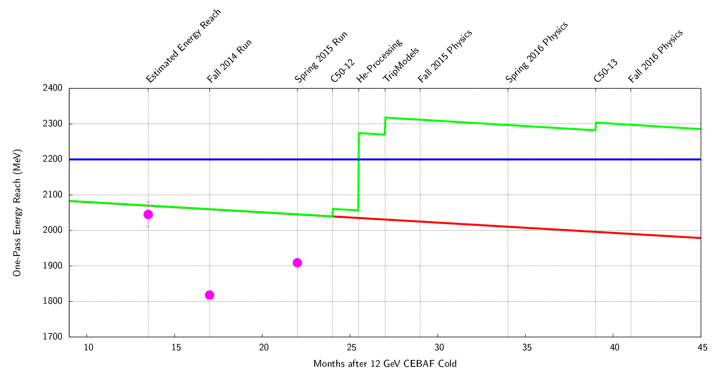
Energy Reach: Past and Future
Estimated gain based on HeProc to date (20%).
Cannot support 12GeV with the loss of one C100 module.
Helium processing of all cavities planned for Summer 2015
Energy Reach: Maximum CEBAF energy with less than 10 RF trips/h.
12GeV operations to Hall-D requires an energy reach of 2.2GeV/pass
Notes:
With 20+ years of SRF operations on over 320 cavities, gradient degradation of roughly 34MeV/pass of energy has been observed.
In order to restore the energy gain of CEBAF to support high availability physics operations, all the cavities will be helium processed this summer. The plot shows the gain expected from this effort. This gain is based on previous helium processing cycles in the 6GeV era and some recent measurements.
Long term, a continuous C50 upgrade program, one C50 per year, will help keep the gradient from declining at a large rate.
Also effort in minimizing the gap between the Commissioning gradients and operations gradient is on going.

Slide 22
Energy Reach: Maintenance and Risks
Energy reach degrades ~34 MeV/pass-year
Expected headroom after Summer 2015: ~100MeV/pass.
Time until CEBAF can no longer support 12GeV operations: 3yrs (2018).
C50 program:
Refurbish original CEBAF C20 module, one per year.
~20MeV of net energy reach per C50.
Time until CEBAF can no longer support 12GeV operations: 7yrs (2022).
If no other gradient mitigation in place by 2022, another round of Helium processing will be required to restore the energy reach in 2022.
C100 Spare:
Peak gradient headroom is expected to be about 100MeV/pass.
Loss of one C100 cryomodule (~100MeV energy gain) results in CEBAF’s inability to operate at 12GeV: Major impact to the Physics program.
Near miss: C100 vacuum event during Fall2014.
Sufficient gradient headroom (CEBAF @ 1.8GeV/pass), allowed the program to proceed without altering the energy (by-passed the leaky module, repaired during accelerator maintenance period).

Slide 23
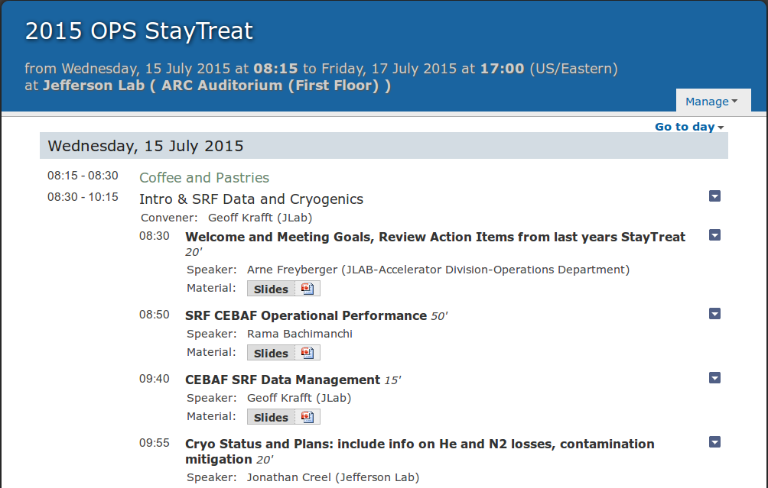
Operations 3-day StayTreat
3 days, July 15-17, 58 presentations.
Presentations available on Indico: www.jlab.org/indico/conferenceDisplay.py?confId=109
This year’s theme: Operating CEBAF at design energy (12GeV).

Slide 24
12GeV Operations: Future
Complete the Summer 2015 shutdown tasks.
Operate RF systems 24/7 for two weeks prior beam operations.
Optimize C100 LLRF to achieve design gradients (or beyond).
Collect data on C20 trip rates, used to optimize gradient distribution with minimal trip rate.
Decrease the gap between the commissioning and operations gradients for all cavity types.
Fall2015 (E_{linac} = 1100 MeV):
2015-Oct-26 to 2015-Dec-21
Emittance/energy spread growth studies.
SRF performance optimization at full energy.
Minimize trip rate
Minimize recovery time
Maximize gradient
Detector commissioning at full energy.
Opportunistic beams for Physics.
Spring2016 (E_{linac} = 1100 MeV):
2016-Jan-28 to 2016-Mar-31
First Physics runs with CEBAF at 12 GeV energy: Halls A&D
Notes:
In two weeks, the Summer shutdown starts. During the following major activities are planned:
Helium processing of every cavity
Complete tunnel air conditioning so that the temperature in the Arc regions of the tunnel do not exceed the 45C (electronics in tunnel).
Complete the pathlength chicane upgrade to minimize the need to change arc orbit offsets or the MO.
Repair the 2K cold box.
In the fall, a 12GeV, 1100MeV/linac configuration will be setup following the same process used this past run. All eyes will be on measuring emittance/energy spread growth and the SRF performance.
In the Spring, the plan is to support the Physics program at the design enegy.

Slide 25
Recent Accelerator Improvement Projects (AIP)
AIP work completed FY15
Dogleg Upgrade -- Restores CEBAF path length adjustment to pre-12GeV upgrade range. Reduced time spent adjusting pathlength, improve CEBAF operability. FY13-FY15
AIP work completed FY14
Injector Upgrade (R100) – Install, commission and operate R100, 100MeV capable cryomodule, effectively doubling the Injector energy gain for compatibility with 12GeV CEBAF.
AIP work completed FY13
Injector Upgrade (Gun portion) – Install 200keV capable DC gun, operate for physics at 130keV. Decrease the space charge effects for improved parity quality beams. FY12-FY13
AIP work completed FY12
CHL Controls Upgrade – Procure PLC hardware, program controls software, bench test controls module for Central Helium Liquifier. Controls equipment obsolescent, system maintainability. FY09-FY12

Slide 26
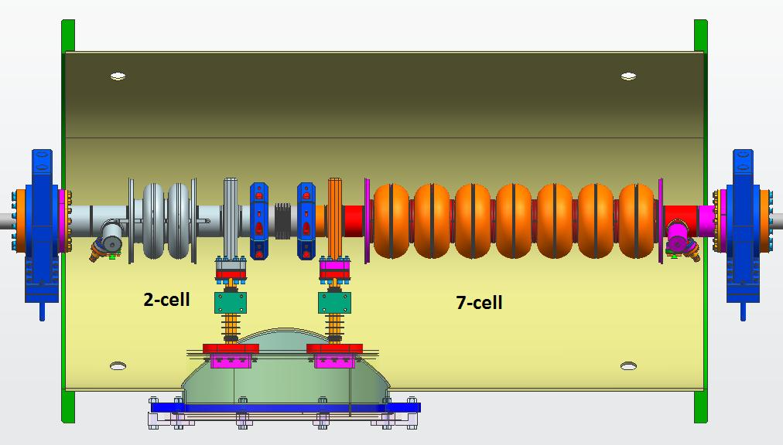
AIP Plan
 | FY14 | FY15 | FY16 | FY17 | FY18 | FY19 | FY20 | FY21
Dogleg Upgrade | 925 | 639
Full Energy Injector – 1/4 Cryomodule | 375 | 540 | 444
Full Energy Injector – Integration |  |  | 759 | 877 | 645 | 127
C50 RF Power & Controls |  |  |  | 350 | 607 | 725 | 733 | 796
Global Timing System |  |  |  |  |  | 225 | 280 | 283
6D Beam Diagnostics |  |  |  |  |  | 200 | 250 | 250
Operability
Parity
Quality
Beams
0 trip operations
Fault resolution
Operability
AIP work planned for FY15 – FY19
Injector Upgrade – Upgrade the CEBAF Injector for 12GeV parity program.
Build ¼ Cryomodule – Establish uncoupled transport in the injector. FY11-FY16
Integration – Commission the new ¼ cryomodule in the Upgrade Injector Test Facility (UITF). Upgrade CEBAF Injector components in the warm RF region to support 200keV operation. Install the commissioned new ¼ cryomodule. Commission the complete upgraded injector, from the 200keV gun operation through the new ¼ cryomodule and R100. FY15-FY19

Slide 27
Non-Beam Accomplishments
Accelerator Readiness Review: Successfully completed the ARR process (four staged reviews) for 12GeV CEBAF.
2K Linacs: Commissioned the cryo plants and established 2K operations in North and South linacs.
Configuration Control: Established the CEBAF Element Database (CED) as the definitive source for CEBAF configuration.
CED used to drive many other new developments, Hot Check Out tool, control screen generation, beam matching tool, etc.
Hot CheckOut: Installed and checked every CEBAF element (over 8000) before beam transport.
12GeV KPP demonstrated: 12GeV CEBAF elements installed and operated without beam.
SRF Baseline: Fully characterized (E_{max}, Q₀, Field Emission) every SRF cavity before the start of 12GeV operations.
Provides a baseline for gauging SRF performance in the future.

Slide 28
Beam Commissioning Accomplishments
2.2GeV/pass one-pass beam transport with greater than 50% availability.
Accelerator 12GeV Project KPP demonstrated
Identified gap in SRF energy reach and developed plan to close the gap.
Multi-pass capability established.
First use of small (kHz) change of the Master Oscillator to deal with large (2cm’ish) changes in CEBAF circumference.
5.5pass beam transported to the Hall-D dump.
CW beam successfully transported to Hall-D dump.
First polarized and unpolarized photons generated and sent into Hall-D.
Hall-D detector 12GeV Project KPP demonstrated.

Slide 29
Beam Commissioning Accomplishments (cont.)
Multi-user capability established.
CW beam, up to 50μA delivered to Hall-A (2-pass).
Extraction system 499MHz and 750MHz commissioned.
Physics quality beams delivered to Hall-A and Hall-B.
Hall-A DVCS exp. one Q² point measured.
Hall-B HPS exp. ~1/3 of the 1GeV data collected (additional runs at 2.2,4.4 and 6.6 GeV).
Every 12GeV CEBAF beamline element, except Hall-C beamline , has successfully transported beam.

Slide 30
Summary
ARR process successfully completed for the 12GeV upgrade.
Roles and responsibilities well defined and appropriate for the commissioning effort.
Processes and commissioning plan well defined.
12GeV Project accelerator deliverable (CD-4A) achieved on 2014-July-30, five months ahead of schedule.
12 GeV CEBAF complete!
Accelerator effort continues to build towards robust operations and physics quality beam at the 12 GeV design energy.
Continue the model driven, database centric approach to beam operations.
Helium processing scheduled for Summer 2015, in support of achieving robust 12 GeV operations in Fall 2015.
Tunnel AC, Dogleg upgrade, 750MHz cavity, vacuum system hardening, etc. in support of 12GeV operations.
CEBAF energy reach, post Helium processing, supports 12 GeV operations through 2022.
CEBAF 12 GeV program at risk due to lack of a C100 spare.

