Slide 1
CEBAF Commissioning Homework-1
Arne Freyberger

Slide 2
Accelerator Homework: Question 1
Couple of slides:
How is the facility AIP plan strategically correlated to risks and requirements in operations, including beam performance, 12 GeV energy, and reliability;
How does the sequence of AIP upgrades for parity quality beams progress in time and integrate with experimental plans?

Slide 3
Parity Quality Beam Requirements
Experiment | Energy (GeV) | Pol (%) | I (µA) | Target | A_{pv} (ppb) | Maximum Charge Asym (ppb) | Maximum Position Diff (nm) | Maximum Angle Diff (nrad) | Maximum Size Diff (δσ/σ)
QWeak (Achieved) | 1.155 | 89.0 | 180 | ¹H (35 cm) | 281±46 | 8±15 | 5±1 | 0.1±0.02 | 10⁻⁴
PREx-II | 1.0 | 90 | 70 | ²⁰⁸Pb (0.5mm) | 500±15 | 100±10 | 1±1 | 0.3±0.1 | 10⁻⁴
C-REx | 2.2 | 90 | 150 | ⁴⁸Ca (5mm) | 2000±42 | 100±10 | 1±1 | 0.3±0.1 | 10⁻⁴
MOLLER | 11.0 | 90 | 60 | ¹H (150 cm) | 35.6±0.74 | 10±10 | 0.5±0.5 | 0.05±0.05 | 10⁻⁴
PREx-II is tentatively scheduled for Hall A in 2017
C-REx is tentatively scheduled for Hall A in 2017
MOLLER is planned for Hall A in 2022
Riad PQB 2015 OPS StayTreat

Slide 4
Injector Upgrade and Parity Experiments
As it stands now the CEBAF injector is unmodified from the Qweak experiment at the end of the 6GeV era.
The Mott polarimeter has been upgraded for better precision.
CEBAF parity quality beam capabilities same as at the 12GeV era.
Parity Quality Beam Team (Physics, Accelerator and Users) actively preparing for beam measurements Fall2015 and beyond.

Slide 5
AIP
 | Fiscal Year | Beam Performance | 12GeV Upgrade | Reliability
CHL Controls Upgrade | FY12 |  |  | X
200keV capable Gun | FY12-FY13 | Parity Beam
Inj. R100 module | FY13-FY14 |  | X
Dogleg Upgrade | FY14-FY15 |  | X
¼ cryomodule | FY14-FY16 | Parity Beam |  | X
Full Inj. Upgrade | FY16-FY19 | Parity Beam |  | X
C50 Controls Upgrade | FY17-> |  |  | X
Global Timing | FY19-> |  |  | X
6D Diagnostics | FY19-> | Out-years and beyond beam specification

Slide 6
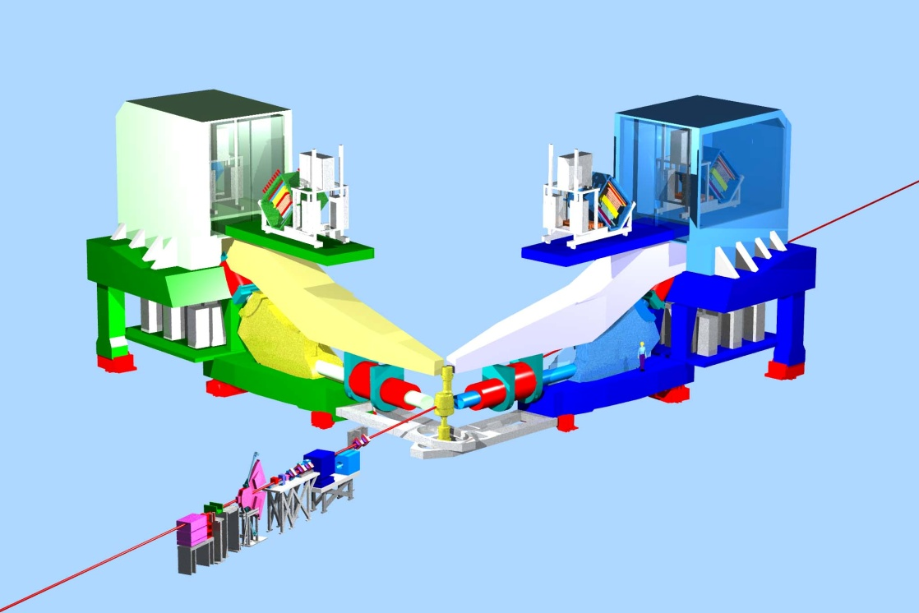
Plans for Early Beam Physics in Hall A
high impact
Early Experiments
PREX/
CREX
Neutron skin
high impact
Injector Upgrade Installed and Commissioned: Summer/Fall2018
¼ Cryomodule Commissioned
12 GeV Projects:
1. Moller polarimeter
2. Compton polarimeter
3. Energy Meas. upgrade
¼ Cryomodule Complete
Beam 1st to Hall A
11 GeV
FY 2014
FY 2015
FY 2016
FY 2017
FY 2018
FY 2019

Slide 7
Recent Accelerator Improvement Projects (AIP)
AIP work completed FY15
Dogleg Upgrade -- Restores CEBAF path length adjustment to pre-12GeV upgrade range. Reduced time spent adjusting pathlength, improve CEBAF operability. FY13-FY15
AIP work completed FY14
Injector Upgrade (R100) – Install, commission and operate R100, 100MeV capable cryomodule, effectively doubling the Injector energy gain for compatibility with 12GeV CEBAF.
AIP work completed FY13
Injector Upgrade (Gun portion) – Install 200keV capable DC gun, operate for physics at 130keV. Decrease the space charge effects for improved parity quality beams. FY12-FY13
AIP work completed FY12
CHL Controls Upgrade – Procure PLC hardware, program controls software, bench test controls module for Central Helium Liquifier. Controls equipment obsolescent, system maintainability. FY09-FY12

Slide 8
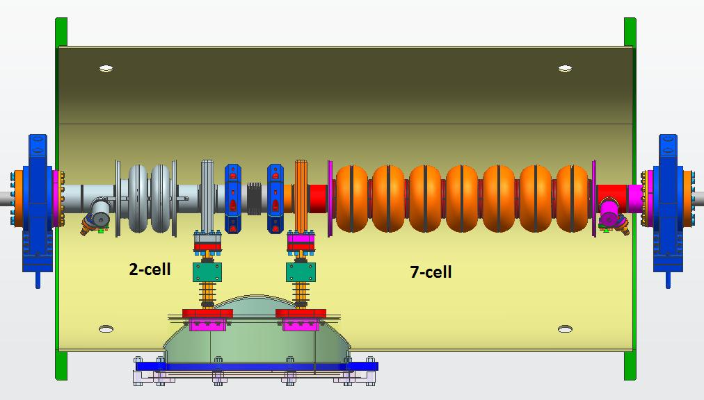
AIP Plan
 | FY14 | FY15 | FY16 | FY17 | FY18 | FY19 | FY20 | FY21
Dogleg Upgrade | 925 | 639
Full Energy Injector – 1/4 Cryomodule | 375 | 540 | 444
Full Energy Injector – Integration |  |  | 759 | 877 | 645 | 127
C50 RF Power & Controls |  |  |  | 350 | 607 | 725 | 733 | 796
Global Timing System |  |  |  |  |  | 225 | 280 | 283
6D Beam Diagnostics |  |  |  |  |  | 200 | 250 | 250
Operability
Parity
Quality
Beams
0 trip operations
Fault resolution
Operability
AIP work planned for FY15 – FY19
Injector Upgrade – Upgrade the CEBAF Injector for 12GeV parity program.
Build ¼ Cryomodule – Establish uncoupled transport in the injector. FY11-FY16
Integration – Commission the new ¼ cryomodule in the Upgrade Injector Test Facility (UITF). Upgrade CEBAF Injector components in the warm RF region to support 200keV operation. Install the commissioned new ¼ cryomodule. Commission the complete upgraded injector, from the 200keV gun operation through the new ¼ cryomodule and R100. FY15-FY19

