Slide 1


Early Physics Program
  Initial Physics Planning
  Ongoing Experiments – FY15
  Upcoming Physics – FY16 & FY17
Rolf Ent

Slide 2
Initial Physics Planning - General
The Halls presented their commissioning and early physics plans to PAC-39 in 2012. Hall A’s plan was revisited, and plans were shown again to PAC-40 in 2013
Many factors come into the commissioning and early physics planning:
    Science priority
    Impact on field
    Practicalities
        Early beam specifications and requirements
        Appropriateness for commissioning new apparatus
        Readiness of ancillary equipment
        Analysis time to publication
    Involvement of young scientists
PAC-41 looked at overall reprioritization of the approved program for the initial 3-5 years of physics – and declared a select set of experiments as of high impact, to fold into the scheduling process.
(see also J. Napolitano presentation)
high impact

Slide 3
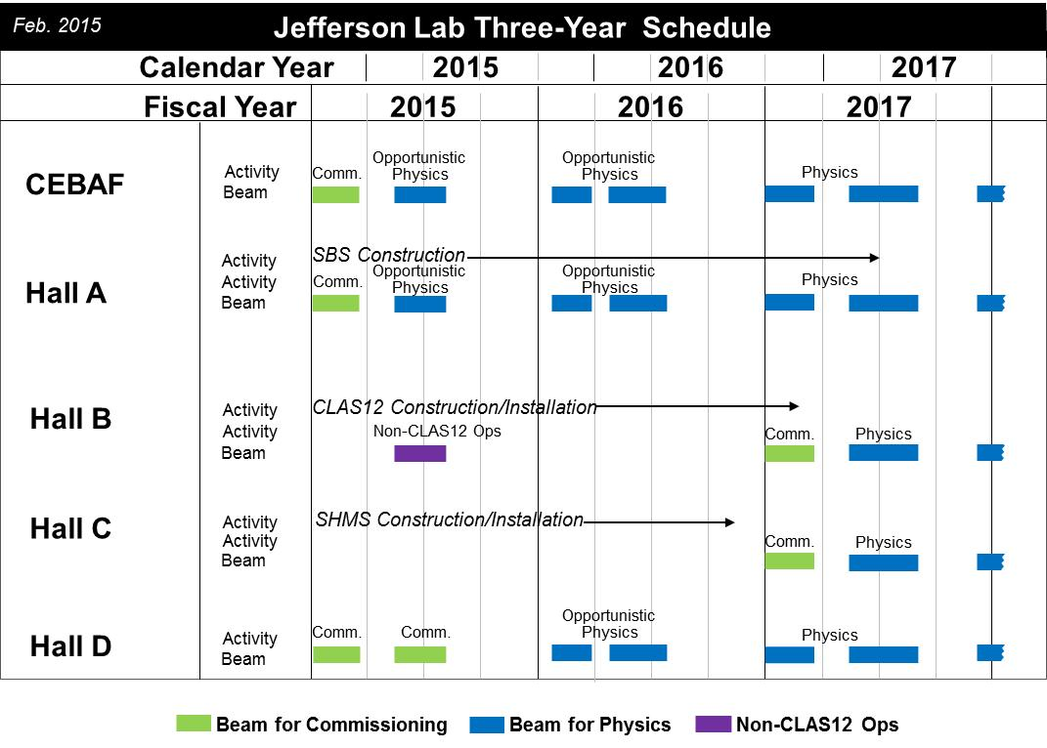

Slide 4
Experiment Scheduling Process Started
https://www.jlab.org/exp_prog/experiments/scheduling.html
Started process in 2014, one call per year – only for those experiments with “frozen floor layout” and near-final equipment construction
Introduced electronic beam requests – all user-provided information (still few wrinkles)
2nd call ongoing, will release schedule for up to June 2017 by October 1, and for up to end of 2017 by April 1, 2016.
Scheduling remains rough, to fold in:
  12 GeV pre-ops
  establishing robust accelerator operations
  budget uncertainties
  experiment goals
Nominal Dates for Scheduling Process
June 1 Call for Scheduling (Beam Time) Request
June 30 Deadline for Scheduling Request Submissions
September 1 Draft 18-Month Schedule Released
September 15 Deadline for Input of User Community on Draft Schedule
October 1 18-Month Schedule Released
Year 1 January – June Schedule Reaffirmed
Year 1 July – December Firm Schedule
Year 2 January – June Tentative Schedule
March 1 Draft 18-Month Schedule Released
March 15 Deadline for Input of User Community on Draft Schedule
April 1 18-Month Schedule Released
Year 1 July – December Schedule Reaffirmed
Year 2 January – June Firm Schedule
Year 2 July – December Tentative Schedule

Slide 5
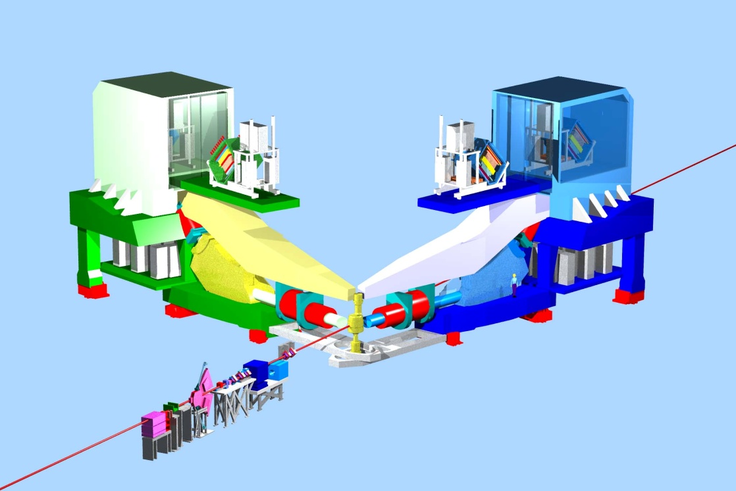
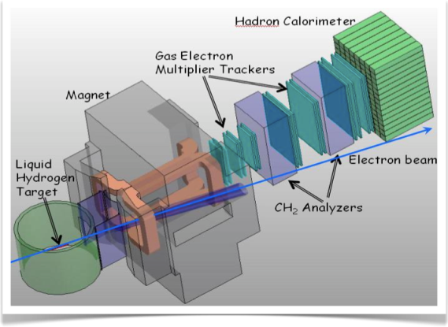
Plans for Early Beam Physics in Hall A
3 A-rated experiments in first years of running
DVCS (HRS-L + calo) and G_{M}^{p} (HRS-R) run is combined
Plan to run 3H and PREX/CREX expts as groups also
Some flexibility incorporated
16 mo. Shutdown
12 GeV Commissioning
high impact
Early Experiments
DVCS-I / G_{M}^{p}
³H/³He PREX / (A₁^{n}, APEX)
CREX
Access to GPDs
EM Form Factor
d/u at High x
Short-range correlations
Neutron spin structure
high impact
Neutron skin
SBS Experiments
high impact
high impact
high impact
EM Form Factors
at high Q²
12 GeV Projects:
1. Moller polarimeter
2. Compton polarimeter
3. Energy Meas. upgrade
SBS Project
SuperBigbite Spectrometer
Beam 1st to Hall A
11 GeV
FY 2014
FY 2015
FY 2016
FY 2017
FY 2018
FY 2019

Slide 6
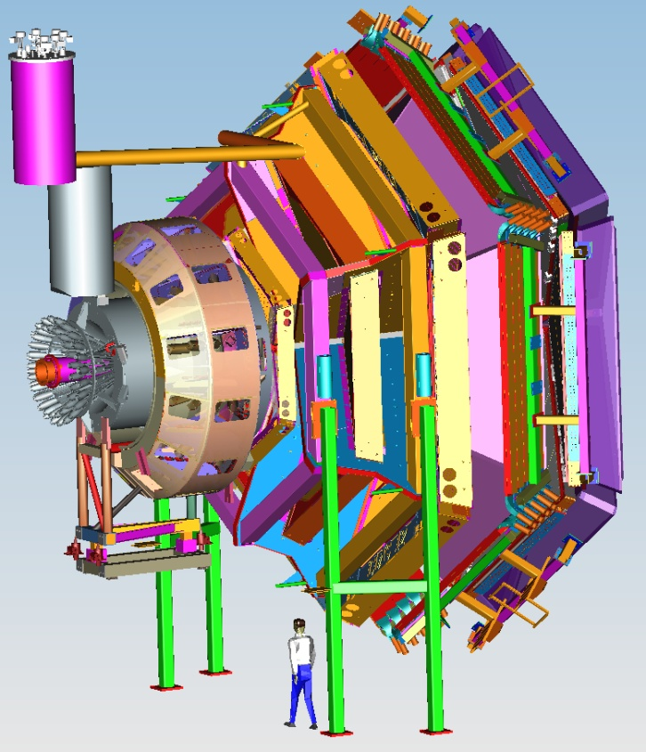
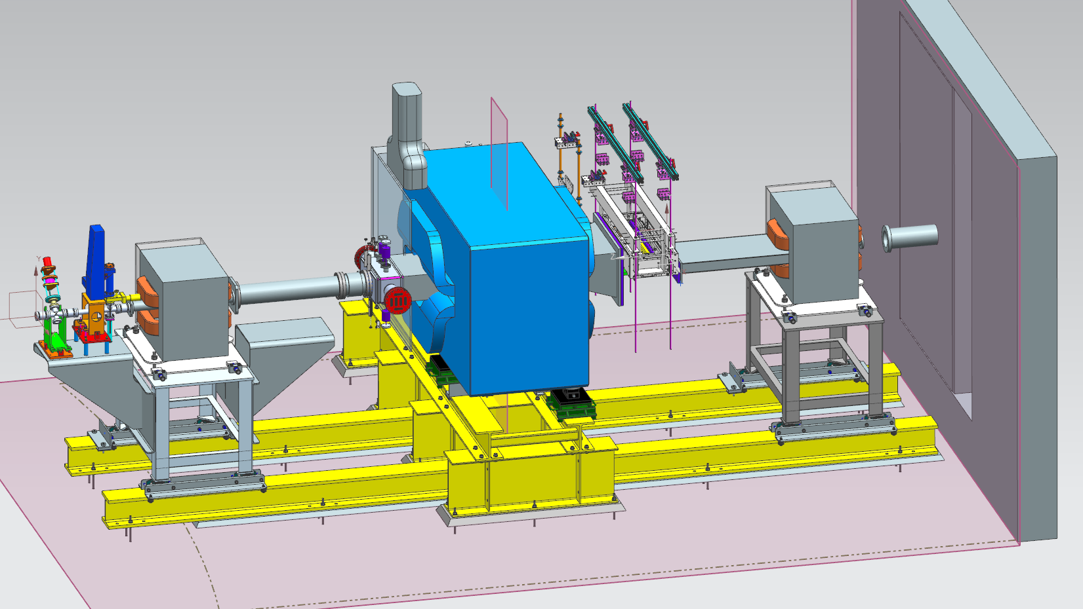


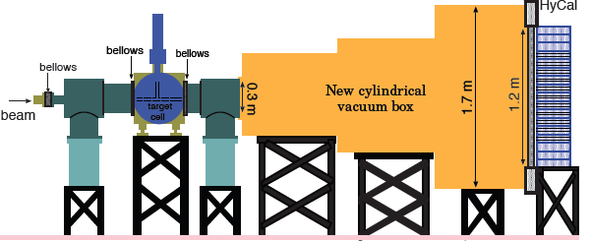
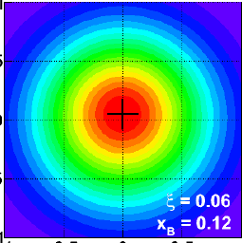
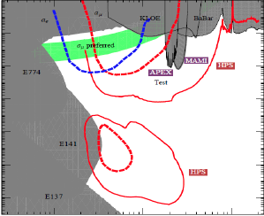
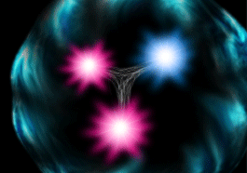
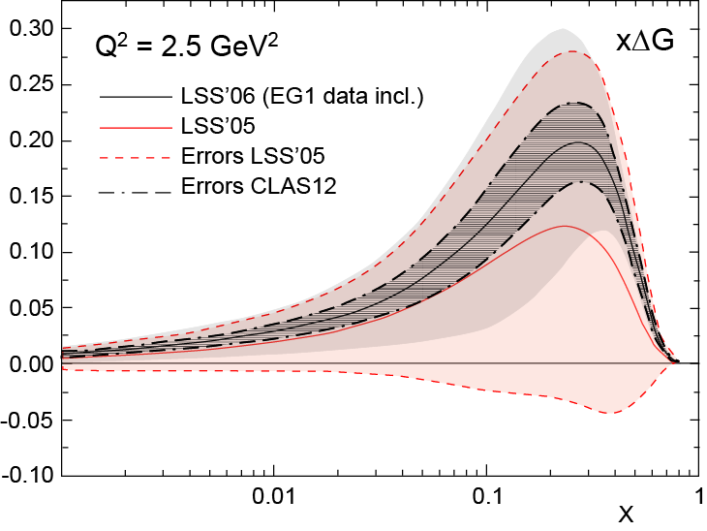
Plans for Early Beam Physics in Hall B
6 A-rated experiments in first 5 years: HPS, PRad, pDVCS, nDVCS, pSIDIS, g₁^{p}/g₁^{n}
non-CLAS12
CLAS12
Construction & Installation
Commissioning & early 11 GeV Experiments
< 6 GeV beam
Installation
pDVCS & GPDs
pSIDIS &TMDs
neutron F2
high impact
g₁^{p} , g₁^{n} - large x
spin structure
high impact
high impact
nDVCS & GPDs
nSIDIS & TMDs
QCD in nuclei
11 GeV
FY 2015
FY 2016
FY 2017
FY 2018
FY 2019

Slide 7
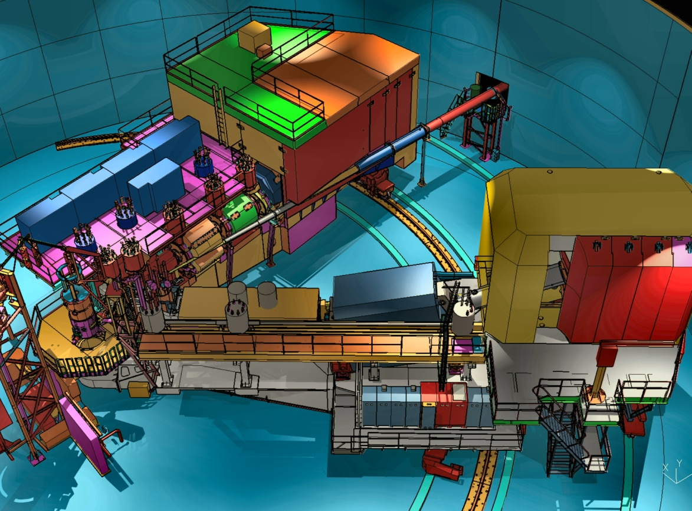
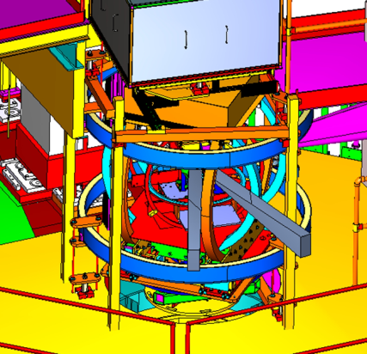
Plans for Early Beam Physics in Hall C
Straightforward “commissioning experiments”
Basic SIDIS and easiest L/T separation
Base equipment in early years
Ramping up to systematic understanding of Hall/SHMS and A-rated experiments
SHMS Installation
12 GeV Commissioning
Early Experiments
p, d,A(e,e’), A(e,e’p), d(e,e’p)
high impact
A₁^{n}, d₂^{n}
High x nucleon structure
Short-range nuclear structure
Neutron Spin Structure
TMDs, CSV, (e,e’K)
Polarized ³He Experiments
1st 11 GeV Beam
Basic SIDIS cross sections
Charge Symm. Violation
Deep Exclusive Kaon Prod.
FY 2016
FY 2017
FY 2018
FY 2019
FY 2018

Slide 8
Early Hall C running plans – “Year 1”
Spring 2016: hope to have beam dump refurbished and have minimal beamline and beam dump checkout (risk reduction)
        (but would require readiness review)
Fall 2016: 12 GeV pre-ops
Fall 2016/Spring 2017 ~25 PAC days – Commissioning “Experiment”:
  9 days of E12-06-107 search for color transparency
  A(e,e’p) only – “easy” coincidence measurement
  11 days of E12-10-002 F₂^{p,d} structure functions at large x
  Inclusive momentum scans help understand acceptance
  2 days E12-10-108 EMC Effect in (some) light nuclei (B, Be, C)
  Integrate light nuclei with F₂ run,
  Point target helps acceptance studies
  3 days of E12-10-003 D(e,e’p) – push to large missing momentum
  If time available
  Push to lower cross sections
Notes:
F2 and C12 scans good for acceptance studies

Slide 9
Early Hall C running plans – “Years 2-3”
Recall that Hall C is the high precision spectrometer Hall
~2017/18:
E12-09-017 P_{t} dependence of basic SIDIS cross sections
Push particle ID capabilities of SHMS
E12-09-002 Precise π⁺π⁻ ratios in SIDIS – Charge Symmetry Push understanding of detector efficiencies
E12-09-011 L/T separated p(e,e′K⁺) factorization test
Easiest L/T separation – push systematic understanding
~2018/19:
Choose a “High Impact Experiment”
E12-06-101 Pion Form Factor (needs well understood SHMS)
E12-06-105 x>1 (needs well understood background reduction)
E12-06-110 A₁^{n} (needs high-luminosity ³He)
high impact

Slide 10
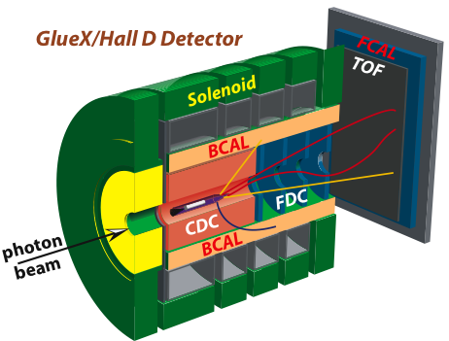
Plans for Early Beam Physics in Hall D
Search for Gluonic Excitations (GlueX)
η, η’ couplings, rare decays using Primakoff reaction
12 GeV Commissioning
Primakoff
η→γγ
GlueX
Hardware
10⁷γ/s
Light quark mass ratio
η and η’ mixing angle
Polarized Beam
high impact
E = 12 GeV
polarized
10⁸γ/s preparations
E < 12 GeV
unpolarized
FY 2014
FY 2015
FY 2016
FY 2017
FY 2018

Slide 11
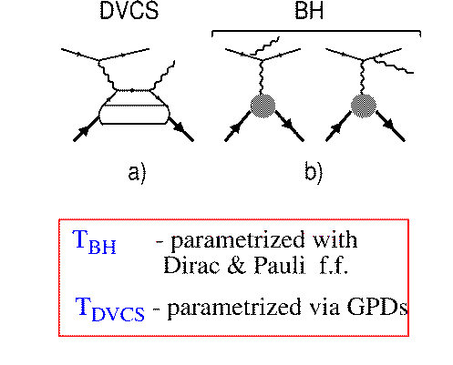
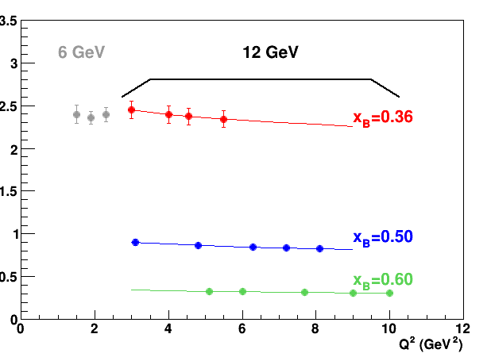
Towards the 3D Structure of the Proton: Hall A DVCS
Simplest process: e + p → e’ + p + γ (DVCS)
DVCS
e
e
BH
3rd Generation DVCS Experiment
high impact
p
p
Hall A data for Compton form factor (over limited Q² range) agree with hard-scattering
12 GeV projections: confirm formalism
Im C’
Goals for E12-06-114 (Hall A DVCS):
To measure precise absolute cross-sections (3-5% stat and 4% sys uncertainties),
To test the scaling of the DVCS amplitudes,
To separate the Re and Im part of the DVCS Compton amplitudes.

Slide 12
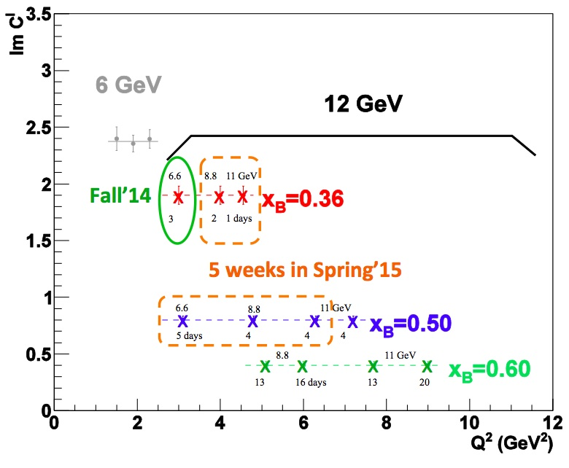
DVCS and G_{M}^{p}: Concurrent Experiments in Hall A at 11 GeV
DVCS
High impact experiment for 3D nucleon imaging
  Deeply Virtual Compton Scattering (DVCS) provides access to Generalized Parton Distributions (GPDs)
Will provide highest available Q² measurement of the DVCS cross section
  Demonstration of scaling critical to full JLab 12 GeV GPD program
now ’16
G_{M}^{p}
5 weeks in Spring ‘15
DVCS and G_{M}^{p}:
7 graduate thesis students (MIT, Ohio, Orsay, Catholic, William and Mary, ODU, Hampton)
now ’16
High Q² Form Factors
  Reducing G_{M}^{p} uncertainties will enable Super BigBite high impact program of Form Factor Measurements

Slide 13
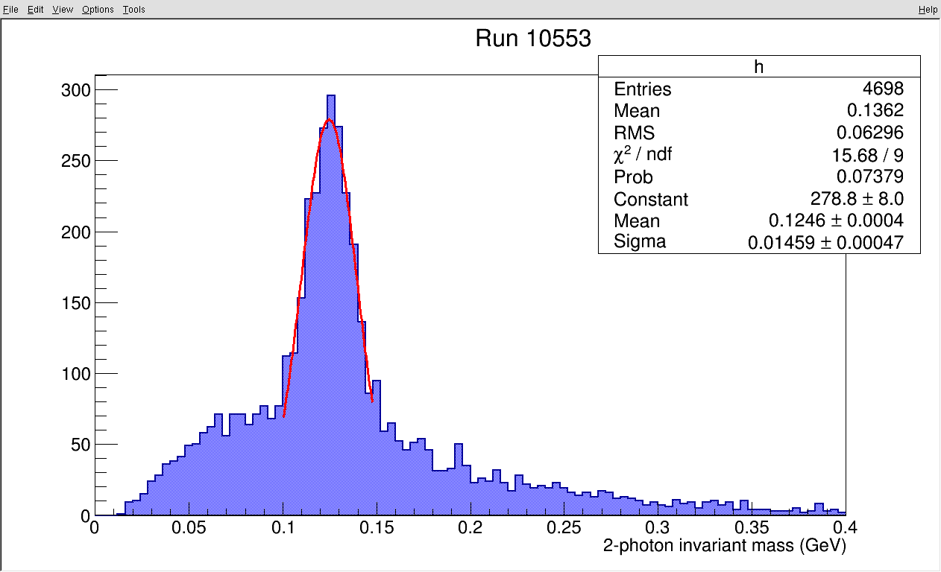
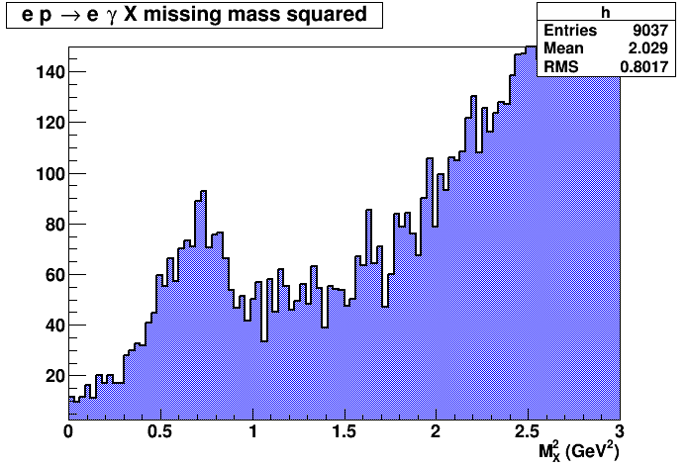
DVCS: online results from Fall’14 run
Beamline commissioning:
Moller measurement (P = 88%)
BPM calibration (+ harps operational)
BCM calibration
New raster
(Refurbished) beam dump
π⁰ ’s reconstructed in DVCS calorimeter
DVCS experiment commissioning:
Coincidence (e + γ) trigger
1 GHz sampling electronics
ep → ep calorimeter elastic calibration
Completed the 1st DVCS kinematic setting
DVCS events
(1.5 h of beamtime)

Slide 14
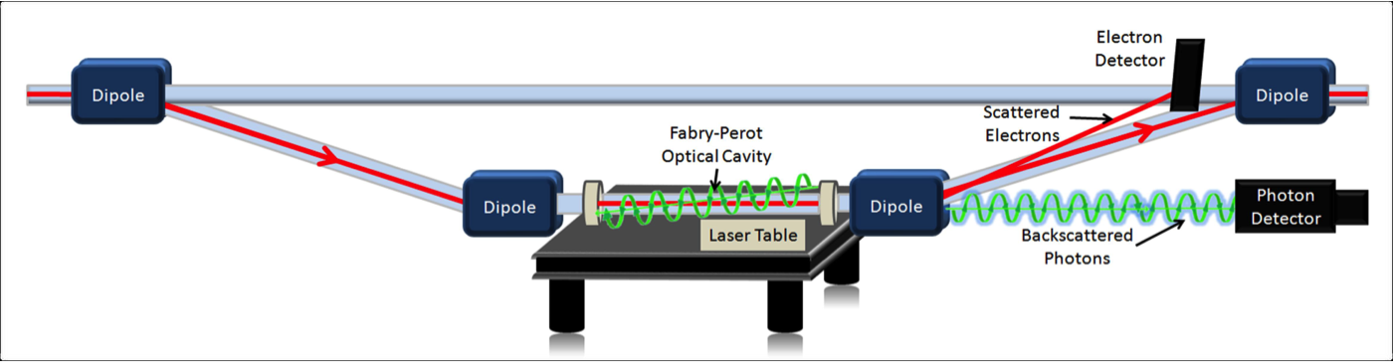
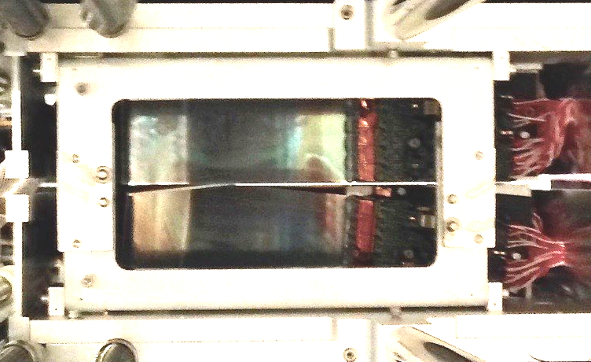
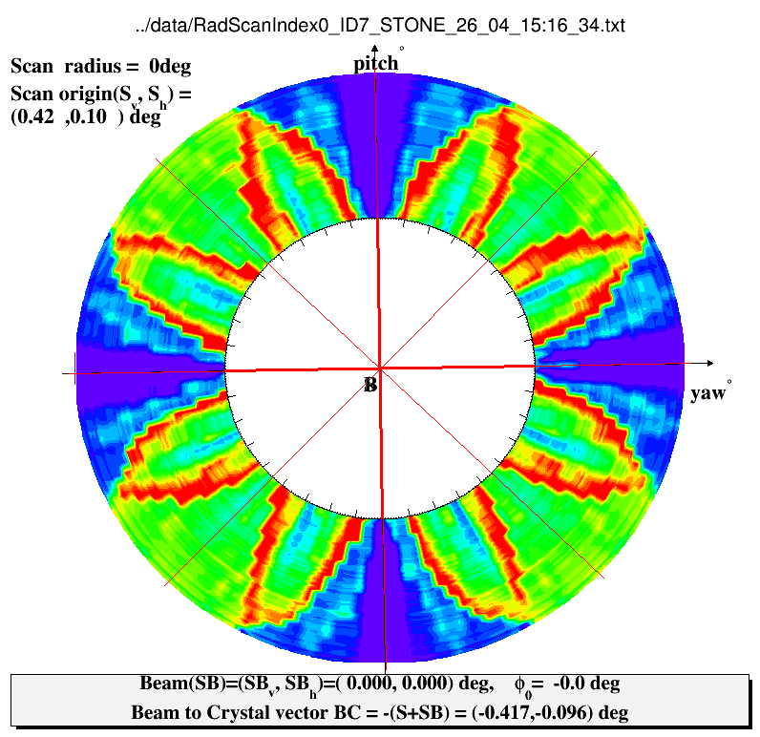
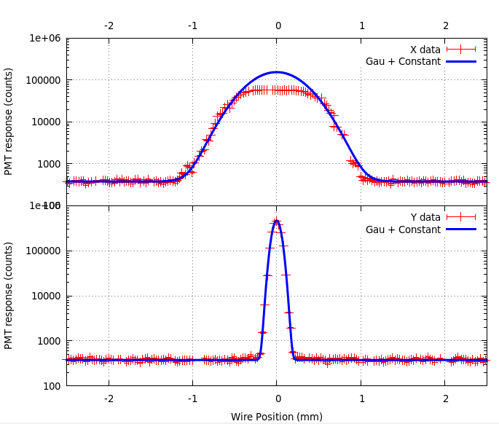
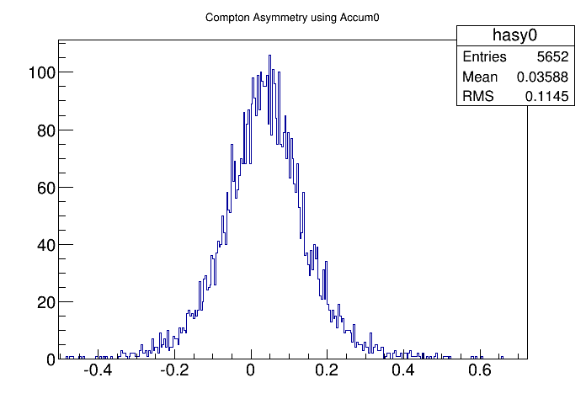
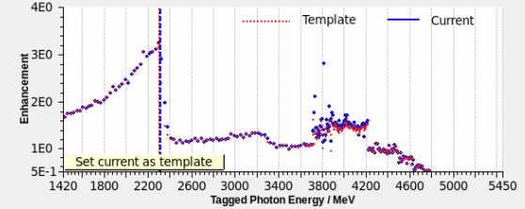


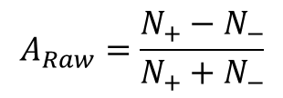
Alternate Physics Program: (E_{pass}= 1.0 GeV)
Hall-A: Commissioning beam line + e⁻ polarimeters
Hall-B: Physics/HPS
Ribbon beam for dark matter search
Hall-D: Detector commissioning only
First coherent bremsstrahlung spectrum
Si detectors
BEAM goes here, 1mm gap in Si
$$A_{Raw}=\frac{N_{+}−N_{−}}{N_{+}+N_{−}}$$
$σ_{x}^{}=$ 294µm
Compton Asymmetry
$σ_{y}^{}=$ 48µm
Notes:
With CEBAF reconfigured at a lower energy, progress in all three halls.
Hall-A commissioned their upgraded polarimeters and were able to measure an asymmetry in the compton polarimeter.
Hall-B has transitioned from commissioning the dark matter experiment to taking data. This experiment requires a ribbon beam to pass between SI strip detectors that reside 0.5mm from the beam. Stability!!!
Hall-D has established the alignment of the diamond radiator and the generation of a coherent bremsstrahlung photon beam.

Slide 15
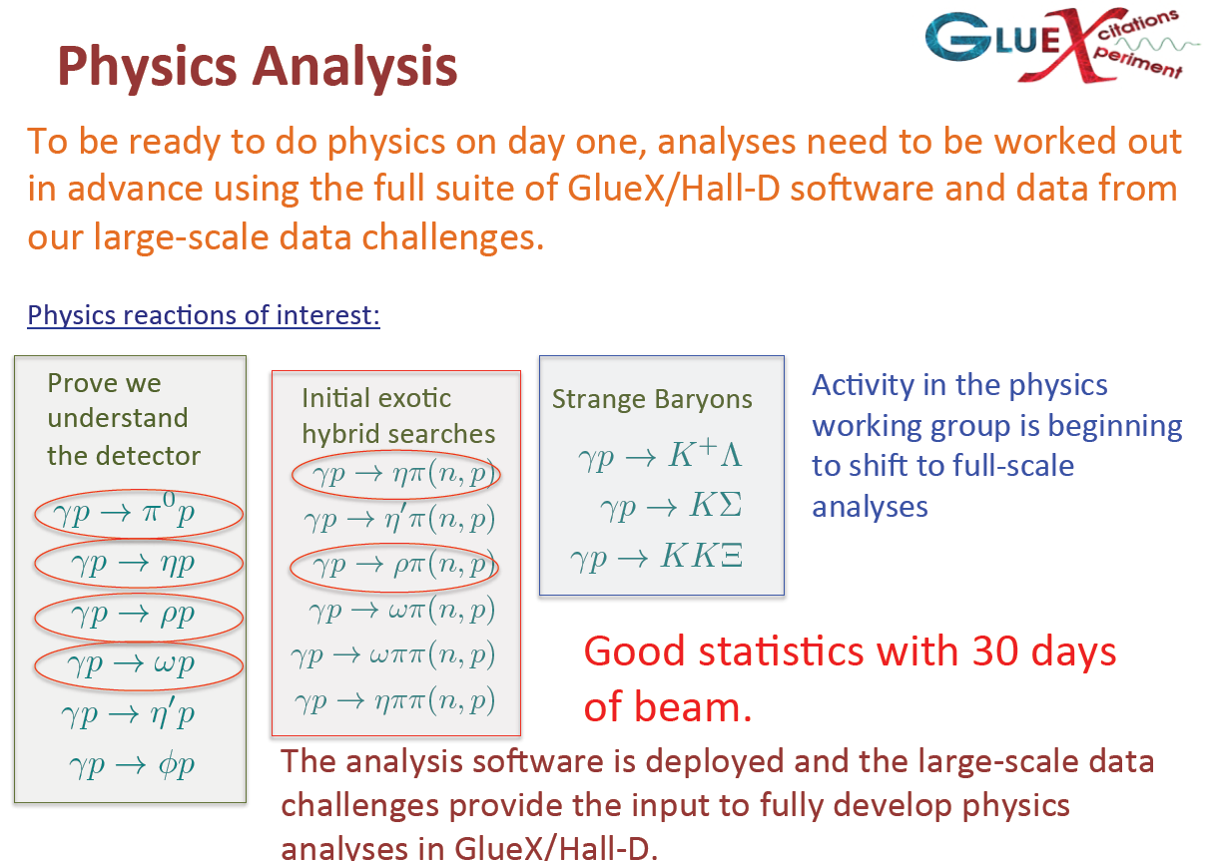
Towards Gluonic Excitations: Hall D
See presentation of J. Stevens for further update on GlueX science, on detector commissioning and understanding,
and further plans.
high impact

Slide 16

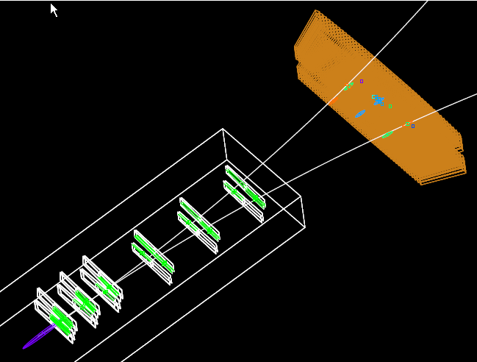
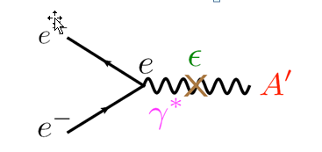
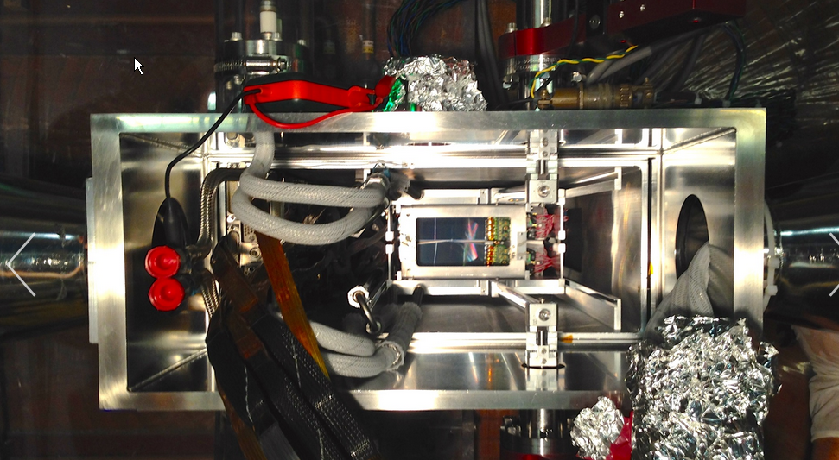
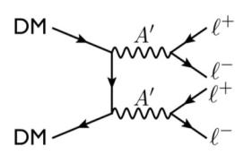
Heavy Photon Search at JLAB
Dark Matter may reside in a Hidden Sector, carry “dark charge”, and couple to hidden sector gauge bosons (“heavy photons”, A’s)
Heavy Photons mix with the SM γ, so will couple weakly (εe, ε~10⁻³) to electric charge.
high impact
Run 5623
Event 62
N. Graf
An actual e⁺e⁻ pair, produced in the HPS W target, is tracked by the 6-layer silicon vertex tracker (SVT) placed inside an analyzing magnet. The highly segmented PbWO₄ Ecal, downstream of the SVT, was used to trigger the event. The A’ signal must be identified above a huge background of QED tridents. https://confluence.slac.stanford.edu/display/hpsg/Heavy+Photon+Search+Experiment
Since they couple to electric charge, A’s can be electro-produced and can decay to e⁺e⁻.
Heavy photons may mediate DM annihilation and interactions of DM with regular matter.
The Heavy Photon Search (HPS) identifies A’s as mass bumps with finite decay length in a compact forward spectrometer at JLAB.
Beam’s Eye View of Si Vertex Tracker

Slide 17
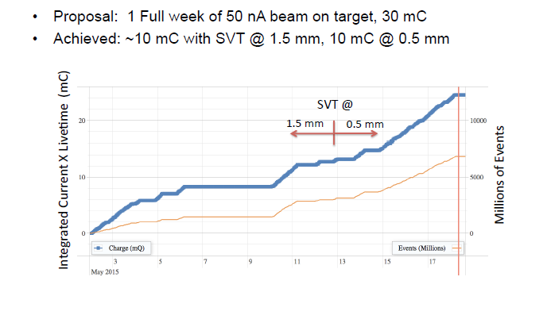
Heavy Photon Search - Spring 2015 Run @ 1 GeV
This was achieved by extending the beam schedule – after the power loss and the resulting cryo problems – up to May 18. HPS only ran in late evenings/nights and in weekends to ensure there was no interference with CLAS12 installation.

Slide 18
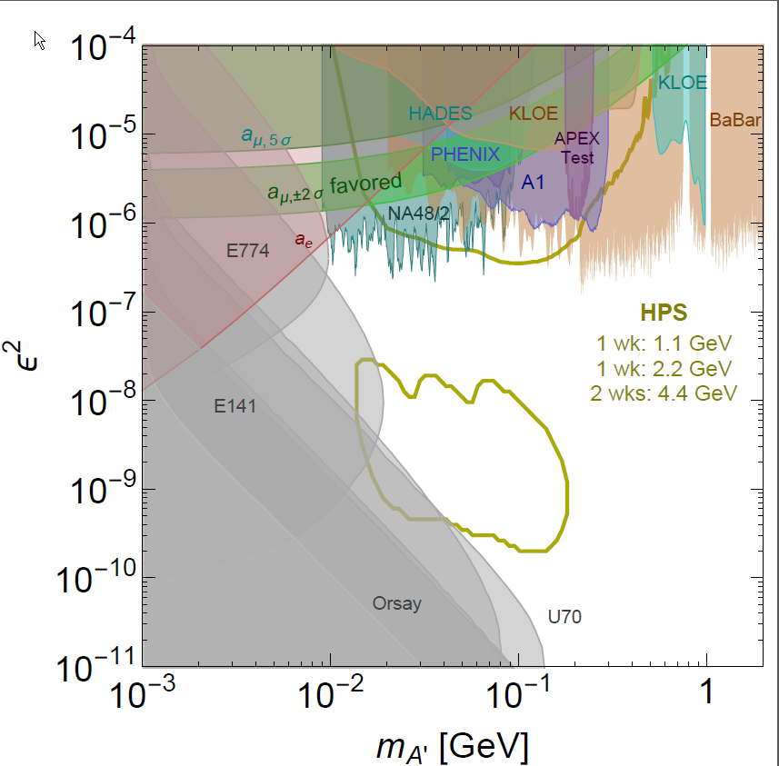
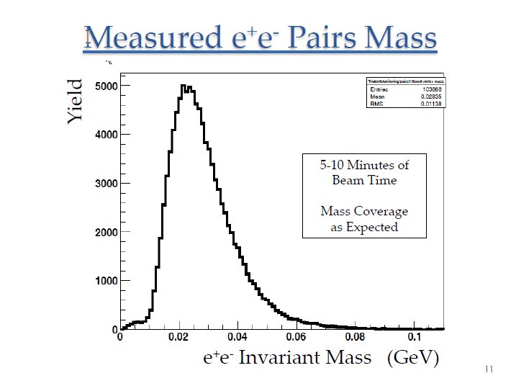
Heavy Photon Search at JLAB
HPS Reach and Existing Limits
HPS was fully installed and commissioned
for the Spring 2015 Engineering Run. Beamline, detector, and trigger work as designed!
Took 1/3 week of data at 1.05 GeV with the SVT just 500 μm from the electron beam. Search for an A’ in uncharted territory has begun. First results by March 2016?
Looking for opportunistic data taking at 2.2 and 4.4 GeV in FY16. John Jaros: “Chance for a game changing discovery!”
2σ
4.5 σ
2015
2017
Preliminary!

Slide 19

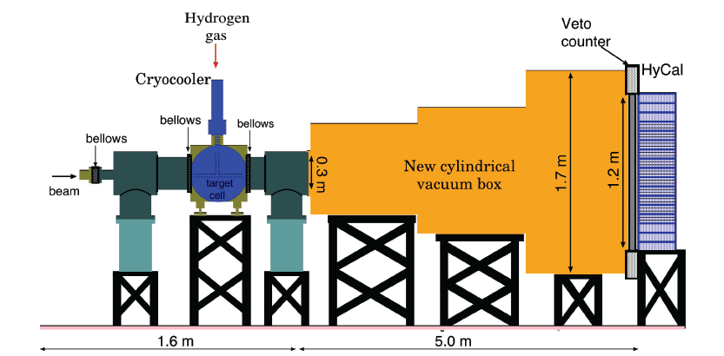
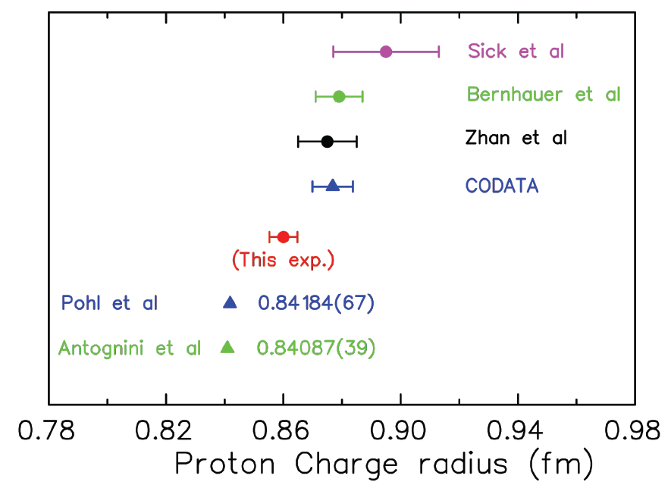
Potential for Hall B non-CLAS12 Science - PRad
Proton Radius Puzzle
Discrepancy between proton radius as extracted from muonic hydrogen Lamb shift measurements and the determinations from the slope of e-p elastic form factor measurements at small q².
The PRad experiment determines the e-p elastic cross section by electromagnetic calorimetry only → can rule out origin of discrepancy if due to any systematics of e-p scattering
high impact

Slide 20
Early Physics Program - Summary
We have made all the necessary preparations to ensure high-impact science already early in the schedule
The Experiment Readiness Review process has been revised, with high praise of external committee at the accelerator readiness review phase II (see earlier presentation and also presentation by Javier Gomez)
We have re-started the (18-month) scheduling process to guarantee priorities
In Hall A, equipment is on the floor to execute together both a 3rd generation DVCS experiment to validate the formalism towards 3D spatial imaging in the simplest process, and a precision measurement of the elastic e-p cross section - a necessary ingredient of the JLab form factor program.
In Hall D, all preparations have been made to possibly reap science benefit from the engineering run. With 30 days of engineering run exciting discovery science can come out if we are lucky… We already can do ρ photoproduction.
In Hall B, two experiments installed in the up- and downstream beam line alcove could run, if compatible with CLAS-12 installation, to do a Heavy Photon Search (some data are in!) and to measure the Proton Radius.

