Slide 1


Experimental Nuclear Physics Progress
Rolf Ent

Slide 2
Experimental Nuclear Physics - Outline
Science Highlights since 2012 S&T Review
People
Key planning efforts to support 12 GeV physics
  Software and Computing reviews
  Experiment readiness review planning
  Cryogenic capability planning
  Capital equipment planning
  Generic detector R&D and leveraging synergy

Slide 3
Highlights since 2012 + overview of presentations
QCD and the Structure of Hadrons
  d₂^{p} and d₂^{n}, d/u, two-photon exchange, Λ(1405), Δ(2200)7/2⁻, pion life time, GlueX, DVCS: from GPDs to imaging
Nuclei: From Structure to Exploding Stars
  New information on correlations
In Search of the New Standard Model
  New constraints on electron-quark weak couplings
  Determination of the weak charge of the proton (and neutron)
R. Ent Early Physics Program
J. Gomez Experimental Facilities and Operations Metrics
T. Keppel SBS, MOLLER, SoLID
P. Rossi Other Physics Capital Equipment Projects
J. Stevens GlueX Progress and Plans
V. Zeigler CLAS12 Simulation and Analysis Plans
D. Weisenberger Detector Technology & Applications

Slide 4
Physical Review Letters Vol. 113, Issue 2 (11 July 2014)

Slide 5

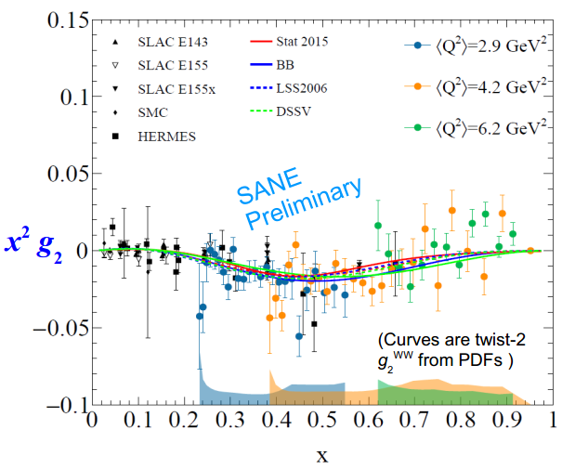
Unpolarized and Polarized Structure Functions – measure the lowest moments of (separated, p and n) structure functions
Lowest Moments of Structure Functions
proton
NSAC milestone HP6 (2011) completed
neutron
Provides a measure of the nucleon’s color electric and magnetic polarizability
Calculable in lattice QCD

Slide 6
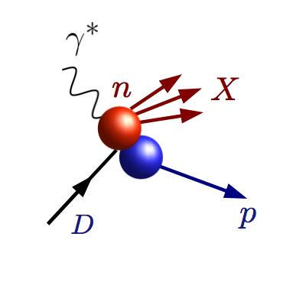
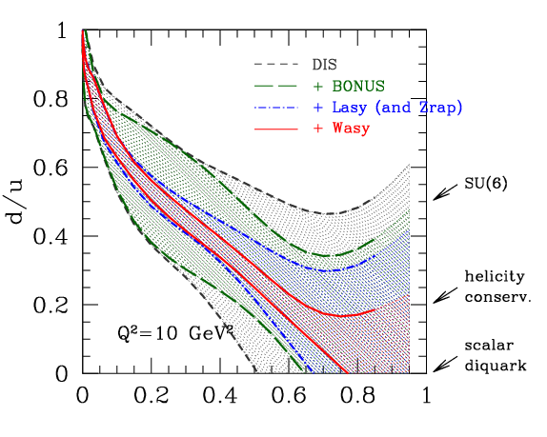
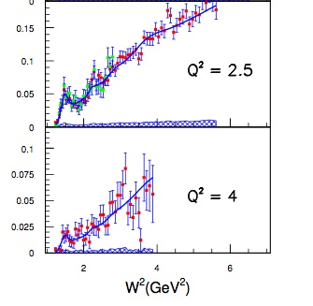
Down quarks at large x: the elusive d/u ratio
The uncertainty of the d parton distribution function (PDF) has been a longstanding issue
Significant PDF uncertainty reduction recently achieved by “CJ” (CTEQ-Jefferson Lab) Collaboration
CJ global PDF fit includes Hall C DIS and now also Hall B BONuS neutron data
Continued reduction planned for 12 GeV era – will be a solved problem
BONUS Full Results: Phys. Rev. C90 (2014) 059901

Slide 7
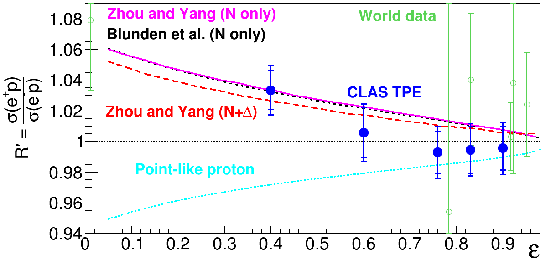
Exploring Proton Structure with Electrons and Positrons
Proton electric form factor G_{E}^{p}, describes proton charge distribution.
There is a discrepancy between G_{E}^{p} measurements with polarized and unpolarized electrons.
Mixed electron and positron beam was produced in Hall B to measure elastically scattered events.
Complementary experiments at VEPP-3 at Novosibirsk and OLYMPUS at DESY used sequential beams.
Unpolarized Measurements
Polarized Measurements
The e⁺p and e⁻p cross section ratio versus
virtual photon polarization ε at Q² = 1.5 GeV².
Big discrepancy is possibly due to two photon exchange, which can’t be calculated exactly.
Comparing electron and positron scattering off protons directly measures the two photon exchange correction.
Positron to electron (e⁺p/e⁻p) ratios agree with hadronic two photon exchange calculations
Would resolve proton form factor discrepancy up to Q² ~2.5 GeV².
D. Adikaram et al. (Jefferson Lab CLAS Collaboration), Phys. Rev. Lett. 114 062003 (2015).
DOI: http://dx.doi.org/10.1103/PhysRevLett.114.062003

Slide 8
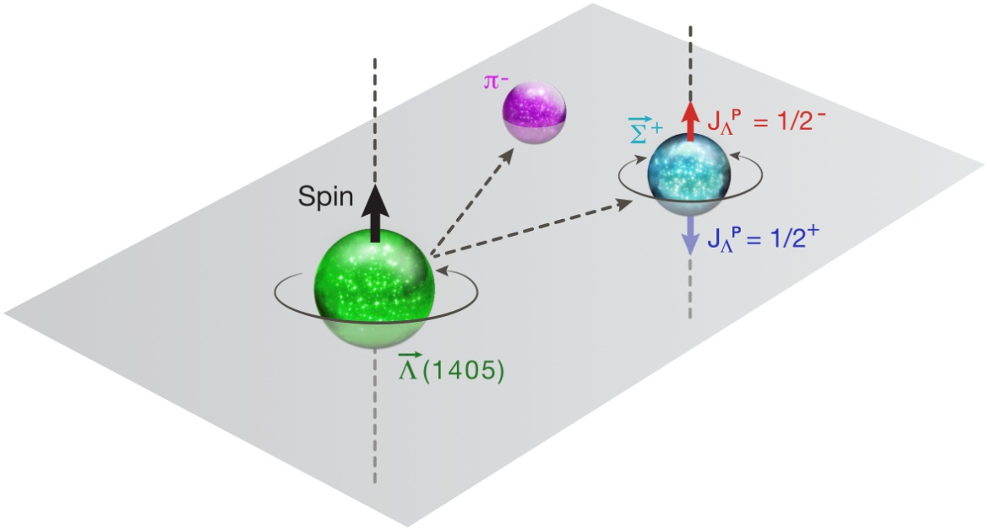
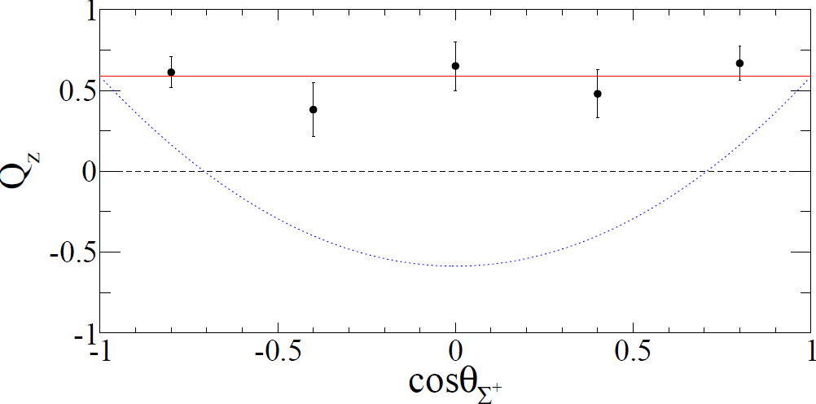


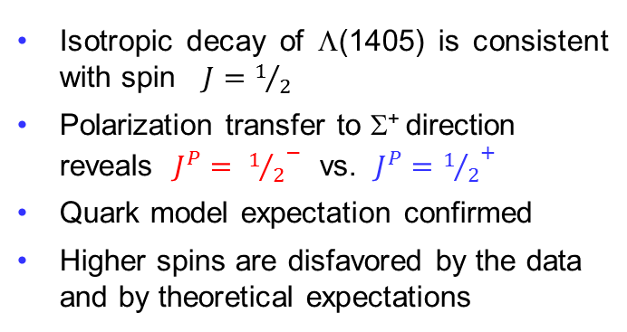




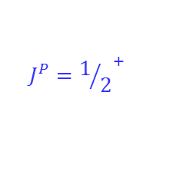
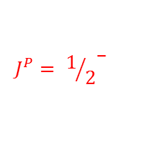
Spin and Parity of the Λ(1405) Baryon
Λ(1405) is a well‐known hyperon (PDG Status: )
Spin-Parity, J^{P}, has never been definitively measured
Λ(1405) created polarized via photoproduction in liquid hydrogen & detected in CLAS
$$\overset{→}{\text{L}}$$
$$\overset{→}{\text{L}}$$
$$\overset{→}{\text{S}}$$
γ + p → K⁺ + (1405),
(1405) → ⁺ + π⁻
(1405) → ⁺ + π⁻
$$\overset{→}{\text{L}}$$
$$\overset{→}{\text{S}}$$
$$\overset{→}{\text{S}}$$
⁺ → p + π⁰
$$J^{P}= {1/2}^{−}$$
Isotropic decay of $\text{L}$(1405) is consistent with spin $J=1/2$
Polarization transfer to Σ⁺ direction reveals $J^{P}= {1/2}^{−}$ vs. $J^{P}={1/2}^{+}$
Quark model expectation confirmed
Higher spins are disfavored by the data and by theoretical expectations
$$J^{P}={1/2}^{+}$$
K. Moriya, R. A. Schumacher et al. (CLAS Collaboration), Phys. Rev. Lett. 112 082004 (2014).
Selected as an "Editors' Suggestion" by PRL

Slide 9
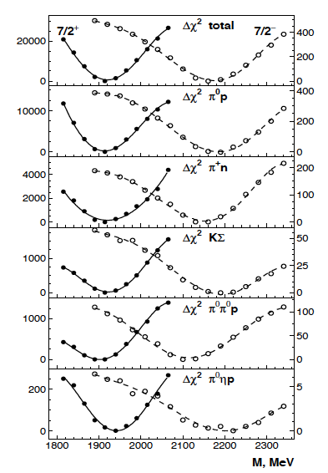
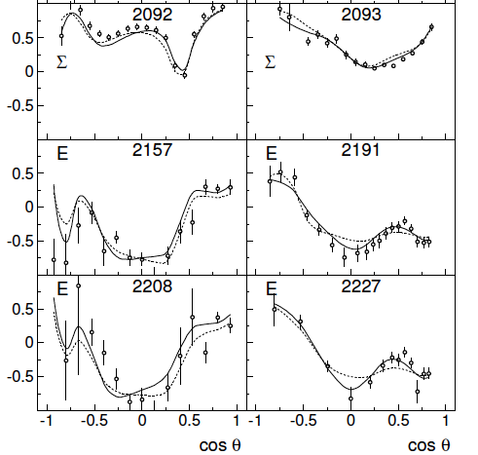
No Restoration of Chiral Symmetry Breaking at High Mass
Breaking of chiral symmetry at low energies gives rise to large mass gaps for mesons and baryons. At higher energies, states have been observed where parity partners have nearly degenerate masses. This led to conjecture that, for highly excited states, chiral symmetry may be restored.
γp → pπ⁰
γp → nπ⁺
Polarized beam asymmetry and double beam-target polarization asymmetry results at CLAS and CBELSA.
A.V. Anisovich, et al. (w. Bonn/Gatchina group), arXiv 2015, submitted to PRL
Mass of Δ(2200)7/2⁻ was established at 2176 ± 40 MeV, which is 200 - 250 MeV higher than the mass of its parity partner Δ(1950)7/2⁺. This rules out restoration of chiral symmetry for baryons at such masses.
Δ(1950)7/2⁺
Δ(2200)7/2⁻
Strong signal of Δ(2200)7/2⁻ (*)

Slide 10
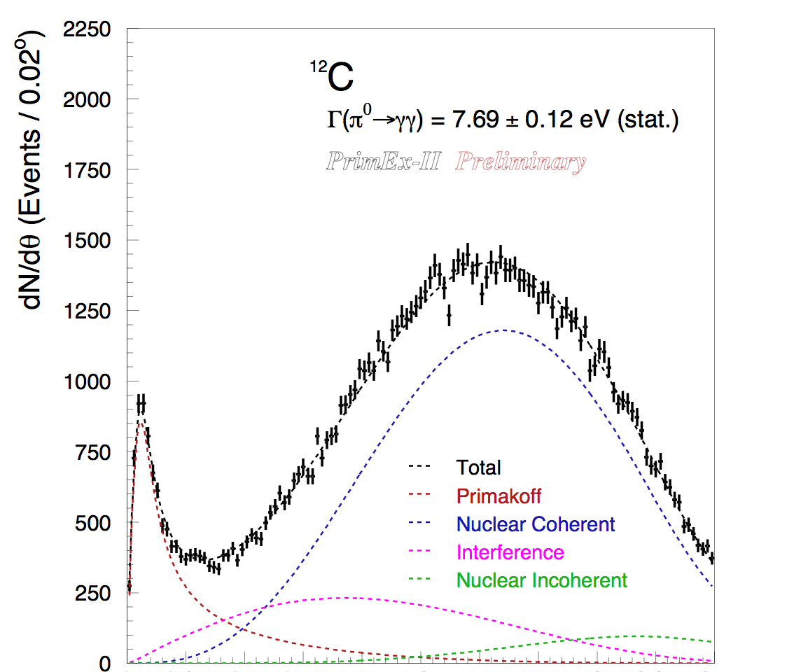
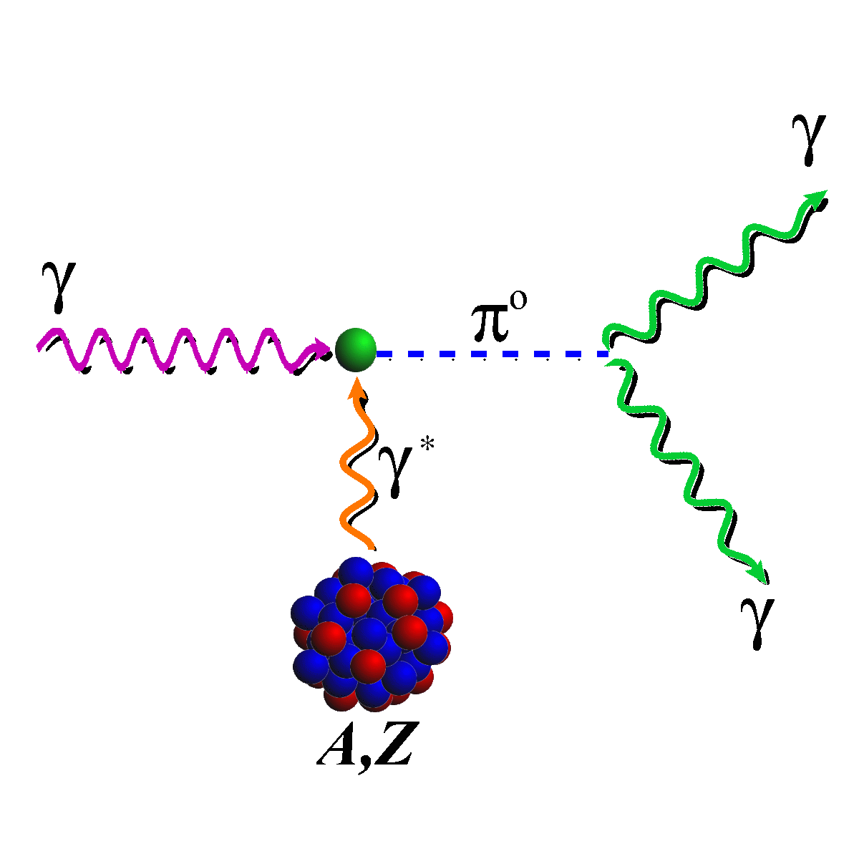
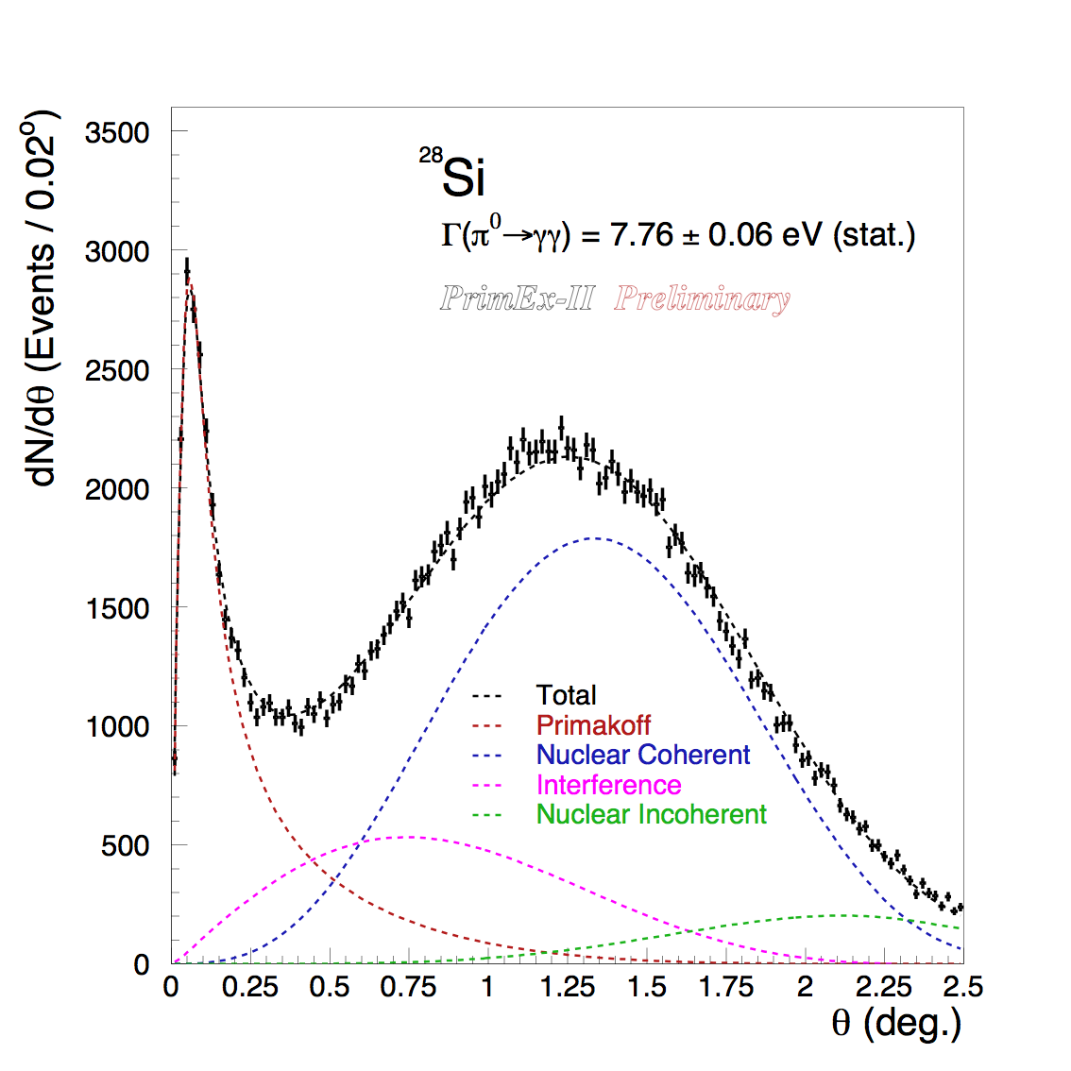
PRIMEX-II – Measurement of the π⁰ Lifetime
π⁰→γγ proceeds primarily via the chiral anomaly in QCD.
The anomaly prediction is exact for massless quarks.
Precision measurement of Γ(π⁰→γγ) provides a stringent test of low-energy QCD.
Γ(π⁰→γγ) = 7.74 ± 0.06(stat.) ± 0.12(syst.) eV
1.7% total uncertainty
Another independent analysis is on the way.

Slide 11
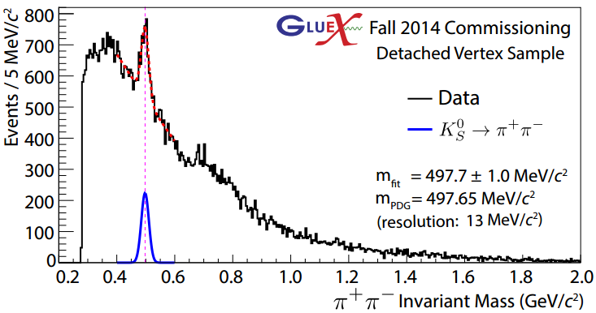
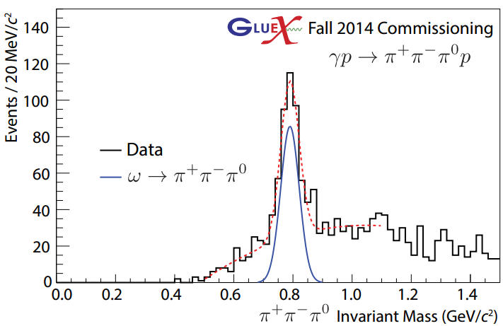
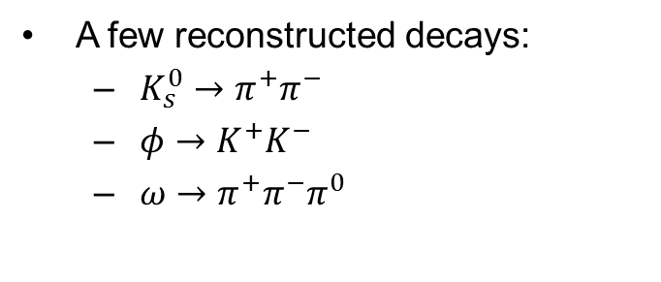
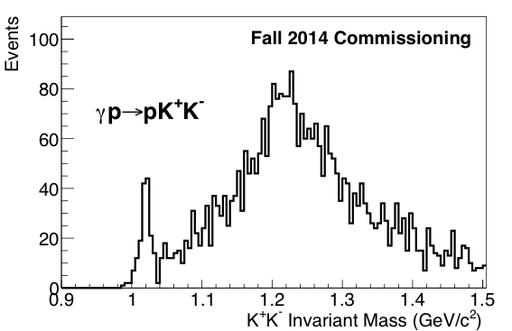



GlueX: Early Detector Commissioning Ongoing
For far more see presentation of Justin Stevens
Fall 2014 first beam to GlueX!
$$K_{s}^{0}$$
Using a CH2 target
A few reconstructed decays:
  $K_{s}^{0}→π^{+}π^{−}$
  $φ→K^{+}K^{−}$
  $ω→$ $π^{+}π^{−}π^{0}$
$$ϕ$$
$$ω$$

Slide 12
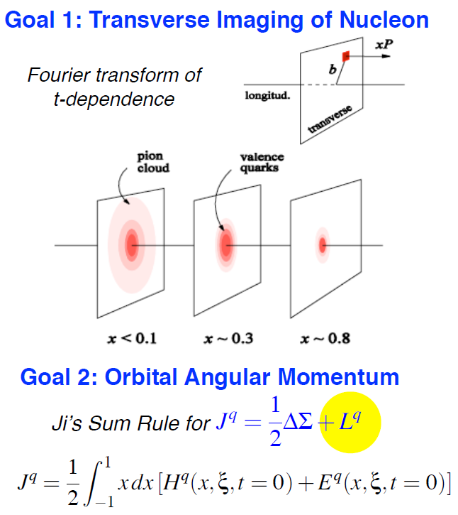
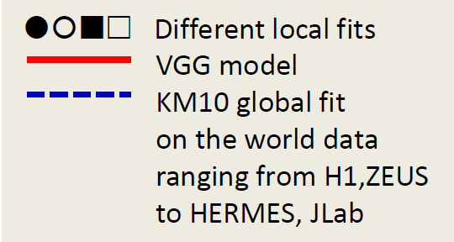
Hard Exclusive Processes → GPDs
The First Crude Images - the GPD H in Im DVCS
Simplest process:
e + p → e’ + p + γ (DVCS)

Slide 13
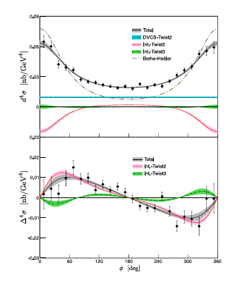
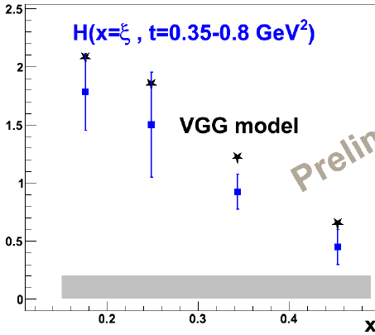
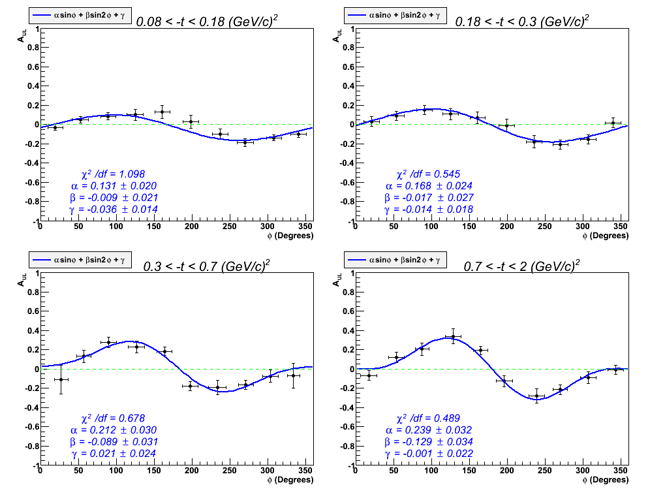
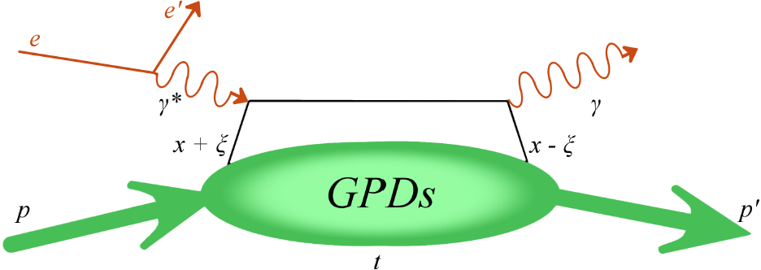
Extracting GPD H from DVCS
New precision data from Hall A and CLAS
E. Seder et al., Phys. Rev. Lett. 114, 032001 (2015)
H. S. Jo et al., arXiv:1504.02009, subm. PRL (2015)
M. Defume et. al., arXiv:1504.05453 (2015)
Extraction of GPD H(x=ξ,t) in LO/twist-2 from:
Preliminary results of A_{UL}, A_{LL} w/ polarized target
Absolute DCVS cross sections σ
DVCS cross section (Hall A)
VGG model
DVCS/BH target asymmetry A_{UL}(CLAS)

Slide 14
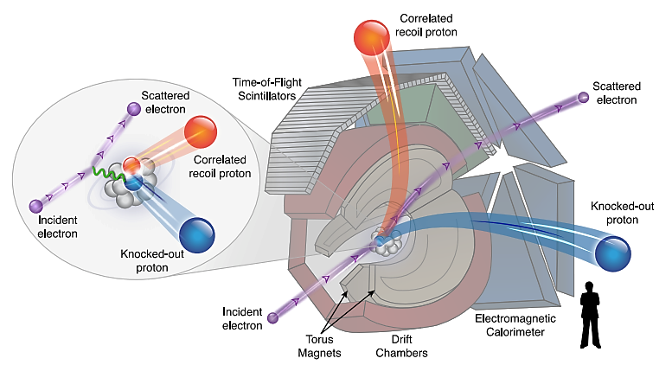
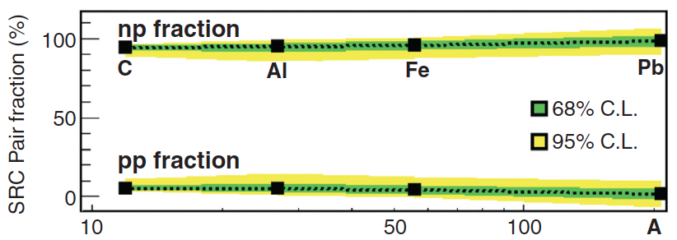
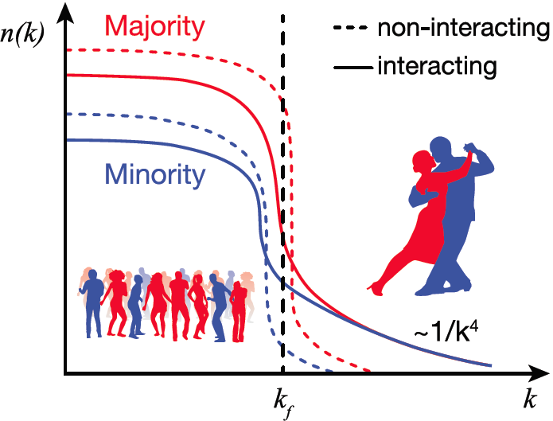
Momentum Sharing in Imbalanced Fermi Systems
O. Hen et al., (Jefferson Lab CLAS Collaboration ), Science 346 (2014) 614
Selected for Science Express (16 October 2014)
For heavy nuclei, N (#neutrons) > Z (#protons)
For noninteracting Fermi gases, neutrons would dominate at all momenta, even k>k_{F}
In reality, short range nucleon-nucleon correlations dominate the population at k>k_{F}
Isospin dependence of the nucleon-nucleon interaction implies equal numbers of protons and neutrons at k>k_{F}
Experimental Result:
CEBAF Large Acceptance Spectrometer (CLAS)
This has implications for the equations of state of neutron stars and atomic interactions in ultra-cold atomic gases.
Notes:
Bob edited.

Slide 15
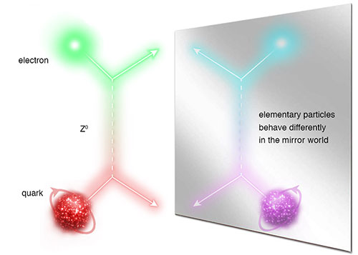
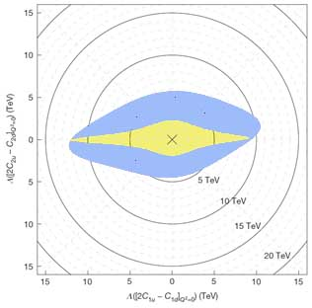
Measurement of the Parity-Violating Asymmetry in eD Deep Inelastic Scattering
Nature 506, 67–70 (06 February 2014)
The Jefferson Lab PVDIS Collaboration
See also News & Views, Nature 506, 43–44 (06 February 2014)
Z⁰
Longitudinally Polarized Electron Scattering from Unpolarized Deuterium
Precise determination of the effective electron-quark weak coupling combination 2C_{2u} – C_{2d} , five times more precise than previous measurement.
Combined with previous experiments like Qweak, first non-zero C_{2q} (at 95% confidence level).
Provides a mass exclusion limit (Λ) on the electron and quark compositeness and contact interactions of ~5 TeV.
JLab PVDIS
SLAC E122

Slide 16
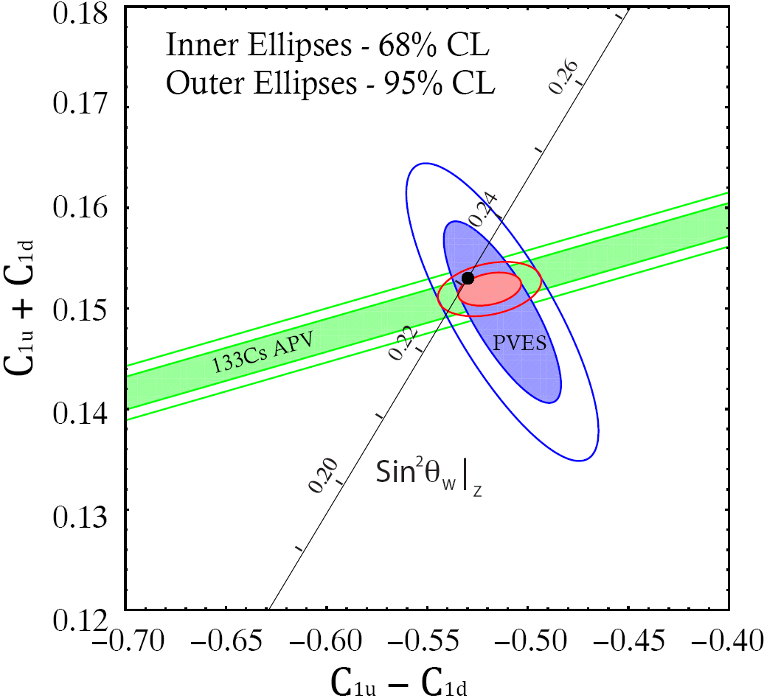
Qweak Commissioning Run - PRL 111,141803 (2013)
Instrumentation paper: NIM A781, 105 (2015)
C_{1u} = -0.184 ± 0.005
C_{1d} = 0.336 ± 0.005
Correlation. coef. -0.98
(only 1/25th of data)
APV + PVES
Combined Result
SM
Q_{W}(p) = -2(2C_{1u} + C_{1d}) = 0.063 ± 0.012
(only 1/25th of data)
SM value = 0.0710(7)
Q_{W}(n) = -2(C_{1u} + 2C_{1d}) = -0.975 ± 0.010
(only 1/25th of data)
SM value = -0.9890(7)
25x more production data still being analyzed, final result 2016

Slide 17
Qweak - 25x More Data in Runs 1 & 2 to Un-blind!
Schedule: September Decision point to commit to un-blinding
January 2016 Final Result
April 2016 Results presented at the Spring APS meeting. The final result will consist of run 2 (~70% of all data) and run 1 (~30%).

Slide 18
New Staff and Postdoctoral Appointments 2014-15
Name of Staff | From | Group | Comment
Gagik Gavalyan | ODU | Division | Spearheaded the CLARA-based data mining effort – task is to coordinate the software amongst Halls, presently working with Hall B on folding in tracking efforts within CLARA
Sergey Furletov | Juelich | Hall D | One of recent hires of Hall D, with strong expertise in online and data acquisition, and in charm production physics
Justin Stevens | MIT | Hall D | Replacement of Yi Qiang in Hall D, will be responsible for the planned DIRC-based Hall D Cherenkov detector.
James Maxwell | MIT | Target | Replacement of Josh Pierce in Target Group, with expertise in polarized targets and in 3He polarized source development.
Markus Diefenthaler | UIUC | MEIC | Term position supported by Commonwealth of Virginia funds. Strong familiarity with TMDs (from HERMES), and expertise from SeaQuest.
Postdoctoral Appointments (typical two per Hall)
Hall A | Luke Meyers, Dasuni Adikaram
Hall B | Charles Hanretty, Nathan Baillie
Hall C | Simona Malace, Buddhini Waidyawansa
Hall D | Paul Mattione, open (search ongoing)

Slide 19
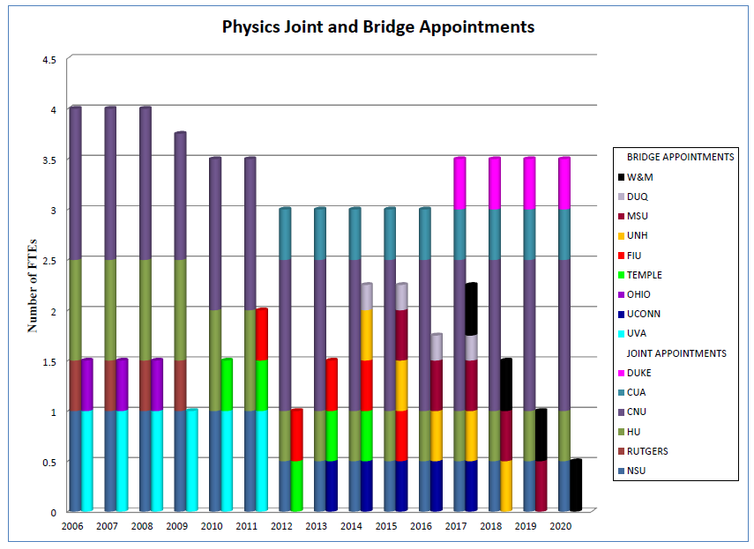
Joint & Bridged Appointments

Slide 20
Joint and Bridged Appointments
Joint/Bridged | Name | University | FTE | Hall
Joint | Carlos Salgado | Norfolk State University | 0.5 | D
 | Michael Kohl | Hampton University | 0.5 | C
 | Tanja Horn | Catholic University | 0.5 | C
 | Ed Brash | Christopher Newport U | 1.5 | C
 | Robert Fersch |  |  | B
 | Dave Heddle |  |  | B
 | Peter Monaghan |  |  | A
Bridged | Lei Guo | Florida International U | 0.5 | D
 | Andrew Puckett | University of Connecticut | 0.5 | A
 | Patricia Solvignon | University of New Hampshire | 0.5 | C
 | Lamiaa El Fassi | Mississippi State University | 0.5 | B
 | Fatiha Benmokhtar | Duquesne University | 0.25 | B
Expect two new searches to start FY16
These four CNU faculty split their research time so count as 3 from JLab’s view

Slide 21
Joint & Bridged Appointments – some highlights
Dave Heddle (CNU) instrumental in CLAS12 software development
Ed Brash (CNU) represents Users Group on Director’s Safety Council, very valuable input related to student safety and mentoring
Tanja Horn (CUA) member of the writing committee of the EIC White Paper and lead of the Neutral Particle Spectrometer development
Carlos Salgado (NSU) authored a Physics Reports in 2014
Patricia Solvignon (UNH) received Early Career Award 2015
Andrew Puckett (UConn) received Early Career Award 2015

Slide 22
12 GeV – Software and Computing Reviews
Convened by R. McKeown with both IT and Physics Division
Committee: Torre Wenaus (BNL/ATLAS – Chair)
David Nathan Brown (LBL/Babar) (absent in 3rd review)
Sergei Gerassimov (TU Muenchen/COMPASS)
Chris Jones → Elizabeth Sexton-Kennedy (FNAL/CMS)
Martin Purschke (BNL/PHENIX)
Purpose: To ensure that detector software will be ready for science, facilitating timely reporting of physics results for the 12 GeV program.
Meeting | Date | Overall High-Level Comments
First | June 7-8 2012 | Good feedback, positive experience
Second | Nov. 25-26 2013 | Many positive comments on progress, on combining Halls A/C software, on Hall D challenges, on Hall B/CLARA cloud computing framework
Third | Feb. 10-11 2015 | Again very positive, Halls are on track – GlueX data analysis visible evidence! (but GlueX should move to GEANT4/GEMC)
  For Hall B/CLARA see presentation of V. Ziegler on CLAS12 Analysis Plans

Slide 23
Cryogenic Capability Planning
End Station Refrigerator concerns:
1) Aging (~40 year old) refrigerator introduces high risk for cryogenic operations in Halls A, B and C
2) Does not provide cryogenic capacity for effective experimental program (requires warm-up/cool-down of SC magnets when alternating Halls A and C)
Science impact examples
Can not reach Hall multiplicity of 3 due to reduced flexibility, max is ~2.5
Can not run pion form factor in Hall C and PREX in Hall A together
Can not run MOLLER with 5 kW cryogenic target
To reduce risk of Major Disruptions to Experimental Hall Operations and provide the required cryogenic capacity, an End Station Refrigerator upgrade is required.
→ With support from DOE/NP, this is proposed as an $8M, 3-year SLI (Science Laboratories Infrastructure) project to upgrade the end station cryogenic plant facility.

Slide 24
Experiment Readiness Reviews
Experiment Systems Readiness Process has been used effectively for
all JLab experiments or equipment since start of experiments in 1995
Revisited experiment systems readiness process, e.g.
    Updated safety documentation and Hall safety walkthrough to make as generic as possible for all Halls (A-D)
    - Introduced emergency response guidance for each experiment
    - Included decommissioning plans more explicitly
Experiment Readiness Rev (ERRs) used as part of Accelerator Readiness Rev (ARRs):
Hall A ERR Dec 9, 2013 Folded into ARR Phase II
Hall D ERR Jul 1/2, 2014 (to prepare for Hall D Start of Operations)
HPS/Hall B ERR Jul 10, 2014 (ERR required to support potential engineering run)
Two ERRs above will be folded into ARR Phase III
To do: ERRs for Hall B/CLAS12 and Hall C
ERRs also used as hand-off from 12 GeV Upgrade Project to Physics Division
More information on process for specific examples (Hall C HB, Hall D solenoid) in presentation of J. Gomez

Slide 25
Hall D Experiment Readiness Review
July 1 & 2, 2014
Committee [review scope]
Roger Carlini [chair, machine protection]
Arne Freyberger [accelerator operations]
Dave Kausch [fire protection]
Todd Kujawa [EH&S]
Henrik von der Lippe (LBNL) [electronics]
Bert Manzlak [EH&S]
Howard Pfeffer (FNAL) [engineering/magnet]
Bernd Surrow (Temple U) [detector]
Flemming Videbaek (BNL) [detector]
Vashek Vylet [radiation control]
Given that this is a new Hall, a mix of Subject Matter Experts and External Technical Experts
Report feeds into Accelerator Readiness Review Phase III (Experiment Readiness Review process itself was reviewed and o.k.’d at ARR II)

Slide 26
Enhancements beyond 12-GeV Upgrade
• Hall A DVCS Calorimeter (France - Orsay) installed
• Hall A SBS – ongoing (Capital Equipment (CE))
• Hall A SBS GEMs (Italy INFN, UK), Hadron Cal. (CMU+INFN) ongoing (ops)
• Hall A pre-R&D toward PV (MOLLER magnet concept, with MIT) ongoing (ops)
• Hall A SOLID (China, Temple, Duke, ANL, …) ongoing (magnet - CE)
• Hall A APEX septum magnet (Canada, Stony Brook) complete
• Hall B longitudinally polarized target (ODU …, NSF/MRI) ongoing (infrastr. - CE)
• Hall B forward tagger (Italy INFN & NSF/MRI) near-complete
• Hall B RICH sector(s) (Italy INFN, Chile) ongoing (PMTs, materials - CE)
• Hall B MicroMegas (France - Saclay) ongoing
• Hall B Central Neutron Detector (France - Orsay) complete
• Hall B Heavy Photon Search (HPS) (DOE HEP, France, INFN) installed/used for run
• Hall B H Gas Target for Proton Charge Radius (NSF/MRI) near-complete
• Hall C Kaon Detection System (CUA …, NSF/MRI) complete
• Hall C Backward nucleon detection system (Israel/ODU) ongoing
• Hall C Neutral-Particle Spectrometer (US/France/UK/Armenia & NSF/MRI) started
• Hall D PID/Cherenkov system (US) pre-R&D/planning (CE)
• Hall D Discussions with China on calorimeter upgrades (UNCW, NCAT) planning
• LERF: DarkLight Phase-I Equipment (MIT …, NSF/MRI) ongoing
• Injector: Bubble Chamber for ¹⁶O(γ,α)¹²C inverse kinematics (ANL) ongoing
Very active and engaged (international) user community showing large interest in JLab-12 GeV science program
26

Slide 27
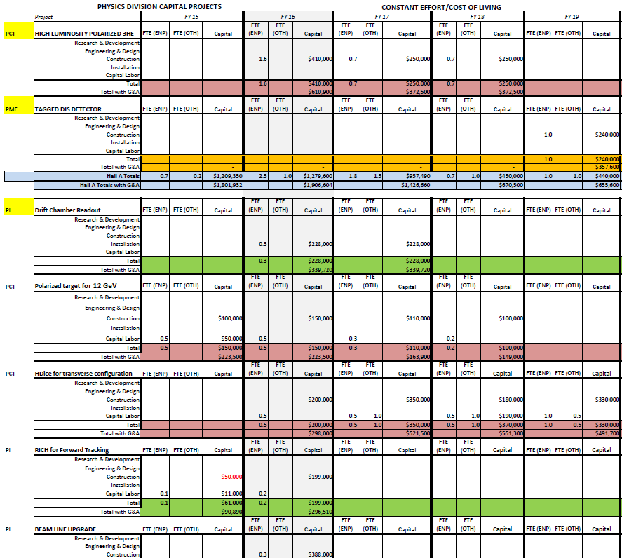
Capital Equipment Projects Planning
Developed planning tool for various Capital Equipment projects (SBS, RICH, DIRC, polarized 3He, HDIce for electron runs, Calorimeters, major experiments)
Added description of each project at request of DOE/NP (not shown here)
More on capital equipment projects in presentations of Thia Keppel and Patrizia Rossi
27

Slide 28
Leverage synergy amongst enhancements
• Hall B RICH sector(s) (Italy INFN, Chile) ongoing (PMTs, materials - CE)
• Hall D PID/Cherenkov system (US) pre-R&D/planning (CE)
October 13/14, 2015: Mid-project review of Hall B RICH &
Kick-off review of Hall D DIRC-based Cherenkov
Reviewers: Tom Hemmick (chair), Clara Matteuzzi, Curtis Meyer (Marco Contalbrigo),
Dave Abbott, Javier Gomez, Allison Lung, Bob Miller (Tim Whitlatch)
+ DOE/NP Observers
Multi-anode PMTs for RICH and development of associated readout electronics also of relevance for DIRC-based Cherenkov and future SoLID readout
• Hall C Neutral-Particle Spectrometer (US/France/UK/Armenia & NSF/MRI) started
• Hall D Discussions with China on calorimeter upgrades (UNCW, NCAT) planning
Recent NSF/MRI approved for NPS infrastructure (no new crystals)
PbWO4 detector R&D supported through JLab and EIC-related generic detector R&D
(CUA, IPN Orsay with U Giessen, BNL, Caltech, Yerevan)
PbWO4 also detector of choice for Hall D (inner) forward calorimeter upgrade & for
Jefferson Lab Eta Facility (JEF)
Some PbWO4 foreseen from JLab Capital Equipment (CE)
28

Slide 29
Generic Detector (Pre-)R&D
GEM detector pre-R&D
  University of Virginia, INFN
  Large GEM foil development and GEM electronics
  Applied in SBS project, relevant for future SoLID
Magnet pre-R&D
  MIT/Bates, U Manitoba
  Resistive magnet with odd number of coils
  Relevant for Parity Violating experiments such as MOLLER
DIRC-based Cherenkov pre-R&D
  Indiana University, MIT
  DIRC bar transportation, application of DIRC in GlueX configuration, focusing oil box/index of refraction studies
  To be applied in Hall D particle identification detector
PbWO4 pre-R&D
  Catholic University, IPN Orsay, Yerevan - also with U Giessen
  Development of radiation hard PbWO4 crystals, quality assurance – resuscitate the PbWO4 quality delivered at the time of CMS (and initially at PANDA)
  To be applied in Halls C (&A?) Neutral Particle Spectrometer, Hall D forward calorimeter upgrade, future Hall B/CLAS12 @ high luminosity?
Thia Keppel’s presentation
Patrizia Rossi’s presentation
29

Slide 30
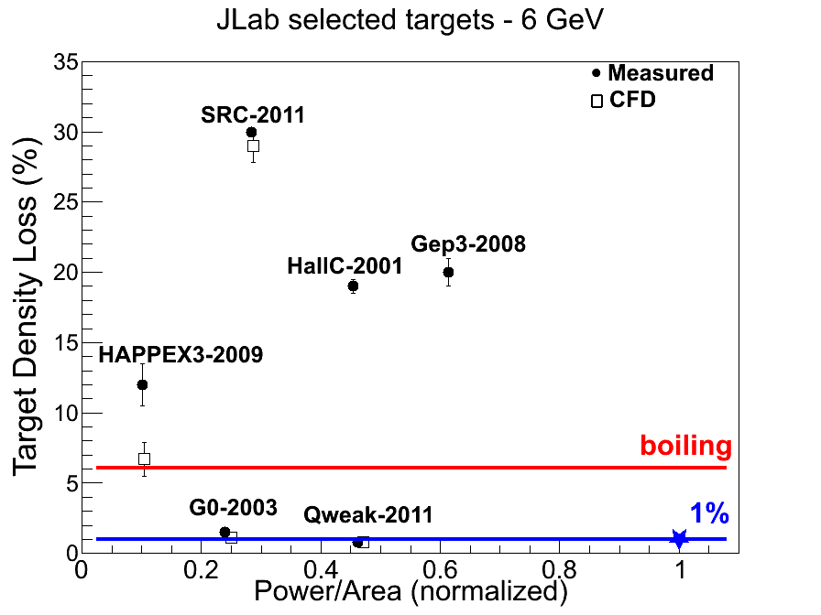
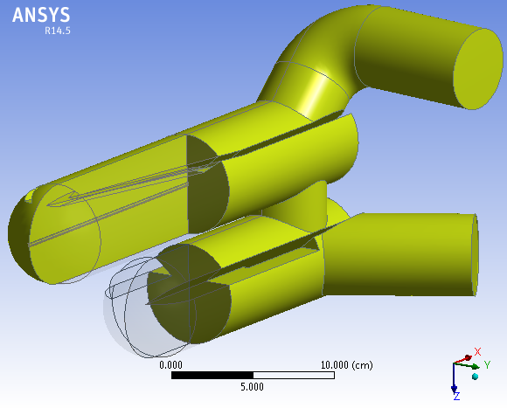
Generic Target R&D – Covrig Early Career Award
Computational Fluid Dynamics (CFD) calculations were first successfully used in understanding sources of cryogenic target boiling – resulting in density loss - caused by a high power electron beam impinging on a low-temperature cryogenic target. The calculations led to the success of the 2.5 kWatt power target used for Jefferson Lab’s Qweak experiment.
CFD calculations were then used to simulate earlier JLab cryogenic targets to try to understand their performance, with good agreement, and mitigate boiling in future designs.
A CFD facility has been set up and is used for generic CFD calculations of the standard hydrogen cryogenic targets and other targets. It will also be used to develop a 5 kWatt cryogenic target with as design goal a density loss less than 1% (blue star, used as the normalization point), and to assist in the high-power target design for MESA at Mainz.
CFD-based design of 2 target cells in one cell-block.
Impingent electron beam

Slide 31
Technology Transfer: Nuclear Medicine Imaging
Clear 3D Brain Scans of Moving Mice
AwakeSPECT System is based on technology developed by Jefferson Lab, with contributions from ORNL, Johns Hopkins University and University of Maryland:
  Utilizes custom-built gamma cameras, image processing system, infrared camera system and commercial CT system.
Journal of Nuclear Medicine, 2013
Three markers attached to the head of a mouse enable the AwakeSPECT system to obtain detailed, functional images of the brain of a conscious mouse as it moves around inside a clear burrow.
  Acquires functional brain images of conscious,
  unrestrained, and un-anesthetized mice.
  Documents for the first time the effects of anesthesia on the action of dopamine transporter imaging compound, and shows the drug was absorbed less than half as well in awake mice than in anesthetized mice.
  Can aid research into Alzheimer’s, dementia, Parkinson’s, brain cancers and drug addiction.
  See also presentation of D. Weisenberger on Detector Technology and Applications

Slide 32
Experimental Nuclear Physics Progress- Summary
Multiple science highlights since 2012 S&T review, including high-impact publications in Nature and Science
Multiple and successful key planning efforts to prepare for 12-GeV science and beyond
    - Computing and software preparations
    - Experiment Readiness Review (with high praise on process from Accelerator Readiness Review team members)
    Equipment and Capital Equipment project planning
    Detector (pre-)R&D projects
Leveraging synergy amongst equipment projects, detector (pre-)R&D, tech transfer and EIC efforts
Also tremendous progress on development of science case, integration of detector in interaction region, advancing simulations and engaging community for Electron-Ion Collider (see later presentation)

