Slide 1

Accelerator Overview
S&T Review 2015
Andrew Hutton

Slide 2
Outline
Accelerator Division Overview
CEBAF operations
Major accomplishments since the last S&T Review
Introduction to MEIC at Jefferson Lab
Overview of accelerator R&D
  SRF
  Accelerator physics
  Injector
Support for other projects: FRIB,LCLSII, HZB, CERN (US LARP & LHeC)
Education
IPAC’15 in Richmond

Slide 3
Accelerator Organization
Andrew Hutton
Associate Director
Fulvia Pilat (MEIC)
Deputy Associate Director
Ops – 47
Arne Freyberger
CIS – 9
Matt Poelker
CASA – 16
Mike Spata
SRF R&D – 17
Bob Rimmer
SRF Ops – 49
Joe Preble
Division Office
Evelyn Akers
Hari Areti
Steve Benson
Harry Fanning
TOTAL IN DIVISION | 154
Permanent | 149
Term | 4
Casual | 1
Graduate Students | 13
Notes:
EC revised

Slide 4
Accelerator Mission and Goals
The Accelerator Mission is to advance the capability of Jefferson Lab to carry out world-class nuclear science and, more broadly, to develop Jefferson Lab’s expertise in technologies associated with high-power superconducting linacs
The goals to achieve the mission deliver results in five areas:
Operate and upgrade the JLab accelerator facilities
Achieve all deliverables for FRIB and the LCLS II Projects, on schedule, under budget
Prepare for a Medium-Energy Electron Ion Collider (MEIC) at Jefferson Lab
Sustain Jefferson Lab’s core accelerator competencies to support DOE Office of Science projects and other partnerships
Attract and educate the next generation of accelerator scientists and engineers

Slide 5
Operate and Upgrade the JLab Accelerator Facilities
Operate 12 GeV CEBAF Nuclear Physics program (initiated)
Develop capabilities to support the CEBAF long-term experimental program (ongoing)
Deliverables for FY15
Operate CEBAF for funded weeks (includes 3 weeks of 12 GeV pre-ops)
  Planned 21 weeks; delivered 19.7 weeks (power event – Arne Freyberger’s talk)
  Deliver high-quality 5.5 pass beam to the Hall D for detector check-out
  Deliver 5.5-pass beam to Hall D and 4-pass beam to Hall A simultaneously
  Complete and install C50-12: remove worst C20 and start rebuild into C50-13
  Helium-process all C20 and C50 cryomodules that would benefit (ongoing)
  Complete dog-leg upgrade (AIP)
  Commission separators for 4 Hall capability in Q2FY15
  Complete new quarter cryomodule (AIP)
  Improve parity quality ahead of future experiments
  Develop non-invasive diagnostics
  Plan for upgrade of C20 LLRF to digital C50 system

Slide 6
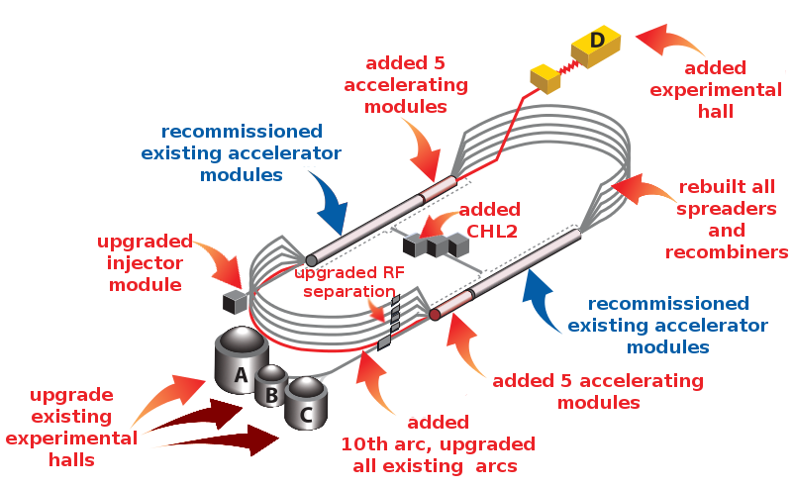
CEBAF and the 12 GeV Upgrade
More from Allison Lung

Slide 7
CEBAF Operations Accomplishments Since 2012
Successfully terminated the 6GeV program
Completed installation and check-out of all 12 GeV Project Accelerator components
Checked and signed off on >8,000 components as part of the Accelerator Readiness Review (ARR) process (12 GeV Project KPP)
Demonstrated 2.2 GeV/pass (12 GeV Project KPP)
Achieved 12GeV Project CD-4A deliverable in July-2014, months ahead of schedule
Delivered 5.5 pass beam to the Hall D dumplet (12 GeV Project KPP)
Initiated Hall D detector commissioning (12 GeV Project KPP)
Delivered simultaneous beam to three Halls (A, B, D)
More from Arne Freyberger

Slide 8
Present CEBAF Status
The Summer shutdown is ongoing; preparing for robust 12 GeV operation
Major activities are:
  Helium processing of every cavity to reduce RF trip rate from field emission at top energy
  Complete improvements to 11 GeV Separators to provide full energy separation
  Complete the pathlength chicane “dogleg” upgrade (AIP) to minimize the need to change arc orbit offsets or the Main Oscillator frequency
  Complete tunnel air conditioning so that the temperature in the Arc regions of the tunnel do not exceed the 45°C because of electronics in tunnel
  Repair the 2K cold box damaged in the power event
  Completing the Utilities Infrastructure Modernization (UIM) Projects to improve electrical power distribution and cooling tower upgrades, etc.
In the fall, CEBAF will be set up for 12GeV, 1100MeV/linac configuration will be setup following the same process used this past run
  All eyes will be on measuring emittance/energy spread growth and the SRF performance
In the spring, the plan is to support the Physics program at the design energy

Slide 9
Accelerator Improvement Projects
AIP work completed FY12
CHL Controls Upgrade – Improve reliability of Central Helium Liquefier controls
AIP work completed FY13
Injector Upgrade (Gun portion) – Install 200keV capable DC gun, operate for physics at 130keV to improve parity quality at high bunch charge
AIP work completed FY14
Injector Upgrade (R100) – Install, commission and operate R100, 100MeV capable cryomodule, to match Injector energy to 12GeV CEBAF
AIP work completed FY15
Dogleg Upgrade -- Restores CEBAF path length adjustment to pre-12GeV upgrade range (On track for completion by September 2015)

Slide 10
AIP – Future projects
AIP work planned for FY15 – FY19
Injector Upgrade – Upgrade the CEBAF Injector to further improve 12GeV parity properties of the beams
  Build ¼ Cryomodule – Establish uncoupled transport in the injector
  Integration – Commission the new ¼ cryomodule in the Upgrade Injector Test Facility (UITF). Upgrade CEBAF Injector components in the warm RF region to support 200keV operation
  Install the commissioned new ¼ cryomodule in CEBAF. Commission the complete upgraded injector, from the 200keV gun operation through the new ¼ cryomodule and R100.
Together, these projects will provide at least an order of magnitude improvement in parity quality of the electron beam – a JLab specialty

Slide 11
Simultaneous Beams to Four Halls
Idea from Reza Kazimi
A/B/C separator is located downstream
Beam to Halls
A
A
C
C
B
B
A
A
C
Accelerator
Frequency
1500 MHz
C
A
A
B
B
C
A
B
C
D
C
A
B
D
A
A
Hall Lasers
Hall A: 250 MHz
Hall B: 250 MHz
Hall C: 250 MHz
C
C
B
B
C
D
C
B
B
A
A
C
C
B
B
Hall D
Beam
Hall D: 250 MHz
(existing hall lasers run at 500 MHz)
5th Pass RF Separator Cavity
750 MHz
Four-Hall Operation!
(D+3)
New Hall D laser fills empty buckets at 250 MHz

Slide 12
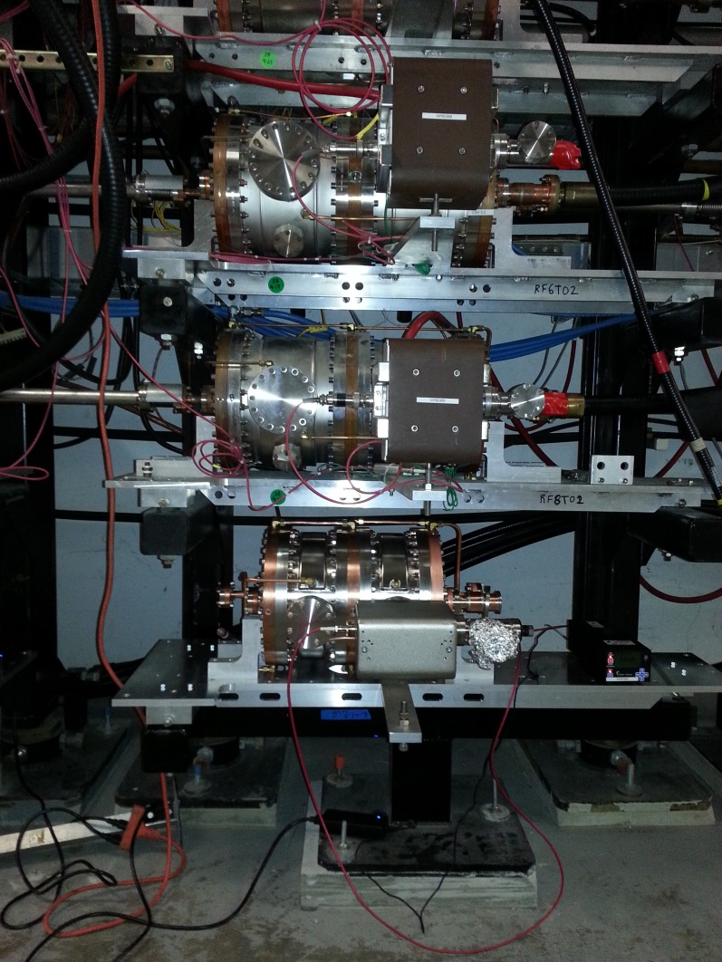
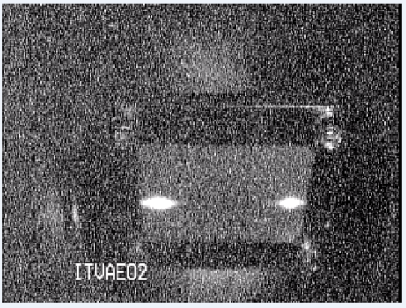
750MHz Separators Provide 11GeV capability
A & D beam separated on 5th pass at 9.6 GeV
500MHz
750MHz
The majority of the experiment proposals in Halls A,B &C require full 5-pass energy
The additional 750 MHz separators enable simultaneous high-energy operation to all 4 Halls

Slide 13
MEIC Update since 2012 S&T Review
Established a MEIC Organization at JLAB by the Lab Director (July 2014)
MEIC went through a significant performance and cost optimization (July – December 2014)
  Adopted PEP-II electron ring (magnets, vacuum chambers, RF)
  Adopted super-ferric magnets for ion and booster ring
  Consolidated pre-booster and high-energy booster in 1 ring
MEIC Design Report was prepared (August 2012), updated with a Design Summary (January, 2015)
MEIC was extensively reviewed for technical viability, reviews were positive
Baseline design and cost estimate presented at the EIC Cost review (January 2015), costs were accepted
Organized EIC14, The International Workshop on Accelerator Science and Technology for Electron-Ion Colliders at Jefferson Lab in with over 100 participants (March 2015)
Held the first MEIC Collaboration Meeting with collaborating institutions and industry (March 2015)
More from Rolf Ent

Slide 14
MEIC Organization
Hugh Montgomery
Bob McKeown
Cost Estimate
Leigh Harwood
Accelerators
Fulvia Pilat
Physics
Rolf Ent
Design
Yuhong Zhang
R&D
Fulvia Pilat
Facilities
Rebecca Yasky
Engineering
Tim Michalski
MEIC Organization established in July 2014
Funding: NP Accelerator R&D, JLAB re-direct, LDRD, SBIR, Commonwealth of Virginia

Slide 15
MEIC Planned Activities in FY15
Produce an MEIC Conceptual Design Report by 2017 to prepare for a down-select
  Advance the design of MEIC
  Develop engineering solutions for critical components
  Develop cost estimates for MEIC and future upgrades
  Collaborate with BNL and MIT on generic electron-ion collider R&D
Deliverables for FY15
  Study feasibility of re-using PEP-II machine components
  Study feasibility of 2.5 km ring with superferric magnets
  Finalize interaction region, non-linear corrections and polarization
  Complete preliminary design of circulator cooler
    Design started
  Optimization of design, cost and potential for upgrades
  Develop an initial cost estimate
  Initiate MEIC engineering studies
  Develop complete RF system requirements for the updated MEIC design
  Begin engineering the most challenging SRF cavities and components
    Design started

Slide 16
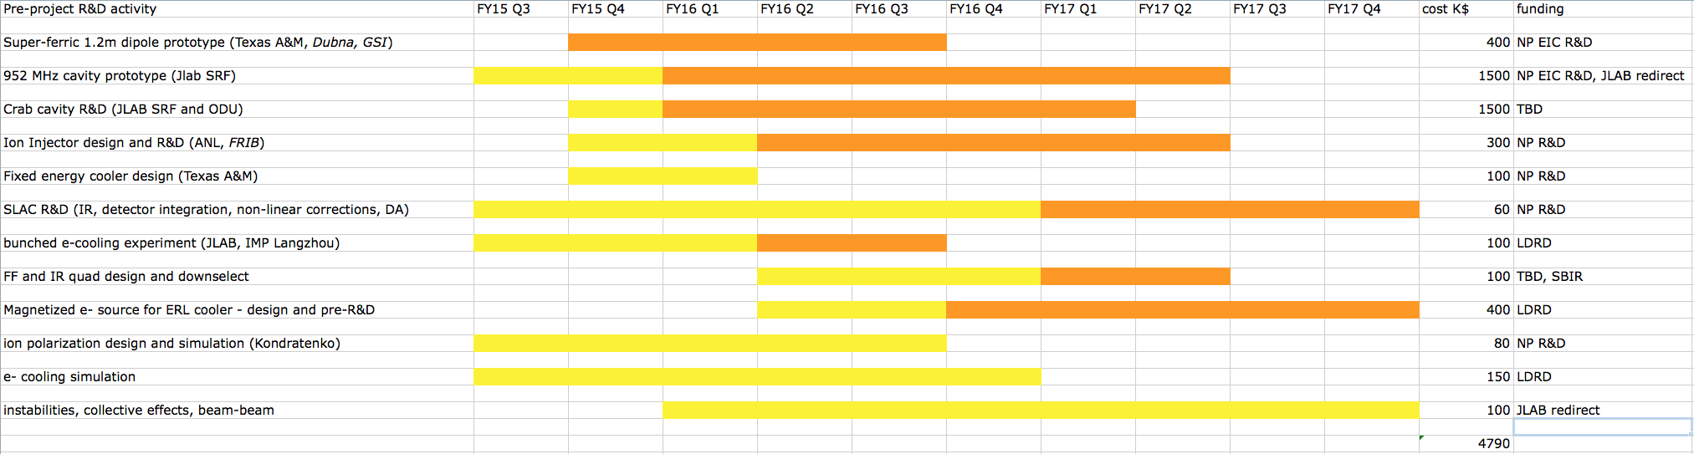
Preliminary Planned R&D FY15-17
R&D funded by NP EIC R&D
IR design, Non-linear corrections, PEP-II | SLAC Collaboration
Ion injector design optimization | ANL Collaboration
Ion complex polarization design | Collaboration Kondatenko
2 Post-docs for EIC design and R&D | 1 position filled, 1 in progress
Prototype C-I-C SF magnet (new grant) | Collaboration Texas & M
952 MHz cavity design and pre-prototypes (new grant) | JLAB SRF, ODU
Total proposed pre-project
R&D estimate < 5 M$
Reviews:
Super-Ferric magnets (external) June 4 2015
Crab cavity R&D (internal) June 9 2015
SRF R&D (internal) June 18 2015
MEIC engineering ongoing
Overall MEIC R&D review Aug 12 2015

Slide 17
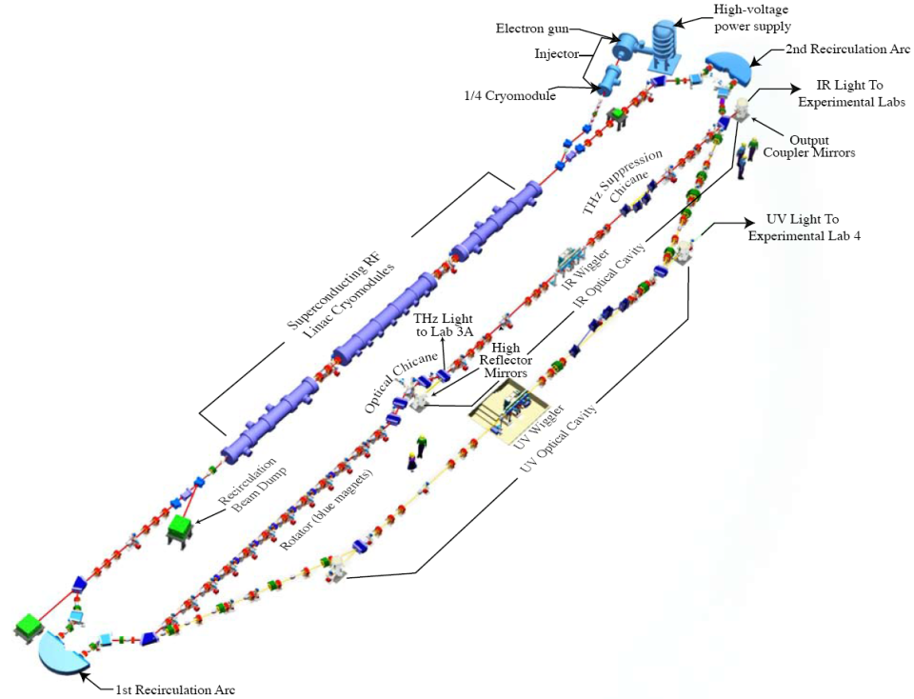
Future Missions for LERF (former FEL)
Unique Energy Recovery Linac (ERL) capability
Constructed and previously operated by ONR (>$100M investment)
Recent $3M upgrade and commissioning funded by Commonwealth of Virginia
JLab Leadership held Strategic Planning Retreat in January to assess future missions:
Under development:
  DarkLight (NSF MRI)
  FEL-based EUV Lithography Development
  Medical Isotope Production R&D
  Accelerator R&D:
  MEIC related
  Generic
  Still evaluating:
Low Energy NP Program
Positrons for materials science
More from Steve Benson in Breakout Session

Slide 18
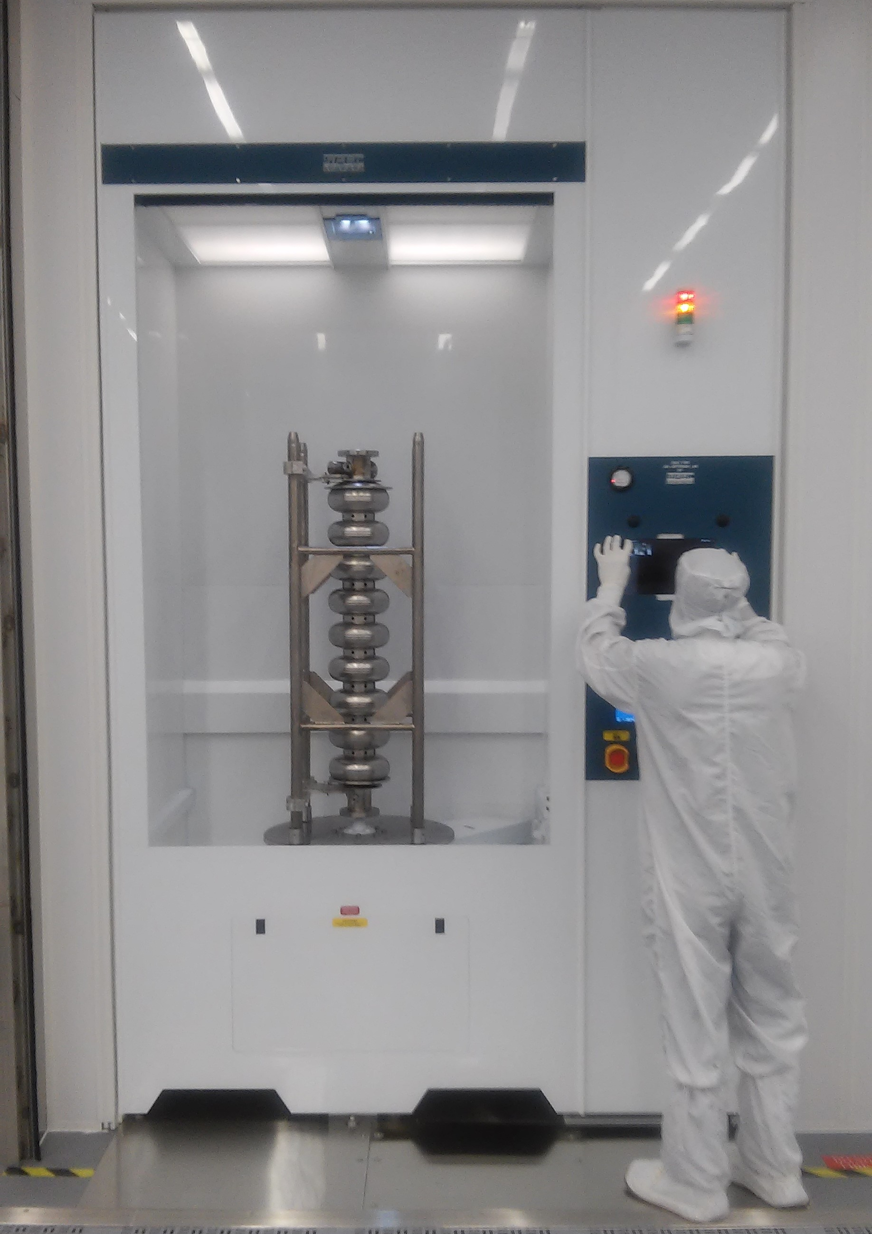
SRF Activities
SRF Facility upgrades
  New High Pressure Rinse tool
SRF R&D
  Understanding low Q0 in CEBAF cavities
  Thin films
WFO
  HZB
  CERN

Slide 19
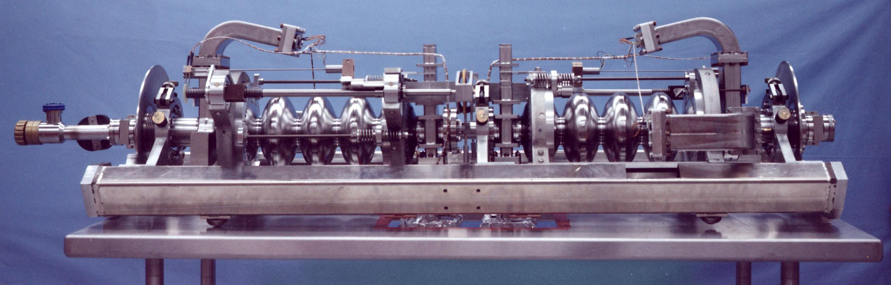
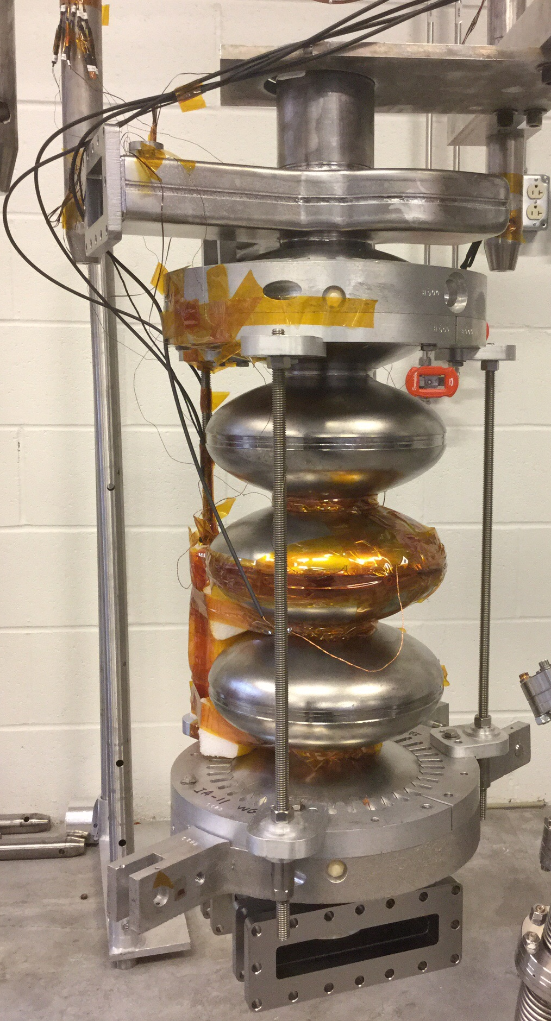
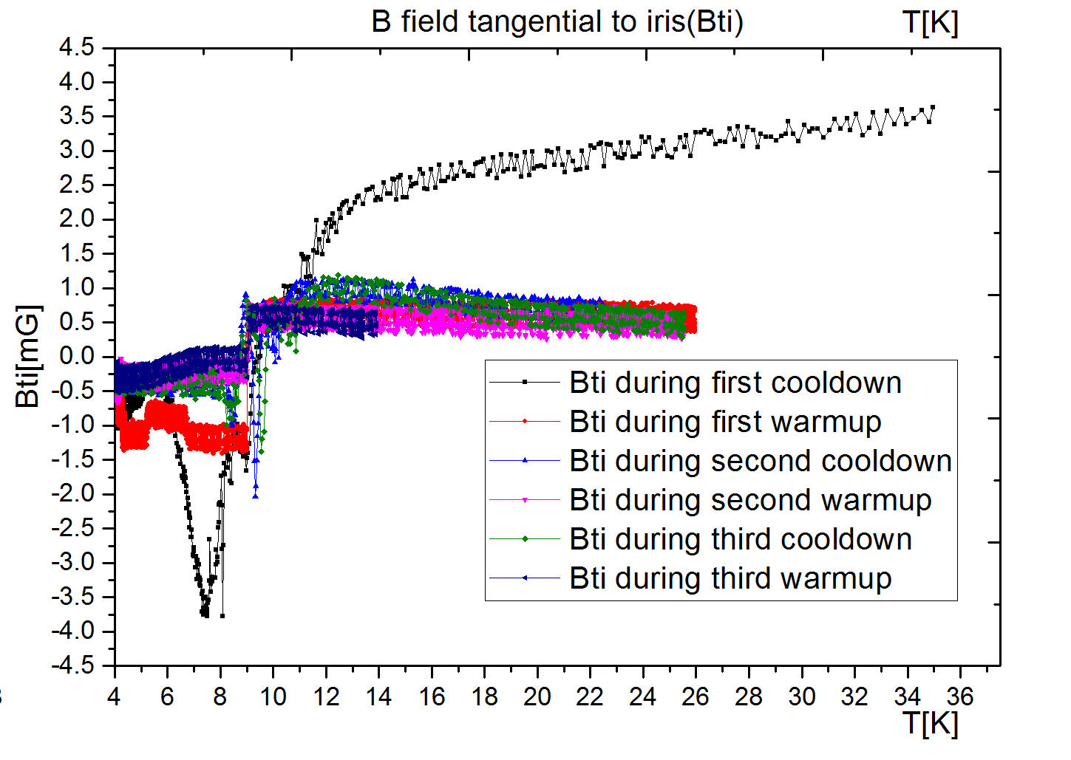
5-Cell CEBAF Cavities Low Q₀: Understanding, Cure
Purpose: Raise Q₀ of cavities installed in CEBAF, save operation cost and secure CEBAF energy reach
Previously:
Identification of frozen-flux effect as the source of low Q₀ in 5-cell cavities installed in CEBAF tunnel (a factor of 2 degradation as compared to vertical test).
“Discovery” of magnetized tuner components enclosed in the cold magnetic shield. The worst case is strut spring: 6 Gauss at contact.
Replacement strut springs implemented in C50-11.
Two more recommended solutions to be implemented in C50-12.
Thermally generated flux during initial cool down
Niobium cavity
After 20K warm up followed by
Re-cool down
magnetometers
Presently:
Examination of magnetic flux thermally generated inside the loop formed between niobium cavity and stainless steels rods
A potential “thermal therapy” is being developed for zero out the thermally generated flux.
Flux jump
near 9.25K,
Tc of Nb
Stainless steel rod
Series test of thermal current and generated flux using a 5-cell CEBAF cavity
Rongli Geng

Slide 20
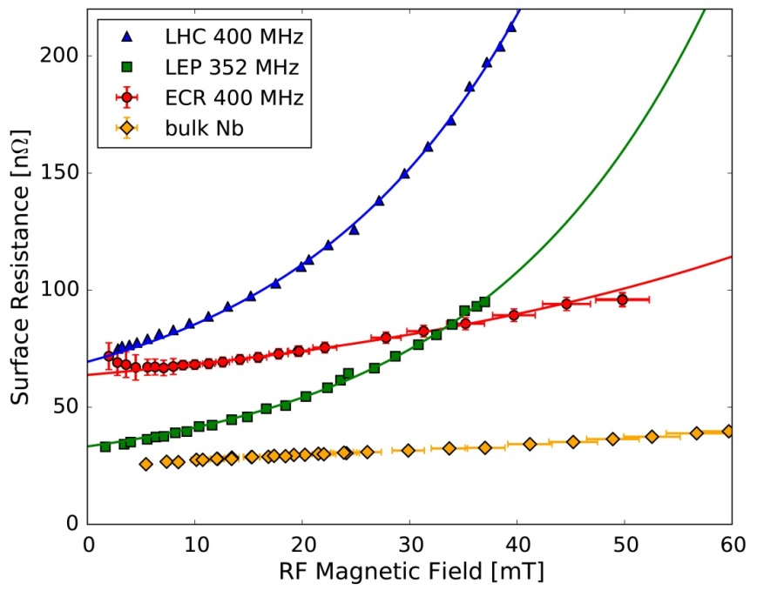
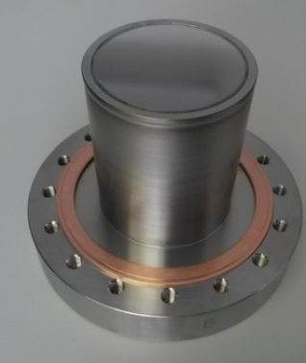
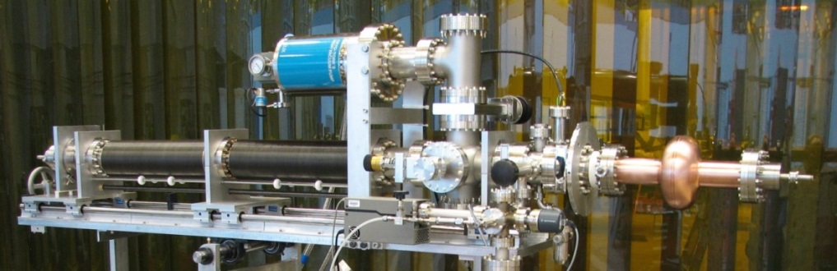
Development of Nb/Cu films by Energetic Condensation
Learning how to grow high quality crystalline Niobium films on Copper to replace bulk Niobium
Now producing Niobium films with higher purity and fewer defects than bulk Niobium
Collaborating with CERN for characterization of SRF properties
  Demonstrated lowest-yet non-linear losses (greatly reduced “Q slope”)
  Best controlled samples now under test
Migrating all lessons learned to new cavity deposition system with refinement/analysis of deposition conditions, film character, and RF performance
  Involving DOE Office of Science Graduate Student Research Award winner
Sample configuration for CERN RF test system
Anne-Marie Valente
Larry Phillips
First HiPIMS Nb/Cu cavity coated

Slide 21
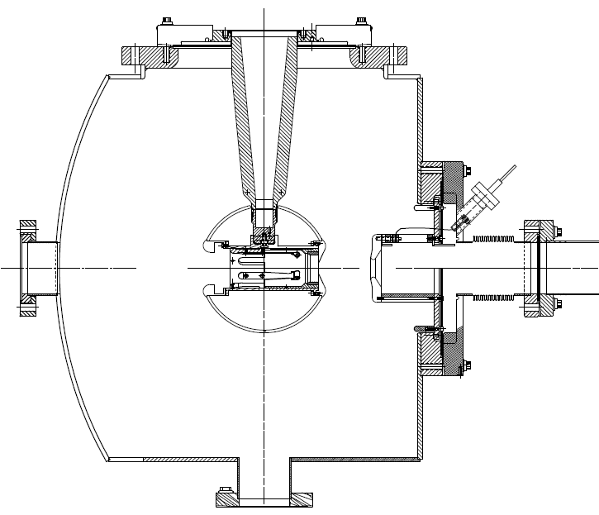
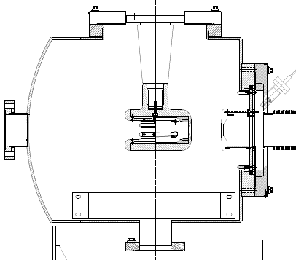
350 kV dc high voltage “inverted” Photogun
Inverted Load Lock Photogun:
CEBAF at 130kV
Spare gun at 200 kV
Will use either CsK₂Sb or
GaAs/GaAsP photocathode
unpolarized or polarized beam
Based on test results, we purchased doped R30 insulators, hope to be making beam at 350 kV this fall
Longer “R30” insulator
Spherical electrode
Thin NEG sheet moves ground further away
Maximum Field strength ~ 10 MV/m

Slide 22
CASA R&D
Accelerator Physics
  Lattice, interaction region and bunched beam cooler design for MEIC
  Detailed design studies for next generation Energy Recovery Linacs
Computational Physics
  Numerical code development for simulating field emission in waveguides (SLAC)
  Study of bunched beam electron cooling (LDRD)
  Study of suppression of Coherent Synchrotron Radiation driven effects (LDRD)
  Model development related to beam parity quality (CEBAF)
  Collective effects and tracking studies for MEIC (ODU Collaboration)
Diagnostics Development
  Laser-wire Beam Profile Monitor (BES Early Career Award)
  Large Dynamic Range Diagnostic System (BES Early Career Award)
  Bunch Length Interferometer
Research Experience for Undergraduates
  Supported 4 summer students
More from Pavel Evtushenko in Breakout Session

Slide 23
Support for Other Projects
FRIB
LCLS II
Helmholtz-Zentrum Berlin
CERN – LHeC and US-LARP

Slide 24
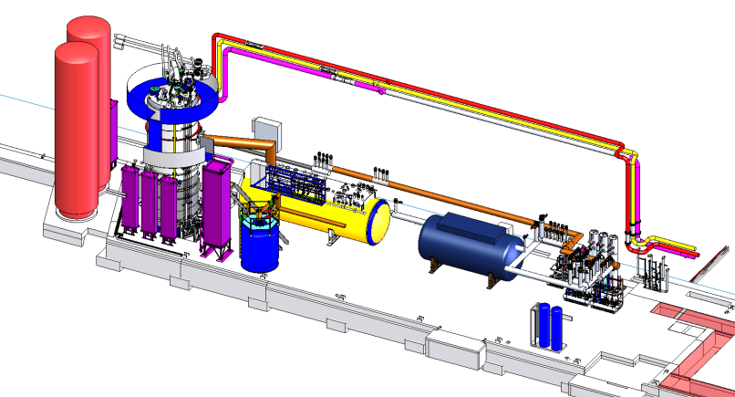
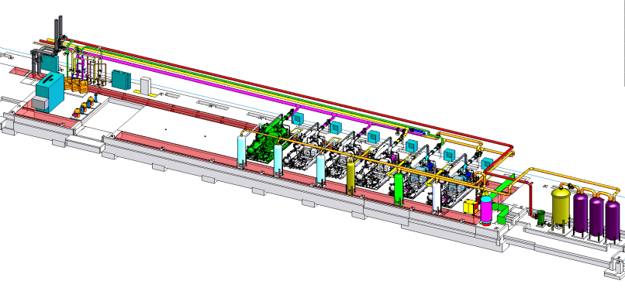
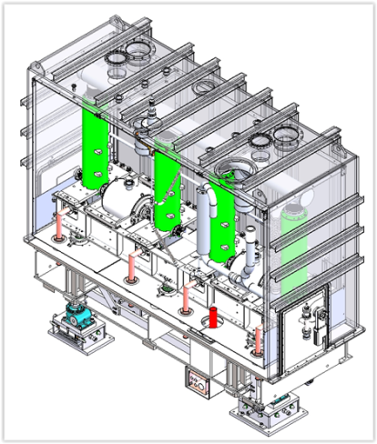
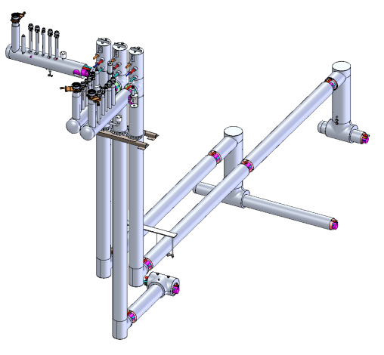
FRIB Cryogenic Support (Engineering Division)
Cryoplant and Distribution
  Overall layout
  Equipment design and procurement
  Training
  Commissioning
Cryomodule Design
  Vacuum shell
  Thermal and magnetic shielding
  Piping
  Component alignment
Contracts complete in 2018
More from Kelly Dixon in breakout session

Slide 25
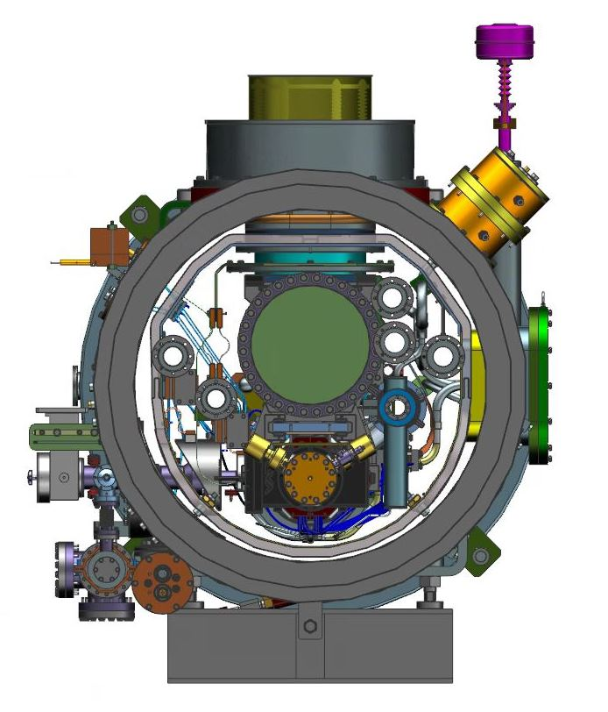
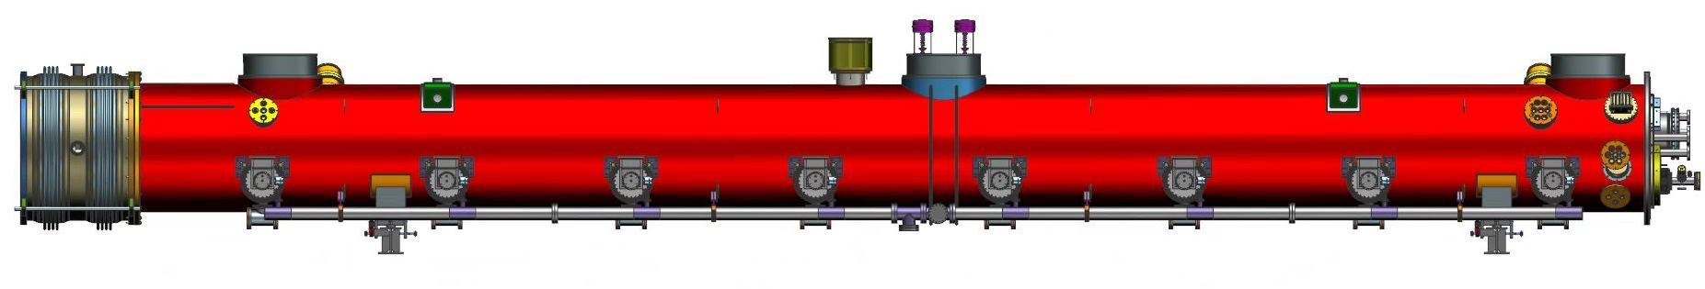
LCLS II
Accelerator Division is responsible for ~half the superconducting linac
SRF R&D group has validated new processing procedures
SRF Production Group has modified infrastructure for LCLS II cryomodules
Started the LCLS II prototype cryomodule production
Engineering Division is responsible for the cryogenic plants (there are now two full size plants)
More from George Neil in breakout session

Slide 26
Improving SRF Cavity Efficiency via Doped Materials
Learning how to minimize SRF losses (maximize cavity Q) via Nitrogen Doping of Niobium
Collaborated with FNAL and Cornell to validate High-Q process for LCLS-II
  Enabled >50% reduction in cryo-load compared with previous methods
  Now transferring the protocols to vendors
Systematically studying the doping protocols, material effects, and SRF properties
  Involving university collaborators (including graduate students) in detailed material characterization
  Beginning to interpret new RF performance in terms of latest basic SRF theory
Ari Palczewski
Charles Reece

Slide 27
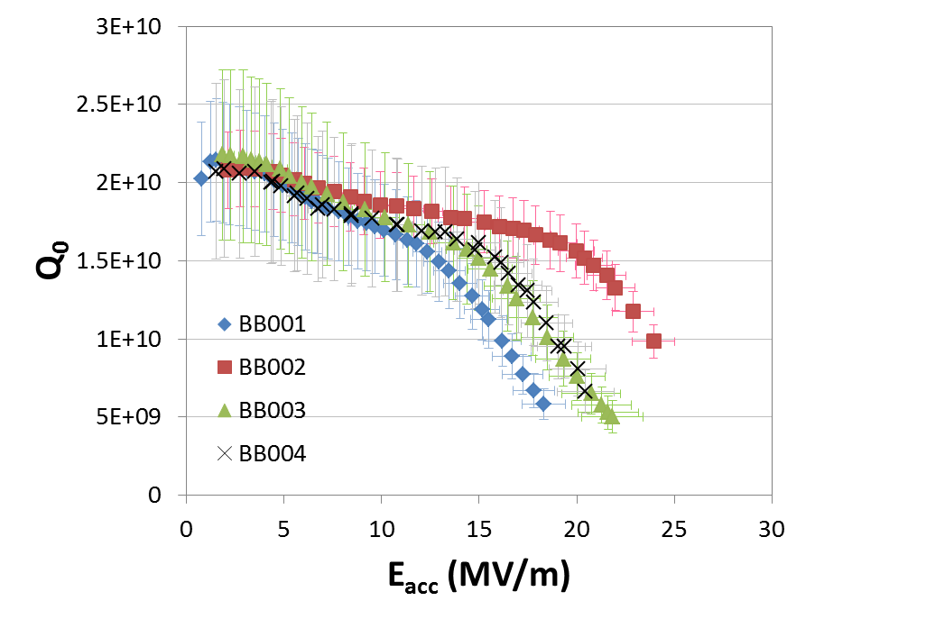
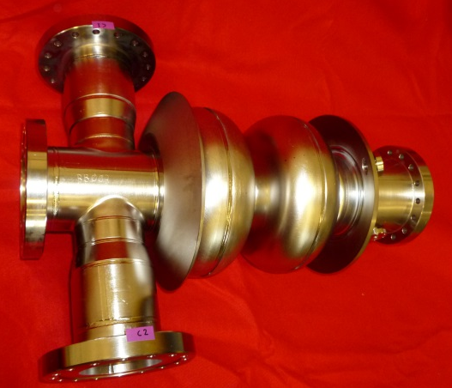
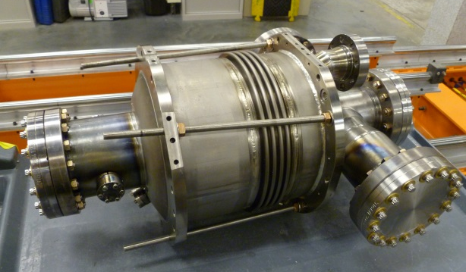
Cavity Production for Helmholtz-Zentrum Berlin
Fabricate, process and cryogenic RF test four 2-cell 1.3 GHz cavities for the bERLinPro accelerator at HZB, Germany
Weld He-vessel on three cavities, process and cryo RF test
T=1.8 K
Gigi Ciovati et. al.
Performance qualification after welding He-vessel is ongoing
Performance spec

Slide 28
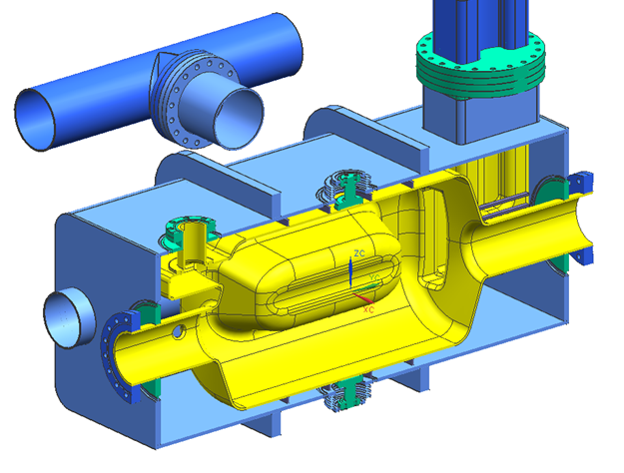
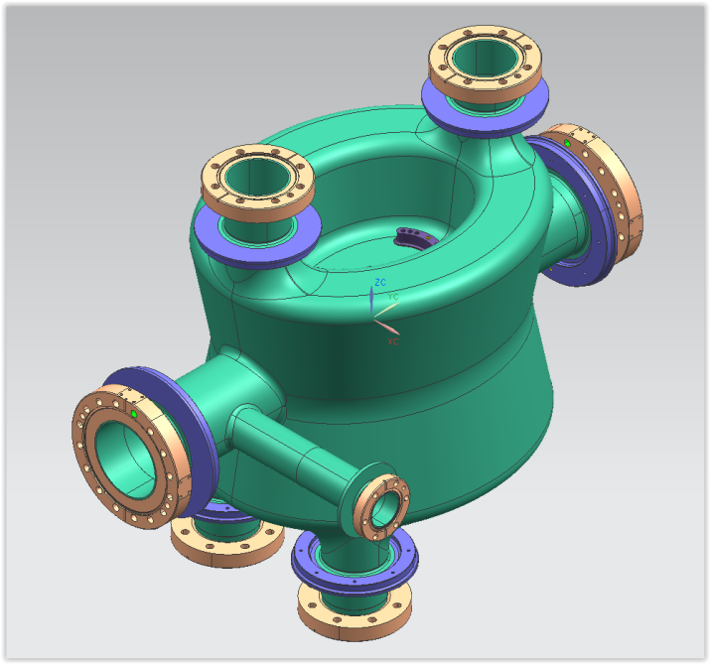
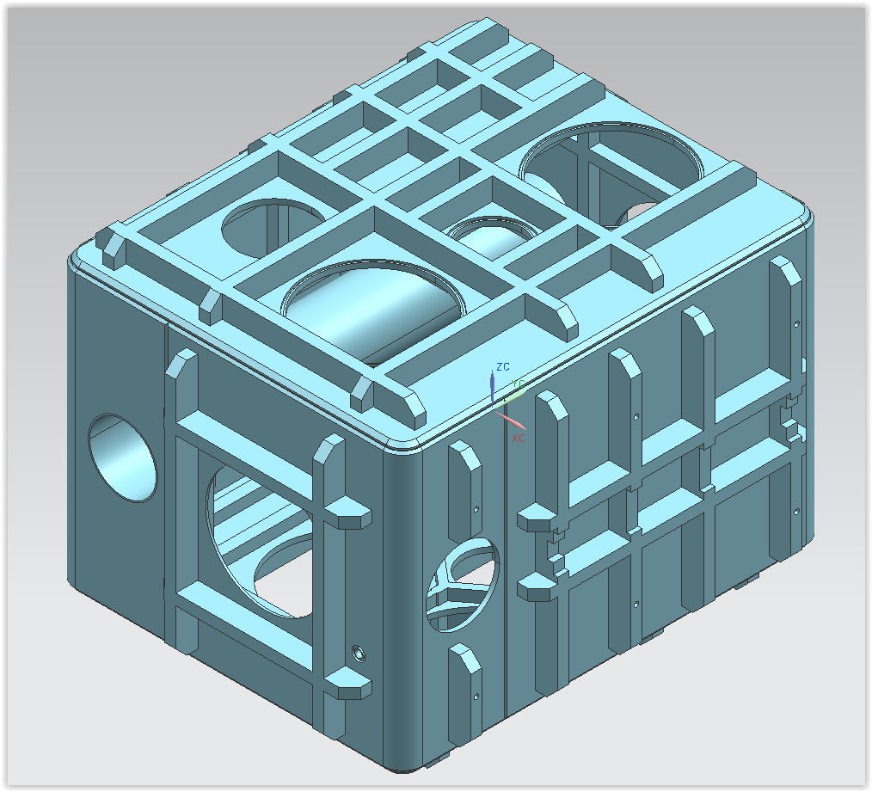
Prototype Crab Cavities for LHC (US LARP)
FY15 funding on its way ($1.08M
RF Dipole – cut-away view of cavity and helium vessel
Dipole Quarter Wave:
cavity
helium vessel
Fabricate, process and test two each of two types of cavities for US LARP by end of 2015
Deliver to CERN for cryostat assembly in 2016 to support beam tests in SPS

Slide 29
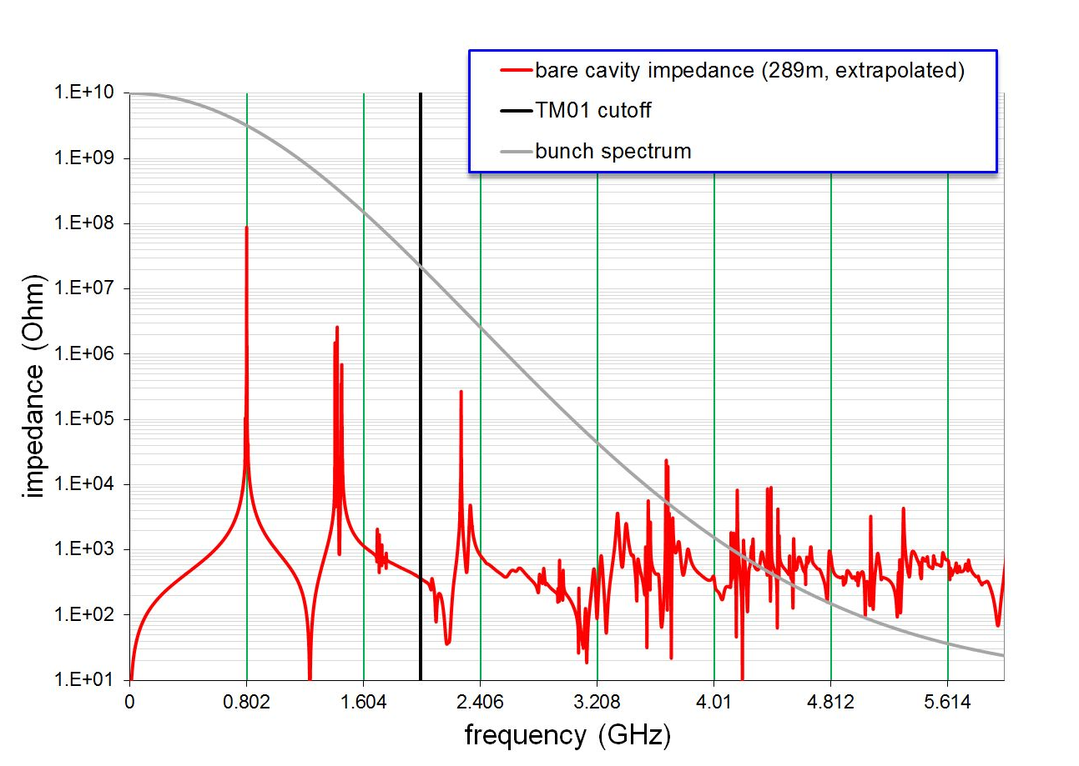
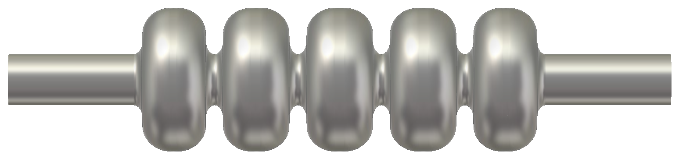
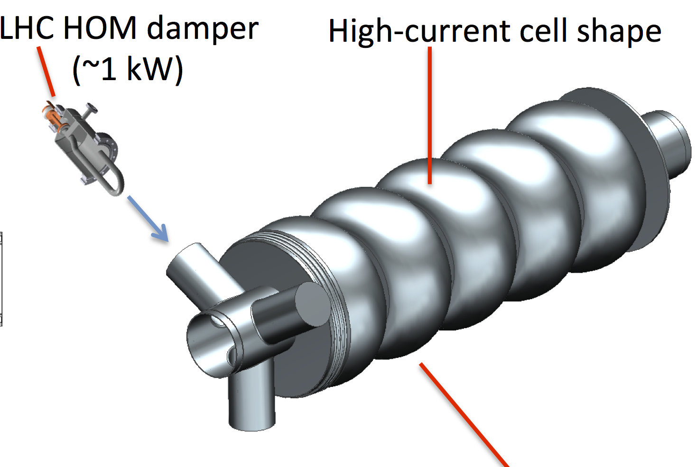
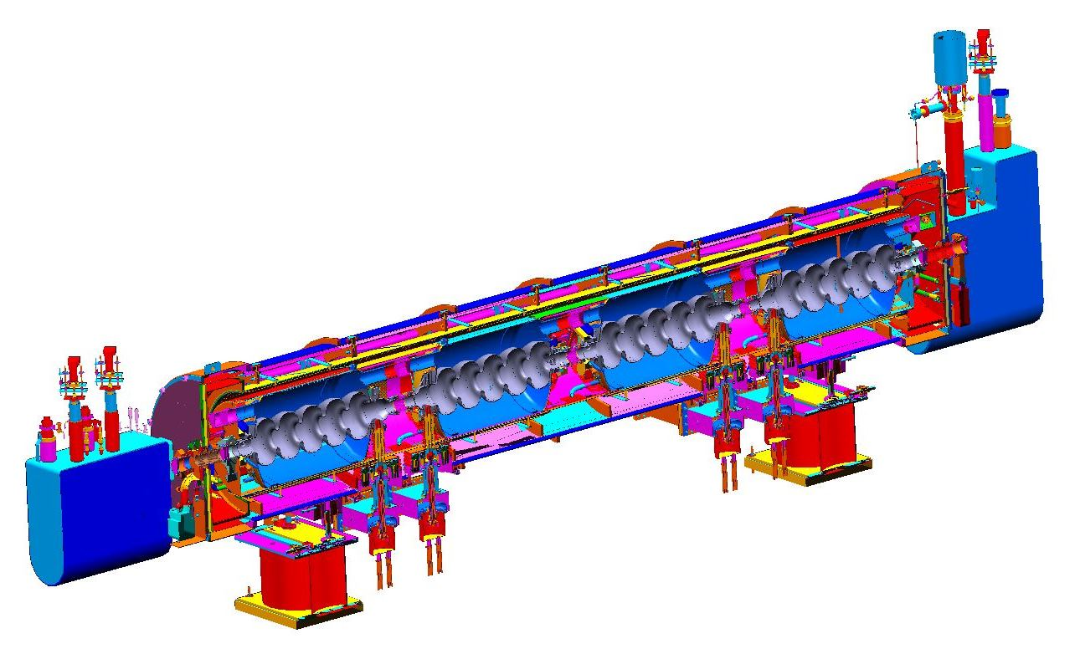
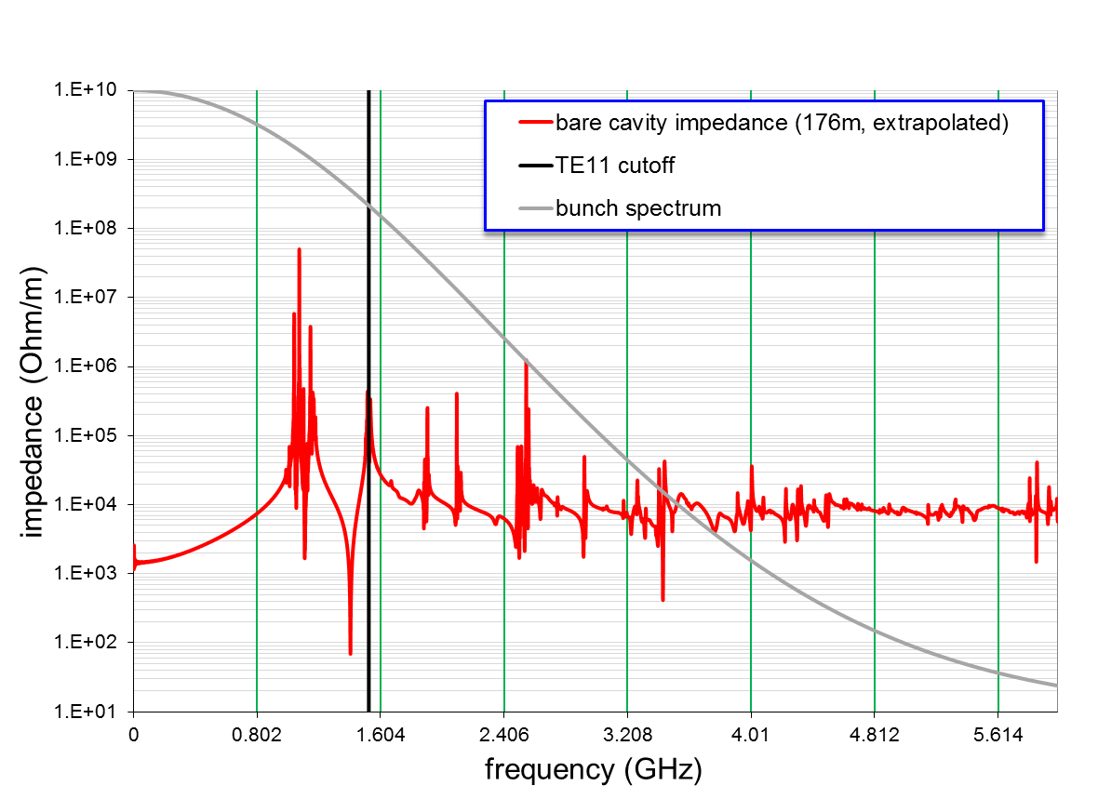
Proposed collaboration with CERN on SRF for LHeC
Collaboration on 802 MHz SRF for LHeC
ERL cavity design and prototype
Joint study on cryomodule
Cryomodule design applicable to MEIC
ERL cavity
HOM spectrum looks good
Cryomodule based on SNS

Slide 30
Education Goals
Attract and educate the next generation of accelerator scientists and engineers
Maintain the number of doctoral students in accelerator science ≥ 12
  13 graduate students
Strengthen the Center for Accelerator Science at ODU
  3 Jefferson Lab Professors teaching
  CAS added a faculty member in Computational Accelerator Physics
    Recently received an NSF grant)
Create a pipeline for future minority accelerator physicists at Jefferson Lab
  Working on MOU with Morehouse College to establish a pipeline
    Mentoring 2 students per summer( 2014, 2015)
Provide research opportunities in accelerator science for undergraduate students, specifically those at non-research institutions
  5 out of 8 undergraduates in Accelerator Division are from non-research institutions in 2015

Slide 31
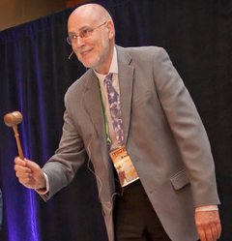
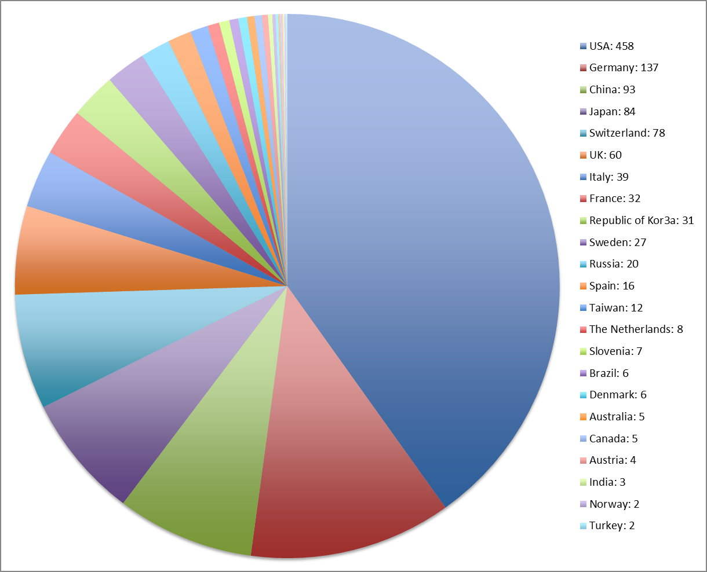
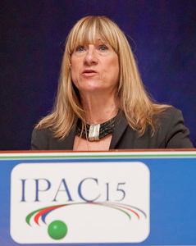
IPAC’15 – Richmond, VA
Conference organized by a large number of Jefferson Lab volunteers in addition to their normal workload
Demonstrates accelerator leadership within world-wide community
Conference Chair
USA
458
UK 60
Switzerland
78
Japan
84
LOC Chair
China
93
Germany
137
1187 attendees from 309 institutions in 31 countries
59 from Jefferson Lab

Slide 32
Vision for the Future
Operate and upgrade the JLab accelerator facilities
  Deliver 12 GeV physics program
  Improve parity quality of beams
Achieve all deliverables for FRIB and the LCLS II Projects, on schedule, under budget
Prepare for MEIC at Jefferson Lab
  Complete detailed design optimization
  Initiate value engineering and prototyping
Sustain Jefferson Lab’s core accelerator competencies to support DOE Office of Science projects and other partnerships
  Be the partner of choice for SRF accelerators world-wide
  Associate other core competencies with SRF to expand our capabilities
Attract and educate the next generation of accelerator scientists and engineers
    Continue at about the same level

Slide 33
Summary
CEBAF accelerator operations progressing well
  Commissioned 3 hall operation, 10.5 GeV beam
  Preparing for 12 GeV operations
  Concern: need spare C100 cryomodule for risk mitigation
(see A. Freyberger talk)
Preparing for the MEIC at Jefferson Lab – design is progressing well
    Concern: need dedicated MEIC R&D program
Accelerator R&D is vibrant
We are strong partners in FRIB and LCLSII
Education activities are broad-based and effective

Slide 34
Supplemental Information
Notes:
Suggestion to delete Supplemental Info. from the presentation file.

Slide 35
Capital Equipment/AIP Funds @ Proposed ($k)

Slide 36
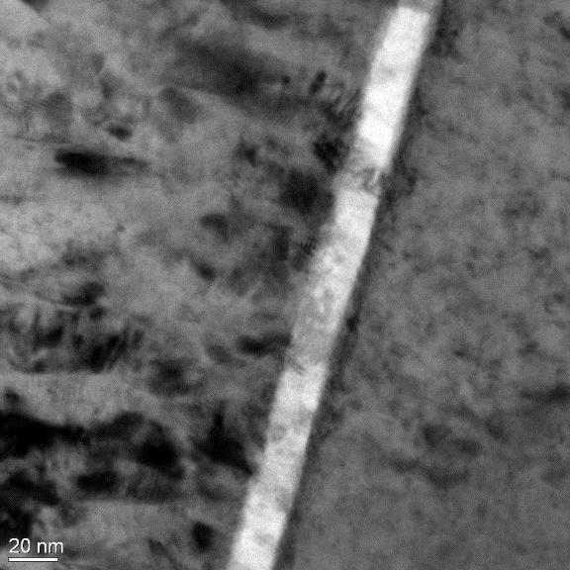
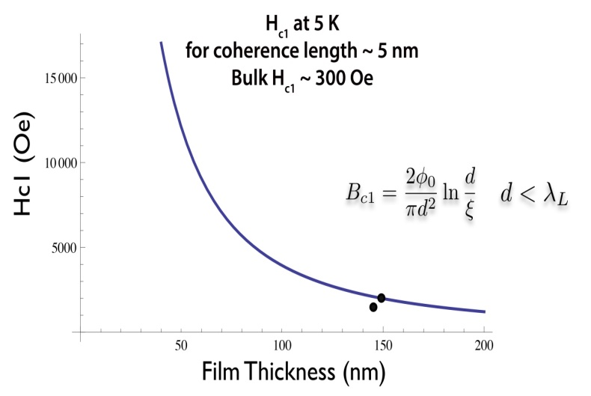
Development of SIS NbTiN/AlN structures on Nb surfaces
Learning how to grow high quality Superconductor/Insulator/Superconductor films
  Multi-layer SIS films may be a path to support very high surface RF fields
  Now producing high quality NbTiN/AlN/Nb films by multi-target sputter deposition
    Candidate system to test the SIS SRF theory
    Showing excellent progress in avoiding parasitic losses
    Initial results are consistent with theory
 | Thickness [nm] | H_{c1} [mT] | T_{c} [K]
NbTiN/MgO | 2000 | 30 | 17.25
NbTiN/AlN/AlN ceramic | 145 | 135 | 14.84
NbTiN/AlN/MgO | 148 | 200 | 16.66
NbTiN
AlN
Nb (ECR film)
A-M Valente-Feliciano
Notes:
Gurevich SIS/multilayer aimed at higher performance (delay entry of magnetic field into material). First tests show good quality multi layers and HC1 consistent with expectations. RF measurements show lower surface resistance above 4 K for mulitlayer coated Nb surfaces compared to Nb alone. AMV research topic ongoing.

Slide 37
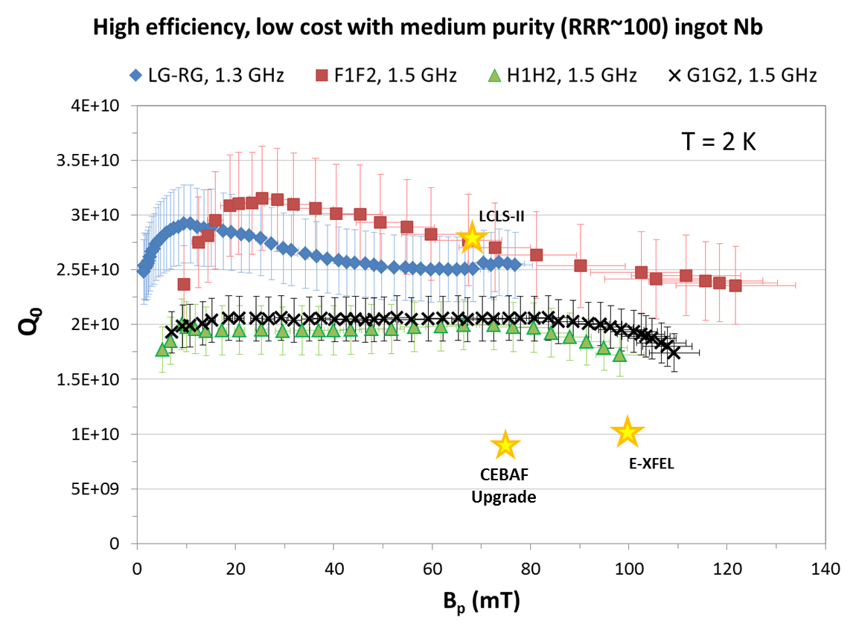
High efficiency at low cost: ingot Nb
Performance of four single-cell cavities made of different ingots after standard processes (Electropolishing and 120°C bake)
Cost may be 50-60% of fine-grain high RRR in project scale
G. Ciovati, et. al.
Notes:
Medium purity (RRR~100) ingot material seems to meet all requirements for moderate gradient CW uses such as CEBAF,X-FEL, LCLS. Uses fewer melts, cheaper material, less waste and fewer process steps using disks direct from ingot. Maybe cut material cost in half in large quantity. Being evaluated by INFN for ESS. High Ta also not a problem (CBMM material).

Slide 38
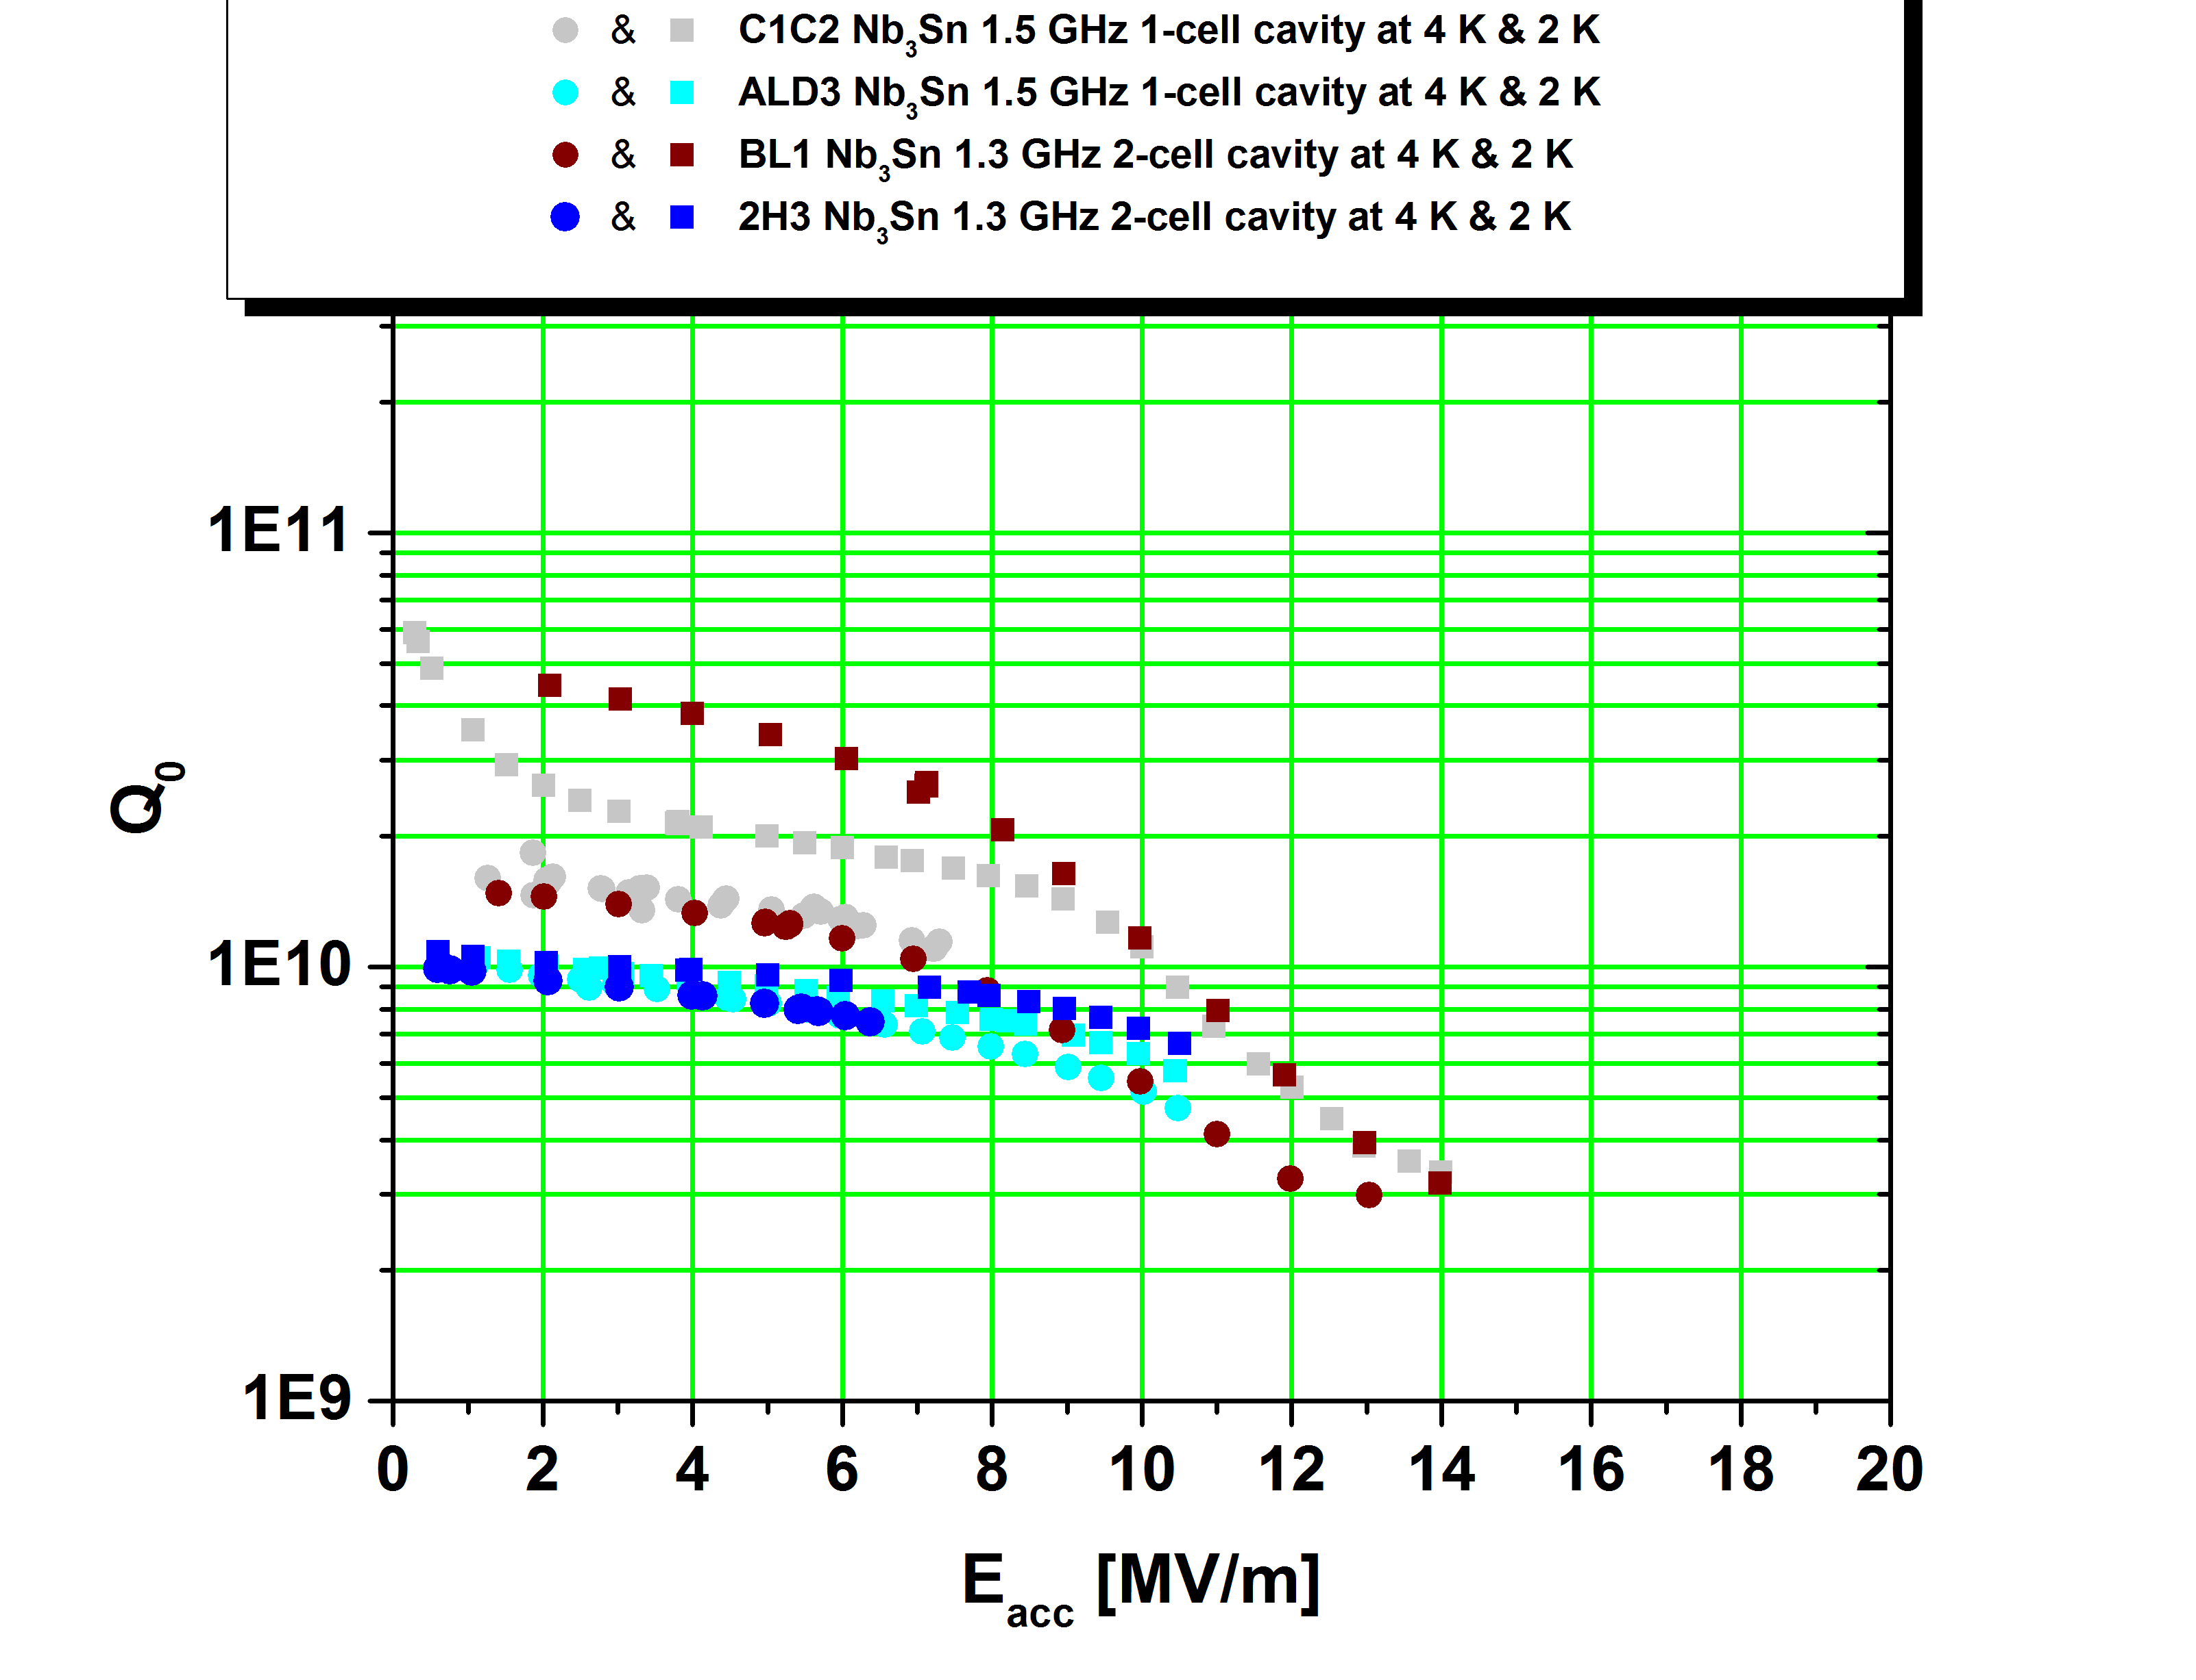
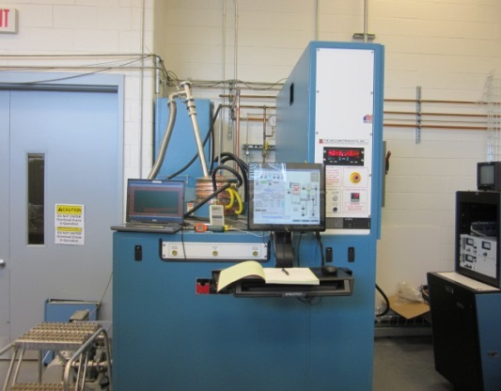
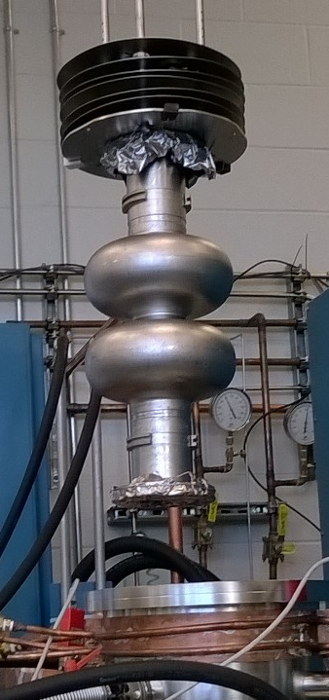
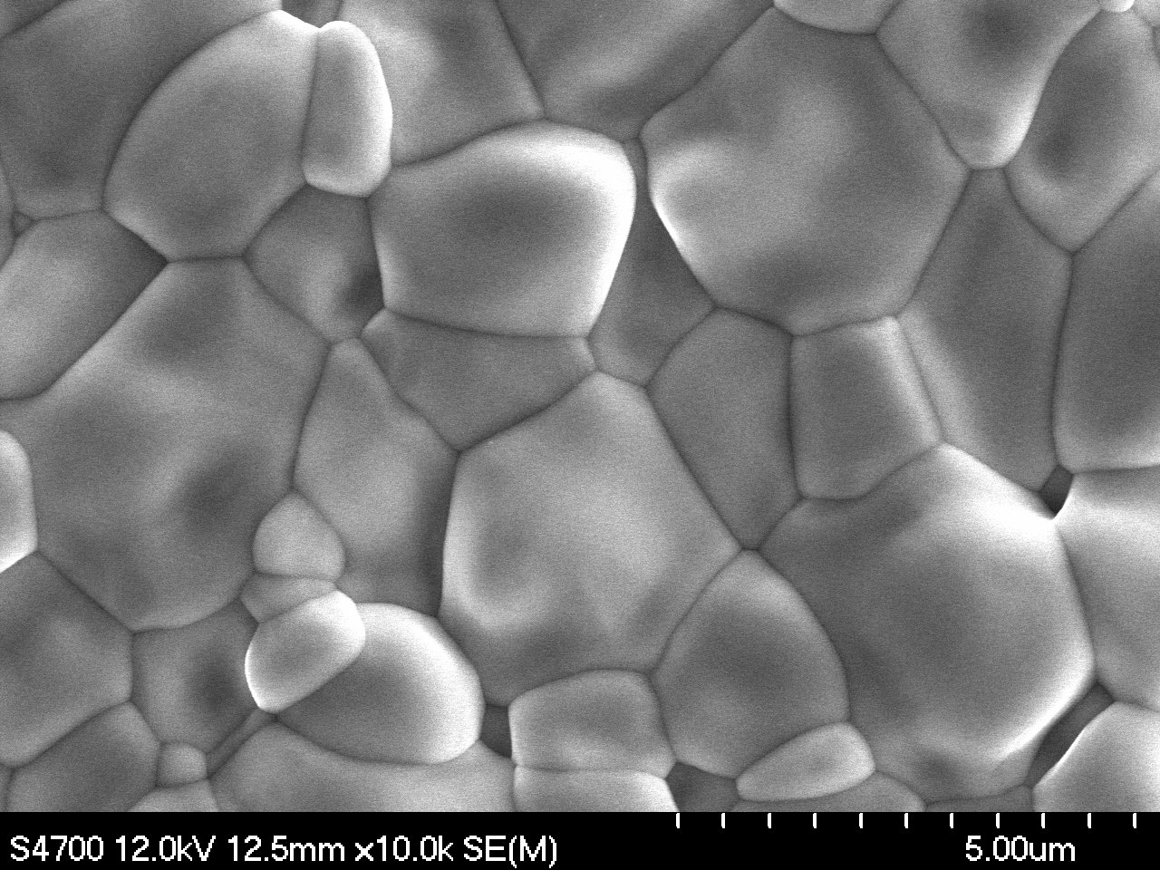
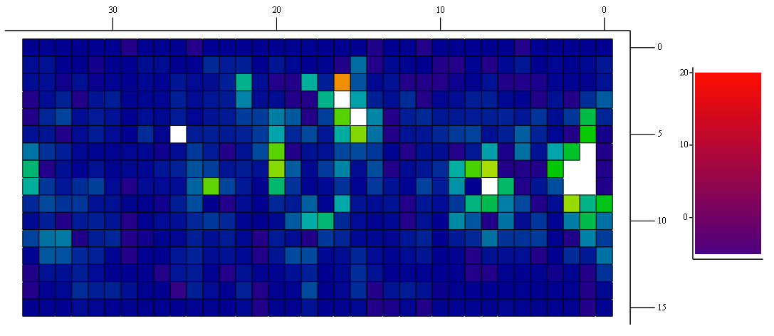
G. Eremeev et. al.
Nb₃Sn progress
1.5 GHz 1-cell, 1.3 GHz 1-cell, and 1.3 GHz 2-cell seamless cavities have been coated.
All cavities had the transition temperature of about 18 K with the low field Q₀ of about 10¹⁰ at 4.3 K.
The best cavities reached E_{acc} above 10 MV/m limited by localized defects and “Wuppertal” slope.
Small coated samples and cutouts from a 1.5 GHz cavities are being analyzed towards understanding of present limitations.
“Wuppertal” slope
Nb₃Sn coating system
Original CEBAF 2K spec
BES/ICS 4K goal
WSLH1
WSLH2
HH1
SSHH1
WS2
WSHH2
WS1
QSW3
QSW4
QSW1
SQ02
QSW2
WSHH1
SQ01
Notes:
Good low field Qo achieved, still dominated by Q slope. Understanding and fixing this is main focus of investigation. W&M & VT graduate students involved. 4K Qo’s already usable for some applications (meets old BES/ICS 4K spec). T-map shows Q-slope comes from hot spots, not global. Nb3Sn morphology very different from substrate. First coating of seamless 2-cell cavity. Collaborating with Cornell and Fermi.

Slide 39
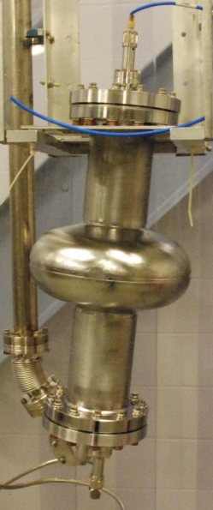
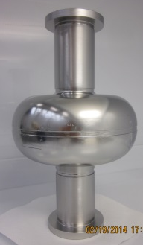
High Gradient: New Results and Next Steps
Purpose: achieve high gradient with high efficiency, at a low cost and high reliability
Approach: Low-Surface-Field Shape + Large-grain Niobium material + advanced processing
Future cavities:
LSF cavity
1.3GHz 1-cell
TTF shape
Large-grain Nb
In-house built
In-house proc.
1.4 K
1.8 K
1 TeV
ILC Goal
Prototypes:
Two each 1-cell built and tested
Two each 3-cell and one each 9-cell in process of fabrication.
2.0 K
LCLS-II spec
500 GeV
ILC spec
R. Geng
Notes:
Very small scale effort remaining due to loss of ILC funds, mainly supported by Japan–USA funds. Low Surface Field (LSF) cavity design from SLAC. We proposed this for LCLS-II but declined. Probably would have met their spec without doping leaving lots of gradient headroom.

Slide 40
Graduate Education
The Accelerator Division Fully or Partially supports 13 graduate students (10 from ODU, 1 Each from Virginia Tech, College of William & Mary and Virginia Commonwealth University)
Partial support comes from JSA Graduate Fellowship program or from grants awarded to the student’s university adviser (5 students)
One student from Hampton University (fully supported by Hampton U.) is defending his theses this month. (polarized positron source)

Slide 41
Theses during this decade (2011-12)
Daniel Bowring (2011), Multilayer Thin Films for SRF Accelerating Cavities University of Virginia (SLAC)
Hisham Sayed (2011), Compensation Techniques in Accelerator Physics, Old Dominion University, (BNL)
Jonathan Dumas (2011), Feasibility Studies of a Polarized Positron Source based on the Bremsstrahlung of Polarized Electrons, Universite Joseph Foruier (Post-doc, Jerusalem University)
Senthilraja Singaravelu (2012), Laser Processing of Metals and Polymers, Old Dominion University (Finisar Corp)
Dhawale, Ashwini (2012), Study of RF structures for Linear Accelerators, Homi Bhabha National Institute (Bhabha Atomic Research Centre, India)
Alicia Hofler (2012), Optimization Framework for a Superconducting Radio Frequency Gun Based Injector, Old Dominion University (JLAB)
Michael Spata (2012), Application of Chebyshev Formalism to Identify Non-linear Magnetic Fields in Beam Transport Systems, Old Dominion University (JLAB)

Slide 42
Theses during this decade (2012-13)
Binping Xiao (2012), Surface study of niobium for superconducting radio frequency (SRF) accelerators, College of William and Mary (BNL)
Ryan Bodenstein (2012), A Procedure for Beamline Characterization and Tuning in Open-ended Beamlines, University of Virginia (Oxford U)
James McCarter (2012), Photocathode Research for Electron Accelerators, University of Virginia (Niowave)
Prateek Maheshwari (2012), Surface Characterization of Impurities in Superconducting Niobium for Radio Frequency (RF) Cavities used in Particle Accelerators, North Carolina State University (Intel)
Chen Xu, (2013), Advanced topographic characterization of variously prepared niobium surfaces and linkage to RF losses, College of William and Mary (BNL)
Ilkyoung Shinn (2013), Multipass Beam Breakup Study at Jefferson Lab for the 12 GeV CEBAF Upgrade, University of Connecticut (Rare Isotope Science Project, Institute of Basic South Korea)
Milka Nikolic (2013), Characterization Of Microwave Discharge Plasmas For Surface Processing, Old Dominion University (ODU)

Slide 43
Theses during this decade (2013-15)
Ashraf Hasan Farha (2013), Investigation of NbN, Thin Films and Nanoparticles Grown by Pulsed Laser Deposition and Thermal Diffusion, Old Dominion University (Faculty – Ain Shams University)
Mahzad BastaniNejad (2013), Field Emission Studies Toward Improving the Performance of DC High Voltage Photoelectron Guns, Old Dominion University (Adjunct Faculty – CNU)
Suba De Silva (2014). Crabbing and Deflecting Cavity design for JLab and CERN. Old Dominion University (ODU)
Liang Zhao (2014). Surface polishing of niobium for superconducting radio frequency (SRF) applications, College of William and Mary (LCLS)
Christopher Hopper (2015) Development of Superconducting Spoke Cavities for High-velocity Applications, Old Dominion University

Slide 44
Graduates
Milka Nikolic (ODU), Graduated in 2013
  2014 Lee Entsminger Outstanding Ph.D. Dissertation Award, College of Science, Old Dominion University
Suba De Silva (ODU) Graduated in 2014
  2014 Particle Accelerator Science and Technology Award
  The IEEE Nuclear and Plasma Sciences Society awards individuals who have made outstanding contributions to the development of particle accelerator science and technology
  2015 Lee Entsminger Outstanding Ph.D. Dissertation Award, College of Science, Old Dominion University

Slide 45
Undergraduates
In order to attract undergraduate students into Accelerator Sciences, Accelerator Division mentors undergraduates during summer months.
Jointly with ODU, the NSF funded Research Experience for Undergraduates has mentored 38 undergraduates in Accelerator Science
Promising students are kept engaged in Accelerator Science research during school year – thanks to JSA initiatives funds.

Slide 46
Accelerator Division Scientific Profile
Awards
Recently Awarded Patents
Committee and Board Memberships, etc
Collaborations

Slide 47
Recent Awards and Patents
Awards/Recognition
Patents Continued
Yaroslav Derbenev, 2013 Deiter Mohl Award
Kevin Jordan, R&D 100 Award for Free Electron Laser
“Apparatus and Method for Fast Recovery and Charge of Insulation Gas”, Kevin Jordan – 09/13/2013
“Unbalanced Field RF Gun”, Alicia Hofler – 11/05/2013
“Temperature Controlled Articulating High Pressure Feedstock Delivery Device”, Kevin Jordan – 11/05/2013
“Efficient Boron Nitride Nanotube Formation via Combined Laser Gas Flow Levitation”, Roy Whitney, Kevin Jordan, and Michael Smith – 03/18/2014
“Integrated Rig for the Production of Boron Nitride Nanotubes via the Pressurized Vapor-Condenser Method”, Kevin Jordan and Michael Smith – 03/25/2014
“Apparatus for the Production of Boron Nitride Nanotubes”, Michael Smith and Kevin Jordan, 06/17/2014
“Method of Nitriding Niobium to Form a Superconducting Surface”, Michael J. Kelley, John M. Kloph, and Senthilaraja Singaravelu – 08/19/2014
“Practical Method and Device for Enhancing Pulse Contrast Ration for Laser and Electron Accelerators”, Shukui Zhang and Guy Wilson – 09/23/2014
“Apparatus and Process for Passivating an SRF Cavity”, Ganapati R. Myneni and John Wallace – 12/02/2014
Patents
“Use of Off-Axis Injection as an Alternative to Geometrically Merging Beams in an Energy-Recovering Linac”, David R. Douglas – 01/10/2012
“Large Grain Cavities from Pure Niobium Ingot”, Ganapati R. Myneni, Peter Kneisel, and Tadeu Cameiro – 03/06/2012
“Boron Nitride Nanotube”, Michael Smith and Kevin Jordan – 07/01/2012
“Method of Controlling Coherent Synchrotron Radiation-Driven Degradation of Beam Quality during Bunch Length Compression”, David Douglas and Christopher Tennant – 07/17/2012
“Laser Ablation for the Synthesis of Carbon Nanotubes”, Brian Holloway, Peter Eklund, Michael Smith, Kevin Jordan, and Michelle Shinn – 11/27/2012
“Protective Laser Beam Viewing Device”, George Neil and Kevin Jordan – 12/18/2012
“Method for High-Energy Laser Pulses from Cw Amplifiers”, Shukui Zhang – 06/19/2013

Slide 48
Recent Awards and Patents
Patents Continued
“Efficient Boron-Carbon Nitrogen Nanotube Formation via Combined Laser Gas Flow Levitation”, Roy Whitney, Kevin Jordan, and Michael Smith – 03/24/2015
“Additive Manufacturing Method for SRF Components of Various Geometries”, Robert A. Rimmer, Pedro E. Frigola, Alex Y. Murokh – 05/05/2015
“Bunch Length Compression Method for Free Electron Lasers to Avoid Parasitic Compressions”, David Douglas, Stephen Benson, David Nguyen, Christopher Tennant, G. Wilson – 05/26/2015
“Magnesium Doping of Boron Nitride Nanotubes”, Robert Legg, Kevin Jordan – 06/16/2015
"Magnesium Doping of Boron Nitride Nanotubes“, Bob Legg – U.S. Pat. No. 9,059,361

Slide 49
Committee and Board Memberships, etc.

Slide 50
Committee and Board Memberships, contd.

Slide 51
Collaborations
Alameda Applied Sciences
Characterization Of Niobium Thin Films (SBIR)
Anatoliy Kondratenko
MEIS Development of interaction region, study of nonlinear beam dynamics
ANL
Pre-conceptual design of the ion accelerator complex
Measurement of 19F(g,a)15N with a bubble chamber and a bremsstrahlung beam
MEIC Ion Linac and Booster Ring
Bailey Tool and Manufacturing, Texas
Seamless cavity fabrication (SBIR)
BNL
EIC Collaboration
Photocathode – CEC
Energy Recovery Study at CEBAF
BNNT, LLC
Based bakeable UHV to XHV Cryopump
Carnegie Mellon University
Mapping the Spectrum of Light Quark Mesons and Gluonic Excitations with Linearly Polarized Photons
CERN
LARP coating cavities
LHeC – Cavity Research and Development
DESY
MEIC Electron Polarization
ESS
Research and Development on SRF Technologies
FERMI
Collaboration on SRF Research and Development
FZD
Design and manufacture of the superconducting cavity
Hampton University/Idaho Accelerator Center/CNRS
Polarized Electrons for Polarized Positrons (PEPPo)
Helmholtz-Zentrum Berlin
Collaborate on development of the Bunchlength interferometer and laserwire scanner development
Helmholtz-Zentrum Dresden
Design and manufacture of the superconducting cavity
IHEP
Development of Electron Collider Design
Indiana University
Accelerator development of an upgrade radiation effects laboratory
INFN
Ingot niobium for ESS
Institute of Modern Physics (IMP), Lanzhou
+e-Cooling experiment
SRF Collaboration
Development of Electron Ion Collider
LARP
Crab cavities
MSU
FRIB
Muons, Inc.
6D Cooling
Reverse Emittance Beam Cooling
PIC (Parametric Induced Resonances)
Magnetron RF Sources (SBIR)
Cooling End to End Simulations
ERL for Commercial Radioisotope
RLA Design
EPIC Parametric Resonance Cooling
NASA
Nanotube Synthesis
Niowave
Liquid metal target positron target

Slide 52
Collaborations
Old Dominion University
Computational Accelerator Physics
RadiaSoft – integrable beam optics
South Dakota School of Mines – nuclear safeguards and security
Crab Cavity Development
MEIC Interaction Region Design & Detector Integration
MEIC Computational Study
Peking University
Collaborate in areas of common interest
Pohang National Laboratory
Research, assemble, program, and install a new low level RF
Radiabeam
3D printed Niobium Cavity (SBIR)
Reference Metals
High RRR Niobium Studies
Large Grain/Single Crystal Niobium Studies
SLAC
Linac Coherent Light Source II
Waveguide Simulation
Soreq Nuclear Research
Design, develop, and prototype and test LLRF systems
Stonybrook
An Ultra-precise Measurement of the Weak Mixing Angle using Moller Scattering
Stonybrook University, SLAC, Stanford
Search for new Vector Boson A1 Decaying to e+e- (APEX)
Stonybrook University, University of Virginia
PREXII Precision Parity-Violating Measurement of the Neutron Skin of Lead
Texas A&M
Super-ferric magnets
TRIUMF
Loan Beam Loss Monitor
Loan cavity tuner assembly
University of Virginia
Facilitate development of a compact, intense, broadband THz
Variable Energy Cyclotron Center (VECC)
Establish a Nuclear Science and Accelerator Collaboration
U. of William and Mary, MIT, U Manitoba
The Qweak Experiment: A Search for New Physics at the TeV scale via a Measurement of the Proton's Weak Charge
U of Wisconsin
SRF Electron Gun
U Manitoba, ISU, U of VA, Syracuse, U
CREX: Parity-Violating Measurement of the Weak Charge Distribution of 48Ca to 0.02 fm accuracy
U Mass
The EMC PVDIS Experiment: A Constraint on Isovector Dependent Nuclear Modification Effects Using Parity-Violating Deep Inelastic Scattering

