Slide 1

Science Overview
Bob McKeown

Slide 2
Outline
JLab context in Nuclear Physics
12 GeV Physics Program
phenomenology
techniques (theory+exp)
standard model tests
MEIC
Outlook
Discovery
Potential
New
Note: Recent Accomplishments, Accelerator S&T, Theory/Computation
to be covered in following talks
Notes:
Like to give an overview of Jefferson Lab.
I can’t get going without saying something of the current status of the lab.
The dominant part of the talk will concern our 12 GeV Upgrade Project, the physics and the project status.
However, the technology which enables our nuclear physics and its enhancement also provides opportunities in the future
Photon Science
Accelerator Driven Systems
Nuclear Physics
Conclude

Slide 3
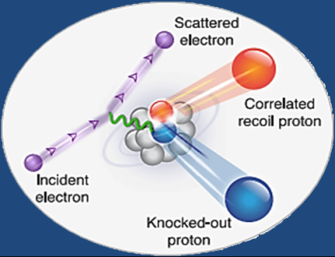
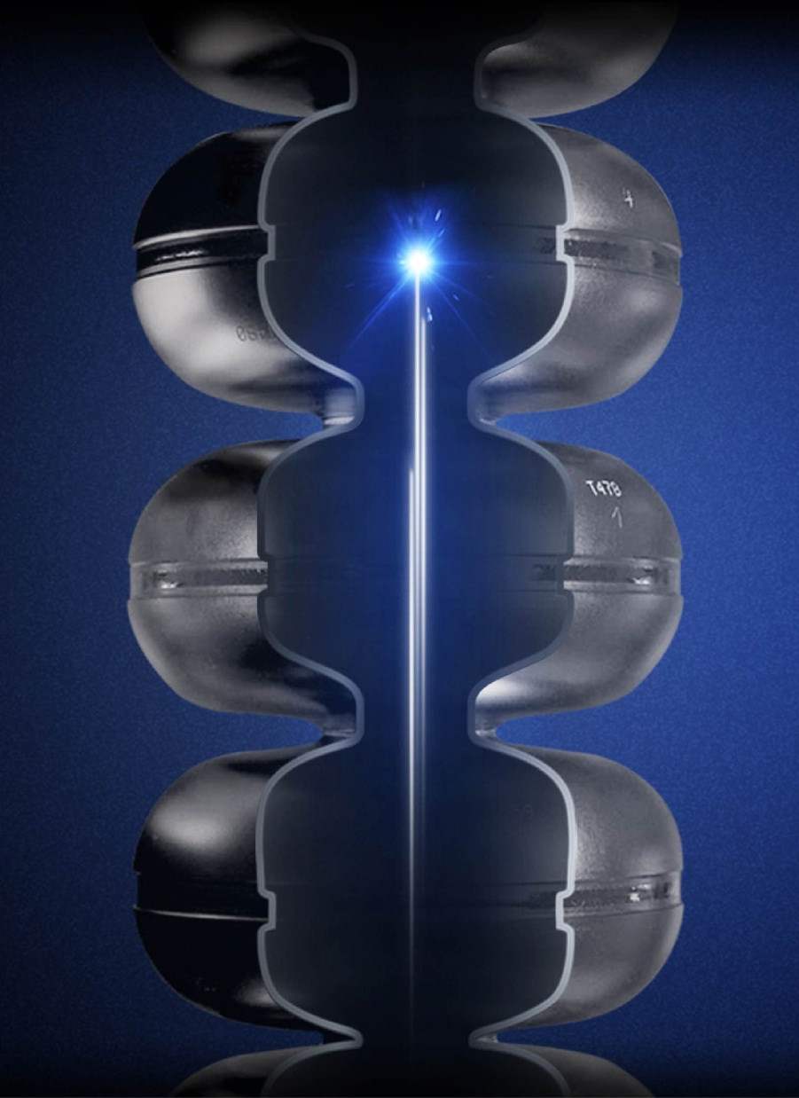
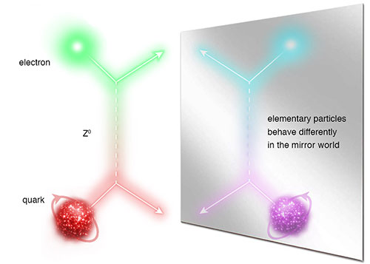
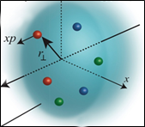
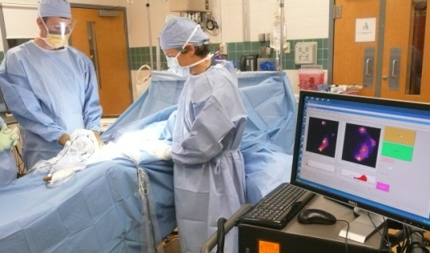
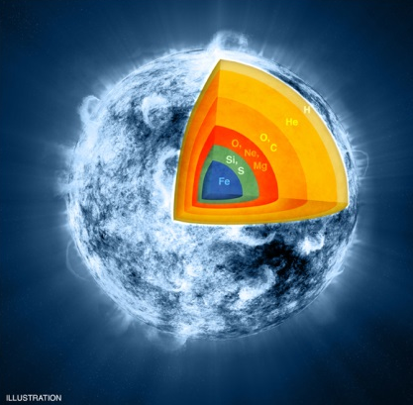
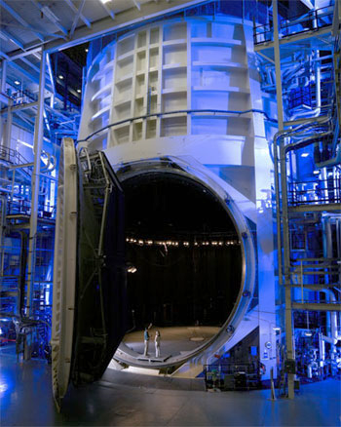
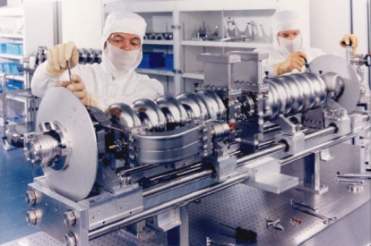

JLab: A Laboratory for Nuclear Science
Z⁰
Nuclear Structure
Fundamental
Forces & Symmetries
Structure of Hadrons
Medical Imaging
Nuclear Astrophysics
Accelerator S&T
Cryogenics
Theory & Computation

Slide 4
International Character of Jefferson Lab
Remarkable and unique facility, complementary efforts in the international scene for the hadron physics program:
COMPASS at CERN: ~200 GeV muon beam, large acceptance, much lower luminosity.
Mainz (Germany): excellent 2 GeV CW polarized electron beams but limited kinematic reach.
JPARC (Japan): Hadron beam facilities with high intensity kaon and pion beams.
BES (China), BELLE (Japan), BABAR: heavy quark meson spectroscopy in e⁺-e⁻ collisions.
PANDA at GSI (Germany): heavy quark meson spectroscopy in proton-antiproton collisions.
International Users at Jefferson Lab
~1/3 of our 1380 users (FY14) are international, from 30 countries
FY2014

Slide 5
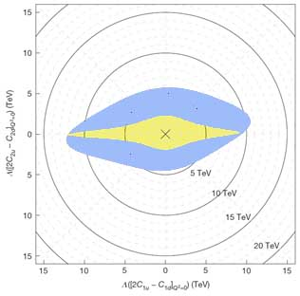
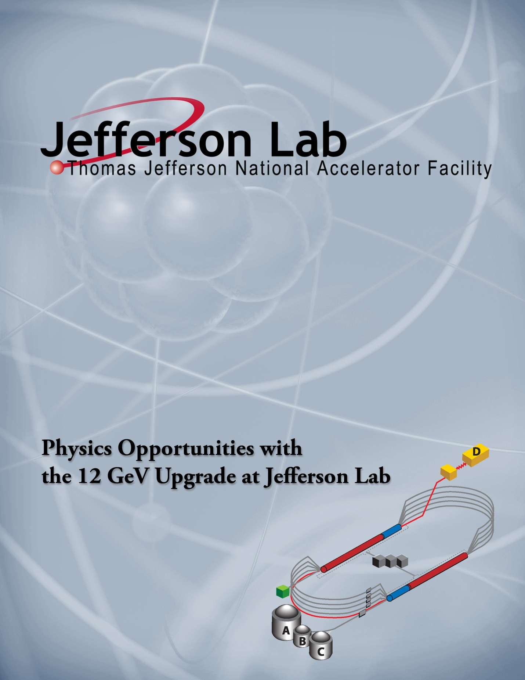
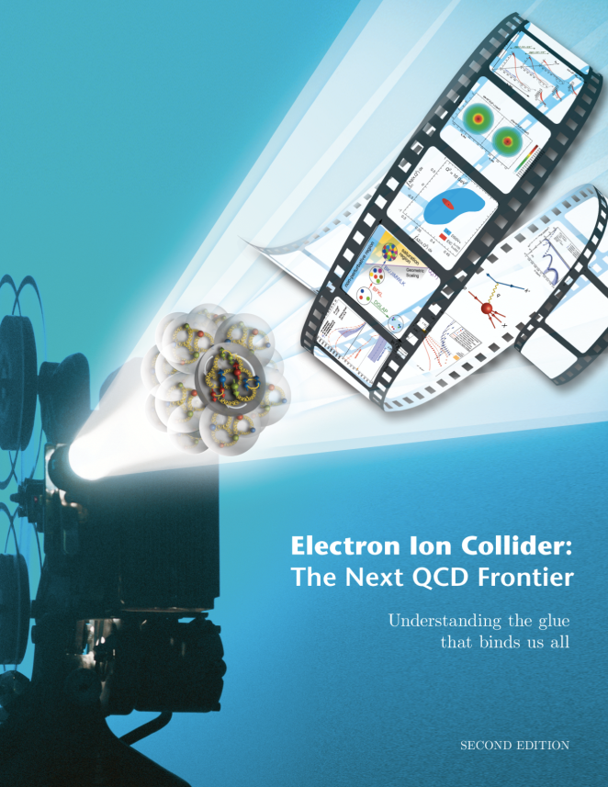
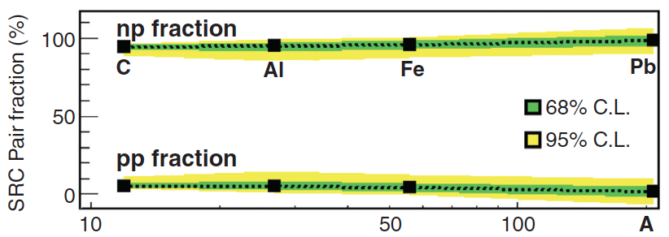
JLab 2014 Near-Future Future
Nature 506, 67 (6 February 2014)
Parity Violating DIS
Decade of Experiments Approved
Eager to Start 12 GeV Science!
Electron Ion Collider
The Next QCD Frontier
SLAC E122
JLab PVDIS
Science 346, 614 (October 2014)
Short Range NN Correlations
Confinement
Hadron Structure
Nuclear Structure
and Astrophysics
Fundamental Symmetries
Role of Gluons in Nucleon and Nuclear Structure
Notes:
Removed of “long” and sea quarks

Slide 6
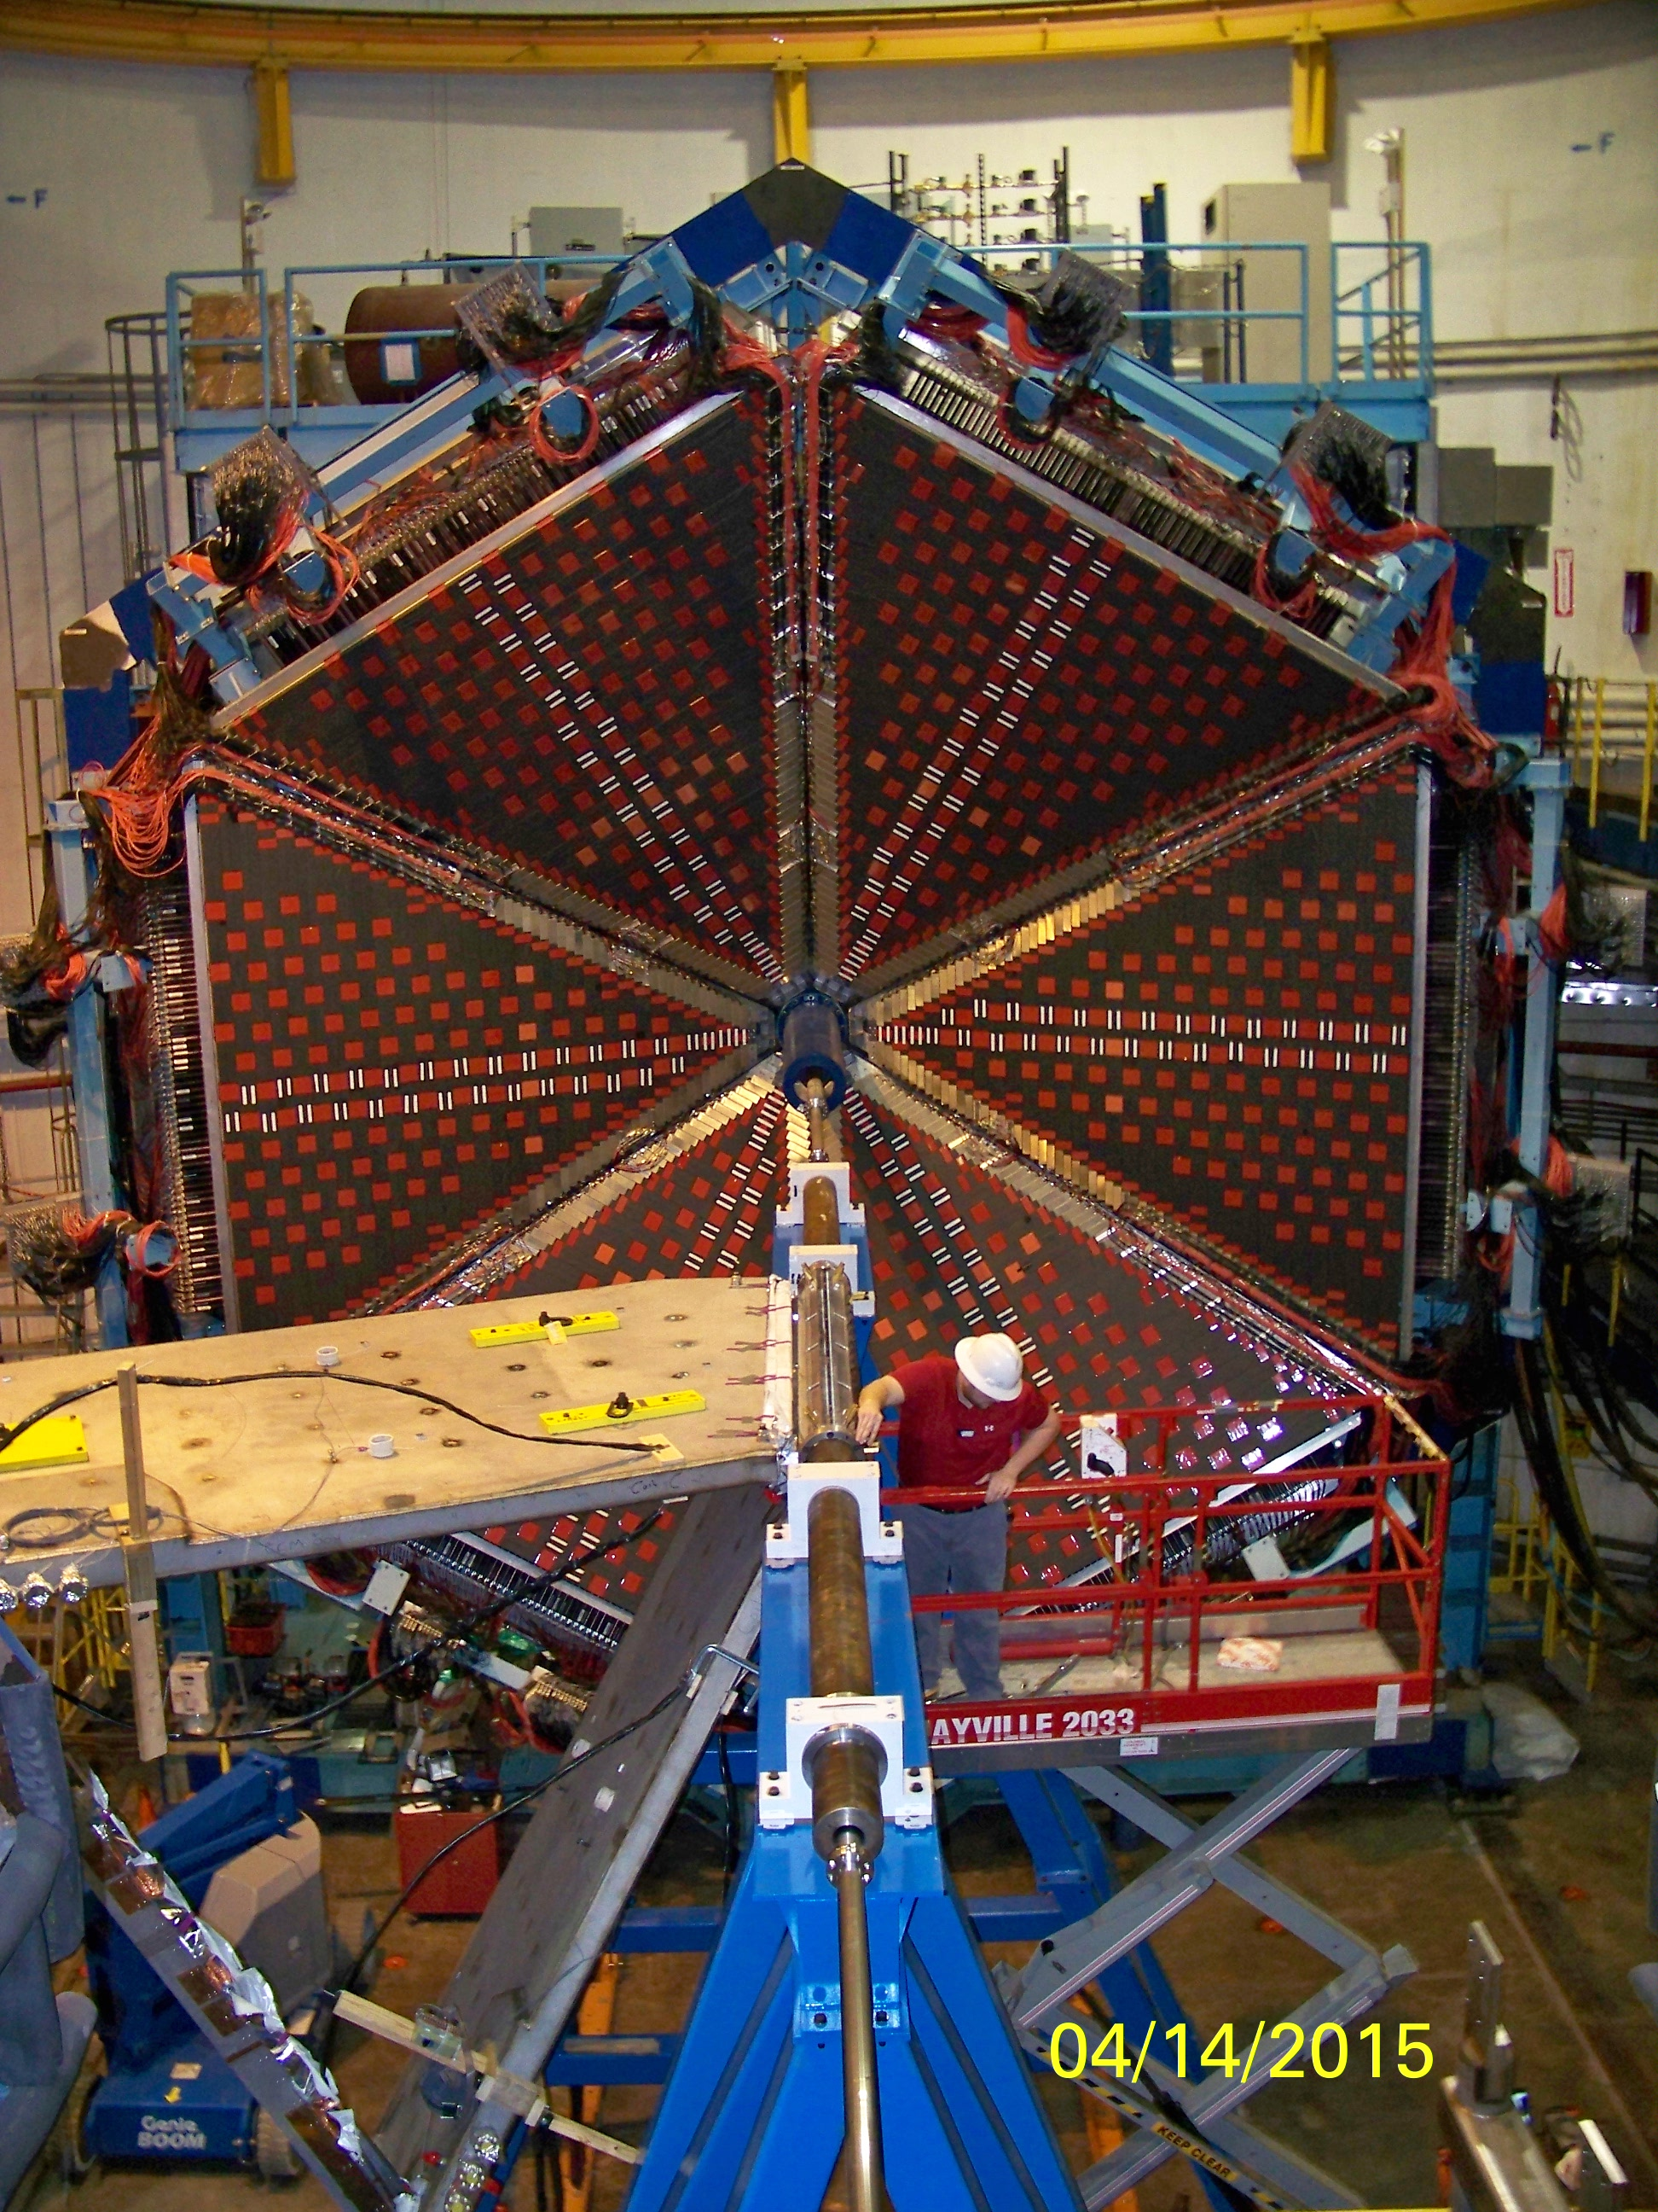
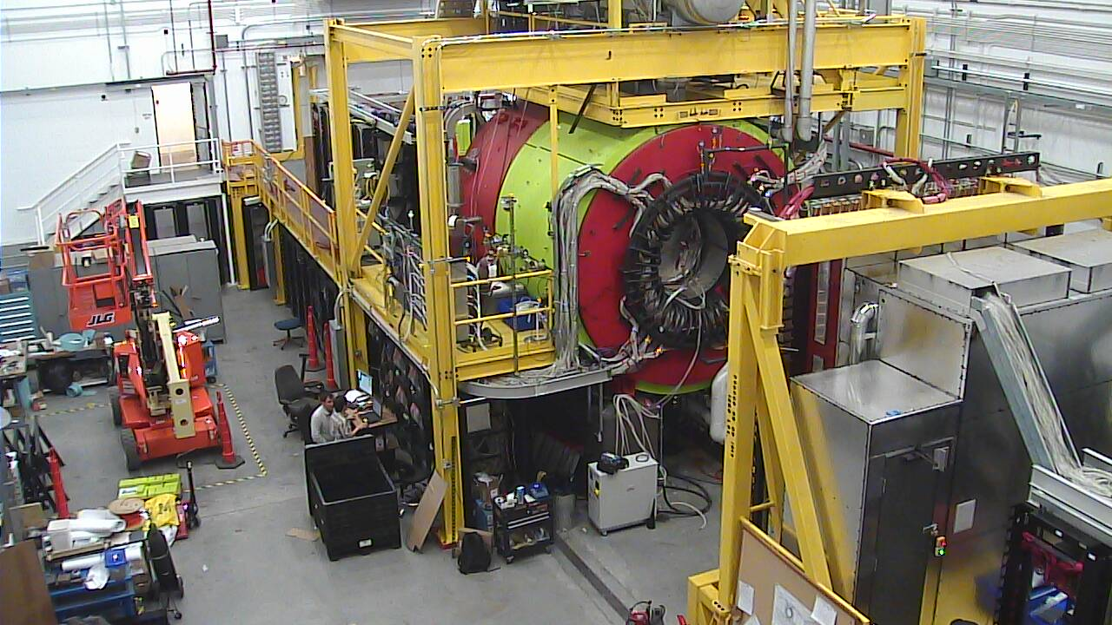
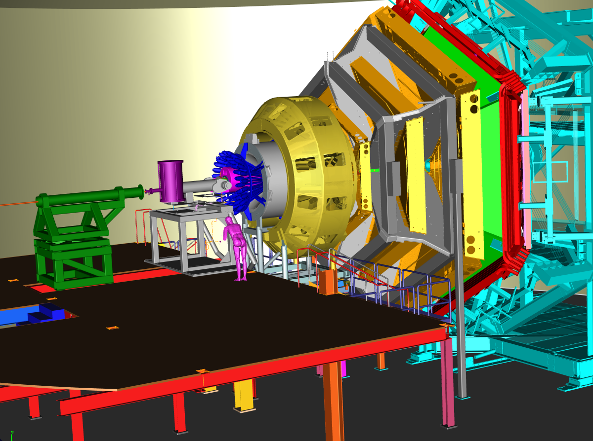
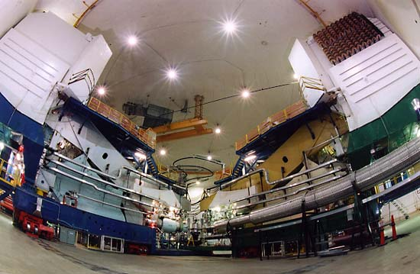
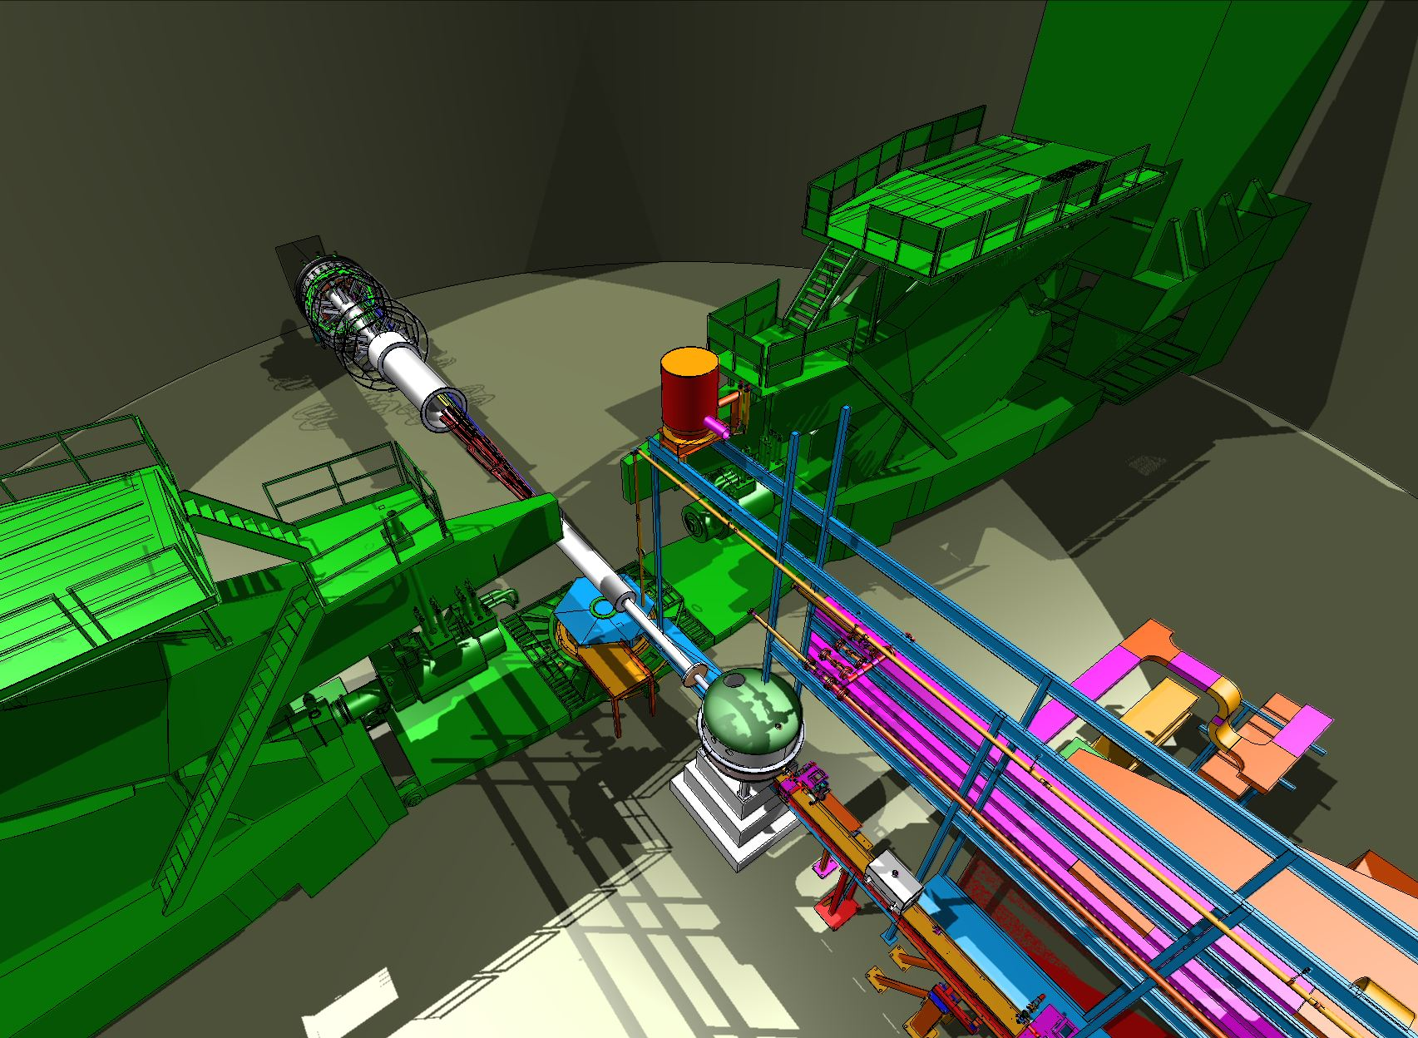
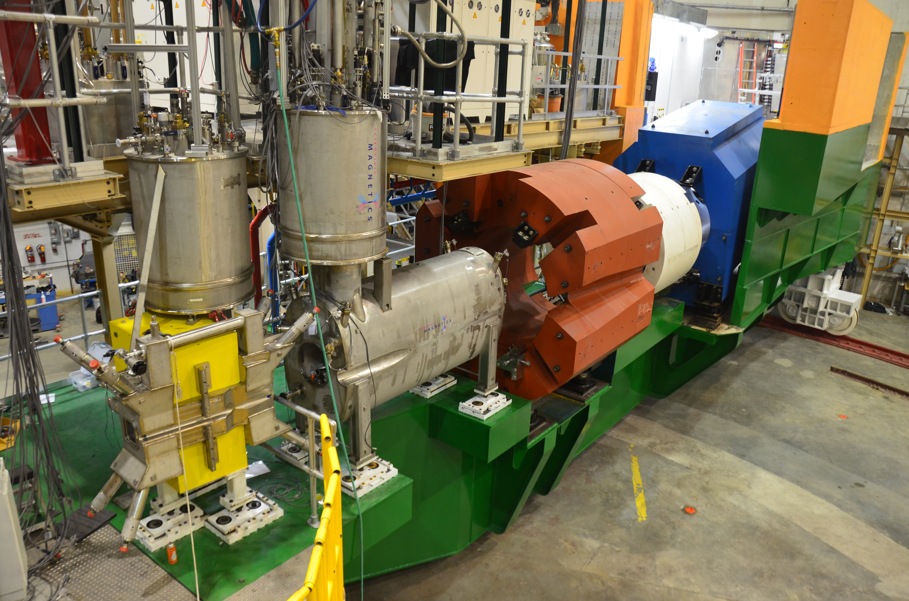
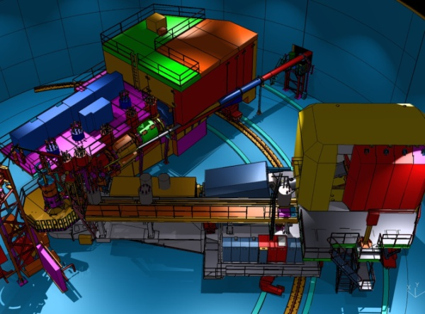
12 GeV Scientific Capabilities
Hall B – understanding nucleon structure via generalized parton distributions
Hall D – exploring origin of confinement by studying exotic mesons
Hall A – form factors, future new experiments (e.g., SoLID and MOLLER)
Hall C – precision determination of valence quark properties in nucleons/nuclei
Notes:
6
Note BSM not included in project

Slide 7
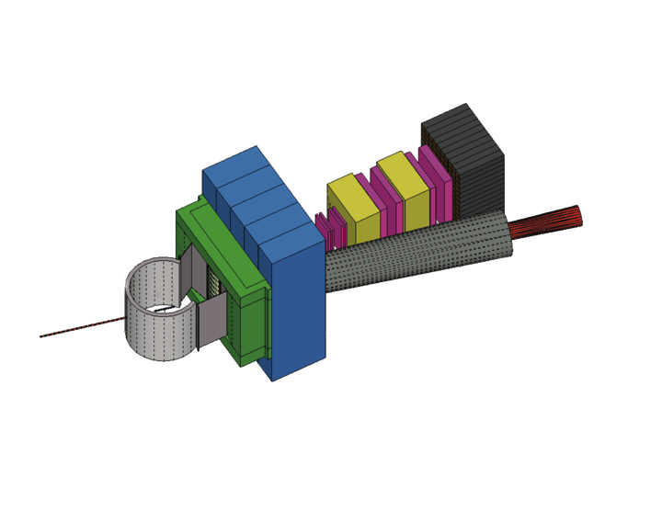
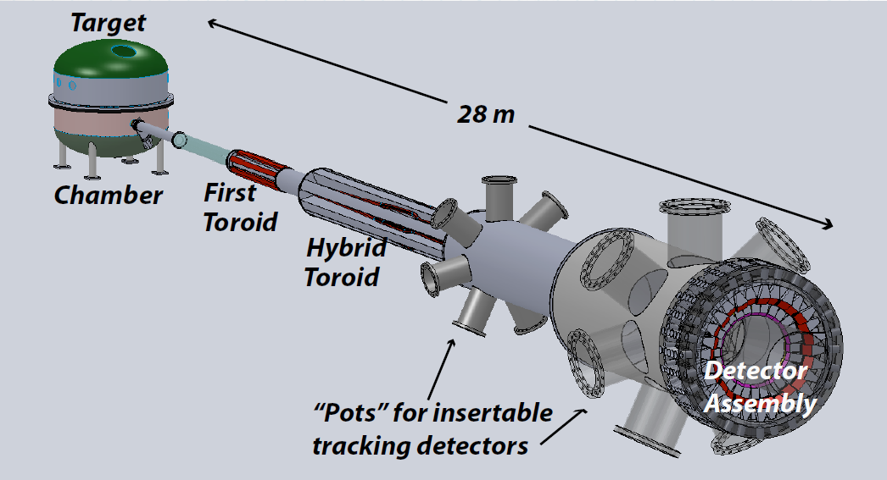

Additional Experimental Equipment
Super BigBite Spectrometer
(FY13-17 construction)
– High Q² form factors
– SIDIS
MOLLER experiment
(MIE – FY17-19?)
  – Standard Model Test
  – DOE science review (Sept. 2014) – strong endorsement
  – Technical, cost & schedule reviews?
SoLID
– SIDIS and PVDIS
– Chinese collaboration
– CLEO Solenoid
– Director’s review (Feb. 2015)
→ lots of good feedback

Slide 8
Enhancements beyond 12-GeV Upgrade
• Hall A DVCS Calorimeter (France - Orsay) installed
• Hall A SBS – ongoing (Capital Equipment (CE))
• Hall A SBS GEMs (Italy INFN, UK), Hadron Cal. (CMU+INFN) ongoing (ops)
• Hall A pre-R&D toward PV (MOLLER magnet concept, with MIT) ongoing (ops)
• Hall A SOLID (China, Temple, Duke, ANL, …) ongoing (magnet - CE)
• Hall A APEX septum magnet (Canada, Stony Brook) complete
• Hall B longitudinally polarized target (ODU …, NSF/MRI) ongoing (infrastr. - CE)
• Hall B forward tagger (Italy INFN & NSF/MRI) near-complete
• Hall B RICH sector(s) (Italy INFN, Chile) ongoing (PMTs, materials - CE)
• Hall B MicroMegas (France - Saclay) ongoing
• Hall B Central Neutron Detector (France - Orsay) complete
• Hall B Heavy Photon Search (HPS) (DOE HEP, France, INFN) installed/used for run
• Hall B H Gas Target for Proton Charge Radius (NSF/MRI) near-complete
• Hall C Kaon Detection System (CUA …, NSF/MRI) complete
• Hall C Backward nucleon detection system (Israel/ODU) ongoing
• Hall C Neutral-Particle Spectrometer (US/France/UK/Armenia & NSF/MRI) started
• Hall D PID/Cherenkov system (US) pre-R&D/planning (CE)
• Hall D Discussions with China on calorimeter upgrades (UNCW, NCAT) planning
• LERF: DarkLight Phase-I Equipment (MIT …, NSF/MRI) ongoing
• Injector: Bubble Chamber for ¹⁶O(γ,α)¹²C inverse kinematics (ANL) ongoing
8

Slide 9
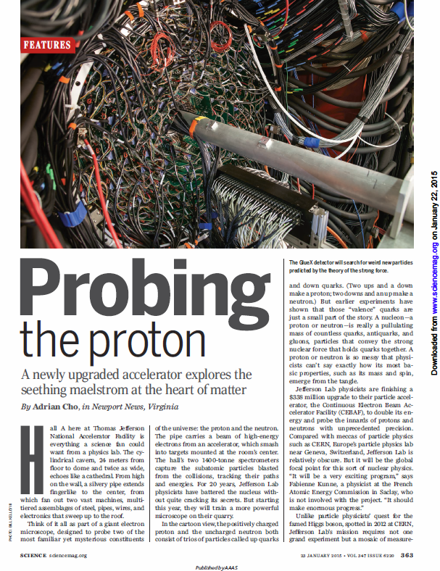
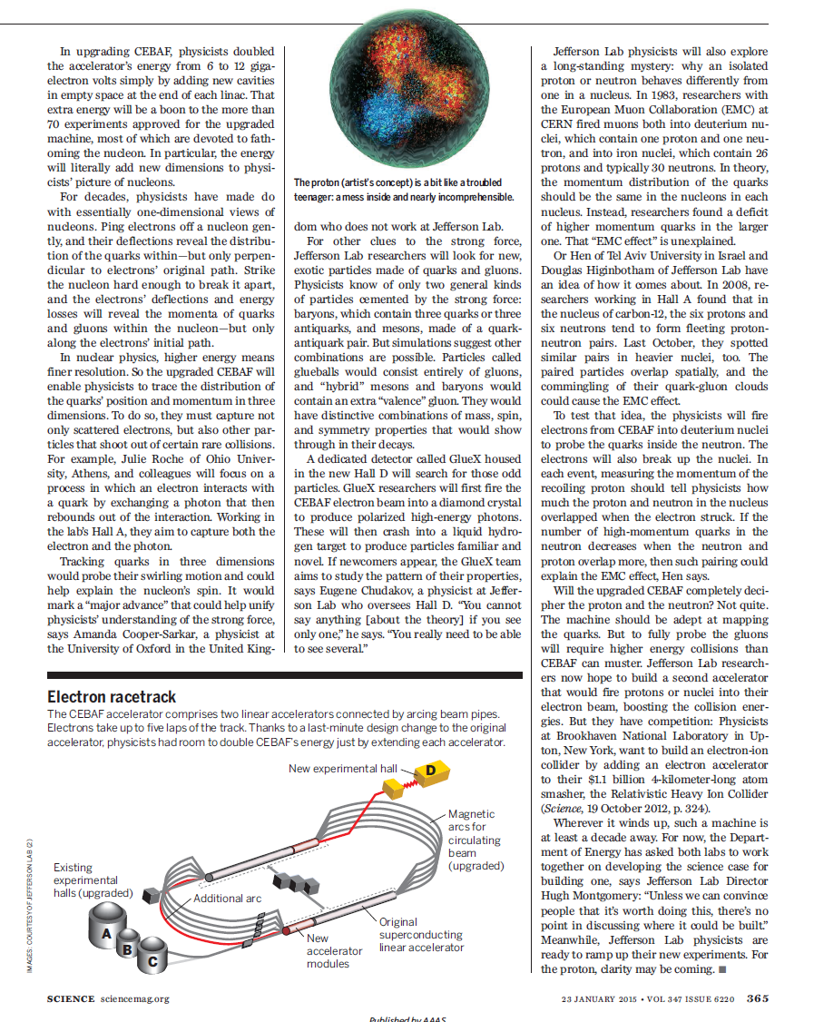
Journal “Science” Features Jefferson Lab Science in the 12 GeV era (Jan. 2015)
9

Slide 10
JLab: 21st Century Science Questions
What is the role of gluonic excitations in the spectroscopy of light mesons? Can these excitations elucidate the origin of quark confinement?
Where is the missing spin in the nucleon? Is there a significant contribution from valence quark orbital angular momentum?
Can we reveal a novel landscape of nucleon substructure through measurements of new multidimensional distribution functions?
What is the relation between short-range N-N correlations and the partonic structure of nuclei?
Can we discover evidence for physics beyond the standard model of particle physics?

Slide 11
12 GeV Approved Experiments by Physics Topics
Topic | Hall A | Hall B | Hall C | Hall D | Other | Total
The Hadron spectra as probes of QCD (GlueX and heavy baryon and meson spectroscopy) |  | 1 |  | 3 |  | 4
The transverse structure of the hadrons (Elastic and transition Form Factors) | 5 | 3 | 2 | 1 |  | 11
The longitudinal structure of the hadrons (Unpolarized and polarized parton distribution functions) | 2 | 3 | 6 |  |  | 11
The 3D structure of the hadrons (Generalized Parton Distributions and Transverse Momentum Distributions) | 5 | 9 | 7 |  |  | 21
Hadrons and cold nuclear matter (Medium modification of the nucleons, quark hadronization, N-N correlations, hypernuclear spectroscopy, few-body experiments) | 6 | 3 | 7 |  | 1 | 17
Low-energy tests of the Standard Model and Fundamental Symmetries | 3 | 1 |  | 1 | 1 | 6
TOTAL | 21 | 20 | 22 | 5 | 2 | 70

Slide 12
12 GeV Approved Experiments by PAC Days
Topic | Hall A | Hall B | Hall C | Hall D | Other | Total
The Hadron spectra as probes of QCD (GluEx and heavy baryon and meson spectroscopy) |  | 119 |  | 540 |  | 659
The transverse structure of the hadrons (Elastic and transition Form Factors) | 145.5 | 85 | 102 | 25 |  | 357.5
The longitudinal structure of the hadrons (Unpolarized and polarized parton distribution functions) | 65 | 230 | 165 |  |  | 460
The 3D structure of the hadrons (Generalized Parton Distributions and Transverse Momentum Distributions) | 409 | 872 | 212 |  |  | 1493
Hadrons and cold nuclear matter (Medium modification of the nucleons, quark hadronization, N-N correlations, hypernuclear spectroscopy, few-body experiments) | 180 | 175 | 201 |  | 14 | 570
Low-energy tests of the Standard Model and Fundamental Symmetries | 547 | 205 |  | 79 | 60 | 891
TOTAL | 1346.5 | 1686 | 680 | 644 | 74 | 4430.5
Total Approved Run Group Days | 1346.5 | 671 | 667 | 644 | 74 | 3402.5
A Decade of Experiments

Slide 13
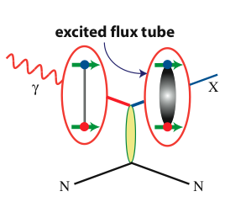
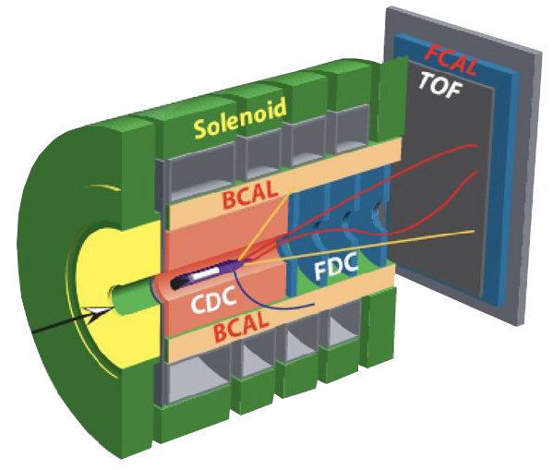

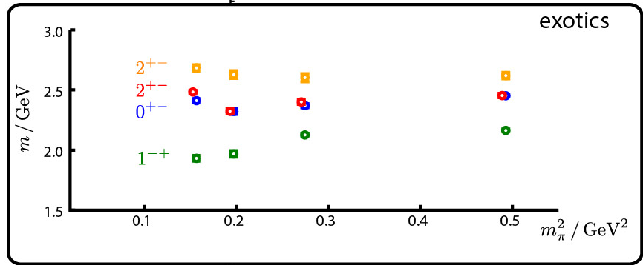
Gluonic Excitations and the mechanism for confinement
Excited Glue
Hall D@JLab
QCD predicts a rich spectrum of as yet to be discovered gluonic excitations - whose experimental verification is crucial for our understanding of QCD in the confinement regime.
Dudek et al.
States with Exotic Quantum Numbers

Slide 14
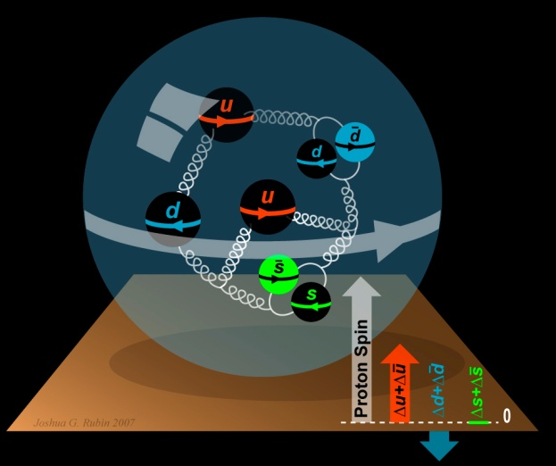
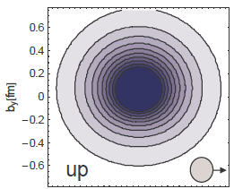
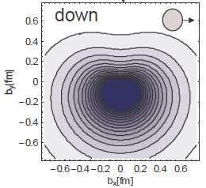
The Incomplete Nucleon: Spin Puzzle
1
1
ΔΣ
+
L_{q}
+
J_{g}
=
2
2
[X. Ji, 1997]
DIS → ΔΣ ≅ 0.25
RHIC + DIS → ΔG~0.2
→ L_{q}

Slide 15
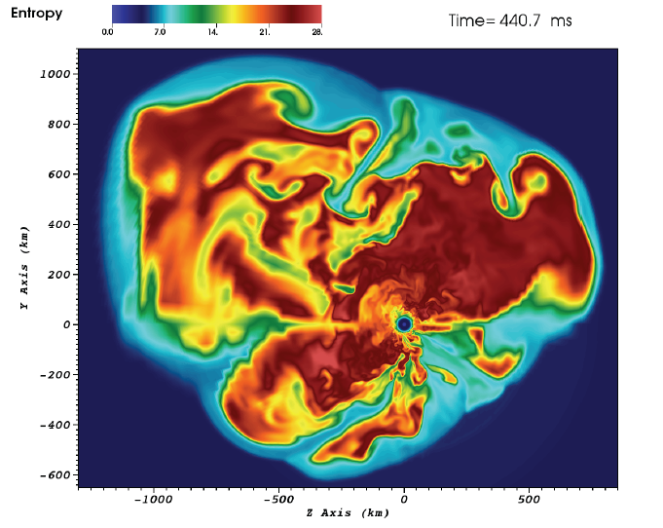
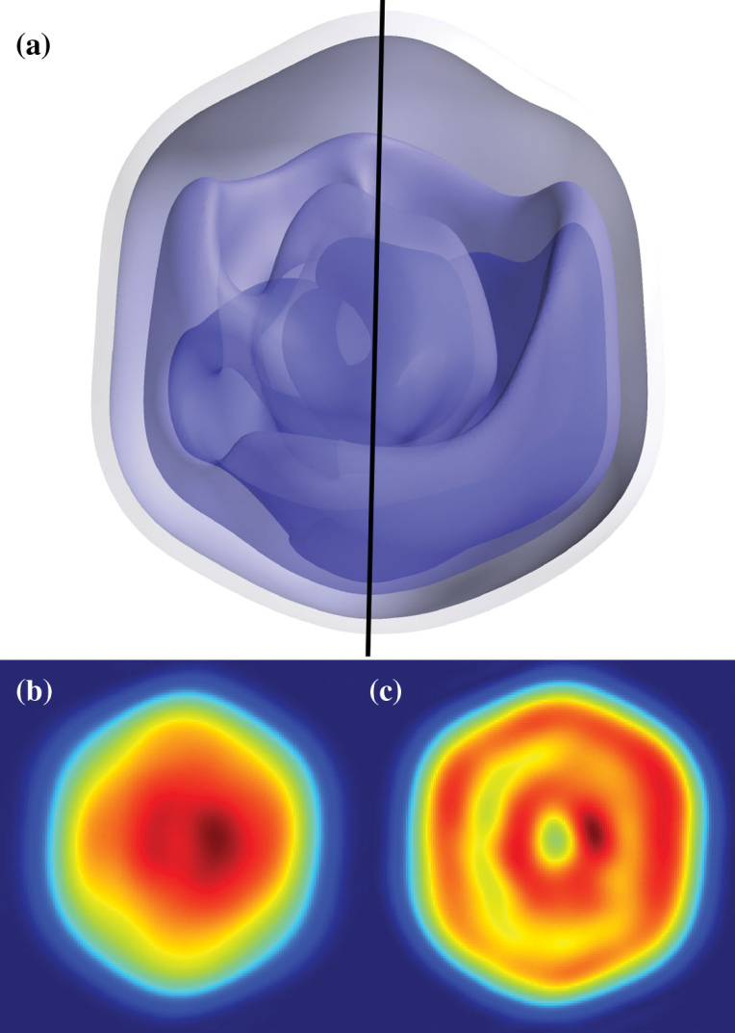
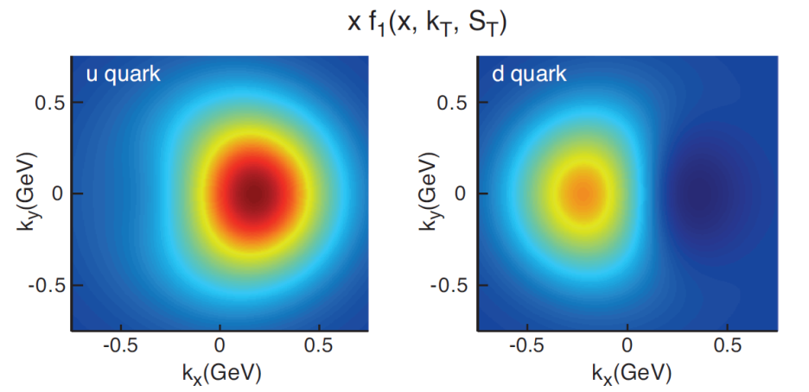
Science in 3-Dimensions
3D simulation of
15M supernova
(ORNL)
Predicted
quark
Transverse
Momentum
Distributions
for a
polarized
proton
(accessible with JLab @ 12 GeV)
Mimivirus imaged at LCLS
(SLAC)

Slide 16

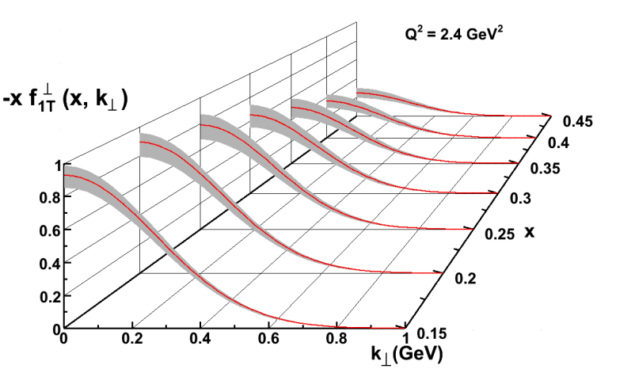
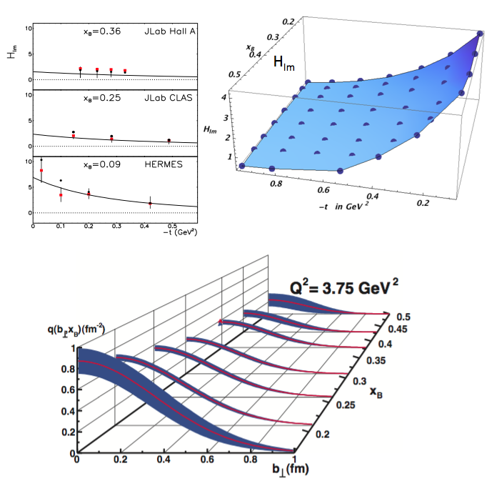
Imaging the Nucleon
5D
Transverse Momentum Dist. (TMD)
– Confined motion in a nucleon
(semi-inclusive DIS)
Generalized Parton Dist. (GPD)
– Spatial imaging
(exclusive DIS)
Requires
− High luminosity
− Polarized beams and targets
− Sophisticated detector systems
3D
Major new capability with JLab @ 12 GeV

Slide 17
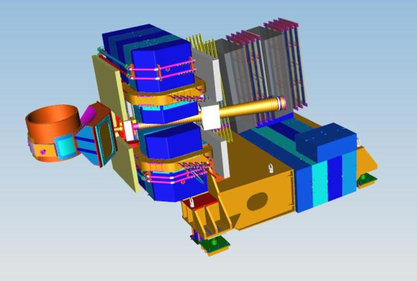
Imaging with JLab @ 12 GeV
Generalized Parton Distributions (GPDs) and Transverse Momentum Distributions (TMDs)
CLAS12 in Hall B: general survey experiments, large acceptance and medium luminosity
SHMS, (HMS) and Neutral-Particle Spectrometer (NPS) in Hall C: precision cross sections for L-T studies and ratios, small acceptance and high luminosity
SBS in Hall A : dedicated large-x TMD study
medium acceptance and high luminosity
Future: SoLID in Hall A: large acceptance and high luminosity
Notes:
Bob reworked

Slide 18
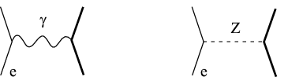
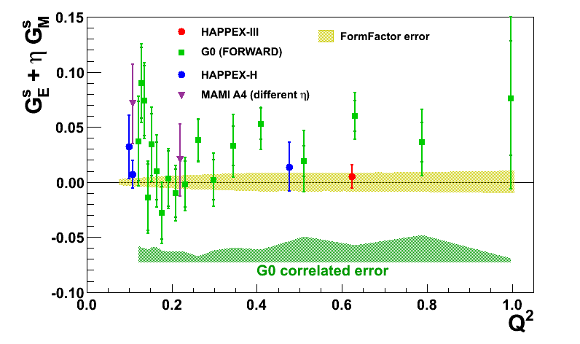
Parity Violation at JLab
Nucleon Strangeness Form Factors (complete)
- HAPPEX (Hall A)
- G0 (Hall C)
Neutron Skin
- PREX
- CREX
Precision Tests of Standard Model
- Qweak (Under analysis)
- MOLLER
- SoLID

Slide 19
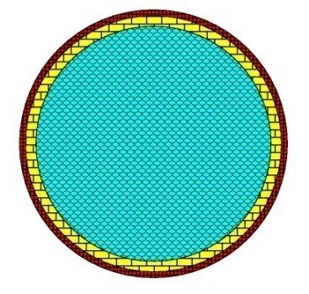
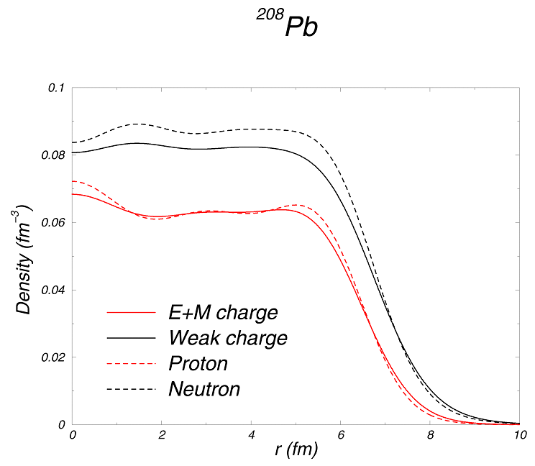
Measuring the Neutron “Skin” in the Pb Nucleus
Q_{w}^{p} =(1 – 4 sin² θ_{W})
Q_{W}^{n} = -1
Weak interaction selects neutrons
Parity violating electron scattering
Sensitive to neutron distribution
Neutron Star
Lead Nucleus
10 km
10 fm
skin
crust
Applications: Nuclear Physics, Neutron Stars,
Atomic Parity, Heavy Ion Collisions

Slide 20
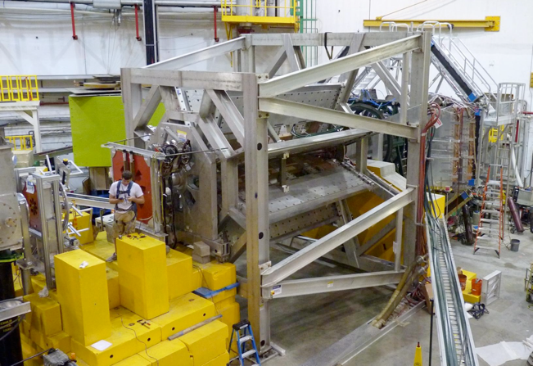
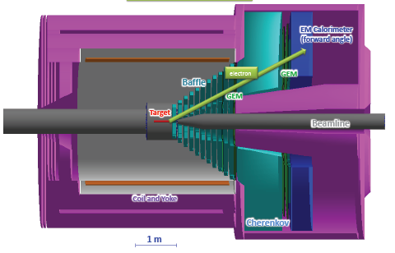
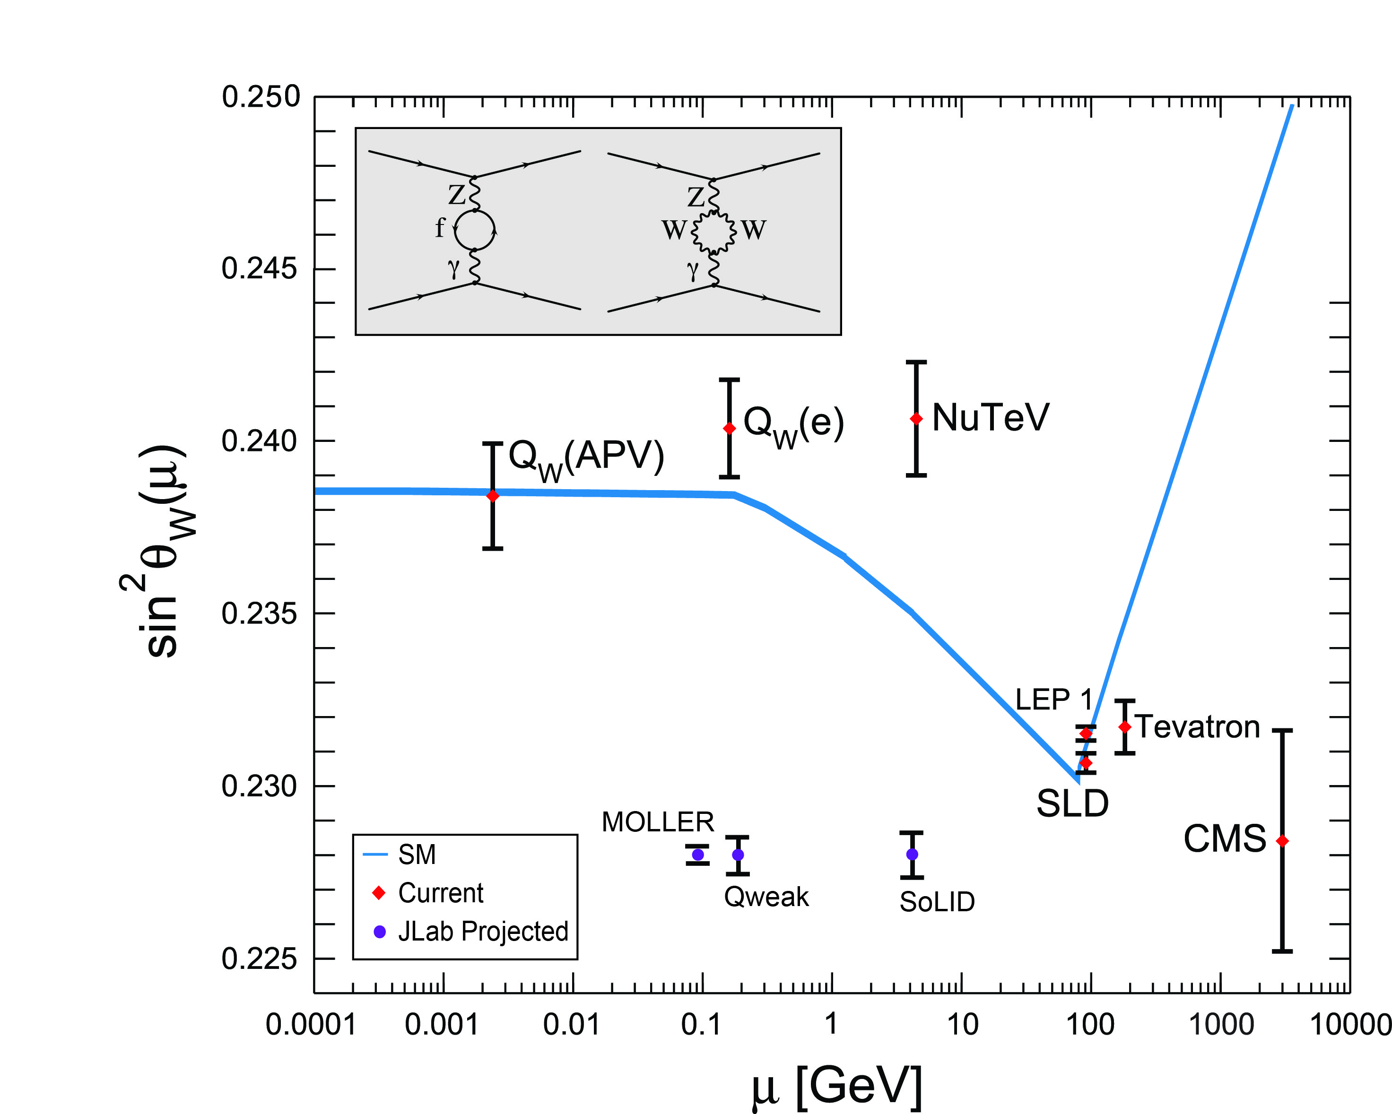
Testing the Standard Model at JLab
Standard Model
JLab
Data
Projected
JLab data:
(from PDG 2014)

Slide 21
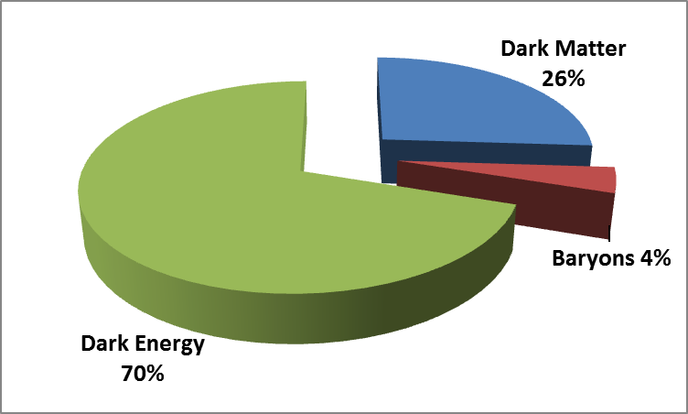
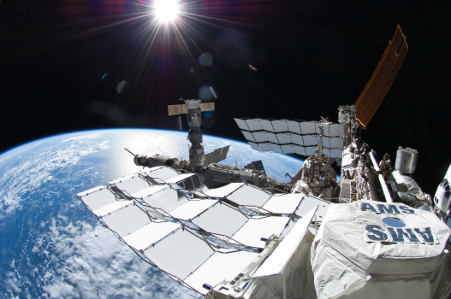
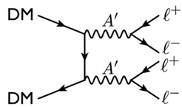
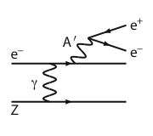
Heavy Photons and Dark Matter
Could indicate low mass A’
(M_{A’} < 1 GeV )
Laboratory (JLab) search:
21
Notes:
Retitled to “Early physics “
Reconstructed pie chart
Animation removed

Slide 22
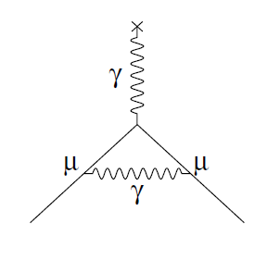
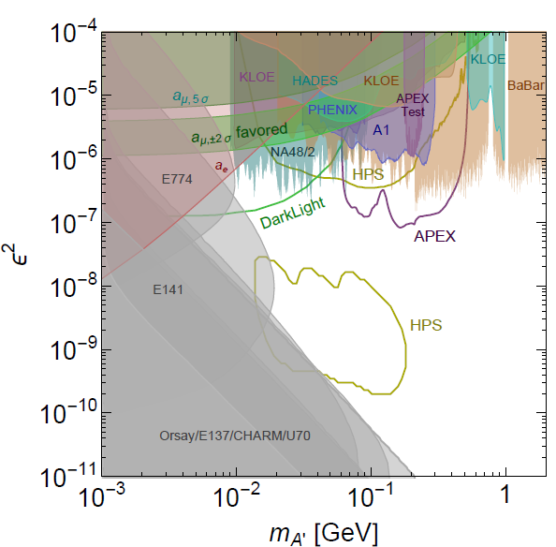
New Opportunity: Search for A’ at Jefferson Lab
BNL “g-2” expt: Δa_{μ}(expt-thy) = (295±88) x 10⁻¹¹ (3.4 σ)
No evidence for SUSY at LHC (yet)
Another solution: A’, a massive neutral vector boson
3 Jefferson Lab proposals:
APEX test run (Hall A) – published
PRL 107, 191804 (2011)
HPS (Hall B) –initial FY15 run completed
DarkLight (LERF) – NSF-MRI funds

Slide 23
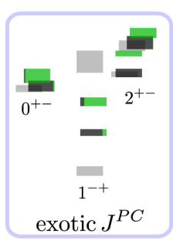

Jefferson Lab Nuclear Theory
Lattice QCD
Phenomenology
  ◻ Physics Analysis Center
Nuclear Structure
Electroweak
e⁻
e⁻
γ
Z
N
N
Strong support for experimental program
An intellectual center for a global theory effort

Slide 24
12 GeV JLab – The Potential
Opportunity to discover and study new exotic mesons to elucidate the mechanism of confinement.
Opportunity to discover and study new exotic mesons to elucidate the mechanism of confinement.
Open a new landscape of nucleon tomography, with potential to identify the missing angular momentum.
Establish the quantitative foundation for the short-distance behavior in nuclei, underpinning the development of precision nuclear structure studies.
Provide stringent new tests of the standard model and extensions, complementing the information obtained at LHC.
Establish a firm basis for higher energy studies with a future
Electron Ion Collider

Slide 25
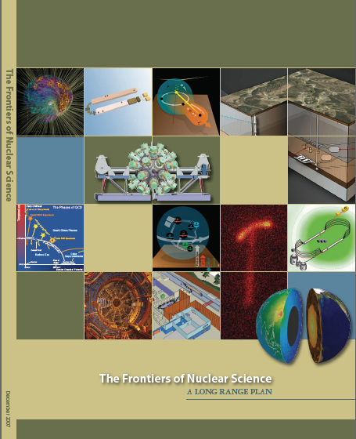

Electron Ion Collider
NSAC 2007 Long-Range Plan:
“An Electron-Ion Collider (EIC) with polarized beams has been embraced by the U.S. nuclear science community as embodying the vision for reaching the next QCD frontier. EIC would provide unique capabilities for the study of QCD well beyond those available at existing facilities worldwide and complementary to those planned for the next generation of accelerators in Europe and Asia.”
NSAC 2015 Long-Range Plan:
EIC unanimously endorsed by QCD Town Meetings
as next QCD frontier
Community has reached consensus on parameters
EIC Community White Paper arXiv:1212.1701v2
Notes:
Condensed bullets

Slide 26

The Reach of EIC
High Luminosity
◻ 10³⁴cm⁻²s⁻¹
Low x regime
x ◻ 0.0001
High Polarization
◻ 70%
Jab
12
EIC
Discovery
Potential!
EMC
HERMES

Slide 27
Jefferson Lab Future: MEIC
JLab MEIC Figure 8 Concept
Initial configuration:
  3-10 GeV on 20-100 GeV ep/eA collider
  Optimized for high ion beam polarization:
    polarized deuterons
  Luminosity:
    up to few x 10³⁴ e-nucleons cm⁻² s⁻¹
    Low technical risk
    Upgradable to higher energies
    250 GeV protons on 20 GeV electrons
    Flexible timeframe for Construction
    consistent w/running 12 GeV CEBAF
    Thorough cost estimate completed
    presented to NSAC EIC Review
    Cost effective operations
    Fulfills White Paper Requirements
Current Activities
Site evaluation (VA funds)
Accelerator, detector R&D
Design optimization
Cost reduction
Notes:
Added new campus map 2025

Slide 28







Jefferson Lab: Today and Tomorrow
The Jefferson Lab electron accelerator is a unique world-leading facility for hadron and nuclear physics research
12 GeV upgrade ensures at least a decade of excellent opportunities for discovery
– New vistas in QCD
– Growing program Beyond the Standard Model
– Additional equipment: MOLLER, SoLID,
plus smaller projects
EIC moving forward:
– Strong science case, much builds on JLab 12 GeV program
– MEIC design well developed – time scale following 12 GeV program is “natural”
– Awaiting NSAC 2015 Long Range Plan

Slide 29




JLab @ 12 GeV: Nuclear Physics for the Future
29

