Slide 1
LERF
A High Current, Low Energy Research Facility for Nuclear and Accelerator Research
Stephen Benson
S&T Review, July 29, 2015

Slide 2
Outline
LERF General Description and Operational parameters
Strategic Retreat
Active Research projects
DarkLIGHT
Pending Research Projects
EUV FEL Design
Isotope production
Proposed Projects
Diagnostic studies
Positron production
MEIC studies (LDRD)
Summary

Slide 3
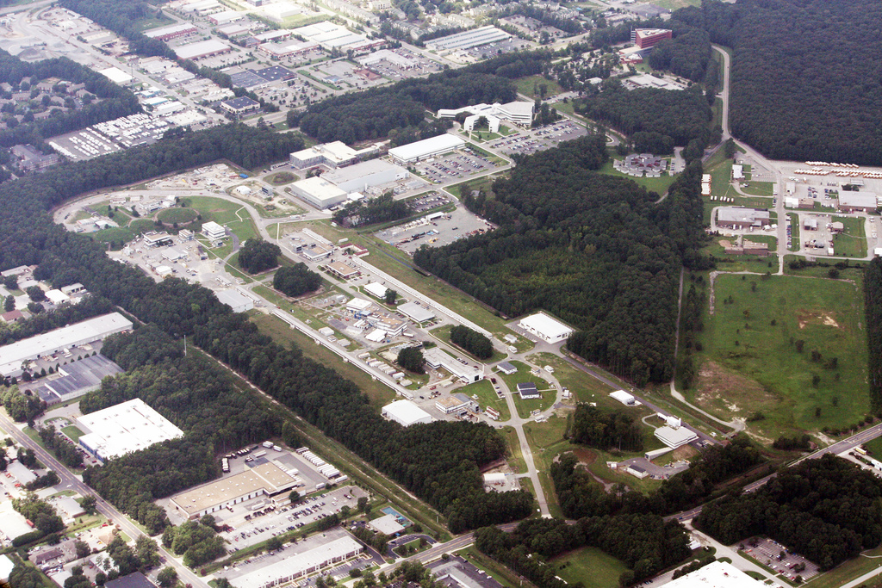
JLAB Low Energy Research Facility (LERF)
Beam accelerated from 9 to 170 MeV and then decelerated back to ~10 MeV, to recover the energy
Unique Energy Recovery Linac (ERL) capability
Constructed and previously operated by ONR (>$100M investment)
Recent $3M upgrade and commissioning funded by Commonwealth of Virginia
3

Slide 4
LERF Capabilities
The ERL in the LERF is available for:
Fixed target experiments at medium current (With new RSAD)
Internal target experiments at high current
Offline accelerator research and development
Diagnostic development
FEL studies in the IR and UV
THz production
Parameter Maximum value
Current (ERL) 8 mA
Energy 170 MeV
Charge 150 pC
Frequency 75 (750) MHz
Current (fixed target) 2.4 mA (depending on energy)

Slide 5
Strategic Planning Retreat
January, 2015
Explore existing proposed uses for LERF – take a fresh look
Attempt some assessment of the value of these, considering
- Scientific technical merit
- Technical feasibility
- Funding probability
Discuss procedure for reviewing/approving
Begin to develop a vision of where we should go
Under development:
DarkLight (NSF MRI)
FEL-based EUV Lithography Development
Medical Isotope Production R&D
Accelerator R&D:
MEIC related
Generic
Still evaluating:
Low Energy NP Program
(MESA, Cornell workshop)
Positrons for materials science

Slide 6
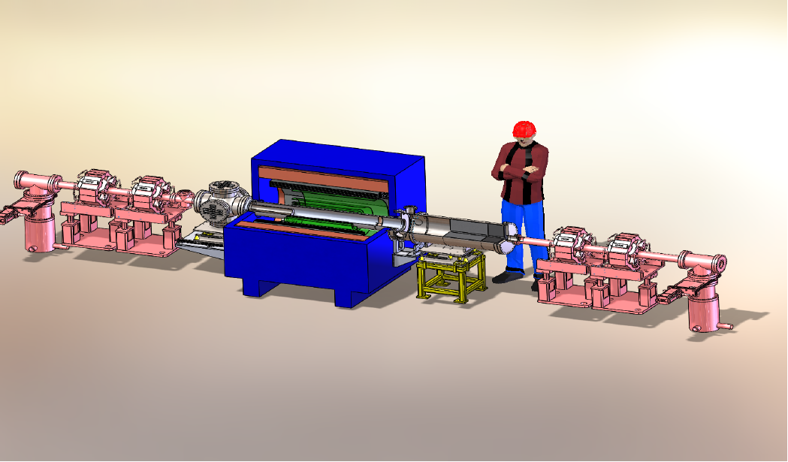
DarkLIGHT Experiment - Status
Phase Ia: funded by NSF MRI: $1M approximately
Install magnet and detector in place of current IR wiggler
Reuse existing SC magnet, use prototype GEM trackers and silicon detectors, funds low-pressure target & differential pumping system (under construction using elements of windowless gas target of OLYMPUS experiment)
Phase II: (complete experiment): $5-10M
Collaboration seeking future funding

Slide 7
Dark Light Schedule
Summer 2015 Resuscitate ERL
Fall 2015 Recommission with beam, measure solenoid
Late Fall 2015 Install magnets and re-arrange quads
Winter 2015-16 Commission with solenoid on
Early Summer 2016 Run with internal target
Late summer 2016 Run low current through DLC Möller target
Summer 2017 Statistics run
Parameter Value
Current (ERL) 8 mA (10 µA for Möller run)
Energy 100 MeV
Charge 120 (12) pC
Frequency 75 (750) MHz
Energy spread <0.1% rms

Slide 8
Project E
Project E is an industrial Collaboration for design of high power 13.5 nm lithography light source for next generation integrated circuit manufacturing based on an Energy Recovering Linac FEL.
Project E technical developments might provide a large benefit to technologies and hardware required for Internal target experiments such as dark matter searches and MEIC Projects using the TJNAF ERL (seen here).
Risk reduction activities might occur over the next two years. Design should be done before FY 2017.

Slide 9
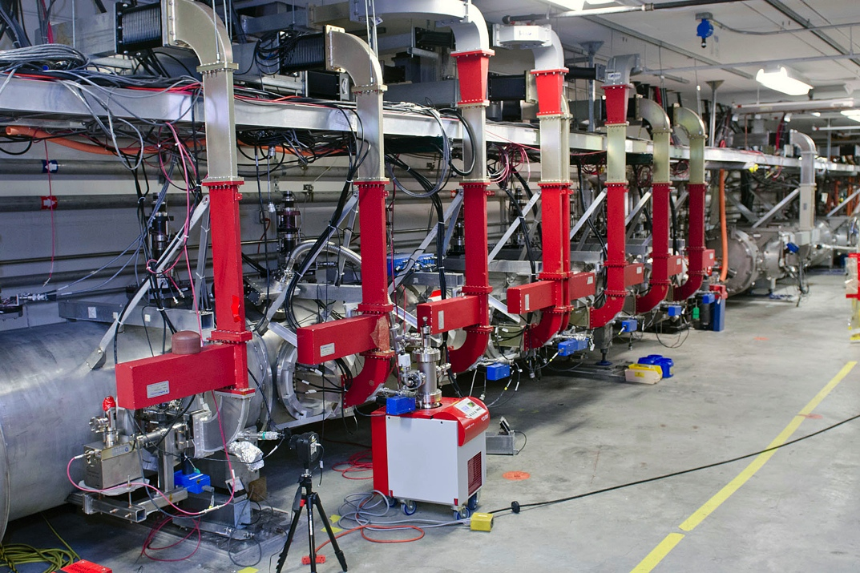
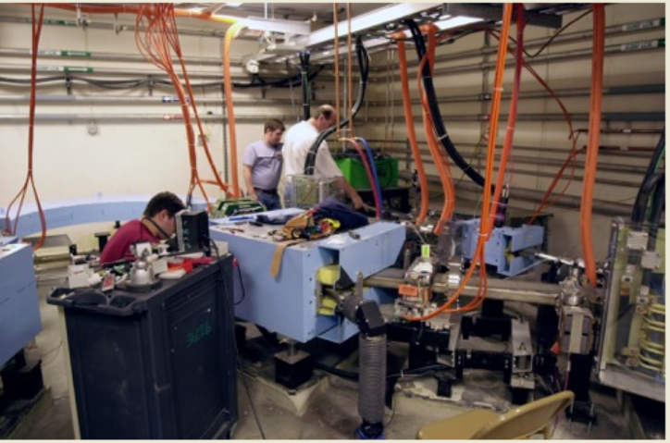
Isotope Production at LERF
Photonuclear reactions can generate isotopes for medical and industrial purposes
The electron accelerator used as a source should be capable of creating intense 15-25 MeV photon beams.
Low-energy Electron Recirculating Facility (LERF) is a 120 KW accelerator tunable in energy and current for optimizing isotope production
LERF Accelerating Section Radiator and Target Area

Slide 10
Technical Aspects
At 50 MeV beam energy, beam current at LERF is 2.4 mA
Radiator used for γ conversion through bremsstrahlung must be capable of handling high beam power (~20 KW for one radiation length of tungsten converter)
Need to simulate the optimum converter thickness for the most photon yield without melting the converter (possible measures: segmentation of the converter, water cooling, ..)
For having the most photon flux on the isotope target, the target should be close to the converter
e.g. 1 radiation length, (1.7 cm.) of Zn target for producing ⁶⁷Cu will have ~40KW of power deposited by the electron beam
Need strategies for handling this power (possible measures thinner target, larger distance from the converter with a sweeping magnet, trading off photon flux for reduced heat handling complexity)

Slide 11
Diagnostic Studies
The LERF provides a very flexible test-bed for testing out diagnostics that might be used on CEBAF or other machines. Examples include:
High Dynamic Range viewer systems to see very low current halo
Electro-optic sampling system can measure sub-picosecond bunches with no phase ambiguity
New THz interferometers can measure very short bunches over a wide range of beam parameters.
New scanning slits can be used to map out the phase space at locations of high space charge forces.

Slide 12
Potential for a Positron source
A 120 MeV beam is very advantageous for high flux positron production. A new moderator design might produce 1000 times as high a positron brightness than existing sources.
This source design must be user driven. NCCU is collaborating with NASA on the possible applications.

Slide 13
LDRD Experiment at LERF for MEIC
Introduce THz modulation on drive laser.
Measure growth in modulation in the accelerator vs. frequency.
Compare microbunching gain to modeling and simulation predictions.
Beam Parameters:
Beam energy: 88-210 MeV
Bunch charge: 60-270 pC
Bunch compression: vary
Diagnostics:
Happek bunch length monitor
(present setup ~ 30um,
possible extension to ~ 2um)
Synchrotron light monitors
Synchrotron light streak camera
FLIR (7-13um)
UV Line

Slide 14
Summary
DarkLIGHT Phase I is on track for initial running in FY16
We are working on a plan for future mission(s) with LERF
Isotope production under discussion with ONP
Other options still under development

